Slide 1
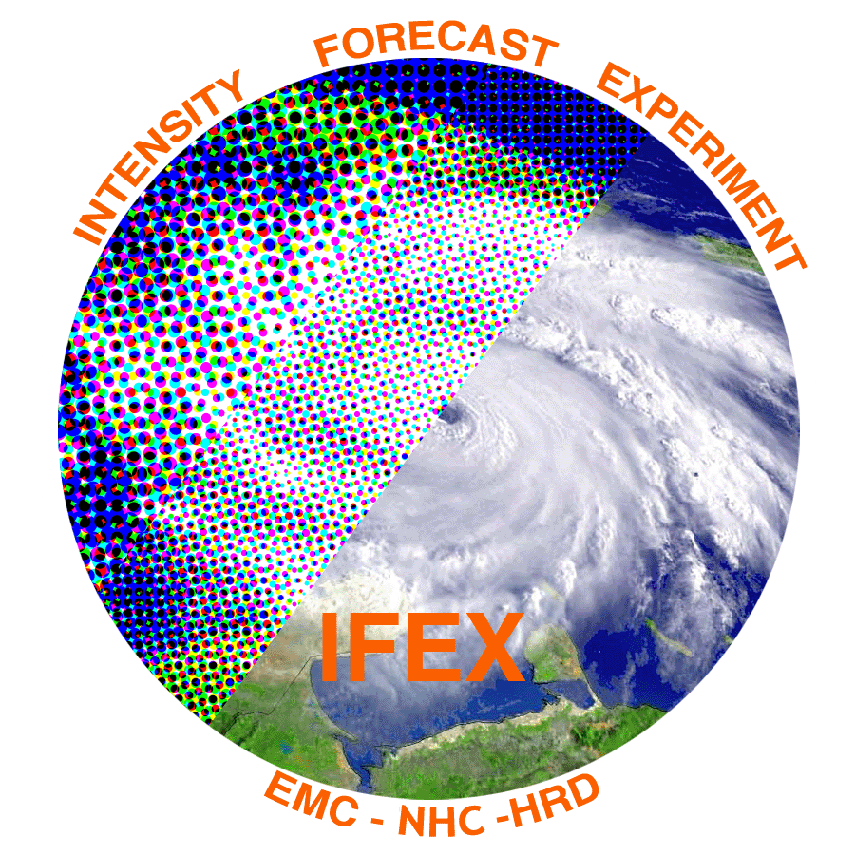
2018 NOAA/AOML/HRD Hurricane Field Program
Intensity Forecast Experiment (IFEX)
AL07/Gordon Debrief

Slide 2
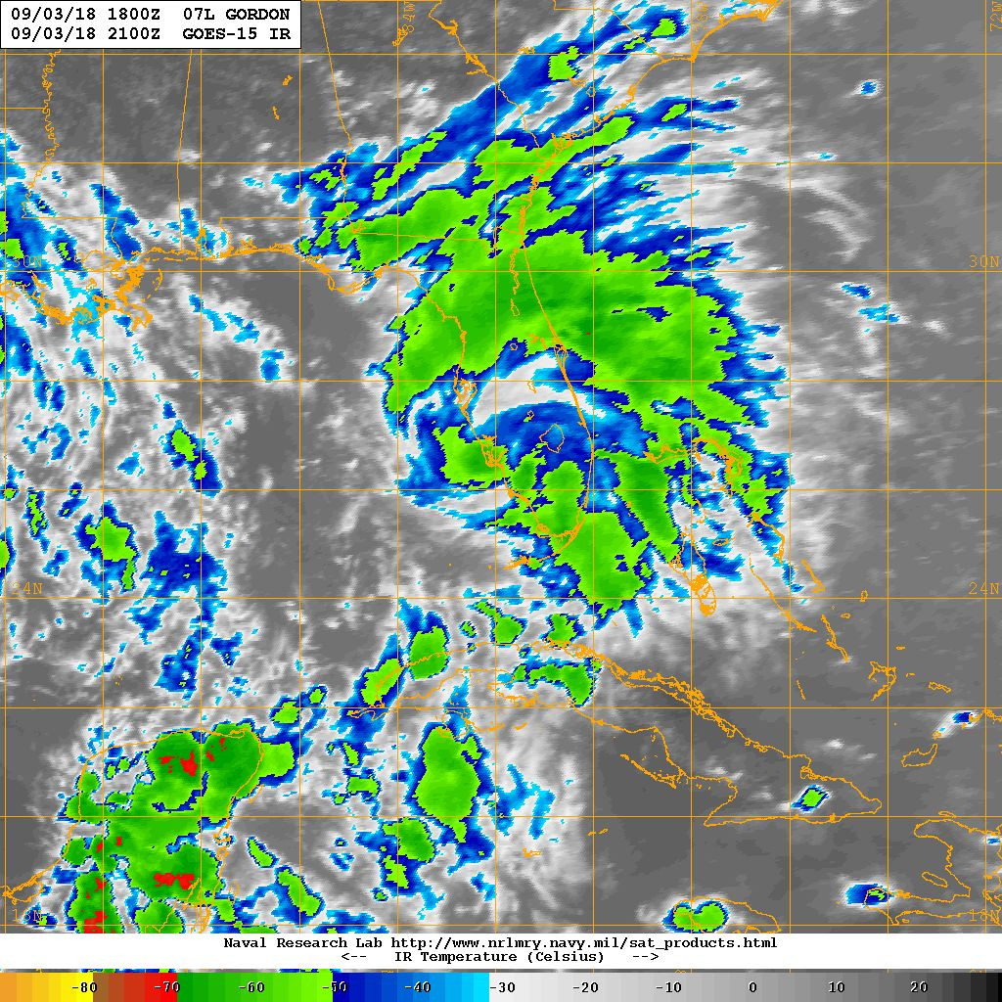
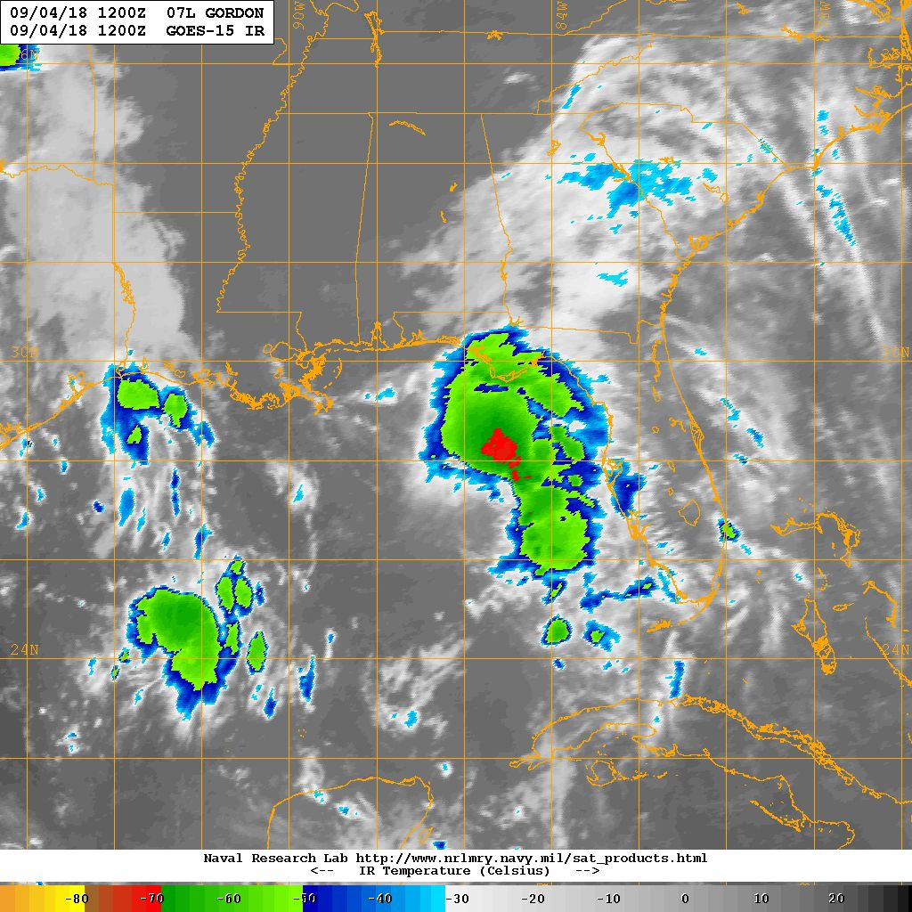
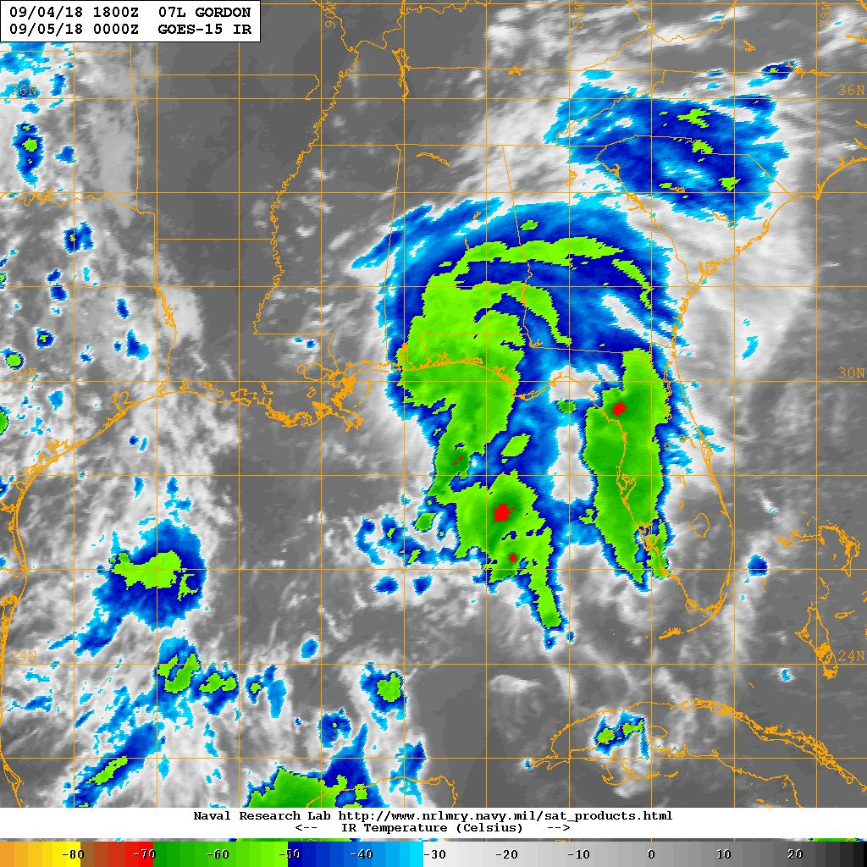
2018 NOAA/AOML/HRD Hurricane Field Program
Intensity Forecast Experiment (IFEX)
AL07/Gordon Debrief
September 3-4
Missions Overview
Deployment Overview
180903H1 (Rogers)
180904H1 (Alaka)
180904H2 (Christophersen)
EMC Review (Winterbottom)
2 EMC-tasked P-3 Missions
1 NHC-tasked P-3 Mission
18 P-3 Flight Hours
45 Dropsondes
10 AXBTs
Agenda
180903H1
180904H1
180904H2

Slide 3
2018 NOAA/AOML/HRD Hurricane Field Program
Intensity Forecast Experiment (IFEX)
AL07/Gordon Debrief
Purpose:
EMC-tasked P-3 data collection targeting the 00 and 12Z HWRF cycles
Accomplish objectives of the “Early Stage Experiment: Objective #1 (AIPEX)”,
“End Stage Experiment: Objective #1 (Landfall)”
Target:
Intensifying Tropical Storm Gordon as it moved off Florida, northward through the Gulf of Mexico
Mission Timeline:
P-3 missions every 12 hours, takeoff at 4:30 AM (0830Z) and 4:30 PM (2030Z)
3 C-130 missions

Slide 4
2018 NOAA/AOML/HRD Hurricane Field Program
Intensity Forecast Experiment (IFEX)
AL07/Gordon Debrief
Mission Highlights:
First EMC mission [180903H1] completed “high altitude circumnavigation”, one pass through the center, and SFMR High Incidence Angle Module (“circles”), but had to return early due to a mechanical issue
Second EMC mission [180904H1] completed full rotated Figure 4
Third mission [180904H2] was tasked by NHC for reconnaissance during Gordon’s landall
TDR analyses transmitted to EMC and for AWIPS-II visualization [NHC first?]

Slide 5
2018 NOAA/AOML/HRD Hurricane Field Program
Intensity Forecast Experiment (IFEX)
AL07/Gordon Debrief
Deployment Notes:
HRD crewed all missions, including the final, NHC-tasked mission [180904H2]
Paul Reasor, John Gamache, and Joe Griffin provided ground radar support -- record number of profile analyses on the landfall flight (beach survey)
P-3 did have to return on the first mission -- any other safety issues?
Avoid interruption of EMC pattern
Kyle Ahern (FSU) and Joshua Alland (SUNY Albany), HRD collaborators, flew on missions

Slide 6
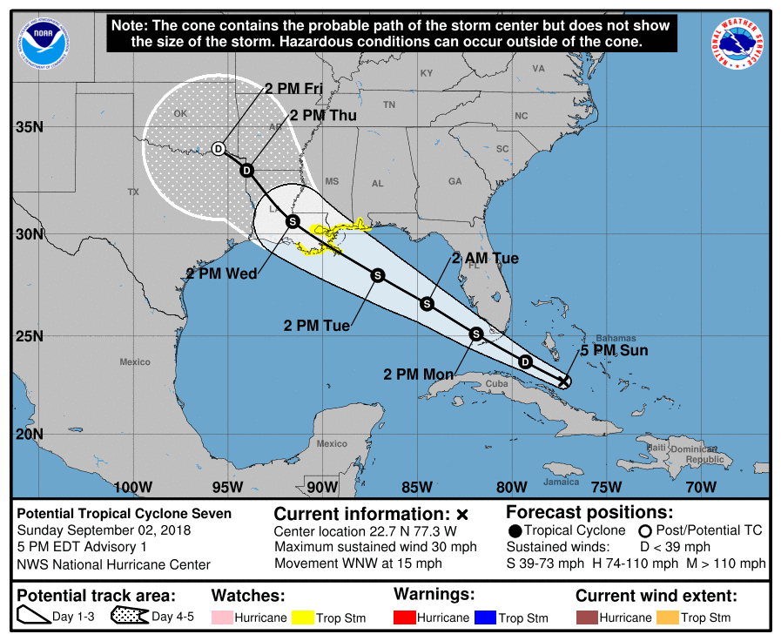
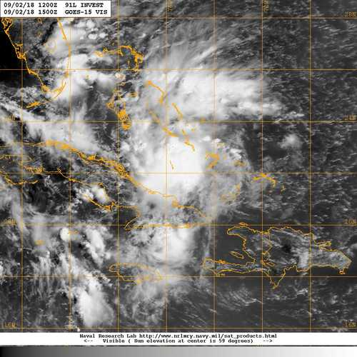
2018 NOAA/AOML/HRD Hurricane Field Program
Intensity Forecast Experiment (IFEX)
AL07/Gordon Debrief
Sunday, September 2
180902 1500 UTC
INIT 02/2100Z 22.7N 77.3W 25 KT 30 MPH...PTC 12H 03/0600Z 23.7N 79.3W 30 KT 35 MPH...TD
24H 03/1800Z 25.1N 81.9W 35 KT 40 MPH 36H 04/0600Z 26.6N 84.5W 40 KT 45 MPH 48H 04/1800Z 28.0N 87.1W 50 KT 60 MPH 72H 05/1800Z 30.6N 91.6W 35 KT 40 MPH...INLAND
NRL

Slide 7
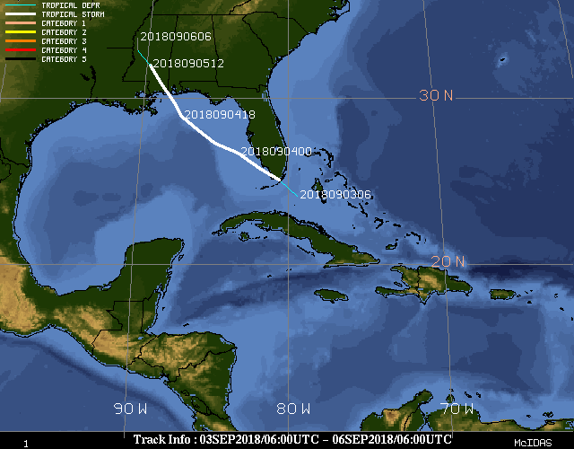
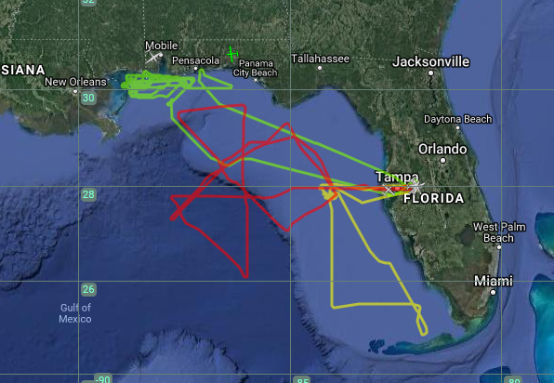
2018 NOAA/AOML/HRD Hurricane Field Program
Intensity Forecast Experiment (IFEX)
AL07/Gordon Debrief
Best Track
P-3 Flight Tracks
180904H2
180904H1
180903H1
CIMSS
NASA MTS

Slide 8
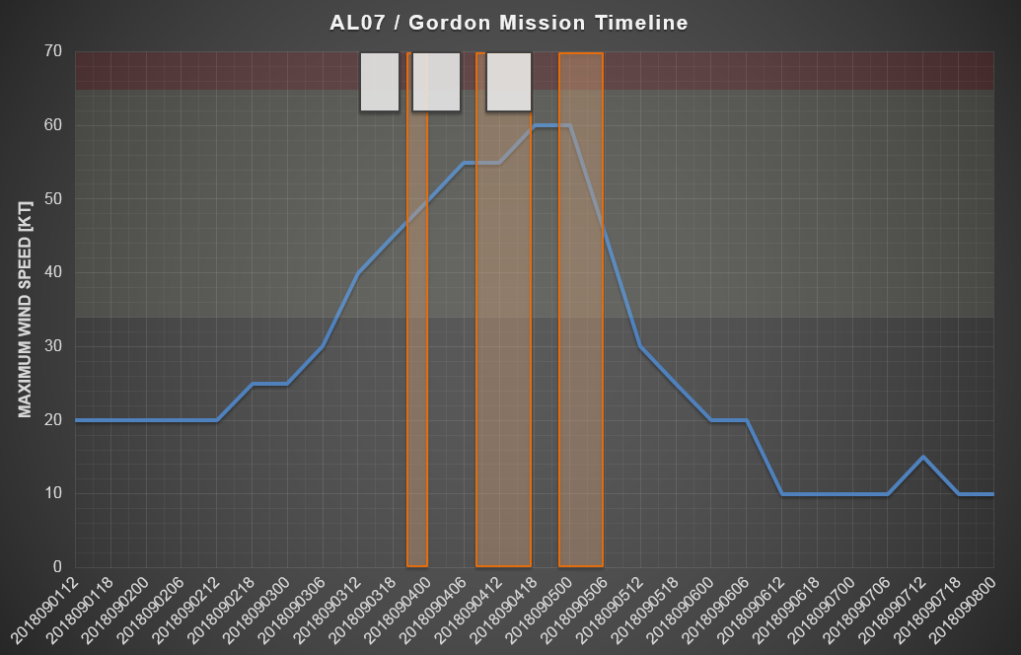
2018 NOAA/AOML/HRD Hurricane Field Program
Intensity Forecast Experiment (IFEX)
AL07/Gordon Debrief
53rd WRS
Category 1 Hurricane
P-3
Tropical Storm

Slide 9
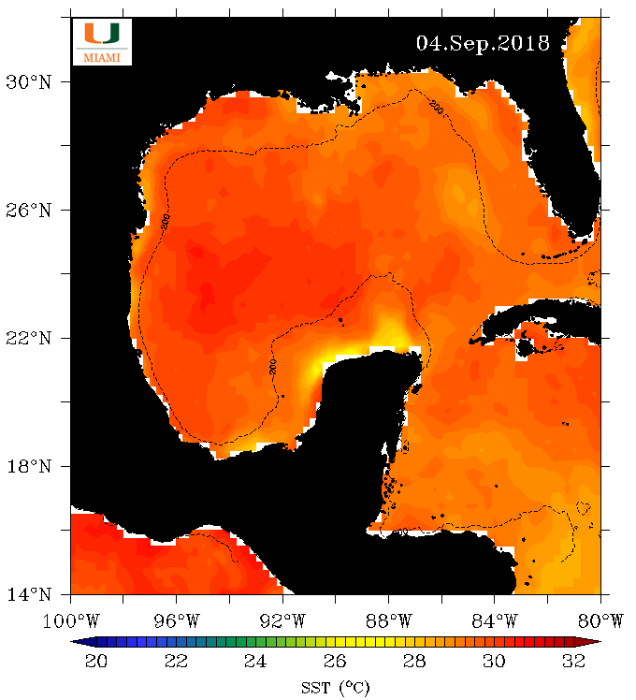
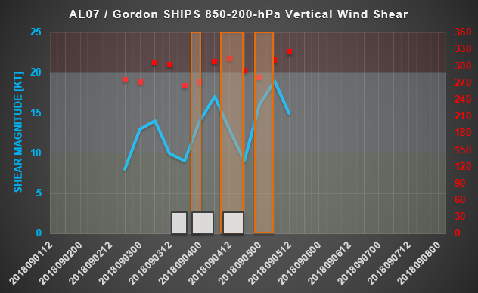
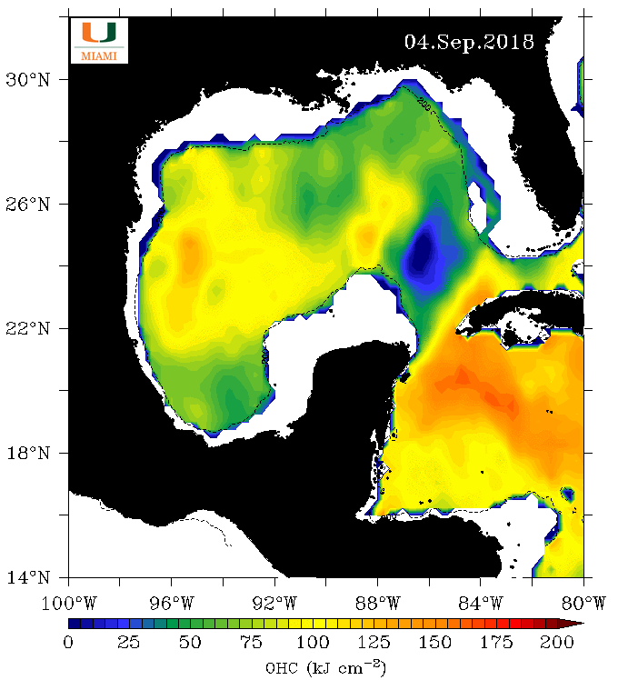
2018 NOAA/AOML/HRD Hurricane Field Program
Intensity Forecast Experiment (IFEX)
AL07/Gordon Debrief
53rd WRS
“High” Shear
P-3
“Moderate” Shear
“Low” Shear

Slide 10
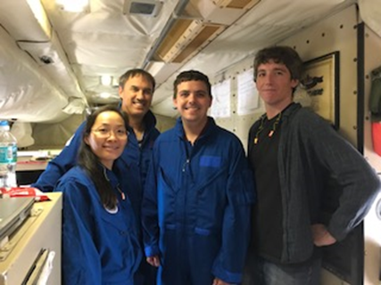
2018 NOAA/AOML/HRD Hurricane Field Program
Intensity Forecast Experiment (IFEX)
AL07/Gordon Debrief
Tropical Storm Gordon - Mission 180903H1
Lead Project Scientist: Rogers/Christophersen
Radar: Christophersen/Rogers
Dropsonde/AXBT: Hazelton
Observer: Ahern (FSU)
Science crew
180903H1 Science crew
Objectives
EMC-tasked mission, collect TDR for assimilation
possible SFMR circles
Highlights
storm experiencing some light/moderate westerly shear
forecasts suggested intensification possible
L-shaped survey pattern at high altitude on upshear side
single SE-NW pass through center, SFMR circles on NW side
12 GPS dropsondes, 3 AXBTs (only 1 worked)
highly asymmetric storm, small core of strong winds on NE side

Slide 11
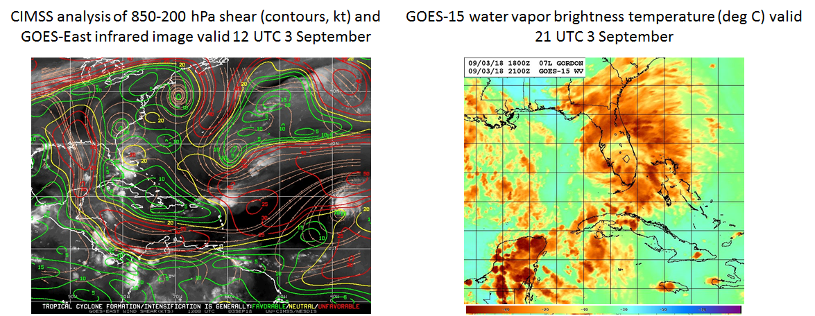
2018 NOAA/AOML/HRD Hurricane Field Program
Intensity Forecast Experiment (IFEX)
AL07/Gordon Debrief
Environmental characteristics
upper-level low to north of Gordon providing some light to moderate westerly shear
some evidence of mid- to upper-level dry air on upshear side, highly asymmetric with very moist environment of FL peninsula

Slide 12
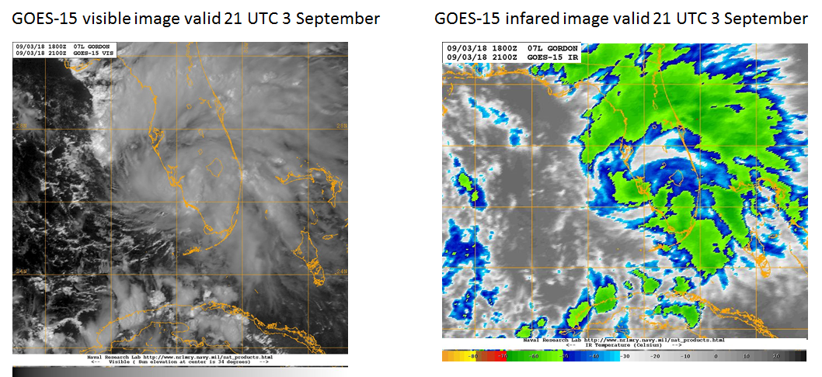
2018 NOAA/AOML/HRD Hurricane Field Program
Intensity Forecast Experiment (IFEX)
AL07/Gordon Debrief
Storm-scale characteristics
bulk of cloud shield on northeast side of center
little to no cold cloud tops, indicative of little to no deep convection

Slide 13
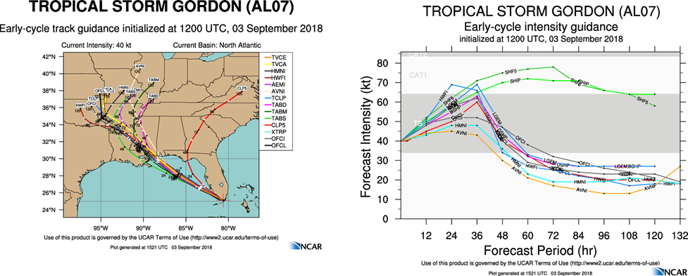
2018 NOAA/AOML/HRD Hurricane Field Program
Intensity Forecast Experiment (IFEX)
AL07/Gordon Debrief
Forecasts
models in close agreement on track through eastern Gulf, landfall near AL/LA
general agreement toward intensification, though uncertainty in amount

Slide 14
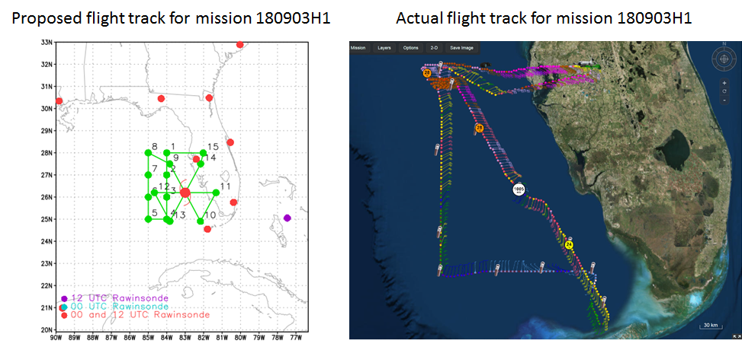
2018 NOAA/AOML/HRD Hurricane Field Program
Intensity Forecast Experiment (IFEX)
AL07/Gordon Debrief
Flight pattern
plan called for a high-altitude survey upshear of center, followed by butterfly
modified to an “L”-shaped survey to cover both west and south
A
A
B
C

Slide 15
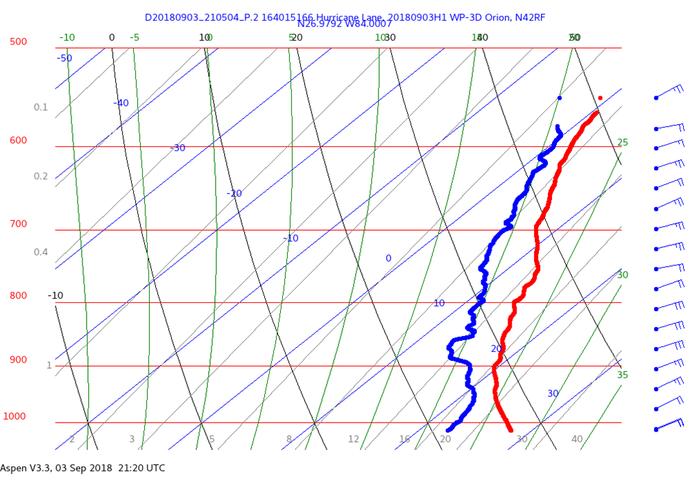
2018 NOAA/AOML/HRD Hurricane Field Program
Intensity Forecast Experiment (IFEX)
AL07/Gordon Debrief
Skew-T “A” from L-survey
fairly moist profile, some shallow layers of slightly drier air at 750, 900 hPa
well-mixed boundary layer
A
A
B
C

Slide 16
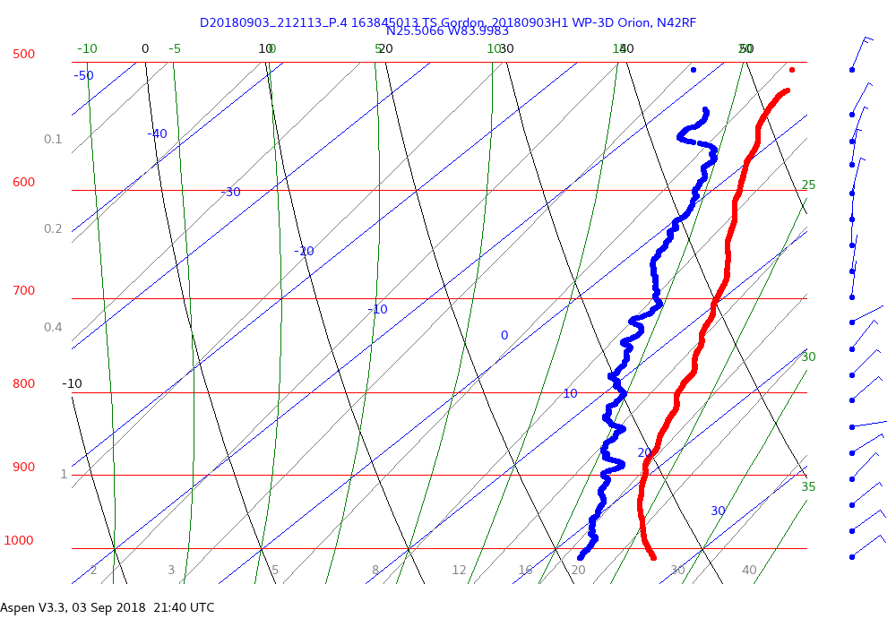
2018 NOAA/AOML/HRD Hurricane Field Program
Intensity Forecast Experiment (IFEX)
AL07/Gordon Debrief
Skew-T “B” from L-survey
slightly dryer profile than skew-T “A”
weak winds over entire profile
A
A
B
C

Slide 17
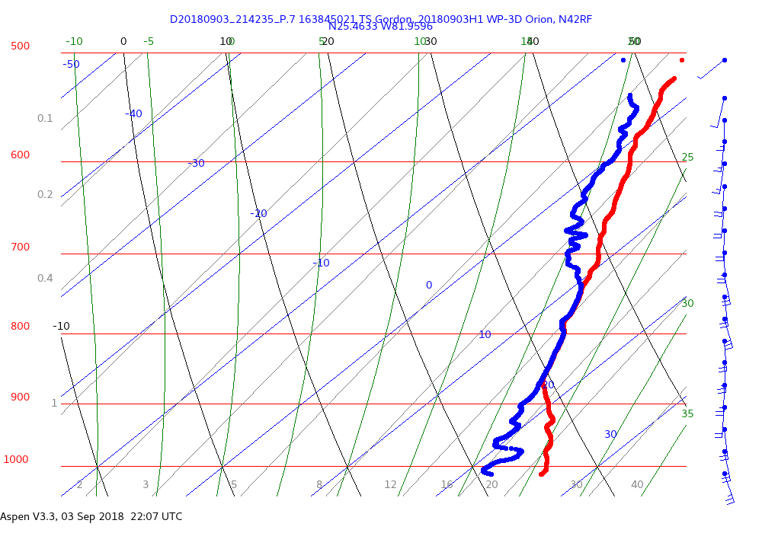
2018 NOAA/AOML/HRD Hurricane Field Program
Intensity Forecast Experiment (IFEX)
AL07/Gordon Debrief
Skew-T “C” from L-survey
moist profile, cloud layer between 875 and 750 hPa
possible subsidence signature beneath cloud layer
on east side of circulation/trough axis
A
A
B
C

Slide 18
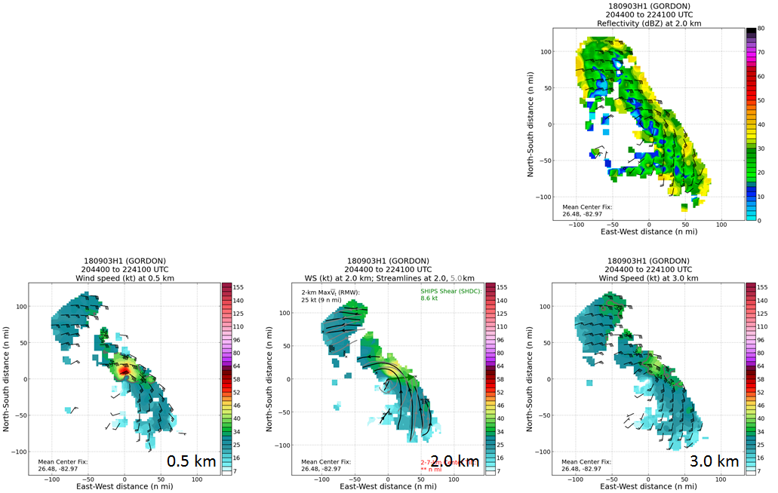
2018 NOAA/AOML/HRD Hurricane Field Program
Intensity Forecast Experiment (IFEX)
AL07/Gordon Debrief
Real-time Doppler radar analyses
asymmetric wind structure; strongest winds on NE side, nearly calm on west side
small core of winds > 50 kt at 0.5 km N of center

Slide 19
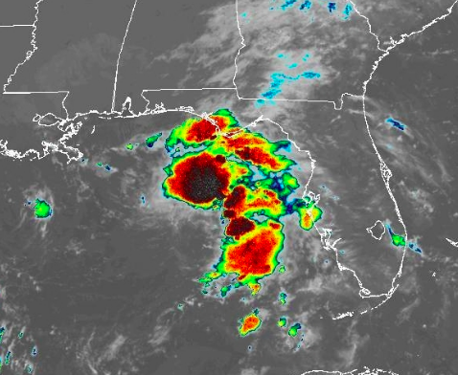
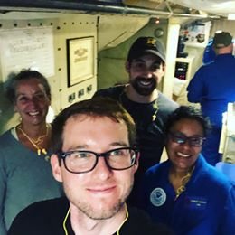
2018 NOAA/AOML/HRD Hurricane Field Program
Intensity Forecast Experiment (IFEX)
AL07/Gordon Debrief
Mission 180904H1 into Tropical Storm Gordon
Takeoff: 0833 UTC (LAL)
Landing: 1522 UTC (LAL)
Pattern: Rotated Butterfly
Drops: 19 (end/mid/ctr)
AXBTs: 8 (5 good)
Fixes: 5 w/ drops
04/03Z: 26.9N, 84.3W 50 kt
LPS: Alaka
Radar: Murillo
Drops: Sellwood
Observer: Alland
OBJECTIVES
EMC-tasked mission (TDR for DA)
NHC center fixes
HIGHLIGHTS
Convection confined to E semicircle
Forecasts called for intensification
Surface circulation almost open to SW
Great situational awareness to adjust flight pattern many times.

Slide 20
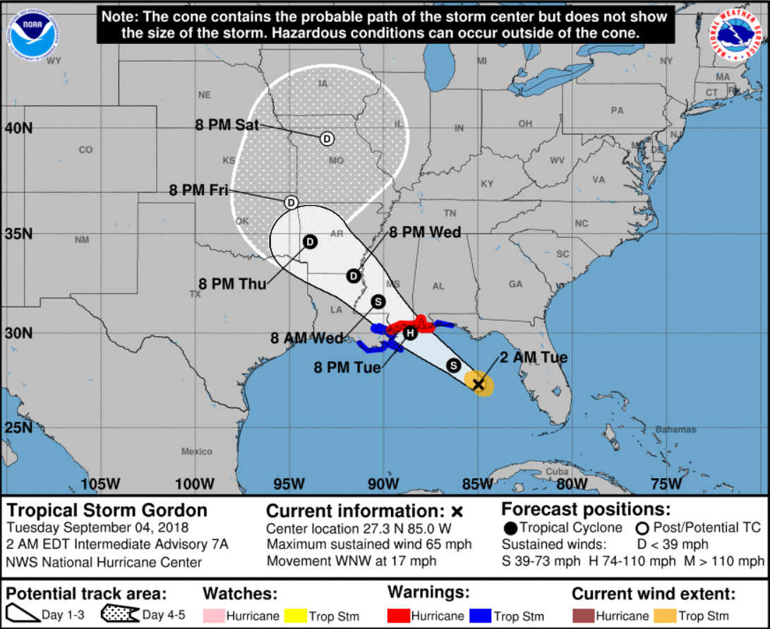
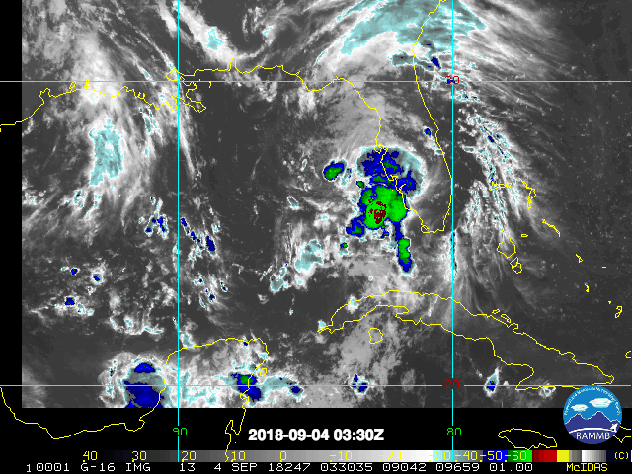
2018 NOAA/AOML/HRD Hurricane Field Program
Intensity Forecast Experiment (IFEX)
AL07/Gordon Debrief
Heading into the flight
NHC forecast called for Gordon to remain a TS during this mission
Convection very disorganized, mostly east of center

Slide 21
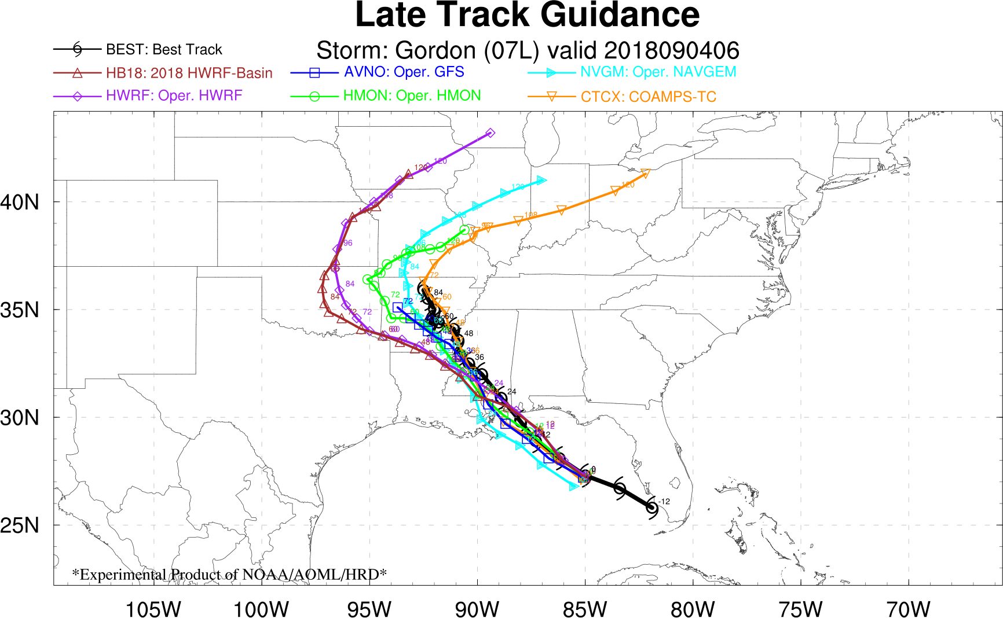
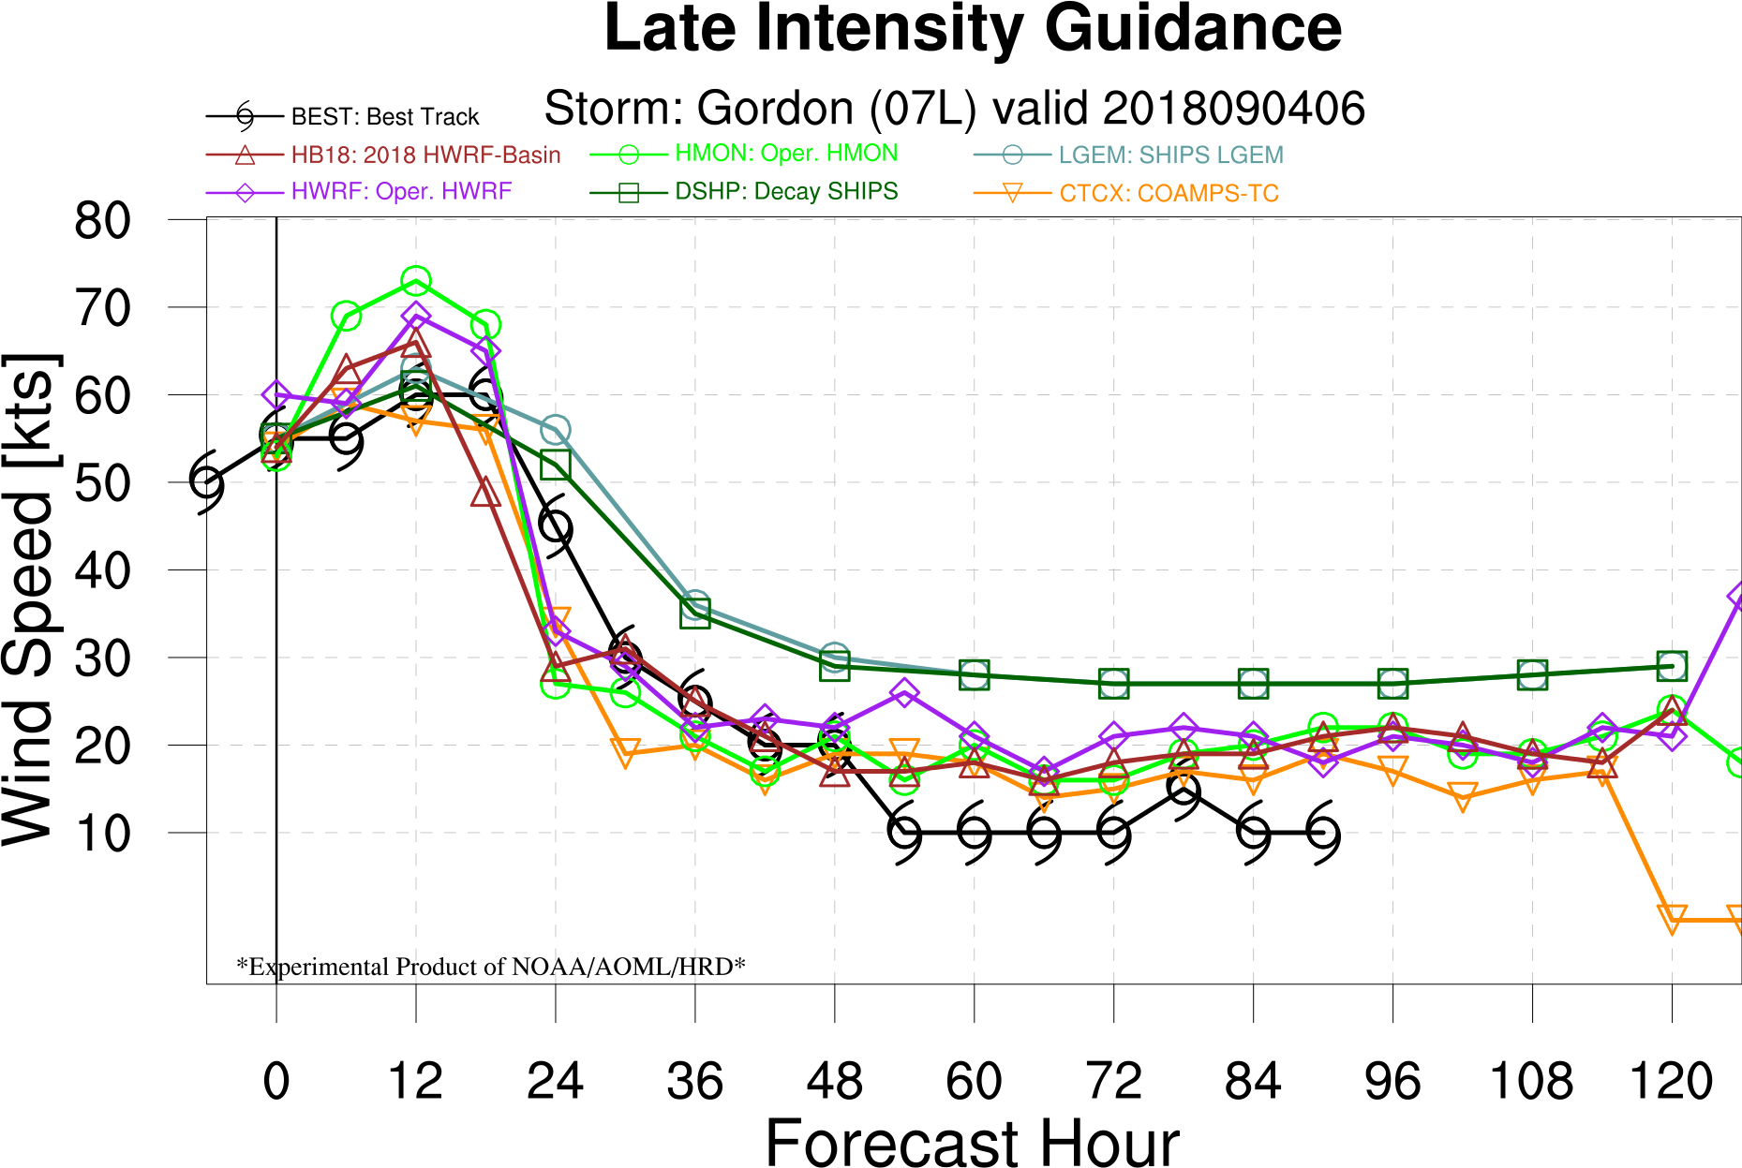
2018 NOAA/AOML/HRD Hurricane Field Program
Intensity Forecast Experiment (IFEX)
AL07/Gordon Debrief
Forecast Guidance
Models generally agreed on track and intensity forecasts through landfall
Slight westward bias in U.S. model tracks prior to landfall
U.S. model intensities pretty good, slight high bias before landfall
→ Gordon became a hurricane in HMON, HWRF, HB18 forecasts...

Slide 22
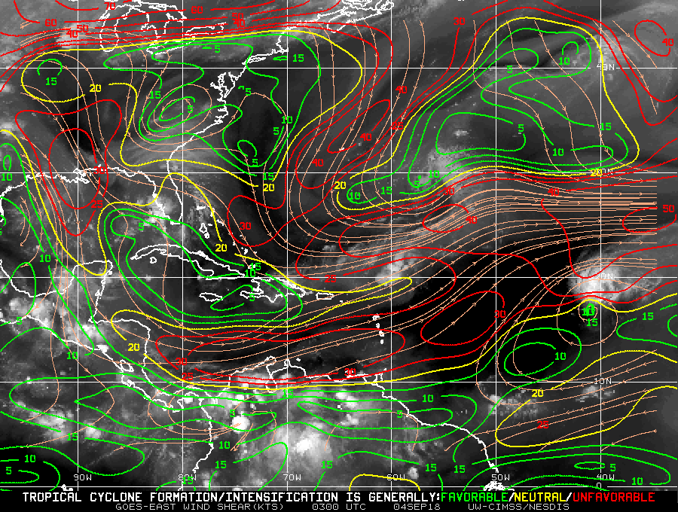
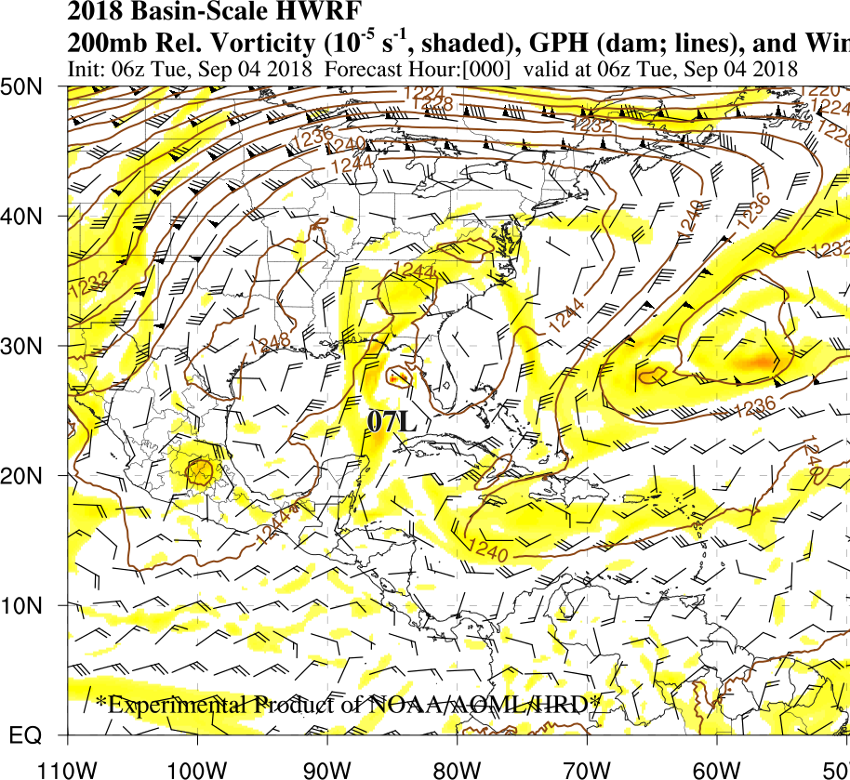
2018 NOAA/AOML/HRD Hurricane Field Program
Intensity Forecast Experiment (IFEX)
AL07/Gordon Debrief
Prevalent Environmental Conditions
Moderate deep-layer shear (~20 kt)
(3) nearby upper-level lows; biggest impact from ULL to Gordon’s north
X
X
CIMSS 200-850 hPa vertical wind shear magnitude (contour; kt) and direction (streamlines) and GOES-East infrared image valid at 0300 UTC 04 September 2018.
200 hPa relative vorticity (shading), winds (barbs), geopotential heights (contours)

Slide 23
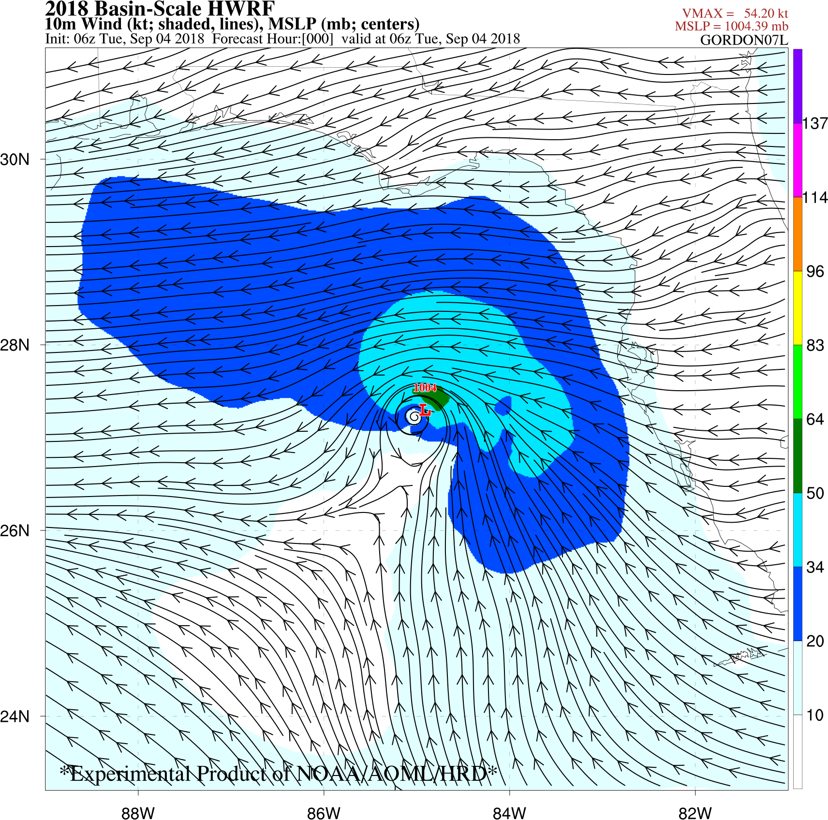
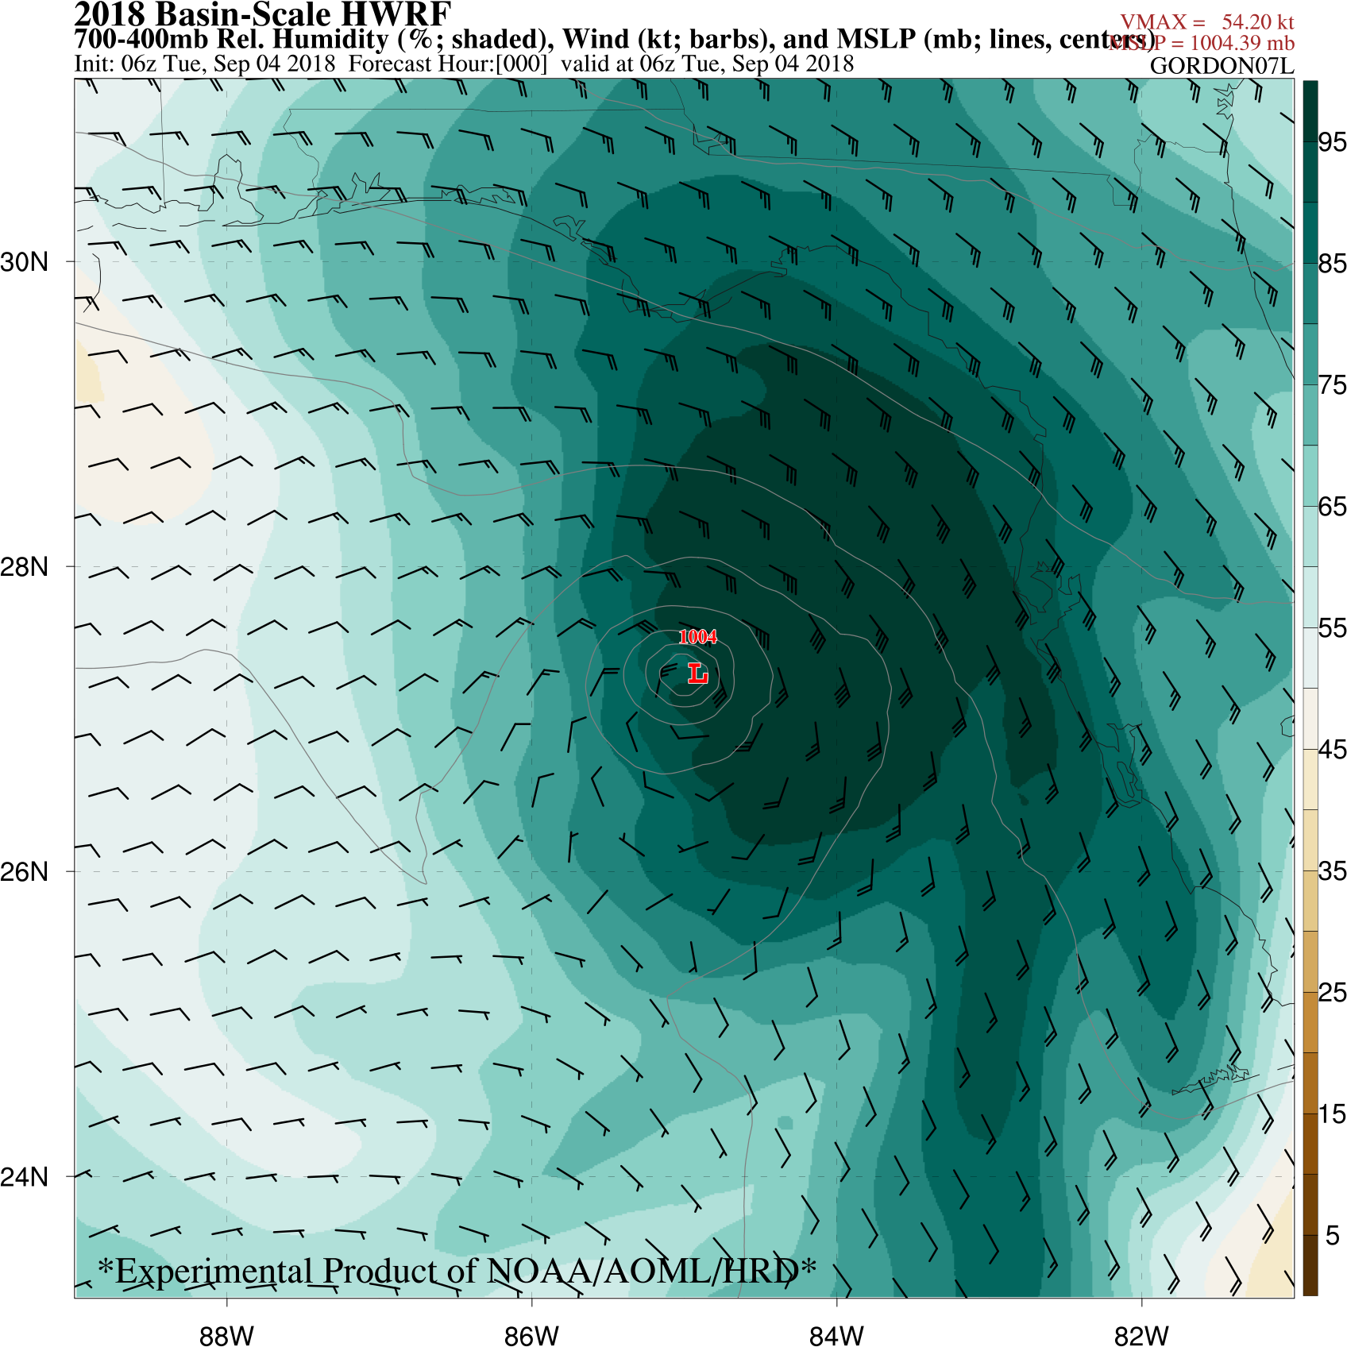
2018 NOAA/AOML/HRD Hurricane Field Program
Intensity Forecast Experiment (IFEX)
AL07/Gordon Debrief
Storm-Scale Characteristics
Surface circulation is very asymmetric; strongest winds to the northeast
Mid-level moisture gradient asymmetric, but not too dry on west side
Analysis of 10-m wind (kt, shaded, lines) and MSLP (mb, centers) from Basin-Scale HWRF valid at 0600 UTC 04 September 2018.
Analysis of 700-400 mb relative humidity (%, shaded), 700-400 mb wind (kt, barbs) and MSLP (mb, lines, centers) from Basin-Scale HWRF valid at 0600 UTC 04 September 2018.

Slide 24
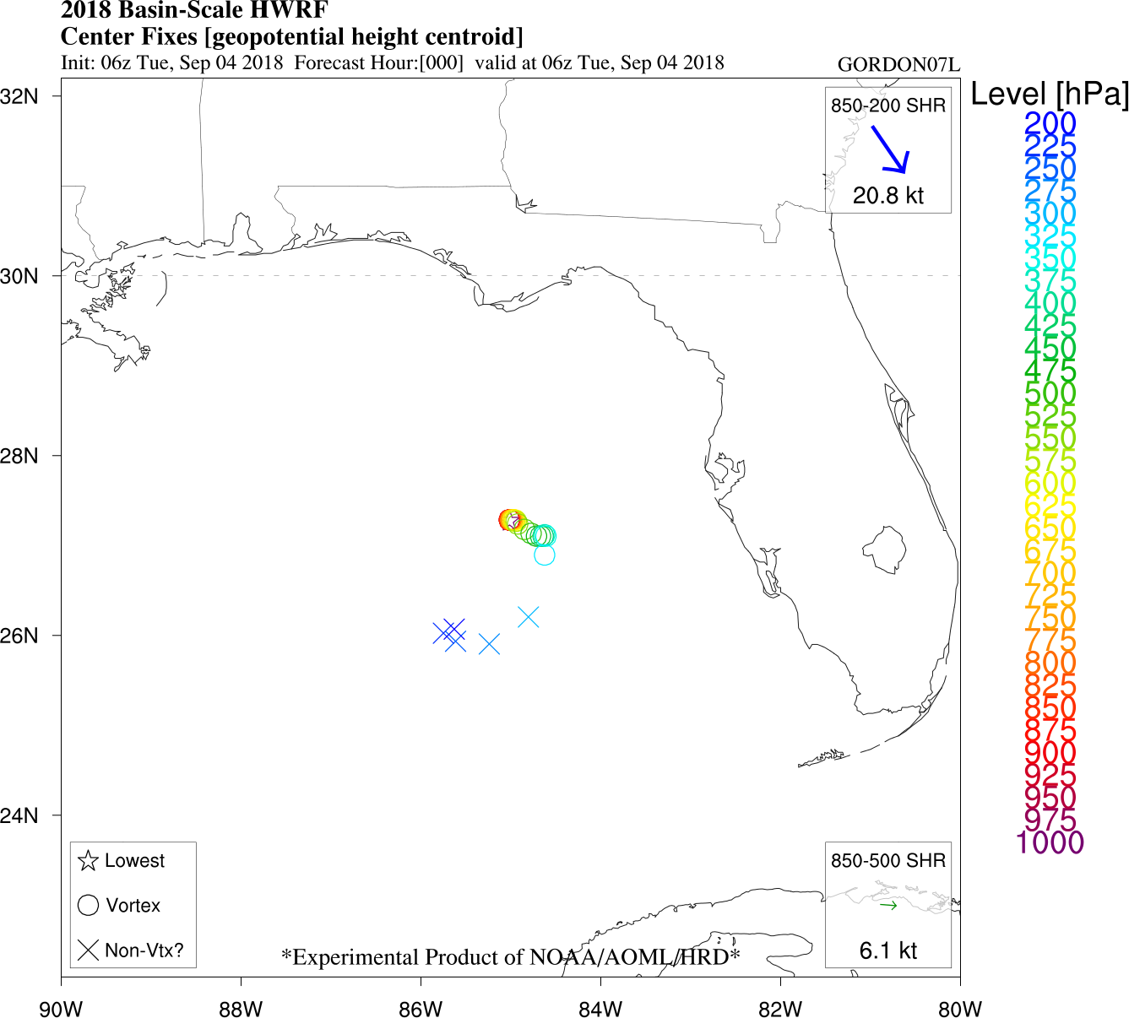
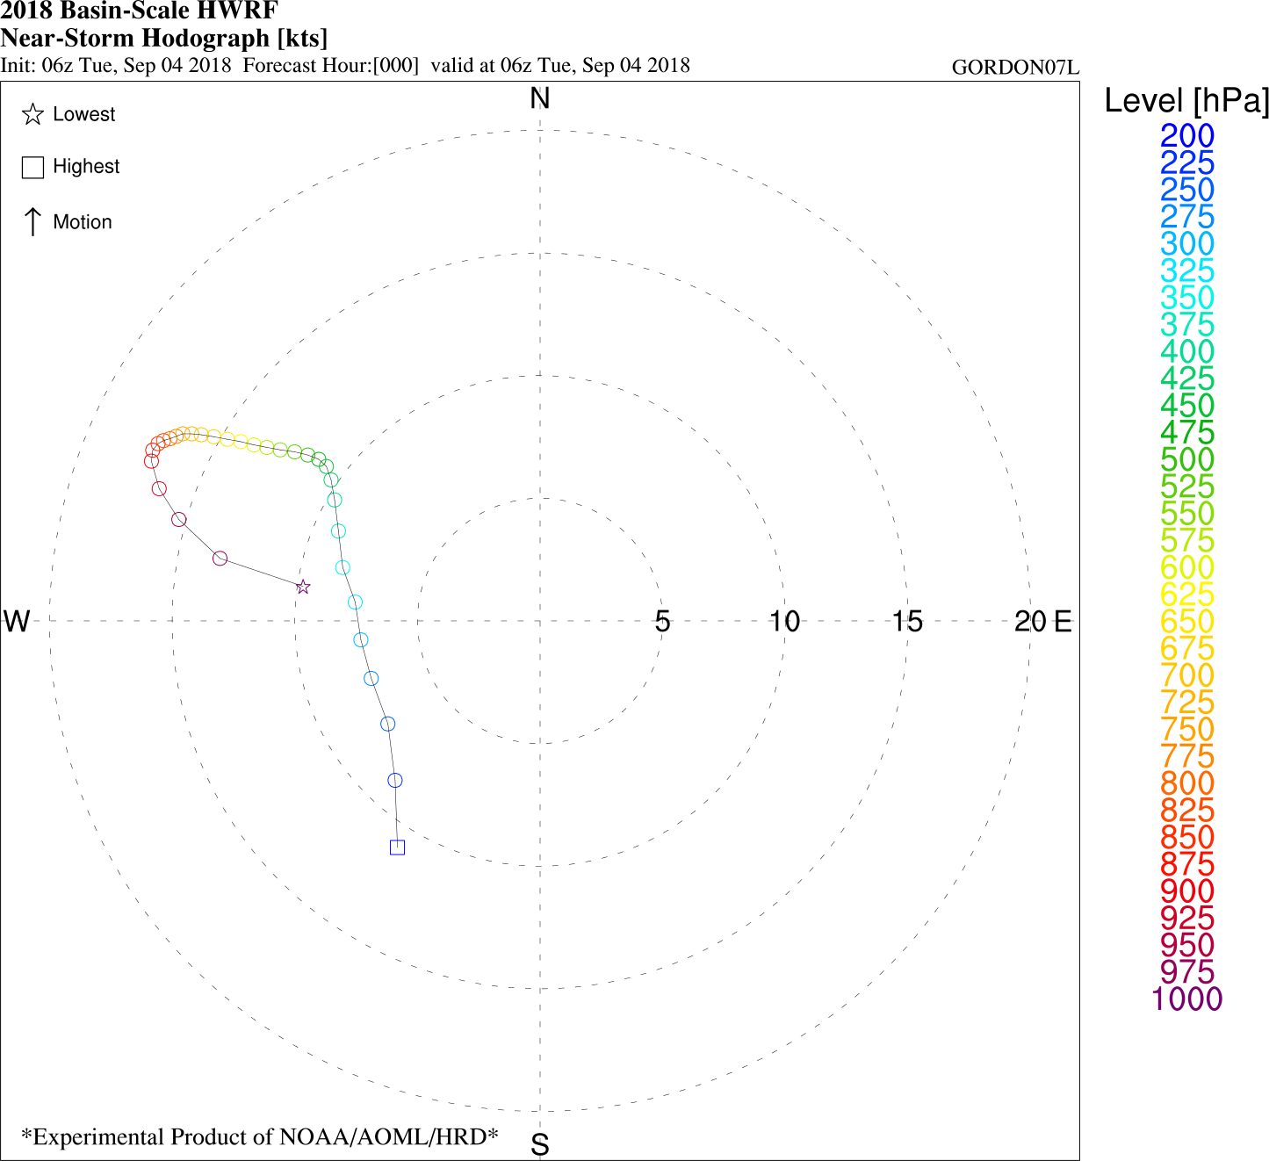
2018 NOAA/AOML/HRD Hurricane Field Program
Intensity Forecast Experiment (IFEX)
AL07/Gordon Debrief
Storm-Scale Characteristics
Vortex tilt to the east with height evident up through ~300mb
TC Hodograph shows westerly component to average wind at all levels
TC center fixes (geopotential height centroid) at each level from Basin-Scale HWRF valid at 0600 UTC 04 September 2018.
Near-TC hodograph (200-800-km annulus at each level) from Basin-Scale HWRF valid at 0600 UTC 04 September 2018.

Slide 25
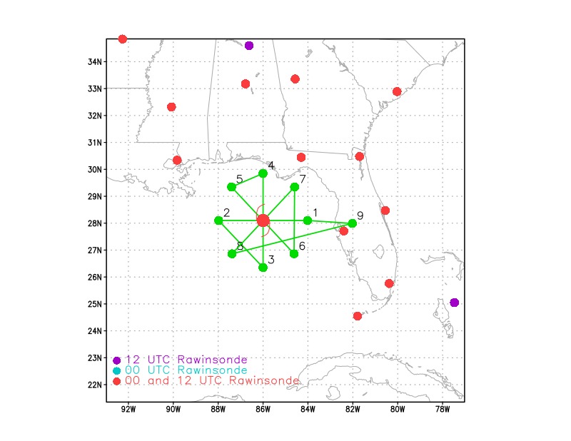
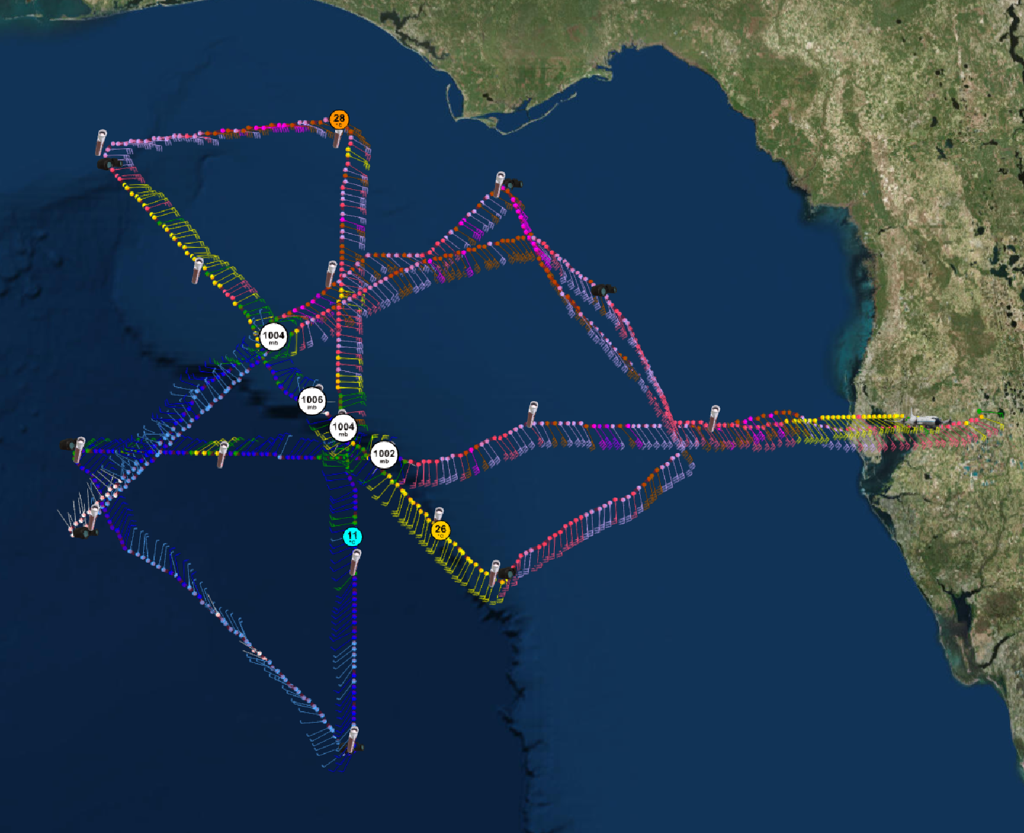
2018 NOAA/AOML/HRD Hurricane Field Program
Intensity Forecast Experiment (IFEX)
AL07/Gordon Debrief
Flight Track
Pre-Flight → rotated IP to the east
TC Hodograph shows westerly component to average wind at all levels
Updated proposed flight track for mission 180904H1.
Actual flight track for mission 180904H1.

Slide 26
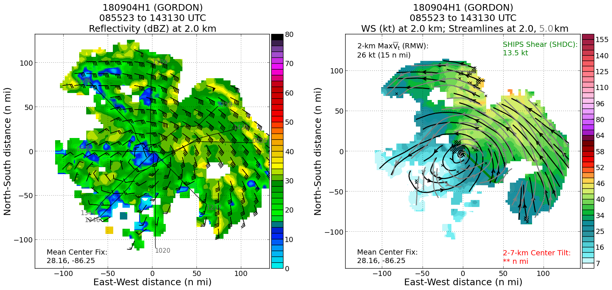
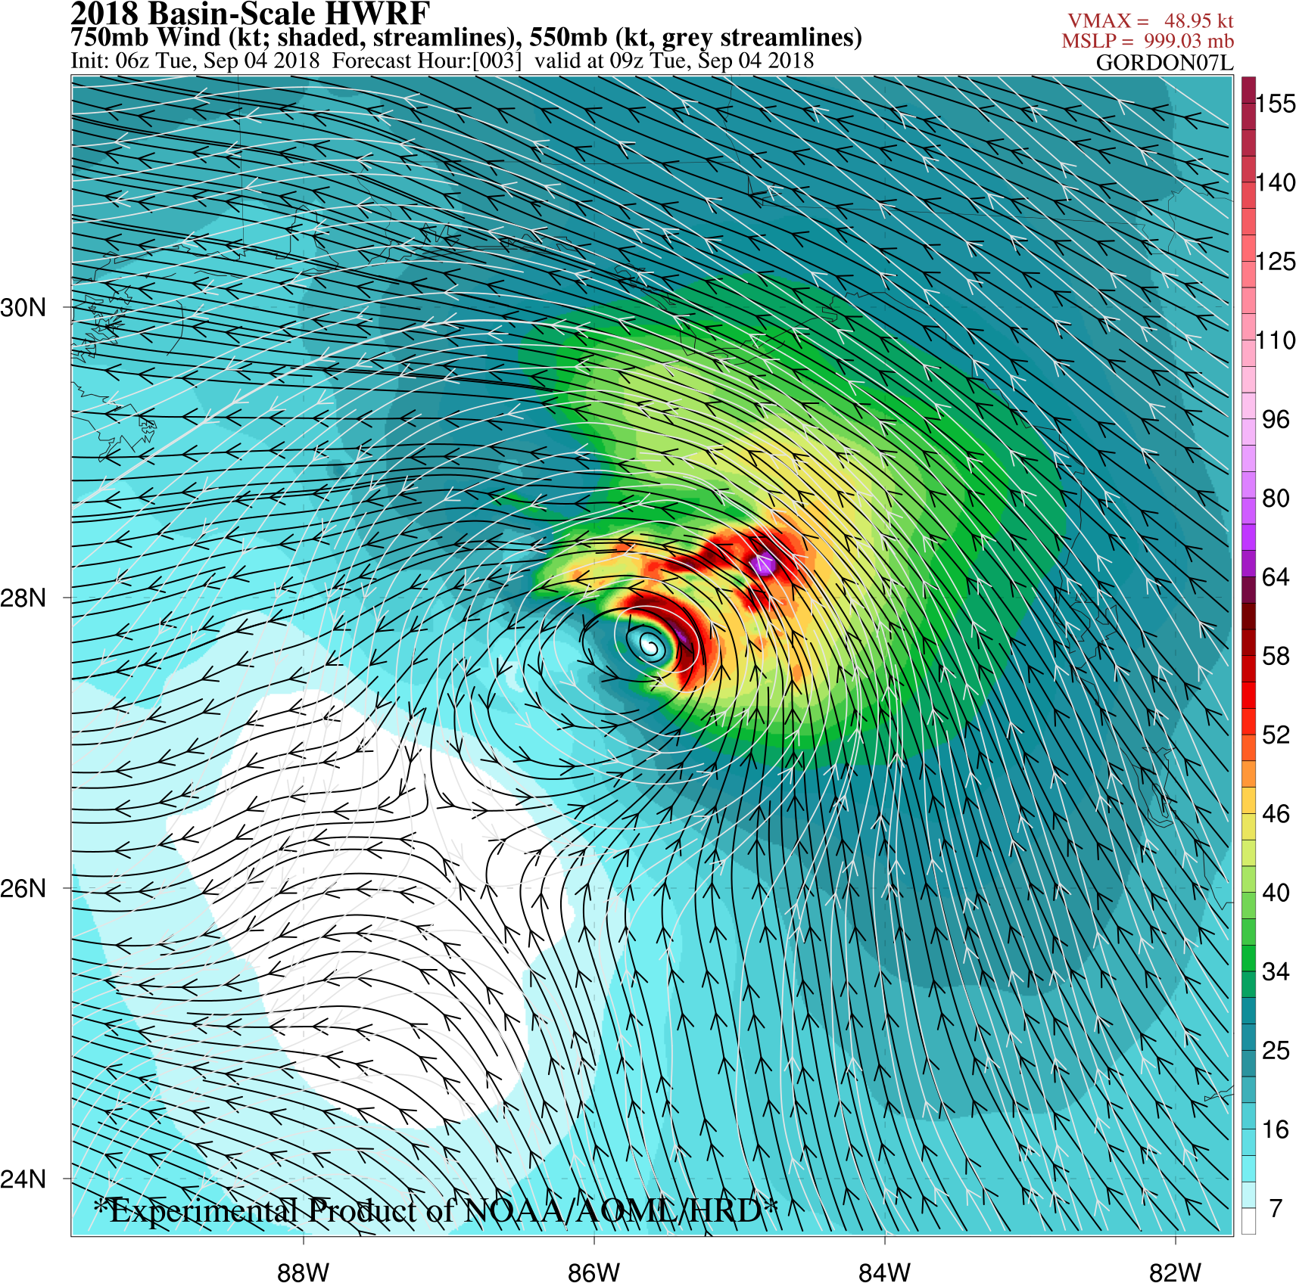
2018 NOAA/AOML/HRD Hurricane Field Program
Intensity Forecast Experiment (IFEX)
AL07/Gordon Debrief
Real-Time Analyses
Strongest winds on the NE side
2- & 5-km centers were offset → supported by Basin-Scale HWRF

Slide 27
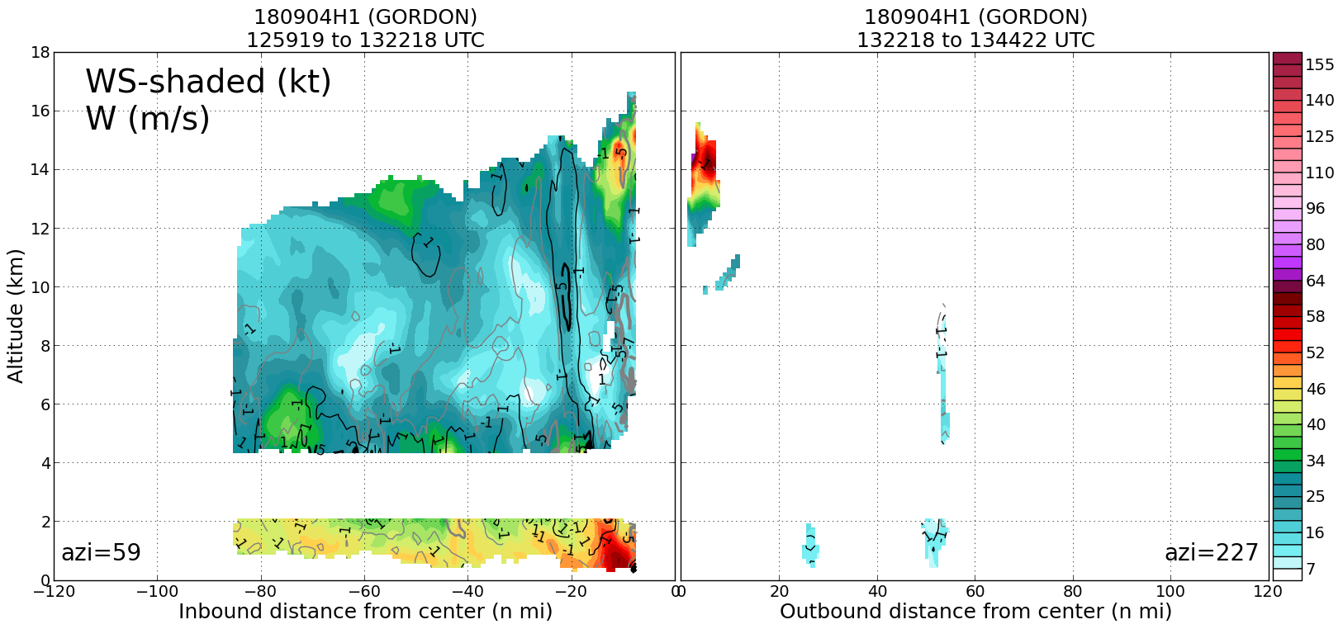
2018 NOAA/AOML/HRD Hurricane Field Program
Intensity Forecast Experiment (IFEX)
AL07/Gordon Debrief
Real-Time Analyses
Strongest winds on the NE side
2- & 5-km centers were offset → supported by Basin-Scale HWRF
NE
SW
Few scatterers SW of the center

Slide 28
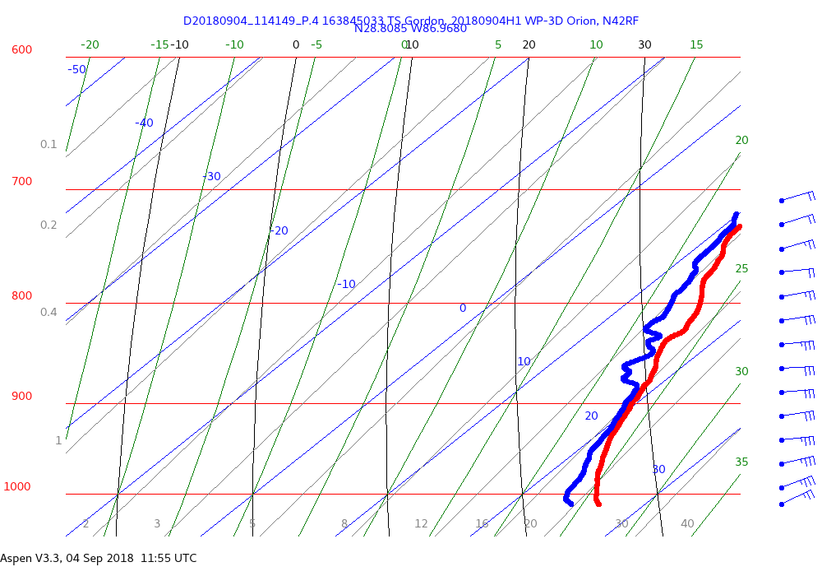
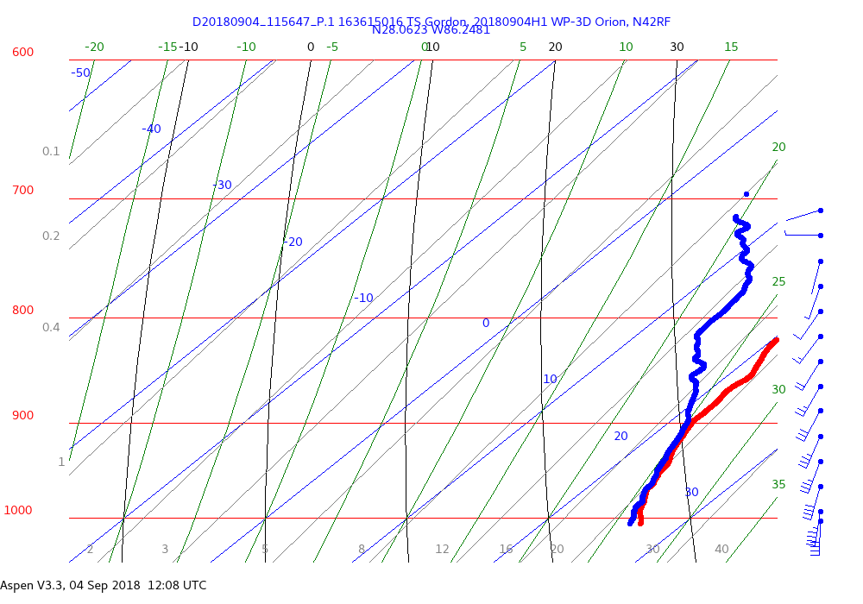
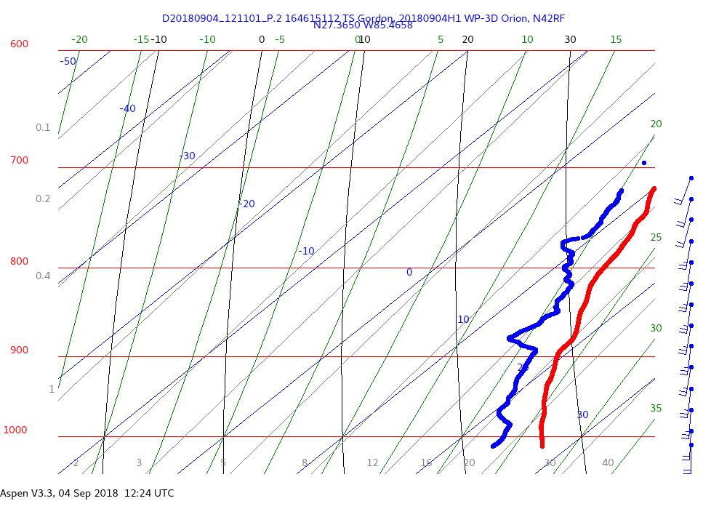
2018 NOAA/AOML/HRD Hurricane Field Program
Intensity Forecast Experiment (IFEX)
AL07/Gordon Debrief
Real-Time Analyses
From the final NE-SW pass (4/5) through Gordon’s center
Profile much drier on the SW side, where there were few scatterers.
NE of Center moist profile
cloud → 875-950
some drier layers
Center
moist profile, esp. below 900mb
Dry above 900mb → subsidence?
SW of center
much drier profile
shallow layers of dry air (875mb)

Slide 29
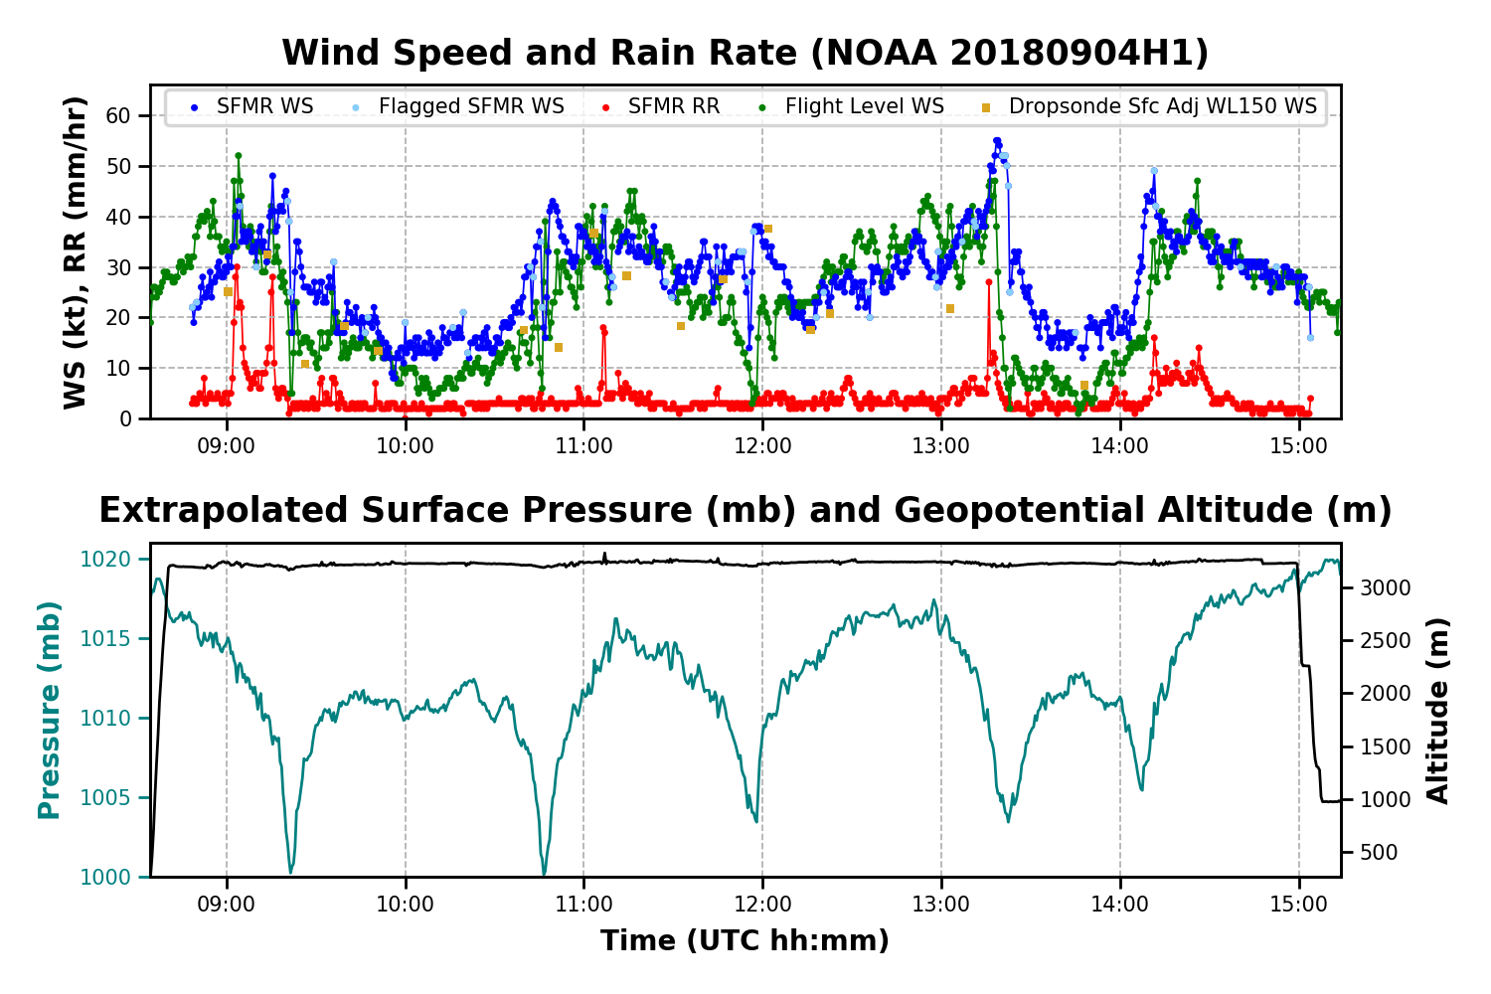
2018 NOAA/AOML/HRD Hurricane Field Program
Intensity Forecast Experiment (IFEX)
AL07/Gordon Debrief
Real-Time Analyses

Slide 30
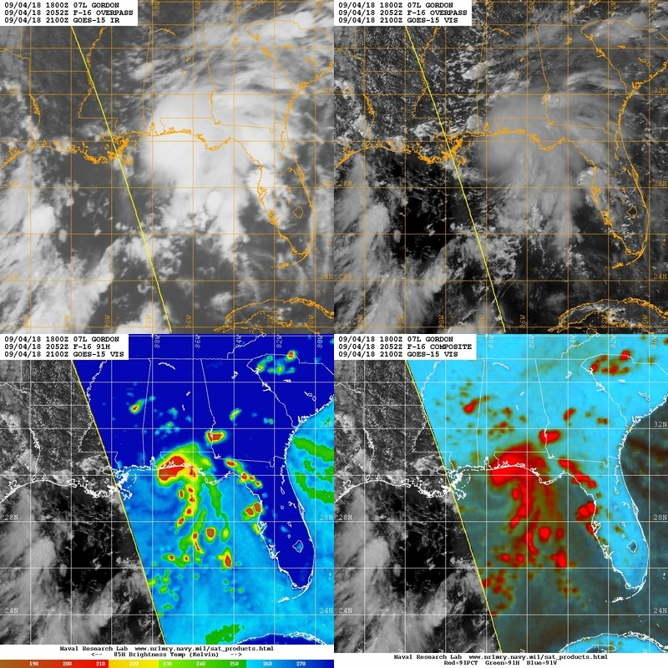
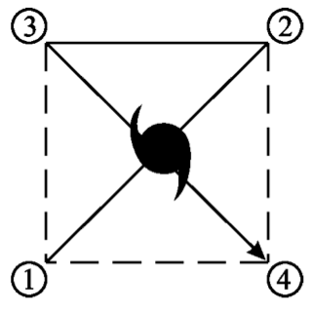
2018 NOAA/AOML/HRD Hurricane Field Program
Intensity Forecast Experiment (IFEX)
AL07/Gordon Debrief
Mission 3: 20180904H2 (NHC-Tasked operation)
55 kt / 1001 mb
LPS: Christophersen
Radar: Rogers
Drops: Hazelton
Ground Radar: Gamache
Guest: Zawislak, Chang, Sapp, De Solo
Takeoff: 2026 UTC, Landing: 0000 UTC
Pattern: ALPHA, 10 kft
Drops: 14 (centers, endpoints, module)
AXBTs: 0
Fixes: 7
Repeat
Modified ALPHA pattern
Adopted from National hurricane operations plan FCM-P12-2018 Figure 5-7.
Motion: 310/13 kt

Slide 31
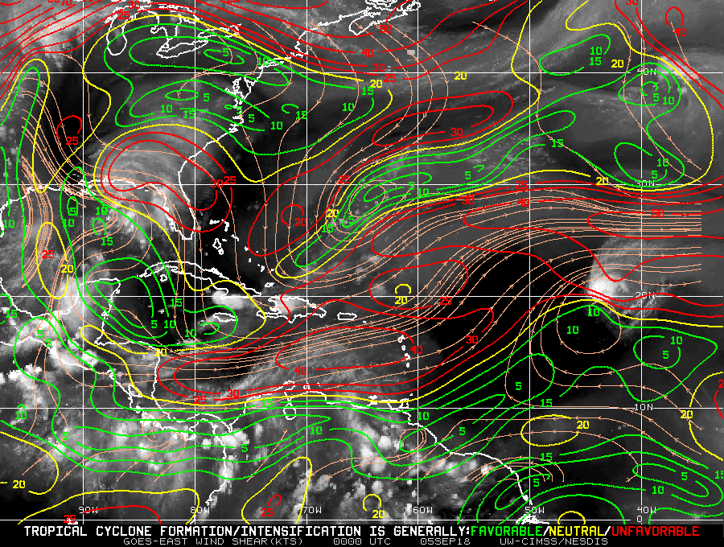
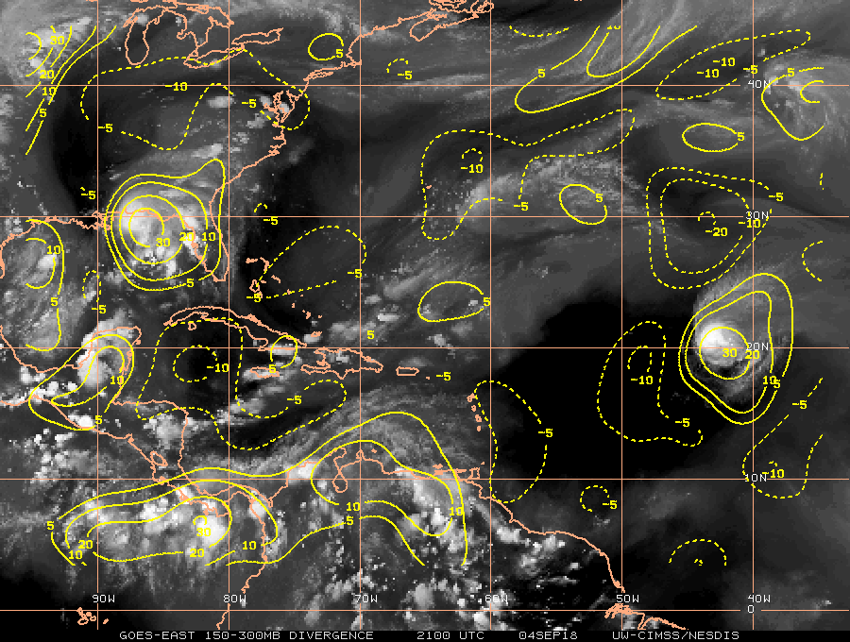
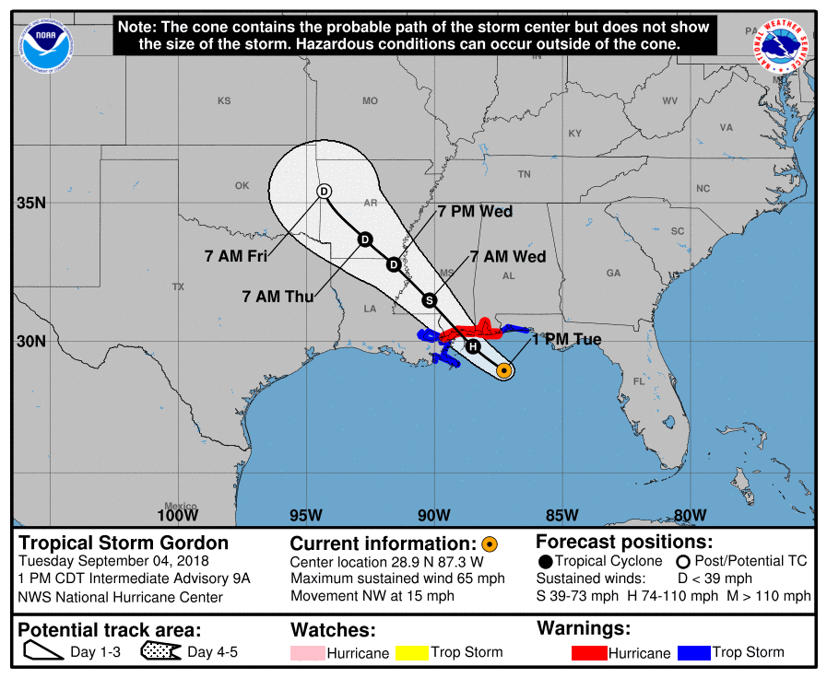
2018 NOAA/AOML/HRD Hurricane Field Program
Intensity Forecast Experiment (IFEX)
AL07/Gordon Debrief
Synoptic-Scale Evaluation
200-850mb deep shear
Ocean heat content
Upper-level divergence
Gordon was situated in a moderate to high shear region
~6 h of over warm SSTs before landfall, diffluent SE upper-level flow, increased convergence from land interaction-> potential room for intensification
NHC forecast it become a Hurricane right before landfall

Slide 32
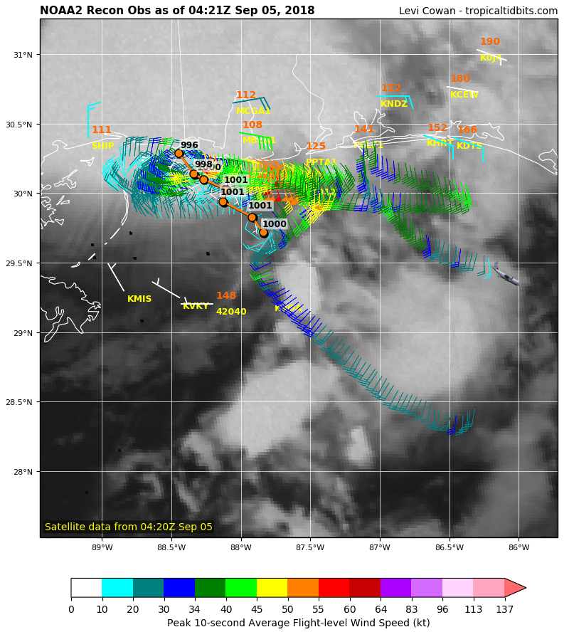
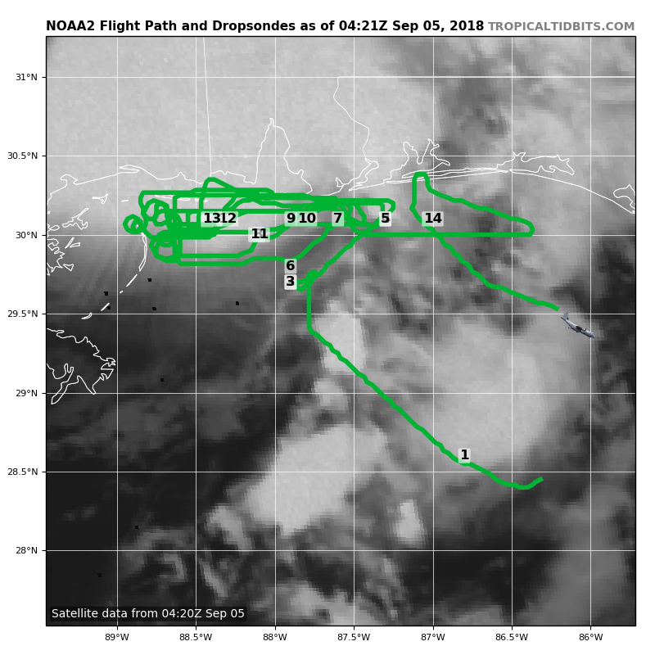
2018 NOAA/AOML/HRD Hurricane Field Program
Intensity Forecast Experiment (IFEX)
AL07/Gordon Debrief
Mission Overview
Truncated alpha pattern to target maximum wind region
Center drops for fixes
Beach survey pattern
Offshore intense convection module (3 sondes by HRD)
Records of 8 TDR analyses in real time

Slide 33
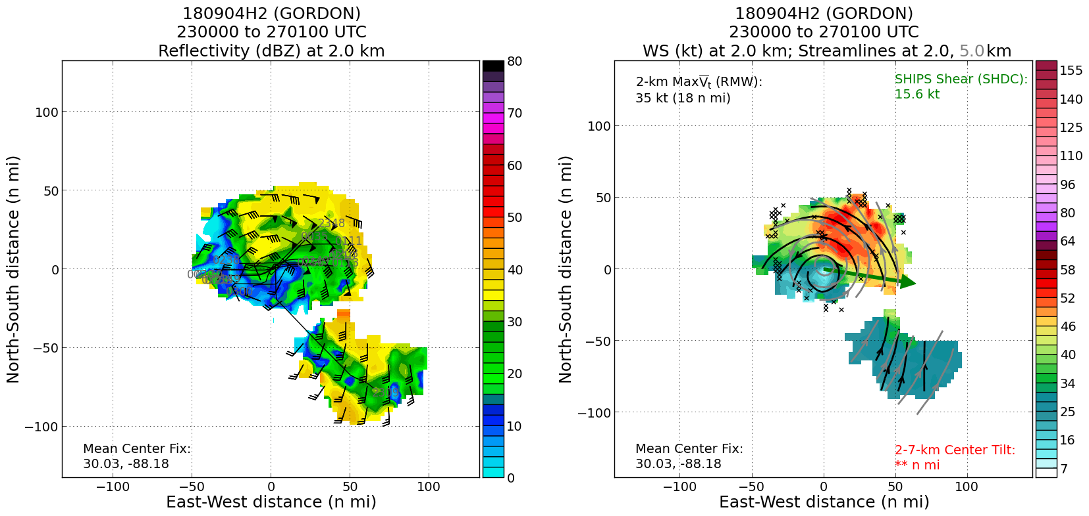
2018 NOAA/AOML/HRD Hurricane Field Program
Intensity Forecast Experiment (IFEX)
AL07/Gordon Debrief
TDR Analysis
Reflectivity
Very asymmetric storm
Most of the reflectivity and max wind in NE quadrant
Wind speed

Slide 34
2018 NOAA/AOML/HRD Hurricane Field Program
Intensity Forecast Experiment (IFEX)
AL07/Gordon Debrief
Offshore Intense Convection Module
WSR88D radar
IR screenshot at 0345 UTC
An intense convective rainband just offshore south of pensacola
Flash flooding was issued from WPC near the cost of mobile and pensacola

Slide 35
2018 NOAA/AOML/HRD Hurricane Field Program
Intensity Forecast Experiment (IFEX)
AL07/Gordon Debrief
Offshore Intense Convection Module
0355 UTC
0358 UTC
0400 UTC
0402 UTC
0400 UTC

Slide 36
2018 NOAA/AOML/HRD Hurricane Field Program
Intensity Forecast Experiment (IFEX)
AL07/Gordon Debrief
Mission 3: 20180904H2 NHC Tasked Operation
Summary
T/O: 1001 mb / 55 kt L/D: 996 mb / 60 kt
Slight intensification, asymmetric precip throughout the mission
Peak 58 kt from a dropsonde in NE max wind quadrant, peak 63 kt flight-level winds
7 fixes throughout the mission
Gordon made landfall ~1015 PM CDT (0315 UTC) just west of the Alabama-Mississippi border with estimated maximum sustained winds of 70 mph (110 km/h).
Partially completed offshore intense convention module (only the eastern flank of the convective rainband)
Problems
SFMR not getting surface winds because too close to land? Though it still reads brightness temperature
Textbook module describes a stationary rainband while in real world a rather quick-evolving rainband, not able to sample western flank of the target rainband
Expendables
14 drops (11 NHC, 3 HRD)

