Slide 1
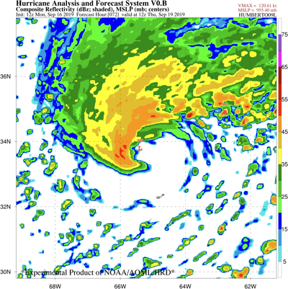
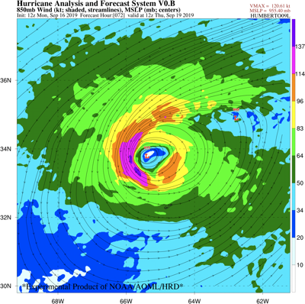
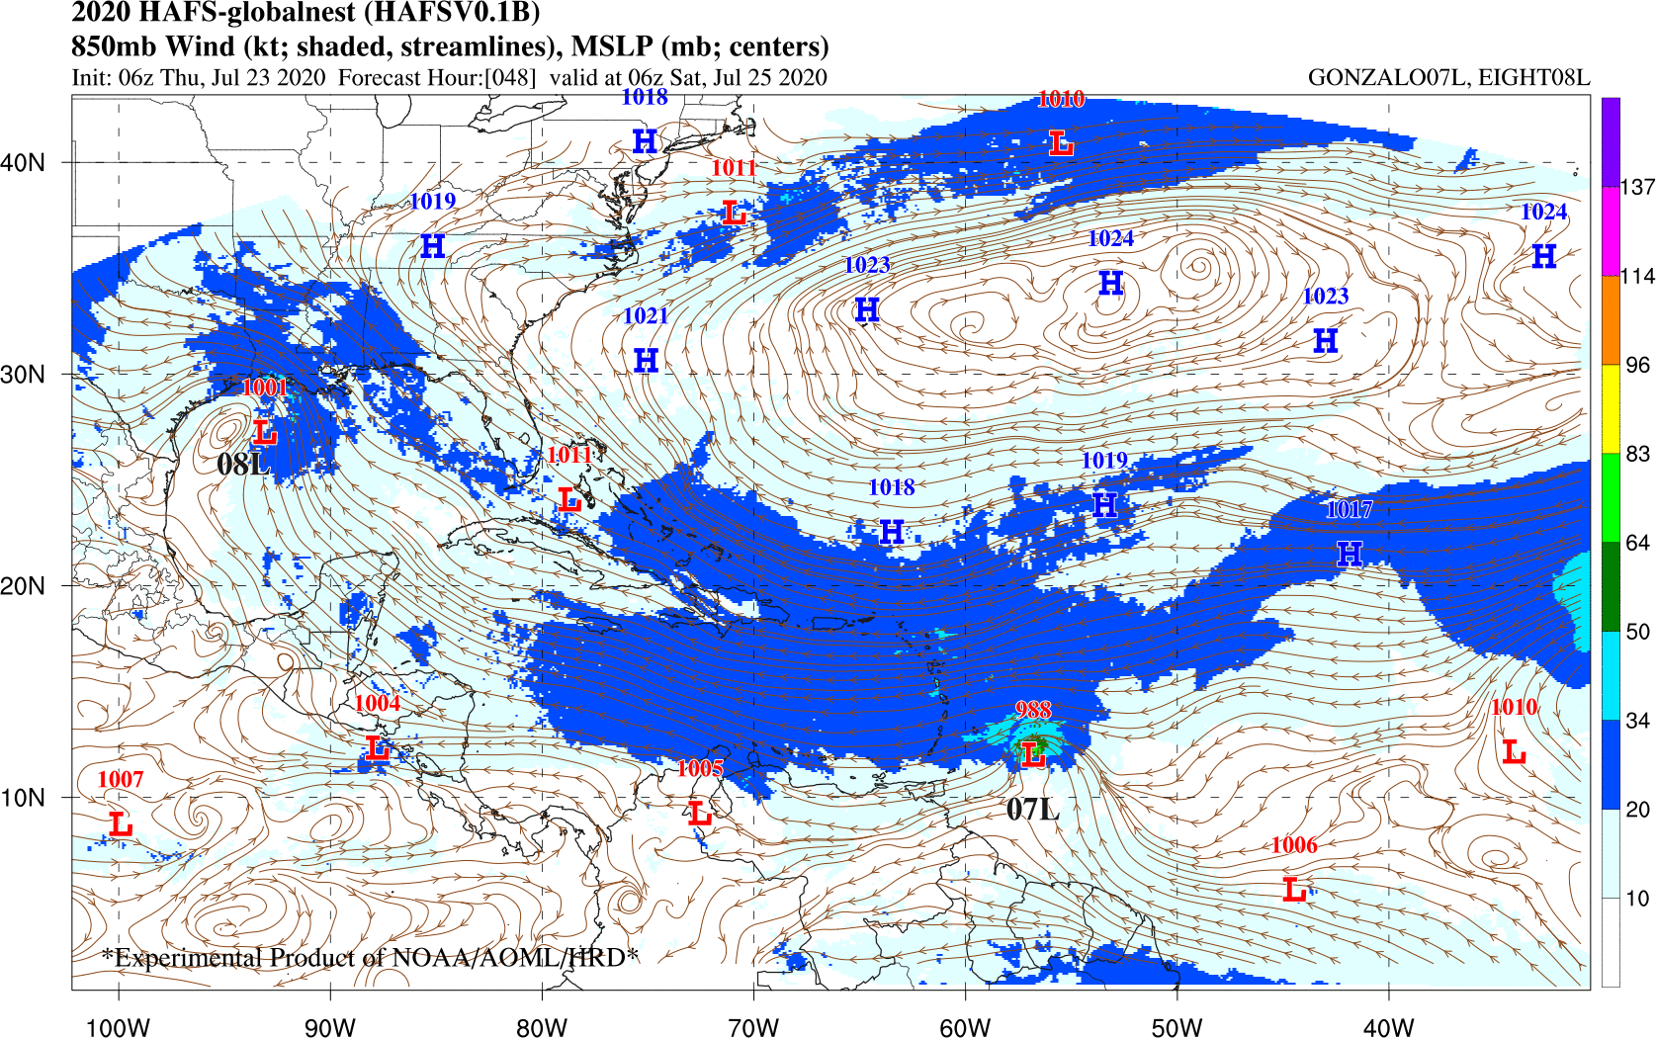
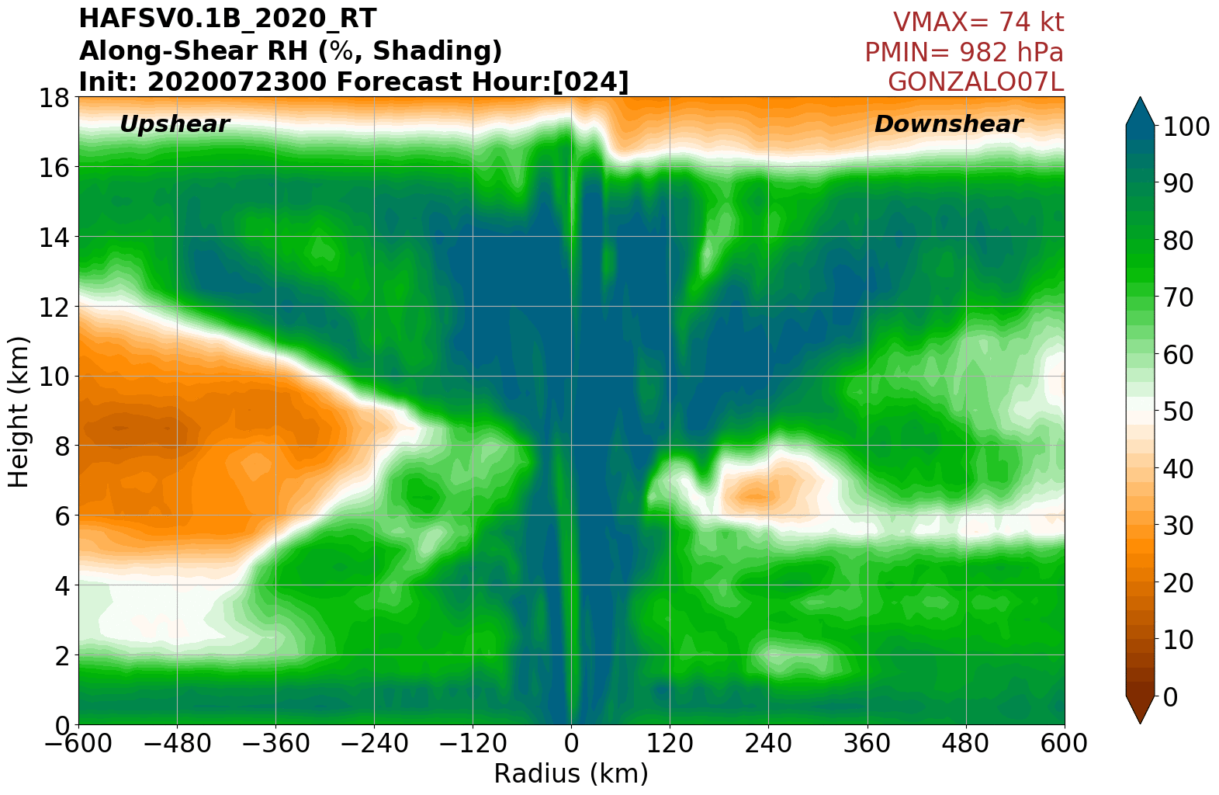

The HAFS-globalnest
Real-Time System and its Performance
Andrew Hazelton
Collaborators: G. Alaka, L. Cowan, X. Zhang, J. Zhang, S. Gopalakrishnan, F. Marks, L. Gramer, B. Liu, Z. Zhang, J. Dong, L. Zhu, C. Zhang, A. Mehra, M. Bender, T. Marchok, L. Harris

Slide 2
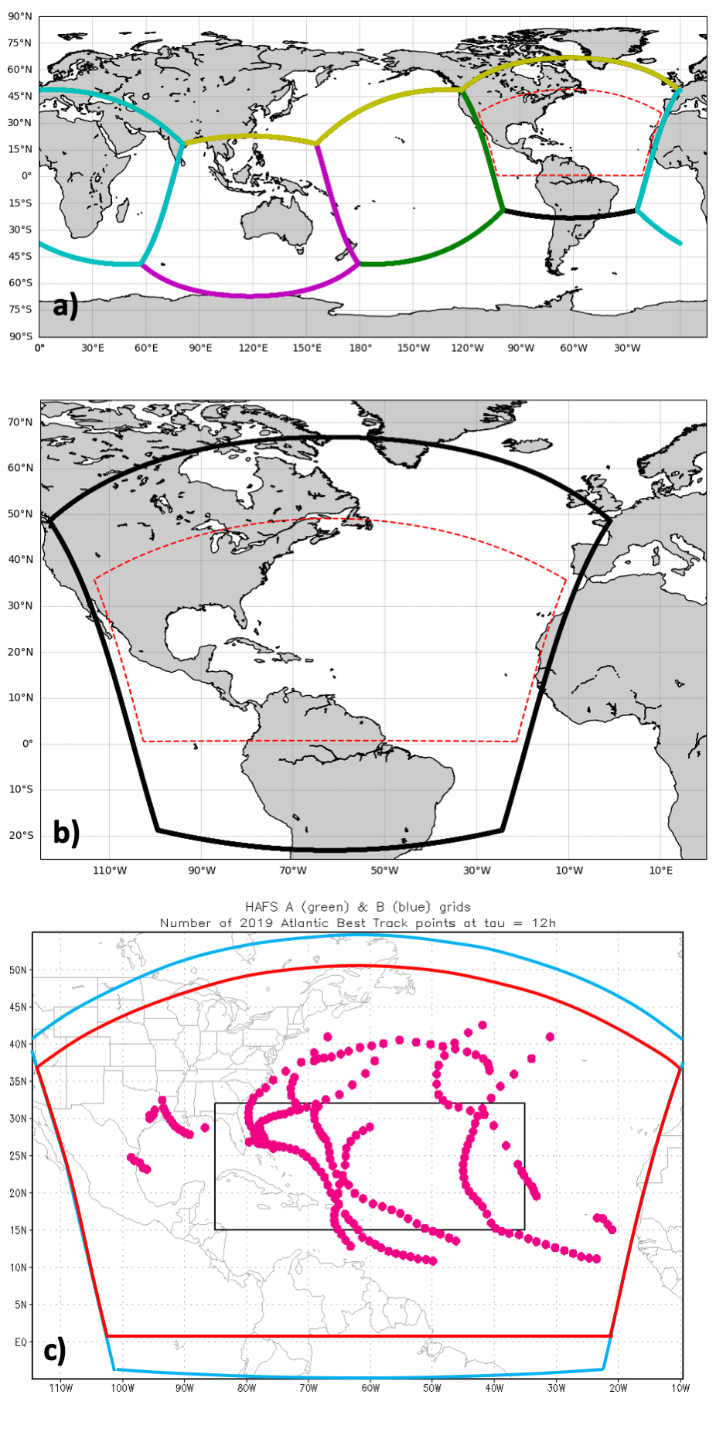
2019 Real-Time Configuration
HAFS-globalnest uses the global-nested capability of FV3
GFS physics with some PBL, surface modifications for hurricanes
6-tile layout focused on the Atlantic
Large static nest covering the Atlantic
Slightly smaller than HAFS-SAR domain
Most cases near the center of the domain
7-day forecasts
3-km horizontal grid spacing
64 vertical levels

Slide 3
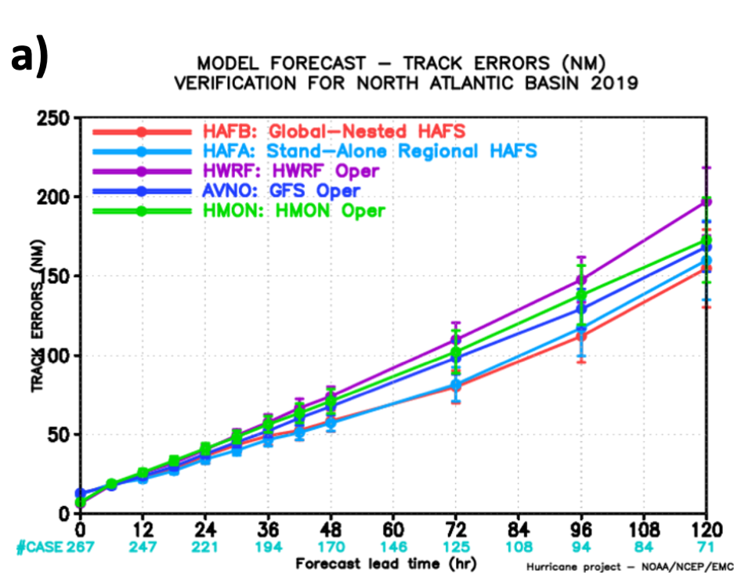
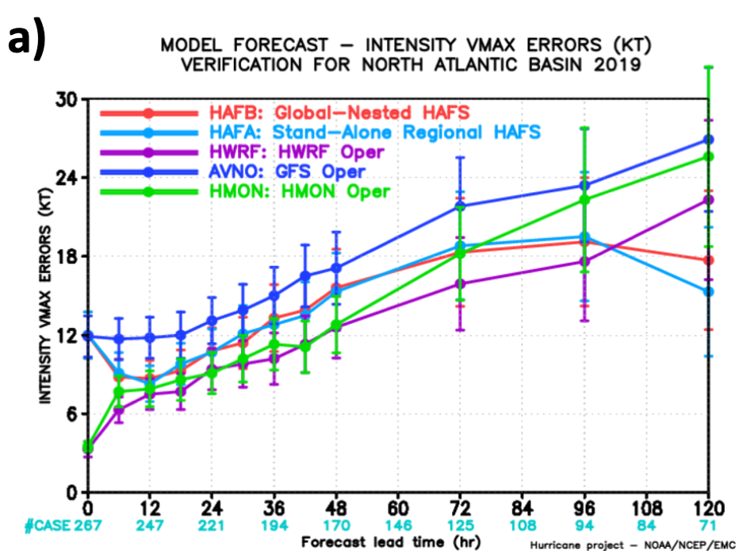
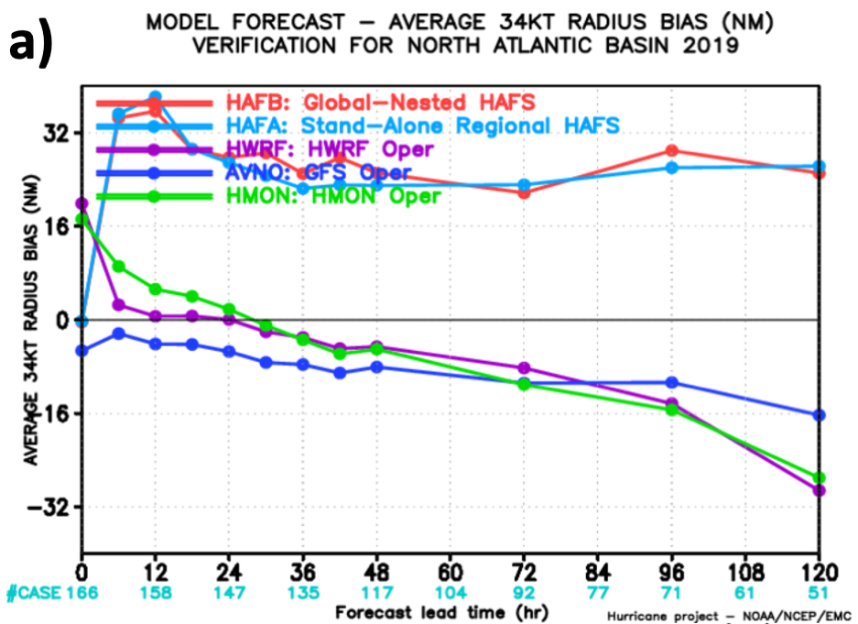
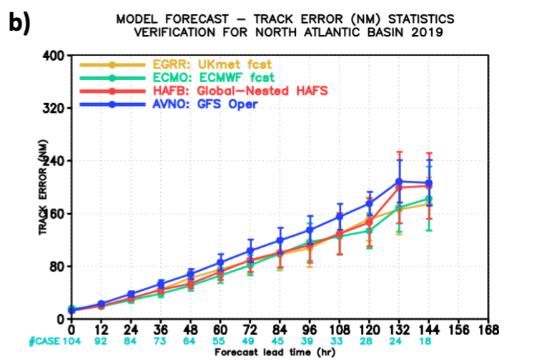
2019 Performance Statistics
HAFS-globalnest had skillful track compared to GFS/HWRF
Intensity forecasts behind HWRF early (initialization?)
R34 high bias (being explored)
Long-term track better than GFS through D5, similar after (small sample)

Slide 4
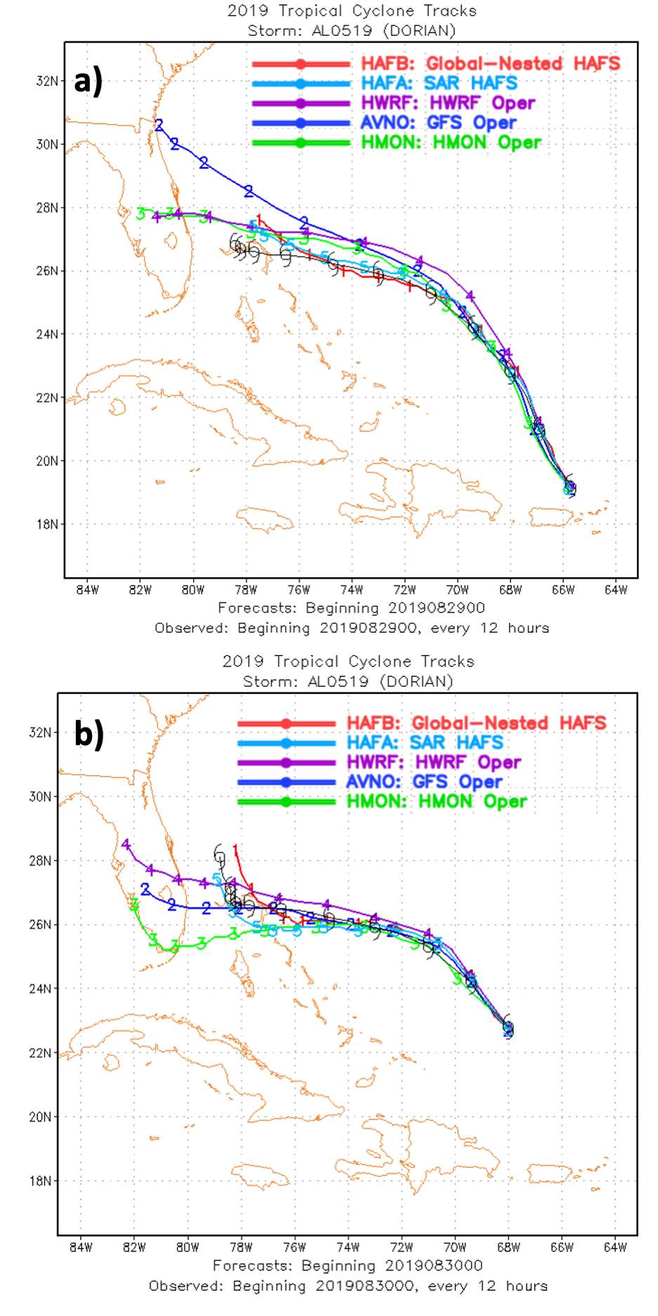
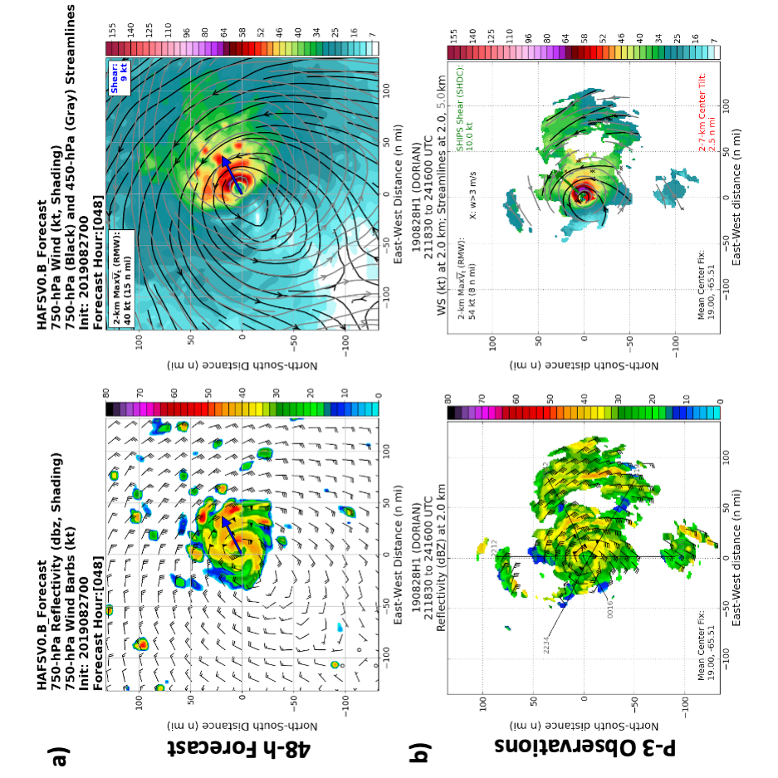
2019 Highlight Cases: Dorian
HAFS-globalnest generally showed stall/turn in the Bahamas
Some early forecasts correctly showed small-scale core forming

Slide 5
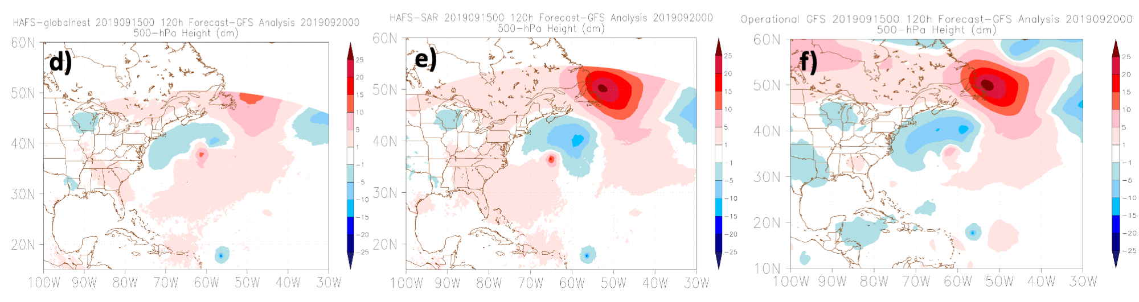
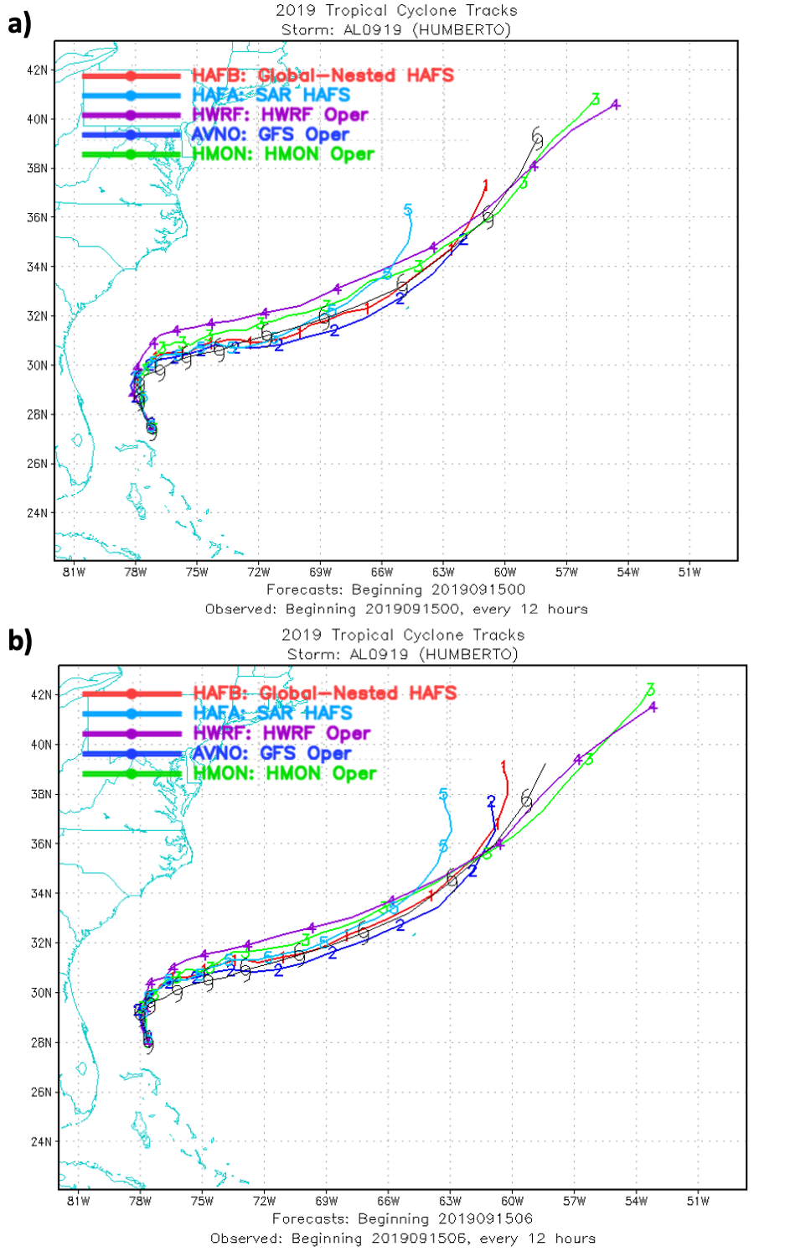
2019 Highlight Cases: Humberto
Humberto was a case where the 2-way feedback was important
Both HAFS-globalnest and HAFS-SAR turned NW too quickly, but HAFS-globalnest was closer to reality
HAFS-globalnest had smaller errors with the synoptic pattern along the North Atlantic
HAFS-SAR and GFS were similar

Slide 6
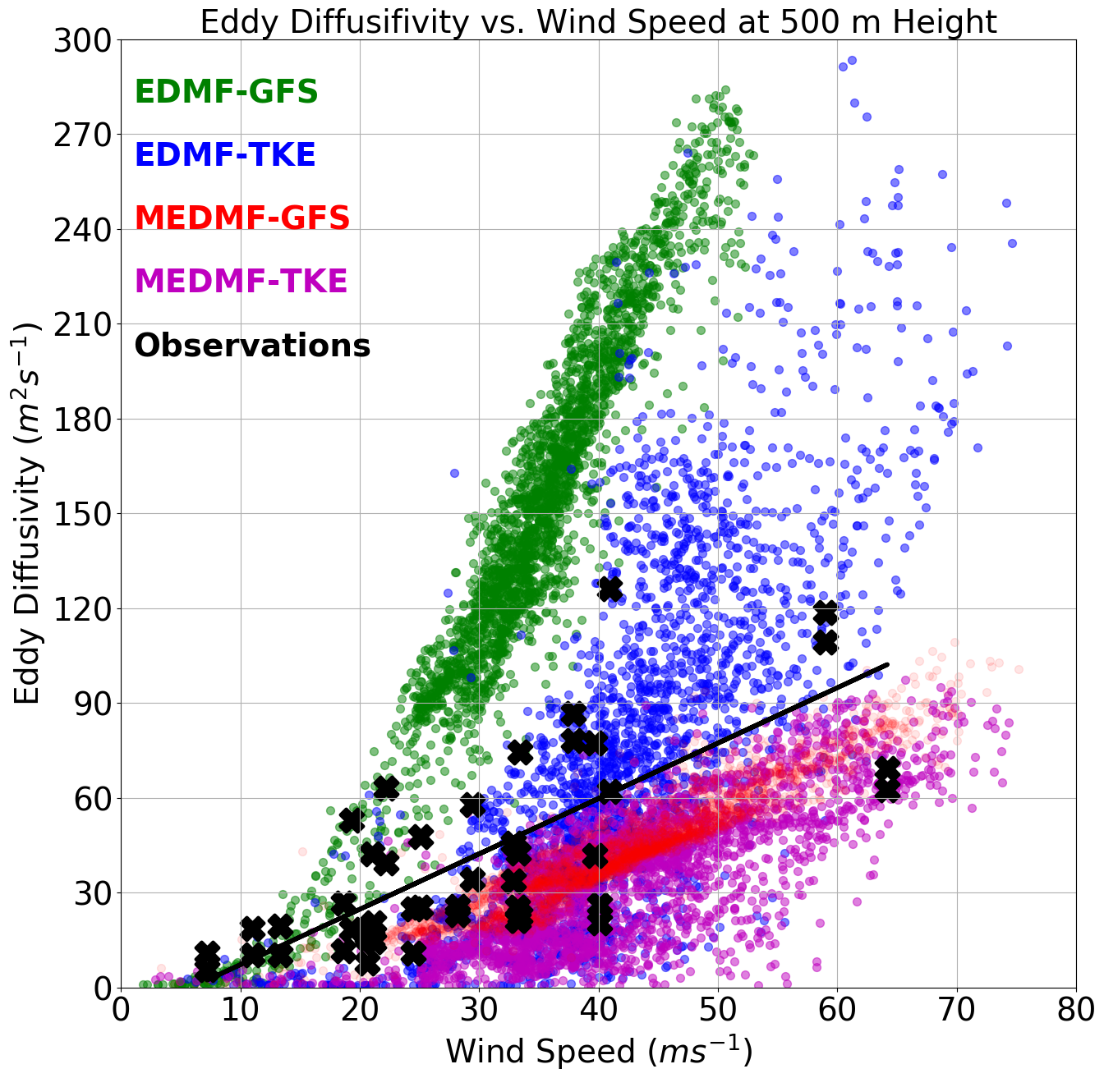
EDMF-TKE Physics Changes
Modifications made to EDMF-TKE based on observations of eddy diffusivity and mixing length
Default EDMF-TKE is better than default EDMF-GFS
Modifications lead to convergence of solutions

Slide 7
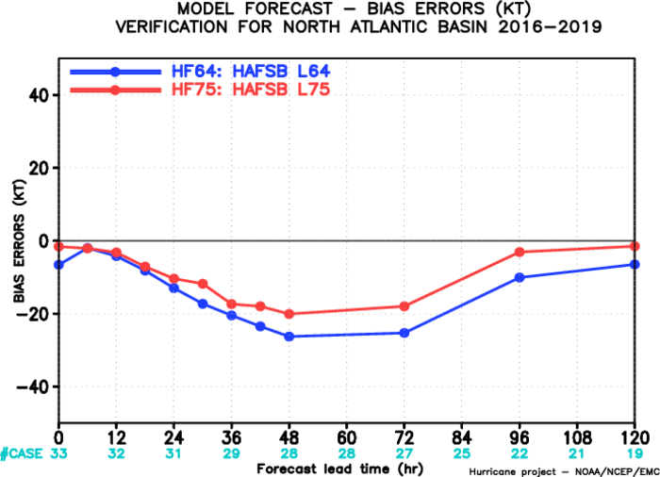
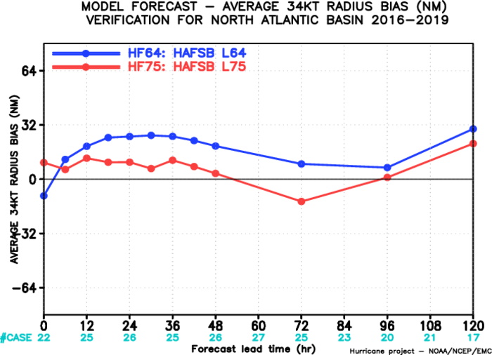
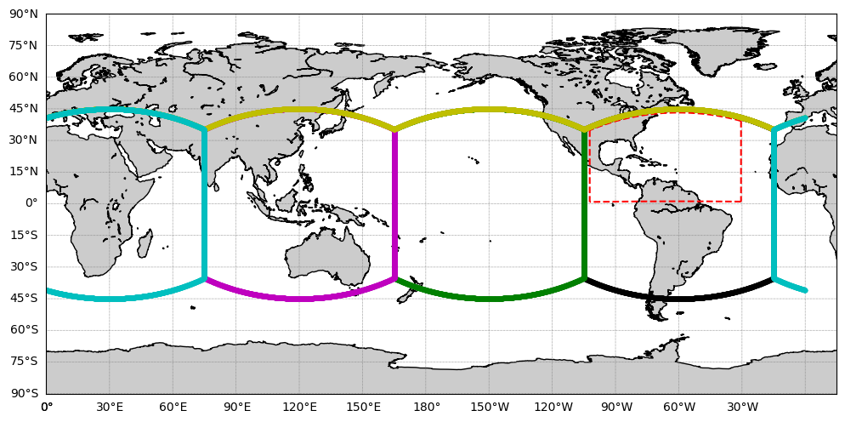
2020 Real-Time Configuration
Testing shows 75-level configuration improves the forecast for HAFS-globalnest
L75, modified EDMF-TKE incorporated into 2020 forecasts
Slightly smaller Atlantic nest used to fit into run time for reservation
Tropical channel global tile layout used
Forecasts at: https://storm.aoml.noaa.gov/basin/?projectName=BASIN

Slide 8
Future Plans
Ongoing physics development to improve TC structure, focusing on PBL physics through comparisons with obs, LES
Multiple-nesting capability (already available experimentally)
Ongoing development of TC graphical products for real-time display and research purposes
Testing moving nest in real-time (2021 hopefully)
Incorporation of Data Assimilation

Slide 9
Questions?

