Slide 1
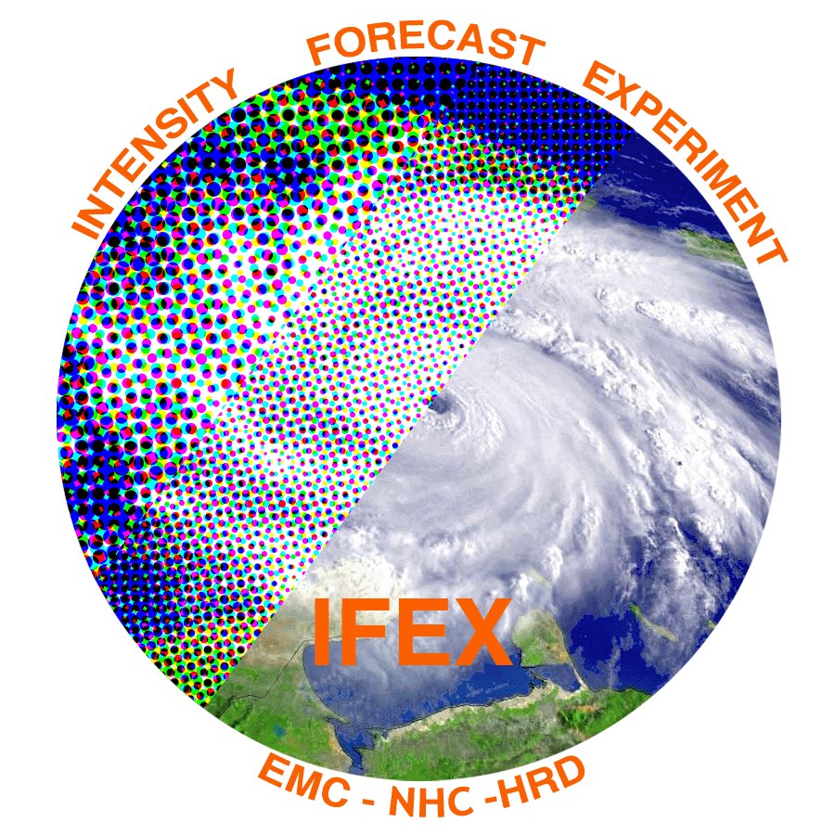

The Inner-core Structure of
Rapidly-Intensifying Tropical Cyclones
Robert Rogers
NOAA/AOML Hurricane Research Division
Collaborators: Paul Reasor¹, Jun Zhang², Andy Hazelton³, Gopal¹, Hua Chen², Robert Hart³
¹NOAA/AOML Hurricane Research Division
²Cooperative Institute for Marine and Atmospheric Studies/Univ. Miami
³Florida State University

Slide 2
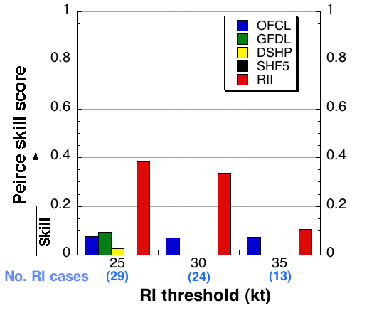
Motivation
Advances in forecasts of tropical cyclone (TC) intensity, and rapid intensity change (RI) in particular, lag advances in TC track forecasts
Multiscale interactions major reason for this – environmental to microscale
RI forecasts (e.g., RI index) based largely on environmental-scale fields generally explain about 35% of skill in RI forecasts
(Kaplan et al. 2009)
To what extent can processes smaller than the environmental scale explain remainder of skill?
  Aircraft data and numerical model forecasts are valuable tools for potentially detecting differences in inner-core structure for rapidly intensifying and steady-state TC’s

Slide 3
Motivation and background
Composite study of airborne Doppler radar observations of vortex- and convective-scale structure and TC intensification
Automatic data QC: HRD real-time procedure
  (www.nhc.noaa.gov/jht/2003-2005reports/DOPLRgamache_JHTfinalreport.pdf)
Analyze wind & reflectivity for each eyewall pass (Gamache 1997; Reasor et al. 2009)
  2 km horizontal spacing; 0.5 km vertical spacing
Merge analyses of eyewall passes for each flight to create an Intensive Observing Period, or “IOP”
Complete radar database: 261 eyewall passes in 77 IOP’s from 19 different TC’s provide “snapshots” of inner-core structure
|V|
pass 2
pass 1
pass 3
Rogers et al. 2012
Wind speed from IOP centered at 00 UTC Aug. 30 in Hurricane Earl

Slide 4
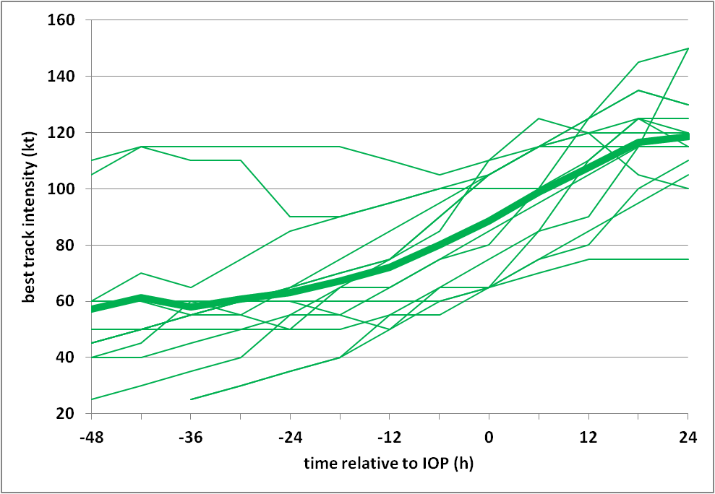
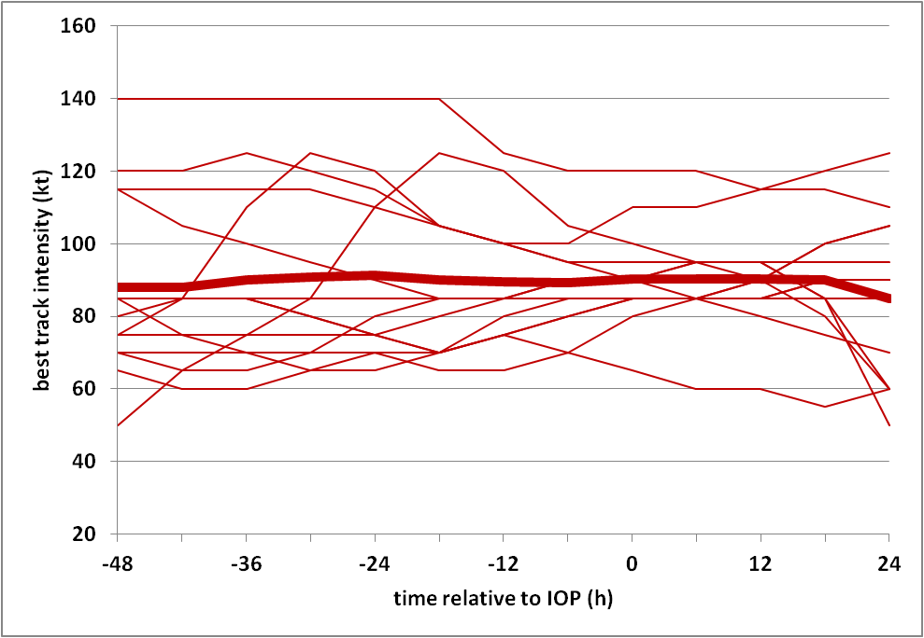
Motivation and background
Composite study of airborne Doppler radar observations of vortex- and convective-scale structure and TC intensification
Best track intensity history for each IOP (thick line is mean)
Intensifying
Steady-state
IOP
IOP
  40 eyewall passes from 14 IOP’s in 8 intensifying TC’s
53 eyewall passes from 14 IOP’s in 6 steady-state TC’s
Many IOP’s in IN dataset occur in middle of intensification period

Slide 5
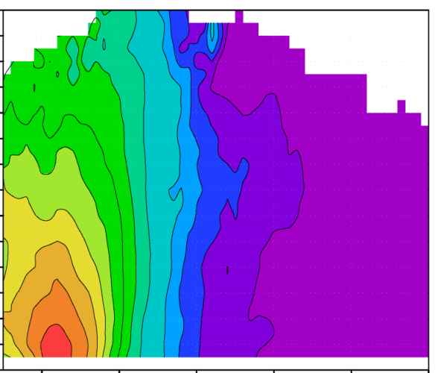
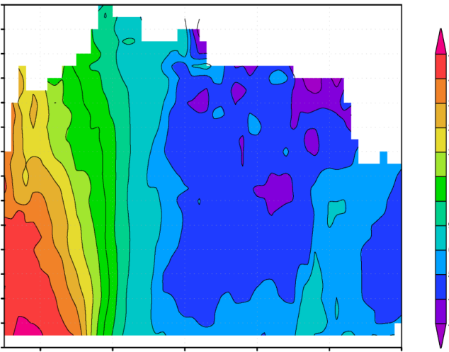
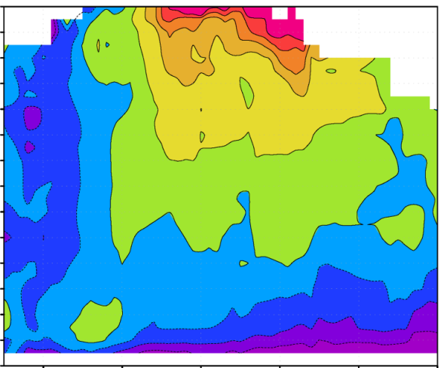
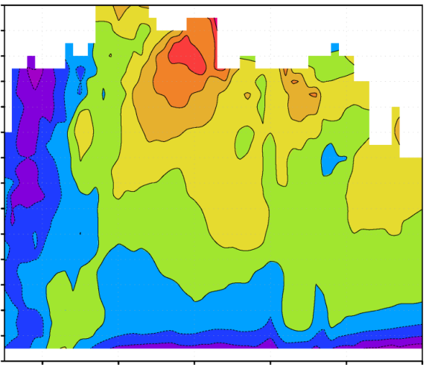

Motivation and background
Composite results: Axisymmetric vortex-scale properties
14
IN
14
SS
0
13
13
12
12
33
11
11
30
10
10
27
height (km)
9
height (km)
9
24
Vertical vorticity (x 10⁻⁴ s⁻¹)
8
8
21
7
7
18
6
6
12
5
5
9
4
4
6
3
3
5
2
2
4
1
1
3
0
0.5
1
1.5
2
2.5
3
0
0.5
1
1.5
2
2.5
3
r/RMW
r/RMW
14
IN
14
0
SS
13
13
12
12
5
11
11
4
10
10
Radial wind (m s⁻¹)
height (km)
9
height (km)
9
3
8
8
2
7
7
1
6
6
0
5
5
-1
4
4
3
3
-2
2
2
-3
1
1
0
0.5
1
1.5
2
2.5
3
0
0.5
1
1.5
2
2.5
3
r/RMW
r/RMW
  IN cases have ring-like eyewall vorticity structure; weaker vorticity, lower inertial stability outside RMW
  IN cases have a deeper inflow layer

Slide 6
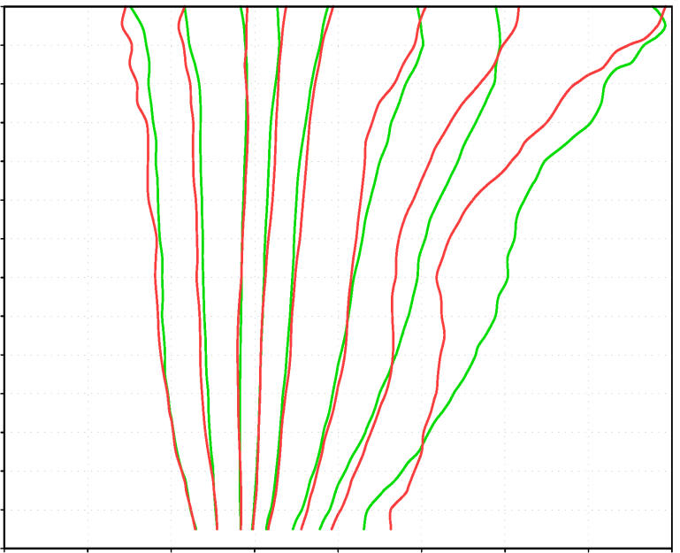
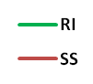
Motivation and background
Composite results: Convective-scale comparisons
Percentiles of eyewall (0.75 < r/RMW < 1.25) vertical velocity
1
5
25
50
75
95
99
99.9
14
13
12
11
10
height (km)
9
8
7
6
5
4
IN
3
2
SS
1
0
12
15
-9
-6
-3
0
3
6
9
vertical velocity (m/s)
  IN cases have stronger updrafts above freezing level for extreme portions of updraft spectrum (top 1% and greater)
  no significant differences in profiles for weaker portions of spectrum, or for downdrafts

Slide 7
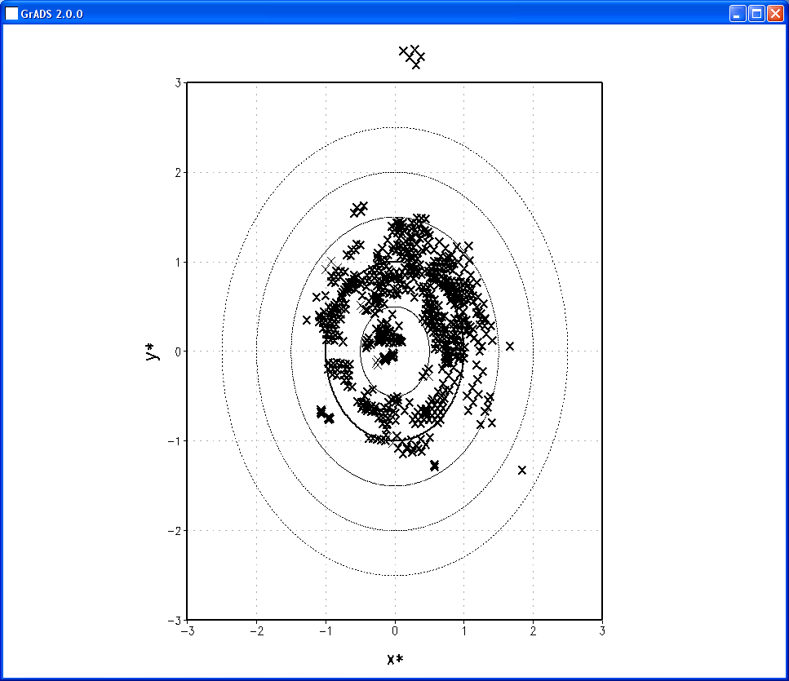
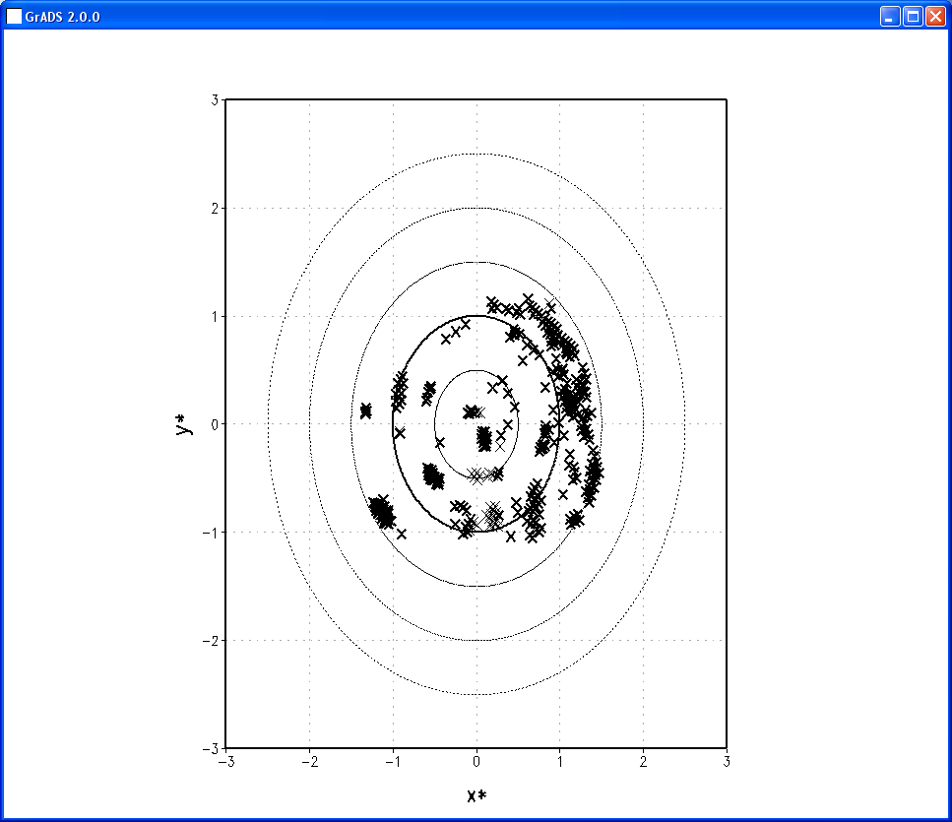
Motivation and background
Composite results: Convective-scale comparisons
Number and location of convective bursts
(Bursts defined as locations where w > 5.5 m/s at 8 km altitude, i.e., top 1% of w)
IN
SS
3
N=749
3
N=342
2
2
1
1
y*
0
y*
0
850-200 hPa shear
850-200 hPa shear
-1
-1
-2
2-km RMW
-2
2-km RMW
-3
-3
-2
0
1
2
3
-3
-2
-1
0
1
2
3
-3
-1
x*
x*
  IN cases have more convective bursts
  greater proportion of bursts in downshear left quadrant

Slide 8
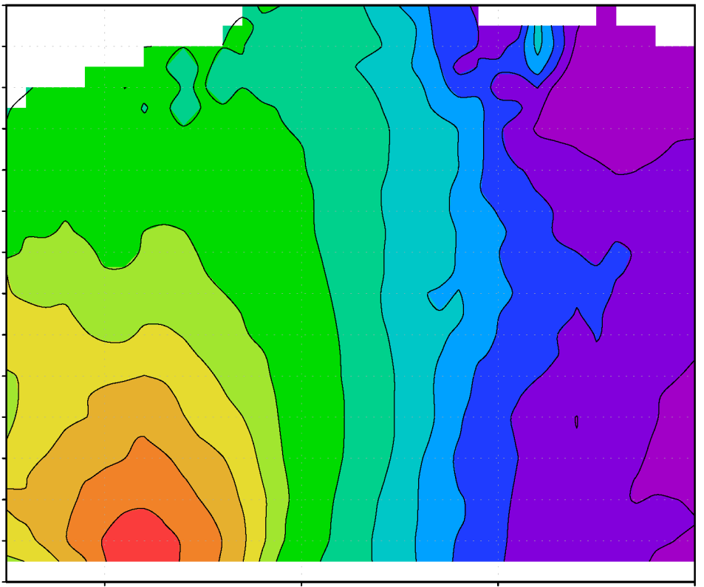
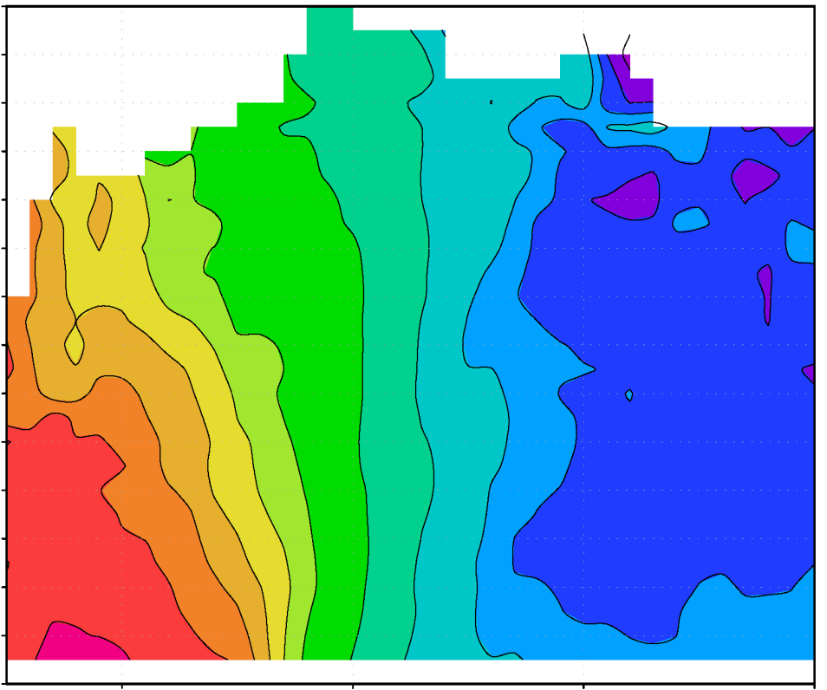
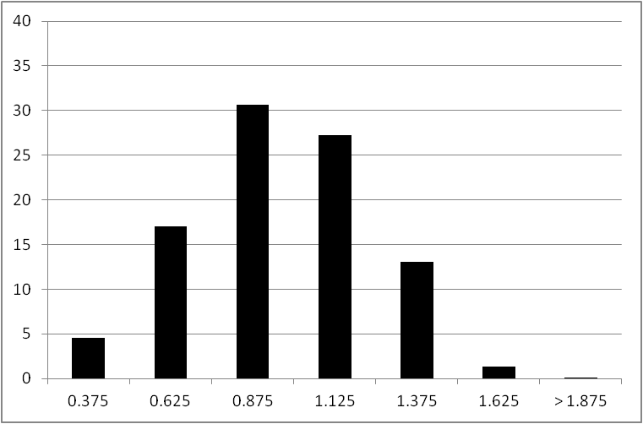
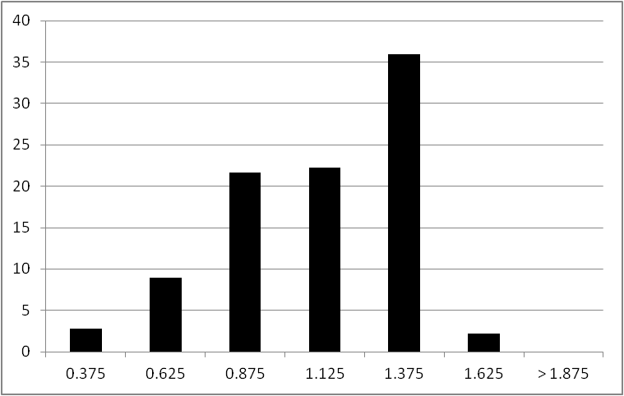
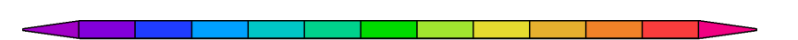
Motivation and background
Composite results: Convective-scale comparisons
Radial distribution of convective bursts
vorticity (x 10⁻⁴ s⁻¹)
vorticity (x 10⁻⁴ s⁻¹)
40
IN
40
SS
35
35
30
30
percentage
25
percentage
25
20
20
15
15
10
10
5
5
0
0
0.25
0.5
1
1.25
1.5
2
0.25
0.5
1
1.25
1.5
2
0.25
0.5
0.75
1
1.25
1.5
1.75
2
0.25
0.5
0.75
1
1.25
1.5
1.75
2
0.75
1.75
0.75
1.75
r/RMW
r/RMW
r/RMW
r/RMW
3
4
5
6
8
12
18
21
24
27
30
33
3
4
5
6
8
12
18
21
24
27
30
33
IN cases show radial distribution of convective bursts that peaks inside RMW compared with outside RMW for SS cases
relationship between radial location of diabatic heating and intensification consistent with balance model studies (Vigh and Schubert 2009, Pendergrass and Willoughby 2009, others)

Slide 9
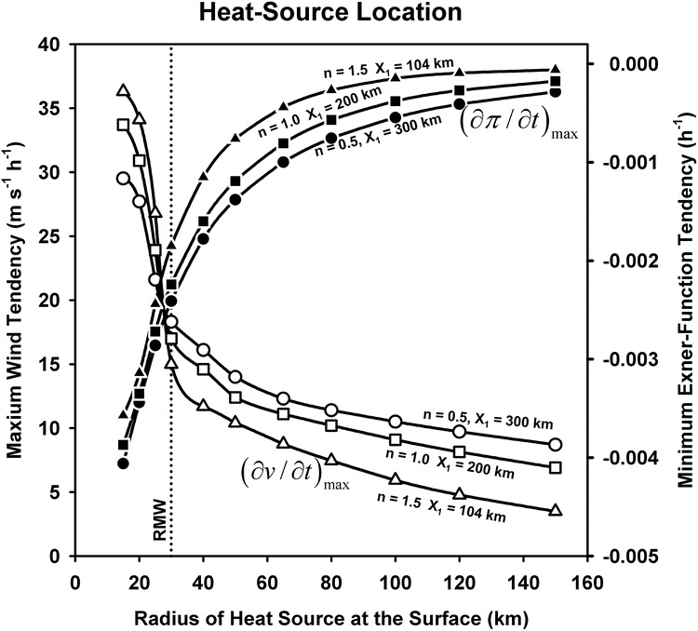
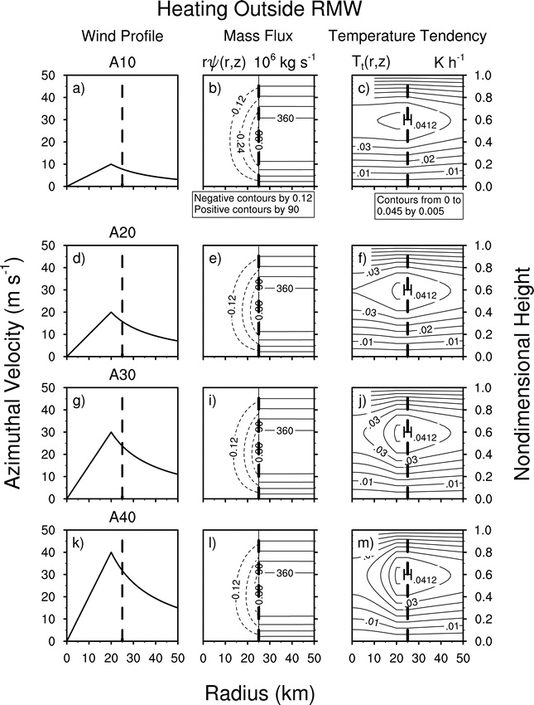
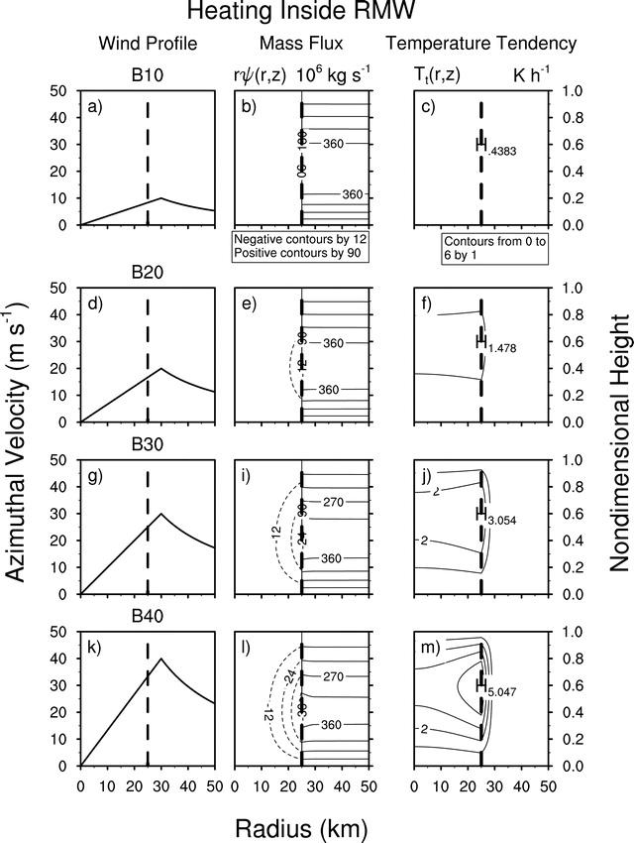
Motivation and background
Analytic studies of diabatic heating and its role in TC intensification
heating outside RMW
diabatic heating
heating inside RMW
diabatic heating
Vigh and Schubert 2009
Pendergrass and Willoughby 2009
Radial location of heating key determinant of subsequent intensity change

Slide 10
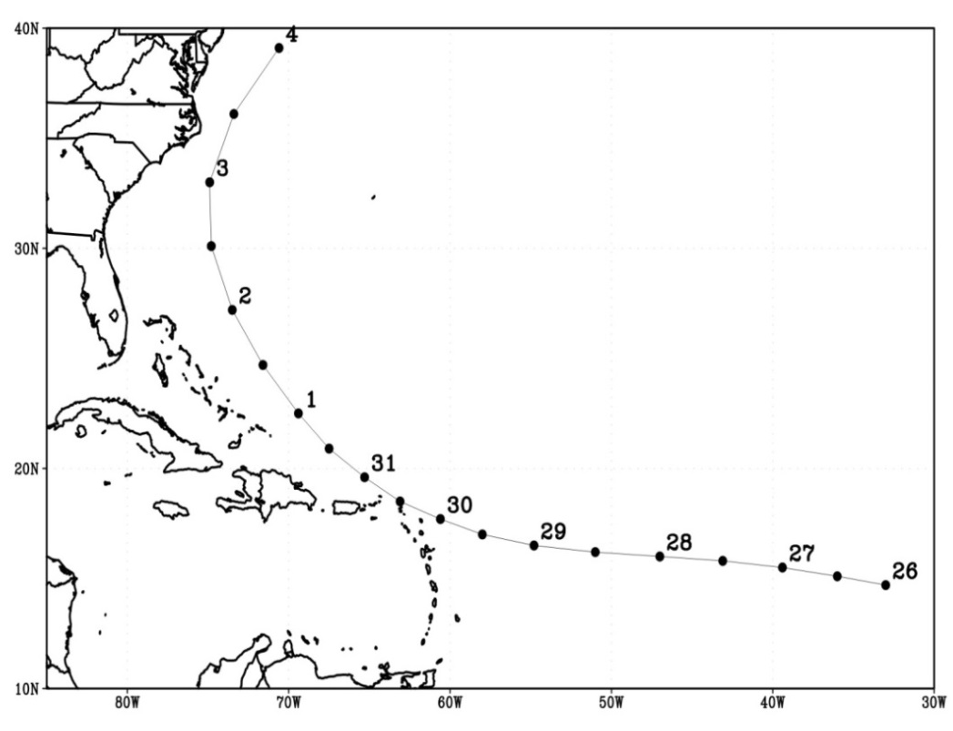
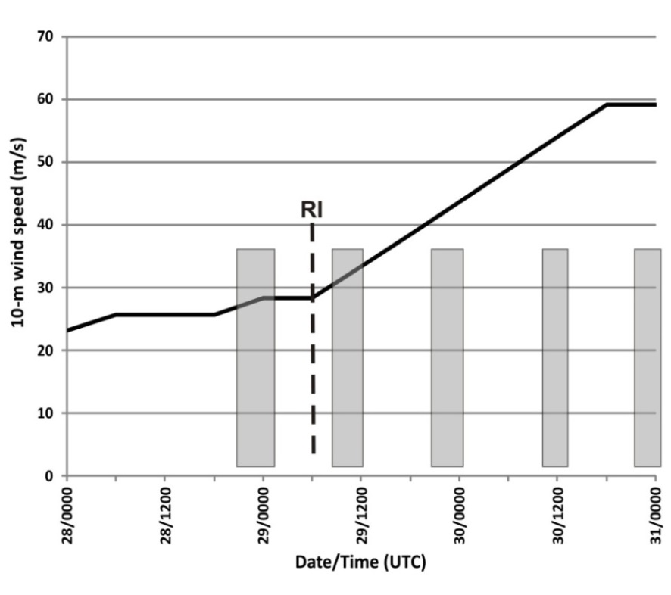
Case Study: Hurricane Earl (2010) – Observations
Long-lived TC developed in eastern Atlantic, underwent RI near Leeward Islands
Intensified from 25 m s⁻¹ to 60 m s⁻¹ in 36 h; RI onset at 06 UTC August 29
Sampled by NOAA P-3’s, G-IV; NASA DC-8, Global Hawk; Air Force C-130’s
  Several studies have looked at observations of this case (Rogers et al. 2014, Stevenson et al. 2014, Susca-Lopata et al. 2014)
Moderate (8 m s⁻¹) northeasterly shear at RI onset, became weak by third P-3 flight
Focus here on inner-core structure and evolution
  airborne Doppler and dropsonde observations (Rogers et al. 2014)
Track
Intensity
On station times for P-3 flights
Portion covered by P-3 flights considered here

Slide 11
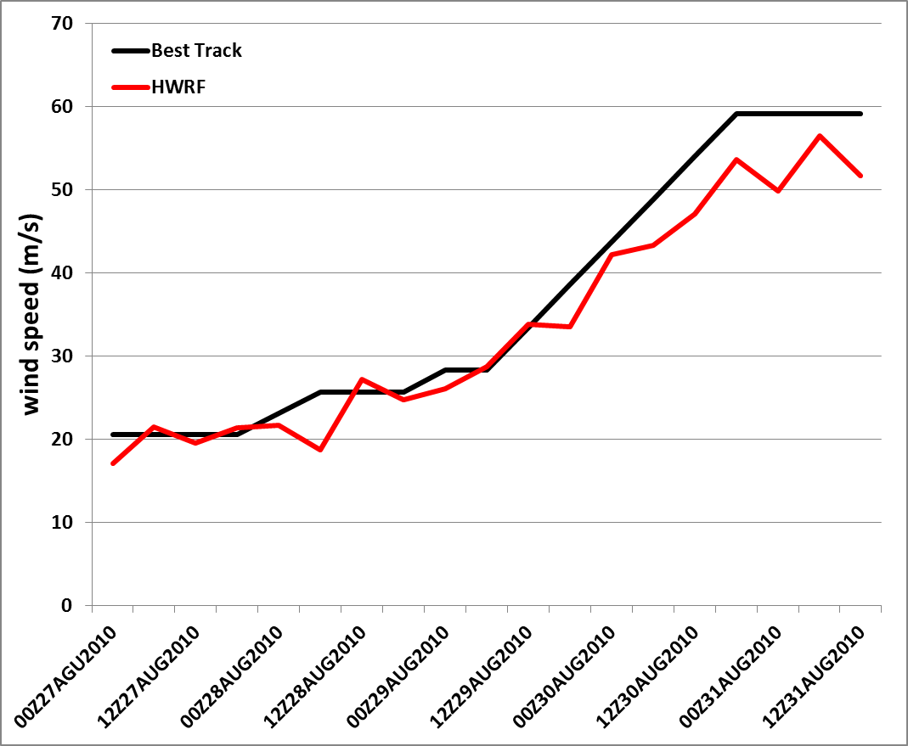
Case Study: Hurricane Earl (2010) - Model
HWRF model (Chen and Gopalakrishnan 2014, Gopalakrishnan et al. 2013, Tallapragada et al. 2013)
Three meshes of 27, 9, and 3 km grid spacing
Vortex initialization with cycling
Ferrier microphysics, GFS PBL scheme with improved K_{m}
Coupled with POM ocean model
2-minute output frequency
Track
Intensity

Slide 12
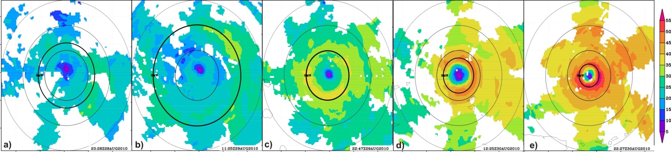
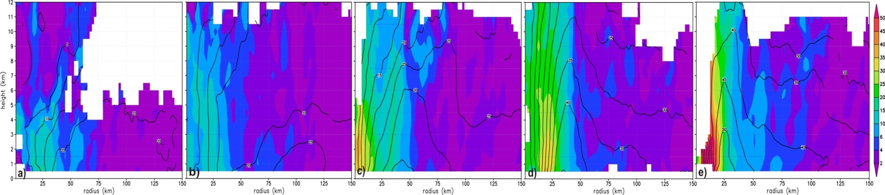
Case Study: Hurricane Earl (2010)
Observed storm-relative wind speed at 2 km altitude (shaded, m s⁻¹)
55
50
45
40
35
-100
-50
0
50
100
30
25
20
15
10
5
00 UTC Aug 29
12 UTC Aug 29
00 UTC Aug 30
12 UTC Aug 30
00 UTC Aug 31
-100
-50
0
50
100
-100
-50
0
50
100
-100
-50
0
50
100
-100
-50
0
50
100
-100
-50
0
50
100
distance (km)
distance (km)
distance (km)
distance (km)
distance (km)
Radius-height plot of axisymmetric vorticity (shaded, x 10⁻⁴ s⁻¹) and tangential wind (contour, m s⁻¹)
12
11
50
10
45
9
40
8
35
height (km)
30
7
25
6
20
5
15
4
10
3
6
2
00 UTC Aug 29
12 UTC Aug 29
00 UTC Aug 30
12 UTC Aug 30
00 UTC Aug 31
4
1
2
0
25
50
75
100
125
150
25
50
75
100
125
150
25
50
75
100
125
150
25
50
75
100
125
150
25
50
75
100
125
150
radius (km)
RI onset
radius (km)
radius (km)
radius (km)
radius (km)
RI continuing
Two stages of Earl’s RI:
RI onset – shallow symmetric vortex, broad RMW, RI onset in moderate shear
RI continuing – deep symmetric vortex, contracting eyewall, majority of intensification in low shear

Slide 13
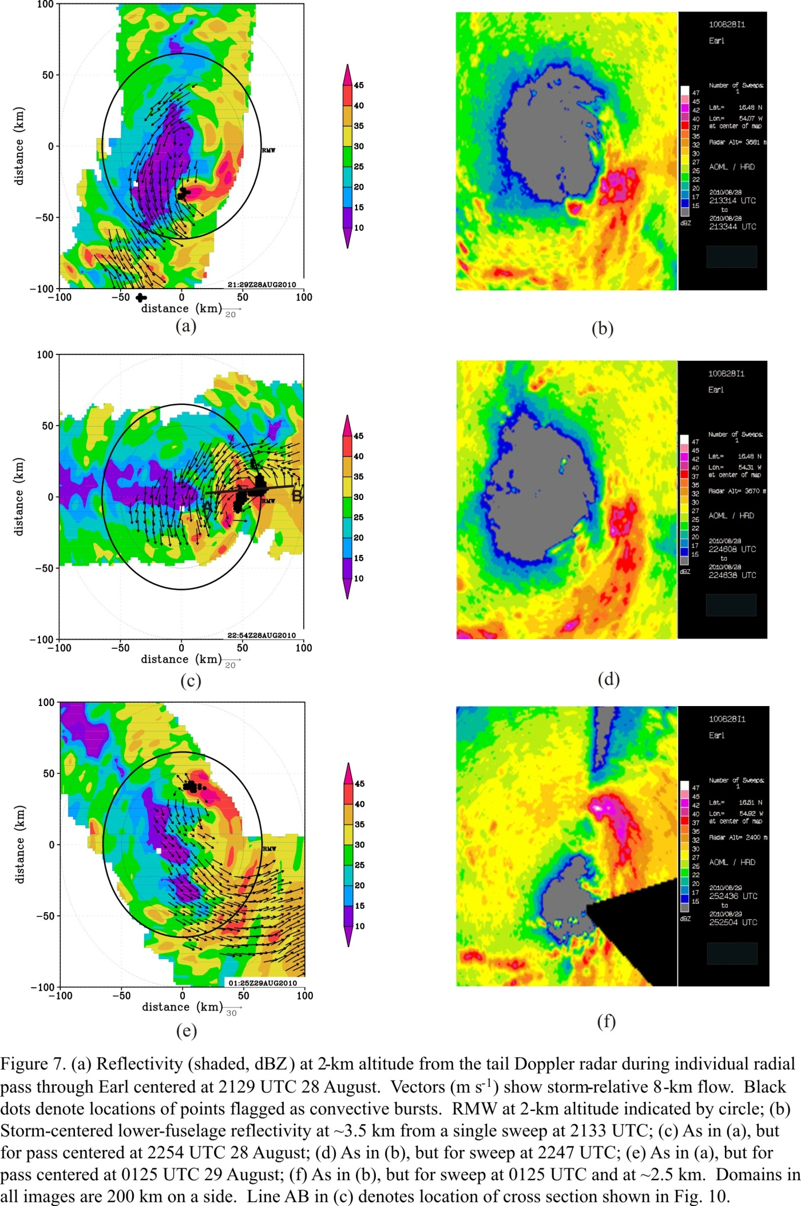

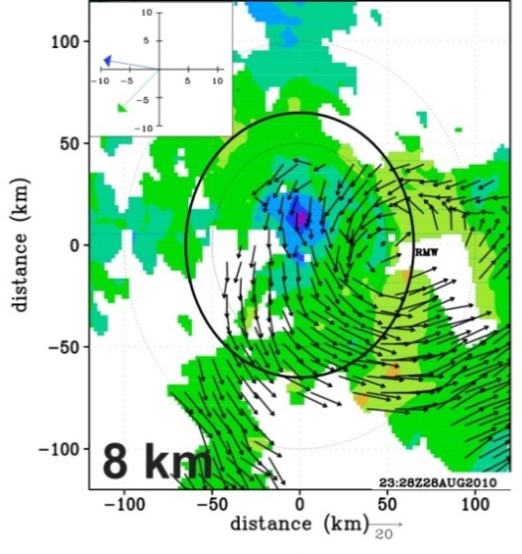


RI onset: Convective bursts and vortex alignment
Reflectivity (shaded, dBZ) from lower fuselage radar at ~ 3 km
100
47
45
50
42
40
37
distance (km)
35
32
0
30
27
25
22
20
-50
17
15
dBZ
-100
-50
21:29 UTC Aug 28
-50
22:54 UTC Aug 28
01:25 UTC Aug 29
0
50
-100
0
50
100
-50
-100
100
distance (km)
-100
0
50
100
distance (km)
distance (km)
2-km wind speed (shaded, m s⁻¹) and 8-km wind vectors from airborne Doppler (m s⁻¹)
motion
motion
shear
shear
00 UTC Aug 29
12 UTC Aug 29
Rogers et al. 2014
Displaced circulation center during first flight
Convective bursts tracked around storm left of shear vector during first flight, inside RMW; evolution supported by lightning data
RI began ~ 6 h after end of first flight
Vortex had aligned by time of second flight
Notes:
Circulation center at 8 km ~50 km displaced southeast of 2-km center during first mission, left of shear
Convective bursts evident inside RMW, tracks around left of shear side of storm during first mission

Slide 14
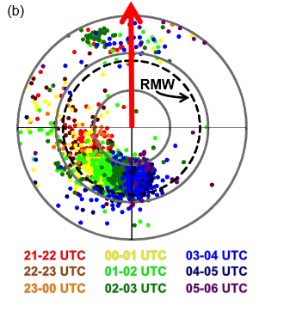
RI onset: Convective bursts and vortex alignment
WWLLN lightning strike frequency relative to GFS shear vector from 21 UTC 28 – 06 UTC 29 August
WWLLN lightning frequency and time-radius Hovmoller of density
8 km RMW
2 km RMW
Stevenson et al. (2014)
Susca-Lopata et al. (2014)
Lightning data shows a similar structure and evolution – rotating upshear inside RMW

Slide 15
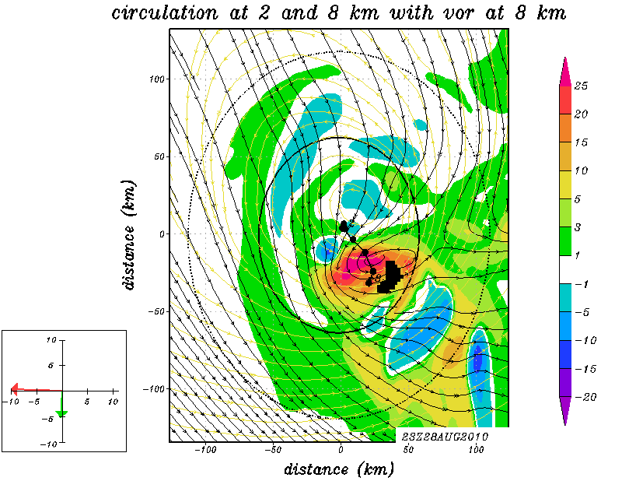
RI onset: HWRF forecast
HWRF vorticity (shaded, x 10⁻⁴ s⁻¹) and storm-relative winds (streamlines, m/s) at 2 km (yellow) and 8 km (black) valid 2300 UTC 28 Aug. Shear and motion shown in inset.
Doppler-derived vorticity (shaded, x 10⁻⁴ s⁻¹) and storm-relative winds (vector, m/s) at 8 km valid 2328 UTC 28 Aug. Shear and motion shown in inset.
Distance (km)
shear
shear
motion
motion
RMW
2 km
RMW
2 km
8 km
distance (km)
distance (km)
HWRF captures the displacement of the circulation remarkably well compared with radar

Slide 16
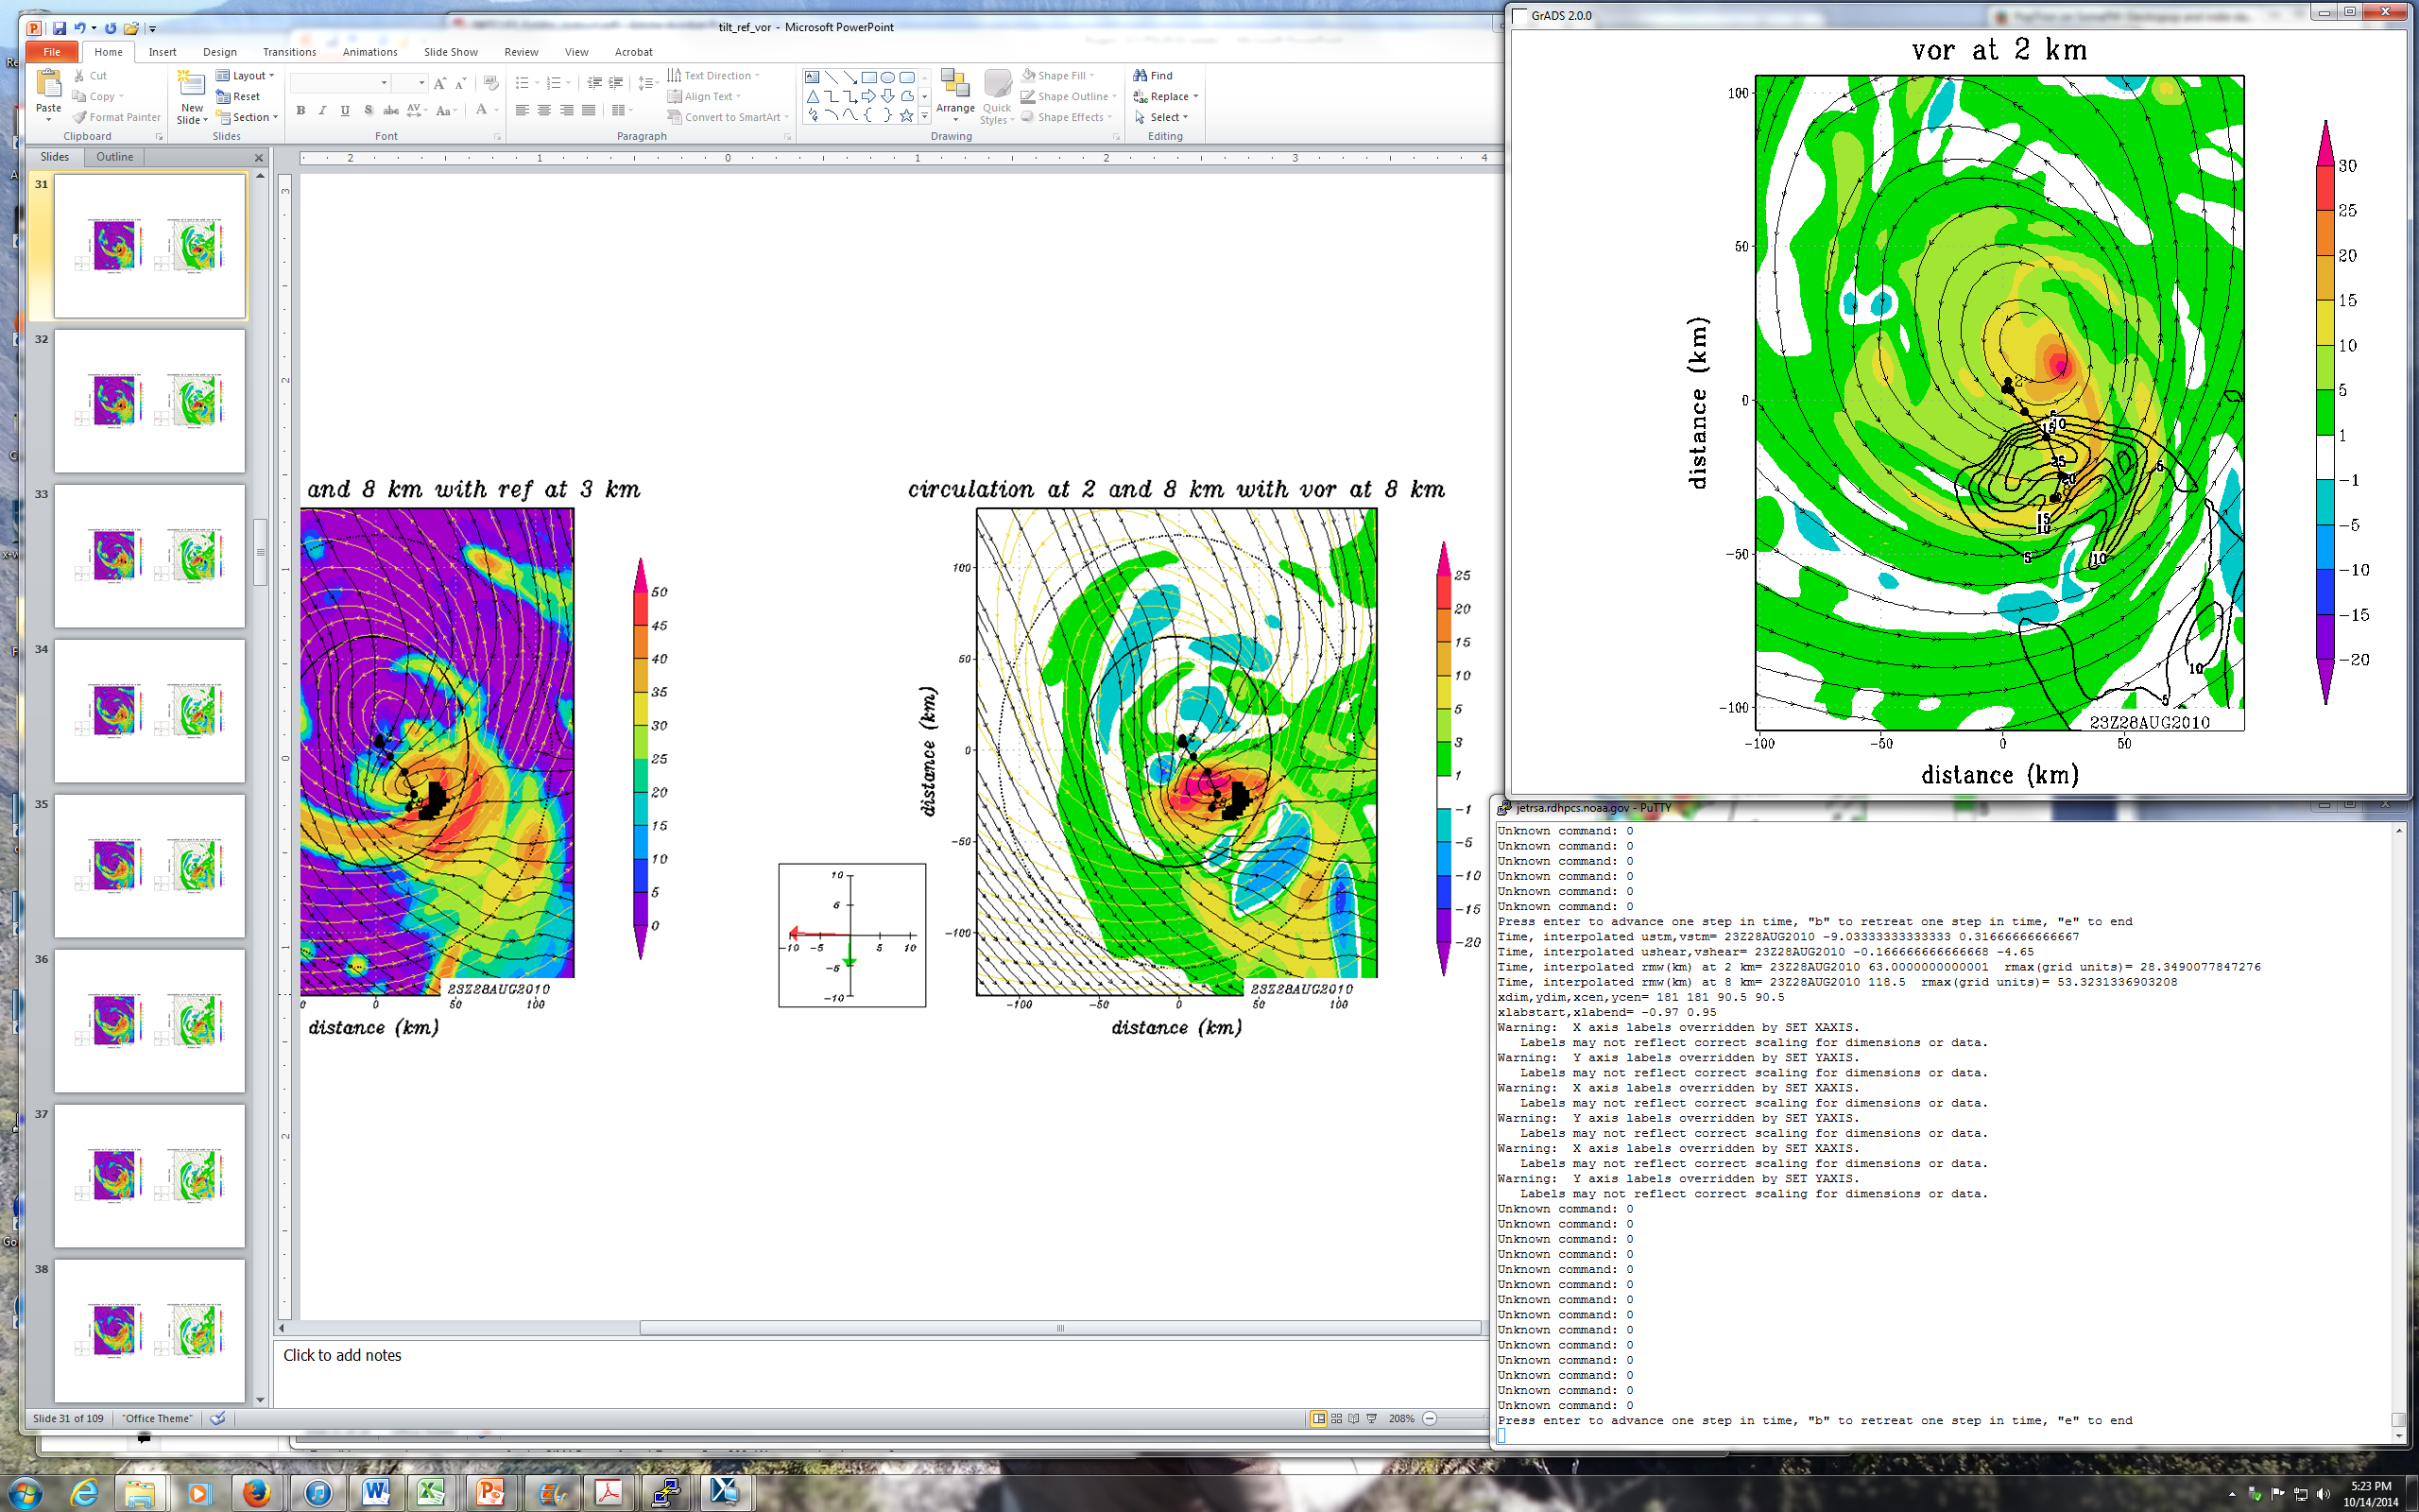
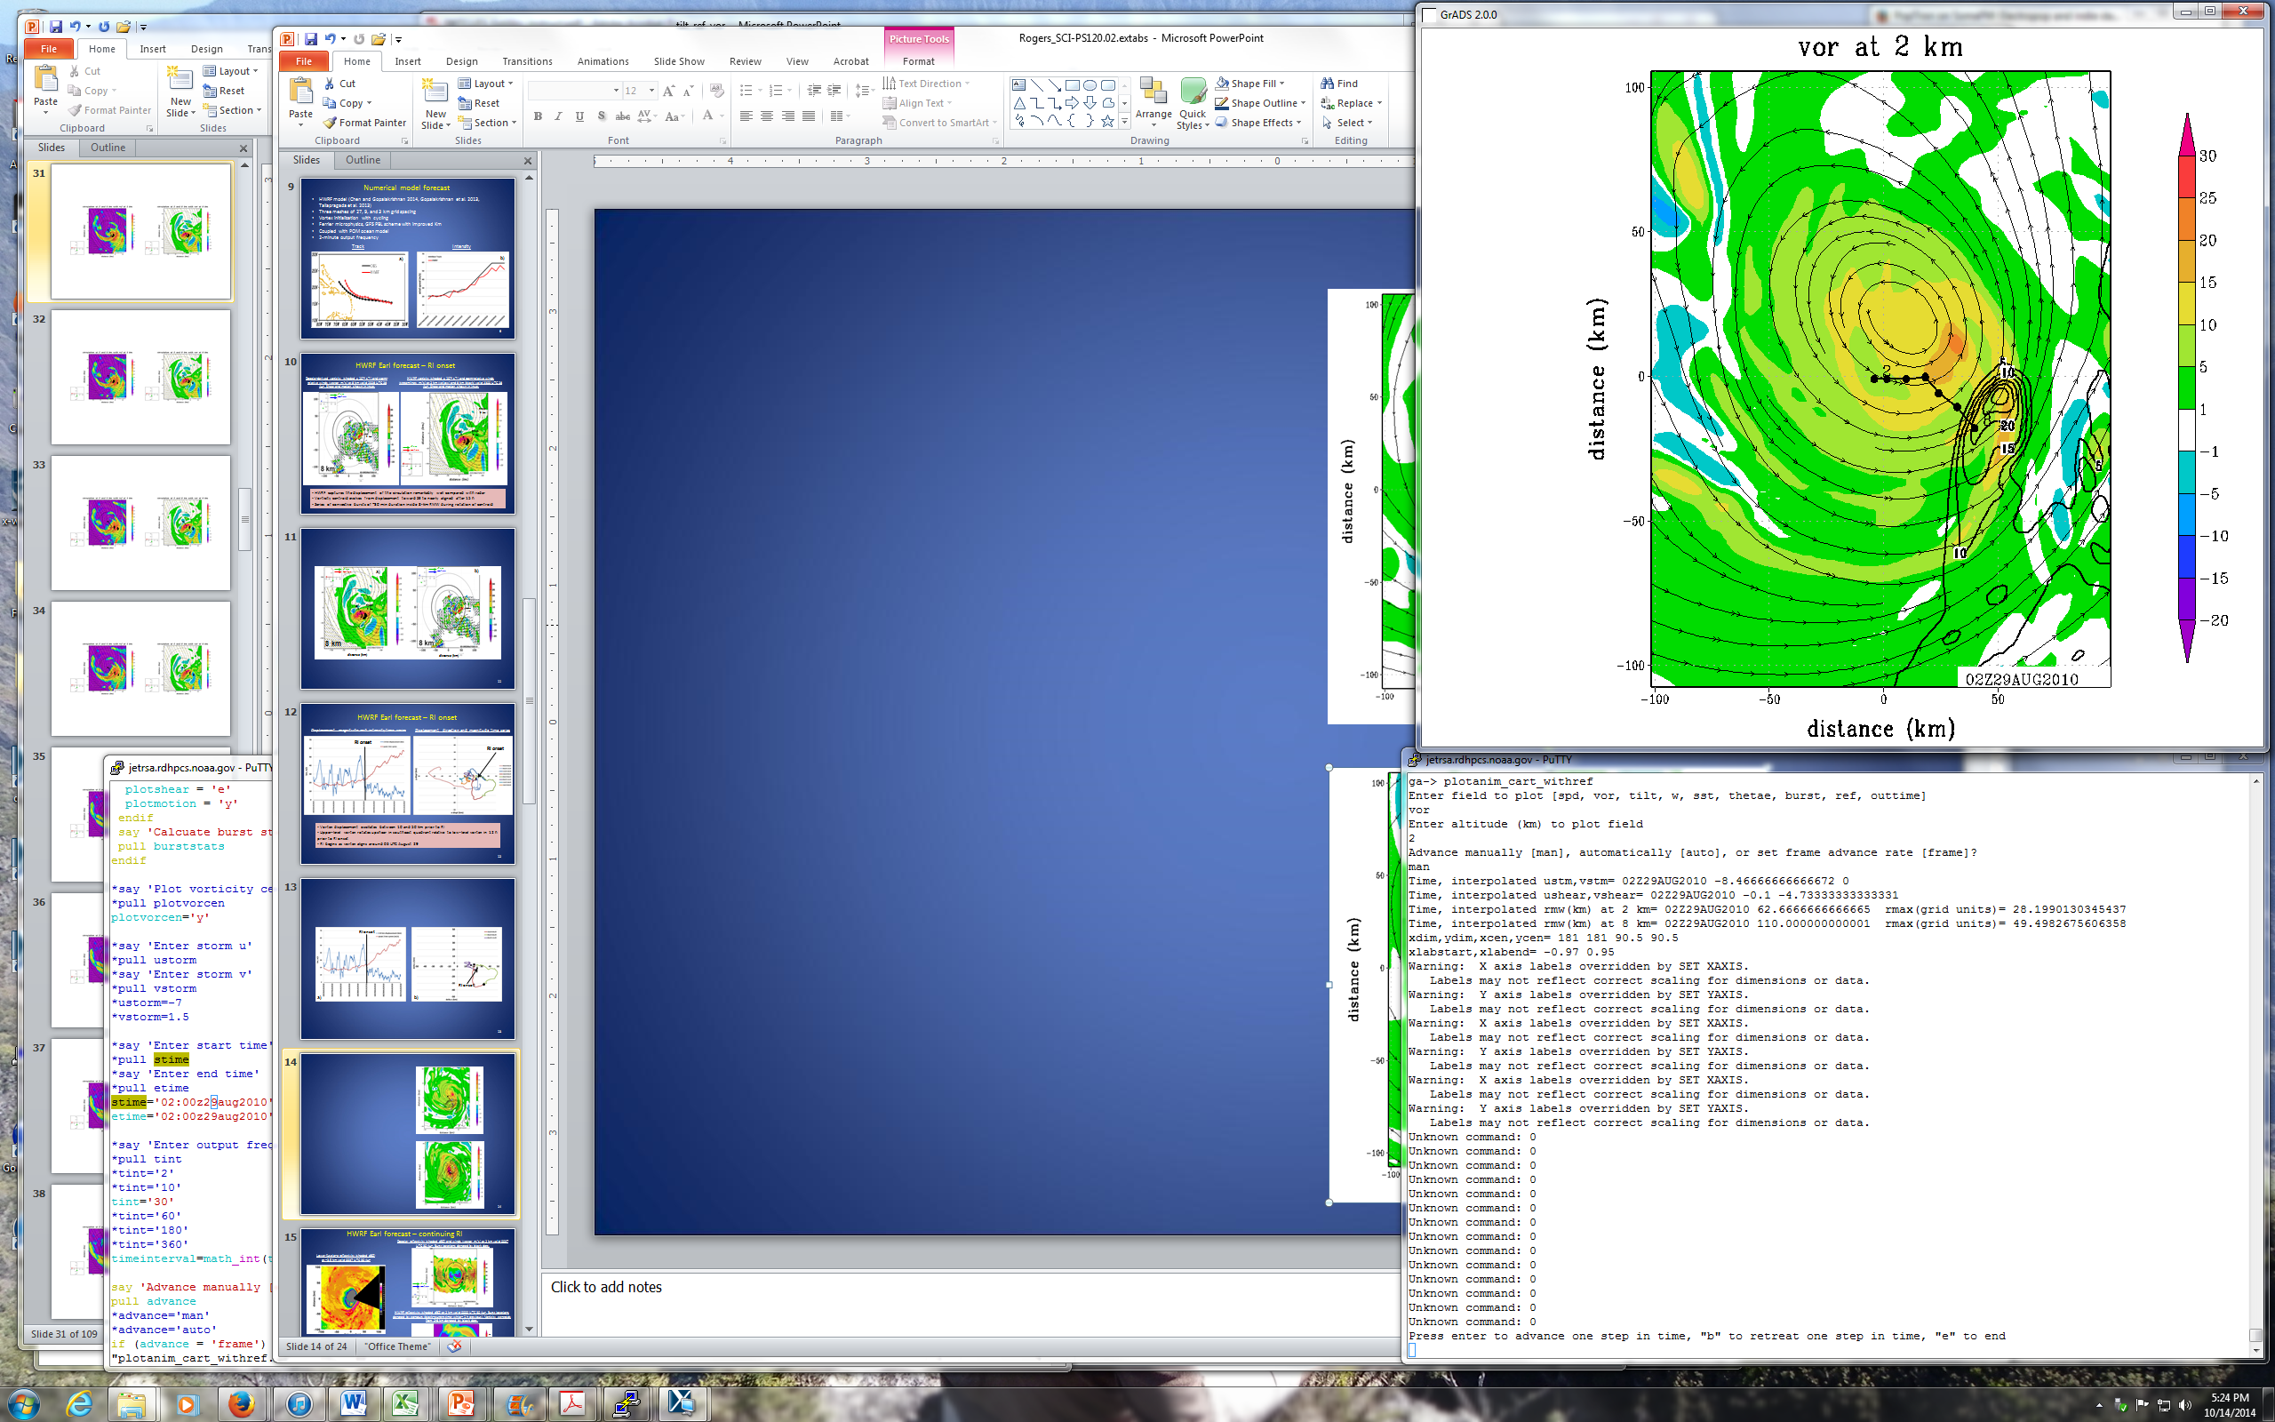
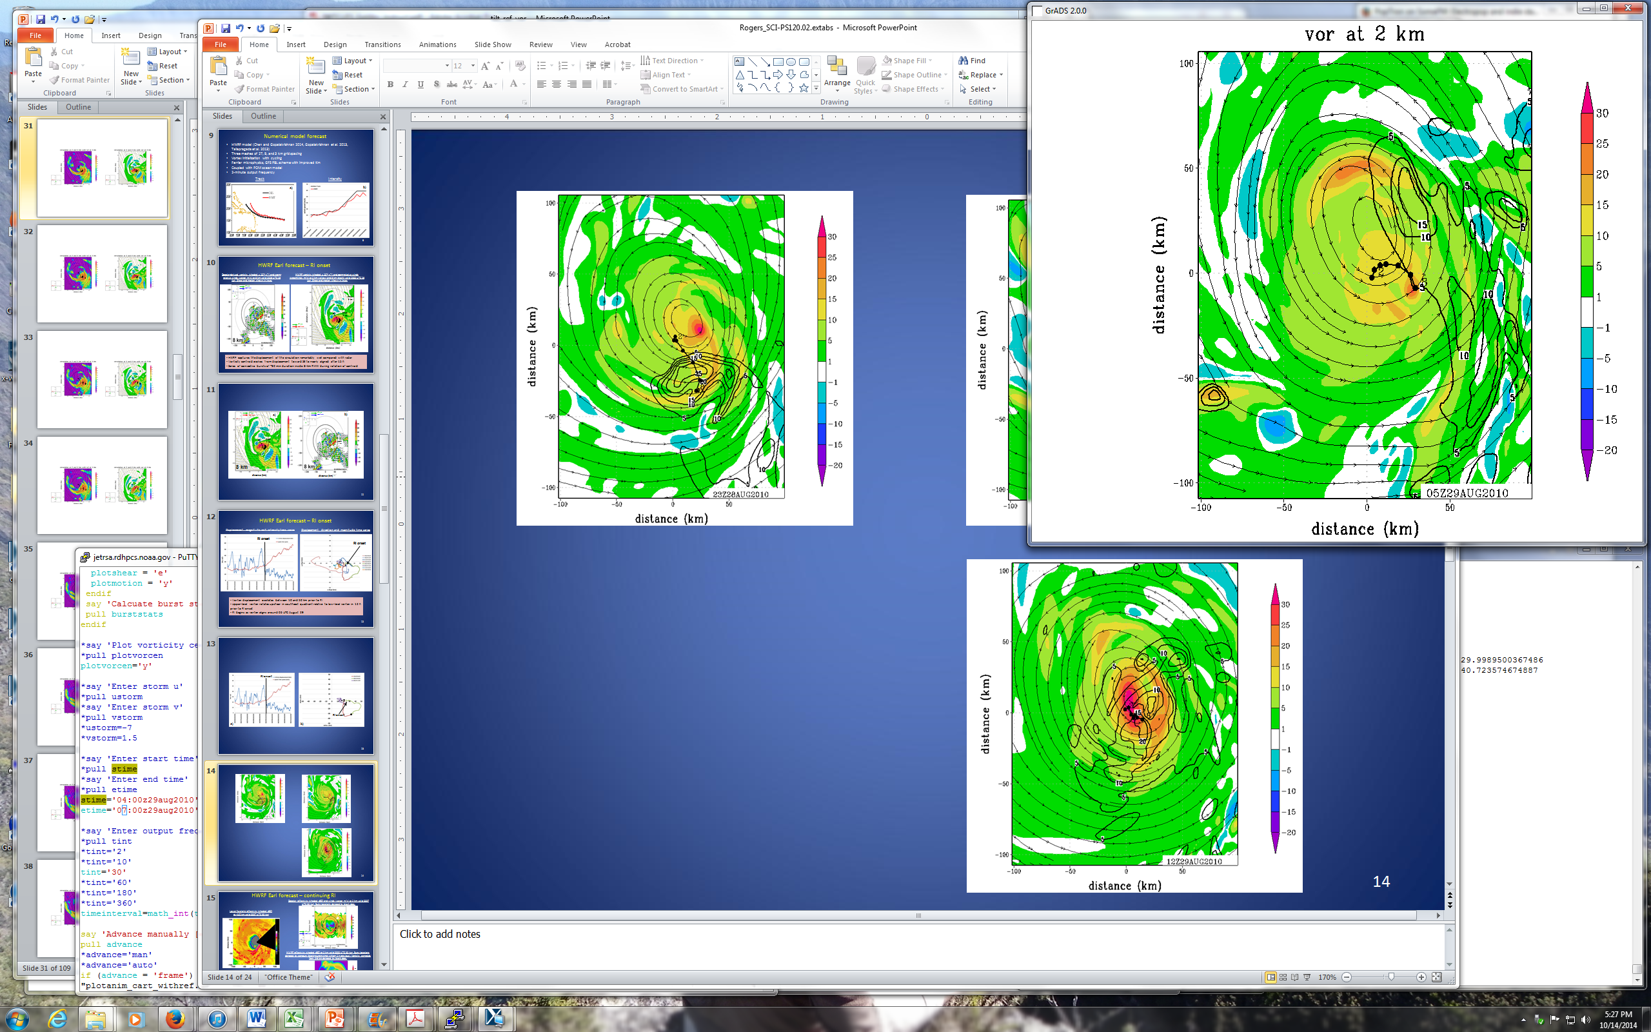
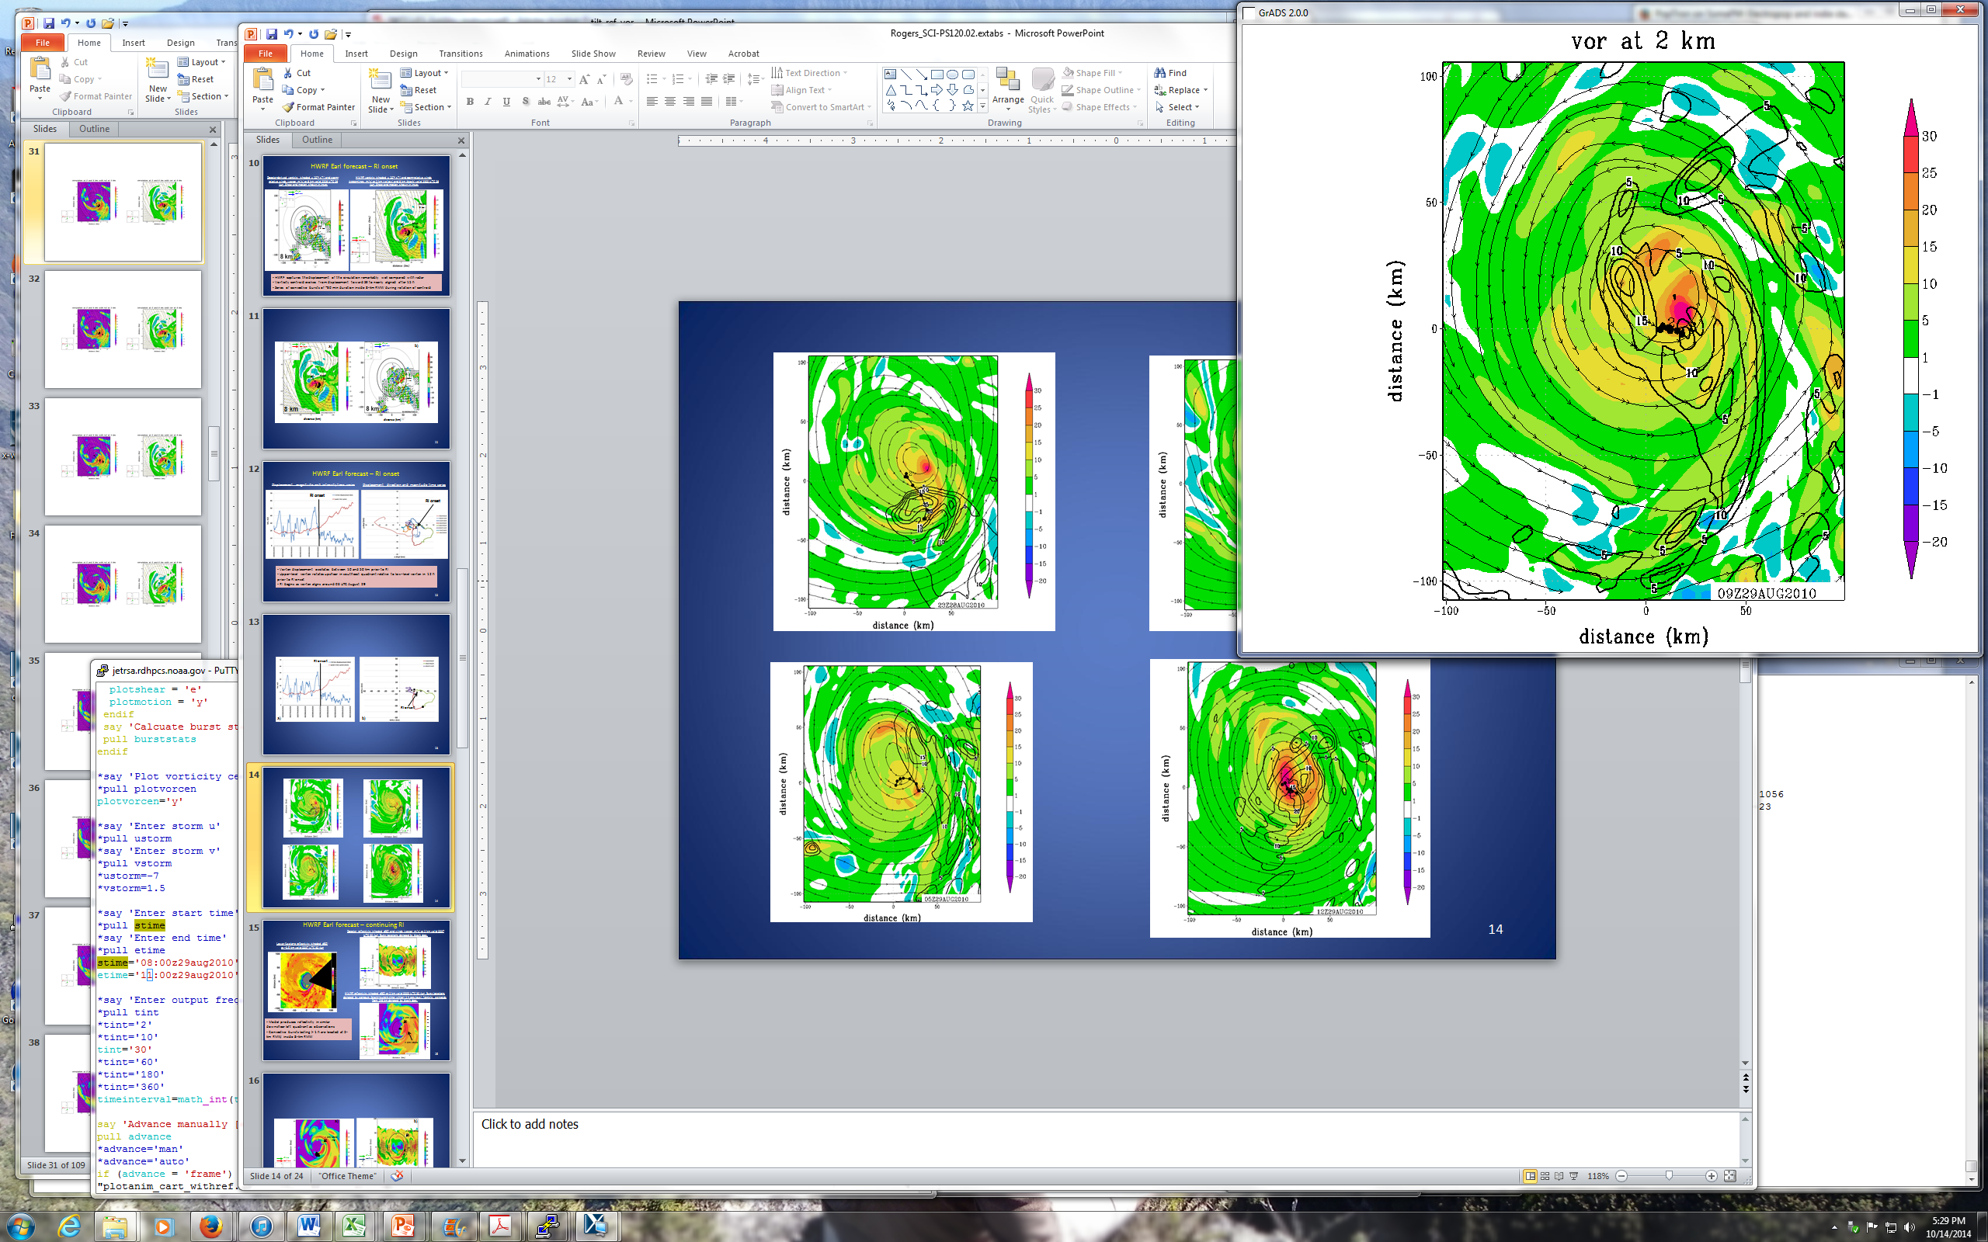
RI onset: HWRF forecast
Relative vorticity (x 10⁻⁴ s⁻¹) at 2 km (shaded) and 8 km (contour); storm-relative circulation at 2 km (streamlines); vorticity centroid locations from 2-8 km shown
23 UTC 28 Aug
02 UTC 29 Aug
05 UTC 29 Aug
09 UTC 29 Aug
Upper-level vorticity maximum rotates around low-level center, remains displaced until 05 UTC
By 09 UTC upper-level maximum overlays low-level maximum

Slide 17
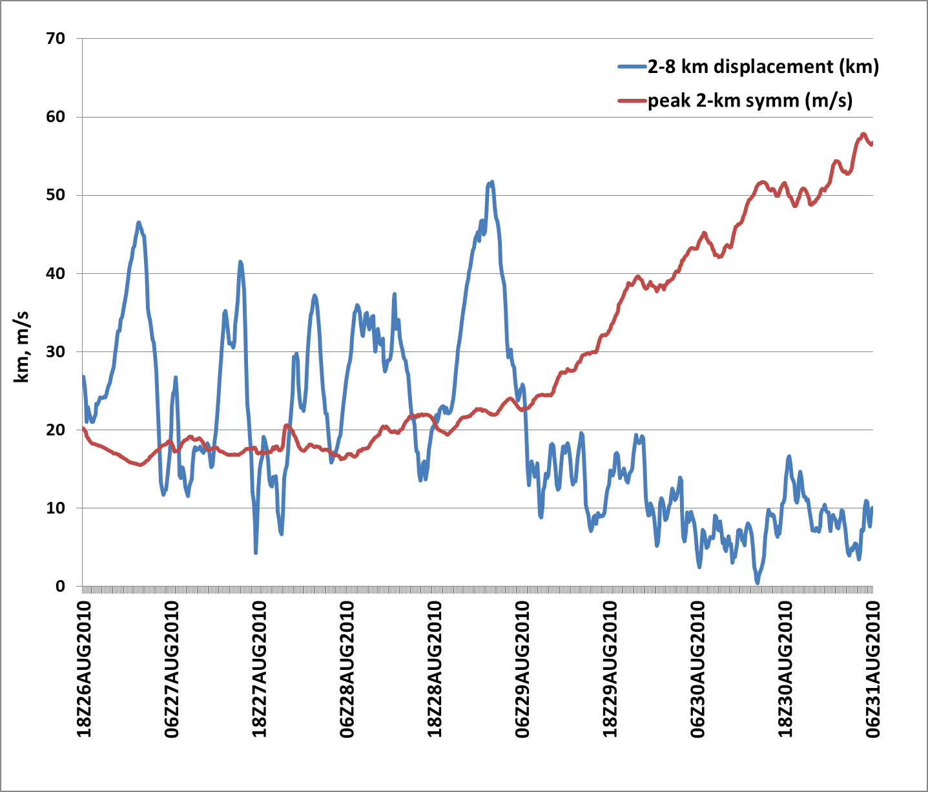
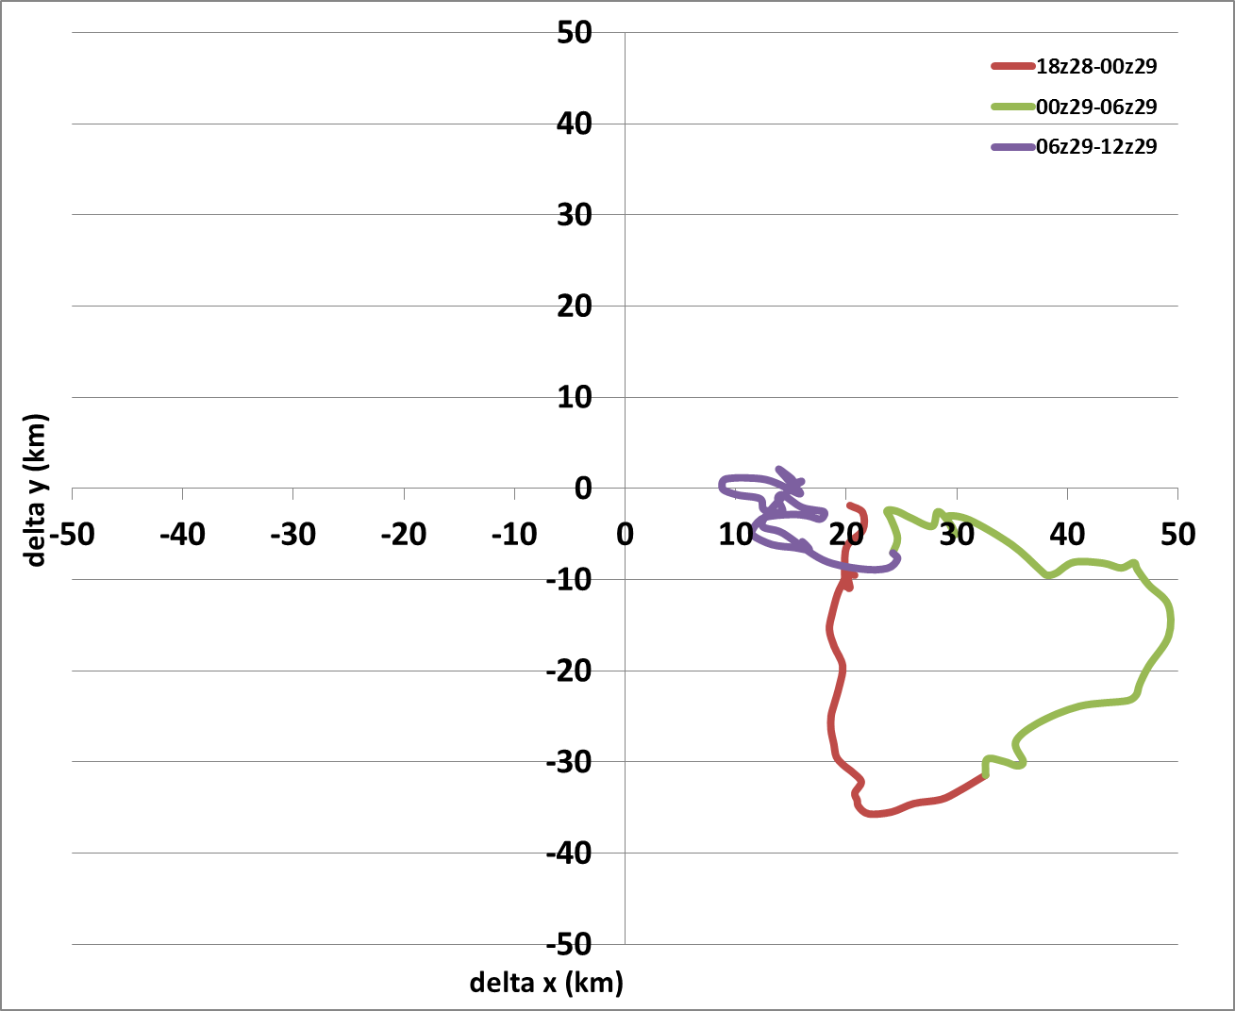
RI onset: HWRF forecast
Displacement magnitude and intensity time series
Displacement direction and magnitude time series
RI onset
RI onset
Vortex displacement oscillates between 10 and 50 km prior to RI
Upper-level vortex rotates upshear in southeast quadrant relative to low-level vortex in 12 h prior to RI onset
RI begins as vortex aligns around 06 UTC August 29

Slide 18
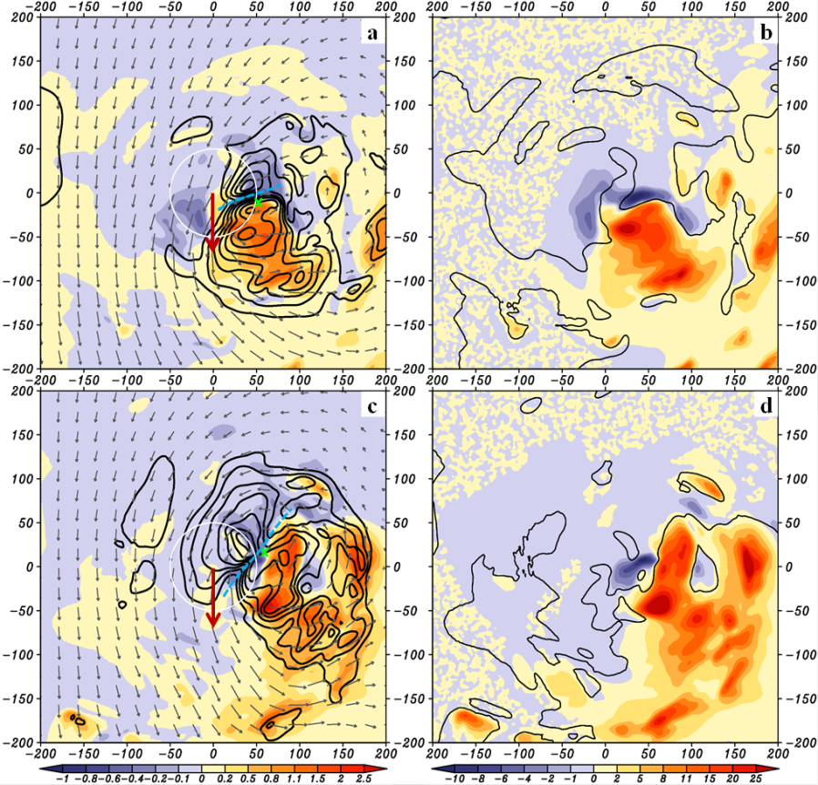
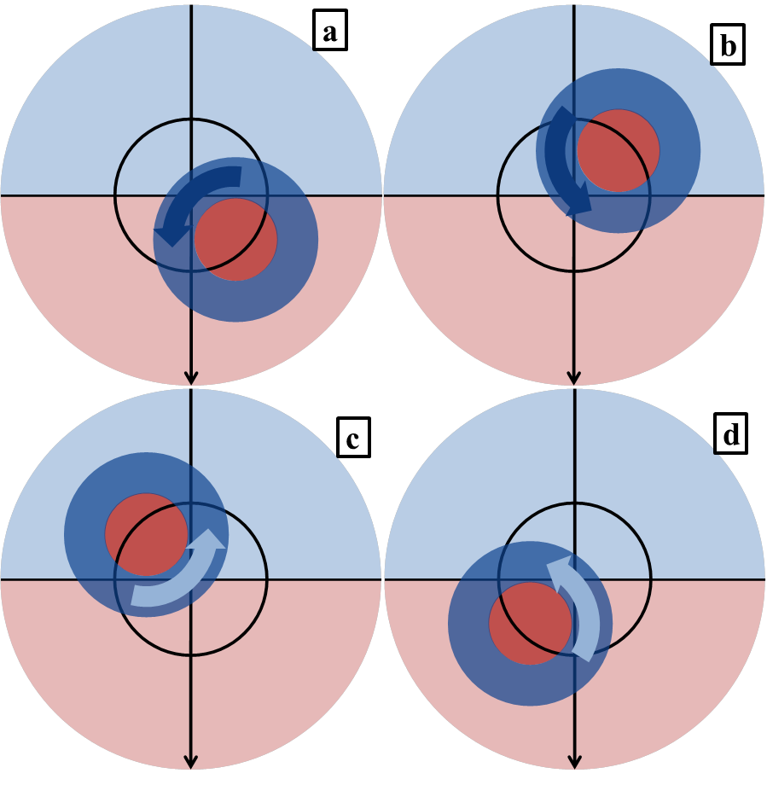
RI onset: HWRF forecast
Relationship between azimuthal location of convective bursts and alignment
Vertical velocity (shaded, m s⁻¹), potential temperature anomaly (contour, K), and storm-relative flow (streamlines)
Schematic showing relationship between mesoscale and convective-scale subsidence and position of convective burst relative to shear vector
DSL
USL
CB
shear vector
CB
00-01 UTC 29 Aug
shear vector
shear vector
CB
CB
shear vector
shear vector
shear vector
USR
DSR
03-04 UTC 29 Aug
Chen and Gopalakrishnan 2014
horizontal advection of air warmed by mesoscale and convective-scale subsidence can lead to vortex alignment
positioning of CB in DSL and USL quadrants maximizes advection of subsidence-induced warming over low-level center

Slide 19
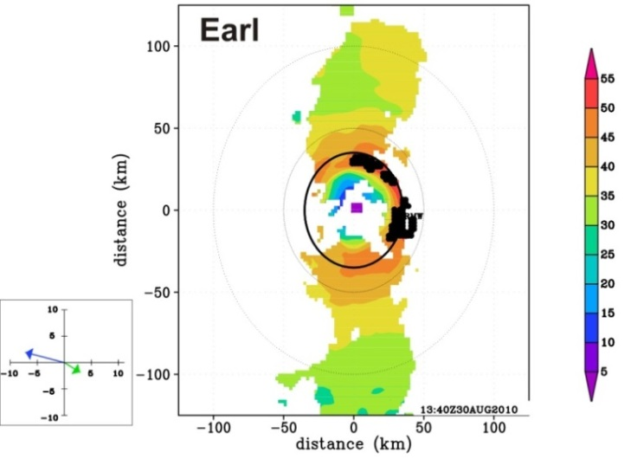


RI continuing : Convective bursts located inside RMW
Two examples: Earl 2010 (RI) and Gustav 2008 (SS)
Wind speed at 2 km (shaded, m/s) and burst locations
Radial distribution of convective bursts
RMW
13:40 UTC Aug 30 2010
shear
motion
both storms ~ 50 m/s hurricane, RMW of ~35 km
burst distribution peaked inside RMW for Earl, outside RMW for Gustav
22:26 UTC Aug 31 2008
shear
motion
What causes observed relationship between RMW-relative convective burst activity and intensity change?
Differences in radial profiles of boundary layer convergence
Differences in outer-core inertial stability, radial inflow depth
Differences in slopes of updraft and reflectivity cores

Slide 20
RI continuing: Radial profiles of boundary layer convergence
Boundary-layer profiles of axisymmetric fields from dropsondes during Earl’s RI
Earl - 00 UTC Aug 30 2010
Earl - 00 UTC Aug 30 2010
Low-level supergradient flow inside RMW
Convergence peaked below 0.3 km altitude inside RMW
Limited dropsonde data for SS cases
r / RMW
r / RMW
Agradient wind (V_{ag}; m s⁻¹)
Divergence (dV_{r}/dr + V_{r}/r; 10⁻³ s⁻¹)
Earl - 00 UTC Aug 30 2010
Earl - 00 UTC Aug 30 2010

Slide 21
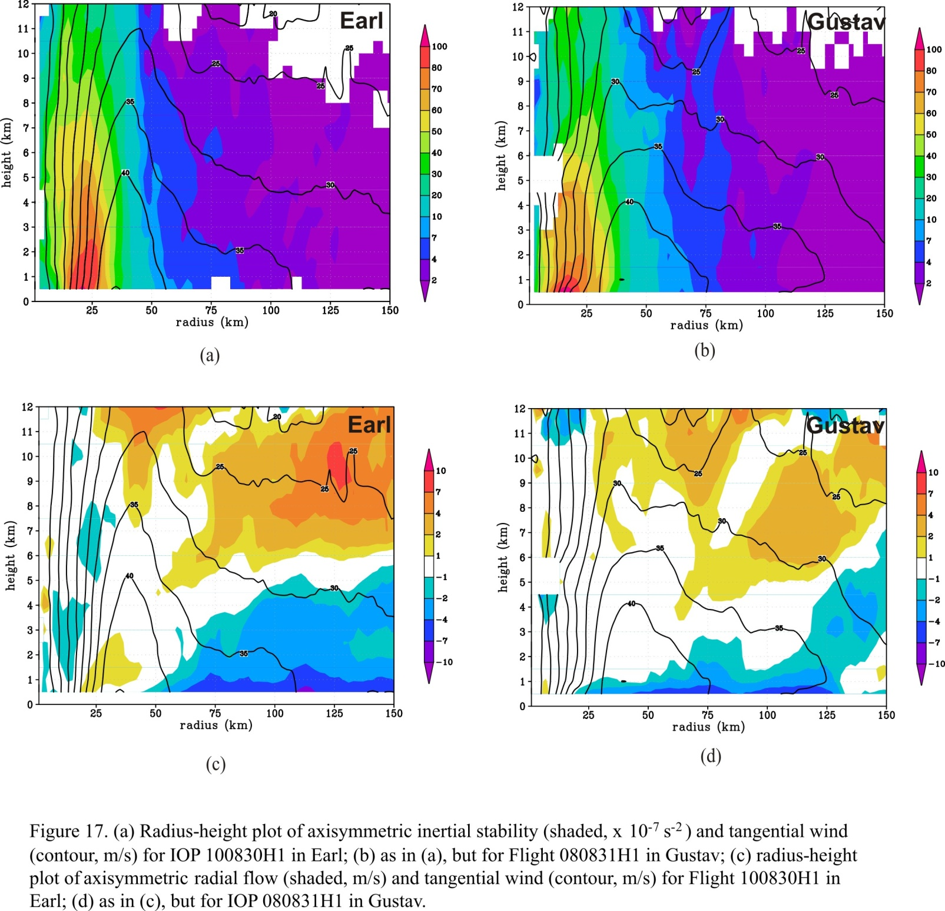
RI continuing: Inertial stability, inflow depth differences
Axisymmetric inertial stability (I², shaded, x 10⁻⁷ s⁻²) and tangential wind (contour, m s⁻¹)
12
12
11
11
10
100
10
100
9
80
9
80
8
70
8
70
7
60
7
60
height (km)
50
height (km)
50
6
40
6
40
5
30
5
30
4
20
4
20
3
10
3
10
2
7
2
7
1
4
1
4
0
12 UTC Aug 30 2010
2
00 UTC Sep 1 2008
2
25
50
75
100
125
150
0
25
50
75
100
125
150
radius (km)
radius (km)
Axisymmetric radial flow (shaded, m s⁻¹) and tangential wind (contour, m s⁻¹)
12
12
11
11
10
10
10
10
9
7
9
7
8
4
8
4
7
7
height (km)
2
height (km)
2
6
1
6
1
5
-1
5
-1
4
-2
4
-2
3
-4
3
-4
2
-7
2
-7
1
-10
1
-10
0
25
50
75
100
125
150
0
25
50
75
100
125
150
radius (km)
radius (km)
Lower outer-core inertial stability for Earl than for Gustav
Deeper inflow layer for Earl than Gustav

Slide 22
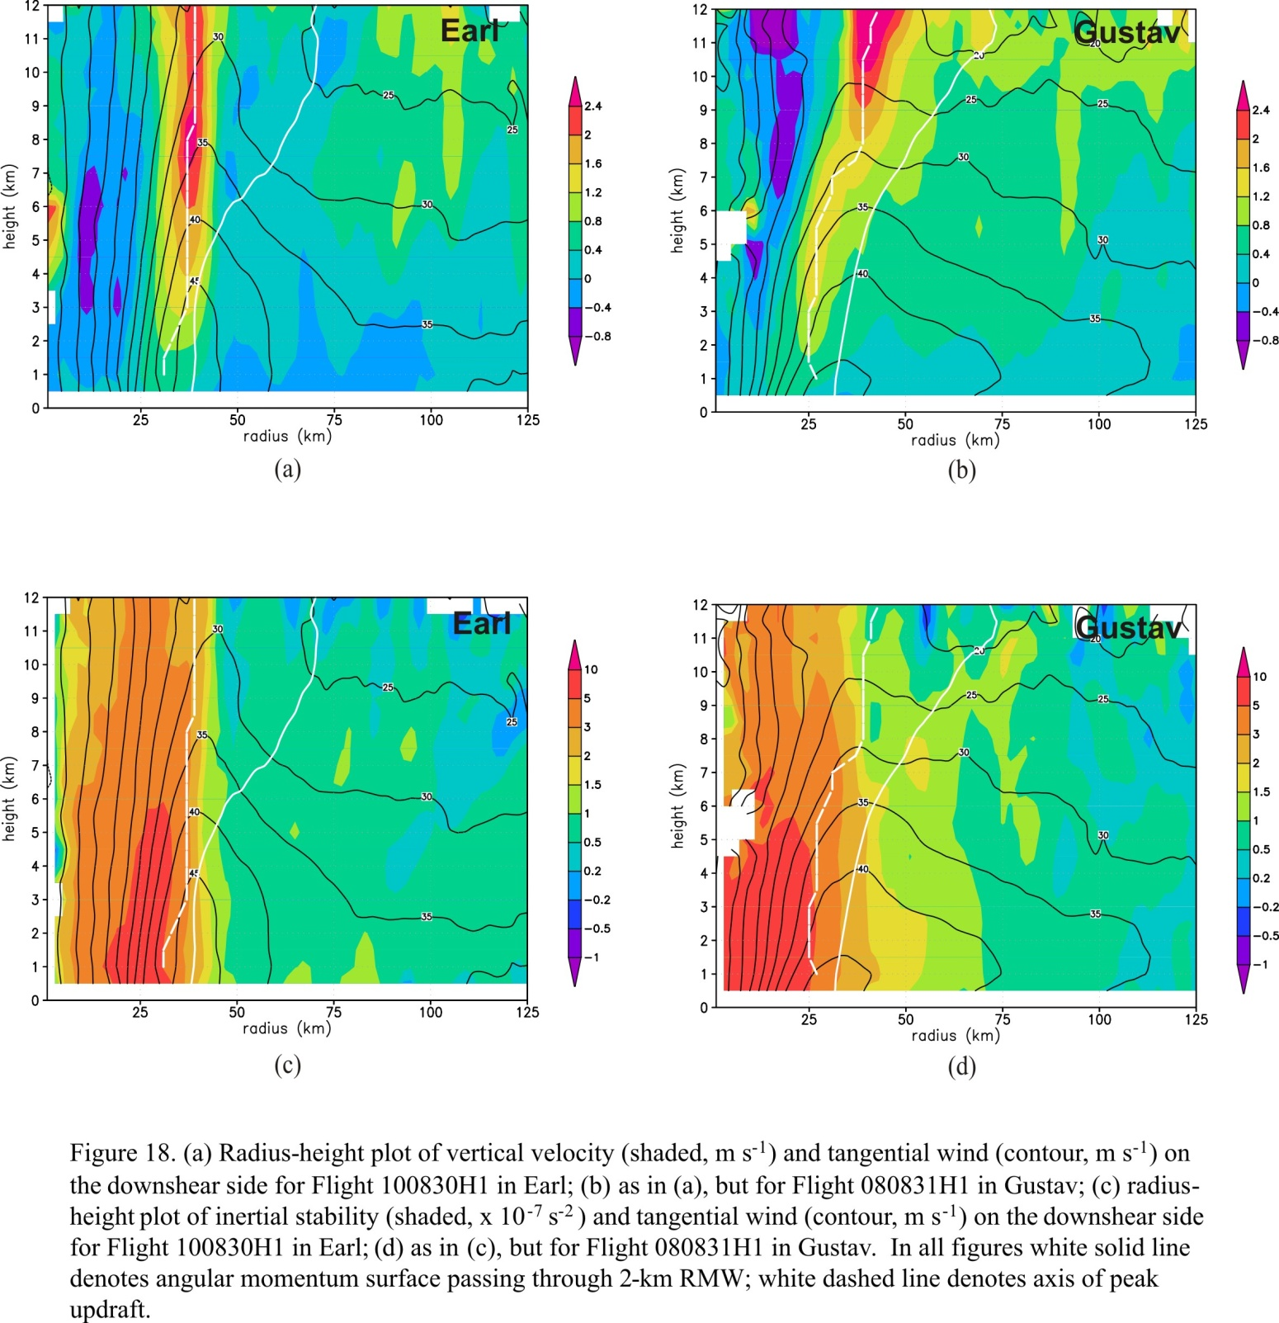
RI continuing: Updraft slope differences
Downshear vertical velocity (shaded, m s⁻¹) and tangential wind (contour, m s⁻¹)
12
12
11
peak w
11
10
10
peak w
9
M surface
2.4
9
M surface
2.4
8
2
8
2
7
1.6
7
1.6
height (km)
1.2
height (km)
1.2
6
0.8
6
0.8
5
0.4
5
0.4
4
0
4
0
3
-0.4
3
-0.4
2
-0.8
2
-0.8
1
12 UTC Aug 30 2010
1
00 UTC Sep 1 2008
0
25
50
75
100
125
0
25
50
75
100
125
radius (km)
radius (km)
Updraft core originates inside RMW for both cases
Slope of updraft core departs from M surface for Earl, parallels M surface for Gustav
Peak heating inside local RMW for Earl, outside for Gustav
Notes:
Updraft core originates from PBL inside RMW for both cases
Slope of updraft core departs signficantly from M surface for Earl, closer to M surface for Gustav
Updraft core inside local RMW, in high inertial stability regime for Earl, outside local RMW for Gustav
Relationship consistent with composite slope results from Hazelton et al. (17C.7, Fri. 3:00 pm talk)

Slide 23
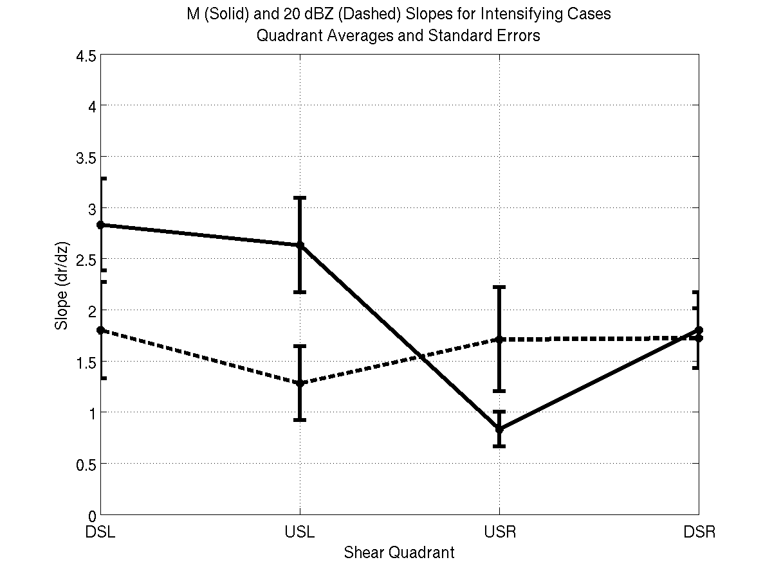
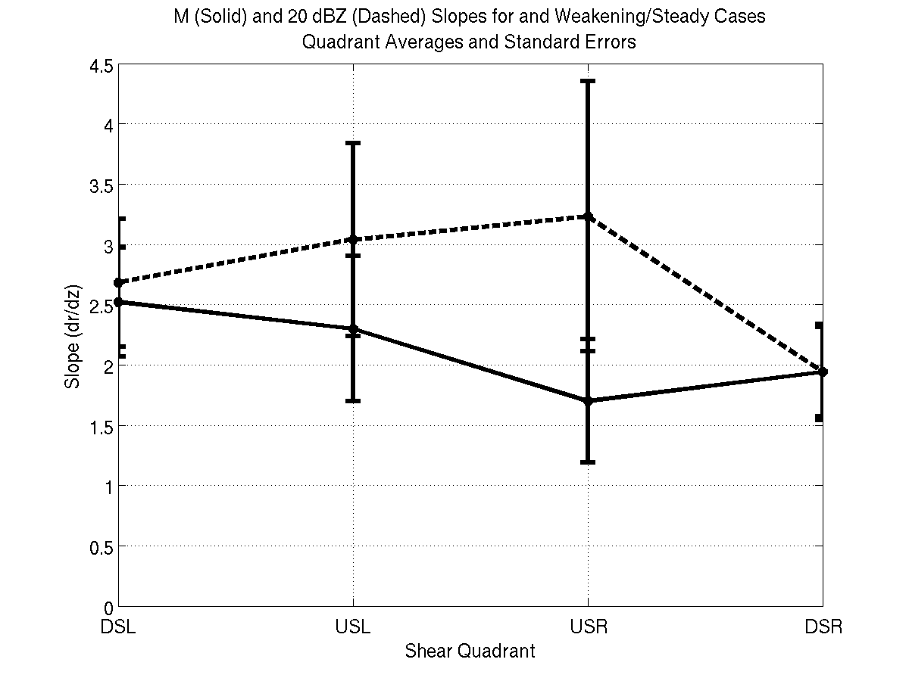
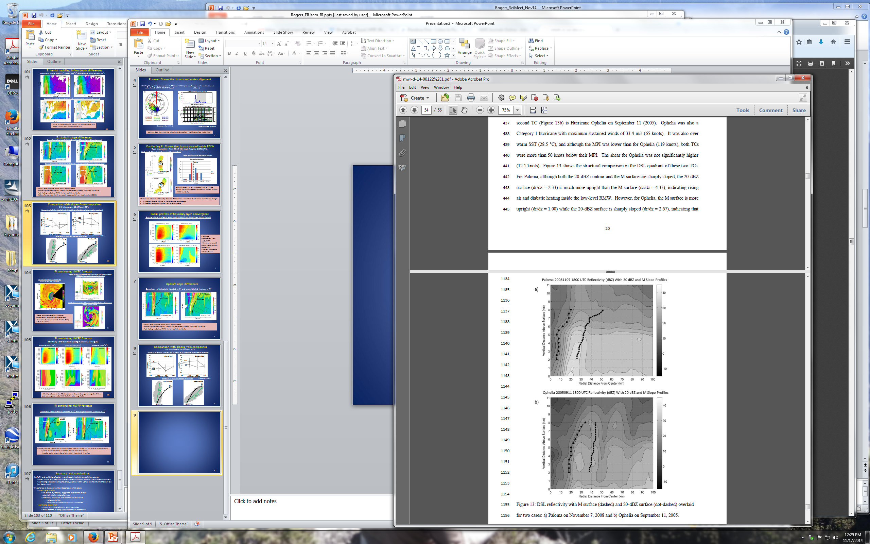
RI continuing: Comparison with slopes from composites
36 Missions in 15 different TC’s
Slopes of reflectivity (dashed) and M (solid) as a function of shear-relative quadrant
4.5
Intensifying
4.5
Steady-state
Schematic of slope differences left of shear
4
4
3.5
3.5
dBZ
Steady-state
3
M
Intensifying
3
slope (dr/dz)
slope (dr/dz)
2.5
2.5
M
2
2
M
1.5
M
1.5
dBZ
1
1
0.5
0.5
20 dBZ
DSL
USL
USR
DSR
DSL
USL
USR
DSR
Shear-relative quadrant
Shear-relative quadrant
20 dBZ
Paloma
Ophelia
dBZ
M
dBZ
M
RMW_{2km}
RMW_{2km}
(Hazelton et al. 2014)

Slide 24
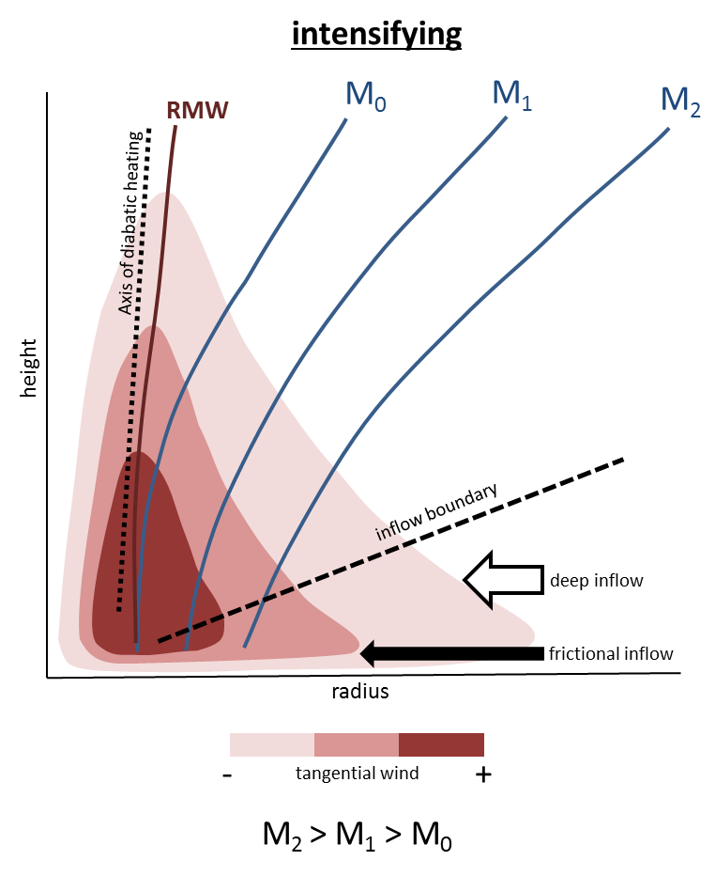
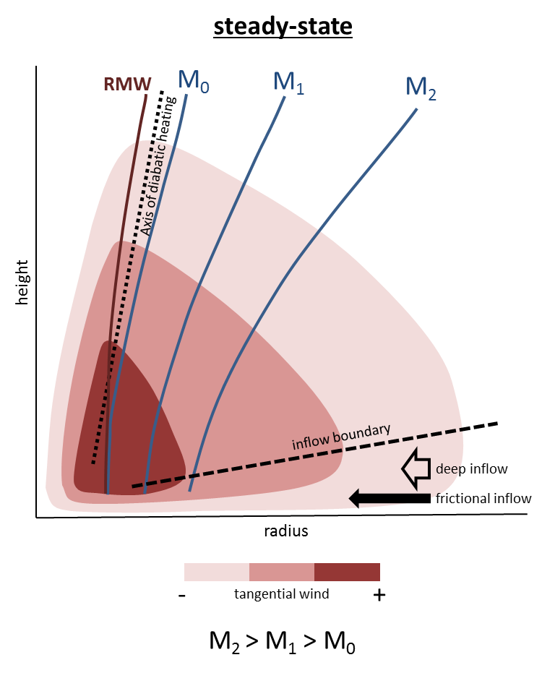
RI continuing:
Schematic of inner-core structure of intensifying vs. steady-state TC’s
inflow depth and strength differences
M vs diabatic heating slope differences
radial location of diabatic heating

Slide 25
Summary
Characteristics of inner-core structure can distinguish RI from SS cases
  axisymmetric structure
  radial distribution of deep convection
Individual cases support this: Earl (2010)
  RI onset: vortex aligned in moderate shear with bursts likely playing a role in alignment
  RI continuing: RMW contracted with convective burst activity concentrated inside RMW
Mechanisms explored to explain this radial distribution of convective bursts
    PBL convergence
    outer-core vorticity and inflow depth
    slope differences in updraft
Other cases also support these relationships
  Gustav (2007), Paloma (2008), Ophelia (2005)
Notes:
Three mechanisms explored to explain this relationship
PBL convergence – maximized inside RMW for Earl, inadequate data in other cases
outer core inertial stability and inflow depth – RI case (Earl) showed lower I, deeper inflow, than SS case (Gustav). Stronger secondary circulation and intensification via enhanced angular momentum import.
slope differences in updraft – Slope of updraft core departs significantly from M surface for Earl, closer to M surface for Gustav. Updraft inside local RMW for Earl, in higher I regime, compared with Gustav, which is outside local RMW aloft.

Slide 26
Future work
RI onset
  is alignment necessary for RI to begin?
  what are mechanisms of alignment?
RI continuing
  what are causes of differences in radial location of convective bursts?
  what is role of PBL convergence in determining radial location?
  does buoyancy of inflowing air play a role?
Additional datasets
  dropsonde measurements for PBL convergence, buoyancy calculations
  Target measurements outside RMW
  Hurricane Edouard (2014) excellent candidate for this analysis
Numerical models
  3-km HWRF forecast of Hurricane Earl (Chen and Gopal, 2014)
  vorticity, PV budgets during early stage, buoyancy calculations from model
  RI vs. non-RI cases

Slide 27
Thank you!

