Slide 1
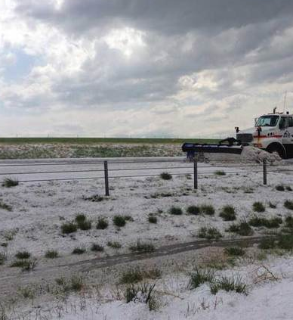
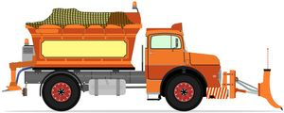
Plowable hailstorms and hurricanes: Using novel observing platforms to improve forecasts of extreme weather events
Evan Kalina (PSD/HRD) – 13 August 2015
Coauthors: J. Cione, K. Friedrich, E. Uhlhorn, B. Motta, W. Deierling, G. Stano, N. Rydell
A portion of this research was performed while the author held a National Research Council Research Associateship Award at ESRL/AOML. Additional support from NSF DGE 1144083.

Slide 2
Part 1 Colorado Plowable Hailstorms: Synoptic Weather, Radar, and Lightning Data
Kalina, E. A., K. Friedrich, B. C. Motta, W. Deierling, G. T. Stano, and N. N. Rydell, 2015: Colorado plowable hailstorms: Synoptic weather, radar, and lightning data. Wea. Forecasting, in review.
Supercell thunderstorm east of Denver, CO on 21 May 2014

Slide 3
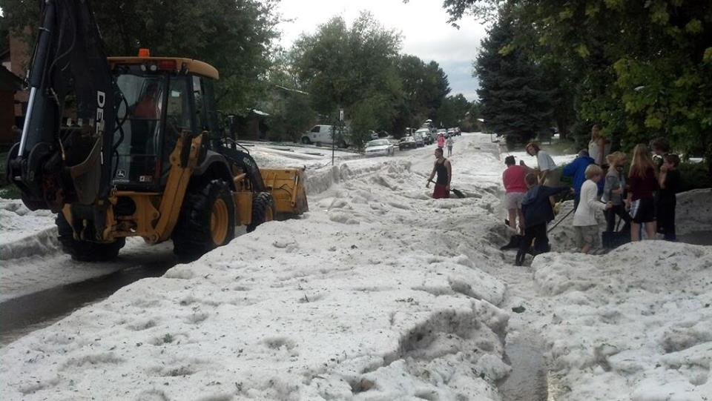
How do we forecast events like these?
Photo credit: 7NEWS Reporter Marshall Zelinger
Lakewood, CO on 9 Sept 2013
Multi-car accidents, aircraft damaged, water rescues (Chappell and Rodgers 1988; Schlatter and Doesken 2010)
$1.8 M in damage (Grahame et al. 2009)
Can’t use numerical models to pinpoint (for now)
Part 1: Motivation

Slide 4
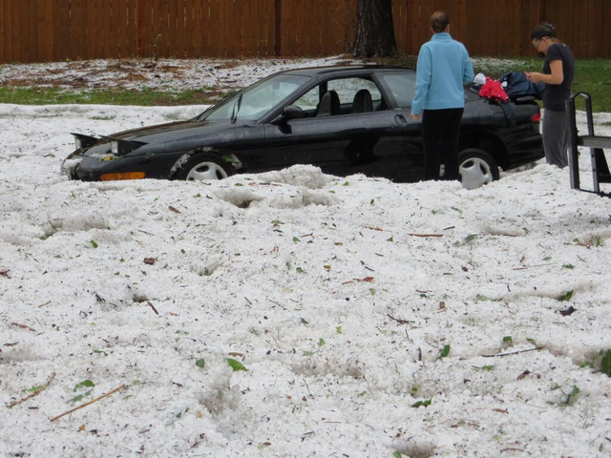
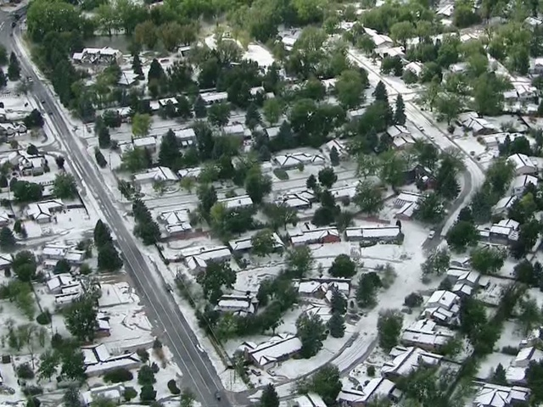
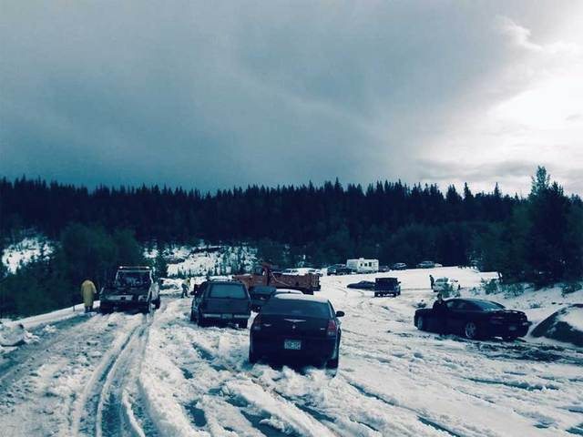
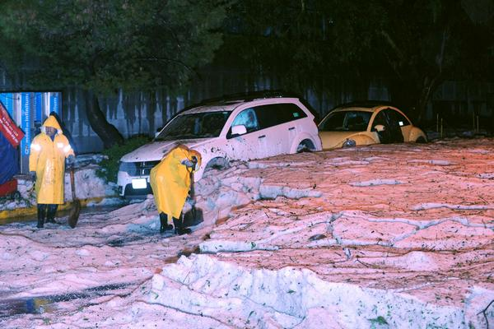
Lakewood, CO (W Denver)
9 Sept 2013
Image Credit: 7NEWS Denver
Ken Caryl, CO (SW Denver)
22 Aug 2013
Image Credit: 7NEWS Denver
Cripple Creek, CO
10 Aug 2014
Image Credit: CO State Patrol
Mexico City!
17 Aug 2014
Image Credit: Washington Post
Part 1: Motivation

Slide 5
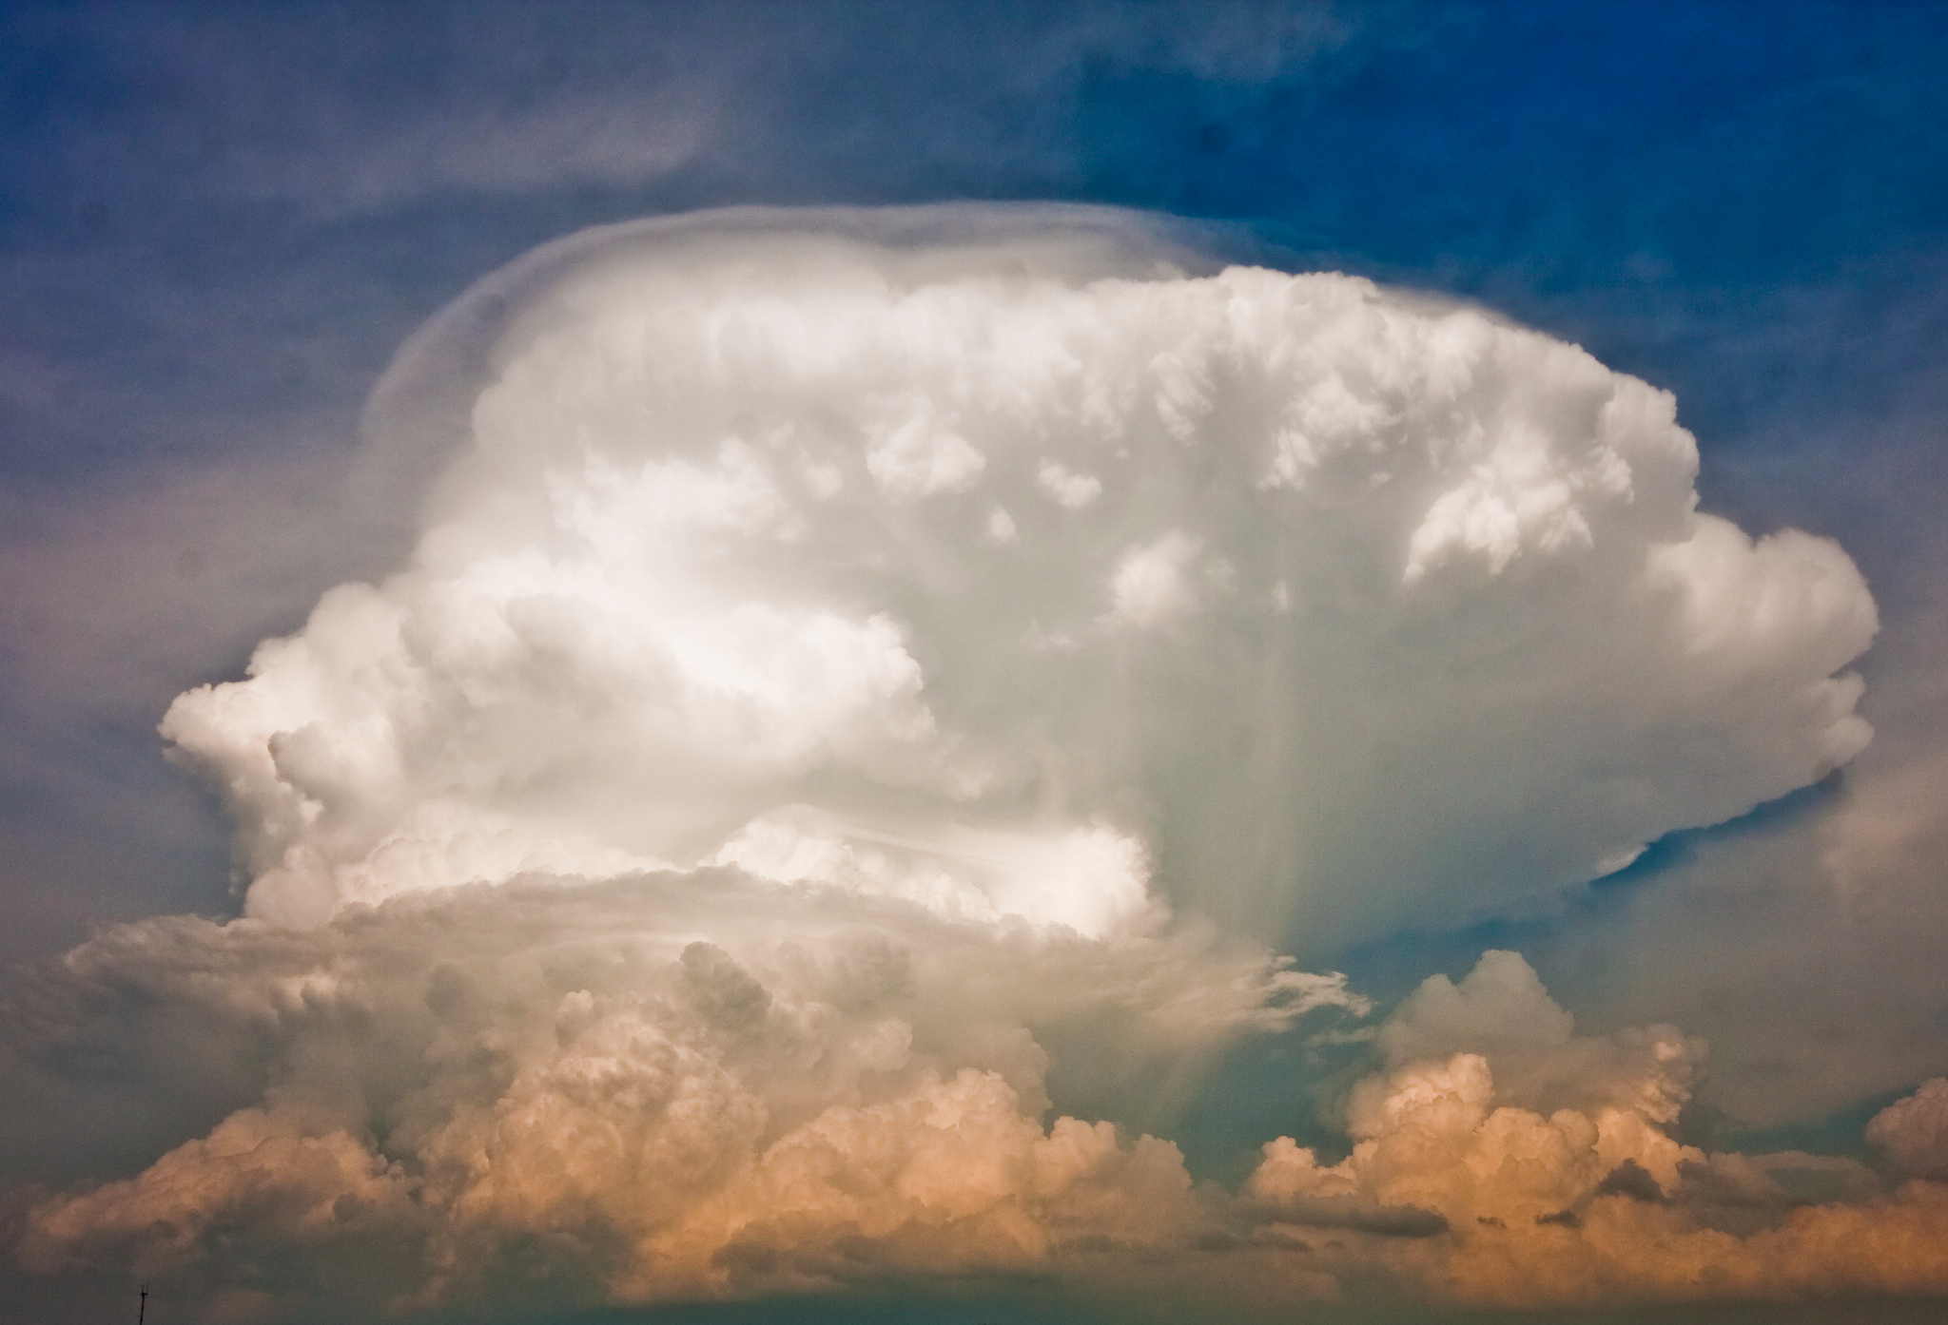
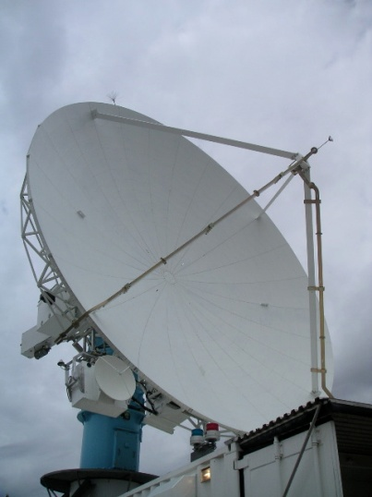
Can advanced measurement networks be used to predict deep hail?
Dual-polarization radar
Particle size, shape, type
Ice mass (derived)
Lightning detection net
Rison et al. (2012)
3-D location and time
Flash rate, flash size
Motivation
Rutledge (2012)

Slide 6
Can advanced measurement networks be used to predict deep hail?
Challenges:
-No quality-controlled database for hail depth, just hail size
-No standards followed for measuring hail depth
-Large size ranges often reported (“1 to 2 feet”)
-If it isn’t in a populated area, it likely goes unnoticed
Dual-polarization radar
Particle size, shape, type
Ice mass (derived)
Lightning detection net
Rison et al. (2012)
3-D location and time
Flash rate, flash size
Motivation
Rutledge (2012)

Slide 7
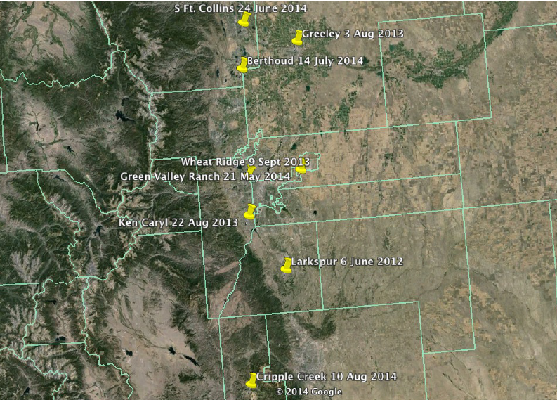
Colorado plowable hail cases
2012-2014
Part 1: Data

Slide 8
Four cases analyzed here
Part 1: Data

Slide 9
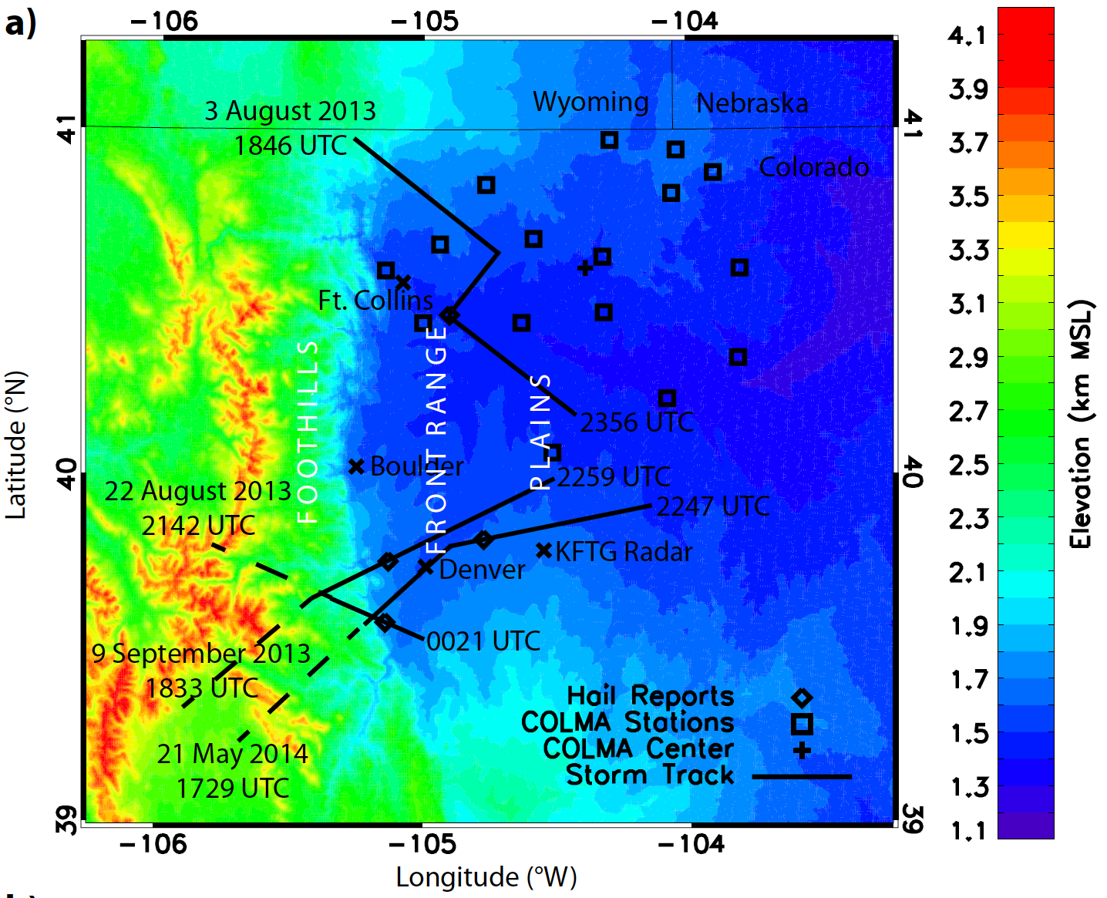
Case Overview
Part 1: Data

Slide 10
Accumulating Hailstorms: Synoptic Weather Conditions What weather patterns favor accumulating hailstorms in Colorado?

Slide 11
Ingredients for…
Hail at the surface?
Accumulating hail?
☑ Convective Available Potential
Energy (i.e., fast updrafts)
☑ Hailstone embryos
☑ Supercooled Liquid Water
☑ Low Freezing Level
☑ Vertical Wind Shear
(helpful, not required)
e.g., Dessens (1960); Pappas (1962); Xie et al. (2010); Berthet et al. (2013)

Slide 12
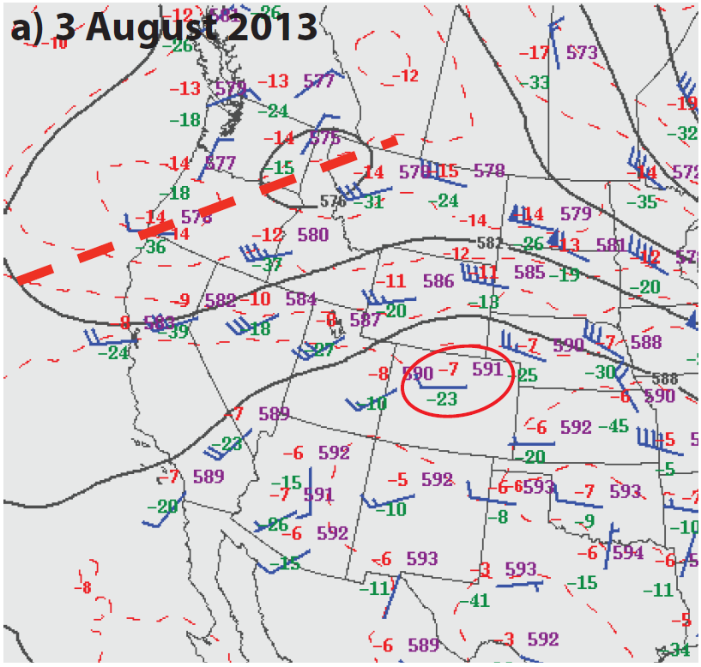
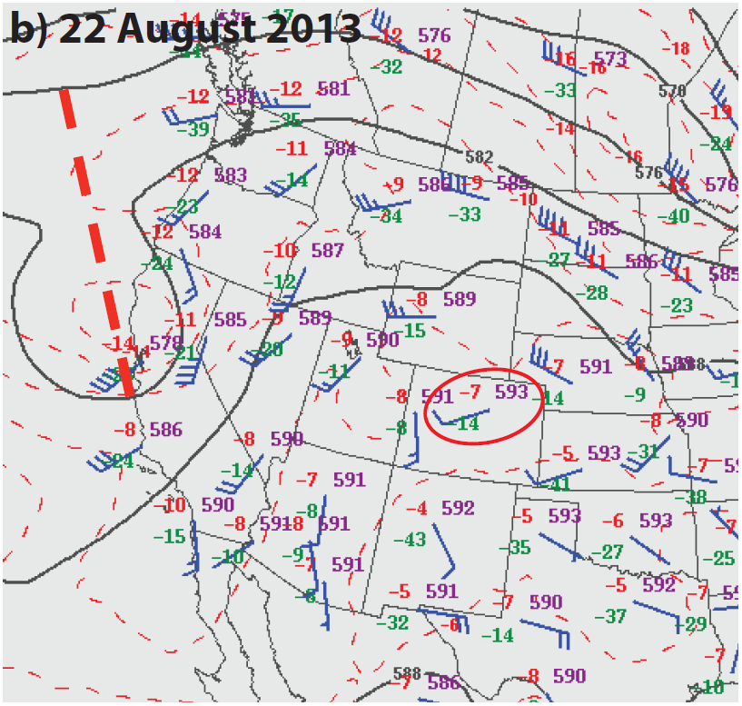
500 hPa pattern on morning of accumulating hail:
Trough to the west, with moist, slow
southwesterly flow over Colorado
3 August 2013
v̄(0-6 km) = 5 m s⁻¹
22 August 2013
v̄(0-6 km) = 2 m s⁻¹
Moisture
source
1200 UTC
1200 UTC
1200 UTC
Light winds throughout column led to average storm speeds of 6-9 m s⁻¹
Part 1: Results, Synoptic Weather

Slide 13
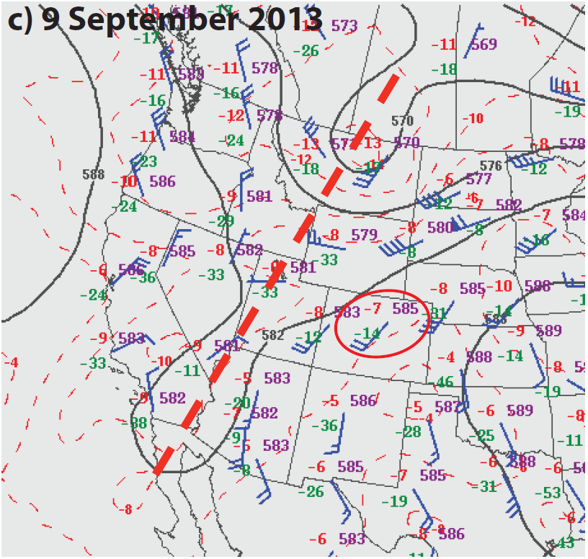
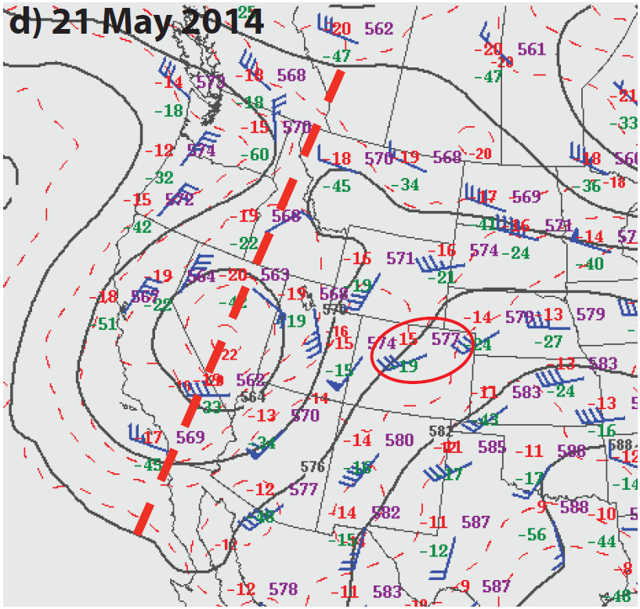
500 hPa pattern on morning of accumulating hail:
Trough to the west, with moist, slow
southwesterly flow over Colorado
9 September 2013
v̄(0-6 km) = 4 m s⁻¹
21 May 2014
v̄(0-6 km) = 12 m s⁻¹
1200 UTC
1200 UTC
1200 UTC
Light winds throughout column led to average storm speeds of 6-9 m s⁻¹
Part 1: Results, Synoptic Weather

Slide 14
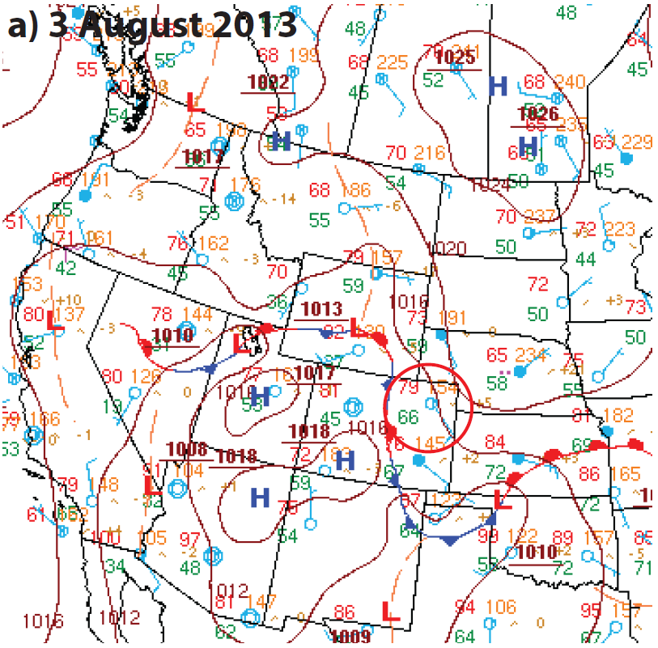
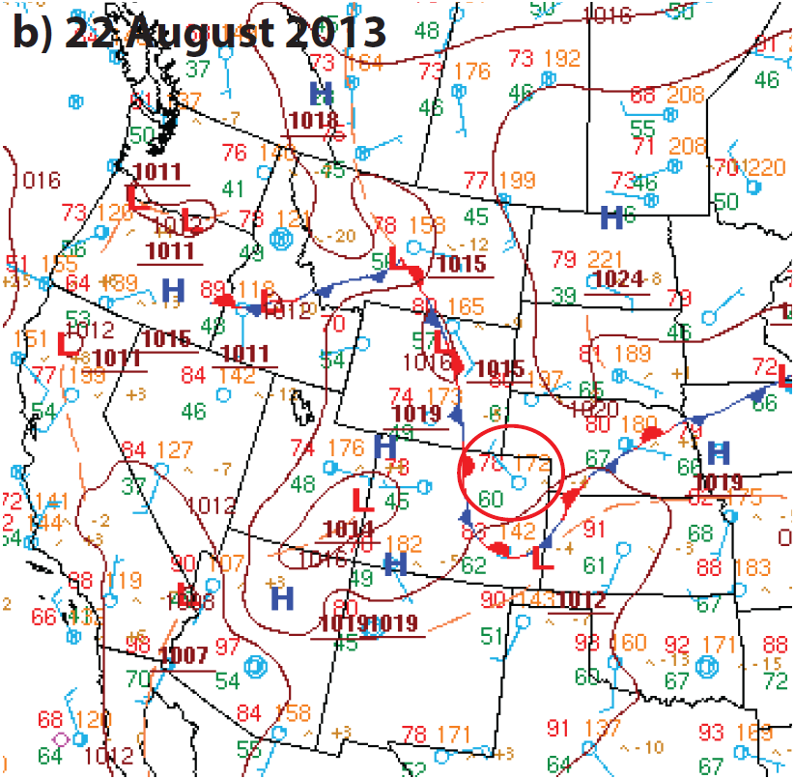
Surface pattern at noon LST:
Post-frontal, low-level upslope flow
Moist dewpoint temperatures (T_{d}; 11-19 °C)
3 August 2013
22 August 2013
1800 UTC
1800 UTC
T_{d} = 66°F = 19°C
T_{d} = 60°F = 16°C
Part 1: Results, Synoptic Weather

Slide 15
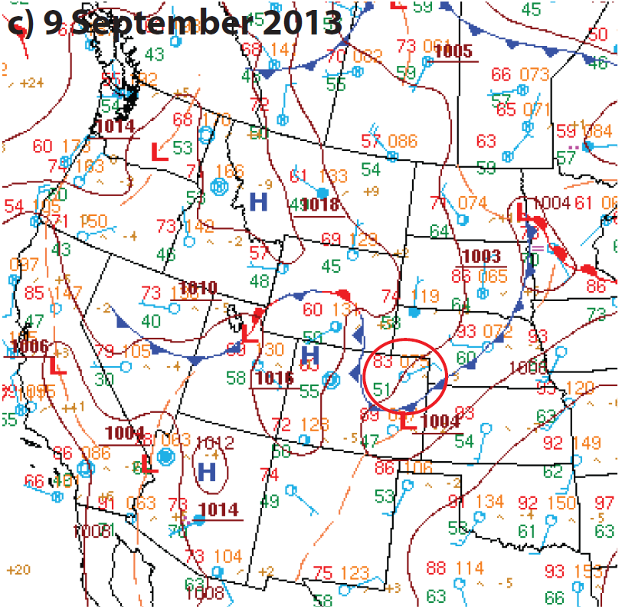
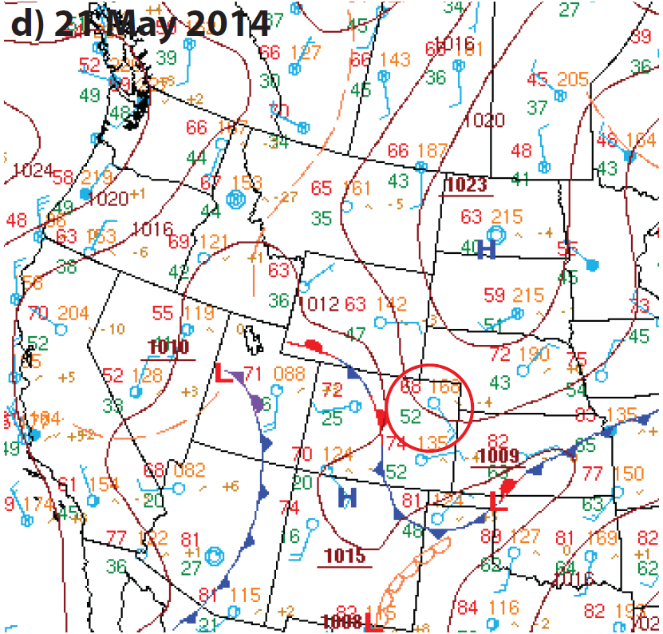
Surface pattern at noon LST:
Post-frontal, low-level upslope flow
Moist dewpoint temperatures (T_{d}; 11-19 °C)
9 September 2013
21 May 2014
1800 UTC
1800 UTC
T_{d} = 51°F = 11°C
T_{d} = 52°F = 11°C
Part 1: Results, Synoptic Weather

Slide 16
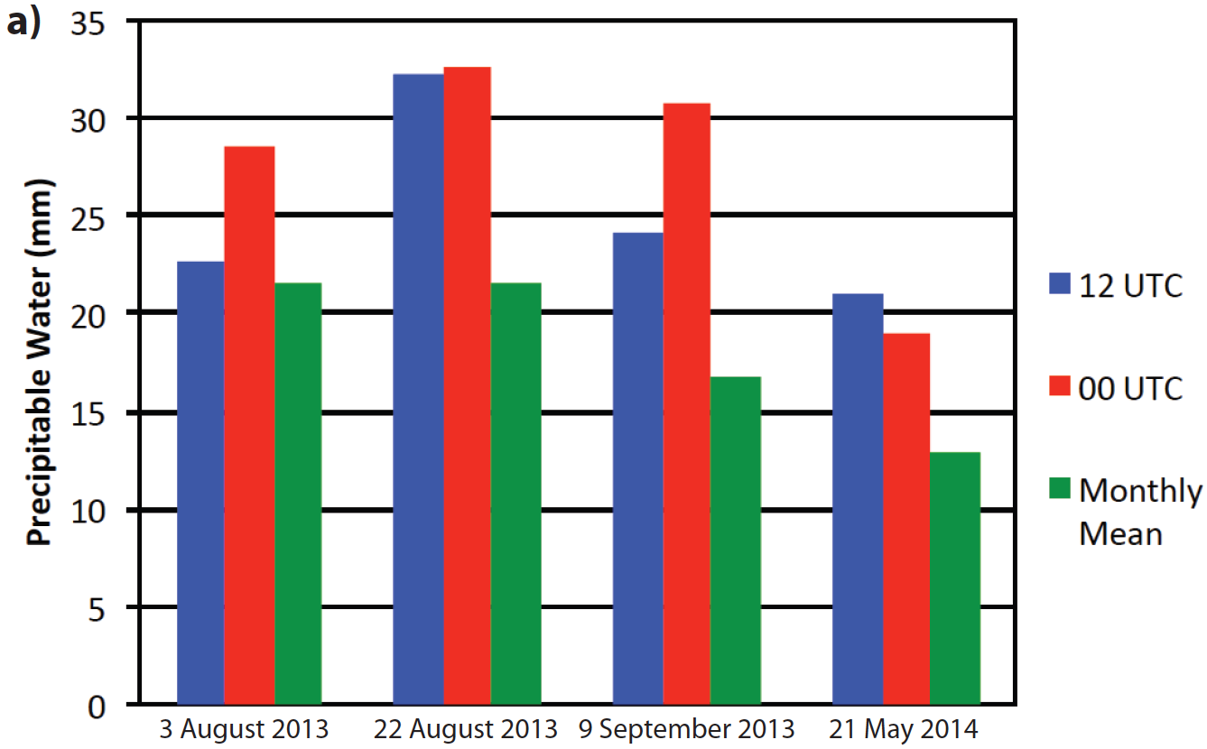
Precipitable water vapor at Denver was 132-184% of the monthly means on accumulating hail days.
More than two standard deviations above average
*
*Calculated from Denver rawinsondes with non-zero CAPE from 1957-2014.
Part 1: Results, Synoptic Weather

Slide 17
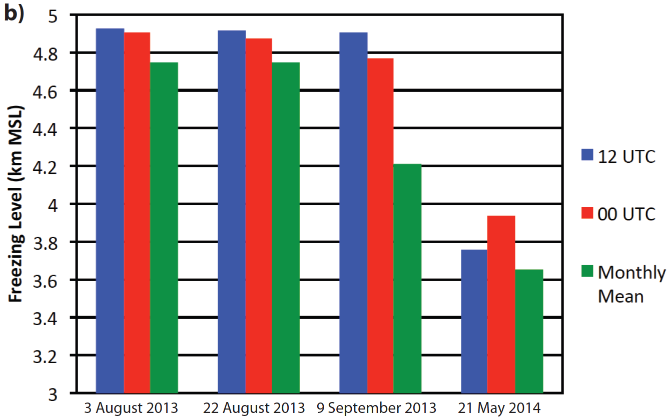
Freezing level height at Denver was 100-700m higher than monthly means on accumulating hail days.
*
*Calculated from Denver rawinsondes with non-zero CAPE from 1957-2014.
Part 1: Results, Synoptic Weather

Slide 18
Freezing level height at Denver was 100-700m higher than monthly means on accumulating hail days.
Why?
Temperature proportional to moisture content
(Clausius-Clapeyron)
*
*Calculated from Denver rawinsondes with non-zero CAPE from 1957-2014.
Part 1: Results, Synoptic Weather

Slide 19
Synoptic weather pattern favoring…
Hail at the surface?
Accumulating hail?
☑ Convective Available Potential
Energy (i.e., fast updrafts)
☑ Hailstone embryos
☑ Supercooled Liquid Water
☑ Low Freezing Level
☑ Vertical Wind Shear
(helpful, not required)
☑ Slow storm motions due to light column winds
☑ (Anomalously) large
atmospheric moisture
☒ (Anomalously) low
freezing level

Slide 20
Plowable Hailstorms: Radar Data/Analysis What radar products and hailstorm signatures can forecasters use to nowcast accumulating hailstorms?

Slide 21
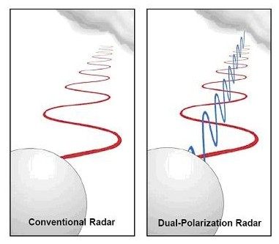
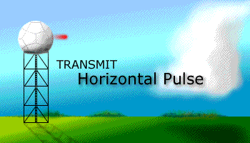
How does a dual-polarization radar work?
Conventional Radar
Only horizontal
polarization
Dual-Pol Radar
Horizontal
and vertical
polarization
Part 1: Background, Radar

Slide 22
What new information does dual-pol radar give us?
Differential Reflectivity (Z_{DR})
Indicates particle shape
V
H
More oblate drops
have larger Z_{DR}
Beard and Chuang (1987)
Part 1: Background, Radar

Slide 23
Radar data processing
Step 1: Remove all radar data except the plowable hailstorm.
Reflectivity with ground clutter, biological scatterers, precipitating echoes
Reflectivity with everything removed except hailstorm
Other weather
Ground clutter
Insects
Dust
Part 1: Method, Radar

Slide 24
KFTG radar data processing, continued
Step 2: Convert data from polar to Cartesian coordinates
19.5°
1.8°
z = 15 km
…
…
1.3°
z = 3.5 km
0.9°
z = 3.0 km
0.5°
z = 2.5 km
z = 2.0 km
(MSL)
Reflectivity
0.5° elevation
Reflectivity
z = 2.5 km MSL
Part 1: Method, Radar

Slide 25
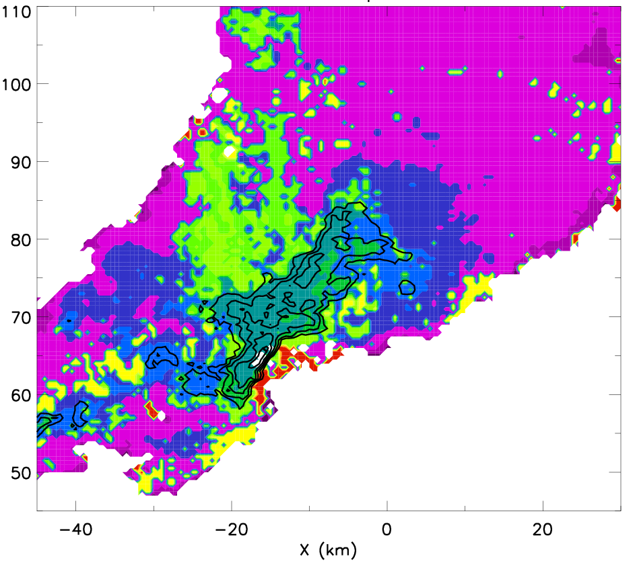
KFTG radar data processing, continued
Step 3: Apply NCAR Particle Identification Scheme (Vivekanandan et al. 1999) and estimate graupel and hail masses (Heymsfield and Miller 1988)
Hail gates:
M_{hail} = 0.000044Z^{0.71}
Graupel gates:
M_{grau} = 0.0052Z^{0.5}
Part 1: Method, Radar

Slide 26
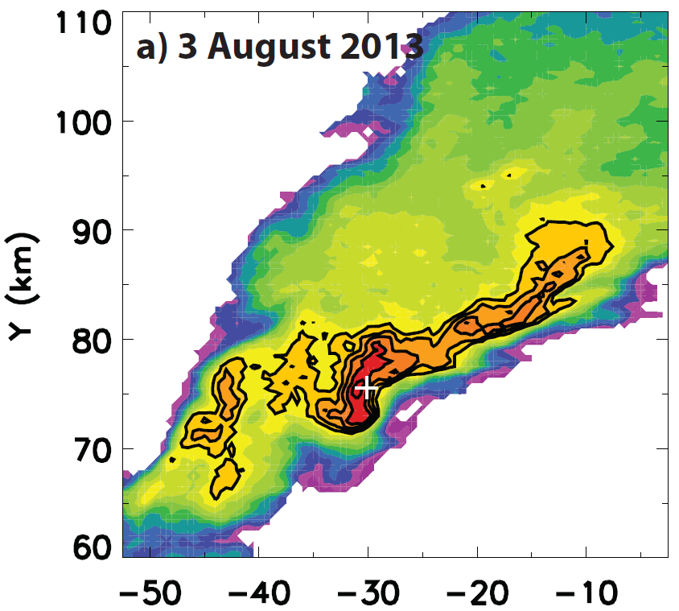
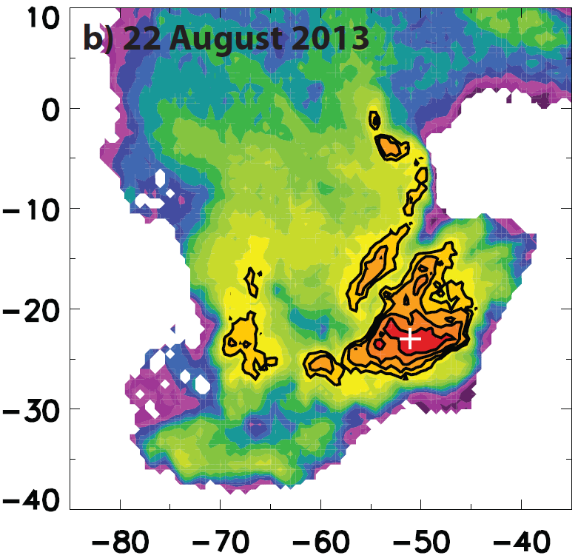
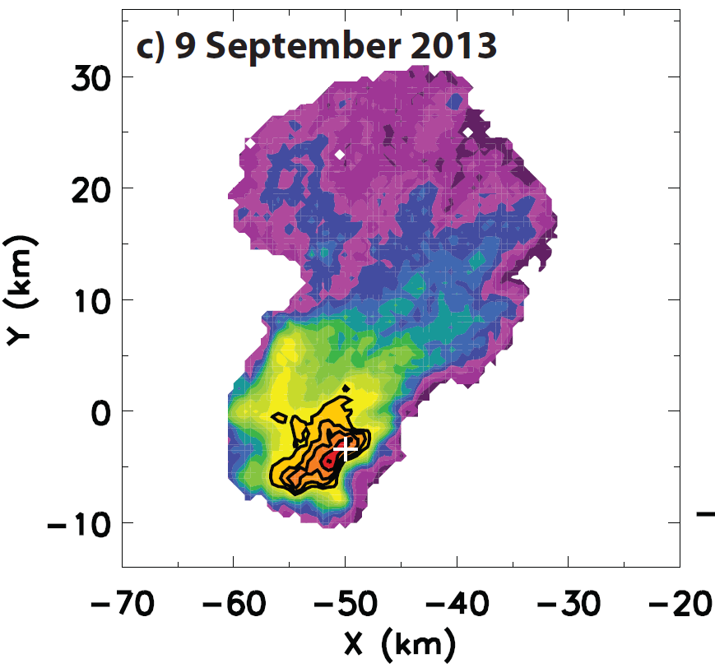
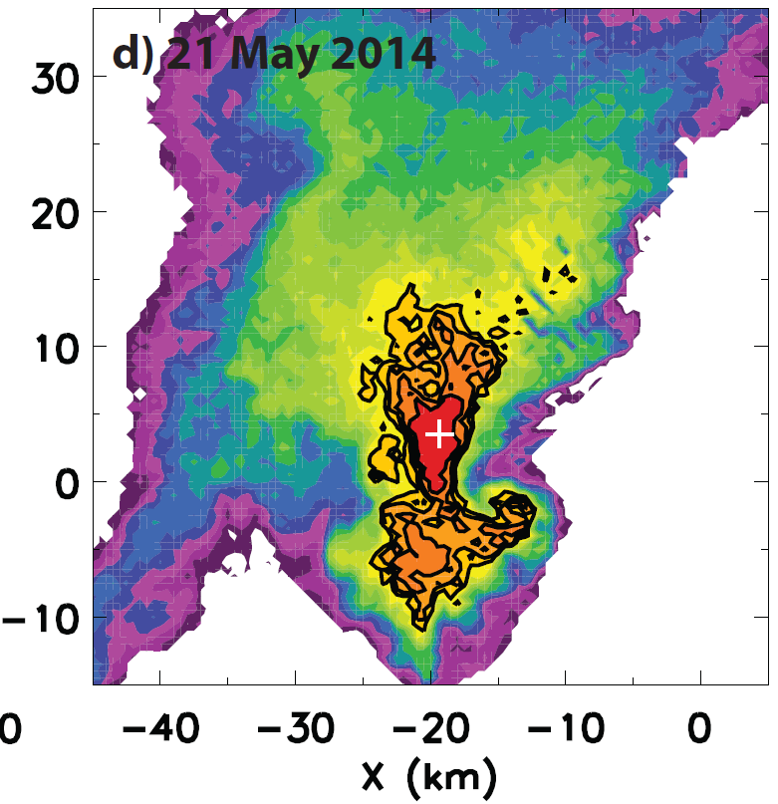
All four cases:
Z > 65 dBZ
z = 3.5 km MSL
z = 3.0 km MSL
Black contours: 50-70 dBZ at 5-dBZ increments
+ indicates hail report
Supercell
D_{max} = 45 mm
Multicell
D_{max} = 45 mm
z = 2.5 km MSL
z = 2.5 km MSL
Supercell
D_{max} = 13 mm
Supercell
D_{max} = 24 mm
Part 1: Results, Radar

Slide 27
All four cases:
Z > 65 dBZ
z = 3.5 km MSL
z = 3.0 km MSL
Black contours: 50-70 dBZ at 5-dBZ increments
+ indicates hail report
Z > 70 dBZ due to hail near giant size (D ~ 50 mm; Ryzhkov et al. 2010)
Multicell
D_{max} = 45 mm
Supercell
D_{max} = 45 mm
z = 2.5 km MSL
z = 2.5 km MSL
Supercell
D_{max} = 13 mm
Supercell
D_{max} = 24 mm
Part 1: Results, Radar

Slide 28
All four cases:
Z > 65 dBZ
z = 3.5 km MSL
z = 3.0 km MSL
Black contours: 50-70 dBZ at 5-dBZ increments
+ indicates hail report
Z > 70 dBZ due to hail near giant size (D ~ 50 mm; Ryzhkov et al. 2010)
Multicell
D_{max} = 45 mm
Supercell
D_{max} = 45 mm
z = 2.5 km MSL
z = 2.5 km MSL
Z > 70 dBZ due to melting hail
(e.g., Snyder et al. 2010)
Supercell
D_{max} = 13 mm
Supercell
D_{max} = 24 mm
Part 1: Results, Radar

Slide 29
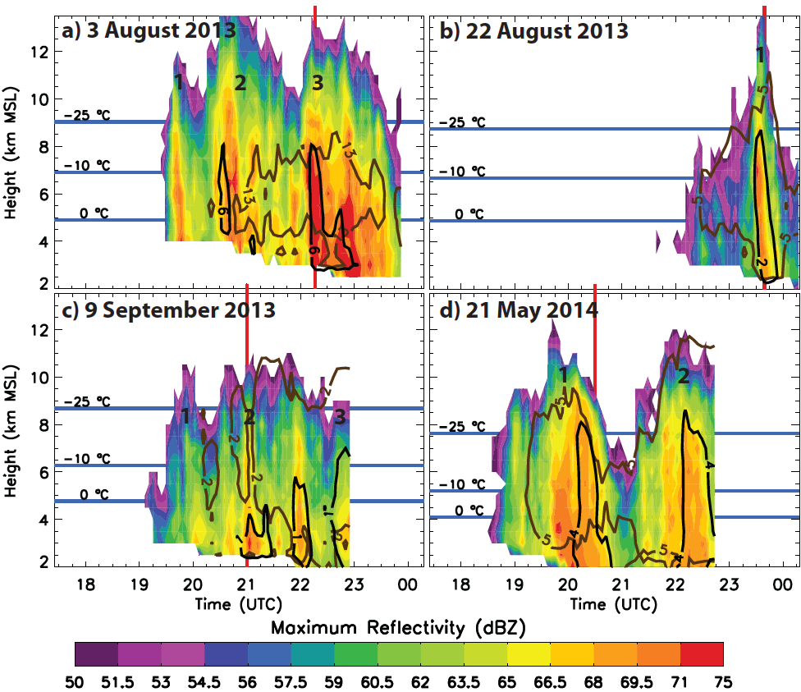
Hail reports occurred with peaks in 50-dBZ echo tops
Local maxima in echo top height
Part 1: Results, Radar

Slide 30
Maxima in reflectivity collocated with hail reports
Max column reflectivity > 70 dBZ
Part 1: Results, Radar

Slide 31
Enhanced graupel production 15-90 min before hail reports
Increased graupel mass
Part 1: Results, Radar

Slide 32
Greatest hail production coincident with hail reports
Max hail mass w/ hail report
Part 1: Results, Radar

Slide 33
Greatest hail production coincident with hail reports
Did accumulating hail occur here?
Part 1: Results, Radar

Slide 34
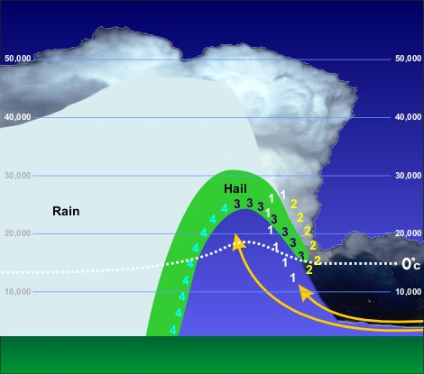
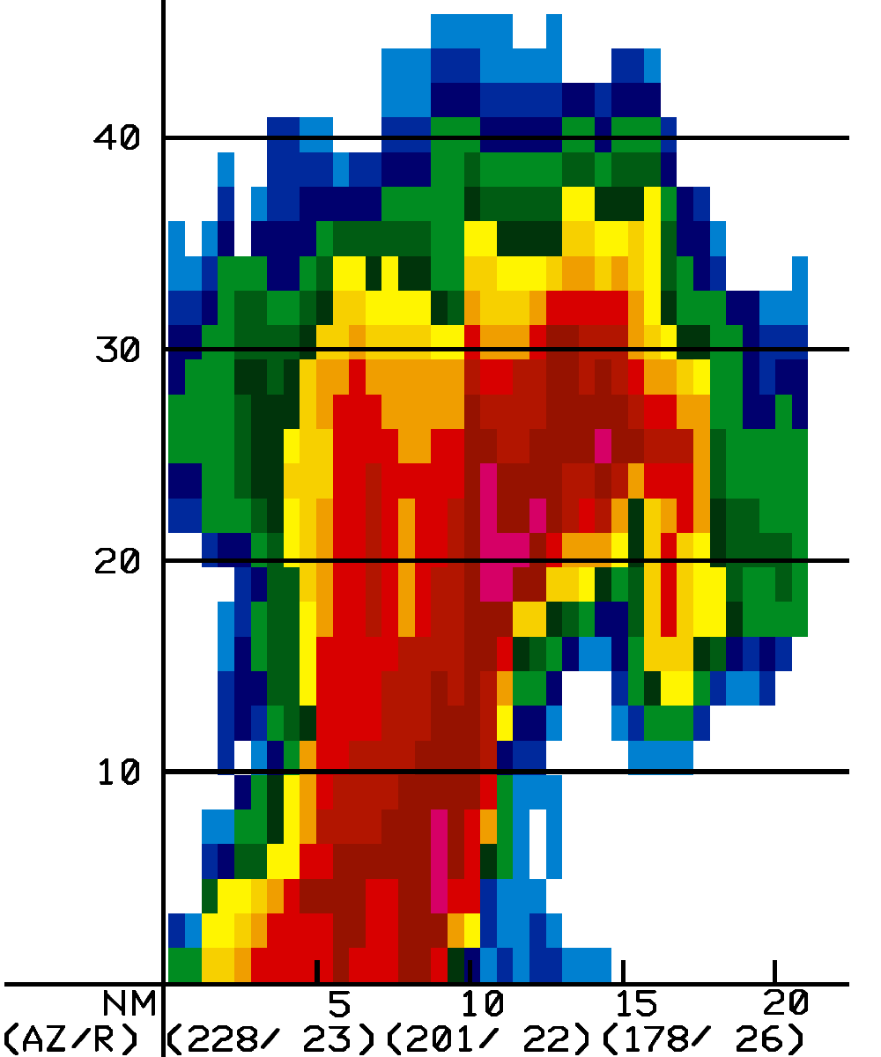
Bounded Weak Echo Regions (BWERs) occur near the time of plowable hail in the three supercell thunderstorms
Idealized schematic
Radar vertical cross section
Mid-level airflow
BWER
Updraft
BWER
Source: NOAA/NWS
For more information: Knight, C. A., and N. C. Knight, 2001: Hailstorms. Meteorological Monographs, 28, 223—248.

Slide 35
Bounded Weak Echo Regions (BWERs) occur near the time of plowable hail in the three supercell thunderstorms
= Weak Echo Region (WER)
= Bounded Weak Echo Region (BWER)

Slide 36
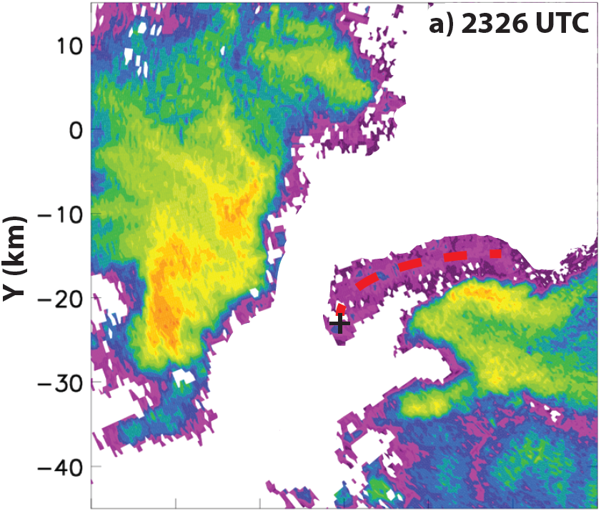
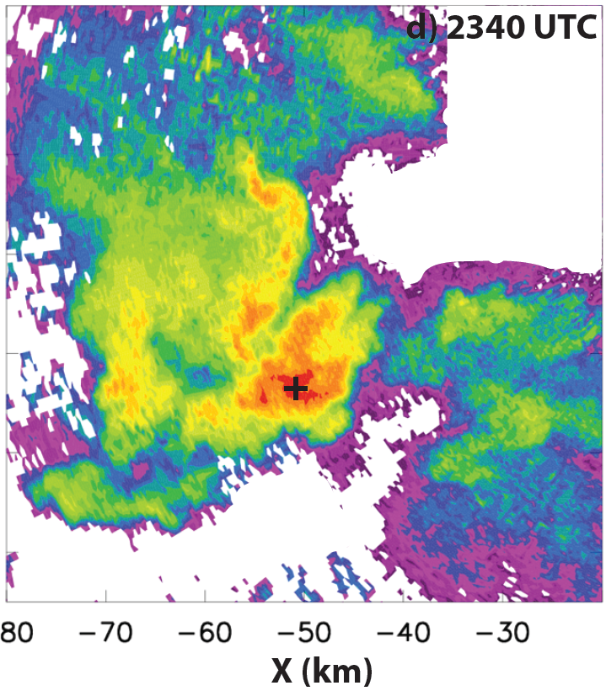
Multicell case: Initiated by boundary collision with existing thunderstorm
New cell
Hail report

Slide 37
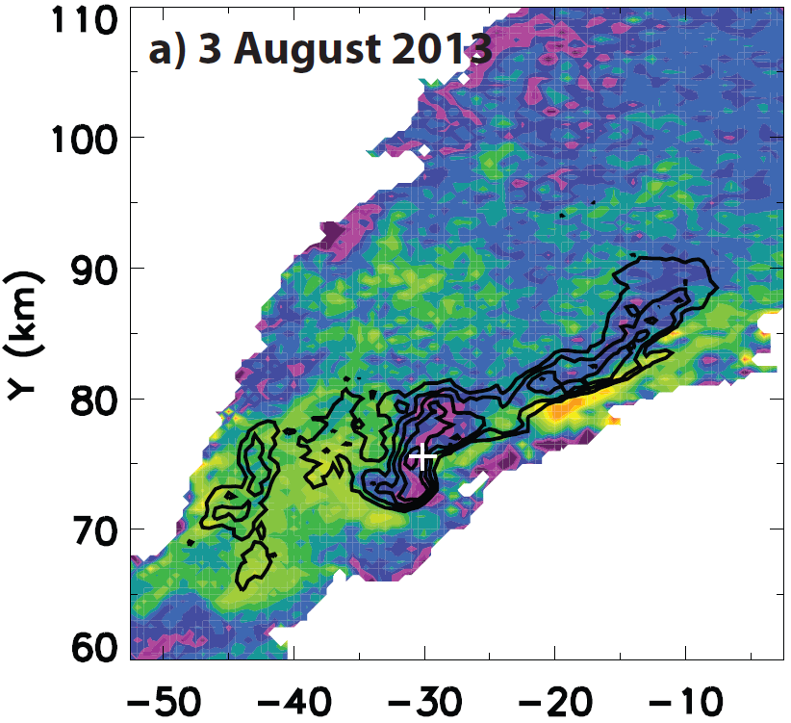
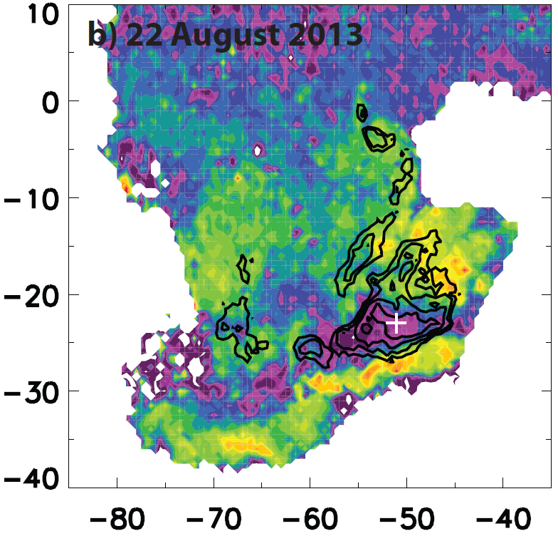
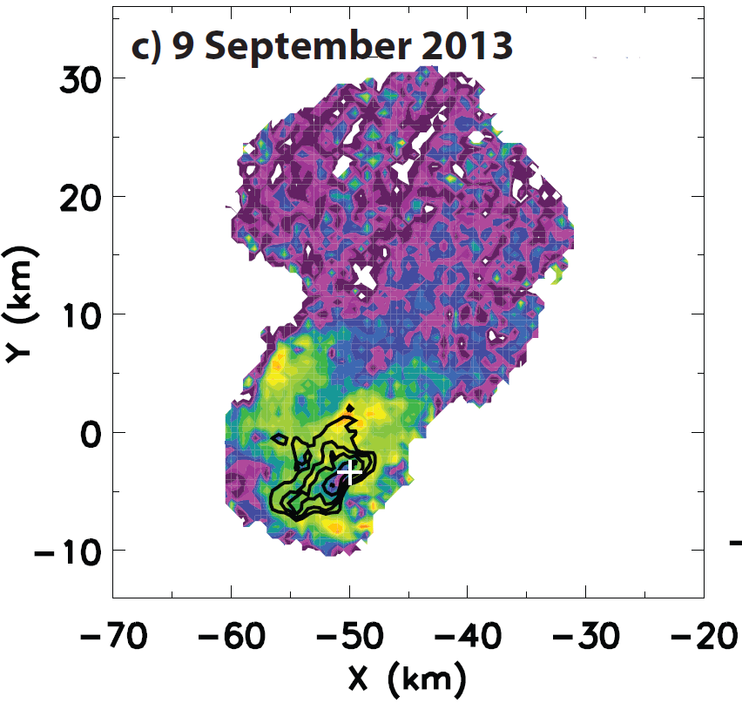
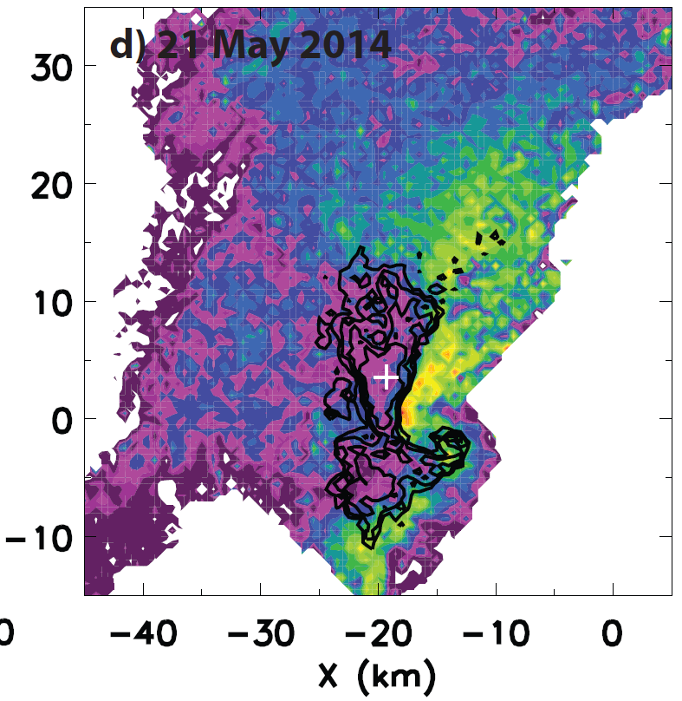
Z_{DR} 0 to -3 dB in maximum Z region
z = 3.5 km MSL
z = 3.0 km MSL
Black contours: 50-70 dBZ at 5-dBZ increments
+ indicates hail report
D_{max} = 45 mm
Large hail has Z_{DR} ~ 0 dB
Kumjian and Ryzhkov 2008
D_{max} = 45 mm
z = 2.5 km MSL
z = 2.5 km MSL
D_{max} = 13 mm
D_{max} = 24 mm
Part 1: Results, Radar

Slide 38
Z_{DR} 0 to -3 dB in maximum Z region
z = 3.5 km MSL
z = 3.0 km MSL
Black contours: 50-70 dBZ at 5-dBZ increments
+ indicates hail report
D_{max} = 45 mm
Large hail has Z_{DR} ~ 0 dB
Kumjian and Ryzhkov 2008
Small melting hail: Z_{DR} > 0 dB
Ryzhkov et al. 2013
D_{max} = 45 mm
z = 2.5 km MSL
z = 2.5 km MSL
D_{max} = 13 mm
D_{max} = 24 mm
Part 1: Results, Radar

Slide 39
Negative Z_{DR} swaths due to three-body scattering
z = 3.5 km MSL
z = 3.0 km MSL
Hail
Hail
Radar
D_{max} = 45 mm
D_{max} = 45 mm
Radar
Ground
Adapted from Hubbert and Bringi (2000)
z = 2.5 km MSL
z = 2.5 km MSL
Three-body scattering possible if 20 < D_{hail} < 50 mm
Kumjian et al. (2010)
Radar
Also observed in non-accumulating hailstorms.
D_{max} = 13 mm
D_{max} = 24 mm
Part 1: Results, Radar

Slide 40
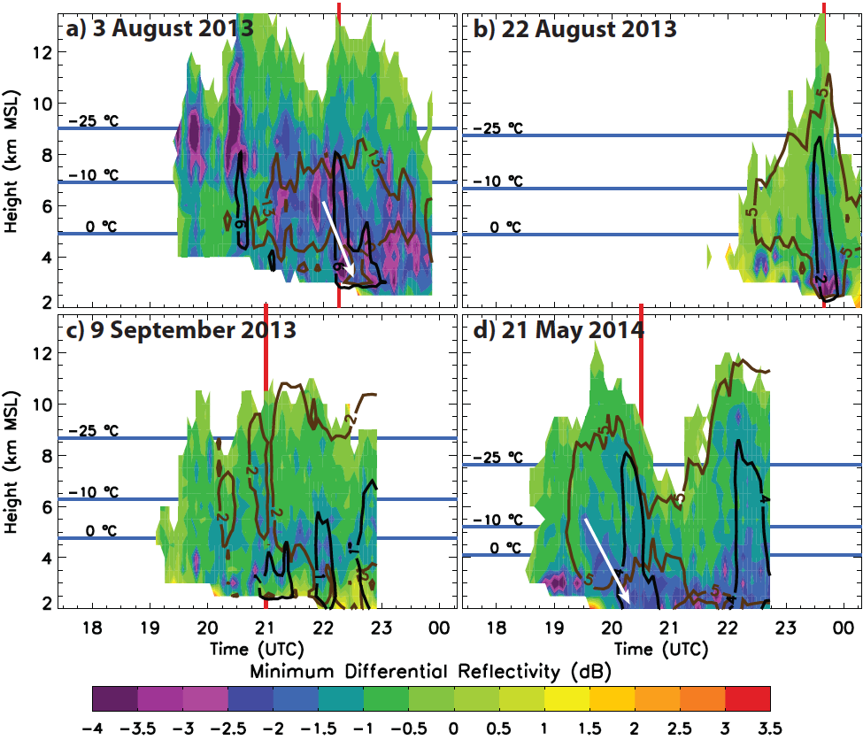
Negative Z_{DR} (-1 to -4 dB) descends from midlevels to surface before/during hail report
Descending areas of small Z_{DR}
No descending area – small, wet hail
Part 1: Results, Radar

Slide 41
Problem: Previously-discussed signatures are common to both accumulating and non-accumulating hailstorms.
How to distinguish? How to pinpoint areas of accumulating hail?

Slide 42
Problem: Previously-discussed signatures are common to both accumulating and non-accumulating hailstorms.
How to distinguish? How to pinpoint areas of accumulating hail?
Solution: Accumulate derived hail mass over successive radar volume scans and map the resulting hail depth (Kalina et al. 2015):

Slide 43
Problem: Previously-discussed signatures are common to both accumulating and non-accumulating hailstorms.
How to distinguish? How to pinpoint areas of accumulating hail?
Solution: Accumulate derived hail mass over successive radar volume scans and map the resulting hail depth (Kalina et al. 2015):
Hail Depth(x, y) = v × η⁻¹ × ρ⁻¹ × Σ[Δt(t) × M_{hail}(reflectivity, x, y, t)]
v: Hail fall speed (assume 15 m s⁻¹ for d = 20 mm hailstone)
η: Packing fraction of hail on ground
ρ: Hail bulk density (assume 900 kg m⁻³)
Σ: Summation from t₀ to current time
Δt: Time between radar volume scans (s)
M_{hail}: Hail mass concentration (kg m⁻³) derived from radar

Slide 44
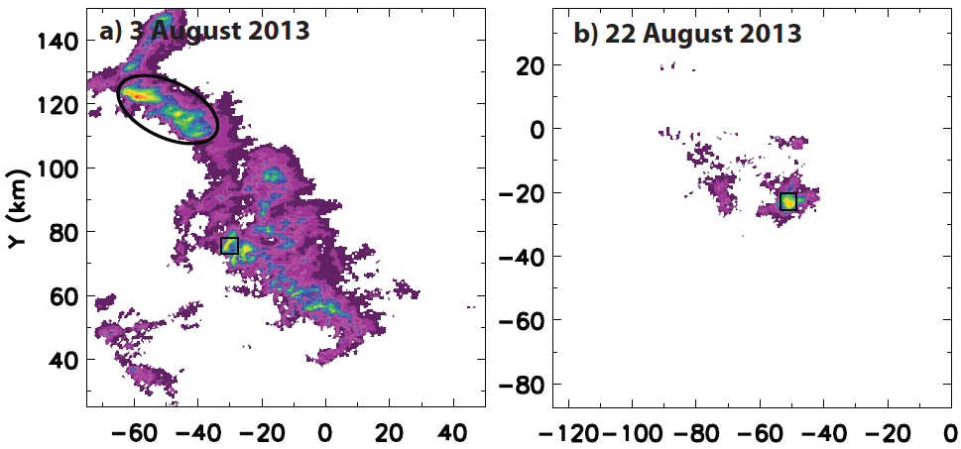
Mapping hail depth: > 5 cm collocated with hail reports. Depths mostly < 1.5 cm elsewhere
Unpopulated area of Foothills
Hail reports
Part 2: Results, Radar

Slide 45
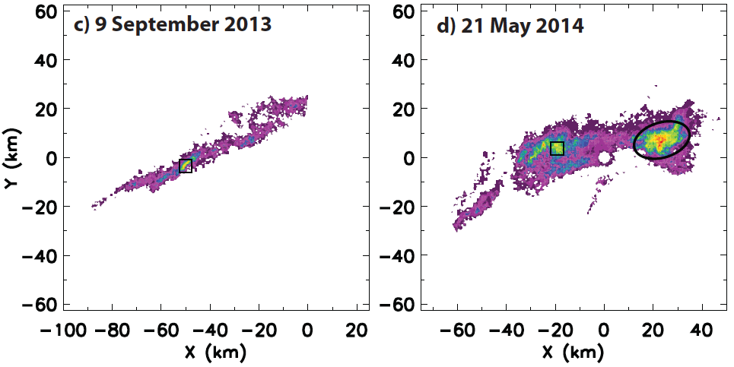
Mapping hail depth: > 5 cm collocated with hail reports. Depths mostly < 1.5 cm elsewhere
Sparsely populated eastern Plains
Hail reports
Part 2: Results, Radar

Slide 46
Hail duration is a strong control on accumulation
Hail Depth(x, y) = v × η⁻¹ × ρ⁻¹ × Σ[Δt(t) × M_{hail}(reflectivity, x, y, t)]
ΣΔt: Radar-estimated hail duration
Date | Hail duration (min)
3 August 2013 | 9.3
22 August 2013 | 28.0
9 September 2013 | 18.6
21 May 2014 | 18.6
Mean | 18.6
Are these durations unusual?
Study | Hail duration (min)
Illinois (Changnon 1967) | Average: 3.2 (n = 99)
Alberta (Wojtiw 1975) | Median: 7 (n = ?)
Saskatchewan (Paul 1980) | Median: 6 (n = 4966)
Southern France (Dessens 1986) | Median: 9 (n = 2524)

Slide 47
Accumulating Hailstorms: Lightning Data/Analysis Can lightning data assist forecasters in identifying accumulating hailstorms?

Slide 48
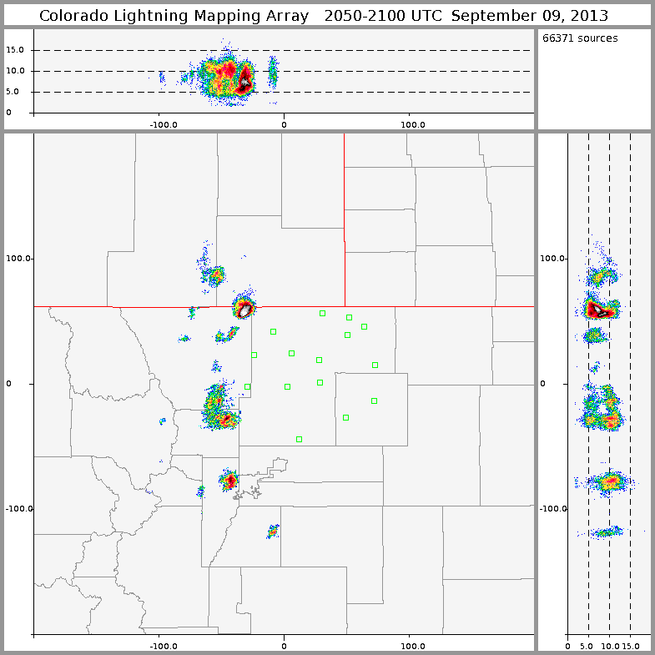
The Colorado Lightning Mapping Array (COLMA): Total lightning data
15 sensors located in Larimer, Weld, and Morgan counties (northern Colorado)
Detect individual Very High Frequency (VHF; 60-66 MHz) emission events
Three-dimensional location and time for IC/CG lightning events
Rutledge (2012)
VHF
Antenna
Solar Cells
Part 1: Background, Lightning

Slide 49
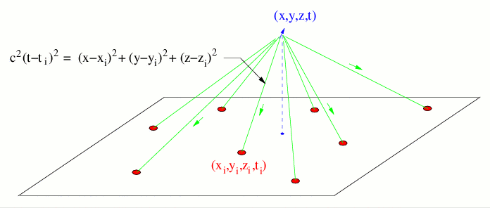
Colorado Lightning Mapping Array: How it works
Rutledge (2012)
Image credit:
New Mexico Tech
Four unknowns: x, y, z, t
At least four stations must measure time-of-arrival (t_{i})
Errors proportional to (x/100 km)² and (z/100 km) ²
Detection limit: 350 km from array center
Part 1: Background, Lightning

Slide 50
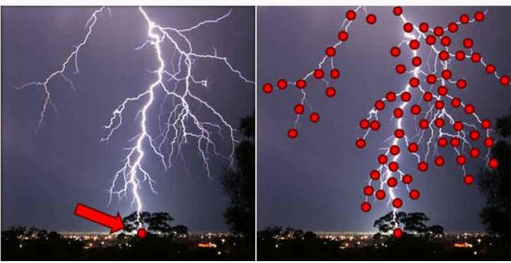
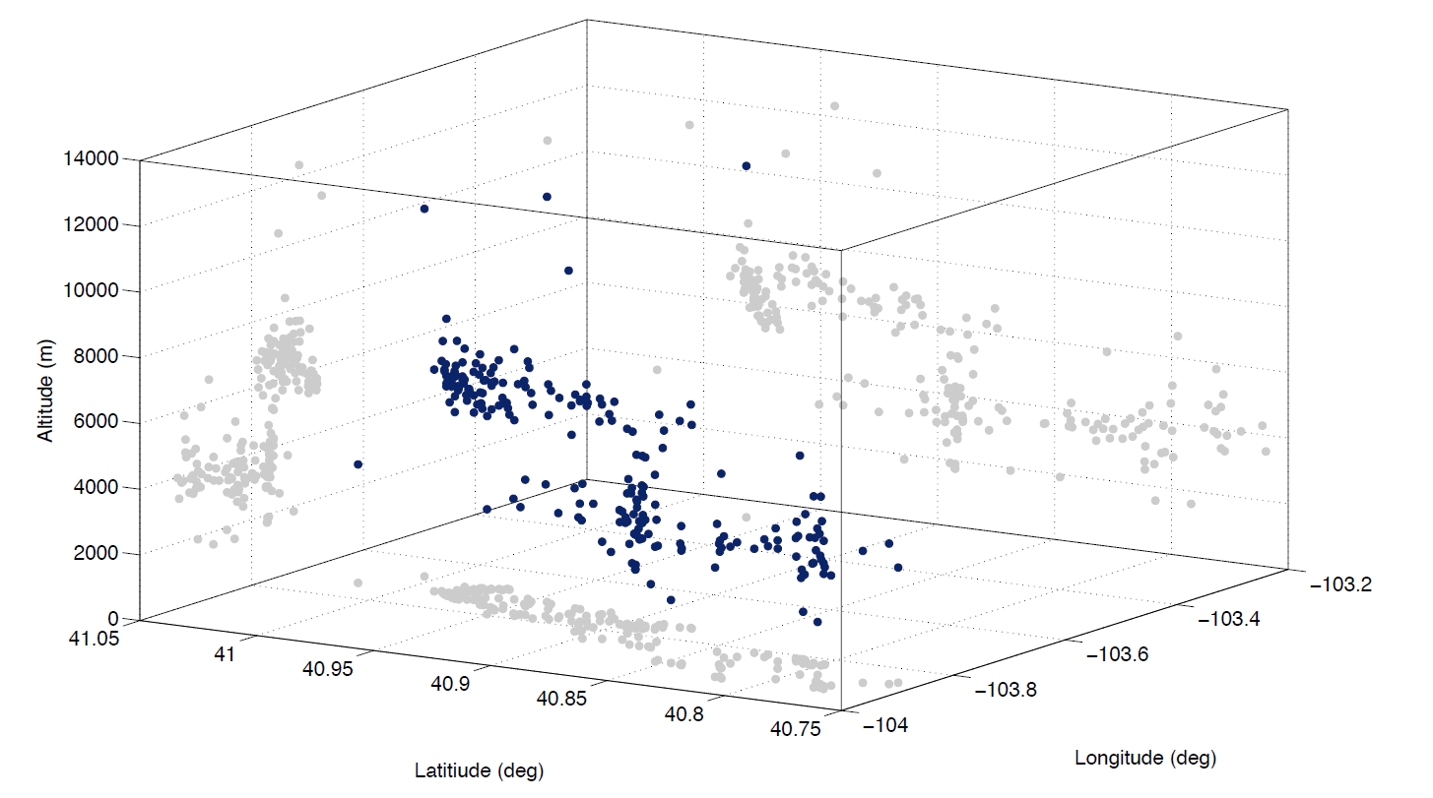
Colorado Lightning Mapping Array provides 3-D lightning sources
vs.
National Lightning Detection Network
(1983-present)
Colorado Lightning Mapping
Array
(2012-present)
3-D lightning sources
Kumjian and Deierling (2014)
How to process?
Apply McCaul et al. (2005, 2009) flash creation algorithm
Regrid
Disregard flash if first source in Z < 0 dBZ
Part 1: Method, Lightning

Slide 51
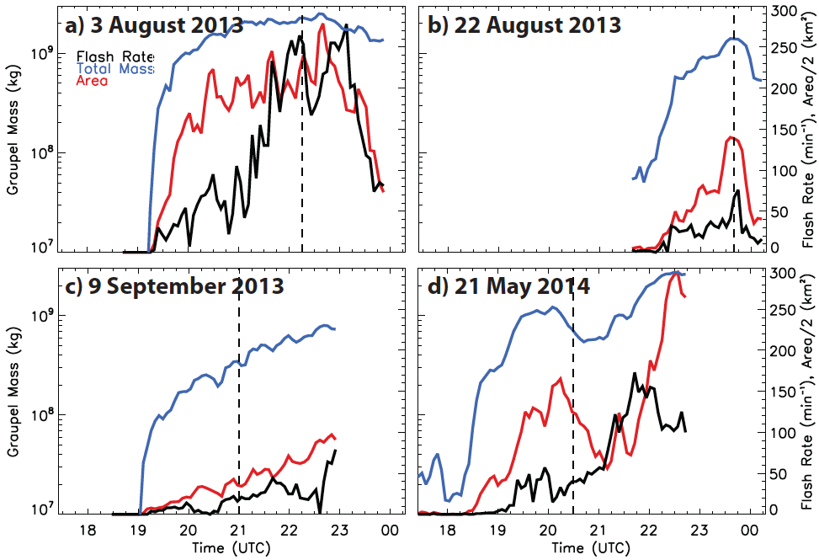
Hail reports occur either at peak lightning flash rate or as flash rate increases
Peak flash rate
Near peak/large increase
Peak thus far
Increasing rate
Part 1: Results, Lightning

Slide 52
Flash rate, storm total graupel mass are well correlated (r = 0.77-0.83)
Part 1: Results, Lightning

Slide 53
Part 1: Summary and Conclusions
Synoptic pattern for accumulating hail in CO?
How to identify
(in a particular storm)?
☑ Slow storm motions due to light column winds
☑ (Anomalously) large
atmospheric moisture
☒ (Anomalously) low
freezing level
☑ Reflectivity >65-70 dBZ
☑ Increases in echo top height
☑ Increases in graupel mass
(15-90 min prior to hailfall)
☑ Peaks in hail mass
☑ Descent of negative Z_{DR}
(15-30 min prior to hailfall)
☑ Estimated hail depths > 5 cm
☑ Long hail durations
☑ Increased lightning activity

Slide 54
Part 2 Observing the Hurricane Boundary Layer with the Coyote Unmanned Aircraft System

Slide 55
Overview
Motivation and background
Critical data gaps in the hurricane boundary layer
Coyote Unmanned Aircraft System (UAS) description
Hurricane Edouard (2014)
UAS and radar/dropsonde data comparison
16 September eye/eyewall flight (wind speed, T, T_{d})
17 September inflow layer flight (wind speed, T, T_{d})
Summary
Next steps
Use thermodynamic data from Coyote and microphysical data from the P-3 particle probes to evaluate HWRF.

Slide 56
Motivation and Background

Slide 57
Boundary layer processes are complex and nonlinear
3 km
2 km
Must have data on all of these boundary layer processes (and more) to evaluate/improve model parameterizations
Model
Height (km)
1 km (Boundary layer)
Heat, moisture, momentum fluxes to sustain storm
(Emanuel 1986)
Convective downdrafts (change latent heat budget, fluxes)
sea spray
wind
T, q
waves
SST

Slide 58
How are we doing with collecting data in the BL?
NOAA P-3
3 km
Flight level: p, T, RH, wind
2 km
Height (km)
1 km (Boundary layer)
Model

Slide 59
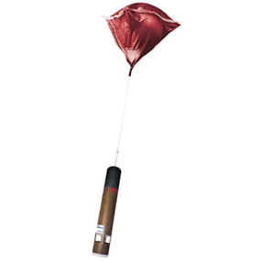
How are we doing with collecting data in the BL?
NOAA P-3
3 km
2 km
Height (km)
1 km (Boundary layer)
IR Dropsonde:
(10-20 per mission)
Vertical profiles of p, T, RH, wind
SST
Model

Slide 60
How are we doing with collecting data in the BL?
NOAA P-3
3 km
X-band tail radar
Reflectivity, winds
(no thermo)
2 km
Height (km)
1 km (Boundary layer)
Below 1 km:
Attenuation, sea clutter
(sparse data)
Model

Slide 61
How are we doing with collecting data in the BL?
3 km
2 km
Height (km)
1 km (Boundary layer)
Problem:
How do we get consistent data, especially thermodynamic information, to evaluate model performance in the critically important hurricane boundary layer?
Model

Slide 62
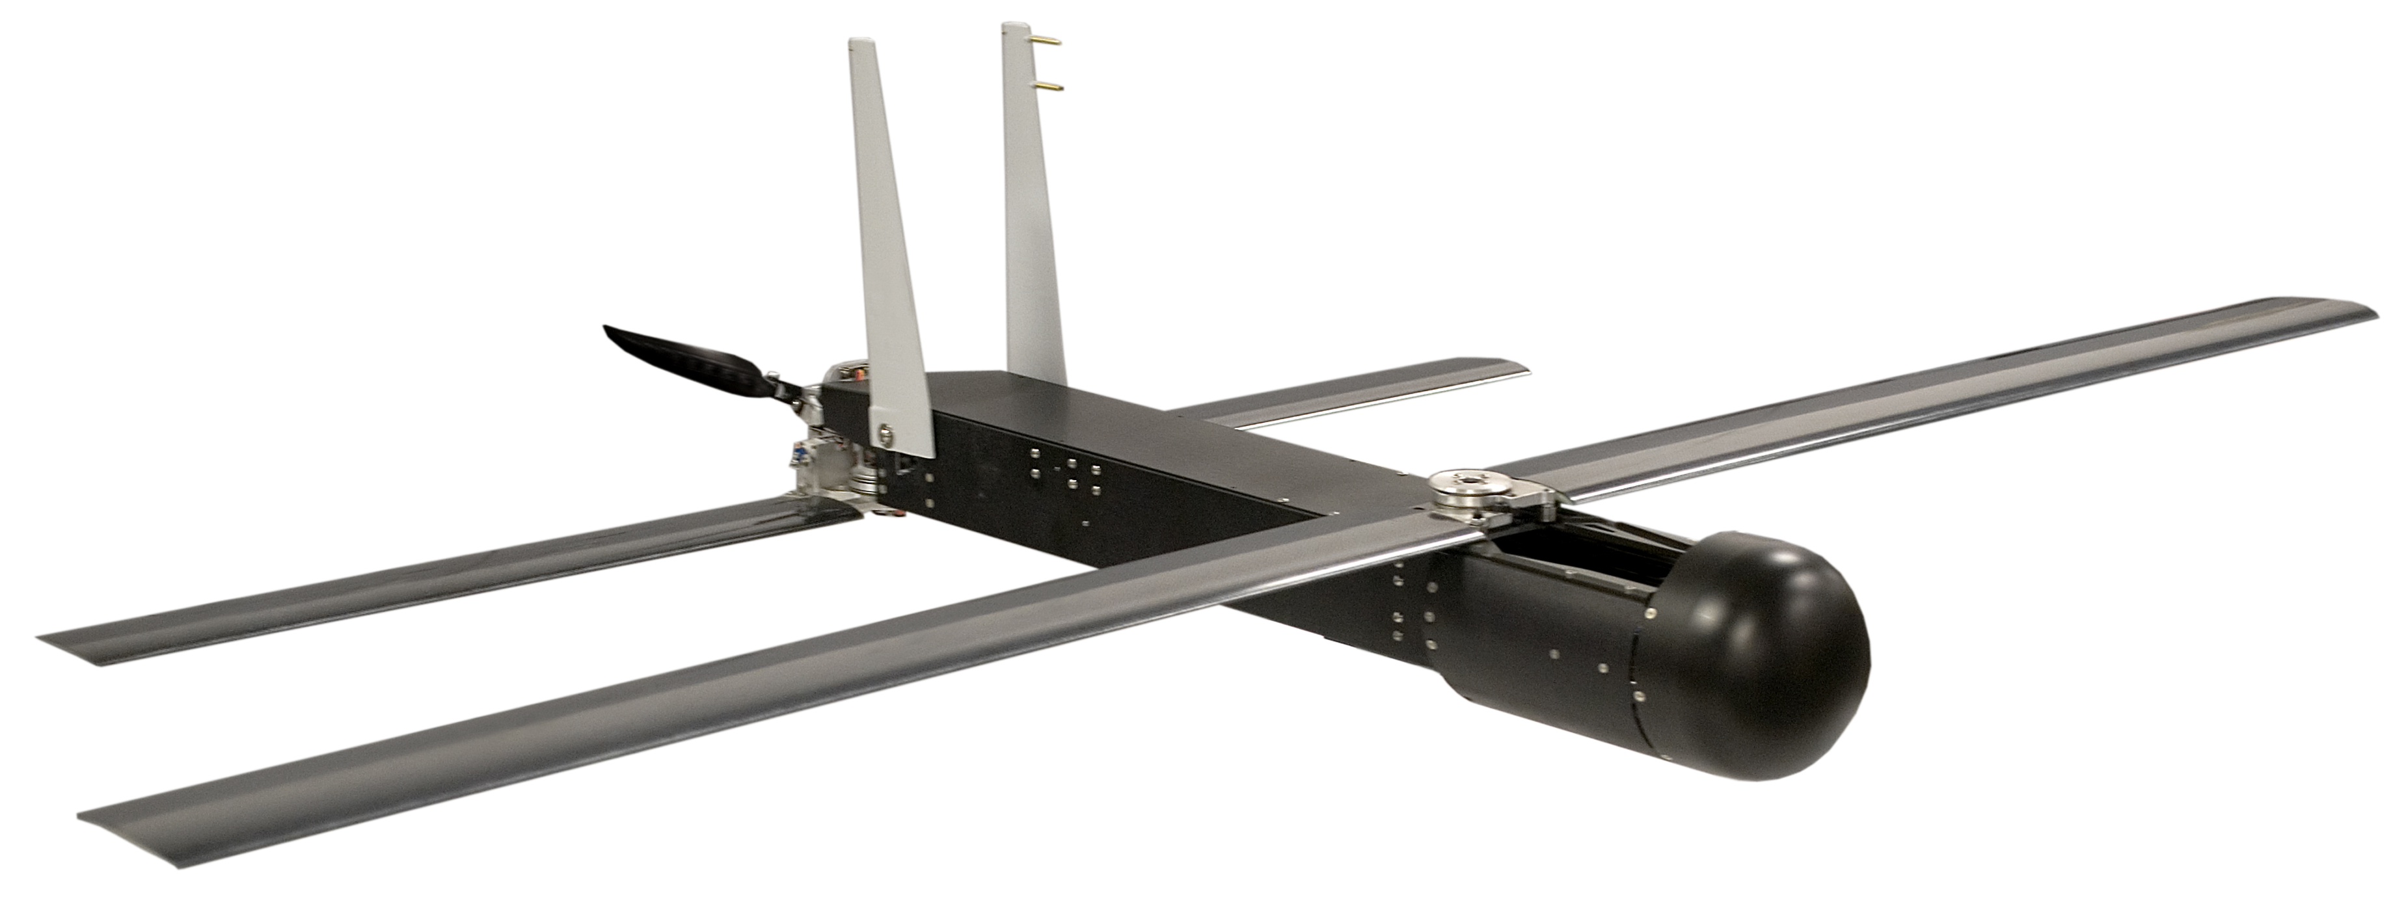
UAS can target the critical data gap in the BL
3 km
2 km
Height (km)
1 km (Boundary layer)
Solution:
Coyote UAS
Model
p, T, RH, winds
(soon: heat, moisture fluxes)

Slide 63
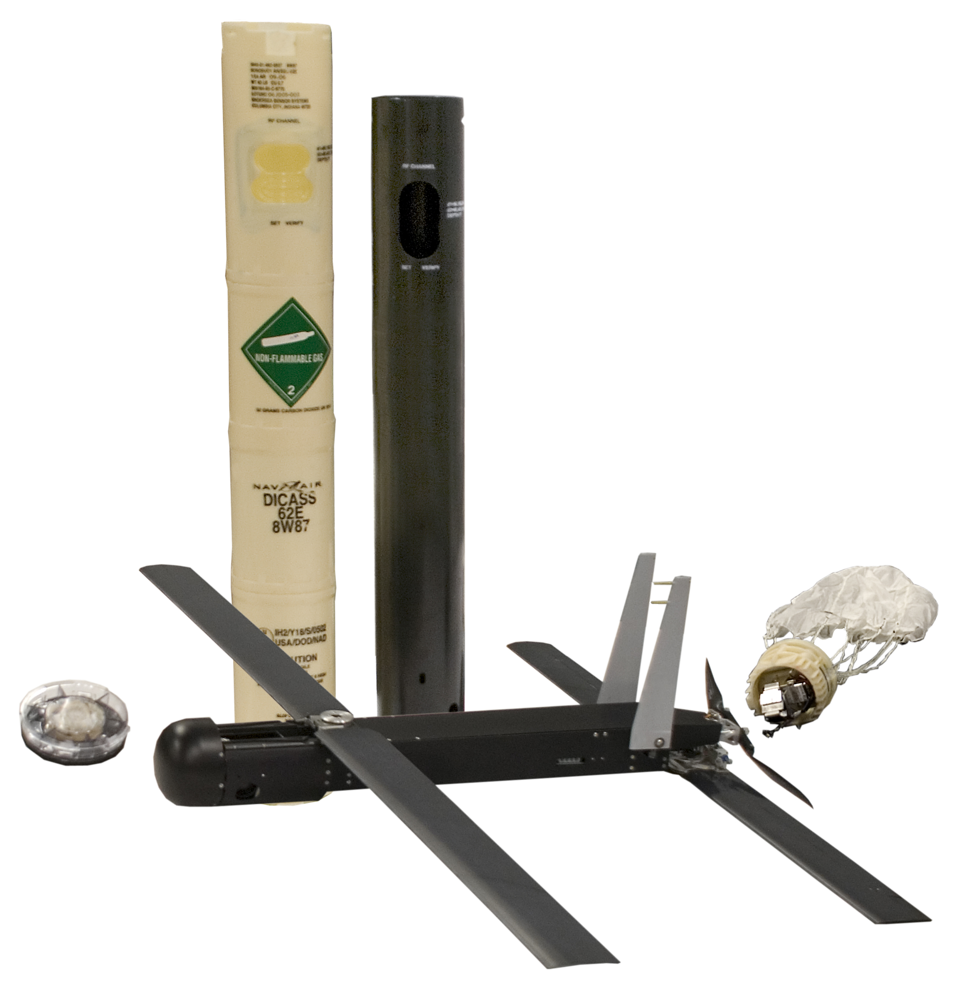
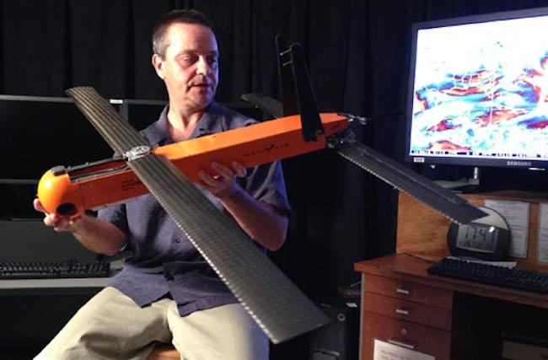
Coyote UAS: Fast facts
Dimensions | 0.91 m length, 1.47 m wingspan
Mass | 6 kg
Sensors | p, T, RH, winds (from GPS); all 1-3 Hz
Delivery | Air-deployable thru P-3 sonobuoy chute
Control | Piccolo autopilot; commands issued from P-3
Copyright: Raytheon

Slide 65
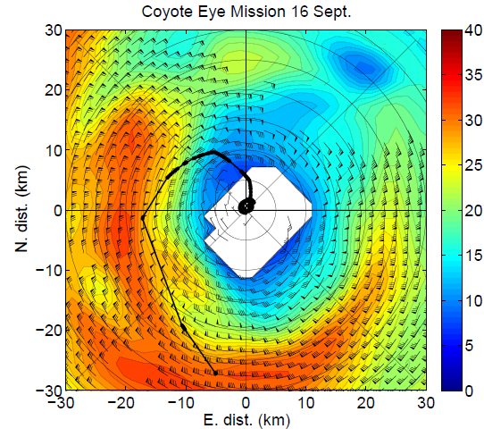
First-ever Coyote UAS Missions in a Tropical Cyclone: Major Hurricane Edouard (2014)
Sept. 16, 2014: Eye/eyewall
Sept. 17, 2014: Inflow layer
COYOTE
Reflectivity (dBZ)
EYE
EYEWALL
 | Sept. 16 | Sept. 17
Min (controlled) altitude: | 896 m | 400 m
Max wind speed measured: | 100 kt @ 971 m (record) | 53 kt @ 6 m
Flight duration: | 28 min | 68 min (record)

Slide 66
Comparison of Coyote Data with Airborne Radar and Dropsonde Data
Cione, J. J., E. A. Kalina, E. W. Uhlhorn, B. Damiano, A. M. Osbrink, and C. D. Troudt, 2015: Validation of Coyote Unmanned Aircraft System observations in Hurricane Edouard (2014). J. Atmos. Oceanic Technol., in preparation.

Slide 67
Goal: Compare sonde T/T_{d} to Coyote T/T_{d} Method: Weight sonde data in space and time and interpolate to Coyote track Blue sondes near Coyote = most weight
Sept. 16, 2014: Eye/eyewall
Sept. 17, 2014: Inflow layer
Coyote
Coyote

Slide 68
Goal: Compare sonde/radar winds to Coyote winds Method: Linearly interpolate P-3 radar wind composite to Coyote track on 9/16 Weighted interpolation of sonde wind to Coyote track on 9/17 (no radar wind)
Sept. 16, 2014: Eye/eyewall
1-km winds (m s⁻¹)
Sept. 17, 2014: Inflow layer
1-km winds (m s⁻¹)
No radar winds:
Need to use sondes

Slide 69
Eye/eyewall mission: Coyote data versus conventional data
EYE
TRANSITION
EYEWALL
COYOTE ALTITUDE
Not much data here:
Communication issues
WIND SPEED
Δv = -1.4 m s⁻¹
Radar (1 km)
Coyote

Slide 70
Eye/eyewall mission: Coyote data versus conventional data
EYE
TRANSITION
EYEWALL
COYOTE ALTITUDE
Not much data here:
Communication issues
WIND SPEED
Δv = -1.4 m s⁻¹
Radar (1 km)
Coyote

Slide 71
Eye/eyewall mission: Coyote data versus conventional data
TEMPERATURE
Coyote
Dropsondes
ΔT = 0.4 °C
DEWPOINT
ΔT_{d} = 0.7 °C

Slide 72
Inflow layer mission: Coyote data versus conventional data
COYOTE ALTITUDE
WIND SPEED
Δv = -0.5 m s⁻¹
Dropsondes
Coyote
RAINBAND

Slide 73
Inflow layer mission: Coyote data versus conventional data
TEMPERATURE
ΔT = 0.0 °C
DEWPOINT
Coyote
ΔT_{d} = 1.3 °C
Dropsondes

Slide 74
Summary
☑ First air-deployments of Coyote into the TC environment (credit: Joe Cione)
☑ Mean agreement: 1-2 m s⁻¹ (winds) and 1-2 °C (temperature and moisture)
☑ More missions planned for this year, weather permitting.
Communicable range from P-3 to Coyote has been greatly expanded
(~10 km in 2014 to ~150 km in 2015)

Slide 75
A LOOK AHEAD
P-3 Tail Doppler Radar
In progress:
Microphysical analyses from Hurricane Edouard (2014) for comparison to HWRF
Height (km)
P-3 track
Precipitation Imaging Probe (PIP)*
*Credit goes to Robert Black (HRD) for these data.
Rain Conc. (cm⁻³)
Precipitation Imaging Probe (PIP)*
Mean Diameter (mm)

Slide 76
Thank you!
Evan Kalina
evan.kalina@noaa.gov

