Slide 1
Nonhydrostatic Multi-scale Model (NMMB)
Zavisa Janjic
NOAA/NWS/NCEP/EMC, College Park, MD

Slide 2
Basic Principles
Forecast accuracy
Fully compressible equations
Discretization methods that minimize generation of computational noise and reduce or eliminate need for numerical filters
Computational efficiency, robustness
Janjic, Z., and R.L. Gall, 2012: Scientific documentation of the NCEP nonhydrostatic multiscale model on the B grid (NMMB). Part 1 Dynamics. NCAR Technical Note NCAR/TN-489+STR, DOI: 10.5065/D6WH2MZX.
http://nldr.library.ucar.edu/repository/assets/technotes/TECH-NOTE-000-000-000-857.pdf

Slide 3
Nonhydrostatic Multiscale Model on the B grid (NMMB)
Wide range of spatial and temporal scales (meso to global, and weather to climate)
Built on NWP and regional climate experience by relaxing hydrostatic approximation rather than by extending a cloud model to synoptic scales (Janjic et al., 2001, MWR; Janjic, 2003, MAP)
Further evolution of WRF Nonhydrostatic Mesoscale Model (NMM) (Janjic, 2005, EGU; Janjic & Black, 2007, EGU; Janjic & Gall 2012, NCAR)
Add-on nonhydrostatic module
  Easy comparison of hydrostatic and nonhydrostatic solutions
  Reduced computational effort at lower resolutions
Pressure based vertical coordinate, nondivergent flow remains on coordinate surfaces

Slide 4
Inviscid Adiabatic Equations
Hydrostatic pressure
Nonhydrostatic pressure
Difference between hydrostatic pressures at surface and top
General hybrid coordinate
Constant depth of hydrostatic pressure layer at the top
Zero at top and bottom of model atmosphere
Increases from 0 to 1 from top to bottom
Gas law
Hypsometric (not “hydrostatic”) Eq.
Hydrostatic continuity Eq.
Continued …

Slide 5
Inviscid Adiabatic Equations, contd.
Integral of
nonhydrostatic continuity Eq.
Vertical acceleration
Third Eq. of motion
Momentum Eq.
Thermodynamic Eq.

Slide 6
Nonhydrostatic Dynamics Specifics
Φ, w, ε are not independent, no independent prognostic equation for w!
More complex numerical algorithm, but no over-specification of w
ε <<1 in meso and large scale atmospheric flows
Impact of nonhydrostatic dynamics becomes detectable at resolutions <10km, important at 1km.

Slide 7
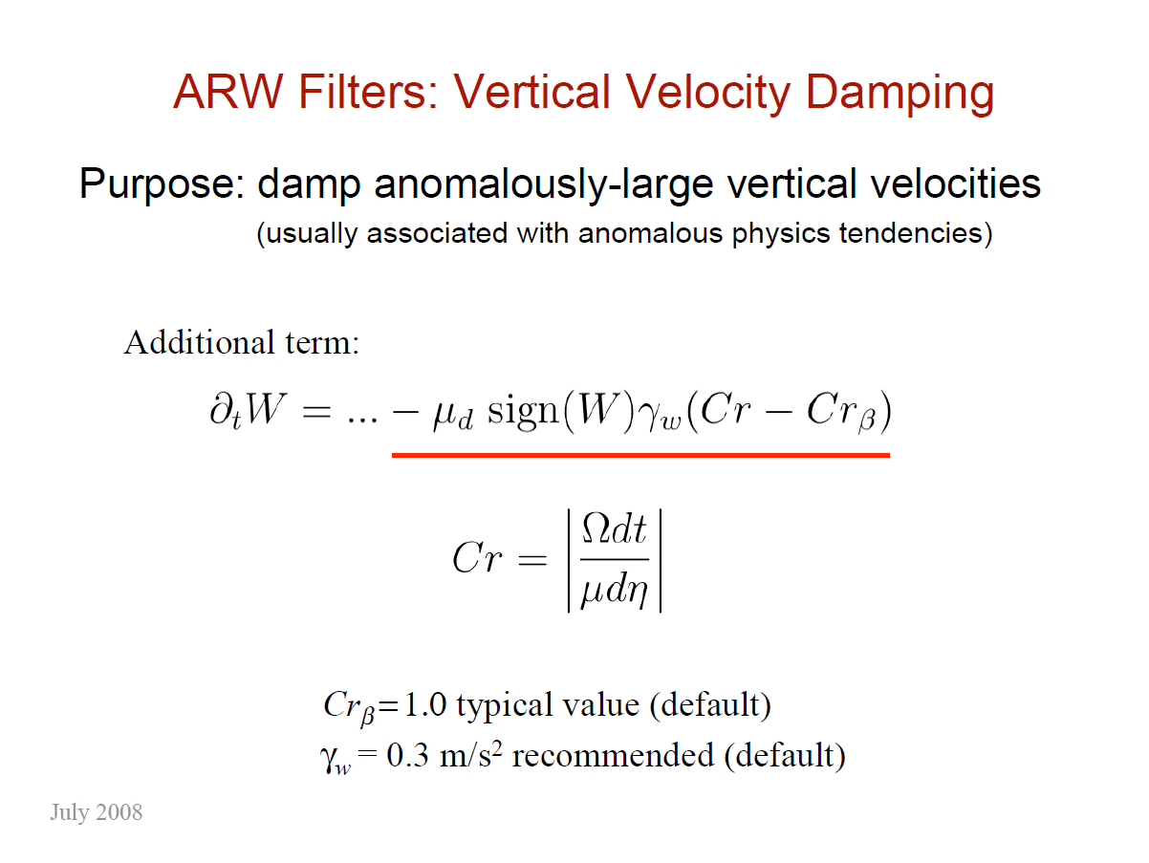

Slide 8
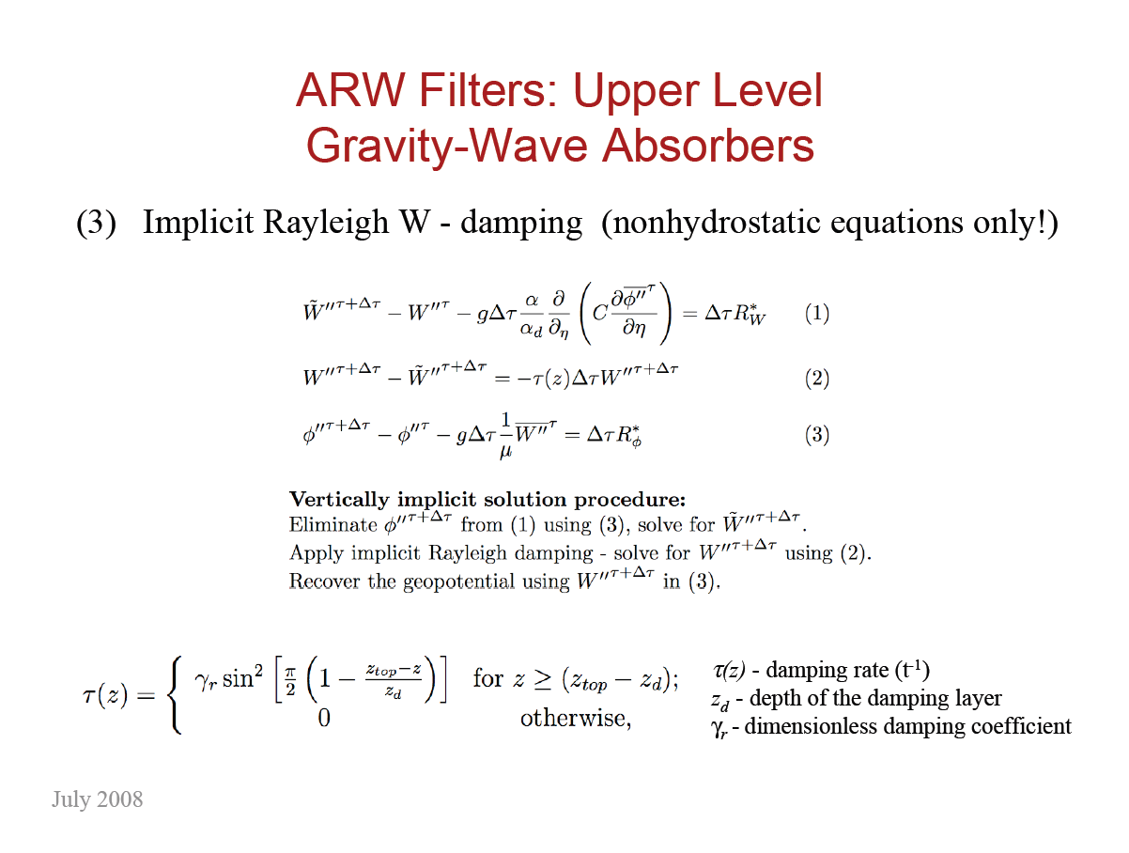

Slide 9
Discretization Principles
Conservation of important properties of the continuous system aka “mimetic” approach in Comp. Math. (Arakawa 1966, 1972, …; Jacobson 2001; Janjic 1977, 1984, …; Sadourny, 1968, … ; Tripoli, 1992 …)
  Nonlinear energy cascade controlled through energy and enstrophy conservation
  A number of properties of differential operators preserved
  Quadratic conservative finite differencing
  A number of first order (including momentum) and quadratic quantities conserved
  Omega-alpha term, transformations between KE and PE
  Errors associated with representation of orography minimized
  Mass conserving positive definite monotone Eulerian tracer advection

Slide 10
Nonhydrostatic Multiscale Model on the B grid (NMMB)
Coordinate system and grid
  Global lat-lon
  Regional rotated lat-lon, more uniform grid size
  Arakawa B grid
  h h h
  v v
  h h h
  v v
  h h h
  Pressure-sigma hybrid (Simmons & Burridge 1981, Eckermann 2008)
  Lorenz vertical grid

Slide 11
Nonhydrostatic Multiscale Model on the B grid (NMMB)
Time stepping
  No splitting
  Adams-Bashforth for horizontal advection of u, v, T and Coriolis force
  Crank-Nicholson for vertical advection of u, v, T (implicit)
  Forward-Backward (Ames, 1968; Gadd, 1978; Janjic and Wiin-Nielsen, 1977, JAS) fast waves
  Implicit for vertically propagating sound waves (Janjic et al., 2001, MWR; Janjic, 2003, MAP)

Slide 12
Nonhydrostatic Multiscale Model on the B grid (NMMB)
Regional domain lateral boundaries
  Narrow zone with upstream advection, no computational outflow BC for advection
  Blending zone
Conservative global polar boundary conditions
Polar filter
  “Decelerator,” tendencies of T, u, v, Eulerian tracers, divergence, dw/dt, deformation
  Waves in the zonal direction faster than waves with the same wavelength in the latitudinal direction slowed down
  Physics not filtered

Slide 13
Lateral Boundaries
Regional domain lateral boundaries
upstream advection
blending zone
outer boundary for mass variables
outer boundary for wind variables

Slide 14
Nonhydrostatic Multiscale Model on the B grid (NMMB)
Upgraded NCEP WRF NMM “standard” physical package
  RRTM, GFDL radiation
  NOAH, LISS land surface model
  Mellor-Yamada-Janjic turbulence
  Ferrier microphysics
  Betts-Miller-Janjic convection
Extensions
  GFS physics, SAS, Zhao,Thompson, GFS PBL, WSM6 ...

Slide 15
Atmospheric Spectrum
Numerical models generally generate excessive small scale noise
  False nonlinear energy cascade (Phillips, 1954; Arakawa, 1966 … ; Sadourny 1975; …)
  Other computational errors
Historically, problem controlled by:
  Removing spurious small scale energy by numerical filtering, dissipation, by far predominant approach
  Preventing excessive noise generation by enstrophy and energy conservation (Arakawa, 1966 …)

Slide 16
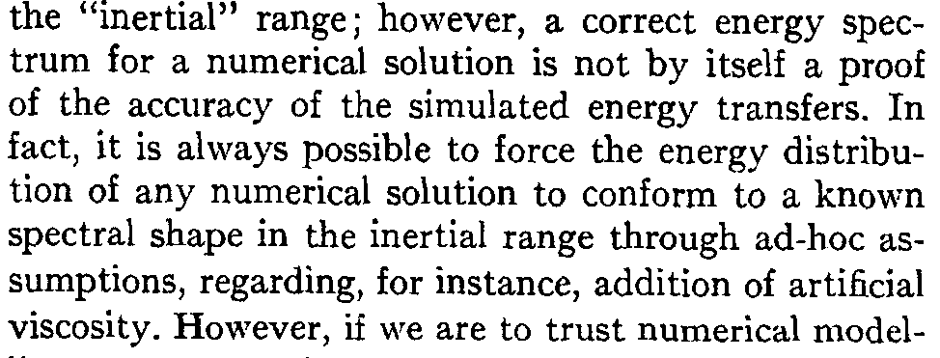
Atmospheric Spectrum
Classical paper by Sadourny, 1975, JAS:
With filtering, one does not need an atmospheric model for “correct” atmospheric spectrum!

Slide 17
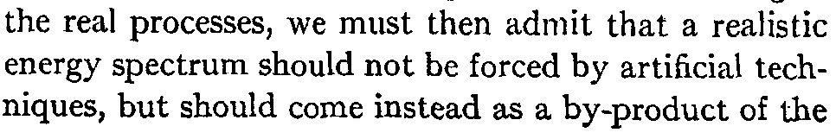

Atmospheric Spectrum
Instead (Sadourny, 1975, JAS):
Philosophy built into the design of the compact nonlinear momentum advection schemes for semi-staggered grids (Janjic, 1984, MWR; Janjic, 2004, AMS; Janjic and Gall, 2012, NCAR)

Slide 18
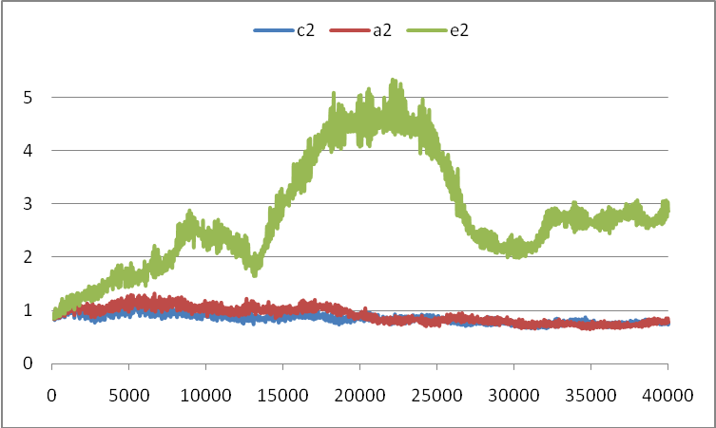
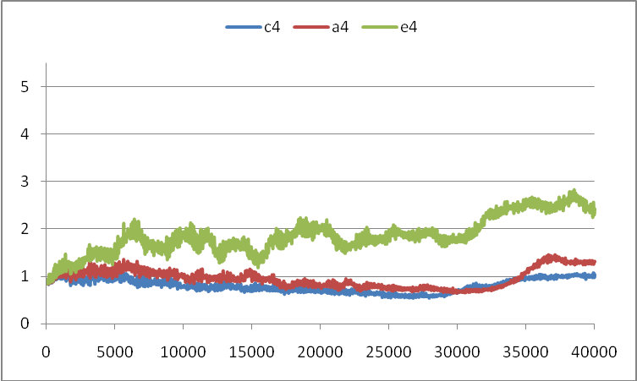
Formal accuracy alone does not solve the problem
Blue – Janjic, 1984, MWR; red – controlled energy cascade, but not enstrophy conserving, Arakawa, 1972, UCLA; green – energy and x (alternative) enstrophy conserving
Different nonlinear noise levels (green scheme) with identical formal accuracy and truncation error (Janjic et al. 2011, MWR)
Enhanced formal accuracy of well behaved conservative nonlinear advection scheme did not add measurable value to global forecasts in terms of Anomaly Correlation Coefficient.
Second order schemes
Fourth order schemes
116 days

Slide 19
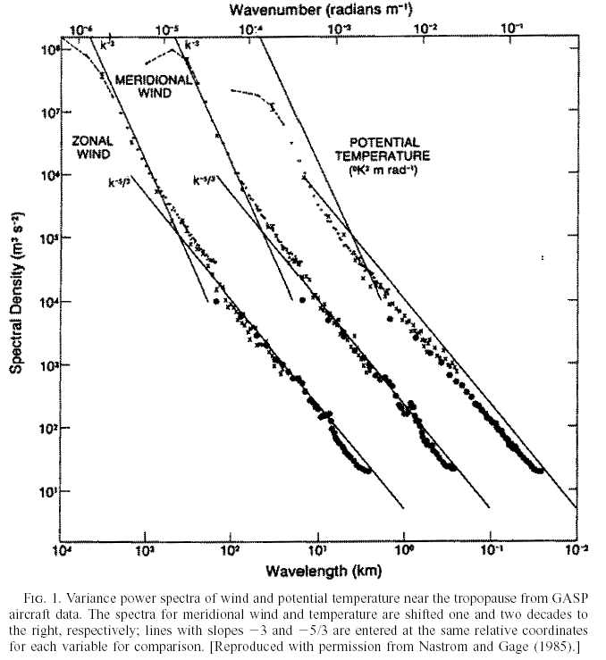
Atmospheric Spectrum
Nastrom-Gage (1985, JAS) 1D spectra in upper troposphere and lower stratosphere from commercial aircraft data
No spectral gap
Transition at few hundred kilometers from –3 to –5/3 slope in the 10²-10³ km (mesoscale) range
Inertial range, 0.01-0.3 m s⁻¹ in the –5/3 range, not to be confused with severe mesoscale phenomena!
10⁸
-3
10⁵
-5/3
10⁴
10³
10²
10³
10²
10¹

Slide 20
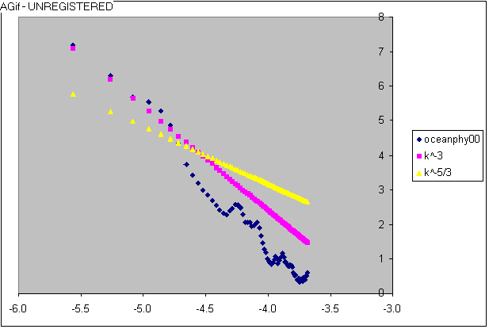
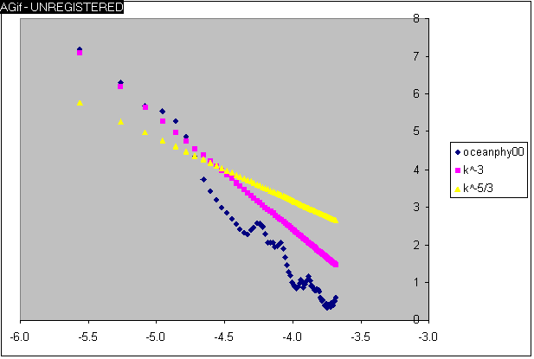
● Small scale energy in short regional runs with controlled nonlinear cascade and controlled noise sources, where from?
Flat bottom (Atlantic), NMMB, 15km, 32 levels, 48h run (Loops)
No Physics
With Physics
-5/3
-5/3
-3
-3
● Spectrum in agreement with observed spun-up given physical (or spurious, e.g. sigma) sources on small scales.

Slide 21
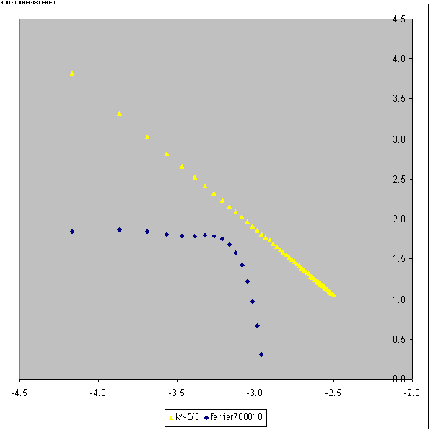
Loop,
decaying 3D turbulence, Fort Sill storm, 05/20/77.
NMM-B,
Ferrier microphysics,
1km resolution, 32 levels,
112km by 112km by 16.4km, double periodic, Smagorinsky constant 0.32.
Note the hump with active convection
Spectrum of w² at 700 hPa.

Slide 22
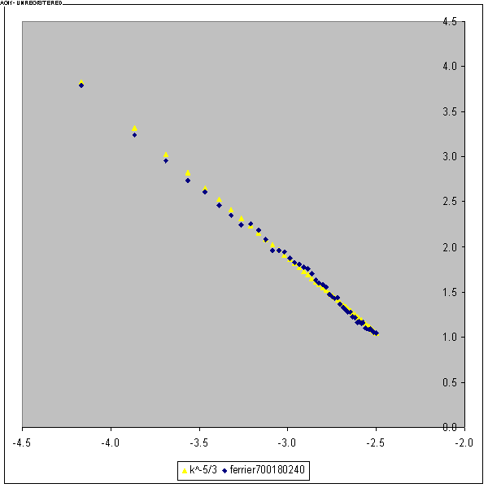
Hours 3-4 average decaying 3D turbulence, Fort Sill storm, 05/20/77.
NMM-B,
Ferrier microphysics,
1km resolution, 32 levels,
112km by 112km by 16.4km, double periodic. Smagorinsky constant 0.32.
Spectrum of w² at 700 hPa.
-5/3

Slide 23
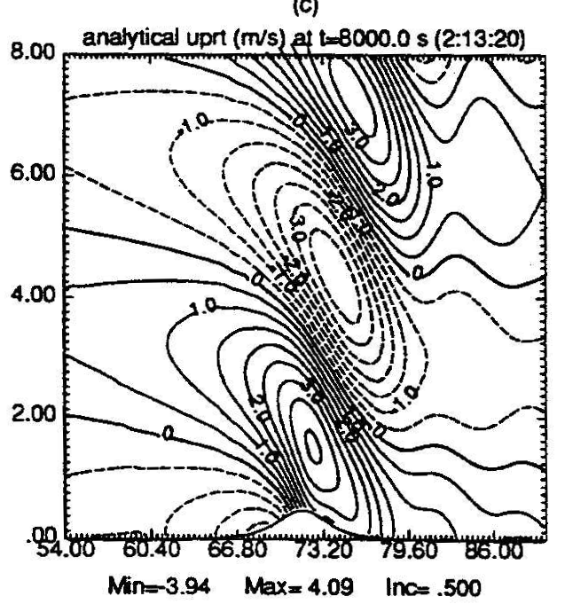
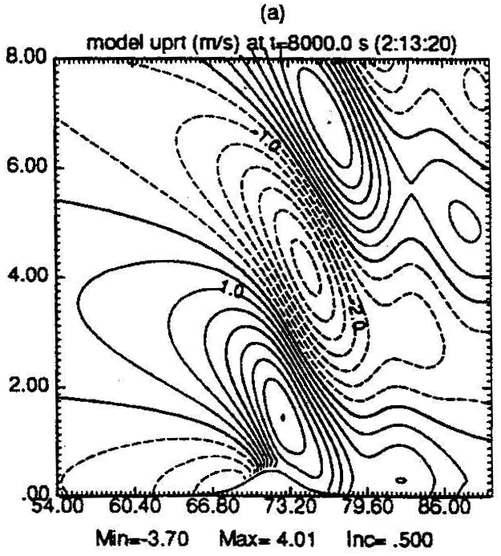
2D very high resolution tests
Warm bubble, 100 m resolution
Normalized vertical momentum flux, 400 m resolution
Cold bubble, 100 m resolution
Nonlinear mountain wave 400 m resolution
Full compressible NMM Analytical (Boussinesque) ARPS (Boussinesque)

Slide 24
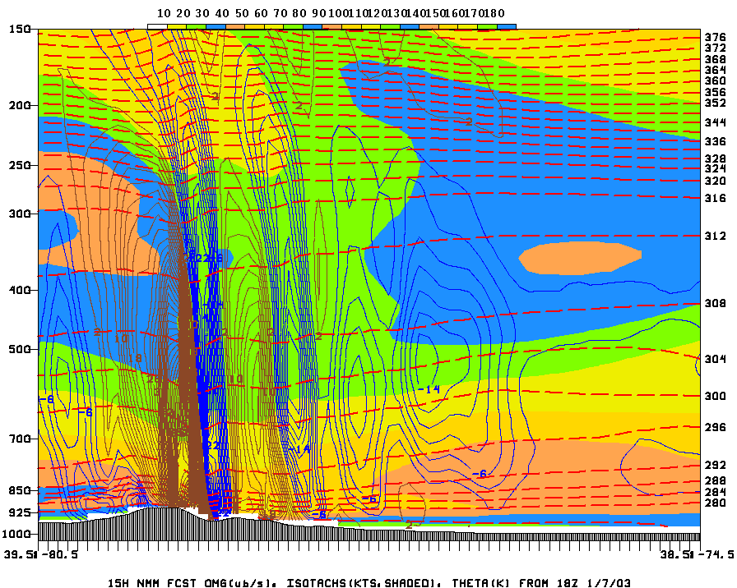
Mountain waves, 8 km resolution
Convection, 1 km resolution

Slide 25
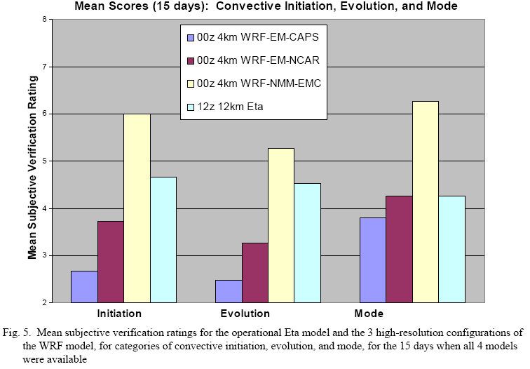
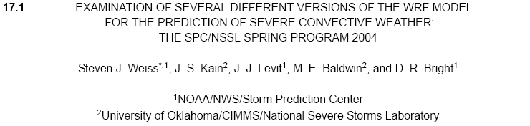
4km resolution, no parameterized convection
2004
WRF-NMM
Breakthrough that lead to application of “convection allowing” resolution for storm prediction
WRF-NMM
WRF-NMM
Eta
Eta
Eta
22nd Conference on Severe Local Storms, October 3-8, 2004, Hyannis, MA.

Slide 26
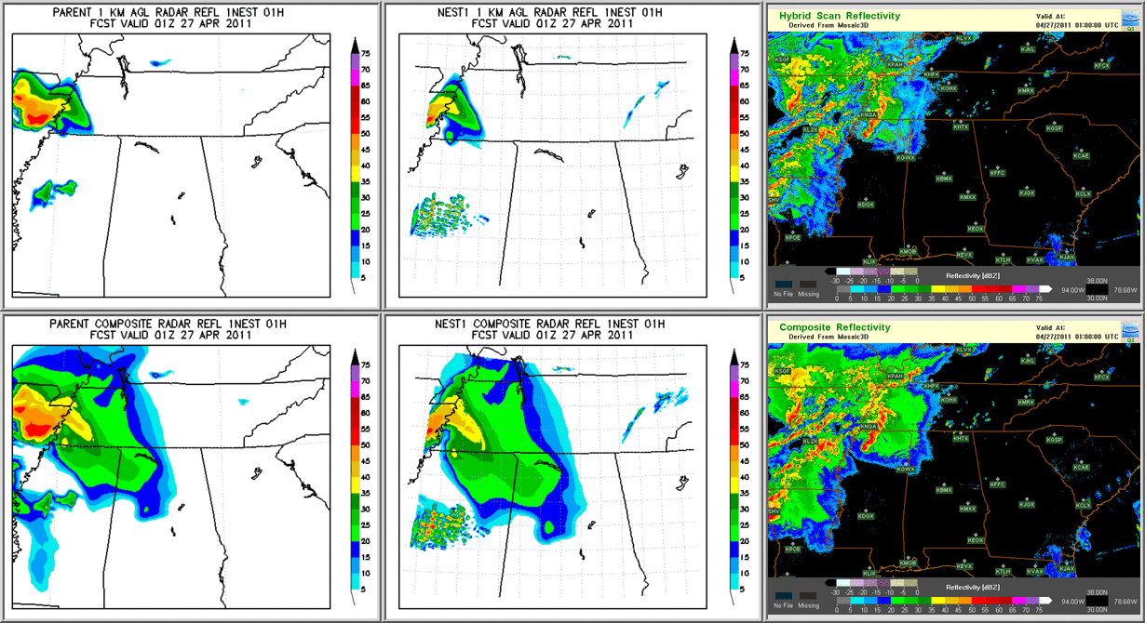
4 km 1.33 km Observed
A difficult tornadic situation from spring 2011, impact of resolution, courtesy of Aligo, Jovic and Ferrier

Slide 27
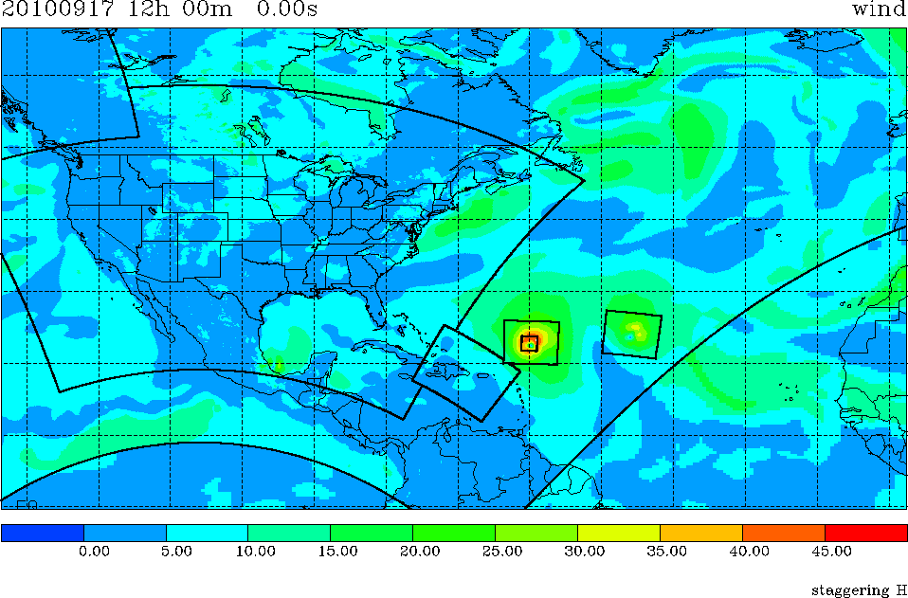
Hypothetical NMMB Simultaneous Run Global [with Igor & Julia] and NAM [with CONUS nest]
Courtesy of DiMego et al.
12 km NAM NMMB
9 km Julia NMMB
4 km NAM-nest NMMB
9 km Igor NMMB
12 km NAM NMMB
27 km Global NMMB
27 km Global NMMB

Slide 28
Meso Scales
Regional NMMB replaced WRF NMM in the NAM slot in 2011
Hierarchy of nests running simultaneously, 12 km, 6 km, 4 km, 1.33 km (fire weather on the fly) resolutions (DiMego et al.)
Hurricane runs with NMMB using HWRF set-up primarily to test the NMMB infrastructure (initialization, mechanics of nest movements, telescoping and 2-way interactions …)

Slide 29
Hurricane testing with NMMB
Dusan Jovic, Tom Black, Qingfu Liu
Mesoscale Branch meeting
Dec 19, 2013

Slide 30
Trunk versions of NPS, NEMS and post (No HWRF physics specifics included yet)
Vortex initialization code, modified to work with NMMB input files (E-grid to B-grid conversion – Qingfu)
GFDL vortex tracker used to calculate storm tracks and intensity. Code and Users Guide available at:
  http://www.dtcenter.org/HurrWRF/users/downloads/index.tracker.php

Slide 31
Storms:
  2011 Irene 09L
  2012 Ernesto 05L
  2012 Isaac 09L
  2013 Humberto 09L
  2013 Karen 12L

Slide 32
HWRF and NMMB configurations
HWRF
 | IM | JM | dx/dy | N points | dt
Parent | 216 | 432 | 0.18 | 93312 | 45 s
Child | 88 | 170 | 0.06 | 14960 | 15 s
Grand | 180 | 324 | 0.02 | 58320 | 5 s
NMMB
 | IM | JM | dx/dy | N points | dt
Parent | 305 | 305 | 0.255 | 93025 | 60 s
Child | 126 | 123 | 0.085 | 15498 | 20 s
Grand | 255 | 231 | 0.028333 | 58905 | 20/3 s
NMMB physics: GFDL/BMJ/FER/MYJ

Slide 33
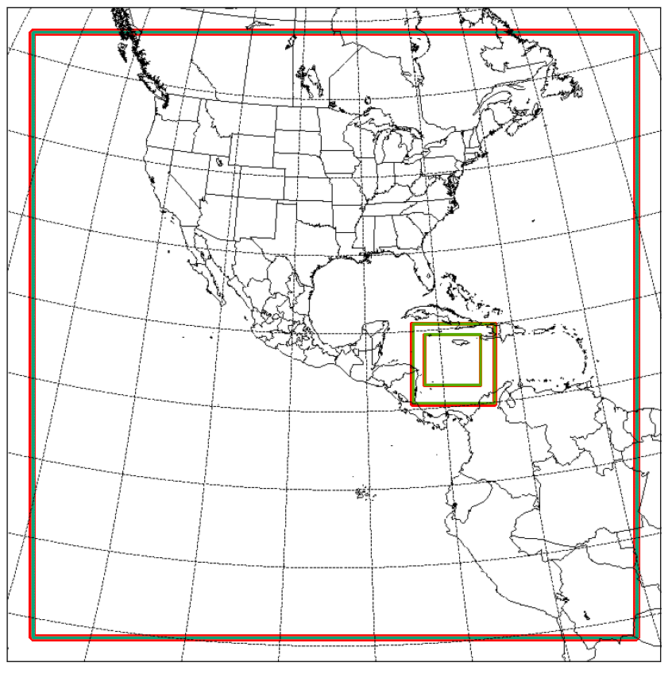
NMMB
HWRF

Slide 34
Vortex Relocation
Vortex relocation step is performed after the NPS and before model run
It changes/adjusts several fields in initial (input) data: T, Q, U, V, PINT, U10, V10
Vortex is relocated in all input files (d01, d02, d03, etc.)
Takes approx. 15min to run

Slide 35
6hr fcst
from prev cycle
GFS cyclone track
tcvitals
Vortex relocation
input_domain_01
input_domain_01
input_domain_02
input_domain_02
input_domain_03
input_domain_03
http://www.dtcenter.org/HurrWRF/users/docs/users_guide/HWRF_v3.5a_Users_Guide.pdf
- Chapter 4: HWRF Atmospheric Initialization

Slide 36
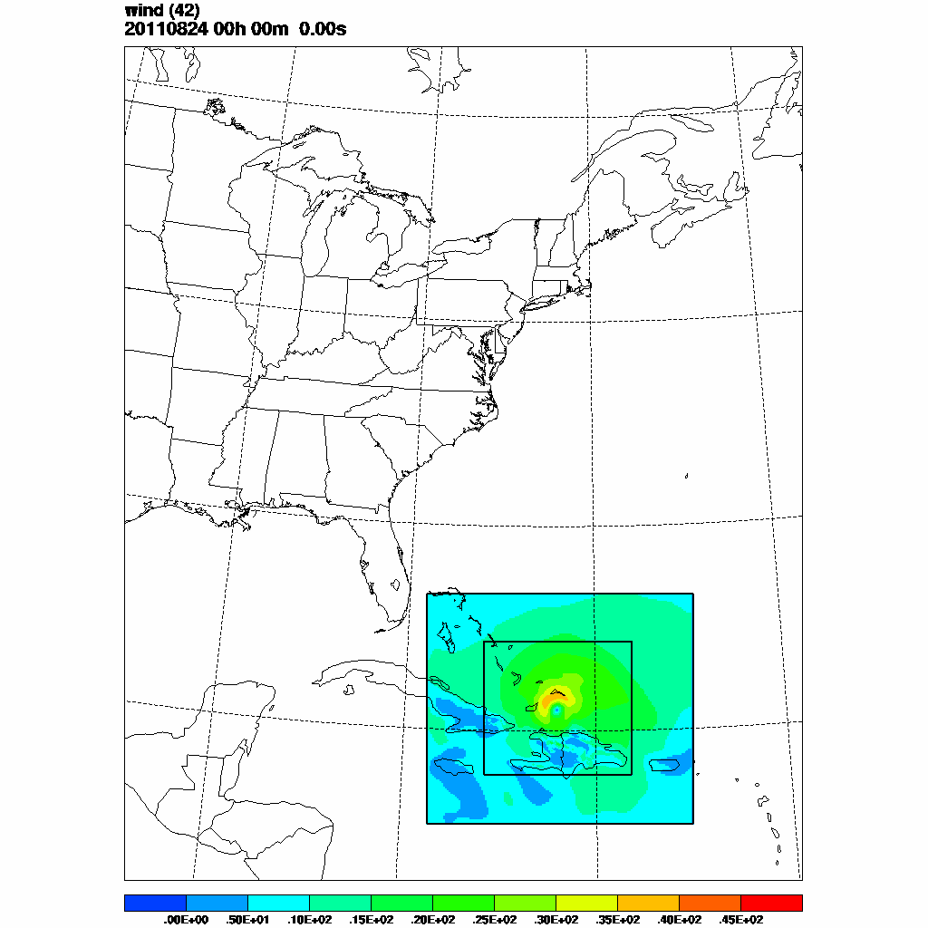
IRENE 09L
2011/08/24 00Z

Slide 37
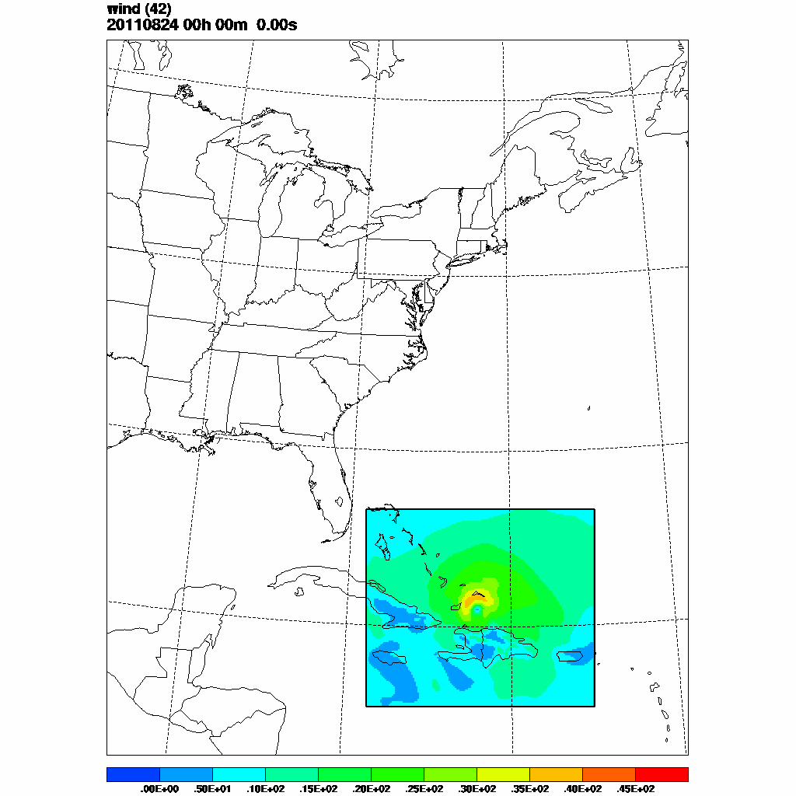
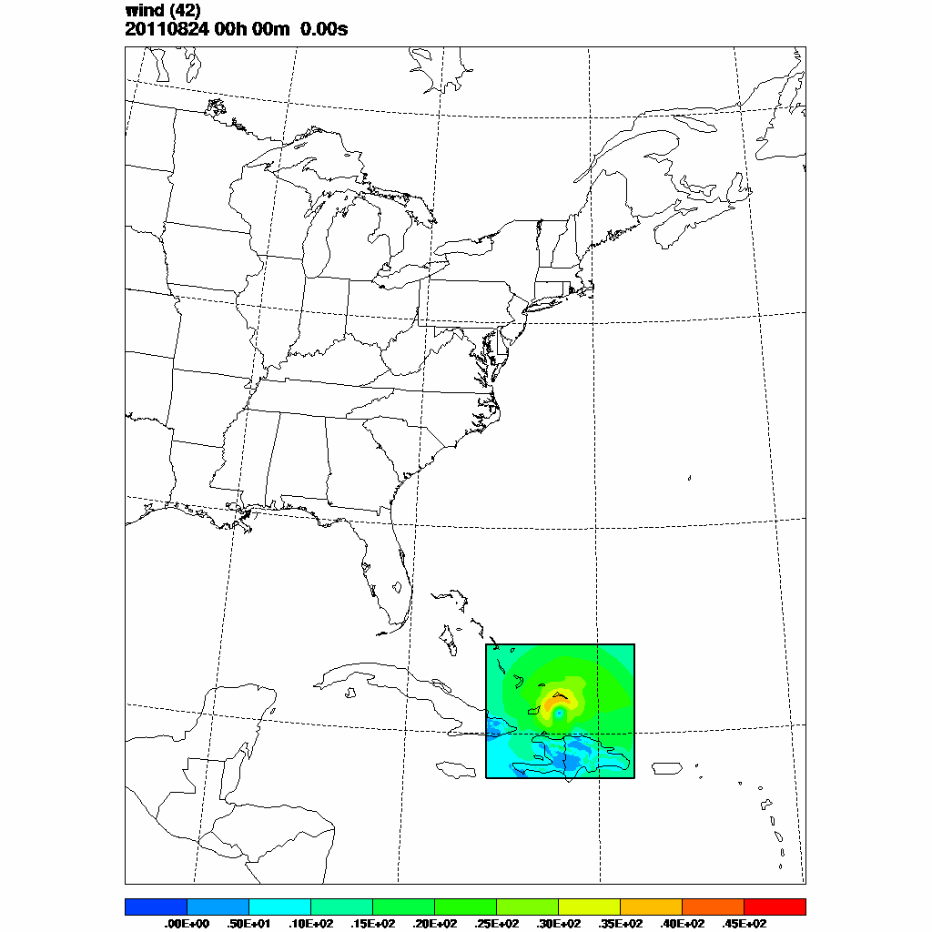
d02
d03

Slide 38
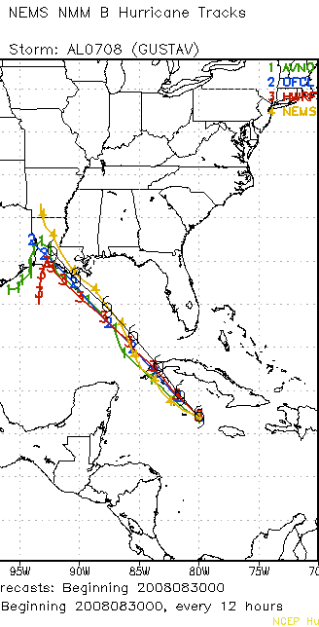
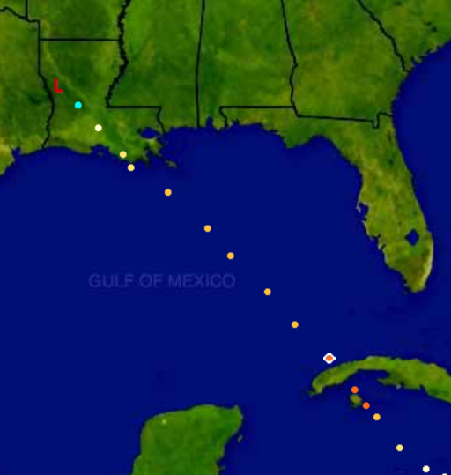
Global NMMB
Courtesy Dusan Jovic

Slide 39
Global Scales
Major GFS update on July 28, 2010
One year of parallel global forecasts before and after July 28, 2010
  Initialized from spectral GFS analyses
    Compatibility issues between grid-point and spectral data (Gibbs phenomenon)
  Verified against GFS analyses and climatology
  500 hPa Height Anomaly Correlation Coefficients
  Although starting from “same” initial conditions, skill of NMMB and GFS forecasts often disparate

Slide 40
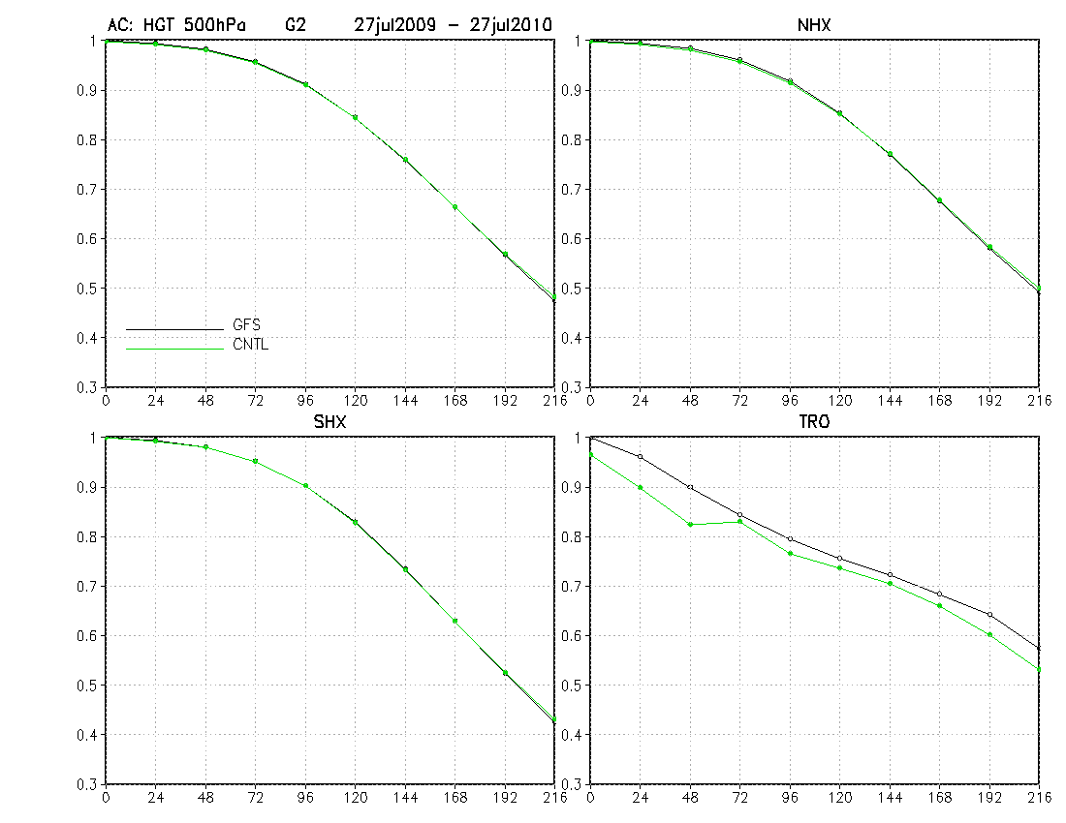
Global NMMB 769 x 541 x 64 pts. vs. GFS T384 x 64
1 year 500 hPa Height Anomaly Correlation Coefficient vs. forecast time
NMMB initialized and verified using GFS analyses and climatology
NMMB comparable or lower resolution

Slide 41
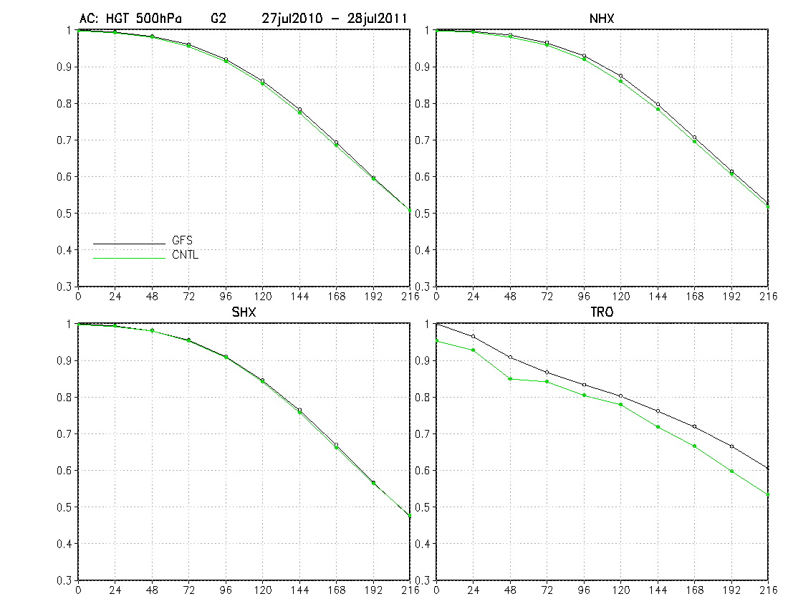
Global NMMB 769 x 541 x 64 pts. vs. GFS T574 x 64
1 year 500 hPa Height Anomaly Correlation Coefficient vs. forecast time
NMMB initialized and verified using GFS analyses and climatology
From July 28 2010 GFS has 3.8 times more points & updated physics

Slide 42
Global Scales
Long verification periods needed to obtain robust scores.
To save on resources and time, a sample of 105 cases over one year at three and a half day intervals (code maintenance, launcher scripts, verification and graphics courtesy of Vasic)
Both 00Z and 12Z initial data equally represented
Sample cases chosen randomly, results should be reasonably representative for a full year population

Slide 43
Radiation-clouds interaction
Difficulties encountered with interaction between radiation and clouds represented through microphysics species
Mean downward long-wave radiation flux too large in higher latitudes in the combination of RRTM radiation and Ferrier microphysics
Problems with ice species
Ferrier microphysics temporarily replaced by simpler Zhao scheme

Slide 44
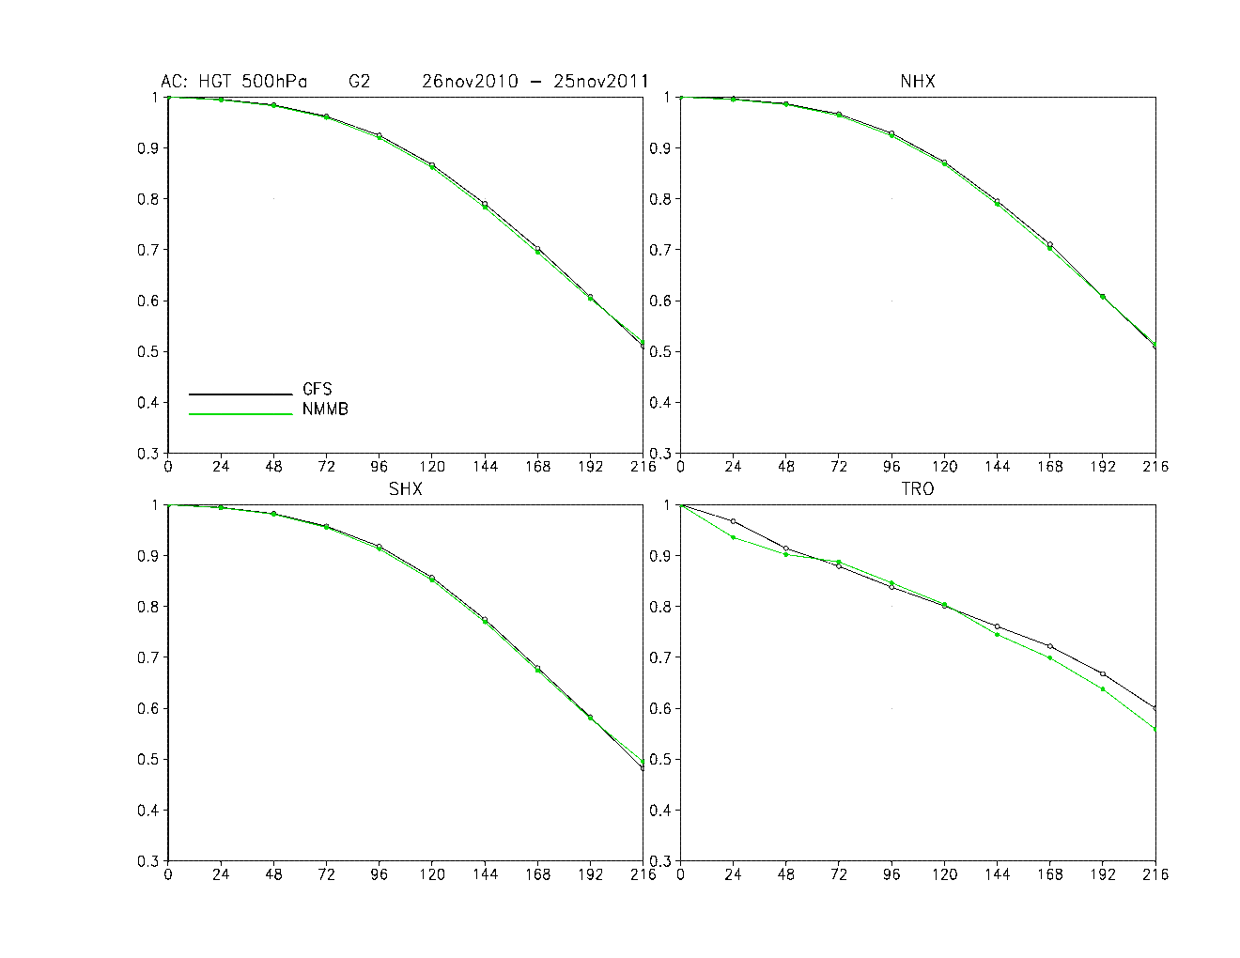
Global NMMB 1149 x 811 x 64 pts. vs. GFS T574 x 64
105 randomly chosen cases from 1 year
500 hPa Height Anomaly Correlation Coefficient vs. forecast time
NMMB initialized and verified using GFS analyses and climatology
Zeus test
Global NMMB 1149 x 811 x 64 pts. vs. GFS T574 x 64
105 randomly chosen 00Z and 12Z cases over 1 year
Zhao, BMJ, mixed shallow, momentum transport
500 hPa Height Anomaly Correlation vs. forecast time
NMMB initialized and verified using GFS analyses and climatology

Slide 45
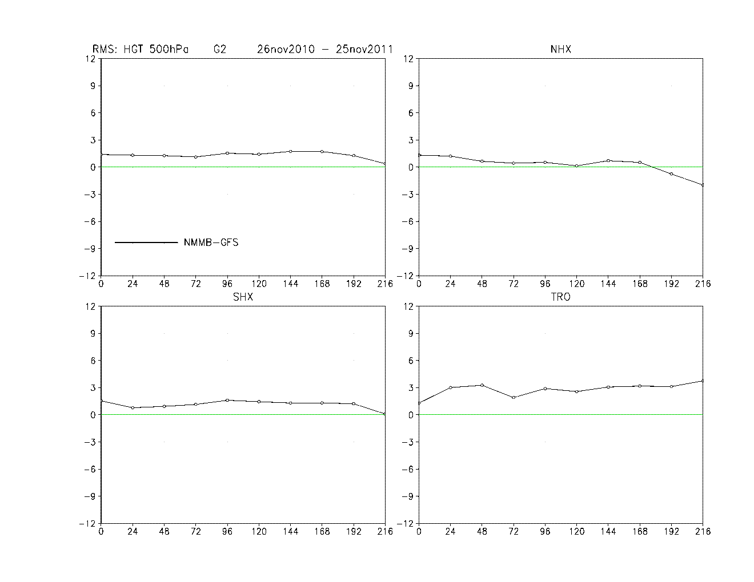
Global NMMB 1149 x 811 x 64 pts. vs. GFS T574 x 64
105 randomly chosen cases from 1 year
500 hPa Height Anomaly Correlation Coefficient vs. forecast time
NMMB initialized and verified using GFS analyses and climatology
Zeus test
Global NMMB 1149 x 811 x 64 pts. vs. GFS T574 x 64
105 randomly chosen 00Z and 12Z cases over 1 year
Zhao, BMJ, mixed shallow, momentum transport
500 hPa RMSE differences vs. forecast time
NMMB initialized and verified using GFS analyses and climatology
RMSE difference generally remains within bounds of initial interpolation errors
Recent test

Slide 46
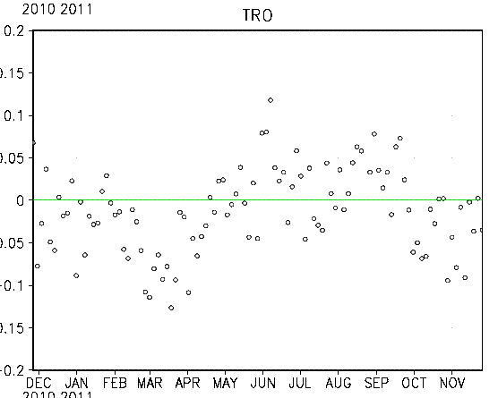
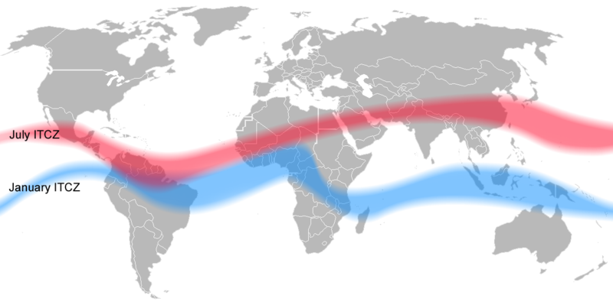
Tropics
Global NMMB 1149 x 811 x 64 pts. vs. GFS T574 x 64
105 randomly chosen 00Z and 12Z cases over 1 year
Zhao, BMJ, mixed shallow, momentum transport
500 hPa differences vs. forecast time
NMMB initialized and verified using GFS analyses and climatology
AC die-off NMMB & GFS
NH convective season NMMB better
Not usual measure in the tropics, but what is going on there?
RMS difference NMMB-GFS (m)
July ITCZ
January ITCZ
~ difference between two analyses
Recent test

Slide 47
Tropics
What is the truth?
Each model has its own “convection scheme climatology”
Insufficient data, more weight on model in DAS
Different gravity-inertia frequency errors and geostrophic adjustment (semi-implicit vs. explicit)
4-5 days oscillation (Riehl, 1954)?
Each model with its own DAS needed for a fair comparison (under development for the global NMMB)

Slide 48
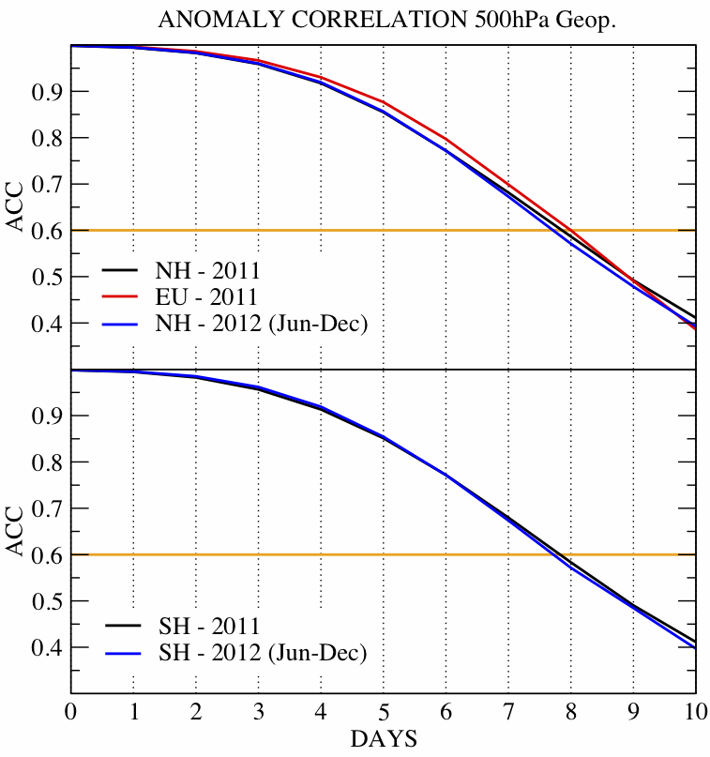
Global NMMB, Hydrometeorological Service of Serbia, Scores for 2011 and 2012, 00Z Cycle
0.47º x 0.33º , ~37km 769x541 x 64 pts.
128 cores, ~12 min/day
GFS analyses
Verified vs. ECMWF
(Djurdjevic et al., 2013, EGU)

Slide 49
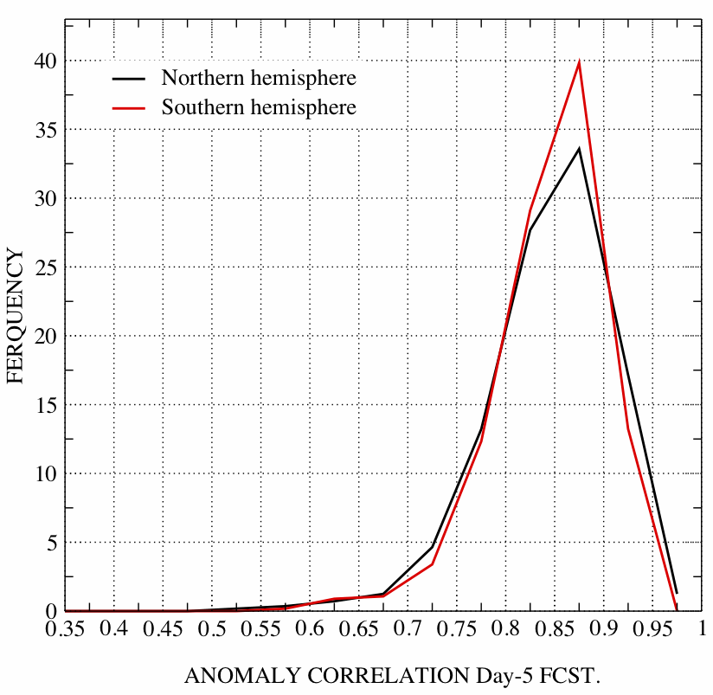
Global NMMB, Hydrometeorological Service of Serbia, Scores for 2011 and 2012, 00Z Cycle
0.47º x 0.33º , ~37km 769x541 x 64 pts.
128 cores, ~12 min/day
GFS analyses
Verified vs. ECMWF
(Djurdjevic et al., 2013, EGU)

Slide 50
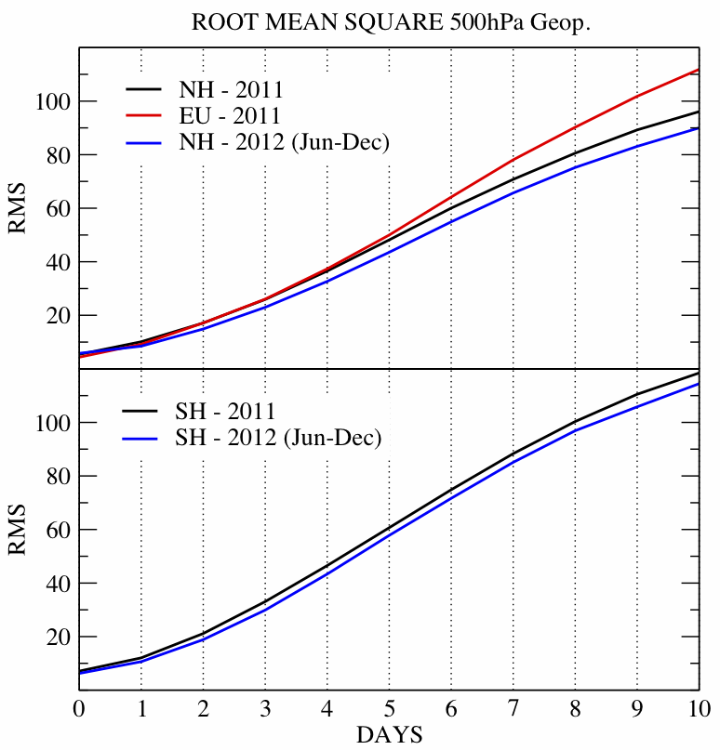
Global NMMB, Hydrometeorological Service of Serbia, Scores for 2011 and 2012, 00Z Cycle
0.47º x 0.33º , ~37km 769x541 x 64 pts.
128 cores, ~12 min/day
GFS analyses
Verified vs. ECMWF
(Djurdjevic et al., 2013, EGU)

Slide 51
NMMB-global; Dropouts 2011
Anomaly correlation day-5 forecast
North Hemisphere
South Hemisphere
DATE | GFS | NMMB(GFS) | NMMB (ECMWF)
20110304 | 0.72 | 0.77 | 0.85
20110317 | 0.71 | 0.79 | 0.89
20110430 | 0.69 | 0.88 | 0.89
20110616 | 0.75 | 0.84 | 0.83
20110617 | 0.74 | 0.73 | 0.84
20110618 | 0.73 | 0.81 | 0.88
20110619 | 0.62 | 0.64 | 0.81
20110620 | 0.70 | 0.61 | 0.72
20110629 | 0.63 | 0.79 | 0.88
20110702 | 0.63 | 0.90 | 0.94
20110713 | 0.71 | 0.38 | 0.55
20110718 | 0.68 | 0.59 | 0.58
20110806 | 0.72 | 0.83 | 0.84
20110807 | 0.71 | 0.73 | 0.83
20110808 | 0.73 | 0.87 | 0.91
20110813 | 0.69 | 0.84 | 0.85
20110912 | 0.71 | 0.76 | 0.81
DATE | GFS | NMMB(GFS) | NMMB (ECMWF)
20110131 | 0.75 | 0.81 | 0.87
20110209 | 0.75 | 0.77 | 0.88
20110222 | 0.70 | 0.75 | 0.81
20110306 | 0.65 | 0.69 | 0.84
20110320 | 0.71 | 0.86 | 0.88
20110325 | 0.62 | 0.69 | 0.70
20110327 | 0.72 | 0.66 | 0.76
20110403 | 0.75 | 0.64 | 0.74
20110414 | 0.72 | 0.72 | 0.75
20110421 | 0.75 | 0.78 | 0.90
20110506 | 0.68 | 0.66 | 0.90
20110507 | 0.72 | 0.84 | 0.88
20110725 | 0.75 | 0.88 | 0.90
20110728 | 0.72 | 0.88 | 0.90
20110925 | 0.73 | 0.73 | 0.84
11/32 significant improvement with both analyses
12/32 significant improvement
with ECMWF analysis in comparison with run with GFS analysis
17/32 improvement in comparison to GFS with same analysis
2/32 score remain less then then 0.7 with both analyses
On average better scores with ECMWF analyses

Slide 52
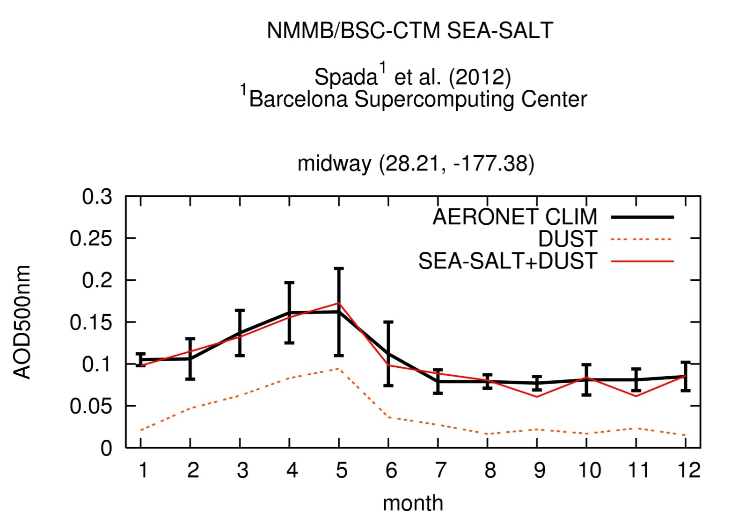
Barcelona Supercomputing Center Aerosol Climatology

Slide 53
Scaling on Zeus
Global, nonhydrostatic, full physics
Resolution 1149 x 811 x 64, ~ 24 km
  500 processors, 7.9 wall clock min/day
  4000 processors, 2.8 wall clock min/day, 1 year of simulation in < 17 hours, climate studies
Resolution 2305 x 1623 x 64, ~ 12 km
  8 x more work than 1149 x 811 x 64, ~ 24 km
  3600 processors, 7.6 wall clock min/day
  7.2 times more processors for 8 times bigger job in less time!
~ 10 km global resolution forecasts possible

Slide 54
Summary and Conclusions
Significant improvements of regional forecasts still possible
Global NMMB competitive with other major medium range forecasting models
Unified model offers consistency in applications on various scales and reduced development and maintenance effort
~10 km resolution medium range global forecasts and high resolution climate studies possible with global NMMB
Limits of deterministic forecasting have not been reached yet
Future work on the global scales
  Issues with radiation cloud-interactions
  Variable surface emissivity
  Precipitation, near surface variables …

Slide 56
Coordinates and Grids
Global lat-lon
Regional rotated lat-lon, more uniform grid size
Semi-staggered Arakawa B grid
h h h
v v
h h h
Pressure-sigma hybrid (Simmons & Burridge 1981, Eckermann 2008)
Lorenz vertical grid

Slide 57
Energy and Enstrophy Conservation and Nonlinear Cascade on Semi-staggered Grids
On semi-staggered grids variables can be represented as (Janjic, 1984, MWR)

Slide 58
Energy and Enstrophy Conservation and Nonlinear Cascade on Semi-staggered Grids
Vorticity computed from grid variables u and v
“Subgrid” vorticity computed from stream function

Slide 59
Energy and Enstrophy Conservation and Nonlinear Cascade on Semi-staggered Grids
“Subgrid” scale enstrophy can be conserved using a compact nonlinear scheme for momentum advection (Janjic, 1984, MWR; Janjic and Gall, 2012, NCAR)
Which definition of enstrophy to choose to conserve?
Examine Charney’s mechanical analogies of Fjortoft’s theorem on nonlinear cascade:

Slide 60

Λ²
λ₁²
λ₂²
λ₃²
λ_{N-1}²
λ_{N}²
Continuous equations
K
K₁
K₂
K₃
K_{N-1}
K_{N}
λ₁²
λ₂²
λ₃²
Energy and
enstrophy conserving, eigenvalues of the Laplacian decreasing at small scales
K_{N-1}
K_{N-2}
K_{N-3}
Λ²
λ₁²
λ₂²
λ₃²
K
K₁
K₂
K₃
Energy and
enstrophy conserving, nonliear cascade strictly controlled (Janjic, 1984, MWR)
Λ²
λ₁²
λ₂²
λ₃²
λ_{N-1}²
K
K₁
K₂
K₃
K_{N-1}

Slide 61
Time Stepping
No time splitting (for computational efficiency)
  Additive splitting inadequate for large Ro
  Splitting with multi-step iterative schemes too expensive
Non-iterative “Stabilized” Adams-Bashforth (Janjic et al., 2010, NCAR) for horizontal advection of u, v, T and Coriolis force
Crank-Nicholson for vertical advection of u, v, T
Forward-Backward (Ames, 1968; Gadd, 1978; Janjic and Wiin-Nielsen, 1977, JAS) fast waves
Implicit for vertically propagating sound waves (Janjic et al., 2001, MWR; Janjic, 2003, MAP; Janjic, 2010, ECMWF)

Slide 62
Lateral and Polar Boundaries, Polar Filter
Conservative global polar boundary conditions
Polar filter
  “Decelerator” (like implicit schemes) tendencies of T, u, v, Eulerian tracers, divergence, dw/dt filtered
  Physics not filtered

Slide 63
Physics
Upgraded NCEP WRF NMM “Unified” physics
  RRTM, GFDL radiation
  NOAH, LISS land surface model
  Mellor-Yamada-Janjic turbulence
  GFS Gravity Wave Drag
  Ferrier, Zhao microphysics
  Betts-Miller-Janjic, SAS convection

Slide 64
Atlantic case, NMM-B, 15 km, 32 Levels, 36-48 hour average
No Physics
With Physics
-5/3
-5/3
-3
-3
● In short range runs energy in the -5/3 range generated by physics, not by nonlinear cascade from large scales -3 range (Janjic, 2004, AMS)

Slide 65
Regional applications
Regional version main deterministic North American short-range forecasting model, also used in a number of other applications
The WRF NMM dynamics drive the Hurricane WRF
High impact weather examples:

Slide 66
Global Scales
Runs for testing and tuning
Initialized from and verified against spectral GFS analyses
  Compatibility issues between grid-point and spectral data (Gibbs phenomenon)
Testing strategy
  Insufficient computational resources for sustainable parallel NMMB tests with enhanced resolution
  Long testing periods required in order to obtain robust representative average scores

Slide 67
Outstanding Issues
Shallow cloud topped marine PBL common problem in numerical models
  Shallow convection parameterization unable to break low level cloudiness
  Example from nested NMMB model:

Slide 68
Condensate
Potential temperature
Pacific CA Mexico Gulf

Slide 69
Outstanding Issues
Modify the PBL scheme to take into account potential instability?
Mellor-Yamada-Janjic (MYJ)
  Heisenberg & Kolmogorov
    Exchange coefficients, dissipation
  Mellor and Yamada (1982) Level 2.5 model
    Proportionality factors
    Empirical “constants”
    Does not work in case of growing convective turbulence (Helfand and Labraga, 1988; Janjic, 1996, 2001)
  Janjic (1996, 2001):
    Realizability condition for growing convective turbulence
    Constraints on diagnostically computed master length scale
    New empirical “constants”
    Numerical algorithm for solving TKE equation

Slide 70
Outstanding Issues
Modify buoyancy production term in TKE Eq.
If:
  LCL within the layer
  Stable stratification
  Potential instability
  Enough TKE

Slide 71
Condensate, no modification
Condensate, modified
Pacific CA Mexico Gulf

Slide 72
Condensate, no modification
Condensate, modified
Pacific CA Mexico Gulf

Slide 73
Outstanding Issues
No convergence of parameterization schemes with resolution (e.g. Arakawa et al. 2011)
Conceptual problem with mass flux convection schemes, fractional convective cloud coverage tends to unity as resolution increases, no “environment"
Betts-Miller-Janjic (BMJ) deep convection
  Betts (1986), Betts & Miller (1986) temperature profiles
  Janjic (1994)
    Regime dependent moisture profiles and relaxation time
    With assumed “minimum microphysics”, moist adiabat asymptote
    No convergence issues

Slide 74
Outstanding Issues
Tests with “convection allowing” 4km resolution
  Much better QPF bias
  Preserved precipitation timing
  Preserved fine structure
  Improved surface and upper-air scores

Slide 75
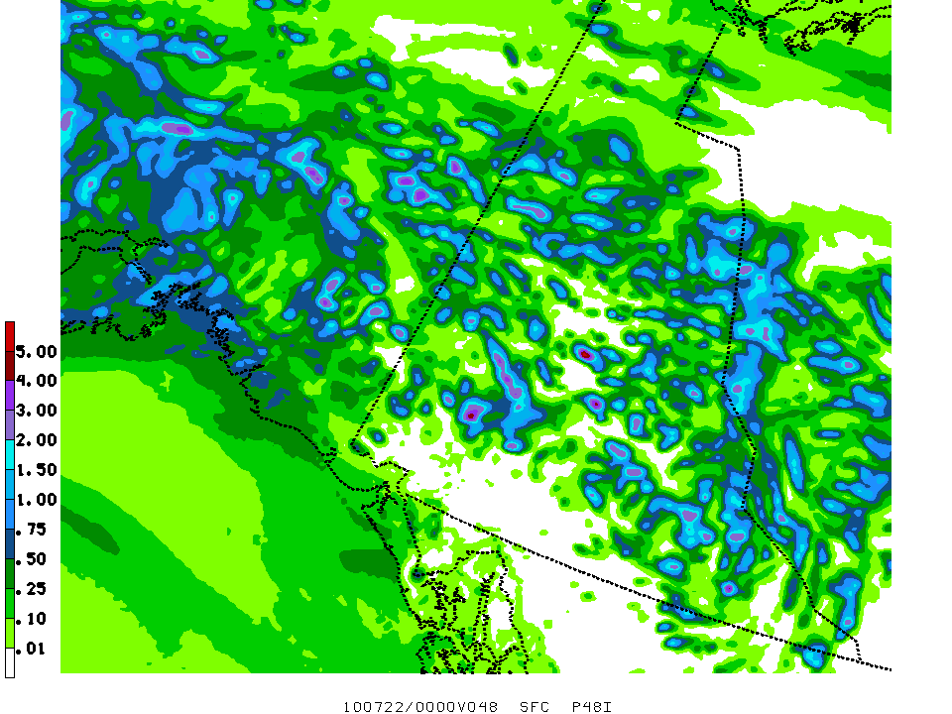
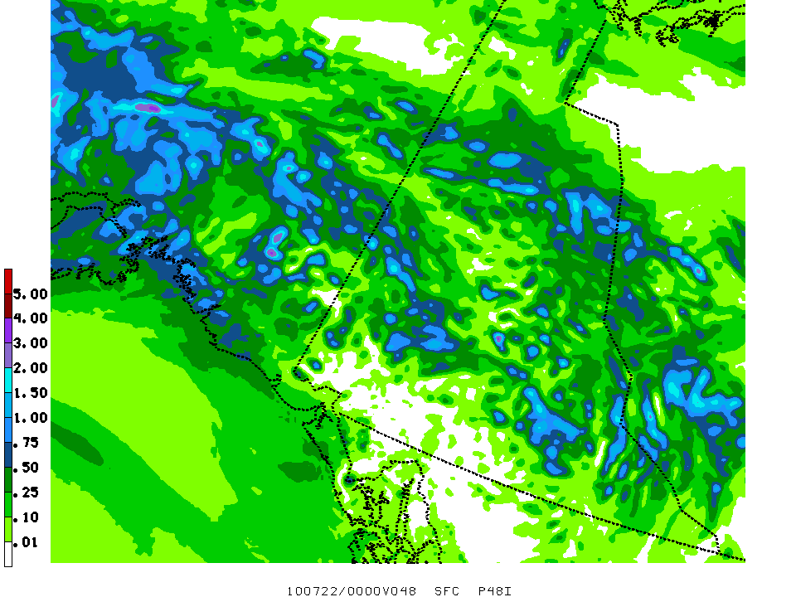
6 km NMMB nest
48 h total precip ending 20100722/00Z
w/o parameterized convection
Max precip = 4.91”
w/ scaled down BMJ convection
Max precip = 3.39”
Test and graphics courtesy of Matt Pyle

Slide 76
Summary and Conclusions
Significant improvements of regional forecasts still possible
Global NMMB competitive with other major medium range forecasting models
Extended MYJ turbulence scheme promising in handling shallow cloud topped marine BLs
BMJ promising at single digit, “convection allowing” resolutions
Unified model offers consistency in applications on various scales and reduced development and maintenance effort
~10 km resolution medium range global forecasts and high resolution climate studies possible with global NMMB

Slide 77
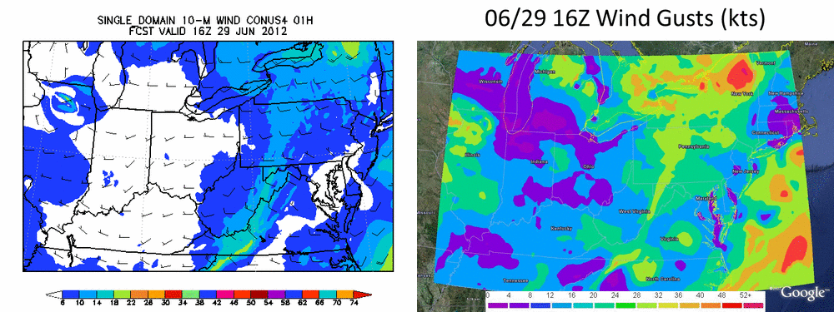
Washington DC
High impact weather, derecho case, full forecast 4 km loops of 10 m wind and gusts, courtesy of Aligo, Jovic and Ferrier

Slide 78
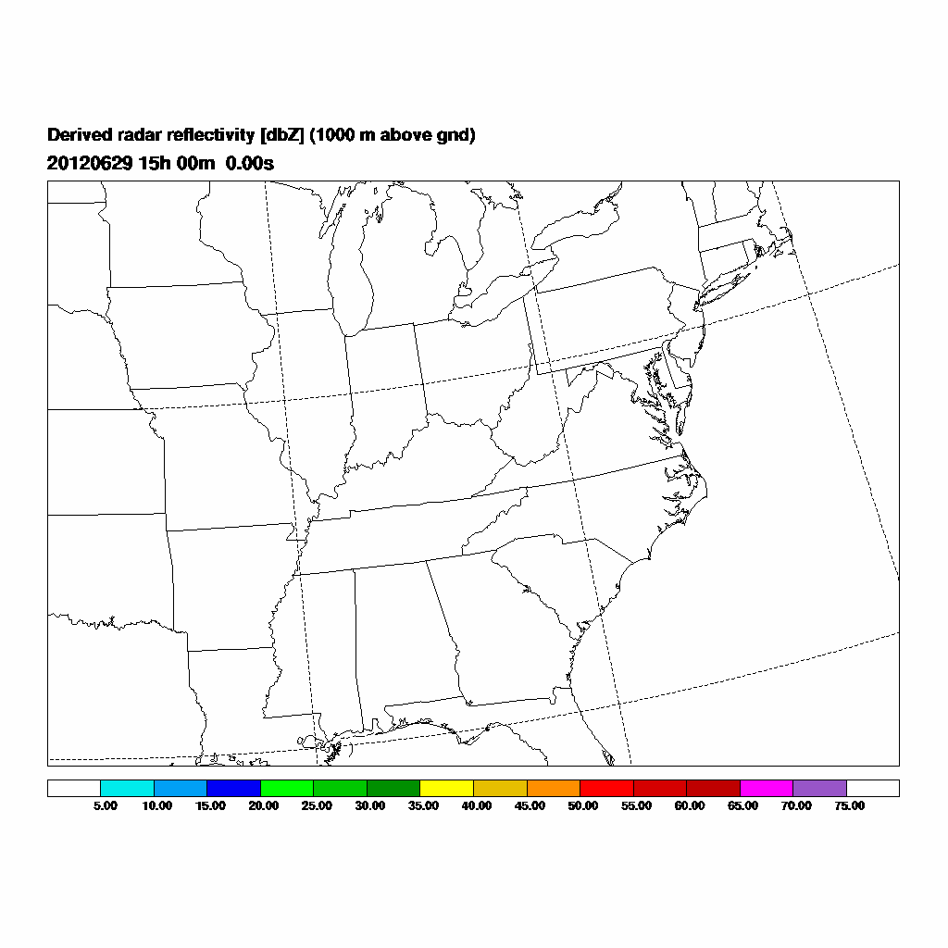
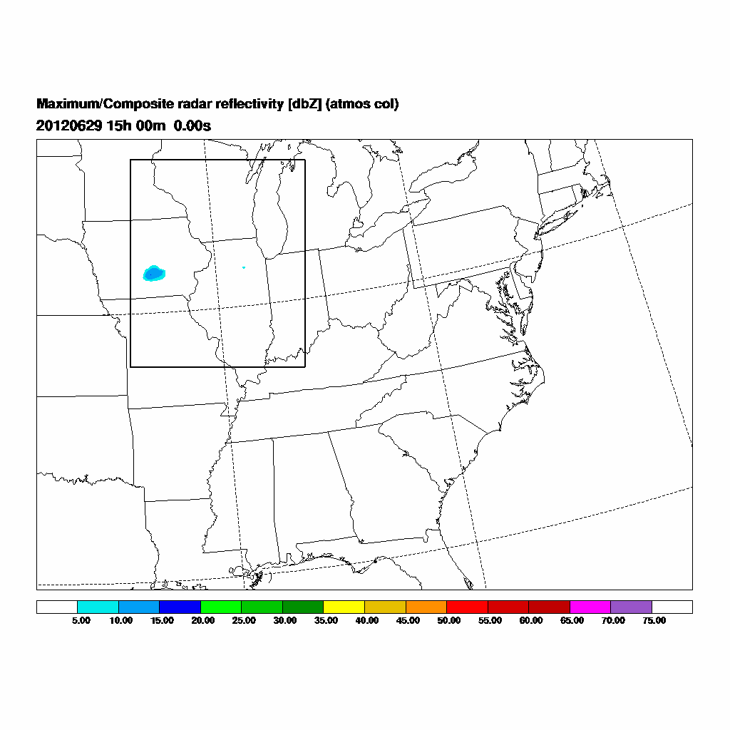
Washington DC
High impact weather, derecho case, full forecast 4 km and 1.33 km nested loops of radar reflectivity, courtesy of Aligo, Jovic and Ferrier

Slide 79
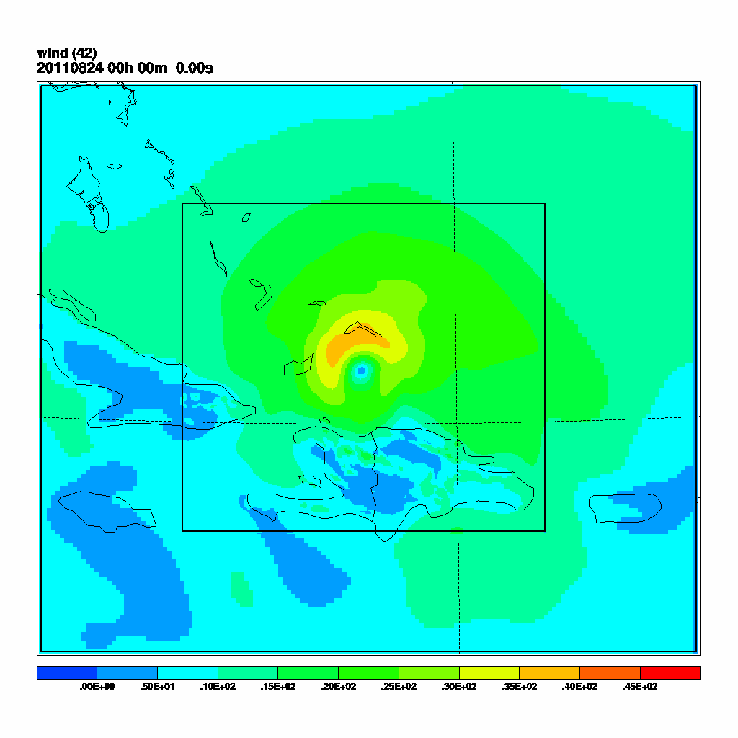

Slide 80
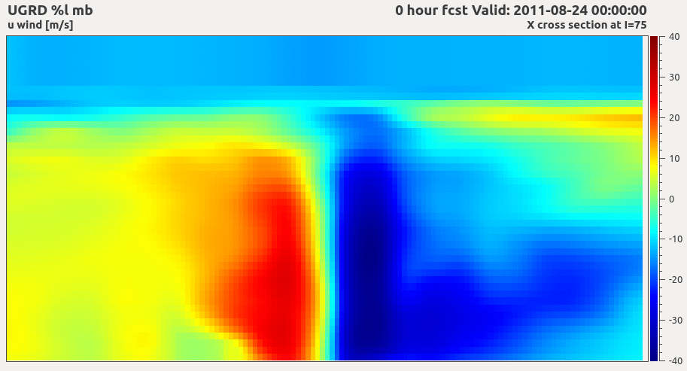
IRENE 09L
2011/08/24 00Z

Slide 81
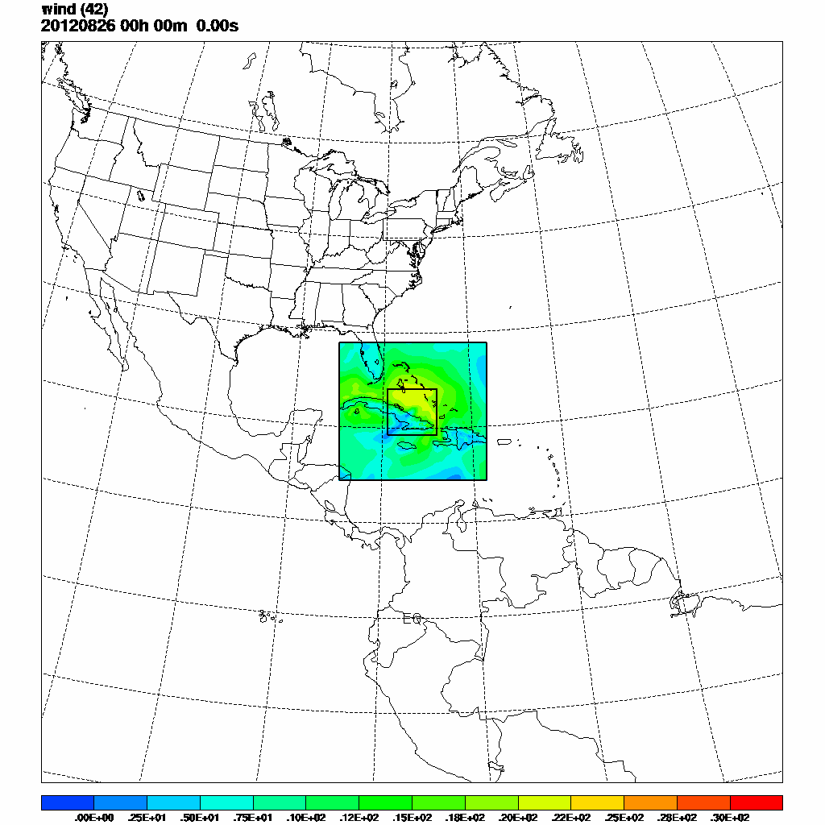
ISAAC 09L
2012/08/26 00Z

Slide 82
ERNESTO 05L
Storm relocation test:
“cold start” vs. “warm start”

Slide 83
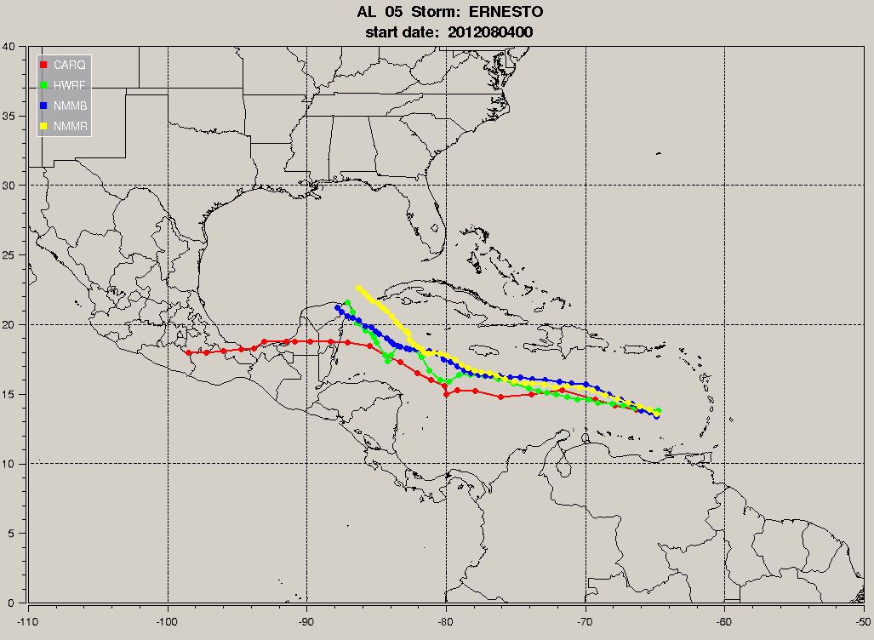
ERNESTO 05L
2012/08/04 00Z
“cold start”

Slide 84
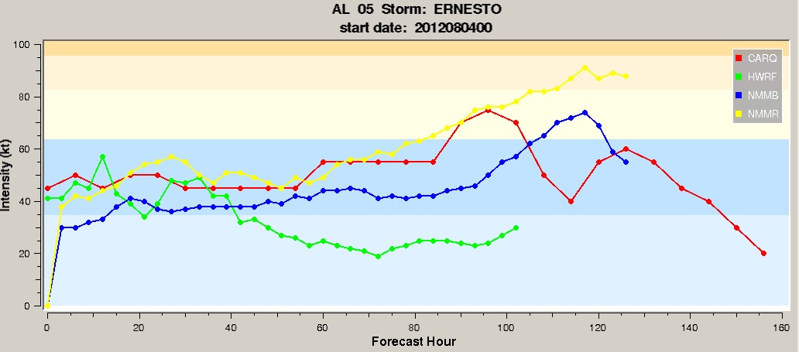
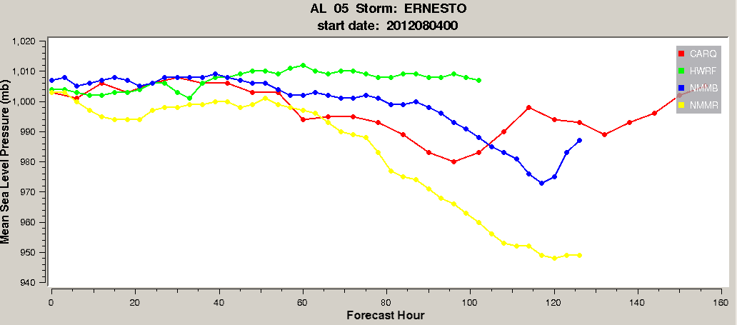

Slide 85
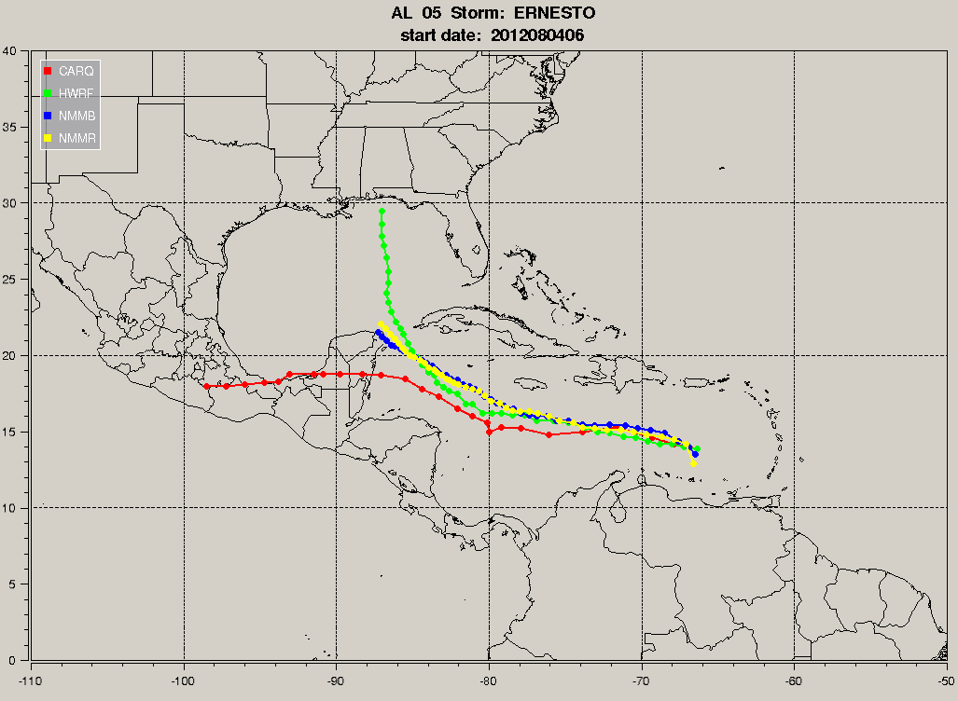
ERNESTO 05L
2012/08/04 06Z
Next cycle - “warm start”

Slide 86
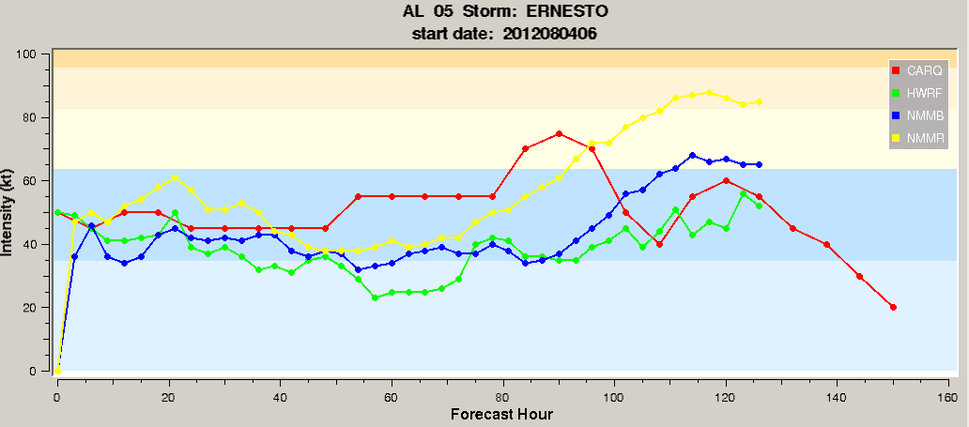
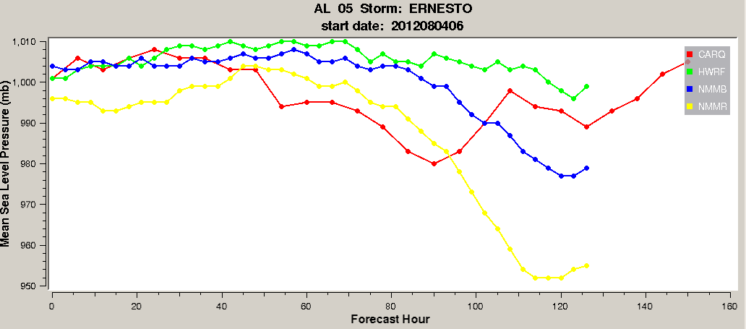

Slide 87
HUMBERTO 09L

Slide 88
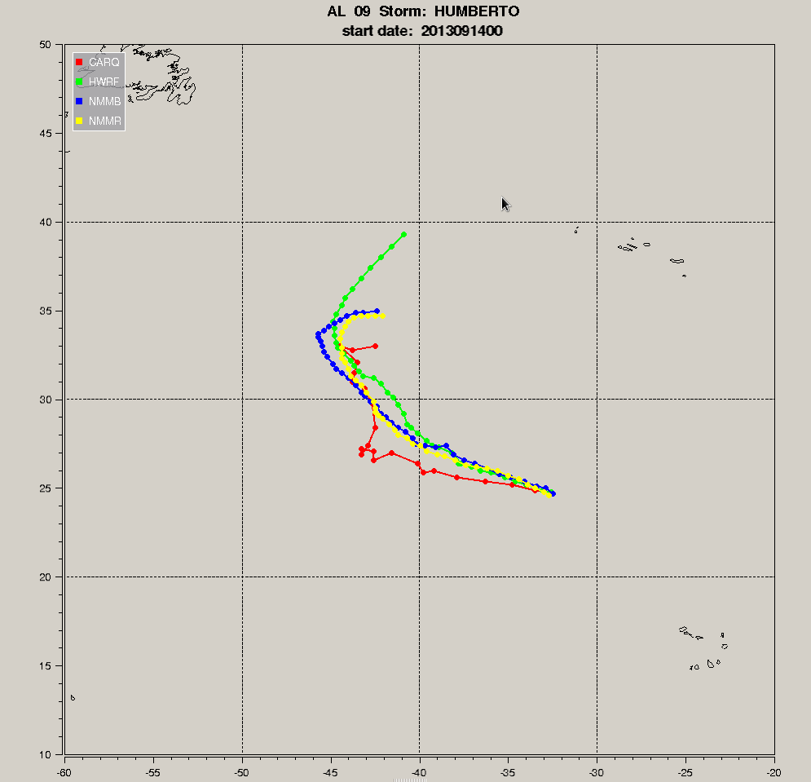
HUMBERTO 09L
2013/09/14 00Z

Slide 89
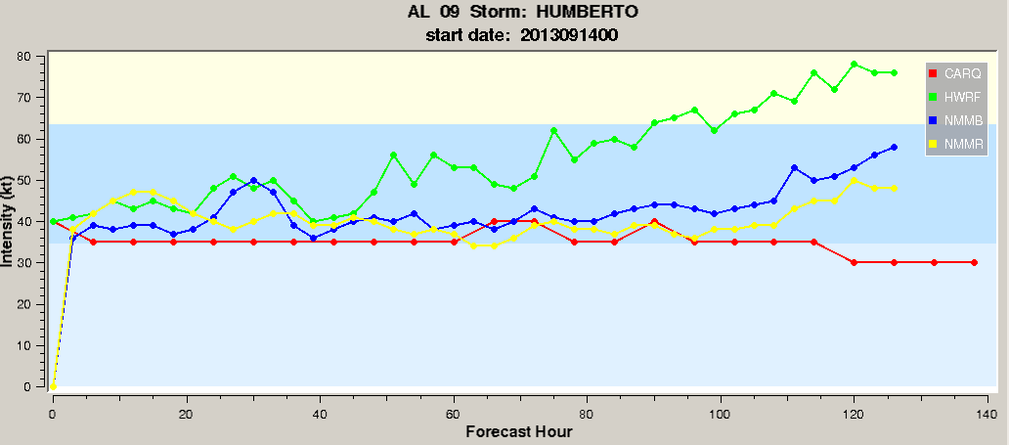


Slide 90
KAREN 12L
Two way interaction test:
“1-way” vs. “2-way”

Slide 91

KAREN 12L
2013/10/03 12Z

Slide 92


Slide 93


Slide 94


KAREN 12L
2013/10/03 12Z
1-way
2-way

Slide 95

KAREN 12L
2013/10/03 12Z

Slide 96



before relocation
after relocation
Isaac 2012, 09L

