Slide 1
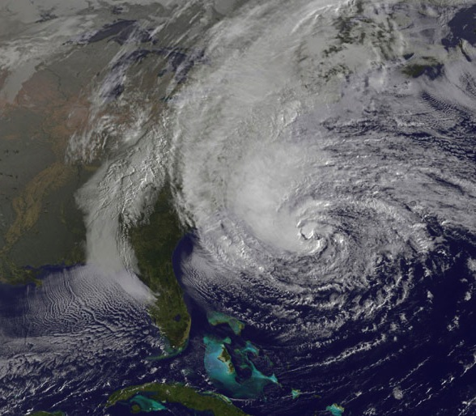
NOAA Hurricane Research
Hurricane Sandy
F. Marks
NOAA HFIP Research Lead
NOAA/AOML Hurricane Research Division
Notes:
Hurricane Sandy 28 October 2012

Slide 2
GOALS:
Advance understanding and prediction of tropical cyclones (TC) through observations, numerical models, and theory, with emphasis on processes within inner part of storm.
NOAA’s hurricane research focus for >50 years
The goals of this research are to:
  1. Advance prediction of TC intensity and structure change (INTENSITY);
  2. Improve prediction of TC track (TRACK); and
  Enhance ability to diagnose and predict impacts of TC on life and property (IMPACTS)
http://www.aoml.noaa.gov/hrd/
WHO:
AOML/Hurricane Research Division (36 employees) 19 research, 17 support, 3-4 summer students

Slide 3

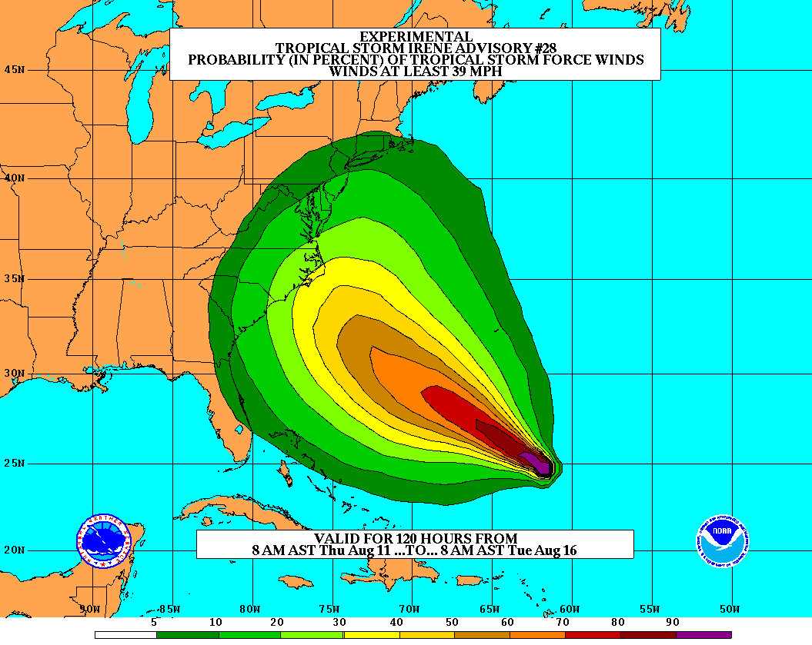
Goals
Improve Forecast Accuracy
  Hurricane impact areas (track) – 50%
  in 10 years
  Severity (intensity) – 50% in 10 years
  Rapid intensity change detection
  Storm surge forecast improvements
Extend forecast reliability out to 7 days
Quantify, bound and reduce forecast uncertainty to enable risk management decisions
Notes:
3

Slide 4
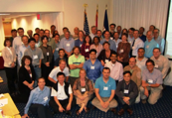
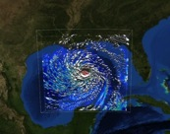



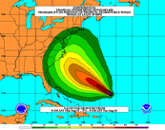
How to get there?
Science
    Improved understanding from combination of observations & models
    High resolution coupled models – critical to storm evolution forecasts – especially intensity changes
    Techniques to understand, reduce & communicate uncertainty
Information Technology
  Increased computing power - run advanced hurricane/global models and reduce uncertainty
  IT infrastructure for inter-agency data exchange
Observing Strategy
Improved use of existing and planned systems
Improved Forecaster Products
Notes:
4
Guide and accelerate HFS improvements (HFS)
Accelerate NOAA operational HFS & GFS development
R&D to improve HFS and GFS (need basic research)
R&D for HFS and GFS ensemble systems (need basic research)
Develop observing system strategy analysis capability (OSE)
R&D to improve observing strategy to improve forecasts & inform NOAA investments
Fully fund transition of research to operations (R2O)
Broaden JHT charter and increase support
Develop interactions between JHT, DTC and JCSDA
Increase high performance computing (res & ops)
Coordinate with research community on basic research
NOAA can not meet goals alone!
Broaden base of expertise in tropical cyclone research community
Work closely with federal, academic, and private sector communities Provide dedicated high performance computing capacity for HFS operations and research & development

Slide 5

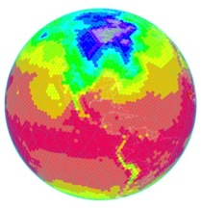
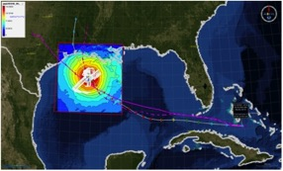
Traditional TC Research Activities:
Observations, analysis, database, & instrument R&D
Statistical-dynamical model development
Advances in operational models
New HFIP Research Thrusts:
Experimental global and regional hurricane model development
Data assimilation techniques and observing system strategy analysis development
Model evaluation tool development
Socioeconomic research and development
Partnership: NCEP, AOC, AOML, ESRL, GFDL, DTC, USWRP, NESDIS/STAR
Notes:
5
Guide and accelerate HFS improvements (HFS)
Accelerate NOAA operational HFS & GFS development
R&D to improve HFS and GFS (need basic research)
R&D for HFS and GFS ensemble systems (need basic research)
Develop observing system strategy analysis capability (OSE)
R&D to improve observing strategy to improve forecasts & inform NOAA investments
Fully fund transition of research to operations (R2O)
Broaden JHT charter and increase support
Develop interactions between JHT, DTC and JCSDA
Increase high performance computing (res & ops)
Coordinate with research community on basic research
NOAA can not meet goals alone!
Broaden base of expertise in tropical cyclone research community
Work closely with federal, academic, and private sector communities Provide dedicated high performance computing capacity for HFS operations and research & development

Slide 6
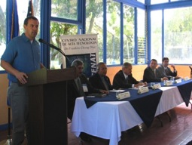
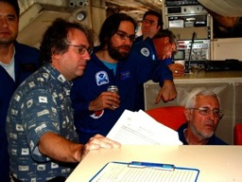
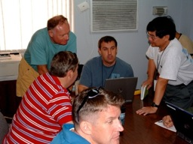
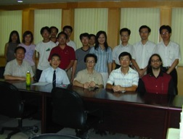
HOW?:
  Joint research programs outside of NOAA with NASA, NSF, and ONR (NSF/PREDICT & NASA/GRIP)
  Cooperative research with scientists at NCAR, and universities (HFIP and NOPP BAA)
  Interact with WMO WWRP and THORPEX, and cooperative research with other countries (IWTC-VII)
  Ensure research benefits NOAA.
IFEX/TCSP
CBLAST
IFEX/RAINEX
DOTSTAR
6
Notes:
6
HRD maintains active research programs with other governmental agencies, in particular, the Department of the Navy’s Office of Naval Research (ONR), National Aeronautics and Space Agency (NASA), and National Science Foundation (NSF).
In program areas where it is beneficial to NOAA, HRD arranges cooperative research programs with scientists at NCAR, and at a number of universities (e.g., NPS, Miami, MIT, PSU, FSU, Washington, CSU, NC State, UNC/Charlotte, Nevada/DRI, Houston).
HRD scientists also interact with the International Tropical Cyclone Community through participation in the WMO International Workshops on Tropical Cyclones, and in cooperative research programs with groups in other countries (e.g., Australia, Canada, China, France, Germany, India, Japan, Taiwan, UK)
HRD is working with these non-NOAA partners to insure their research benefits the HFIP.

Slide 7
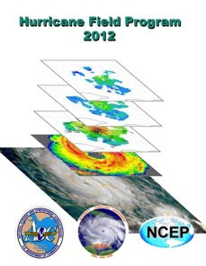
HOW?:
NOAA Intensity Forecast Experiment (IFEX)
Partnership to improve TC intensity/ structure forecasts
Collect targeted observations
  throughout TC life cycle for DA of core circulation
  in and around storm scale circulation to evaluate HWRF
  in variety of atmospheric/oceanic conditions to assess observed & model TC intensity/structure changes
Improve physical understanding & representation of
  Boundary layer
  Surface flux
  Microphysics
  Impact of dry air (SAL)
  Rainbands & eyewall
http://www.aoml.noaa.gov/hrd/HFP2012/IFEX.html
Notes:
• AOML/HRD provides operational support for G-IV surveillance (2 people) and WP-3D reconnaissance SFMR (1 person) missions despite transitioning activities to operations. HRD augments AOC staff by providing meteorological expertise for data QC because they do not have manpower, but we receive no support for these activities. Will become greater issue as we transition airborne Doppler. HRD no longer has internal resources to support these activities.
• 2 tropical cyclones flown from beginning to end of life cycle
Irene
Rina

Slide 8
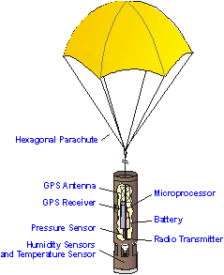

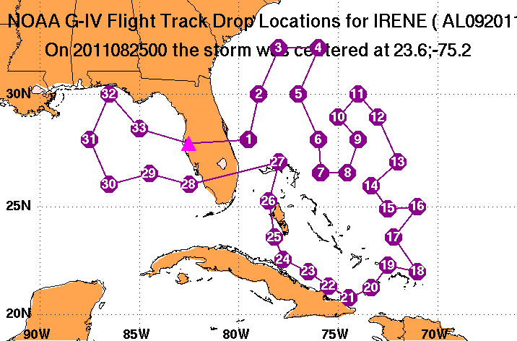
WHAT?:
Current TC research:
Track:
Synoptic-surveillance using dropsondes.
Analytical & numerical studies.
Ensemble track forecasting & targeted observations.
http:/www.aoml.noaa.gov/hrd/data_sub/assesment.html
Notes:
• Track work in partnerships with NWS and NSF. Partially supported through JHT. Work has been slowed by lack of ability to run operational models on EMC development machines since latest model upgrades done at the beginning of 2005 season. Sim has been unable to evaluate 2005 performance to date. This inability to run on development machine is a major stumbling block for this type of model evaluation work like we are proposing for other parameters (surface wind speed, structure). Not sure how we can work with EMC to alleviate this roadblock.

Slide 9
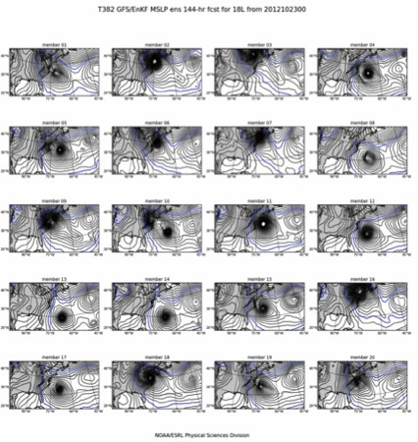
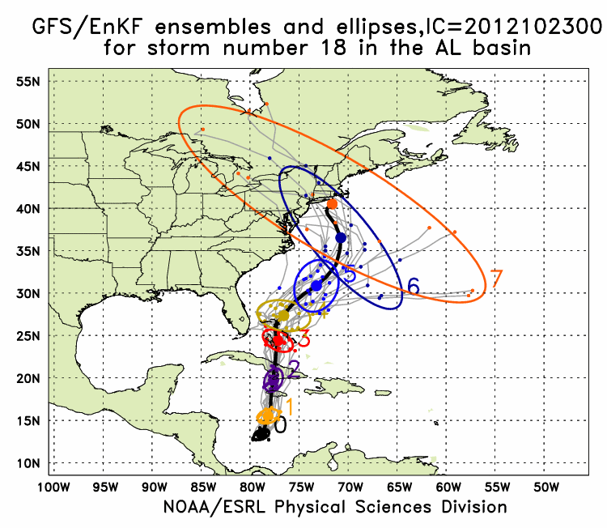
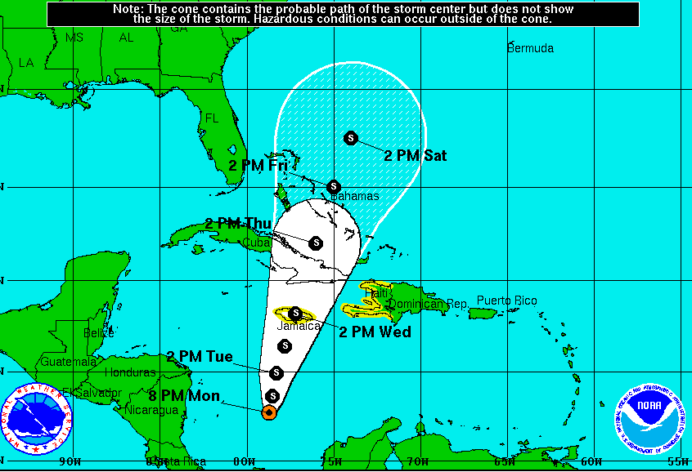
Track (continued):
Global Model Ensembles: Single & Multi-model
Sandy (18L) – init 00Z 23 October
7-Day forecast – 20 member ensemble
GFS/EnKF T382 20 member ensemble
Observed
http://www.esrl.noaa.gov/psd/forecasts/gfsenkf/ens/
Notes:
• As the new models are developed to deal with intensity and structure we need to develop new metrics for model and forecast evaluation beyond the traditional minimum central pressure and peak surface wind. The NWS metric of the peak 1-min sustained surface wind anywhere is not as meaningful anymore. A model or forecast could be correct on those parameters for the wrong reason. Customers want to know more about the impacts to expect and that means structure and size matter. Proposed new metrics are structure (radii of 35, 50, 65 kt, and radius of maximum wind in different quadrants) and rapid intensification (FAR vs POD). They need to be tested and improved with data as well as model output.

Slide 10
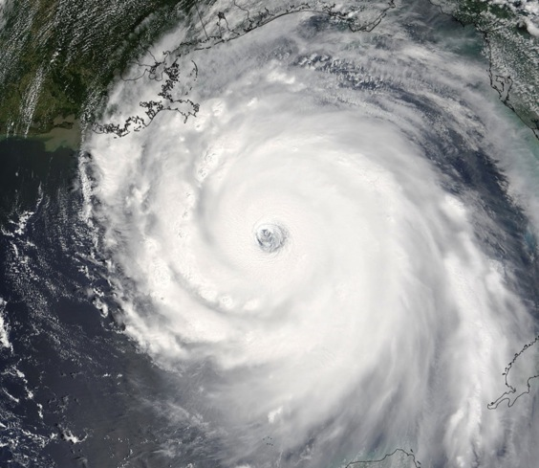
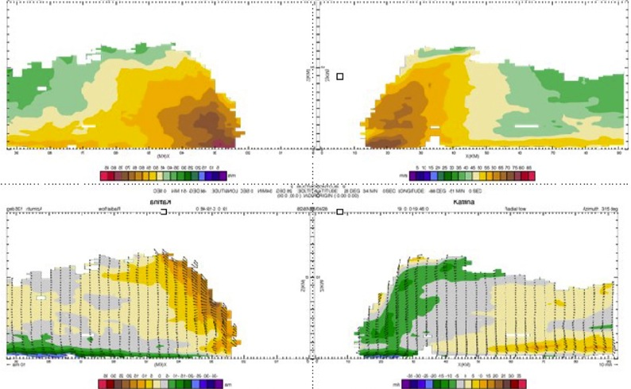
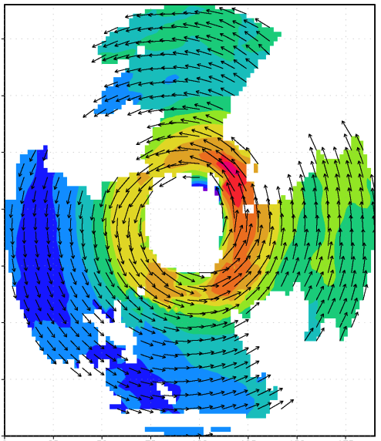

Intensity:
Airborne Doppler radar studies, air-sea interaction studies, and 3-D modeling of TC
V_{θ}
150
100
distance (km)
V_{r}, w
50
0
0
50
100
150
distance (km)
Airborne Doppler-analyzed wind field Hurricane Katrina, 28 September 2005
http://www.aoml.noaa.gov/hrd/Storm_pages/katrina2005/radar.html
Notes:
• Statistical Hurricane Intensity Prediction System (SHIPS) Still show more skill relative to numerical guidance
• IFEX is multi-year data collection effort to test data flow to initialize HWRF and for use in model data sets. IFEX is partnership with NWS, NESDIS, NASA, ONR, NSF
• HRD developed the capability to make a three-dimensional analysis from automatically quality-controlled Doppler data as part of JHT and a G-IV Doppler radar upgrade proposals. Horizontal and vertical cross sections of these analyses were transmitted from the P3 to NHC. The three-dimensional analyses have a vertical resolution of .5 km and a horizontal resolution of 4 km. Analyses of the horizontal and vertical distribution of radius-height-averaged winds are examples of those sent to NHC in nearly all storms for the late phase of IFEX. HRD cooperated with NHC to produce analyses of the greatest interest to NHC, namely the 4-km x 4-km x 0.5-km analyses at 500 m and 1 km.
• Goal is to provide QC Doppler radar-radial-velocity observations from NOAA G-IV and WP-3D aircraft in real time to EMC for assimilation into HWRF. HWRF will be able to use data at 1.5 km horizontal resolution and finer vertical resolution to initialize winds in TC core and immediate environments. Only way to consistently obtain such data is X-Band airborne Doppler radar. 32 real-time analyses sent via SATCOM for NHC
Katrina: 5 analyses on 25 August
4 analyses on 27 August
5 analyses on 28 August
Ophelia: 2 analyses on 8 September
3 analyses on 9 September
5 analyses on 11 September
2 analyses on 12 September
Rita: 1 analysis on 20 September
4 analyses on 21 September
1 analysis on 22 September

Slide 11
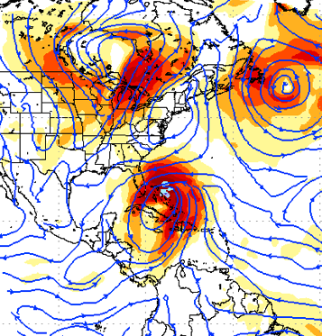
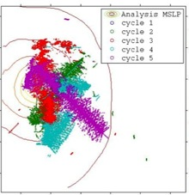
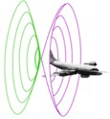
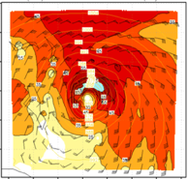
Intensity (continued):
Assimilation of data into numerical models
Synergy of high resolution forecast and airborne observations
P-3 and G-IV observations – superobs (SO)
Data assimilation
Improving the initial condition in storm core region
Improving the high resolution regional forecast
Wind intensity at 10 m
Hurricane Sandy (2012)
F. Zhang (PSU), Aberson, Aksoy, Gamache, Gopal (AOML/HRD)

Slide 12
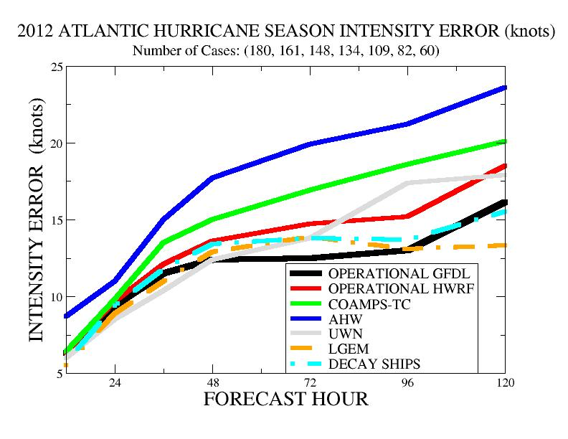
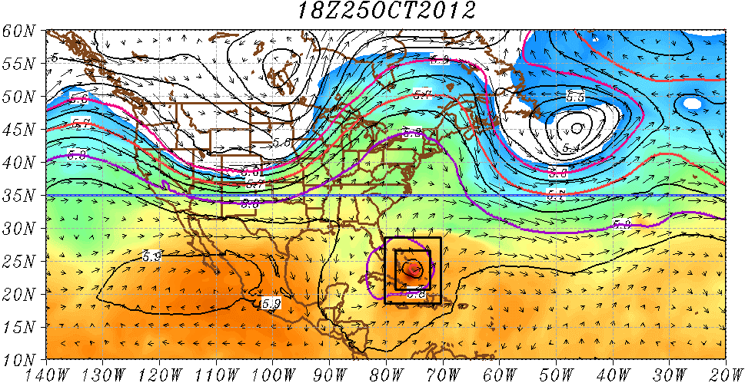
Intensity (continued):
3-D modeling of TC
Experimental HWRF real-time demo simulations
(http://storm.aoml.noaa.gov/hwrfxprojects/?projectName=BASIN)
2012 HWRF
Notes:
• As the new models are developed to deal with intensity and structure we need to develop new metrics for model and forecast evaluation beyond the traditional minimum central pressure and peak surface wind. The NWS metric of the peak 1-min sustained surface wind anywhere is not as meaningful anymore. A model or forecast could be correct on those parameters for the wrong reason. Customers want to know more about the impacts to expect and that means structure and size matter. Proposed new metrics are structure (radii of 35, 50, 65 kt, and radius of maximum wind in different quadrants) and rapid intensification (FAR vs POD). They need to be tested and improved with data as well as model output.

Slide 13
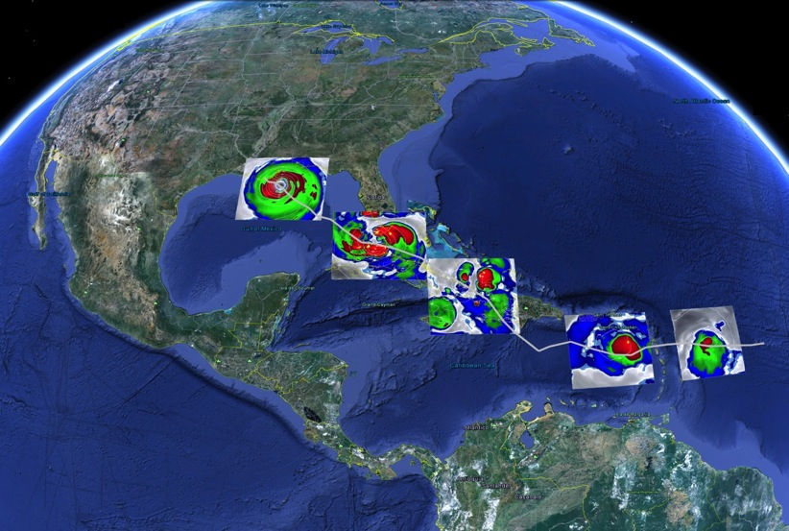

Intensity (continued):
HWRF: Improvement in Forecast Skill
Earl 2010, 3-km HWRF
Intensity Predictions
Warmer sea surface temperatures and no shear
(credits to Dr.Hua Chen, AOML/HRD/NRC)
Vortex tilt, dry air, and size of the storm
Terrain interactions
Size Predictions
Northerly shear and dry air impedes the development of circulation
Enhanced Water Vapor Equivalents obtained from HWRF in the Life cycle of Hurricane Isaac
Aug 26/18 27/18 28/18 29/18 30/18 31/18

Slide 14
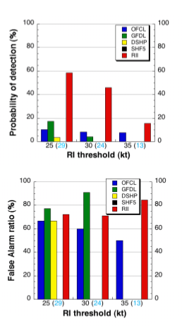
Intensity (continued):
Statistical Models
  Since 1997, D-SHIPS most skillful intensity guidance to NHC/TPC.
  Incorporates wind field decay after landfall.
  Incorporates inner-core SST impact
  Evaluation of SHIPS shows average 6-8% increase in forecast skill for storms with inner-core SST estimates.
  Developed “Rapid intensification (RI)” index.
  Evaluation of RI shows average 5% and 30% improvement for ATL & EPAC.
ATL
RI Index has much higher POD than any dynamical model and OFCL in both ATL and EPAC (EPAC easier than ATL)
FAR for RI index comparable to dynamical models and OFCL
Kaplan et al (2009)
Notes:
• Goal of the HRD 2005 AOP was to upgrade SHIPS with Cione’s inner core SST correction ( see reference CIONE, J.J., and E.W. UHLHORN. Sea surface temperature variability in hurricanes: Implications with respect to intensity change. Monthly Weather Review, 131(8):1783-1796 (2003)) and demonstrate a 5% improvement in SHIPS intensity forecasts. We have yet to complete the 2005 evaluation, but rerunning the 2004 storms with the new correction demonstrated a 4% improvement over the operational SHIPS. This year should be at least as good, given storms such as Ophelia, Rita and Katrina.
• Figure shows actual improvement from rerun of the 2004 season in kt (not %). Note dramatic improvement for hurricanes and especially storms undergoing rapid intensification (>25 kt in 24 h), particularly beyond 48 h. Reason for dramatic improvement at later forecast periods is importance of the SST predictor in SHIPS at later times.
• Important note: SHIPS is an example of providing guidance on guidance,as it uses the global model initial conditions and forecast output as predictors. SST is one of the most important of the predictors and the operational version uses the Reynold’s weekly SST. Where the new version is providing improvements is by adding internal storm information, the correction of the Reynold’s SST by a value more representative of what should be under the eyewall. This is a trend in the development of SHIPS that is telling us that to do intensity right we need to know more about the current state of the inner vortex that is not represented in the global model fields. Mark DeMaria has demonstrated similar improvements by using IR satellite information and flight level data. Unfortunately, that information is only available at the initial time and does not seem to show that much improvement to longer time intervals, whereas Cione’s algorithm is applied to all forecast times and seems to better reflect the actual storm conditions.

Slide 15
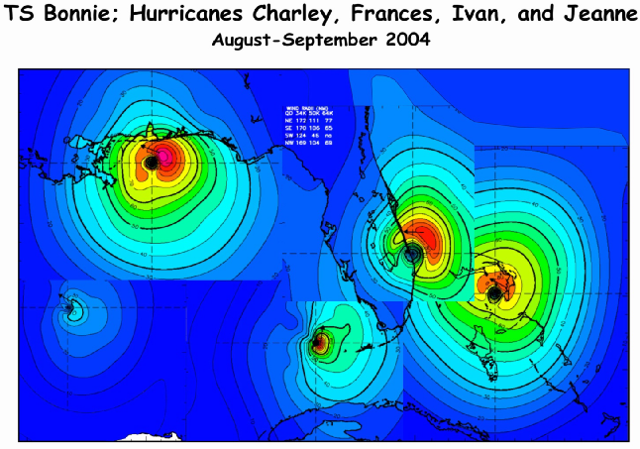
Structure:
Land-based radar, surface data, GIS. Development of a real-time surface analysis system.
http://www.aoml.noaa.gov/hrd/data_sub/wind.html
Notes:
• Surface wind field work is mainly supported through a NOPP that Hans Graber controls (collaboration between UM, USACE, HRD, and Vince Cardone’s Ocean Weather). HRD receives support to provide them near real-time surface winds to drive their surge and wave models. HRD also receives support for these wind fields from the USACE, particularly for the production of wind fields for past storms to use for model testing. Finally, some of the support comes from the development of a wind model for the State of Florida CAT model effort in collaboration with FSU, FIU, and UF.

Slide 16
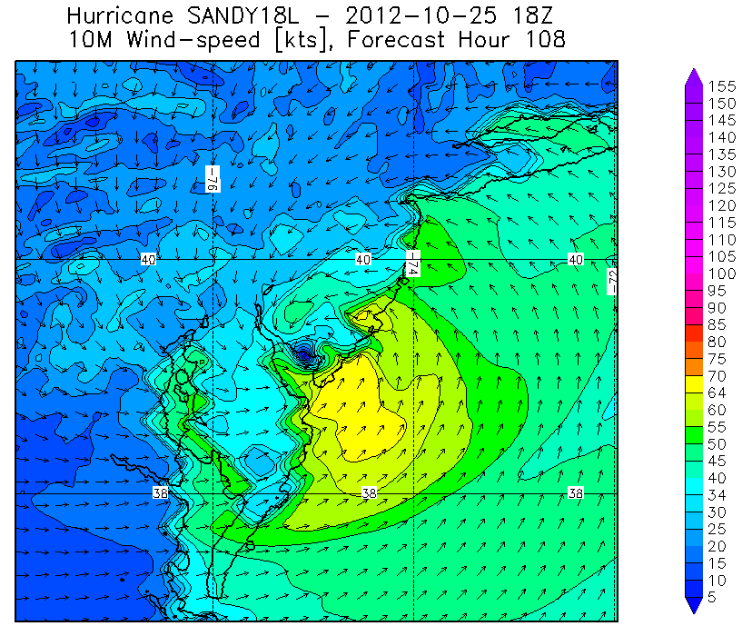
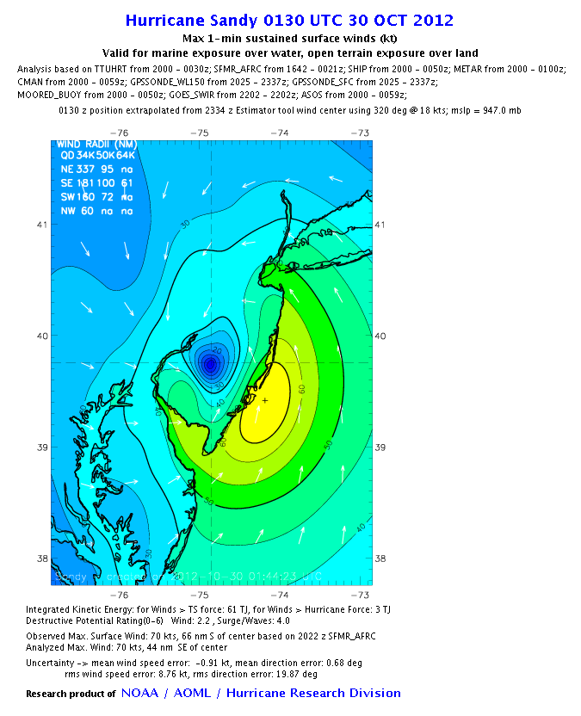

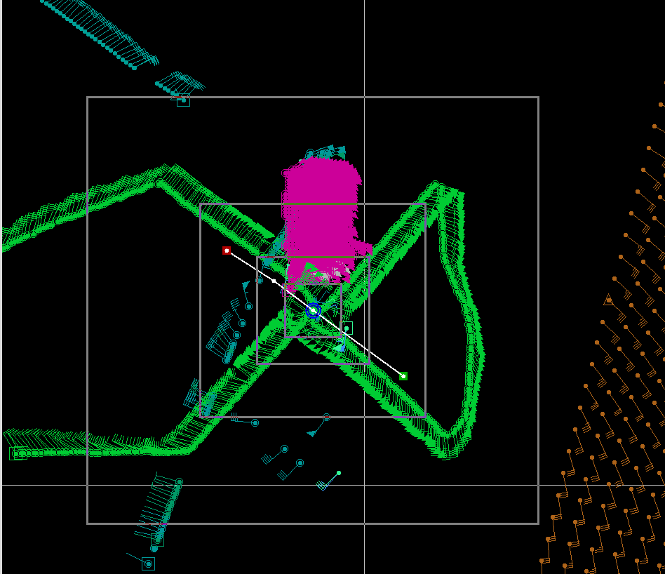
Structure:
Evaluation of Model structure
Data Coverage
H*Wind 10m winds
HWRF 10m winds
HWIND analysis
HWRF Forecast (108 h)
Notes:
• Surface wind field work is mainly supported through a NOPP that Hans Graber controls (collaboration between UM, USACE, HRD, and Vince Cardone’s Ocean Weather). HRD receives support to provide them near real-time surface winds to drive their surge and wave models. HRD also receives support for these wind fields from the USACE, particularly for the production of wind fields for past storms to use for model testing. Finally, some of the support comes from the development of a wind model for the State of Florida CAT model effort in collaboration with FSU, FIU, and UF.

Slide 17
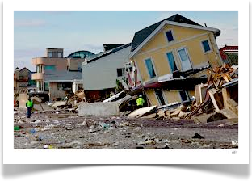
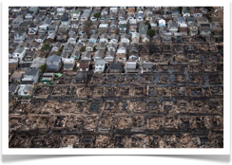
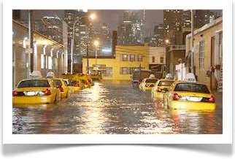
Impacts:
Where do we need to be?
NOAA’s National Weather Service (NWS) mission is to fulfill this commitment through building a Weather Ready Nation.
NWS must contribute to hazard resiliency by continually assessing and improving its services to Nation.
Hurricane Sandy (2012):
    147 (72 along US East Coast) deaths
    >$75 Billion damage
    Major infrastructure losses
    Power lost to 8.5 million

Slide 18


What in 2012 & 2013?:
IFEX 2012
  NOAA aircraft flew ~282 h (18 P-3 and 12 G-IV missions)
  Highlights include Isaac, Leslie, & Sandy
  For details see: http://noaahrd.wordpress.com/category/ifex-discussion
IFEX 2013
  2 NOAA WP-3D, G-IV – 150 flight hours (1 June-30 November)
  Crews available 2/day missions starting July based from Tampa, FL
  Interact with NASA during their HS3 field campaign
HFIP real-time model demonstration

Slide 19
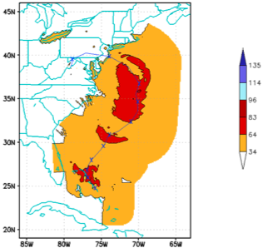
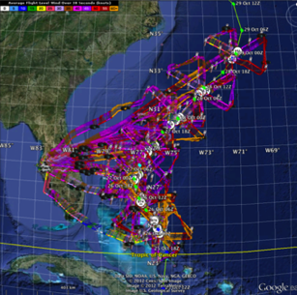
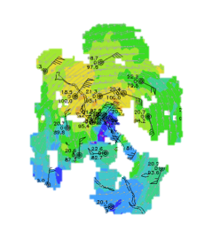
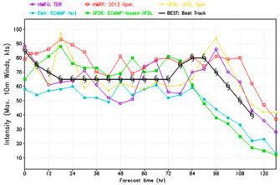
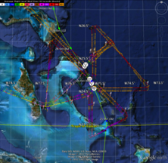
IFEX 2012:
Improved Models & Data: Sandy
7 P-3 Flights
26 October– 29 October 2012
TDR-Experiment: Doppler data transmitted in real-time for assimilation into HWRF
HWRF/GSI
20121026 00UTC
7 P-3 Flights
23 August – 27 August 2011
7 WP-3D TDR missions from 00 UTC 26 – 12 UTC 29 September 2012 at 12 h Doppler sampling (HEDAS/GSI)
3 G-IV missions (TDR)
Sampled Hurricane Sandy from passage N of Cuba to landfall
HWRF/GSI
20121026 00UTC
Aberson, Aksoy, Gamache, Gopal (AOML/HRD), Tong (EMC)
Notes:
Map shows flight tracks for all of the NOAA missions (color coded are the flight level winds for the P-3 missions)

Slide 20
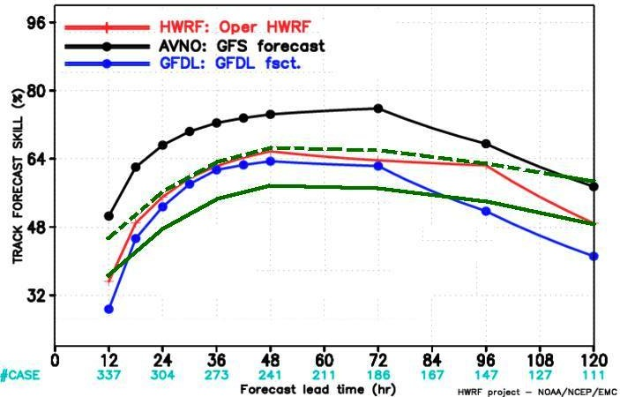
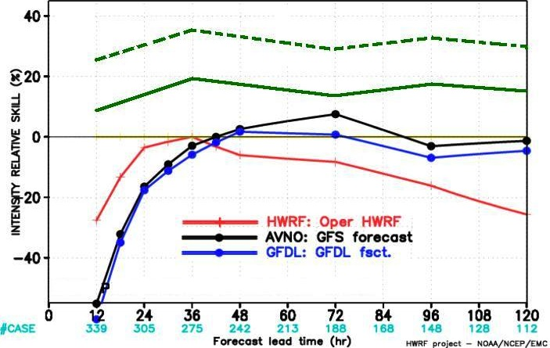
HFIP 2012 Demonstration
Comparison of 2012 NCEP
Operational Models to the 5 Year HFIP
Goal: Track
Comparison of 2012 NCEP
Operational Models to the 5 Year HFIP
Goal: Intensity
HFIP 5 year Goal
Baseline skill
5-year skill goal
Baseline skill

Slide 21




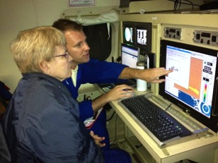
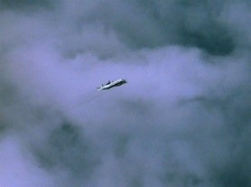
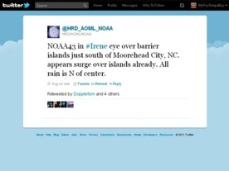
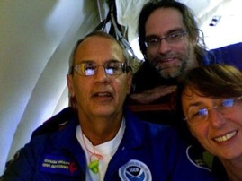
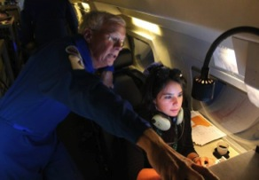
Communicating in the field
Our blog
http://noaahrd.wordpress.com
HRD Web page
http://www.aoml.noaa.gov/hrd
Facebook
http://www.facebook.com/noaahrd
Twitter
http://twitter.com/#!/HRD_AOML_NOAA
Tweets from the eye
Visiting scientist program

