Slide 1

Use of Satellite Transmission of Airborne Data to Improve Hurricane Forecasts
John F. Gamache
NOAA/AOML/Hurricane Research Division

Slide 2
Talk Outline
Hurricane Forecast Problem
Federal Agencies involved in hurricane forecasting and research NOAA plans for improving forecasts (HFIP and IFEX)
Data assimilation into hurricane models
Getting the data into real-time models

Slide 3
Definitions
Superob (SO)
  Intelligent average of data to reduce the number of observations assimilated into models
  Radar data—Doppler radial velocities pointed in nearly same direction (~2 degree interval), at nearly the same distance (~2-km radial interval), and nearly the same time (1-minute interval)

Slide 4
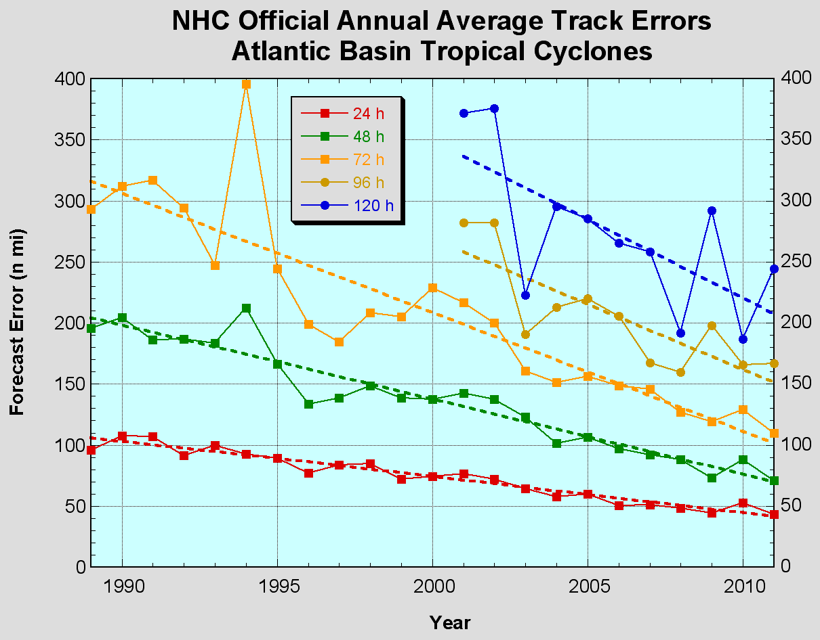
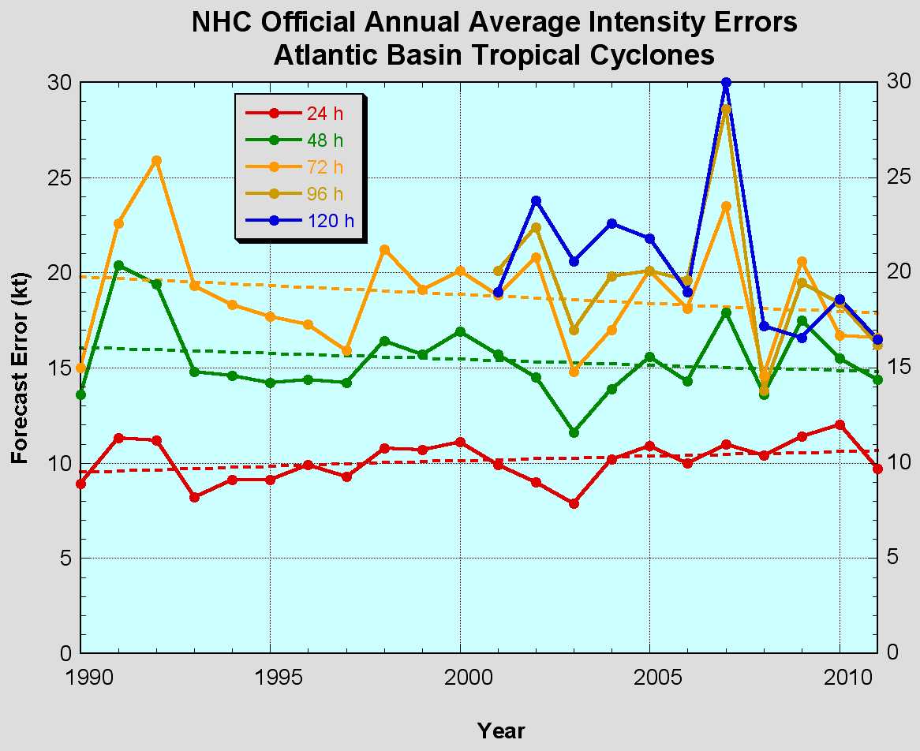
The Good – track forecast improvements
Current Forecast Capabilities
The Bad - Intensity no real gains
No progress with intensity in last 15-20 years
Errors cut in half over past 15 years
10-year improvement - As accurate at 48 hours as we were at 24 hours in 1999
24-48h intensity forecast off by 1 category
Off by 2 categories perhaps 5-10% of time
Notes:
Images from: http://www.nhc.noaa.gov/verification/verify5.shtml

Slide 5
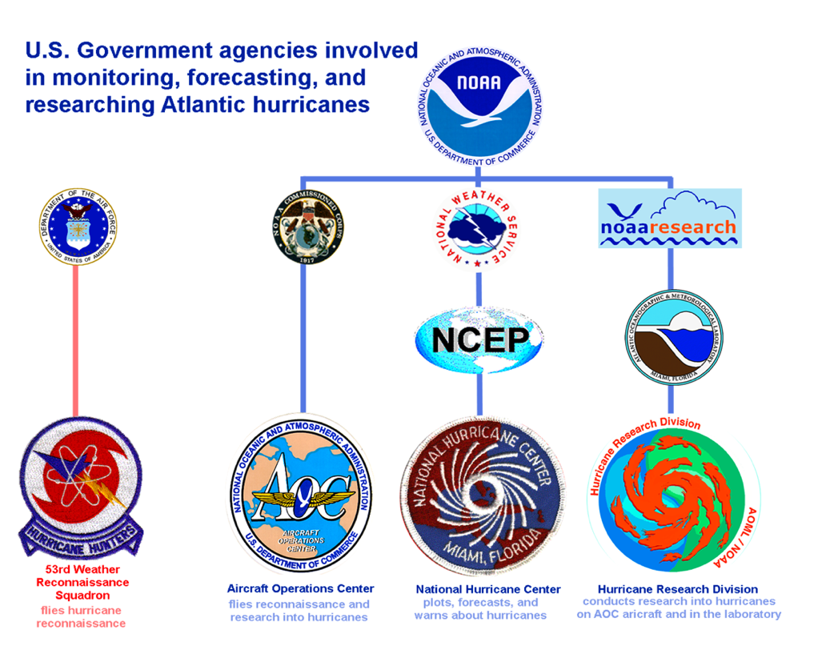


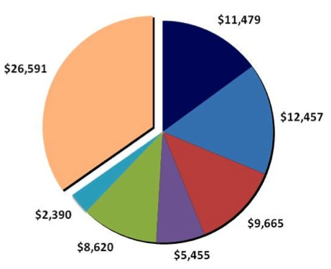





Federal Hurricane Team
2010 Snapshot
Total: $76,658K
HFIP
IFEX, ITOP,
GRIP, &
PREDICT
NOAA Total:
$23,936
Notes:
Operations: $300M/year (NOAA & DoD)– observing, forecasting, instrumentation (satellites)
Research: 2008: $50M/year (16%), 2010: $76M (25%) – leveraged across multiple agencies
Manyears: 2008: 211, 2010: 279
For comparison of 2008 & 2010: http://www.ofcm.gov/ihc11/Presentations/Session01-Comparison%20of%20R&D/IHC11_WG-TCR_110211.pptx

Slide 6
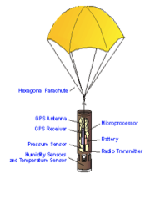

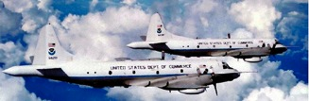
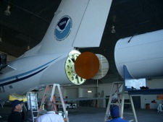

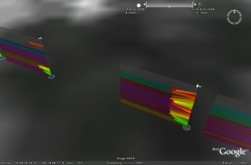
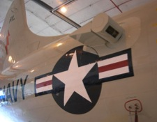
Observations:
Intensity Forecast experiment (IFEX)
In-situ
  Wind, press., temp.
Expendables
  Dropsondes
  AXBT, AXCP, buoy
Remote Sensors
  Doppler Radar
  SFMR
  DWL (ONR)
  WSRA
  Scatterometer/ profiler
  UAS
Rob Rogers, AOML/HRD
Notes:
UR image depicts dropsonde profiles in eyewall of Hurricane Guillermo (1997)
LR image is Doppler Wind Lidar profiles from TCS-08

Slide 7
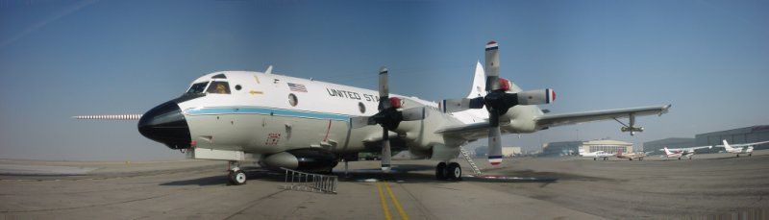
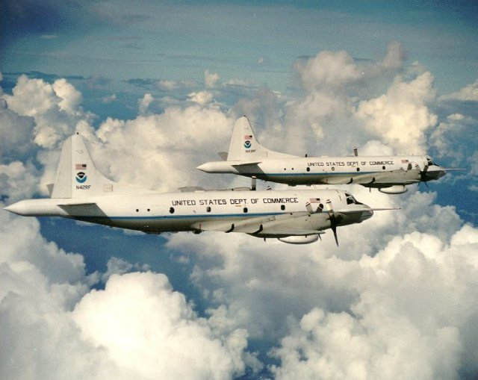
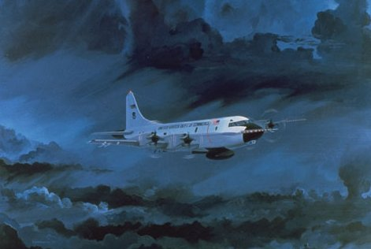
WP-3D Aircraft and their Radars

Slide 8
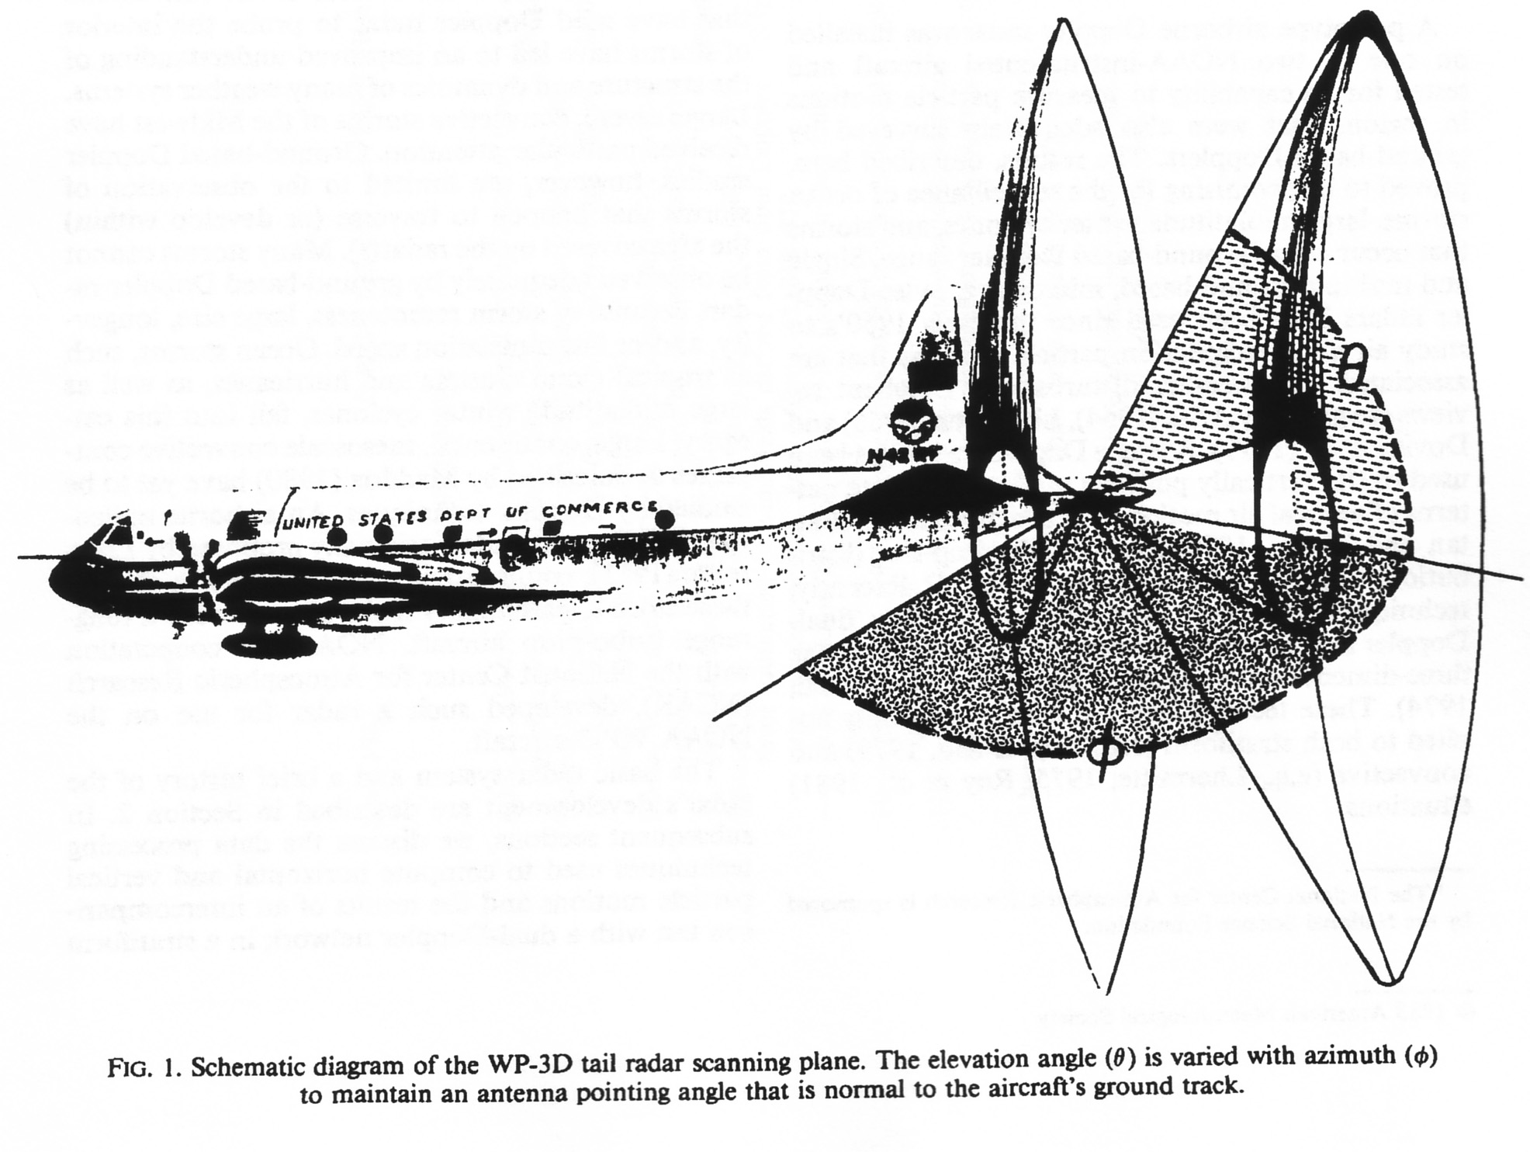

Slide 9
Courtesy of Fuqing Zhang
Notes:
9
Now let me show you some preliminary result of Airborne Radar data assimilation. In this case, we use the same design as ground-based radar experiments except that this case is initialized at 00Z/27 and just airborne radar radial velocity assimilated at 15Z/27.
This figure shows the airborne radar scanning methodology. Every time the antenna will do the forward and backward scanning. When the antenna get the top, it will turn to the other direction.
Like ground-base radar data processing, we also make some data quality control and data thinning.
The left two figures are the wind analysis by RAINEX, the right is the location of super observations.

Slide 10
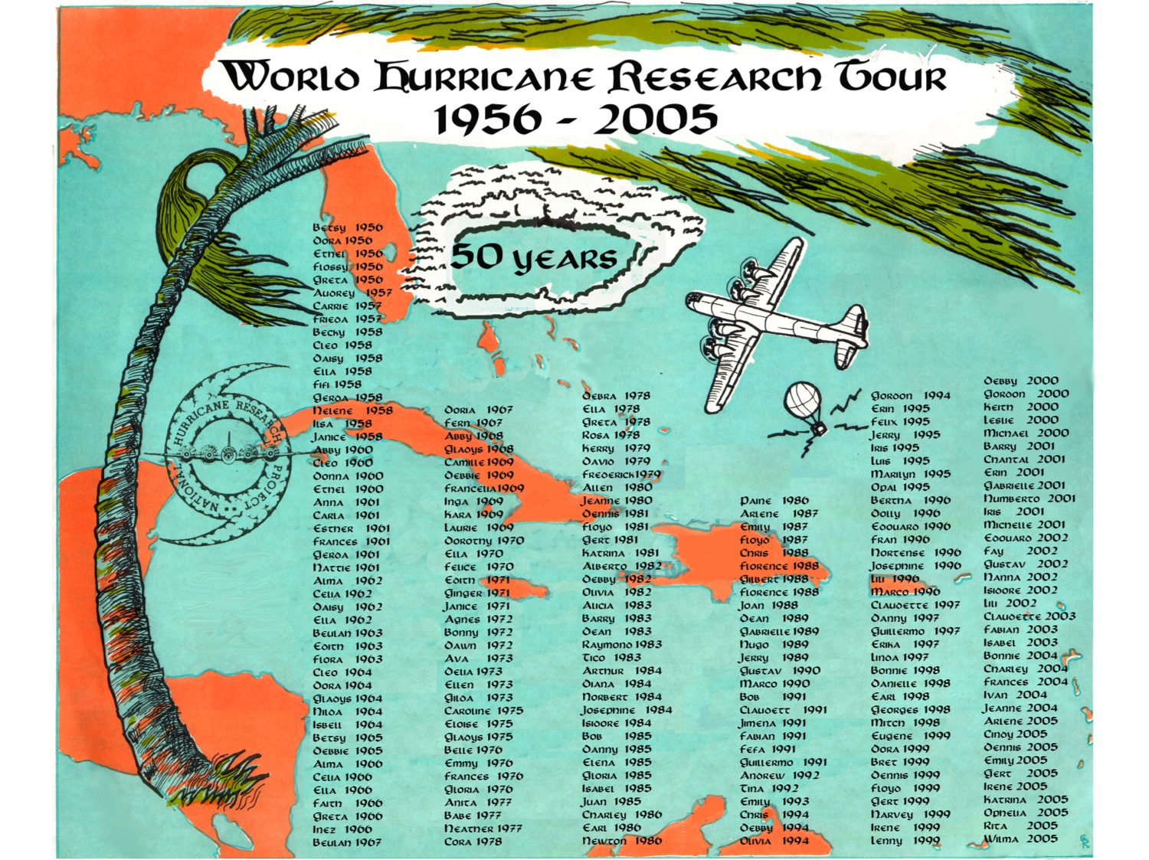
Notes:
205 storms flown total up to 2005, 89 prior to my arrival at HRD in 1980, 126 since 1980

Slide 11
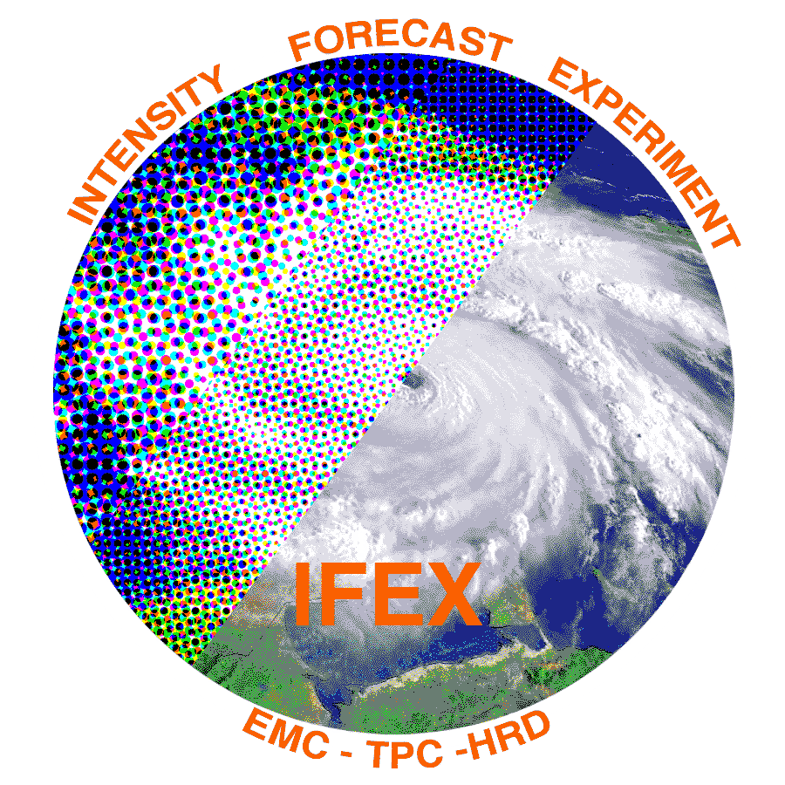
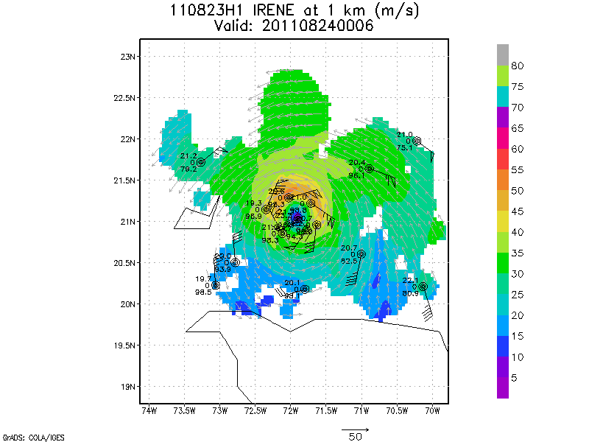
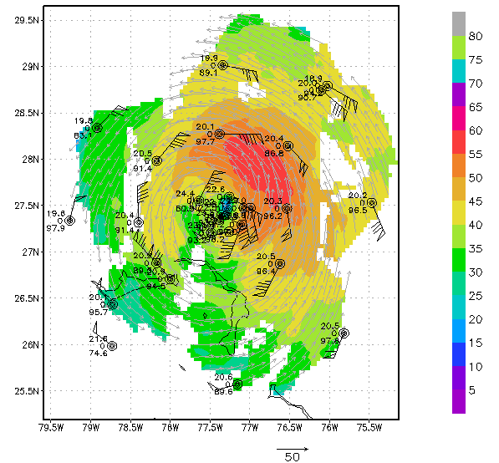
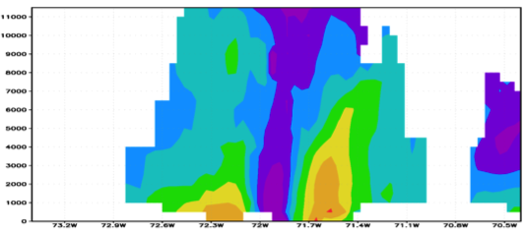
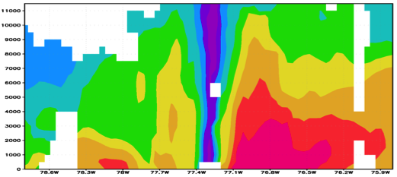

IFEX 2011: Irene
Real-time P-3 Tail Doppler and Dropsonde Composite at 1 km altitude
m/s
Flight 110823H1
Flight 110825H1
South
North
South
North
S. Murillo, R. Rogers (AOML/HRD)
Notes:
Colors denote Doppler winds and station codes denote dropsondes
West-east vertical cross section of wind speed (shaded, m/s).

Slide 12
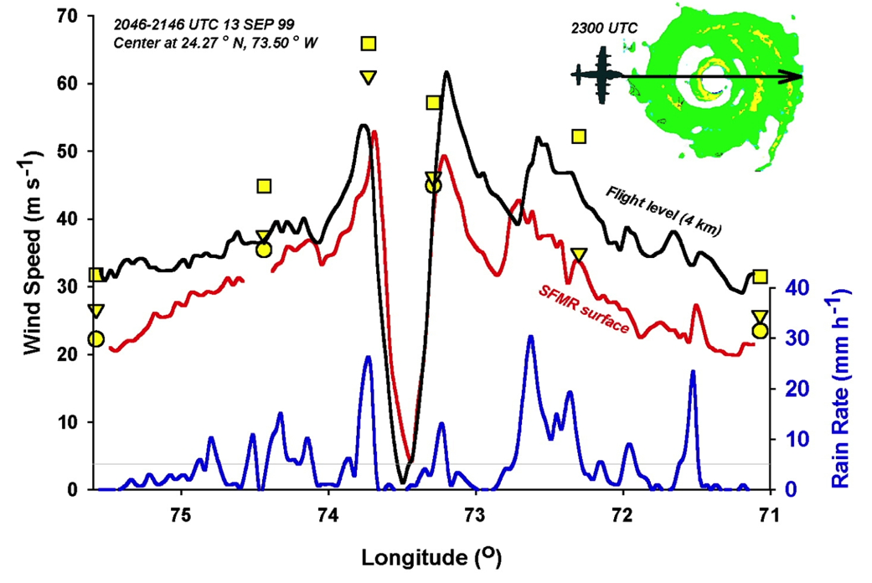
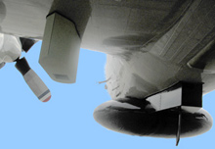
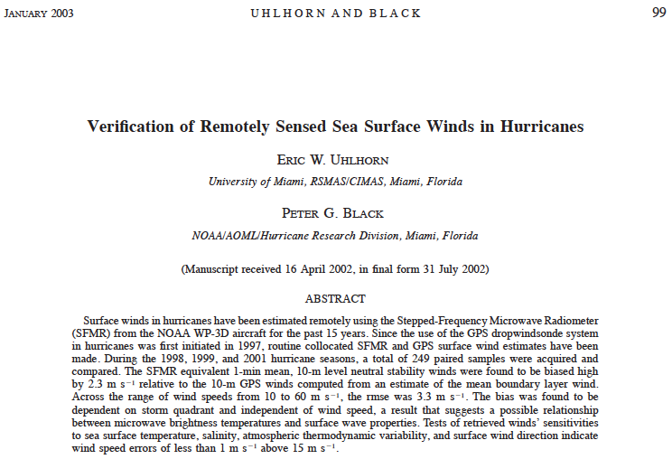
Stepped Frequency Microwave Radiometer (SFMR)
E. Uhlhorn, AOML/HRD

Slide 13
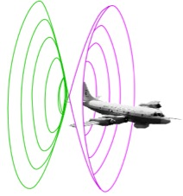
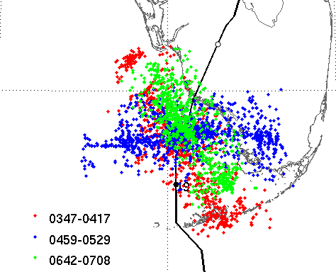
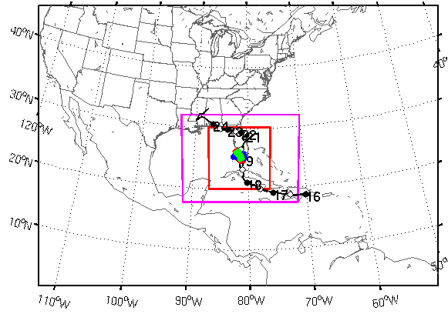
Assimilating Doppler Radar
EnKF data assimilation of inner core observations
20°
V_{r} SOs
03-07Z
19 August
D3
1st real-time SOs transmitted during P-3 mission and assimilated few hours later
D2
D3
TS Fay (2008)
D1
John Gamache AOML/HRD & Fuqing Zhang (PSU)
Notes:
Top left image shows how airborne Doppler scans through storm with alternating fore/aft beams every 0.7 km resulting in herringbone patterns of beam intersections with 1.4 km resolution along track and 150 m resolution across track.
Bottom right image shows ARW domain used this summer by Fuqing to assimilate the Doppler superobs – in this case for TS Fay when it was making 2nd FL landfall. The inset shows SOs used from 3 legs (represented by colors) across the storm. Overlay show model field with many obs superposed
A superob (SO) is an average of several observations in proximity to each other. This averaging reduces the number of costly assimilations and avoids assimilating correlated data
Doppler SOs are averages of the observations of radial component of wind along pointing vector where all observations pointing in nearly same direction at nearly same distance from aircraft
Azimuthal grid resolution (around fuselage axis): 3-5 degrees depending upon radius
Radial grid resolution: 2 km
Along track resolution: 1 min = ~7-8 km
All radial velocity observations within a grid box are candidates for SOs, but only the 25 points closest to grid point used
Velocities >2 SD from bin average rejected
Bins with SD > 2XSD rejected
~5000 SOs per penetration of hurricane

Slide 14
Improved Use of Observations:
Impact of airborne Doppler radar
% Improvement over HFIP baseline
cases
All cases with Doppler data 2008-2011
Need help of Research community to address
F. Zhang (PSU), Aberson, Aksoy, Gamache (AOML/HRD)
Notes:
Intensity Error of Models for all cases (2009-2011) with airborne Doppler data available from NOAA P-3s (% Improvement over HFIP baseline – average intensity error for three years of operational model guidance errors for 2006-2008 when HFIP began)
Black lines are the baseline intensity skill (solid), 20%improvement threshold (large dash), and 50% improvement threshold (small dash)
Green lines represent the average intensity errors for two different regional models: small dash - Advanced Research WRF or ARW used by the bulk of the research community; and solid - high-resolution research version of HWRF developed at HRD and transitioned to EMC for operational implementation this summer
Red line is the average intensity error for the high-resolution research HWRF without the Doppler data
Note that from 36-96 h the average error is very close to or exceeding the 20% improvement threshold for HFIP at 5 years
We are busily investigating the reason for lack of improved skill from 0-24 h when the data should have the most impact. We identified some model biases due to physical parameterizations which we are working with EMC to correct thanks to the ability to use observations to improve the initial conditions.

Slide 15
Satellite Transmission Equipment
NOAA WP-3D aircraft (NOAA42 and NOAA43)
  Thrane & Thrane Aviator 700
  Cobham Chelton HGA 7000 flat plate antenna system
NOAA G-IV aircraft (NOAA49)
  Thrane & Thrane Aviator 700
  EMS Technologies AMT-50G tail mounted antenna

Slide 16
Thrane & Thrane Aviator 700
SwiftBroadBand—350 kBaud typical realized data rate—primary means of transporting data off the aircraft in real time
Swift64—backup internet connectivity for NOAA aircraft—50 kBaud type realized data rate
Voice telephone service

Slide 17
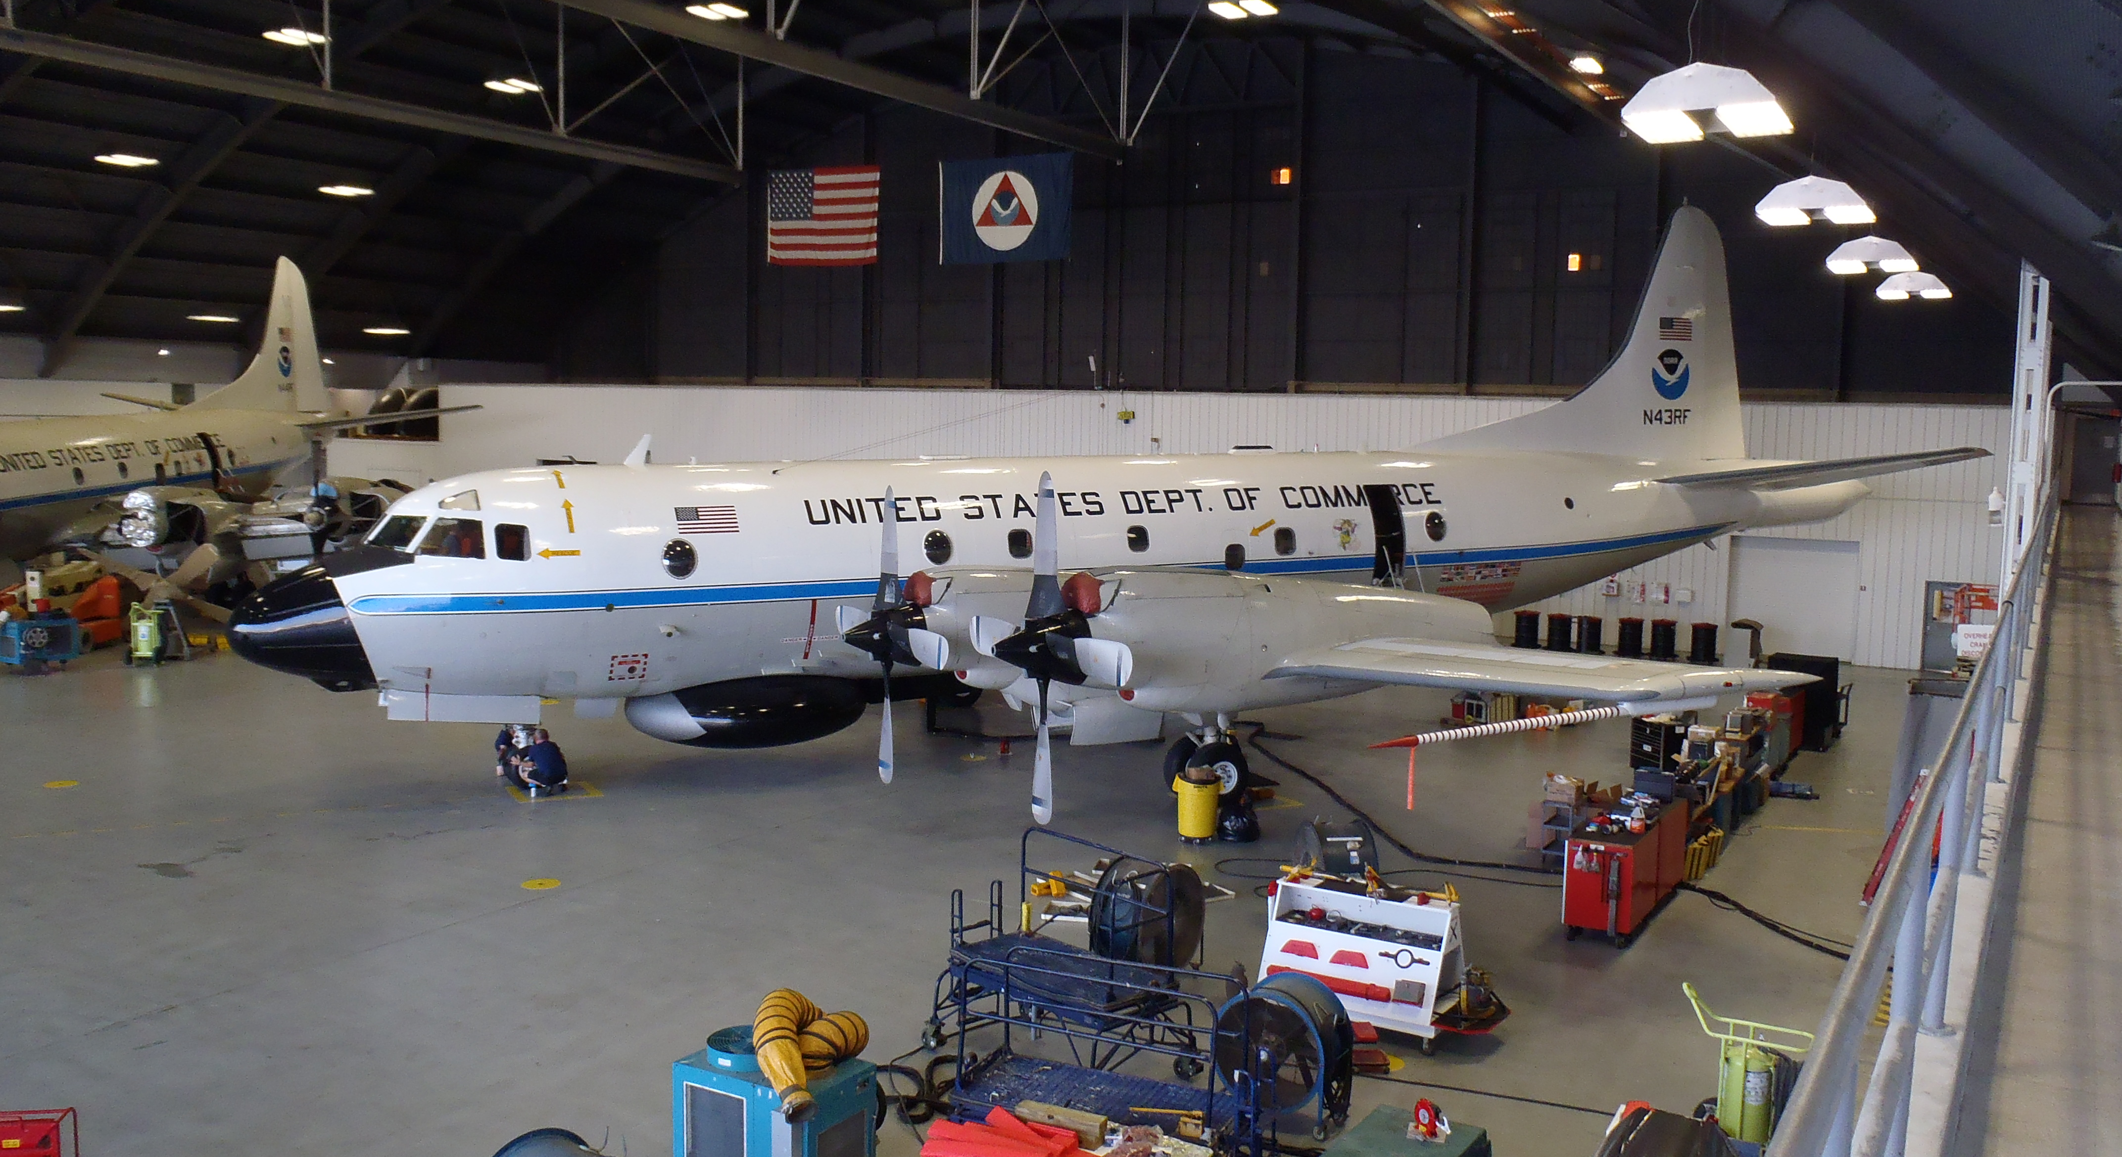
WP-3D Aircraft

Slide 18
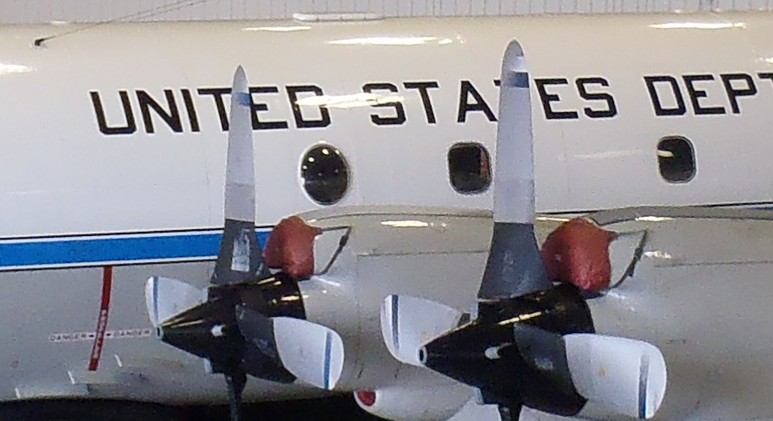
Cobham Chelton HGA 7000

Slide 19
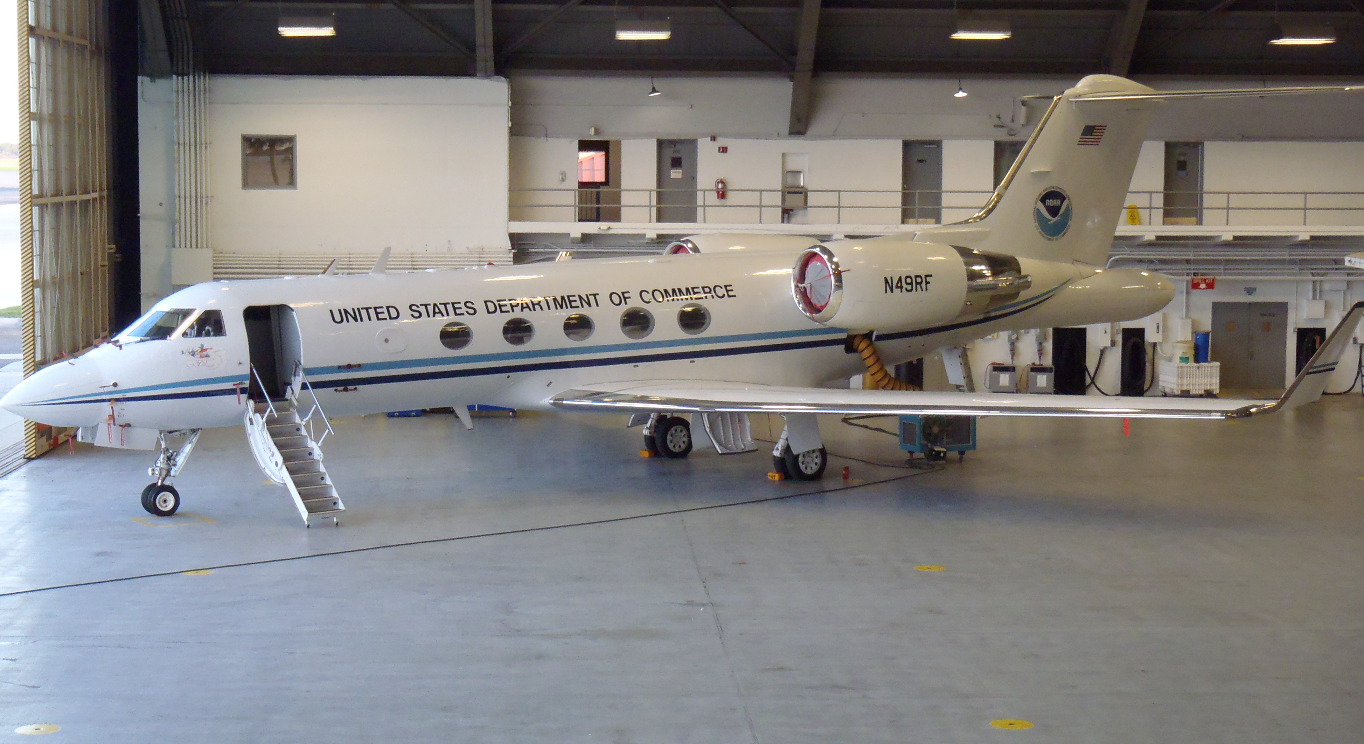
EMS Technologies AMT-50G

Slide 20
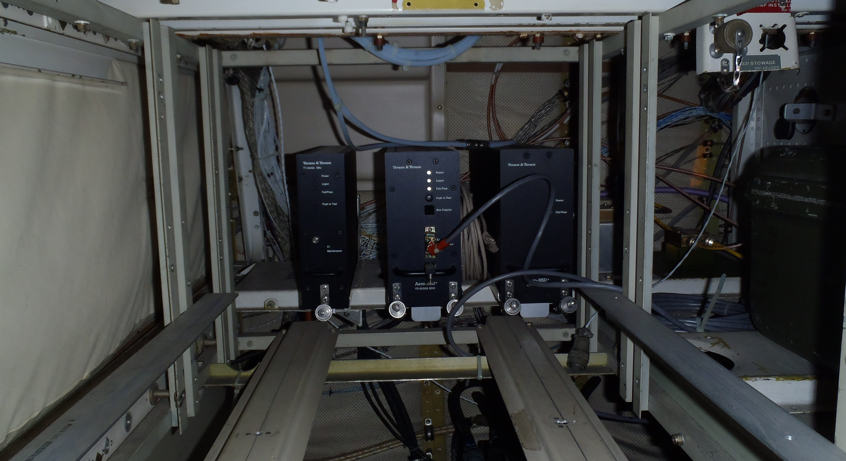

Slide 21
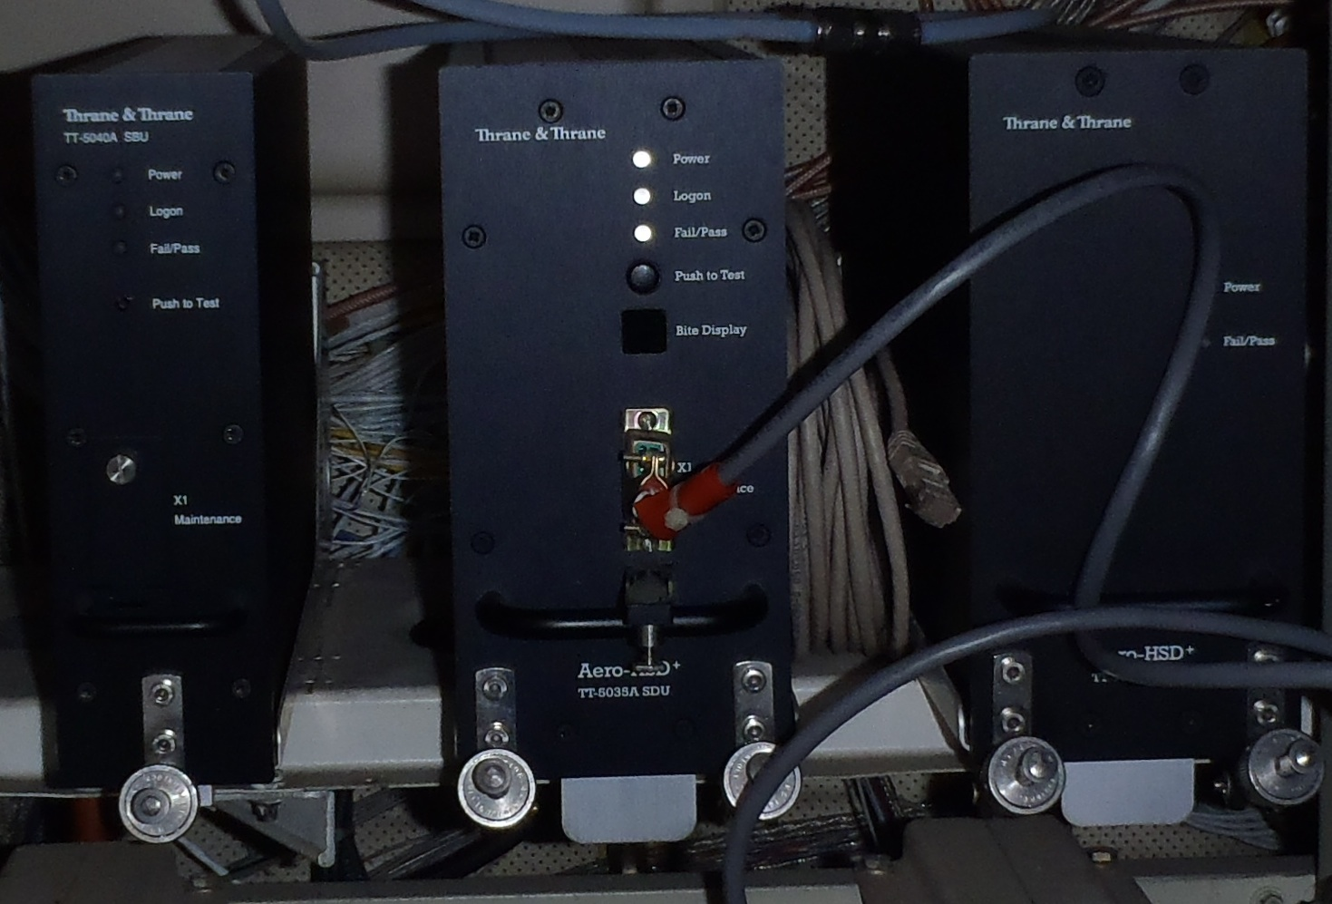

Slide 22
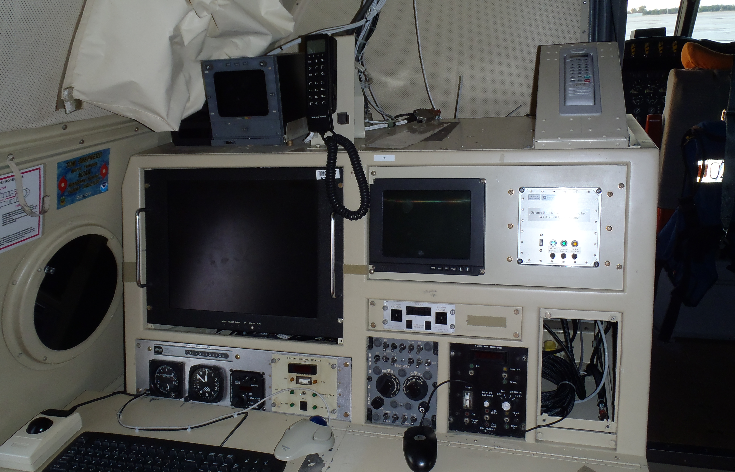
Satellite Thrane & Thrane Phone

Slide 23
Aircraft internet
Doppler-radar data (ftp)
  Quality-controlled nearly-full-resolution data
  Superobs
GPS Dropwindsondes
Flight-level in-situ data
Stepped Frequency Microwave Radiometer (remotely sensed surface wind speed)
IRC chat with scientists and others on ground

Slide 24
Other real-time data
ASCII wind-velocity analyses at 500- and 1000-meter levels, sent to the National Hurricane Center for use in their N-AWIPS data system
ASCII wind-speed profile analysis along flight track from 0-3 km, sent to the National Hurricane Center N-AWIPS data system
Full three-dimensional analyses of wind and radar reflectivity in HRD format and in self-describing NETCDF format, sent to AOML FTP

Slide 25
Typical Date Usage on
Doppler-radar flight
Connection time—7 hours (including 1 hour pre-flight)
311 Mbytes of data
Two voice calls totaling 5 minutes

Slide 26




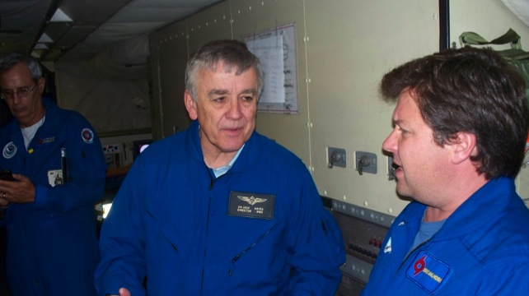
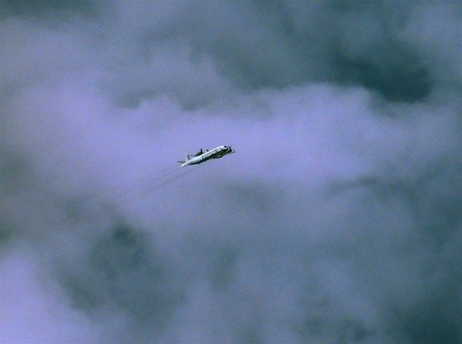
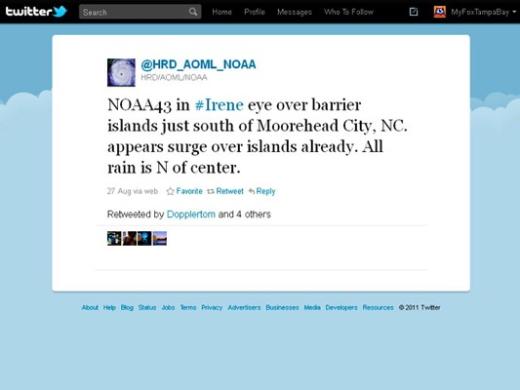
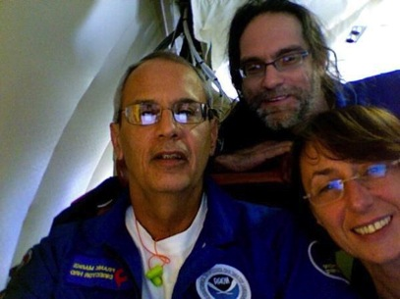
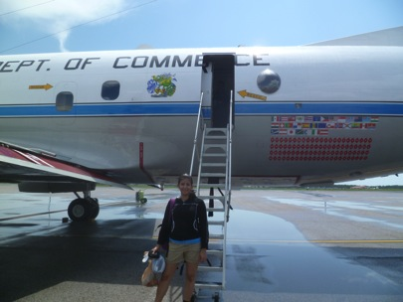
Outreach
Our blog
http://noaahrd.wordpress.com
HRD Web page
http://www.aoml.noaa.gov/hrd
Facebook
http://www.facebook.com/noaahrd
Twitter
http://twitter.com/#!/HRD_AOML_NOAA
Tweets from the eye
Visiting scientist program

Slide 27
Questions?

Slide 28
Real-time Doppler radar data
High-resolution Doppler radial-velocity data
  Quality controlled—sea surface, noise, de-aliasing
  Polar format around axis along fuselage
  Approximately 1 degree resolution in azimuth
  300-m resolution along radar radial direction
  Used by NOAA operations in Hurricane Weather Research and Forecasting Model (at present in “parallel runs”)
Superobs (intelligent averages of above data)

Slide 29

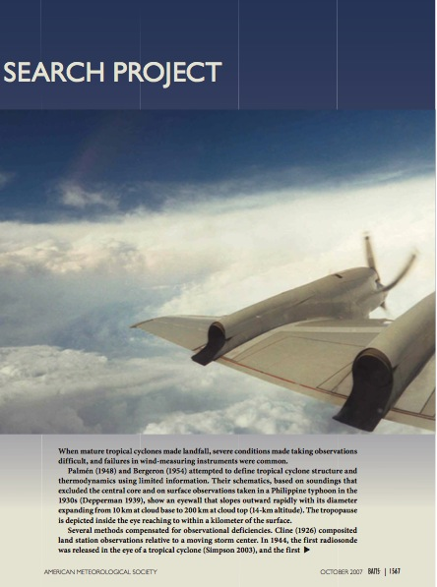

Excellent References
Dorst, N. M., 2007: The National Hurricane Research Project: 50 Years of Research, Rough Rides, and Name Changes. Bull. Amer. Meteor. Soc., 88, 1566–1588.
Aberson, S. D., M. L. Black, R. A. Black, R. W. Burpee, J. J. Cione, C. W. Landsea, and F. D. Marks, 2006: Twenty-five years of tropical cyclone research with the NOAA P-3 aircraft. Bull. Amer. Meteor. Soc., 87, 1039–1055.

Slide 30
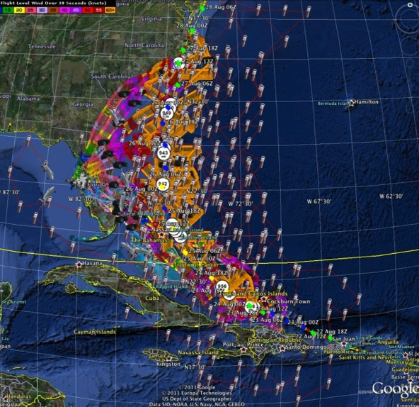
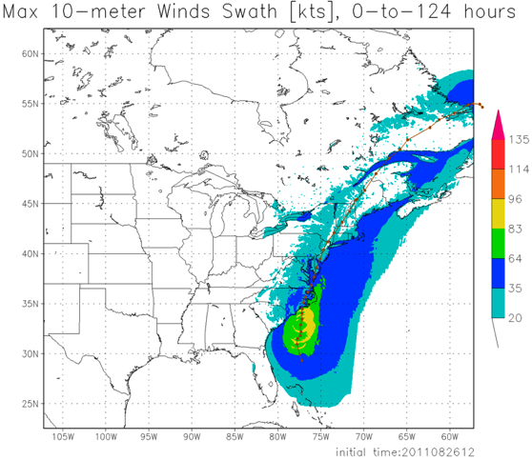
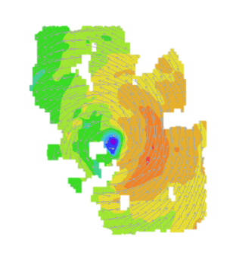
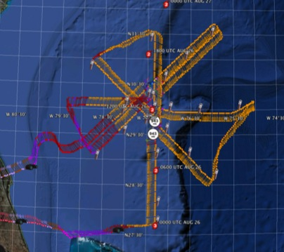
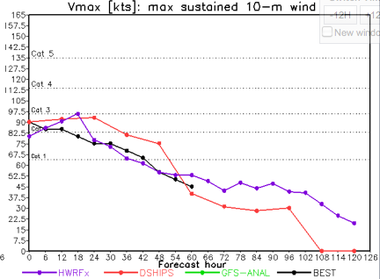
Improved Models & Data:
IFEX 2011: Irene
HWRF/HEDAS
20110826 12UTC
Doppler SO (EnKF) transmitted in real-time for assimilation into HWRF
20110826I1
0926-1416 UTC
7 P-3 Flights
23 August – 27 August 2011
HWRF/HEDAS
20110826 12UTC
7 missions from 23-27 Aug 2011 at ~12 h sampling of Doppler SO (HEDAS) & 8 G-IV missions
Sampled Irene as a major hurricane through landfall
Murillo, Aberson, Aksoy, Gamache, Gopal (AOML/HRD)
Notes:
Map shows flight tracks for all of the NOAA missions (color coded are the flight level winds for the P-3 missions, dropsonde symbols denote G-IV patterns)
Flight track plots courtesy of Tropical Atlantic - http://tropicalatlantic.com/recon/
Model data available at: http://storm.aoml.noaa.gov/realtime

Slide 31
Real-time Radar Data
“Superobs”—carefully chosen spatial averages of Doppler radial velocities
  Typical resolution—3 degrees azimuthally around fuselage axis, 2 km along radial direction, and 1 minute along flight track (~7-8 km for WP-3D)
  Used by research outfits, including NOAA’s Hurricane Research Division and researchers at the Pennsylvania State University

Slide 32
Data paths to ground
3D analyses, full resolution vertical wind profiles along flight track, superobs, ASCII analyses transferred via ftp to Atlantic Oceanographic and Meteorlogical Laboratory at Virginia Key, Miami FL
AOML site polled by National Hurricane Center for ASCII analyses

Slide 33
Data Paths to Ground
High resolution radial velocity vectors transferred to NOAA Aircraft Operations Center, and from there to the National Weather Service Telecommunications Operations Center, and from there to NCEP Central Operations, where the data are assimilated into NOAA’s Hurricane Weather and Research Forecasting Model (HWRF)
John—turn into schematic

Slide 34
National Centers for Environmental Prediction (NCEP)
Environmental Modeling Centers
  Run operational and “parallel” runs of HWRF
  Largest direct users of Inmarsat-transmitted data from NOAA aircraft
  Provide HWRF and other model runs to National Hurricane Center and public

Slide 35
National Centers for Environmental Prediction (NCEP)
National Hurricane Center
  Examines data, including aircraft flight-level in-situ data, SFMR (surface wind speed), and satellite observations
  Provides description of present hurricane motion, intensity, and structure
  Provides the official forecast based upon data, a number of forecast models, including HWRF, and their best human judgment about each model in a given situation

Slide 36
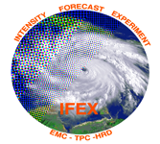

What in 2011 & 2012?:
IFEX 2011
  NOAA aircraft flew ~342 h (31 P-3 and 18 G-IV missions)
  Highlights include Dora (E. Pacific), Irene, Rina
  For details see: http://noaahrd.wordpress.com/category/ifex-discussion
IFEX 2012
  1 NOAA WP-3D, G-IV – 160 flight hours (1 June-30 November)
  Crews available 2/day missions starting July based from Tampa, FL
  Interact with NASA during their HS3 field campaign
HFIP real-time model demonstration

Slide 37

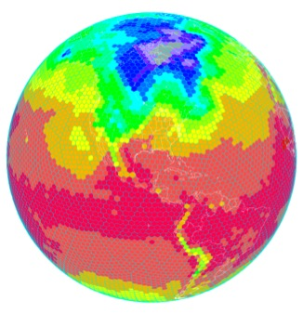
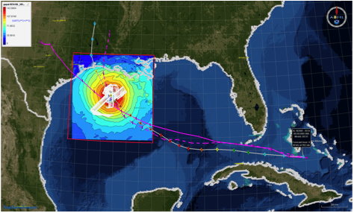
HFIP Activities
Traditional Hurricane Research Activities:
Observations, analysis, database, & instrument R&D (IFEX)
Statistical-dynamical model development
Advances in operational models (Stream 1)
New HFIP Research Thrusts:
Experimental global and regional hurricane model development (Stream 2)
Data assimilation techniques and observing system strategy analysis development (Stream 1 & 2)
Model evaluation tool development
Application and tool development for forecasters
D1
D2
Partnership: NCEP, AOC, AOML, ESRL, GFDL, DTC, USWRP, NESDIS/STAR
http://www.hfip.org/documents/
Notes:
http://www.hfip.org/documents/
Two Stream Approach to HFIP developments:
Stream 1– Operational Transition and Implementation
Stream 2 – Advanced Technology Demonstration
Unconstrained by near-term availability of operational computing
Uses both NOAA’s and computing resources from major supercomputing centers for testing and evaluation.
Emphasis is on high resolution global and regional models run as ensembles
Real-time or near real time runs during hurricane season
Stream 1.5 (JHT-like)
NHC Forecaster Defined.
Subset of Stream 2 that forecasters see as particularly promising or provides demonstrated capability
Will be configured to run in real-time and products made available to NHC.

Slide 38

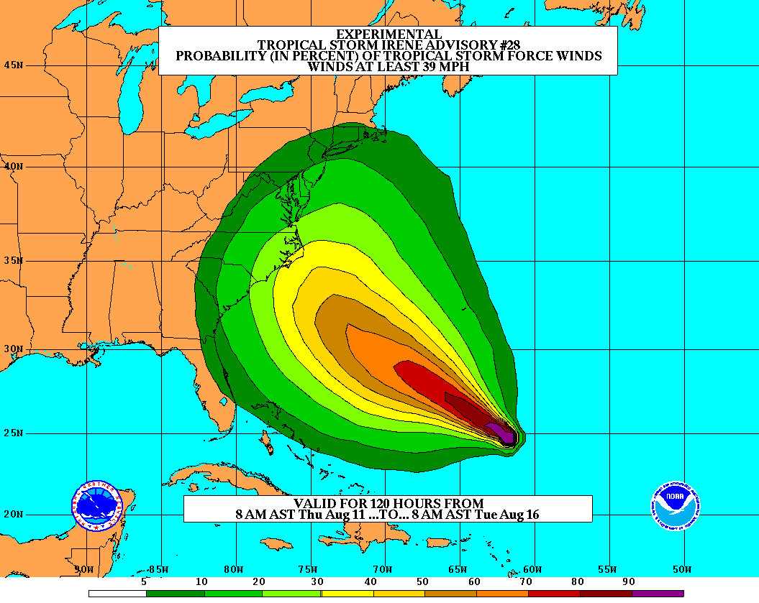
Goals
Improve Forecast Accuracy
  Hurricane impact areas (track) – 50%
  in 10 years
  Severity (intensity) – 50% in 10 years
  Storm surge impact locations
  and severity
Extend forecast reliability out to 7 days
Quantify, bound and reduce forecast uncertainty to enable risk management decisions
Notes:
http://www.hfip.org/
http://www.nrc.noaa.gov/HFIPDraftPlan.html
HFIP Team
Frank Marks, research lead
Ed Rappaport, operations lead
Fred Toepfer, project manager
Robert Gall, development manager
Mark DeMaria
Chris Fairall
Jim McFadden
Daniel Melendez
HFIP executieve oversight board:
OAR DAA/Sandy MacDonald, co-chair
NWS AA/Jack Hayes, co-chair
NCEP/Louis Uccellini,
TPC/Bill Read,
NESDIS/Mark DeMaria,
NOS/Jesse Feyen,
AOML/Bob Atlas
PPI/Paul Doremus
NMFS/Bonnie Ponwith,
NOS/Liz Scheffler,
NMAO-PM Aircraft/Mike Devany
OFCM/Sam Williamson
Executive Secretariat: OAR/Brian Ornsdorff and NWS/Nasheema Lett

Slide 39
HFIP Success to Date
HFIP making significant progress – 5-year goals within reach
  Global ENKF ensembles providing 20% improvement in track guidance
  Improved model initialization and higher resolution models, along with inner core data shows significant (20-40%) improvement in intensity
  3-5 day lead-time hurricane genesis product with acceptable POD’s and FAR’s in development
  Demonstration of Skill for track at 7 days underway
  Still uncertain progress toward goal for POD/FAR of rapid intensification of 90%/10% at day 1 and 60%/40% at day 5.
Notes:
Successes to date shown in 4 Red bullets/sub bullets are demonstrated in the 4 following slides

Slide 40
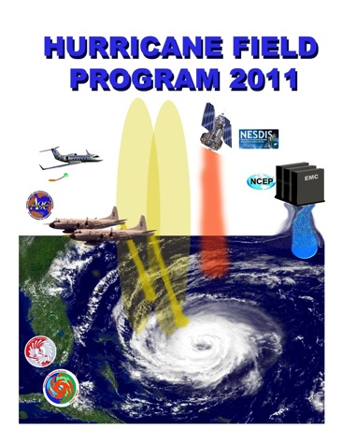
HOW do we improve Hurricane Intensity forecasts?:
NOAA Intensity Forecast Experiment (IFEX)
Partnership to improve TC intensity/ structure forecasts
Collect targeted observations
  throughout TC life cycle for DA of core circulation
  in and around storm scale circulation to evaluate HWRF
  in variety of atmospheric/oceanic conditions to assess observed & model TC intensity/structure changes
Improve physical understanding & representation of
  Boundary layer
  Surface flux
  Microphysics
  Impact of dry air (SAL)
  Rainbands & eyewall
http://www.aoml.noaa.gov/hrd/HFP2011/IFEX.html
Notes:
• AOML/HRD provides operational support for G-IV surveillance (2 people) and WP-3D reconnaissance SFMR (1 person) missions despite transitioning activities to operations. HRD augments AOC staff by providing meteorological expertise for data QC because they do not have manpower, but we receive no support for these activities. Will become greater issue as we transition airborne Doppler. HRD no longer has internal resources to support these activities.
• 2 tropical cyclones flown from beginning to end of life cycle
Irene
Rina

Slide 41
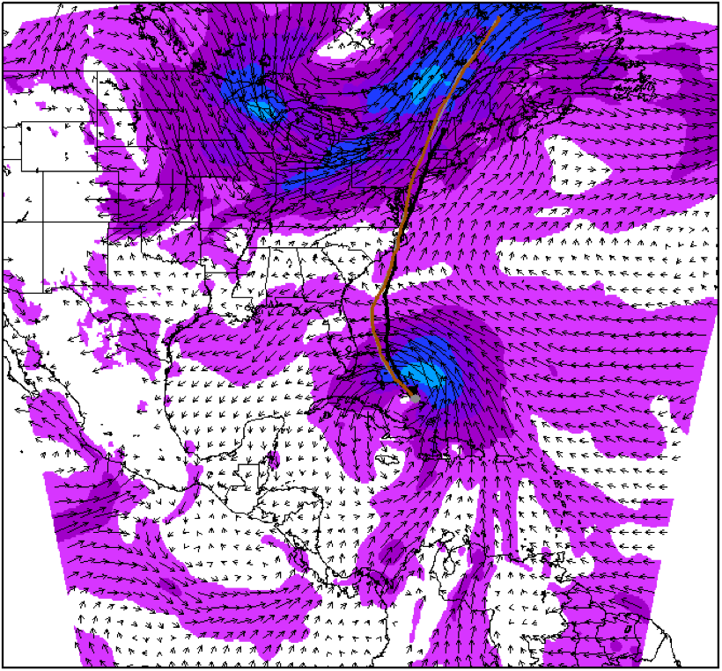
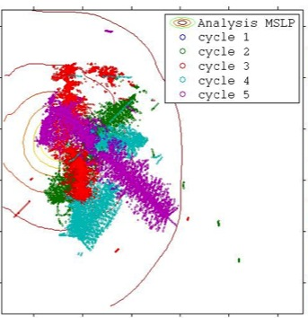
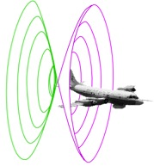

Assimilation of data into numerical models
Synergy of high resolution forecast and airborne observations
P-3 and G-IV observations – superobs (SO)
Data assimilation
Improving the initial condition in storm core region
Improving the high resolution regional forecast
Wind intensity at 10 m
Hurricane Irene(2011)
F. Zhang (PSU), Aberson, Aksoy, Gamache, Gopal (AOML/HRD)

Slide 42
Hurricane Research Division
National Oceanic and Atmospheric Administration
  Office of Oceanic and Atmospheric Research
    Atlantic Oceanographic and Meteorological Laboratory—Physical Oceanography, Ocean Chemistry and Hurricane Research Division
      Hurricane Research Division
        Physical Research (applied and some basic) on Hurricanes using:
        Observations
        Hurricane Modeling
        Data Assimilation

Slide 43
Hurricane Research Division
Observations
  Instrument examples: Airborne Doppler Radar, Stepped Frequency Microwave Radiometer, Dropwindsondes, Cloud Microphysics Instruments, Airborne Expendable BathyThermographs (AXBT), Deployable Buoys, Flight-level in-situ data.
Science:
  Project examples: Tropical cyclones in vertical wind shear, air-sea interactions in hurricanes, hurricane boundary layer structure, hurricane intensity change, hurricane track

Slide 44
Hurricane Research Division
Hurricane Modeling—Hurricane Weather Research and Forecasting Model (HWRF)
  Testing new physics and numerics in the operational model before it’s transitioned to operations
Data Assimilation—Initialization of HWRF by determining an optimal blend of observations and previous model runs, HEDAS (HWRF Ensemble Data Assimilation System)
  observations: airborne Doppler radar, GPS dropwindsondes, flight-level in-situ data, radiosondes, flight-level in-situ data, stepped frequency microwave radiometer (surface wind speed), satellite

Slide 45
Aircraft Operations Center
NOAA
  Office of Marine and Aviation Operations
    Aircraft Operations Center—MacDill AFB, Tampa FL
      Operate NOAA heavy aircraft that penetrate tropical cyclones or probe the immediate environment
        WP-3D aircraft (NOAA42 and NOAA43)
        G-IV aircraft (NOAA49)
      Direct customer of Inmarsat, Thrane and Thrane, Cobham Chelton and EMS Technologies

