Slide 1
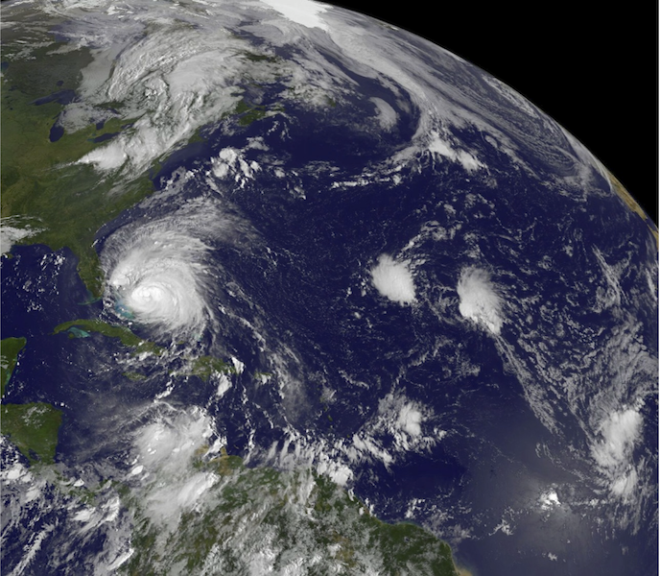
NOAA Hurricane Research
Hurricane Irene
TD 10
F. Marks
NOAA HFIP Research Lead
NOAA/AOML Hurricane Research Division
Notes:
Hurricanes Earl and Fiona 30 August 2010

Slide 2
GOALS:
Advance understanding and prediction of tropical cyclones (TC) through observations, numerical models, and theory, with emphasis on processes within inner part of storm.
NOAA’s hurricane research focus for >50 years
The goals of this research are to:
1. Advance prediction of TC intensity and structure change (INTENSITY);
2. Improve prediction of TC track (TRACK); and
Enhance ability to diagnose and predict impacts of TC on life and property (IMPACTS)
http://www.aoml.noaa.gov/hrd/
WHO:
AOML/Hurricane Research Division (36 employees) 19 research, 17 support, 4-5 summer students
Notes:
Our interactions with PhOD take advantage of the expertise they have in in situ upper ocean observations as well as satellite oceanography. PhOD staff working with HRD are Gustavo Goni on the ocean heat content (OHC) efforts along with some assistance from the Jaoquin Trinanes on the OHC web site. We also are starting to work with Rick Lumpkin on the mini drifters and floats deployed ahead of the storms such as Rita and Frances last year. These data are processed and available through the GOOS Center website also at AOML.
• The multi-decadel work has been covered internally and through some small grants from the Office of Global Programs (OGP). This work is in collaboration with PhOD (Enfield, Mestas-Nunez) and NCEP/CPC.

Slide 3
Unified NOAA approach to guide and accelerate improvements in forecasts, with emphasis on rapid intensity change, and reduction in uncertainty.
Improve forecasts and increase confidence to enhance mitigation and preparedness decisions.
Respond to input from stakeholders, NSB, OFCM, and HIRWG reports.
Embrace strong collaboration with non-NOAA partners through strategic alliance with objective to transition research into operations.
Notes:
3
NOAA established HFIP as a 10-year project designed to accelerate improvements in tropical cyclone forecasts, with an emphasis on rapid intensity change, and to reduce forecast uncertainty.
The goal of HFIP is to improve forecasts of tropical cyclones, particularly intensity change, and increase confidence in those forecasts in order to enhance mitigation and preparedness decisions at all levels of government and by individuals
HFIP responds to input from stakeholders and recent National Science Board (NSB), Office of the Federal Coordinator for Meteorology (OFCM), and the NOAA Science Advisory Board Hurricane Intensity Research Working Group (HIRWG) reports calling for accelerated improvements in hurricane forecasts.
HFIP establishes a unified approach to hurricane improvements across NOAA operating units and calls for collaboration with our federal partners and the external research community in its execution.

Slide 4
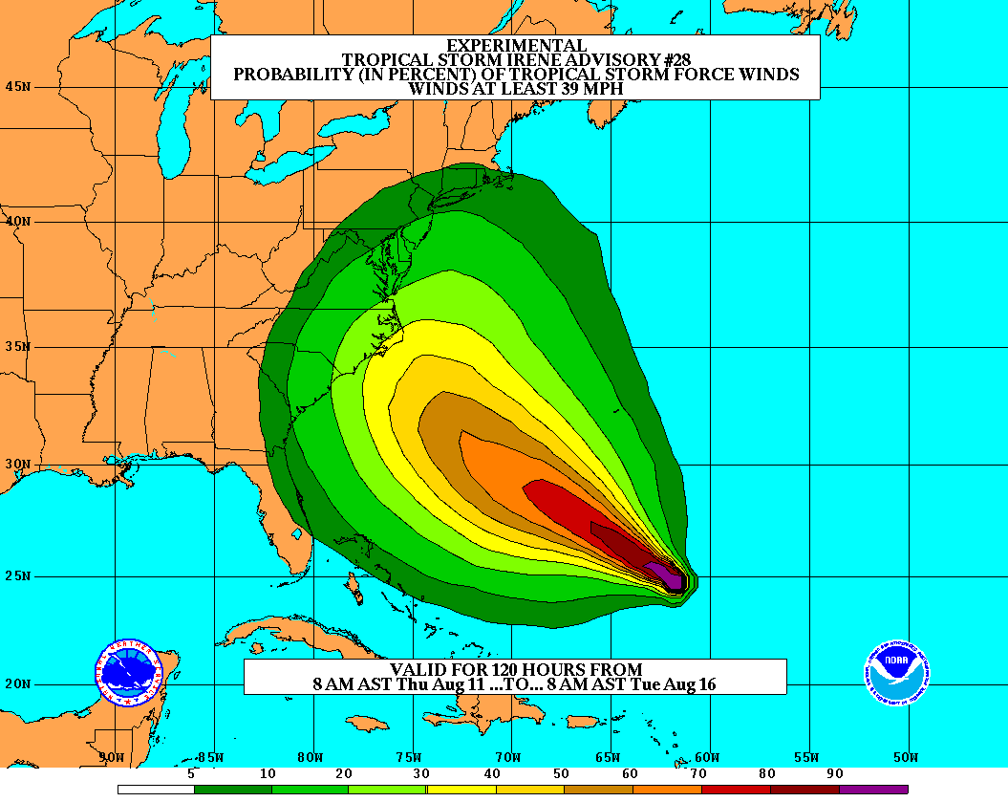
Goals
Improve Forecast Accuracy
Hurricane impact areas (track) – 50% in 10 years
Severity (intensity) – 50% in 10 years
Storm surge impact locations and severity
Extend forecast reliability out to 7 days
Quantify, bound and reduce forecast uncertainty to enable risk management decisions
Notes:
4

Slide 5
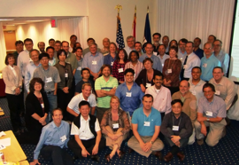
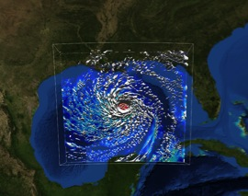
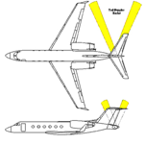
How to get there?
Science
Improved understanding from combination of observations & models
Higher resolution coupled models – critical to storm evolution forecasts – especially intensity changes
Forecast techniques to understand, reduce &communicate uncertainty
Information Technology
Increased computing power - run advanced hurricane/global models and reduce uncertainty
IT infrastructure for inter-agency data exchange
Observing Strategy
Improved use of existing and planned systems
Improved Forecaster Products
Notes:
5
Guide and accelerate HFS improvements (HFS)
Accelerate NOAA operational HFS & GFS development
R&D to improve HFS and GFS (need basic research)
R&D for HFS and GFS ensemble systems (need basic research)
Develop observing system strategy analysis capability (OSE)
R&D to improve observing strategy to improve forecasts & inform NOAA investments
Fully fund transition of research to operations (R2O)
Broaden JHT charter and increase support
Develop interactions between JHT, DTC and JCSDA
Increase high performance computing (res & ops)
Coordinate with research community on basic research
NOAA can not meet goals alone!
Broaden base of expertise in tropical cyclone research community
Work closely with federal, academic, and private sector communities Provide dedicated high performance computing capacity for HFS operations and research & development

Slide 6
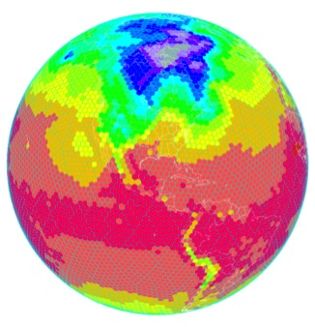
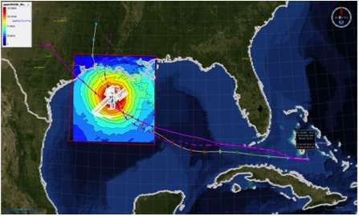
Traditional TC Research Activities:
Observations, analysis, database, & instrument R&D
Statistical-dynamical model development
Advances in operational models
New HFIP Research Thrusts:
Experimental global and regional hurricane model development
Data assimilation techniques and observing system strategy analysis development
Model evaluation tool development
Socioeconomic research and development
Partnership: NCEP, AOC, AOML, ESRL, GFDL, DTC, USWRP, NESDIS/STAR
Notes:
6
Guide and accelerate HFS improvements (HFS)
Accelerate NOAA operational HFS & GFS development
R&D to improve HFS and GFS (need basic research)
R&D for HFS and GFS ensemble systems (need basic research)
Develop observing system strategy analysis capability (OSE)
R&D to improve observing strategy to improve forecasts & inform NOAA investments
Fully fund transition of research to operations (R2O)
Broaden JHT charter and increase support
Develop interactions between JHT, DTC and JCSDA
Increase high performance computing (res & ops)
Coordinate with research community on basic research
NOAA can not meet goals alone!
Broaden base of expertise in tropical cyclone research community
Work closely with federal, academic, and private sector communities Provide dedicated high performance computing capacity for HFS operations and research & development

Slide 7
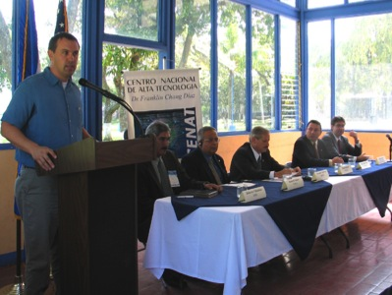
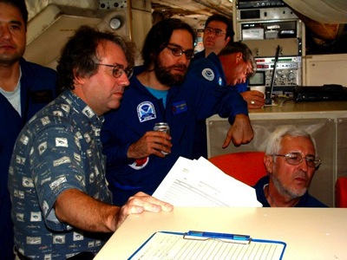
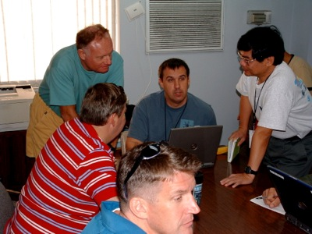
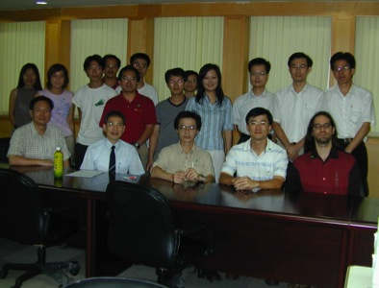
HOW?:
Joint research programs outside of NOAA with NASA, NSF, and ONR (NSF/PREDICT & NASA/GRIP)
Cooperative research with scientists at NCAR, and universities (HFIP and NOPP BAA)
Interact with WMO WWRP and THORPEX, and cooperative research with other countries (IWTC-VII)
Ensure research benefits NOAA.
IFEX/TCSP
CBLAST
IFEX/RAINEX
DOTSTAR
7
Notes:
7
HRD maintains active research programs with other governmental agencies, in particular, the Department of the Navy’s Office of Naval Research (ONR), National Aeronautics and Space Agency (NASA), and National Science Foundation (NSF).
In program areas where it is beneficial to NOAA, HRD arranges cooperative research programs with scientists at NCAR, and at a number of universities (e.g., NPS, Miami, MIT, PSU, FSU, Washington, CSU, NC State, UNC/Charlotte, Nevada/DRI, Houston).
HRD scientists also interact with the International Tropical Cyclone Community through participation in the WMO International Workshops on Tropical Cyclones, and in cooperative research programs with groups in other countries (e.g., Australia, Canada, China, France, Germany, India, Japan, Taiwan, UK)
HRD is working with these non-NOAA partners to insure their research benefits the HFIP.

Slide 8
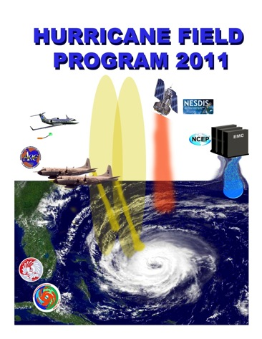
HOW?:
NOAA Intensity Forecast Experiment (IFEX)
Partnership to improve TC intensity/ structure forecasts
Collect targeted observations
throughout TC life cycle for DA of core circulation
in and around storm scale circulation to evaluate HWRF
in variety of atmospheric/oceanic conditions to assess observed & model TC intensity/structure changes
Improve physical understanding & representation of
Boundary layer
Surface flux
Microphysics
Impact of dry air (SAL)
Rainbands & eyewall
http://www.aoml.noaa.gov/hrd/HFP2011/IFEX.html
Notes:
• AOML/HRD provides operational support for G-IV surveillance (2 people) and WP-3D reconnaissance SFMR (1 person) missions despite transitioning activities to operations. HRD augments AOC staff by providing meteorological expertise for data QC because they do not have manpower, but we receive no support for these activities. Will become greater issue as we transition airborne Doppler. HRD no longer has internal resources to support these activities.
• 2 tropical cyclones flown from beginning to end of life cycle
Irene
Rina

Slide 9
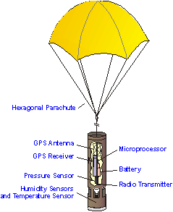
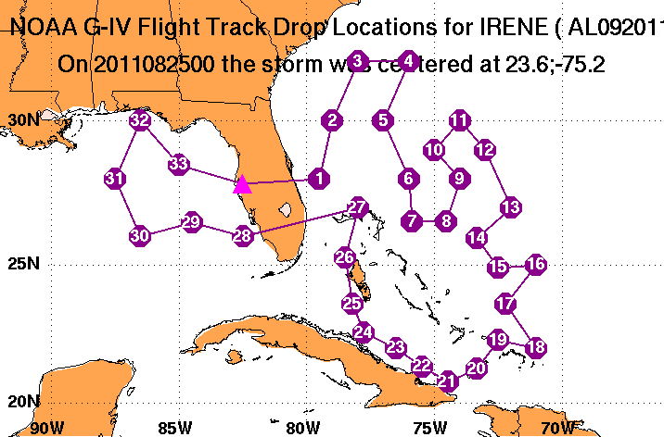
WHAT?:
Current TC research:
Track:
Synoptic-surveillance using dropsondes.
Analytical & numerical studies.
Ensemble track forecasting & targeted observations.
http:/www.aoml.noaa.gov/hrd/data_sub/assesment.html
Notes:
• Track work in partnerships with NWS and NSF. Partially supported through JHT. Work has been slowed by lack of ability to run operational models on EMC development machines since latest model upgrades done at the beginning of 2005 season. Sim has been unable to evaluate 2005 performance to date. This inability to run on development machine is a major stumbling block for this type of model evaluation work like we are proposing for other parameters (surface wind speed, structure). Not sure how we can work with EMC to alleviate this roadblock.

Slide 10
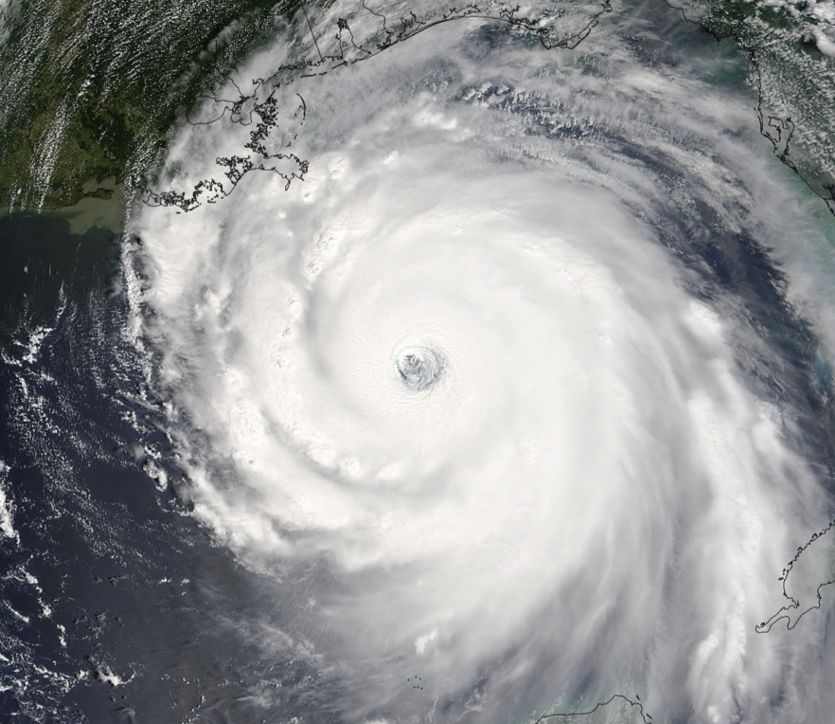
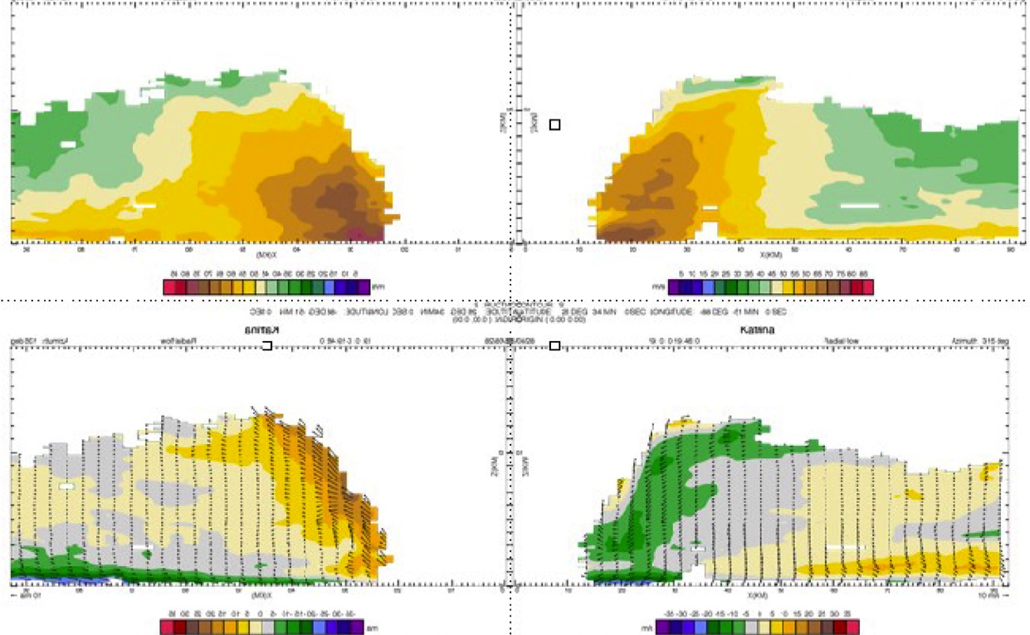
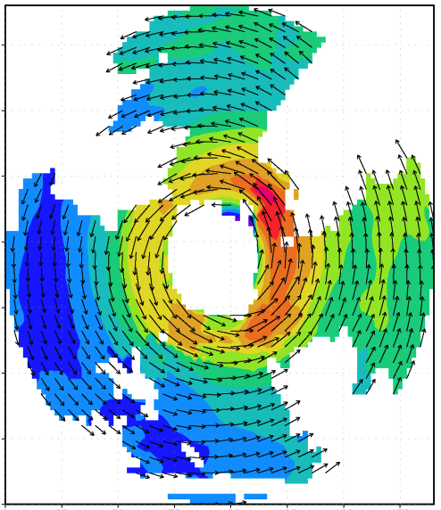
Intensity:
Airborne Doppler radar studies, air-sea interaction studies, and 3-D modeling of TC
V_{θ}
150
100
distance (km)
V_{r}, w
50
0
0
50
100
150
distance (km)
Airborne Doppler-analyzed wind field Hurricane Katrina, 28 September 2005
http://www.aoml.noaa.gov/hrd/Storm_pages/katrina2005/radar.html
Notes:
• Statistical Hurricane Intensity Prediction System (SHIPS) Still show more skill relative to numerical guidance
• IFEX is multi-year data collection effort to test data flow to initialize HWRF and for use in model data sets. IFEX is partnership with NWS, NESDIS, NASA, ONR, NSF
• HRD developed the capability to make a three-dimensional analysis from automatically quality-controlled Doppler data as part of JHT and a G-IV Doppler radar upgrade proposals. Horizontal and vertical cross sections of these analyses were transmitted from the P3 to NHC. The three-dimensional analyses have a vertical resolution of .5 km and a horizontal resolution of 4 km. Analyses of the horizontal and vertical distribution of radius-height-averaged winds are examples of those sent to NHC in nearly all storms for the late phase of IFEX. HRD cooperated with NHC to produce analyses of the greatest interest to NHC, namely the 4-km x 4-km x 0.5-km analyses at 500 m and 1 km.
• Goal is to provide QC Doppler radar-radial-velocity observations from NOAA G-IV and WP-3D aircraft in real time to EMC for assimilation into HWRF. HWRF will be able to use data at 1.5 km horizontal resolution and finer vertical resolution to initialize winds in TC core and immediate environments. Only way to consistently obtain such data is X-Band airborne Doppler radar. 32 real-time analyses sent via SATCOM for NHC
Katrina: 5 analyses on 25 August
4 analyses on 27 August
5 analyses on 28 August
Ophelia: 2 analyses on 8 September
3 analyses on 9 September
5 analyses on 11 September
2 analyses on 12 September
Rita: 1 analysis on 20 September
4 analyses on 21 September
1 analysis on 22 September

Slide 11
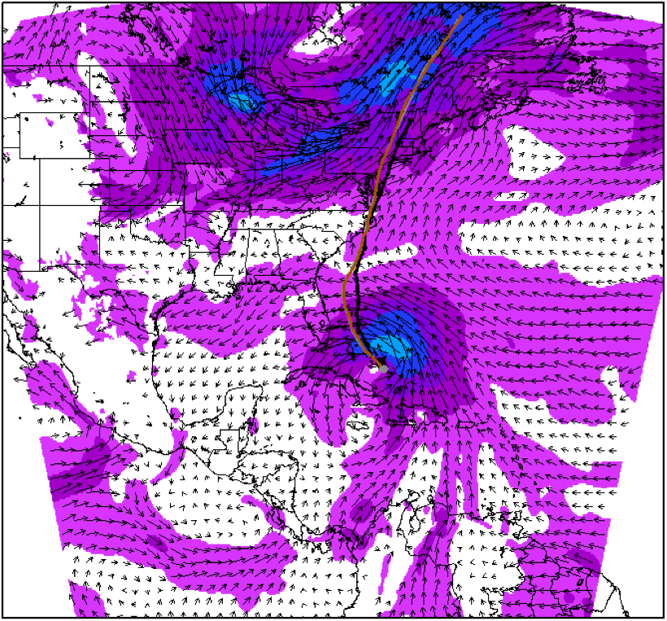
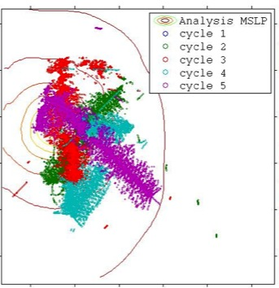
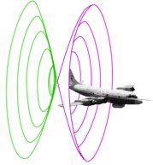
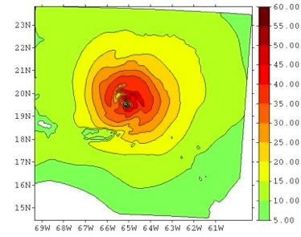
Intensity (continued): Assimilation of data into numerical models
Synergy of high resolution forecast and airborne observations
P-3 and G-IV observations – superobs (SO)
Data assimilation
Improving the initial condition in storm core region
Improving the high resolution regional forecast
Wind intensity at 10 m
Hurricane Irene (2011)
F. Zhang (PSU), Aberson, Aksoy, Gamache, Gopal (AOML/HRD)

Slide 12
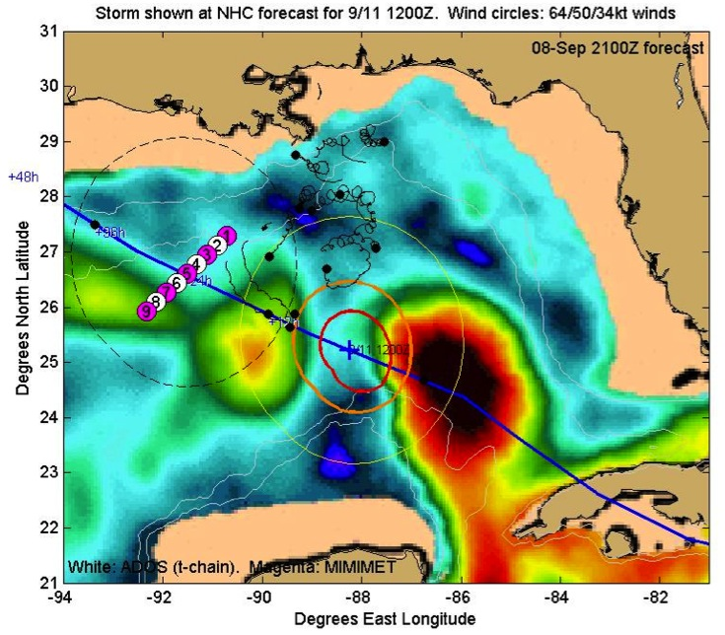
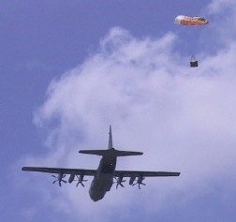
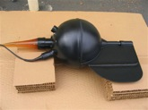
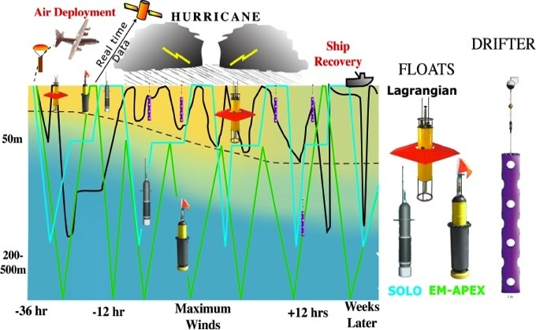
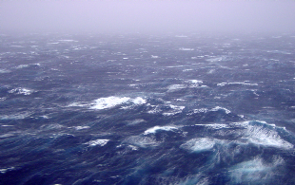
Intensity (continued):
Air-sea interaction studies
TC impact on upper ocean
effect of Hurricanes Gustav & Ike (2008)
http://iwave.rsmas.miami.edu/heat/
CBLAST
Waves from 200’ in Isabel
Targeted upper ocean observations
http://www.aoml.noaa.gov/hrd/cblast/index.html
Notes:
• Hurricane Weather Research and Forecast (HWRF) model system being developed by EMC (uses NMM core versus NCAR mass core) Coupled atmos/land/ocean regional model system
• Stepped Frequency Microwave Radiometer (SFMR) first developed with NASA and UMASS in 80s and 90s. Operational version is commercial product developed by ProSensing (former UMASS students)
• Uninhabited Aerial Systems (UAS) - Aerosonde for now, but we are now working with the NOAA UAS advisory group on getting hurricane observing requirements addressed by other UASs (GlobalHawk and others)
• HRD is working with Paul Chang (NESDIS) and AOC to develop and improve the SATCOM transfer of data from aircraft for operational use. AOC is purchasing a 64KBd SATCOM system like the one on the G-IV for one P-3 next year (currently we have 9.6KBd and 1.2 KBd SATCOM on P-3s). This upgrade will enable us to transmit the raw Doppler data to EMC as well as the real-time analyses. With this upgrade we are even discussing moving some processing of the data to the ground as a backup to the aircraft processing. It also will allow us to consider archiving the data directly from the SATCOM feed through NESDIS. It is a necessary precursor to any UAS technology migration.
• A major outgrowth of our GPS dropsonde work has been Mark Powell’s paper on the drag coefficient roll-off at winds >40 m/s. This new drag coefficient for high winds is being tested in GFDL and HWRF. It is not clear that this new parameterization will improve current coarse res models. These issues need testing and evaluation as we move to finer res models.

Slide 13
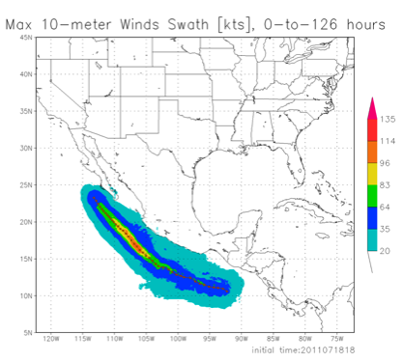
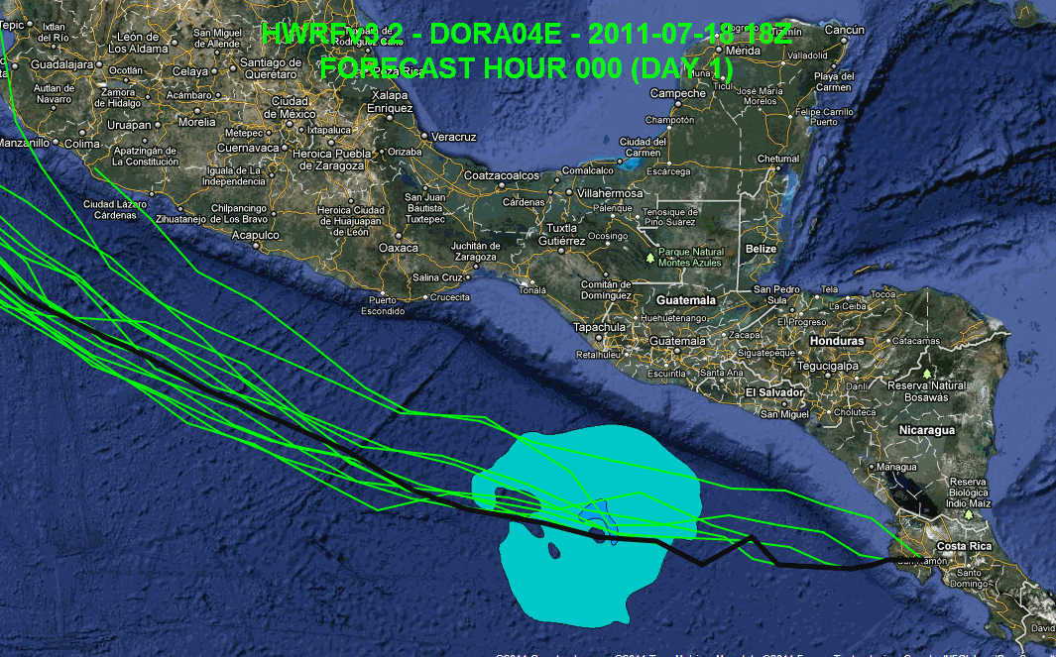
Intensity (continued):
3-D modeling of TC
Experimental HWRF real-time demo simulations
(https://storm.aoml.noaa.gov/hwrfx/)
High –resolution HWRF model system development and evaluation
Notes:
• As the new models are developed to deal with intensity and structure we need to develop new metrics for model and forecast evaluation beyond the traditional minimum central pressure and peak surface wind. The NWS metric of the peak 1-min sustained surface wind anywhere is not as meaningful anymore. A model or forecast could be correct on those parameters for the wrong reason. Customers want to know more about the impacts to expect and that means structure and size matter. Proposed new metrics are structure (radii of 35, 50, 65 kt, and radius of maximum wind in different quadrants) and rapid intensification (FAR vs POD). They need to be tested and improved with data as well as model output.

Slide 14
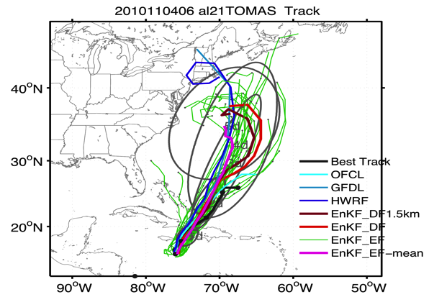
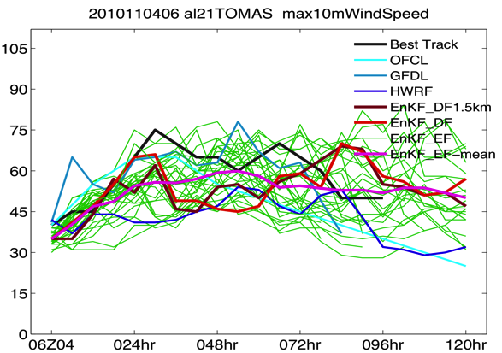
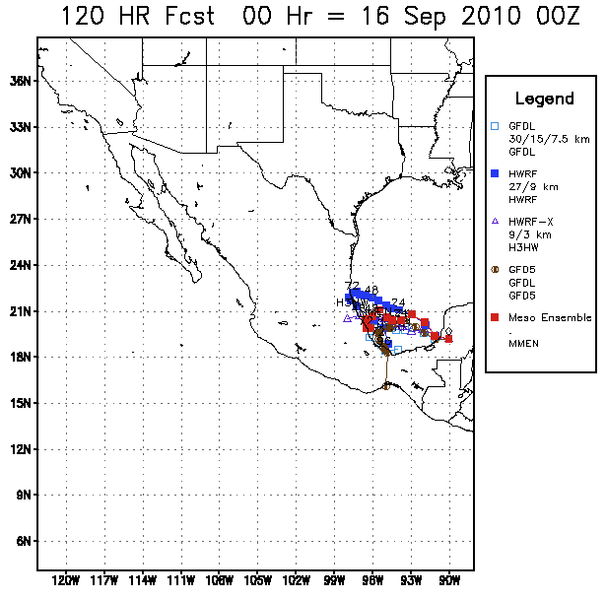
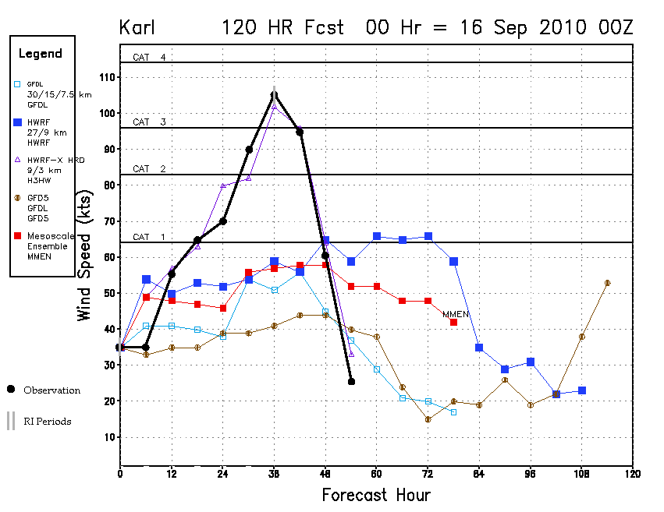
Intensity (continued):
Ensembles: Single & Multi-model
Hurricane Tomas
Hurricane Tomas
Hurricane Karl
Hurricane Karl
Notes:
• As the new models are developed to deal with intensity and structure we need to develop new metrics for model and forecast evaluation beyond the traditional minimum central pressure and peak surface wind. The NWS metric of the peak 1-min sustained surface wind anywhere is not as meaningful anymore. A model or forecast could be correct on those parameters for the wrong reason. Customers want to know more about the impacts to expect and that means structure and size matter. Proposed new metrics are structure (radii of 35, 50, 65 kt, and radius of maximum wind in different quadrants) and rapid intensification (FAR vs POD). They need to be tested and improved with data as well as model output.

Slide 15
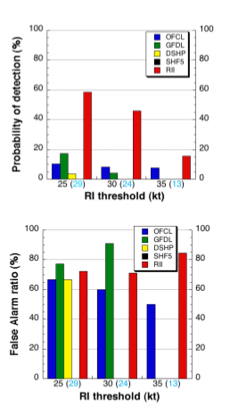
Intensity (continued):
Statistical Models
Since 1997, SHIPS most skillful intensity guidance to NHC/TPC.
Incorporates inner-core SST impact
Evaluation of SHIPS shows average 3%, 6% and 15% increase in forecast skill for all storms with inner-core SST estimates.
“Rapid intensification (RI)” index under developed.
Evaluation of RI shows average 5% and 30% improvement for ATL & EPAC.
ATL
RI Index has much higher POD than any dynamical model and OFCL in both ATL and EPAC (EPAC easier than ATL)
FAR for RI index comparable to dynamical models and OFCL
Kaplan et al (2009)
Notes:
• Goal of the HRD 2005 AOP was to upgrade SHIPS with Cione’s inner core SST correction ( see reference CIONE, J.J., and E.W. UHLHORN. Sea surface temperature variability in hurricanes: Implications with respect to intensity change. Monthly Weather Review, 131(8):1783-1796 (2003)) and demonstrate a 5% improvement in SHIPS intensity forecasts. We have yet to complete the 2005 evaluation, but rerunning the 2004 storms with the new correction demonstrated a 4% improvement over the operational SHIPS. This year should be at least as good, given storms such as Ophelia, Rita and Katrina.
• Figure shows actual improvement from rerun of the 2004 season in kt (not %). Note dramatic improvement for hurricanes and especially storms undergoing rapid intensification (>25 kt in 24 h), particularly beyond 48 h. Reason for dramatic improvement at later forecast periods is importance of the SST predictor in SHIPS at later times.
• Important note: SHIPS is an example of providing guidance on guidance,as it uses the global model initial conditions and forecast output as predictors. SST is one of the most important of the predictors and the operational version uses the Reynold’s weekly SST. Where the new version is providing improvements is by adding internal storm information, the correction of the Reynold’s SST by a value more representative of what should be under the eyewall. This is a trend in the development of SHIPS that is telling us that to do intensity right we need to know more about the current state of the inner vortex that is not represented in the global model fields. Mark DeMaria has demonstrated similar improvements by using IR satellite information and flight level data. Unfortunately, that information is only available at the initial time and does not seem to show that much improvement to longer time intervals, whereas Cione’s algorithm is applied to all forecast times and seems to better reflect the actual storm conditions.

Slide 16
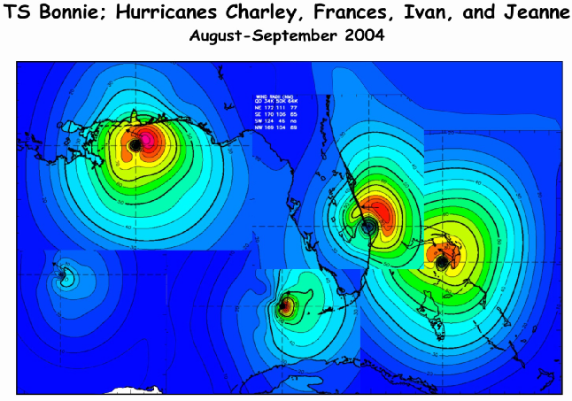
Structure:
Land-based radar, surface data, GIS. Development of a real-time surface analysis system.
http://www.aoml.noaa.gov/hrd/data_sub/wind.html
Notes:
• Surface wind field work is mainly supported through a NOPP that Hans Graber controls (collaboration between UM, USACE, HRD, and Vince Cardone’s Ocean Weather). HRD receives support to provide them near real-time surface winds to drive their surge and wave models. HRD also receives support for these wind fields from the USACE, particularly for the production of wind fields for past storms to use for model testing. Finally, some of the support comes from the development of a wind model for the State of Florida CAT model effort in collaboration with FSU, FIU, and UF.

Slide 17
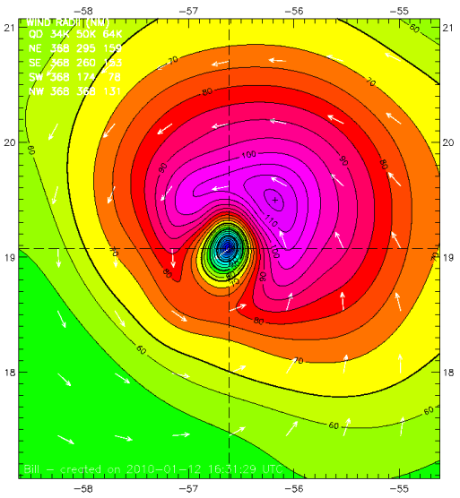
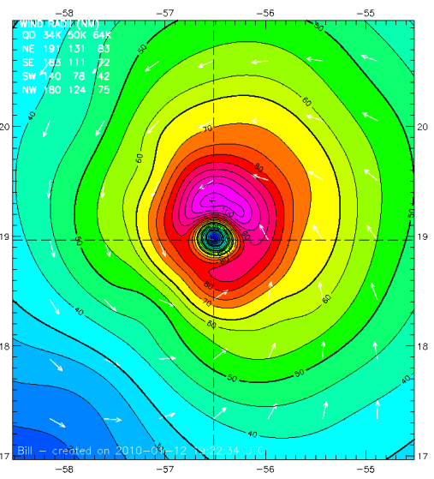
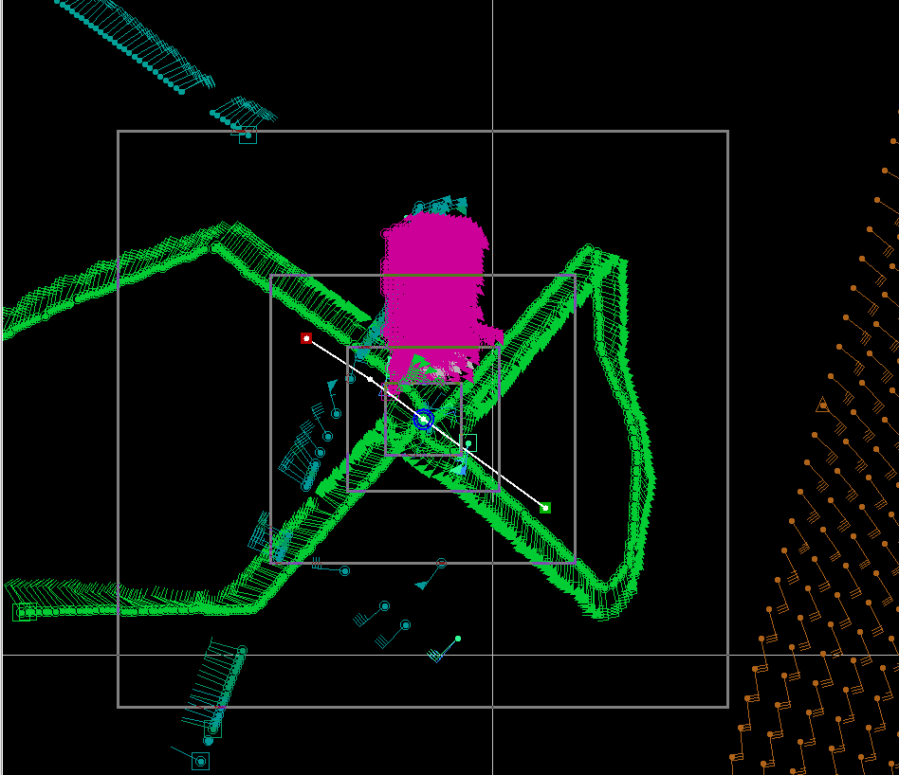
Structure:
Evaluation of Model structure
HWRF 10m winds
Data Coverage
H*Wind 10m winds
IKE : for winds > TS force: 371 TJ, for winds > hurricane force: 109 TJ
IKE : for winds > TS force: 92 TJ, for winds > hurricane force: 30 TJ
Analyzed max wind: 117kt from HWRF, 37 nmi
Analyzed max wind: 107kt from Tail Doppler, 23 nmi
Notes:
• Surface wind field work is mainly supported through a NOPP that Hans Graber controls (collaboration between UM, USACE, HRD, and Vince Cardone’s Ocean Weather). HRD receives support to provide them near real-time surface winds to drive their surge and wave models. HRD also receives support for these wind fields from the USACE, particularly for the production of wind fields for past storms to use for model testing. Finally, some of the support comes from the development of a wind model for the State of Florida CAT model effort in collaboration with FSU, FIU, and UF.

Slide 18
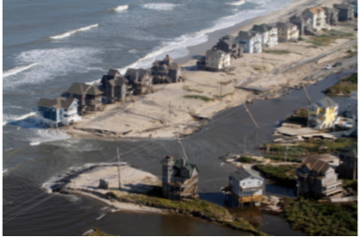
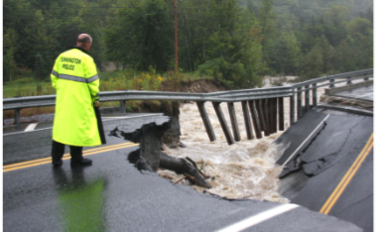
Impacts: Where do we need to be?
NOAA’s National Weather Service (NWS) mission is to fulfill this commitment through building a Weather Ready Nation.
NWS must contribute to hazard resiliency by continually assessing and improving its services to the Nation.
Hurricane Irene (2011):
41 deaths
$7 to $10 Billion damage
Major infrastructure losses
Power lost to 8 million
Virginia Beach, Va
Hatteras Island, N.C.
Woodford, Vt.
Jim R. Bounds/AP
Austen Danforth/Bennington Banner/AP
Brendan Hoffman/Getty Images

Slide 19
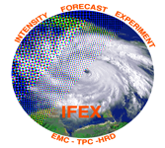
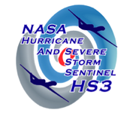
What in 2011 & 2012?:
IFEX 2011
NOAA aircraft flew ~342 h (31 P-3 and 18 G-IV missions)
Highlights include Dora (E. Pacific), Irene, Rina
For details see: http://noaahrd.wordpress.com/category/ifex-discussion
IFEX 2012
1 NOAA WP-3D, G-IV – 160 flight hours (1 June-30 November)
Crews available 2/day missions starting July based from Tampa, FL
Interact with NASA during their HS3 field campaign
HFIP real-time model demonstration

Slide 20
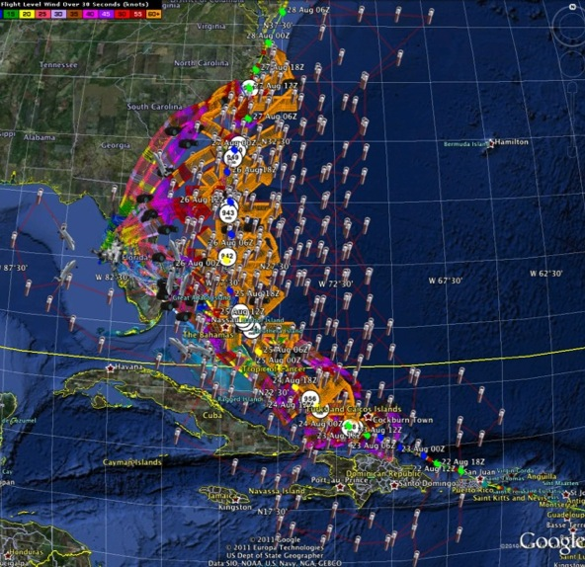
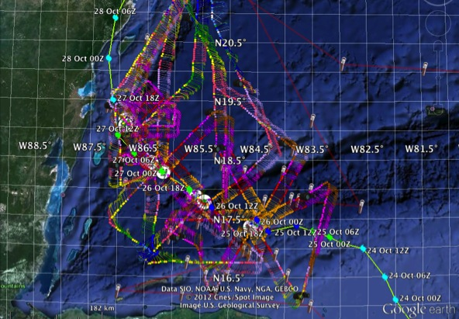
What in 2011?:
Hurricane Irene
7 missions from 23-27 Aug 2011 at ~12 h sampling of Doppler SO (HEDAS) & 8 G-IV missions
Sampled Irene as a major hurricane through landfall
Hurricane Irene
Hurricane Rina
4 missions from 25-27 Oct 2011 at ~12 h sampling of Doppler SO (HEDAS) & 1 G-IV mission
Sampled Rina as a hurricane to decay off Yucatan
Hurricane RIna

Slide 21
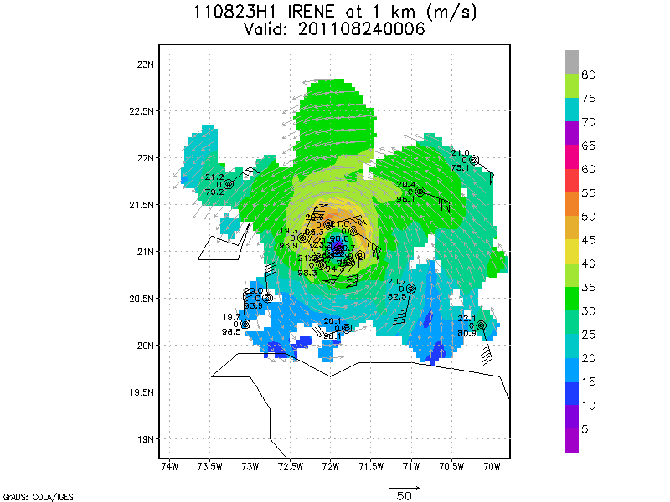
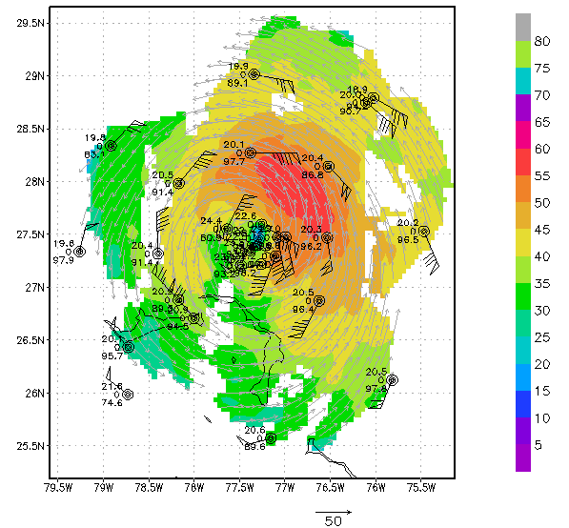
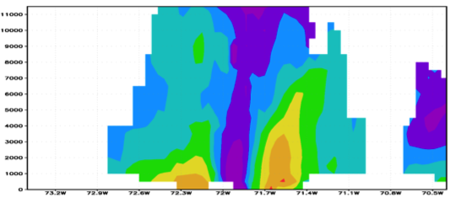
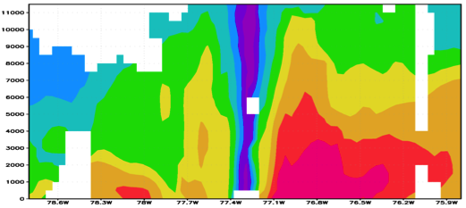
Improved Models & Data: IFEX 2011: Irene
Real-time P-3 Tail Doppler and Dropsonde Composite at 1 km altitude
m/s
Flight 110823H1
Flight 110825H1
N
N
S
S
South
North
South
North
S. Murillo, R. Rogers (AOML/HRD)
Notes:
Colors denote Doppler winds and station codes denote dropsondes
West-east vertical cross section of wind speed (shaded, m/s).

Slide 22
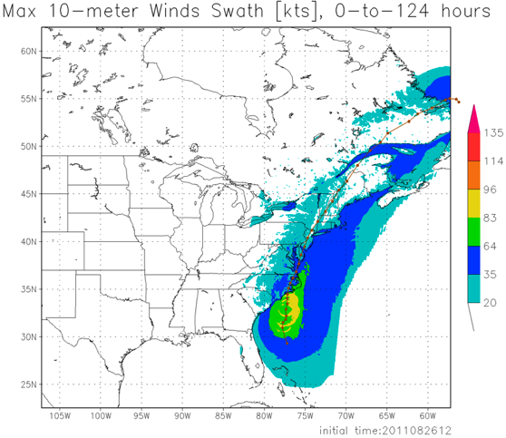
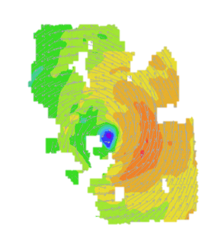
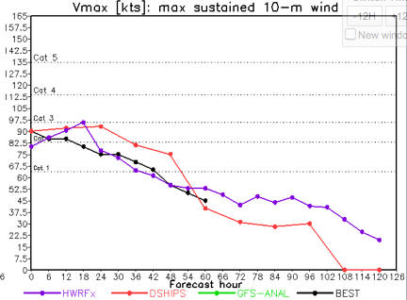
Improved Models & Data: IFEX 2011: Irene
HWRF/HEDAS
20110826 12UTC
Doppler SO (EnKF) transmitted in real-time for assimilation into HWRF
20110826I1
0926-1416 UTC
7 P-3 Flights
23 August – 27 August 2011
HWRF/HEDAS
20110826 12UTC
7 missions from 23-27 Aug 2011 at ~12 h sampling of Doppler SO (HEDAS) & 8 G-IV missions
Sampled Irene as a major hurricane through landfall
Aberson, Aksoy, Gamache, Gopal (AOML/HRD)
Notes:
Map shows flight tracks for all of the NOAA missions (color coded are the flight level winds for the P-3 missions, dropsonde symbols denote G-IV patterns)

Slide 23
Communicating in the field
Our blog
http://noaahrd.wordpress.com
HRD Web page
http://www.aoml.noaa.gov/hrd
Facebook
http://www.facebook.com/noaahrd
Twitter
http://twitter.com/#!/HRD_AOML_NOAA
Tweets from the eye
Visiting scientist program

Slide 24
HFIP 2011 Demonstration
% Improvement over HFIP baseline
Can reach HFIP track goals out to at least 5 days using current global models initialized with EnKF
Will need to be run at higher than current resolution to ensure continued gains
Radar data appears to be critical in initializing regional models (may require ENKF to use effectively)
May solve intensity problem for storms effecting U.S.
Need increased use of satellite data for storms further away
Statistical post processing provides a several percentage point improvement over raw scores (Bias Correction, Correlation Based Correction, other)
79 82 82 81 76 65 46 cases
All cases with Doppler data 2008-2011
Need help of Research community to address
F. Zhang (PSU) & Aberson (HRD)

Slide 25
Opportunities:
Pan-Caribbean Radar Network – support DA

