Slide 1
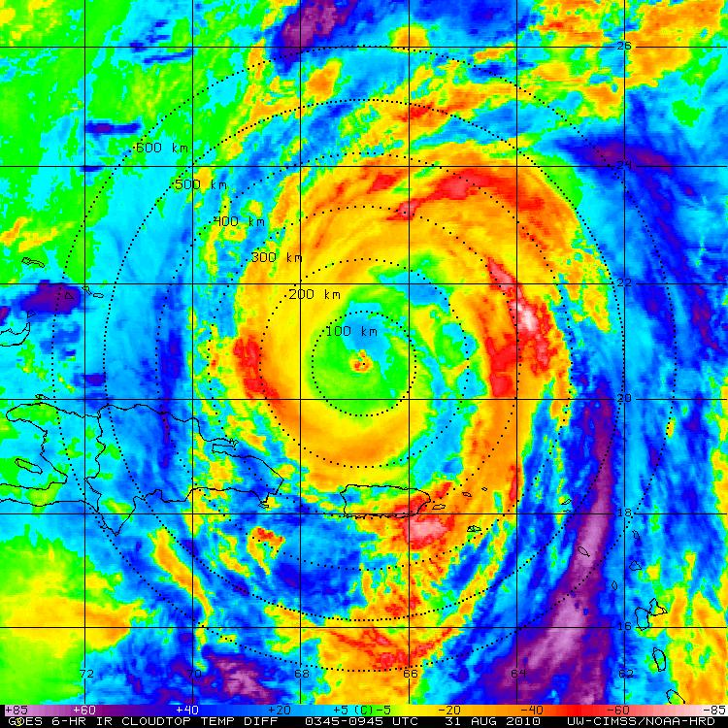
Diurnal Pulsing of Tropical Cyclones: An Overlooked Yet Fundamental TC Process?
Jason Dunion
University of Miami/CIMAS – NOAA/AOML/HRD – SUNY/Albany

Slide 2
Discussion Outline**
Motivation:
-Monitor changes in the CDO and deep convection of TCs;
-Determine if diurnal pulsing of TCs is a fundamental process and what it means;
TC Pulsing and Time of Day
TC Pulsing in the context of NHC Discussions
What are these Diurnal Pulses?
Katia G-IV Research Missions (early impressions)
Conclusions & Future Work
Hurricane Andrew Diurnal Pulsing
**Sponsored by Hurricane Irene and Gary Larson

Slide 3
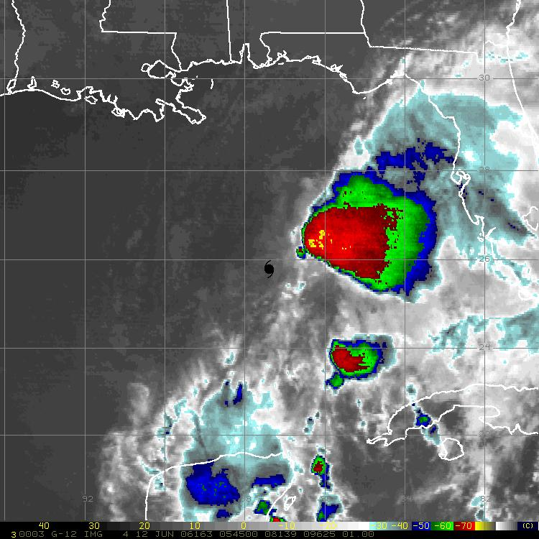
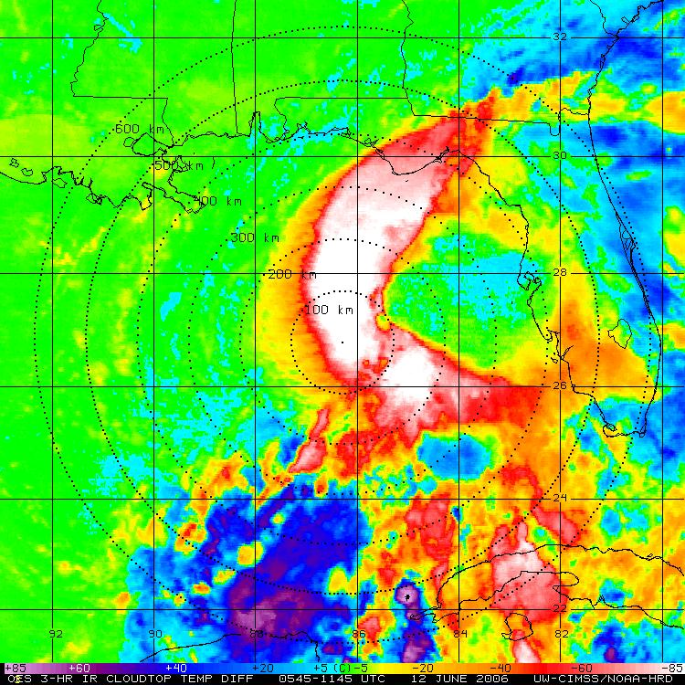
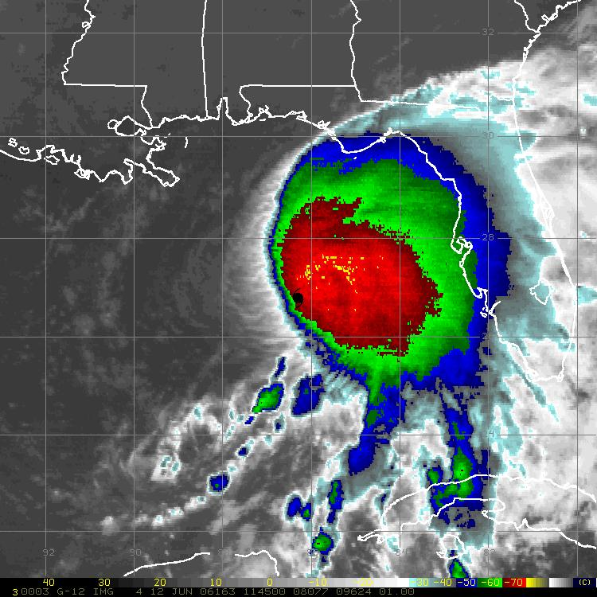
2006 Tropical Storm Alberto
GOES 6-hr BT Temp Difference

Slide 4
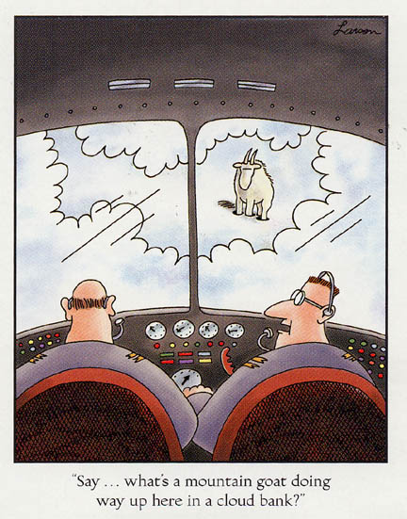
2006 Tropical Storm Alberto
GOES 6-hr BT Temp Difference

Slide 5
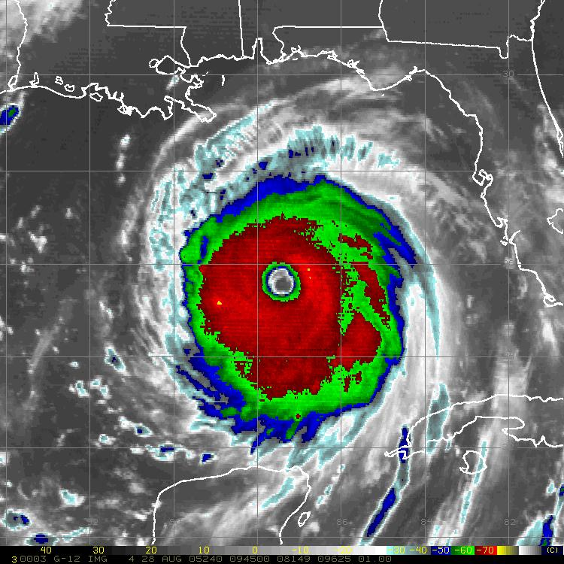
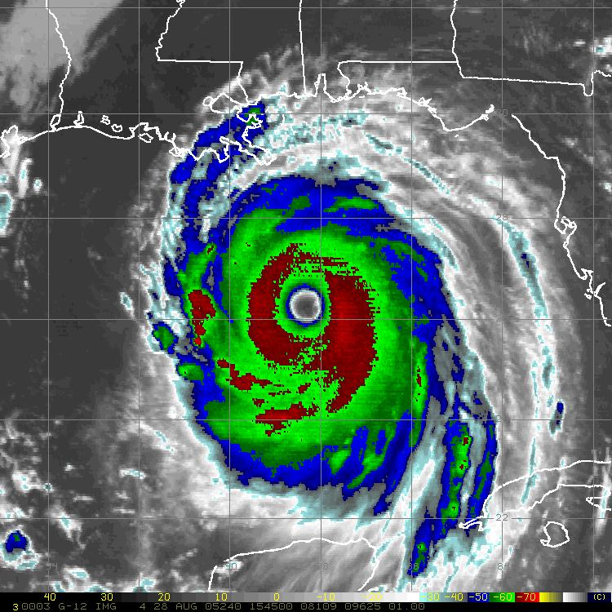
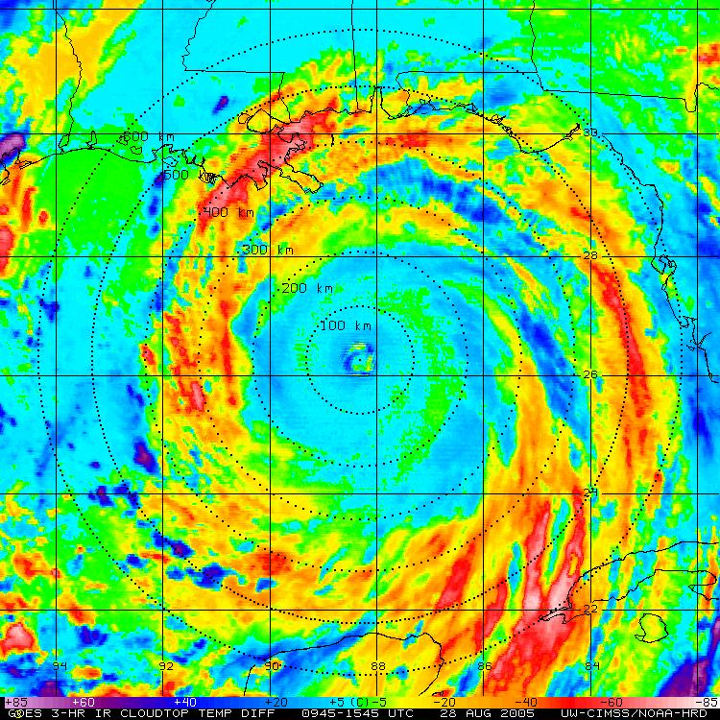
2005 Hurricane Katrina
GOES 6-hr BT Temp Difference

Slide 6
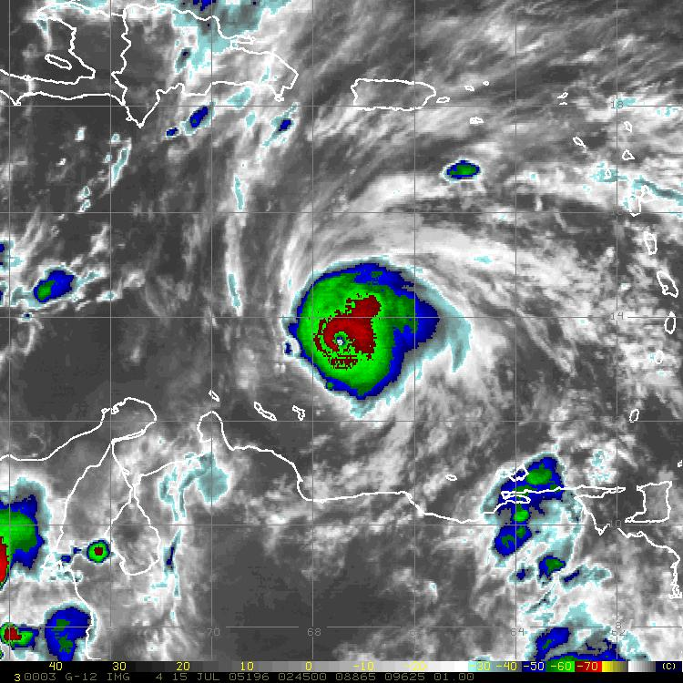
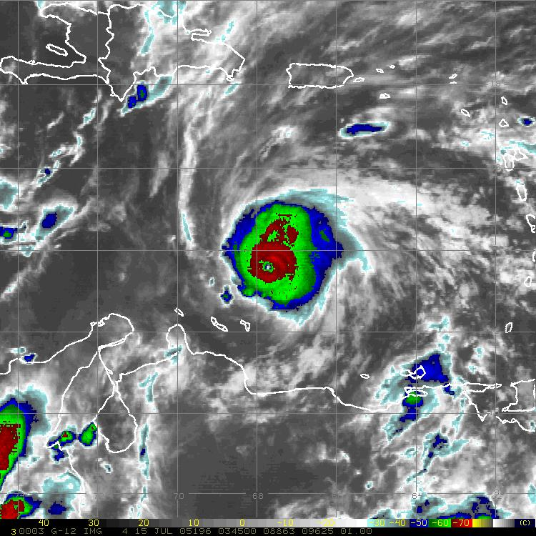
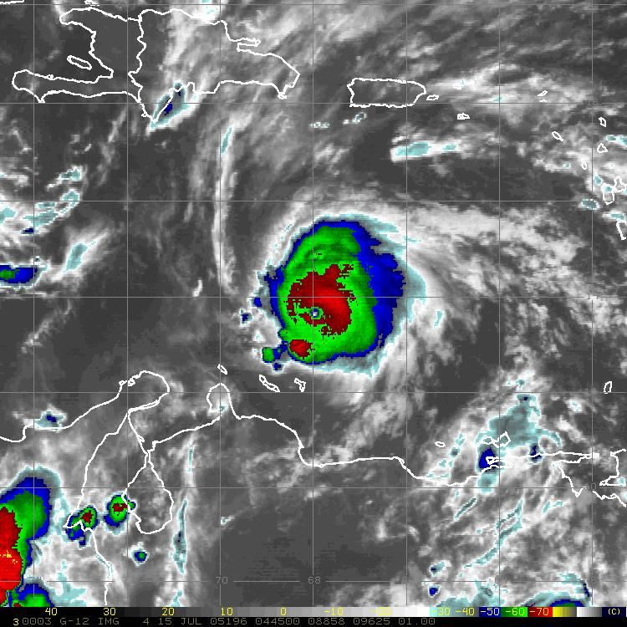
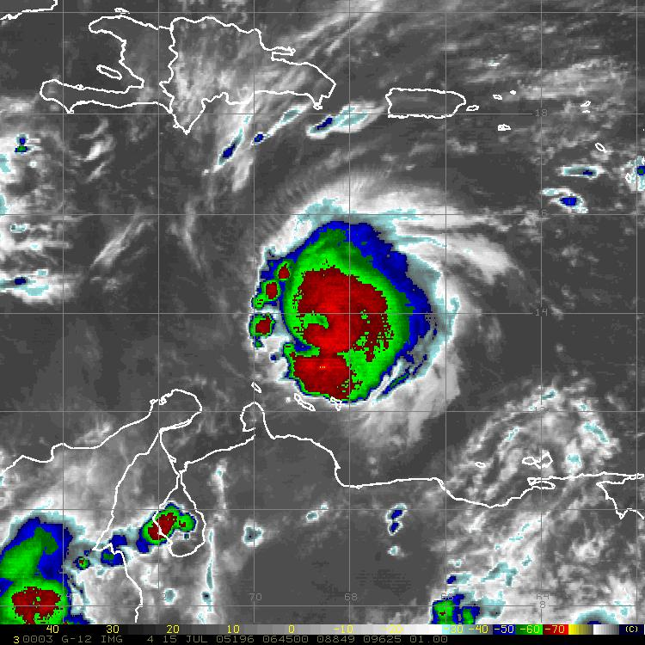
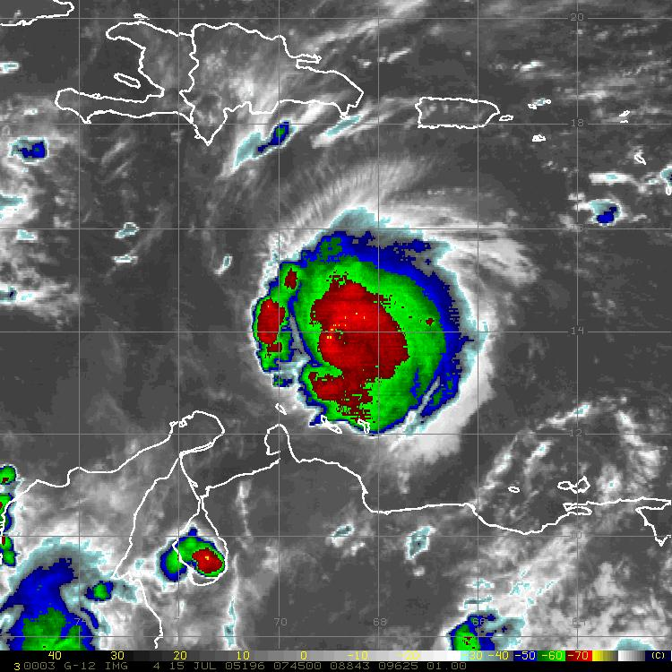
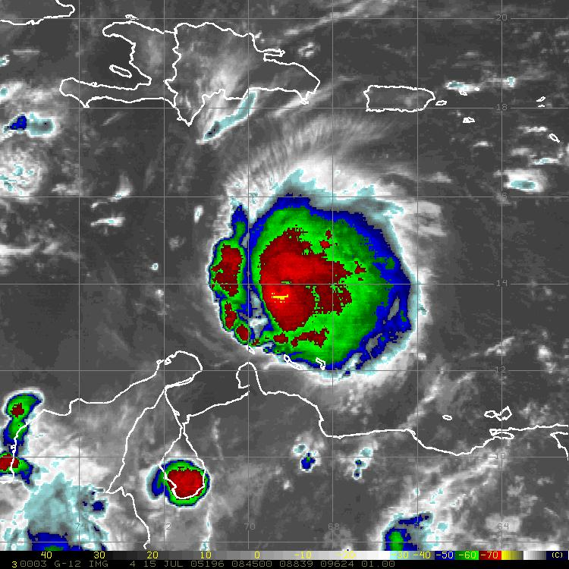
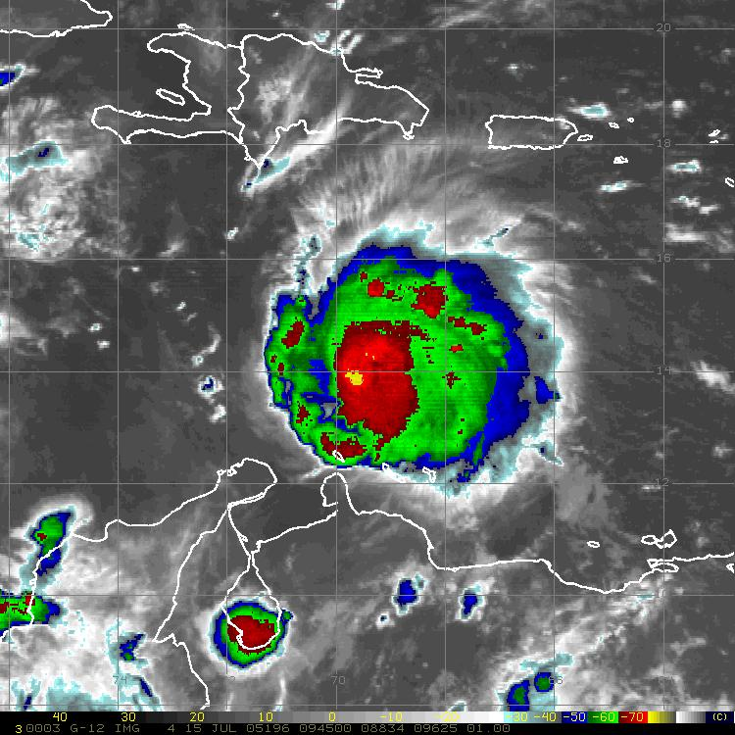
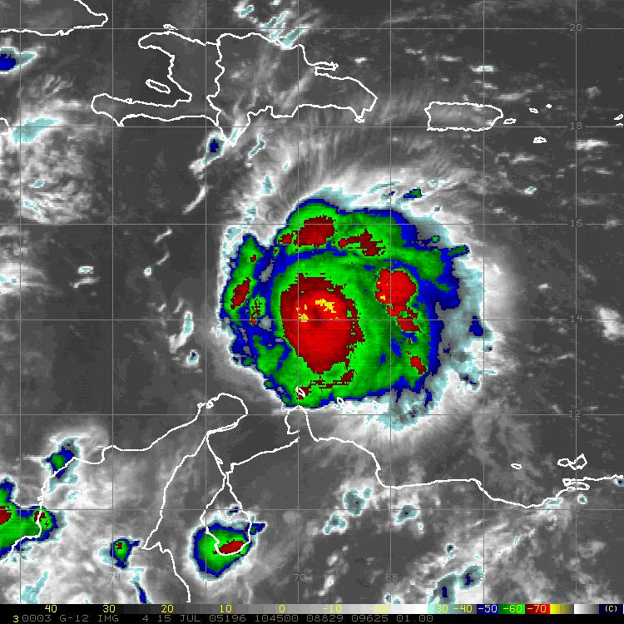
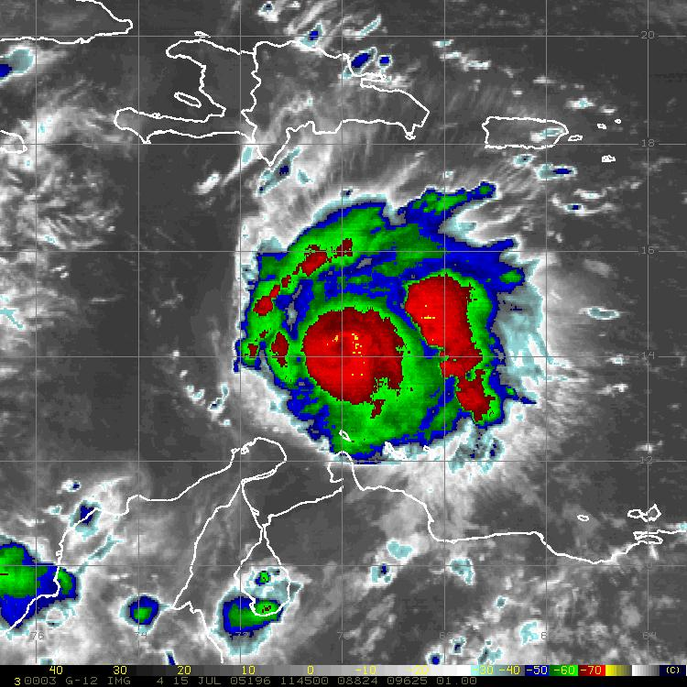
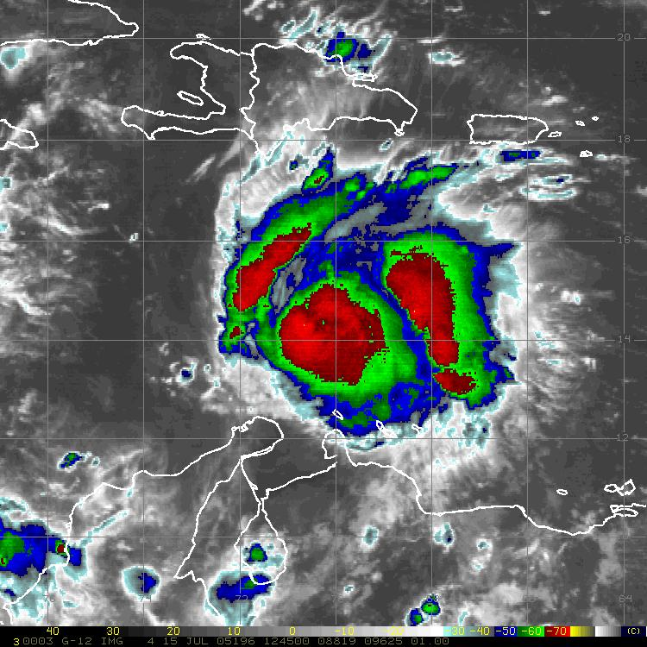
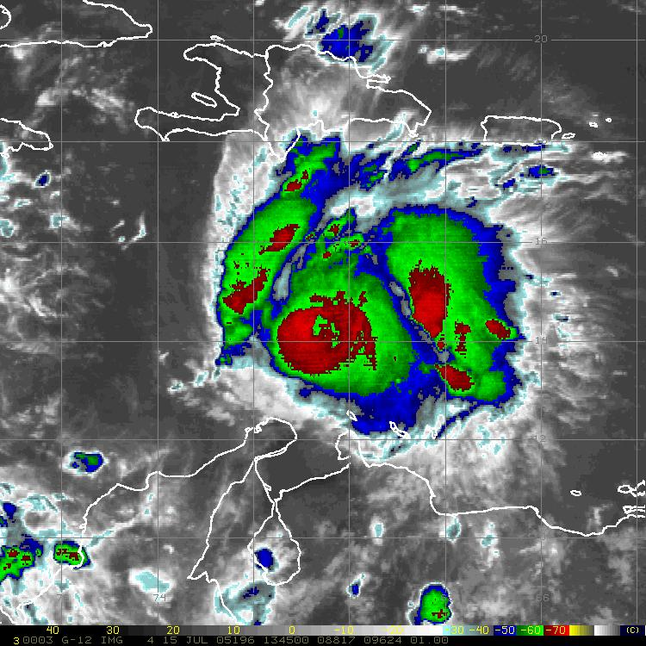
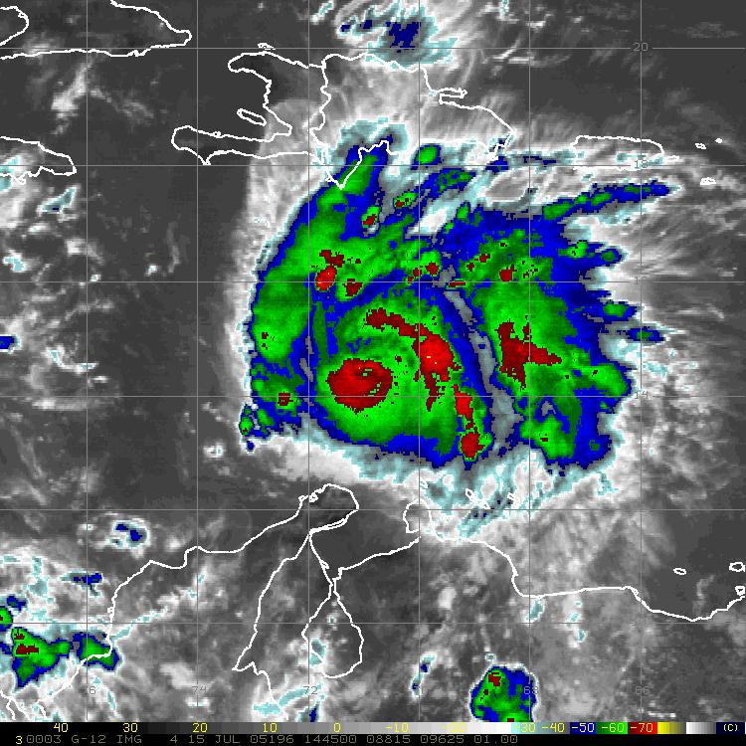
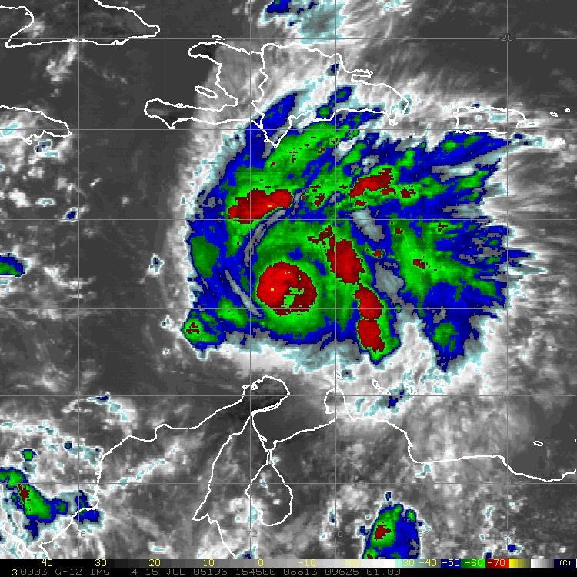
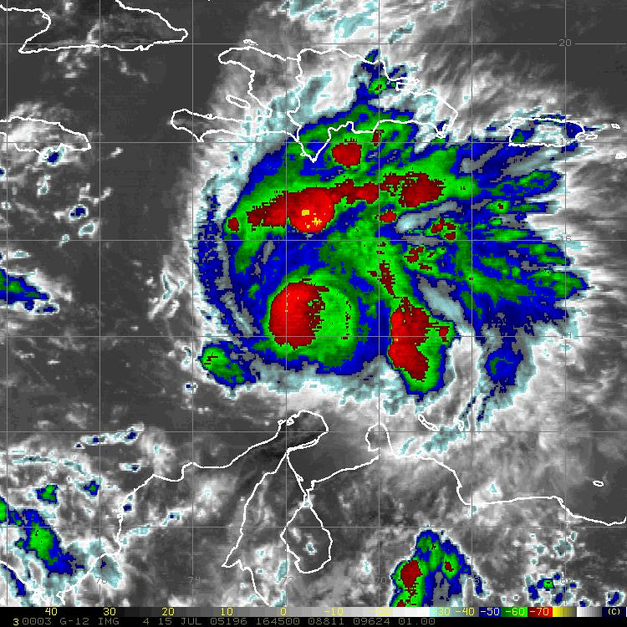
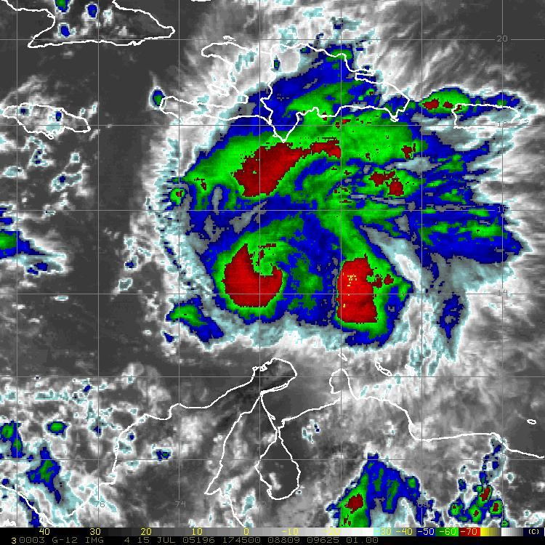
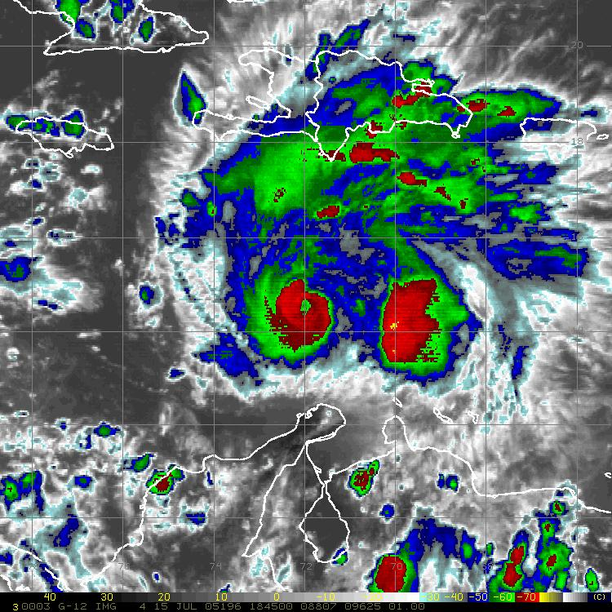
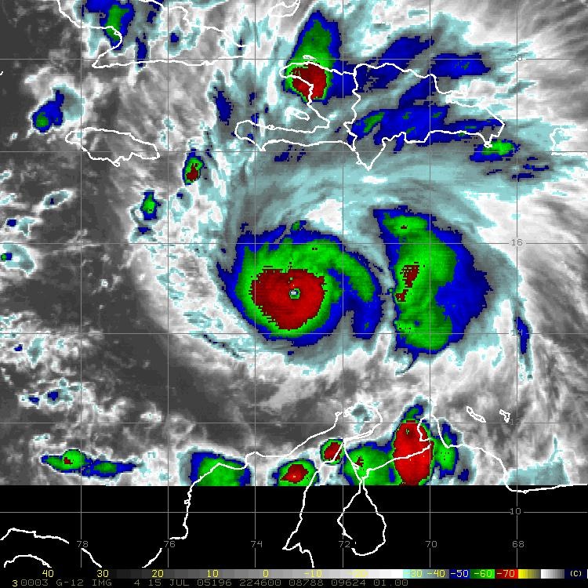
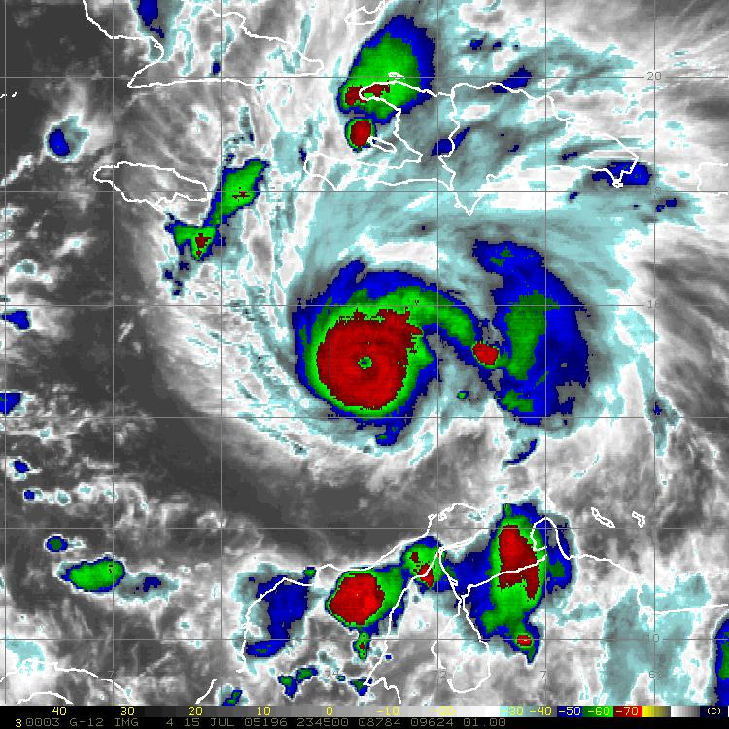
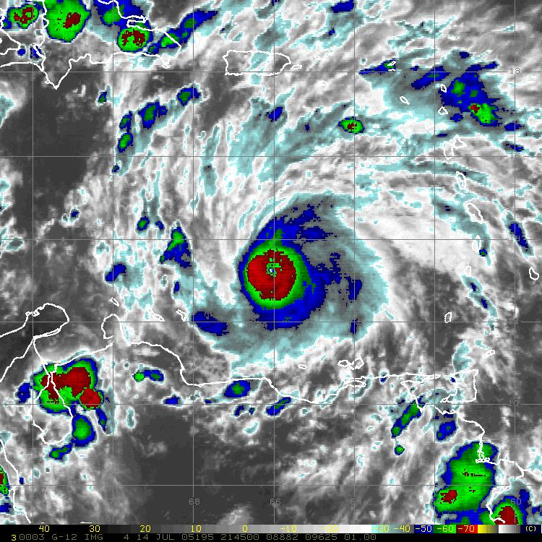
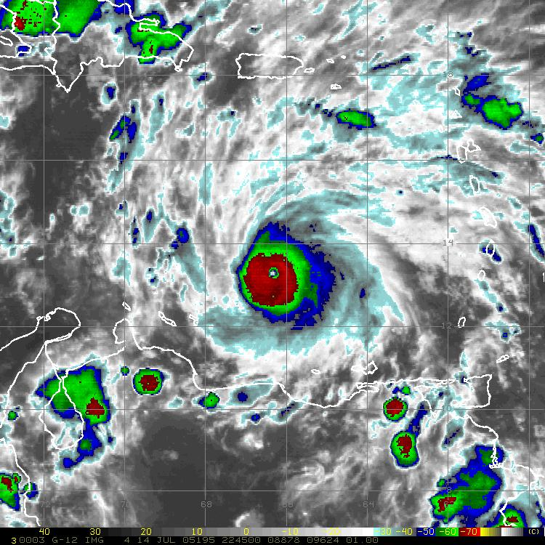
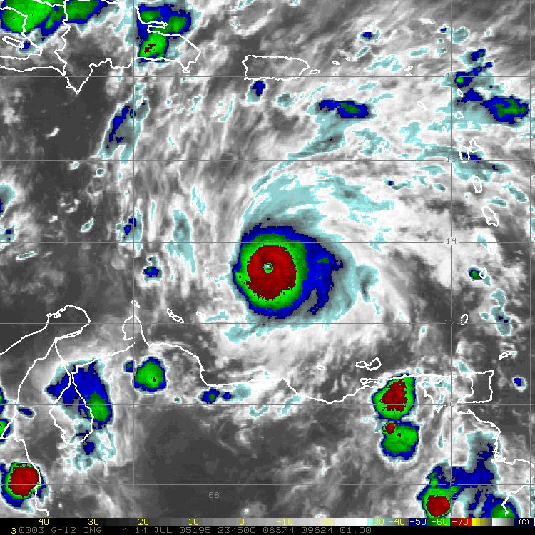
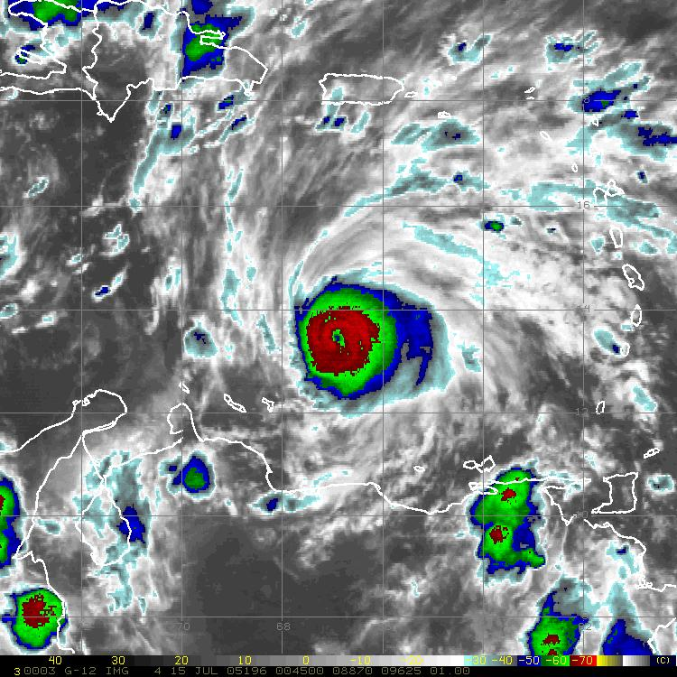
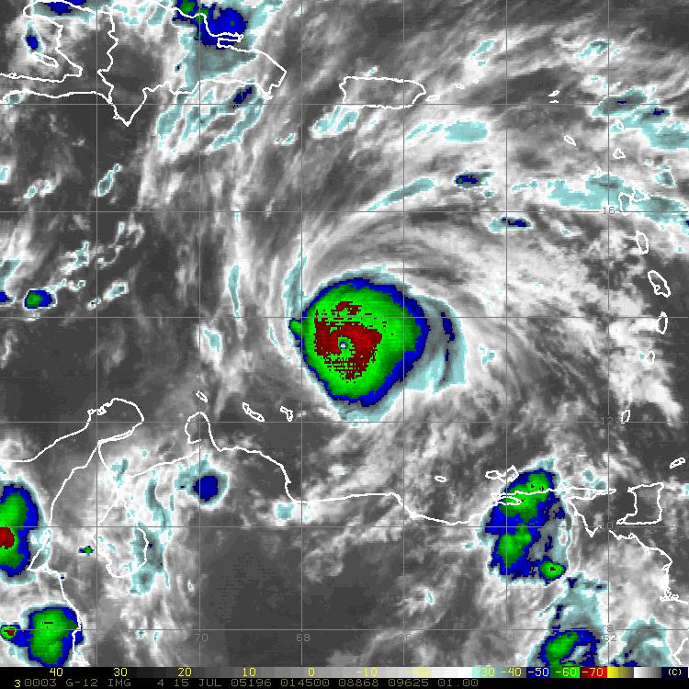
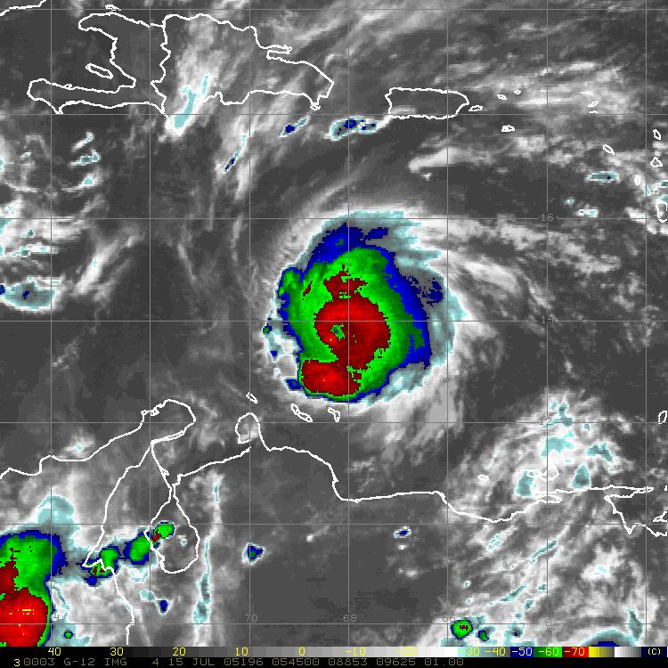
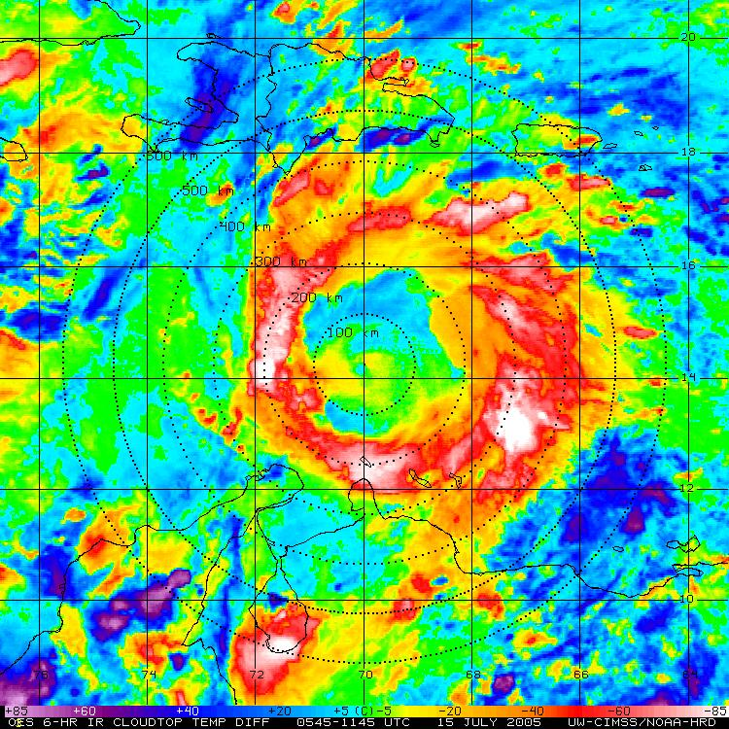
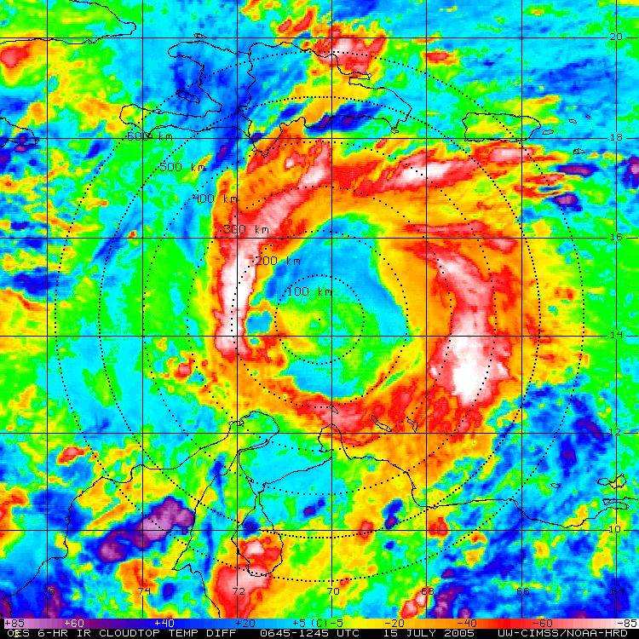
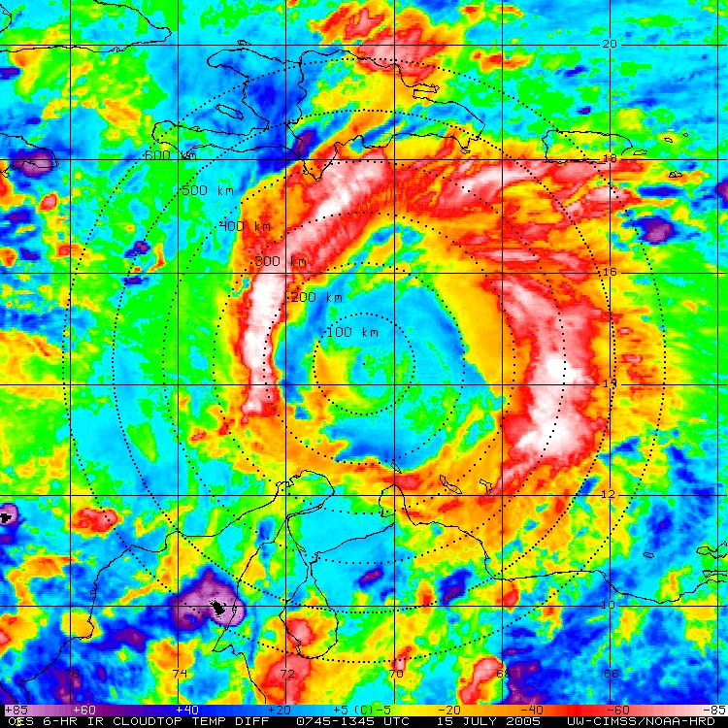
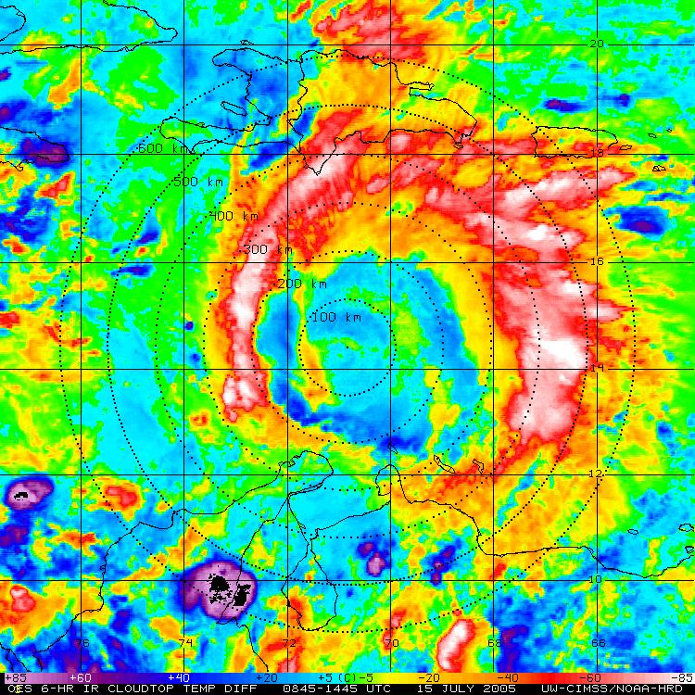
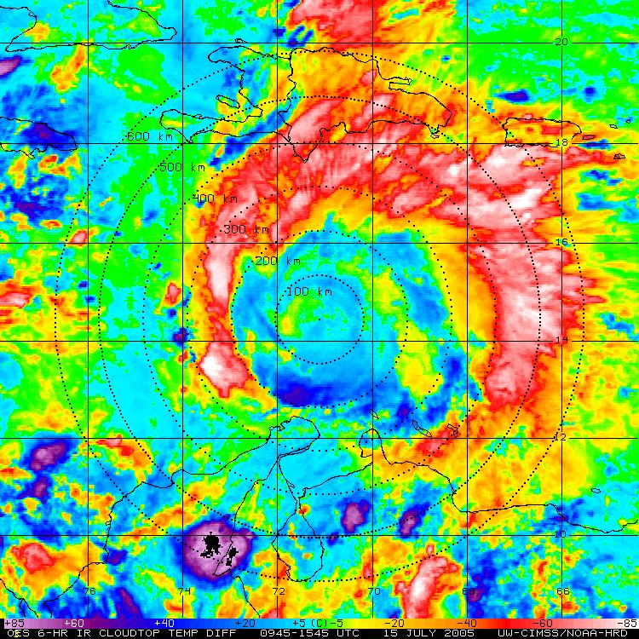
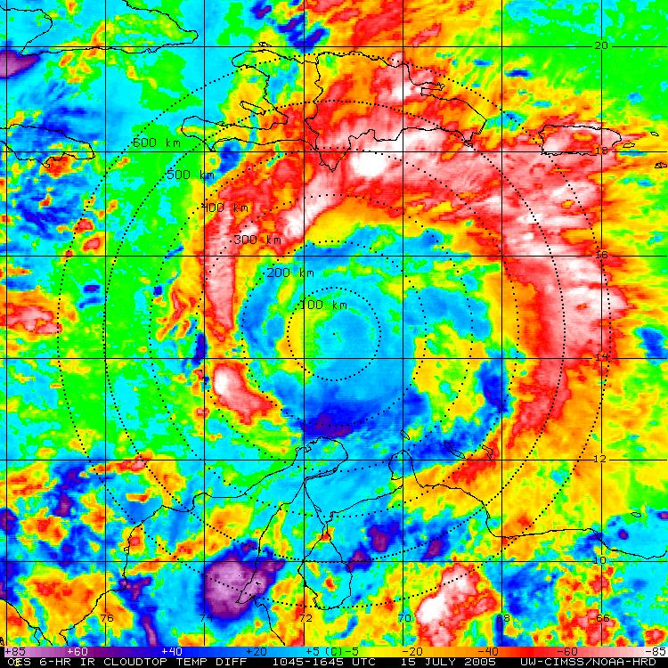
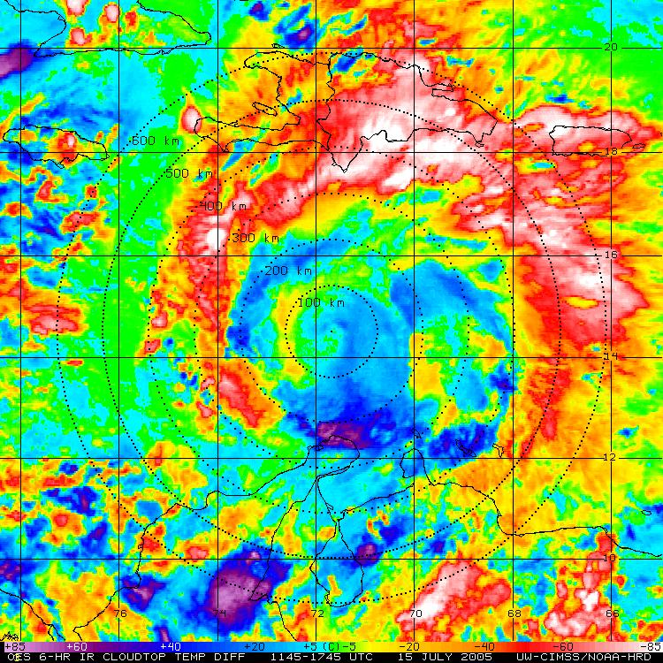
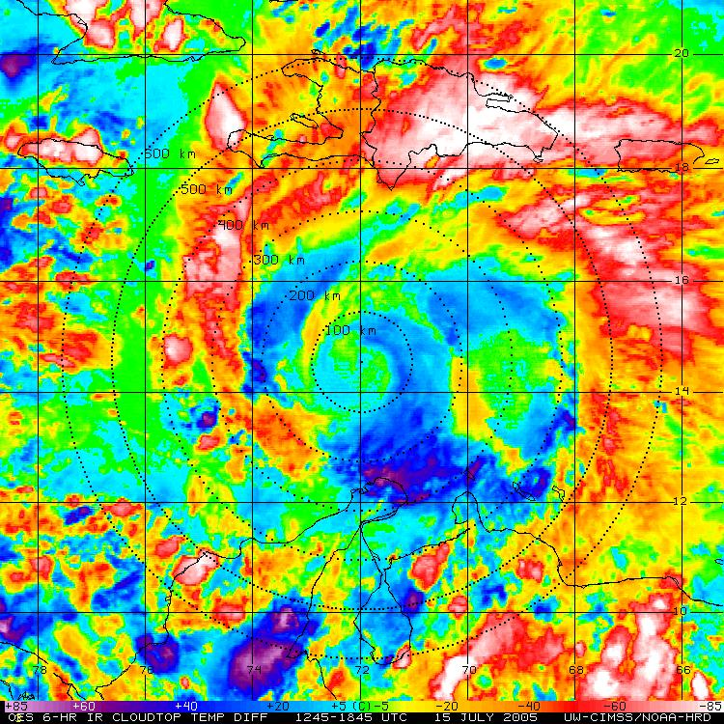
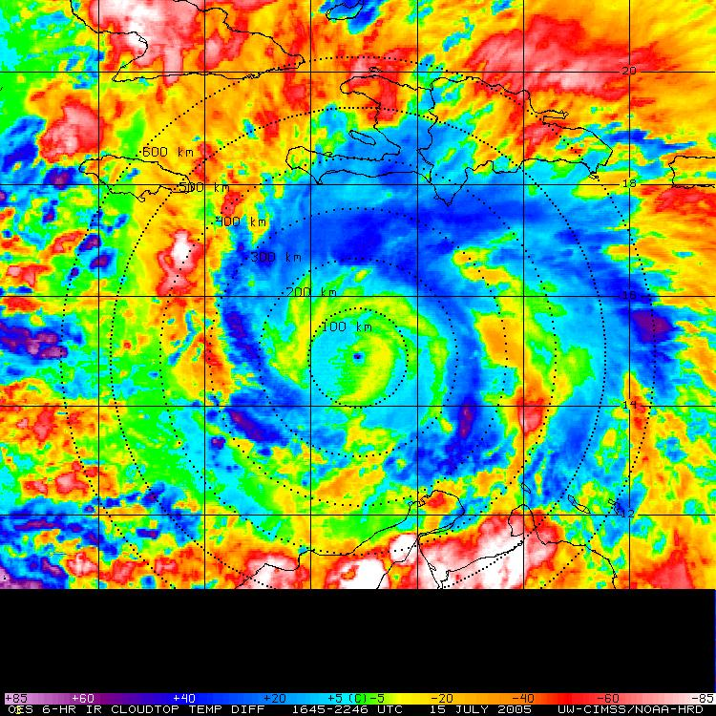
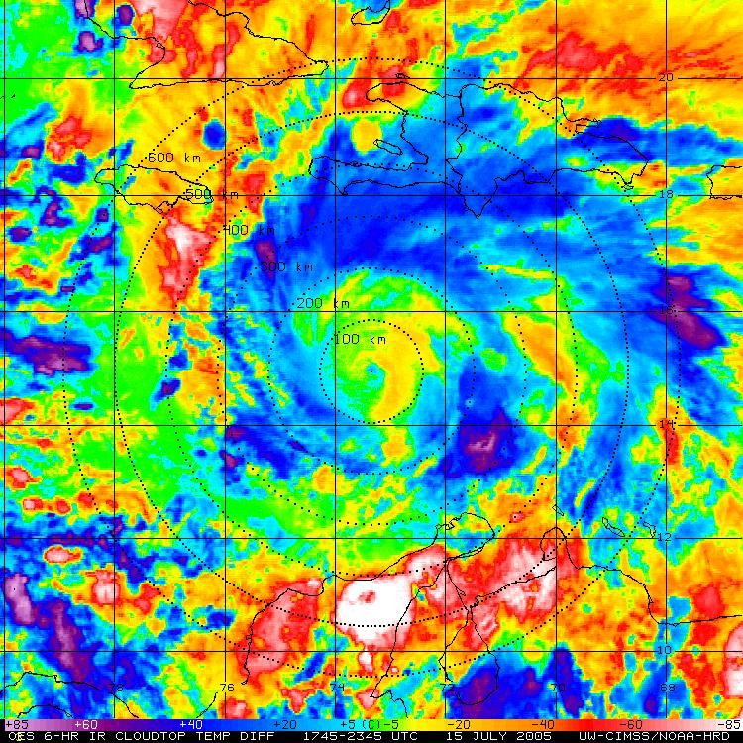
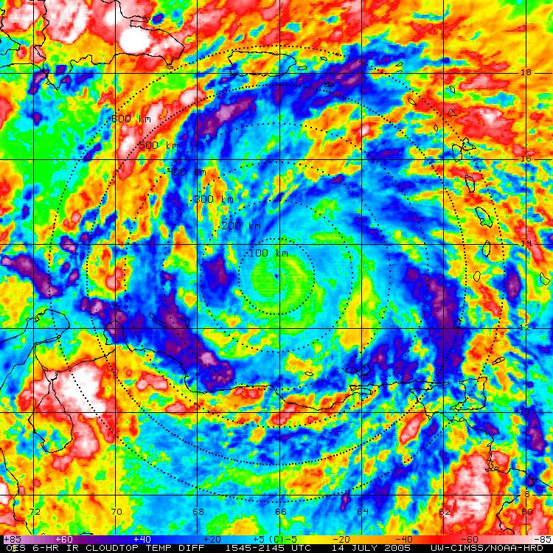
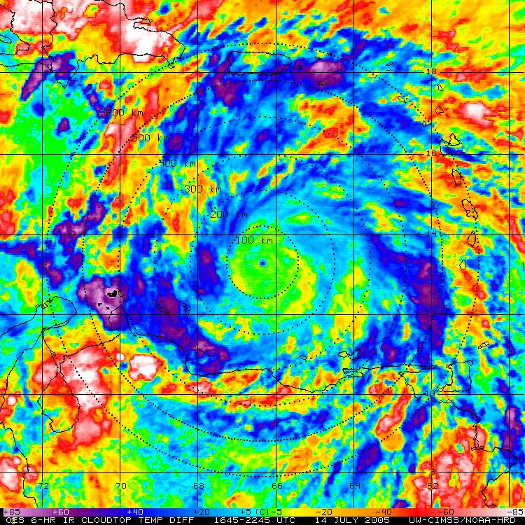
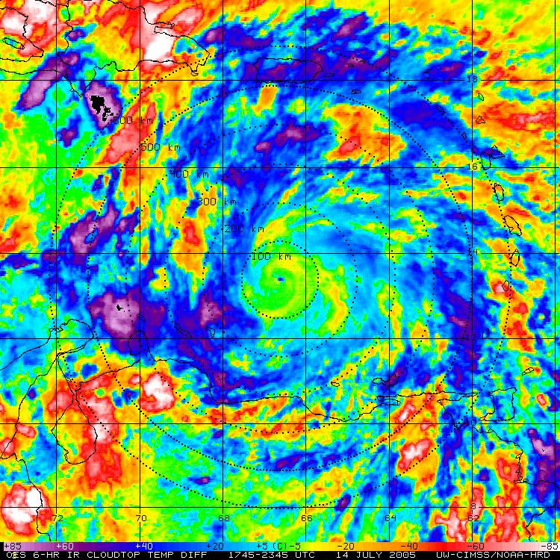
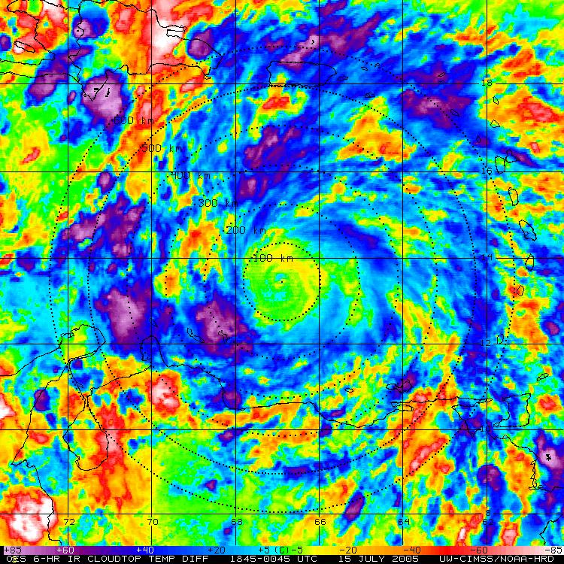
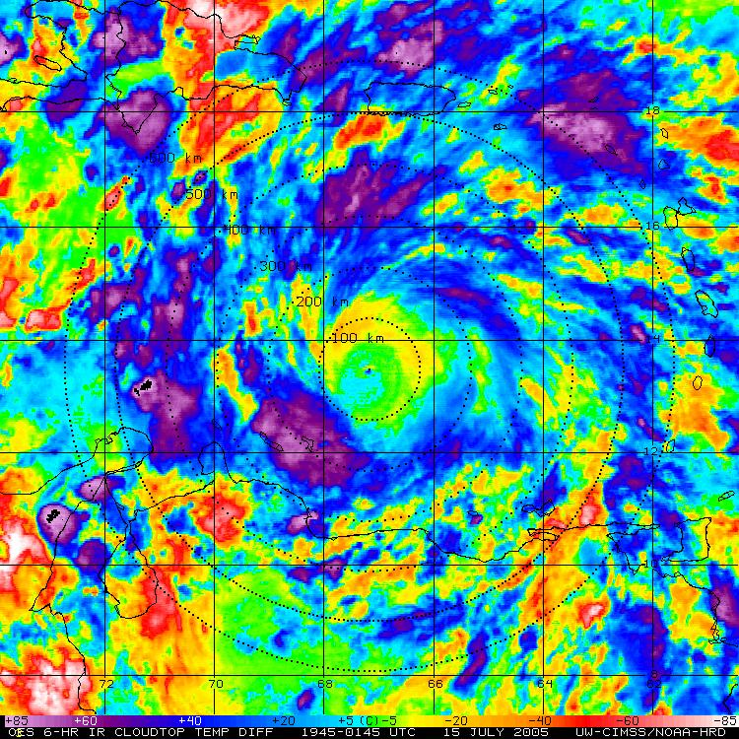
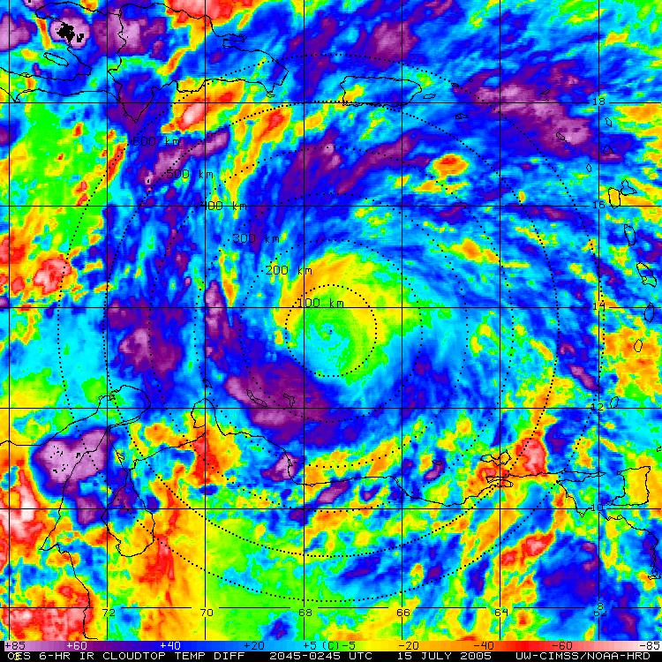
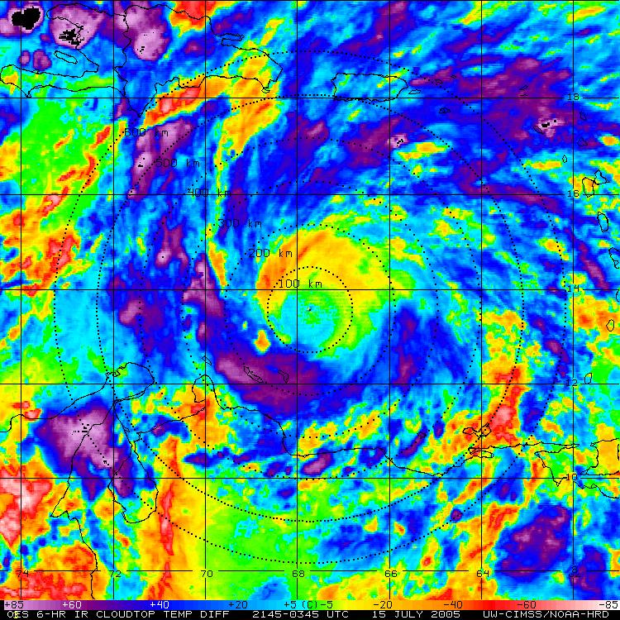
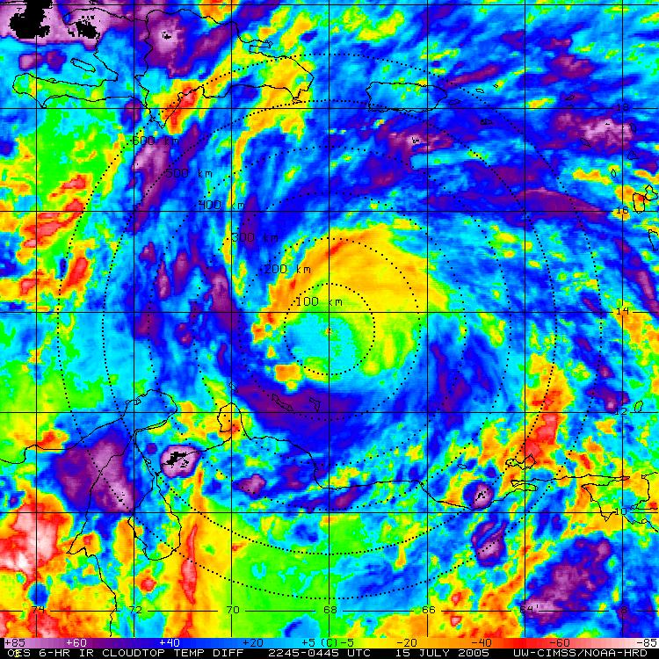
Hurricane Emily: 14-15 July 2005
GOES IR (storm relative)
GOES BT Diff (storm relative)

Slide 7
Hurricane Felix: 02-03 Sept 2007
GOES IR (storm relative)
GOES BT Diff (storm relative)

Slide 8
Hurricane Earl: 30-31 August 2010
GOES IR (storm relative)
GOES BT Diff (storm relative)

Slide 9
IR Cloudtop Temperature Trends
6-hr BT Temp Difference (azimuthal average)
“Cool Rings” (~15-18 UTC)
Notes:
9

Slide 10
GOES IR BT Differences: Azimuthal Mean (400km)
“Cool Rings” (~12-15 UTC)

Slide 11
IR Cloudtop Temperature Trends
GOES 6-hr BT Temp Difference (azimuthal average): 300-500 km
Notes:
11

Slide 12
IR Cloudtop Temperature Trends
“Cool Rings”
(12:00 Local)
Kossin 2002
Notes:
12

Slide 13
Diurnal Pulsing of Tropical Cyclones: An Overlooked Yet Fundamental TC Process?
Notes:
13

Slide 14
Diurnal TC Pulsing: A Global Phenomenon
4 AM LST
Andrew
Georges
Ivan
Emily
Katrina
Helene
Daniel
Dean
Felix
Flossie
Danielle
Earl
Opal
Megi
Bianca
Notes:
4am LST

Slide 15
Diurnal TC Pulsing: A Global Phenomenon
10 AM LST
Andrew
Georges
Ivan
Emily
Katrina
Helene
Daniel
Dean
Felix
Flossie
Danielle
Earl
Opal
Megi
Bianca
Notes:
10 am LST

Slide 16
Diurnal TC Pulsing: A Global Phenomenon
8 PM LST
Andrew
Georges
Ivan
Emily
Katrina
Helene
Daniel
Dean
Felix
Flossie
Danielle
Earl
Opal
Megi
Bianca
Notes:
8pm LST

Slide 17
15 July 0300 UTC
ZCZC MIATCDAT5 ALL
TTAA00 KNHC DDHHMM
HURRICANE EMILY DISCUSSION NUMBER 17
NWS TPC/NATIONAL HURRICANE CENTER MIAMI FL
11 PM EDT THU JUL 14 2005
EMILY CONTINUES TO INTENSIFY. DVORAK DATA T NUMBERS AT 00Z WERE 6.0 FROM ALL AGENCIES...CORRESPONDING TO AN INTENSITY ESTIMATE OF 115 KT…
15 July 1500 UTC
ZCZC MIATCDAT5 ALL
TTAA00 KNHC DDHHMM
HURRICANE EMILY DISCUSSION NUMBER 19
NWS TPC/NATIONAL HURRICANE CENTER MIAMI FL
11 AM EDT FRI JUL 15 2005
AN AIR FORCE PLANE CURRENTLY OBSERVING THE STRUCTURE OF EMILY HAS REPORTED CONCENTRIC EYEWALLS OF 8 AND 25 N MI RESPECTIVELY. THIS SUGGESTS THAT EMILY MAY BE GOING THROUGH AN EYEWALL REPLACEMENT CYCLE...WHICH WOULD RESULT IN FLUCTUATIONS IN INTENSITY. BECAUSE THE LAST TIME THE RECON MEASURED WINDS TO SUPPORT CATEGORY FOUR HURRICANE WAS EARLY THIS MORNING…THERE IS NO EYE OBSERVED ON SATELLITE IMAGERY...AND THE CLOUD PATTERN HAS DETERIORATED…
2005 Emily
GOES IR (storm relative)
GOES BT Diff (storm relative)

Slide 18
17 July 0900 UTC
ZCZC MIATCDAT5 ALL
TTAA00 KNHC DDHHMM
HURRICANE EMILY DISCUSSION NUMBER 26
NWS TPC/NATIONAL HURRICANE CENTER MIAMI FL
5 AM EDT SUN JUL 17 2005
AT 0324Z...THE AIR FORCE RESERVE UNIT HURRICANE HUNTER AIRCRAFT REPORTED FLIGHT-LEVEL WINDS OF 153 KT. THE STANDARD ADJUSTMENT OF THIS VALUE TO THE SURFACE WOULD YIELD 138 KT...OR JUST ABOVE THE CATEGORY FIVE THRESHOLD.
17 July 1500 UTC
ZCZC MIATCDAT5 ALL
TTAA00 KNHC DDHHMM
HURRICANE EMILY DISCUSSION NUMBER 27
NWS TPC/NATIONAL HURRICANE CENTER MIAMI FL
11 AM EDT SUN JUL 17 2005
SATELLITE IMAGERY AND REPORTS FROM AN AIR FORCE RESERVE HURRICANE HUNTER AIRCRAFT INDICATE THAT EMILY HAS WEAKENED SLIGHTLY OVER THE PAST 12 HR. THE EYE HAS BECOME LESS DISTINCT IN SATELLITE IMAGERY AND THE OVERALL CLOUD PATTERN HAS BECOME A LITTLE RAGGED…IT IS UNCLEAR WHETHER THE WEAKENING THAT HAS OCCURRED IS DUE TO AN INTERNAL CYCLE OR EXTERNAL FORCING. A RECENT SSM/I OVERPASS DOES NOT SHOW CONCENTRIC EYEWALLS...AND WHILE CIRRUS OUTFLOW HAS DIMINISHED OVER THE SOUTHERN SEMICIRCLE THERE ARE NO OBVIOUS SIGNS OF SHEAR AT THIS TIME.
2005 Emily
GOES IR (storm relative)
GOES BT Diff (storm relative)

Slide 19
03 Sep 0900 UTC
ZCZC MIATCDAT1 ALL
TTAA00 KNHC DDHHMM
HURRICANE FELIX DISCUSSION NUMBER 12
NWS TPC/NATIONAL HURRICANE CENTER MIAMI FL AL062007
500 AM EDT MON SEP 03 2007
FELIX IS MOVING QUICKLY WESTWARD TOWARD CENTRAL AMERICA AS IT MAINTAINS CATEGORY FIVE INTENSITY. THE EYE DIAMETER HAS SHRUNK TO 10 N MI...AND A CENTRAL PRESSURE OF 931 MB WAS MEASURED... WHILE INNER-CORE STRUCTURAL CHANGES COULD OCCUR AND LEAD TO FLUCTUATIONS IN STRENGTH...I SEE NO REASON TO FORECAST ANY SIGNIFICANT CHANGE IN THE INTENSITY DURING THE NEXT 24 HOURS WHILE FELIX IS GUARANTEED TO STILL BE OVER THE WARM WATERS OF THE CARIBBEAN.
03 Sep 1500 UTC
ZCZC MIATCDAT1 ALL
TTAA00 KNHC DDHHMM
HURRICANE FELIX DISCUSSION NUMBER 13
NWS TPC/NATIONAL HURRICANE CENTER MIAMI FL AL062007
1100 AM EDT MON SEP 03 2007
SATELLITE IMAGES DEPICTED SOME WARMING OF THE CLOUD TOPS WHICH COULD BE INDICATIVE OF SLIGHT WEAKENING….THE CENTRAL PRESSURE HAS RISEN A BIT AND THE EYE IS NOT AS WELL DEFINED ON VISUAL IMAGERY….THERE HAS NOT BEEN MUCH EVIDENCE OF CONCENTRIC EYEWALLS OR AN EYEWALL REPLACEMENT…THE LARGE SCALE ENVIRONMENT…IN TERMS OF WIND SHEAR AND OCEANIC HEAT CONTENT...SHOULD REMAIN CONDUCIVE TO THE MAINTENANCE OF CAT 4/5 INTENSITY
03 Sep 2100 UTC
ZCZC MIATCDAT1 ALL
TTAA00 KNHC DDHHMM
HURRICANE FELIX DISCUSSION NUMBER 14
NWS TPC/NATIONAL HURRICANE CENTER MIAMI FL AL062007
500 PM EDT MON SEP 03 2007
AIRCRAFT DATA INDICATE THAT FELIX HAS WEAKENED TODAY…THE AIRCRAFT REPORTS ALSO INDICATED THAT THE EYEWALL HAD OPENED UP TO THE WEST NORTHWEST. SINCE THE LARGE-SCALE ENVIRONMENT IS STILL CONDUCIVE...THE HURRICANE MAY RE-INTENSIFY PRIOR TO INTERACTING WITH LAND.
2007 Felix
GOES IR (storm relative)
GOES BT Diff (storm relative)

Slide 20
30 Aug 2100 UTC
ZCZC MIATCDAT2 ALL
TTAA00 KNHC DDHHMM
HURRICANE EARL DISCUSSION NUMBER 22
NWS TPC/NATIONAL HURRICANE CENTER MIAMI FL AL072010
500 PM AST MON AUG 30 2010
THE EYE HAS CONTINUED TO CLEAR AND IS SURROUNDED BY CLOUD TOPS TO -70 DEGREES CELSIUS OR COLDER....CATEGORY FOUR. EARL IS EXPECTED TO REMAIN IN A LOW SHEAR ENVIRONMENT AND OVER WARM WATER DURING THE NEXT FEW DAYS AND SOME ADDITIONAL STRENGTHENING IS LIKELY IN THE SHORT TERM. THEREAFTER...EYEWALL CYCLES WILL LIKELY INDUCE SOME FLUCTUATIONS IN INTENSITY...WHICH ARE DIFFICULT TO PREDICT.
31 Aug 0300 UTC
ZCZC MIATCDAT2 ALL
TTAA00 KNHC DDHHMM
HURRICANE EARL DISCUSSION NUMBER 23
NWS TPC/NATIONAL HURRICANE CENTER MIAMI FL AL072010
1100 PM AST MON AUG 30 2010
THE INTENSITY OF EARL APPEARS TO HAVE LEVELED OFF FOR THE TIME BEING…WSR-88D RADAR DATA FROM SAN JUAN SUGGEST THAT A CONCENTRIC EYEWALL OR CONVECTIVE RING MAY BE FORMING. THIS WOULD AT LEAST TEMPORARILY HALT FURTHER INTENSIFICATION…SOME OSCILLATIONS IN INTENSIYY DUE TO EYEWALL REPLACEMENTS OR OTHER INNER-CORE CONVECTIVE PROCESSES ARE ALSO POSSIBLE.
31 Aug 0900 UTC
ZCZC MIATCDAT2 ALL
TTAA00 KNHC DDHHMM
HURRICANE EARL DISCUSSION NUMBER 24
NWS TPC/NATIONAL HURRICANE CENTER MIAMI FL AL072010
500 AM AST TUE AUG 31 2010
A TRMM OVERPASS…SAN JUAN WSR-88D RADAR INDICATE THAT EARL HAS STARTED AN EYEWALL REPLACEMENT CYCLE…THE GFDL AND GFDN MODELS SUGGEST THAT EARL COULD STRENGTHEN DURING THE NEXT 24 HR OR SO…IF THE HURRICANE COMPLETES THE EYEWALL REPLACEMENT QUICKLY ENOUGH. ON THE OTHER HAND...EARL IS FORECAST TO BE IN AN ENVIRONMENT OF MODERATE SW VERTICAL WIND SHEAR...AND VERY DRY MID/UPPER-LEVEL AIR APPROACHING THE HURRICANE FROM THE NORTH. THESE FACTORS COULD PREVENT ADDITIONAL STRENGTHENING.
31 Aug 1500 UTC
ZCZC MIATCDAT2 ALL
TTAA00 KNHC DDHHMM
HURRICANE EARL DISCUSSION NUMBER 25
NWS TPC/NATIONAL HURRICANE CENTER MIAMI FL AL072010
1100 AM AST TUE AUG 31 2010
THE EYE HAS BECOME OBSCURED ON VISIBLE IMAGES AND THIS IS REFLECTED IN A DECREASE IN THE DVORAK NUMBERS AND IN AN INCREASE IN THE PRESSURE TO 939 MB. THIS APPARENT WEAKENING IS MOST LIKELY RELATED TO AN ONGOING EYEWALL REPLACEMENT CYCLE AS INDICATED BY THE DOUBLE EYE STRUCTURE OBSERVED ON MICROWAVE DATA AT 1035 UTC.
2010 Earl
GOES IR (storm relative)
GOES BT Diff (storm relative)

Slide 21
ZCZC MIATCDAT4 ALL
TTAA00 KNHC DDHHMM
HURRICANE IVAN DISCUSSION NUMBER 11
NWS TPC/NATIONAL HURRICANE CENTER MIAMI FL
5 AM EDT SUN SEP 05 2004 (05 Sep 0900z)
INFRARED SATELLITE IMAGERY AND A 0450Z TRMM OVERPASS SHOW THAT IVAN HAS DEVELOPED SUFFICIENT ORGANIZED CONVECTION AROUND THE WARM SPOT SEEN EARLIER TO NOW CALL IT AN EYE. SATELLITE INTENSITY ESTIMATES ARE 77 KT FROM AFWA AND 65 KT FROM TAFB AND SAB. THUS...IVAN IS UPGRADED TO A 65 KT HURRICANE.
LARGE-SCALE GUIDANCE PREDICTS LIGHT VERTICAL SHEAR FOR THE NEXT 3-4 DAYS...SO THERE IS NO OBVIOUS REASON WHY IVAN SHOULD NOT INTENSIFY FURTHER. THE INTENSITY FORECAST FOLLOWS THIS PHILOSOPHY...AND IT IS POSSIBLE THERE COULD BE RAPID STRENGTHENING.
ZCZC MIATCDAT4 ALL
TTAA00 KNHC DDHHMM CCA
HURRICANE IVAN SPECIAL DISCUSSION NUMBER 13...CORRECTED
NWS TPC/NATIONAL HURRICANE CENTER MIAMI FL
1 PM EDT SUN SEP 05 2004 (05 Sep 1700z)
THE PURPOSE OF THIS SPECIAL ADVISORY IS TO REPORT THE RAPID INTENSIFICATION OF IVAN OVER THE LAST FEW HOURS. A SPECIAL DVORAK CLASSIFICATION FROM TAFB AND DATA T-NUMBERS GAVE AN INTENSITY OF ABOUT 100 KT. OBJECTIVE DVORAK T-NUMBERS SUGGEST THAT EVEN THIS ESTIMATE MAY BE CONSERVATIVE.
ZCZC MIATCDAT4 ALL
TTAA00 KNHC DDHHMM
HURRICANE IVAN DISCUSSION NUMBER 16
NWS TPC/NATIONAL HURRICANE CENTER MIAMI FL
5 AM EDT MON SEP 06 2004 (06 Sep 0900z)
FINAL T NUMBERS FROM BOTH TAFB AND SAB INDICATE THAT IVAN HAS WEAKENED A BIT OVERNIGHT. LATEST IMAGERY INDICATES THAT THE EYE HAS BECOME CLOUD FILLED AND THE INITIAL INTENSITY IS LOWERED TO 110 KT FOR THIS ADVISORY.
IVAN IS FORECAST TO SLOWLY DEEPEN OVER THE NEXT 36 HOURS REACHING 130 KT IN 48 HOURS...THIS IN GOOD AGREEMENT WITH BOTH GFDL AND SHIPS INTENSITY GUIDANCE.
2004 Ivan
ZCZC MIATCDAT4 ALL
TTAA00 KNHC DDHHMM
HURRICANE IVAN DISCUSSION NUMBER 12
NWS TPC/NATIONAL HURRICANE CENTER MIAMI FL
11 AM EDT SUN SEP 05 2004 (05 Sep 1500z)
IVAN IS STRENGTHENING RATHER RAPIDLY AT THIS TIME. THE EYE IS BECOMING BETTER DEFINED ON THE VISIBLE IMAGERY AND DVORAK INTENSITY ESTIMATES SUPPORT AT LEAST 75 KT FOR THE CURRENT INTENSITY. THIS MAKES IVAN THE STRONGEST TROPICAL CYCLONE FOR SUCH A LOW LATITUDE IN THE ATLANTIC BASIN RECORDS.

Slide 22
Cold Rings vs Intensity vs CI Number
2005 Emily
2007 Felix
2010 Earl

Slide 23
GOES IR BT-Difference Cool Rings…what’s going on?
Pre-Sunset
Gravity waves dispersed
<
>
Sunset
<
>
Gravity waves reflected: cooling cloud tops (>stability); ~10 m/s propagation?

Slide 24
Guadeloupe

Slide 25
Piarco
Barbados

Slide 26
Hurricane Emily: NASA ER-2 Overflight
17 July 2005 0740-0805 UTC
B
B
A
A
“During this first transit, the ER-2 experienced turbulence at an altitude of 20 km. This turbulence was surprising because there had been substantial filling of the storm immediately prior to the ER-2 flight. Prior ER-2 flights over hurricanes that had already ceased intensification (e.g., Bonnie in 1998, Erin in 2001) had not been problematic. Although the ER-2 did not penetrate convection at ~20-km altitude, we speculate that the difficulties may have been related to upward-propagating gravity waves…”

Slide 27
Hurricane Emily: NASA ER-2 Overflight
17 July 2005 (0740-0805 UTC)
B
A

Slide 28
GOES 6-hr BT Temp Difference: Arc Clouds
Mid-Level Feature?
2003 Isabel
1998 Georges
2005 Emily
2010 Earl

Slide 29
GOES 6-hr BT Temp Difference: Transverse Bands
Upper-Level Feature?
2005 Emily
2003 Isabel
2006 Daniel
2010 Megi

Slide 30
Checking in on the Cousins
07 August 2011: MCS BT Cold Rings?
Gravity Waves?

Slide 31
Checking in on the Cousins

Slide 32
Checking in on the Cousins
MCS BT Cold Rings?

Slide 33
Hurricane Katia: 06-07 September 2011
110906N1
110907N1

Slide 34
Hurricane Katia: 06 September 2011
IP
5
FP
10

Slide 35
Hurricane Katia: 06 September 2011
IP
5
FP
10

Slide 36
GOES BT-Differencing Tweaks
6 hourly
vs
3 hourly
IR
vs
WV

Slide 37
Hurricane Katia: 06 September 2011
http://tropic.ssec.wisc.edu/real-time/bt_diff/bt_diff

Slide 38
IR “Cool Rings”…some hunches
What are they:
-appear to be specific to mature TCs (Cat1+)
-diurnal process
-gravity waves > reflected > cooling of inner core cloud tops at sunset?
-outward propagation: ~10 m s⁻¹ (pass 400 km at ~1300-1500 LST)
-appear to be global (hurricanes, typhoons, cyclones, MCSs, AEWs)
-deep layer features: linked to arc clouds (mid-level) and transverse bands (upper-level)
Possible TC Intensity Implications:
-appear to alter the inner core structure (quantify)
-may have significant DVORAK implications (quantify)
-links to secondary eyewall formations?
-TC pulsing in numerical models
Real-Time Imagery & Analysis:
-testing on CIMSS site to test in the NATL basin
-sampling with the P-3s and G-IV

Slide 39
Hurricane Andrew: 21-23 August 1992
GOES IR (storm relative)
GOES BT Diff (storm relative)

Slide 40
Hurricane Andrew: 21-25 August 1992
South FL Landfall

Slide 41
Hurricane Andrew: 23-24 August 1992
GOES IR (storm relative)
GOES BT Diff (storm relative)

Slide 42
Hurricane Andrew: 21-25 August 1992
South FL Landfall

Slide 43
ZCZC MIAWRKAD4 LOC
TTAA00 KNHC DDHHMM
...FOR INTERGOVERNMENTAL USE ONLY…
HURRICANE ANDREW DISCUSSION NUMBER 30
NATIONAL WEATHER SERVICE MIAMI FL
5 PM EDT SUN AUG 23 1992 (23 Aug 2100z)
THE LAST RECON REPORTED 923 MB...WHICH SUGGESTS THE DEEPENING HAS SLOWED OR MAYBE STOPPED FOR THE TIME BEING. THE 8 NMI DIAMETER EYE WILL LIKELY BE HARD TO MAINTAIN AND WE SHOULD EXPECT TO SEE SOME FLUCTUATIONS IN INTENSITY BEFORE LANDFALL ON THE FLORIDA SOUTHEAST COAST.
ZCZC MIATCDAT4
TTAA00 KNHC 240321 COR
...FOR INTERGOVERNMENTAL USE ONLY...
HURRICANE ANDREW DISCUSSION NUMBER 31
NATIONAL WEATHER SERVICE MIAMI FL
11 PM EDT SUN AUG 23 1992 (24 Sep 0300z)
THERE ARE NO SIGNIFIGANT CHANGES TO REPORT IN EITHER THE TRACK OR INTENSITY OF ANDREW. HOWEVER...MINOR STRUCTURAL EVOLUTION IS UNDERWAY IN THE CORE REGION WITH RECON CONTINUING TO REPORT A CONCENTRIC EYEWALL STRUCTURE. THIS DEVELOPMENT COINCIDES WITH A SLIGHT DECREASE IN THE STRENGTH OF THE INTERIOR EYEWALL...AND SO THE INTENSITY HAS BEEN LOWERED A LITTLE...TO 120 KT.
1992 Andrew

Slide 44
Diurnal Pulsing of Tropical Cyclones: An Overlooked Yet Fundamental TC Process?

