Slide 1
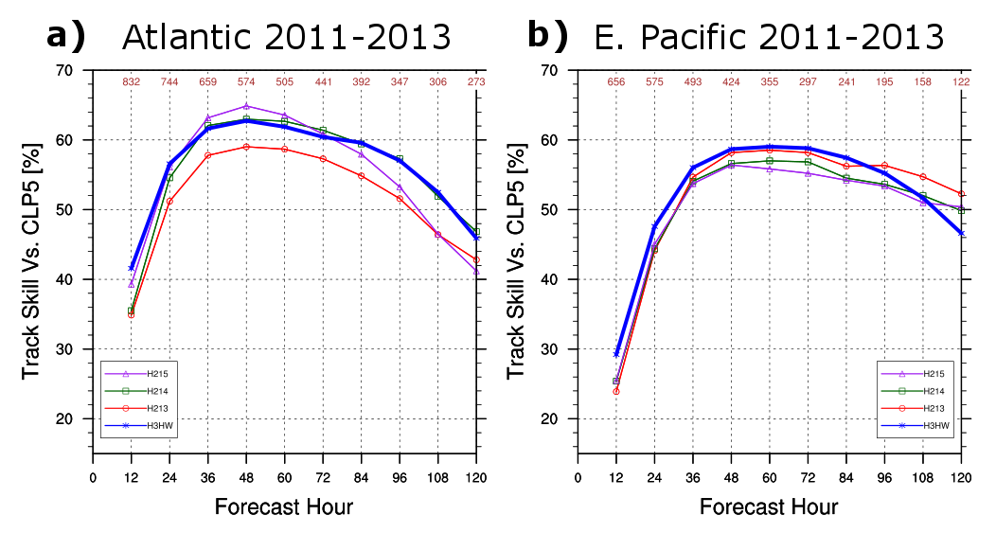
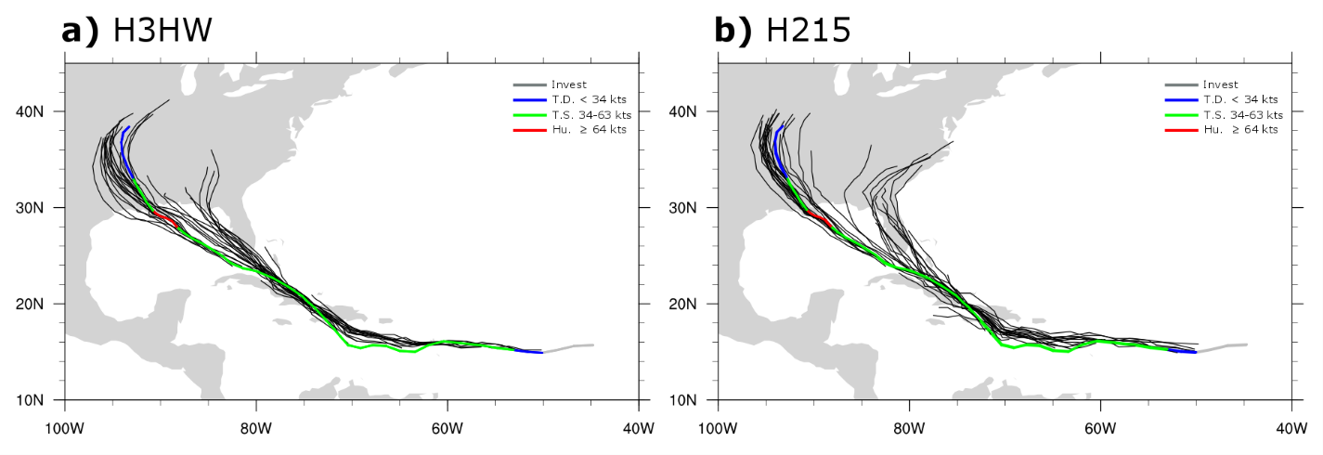
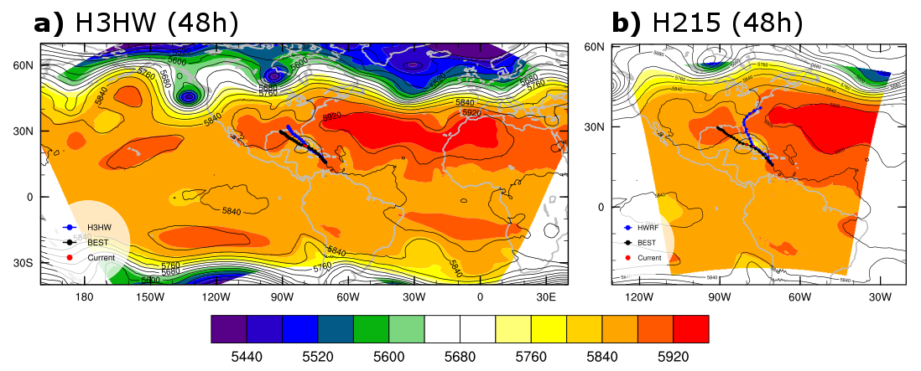
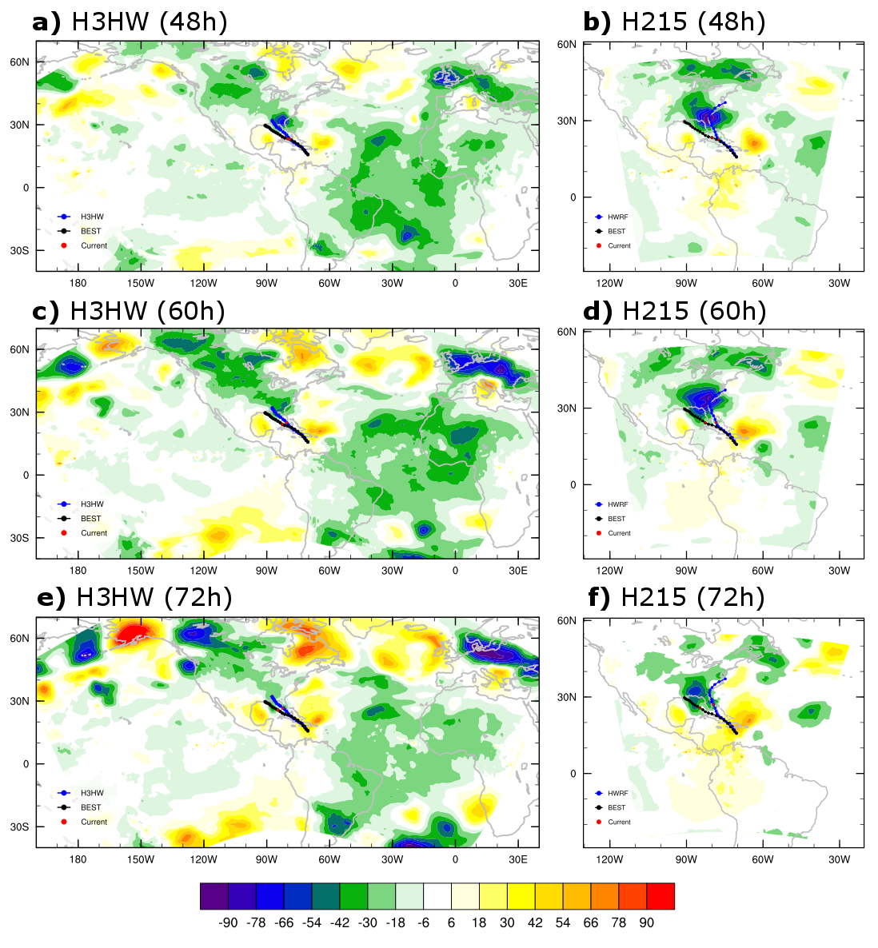
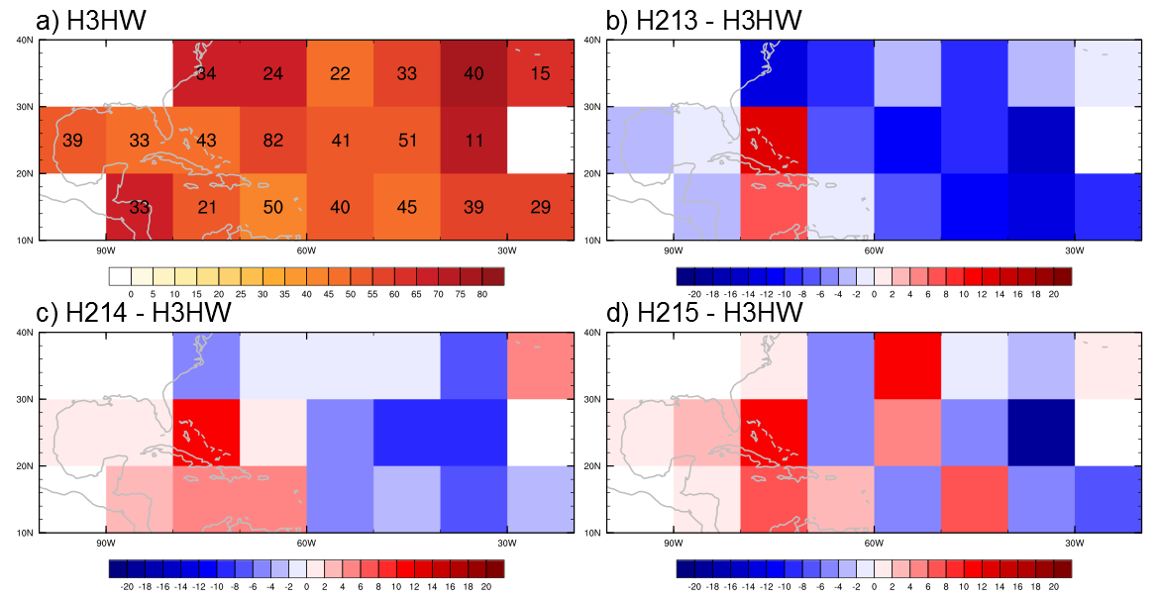
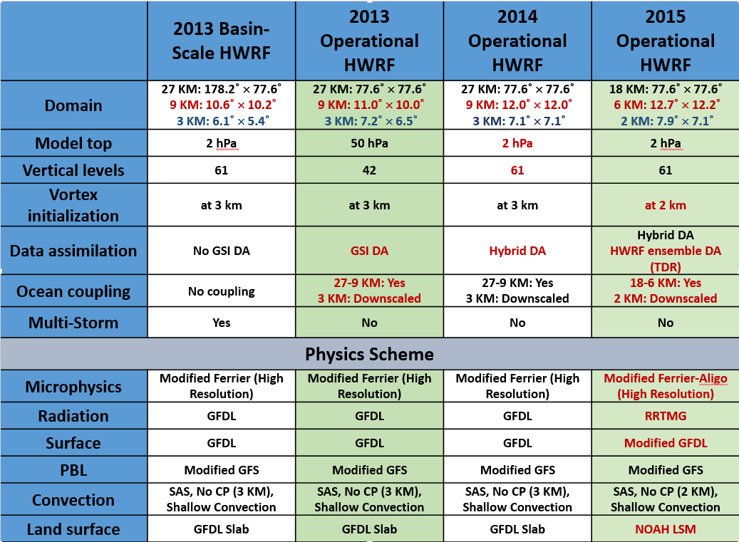
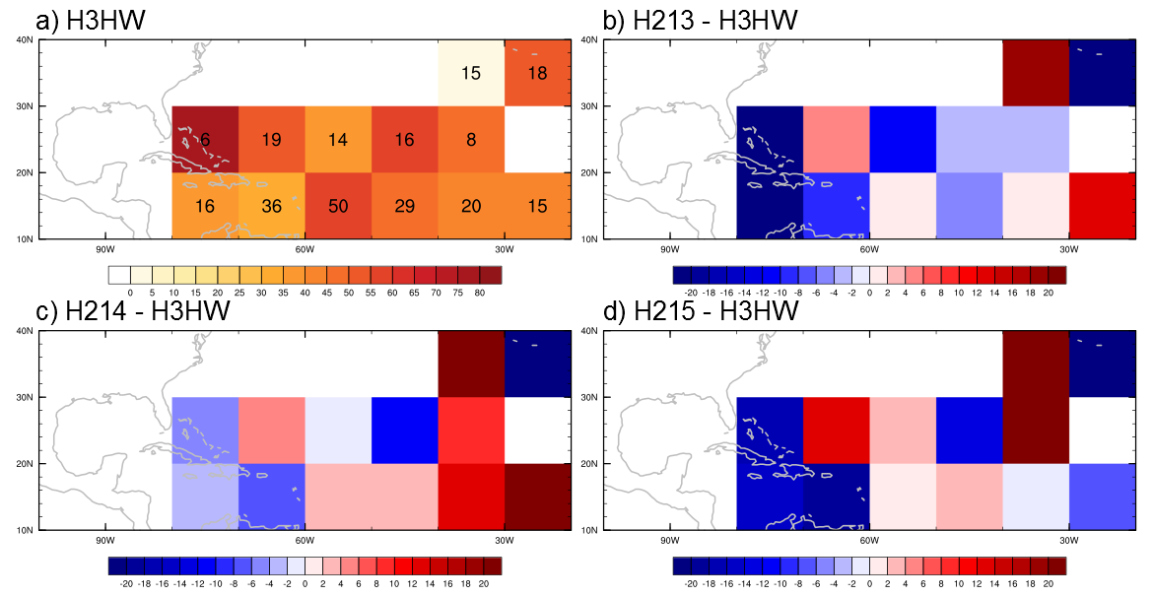
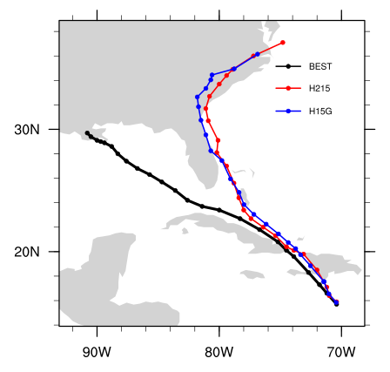
The Value of a Basin-Scale Domain to Improve Tropical Cyclone Track Forecasts in HWRF
Ghassan Alaka Jr.^{1*}, Xuejin Zhang¹, Sundararaman G. Gopalakrishnan², Frank Marks Jr.²
¹Cooperative Institute for Marine and Atmospheric Studies, University of Miami, Miami, Florida
²NOAA/Atlantic Oceanographic and Meteorological Laboratory/Hurricane Research Division, Miami, Florida
*Correspondence: Ghassan.Alaka@noaa.gov
1. Introduction
3. Track Skill Verification
5. Isaac (2012) Case Study
The effort to reduce tropical cyclone (TC) track errors is one of the Hurricane Forecast Improvement Project (HFIP; Gall et al. 2013) goals, in addition to the broader mission of improving community comprehension of the fundamental and complex processes at work within a TC. One important aspect of HFIP is to improve TC forecasts made by the operational Hurricane Weather Research and Forecasting (HWRF) model, which is updated every year to reflect the latest research advances made by the HFIP community. The HWRF model has been a critical tool to help improve TC track forecasts.
However, even as the efforts of HFIP collaborators are integrated into each new version of HWRF, broader shortcomings have been identified with the current system. For example, the operational HWRF features an outer domain that lacks the horizontal expanse to capture critical multi-scale interactions that influence TC tracks, especially in greater lead times. In an effort to build a more robust operational HWRF system for the future, a parallel version of the HWRF model, called the basin-scale HWRF (Zhang et al. 2015, in preparation), has been developed in the AOML/HRD. The basin-scale HWRF features a large domain that covers most of the Northeast Pacific and North Atlantic basins and is capable of including several moving nests (i.e., more than one TC).
The goal of this study is to compare the track skill of the 2013 basin-scale HWRF to the track skill of the operational HWRF versions from 2013, 2014, and 2015 in order to assess the value of a basin-scale domain.
Retrospective forecasts for each HWRF version for all Atlantic and East Pacific TCs from 2011-2013.
Track skill is higher in Atlantic basin.
H3HW produces more skillful tracks than H213 (Fig. 1).
Importance of the increased vertical levels and model top (Table 1).
H3HW is competitive with (or more skillful than) H214 and H215.
H215 erroneously turns Isaac to the North.
H3HW has smaller track errors than H215.
Analyze a specific cycle.
Fig. 4. The best track (multi-colored line) and all forecast tracks (black lines) of Isaac (AL092012).
Fig. 1. Track skill scores for various HWRF models versus CLP5.
Analyzed Cycle:
12Z, 24 Aug. 2012
H215
By 48h, the U.S. East Coast trough is too strong and the central U.S. ridge is too weak.
Isaac is steered erroneously by the U.S. East Coast trough.
Geopotential height anomalies errors approach -100 m north of Isaac.
Isaac forward speed is slower.
Errors may originate from western boundary near Rocky Mountains.
H3HW
Much better simulation of the large-scale environment.
Isaac is correctly steered by the central U.S. ridge and generally tracks to the WNW.
Larger domain and multi-storm capability in H3HW offset H215 upgrades:
e.g., horizontal resolution, model physics, data assimilation, ocean coupling.
Fig. 5. Shaded fields represent 48h model forecasted 500 hPa geopotential height. Contoured fields represent the GFS Analysis 500 hPa geopotential heights at the valid time (18Z, 26 August 2012). Tracks shown are the Best Track (black), corresponding model (blue). The red dot represents the current TC position.
4. Sensitivity to TC Initial Location
The operational HWRF domain moves from one forecast cycle to the next.
TC initial location is used a proxy for the location of the operational HWRF outer domain.
At 24h, H3HW is more skillful in the East Atlantic compared to H213, H214, and H215.
At 120h, H3HW is more skillful in the West Atlantic and Caribbean Sea.
Operational HWRF outer domain boundary is located over the Rocky Mountains.
This introduces mesoscale errors that may grow to the synoptic scale 3-5 days into the forecast.
2. Model Configurations
The versions of the operational HWRF used in this study are: 2013 operational HWRF (H213)
2014 operational HWRF (H214)
2015 operational HWRF (H215)
The 2013 basin-scale HWRF (H3HW) is a simpler version of the operational HWRF system that covers close to ¼ of the Earth.
CLIPER5 (CLP5) is used as a baseline to assess track skill.
GFS Analysis and NHC Best Track are used as observations to compute model errors.
Fig. 2. a) 24h track skill scores for H3HW. The number of cases is shown for each tile. b-d) 24h track skill score differences between H3HW and operational HWRF versions.
Fig. 6. As in Fig. 5, except for the difference between 48h, 60h, and 72h model forecasted 200 hPa geopotential height and GFS Analysis 200 hPa geopotential heights at the corresponding valid times.
Other Cases
Isaac tracks improve in other H215 forecasts when flow over Rocky Mountains is resolved in the outer domain.
Ernesto (2012) is another case with poor H215 tracks and troublesome boundary placement.
Table 1. Configuration and physics for the four HWRF versions analyzed in this study. In general, newer versions are to the right. Red text signifies an upgrade from the previous version.
Fig. 3. As in Fig. 2, except for 120h forecasts.
6. Land Surface Model Sensitivity
7. Conclusions
In H215, the land surface model (LSM) is upgraded from the GFDL slab scheme to the Noah LSM.
A similar upgrade will be present in 2015 basin-scale HWRF (H5HW).
We test an identical version of H215, except for the LSM, which is reverted to the GFDL slab scheme (H15G).
For now, we have only run a few Isaac forecast cycles. In future work, we will test the LSM sensitivity for many TCs, but that work will be performed for H5HW.
The track of Isaac is not very sensitive to choice of LSM.
From 2011-2013, H3HW is more skillful in track forecasts than H213 and is competitive with or better than H214 and H215 track skill scores.
Track skill scores for the operational HWRF versions (H213, H214, H215) are sensitive to the outer domain location.
When the operational HWRF boundary is located over topography, as is the case when TCs are initialized in the Western Atlantic and Caribbean Sea, errors are introduced and track skill scores are reduced.
Boundary-induced errors can grow to the synoptic scale, impact the mid-latitude trough-ridge pattern, and incorrectly steer TCs.
If the flow over the Rocky Mountain is captured within the H215 outer domain, then track skill scores improve.
TC propagation speed is an important factor for its interaction with the large-scale environment.
H215 exhibits a weak sensitivity to LSMs. More extensive tests will be performed with the latest basin-scale HWRF (H5HW).
Acknowledgements
This work is supported by ???.
Additionally, the authors thank the entire HRD Modeling Group for vital input to this work as it has progressed.
Fig. 8. Isaac track for the Best Track (black), H215 (red), and H15G (blue). The two model tracks are from a forecast cycle initiated at 12Z, 24 August 2012.

