Slide 1
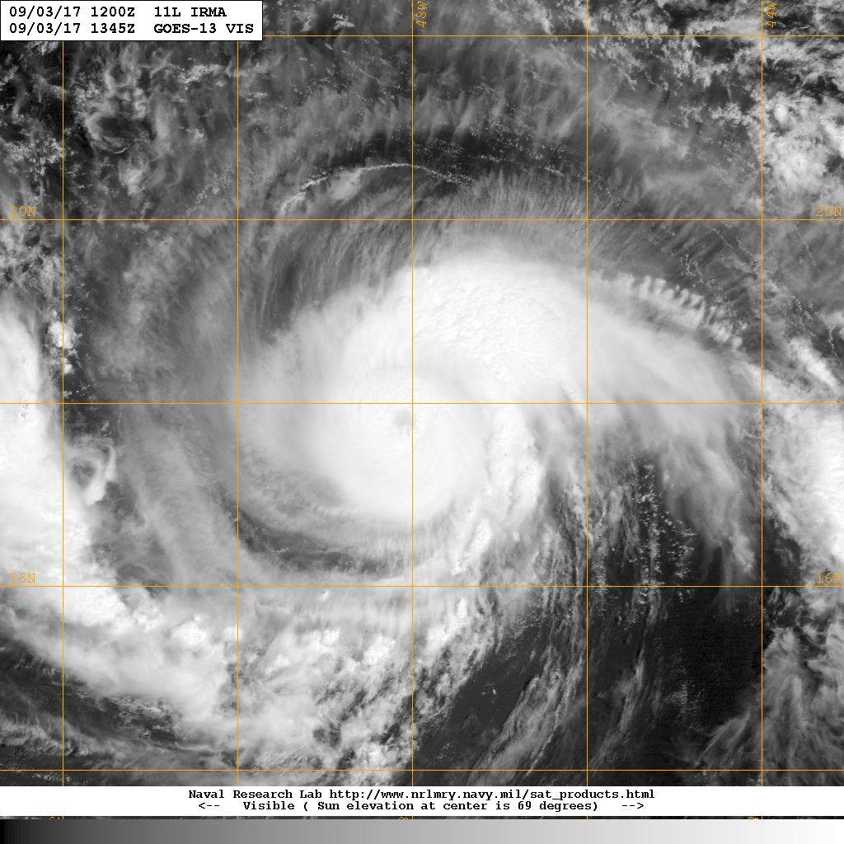
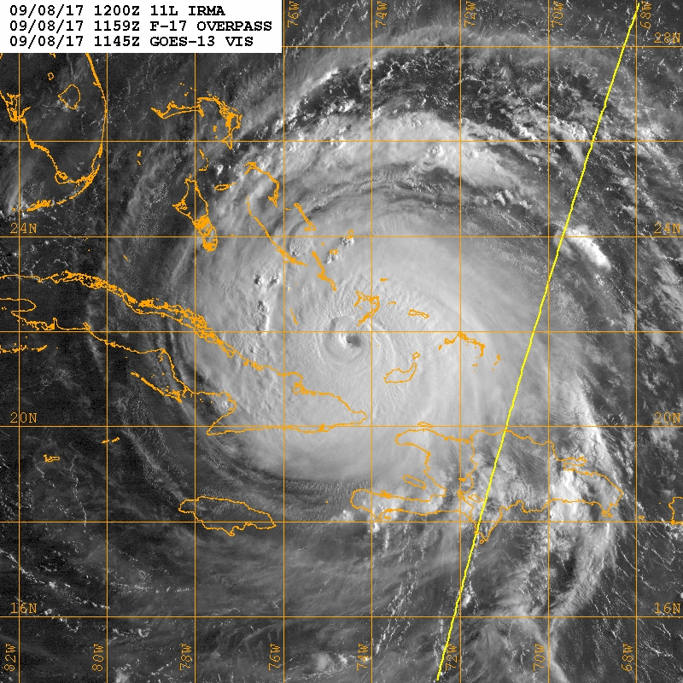


Hurricane Irma Debrief
14Z 03 Sep
12Z 08 Sep
Flight ops re-cap: 7 EMC missions, 1 NHC fix mission
~66 P-3 flight hours; ~65 GPSsondes; ~29 IRsondes; ~42 AXBTs
8 G-IV Synoptic surveillance missions
October 4, 2017

Slide 2
Agenda
Missions Overview (Reasor)
Science Discussions
  170903H1 TDR (Zawislak)
  170904H1 TDR (Rogers)
  170904H2 TDR (Zawislak)
  170905H1 TDR (Rogers)
  170905H2 TDR (Zawislak)
  170908H1 TDR (Zawislak)
  170908H2 TDR (Bucci)
Landfall Teams
Glider operations

Slide 3
Missions Overview
Purpose: EMC-tasked TDR data collection targeting 00 UTC and 12 UTC HWRF cycles
Target: MH Irma on 03-08 Sep during its approach to the lesser Antilles, and again as it neared south Florida
Background: Irma was a major hurricane when missions began. It maintained major hurricane status until its landfall in SW Florida.
Mission highlights: Sampled intense TC w/ significant U.S. impact; transmitted recon data for HWRF DA (00Z & 12Z)

Slide 4
Missions Overview (local times)
02 Sep: N42 ferries to Barbados
03 Sep: 3PM mission
04 Sep: 3AM mission; 4PM mission
05 Sep: 4AM mission aborted after 3rd pass; 4PM mission
06 Sep: N42 ferries to Lakeland
08 Sep: 3AM mission; 3PM mission
09 Sep: 1PM fix mission (no HRD, no TDR transmission)

Slide 5
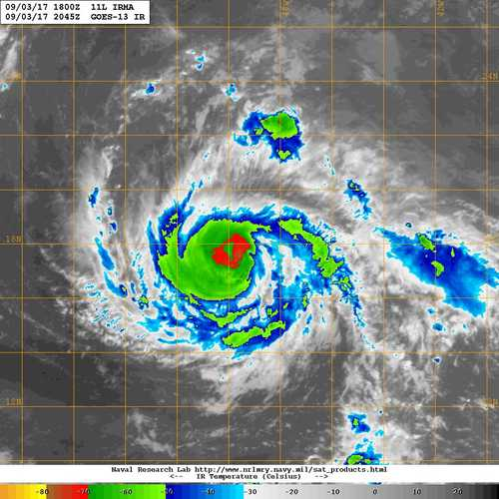
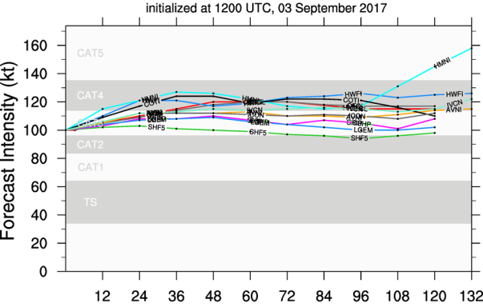
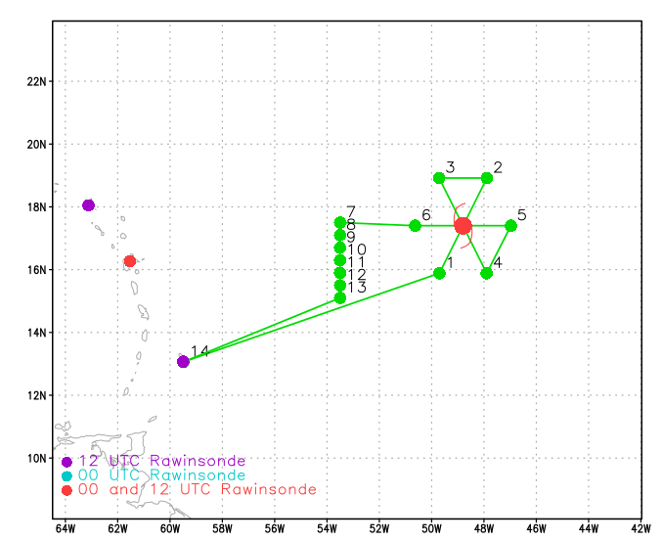
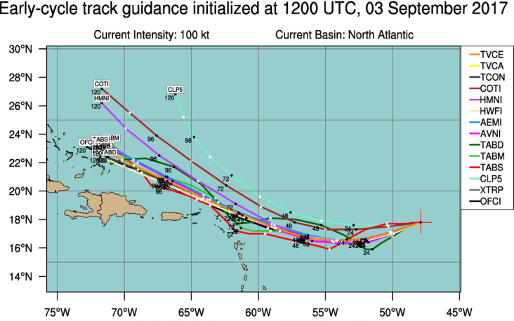
20170903H1 AL11 IRMA (TDR)
Takeoff: 1911 UTC, Landing: 0230 UTC
Butterfly, 8-10 kft, 105 nm
Dropsondes at turn points and each center pass, one on return ferry
AXBT run along 53.5°W (“mini” pre-storm survey)
Fix responsibility on each pass
LPS: Zawislak
Radar: Zhang
Dropsonde: Zawislak
Ground Radar: Reasor
969 mb / 100 kt
MOTION (12 kt)
SHIPS SHEAR (9 kt)
2100 UTC (Arrival at IP)

Slide 6
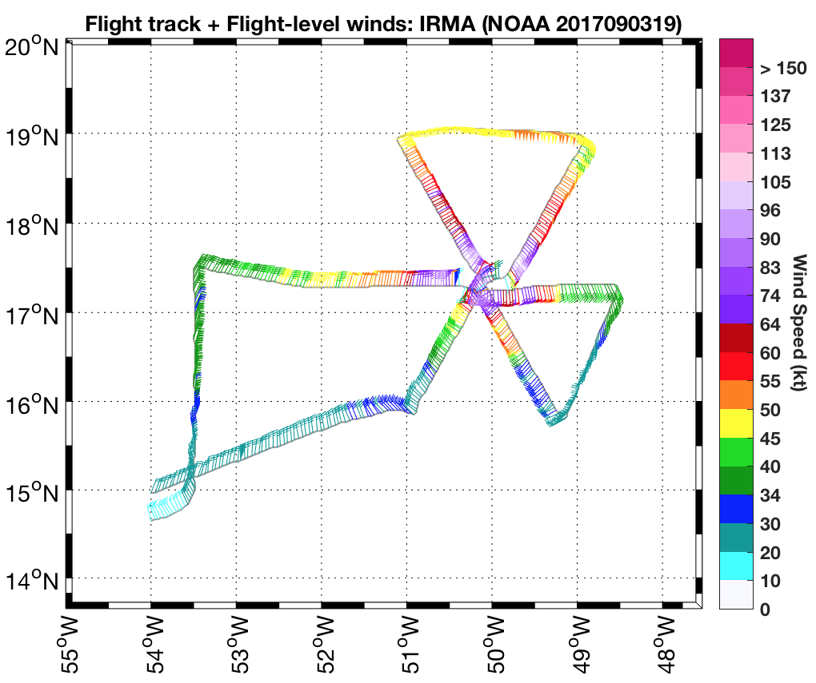
20170903H1 AL11 IRMA (TDR)
AXBT run at 8kft
6/7 reported good data

Slide 7
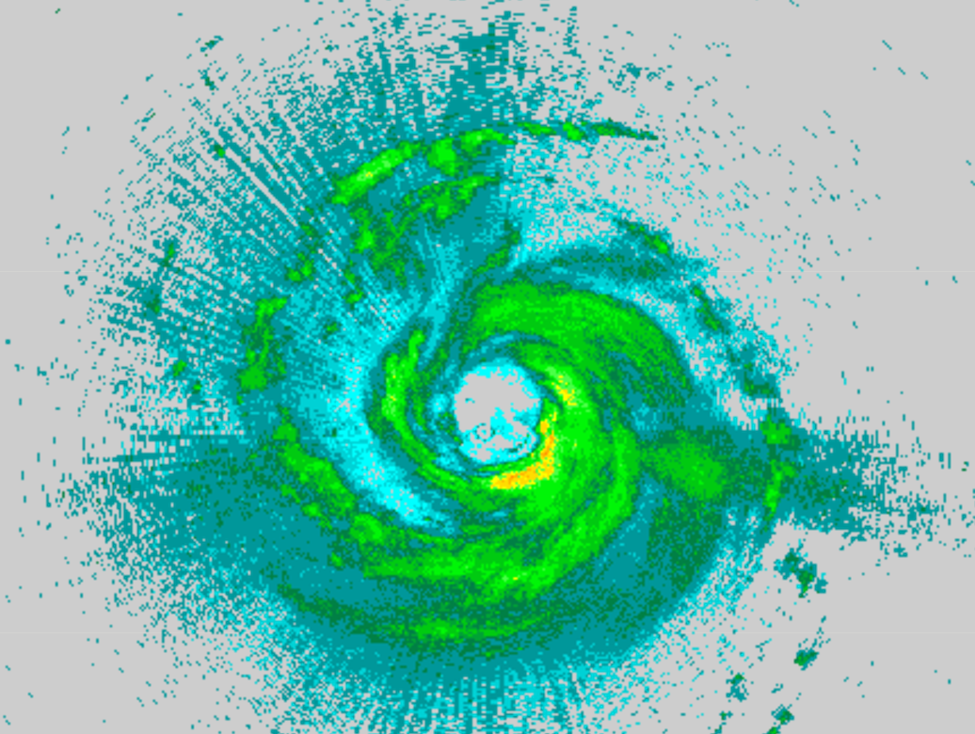
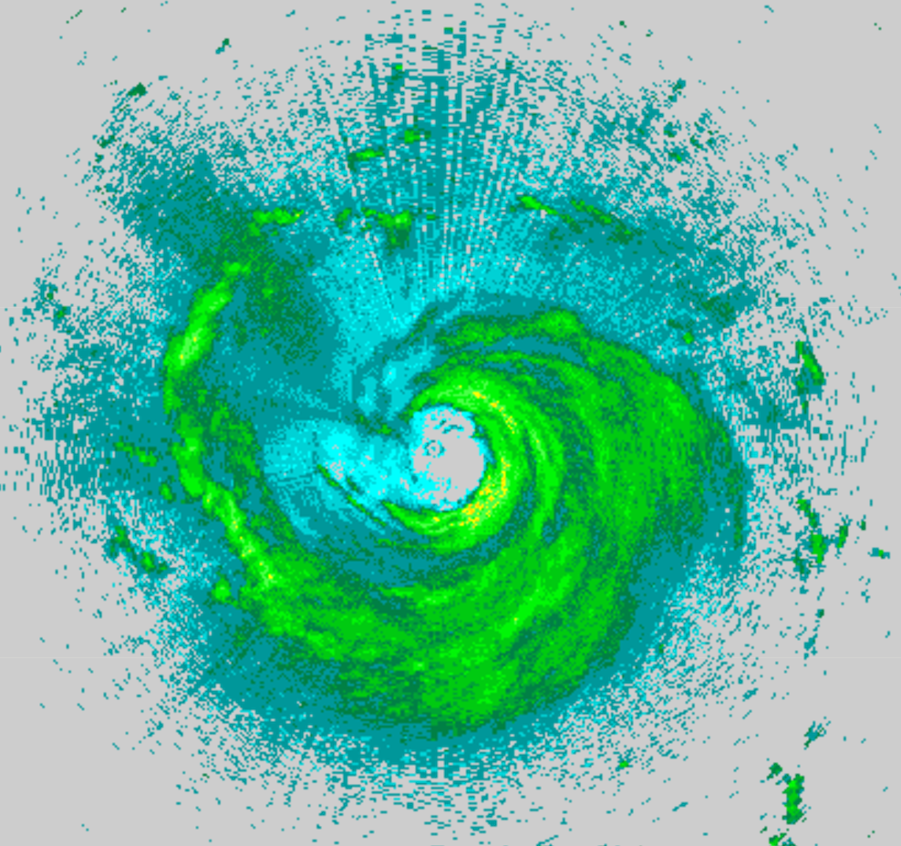
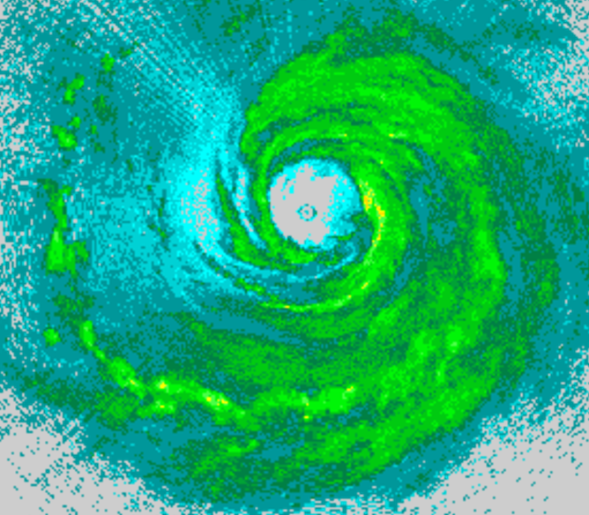
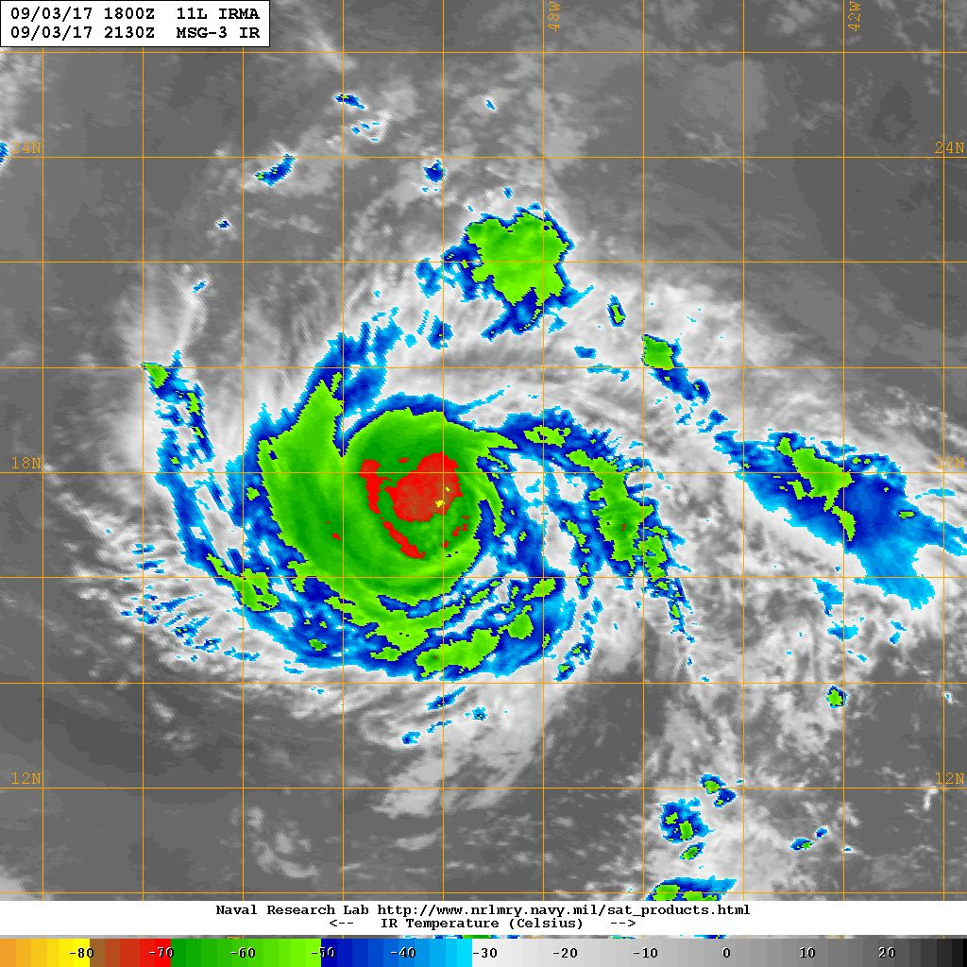
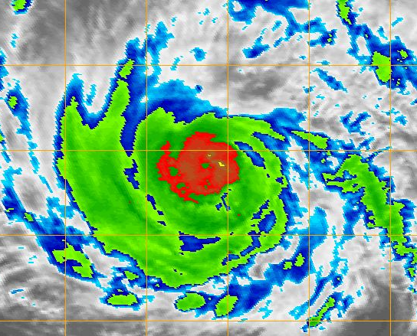
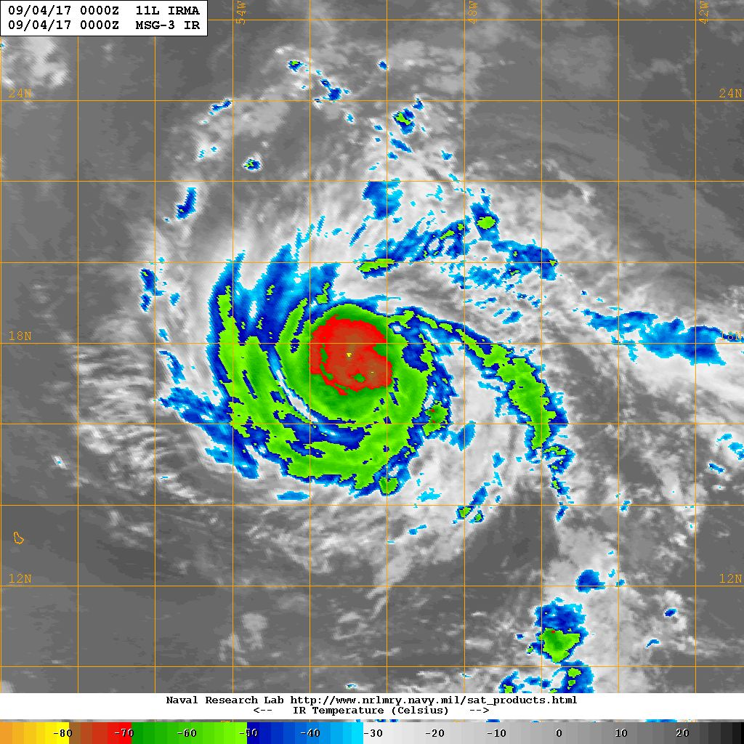
20170903H1 AL11 IRMA (TDR)
2124 UTC
2243 UTC
2359 UTC
2130 UTC
2245 UTC
0000 UTC
Increased symmetry of inner core precipitation; likely to see further intensification in the near-term

Slide 8
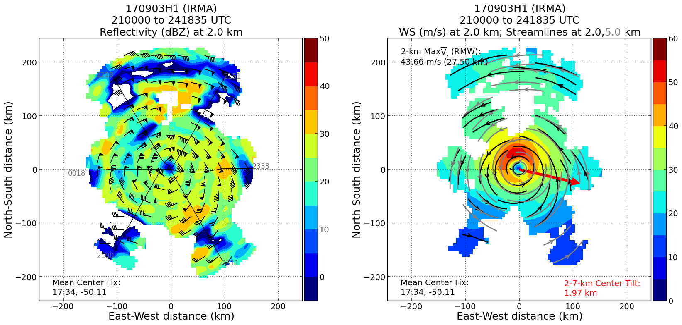
20170903H1 AL11 IRMA (TDR)

Slide 9
20170903H1 AL11 IRMA (TDR)
Summary
T/O: 969 mb / 100 kt L/D: 961 mb / 100 G 120 kt (03 UTC NHC)
Remained fairly steady state (peak SFMR sfc. wind 100 kt, FL 105 kt)
Center Passes: 2124 UTC, 2243 UTC, and 2359 UTC
3 TDR analyses
Increase in eyewall azimuthal precipitation symmetry during mission
Evidence of secondary wind maximum near northern and eastern eyewall
Successful (6/7) AXBT pre-storm survey
Dropsonde on return ferry at 24 kft
Problems
Only 1 AXBT (first in run) did not provide data
Issue with producing WMO messages in ASPEN 33304
Expendables:
10 Dropsondes (7 HFIP, 3 NHC)
7 AXBTs

Slide 10
Hurricane Irma
Flight 170904H1
LPS: Rob Rogers
Radar (air): Sim Aberson
Radar (ground): John Gamache
Dropsonde/PBL: Kathryn Sellwood
Meteorological highlights
Irma a Cat 3 tracking south of due west in MDR
Experiencing light NW shear, moist environment
Generally symmetric distribution of precipitation
Indications of potential outer wind maximum on east (“downshear” left) and north (“upshear” left) sides
Mission highlights
15 GPS dropsondes – 7 HFIP at turn points (no drop on east turn point), 8 NHC at center/eyewall. One drop had no launch detect (NE eyewall)
4 AXBT in combo with eyewall drops, 3 failed
Coordinated first SE-NW leg with CYGNSS overpass for Ocean Winds

Slide 11
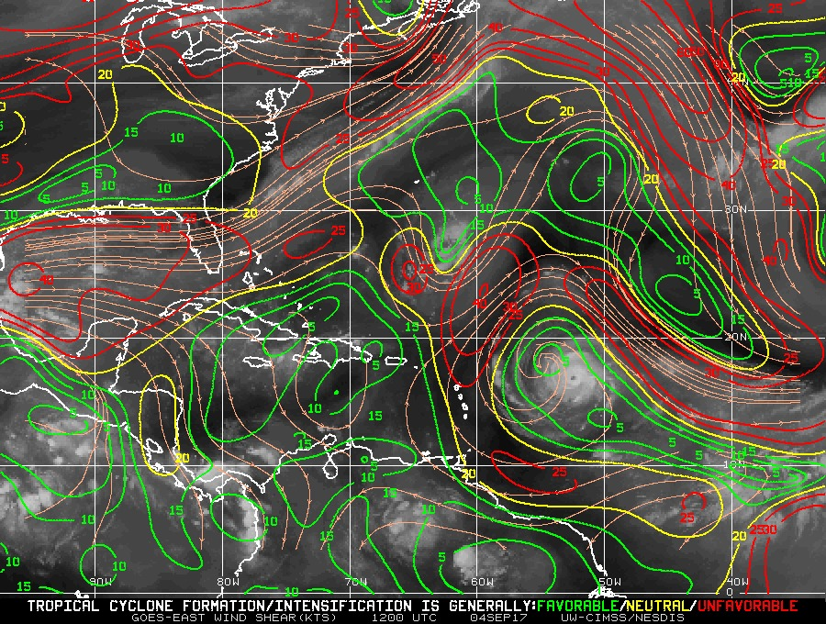
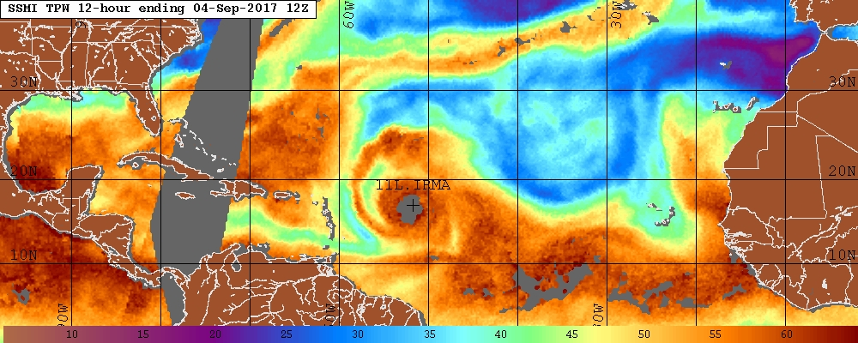
Environmental conditions
CIMSS 850-200 hPa shear 12 UTC Sep 4
TPW 12 UTC Sep 4
Shear 5-10 kt from NW
Moist low-levels all around, except slight dry air on NW

Slide 12
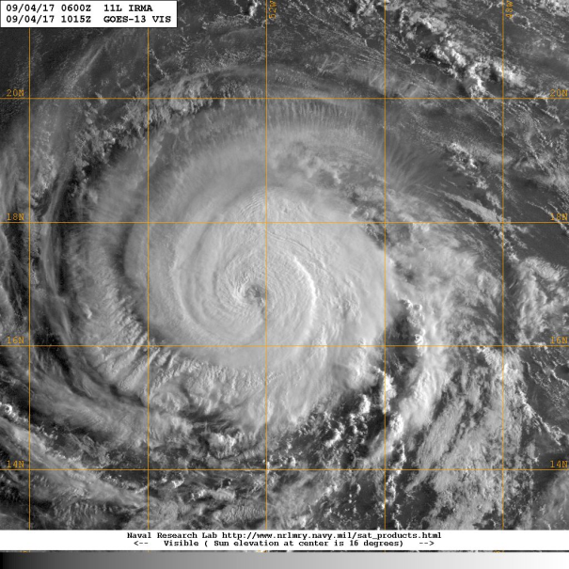
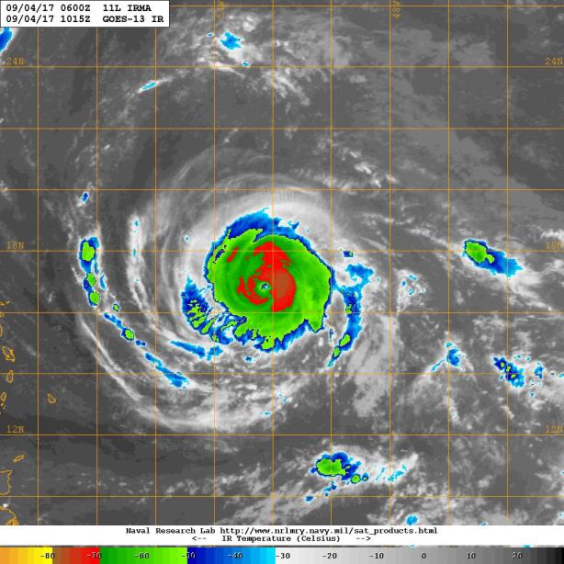
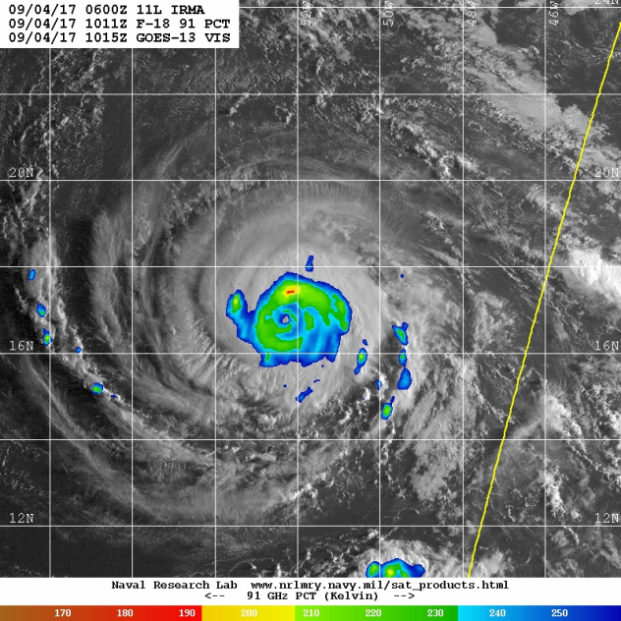
Satellite presentation
GOES-13 Vis valid 1015 UTC Sep 4
GOES-13 IR valid 1015 UTC Sep 4
F-18 91 GHz PCT valid 1011 UTC Sep 4
Eye clearing out, cold cloud tops symmetrically distributed
Moderate levels of ice scattering, small core of high scattering on north (USL) side

Slide 13
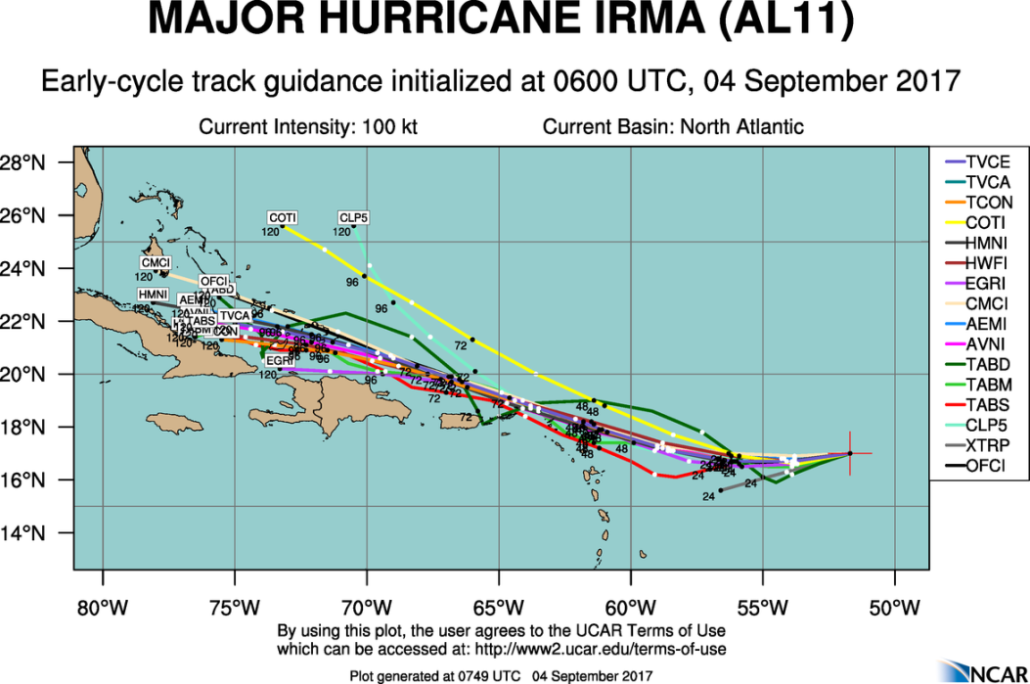
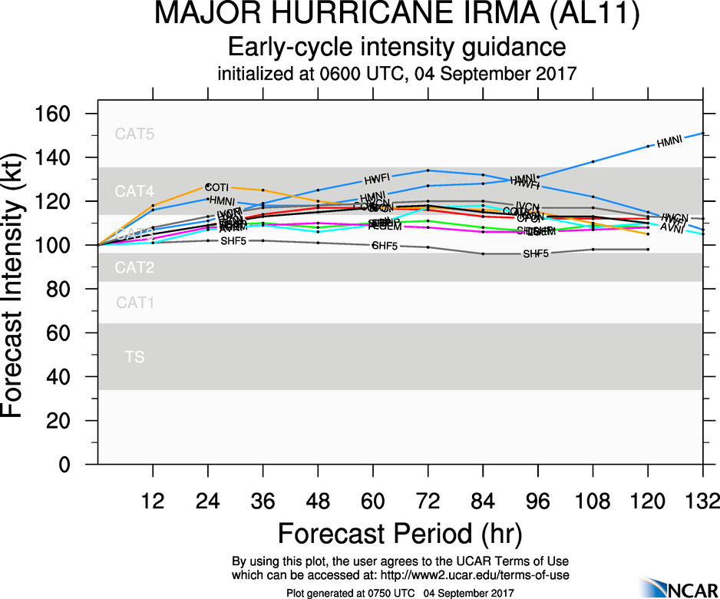
Model guidance

Slide 14
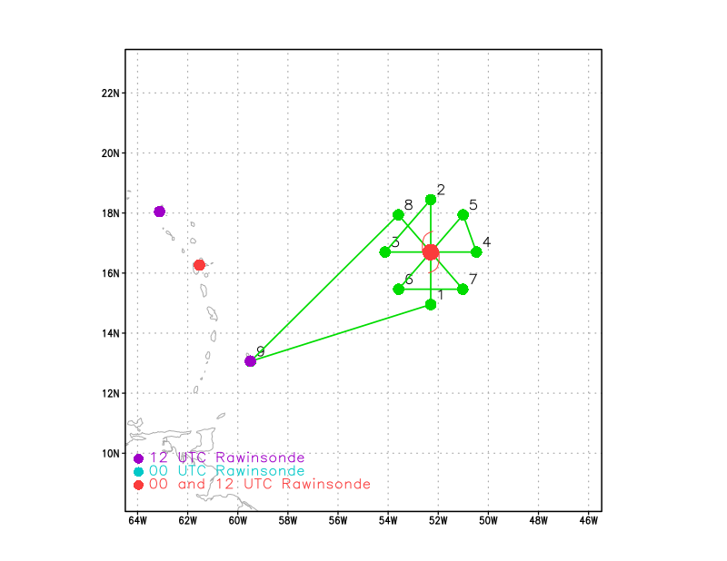
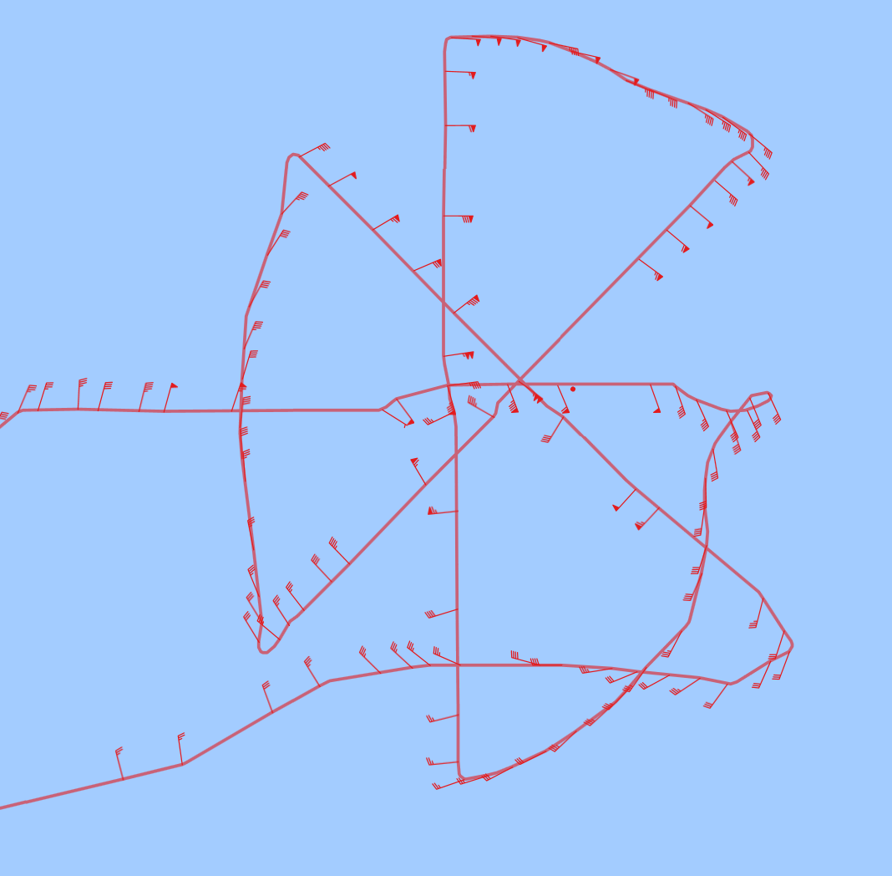
Flight tracks
Planned flight track for 170904H1
Actual flight track for 170904H1
First SE-NW leg aligned with CYGNSS overpass

Slide 15
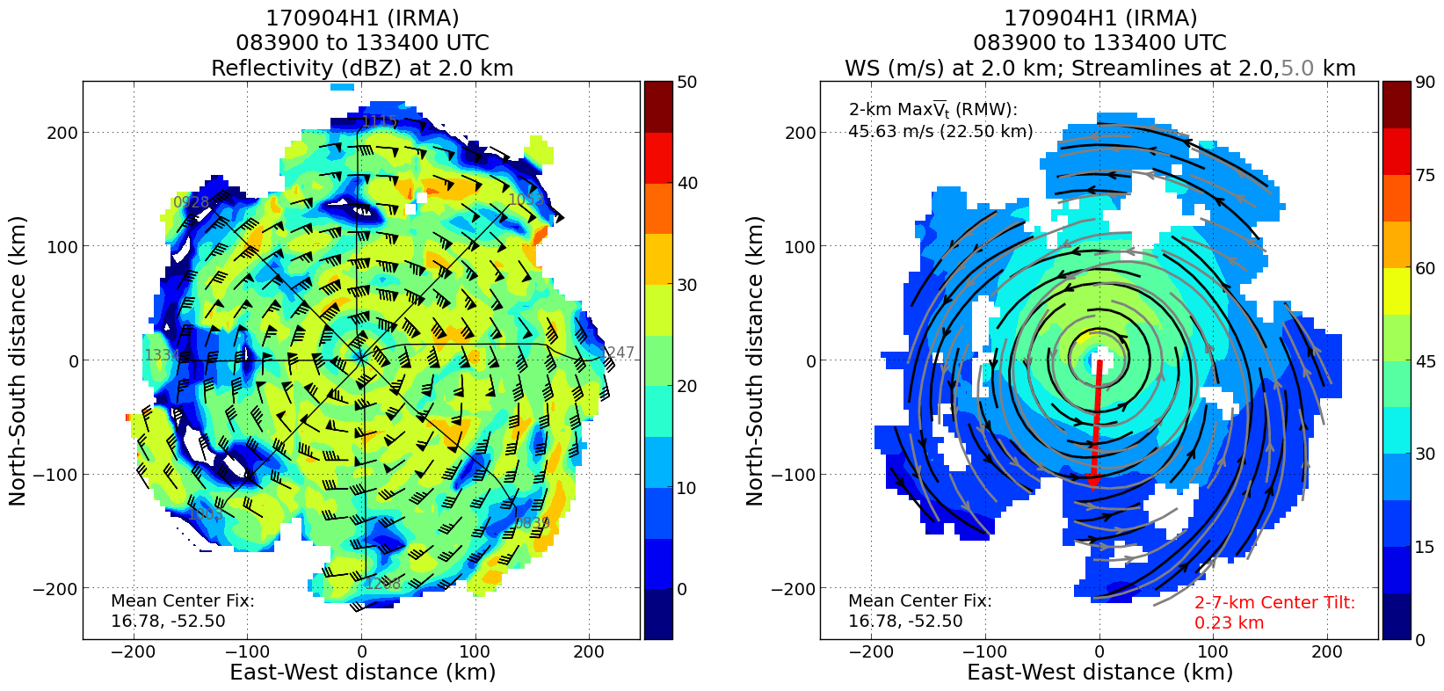
Winds and reflectivity
Nearly perfectly aligned

Slide 16
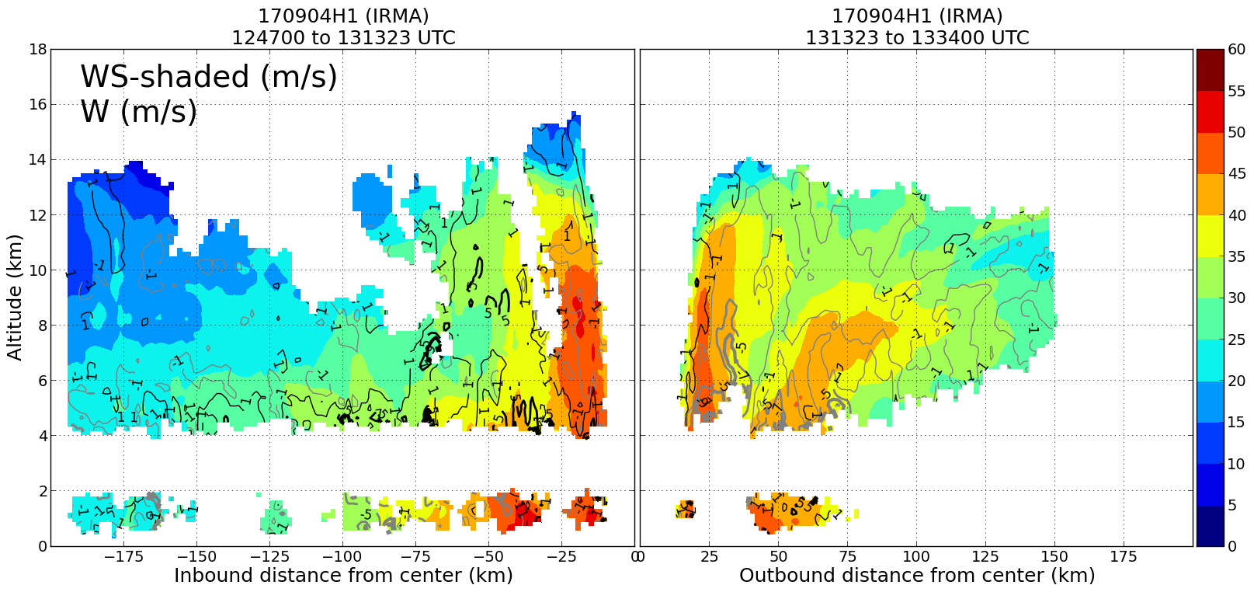
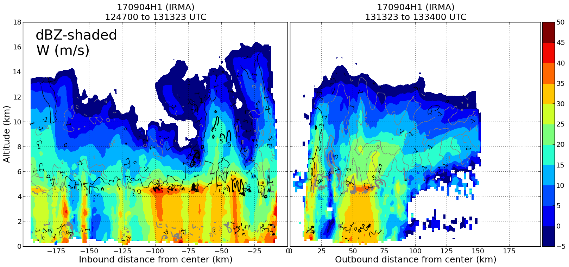
Winds and reflectivity
W
E
W
E
Outer wind max on east side

Slide 17
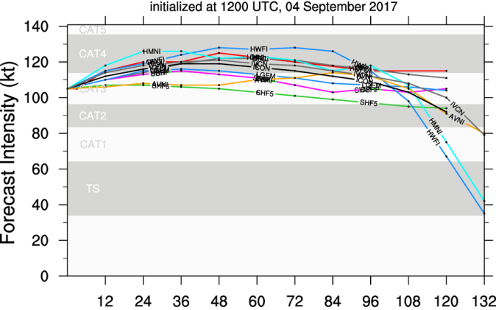
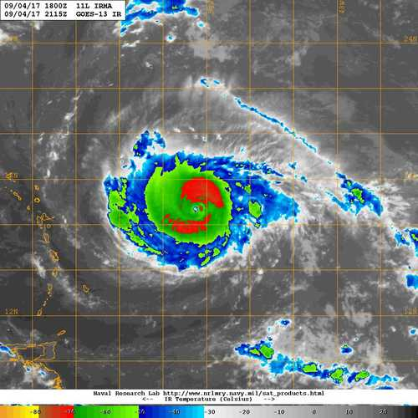
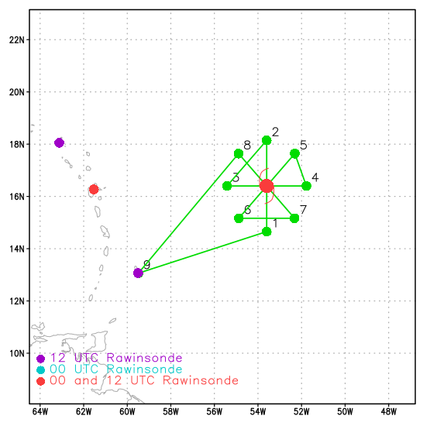
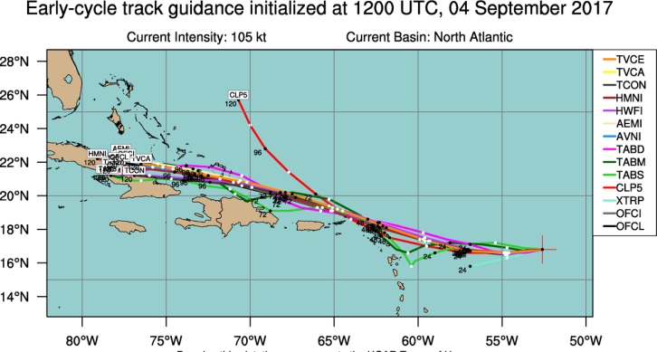
20170904H2 AL11 IRMA (TDR)
LPS: Zawislak
Radar: Zhang
Dropsonde: Zawislak
Ground Radar: Reasor
Takeoff: 2009 UTC, Landing: 0321 UTC
Rotated Figure-4, 8-10 kft, 105 nm
Dropsondes at turn points and each center pass
2 AXBT (NE turn point, and center)
944 mb / 105 kt
MOTION (12 kt)
SHIPS SHEAR (6 kt)
2114 UTC (Arrival at IP)

Slide 18
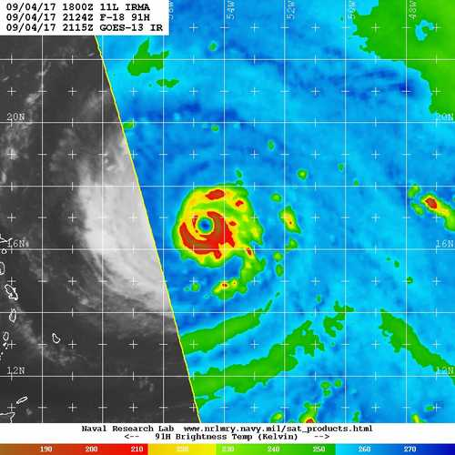
20170904H2 AL11 IRMA (TDR)
SSMIS-18 at 2124 Z (Arrival at IP)
IR at 2115 Z
Suggests that ERC is ongoing

Slide 19
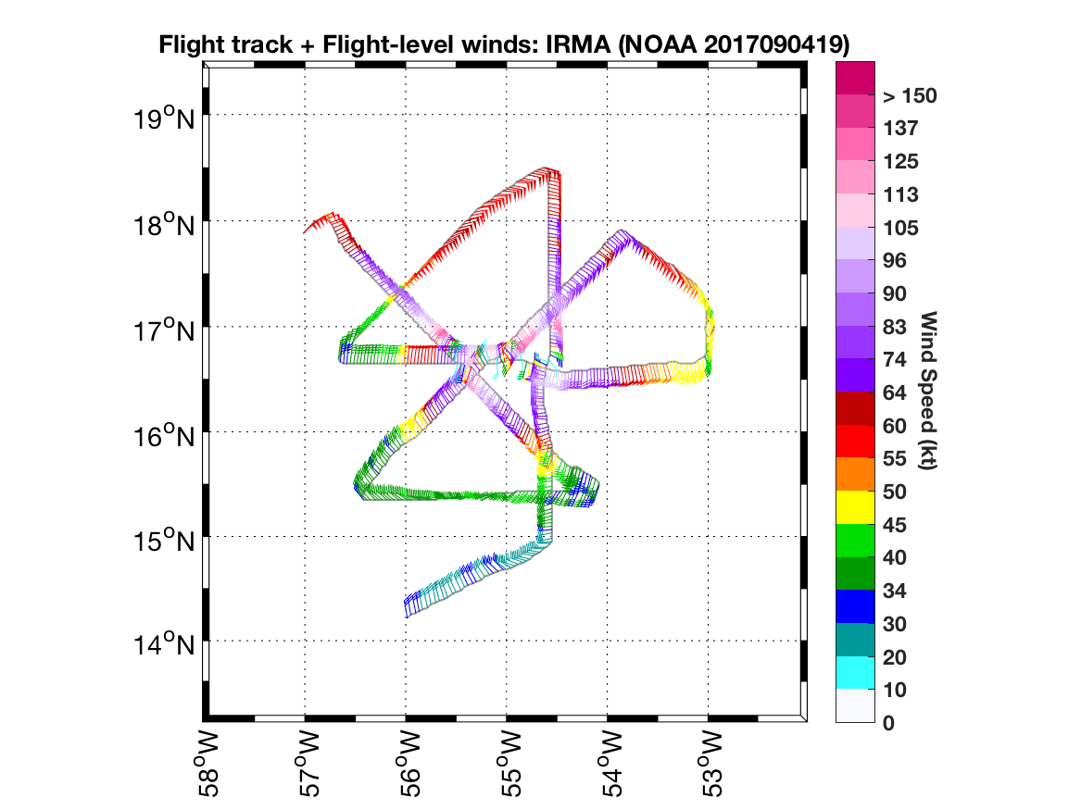
20170904H2 AL11 IRMA (TDR)

Slide 20
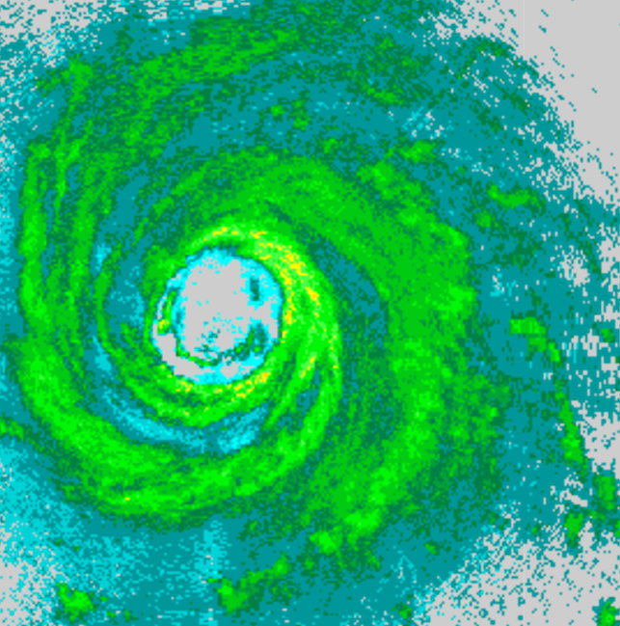
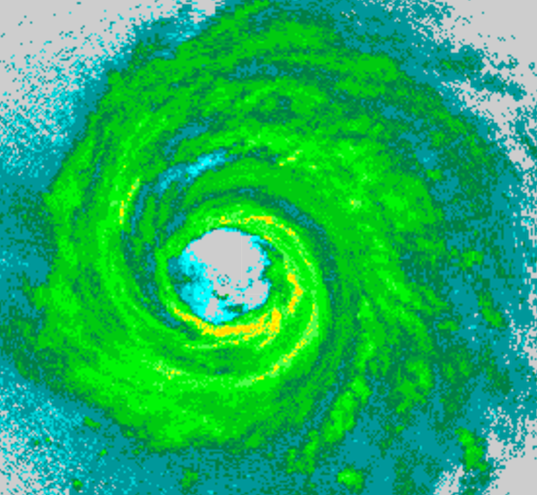
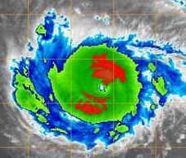
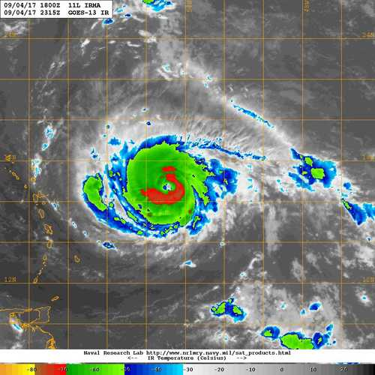
20170904H2 AL11 IRMA (TDR)
2138 UTC
2306 UTC
Remnant eyewall
2145 UTC
2315 UTC

Slide 21
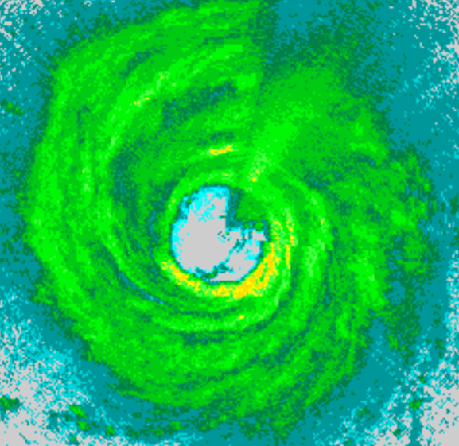
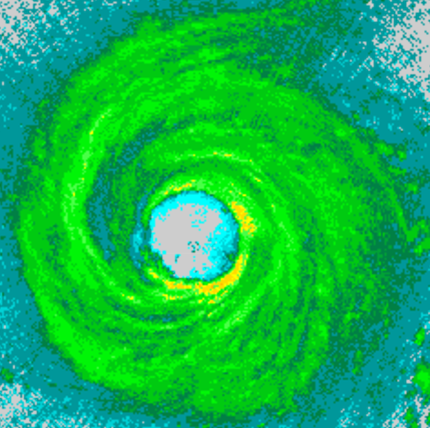
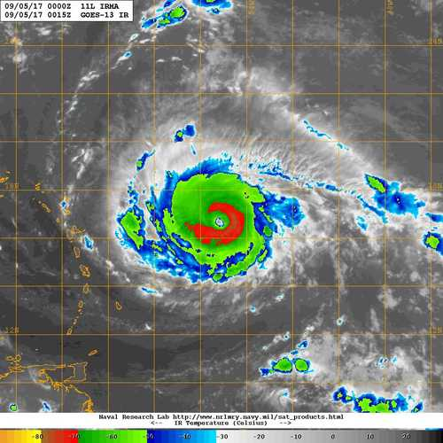
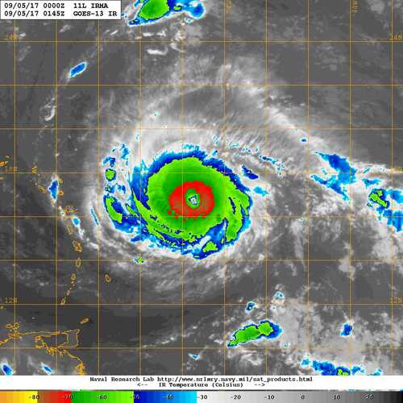
20170904H2 AL11 IRMA (TDR)
0019 UTC
0149 UTC
ERC Complete
0015 UTC
0145 UTC

Slide 22
20170904H2 AL11 IRMA (TDR)
Summary
T/O: 944 mb / 105 kt (18 UTC, NHC); IP: 115 kt (21 UTC, NHC)
L/D: 943 mb / 120 kt (03 UTC, NHC)
Beginning to intensify (peak SFMR sfc. wind 120 kt, FL 138 kt)
Center Passes: 2140, 2307, 0020, and 0149 UTC
Completion of ERC, intensifying (beginning of RI) – even during ERC?
expansion of azimuthal precip. coverage, eye diameter
Problems
Issue with altitude in the TDR sweeps. Related to a swap GPS unit prior to the flight. Resolved on the final outbound leg, so no data sent to EMC.
TDR restarted at 0100 UTC prior to final pass.
1 of 2 AXBT did not provide data (center)
1 sonde had a late launch detect / flagged as fast fall (not transmitted)
Expendables:
12 Dropsondes (8 HFIP, 4 NHC)
2 AXBTs

Slide 23
Hurricane Irma
Flight 170905H1
LPS: Rob Rogers
Radar (air): Sim Aberson
Radar (ground): John Gamache
Dropsonde/PBL: Kathryn Sellwood
Meteorological highlights
Irma becomes a Cat 5 during mission, tracking west approaching NE lesser Antilles
Still light NW shear, moist environment
Eye cleared out, nice stadium effect, ring of high ice scattering
Deep layer of extremely strong (> 70 m/s) winds in NE eyewall
Outer wind maxima evident from radar vertical cross sections on SW, NE sides (not as clear from flight-level though); no clear indication that an eyewall replacement occurred
Mission highlights
Rotated fig-4; 9 GPS dropsondes – 6 HFIP at turn points, 3 NHC at center. All worked. No AXBTs.
Coordinated first SE-NW leg with CYGNSS overpass for Ocean Winds
Mission had to be aborted during third center pass because of a/c vibration

Slide 24
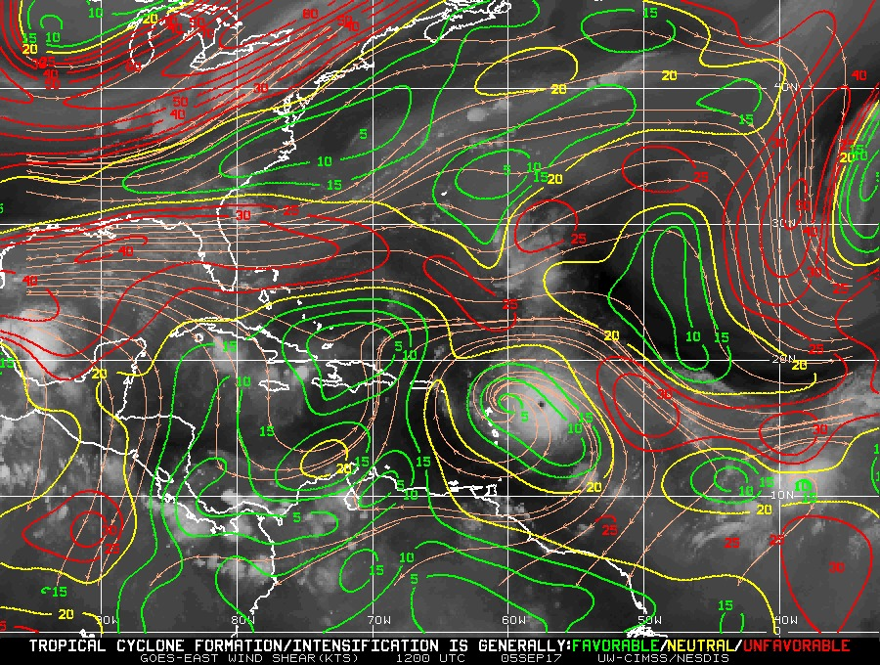
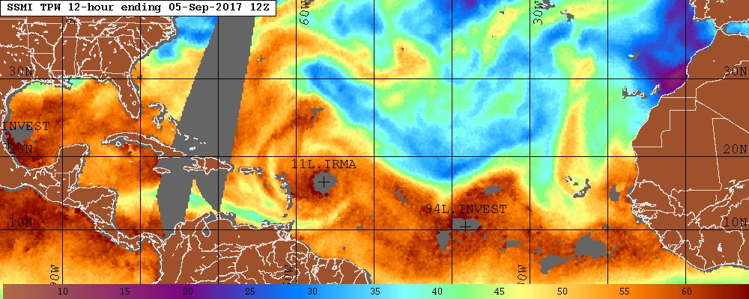
Environmental conditions
CIMSS 850-200 hPa shear 12 UTC Sep 4
TPW 12 UTC Sep 4
(a)
Shear < 10 kt from NW
Moist low-levels all around

Slide 25
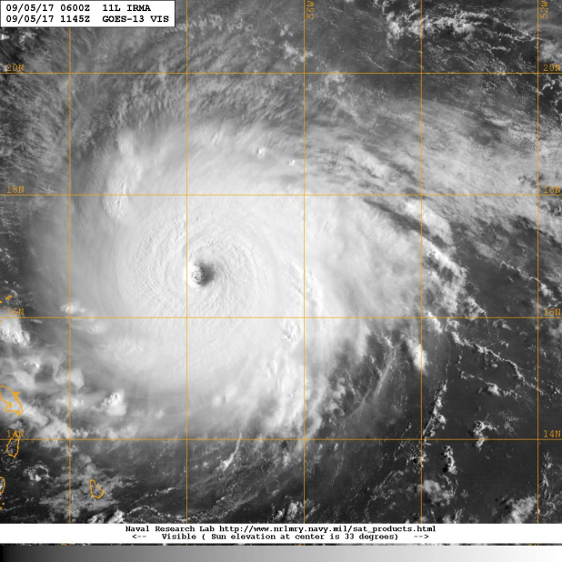
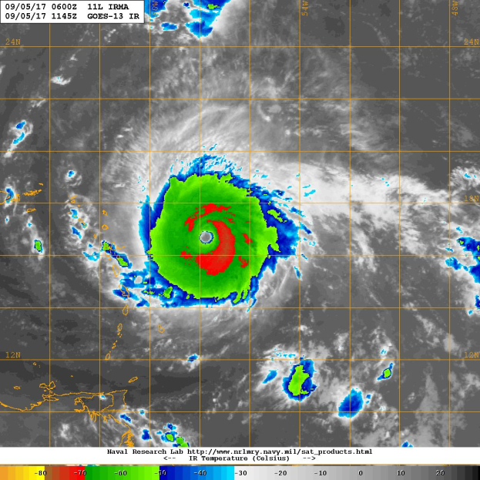
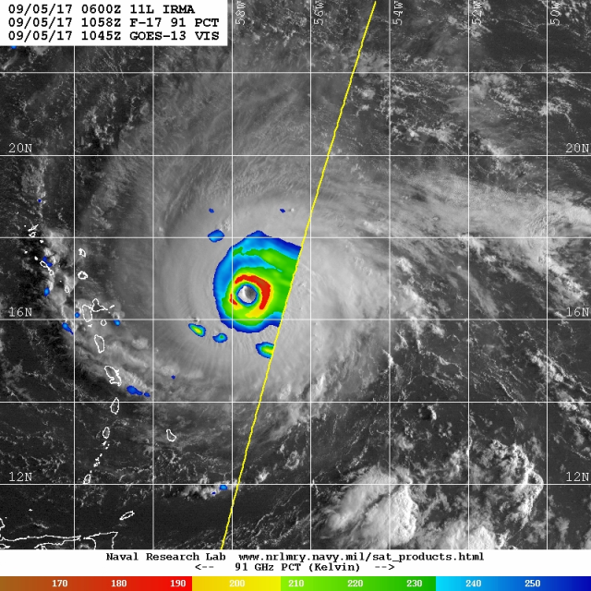
Satellite presentation
GOES-13 Vis valid 1145 UTC Sep 5
GOES-13 IR valid 1145 UTC Sep 5
F-17 91 GHz PCT valid 1058 UTC Sep 5
Eye cleared out
Ring of high ice scattering

Slide 26
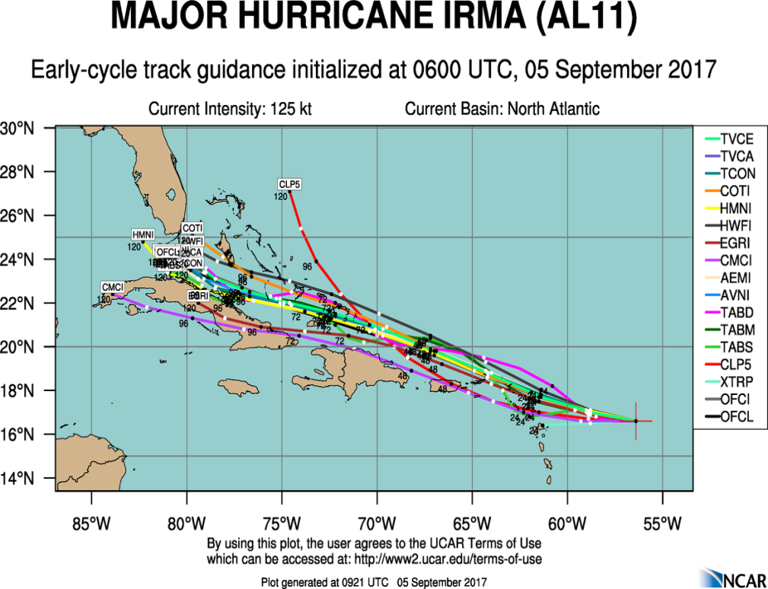
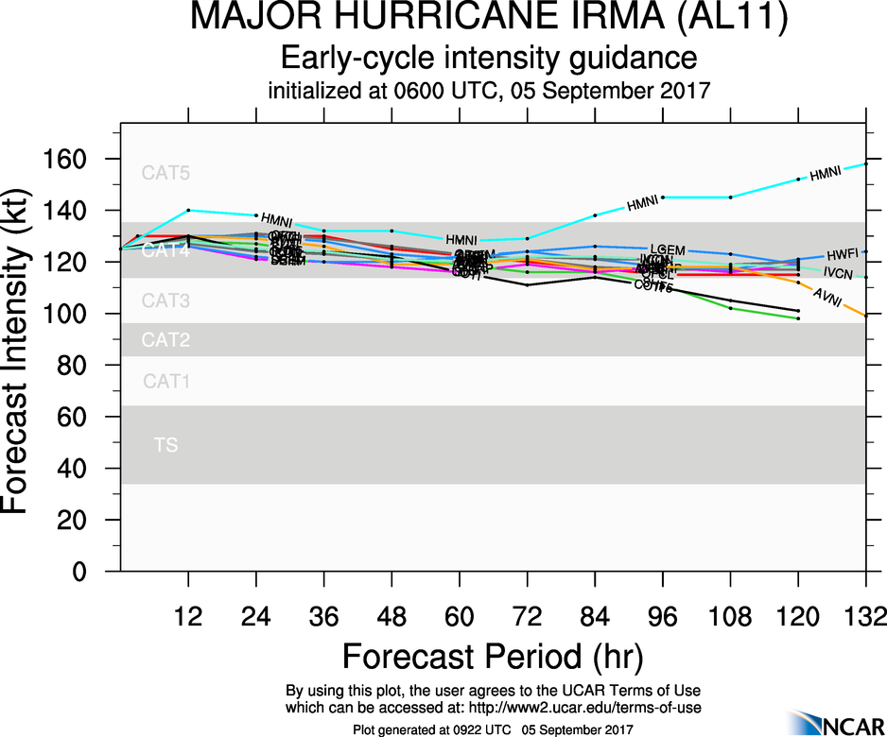
Model guidance

Slide 27
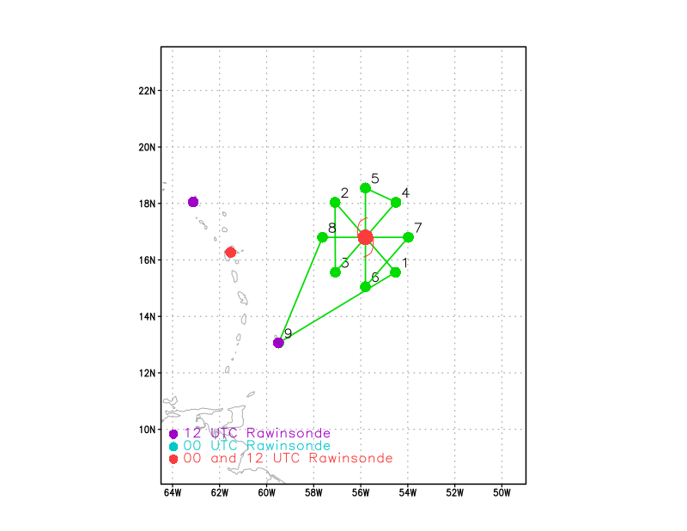
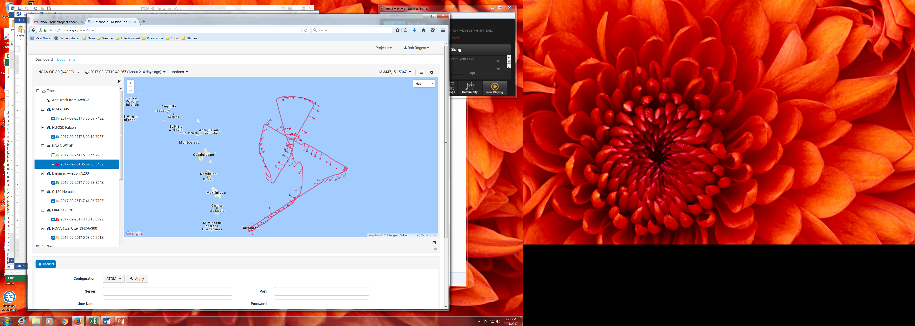
Flight tracks
Planned flight track for 170905H1
Actual flight track for 170905H1
First SE-NW leg aligned with CYGNSS overpass

Slide 28
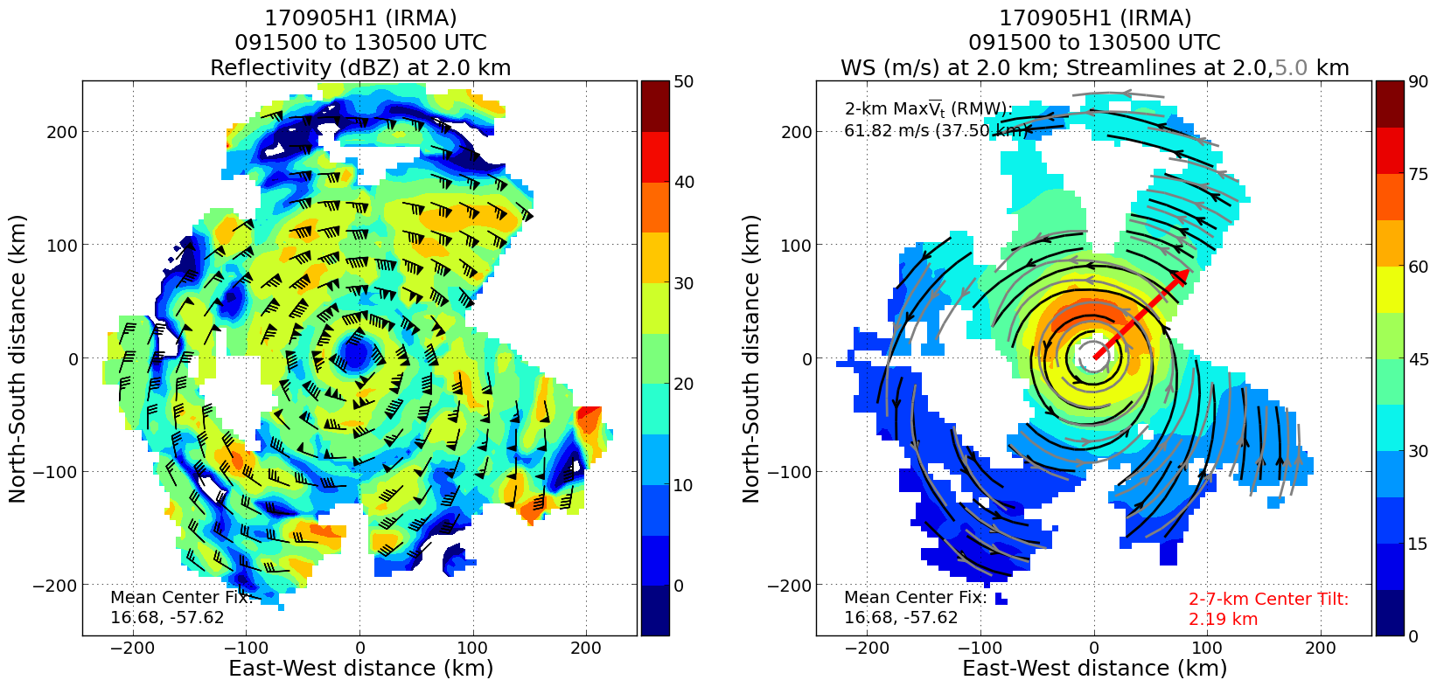
Winds and reflectivity
Very well aligned
Winds ~ 75 m/s at 2 km in N eyewall

Slide 29


Winds and reflectivity
SW
NE
SW
NE
Eyewall winds off the scale on NE side
Outer wind max, extensive stratiform shield on NE side

Slide 30




20170905H2 AL11 IRMA (TDR)
Takeoff: 2034 UTC, Landing: 0247 UTC
Rotated Figure-4, 8-10 kft, 105 nm
Dropsondes at turn points and each center pass
3 max. wind sondes (1 for CYGNSS leg)
CYGNSS coordination, WP #3-4
LPS: Zawislak
Radar: Zhang
Dropsonde: Zawislak
Ground Radar: Reasor
926 mb / 160 kt (Gust 190 kt)
MOTION (12 kt)
SHIPS SHEAR (12 kt)
2108 UTC (Arrival at IP)

Slide 31

20170905H2 AL11 IRMA (TDR)
Abbreviated inbound on CYGNSS coordinated leg (rotate 10° clockwise 235-055°; 2230 UTC)

Slide 32



20170905H2 AL11 IRMA (TDR)
2136 UTC
2244 UTC
2145 UTC
2245 UTC

Slide 33




20170905H2 AL11 IRMA (TDR)
2357 UTC
0117 UTC
0015 UTC
0115 UTC

Slide 34

20170905H2 AL11 IRMA (TDR)

Slide 35

20170905H2 AL11 IRMA (TDR)
Summary
T/O: 926 mb / 160 kt (G 190) L/D: 914 mb / 160 kt (G 195)
RI complete; remained fairly steady state
(peak SFMR sfc. wind 158 kt, FL 170 kt)
Centers: 2138, 2245, 0003, and 0121 UTC
4 TDR analyses
3 maximum wind sondes (1 for CYGNSS)
Good coordination for CYGNSS on 2nd pass
  Considered the best coordination
  opportunity of the season
Problems
Challenges associated with QC’ing maximum wind sondes
Expendables:
15 Dropsondes (8 HFIP, 6 NHC, 1 NESDIS)

Slide 36




20170908H1 AL11 IRMA (TDR)
Takeoff: 0724 UTC, Landing: 1532 UTC
Rotated Figure-4, 8-10 kft, 90 nm (truncation needed)
IR sonde/AXBT at turns, mids, 1 center,1 max. wind
Otherwise regular sondes (center, other max. wind)
Center fixes on each pass
ERC occurring
LPS: Zawislak
Radar: Holbach
Dropsonde: Dunion
Ground Radar: Gamache
920 mb / 145 kt
MOTION (14 kt)
SHIPS SHEAR (5 kt)
0919 UTC (Arrival at IP)

Slide 37


20170908H1 AL11 IRMA (TDR)
AMSR2 at 0616 Z (1 hr before T/O)
IR at 0615 Z
Experiencing ERC (2nd of Irma deployments)

Slide 38


20170908H1 AL11 IRMA (TDR)
Required truncation due to airspace constraint;
Hazard avoidance led to rotation of pattern

Slide 39




20170908H1 AL11 IRMA (TDR)
0939 UTC
1101 UTC
Remnant eyewall
0930 UTC
1100 UTC

Slide 40



20170908H1 AL11 IRMA (TDR)
1229 UTC
No LF image available
1230 UTC
1320 UTC

Slide 41

20170908H1 AL11 IRMA (TDR)
East
West
First pass through Irma

Slide 42
20170908H1 AL11 IRMA (TDR)
15 of these were IR / AXBT combo release with good AXBT data (Ch. 12)

Slide 43
20170908H1 AL11 IRMA (TDR)
Summary
T/O: 920 mb / 145 kt (IP: 925 mb / 135 kt)
L/D: 927 mb / 130 kt
Some weakening during the flight, experiencing ERC
Center Passes: 0937, 1106 UTC, 1225, and 1316 UTC
4 TDR analyses (truncation due to airspace, hazard wx avoidance)
Extensive sampling with IR sondes and AXBTs (18 combo: turn, mid, and 2 center)…compare IR SST with AXBT, surface flux
IR sondes released in varying rain conditions; turn points the clearest
3 max wind sondes (regular), 2 center (IR/AXBT combo)
Problems
Only 3 AXBTs (all Ch. 12) did not provide data (final center, and 2 “midpoint” on the final outbound); only one Ch. 16 released and had good data
LF imagery was not received on the ground
Expendables:
21 Dropsondes (2 HFIP, 1 NHC, 18 IR)
18 AXBT

Slide 44


Mission 20170908H2 (TDR)
LPS/Radar: Bucci/Reasor Drops: Klotz
FL Altitude: 8-10K ft
Peak FL: 153kts
Peak SFMR: 136kts
NHC Intensity: 130kts
Motion: ~12kts 285°
Shear: NW @ 5 kts

Slide 45

Mission 20170908H2 (TDR)
LPS/Radar: Bucci/Reasor Drops: Klotz
Radar Analyses: 3 Regular Drops: 1 IR Drops: 11
AXBTs: 11 (~5 bad) Highest Echo Tops: 17.5km
Issues: Use of SST from IR/BT in WMO message. Lack of announcement of SST. High failure of BTs

Slide 46
Landfall Teams
Forrest Masters (UF): Planned 4 towers.
John Shroeder (TTU): StickNet deployments.
Mike Biggerstaff (OU): Deploy with SR2... the dual-pol radar. SMART radar set up at 26.1459N 80.4973W.

Slide 47


Slide 48


Slide 49


Slide 50


Slide 51


