Slide 1
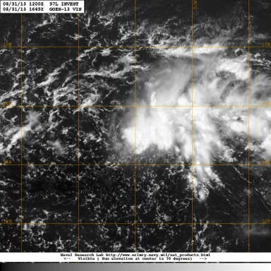
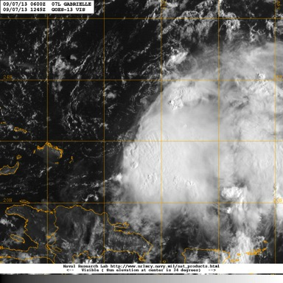
TS Gabrielle Debrief
31 Aug
07 Sept
Flight ops re-cap: 4 Total flight missions
66 Total flight hours; 88 GPSsondes; 49 AXBTs
September 19, 2013

Slide 2
Agenda
Missions Overview (Reasor)
Science Discussions
31 Aug: TC Genesis, G-IV TDR (Gamache)
06 Sept: Ocean Survey (Uhlhorn)
07 Sept: TC Genesis (Gamache/Dunion/Rogers)
10 Sept: Ocean Winds (Chang)
NASA HS3 Coordination (Rogers/Dunion/Chang)
Modeling/HEDAS (Aksoy/Aberson/Zhang)
Issues

Slide 3
Missions Overview
Purpose: Document the kinematic/thermo. structure and evolution of an easterly wave disturbance in the hypothesized region favored for tropical cyclogenesis (i.e., the “pouch”).
Target: Pouch25 identified in the GFS and ECMWF models on 31 Aug; Gabrielle remnants on 7 Sept
Background: In the days prior to sampling on 31 Aug, dry air inhibited vigorous convection. Models, however, indicated some potential for pouch moistening with time.

Slide 4
Missions Overview
31 Aug: G-IV square-spiral survey centered on Pouch25. Convection develops near center. TD forms 4 d later and soon develops into TS Gabrielle.
6 Sept: Gabrielle has dissipated. N42 Ocean Survey done ahead of Gabrielle remnants.
7 Sept: Remnants sampled simultaneously with G-IV (square-spiral), N42 (square-spiral), and N43 (convective burst/PBL modules). TS Gabrielle reforms 3 d later.
10 Sept: N43 conducts Ocean Winds Experiment.

Slide 5
Science Discussions
G-IV TDR (Gamache)
Ocean Survey (Uhlhorn)
P-3 Missions on 7 Sept (Dunion/Rogers)
Ocean Winds on 10 Sept (Chang)

Slide 6
G-IV TDR in Gabrielle 20130831N1 and 20130907N1

Slide 7
G-IV analyses during Gabrielle
20130831N1
Job files made by Gamache at home
Job files accessed by NOAA 49
Joe Greene ran analysis on NOAA 49 (leg by leg)
Analyses and superobs sent in real time
20130907N1
Charles Lynch noticed some timing delay that appeared to be causing aft sweeps not to have correct rotation angle
Data not processed in real time

Slide 8
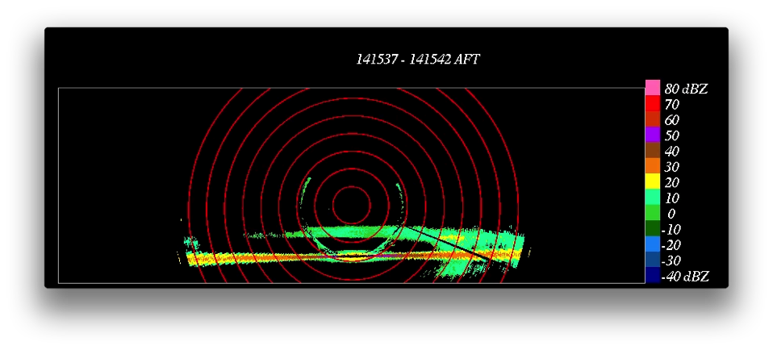

Slide 9
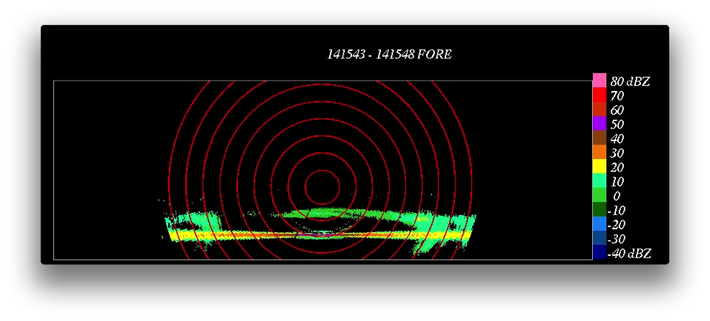

Slide 10
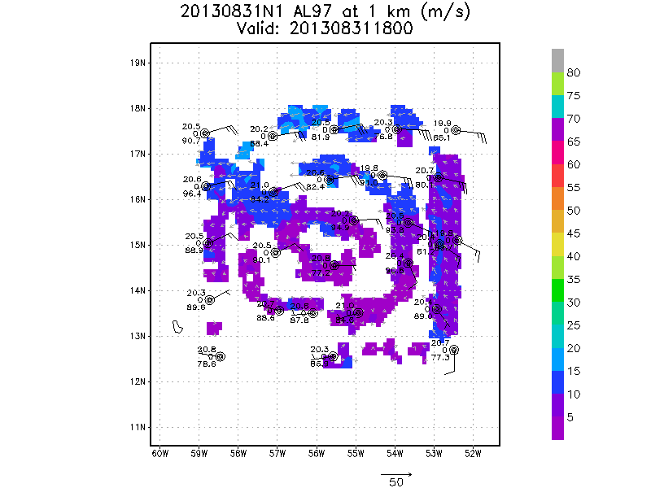

Slide 11
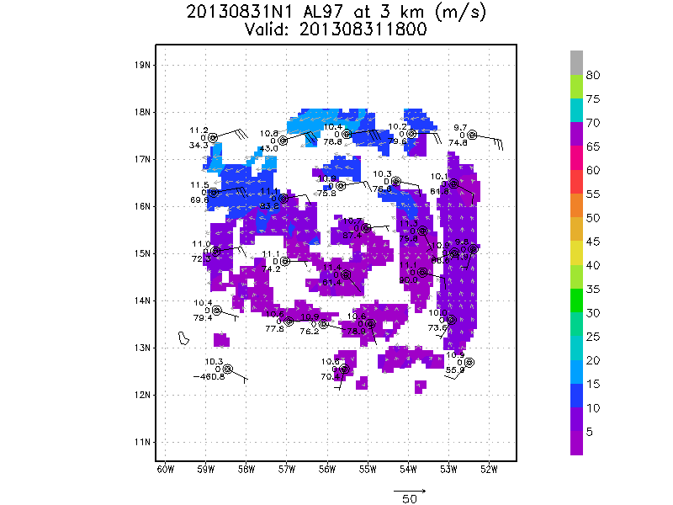

Slide 12
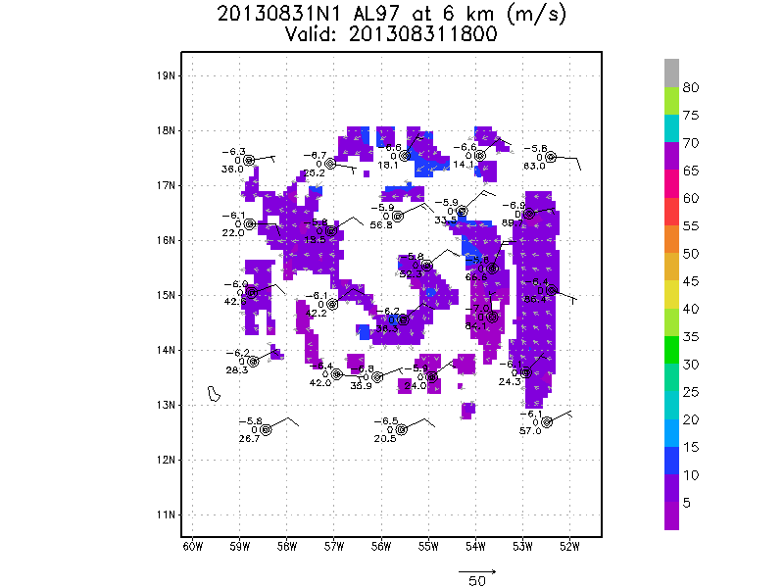

Slide 13
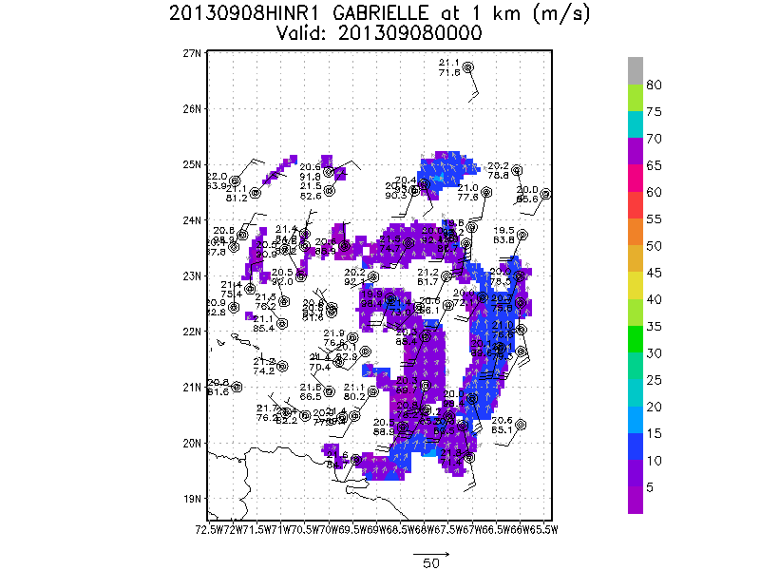

Slide 14
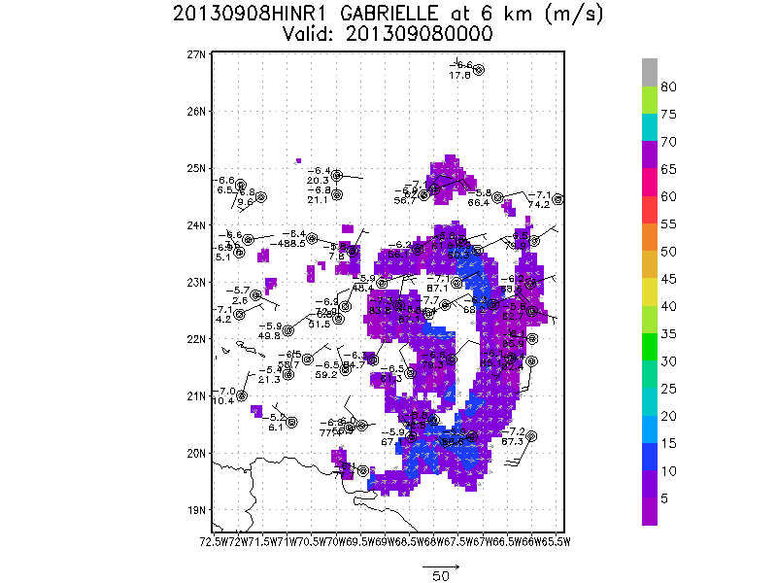

Slide 15
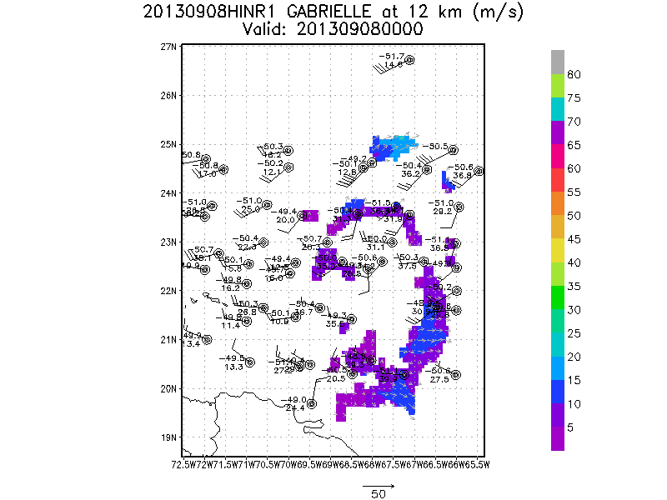

Slide 16
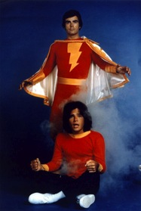
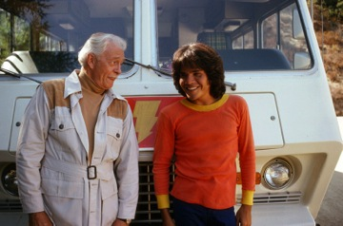
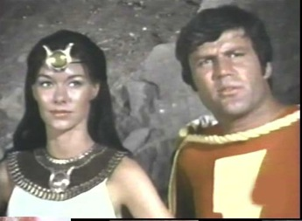
20130906H1
Ferry/Ocean Survey/Superhero Mission

Slide 17
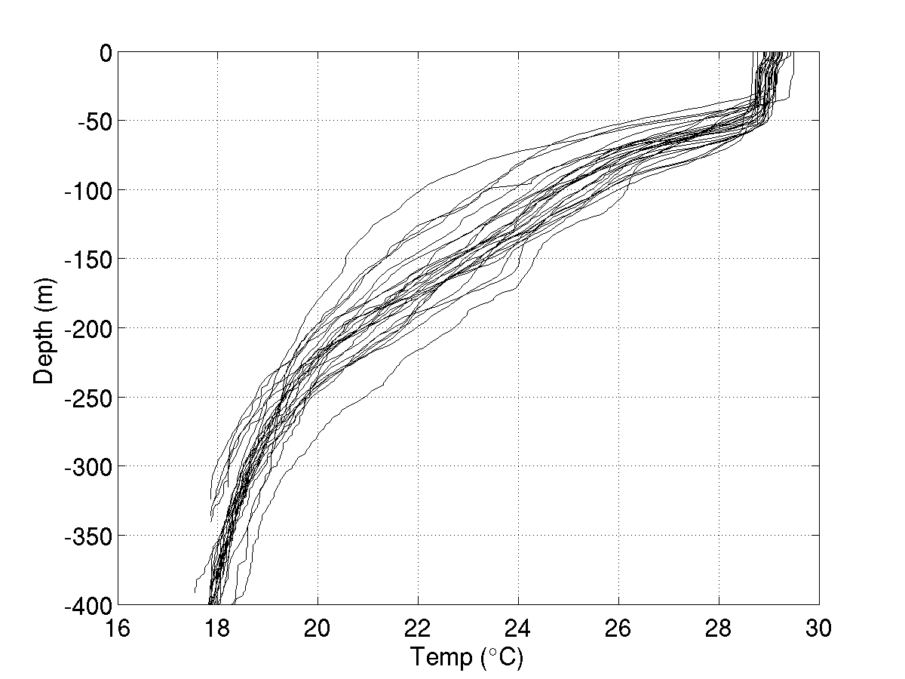
20130906H1

Slide 18
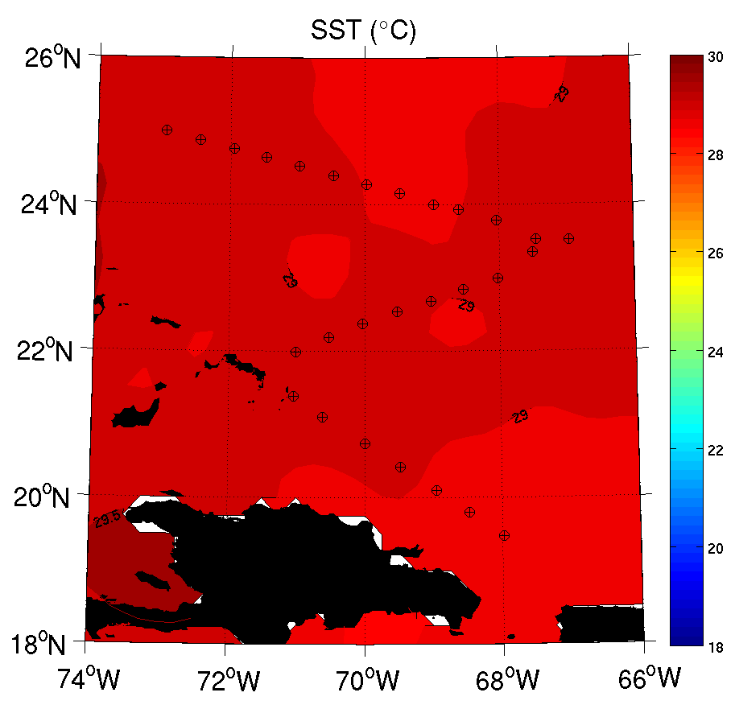
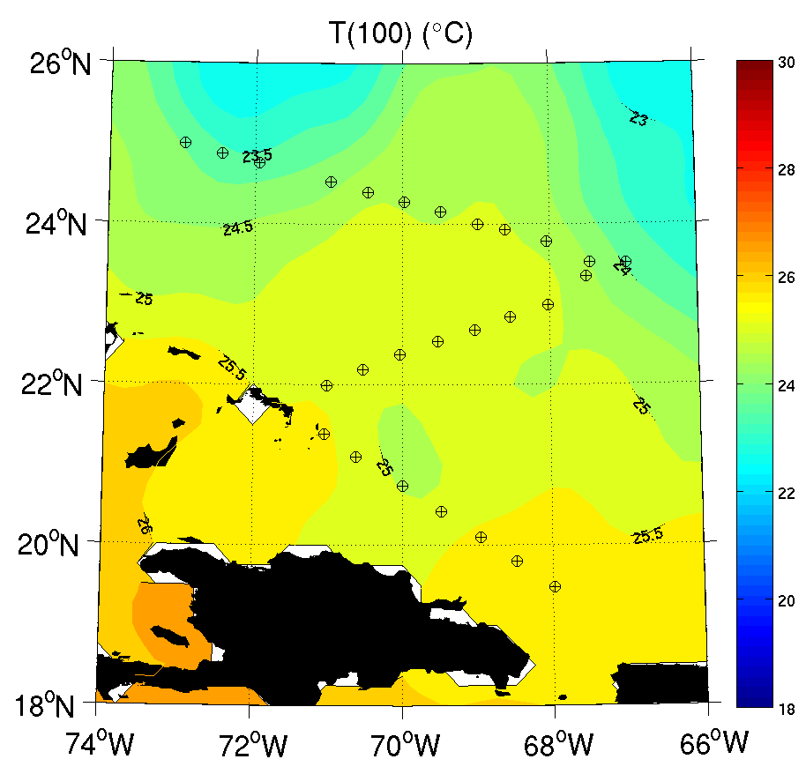
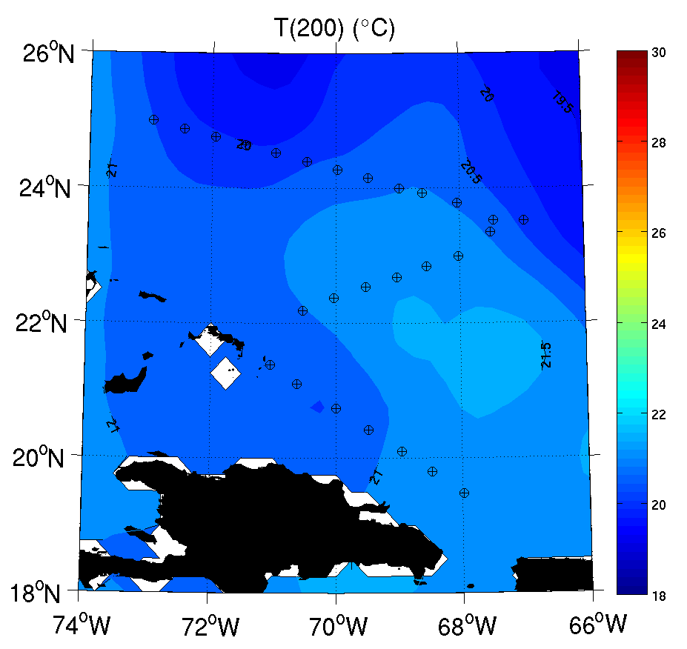
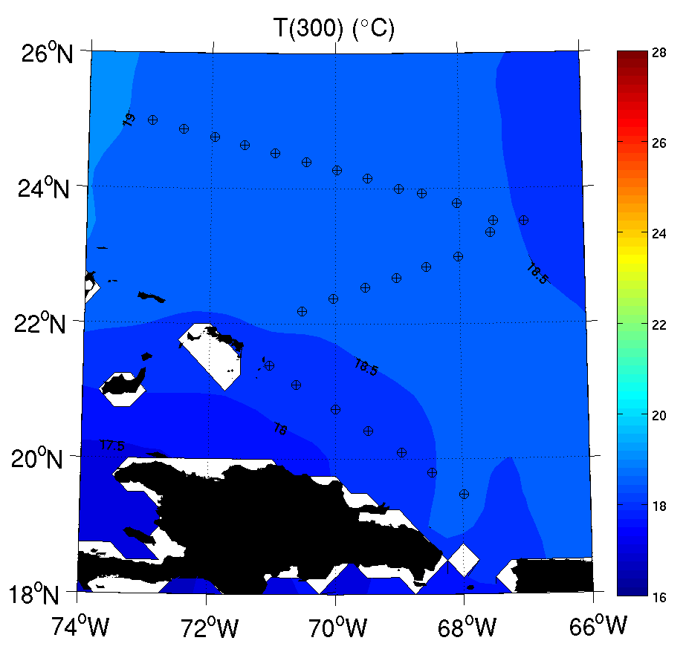
20130906H1

Slide 19
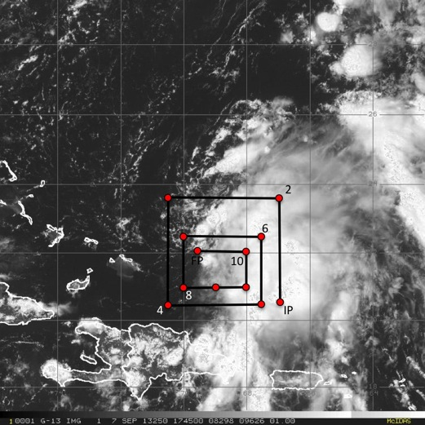
Pre-Gabrielle Genesis Mission: 20130907H1
Take-off 1516 UTC (St Croix);
Landing 2238 UTC (St. Croix)
12 GPS dropsondes; 11 AXBTs
8 Doppler radar analysis transmitted in real-time

Slide 20
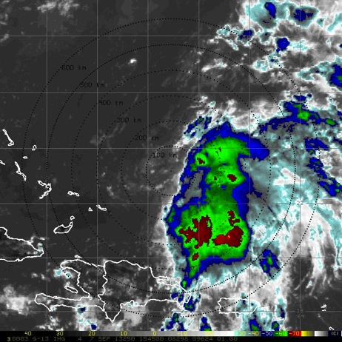
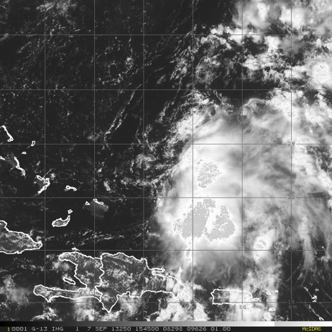
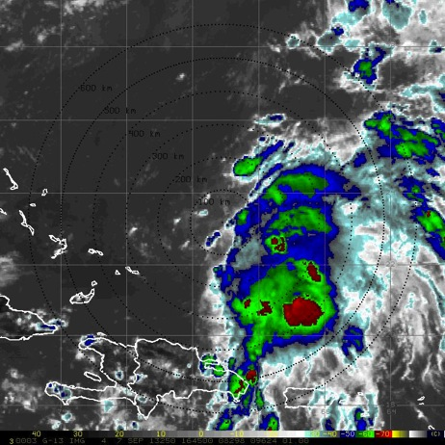
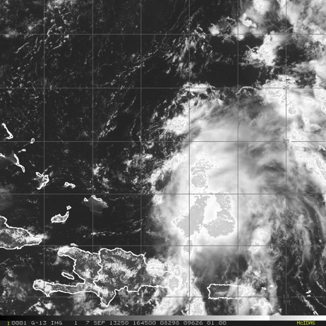
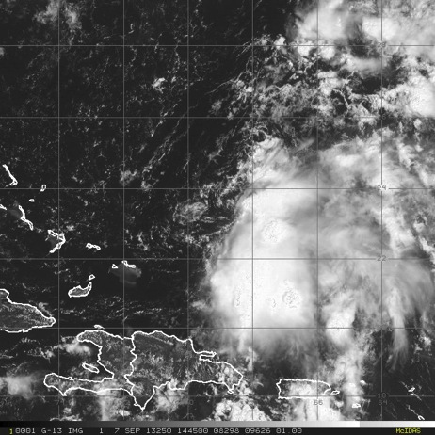
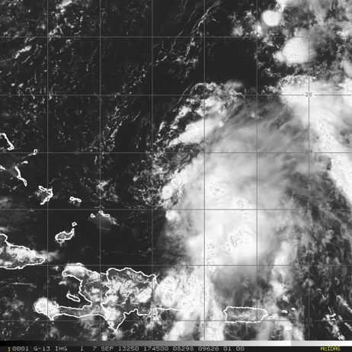
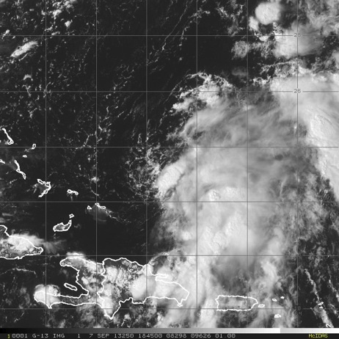
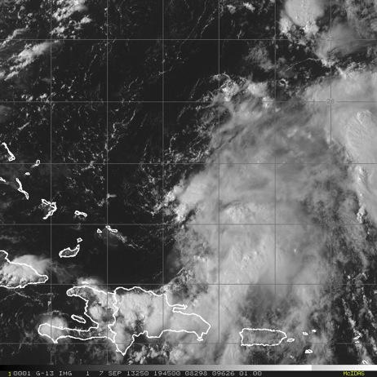
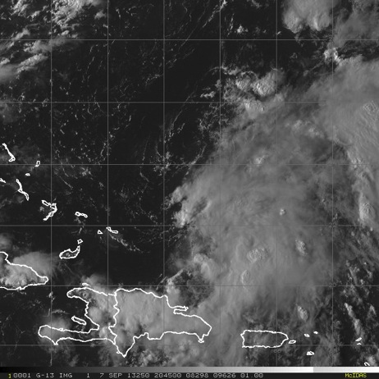
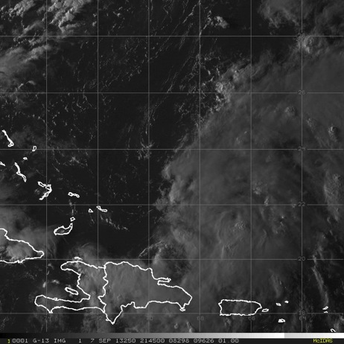
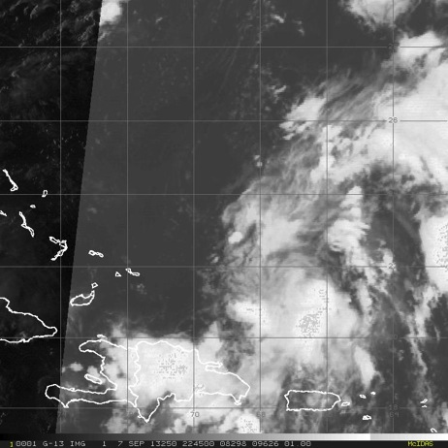
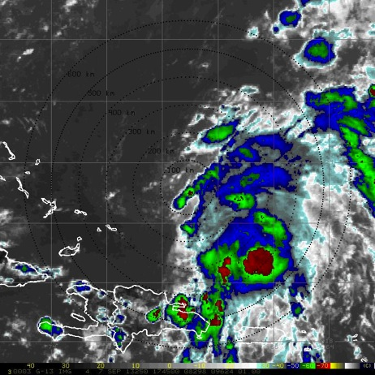
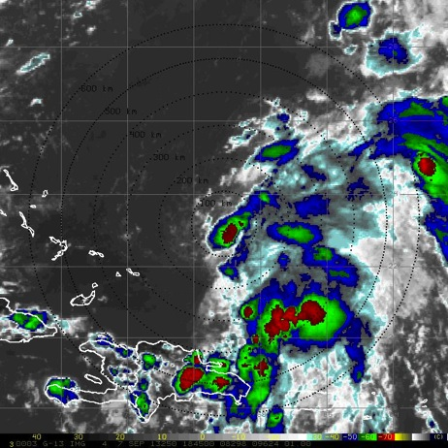
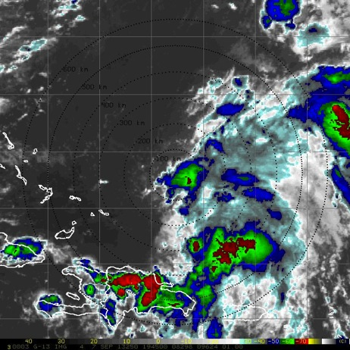
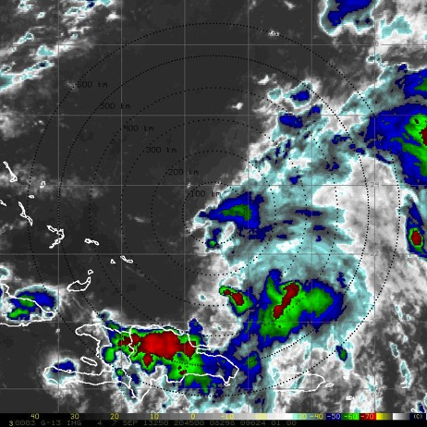
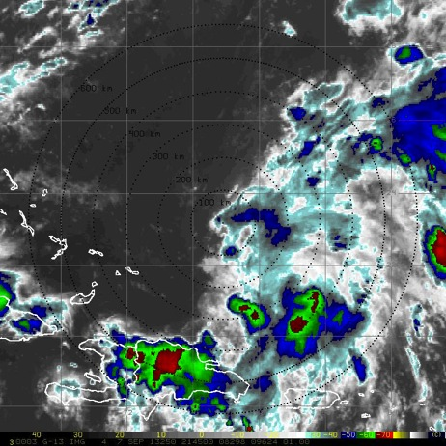
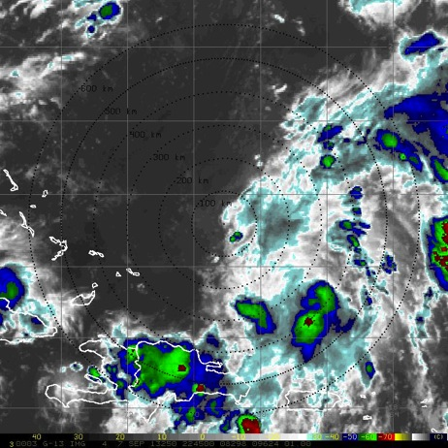
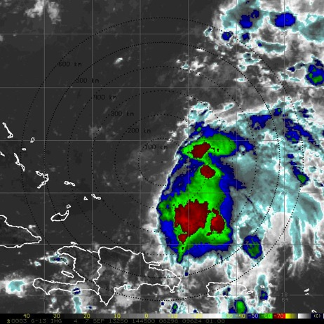
Pre-Gabrielle Genesis Mission: 20130907H1

Slide 21
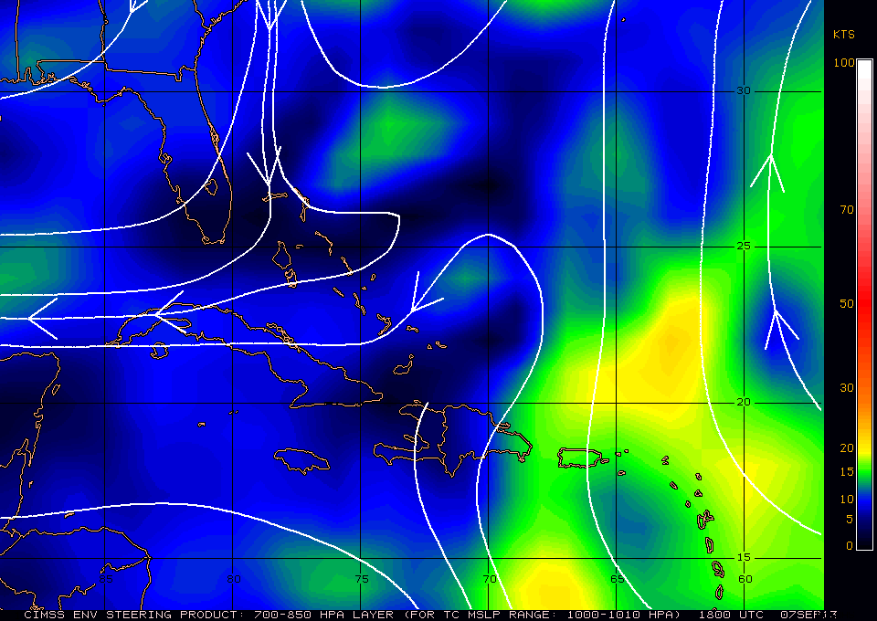
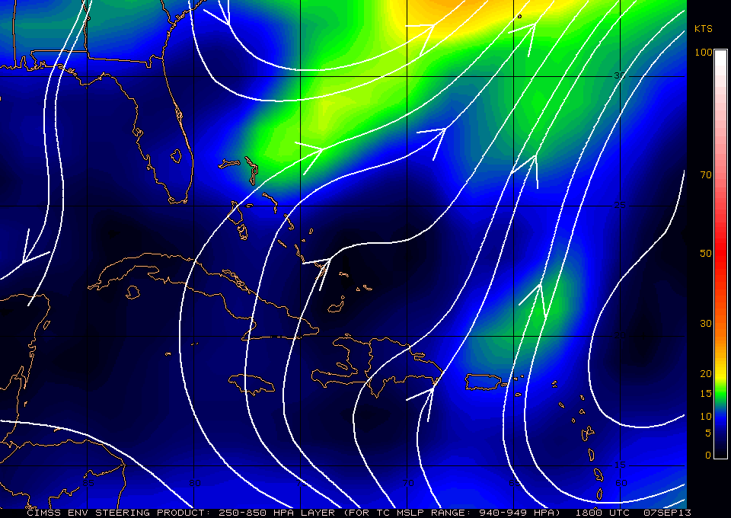
CIMSS Layer Mean Steering
X

Slide 22
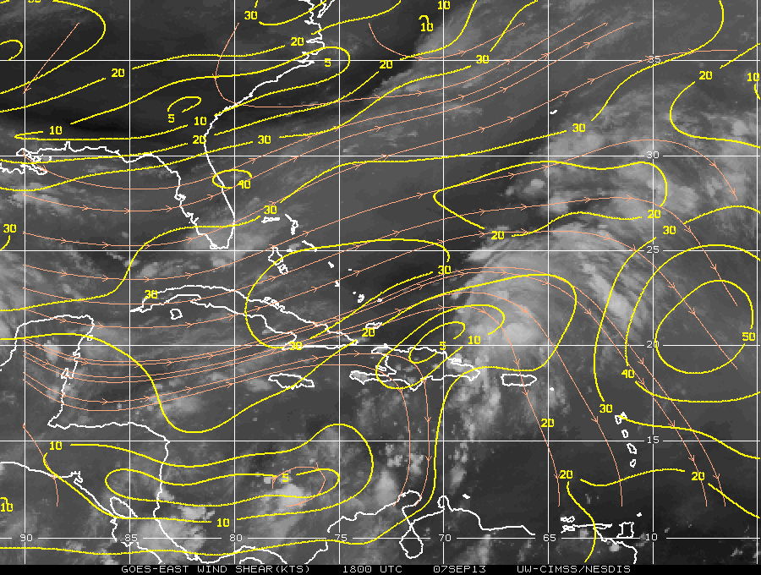
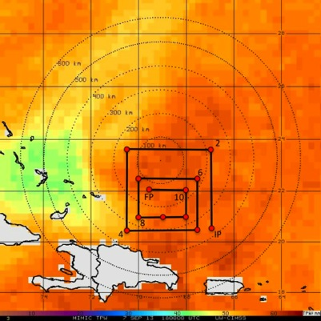
Vertical Shear & TPW

Slide 23
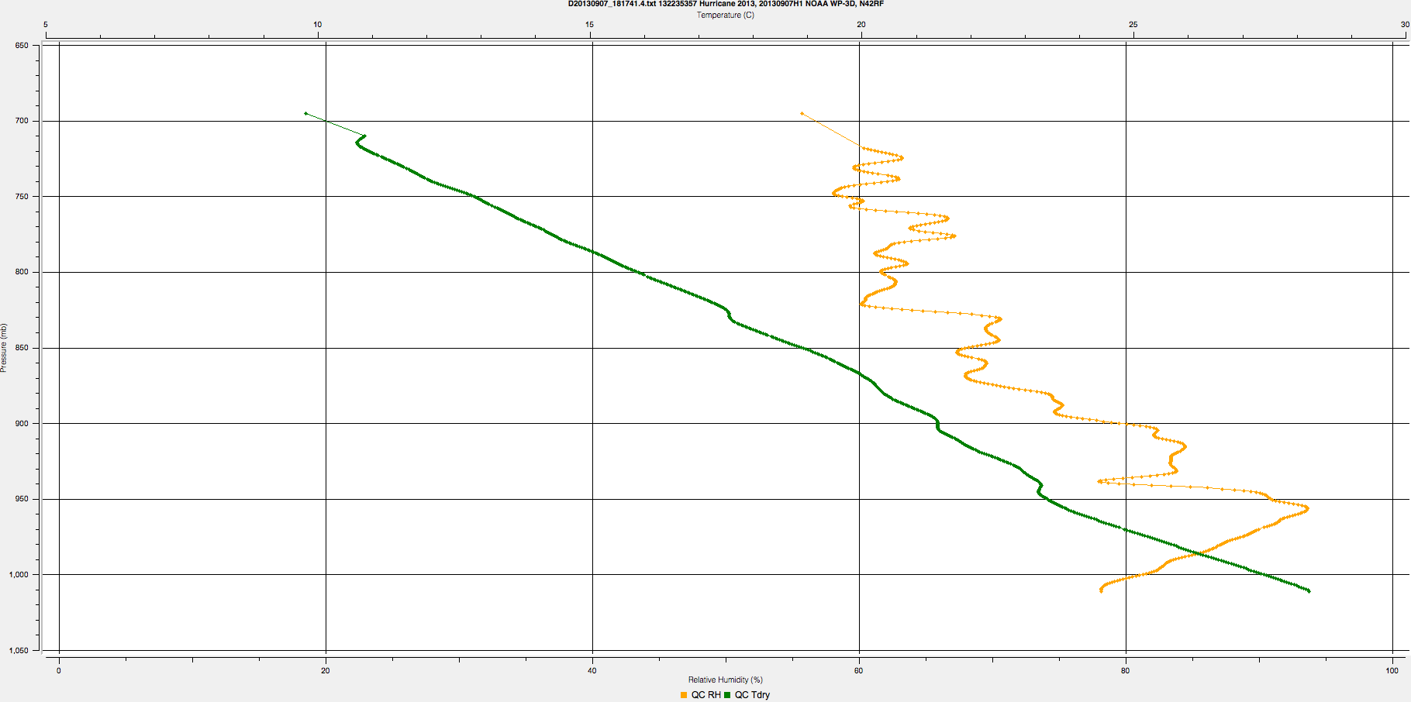
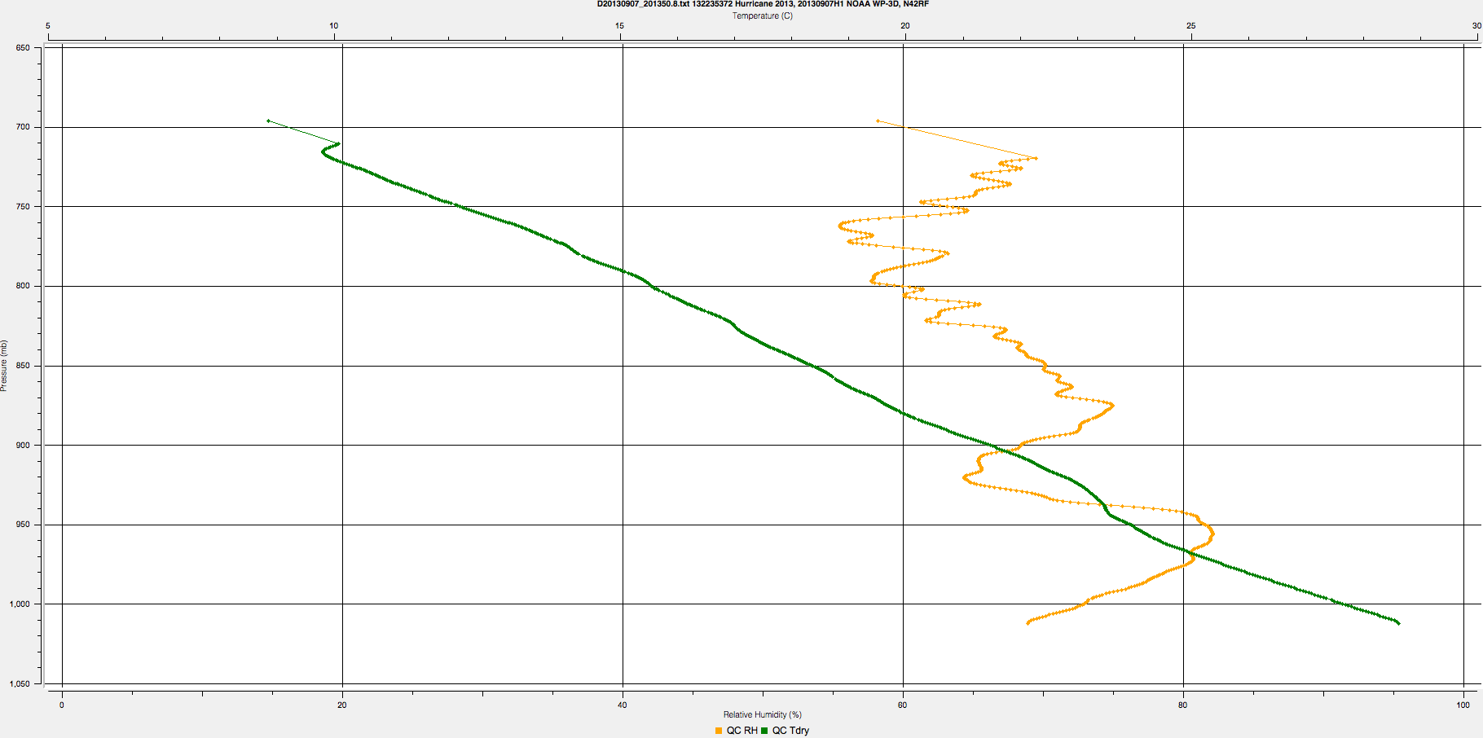
Vertical Shear & TPW
Drop #8
Drop #4
Drop #8

Slide 24
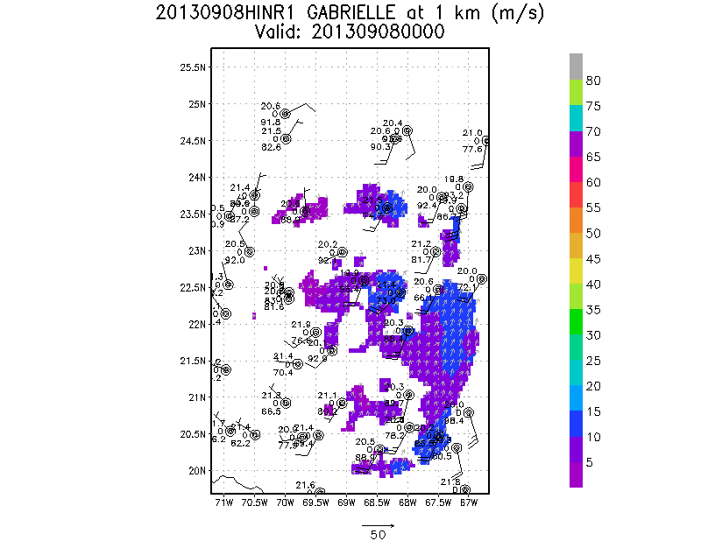
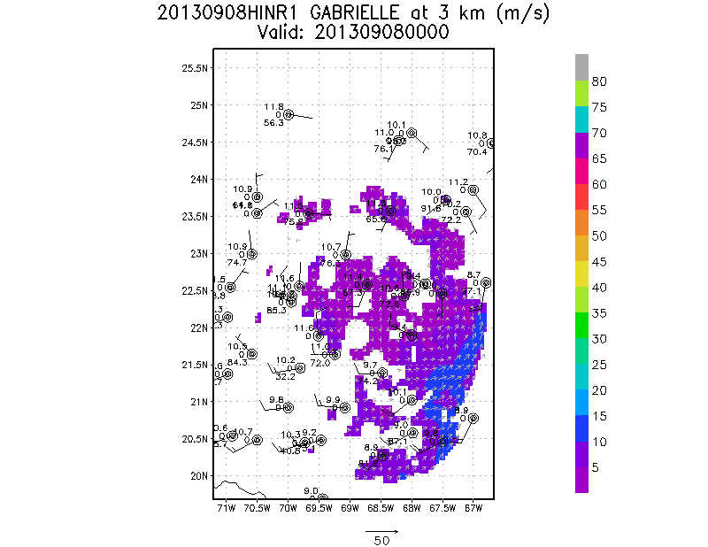
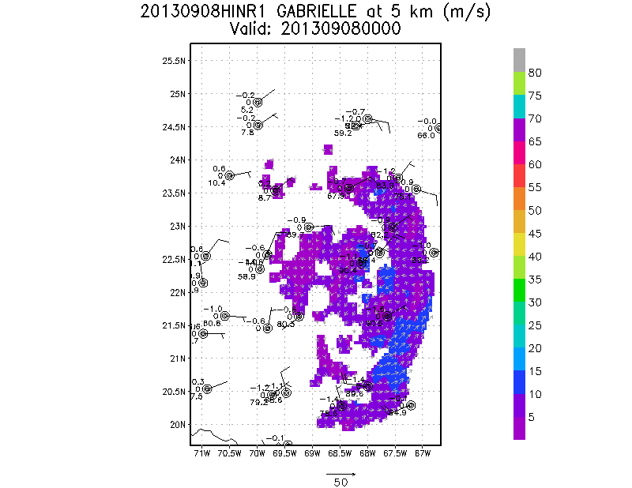
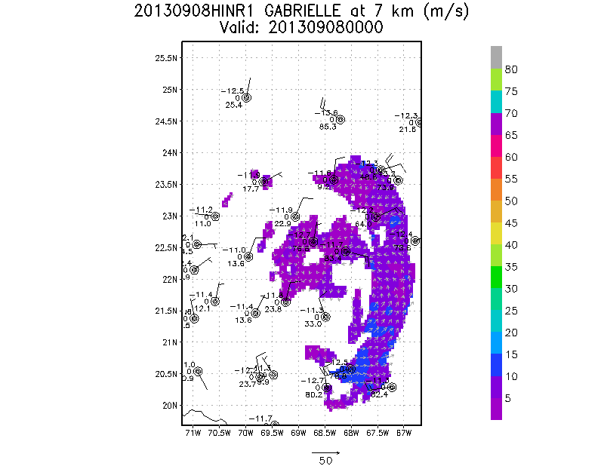
TDR & Dropsonde Analyses

Slide 25
Problems
Summary
Take-off delayed ~1h 15m:
-fuel valve leak (replaced & repaired)
Weak systems like Gabrielle: pilots more concerned about ship traffic below
-required a sea surface visual before dropping AXBTs;
-missed 1 AXBT point >> added pt 8a later in the mission
All 12 GPS dropsondes & 11 AXBTs worked well
Doppler analyses >> inner box of the square spiral used as a single analysis (pt 8-FP)
NASA’s mission monitor >> very useful for situational awareness
-coordinated with HS3 as AV-6 approached from the NE

Slide 26
NOAA Flight 130907I1
Post-Gabrielle/Pre-Gabrielle
LPS: R. Rogers
Radar: J. Zhang
Dropsonde, AXBT: E. Uhlhorn
MISSION GOALS:
Part of multi-plane mission intended to collect data via various modules for model evaluation
“Module” plane – fly convective burst and boundary layer flux modules
Convective burst module:
Collect Doppler and dropsonde data in vicinity of a convective burst at high time frequency (repeated measurements, ~30-45 minutes per sample)
Document structure and evolution of convective-scale properties, e.g., statistics of reflectivity, vertical velocity, vorticity, mass flux over convective/mesoscale time scales
Quantify impact of convective-scale processes on parent system
Evaluate and improve HWRF microphysics parameterization
Boundary layer flux module
To directly measure turbulent fluxes in the hurricane boundary layer.
To study the entrainment effect at the top of the boundary layer.
To evaluate and improve the HWRF model boundary layer physics using in-situ observations

Slide 27
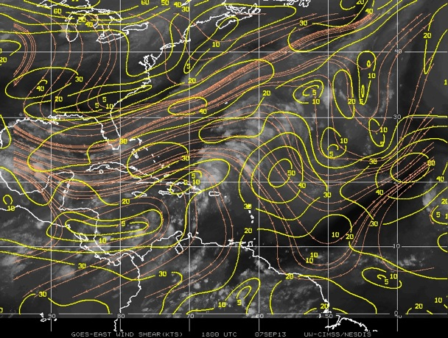
Environmental conditions
850-200 hPa CIMSS shear valid 18 UTC 7 Sept

Slide 28
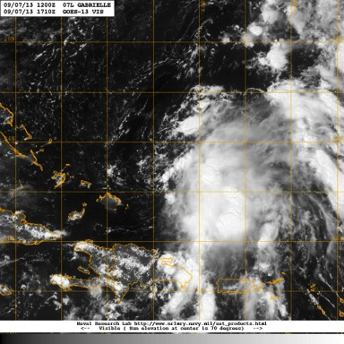
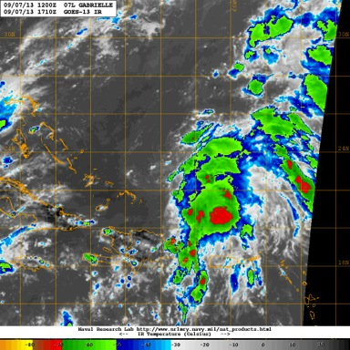
Satellite imagery
Visible satellite image valid 1710 UTC
Infrared satellite image valid 1710 UTC

Slide 29
Flight track for Flight 130907I1

Slide 30
Box 1: 1604 – 1648 UTC
70
68
66
64
24
X
22
20
18
1632 UTC
X - working best track location at 18 UTC

Slide 31
Box 2: 1648 – 1733 UTC
70
68
66
64
24
X
22
20
18
1702 UTC
X - working best track location at 18 UTC

Slide 32
Box 3: 1743 – 1831 UTC
70
68
66
64
24
X
22
20
18
1815 UTC
X - working best track location at 18 UTC

Slide 33
Reflectivity (shaded, dBZ) at 2 km altitude
Box 1: 1604 – 1648 UTC
Box 2: 1648 – 1733 UTC
Box 3: 1743 – 1831 UTC

Slide 34
Reflectivity (shaded, dBZ) and flow (vector, m s⁻¹) at 2 km altitude
Box 1: 1604 – 1648 UTC
Box 2: 1648 – 1733 UTC
Box 3: 1743 – 1831 UTC
convection becoming more cellular, weaker over time
main convective line associated with convergence line along southeast portion of radar domain

Slide 35
Vorticity (shaded, x 10⁻⁴ s⁻¹) and perturbation flow at 2, 5 km altitude
Box 1: 1604 – 1648 UTC
Box 2: 1648 – 1733 UTC
Box 3: 1743 – 1831 UTC
5 km
5 km
5 km
2 km
2 km
2 km

Slide 36
Reflectivity CFAD (shaded, %)
Box 1: 1604 – 1648 UTC
Box 2: 1648 – 1733 UTC
Box 3: 1743 – 1831 UTC
height (km)
height (km)
height (km)
reflectivity (dBZ)
reflectivity (dBZ)
reflectivity (dBZ)
more moderate-to-high reflectivity in lower troposphere early on
little difference in upper levels

Slide 37
Vertical velocity CFAD (shaded, %)
Box 1: 1604 – 1648 UTC
Box 2: 1648 – 1733 UTC
Box 3: 1743 – 1831 UTC
height (km)
height (km)
height (km)
vertical velocity (m s⁻¹)
vertical velocity (m s⁻¹)
vertical velocity (m s⁻¹)
majority of vertical velocity between -2 and 2 m/s
peak updrafts as high as 10 m/s at 12 km altitude

Slide 38
Vorticity CFAD (shaded, %)
Box 1: 1604 – 1648 UTC
Box 2: 1648 – 1733 UTC
Box 3: 1743 – 1831 UTC
height (km)
height (km)
height (km)
vorticity (x 10⁻³ s⁻¹)
vorticity (x 10⁻³ s⁻¹)
vorticity (x 10⁻³ s⁻¹)
little skewness in vorticity, consistent with location of radar analysis, weak system
little difference over time

Slide 39
Flight track of 20130907I1
Color bar –Time (Hr)
Color bar –Height (m)
Boundary layer module
Convective burst module
Both the convective burst module and boundary layer flux module were successfully conducted on September 7, 2013 for the N43 mission.

Slide 40
Boundary layer flux module

Slide 41
To directly measure turbulent fluxes in the hurricane boundary layer.
To study the entrainment effect at the top of the boundary layer.
To evaluate and improve the HWRF model boundary layer physics using in-situ observations.

Slide 42
Lessons learned/challenges/future work
Convective burst module
convective burst module can be successfully conducted, with apparently reliable radar analyses possible
further diagnostics planned: mean profiles of relevant variables, mass flux profiles, joint PDFs (vortical hot towers?)
sub-optimal feature sampled, was not rapidly growing but was essentially steady-state or slowly weakening
challenge: identifying convective bursts in real time on the aircraft – limited bandwidth, no reliable access to satellite animations, no access to rapid-scan imagery – necessitates real-time communication with ground via xchat
Boundary layer flux module
Boundary layer module was successfully conducted in rain-free and low-wind region given the safety constraints
It is the first time the stepped descent module has been conducted since the CBLAST experiment taken 10 years ago
This is the first time the module was conducted with a complete box pattern
Future work include analyzing the 40 Hz data to get direct flux estimates and model evaluation

Slide 43
NASA HS3 Coordination
29 Aug – AV6 (“the one with sondes”)
31 Aug – AV1 cancelled ← NOAA/HRD Mission
3 Sept – AV1
4 Sept – AV6
7 Sept – AV6 ← NOAA/HRD Mission
8 Sept – AV1 cancelled
10 Sept – AV1 aborted ← NOAA/NESDIS

Slide 44
Issues
Was this a model evaluation experiment? (HWRF resumed runs at 6Z on 7 Sept; 3 coordinated aircraft: G-IV large-scale, N42 survey, N43 modules)
G-IV TDR – Rotation angle off on 7 Sept. Did not perform real time analyses.
Miscommunication regarding degree of coordination expected between G-IV and P-3s on 7 Sept. (resolved)
For storm-centered G-IV TDR missions, HRD needs to develop a plan with AOC and ATC. For AM flights, when is this latest time center shifts can be communicated? For 1330L flights?
N42 TDR – ATCF number confusion; data not assimilated by EMC
Real time TDR with 3 coordinated aircraft; Ground-based jobfile creation
Coordination with NASA given cancellations, etc.
Go/no-go decisions for genesis – develop an understanding with AOC
Others?

Slide 45
H*WIND
Seven H*Wind surface wind analyses were performed from 4 Sept to 11 Sept

Slide 46
Modeling/HEDAS

Slide 47
Basin-scale HWRF
Basin-scale ran 37 cycles (18Z Sept. 4-18Z Sept. 13)
Web products: http://storm.aoml.noaa.gov/basin
Genesis products: http://www.met.nps.edu/~mtmontgo/storms2013.html
model name: HWRF-GEN
Track Absolute Error (NM)
Intensity Error (kt)
Case #
Case #
14
13
13
13
13
13
11
11
9
7
5
4
3
2
1
14
13
13
13
13
13
11
11
9
7
5
4
3
2
1
Forecast (hour)
Forecast (hour)

