Slide 1
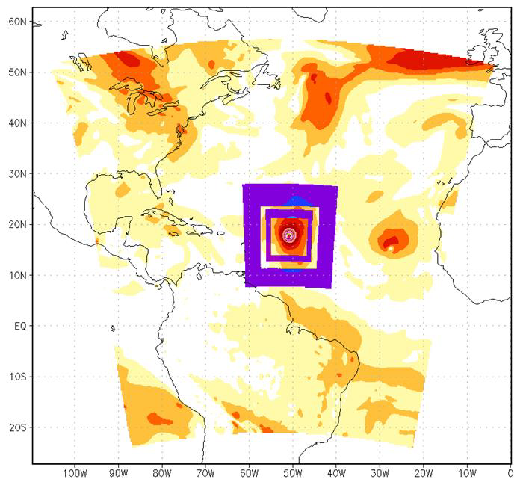
2014 Scientific Documentation :September 2014 – HWRF v3.6a
1- The major upgrade of data assimilation for 2014 operational HWRF is the assimilation of satellite observations into HWRF.
D01 75x75 (0.18), D02 20x20 (0.06), D03 10x10 (0.02)
2- No DA in DO1
3- Conventional observations (contained in prepbufr file) assimilated in ghost d02 and d03 include:
1-radiosondes;
2-dropwindsondes;
3- aircraft reports (AIREP/PIREP, RECCO , MDCRS-ACARS,
TAMDAR , AMDAR);
4- surface ship and buoy observations;
5- surface observations over land;
6- pibal winds;
7- wind profilers;
8- radar-derived Velocity Azimuth Display (VAD) wind;
9- WindSat scatterometer winds; and
10- integrated precipitable water derived from the Global Positioning
System.
4- Satellite observations assimilated in ghost d02 domain include:
1-Radiances from IR instruments: HIRS, AIRS, IASI, GOES Sounders
2- Radiances from MW instruments: AMSU-A, MHS, ATMS
3- Satellite derived wind: IR/VIS cloud drift winds, water vapor winds

