Slide 1
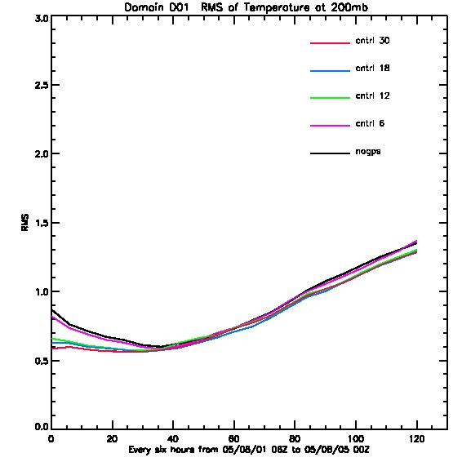
GPSRO
5 experiments;
no GPS, 6, 12, 18, and 30 satellites

Slide 2
OSSE Sampling Candidate Options
Option | Orbit | Temporal | GSD | Nature Run Frame | Notes
1 | Polar | 2x Daily | 45 km | d01, d02, d03, d04 | AIRS ~50km L2
2 | Polar | 2x Daily | 15 km | d01, d02, d03, d04 | AIRS Native Resolution
3 | Polar | 2x Daily | 2km | d01, d02, d03, d04 | ARIES 2km L2
4 | GEO | 5 min | 5km | d01, d02, d03, d04 | HES Mesoscale
5 | GEO | 72 min | 5km | d04 | GEO 5 km d04
6 | GEO | 75 min | 10km | d01, d02, d03, d04 | HES Full Disk
7 | GEO | 72 min | 10km | d01 | GEO 10 km d01
√
√
√
√

Slide 3
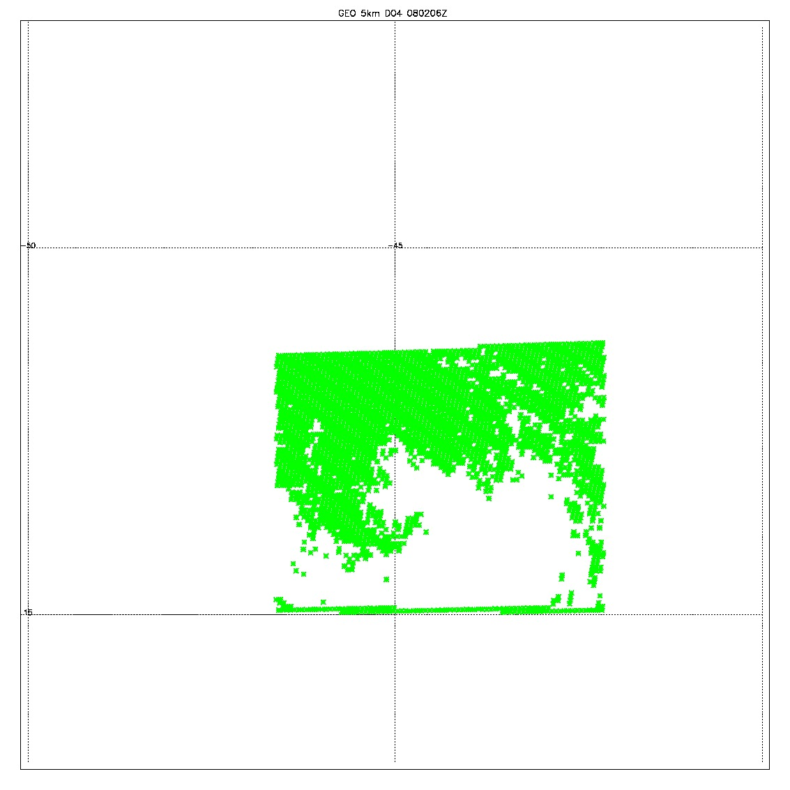
GEO 0802 6Z
original data; 98588
data (yellow); 82334
All zero data (blue); 16254
Keep 14 Levels; 943.8, 813.7, 705.8, 627.9, 544.1, 459.1, 381.9, 306.2, 240.5, 184.4, 142, 109.8, 82.9, 63.3
Remove 9 levels : 46.9, 30.3, 19.6, 11.5, 5.7, 3.3, 1.8, 0.96, 0.1
QCD (qc_t >0.1) data (green): 41889 temperature values left

Slide 4
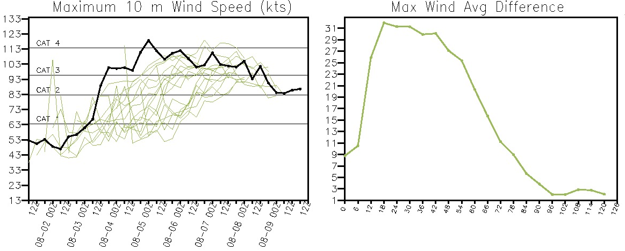
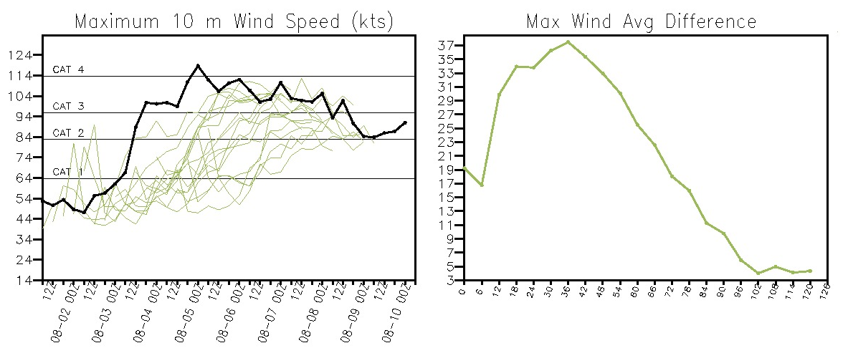
3hr cycle:
519039 temperature values assimilated per day
6hr cycling:
305169 temperature values assimilated per day
6hr cycling:
109692 temperature values assimilated per day

