Slide 1
HWRF_SatV
A new diagnostic software has been developed for verification of satellite observations and HWRF forecasts for potential use in operations
JHT supported project (PI Vukicevic, Co-I Greenwald, CIMSS)
The software utilizes
UPP (operational version, improved for simulation of Tbs for microwave and IR sensors
NOAA’s Weather and Climate Toolkit (http://www.ncdc.noaa.gov/wct/)
BUFR format observations (e.g., real obs from GDAS)
Remapping of forecast into observation resolution based on sensor-specific convolution functions

Slide 2
Sample of plots SSMIS 91H GHz
Remapped forecast-based Tb
Observations
Forecast-based simulated Tb
Observations overlaid on the simulated Tb

Slide 3
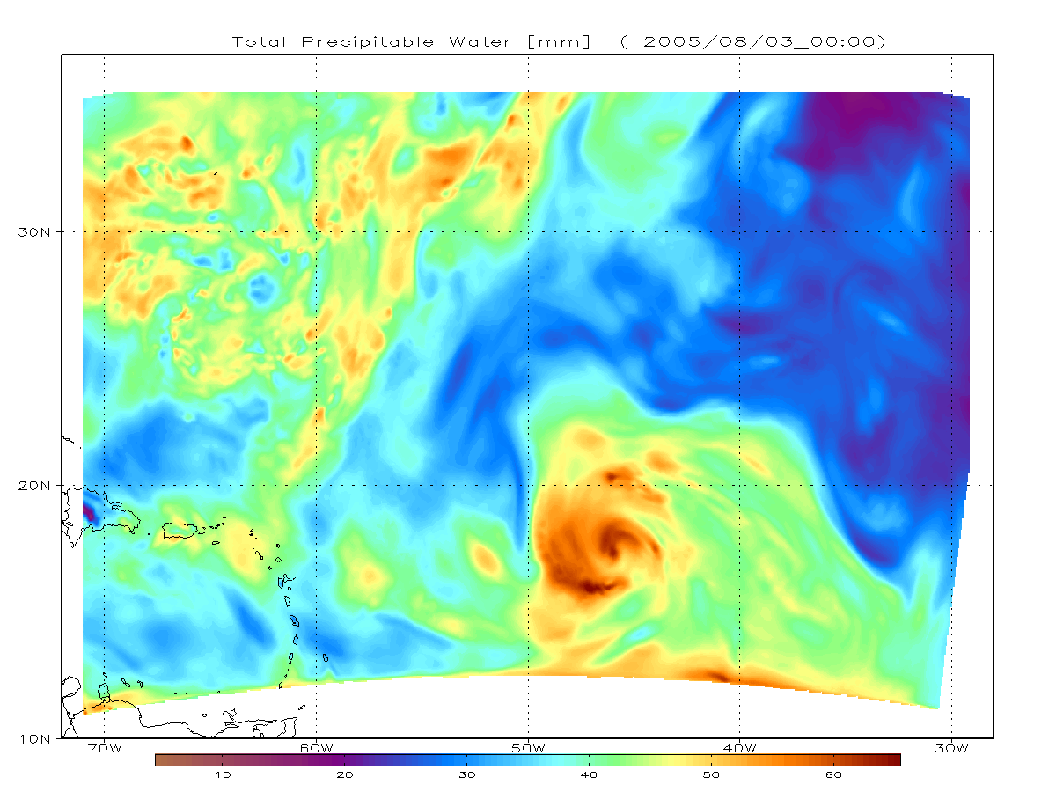
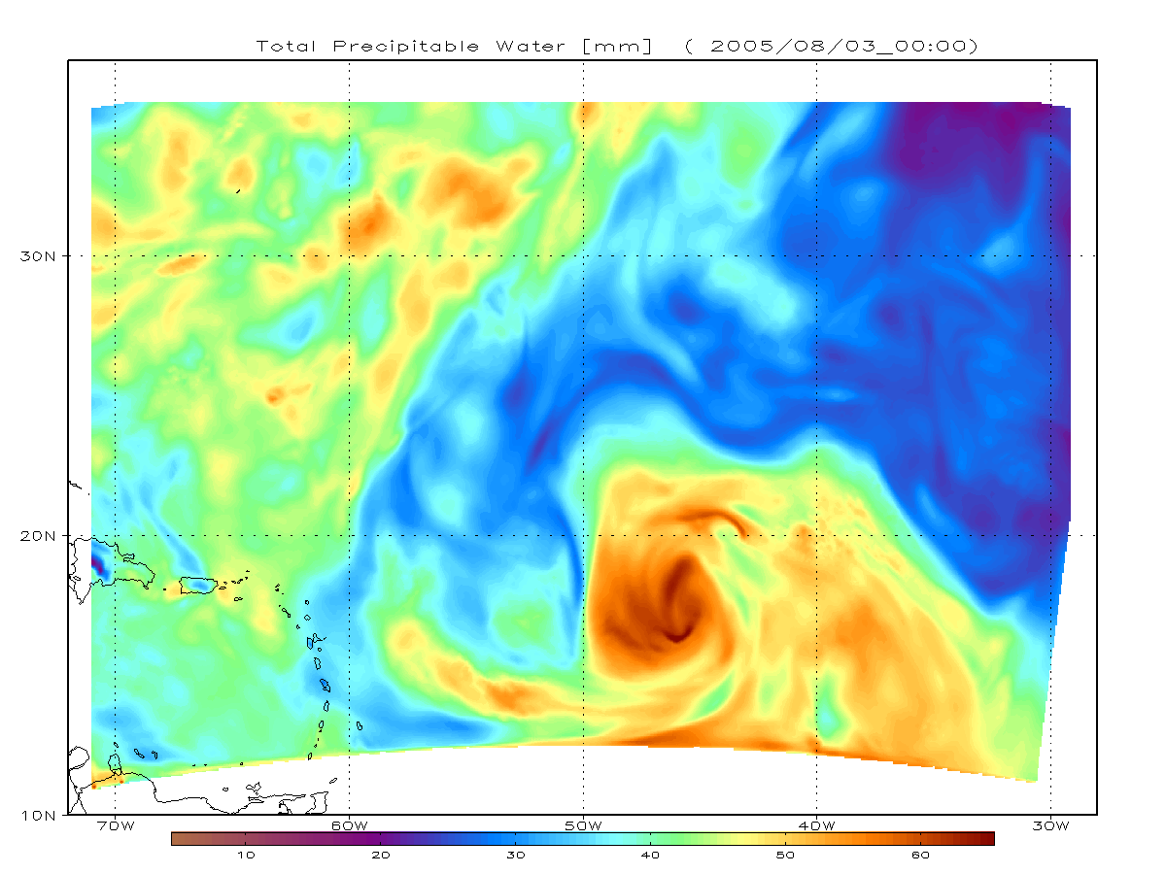
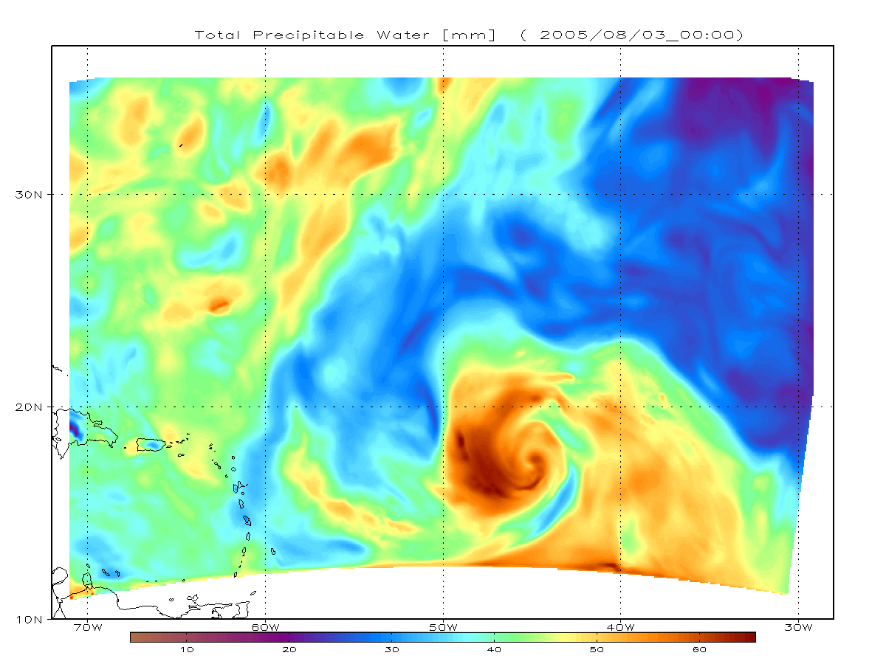

Slide 4
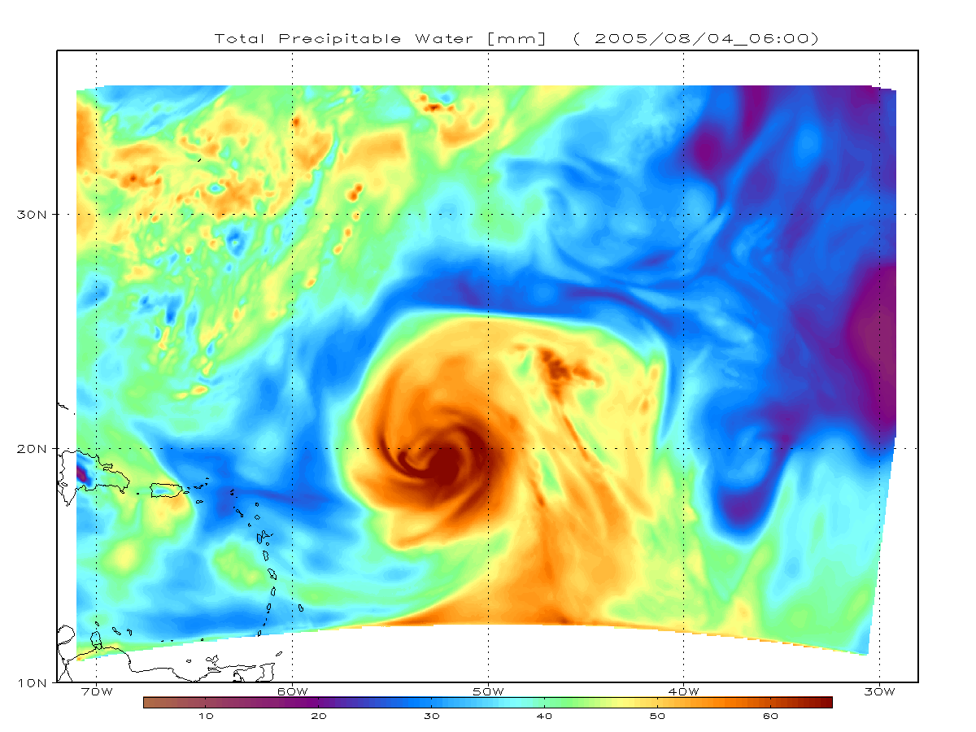
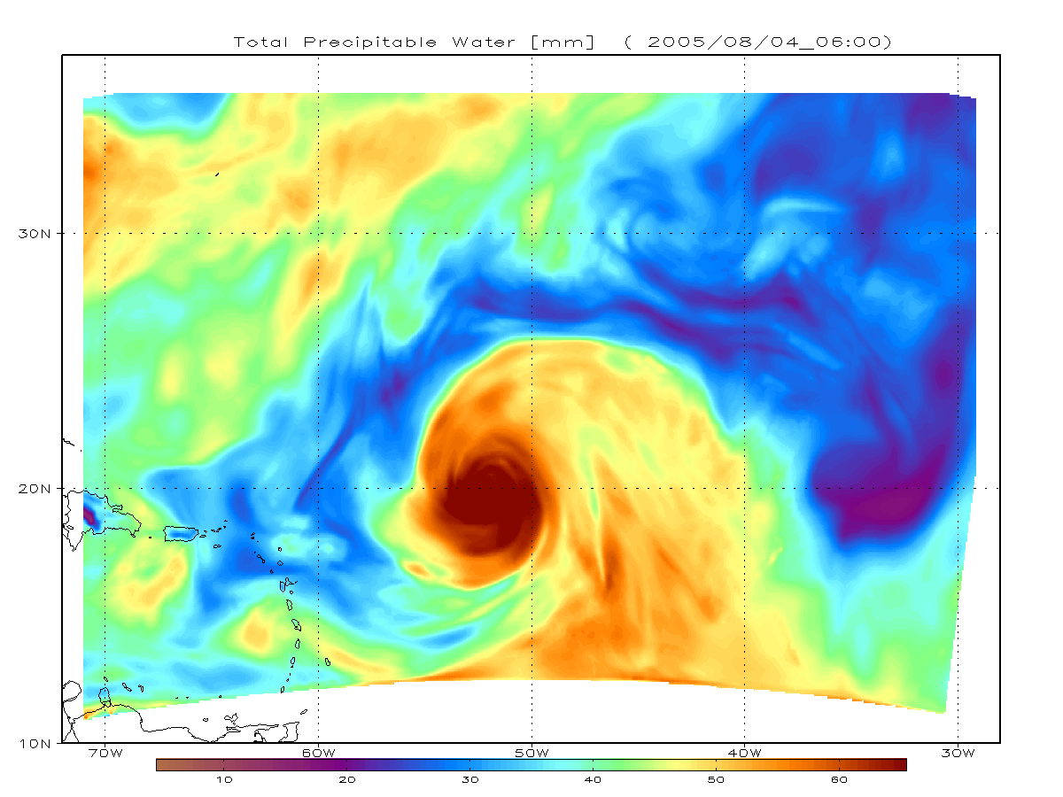
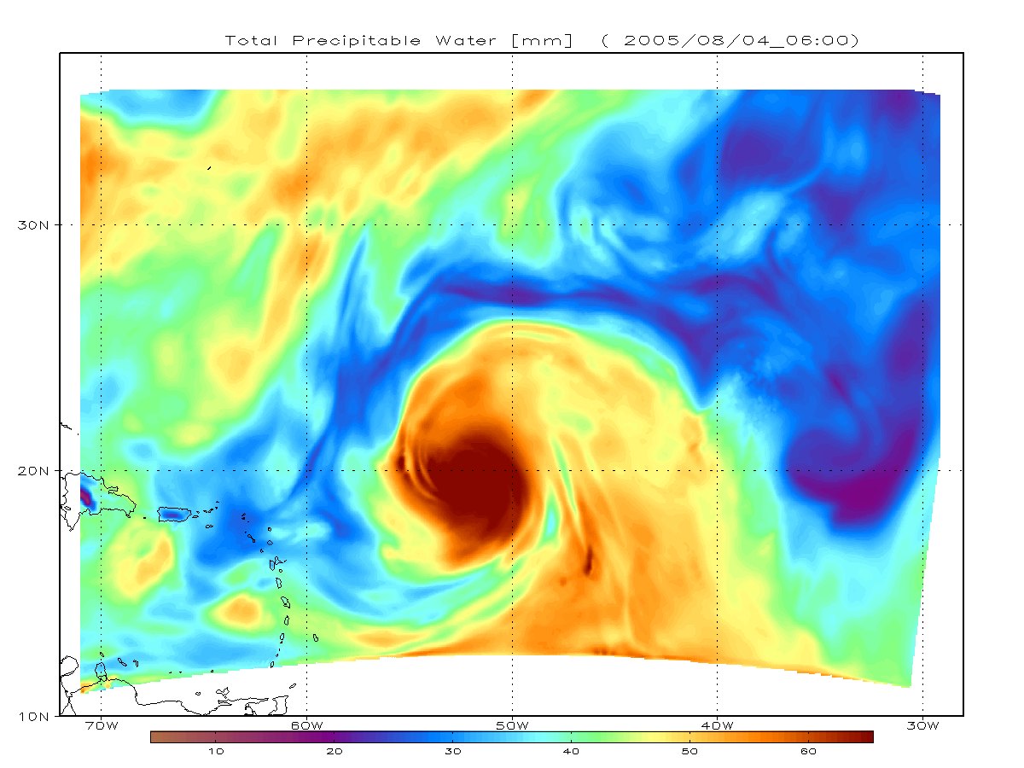

Slide 5
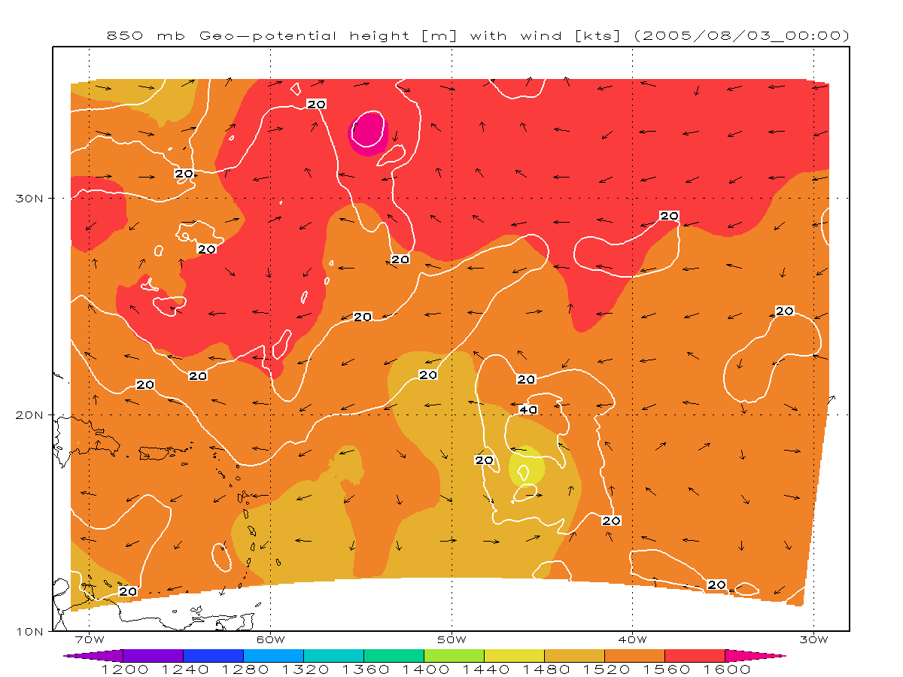
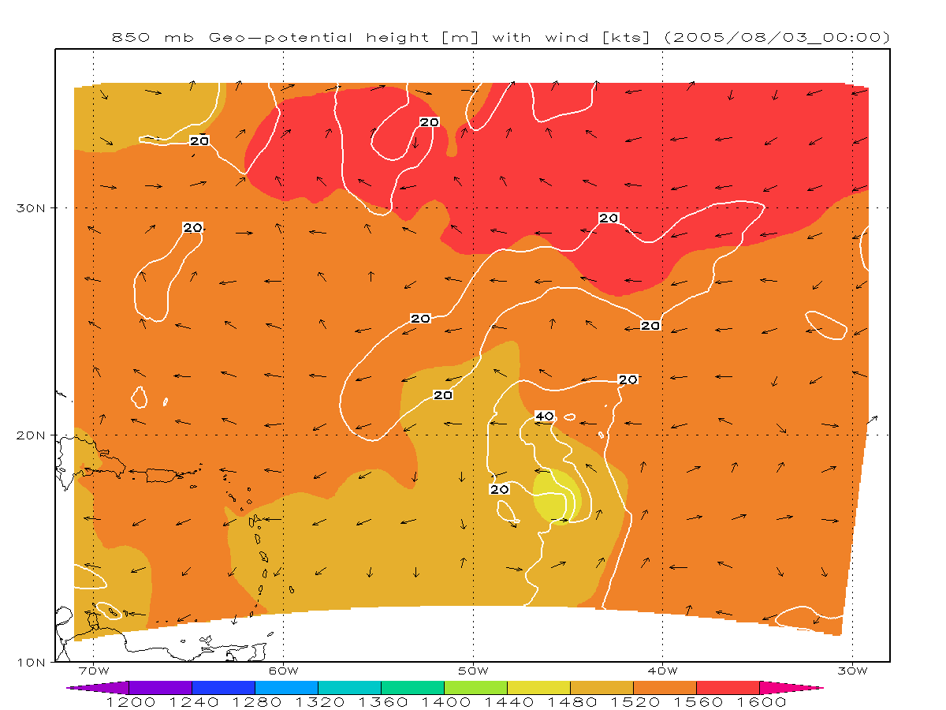
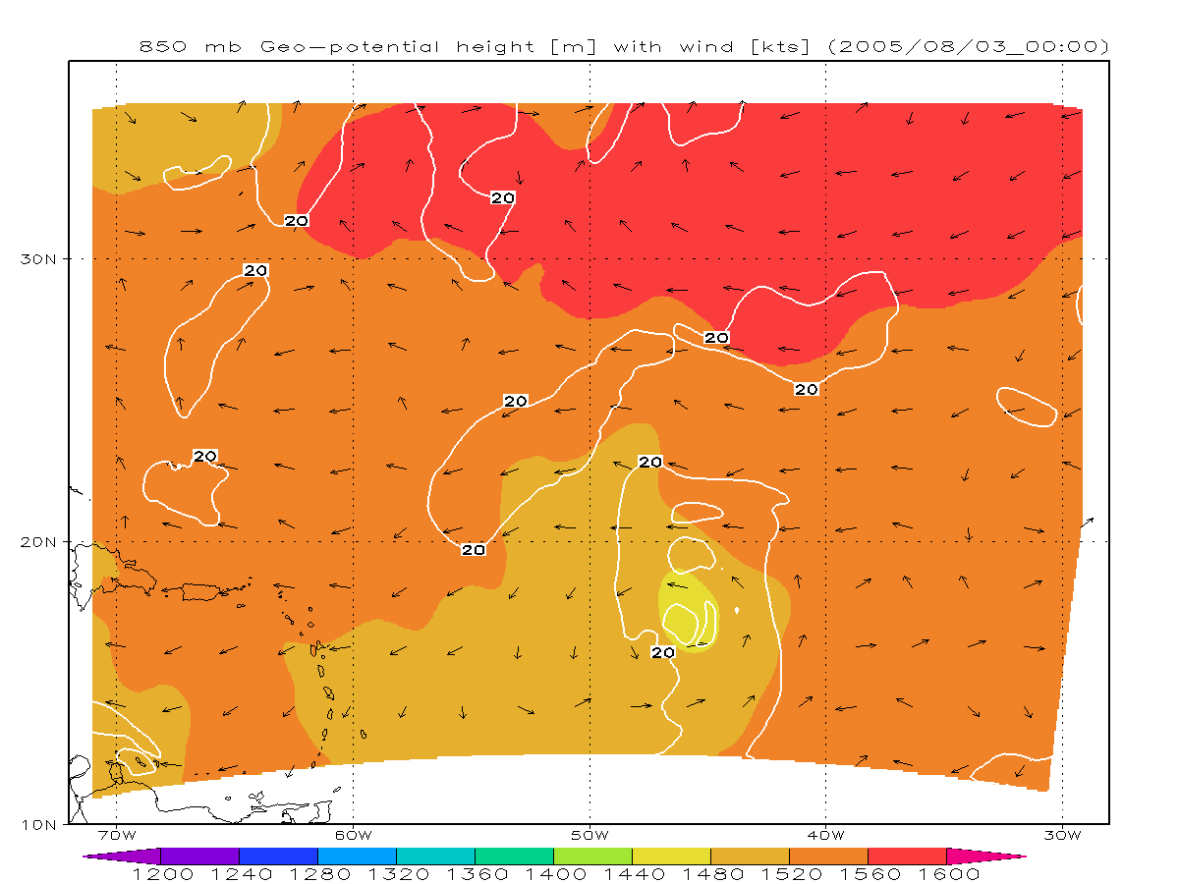

Slide 6
