Slide 1
Simulated GEO AIRS Tb from ECMWF NR

Slide 2
GEO hyperspectral IR radiance simulation
Sample data from 20050801
8 time steps
Interval of 3 hours
Geostationary orbit, 50° W above equator
Clear sky RT model - SARTA V1.07 (Strow et al. 2003)
Option to use cRTM or RTTOV
Cloudy sky RT model (Wei et al. 2004)
Input: cloud-top pressure, cloud optical thickness, cloud phase, particle radius
Single layer model
Single scattering

Slide 3
Window CO2
Lower WV Upper WV

Slide 4
COT CTP
DE Phase

Slide 5
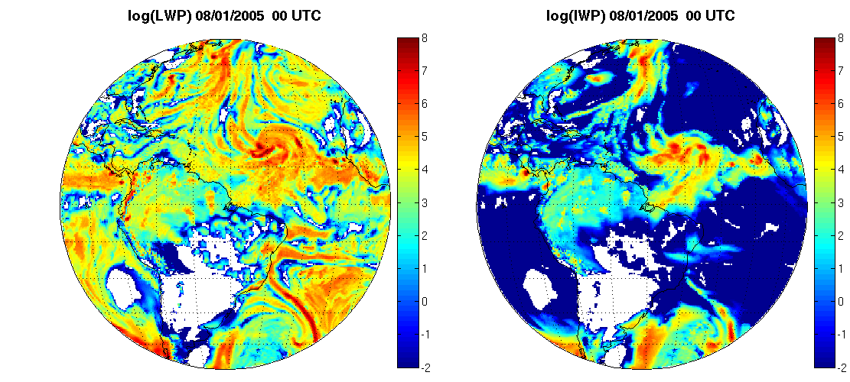
Liquid water path Ice water path

Slide 6
Issues
Low spatial resolution (~ 40 km); original ECMWF NR spatial resolution is retained
Future GEO AIRS should have much better spatial resolution
But data thinning might make this less a problem
Too few clear FOVs due to too much low level water clouds over ocean
Cloud coverage is not used in the simulation
Will reduce the high clouds; not something we want
Will reduce the low clouds; something we want

