Slide 1
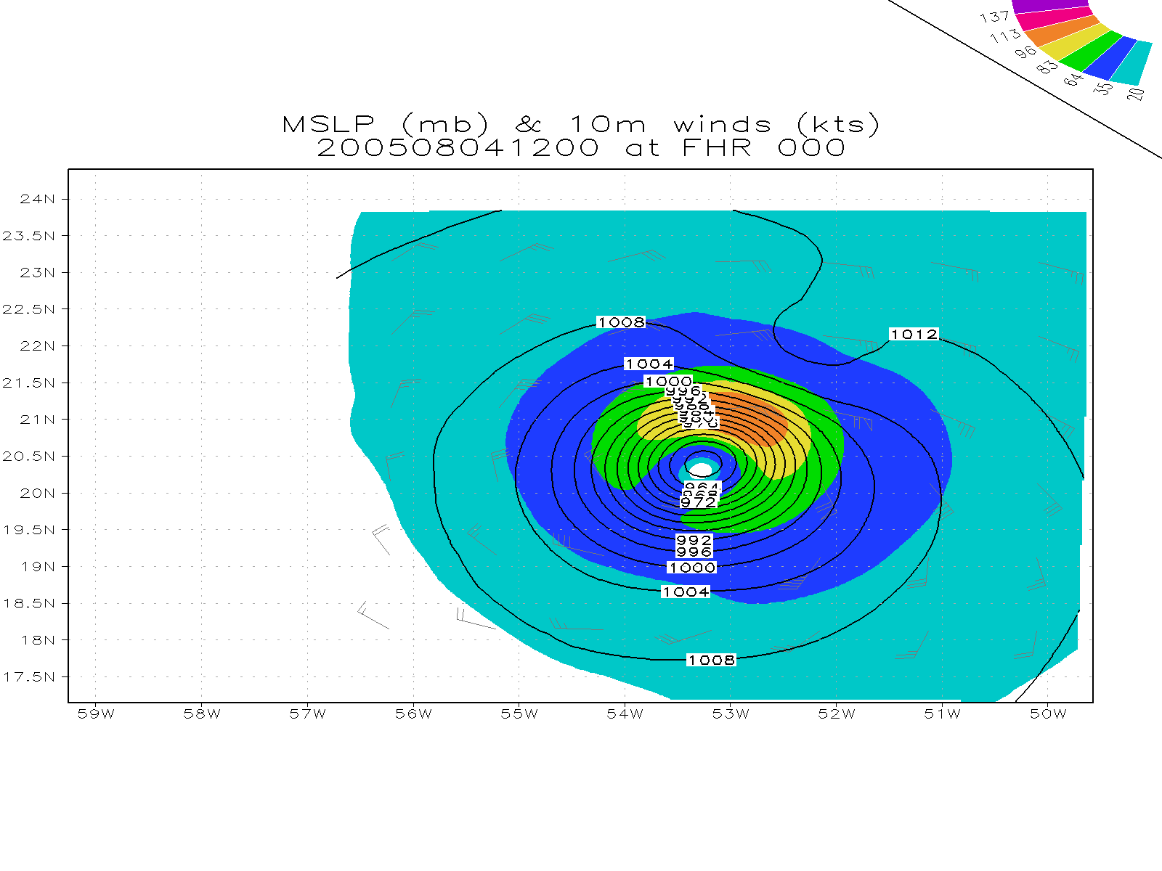
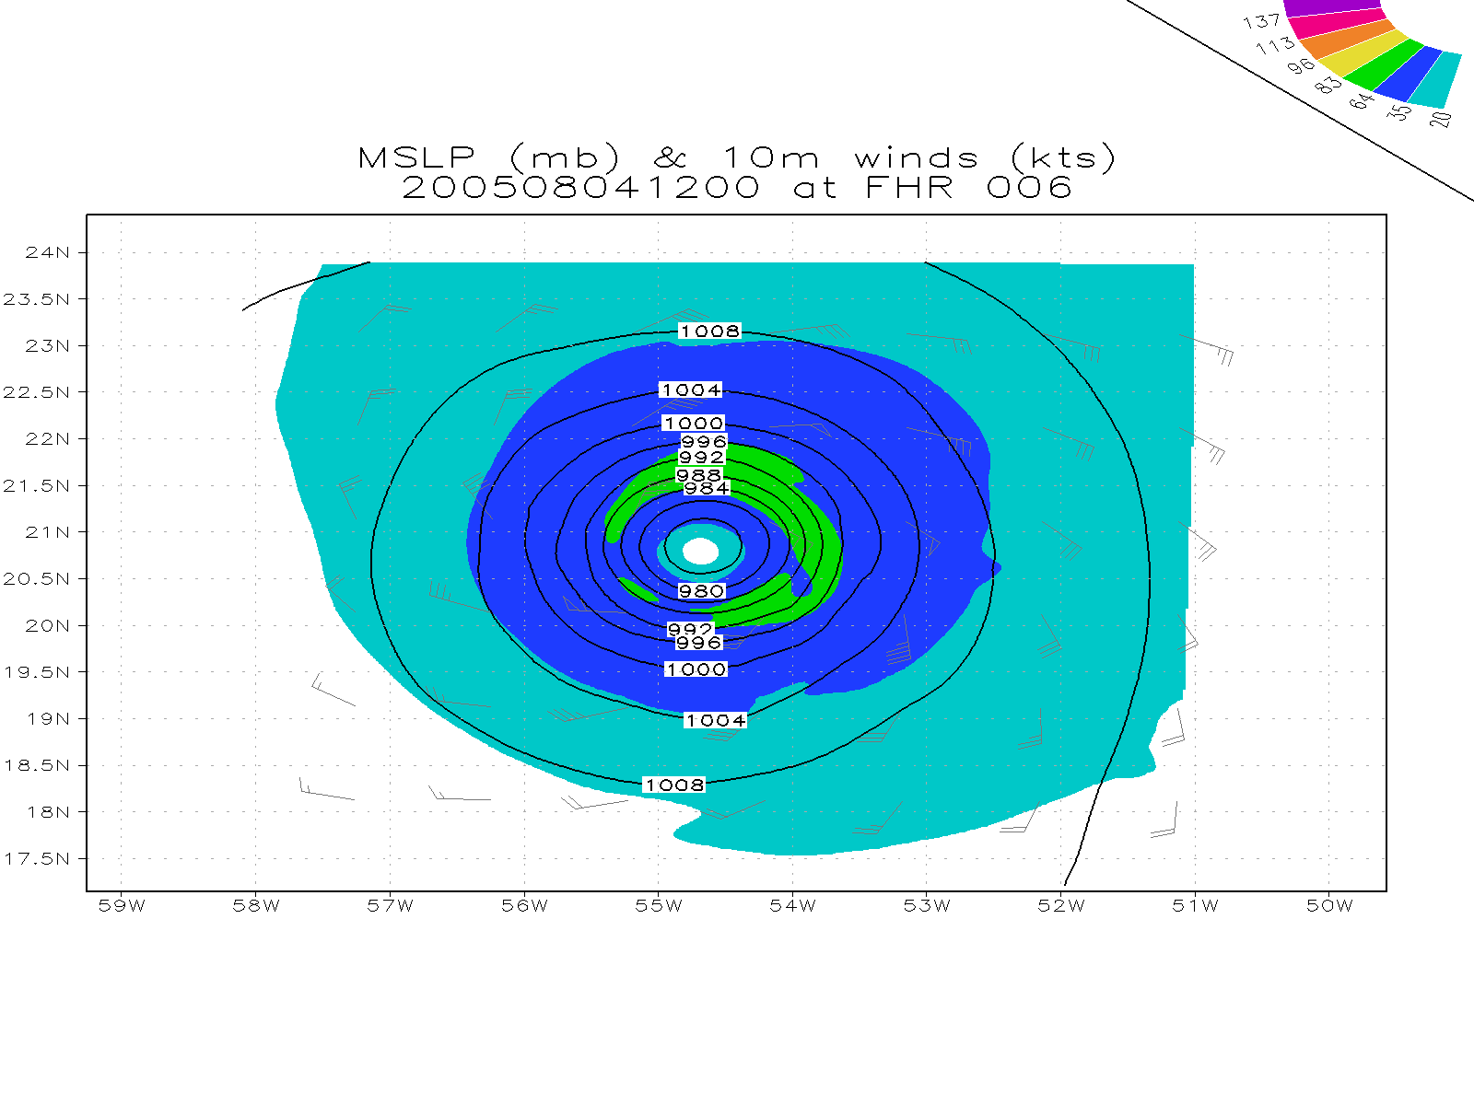
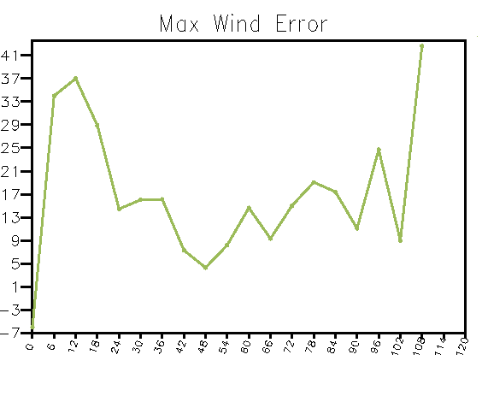
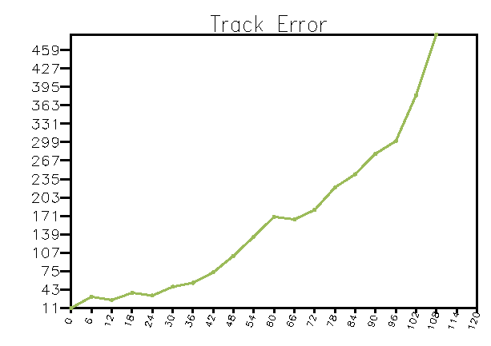
Enkf (control) 08/04 12Z

Slide 2
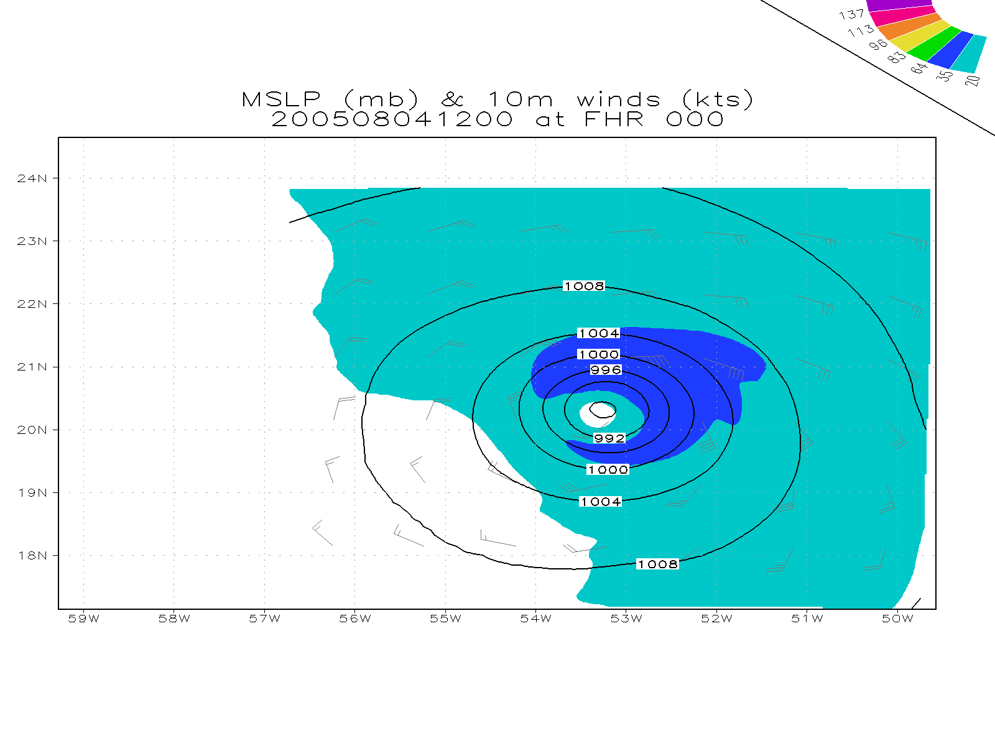
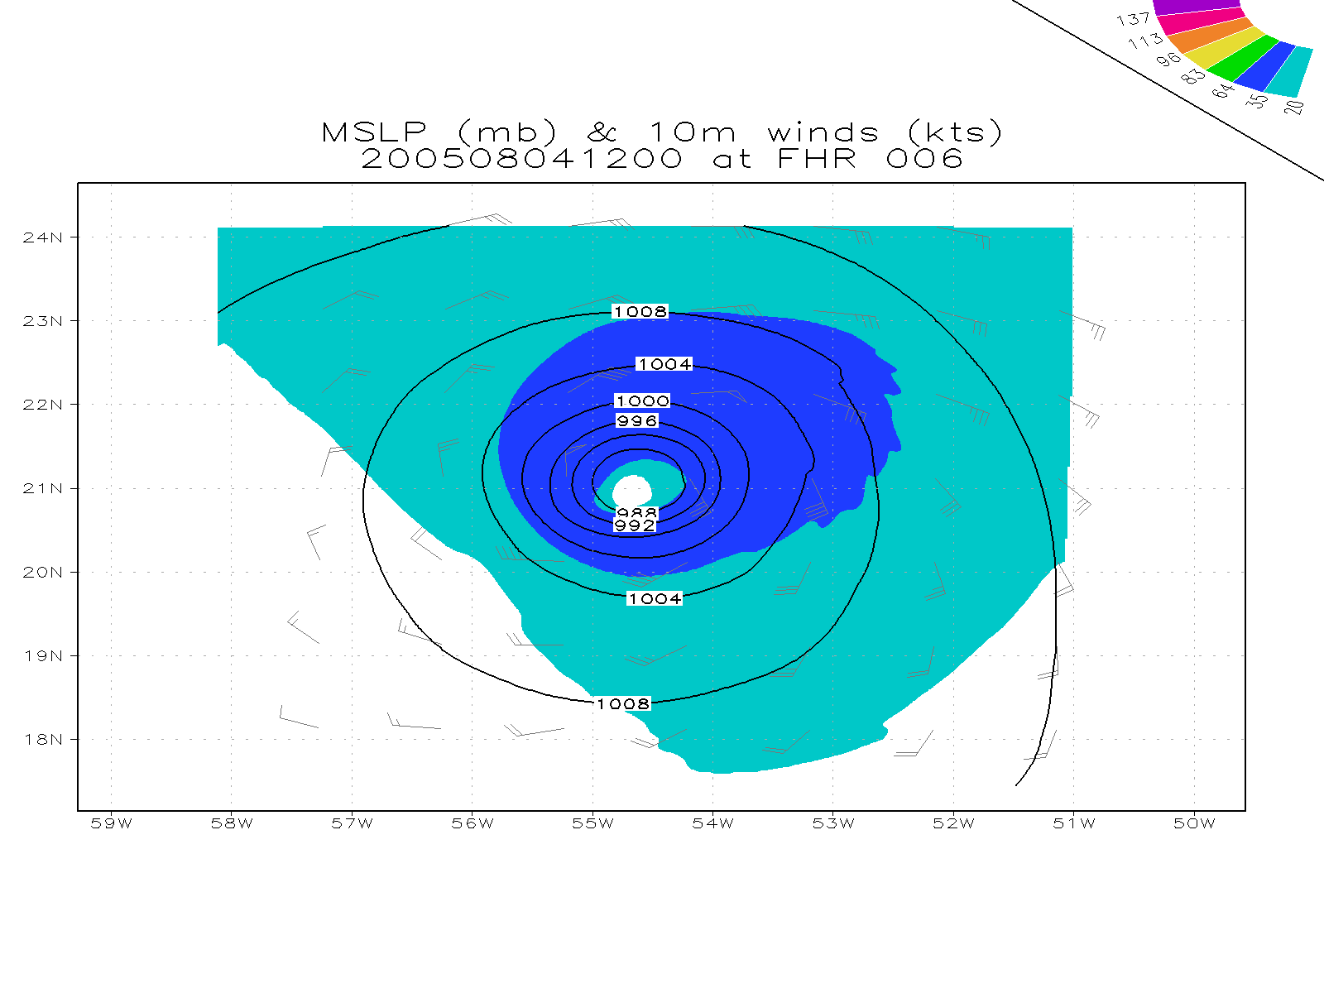
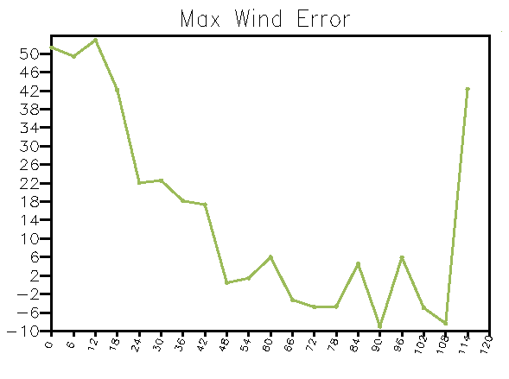
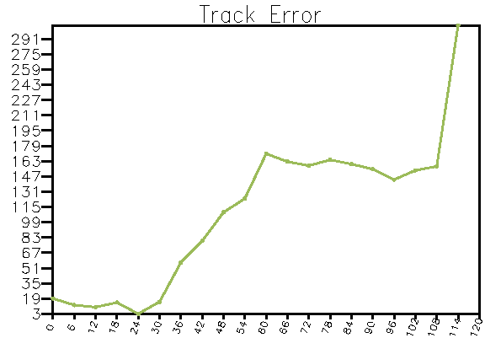
GSI (control) 08/04 12Z

Slide 3
Inconsistency in the use of center information
Date/Time |  |  | TCVitals for Assimilation |  |  | TCVitals for model |  |  | For TC errors calculation |  |  | Diapost value at initial time
02 00Z |  |  | 17.6 | -43.4 |  | 17.2 | -43 |  | 17.6 | -43.4 |  | 16.9 | -44.2
02 06Z |  |  | 16.7 | -44.6 |  | 17.5 | -44 |  | 17 | -44.4 |  | 16.7 | -45
02 12Z |  |  | 17.7 | -45 |  | 17.6 | -44.9 |  | 17.7 | -45 |  | 17.1 | -45.8
04 00Z |  |  | 19.6 | -50.5 |  | 19.7 | -50.5 |  | 19.6 | -50.5 |  | 19.1 | -51
04 06Z |  |  | 20 | -51.9 |  | 20.1 | -51.9 |  | 20 | -51.9 |  | 19.6 | -52
04 12Z |  |  | 20.4 | -53.2 |  | 20.7 | -53.2 |  | 20.5 | -53.3 |  | 20.3 | -53.2

