Slide 1
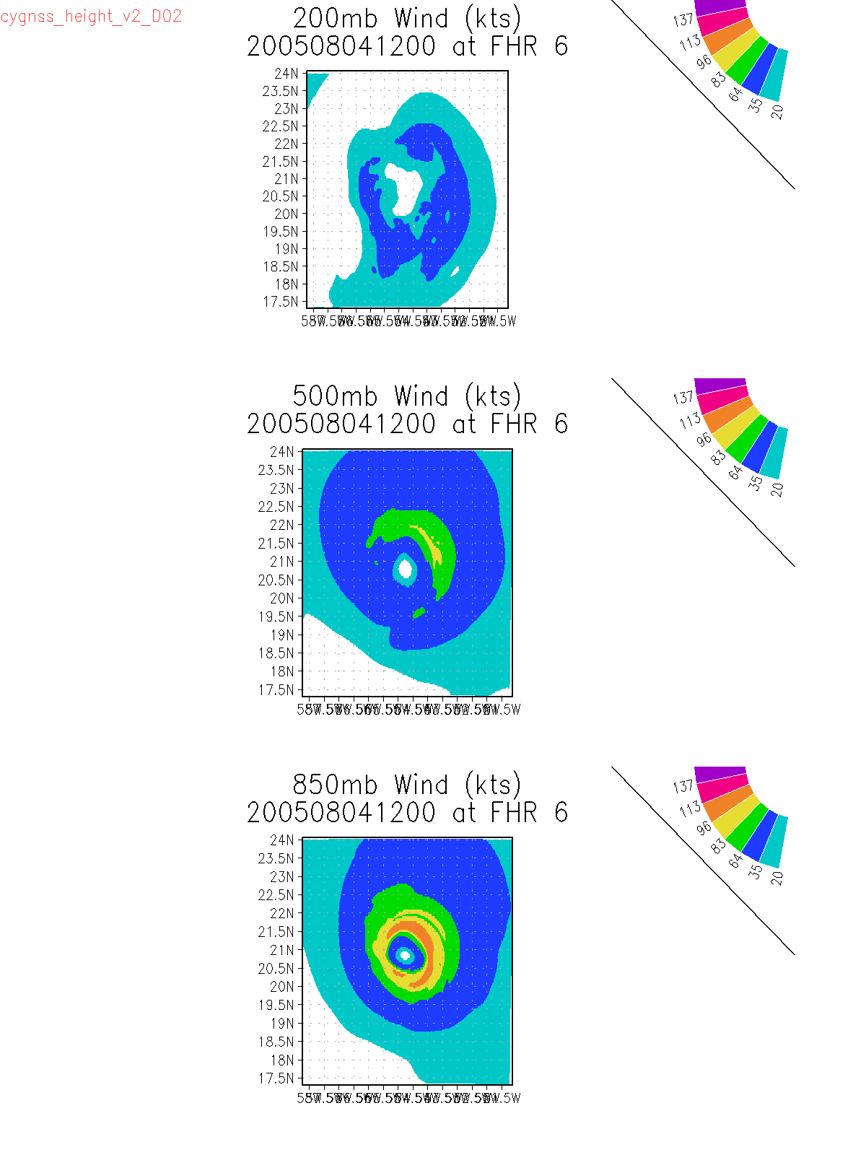
Wind Upper level (850,500,200)
Initial State
6hr forecast

Slide 2
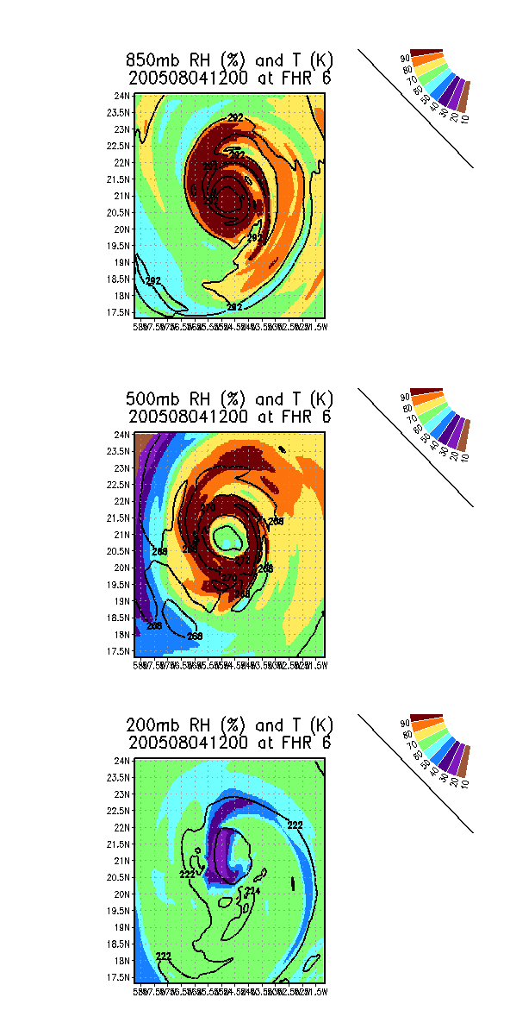
RH Upper level (850,500,200)

