Slide 1
Impact of CYGNSS Data on Tropical Cyclone
Analysis and Forecasts Using the Operational HWRF
Bachir Annane¹, Mark Leidner^{4 ,}Brian McNoldy²,
Robert Atlas³ ,Sharanya Majumdar², Ross Hoffman¹
¹ Univ. of Miami/CIMAS and NOAA/AOML/HRD, Miami, FL
² Univ. of Miami/RSMAS, Miami, FL
³ NOAA/AOML, Miami, FL
⁴ AER, Lexington, MA

Slide 2
Overview
What is CYGNSS? [2]
Review of CYGNSS OSSE results [4]
CYGNSS post-launch status [1]
Preliminary OSE results/HWRF [12]

Slide 3
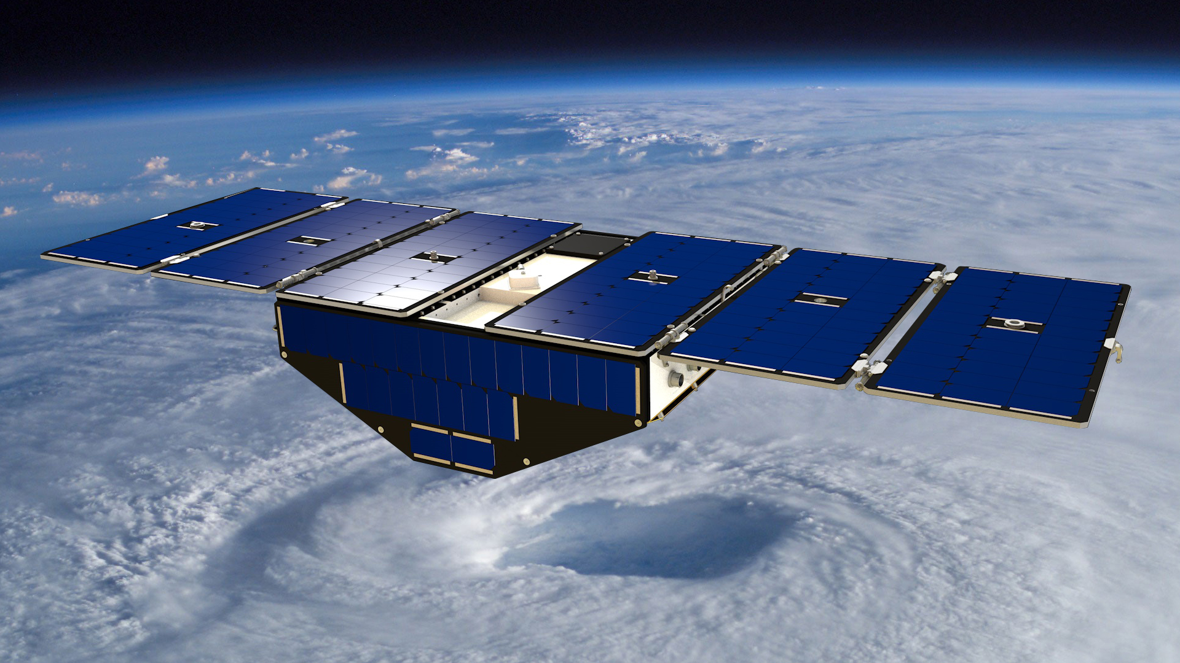
What is CYGNSS?
The Cyclone Global Navigation Satellite System (CYGNSS) is a constellation of 8 micro-satellites that launched on December 15, 2016.
The body of each satellite measures roughly 51x64x28 centimeters, slightly larger than a standard carry-on suitcase., weigh about 29 kilograms, And each microsatellite has wingspan of 1.67 meters.
Rendition of a single CYGNSS observatory
in orbit over a hurricane. (NASA)

Slide 4
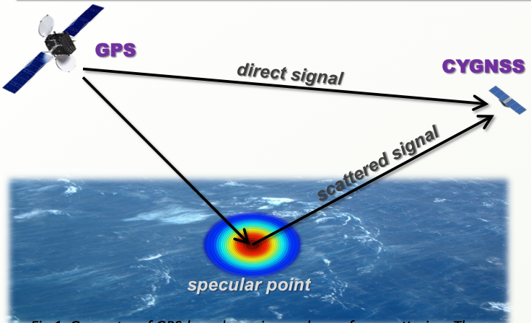
What is CYGNSS?
Utilize signals from existing GPS satellites to measure surface wind speeds (surface roughness affects forward-scattered signal)
Basic geometry of bi-static quasi-specular
scatterometry
· Capable of retrieving usable data over a large range of wind speeds (0-70 m/s) in all precipitating conditions throughout the tropics and subtropics with a frequent revisit times

Slide 5
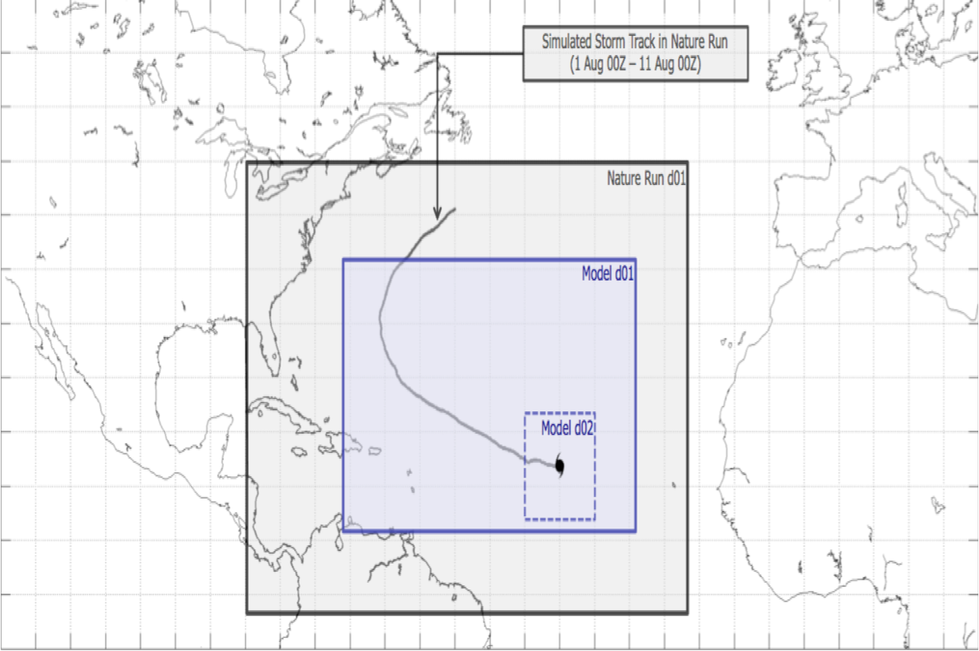
OSSE Framework Details
Nature Runs
- ECMWF: low-resolution T511 (~40km) “Joint OSSE Nature Run”
- WRF-ARW: high-resolution 27 km regional domain with 9/3/1 km storm-following nests (v3.2.1)
Data Assimilation Scheme
- GSI: Gridpoint Statistical Interpolation. a standard 3D variational assimilation scheme (v3.3).
Analyses performed at 9km resolution.
Forecast Model
- HWRF: the 2014 operational
Hurricane-WRF model (v3.5).
Parent domain has ~9km resolution,
single storm-following nest has ~3km
resolution.
DA and model cycling performed every 6,3, 1 hours, each run producing a 5-day forecast.

Slide 6
Simulated CYGNSS data
Four-day synthetic CYGNSS dataset generated to span the WRF nature run.
(animation)
0801 00z - 0805 00z

Slide 7
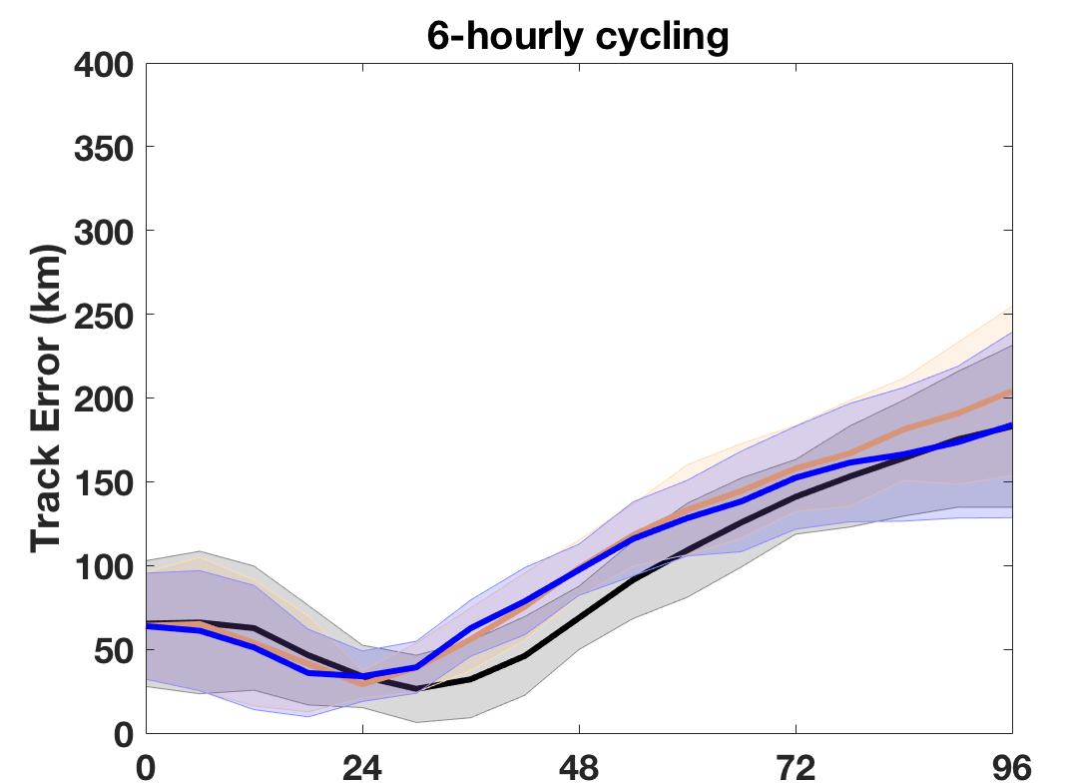
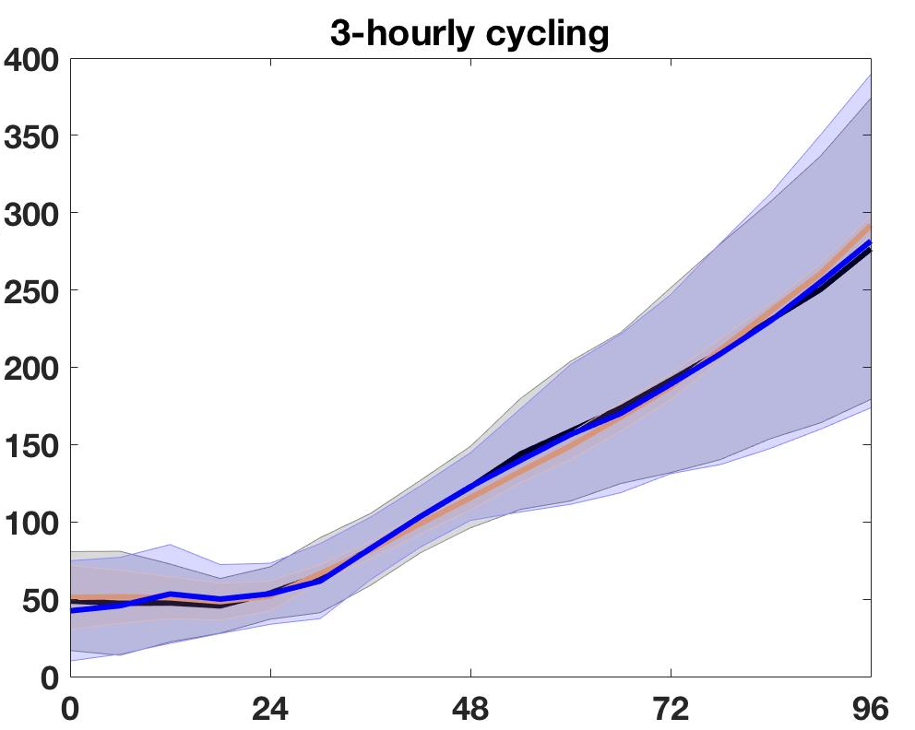
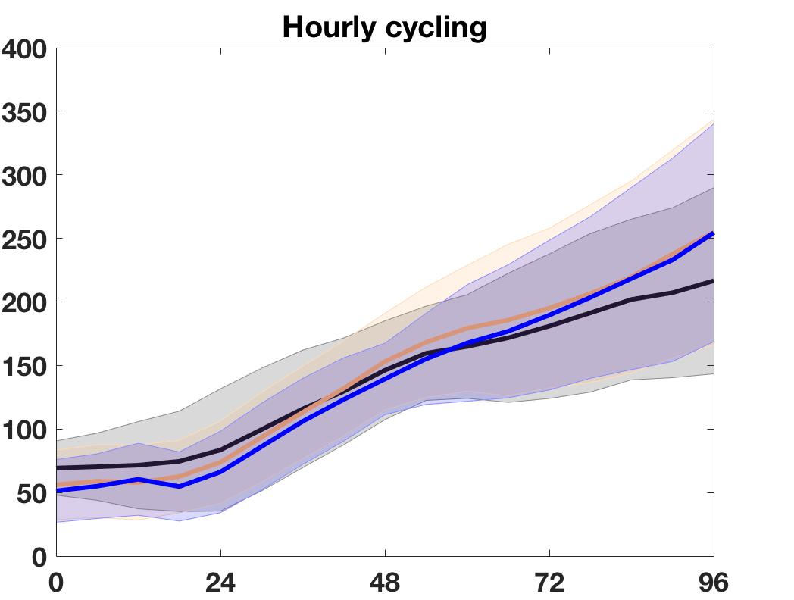
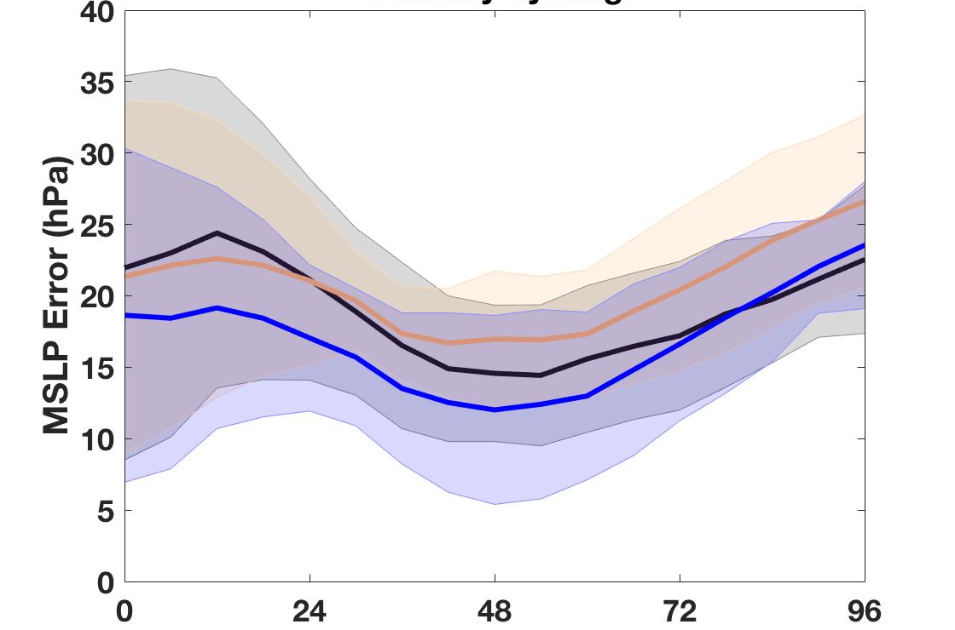
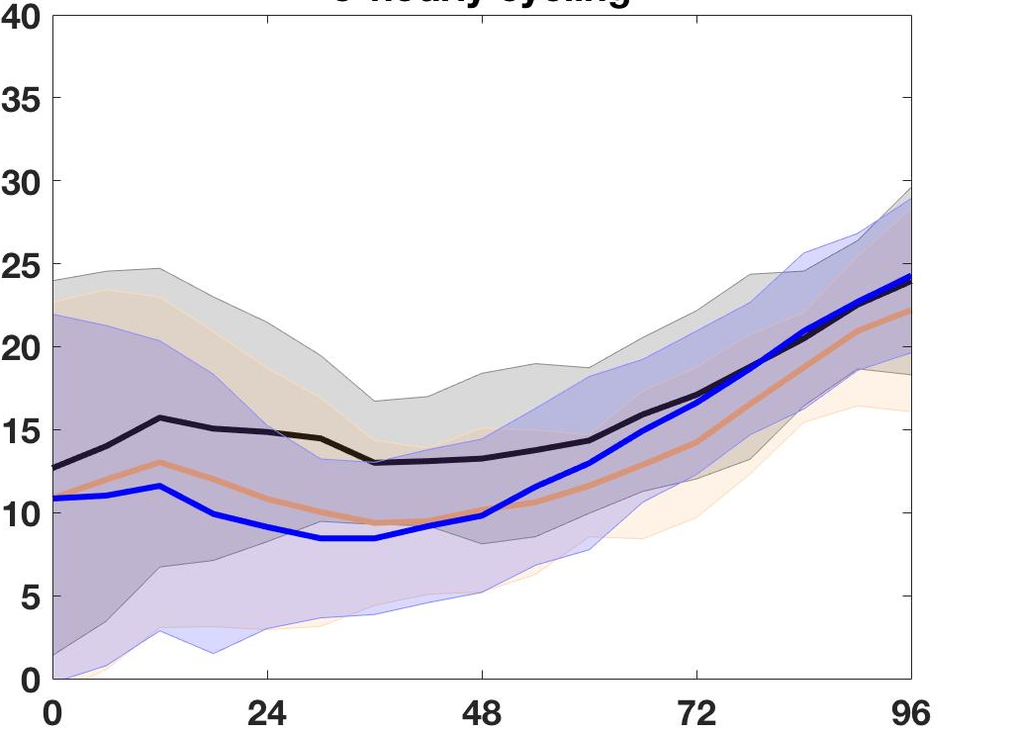
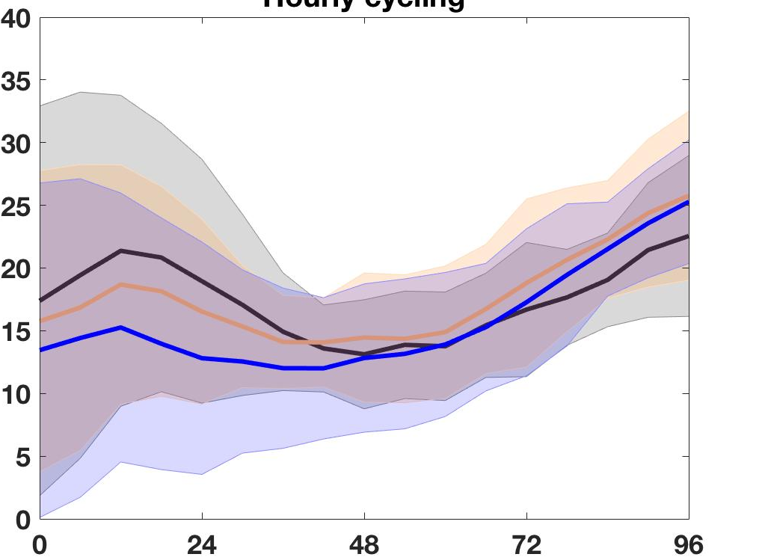
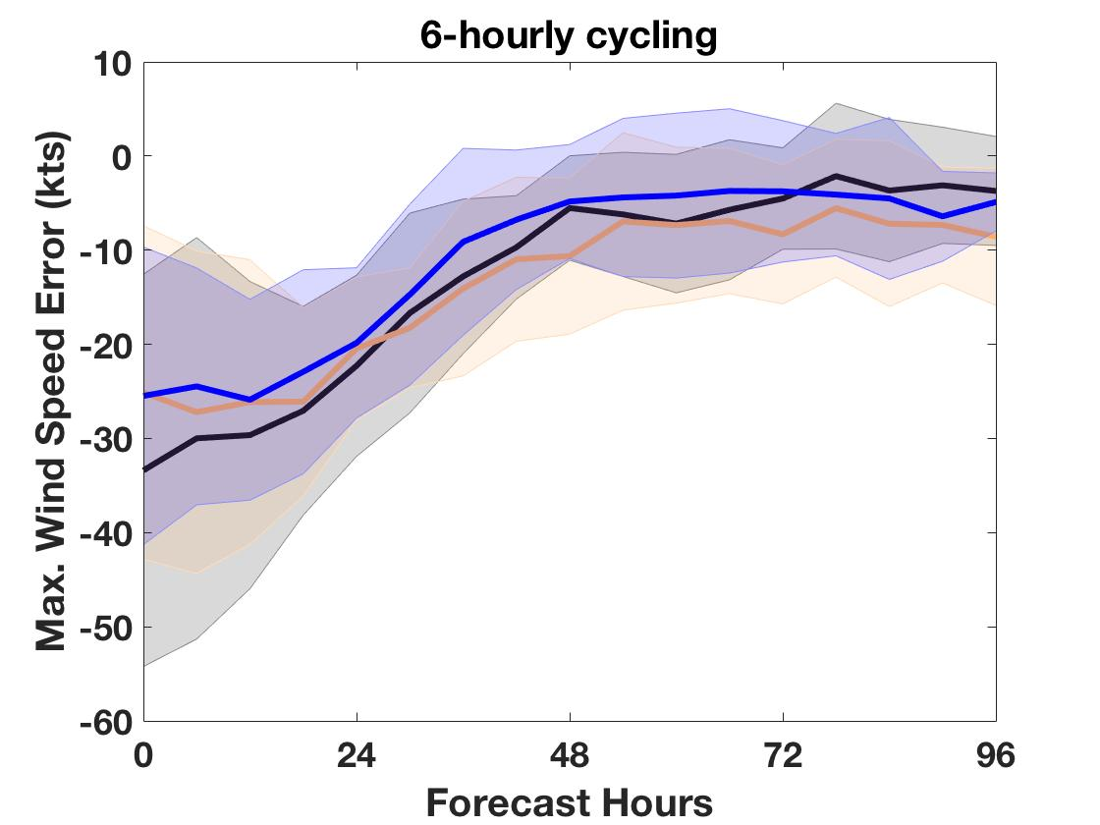
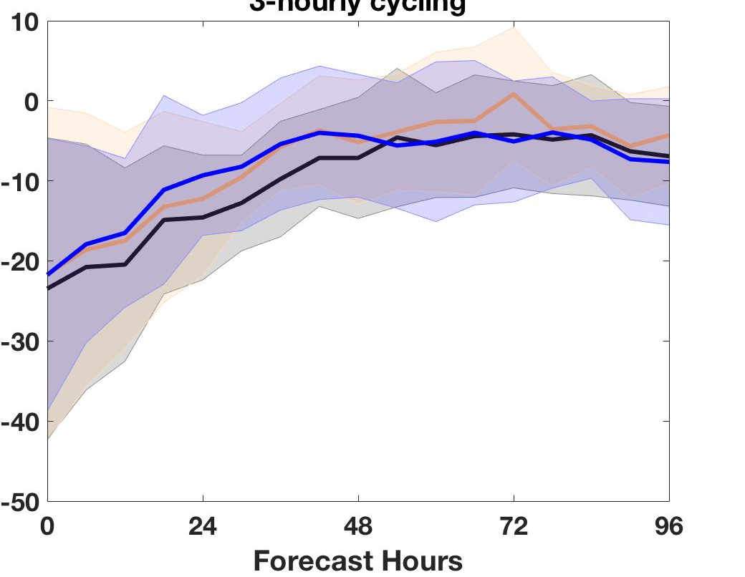
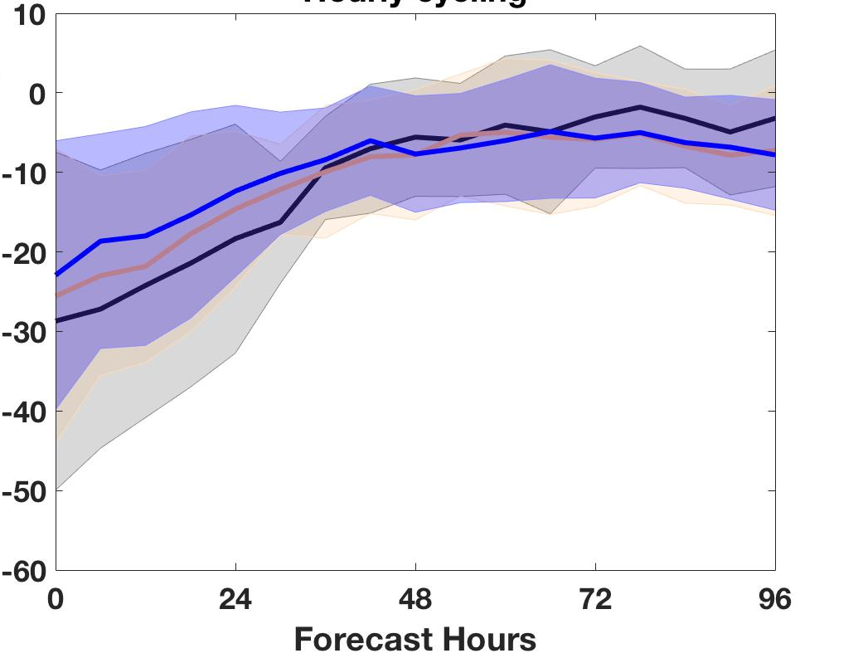
CYGNSS OSSE Avg. T.C. Forecast Errors Track (km) MSLP (hPa) Maximum Wind (kts) (rows) 6-, 3- and hourly cycling (columns) black/grey for CNTL, orange/lgt. orange CYG blue/lgt. blue for VAM
OSSE IMPACT RESULTS
(a)
(b)
(c)
(d)
(e)
(f)
(g)
(h)
(i)

Slide 8
OSSE RESULT SUMMARY
Assimilation of CYGNSS data almost always improves hurricane intensity, track analyses, and short range forecasts (0-48 hrs).
DA cycling frequencies affects analyses and forecast errors.
3-hrly cycling produced minimum errors in our study
There are relatively a few samples from one storm, so error statistics are not robust but provide guidance.

Slide 9
CYGNSS Post-launch status
Calibration of Level 1 data (delay-Dopper maps) is an on-going mission effort
Low wind speeds (< 12 m/s) are currently more reliable than higher winds (less noisy)
Release of version 2.1 of the Level 1 and Level 2 science data to science team & collaborators is expected 1st week of May
v2.1 will address many of the outstanding cal/val issues

Slide 10
HWRF CYGNSS Observing System Experiments (OSEs)
Components of an OSE
Atmospheric forecast model (HWRF operational, “H217”)
Control experiment: NCEP HWRF operations, H217
Data assimilation system
Hybrid 3d-Variational/Ensemble Kalman Filter data assimilation system in the Gridpoint Statistical Interpolation framework
Experiments using different treatments of CYGNSS data
Wind speed in HWRF operational configuration
VAM CYGNSS wind vectors in HWRF operational configuration
Experiments using different configurations
No vortex correction (relocation and initialization)
Allow assimilation within 150 km of TC center
Assimilation on different nests
Compare Experiment treatments to Control to assess impact
Hurricane metrics (minimum sea-level pressure, maximum wind, track error, IKE)

Slide 11
OSE Framework Details
Global Runs
- GFS: low-resolution - WRF-ARW: high-resolution 27km regional domain with 9/3/1 km storm-following nests (v3.2.1)
Data Assimilation Scheme
- GSI: Gridpoint Statistical Interpolation. a standard 3D variational assimilation scheme (v3.3).
Analyses performed at 2 and 6 km resolution.
Forecast Model
- HWRF: the 2017 operational
Hurricane-WRF model (v3.6).
Parent domain has ~18km resolution,
single storm-following nests has ~2km
resolution.
DA and model cycling performed every 6 hours, each run producing a 5-day forecast.

Slide 12
OSE experiments
Explore impact of low CYGNSS winds speeds (< 13 m/s)
Smallest retrieval error and least noisy
Irma – investigate cyclogenesis impacts
CYGNSS v2.0 FDS wind speeds
8, 6-hourly DA cycles: 12 UTC Aug 28 – 06 UTC Aug 30
Katia, Harvey, Maria – explore early lifecycles
CYGNSS v2.0 YSLF wind speeds
Katia:
Harvey:
Maria:

Slide 13
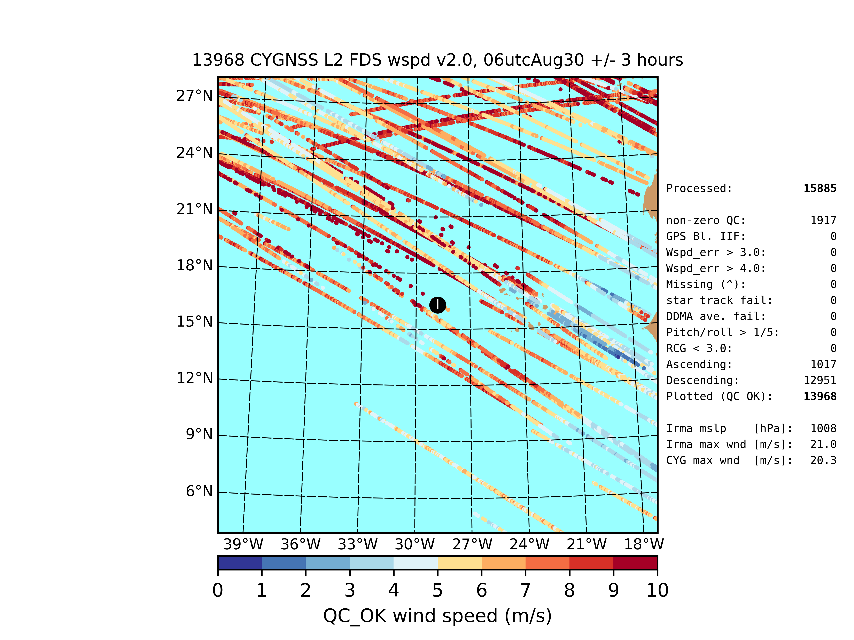
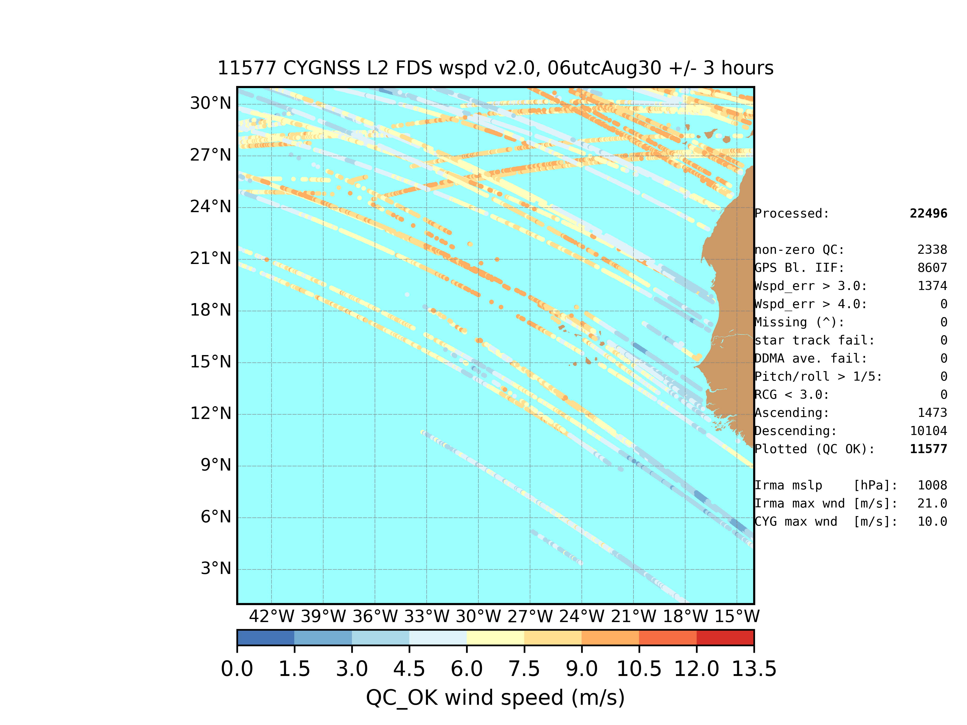
CYGNSS Quality Control 00 UTC Aug 30 TBD: fix both plots!

Slide 14
CYGNSS Quality Control 06 UTC Aug 30 TBD: fix both plots!

Slide 15
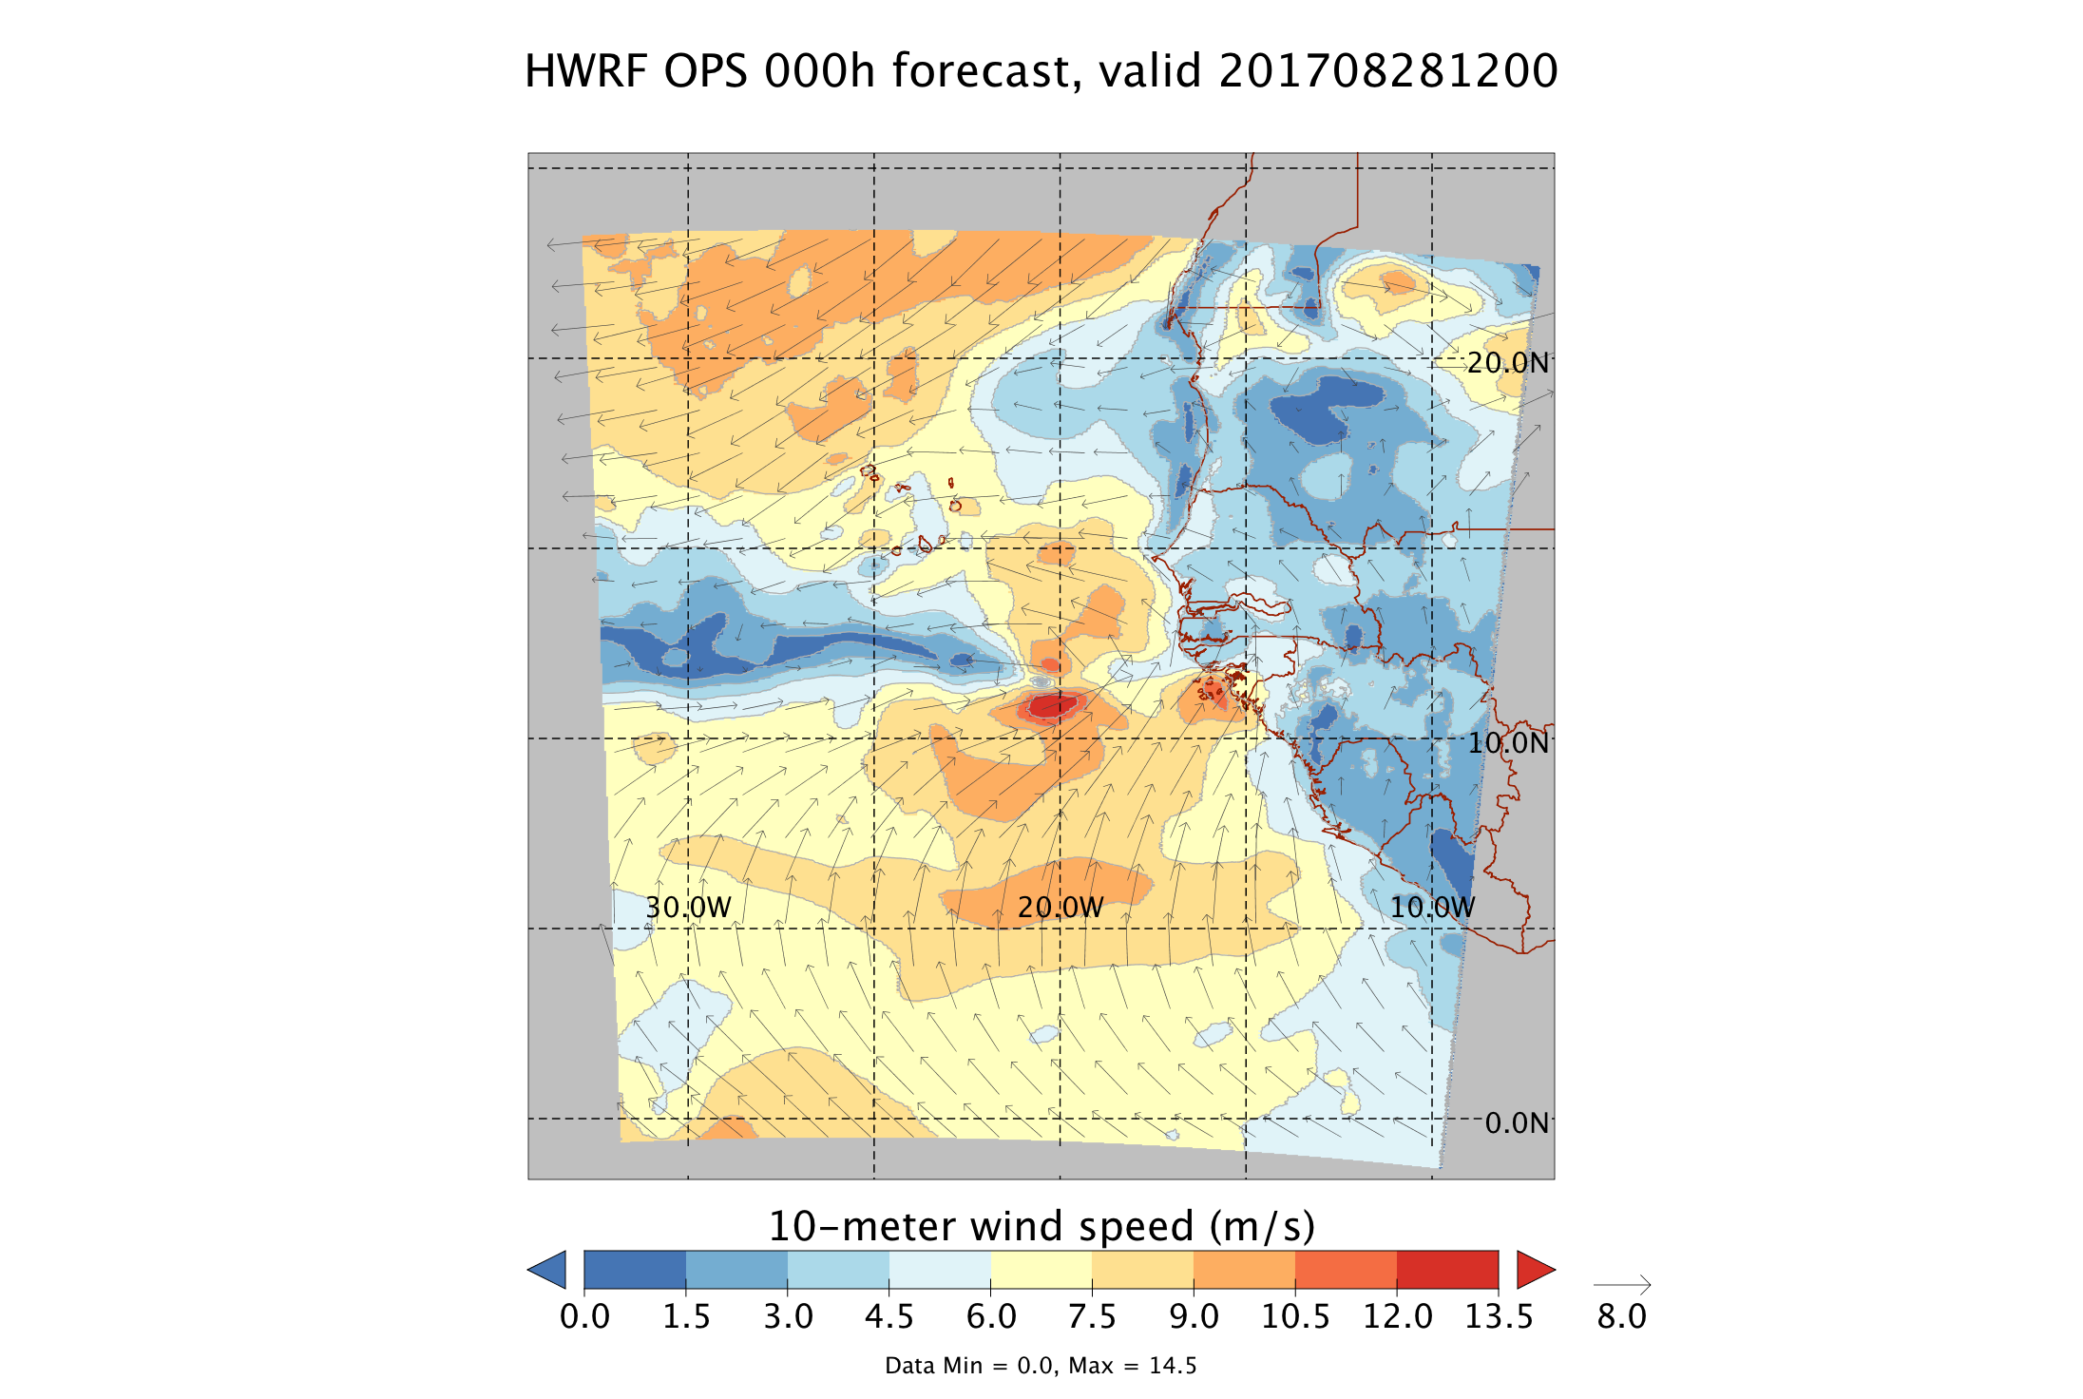
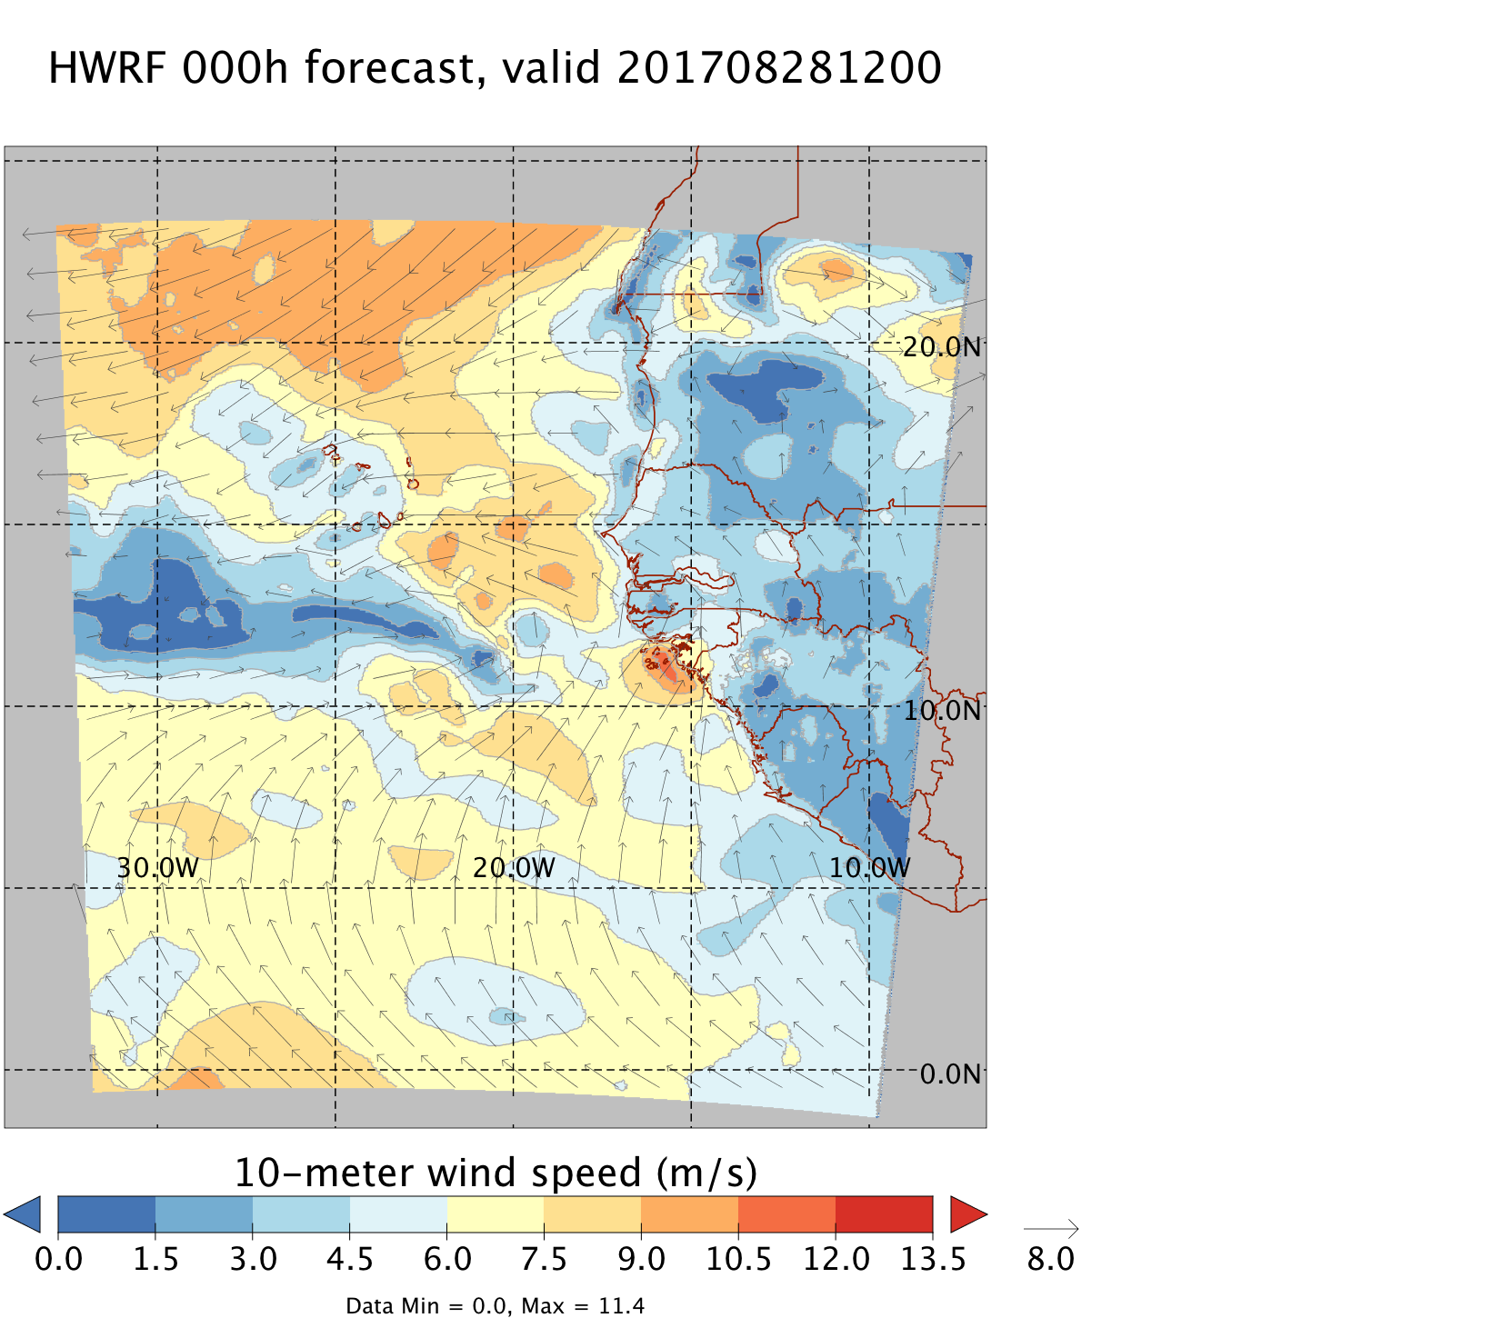
OPS & OSE Experiment I.C. TBD: update plots for 0000 UTC Aug 30!

Slide 16
OPS & OSE Experiment I.C. w/ CYGNSS obs TBD: update plots for 0000 UTC Aug 30!

Slide 17
OPS & OSE Analysis increments
(surface vector wind speed; 00 & 06 UTC Aug 30 -- Irma)
TBD

Slide 18
When did Irma form in HWRF?
(did genesis occur at 00, 06, and/or 12 UTC Aug 30?)
(NHC Irma storm report says genesis at 0000 Aug 30)
From forecast starting 1800 Aug 29 --> look at 6 hr fcst; closed wave?
From forecast starting 0000 Aug 30 --> look at 6 hr fcst; closed wave?
From forecast starting 0600 Aug 30 --> look at 6 hr fcst; closed wave?
TBD

Slide 19
(o-b) & (o-a) statistics table
TBD

Slide 20
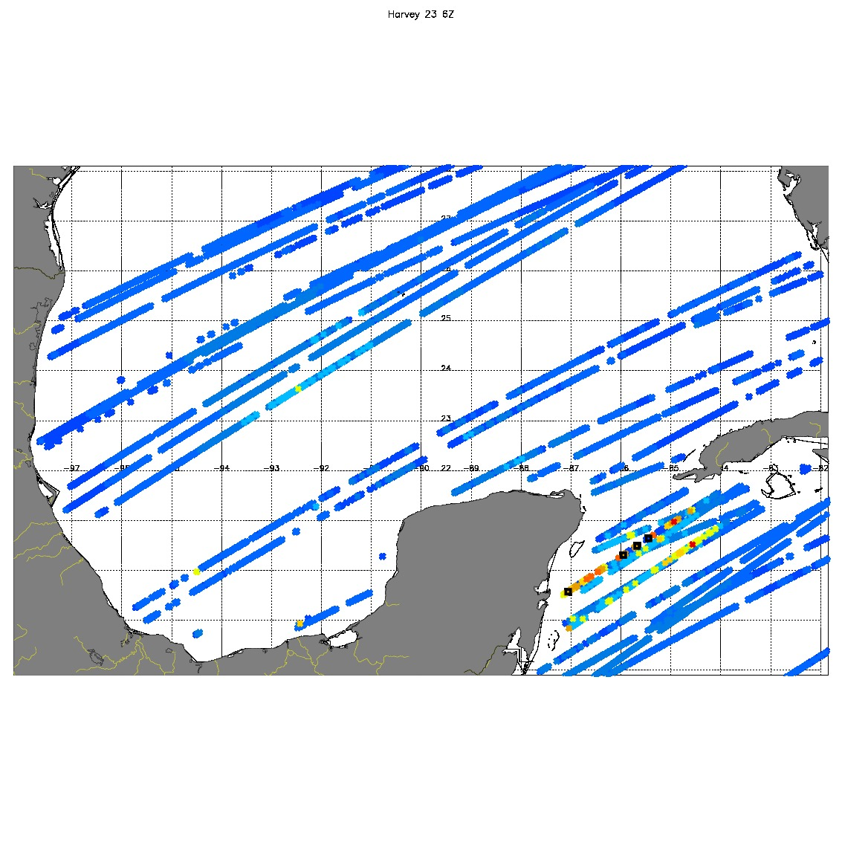
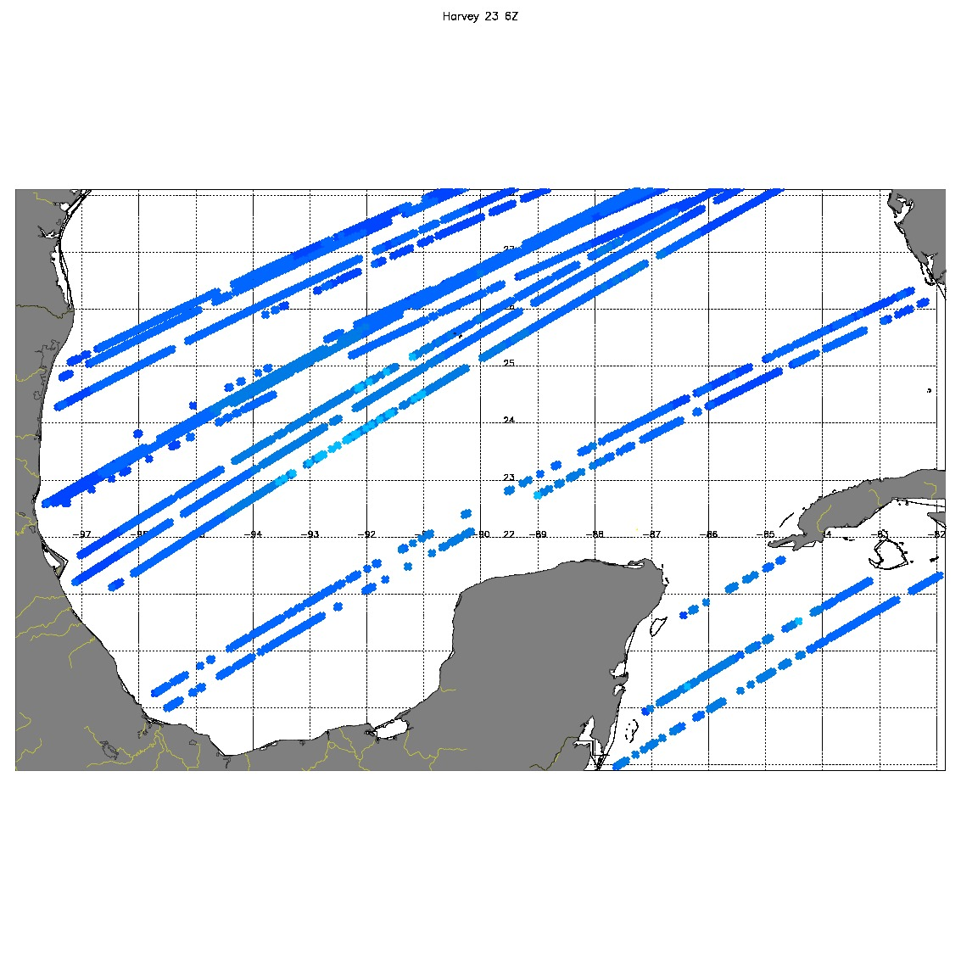
CYGNSS COVERAGE 08/23 06Z Harvey

Slide 21
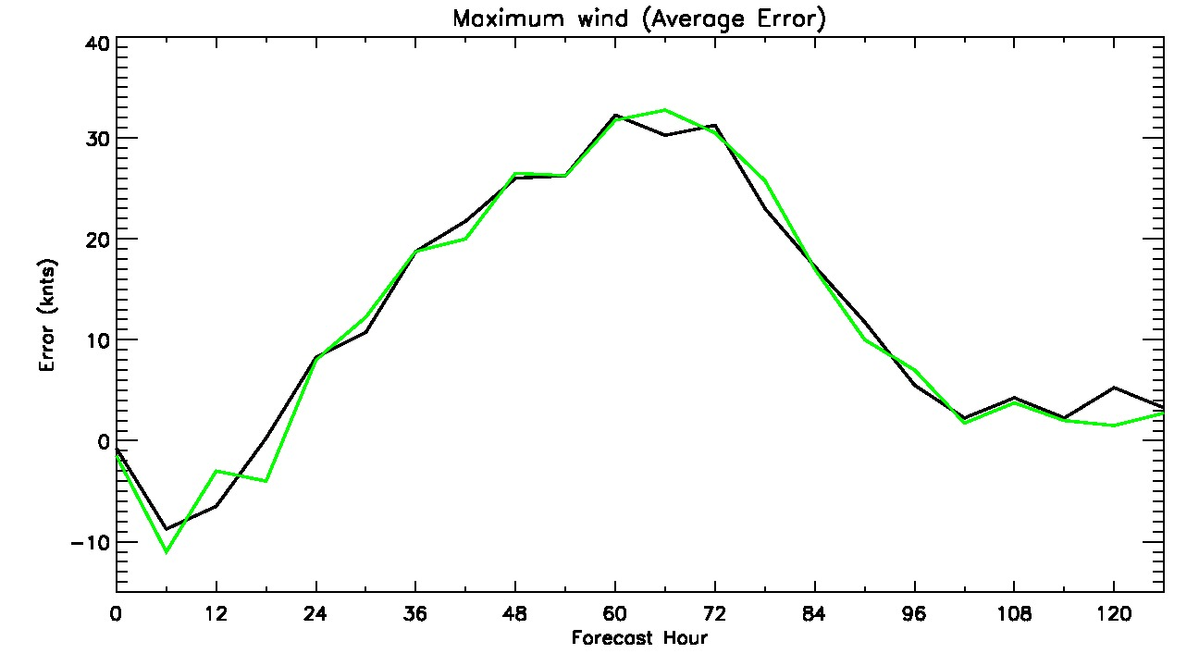
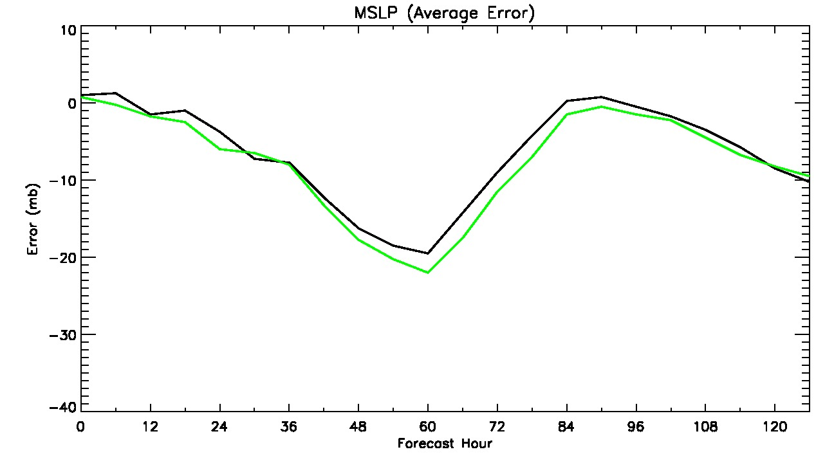
Harvey Intensity errors (4 cycles) 08/23

Slide 22
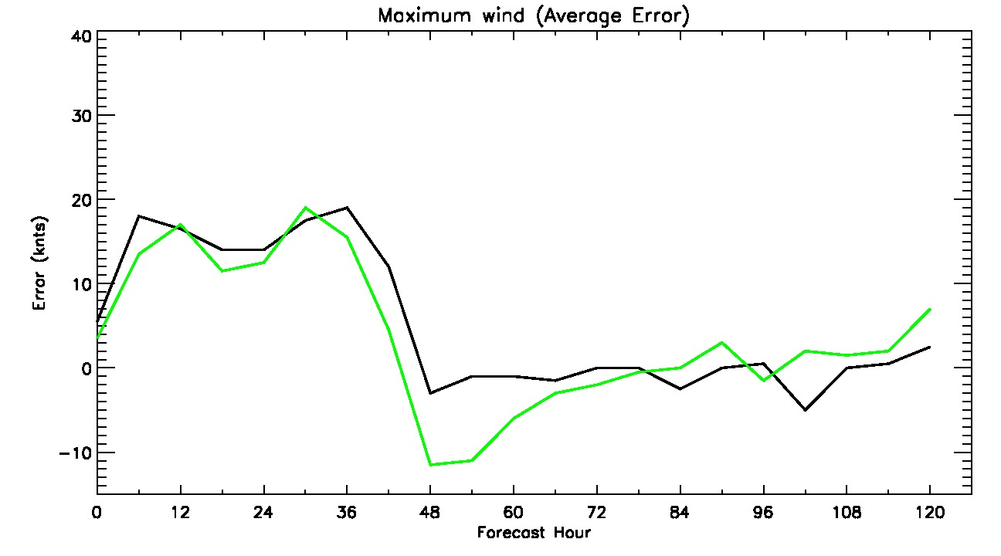
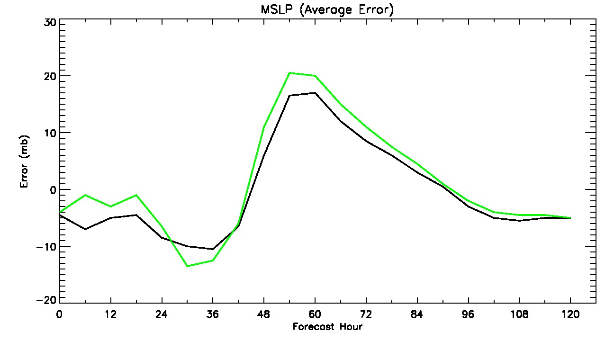
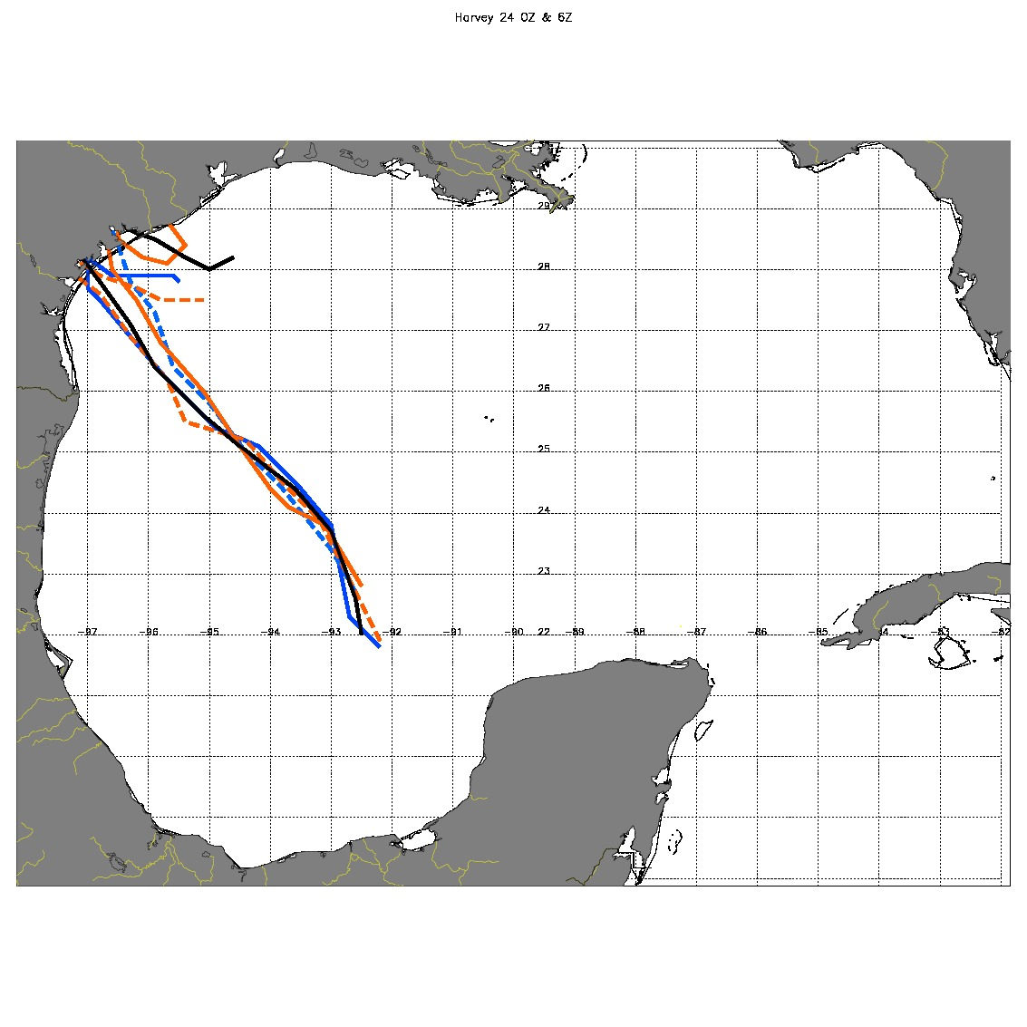
Harvey Intensity/track errors 08/24

Slide 23
SUMMARY
Preliminary OSEs with low CYGNSS wind speeds
Strict CYGNSS observation quality filtering
CYGNSS wind speeds 0-10 m/s
Little impact is seen on track or intensity errors
Reprocessed CYGNSS data (v2.1) will address
many of the current noise issues.
OSSE results based on the full range of wind speeds (0-50 m/s)

Slide 24
Future work
Assimilate CYGNSS observations in the hybrid GSI system to investigate the impact of ensemble covariances on distributing the wind speed information to unobserved variable
Optimize the VAM (use high resolution HWRF as a background, with adjusted weights)

Slide 25
QUESTIONS?

