Slide 1
H*WIND analyses using ‘Perfect’ CYGNSS observations
Bachir Annane, Lisa Bucci, Brian McNoldy, Sharan Majumdar

Slide 2
CYGNSS Observational Coverage
00, 12 UTC mostly at low latitudes
00, 12, 18 UTC at higher latitudes
+/- 3 hr window
Has been sampled from 9 km domain (d02)
Combined set from 9 km and 3 km domains has been produced this week
Perfect CYGNSS from 1 km domain (d04) has been sampled and will be combined with d02 and d03

Slide 3
What does ‘perfect’ mean?
Need to be careful
We are not using representative (i.e. lower resolution) CYGNSS wind speed footprint from Nature run with zero error
Instead, we are taking every lat-lon location from CYGNSS and interpolating (u,v) wind vectors directly from Nature run onto the CYGNSS locations
  Our effective obs spacing is that of the grid
  This is the ‘upper bound’ of what CYGNSS can be with a perfect finer-scale retrieval algorithm
(In the future, we can degrade in several ways)

Slide 4
Experimental design for Perfect Obs
CYGNSS d02 H*Wind results on next slides | SFMR d02 Data processed this week. H*Wind results by COB Friday 28th | CYGNSS+SFMR d02: use CYGNSS to Improve estimates of wind radii over SFMR?
CYGNSS d02+d03 Data processed this week | SFMR d02+d03 Data will be processed by 7th March | CYGNSS+SFMR d02+d03
CYGNSS d02+d03+d04 Will be processed | SFMR d02+d03+d04 Will be processed | CYGNSS+SFMR d02+d03+d04

Slide 5
H*Wind
First time (12Z July 29th): GSI analysis as background using ECMWF nature run as observations
Cycling every successive 6 hours
Data grouped into 6-hour bunches
‘Perfect CYGNSS’ wind vectors
(Conventionally, H*Wind takes wind speeds and assigns a direction based on their algorithms for SSM/I and SFMR)
‘First guess’ = H*Wind analysis 6 hours ago

Slide 6
Ways to verify use of CYGNSS
Peak wind (has caveats … e.g. not fully observable!)
Radius of Maximum Winds
Wind radii for 34 kt, 50 kt, 64 kt
Integrated Kinetic Energy (IKE)
Azimuthally averaged quantities
  Azimuthal wind speed
  Radial inflow

Slide 7
Ways to verify use of CYGNSS
Analysis increment:
  H*Wind Analysis – H*Wind First Guess
Analysis error:
  H*Wind Analysis interpolated onto obs sites – obs data
  H*Wind Analysis – H*Wind sampling Nature on H*Wind grid
  H*Wind Analysis – Raw Nature

Slide 8
Results
Plotted on 8 x 8 degree domain
Nature Run | H*WIND analysis from Nature Run ‘observations’ | H*WIND analysis from perfect CYGNSS
Errors computed using Analysis – Observations | CYGNSS observational coverage

Slide 9
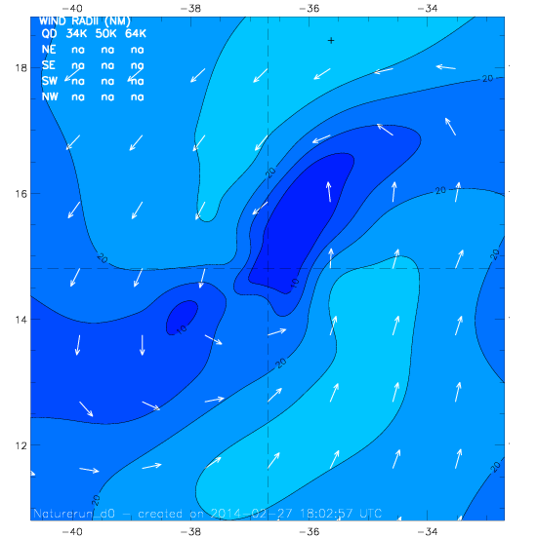
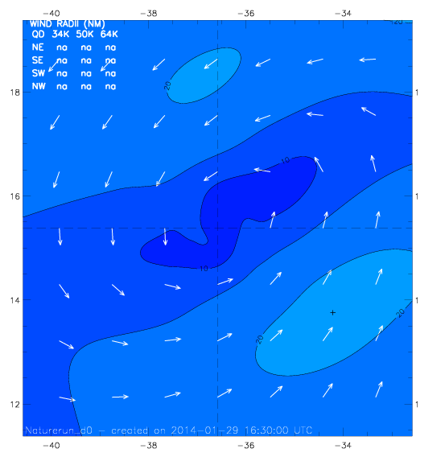
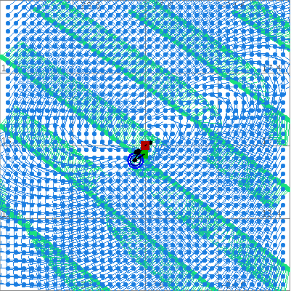
H*WIND Analyses on Jul 31, 2005 @ 00Z
a. Nature
b. H*WIND Perfect analysis from 9km Nature
c. H*WIND with perfect CYGNSS data
Max = 29 kts
TS force = 0 TJ
Max = 21 kts
TS force =0 TJ
Mean: -2, RMS: 4.23

Slide 10
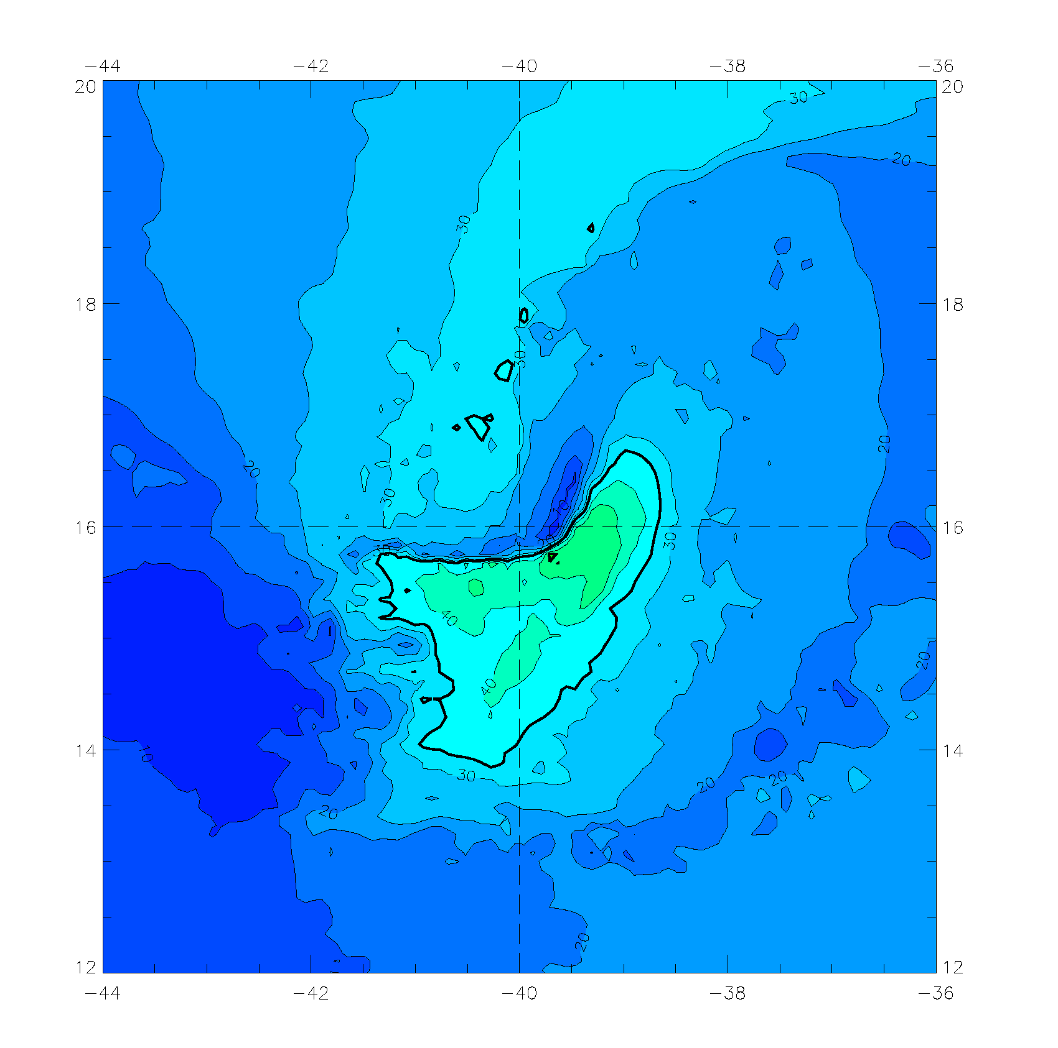
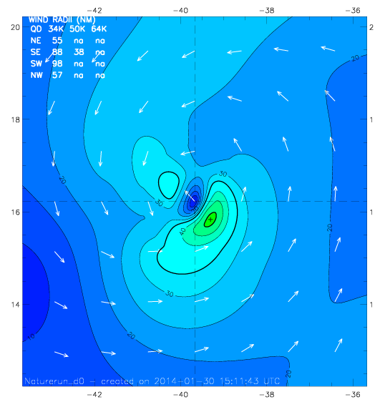
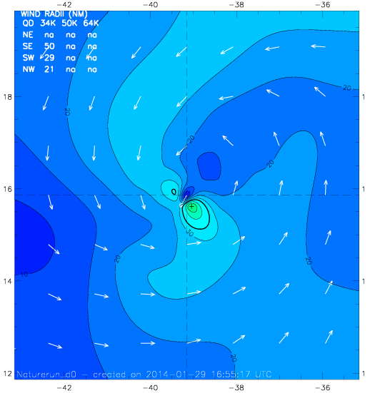
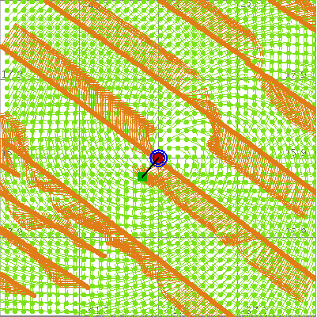
H*WIND Analyses on Aug 01, 2005 @ 00Z
a. Nature
b. H*WIND Perfect analysis from 9km Nature
c. H*WIND with perfect CYGNSS data
Max = 52kts
TS force = 6 TJ
Max = 49 kts
TS force = 1 TJ
Mean:1.61, RMS: 4.93

Slide 11
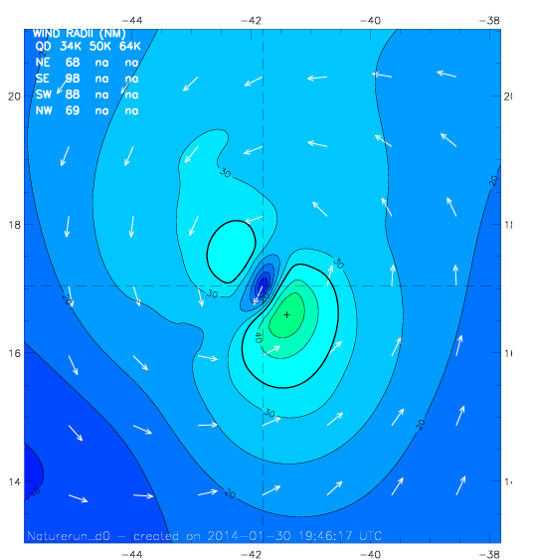
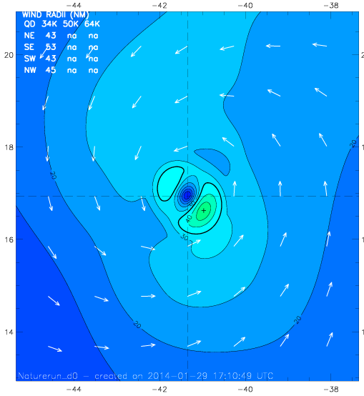
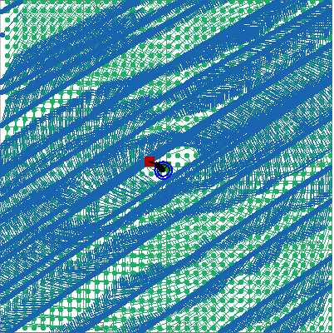
H*WIND Analyses on Aug 01, 2005 @ 12Z
b. H*WIND Perfect analysis from 9km Nature
c. H*WIND with perfect CYGNSS data
a. Nature
Max = 50 kts
TS force = 7 TJ
Max = 48 kts
TS force = 2 TJ
Mean: -0.12, RMS:4.02

Slide 12
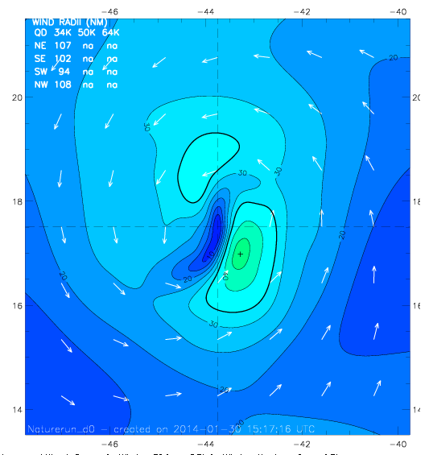
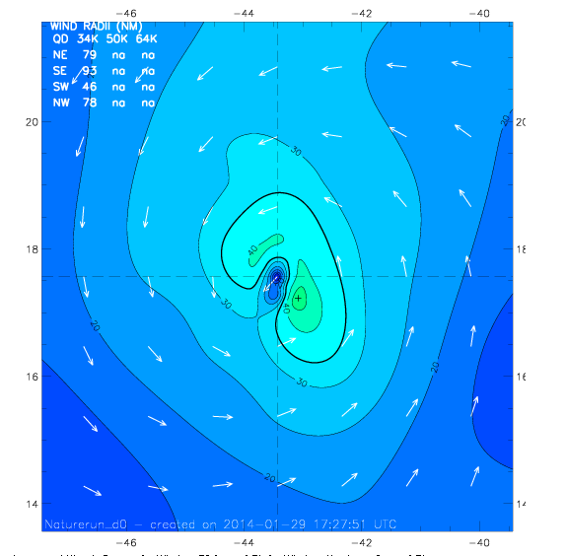
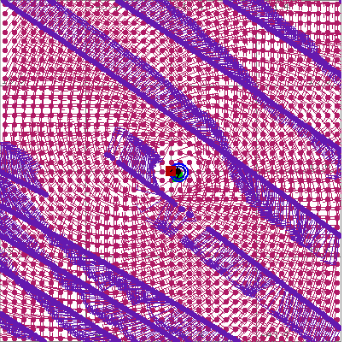
H*WIND Analyses on Aug 02, 2005 @ 00Z
a- Nature
b. H*WIND Perfect analysis from 9km Nature
c. H*WIND with perfect CYGNSS data
Max = 47 kts
TS force = 7 TJ
Max = 47 kts
TS force = 8 TJ
Mean:1.2, RMS:2.85

Slide 13
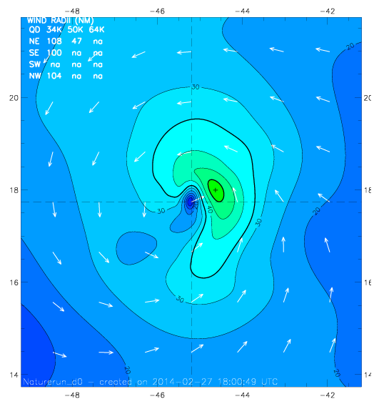
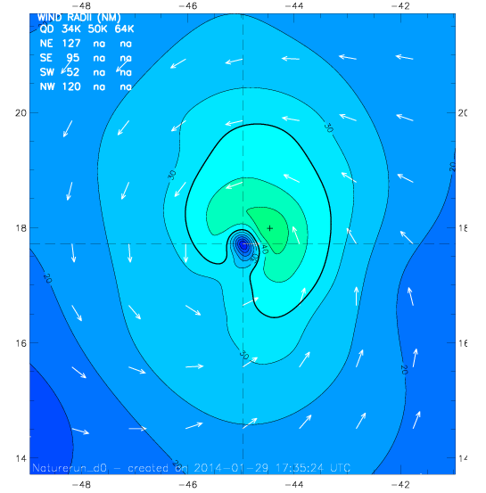
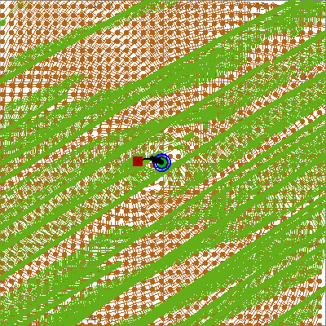
H*WIND Analyses on Aug 02, 2005 @ 12Z
a. Nature
b. H*WIND Perfect analysis from 9km Nature
c. H*WIND with perfect CYGNSS data
Max = 53 kts
TS force = 12 TJ
Max = 50 kts
TS force = 15 TJ
Mean: 0.93, RMS: 2.56

Slide 14
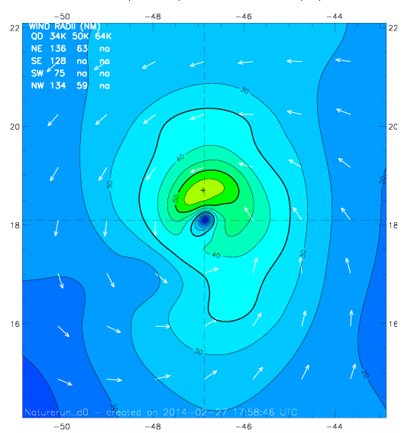
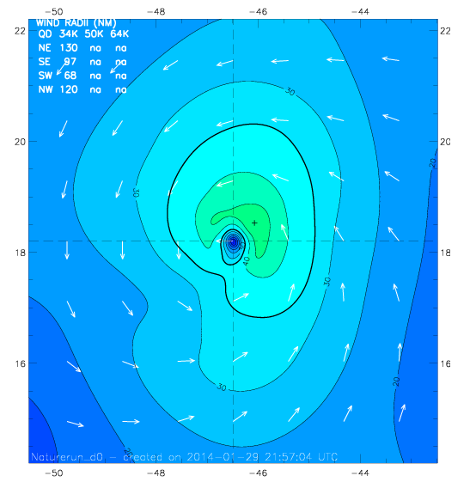
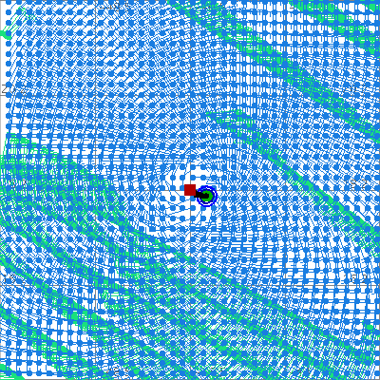
H*WIND Analyses on Aug 03, 2005 @ 00Z
a. Nature
b. H*WIND Perfect analysis from 9km Nature
c. H*WIND with dataperfect CYGNSS
Max = 59 kts
TS force = 26 TJ
Max = 50kts
TS force = 18 TJ
Mean: 1.61, RMS: 4.93

Slide 15
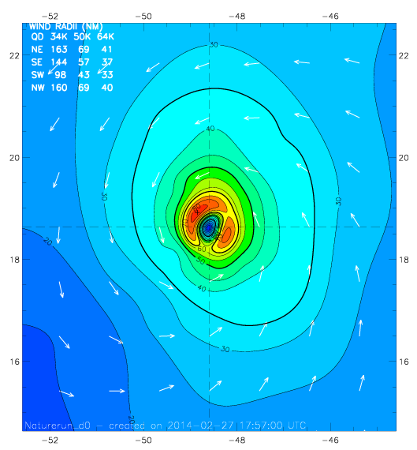
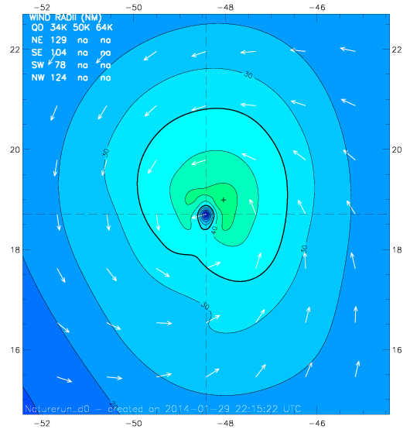
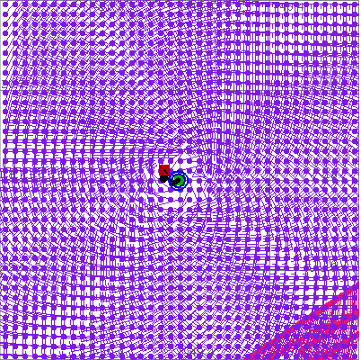
H*WIND Analyses on Aug 03, 2005 @ 12Z
a. Nature
b. H*WIND Perfect analysis from 9km Nature
c. H*WIND with perfect CYGNSS data
Max = 84 kts
TS force = 46 TJ
Max = 49 kts
TS force = 21 TJ
Mean: -0.12, RMS: 4.02

Slide 16
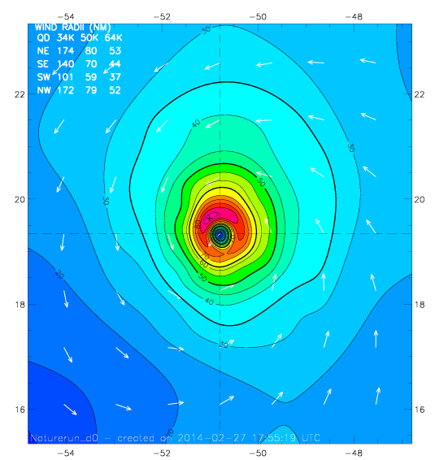
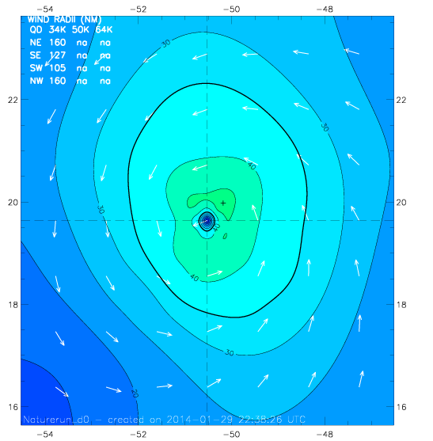
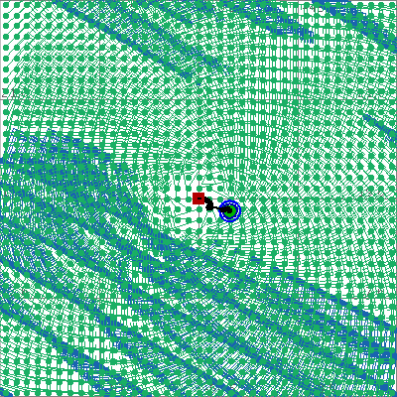
H*WIND Analyses on Aug 04, 2005 @ 00Z
a. Nature
b. H*WIND Perfect analysis from 9km Nature
c. H*WIND with perfect CYGNSS data
Max = 92 kts
TS force = 59 TJ
Max = 48 kts
TS force = 32 TJ
Mean: 0.72, RMS: 1.96

Slide 17
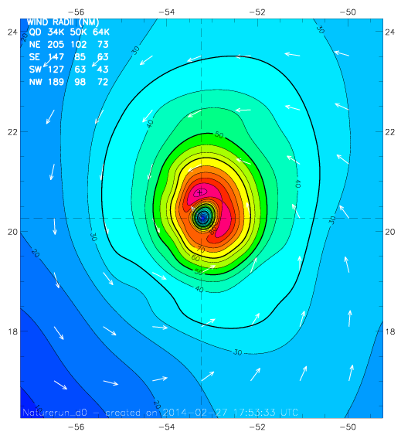
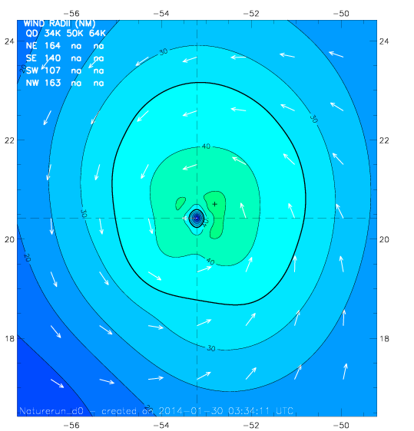
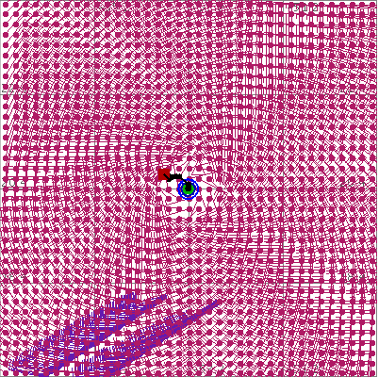
H*WIND Analyses on Aug 04, 2005 @ 12Z
a. Nature
b. H*WIND Perfect analysis from 9km Nature
c. H*WIND with perfect CYGNSS data
Max = 92 kts
TS force = 85 TJ
Max = 47 kts
TS force = 37 TJ
Mean: 0.62,RMS: 1.53

Slide 18
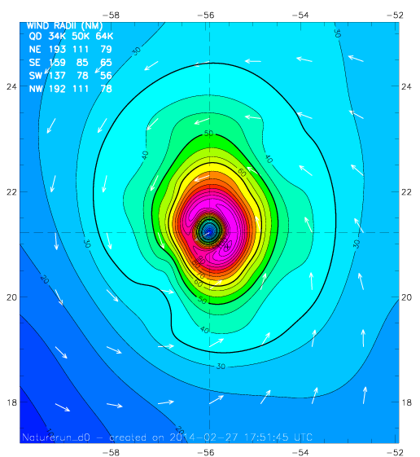
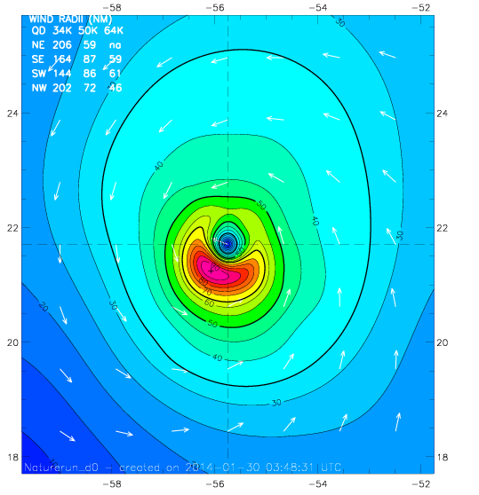
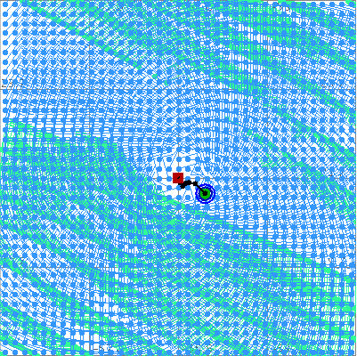
H*WIND Analyses on Aug 05, 2005 @ 00Z
b. H*WIND Perfect analysis from 9km Nature
c. H*WIND with perfect CYGNSS data
a. Nature
Max = 112 kts
TS force = 100 TJ
Max = 95 kts
TS force = 84 TJ
Mean: 2.0, RMS: 4.89

Slide 19
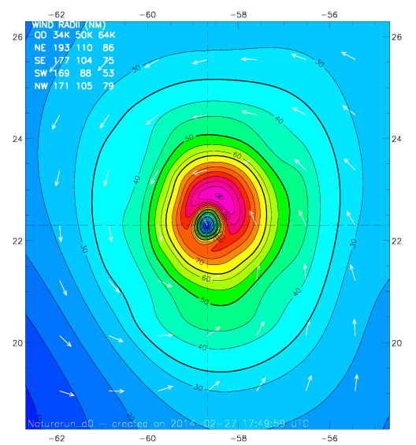
H*WIND Analyses on Aug 05, 2005 @ 12Z
a. Nature
b. H*WIND Perfect analysis from 9km Nature
c. H*WIND with perfect CYGNSS data
Max = 101 kts
TS force = 116 TJ
Max = 93 kts
TS force = 112 TJ
Mean: 1.92, RMS: 3.73

Slide 20
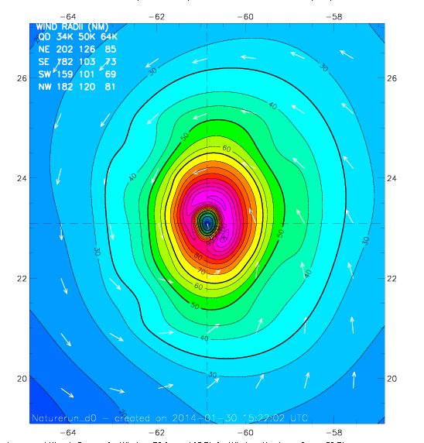
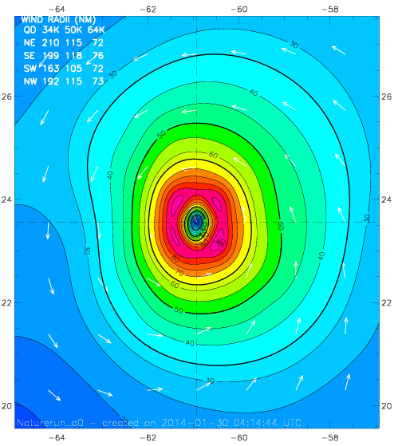
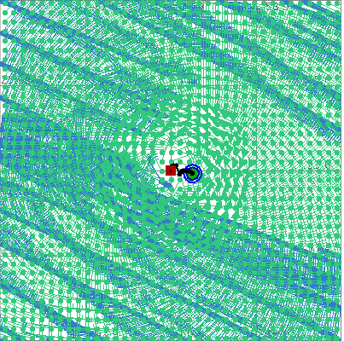
H*WIND Analyses on Aug 06, 2005 @ 00Z
b. H*WIND Perfect analysis from 9km Nature
c. H*WIND with perfect CYGNSS data
a. Nature
Max = 108 kts
TS force = 127 TJ
Max = 93 kts
TS force = 134 TJ
Mean: 1.22, RMS: 3.5

Slide 21
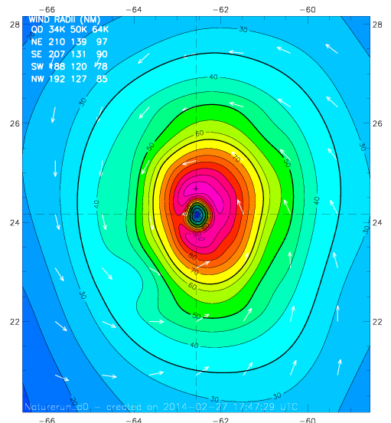
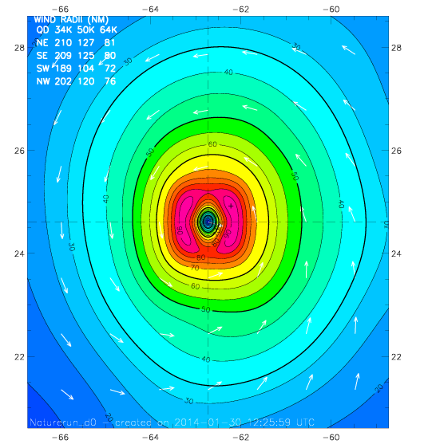
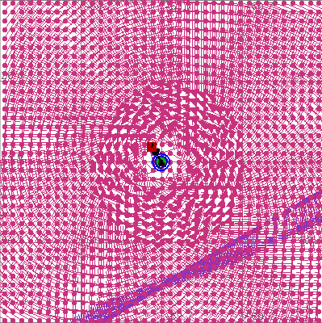
H*WIND Analyses on Aug 06, 2005 @ 12Z
b. H*WIND Perfect analysis from 9km Nature
c. H*WIND with perfect CYGNSS data
a. Nature
Max = 99 kts
TS force = 157 TJ
Max = 93 kts
TS force =155 TJ
Mean: 2.17, RMS: 3.72

Slide 22
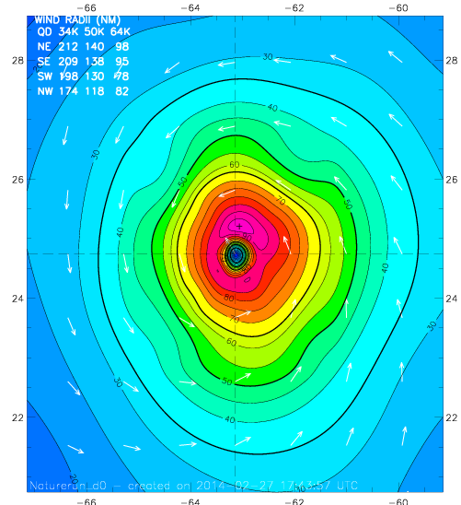
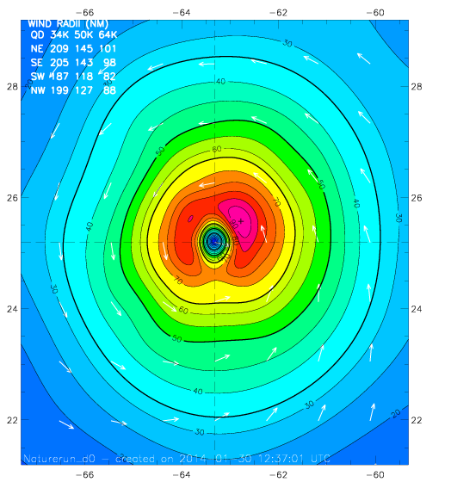
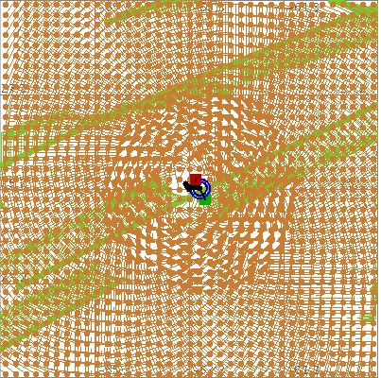
H*WIND Analyses on Aug 06, 2005 @ 18Z
a. Nature
b. H*WIND Perfect analysis from 9km Nature
c. H*WIND with perfect CYGNSS data
Max = 99 kts
TS force = 151 TJ
Max = 95 kts
TS force =168 TJ
Mean: 2.05, RMS: 4.35

Slide 23
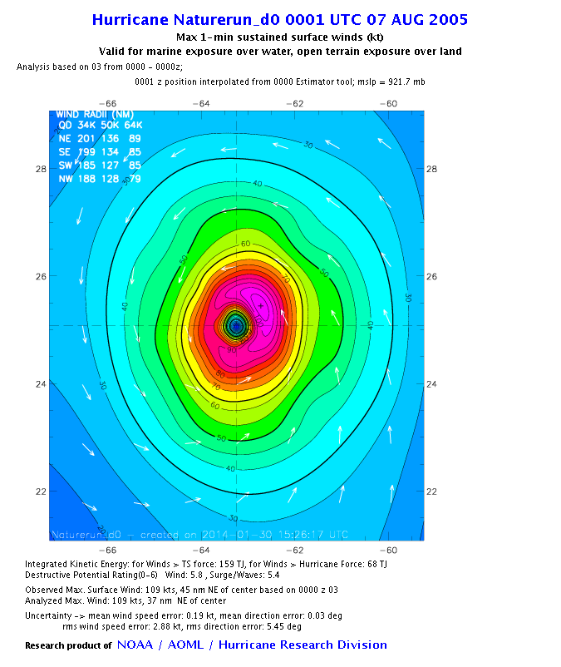
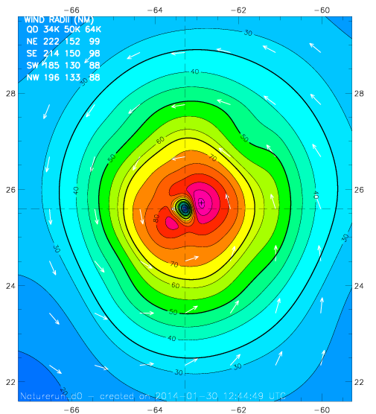
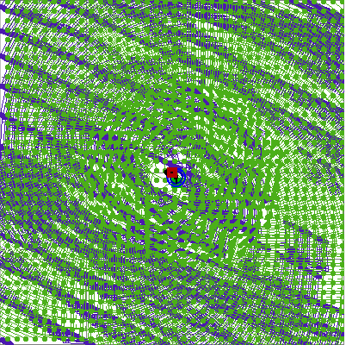
H*WIND Analyses on Aug 07, 2005 @ 00Z
a. Nature
b. H*WIND Perfect analysis from 9km Nature
c. H*WIND with perfect CYGNSS data
Max = 97 kts
TS force = 173 TJ
Max = 109 kts
TS force = 159 TJ
Mean: 1.08, RMS: 3.31

Slide 24
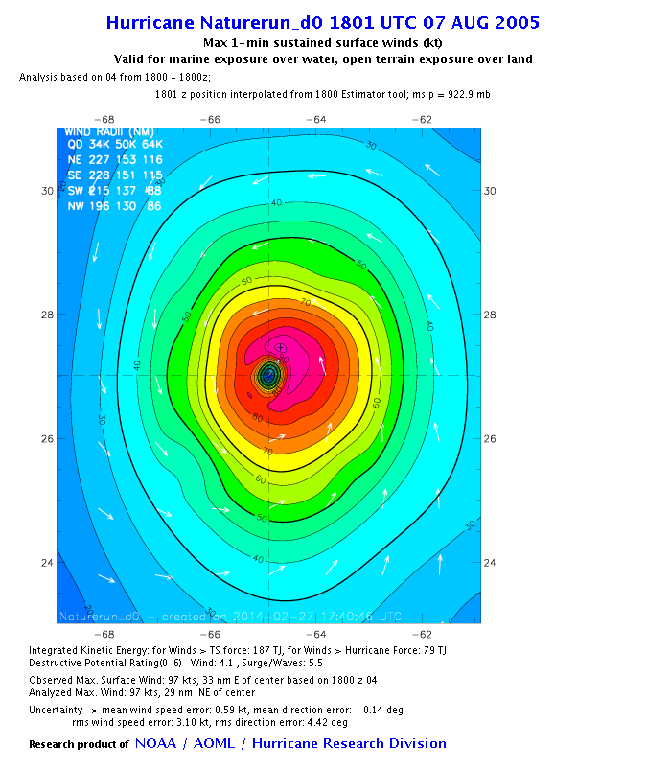
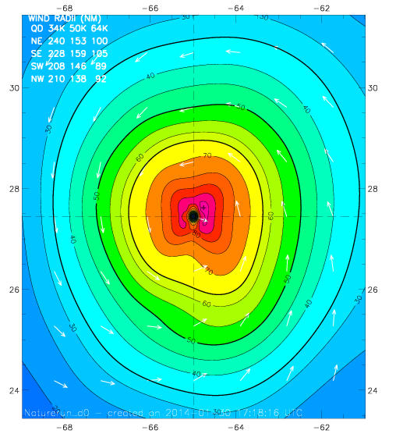
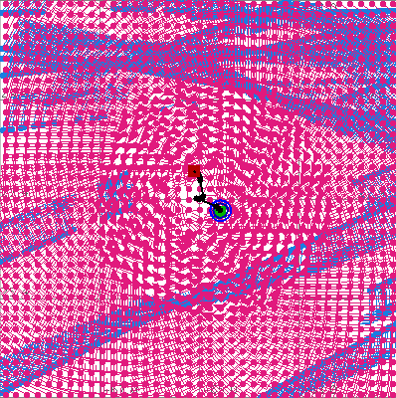
H*WIND Analyses on Aug 07, 2005 @ 18Z
a. Nature
b. H*WIND Perfect analysis from 9km Nature
c. H*WIND with perfect CYGNSS data
Max = 97 kts
TS force = 187 TJ
Max = 92 kts
TS force =204 TJ
Mean: 2.01, RMS: 3.99

Slide 25
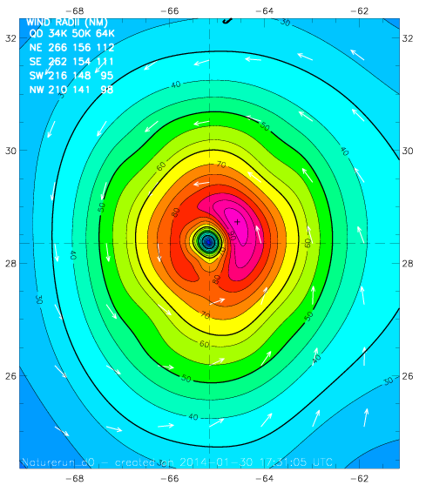
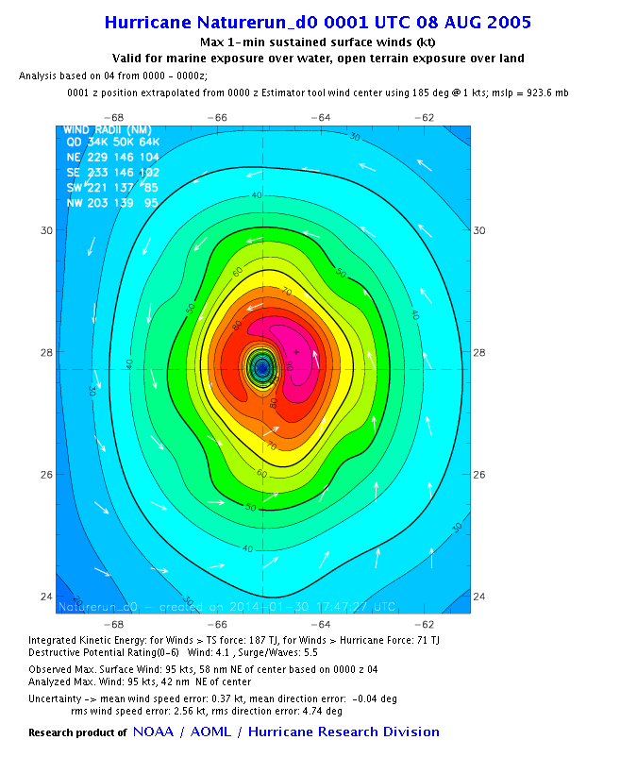
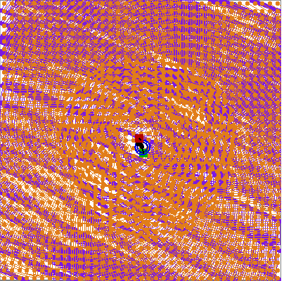
H*WIND Analyses on Aug 08, 2005 @ 00Z
a. Nature
b. H*WIND Perfect analysis from 9km Nature
c. H*WIND with perfect CYGNSS data
Max = 95 kts
TS force = 187 TJ
Max = 99 kts
TS force = 215 TJ
Mean: 1.20, RMS: 3.48

Slide 26
Experimental design for Perfect Obs
CYGNSS d02 H*Wind results on next slides | SFMR d02 Data processed this week. H*Wind results by COB Friday 28th | CYGNSS+SFMR d02: use CYGNSS to Improve estimates of wind radii over SFMR?
CYGNSS d02+d03 Data processed this week | SFMR d02+d03 Data will be processed by 7th March | CYGNSS+SFMR d02+d03
CYGNSS d02+d03+d04 Will be processed | SFMR d02+d03+d04 Will be processed | CYGNSS+SFMR d02+d03+d04

Slide 27
Future Experiments
How do we degrade CYGNSS?
  Assign errors … represent as different weightings in H*Wind
GSI “update”
HEDAS (do before GSI?)
EnKF (NOAA/ESRL)

