Slide 1
CYGNSS Results, Part III
OSSE Team Meeting
September 30, 2014

Slide 2
Data Details
What is included in “CONTROL”?
NO
Scatterometer
Ozone
YES
Radiosondes, ships, buoys, surface stations
SST from VIIRS, GOES-Imager
AMVs from GOES-Imager, SEVERI
T,q soundings from GOES-Sounder, HIRS, AIRS, MHS, ATMS, CrIS, IASI, SSMI/S, AMSU-A, AMSU-B, GPS
“Perfect” CYGNSS runs utilize v0.7 data points with fixed 2.5 m/s error; “Real” CYGNSS runs utilize v0.6 data points with provided standard deviations as errors (removing the bad/flagged obs first).

Slide 3
Large-scale Domain Average
Averaging fields over all of d01 for various experiments and comparing to nature run
“CONTROL” (no CYGNSS data)
“PERFECT_UV_GSI”: Wind vectors created from nature run at CYGNSS coordinates are assimilated, no pressure assignment necessary. GSI DA
“PERFECT_SPD_GSI”: Wind speeds created from nature run at CYGNSS coordinates are assimilated, pressure assigned is from surface pressure field in HWRF analyses. GSI DA
“REAL_SPD_GSI”: CYGNSS wind speeds with realistic errors are assimilated, pressure assigned is from surface pressure field in HWRF analyses. GSI DA
“PERFECT_SPD_ENKF”: Wind speeds created from nature run at CYGNSS coordinates are assimilated. ENKF DA (with climatological perturbations)

Slide 4
D01 Domain Average (10m wind)

Slide 5
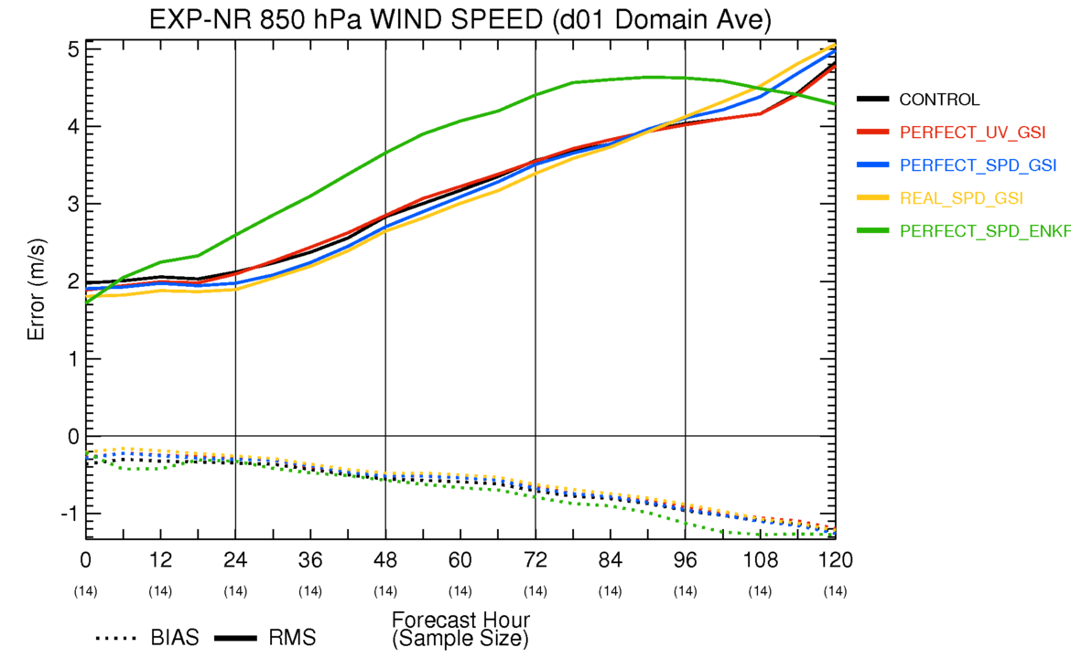
D01 Domain Average (850hPa wind)

Slide 6
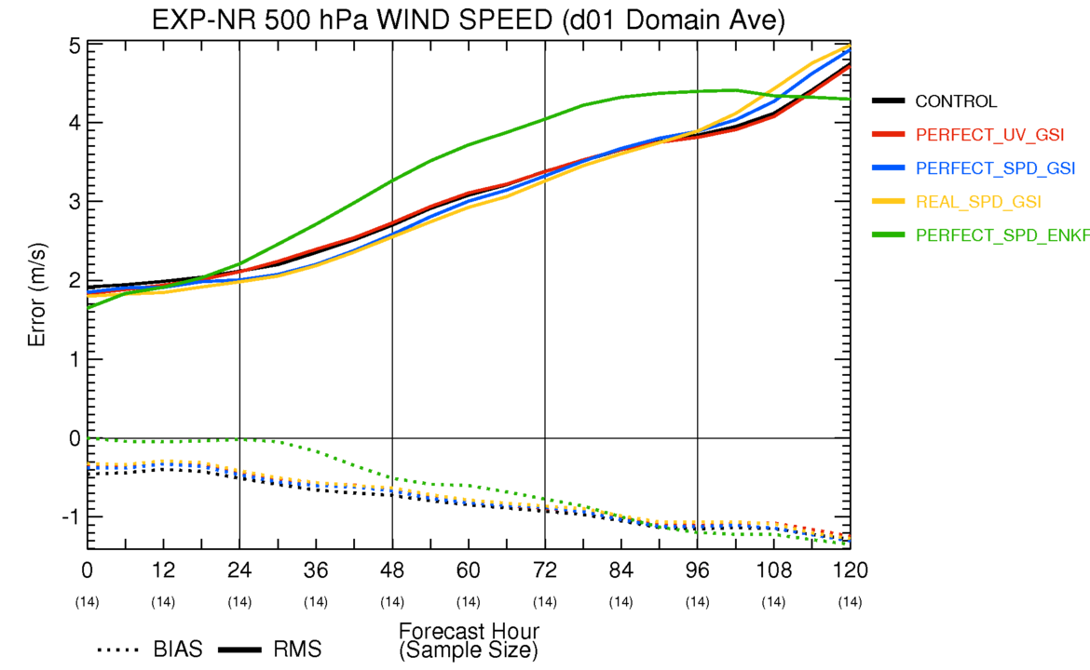
D01 Domain Average (500hPa wind)

Slide 7
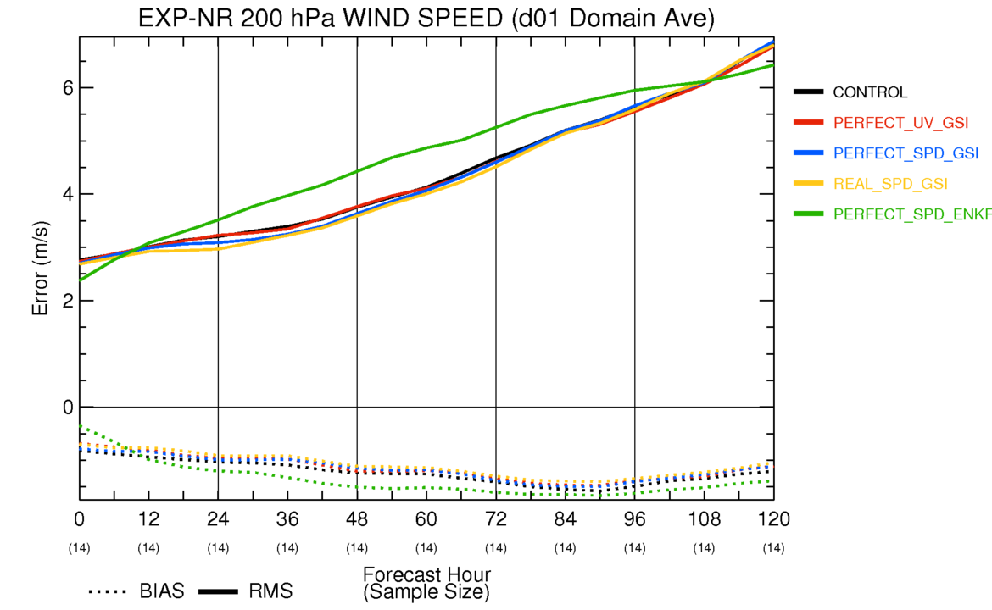
D01 Domain Average (200hPa wind)

Slide 8
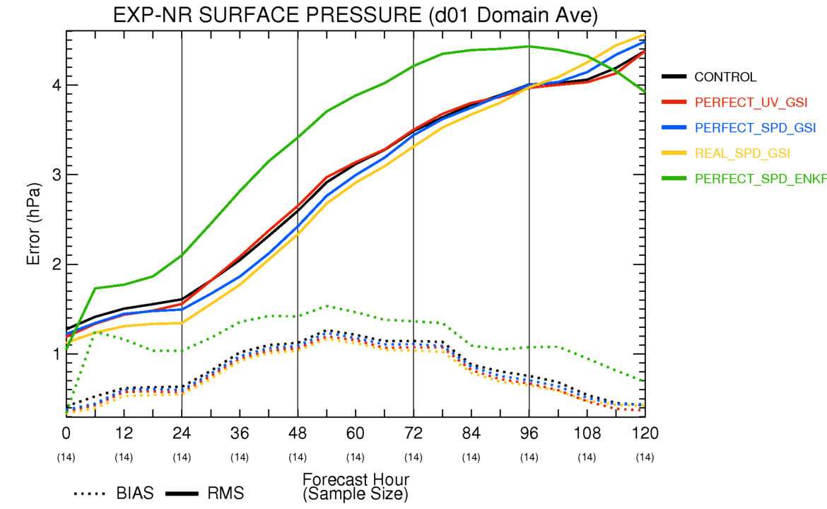
D01 Domain Average (sfc pressure)

Slide 9
Individual Analysis Examples
CYGNSS data over a given 6-hour window are shown for three times with fairly good coverage
6-panel plot of surface wind speed and surface pressure
Nature*, Control, Perfect CYGNSS Vector (GSI), Perfect CYGNSS Speed (GSI), Real CYGNSS Speed (GSI), Perfect CYGNSS Speed (EnKF)
6-panel plot of wind speed and relative humidity vertical cross section taken along computed wind shear vector
Same as above
* Nature is shown from d03 (3km grid spacing).
Others are shown from d02 (2.2km grid spacing).
Domain sizes are ~ 6.5°x6.5° in both cases.

Slide 10
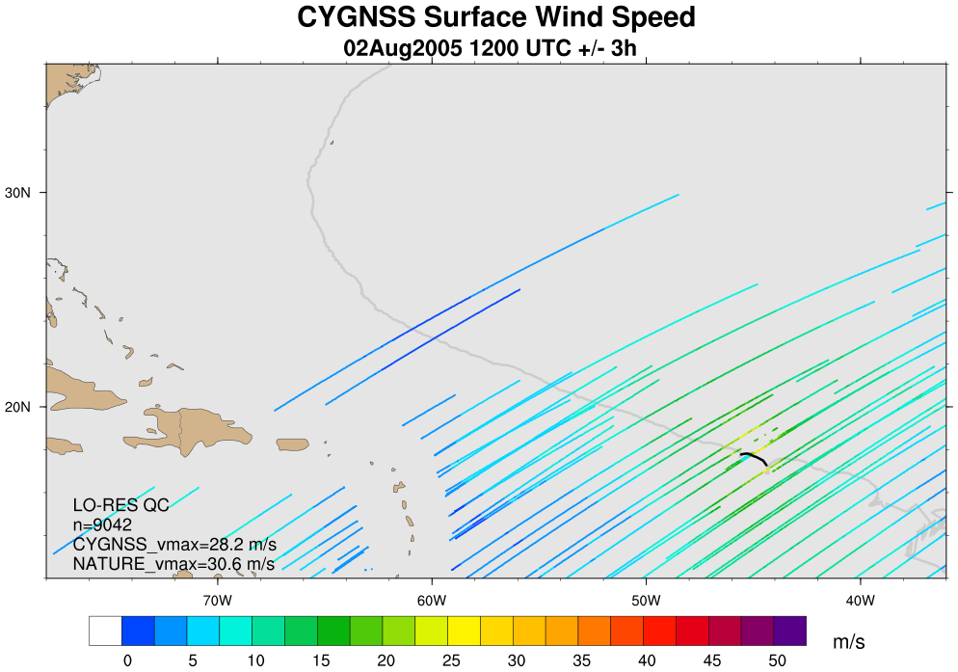
CYGNSS Coverage: 2Aug 12Z (+/-3h)

Slide 11
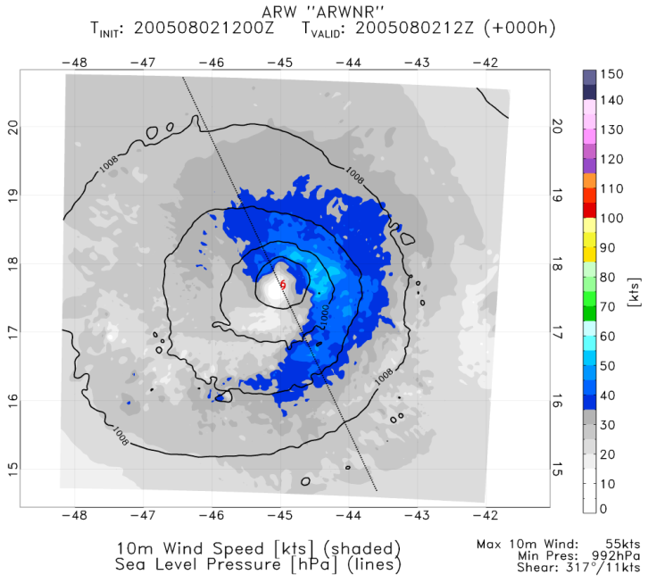
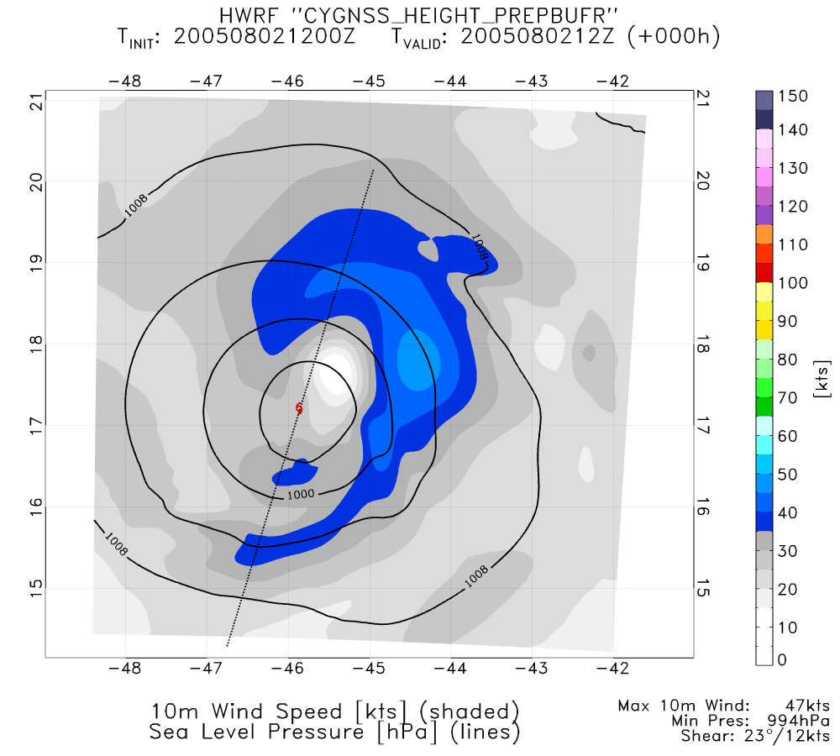
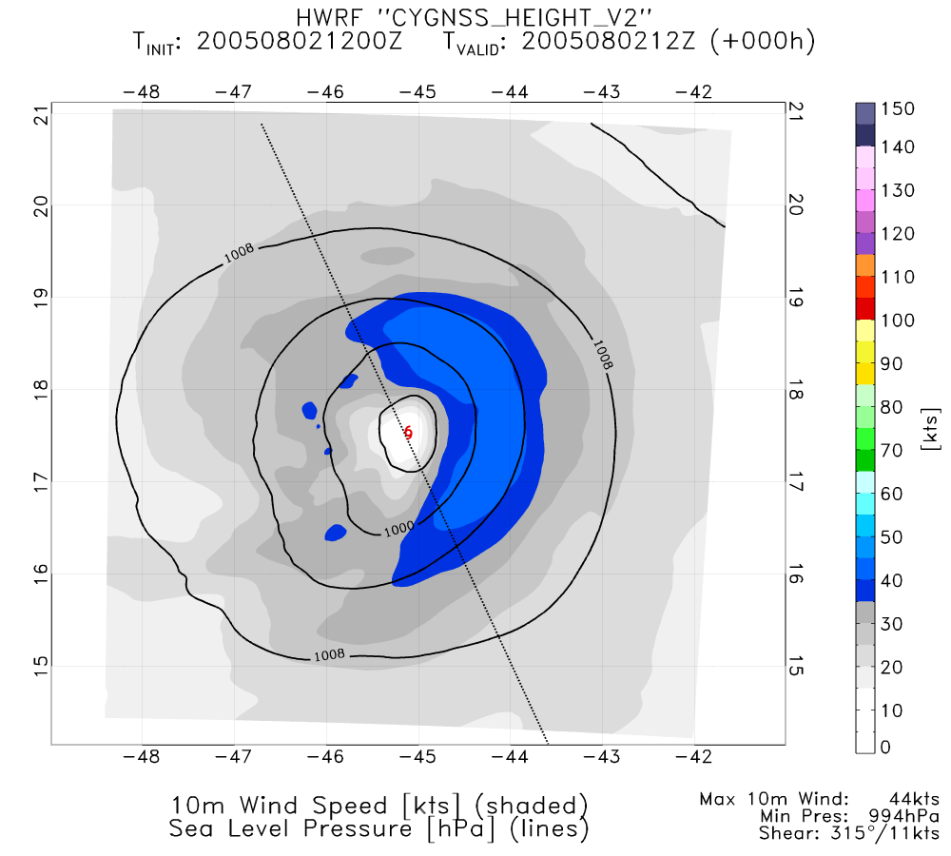
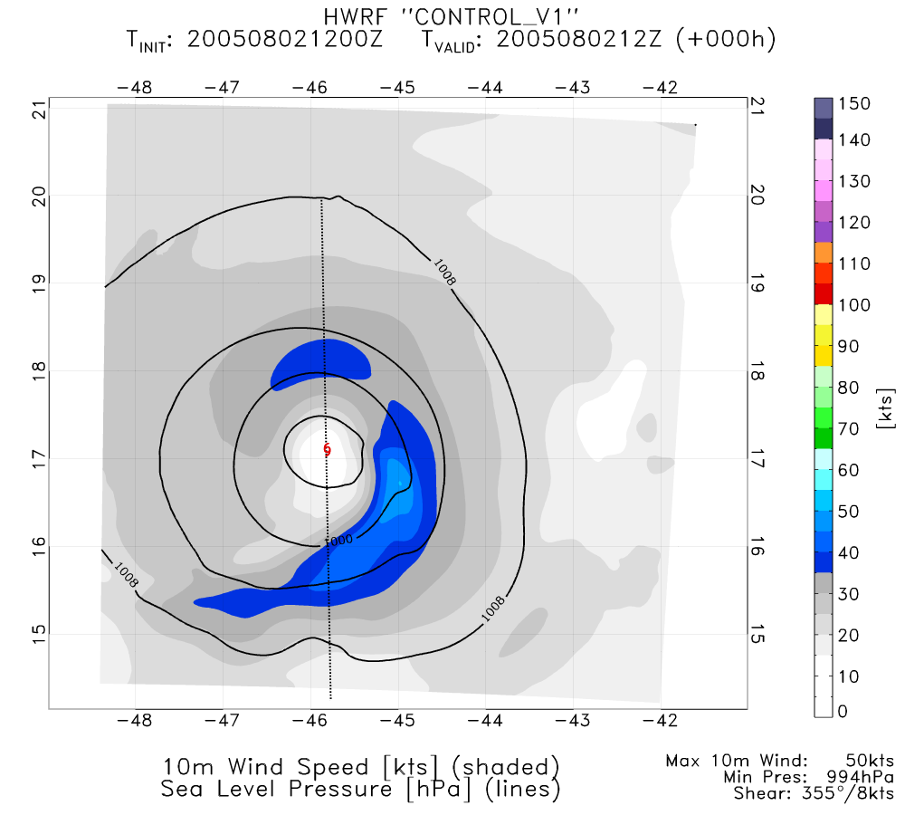
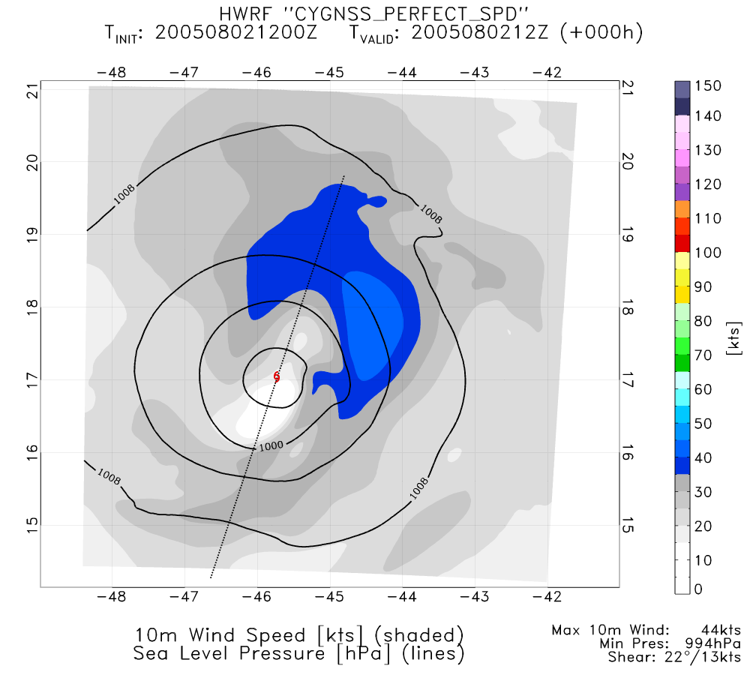
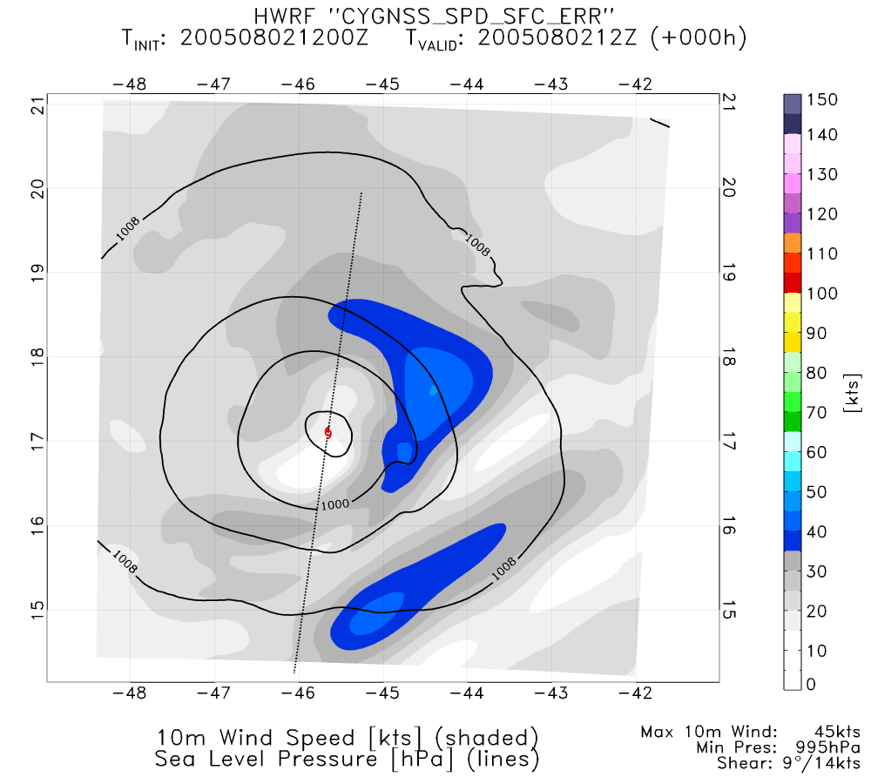
NATURE
PERFECT CYGNSS UV (GSI)
PERFECT CYGNSS SPD (ENKF)
CONTROL
PERFECT CYGNSS SPD (GSI)
REAL CYGNSS SPD (GSI)

Slide 12
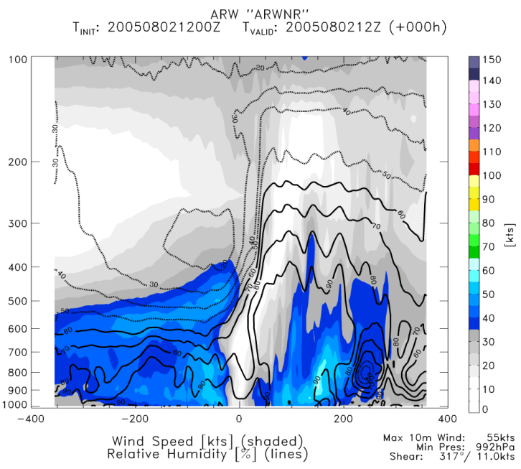
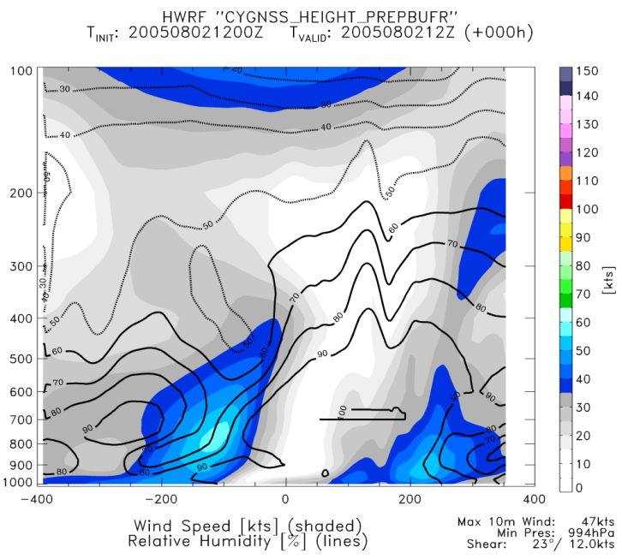
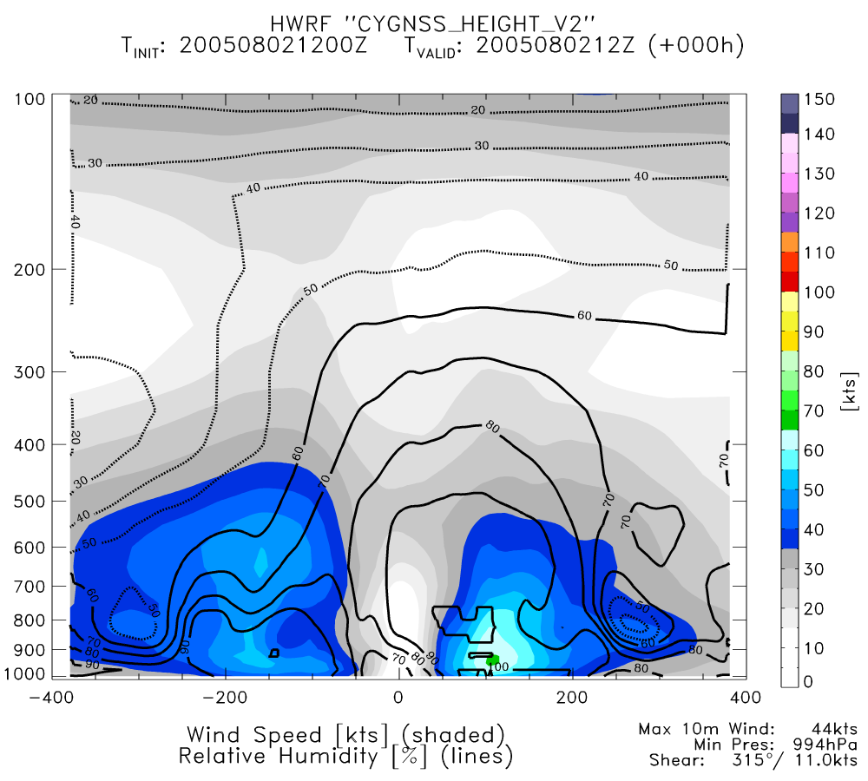
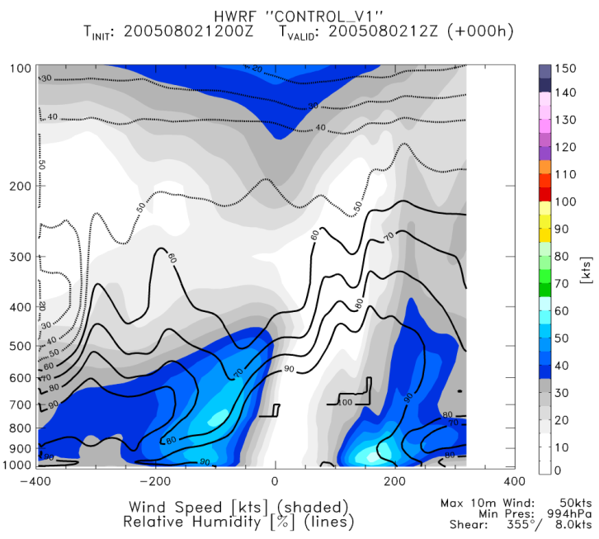
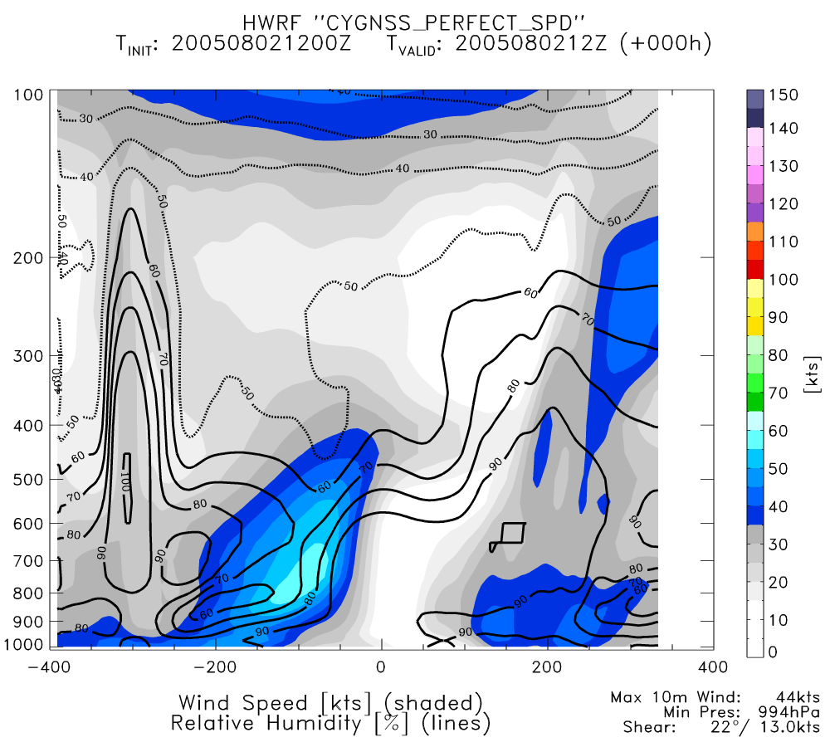
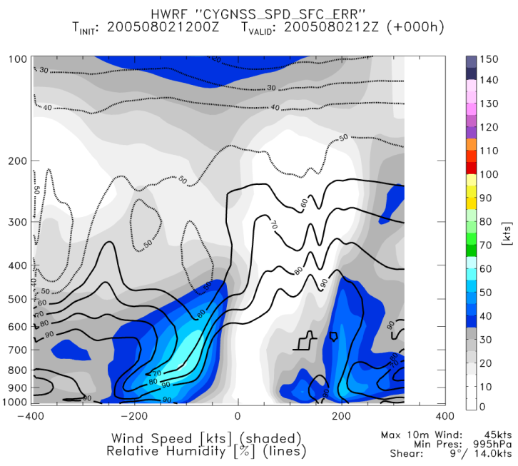
NATURE
PERFECT CYGNSS UV (GSI)
PERFECT CYGNSS SPD (ENKF)
CONTROL
PERFECT CYGNSS SPD (GSI)
REAL CYGNSS SPD (GSI)

Slide 13
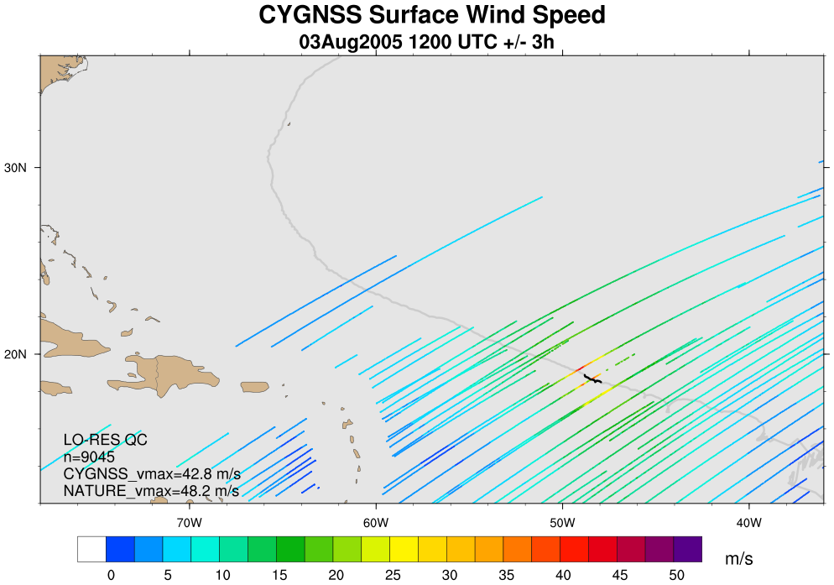
CYGNSS Coverage: 3Aug 12Z (+/- 3h)

Slide 14
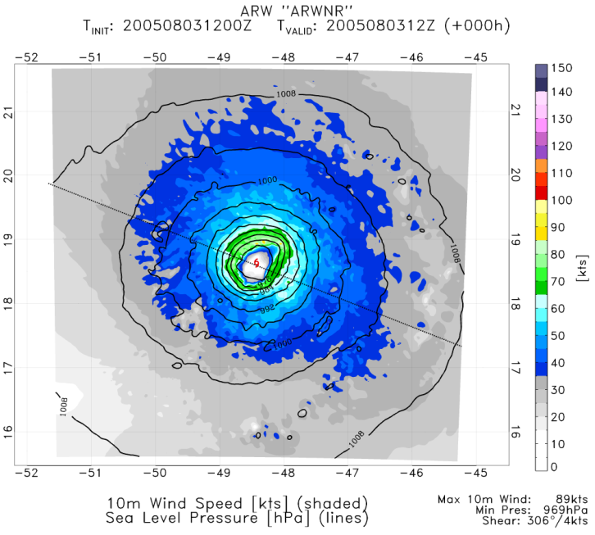
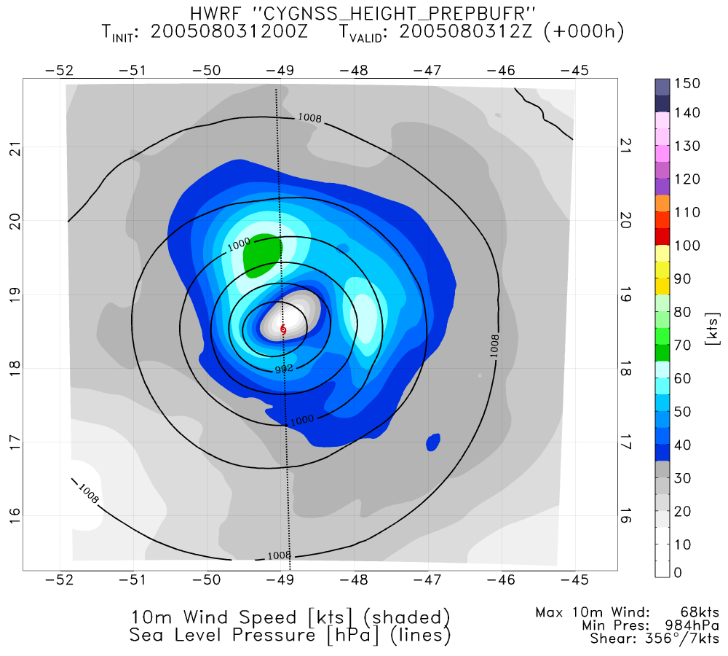
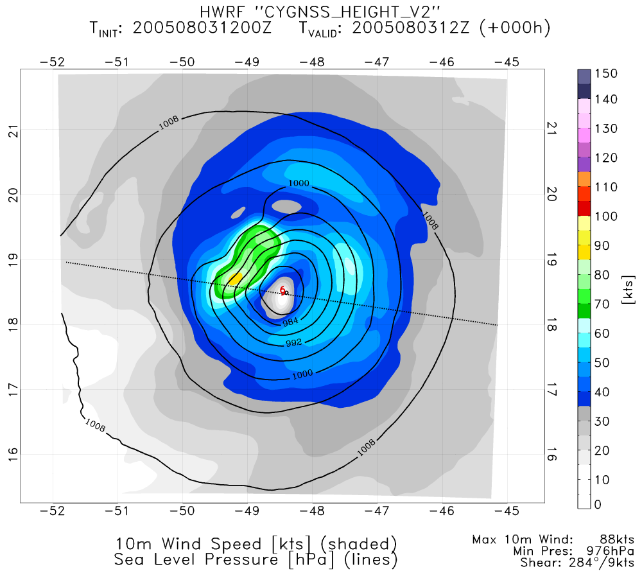
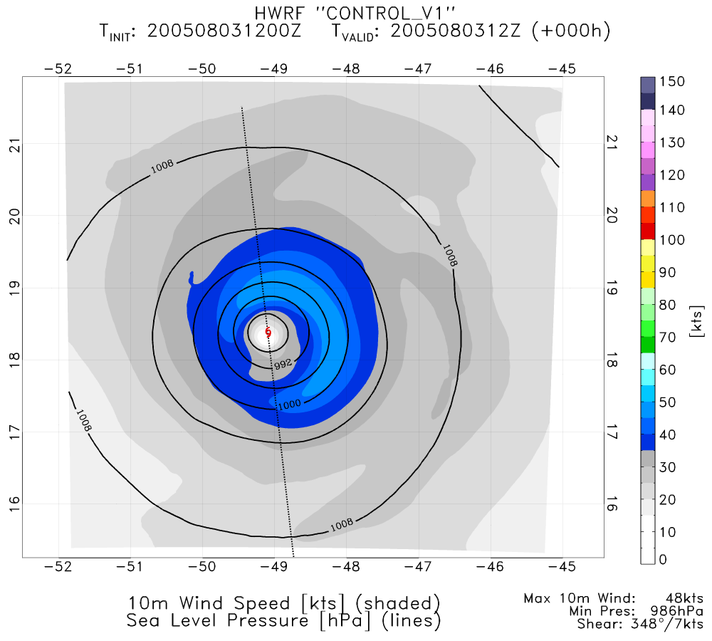
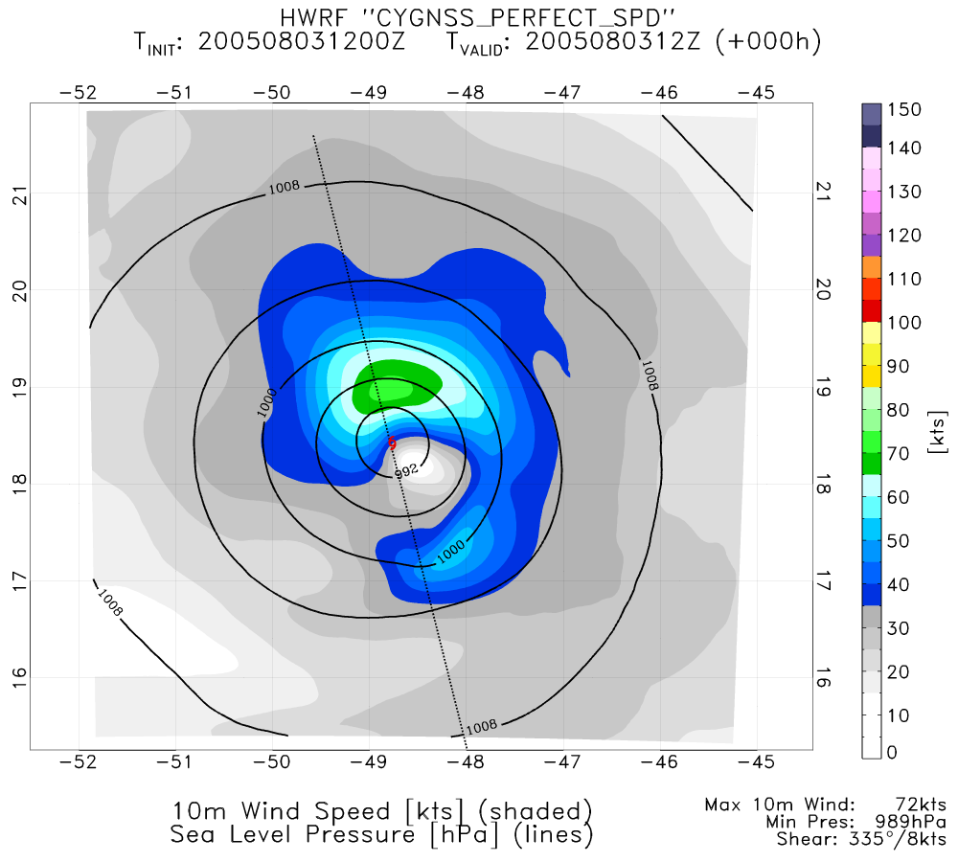
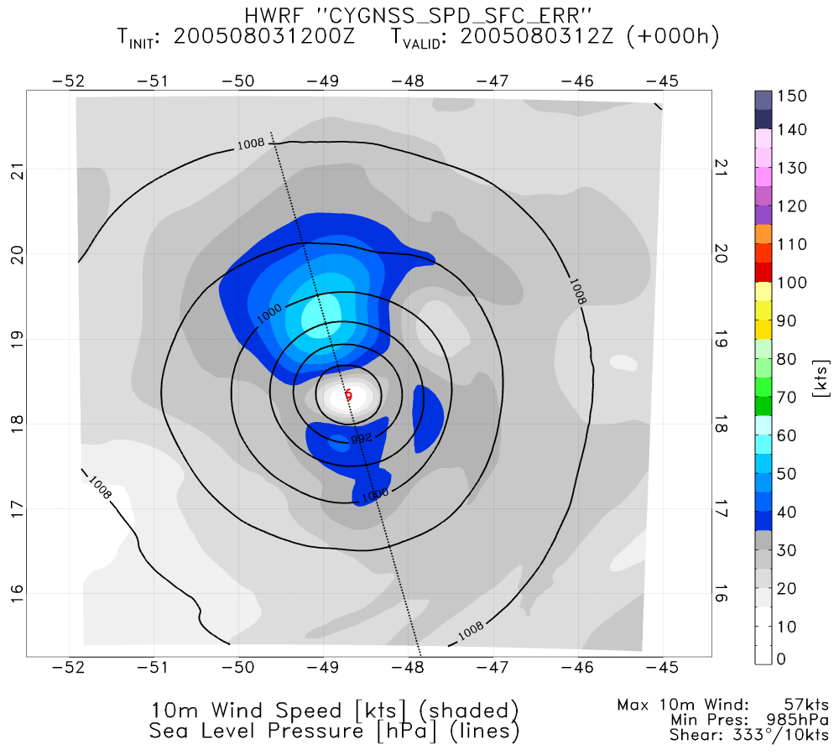
NATURE
PERFECT CYGNSS UV (GSI)
PERFECT CYGNSS SPD (ENKF)
CONTROL
PERFECT CYGNSS SPD (GSI)
REAL CYGNSS SPD (GSI)

Slide 15
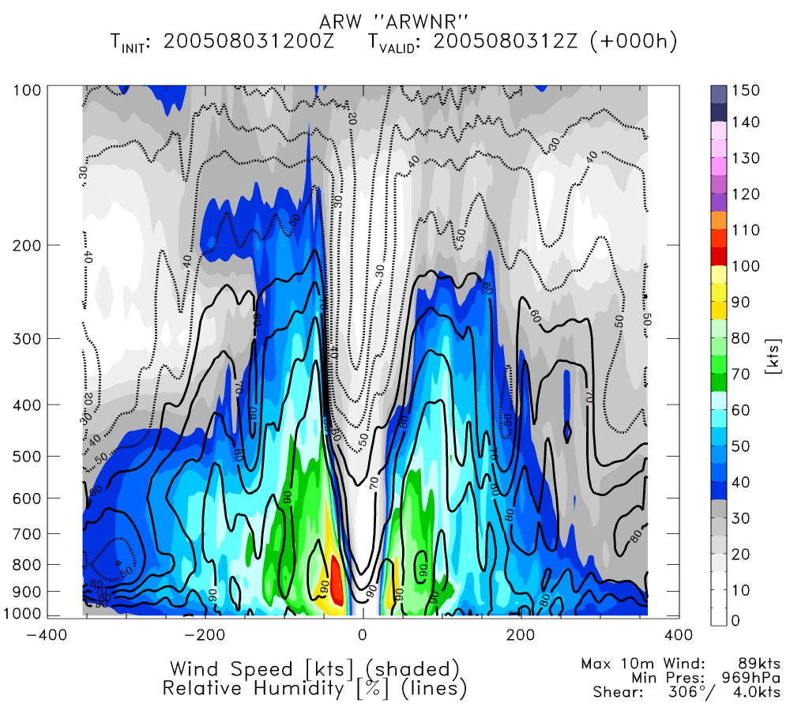
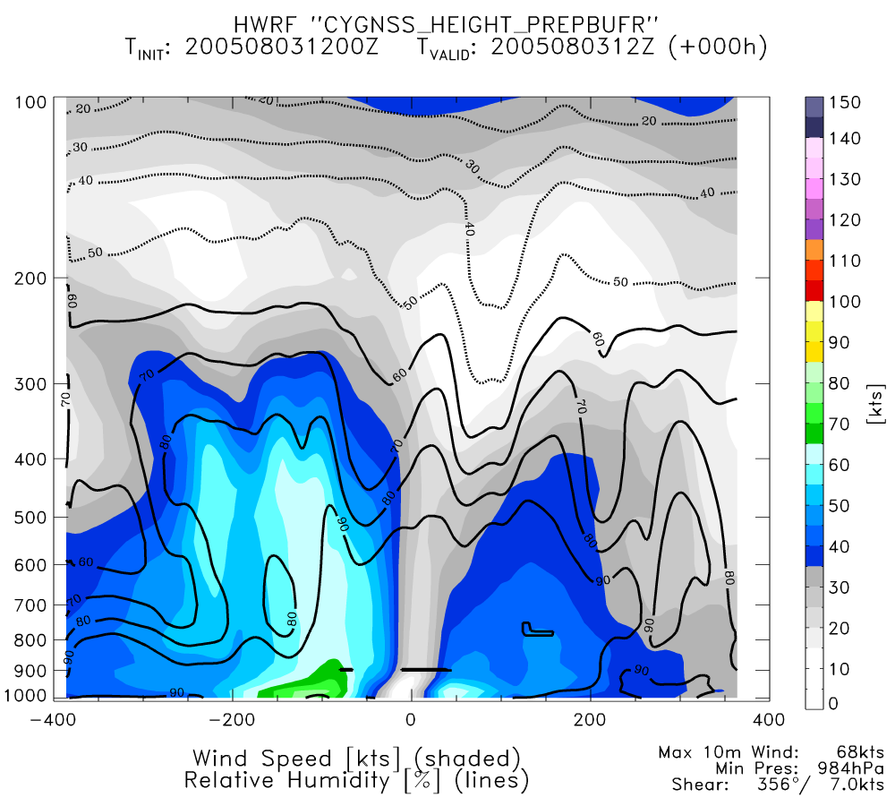
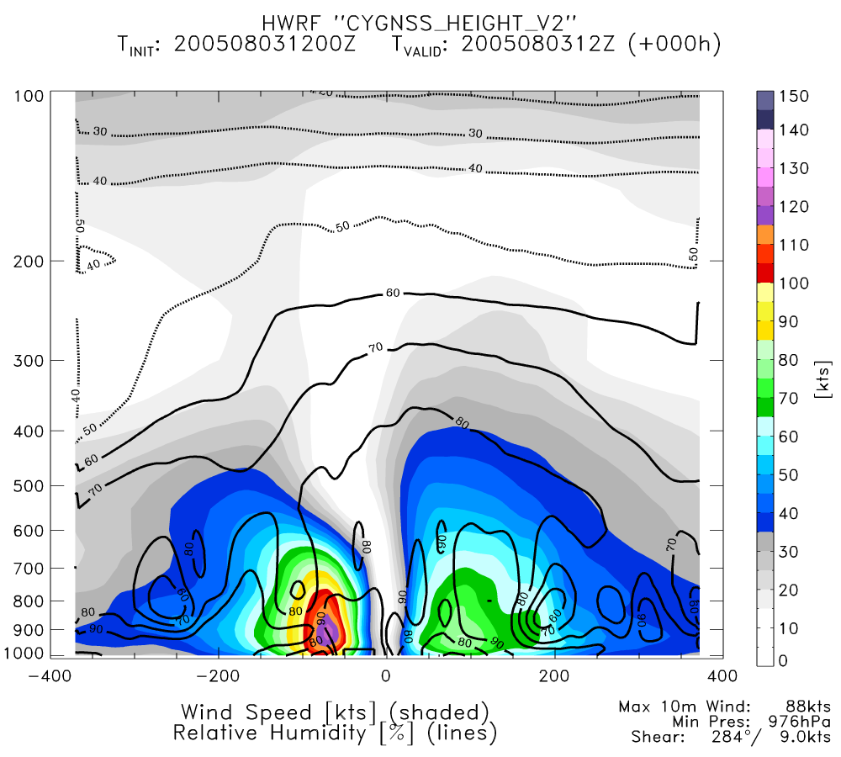
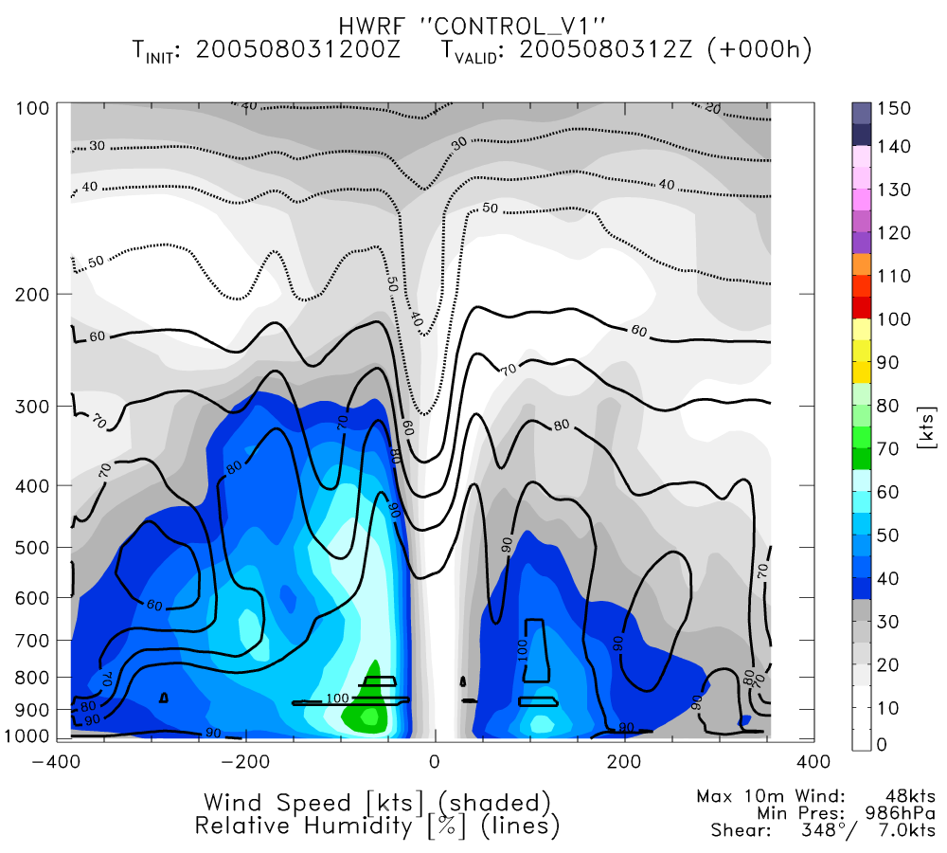
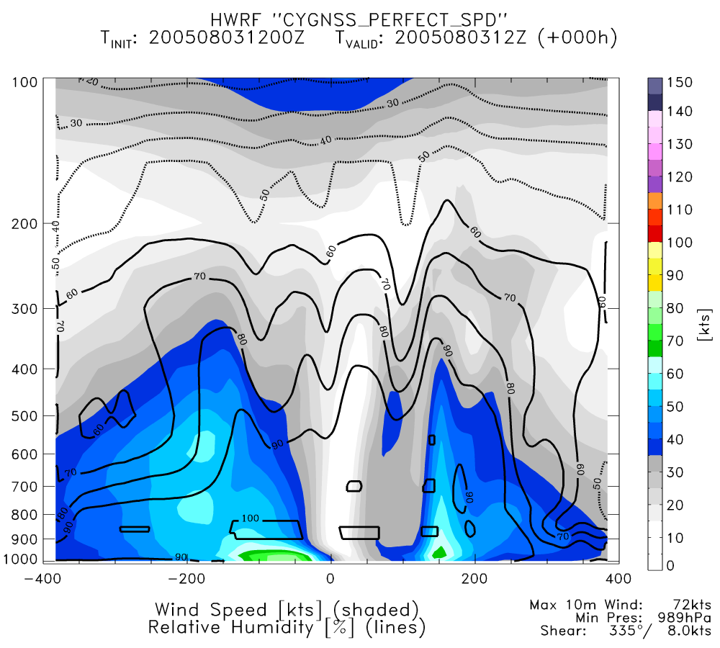
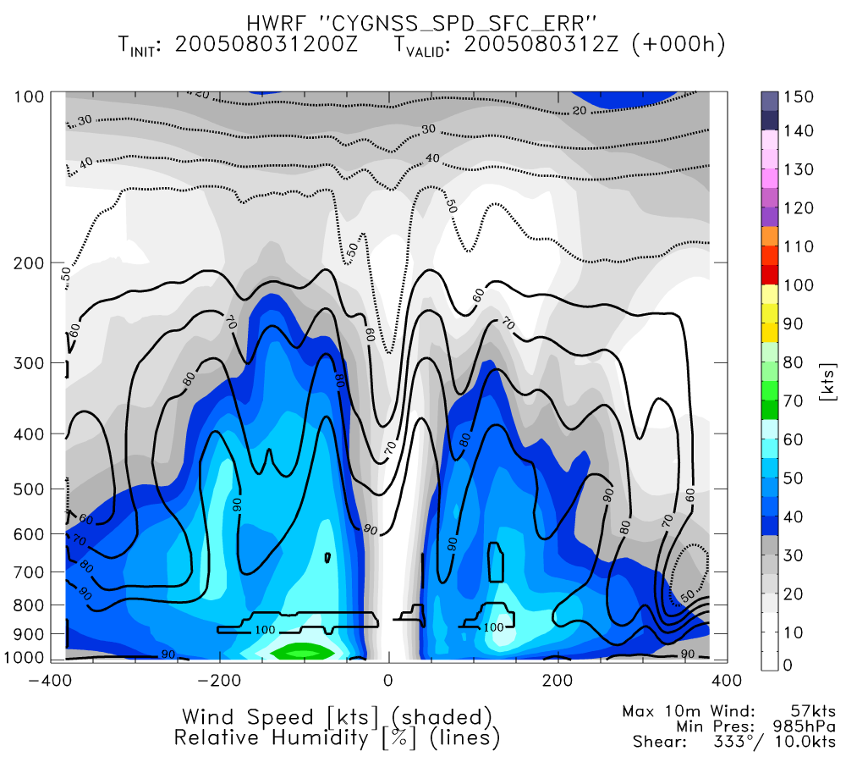
NATURE
PERFECT CYGNSS UV (GSI)
PERFECT CYGNSS SPD (ENKF)
CONTROL
PERFECT CYGNSS SPD (GSI)
REAL CYGNSS SPD (GSI)

Slide 16
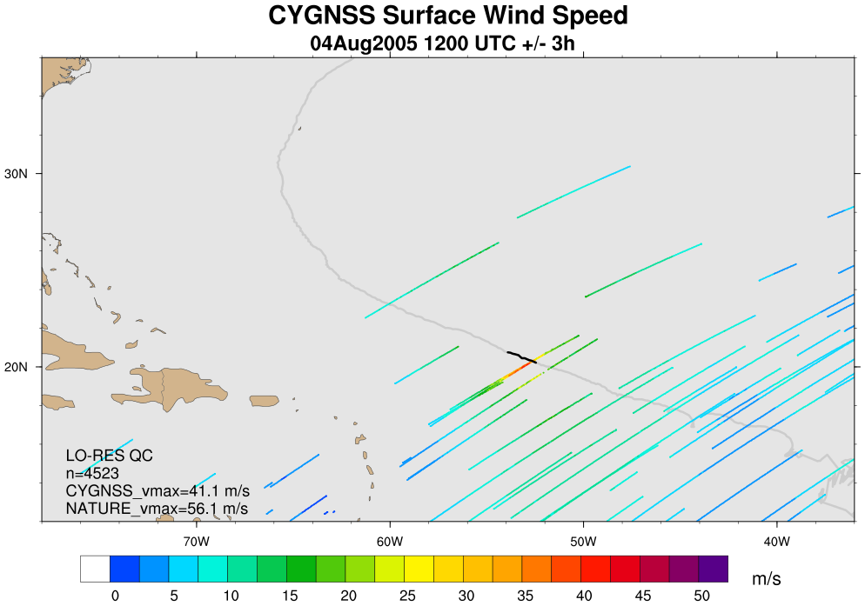
CYGNSS Coverage: 4Aug 12Z (+/- 3h)

Slide 17
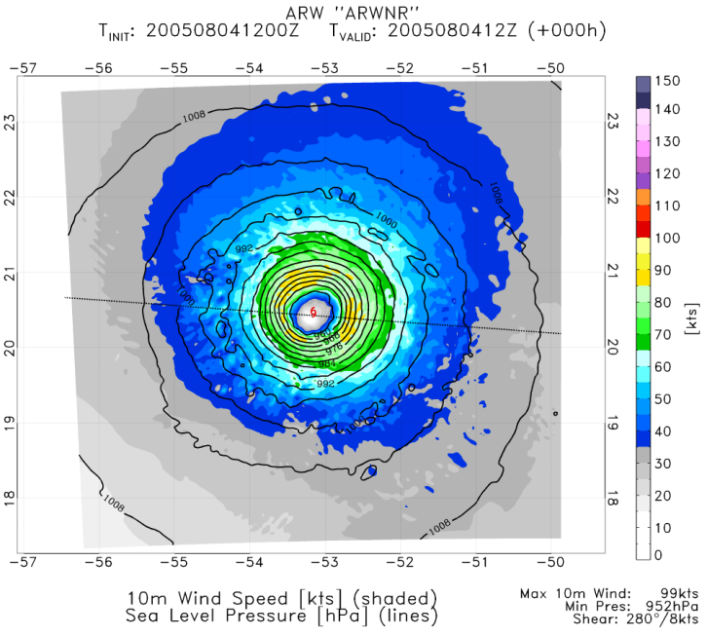
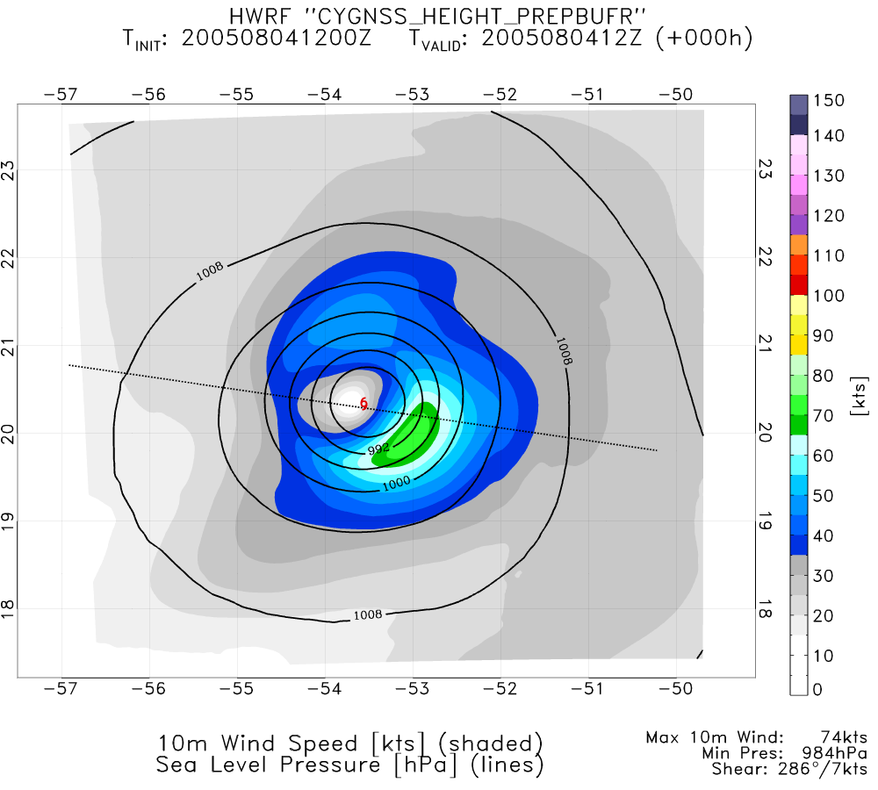
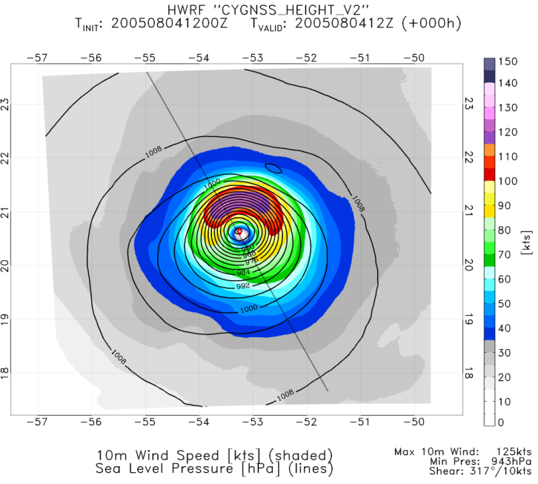
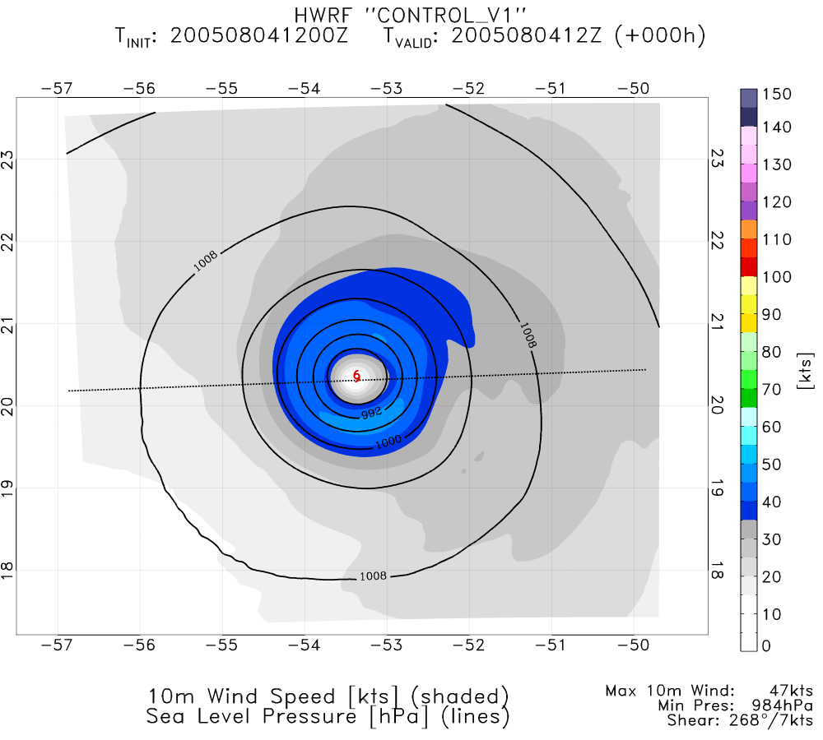
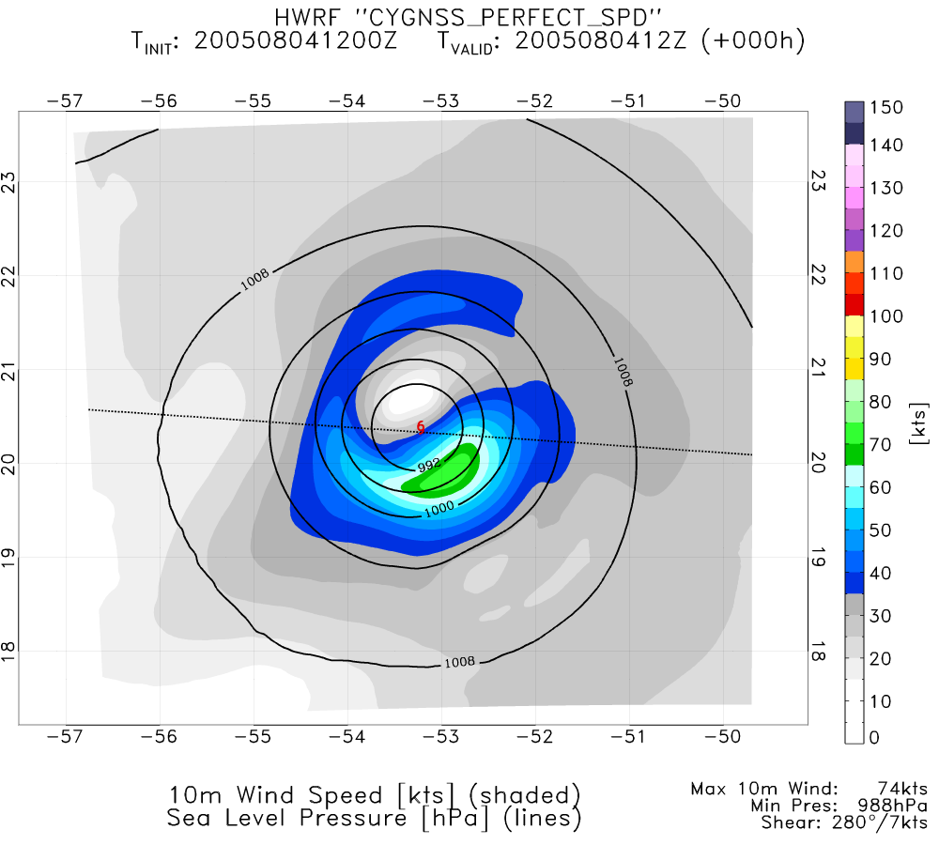
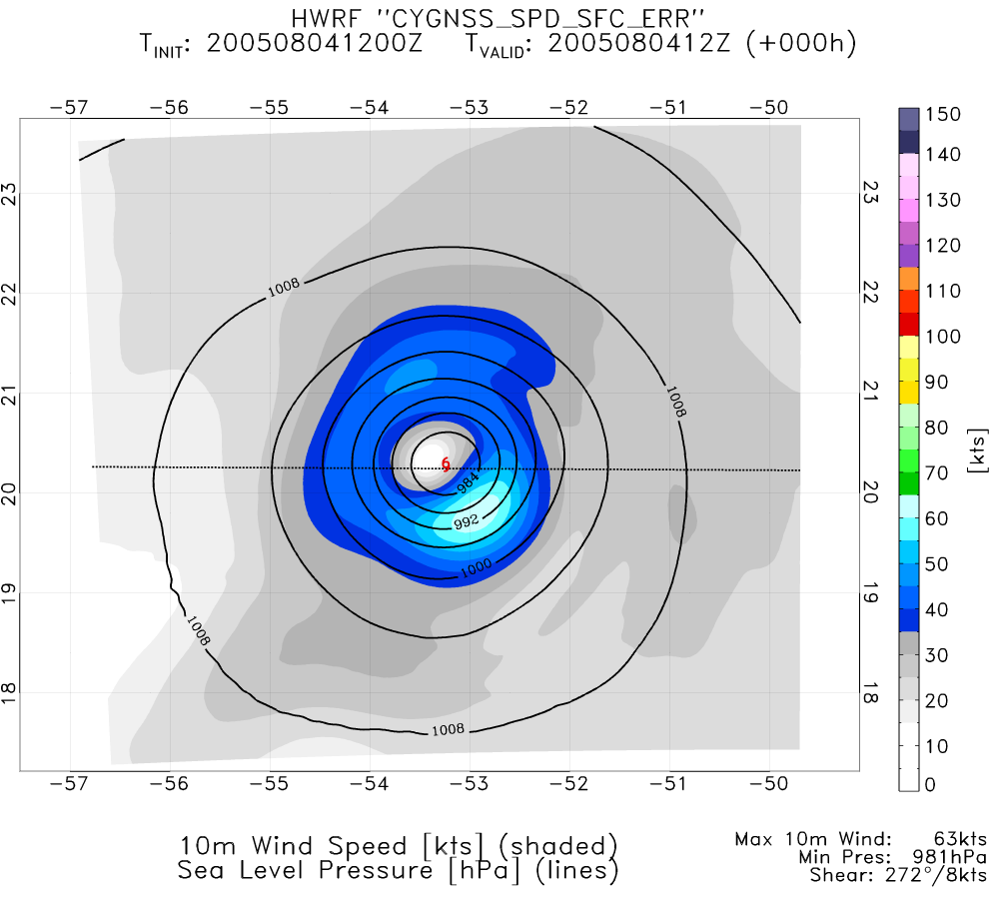
NATURE
PERFECT CYGNSS UV (GSI)
PERFECT CYGNSS SPD (ENKF)
CONTROL
PERFECT CYGNSS SPD (GSI)
REAL CYGNSS SPD (GSI)

Slide 18
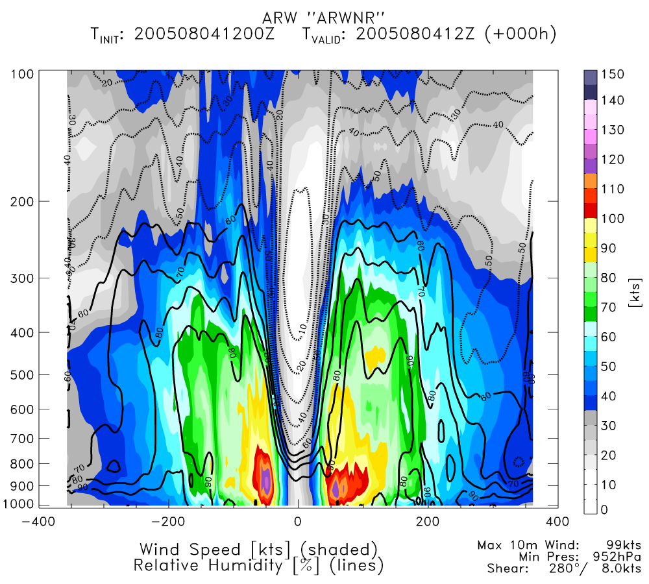
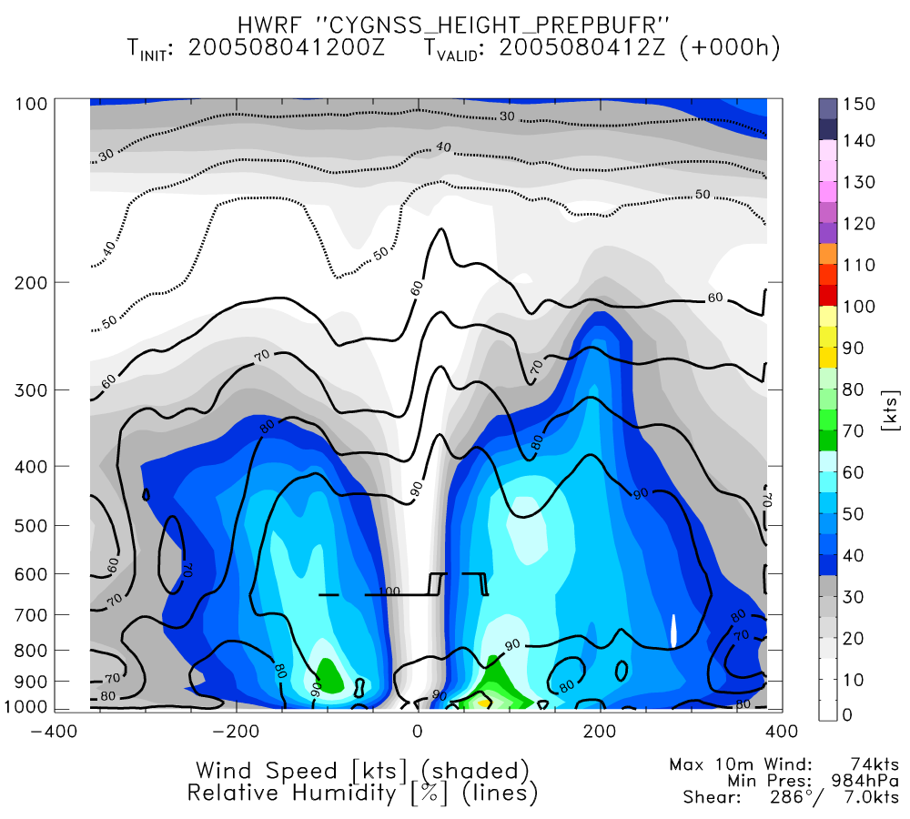
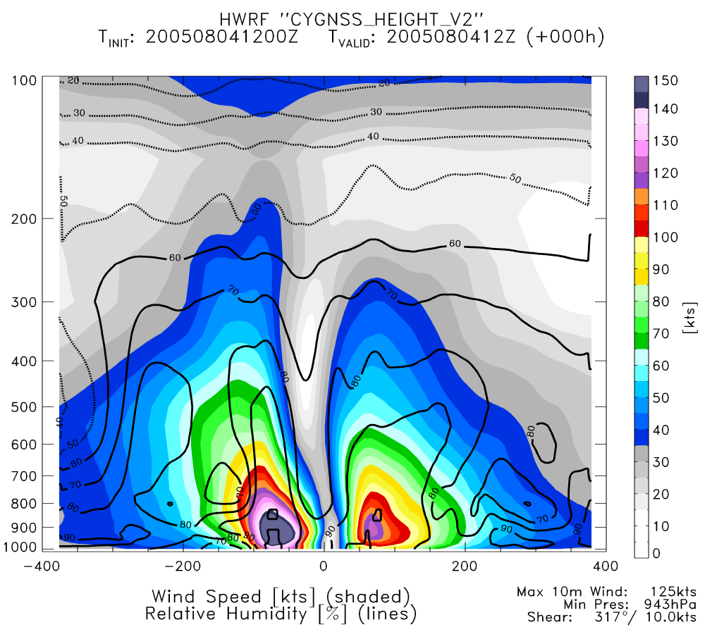
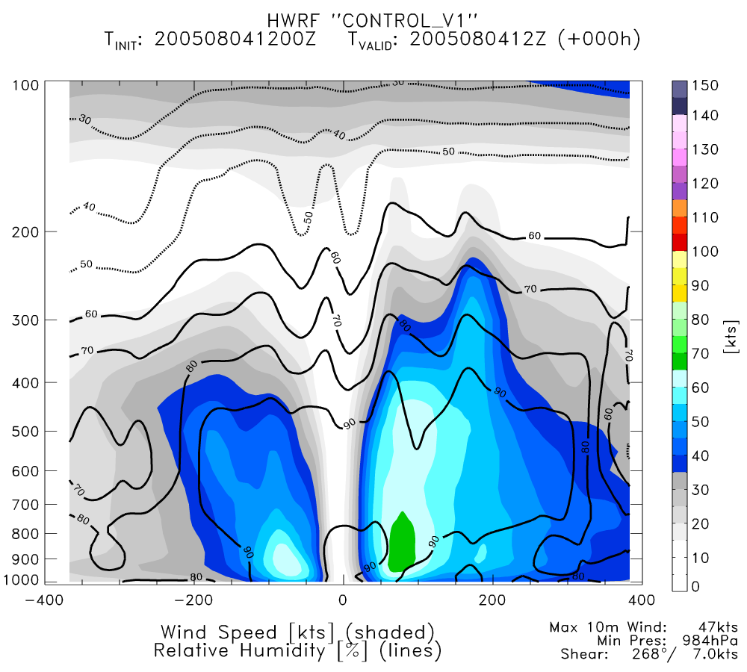
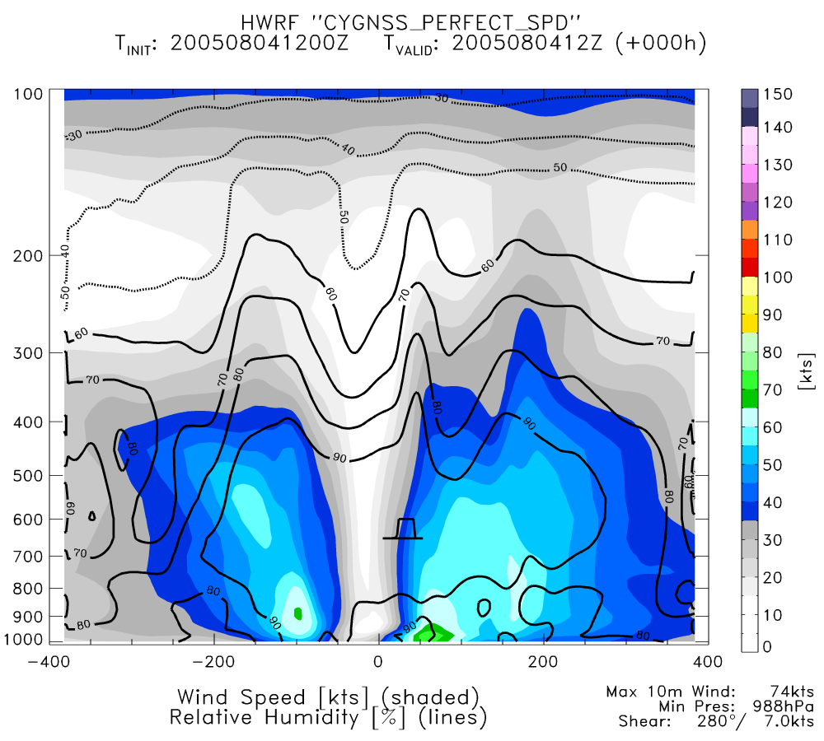
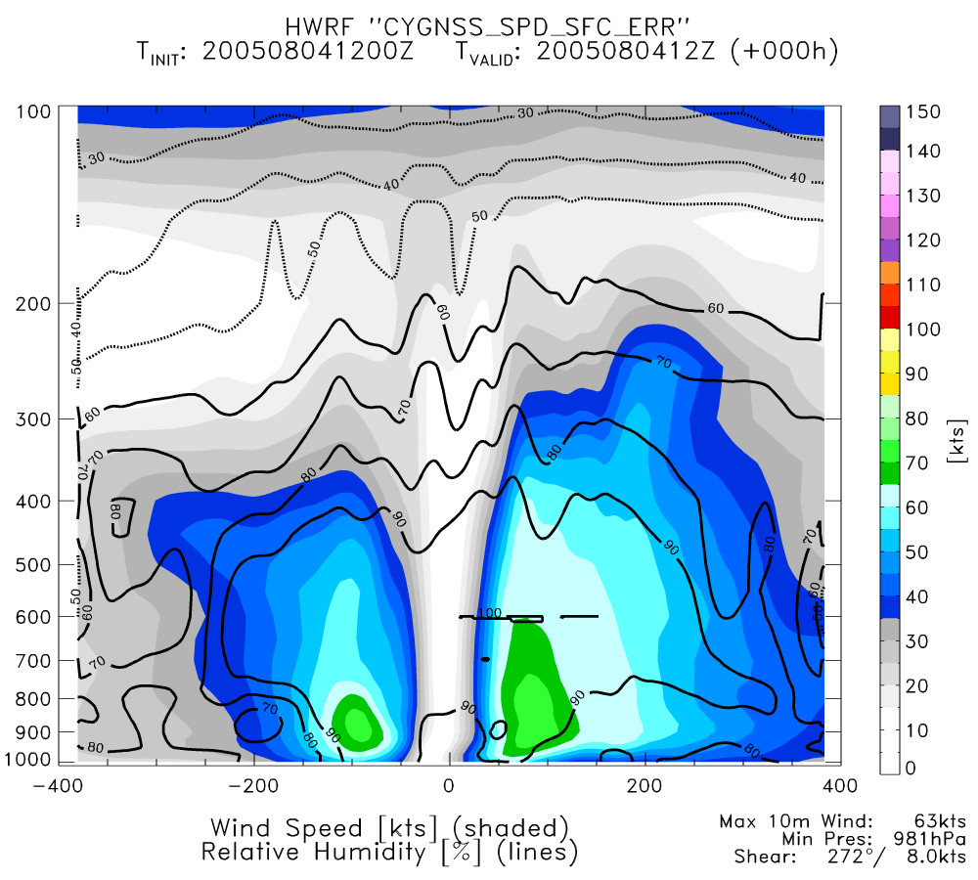
NATURE
PERFECT CYGNSS UV (GSI)
PERFECT CYGNSS SPD (ENKF)
CONTROL
PERFECT CYGNSS SPD (GSI)
REAL CYGNSS SPD (GSI)

Slide 19
Average of Storm Statistics

Slide 20
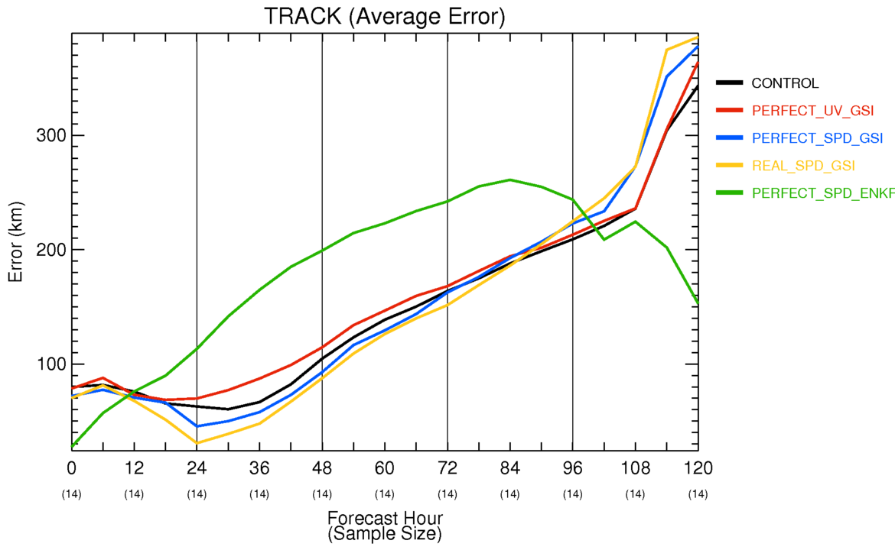

Slide 21
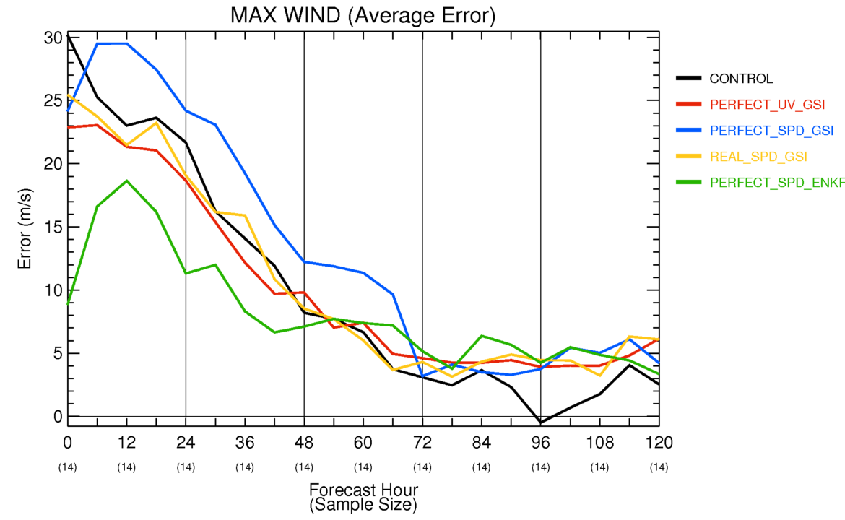

Slide 22
