Slide 1
Preliminary CYGNSS Results
OSSE Team Meeting
September 23, 2014

Slide 2
Large-scale Domain Average
Averaging fields over all of d01 for various experiments and comparing to nature run
“CONTROL” (no CYGNSS data)
“NR_PERF”: Wind vectors are created from nature run at CYGNSS coordinates (GSI)
“ENKF_PERF”: Wind vectors are created from nature run at CYGNSS coordinates (ENKF)
“SPD_L1_ERR”: CYGNSS wind speeds with realistic errors are assimilated, pressure assigned is from lowest model level in HWRF.
“SPD_SFC_ERR”: CYGNSS wind speeds with realistic errors are assimilated, pressure assigned is from surface pressure field in HWRF.

Slide 3
D01 Domain Average (10m wind)

Slide 4
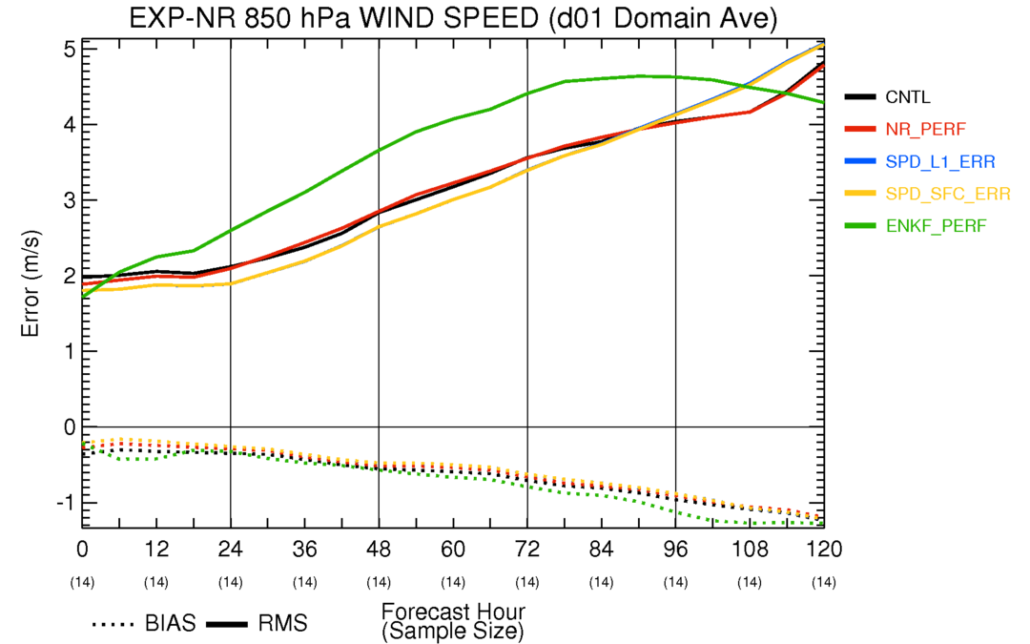
D01 Domain Average (850hPa wind)

Slide 5
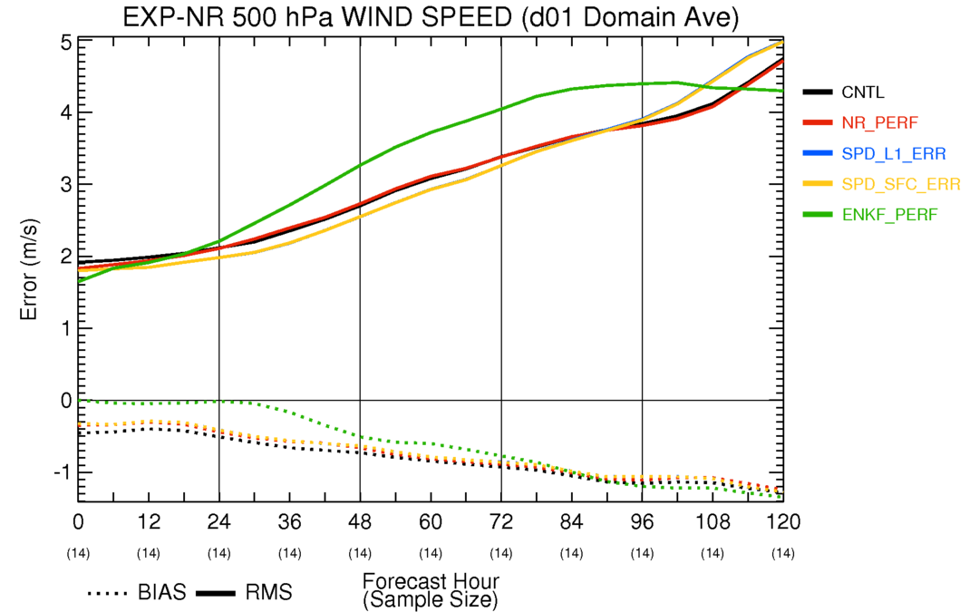
D01 Domain Average (500hPa wind)

Slide 6
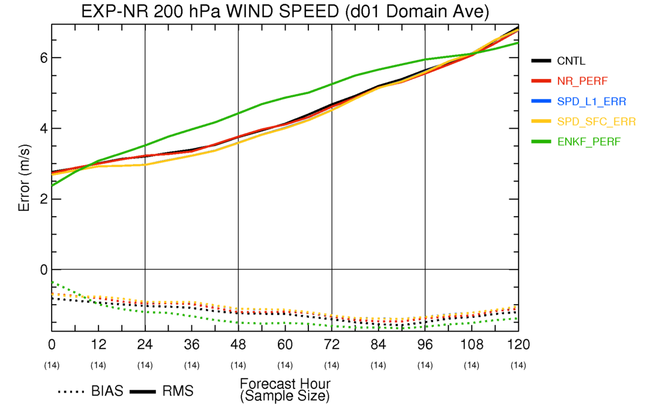
D01 Domain Average (200hPa wind)

Slide 7
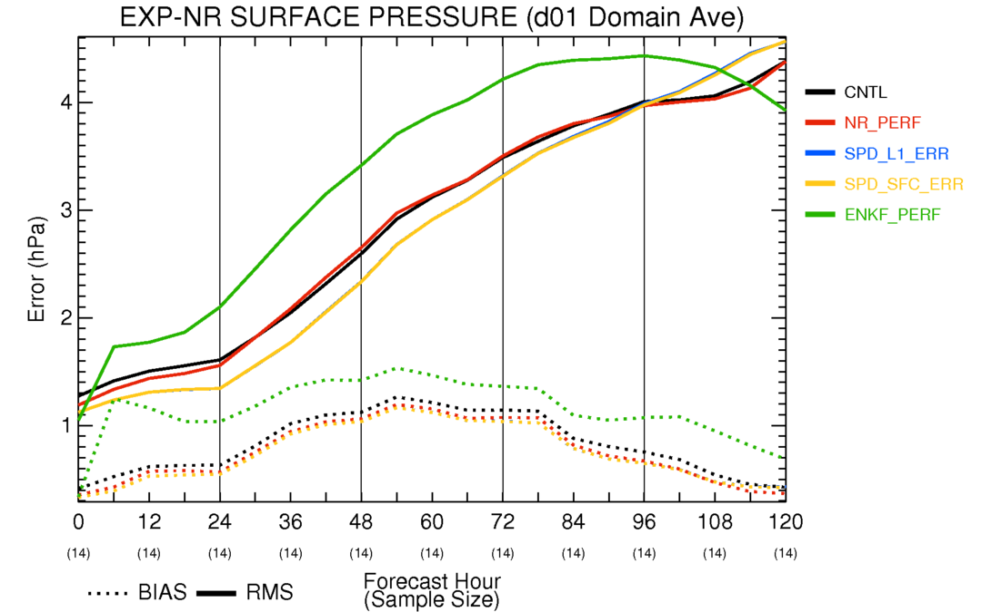
D01 Domain Average (sfc pressure)

Slide 8
Individual Analyses
CYGNSS data over a given 6-hour window are shown for three times with fairly good coverage
4-panel plot of surface wind speed and surface pressure
Nature, Control, Perfect CYGNSS, Real CYGNSS
4-panel plot of wind speed and relative humidity vertical cross section taken along computed shear vector
Nature, Control, Perfect CYGNSS, Real CYGNSS

Slide 9
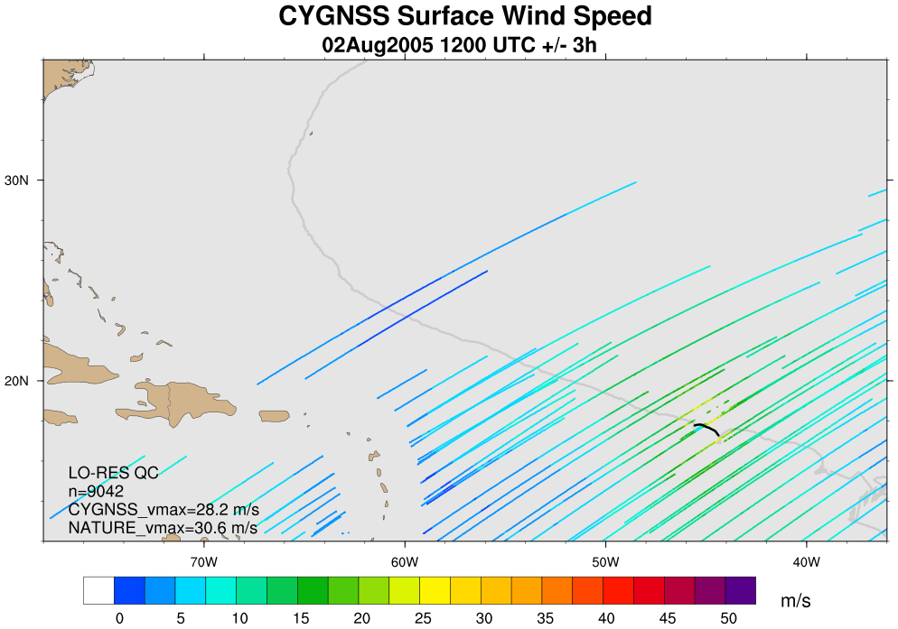
CYGNSS Coverage: 2Aug 12Z (+/-3h)

Slide 10
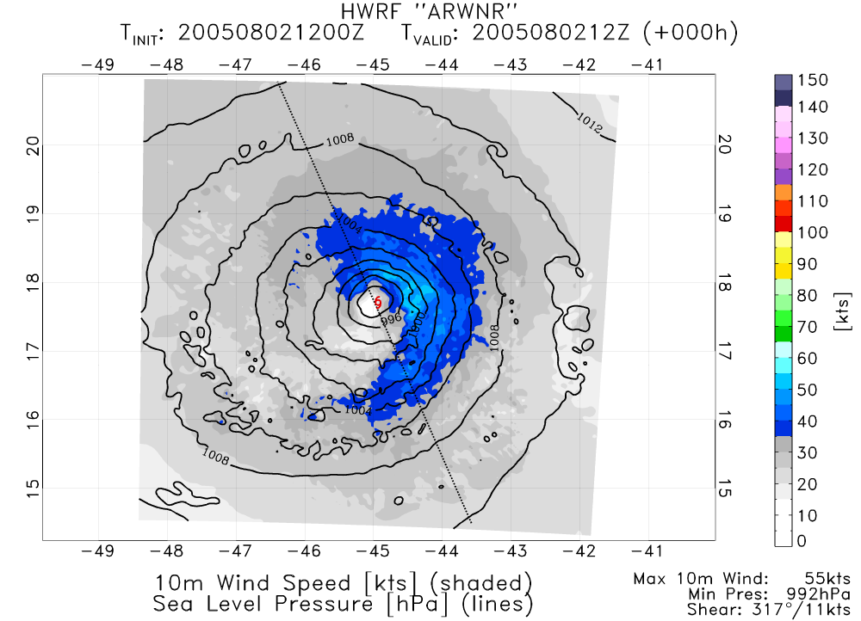
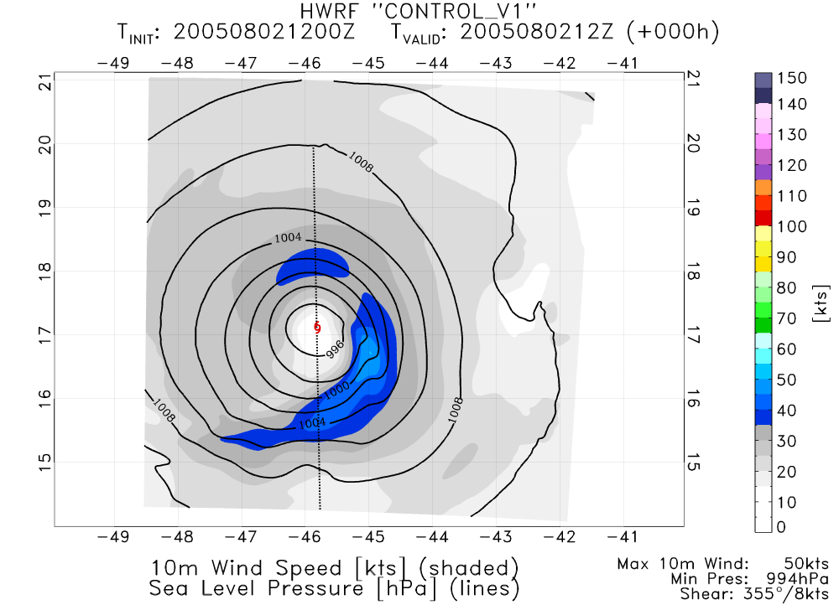
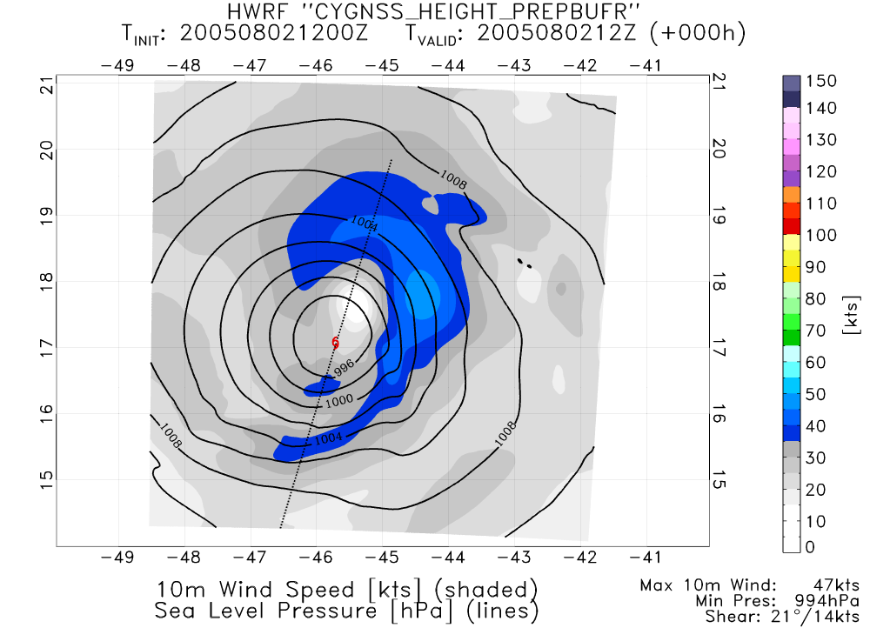
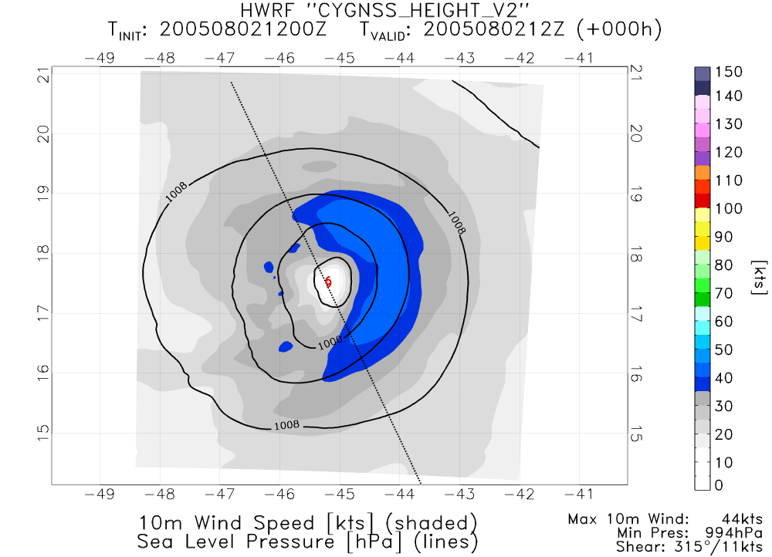
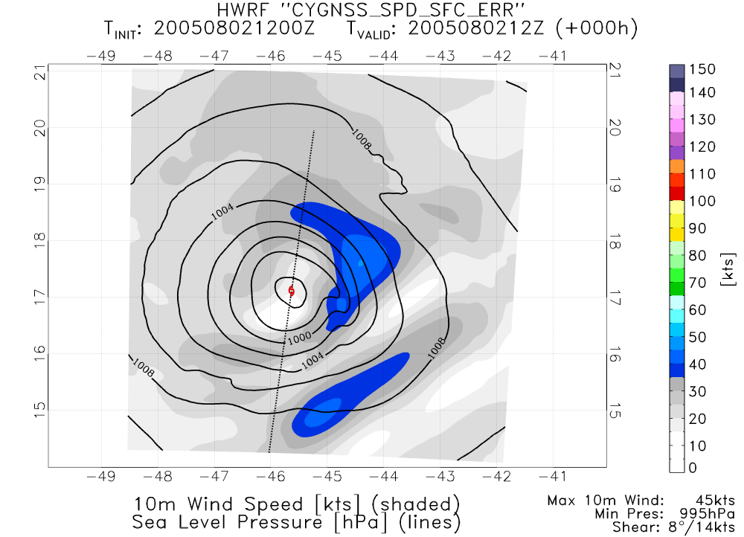
NATURE
CONTROL
PERFECT CYGNSS GSI
PERFECT CYGNSS ENKF
REAL CYGNSS GSI

Slide 11
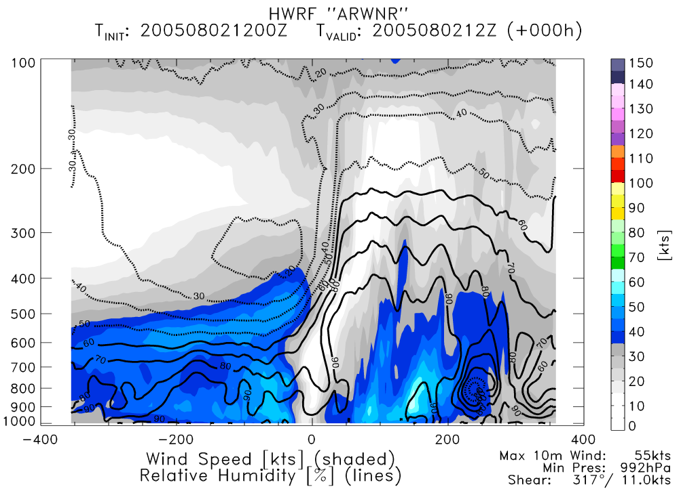
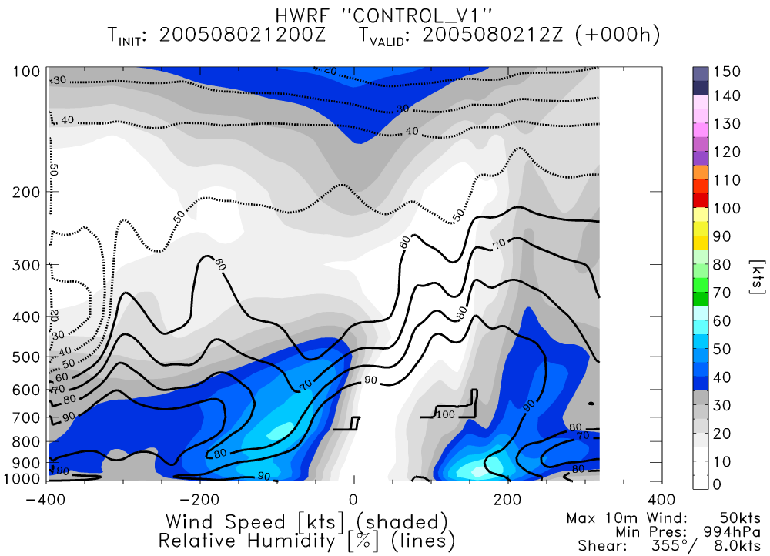
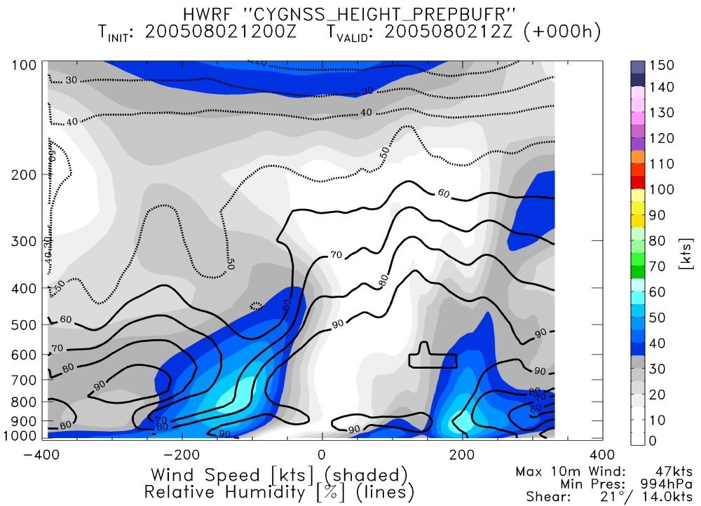
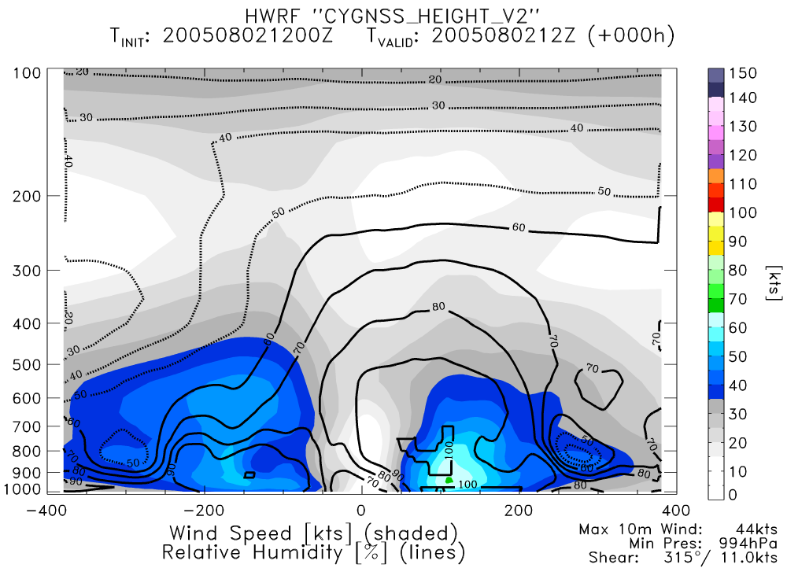
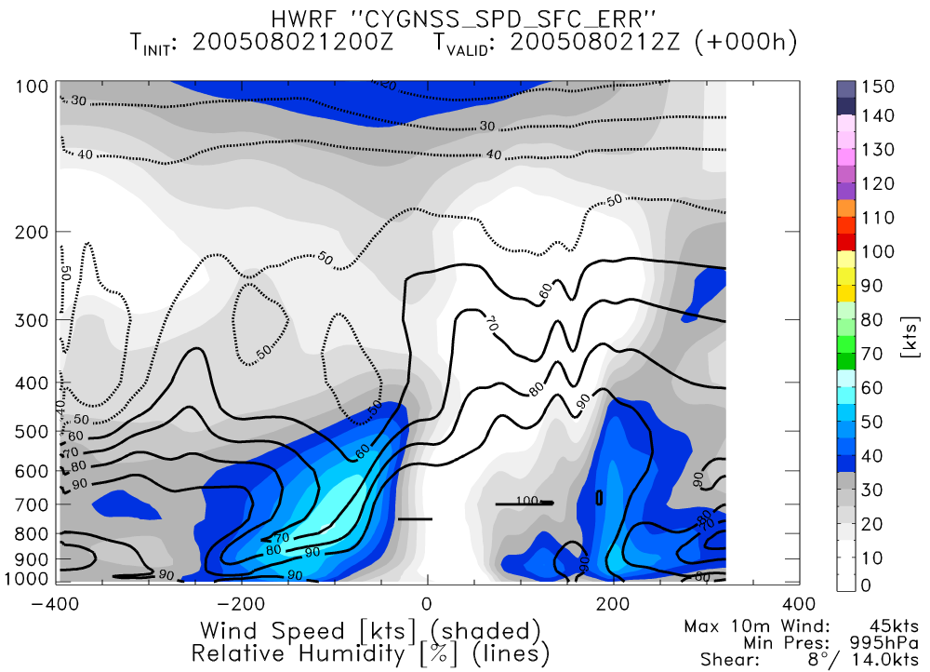
NATURE
CONTROL
PERFECT CYGNSS GSI
PERFECT CYGNSS ENKF
REAL CYGNSS GSI

Slide 12
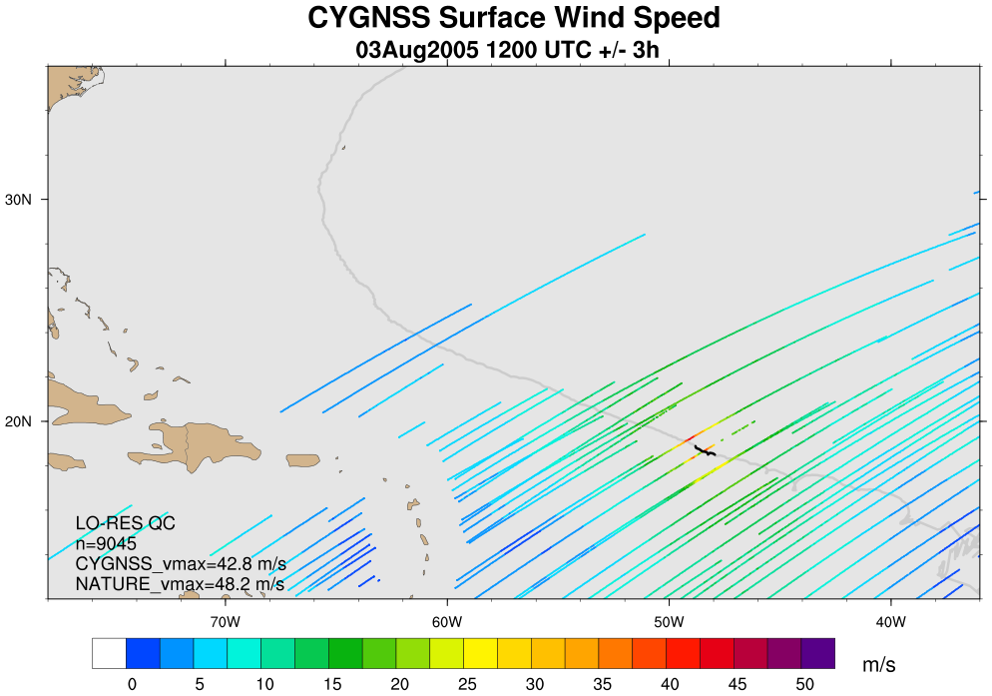
CYGNSS Coverage: 3Aug 12Z (+/- 3h)

Slide 13
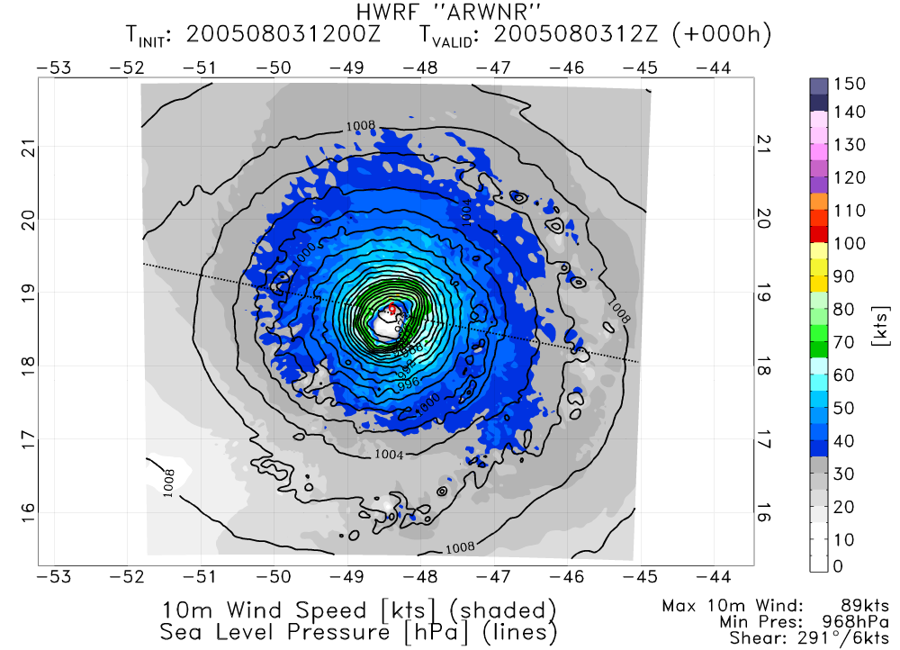
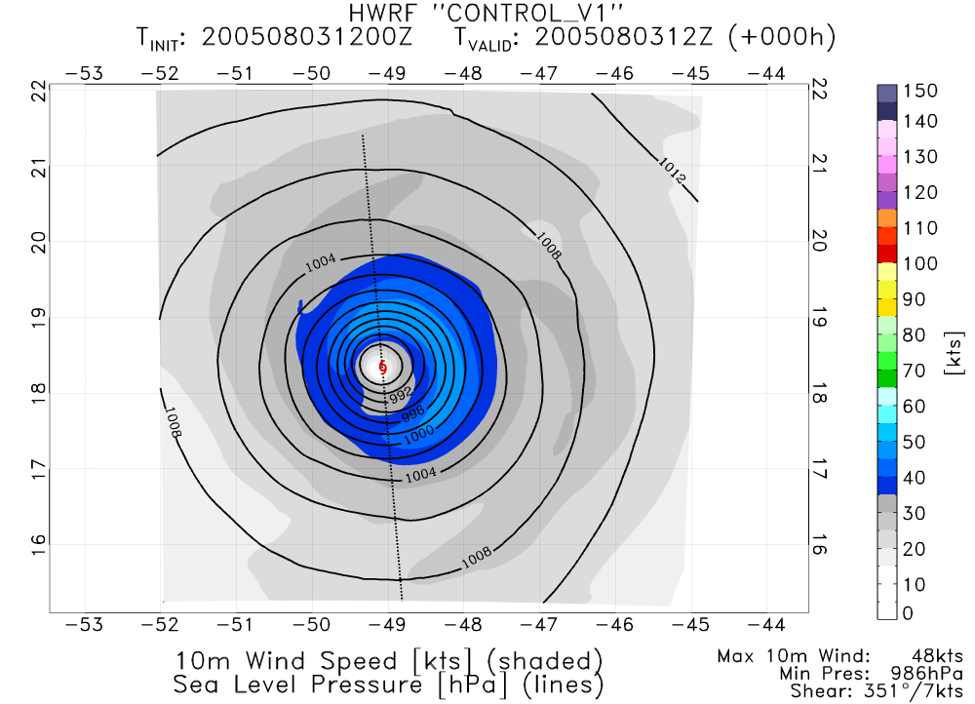
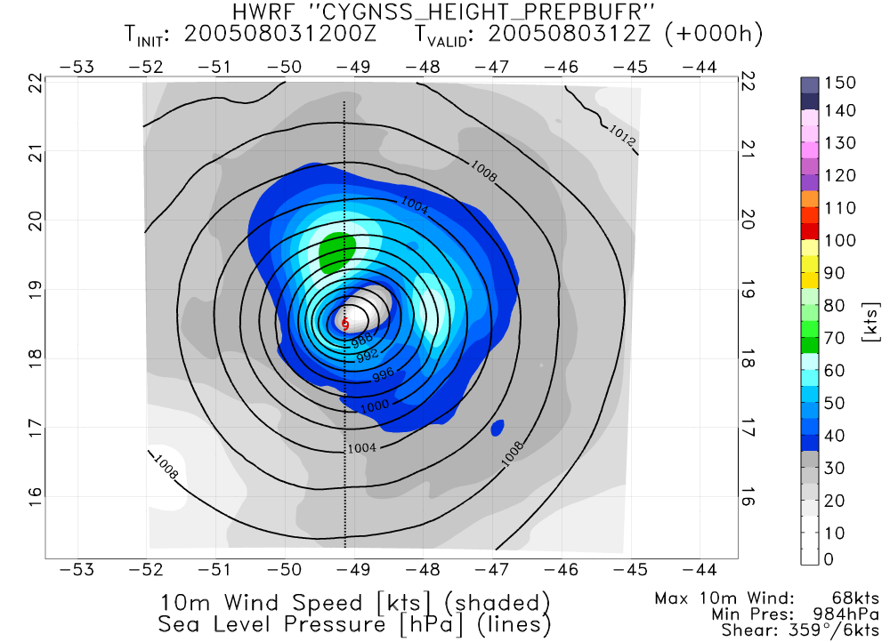
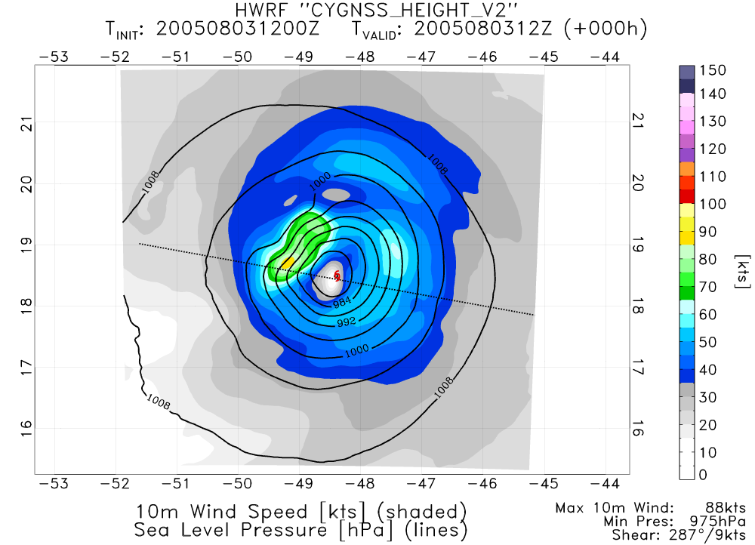
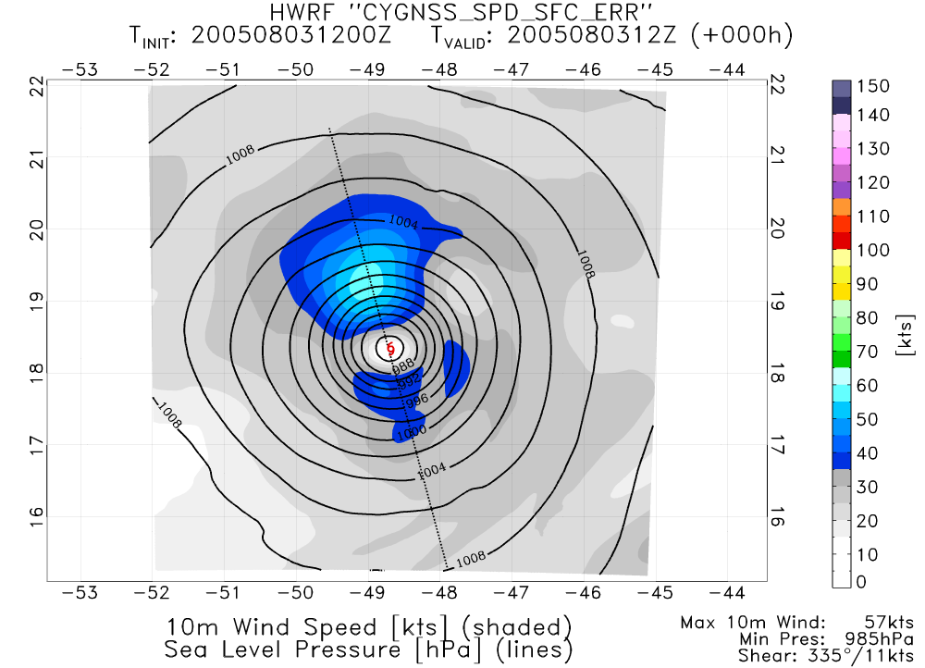
NATURE
CONTROL
PERFECT CYGNSS GSI
PERFECT CYGNSS ENKF
REAL CYGNSS GSI

Slide 14
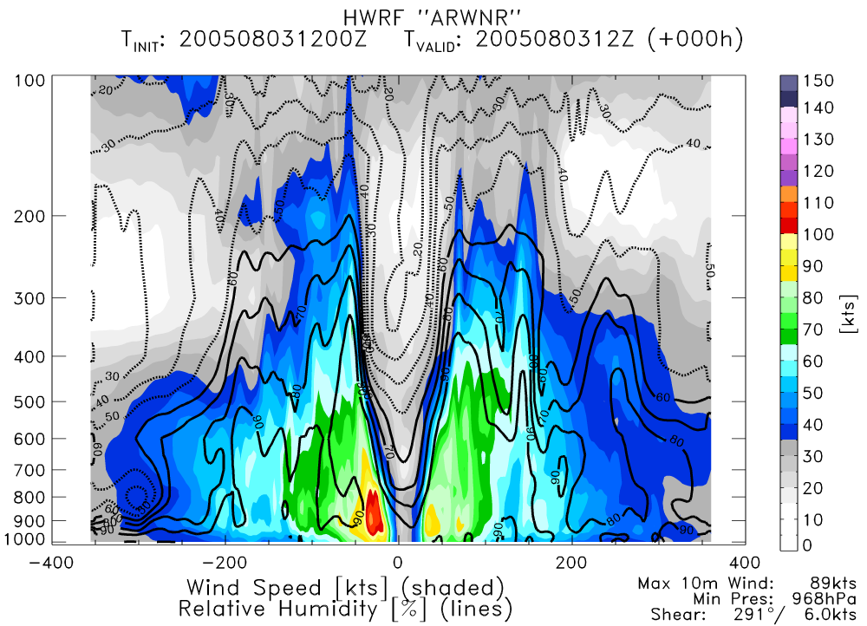
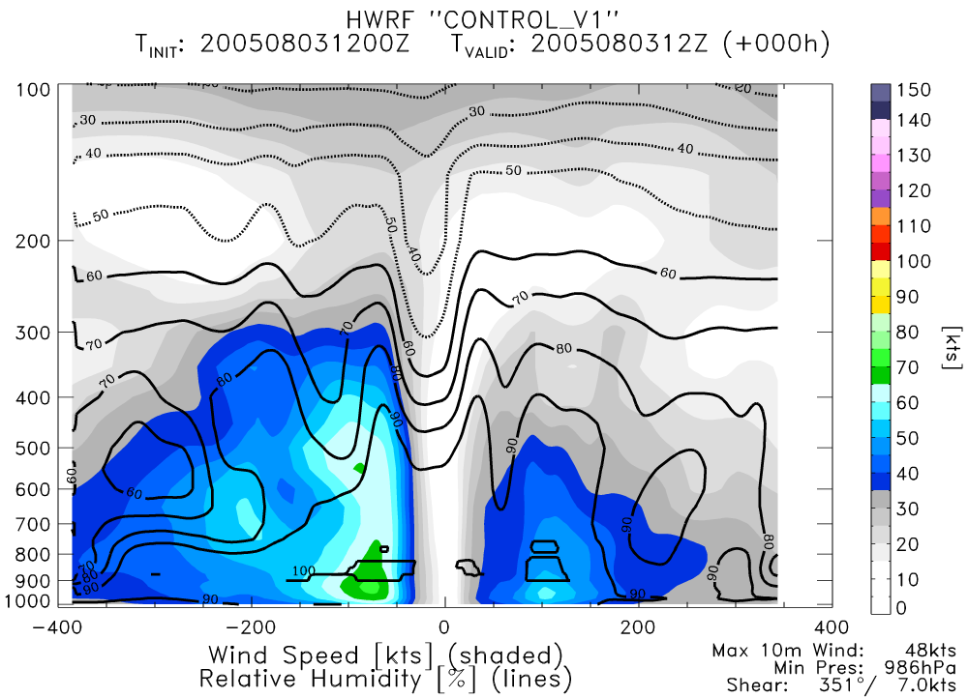
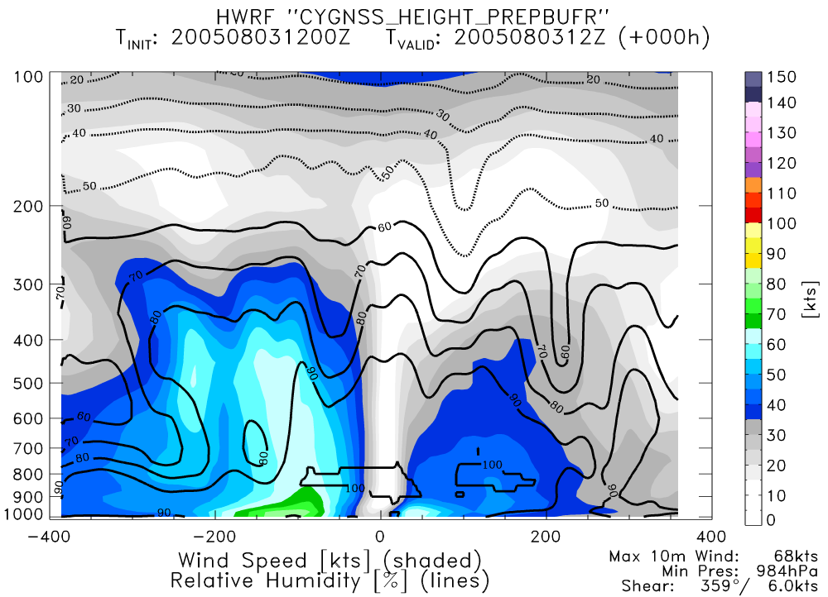
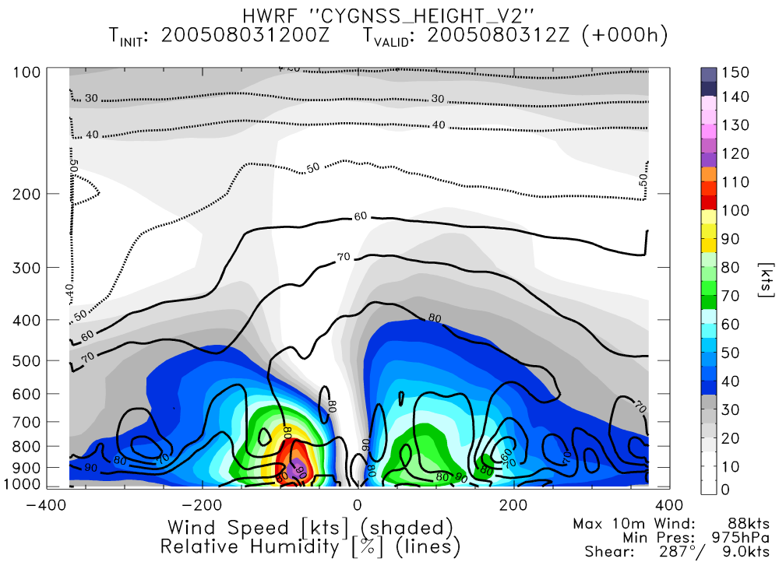
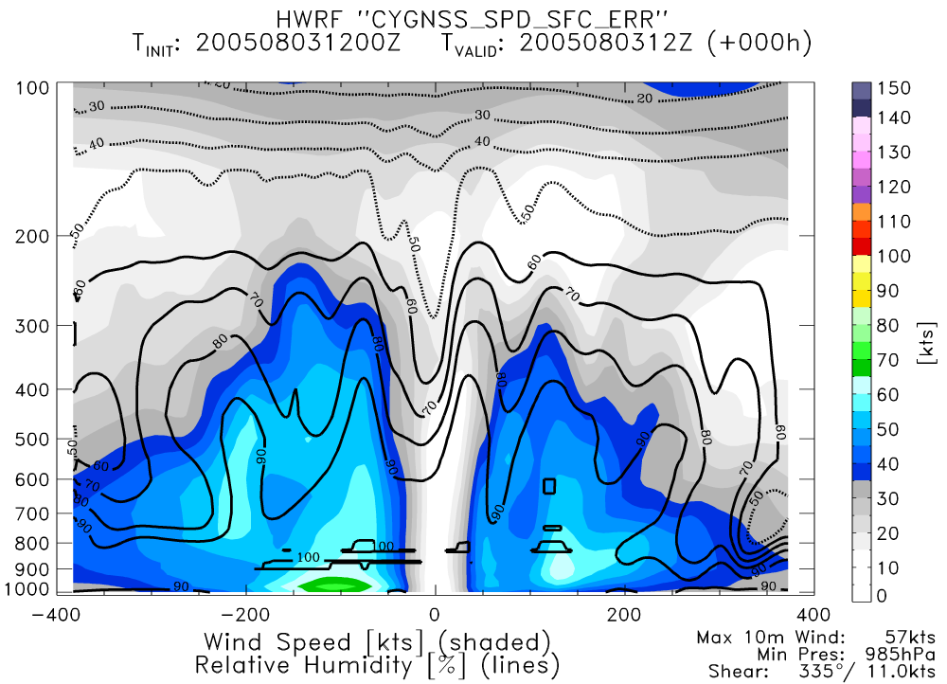
NATURE
CONTROL
PERFECT CYGNSS GSI
PERFECT CYGNSS ENKF
REAL CYGNSS GSI

Slide 15
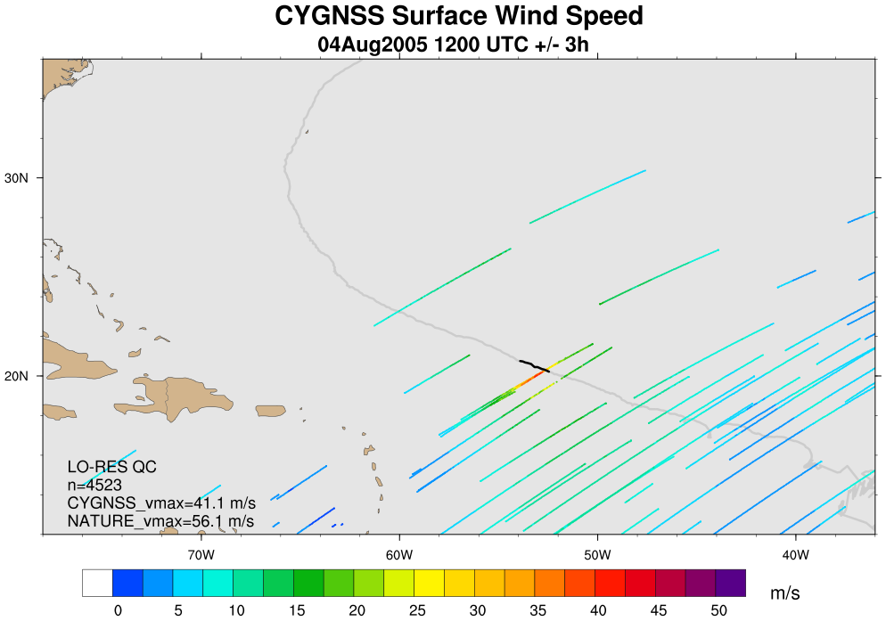
CYGNSS Coverage: 4Aug 12Z (+/- 3h)

Slide 16
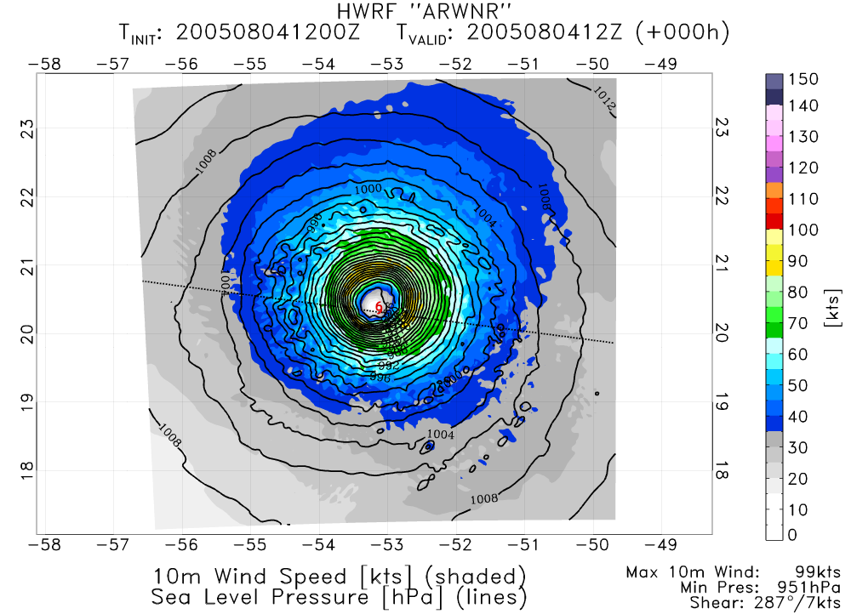
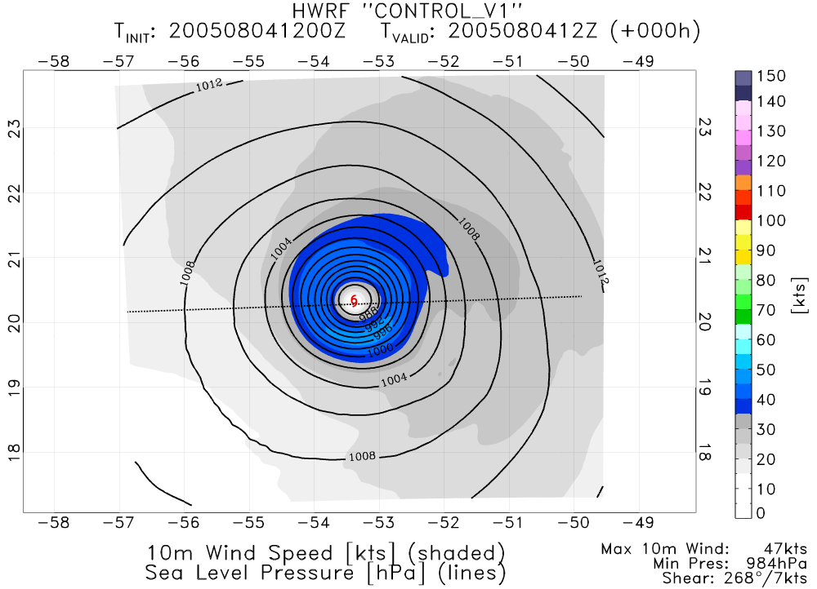
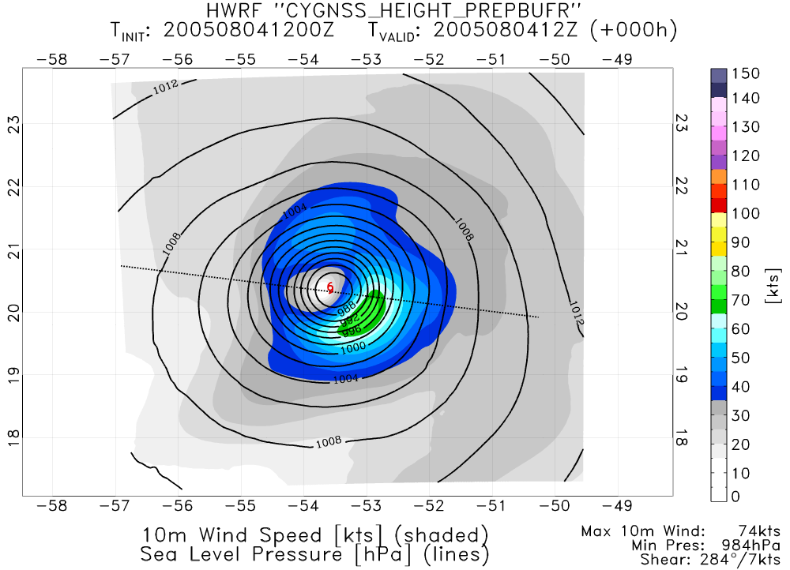
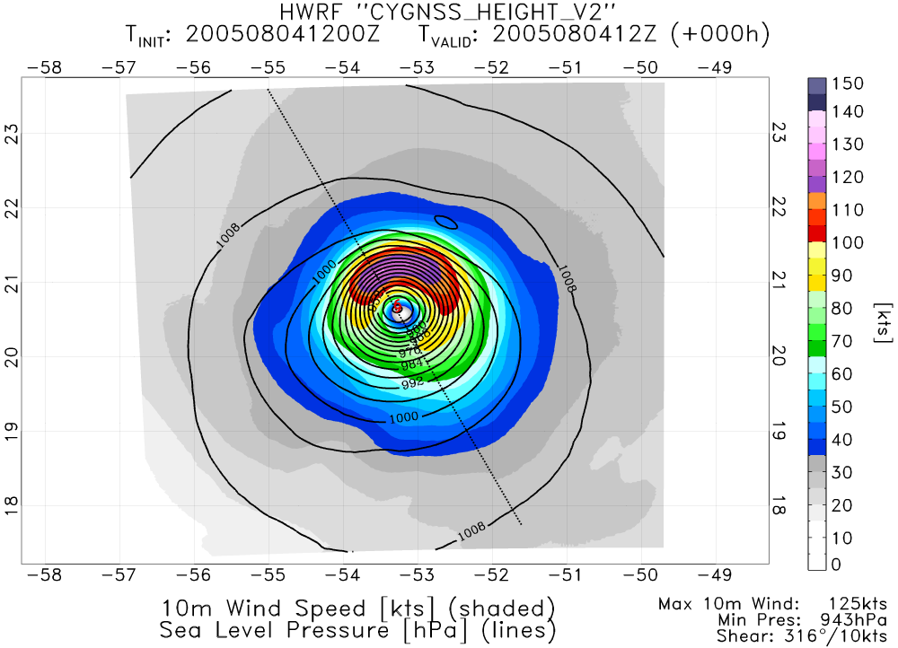
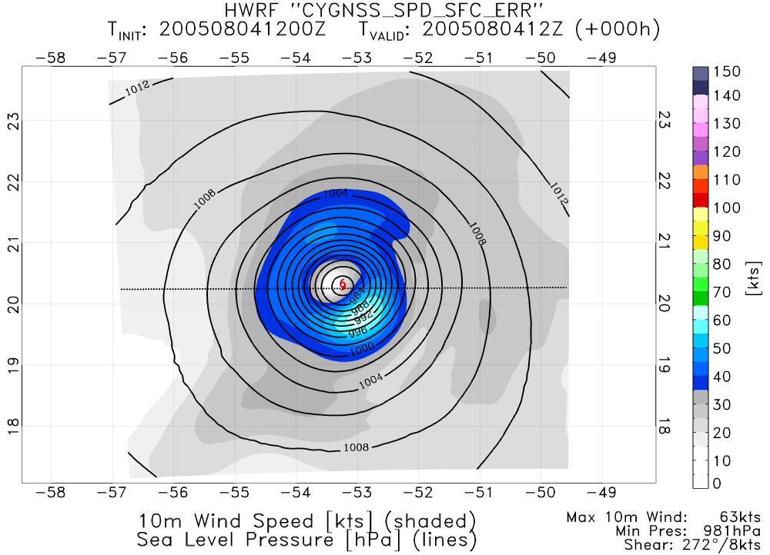
NATURE
CONTROL
PERFECT CYGNSS GSI
PERFECT CYGNSS ENKF
REAL CYGNSS GSI

Slide 17
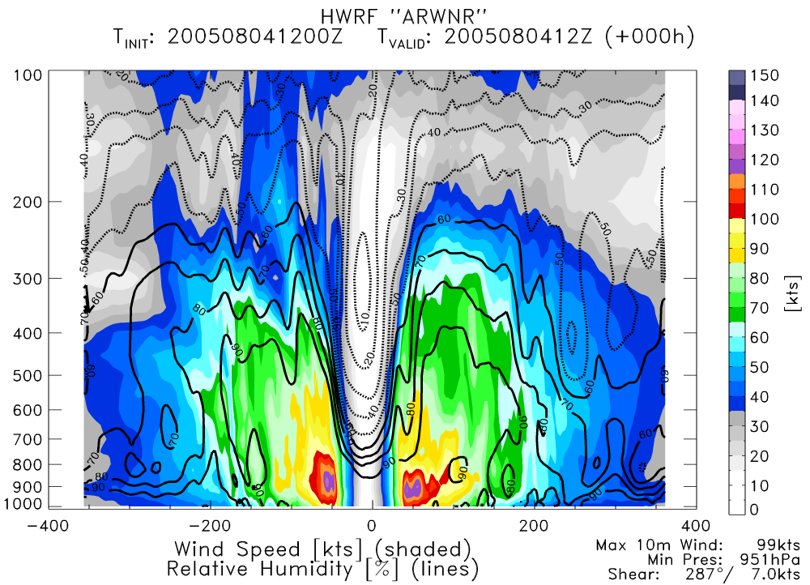
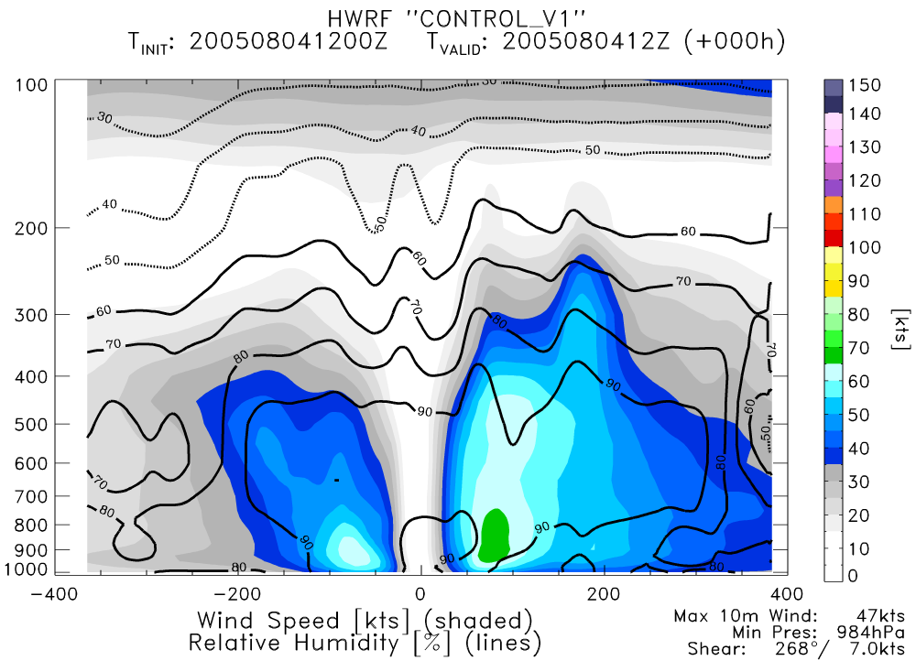
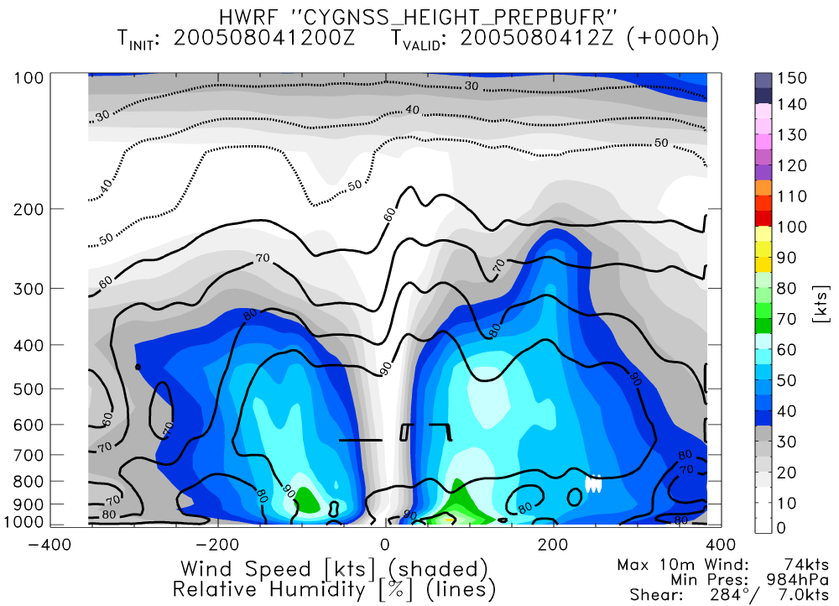
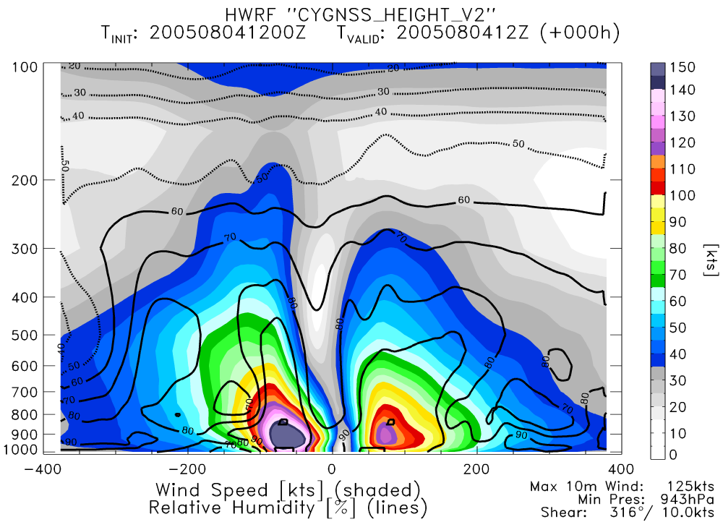
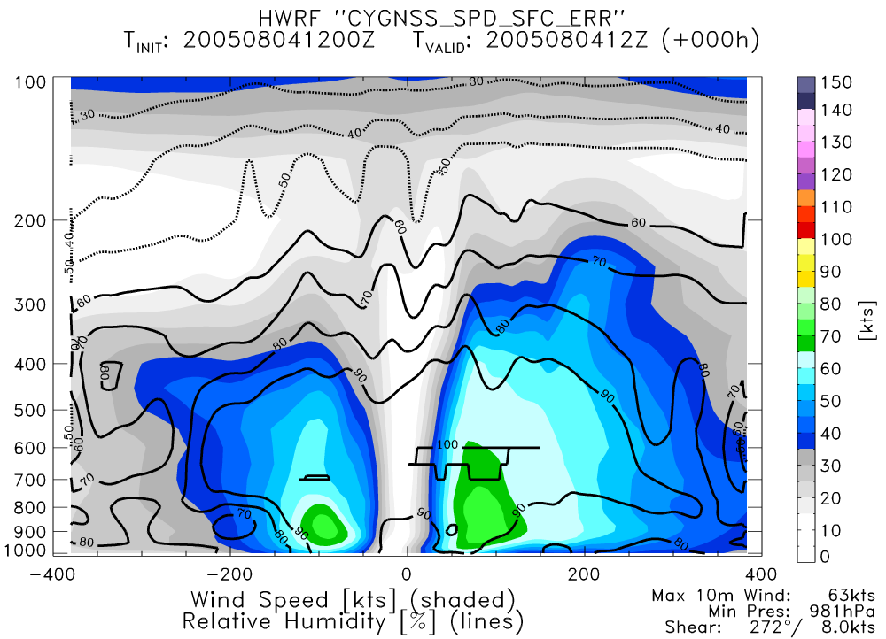
NATURE
CONTROL
PERFECT CYGNSS GSI
REAL CYGNSS GSI
PERFECT CYGNSS ENKF

