Slide 1


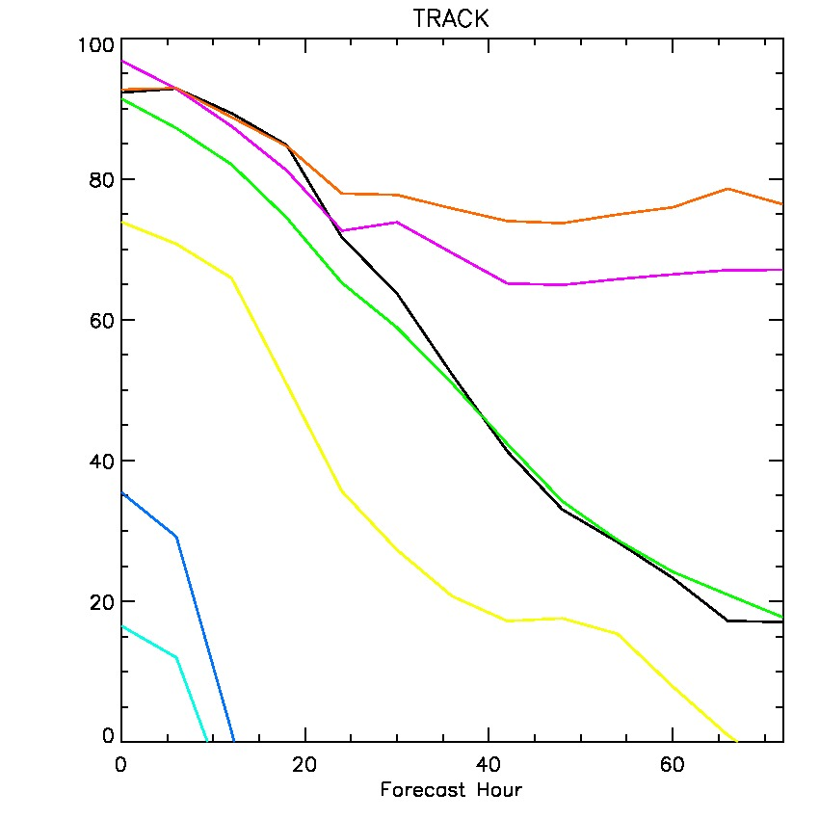
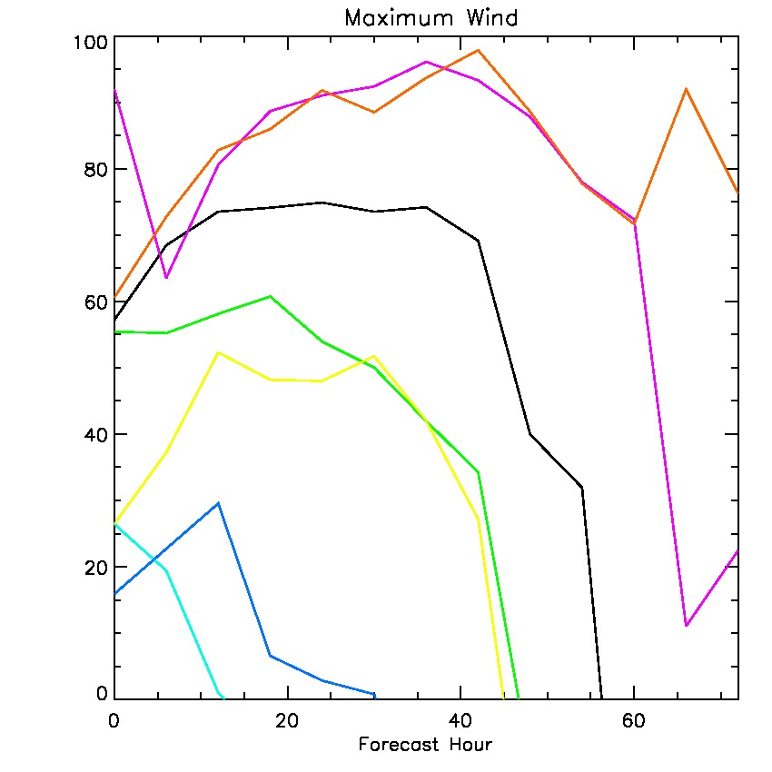
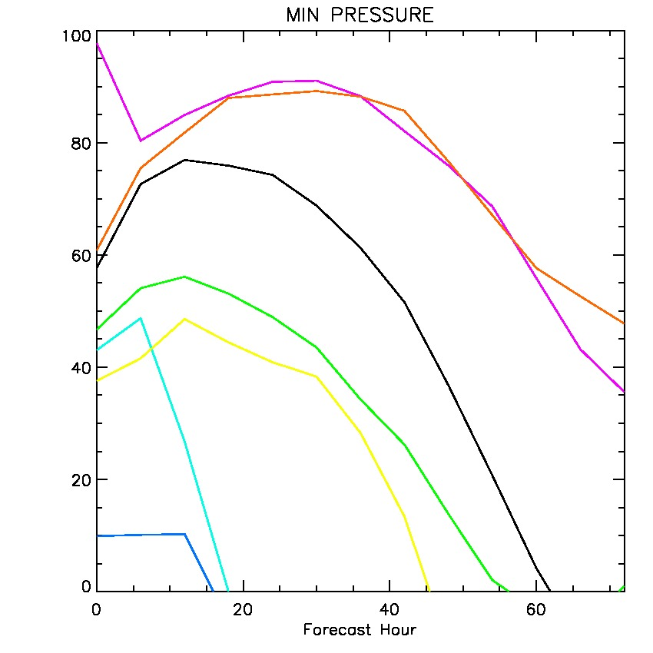
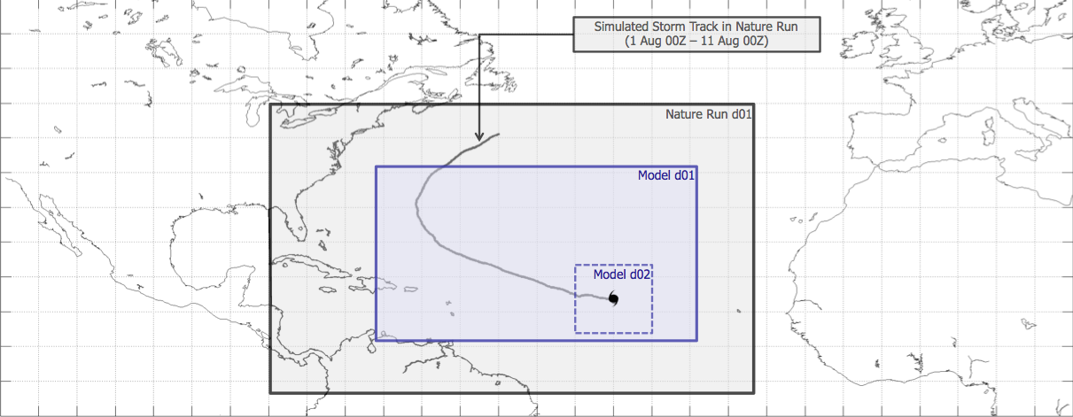
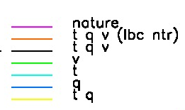
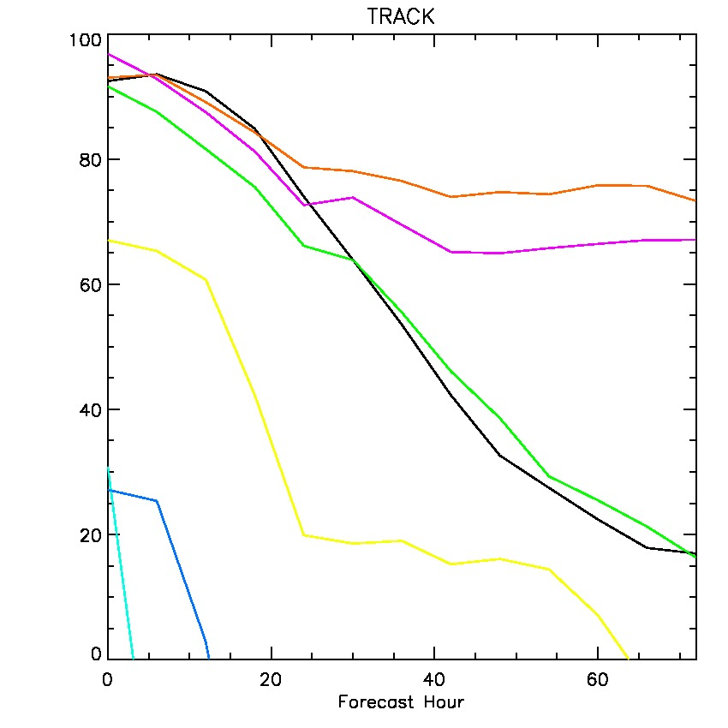
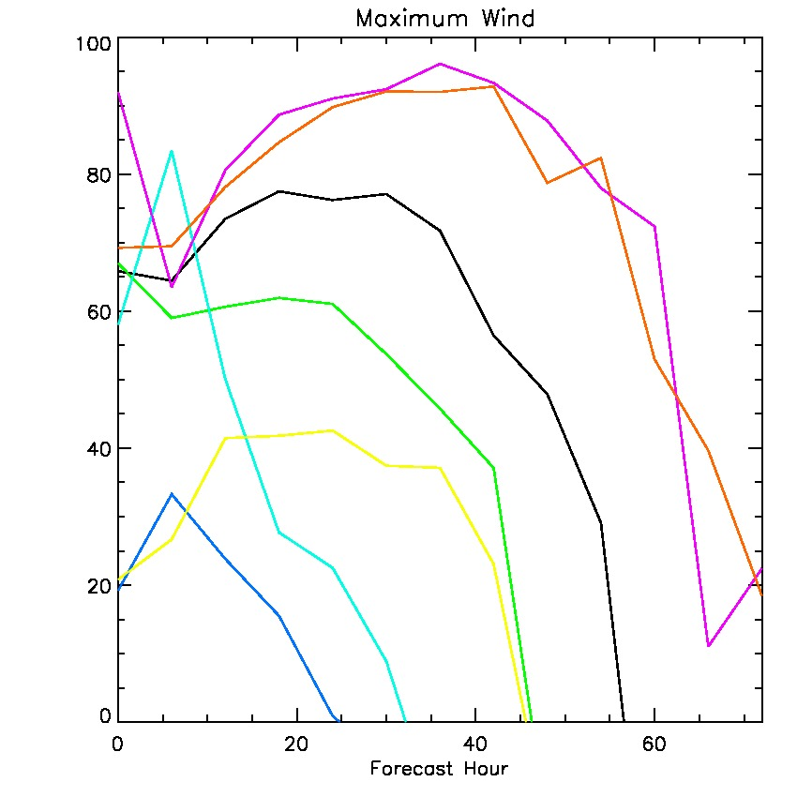
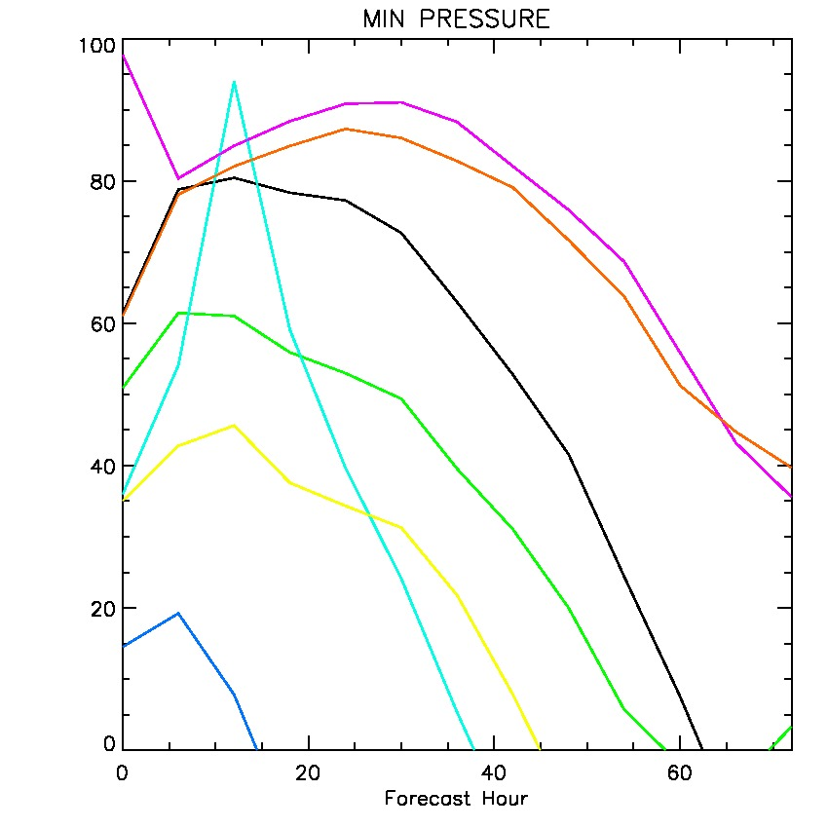
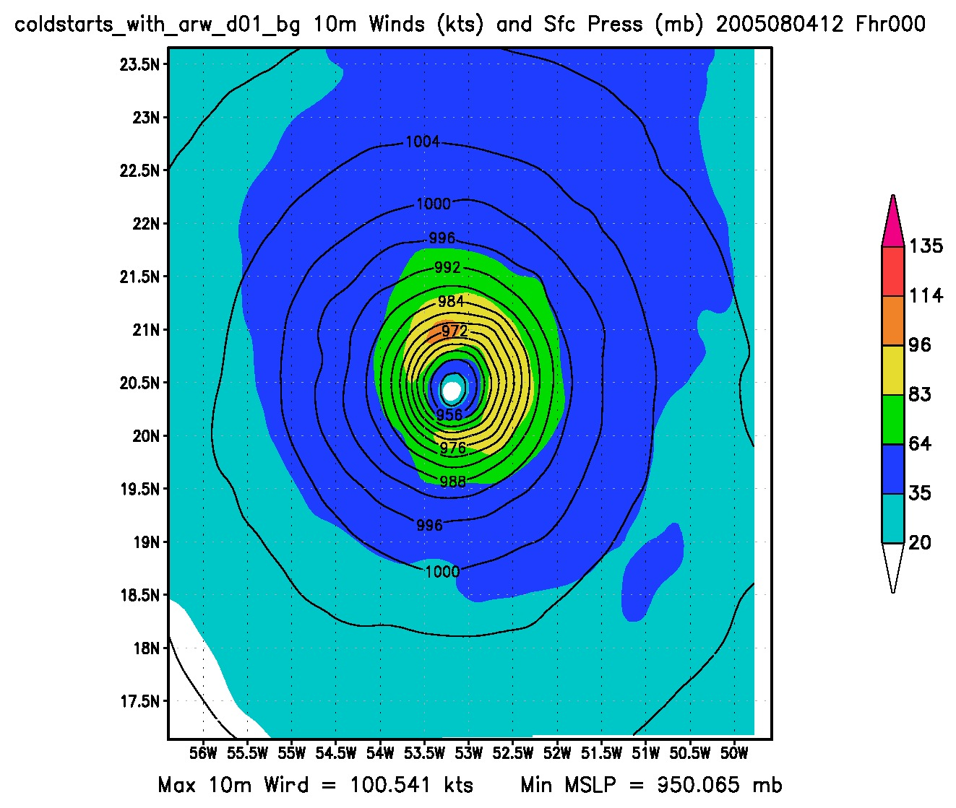
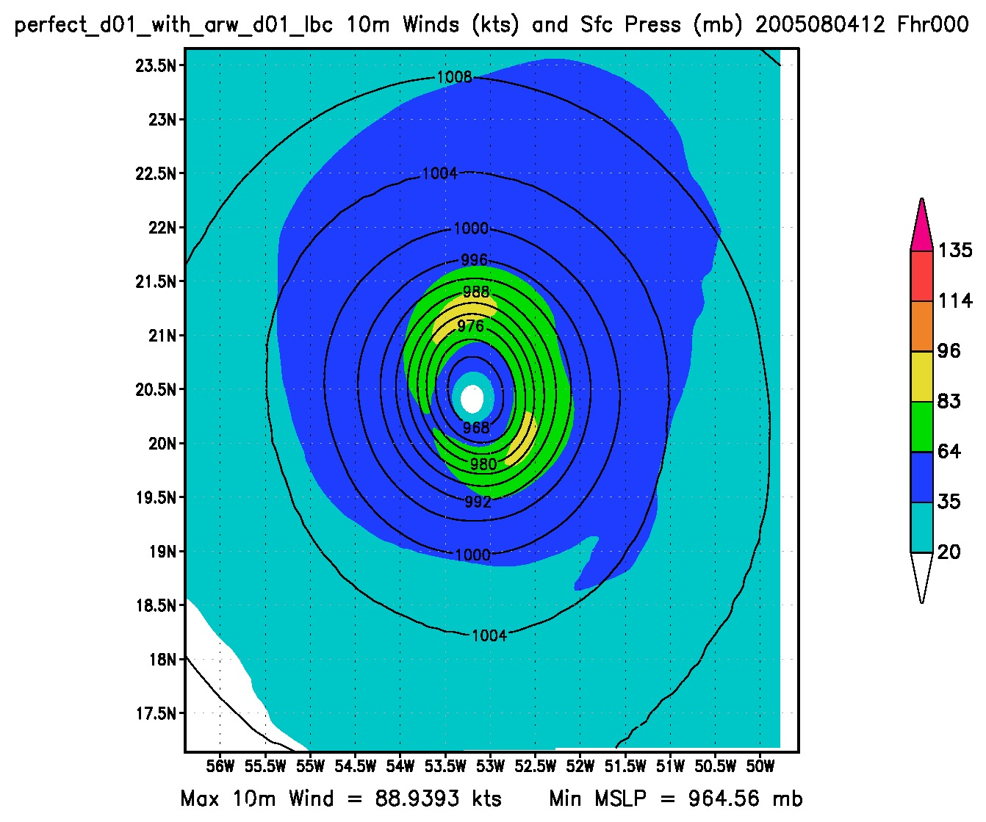
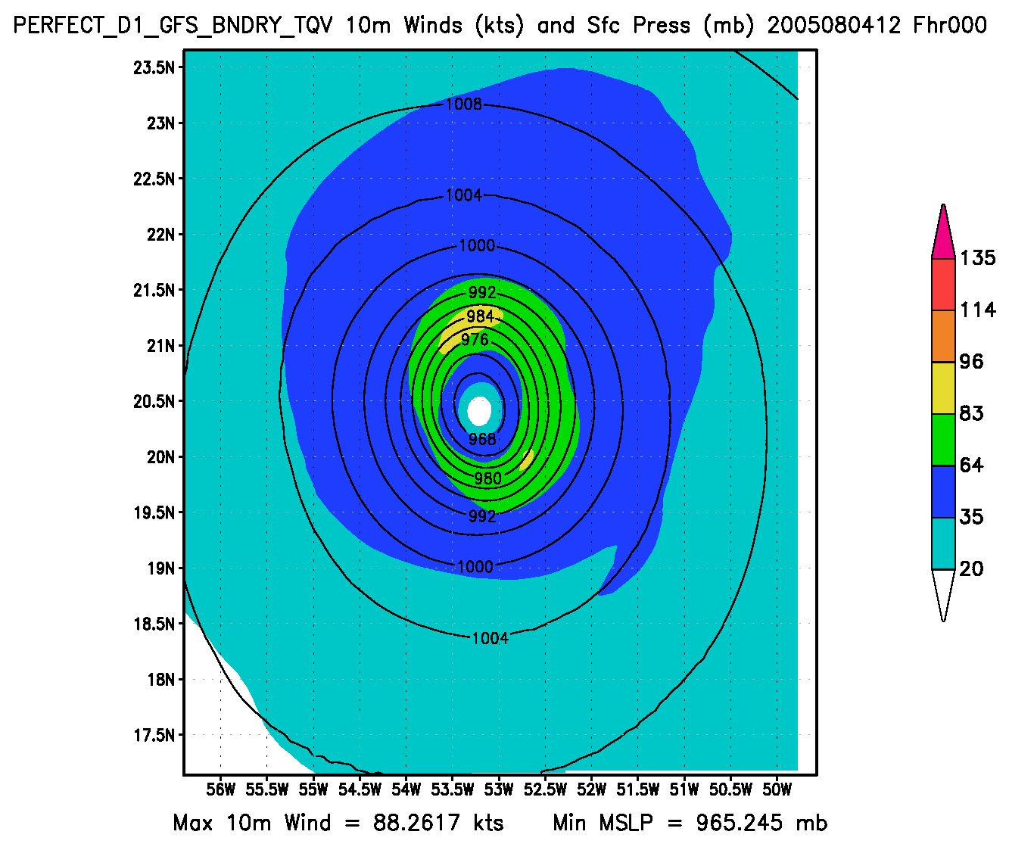
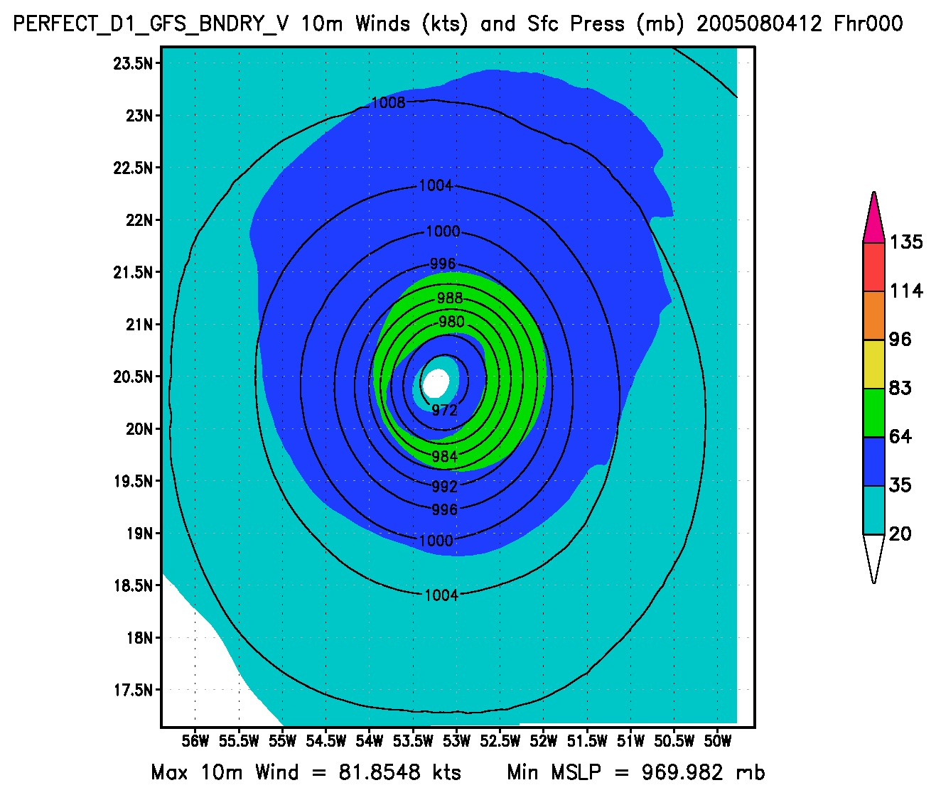
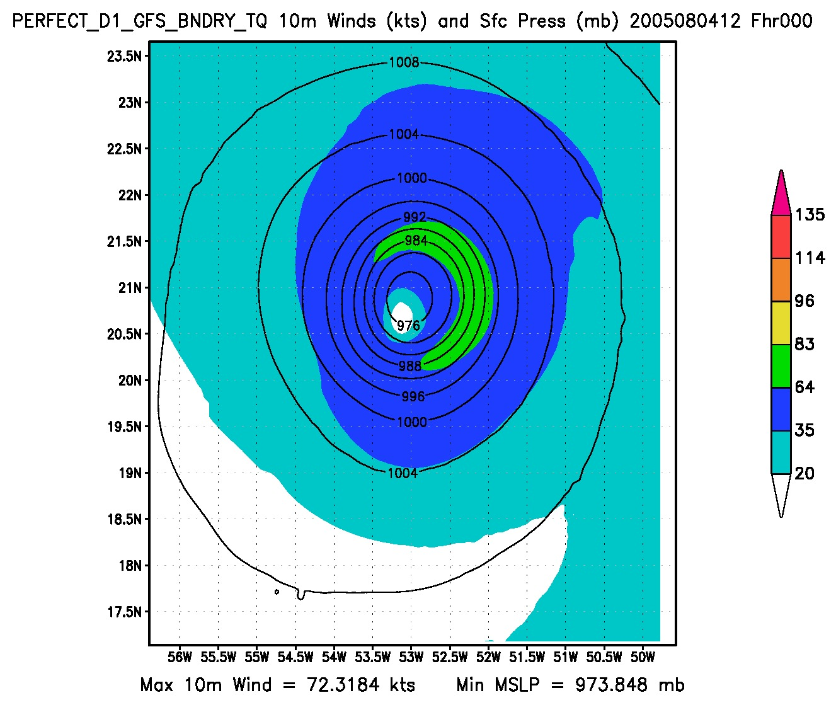
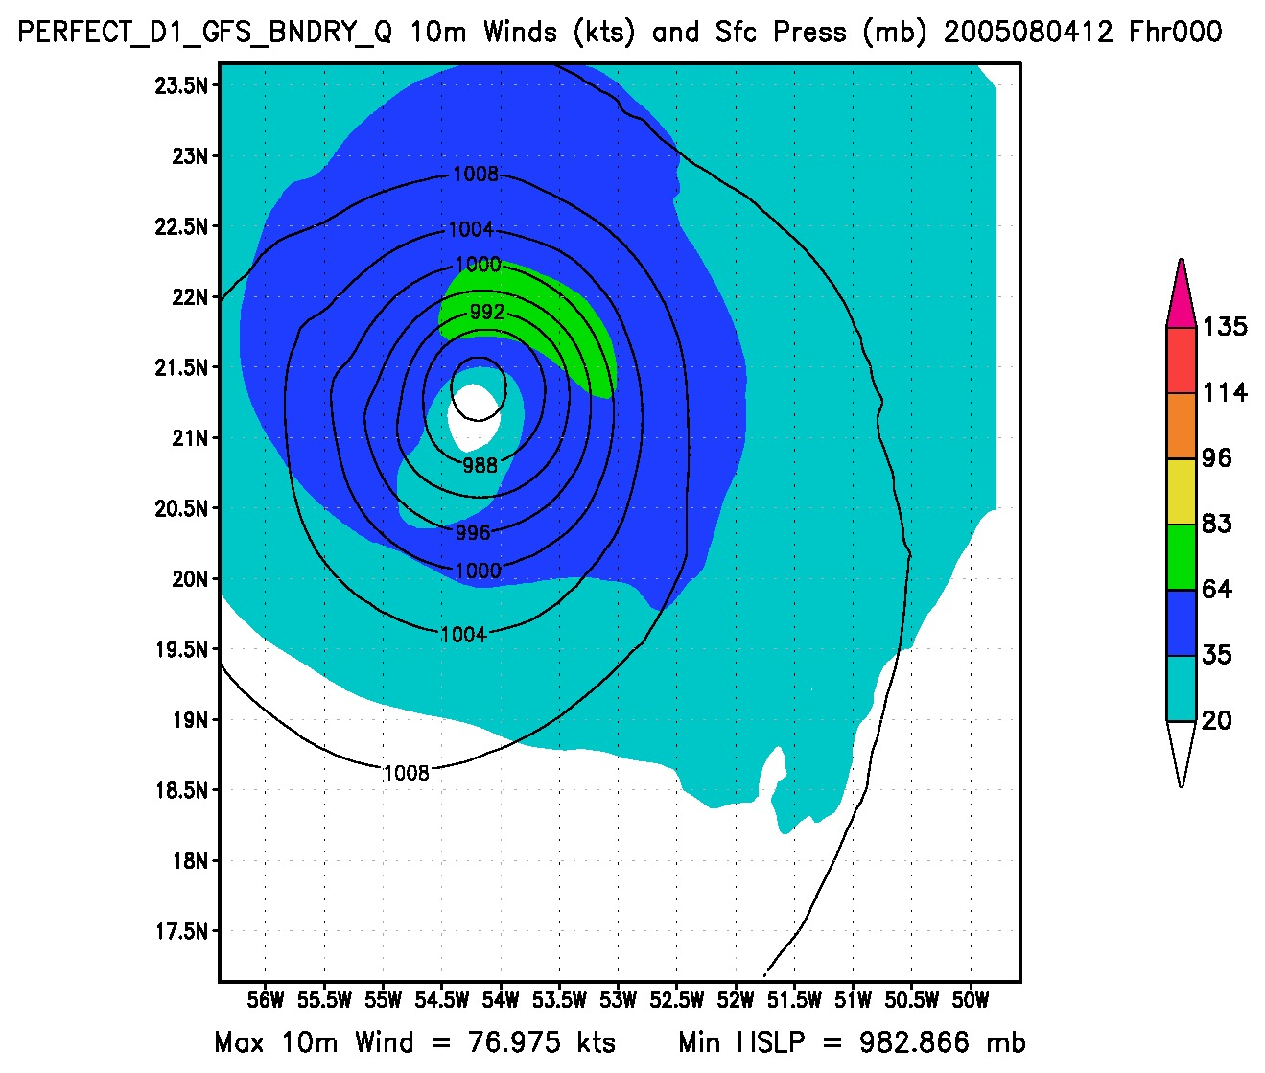
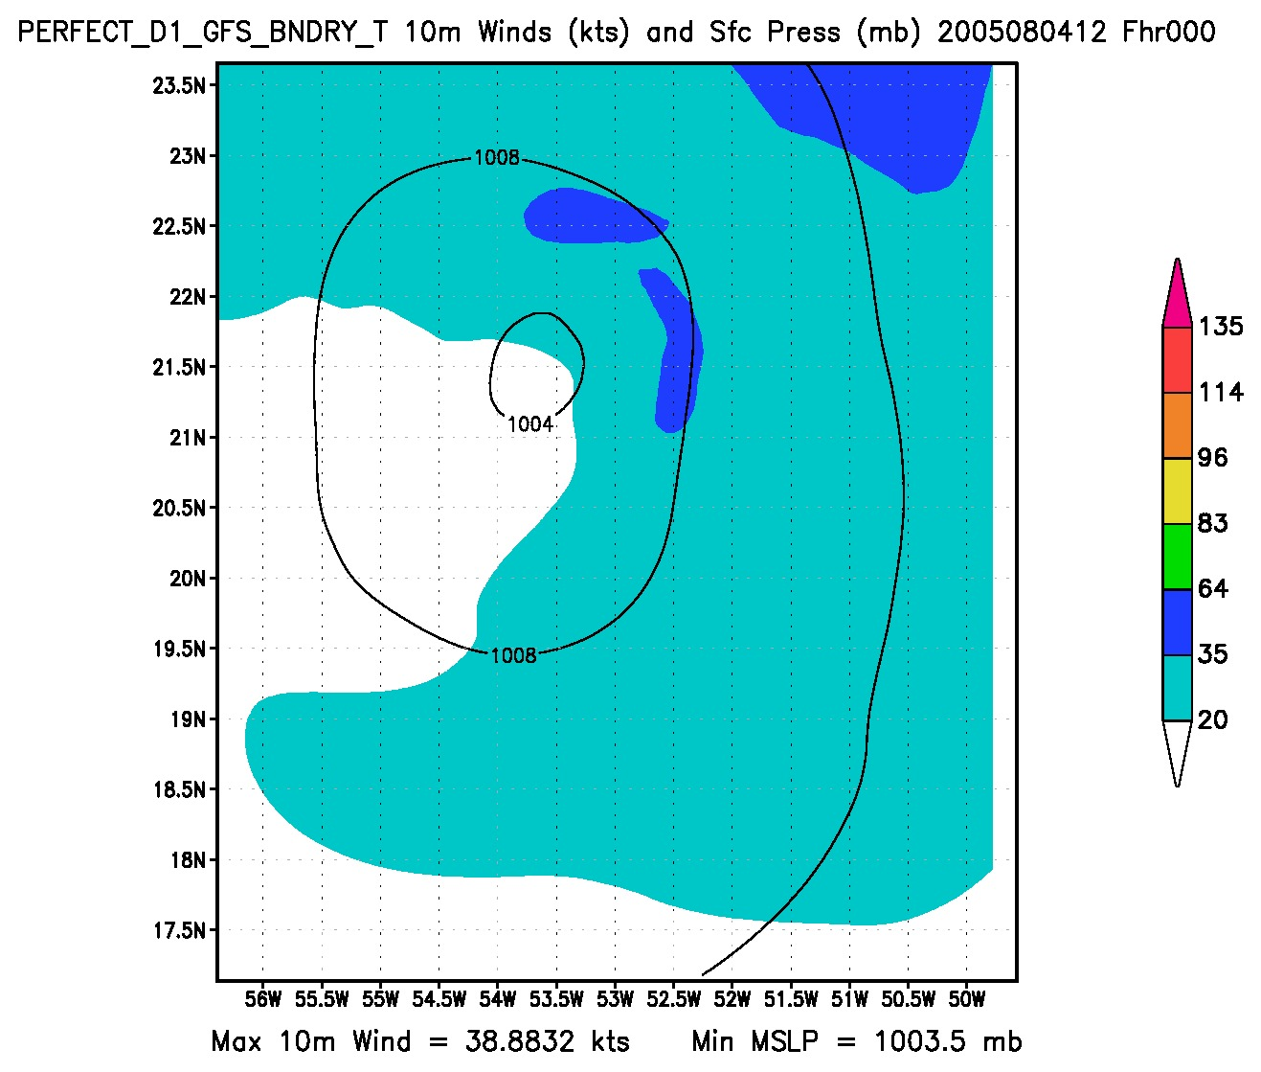
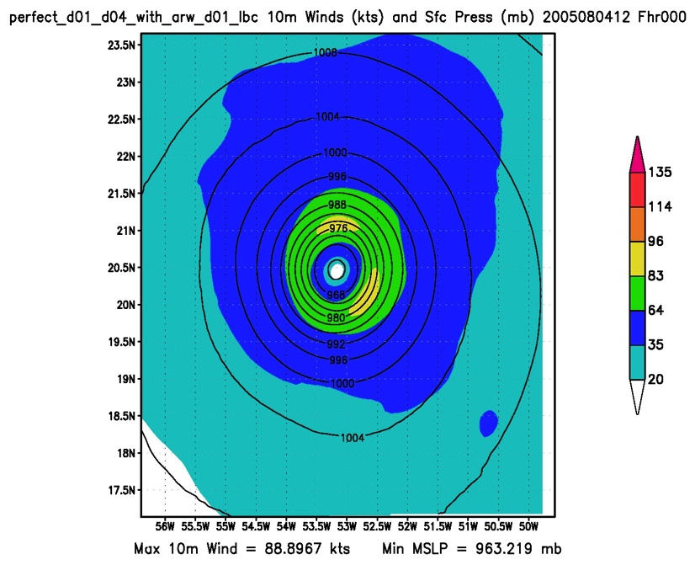
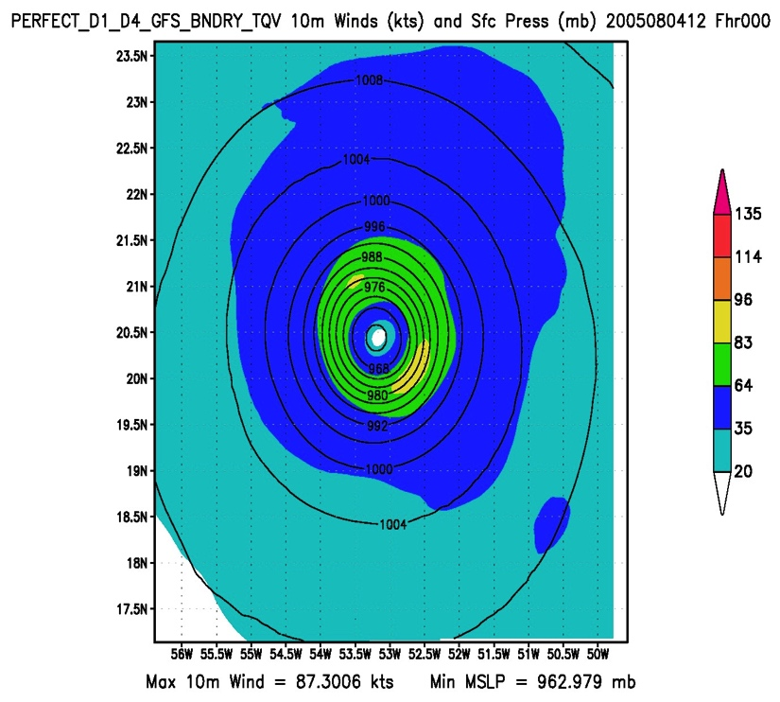
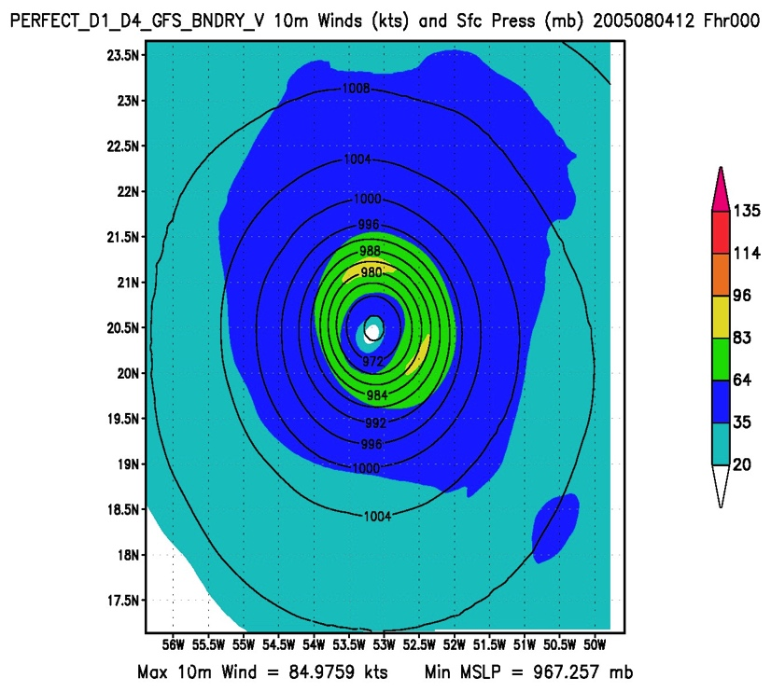
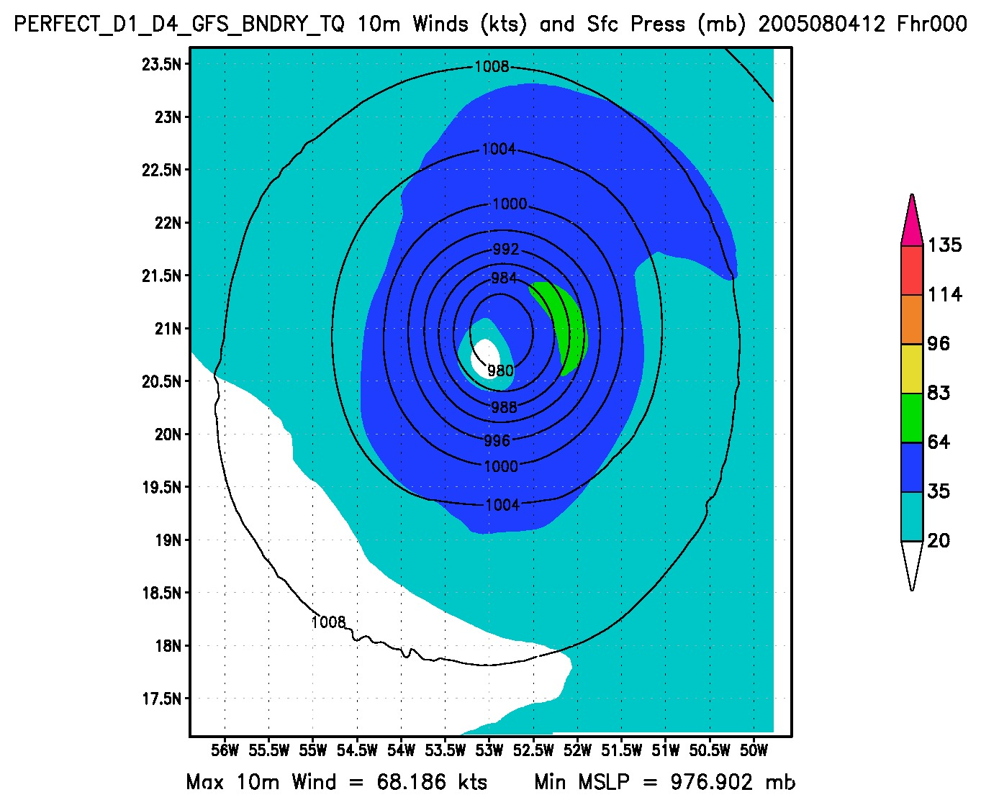
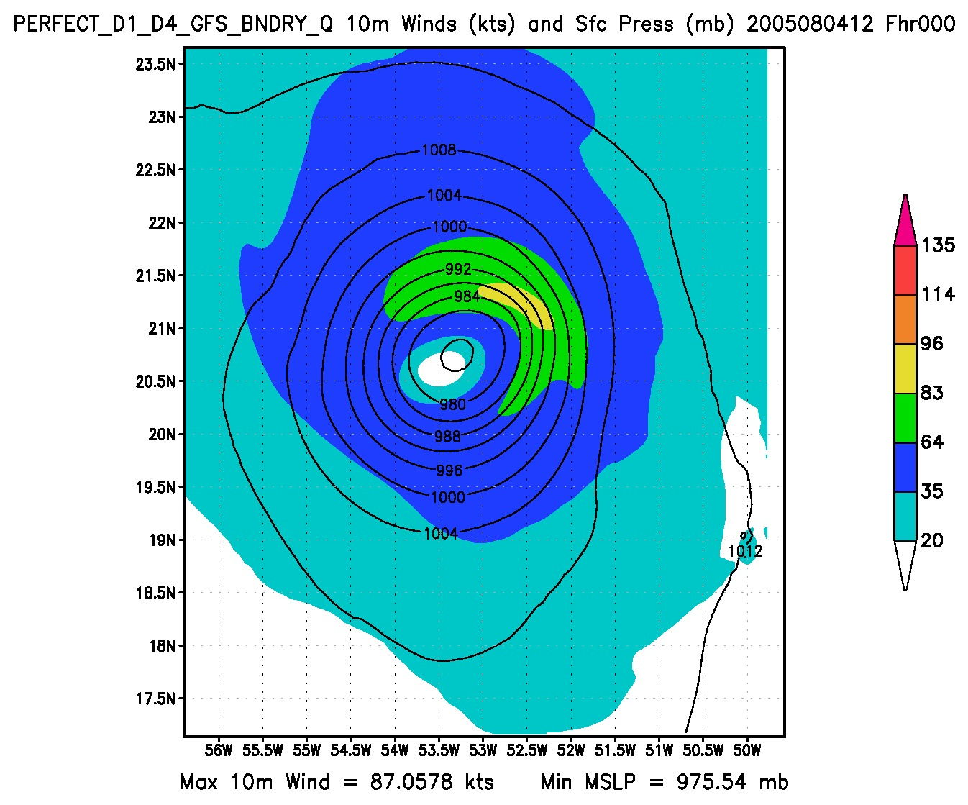
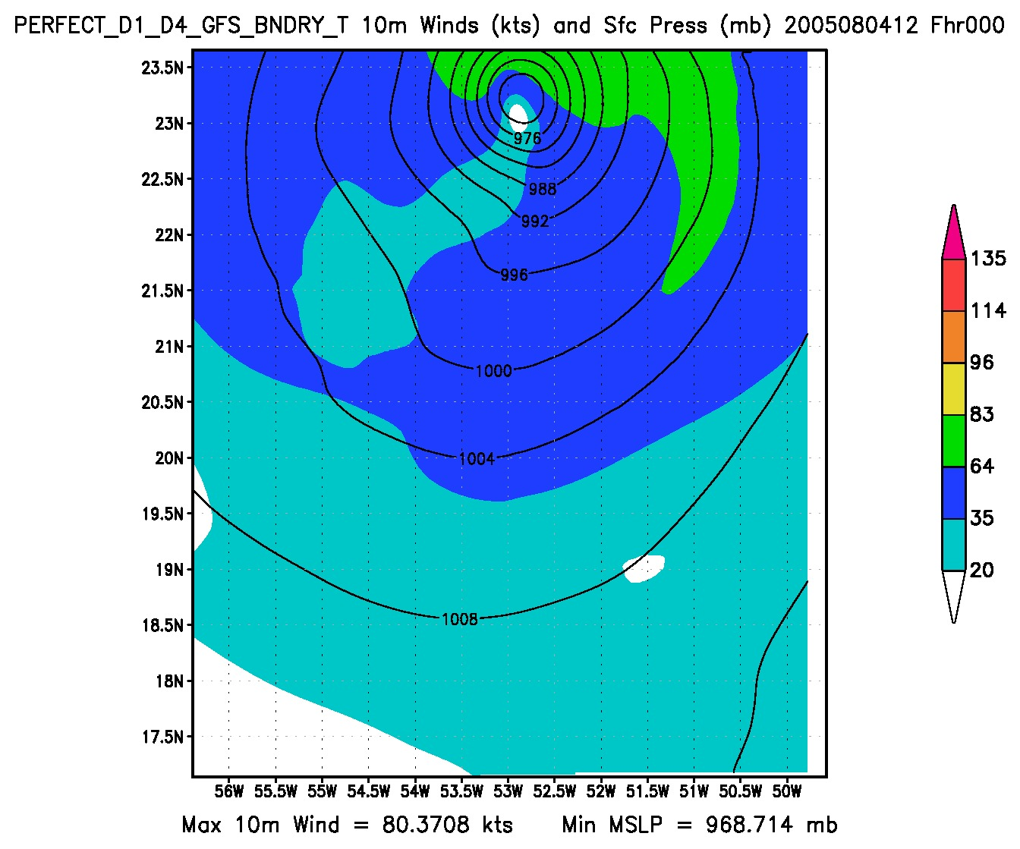
Analysis domain
P244
On the Predictability of Hurricane Track and Intensity Using an
OSSE Framework
Bachir Annane¹, Lisa Bucci², Javier Delgado¹, Altug Aksoy¹, Robert Atlas³, S. T. Murillo³
¹ Univ. of Miami/CIMAS and NOAA/AOML/HRD, Miami, FL
² Univ. of Miami/RSMAS, Miami, FL
³ NOAA/AOML, Miami, FL
Observational Data
Experiments and Results
· Skill Scores - Low Resolution Experiments
Extracted from the Nature Run
Outer domain (d01):
Analysis domain, fits within the Nature Run outer domain and captures most of the storm life cycle
9 km horizontal grid spacing (353x411 grid points) 61 vertical levels
Inner domain (d02):
Storm-following moving nest
3 km horizontal grid spacing (179x339 grid points, ~4°x5°) 61 vertical levels
· All experiments listed use identical configurations of GSI for data assimilation and HWRF for forecasts.
Experiment | Lateral Boundaries | Initialization | Resolution
Nature | Nature | Interpolation | 9km
T Q V (lbc ntr) | Nature | Assimilate wind, temperature, moisture | High
T Q V (lbc ntr) | Nature | Assimilate wind, temperature, moisture | Low
T Q V | GFS | Assimilate wind, temperature, moisture | High
T Q V | GFS | Assimilate wind, temperature, moisture | Low
V | GFS | Assimilate wind | High
V | GFS | Assimilate wind | Low
T Q | GFS | Assimilate temperature, and moisture | High
T Q | GFS | Assimilate temperature, and moisture | Low
Q | GFS | Assimilate moisture | High
Q | GFS | Assimilate moisture | Low
T | GFS | Assimilate temperature | High
T | GFS | Assimilate temperature | Low
D E G R A D A T I O N
Fig 3. skill scores over 16 cycles. Skill include track (left), peak surface wind (middle), and minimum surface pressure (right).
Data:
-BUFR data is generated to span the WRF ARW nature run.
- Arrays of T,Q,U and V are at 27 km and 5 km horizontal resolution .
· Skill Scores – High Resolution Experiments
Fig 1. Nature and experiment domains.
· Analysis Storm Structure
- MSLP (contoured) and 10-m wind speed (shaded) are shown to illustrate the degradation in storm structure in the experiments above. This example is after 13 cycles.
OSSE Framework
The regional OSSE (Observing System Simulation Experiment) framework described here was developed at NOAA/AOML and UM/RSMAS and features a high-resolution regional nature run embedded within a lower-resolution global nature run. Simulated observations are generated and provided to a data assimilation (DA) scheme which provides analyses for a high-resolution regional forecast model.
· Nature Runs
- ECMWF: low-resolution T511 (~40km) “Joint OSSE Nature Run”
- WRF-ARW: high-resolution 27km regional domain with 9/3/1 km storm-following nests (v3.2.1)
· Data Assimilation Scheme
- GSI: Gridpoint Statistical Interpolation… a standard 3D variational assimilation scheme (v3.3). Analyses performed at 9km resolution.
· Forecast Model
- HWRF: the 2014 operational Hurricane-WRF model (v3.5). Parent domain has 9km resolution, single storm-following nest has 3km resolution.
For these results, DA performed every 6 hours, forecast model run every 6 hours, each run producing a 5-day forecast, for total of 16 cycles.
a) NATURE
b) T Q V (lbs ntr)
c) T Q V
d) V
Low-Res
Fig 4. Skill scores over 16 cycles. Skill include track (left), peak surface wind (middle), and minimum surface pressure (right). .
Summary
Even with the perfect initial conditions and perfect boundary conditions, the predictability is quickly lost (compared to imperfect boundary conditions) within 12-18 hours.
Adding kinematic observations improves predictability by about 1 day in terms of forecast lead time.
Assimilating thermodynamic variables does not appear to have positive impact on the predictability of the simulated storm.
A degradation in boundary conditions results in the loss of predictability of intensity/MSLP by about 1 day in terms of forecast lead time.
High resolution experiments with kinematic observations have higher skill than lower resolution experiments.
We have very few samples from one storm, so error statistics are not robust, but provide guidance for future studies.
ECMWF NATURE RUN
ANALYSIS
FORECASTS
VMAX: 100.5 kt, MSLP: 950 hPa
VMAX: 88.9 kt, MSLP: 964.5 hPa
VMAX:88.2 kt, MSLP: 965.2 hPa
VMAX:81.8 kt, MSLP: 969.9hPa
WRF NATURE RUN
observation
simulator
SYNTHETIC DATA
GSI
HWRF
The fact that the thermodynamic variables do not have a strong influence may be an artifact of the DA system itself. In this DA framework, it appears that observing the kinematic properties of the storm is critical.
e) T Q
f) Q
g) T
verification
background
Fig 2. Basic flow chart of the regional OSSE framework.
VMAX: 72.3 kt, MSLP: 973.8 hPa
VMAX:76.9kt, MSLP: 982.8 hPa
VMAX: 38.8 kt, MSLP: 1003.5 hPa
a) NATURE
b) T Q V (lbs ntr)
c ) T Q V
d) V
High-Res
VMAX: 100.5 kt, MSLP: 950 hPa
VMAX: 88.8 kt, MSLP: 963.2 hPa
VMAX: 87.3 kt, MSLP: 962.9 hPa
VMAX: 84.9 kt, MSLP: 967.2 hPa
Observing at higher resolution near the storm improves the analysis with kinematic observations, but does not appear to have a measurable impact on the behavior of the thermodynamic fields.
e) T Q
f) Q
e) T
Acknowledgements
The authors thank NOAA’S QOSAP Program, Office of Weather and Air Quality, OSSE Testbed, the Joint Center for Satellite Data Assimilation, the NOAA HFIP project, the Developmental Testbed Center, and David Nolan at the University of Miami for providing the WRF nature run dataset.
VMAX: 68.1 kt, MSLP: 976.9 hPa
VMAX: 87 kt, MSLP: 975.5 hPa
VMAX: 80.3 kt, MSLP: 968.7 hPa
10-14 January 2016 • 20th IOAS-AOLS Conference • 96th AMS Annual Meeting • New Orleans, Louisiana

