Slide 1
Results for GSI experiments Comparing: Hyperspectral clear radiance / Global OSSE observations/ no DA Verifying against nature run

Slide 2
Analyses at 08050200 2nd cycle

Slide 3
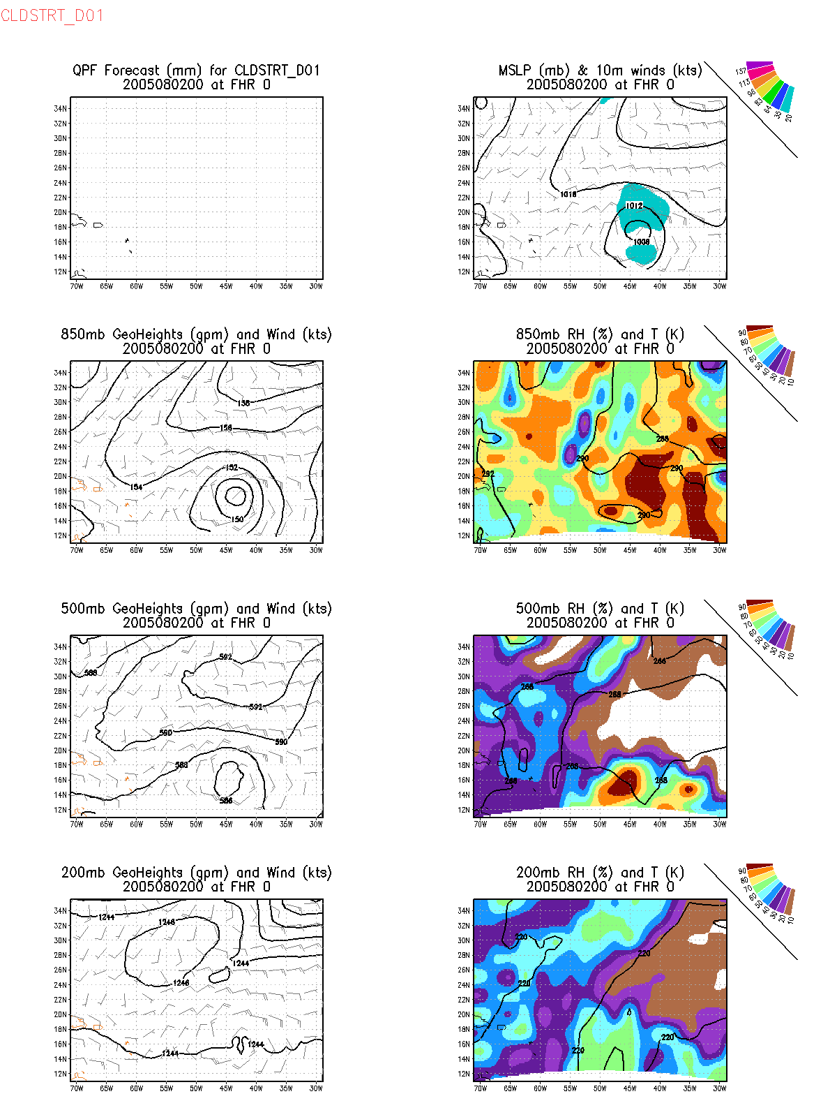
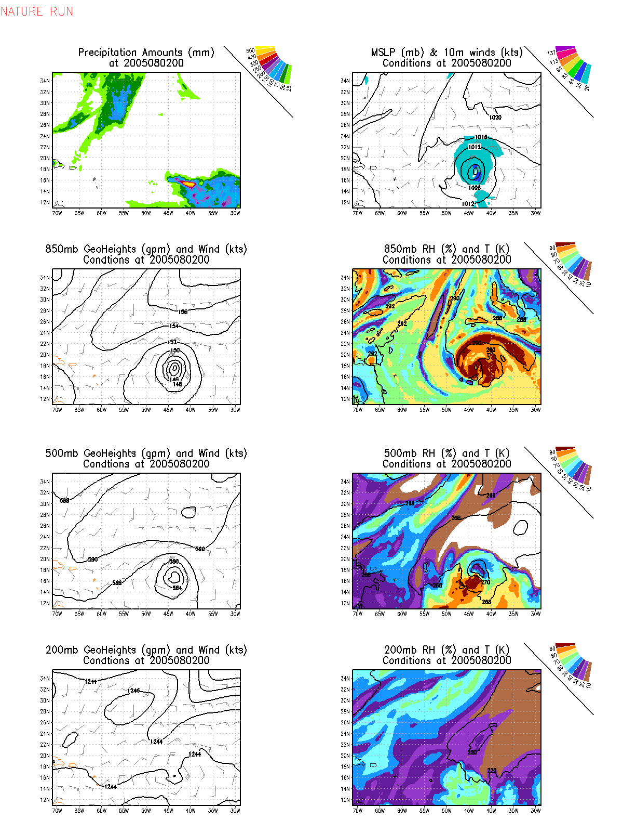

Slide 4
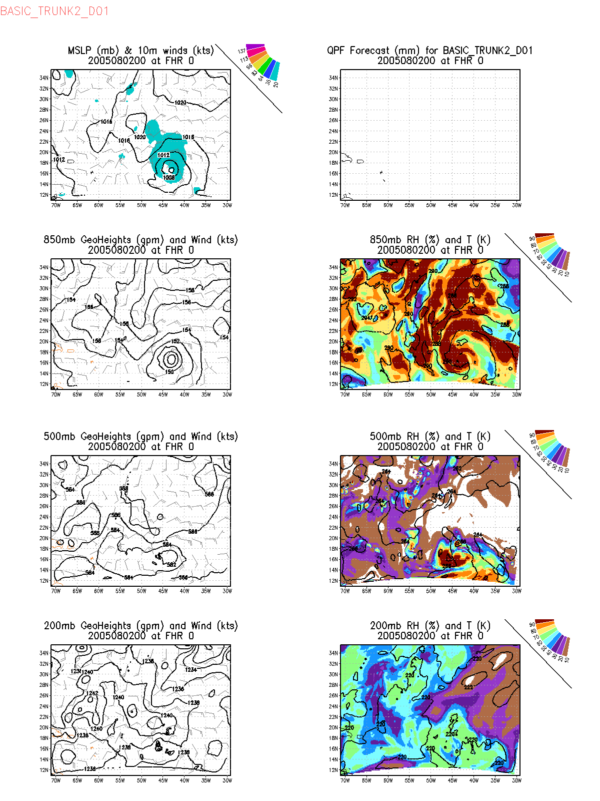

Slide 5
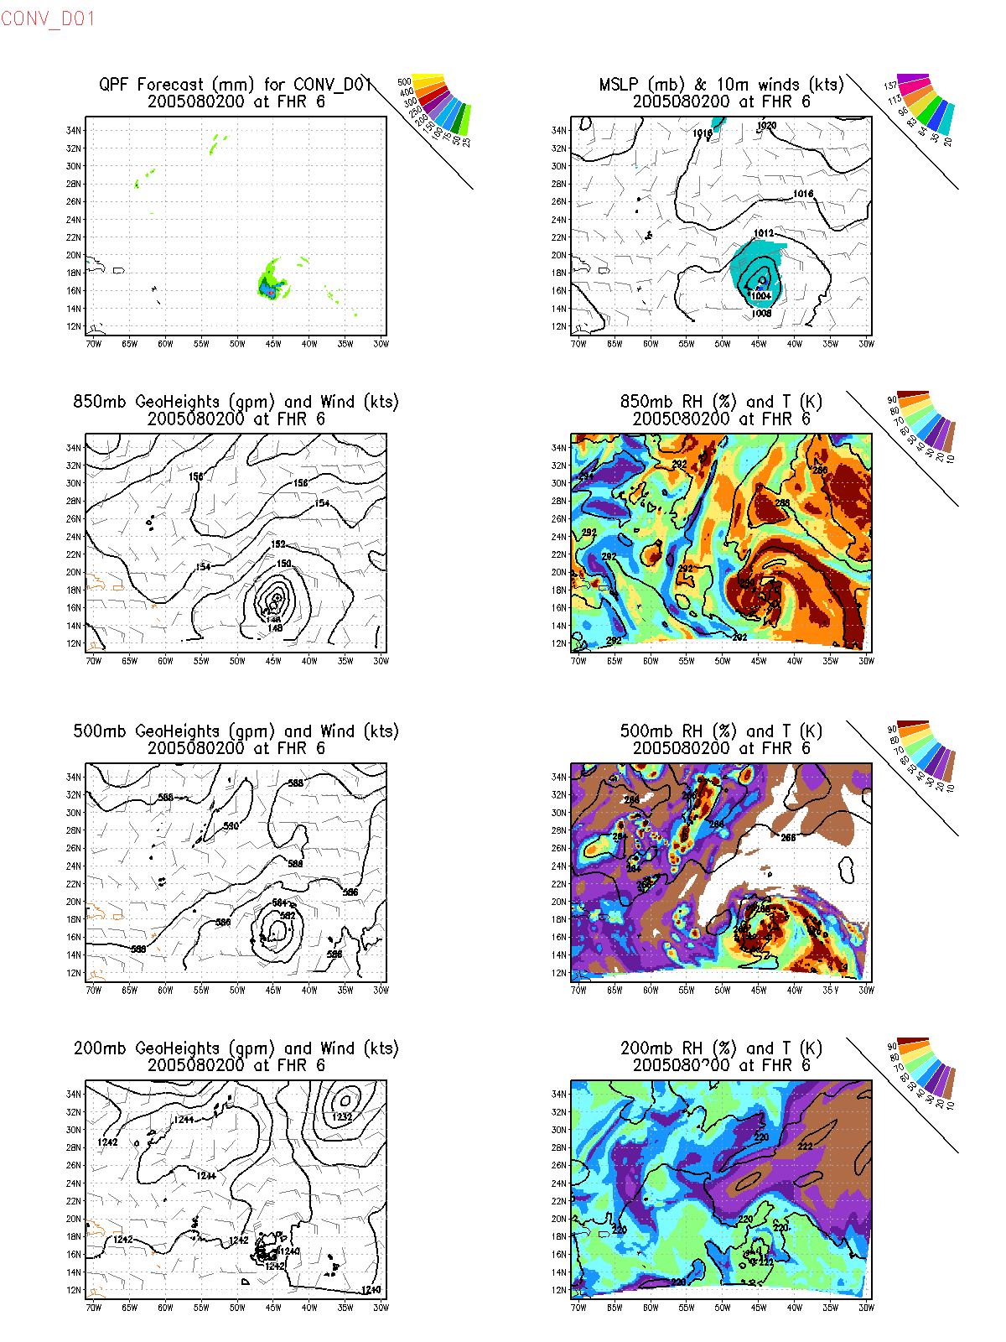

Slide 6
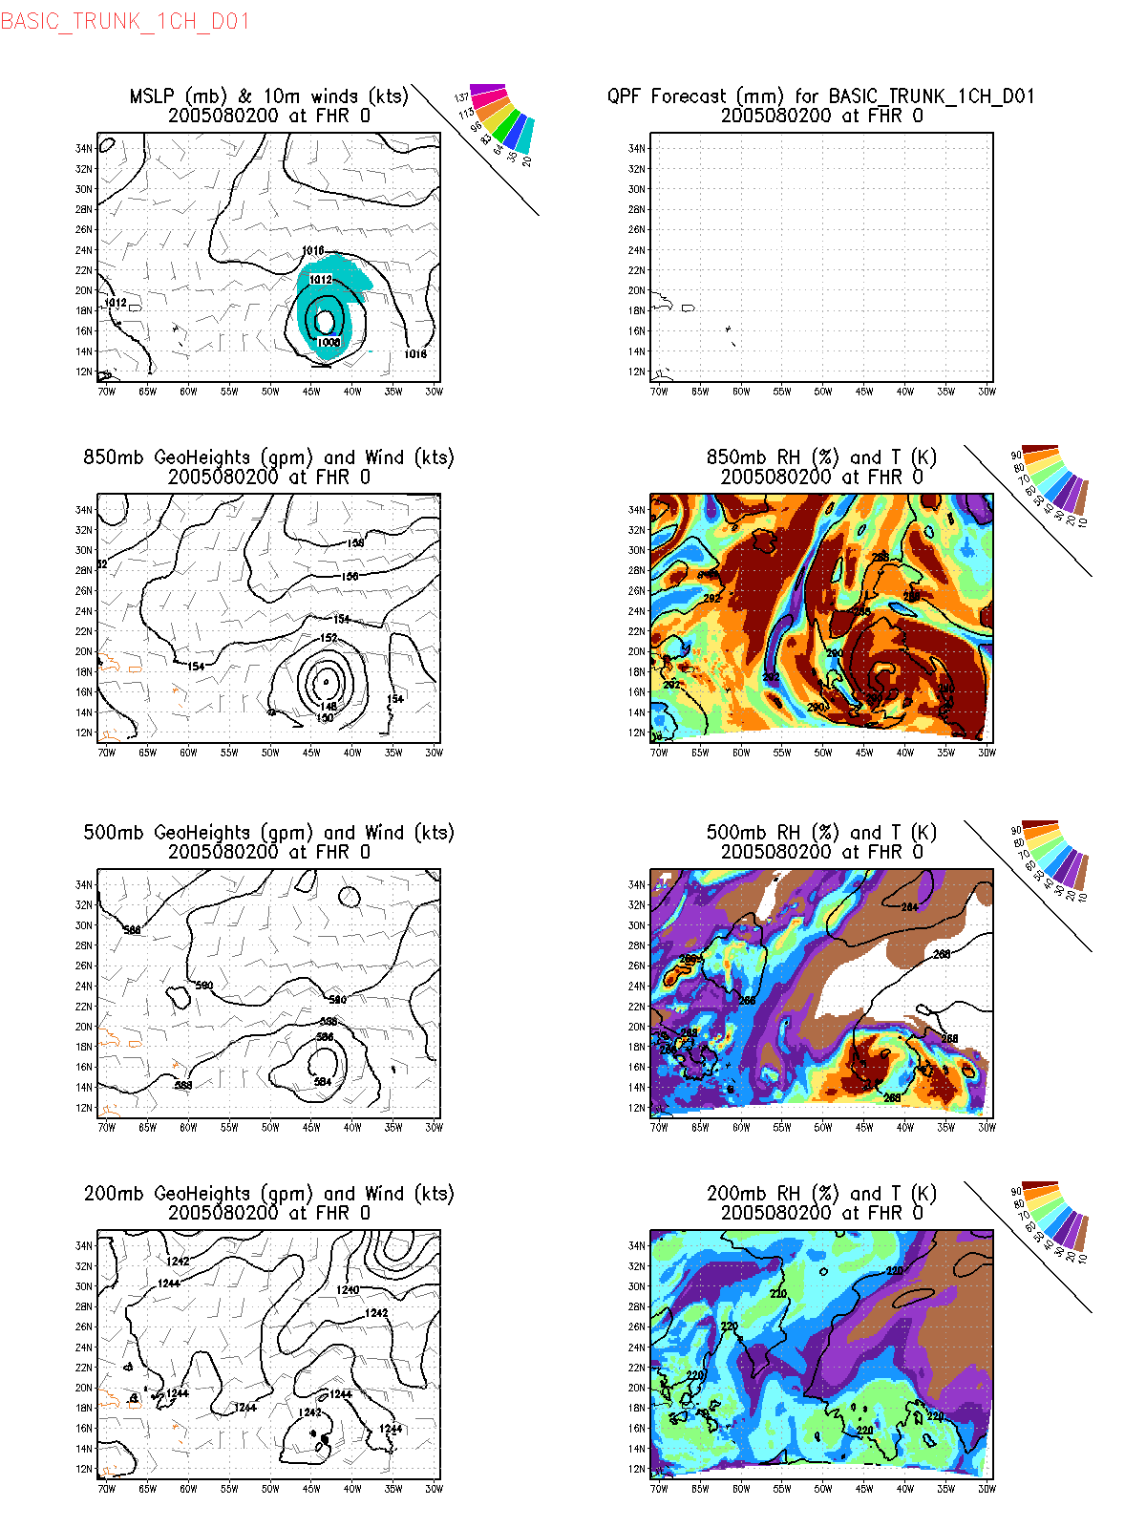

Slide 7
72 h forecasts from 08050200 analyses

Slide 8
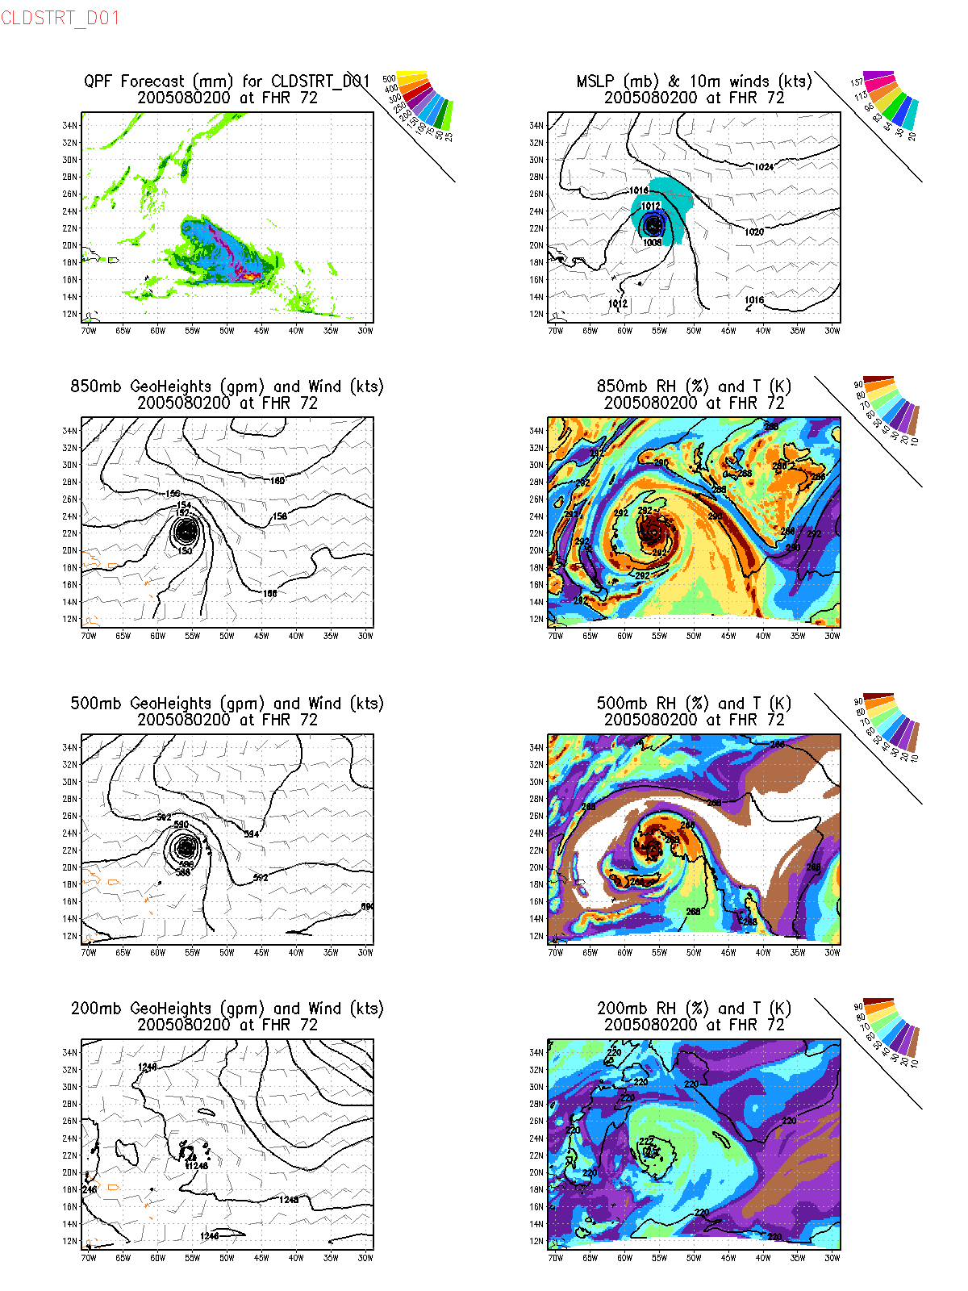
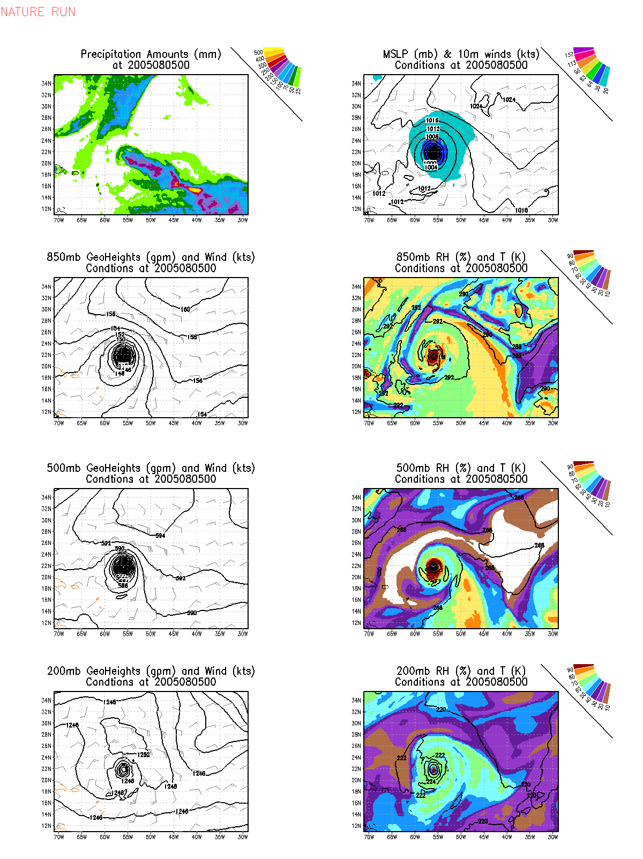

Slide 9
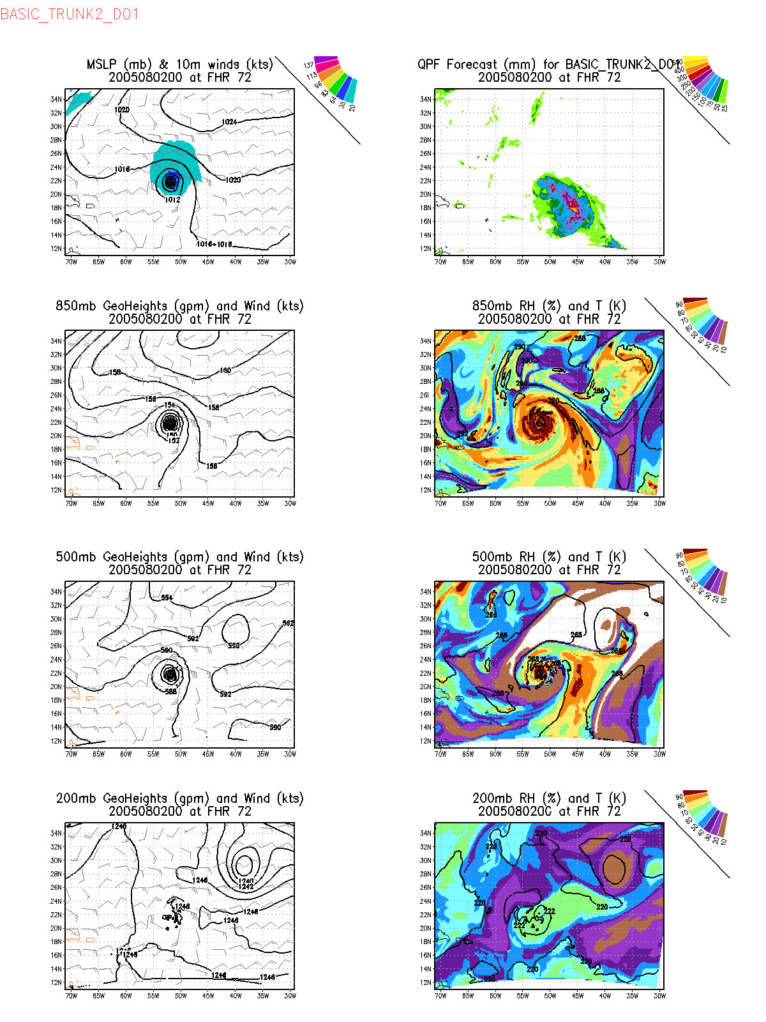

Slide 10
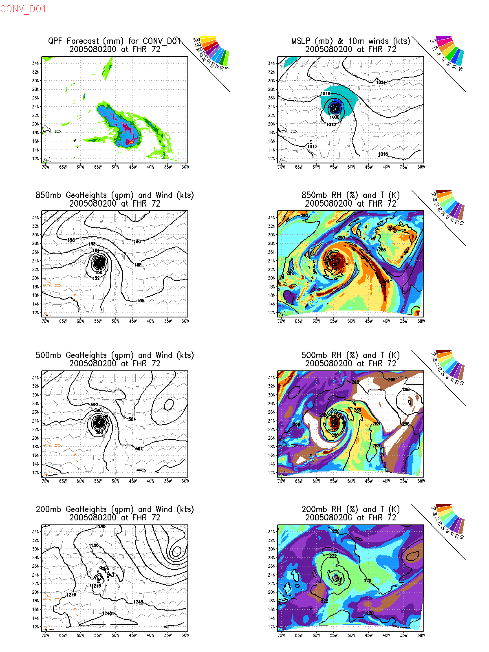

Slide 11
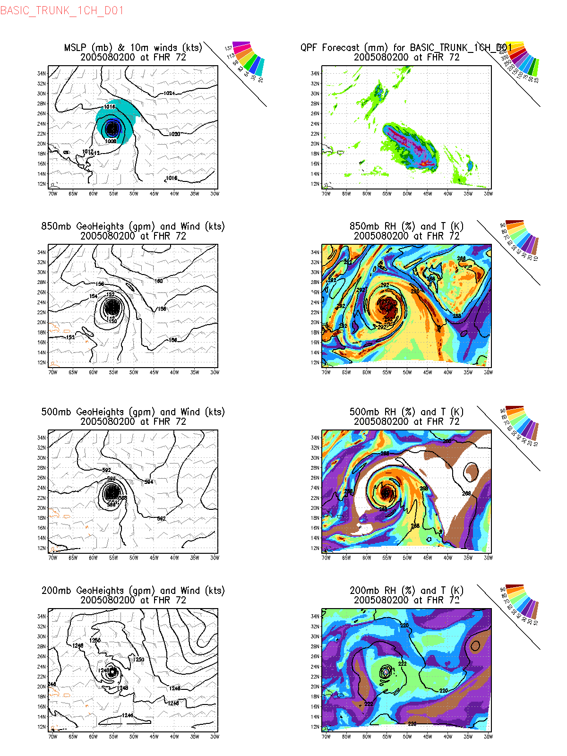

Slide 12
Analyses at 080500 13th cycle

Slide 13
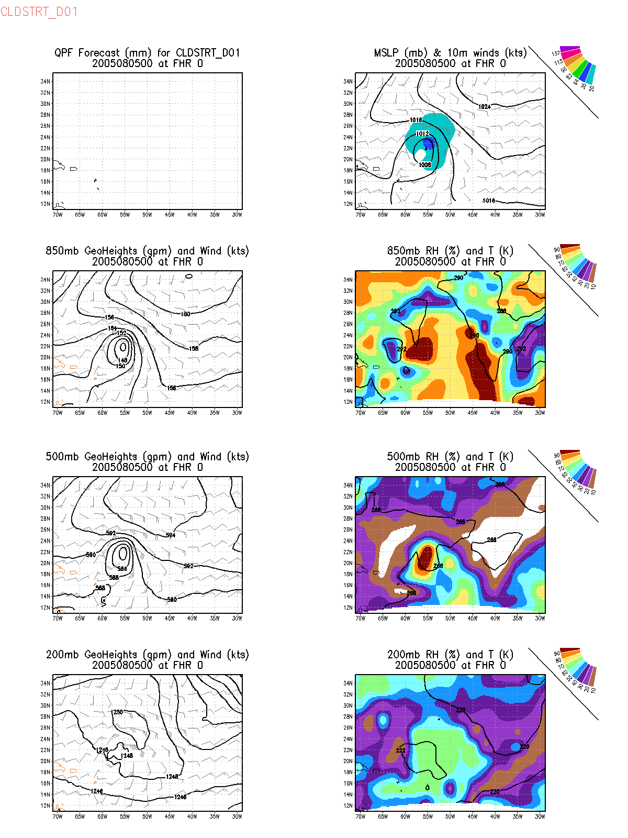

Slide 14
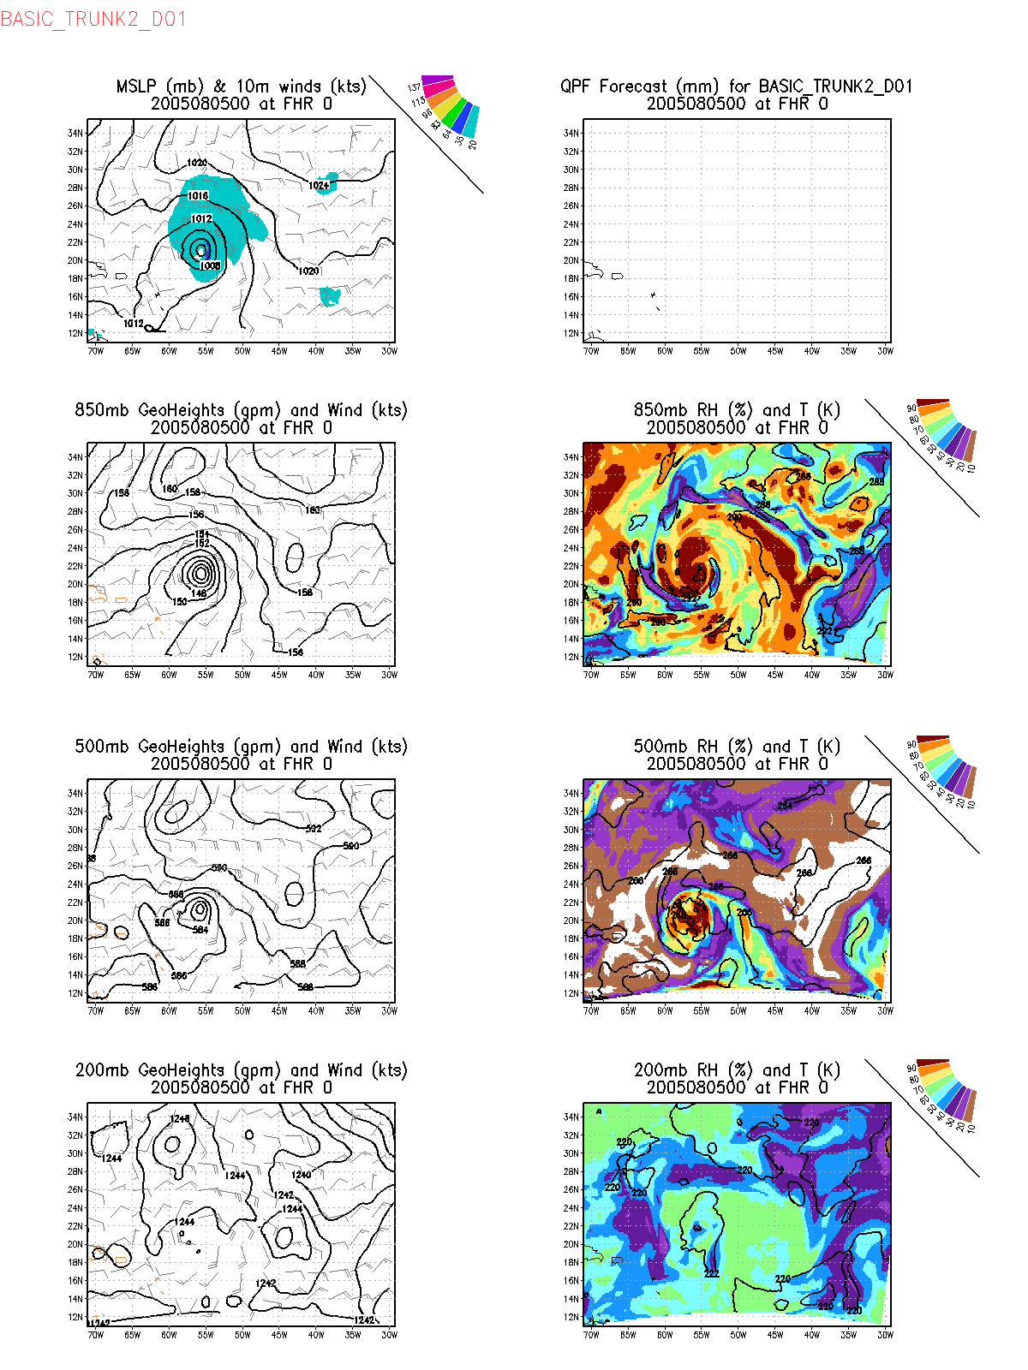

Slide 15
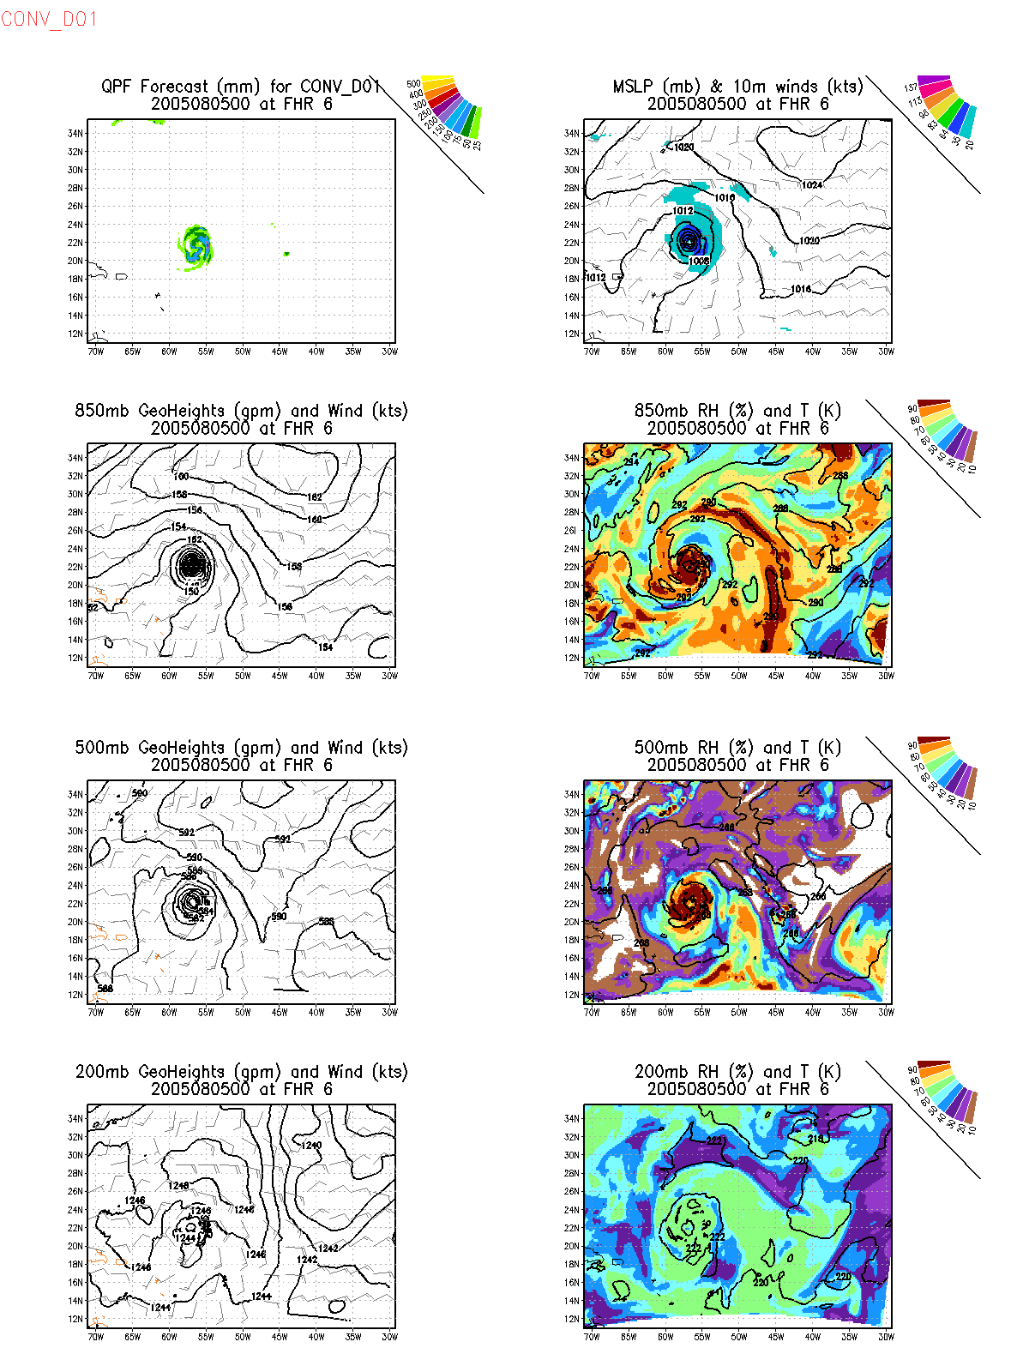

Slide 16
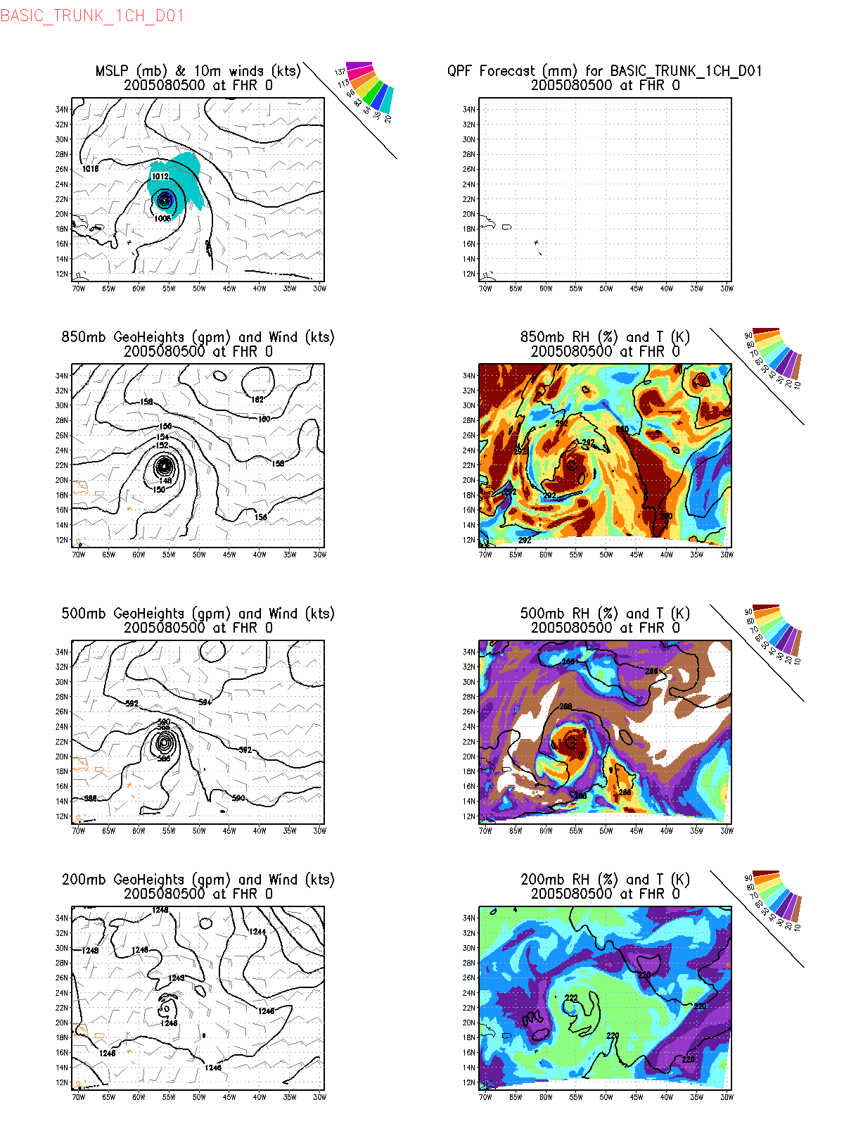

Slide 17
72 h forecasts from 08050200 analyses

Slide 18
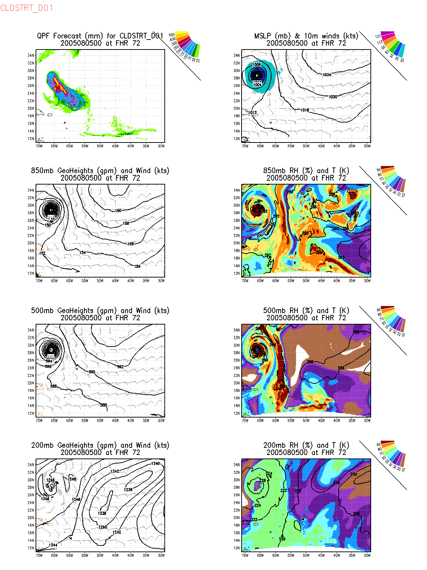
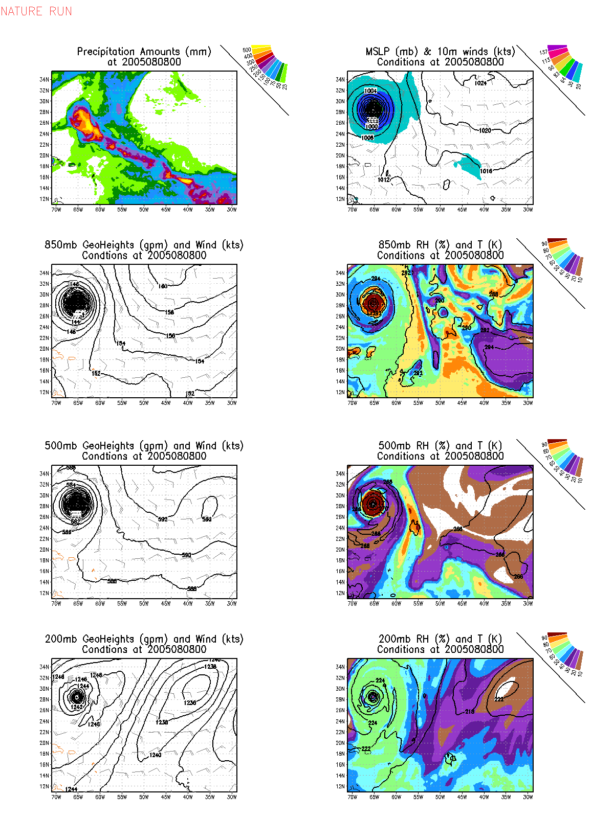

Slide 19
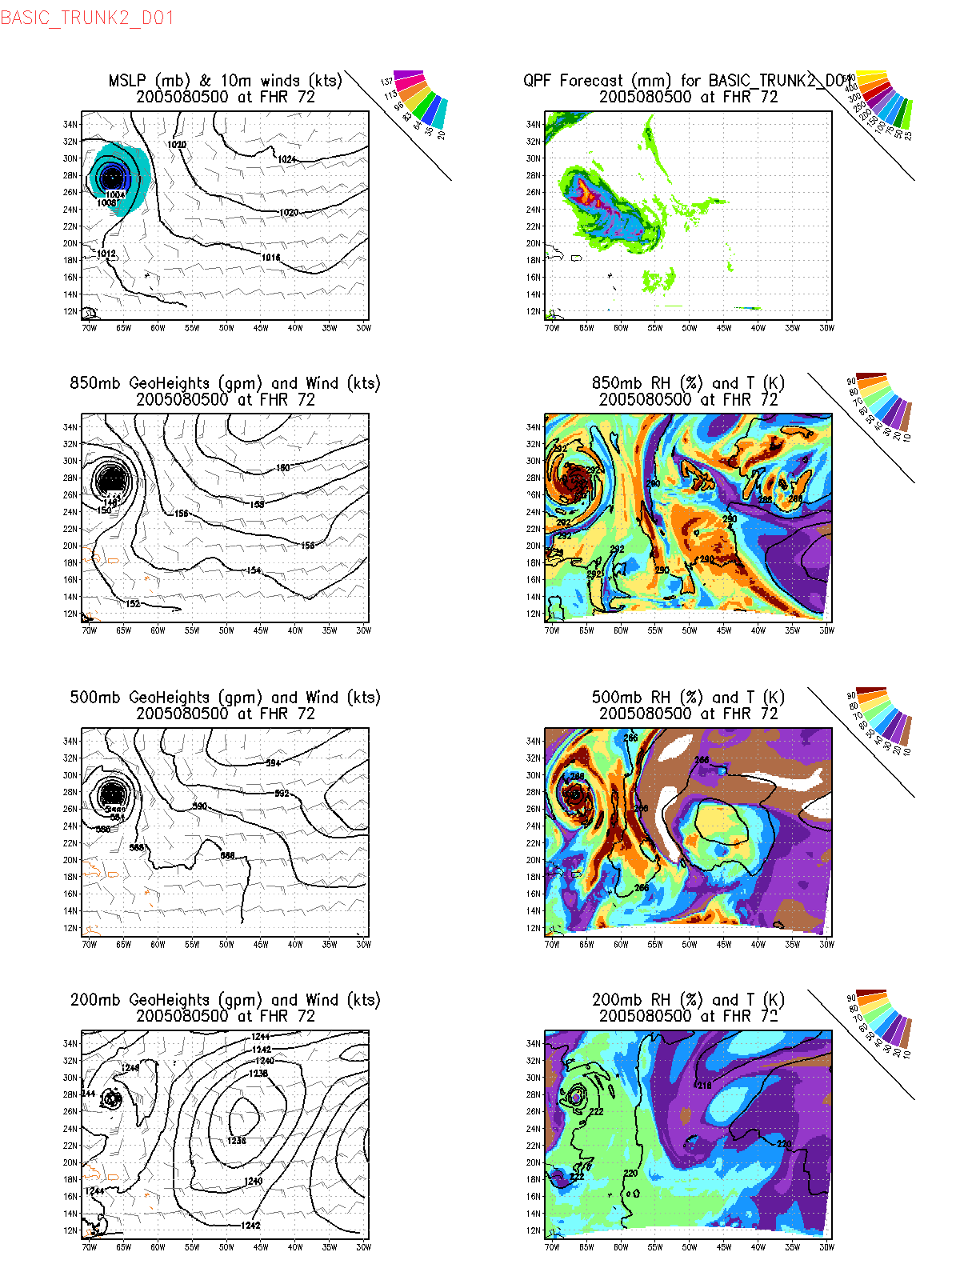

Slide 20
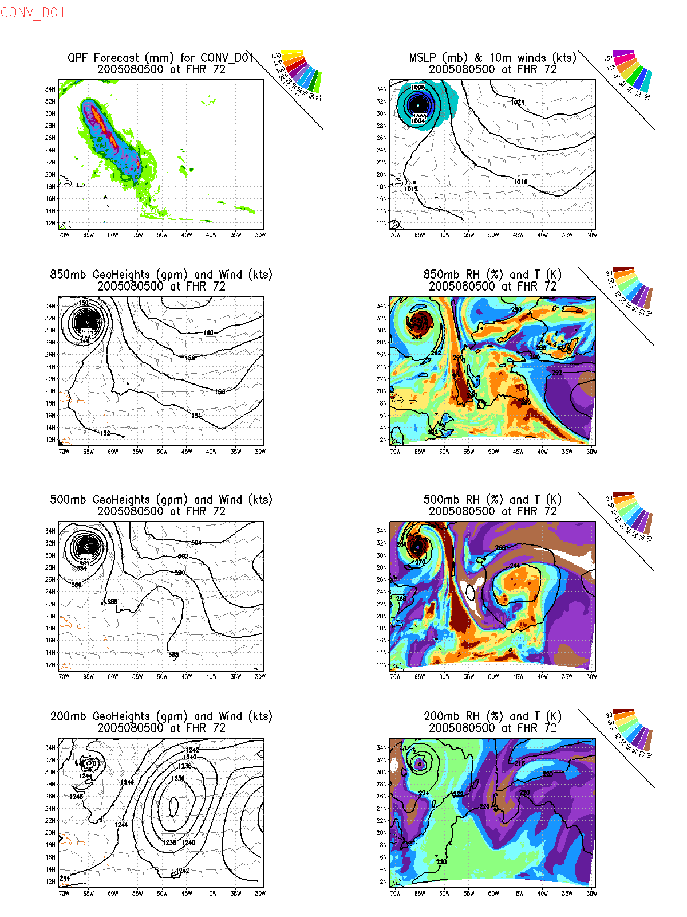

Slide 21
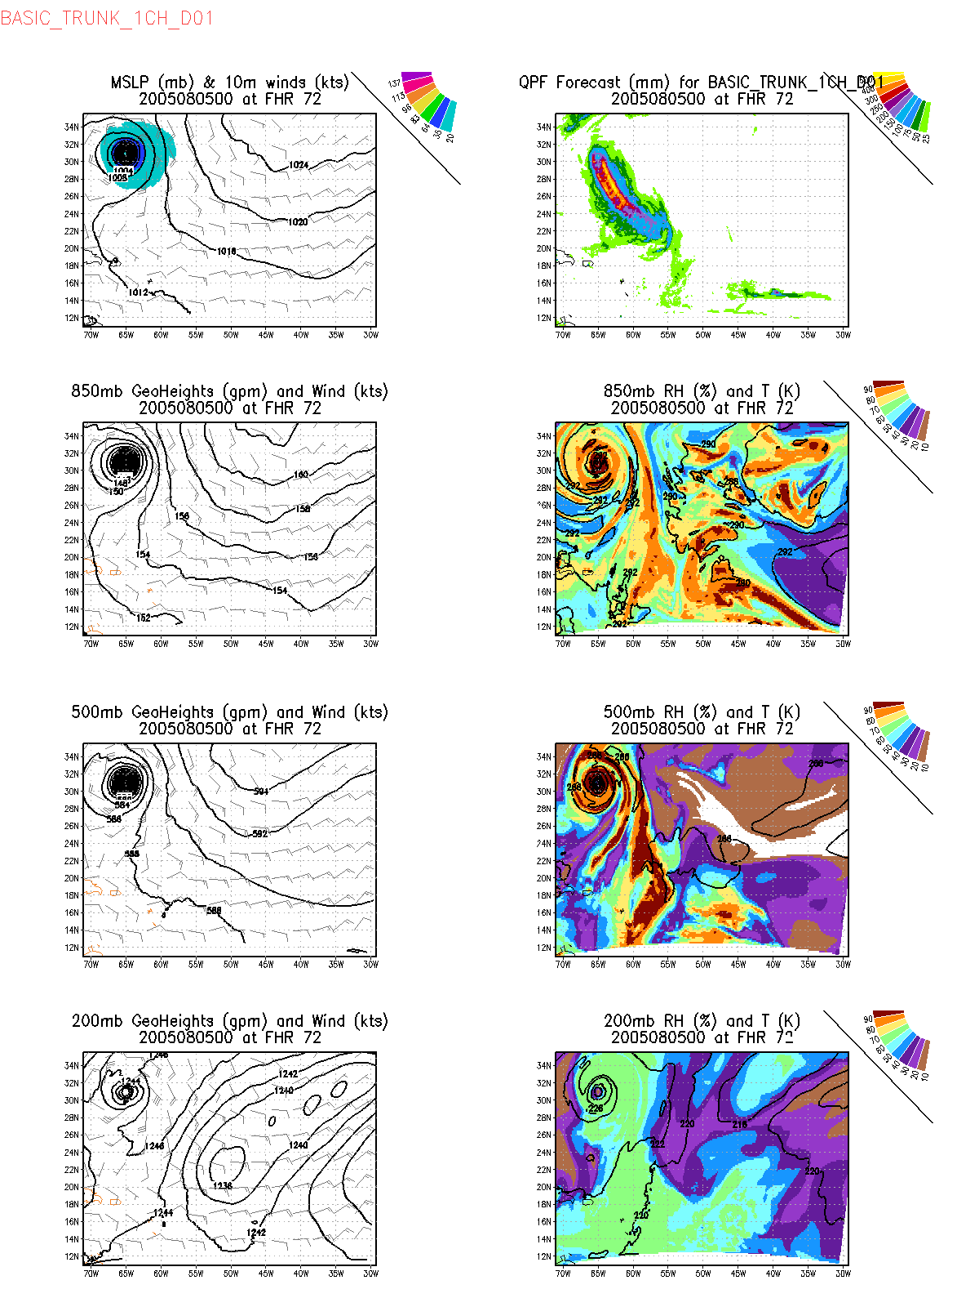

Slide 22
Conclusions
Assimilation of hyperspectral clear radiance is now working properly in GSI
Impacts on the TC forecast with respect to the control (using global OSSE observations) are
reduced storm size
slightly slower storm motion
Not much impact on the intensity
One channel experiment curiously does not produce much different result from the full set of channels
Neither experiment adds much to simple cold start in terms of TC strength and size

Slide 23
EnKF test using only non-satellite observations from the global OSSE 2nd cycle (so far only 2 performed)

Slide 24
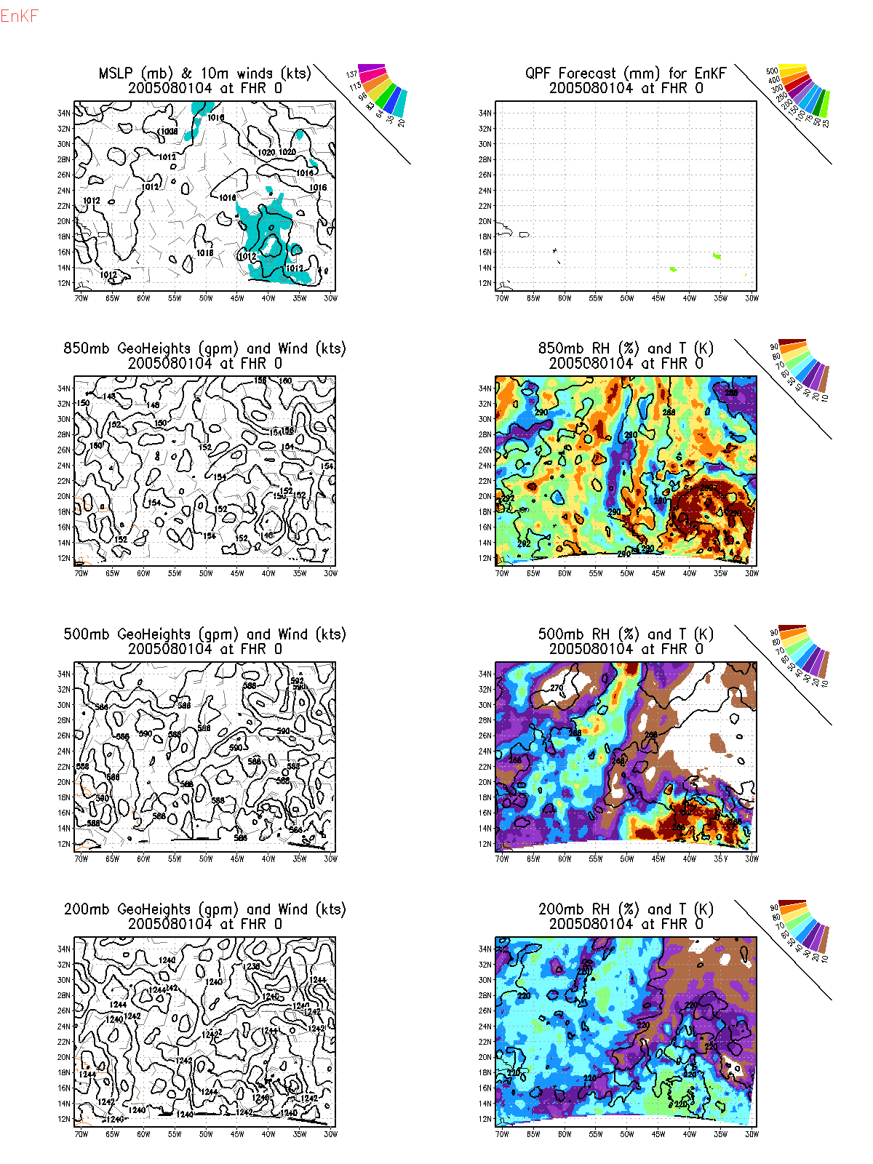
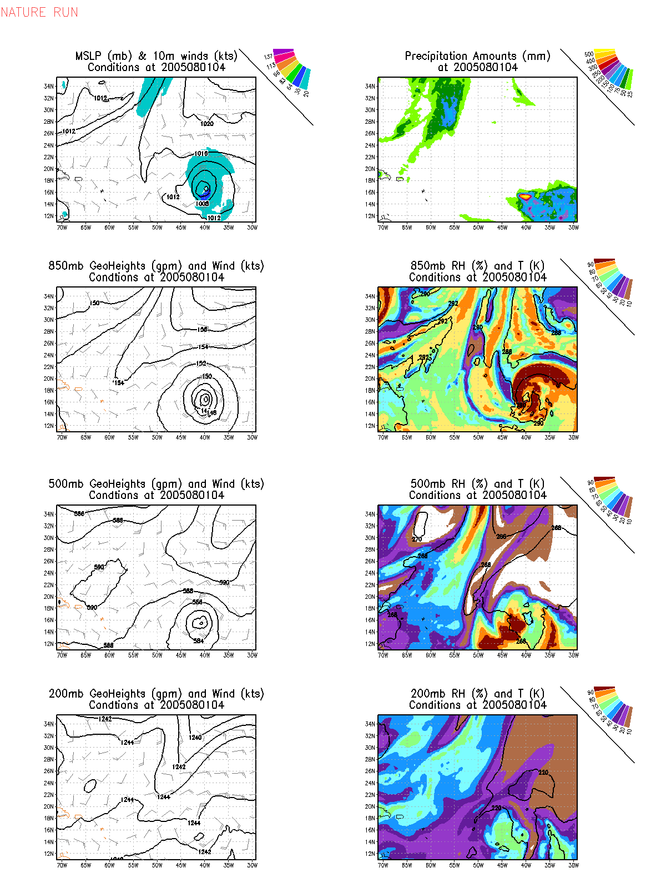

Slide 25
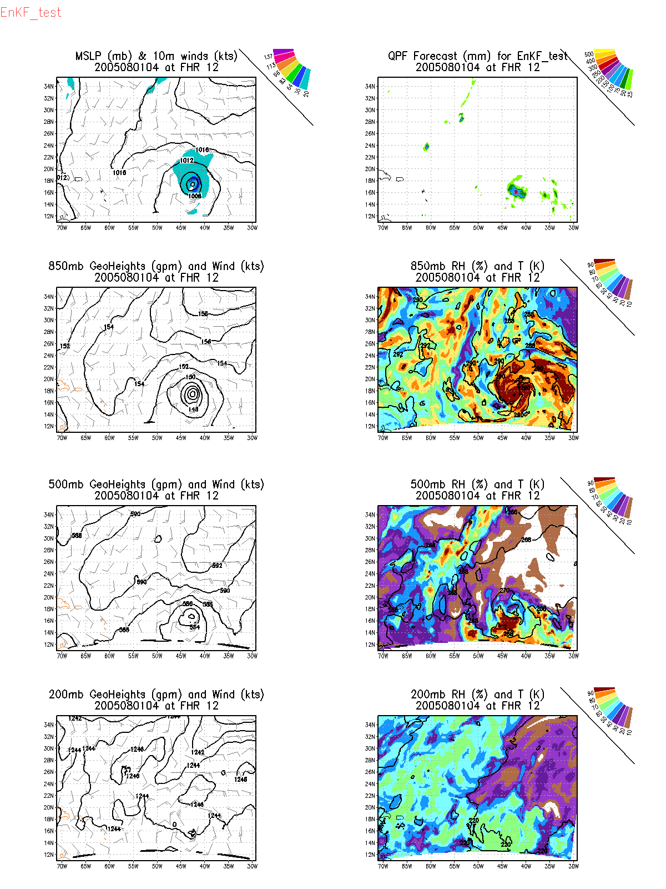
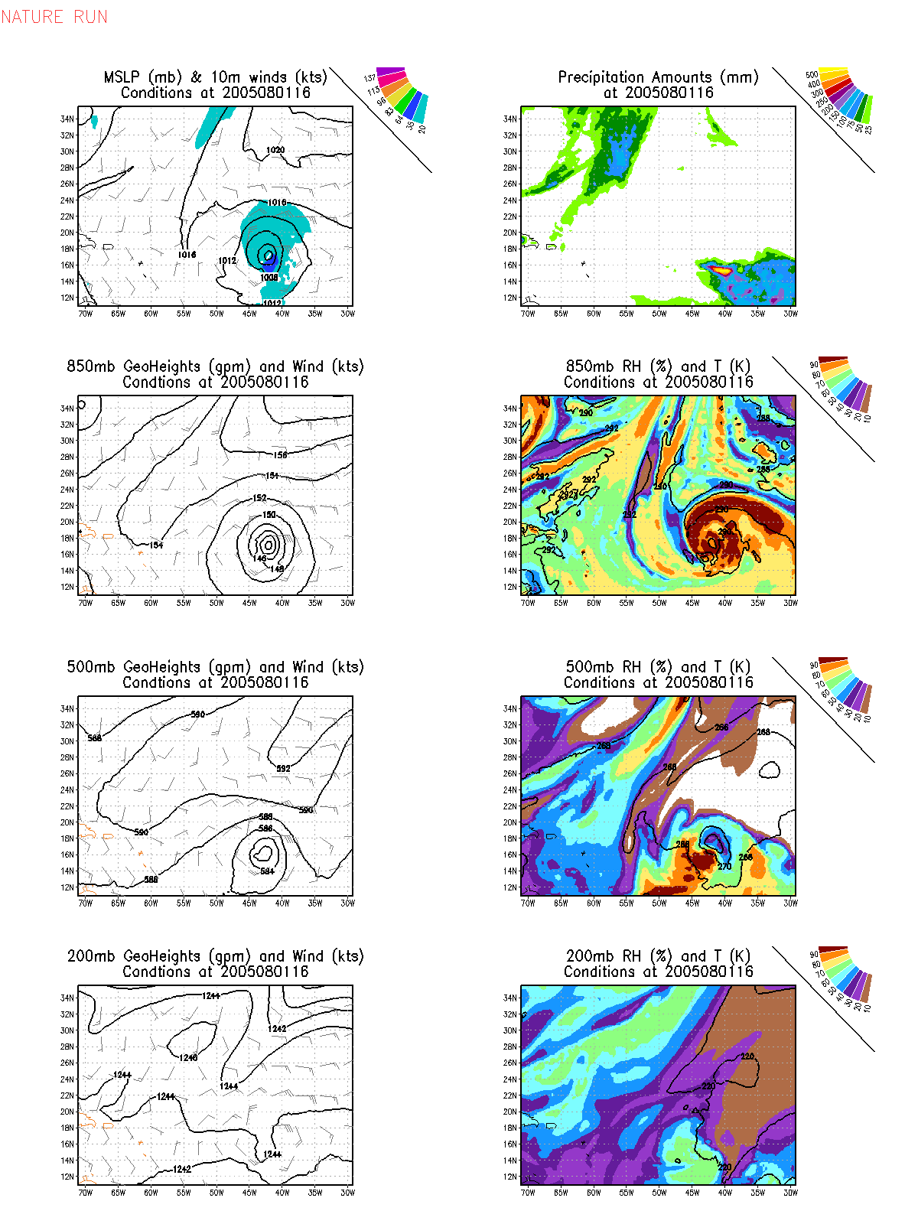

Slide 26
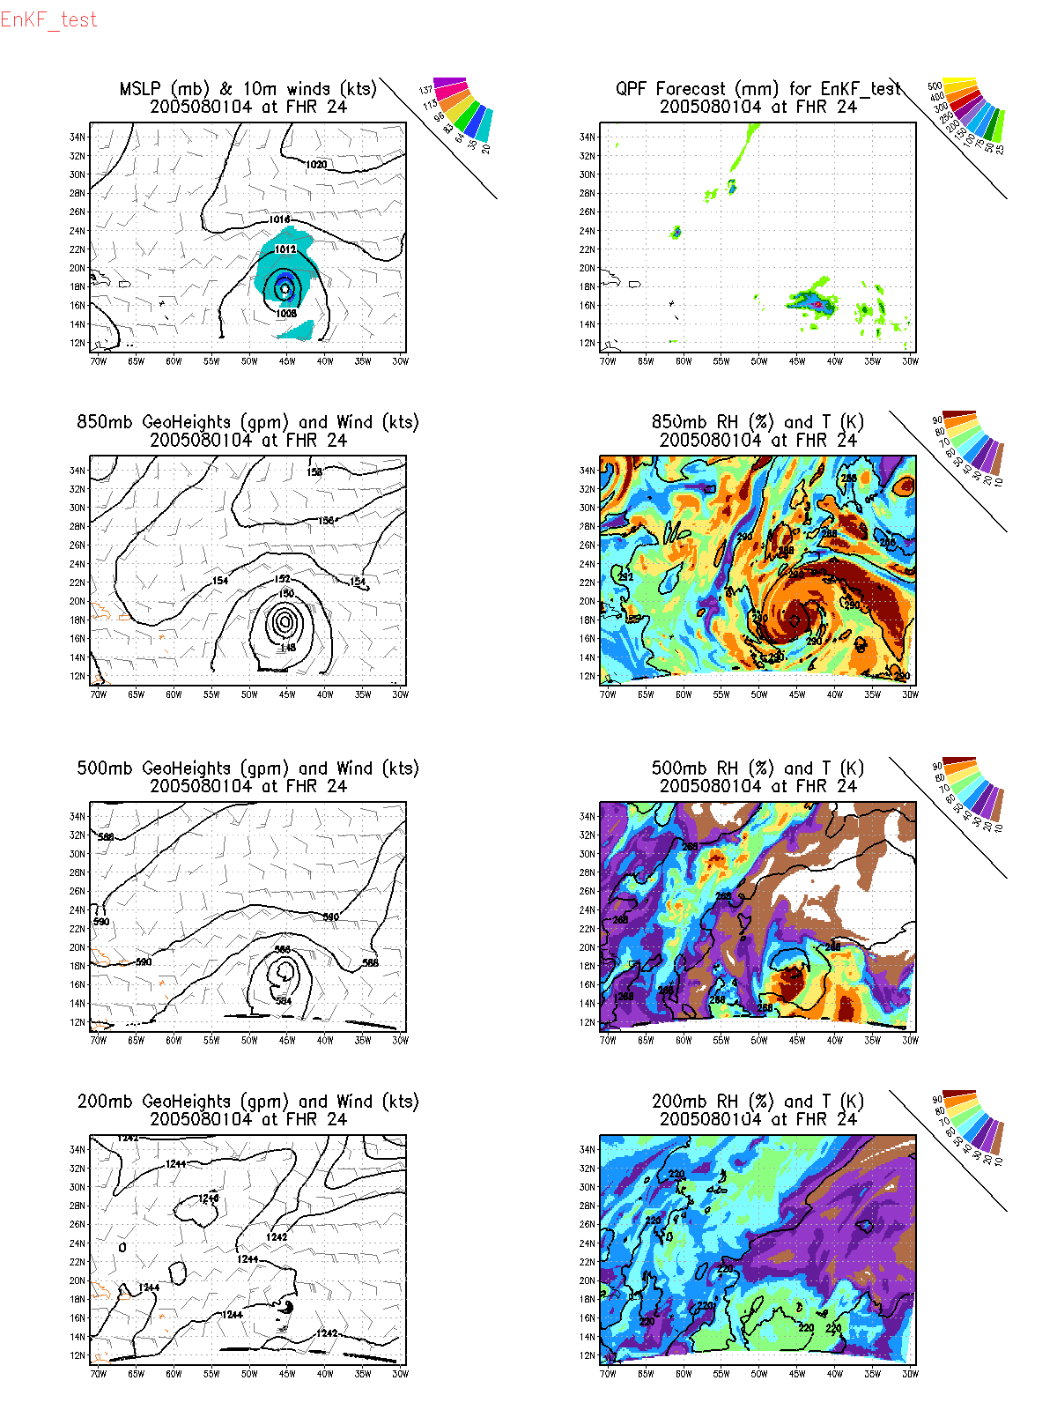
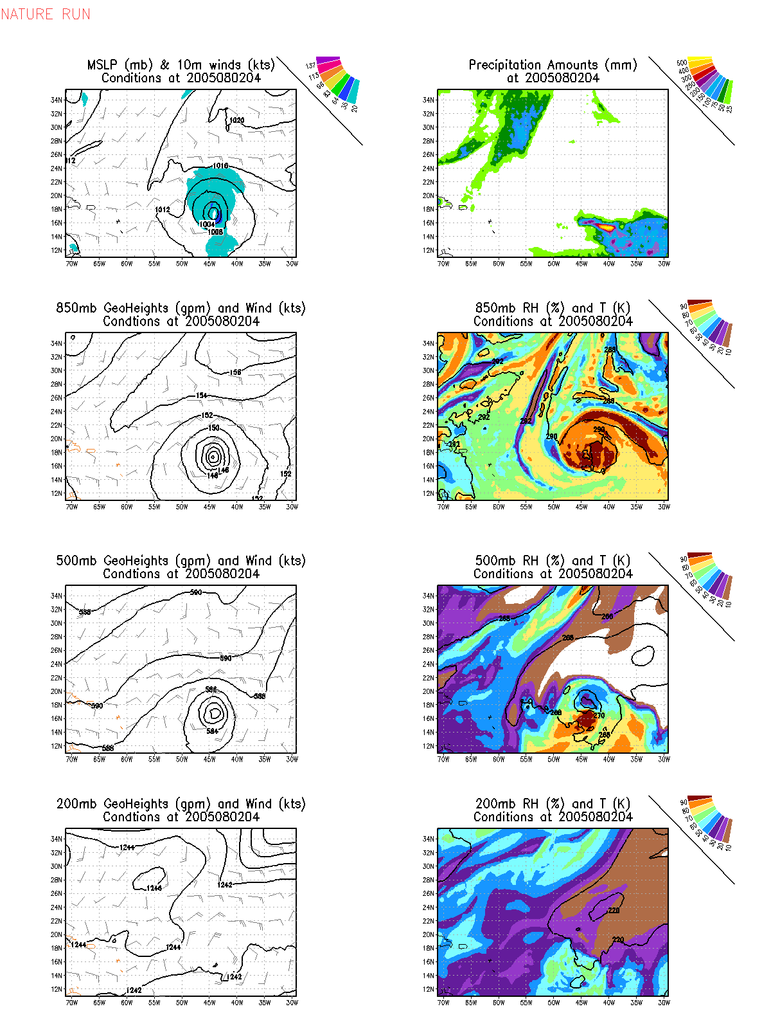

Slide 27
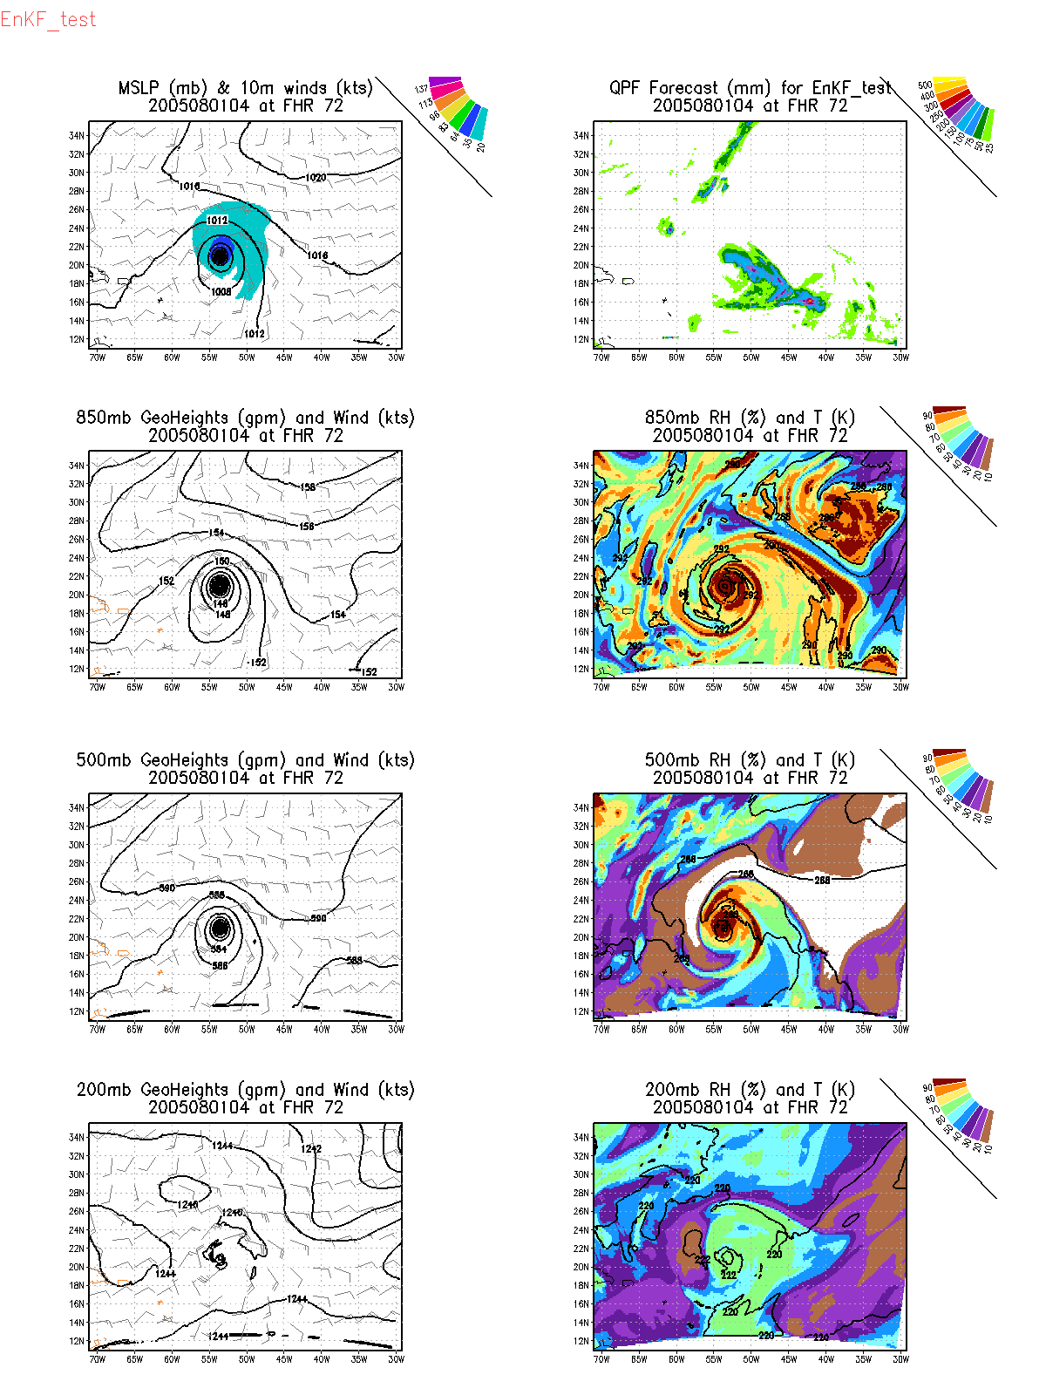
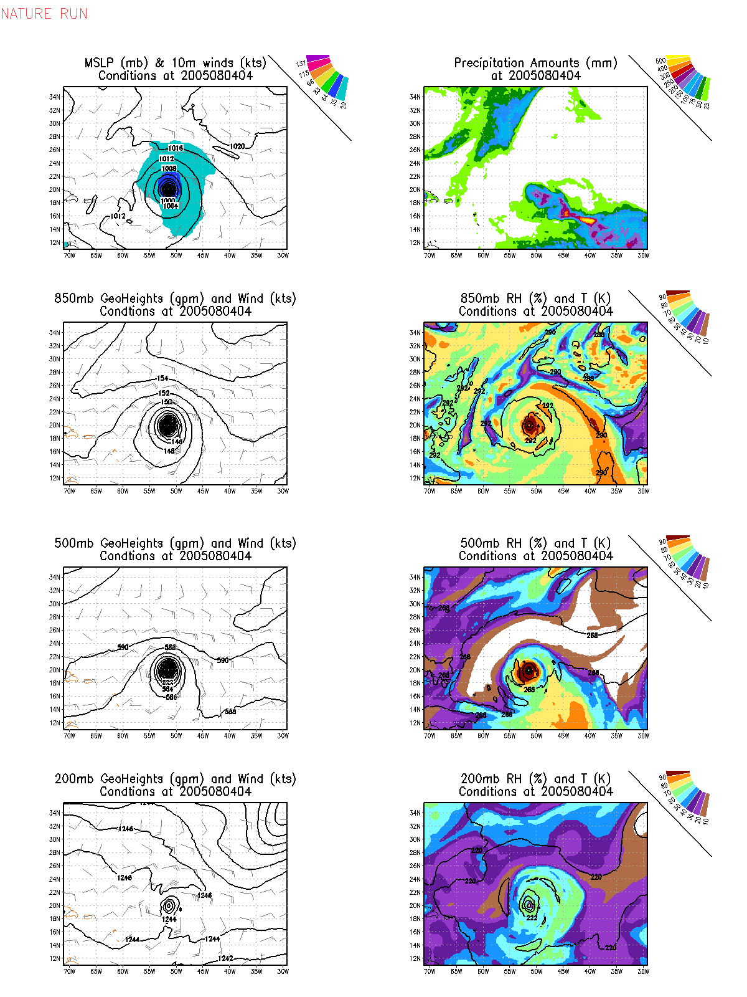

Slide 28
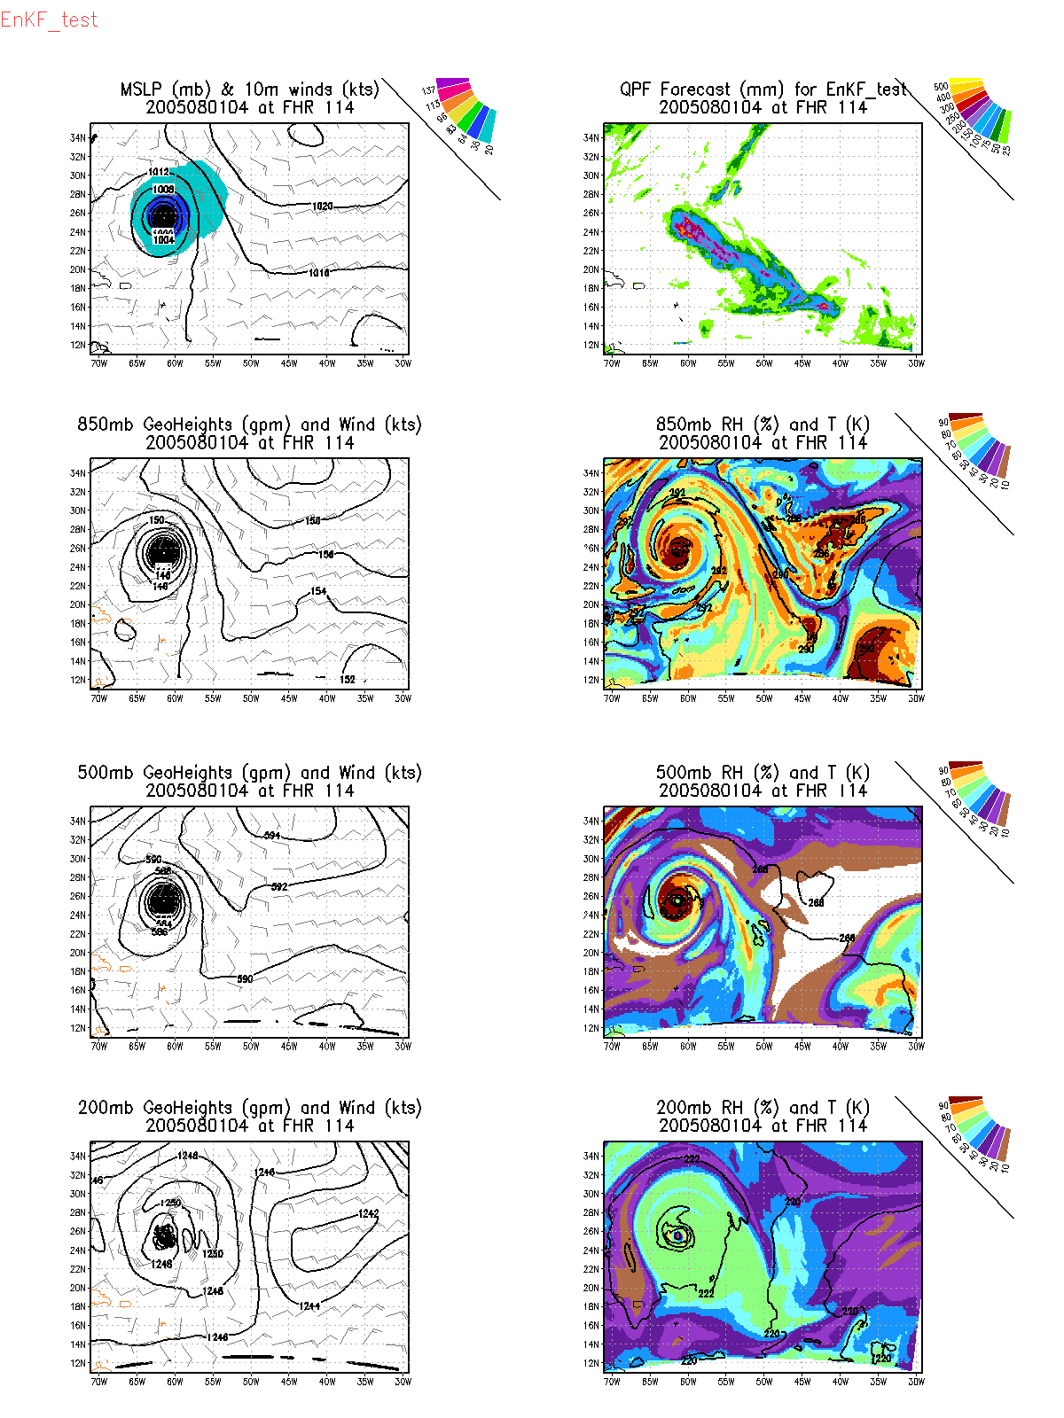
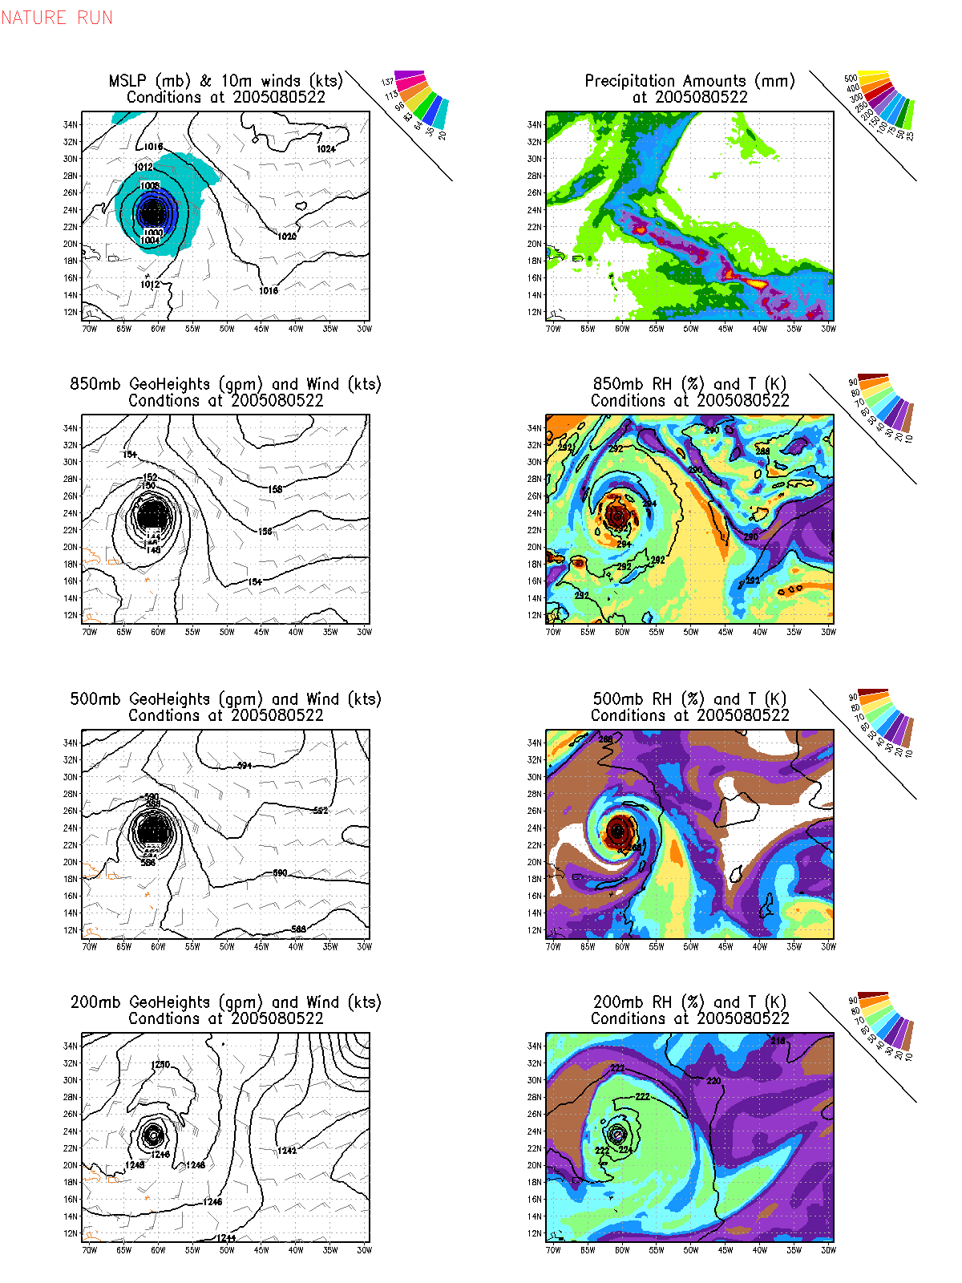

Slide 29
Background error covariance using HWRF forecast ensemble
We have a large ensemble of HWRF forecasts
Take a look at
fhttps://drive.google.com/a/noaa.gov/folderview?id=0BwSVcdNeBxQpSTY3Z1IzSE5fR1U&usp=sharing
8 experiments
Up to 27 cycles in some experiments
These data can be used to compute HWRF-based background error covariance statistics to improve
parameters used in GSI for the background errors
our climatological covariance perturbations

