Slide 1
OSSE Framework
The regional OSSE (Observing System Simulation Experiment) framework described here was developed at NOAA/AOML and UM/RSMAS and features a high-resolution regional nature run embedded within a lower-resolution global nature run. Simulated observations are generated and provided to a data assimilation scheme which provides analyses for a high-resolution regional forecast model.
· Nature Runs
- ECMWF: low-resolution T511 (~40km) “Joint OSSE Nature Run”
- WRF-ARW: high-resolution 27km regional domain with 9/3/1 km storm-following nests (v3.2.1)
· Data Assimilation Scheme
- GSI: Gridpoint Statistical Interpolation. a standard 3D variational assimilation scheme (v3.3). Analyses performed at 9km resolution.
· Forecast Model
- HWRF: the 2014 operational Hurricane-WRF model (v3.5). Parent domain has ~9km resolution, single storm-following nest has ~3km resolution.
DA and model cycling performed every 6/3/1 hours, each run producing a 5-day forecast, for total of 16 cycles.
background
ECMWF NATURE RUN
observation
simulator
SYNTHETIC DATA
GSI
ANALYSIS
HWRF
WRF NATURE RUN
FORECASTS
verification

Slide 2
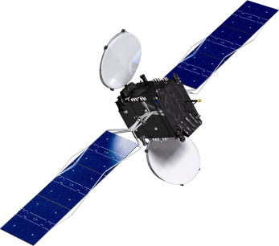
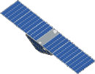

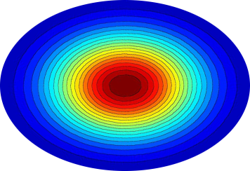
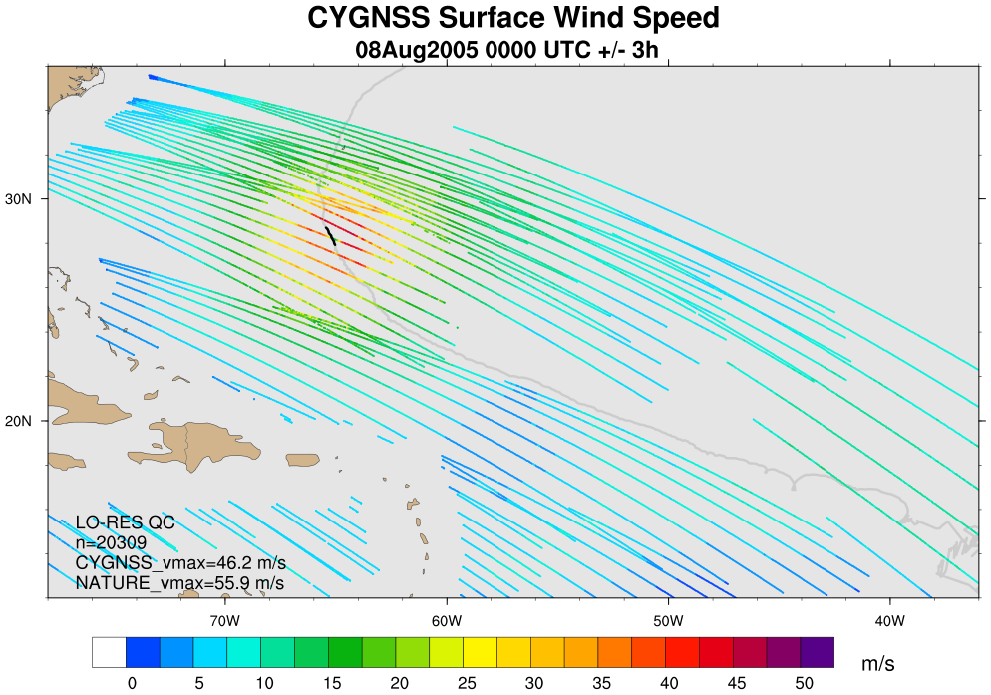
Observational Data: CYGNSS
GPS
· The Cyclone Global Navigation Satellite System (CYGNSS) is a NASA mission planned for launch in 2016 that consists of a constellation of 8 micro-satellites.
· These swan-sized satellites will receive signals reflected off the ocean by existing GPS satellites.
direct signal
CYGNSS
scattered signal
specular point
Fig 1. Geometry of GPS-based quasi-specular surface scattering. The GPS direct signal provides location, timing, and frequency references, while the forward scattered signal contains ocean surface information.
· Scattered signal contains information on ocean surface roughness, from which a wind speed can be derived under precipitating conditions and with sensitivity beyond 50 m/s.
· Spatial and temporal coverage pro-vided by the 8-satellite constellation will be superior to ASCAT and OSCAT combined.
Fig 2. Example of synthetic CYGNSS data coverage over a 6-hour window. Colors correspond to retrieved wind speed.

Slide 3
List of experiments
VAM configurations
  CYG_SPD (control + CYGNSS wind speeds, no direction)
  CYG_VEC (control + CYGNSS wind speeds with VAM analysis directions)
  VAM_VEC (control + VAM analysis wind speed and direction)
DA cycling frequency
  6 HRL (obs assimilated every 6 hours, 5-day forecasts made every 6 hours)
  3 HRL (obs assimilated every 3 hours, 5-day forecasts made every 6 hours)
  1 HRL (obs assimilated every 1 hour, 5-day forecasts made every 6 hours)

Slide 4
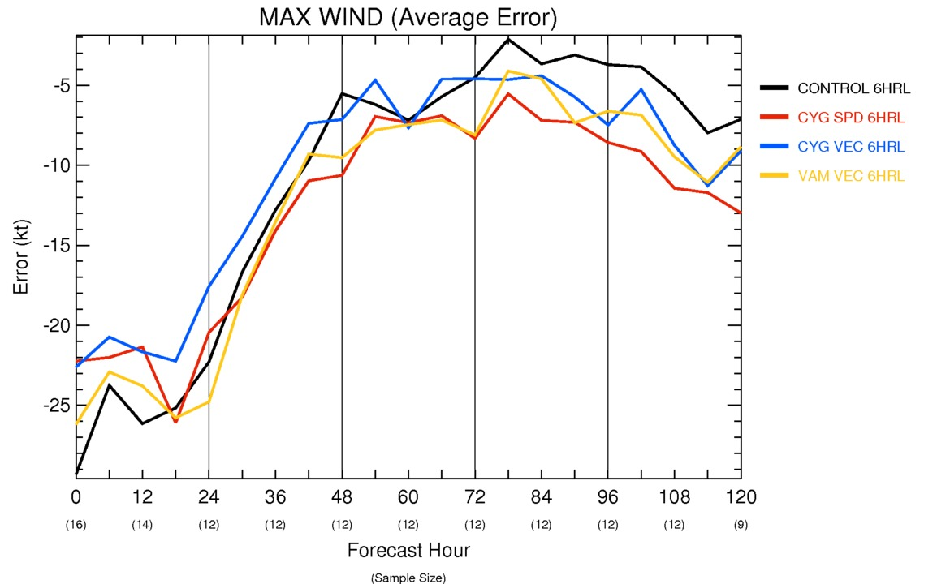
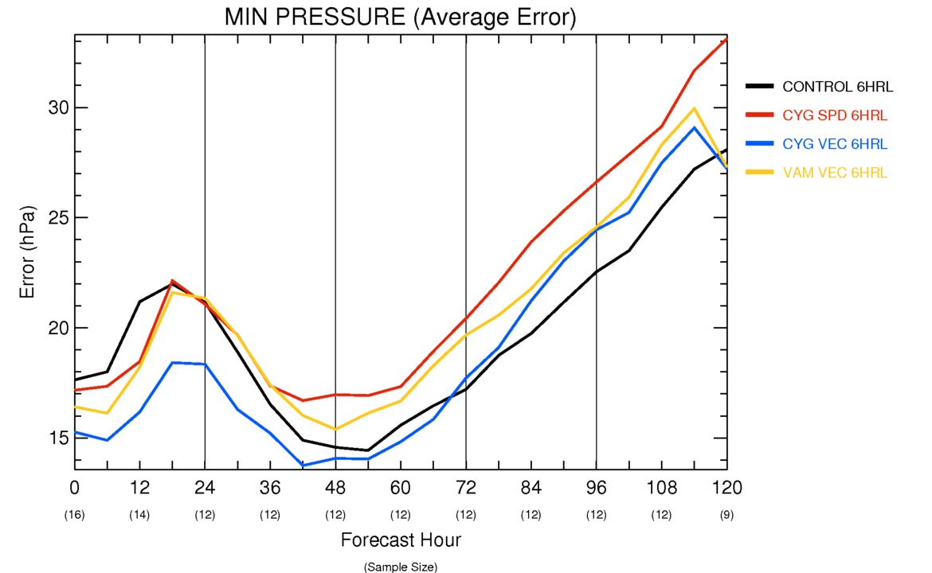
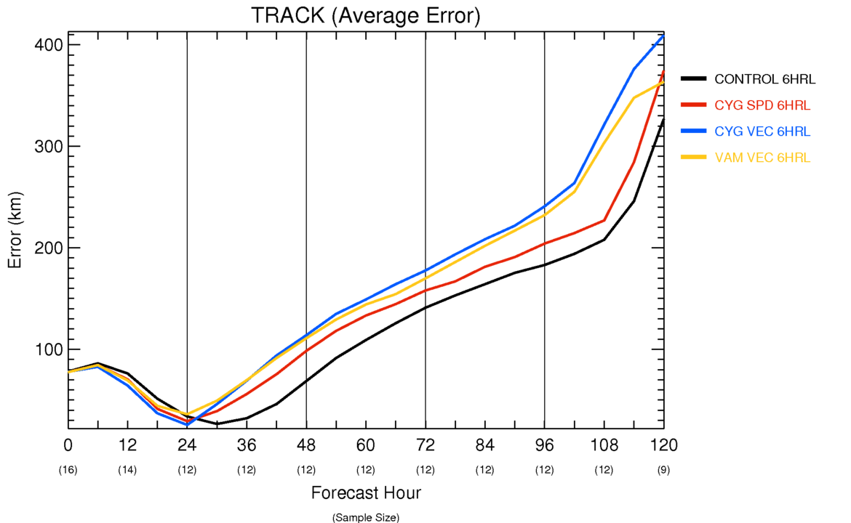
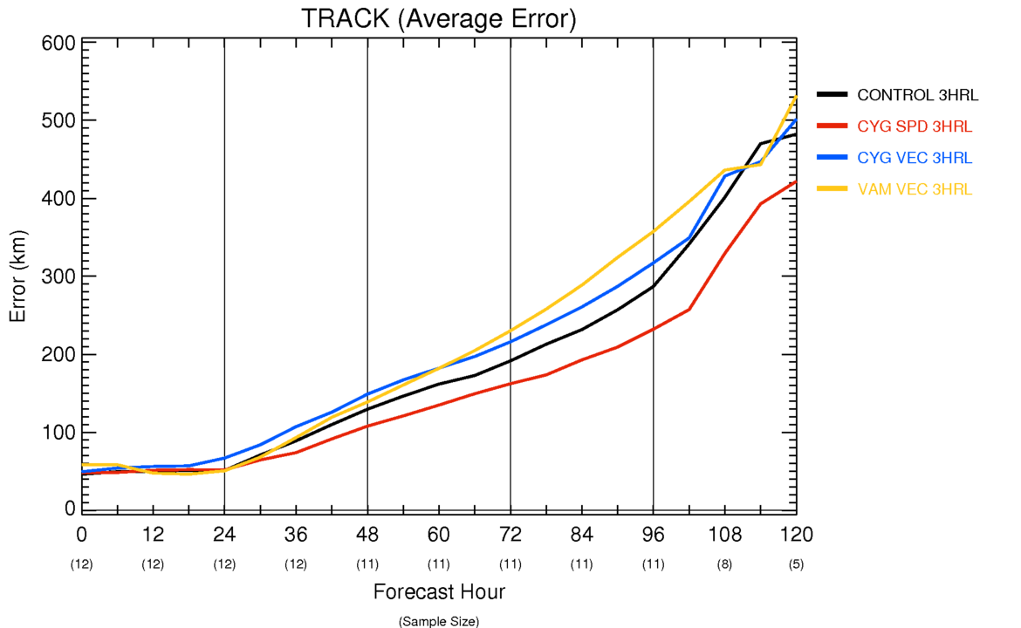
6 HRL storm statistics

Slide 5
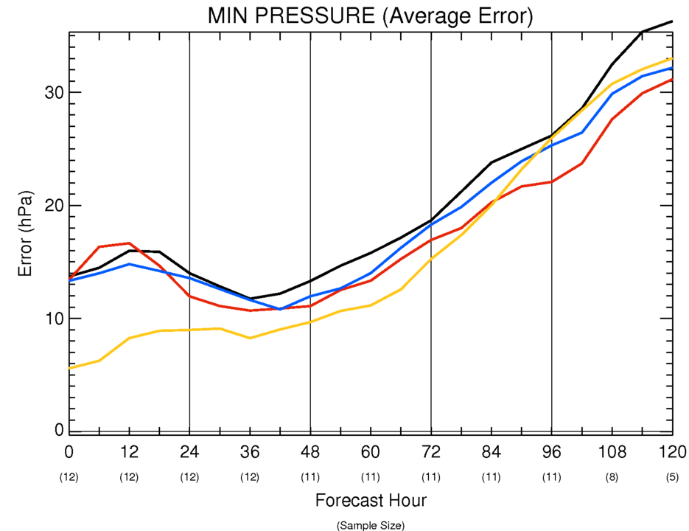
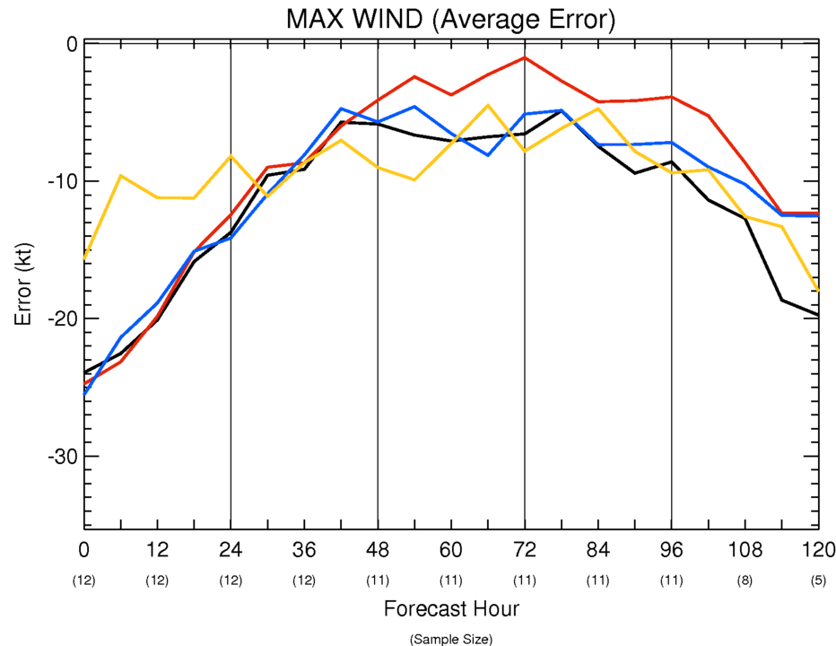
3 HRL storm statistics

Slide 6
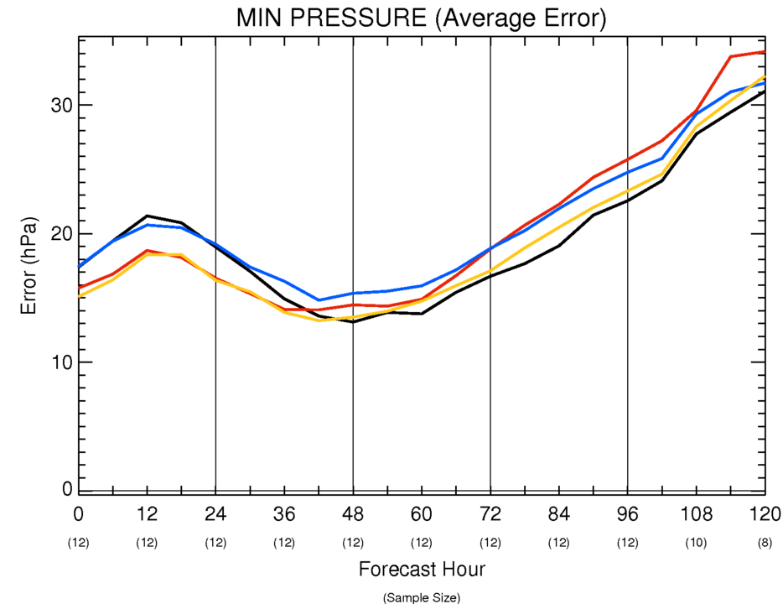
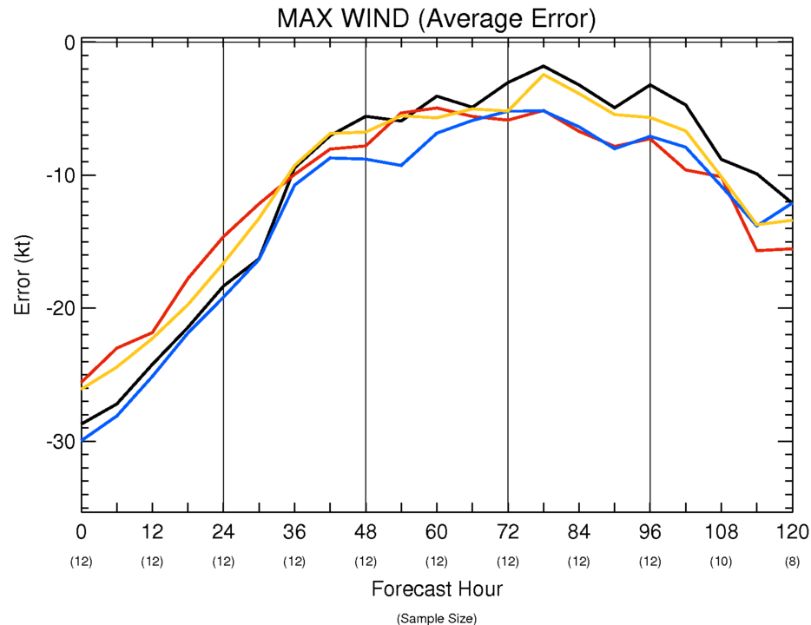
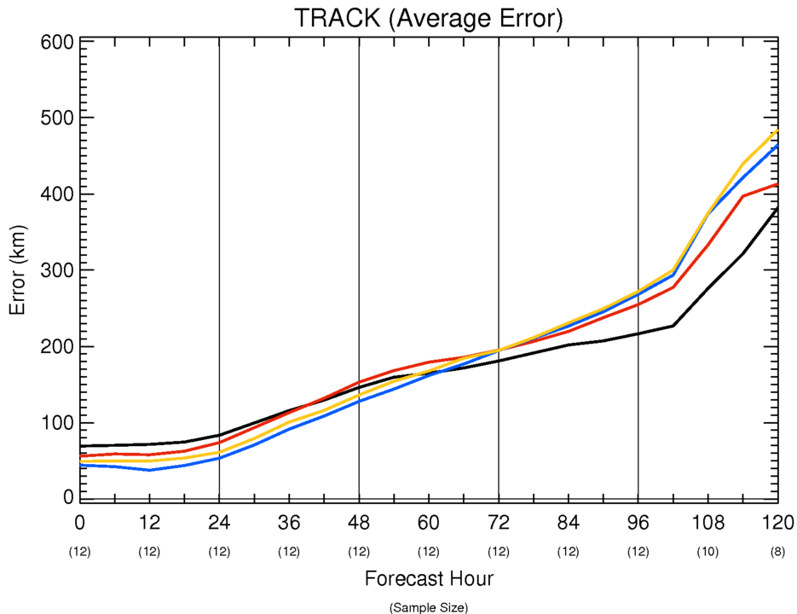
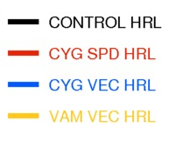
1 HRL storm statistics

Slide 7
Summary
The 3 HRL analysis is better than CONTROL in all experiments
On average, the 3 HRL cycling maintains better performance for about two days, especially for pressure/wind
All CYG and VAM configurations improve track at 0-1 days.

Slide 8
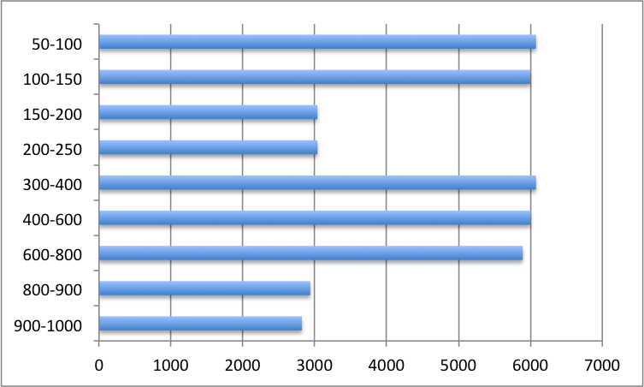
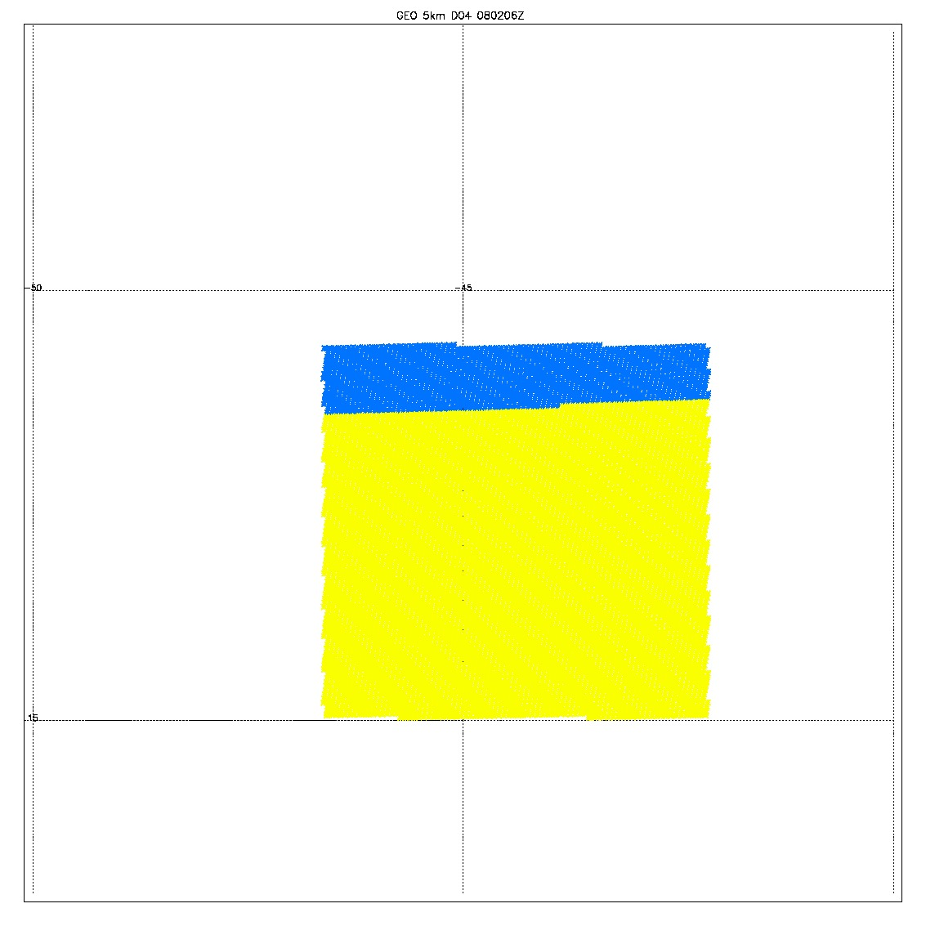
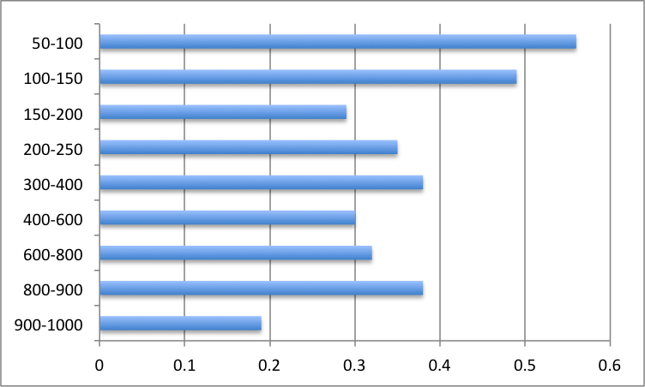
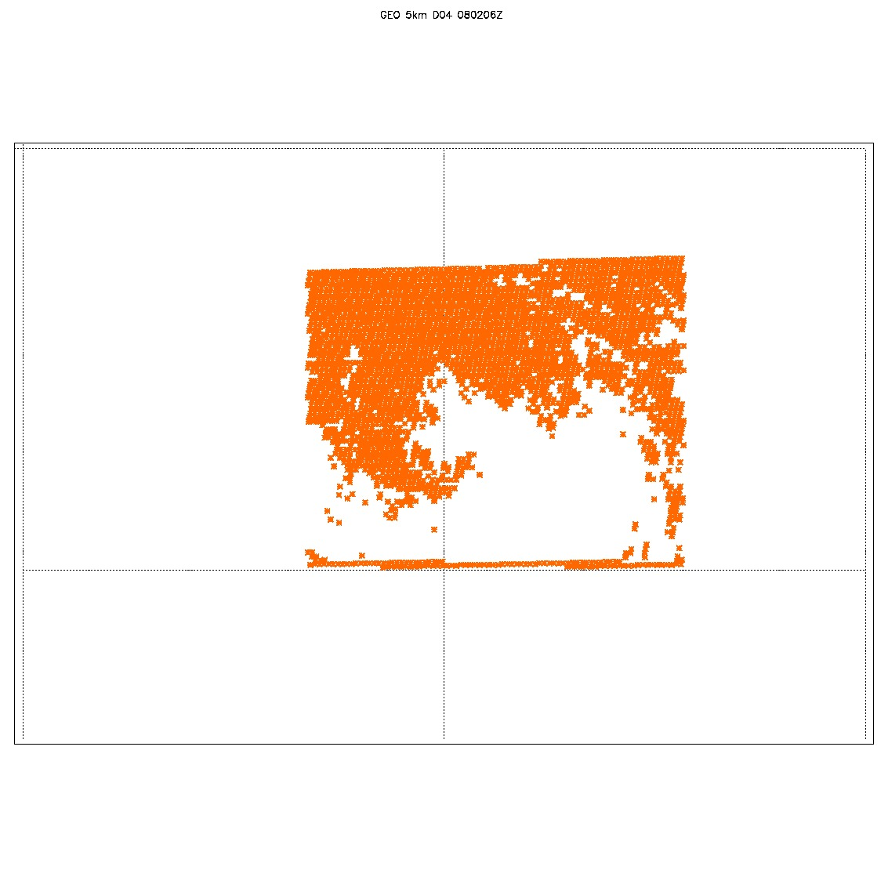
GEO 0802 6Z
AIRS OSSE
Original data; 98588
Filtered data (yellow); 82334
null Data (blue); 16254
14 Levels; 943.8, 813.7, 705.8, 627.9, 544.1, 459.1, 381.9, 306.2, 240.5, 184.4, 142, 109.8, 82.9, 63.3
9 levels removed: 46.9, 30.3, 19.6, 11.5, 5.7, 3.3, 1.8, 0.96, 0.1
Rest of the QCD data point were assimilated 41889

Slide 9
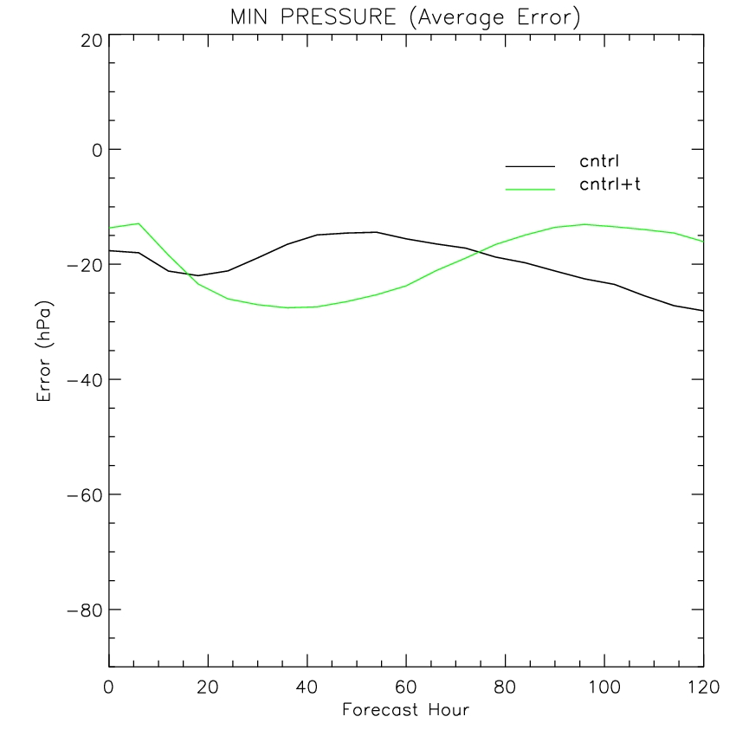
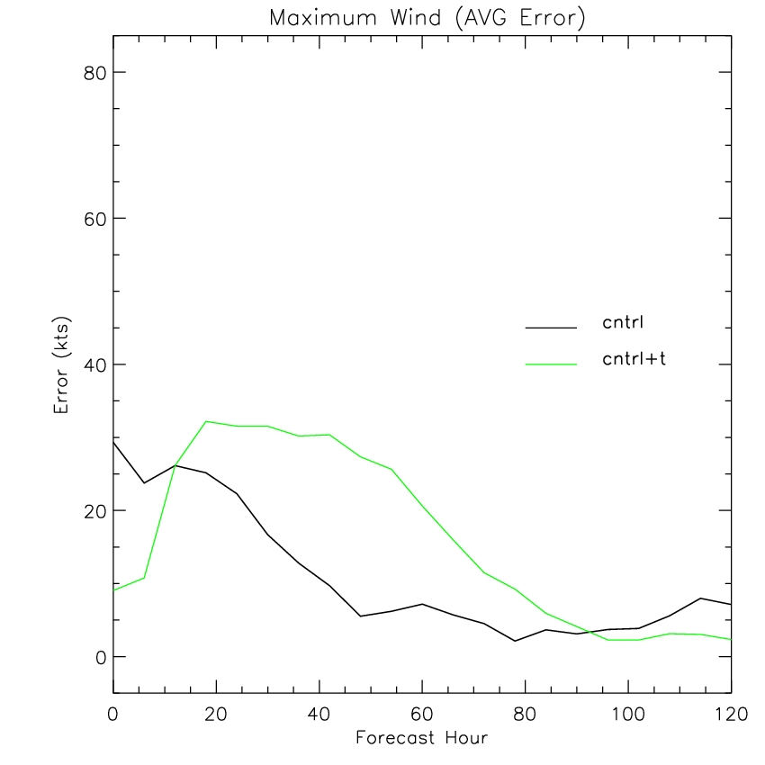
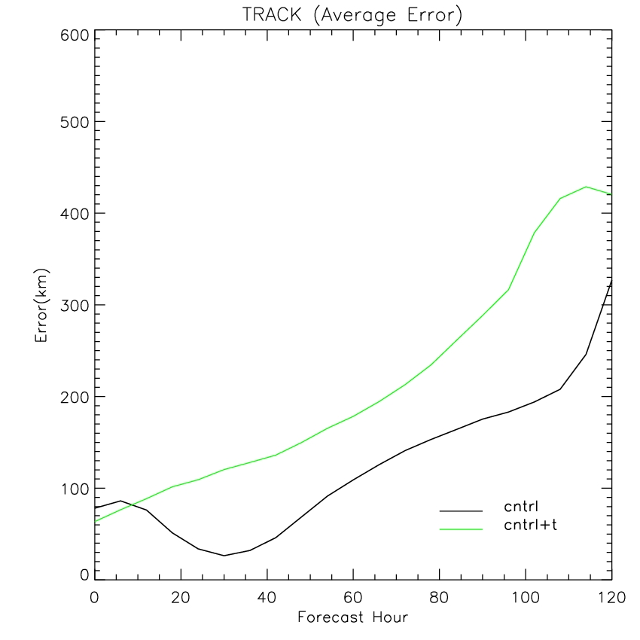
AIRS OSSE
6 HRL storm statistics

