Slide 1
Regional tropical OSSE/OSE system
“OSSE team”
Altug Aksoy, Bachir Annane, Lisa Bucci, Javier Delgado, Xueing Zhang, Tomislava Vukicevic and Robert Atlas

Slide 2
OSSE/OSE system components
Forecast model
  HWRF
  Synchronized research and operational version
Data Assimilation options
  GSI (Gridpoint Statistical Interpolation )
    NOAA operational applied with HWRF
  EnKF (Enseble Kalman Filter)
    HEDAS (HWRF EnKF Data Assimilation developed at AOML)
    GFS-EnKF developed at ESRL/NOAA; operational hybrid DA
  Hybrid EnKF-GSI
    Configured for OSSE/OSE at AOML
Global model data
  GFS (nature or real)
Observations
  Simulated satellite, conventional and airborne
  For OSEs experimental and operational actual observations

Slide 3
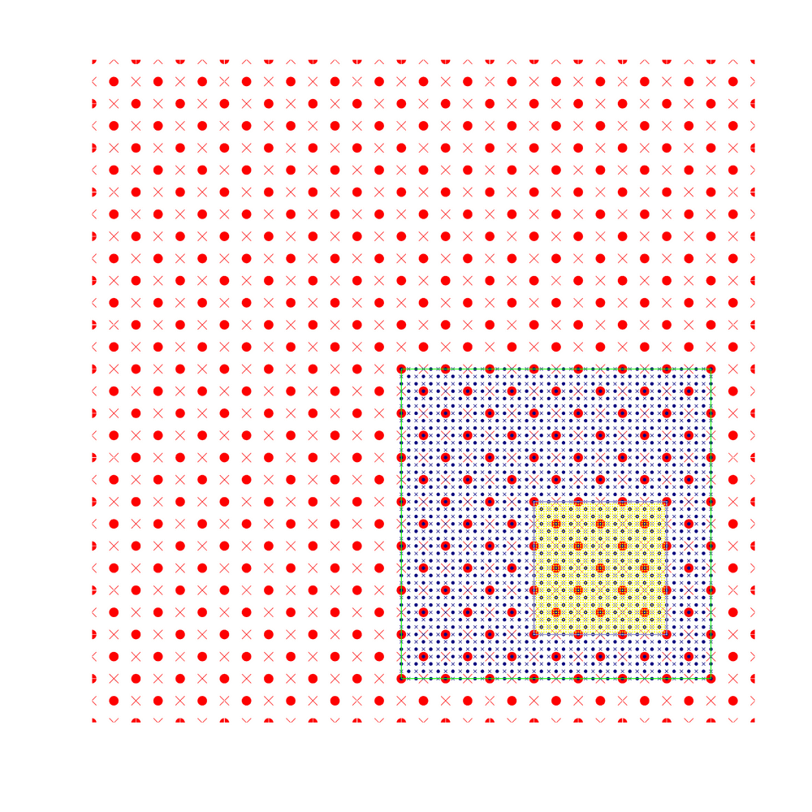
Main HWRF Functionalities
Moving Nest
Starting point at mass points
Aligning at mass points
Mediate domain follows the inner most domain
Nest following centroid MSLP minima
Model
Real and idealized case framework
Flexible physics configuration
Nest Initialization
GSI
Ongoing Developments
Hybrid DA
Multiple moving nests
Repository version and public release
• Mass points × Wind points
Research and operational communities share common repository and directly work together under HFIP
X. Zhang

Slide 4
Current Model Configurations
 | 2012 HWRF Operational | Basin-scale Model (Stream 2)
Domain | 27 KM: 77.76˚ X 77.76˚ 9 KM: 10.56˚ X 10.2˚ 3 KM: 6.12˚ X 5.42˚ | 27 KM: 178.20˚ X 77.58˚ 9 KM: 10.56˚ X 10.2˚ 3 KM: 6.12˚ X 5.42˚
Vortex Initialization | Modified Vortex Initialization at 3 KM, with 30x30º analysis domain and GSI | 27KM: GFS 9-3 KM: same as operational and with Hybrid DA and multiple nest framework
Cycling | Yes (3 km vortex only) | Yes
Ocean Coupling | 27-9 KM: Yes 3 KM: No, Downscaled | 27-9-3 KM: No
Physics schemes
Microphysics | Modified Ferrier (High-Res) | Modified Ferrier (High-Res)
Radiation | GFDL | GFDL
Surface | GFDL (High_res) | GFDL (High_res)
PBL Scheme | 2012 GFS (High_res) | 2012 GFS (High_res)
Convection | SAS (High-Res), No CP (3 KM), Shallow Convection | SAS (High-Res), No CP (3 KM), Shallow Convection
Land Surface | GFDL Slab | GFDL Slab
GWD | Yes(27km); No(9-3km) | No(27km); No(9-3km)
X. Zhang
Notes:
4

Slide 5

AOML’s regional OSSE system flow chart
I/O Interface 1
GFS-HWRF pre-processor for LBCs
HWRF
forecast
Tropical Cyclone forecast products
Ensemble member
HWRF IC
From GSI, EnKF or hybrid
I/O Interface 2
GSI-EnKF
GSI
EnKF
I/O Interface 3
Simulated observations to GSI
(Hyperspectral “AIRS” from CIMSS)

Slide 6
Assimilation of geo-hyperspectral “AIRS”
Observations simulated at CIMSS using regional nature run (WRF-ARW)
Resolution
  Temporal 0.5 h
  Spatial 27/9/3/1 km (model grids)
  TC core region on finest model grid
All-sky (cloudy and clear) radiances

Slide 7
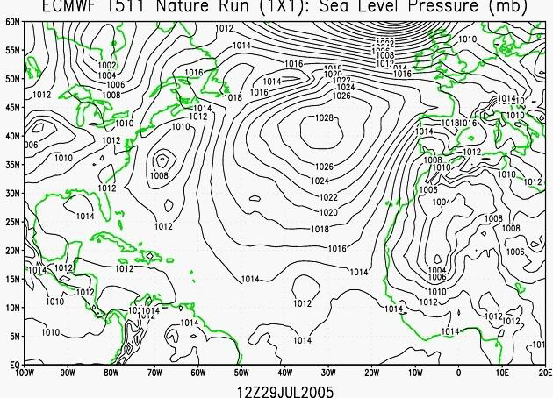
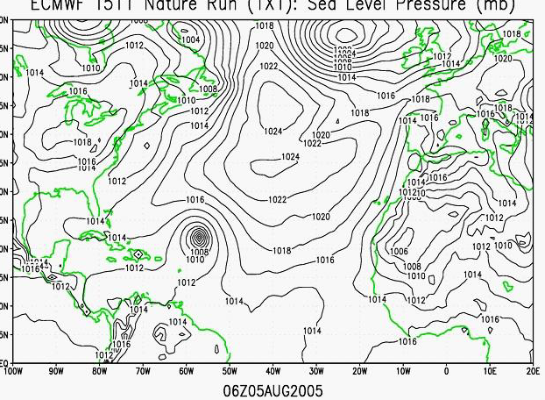
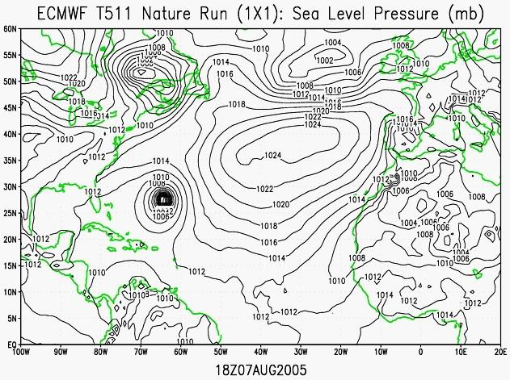
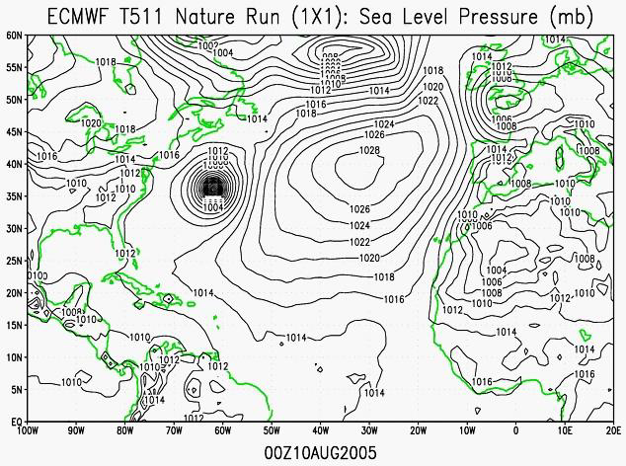
WRF-ARW nature run
Dave Nolan (RSMAS/UM)
RI
genesis
mature
recurving

Slide 8
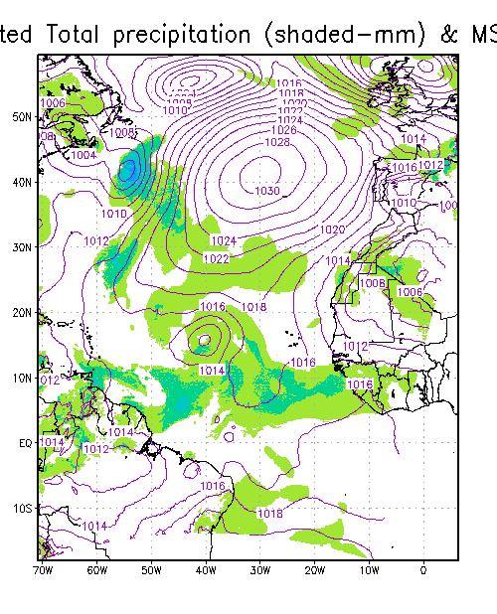
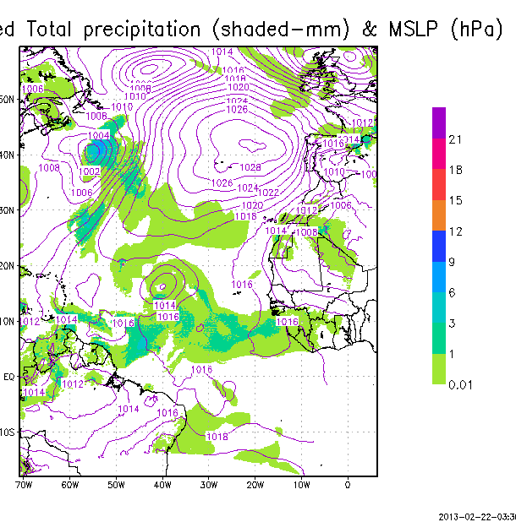
Example of assimilation results using GSI
ASSIMILATED “geo-AIRS” clear only
NO ASSIMILATION

Slide 9
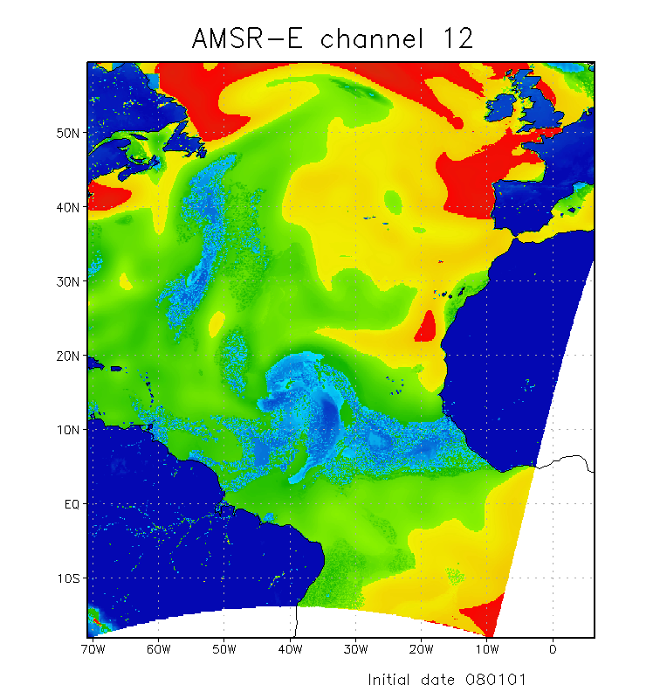
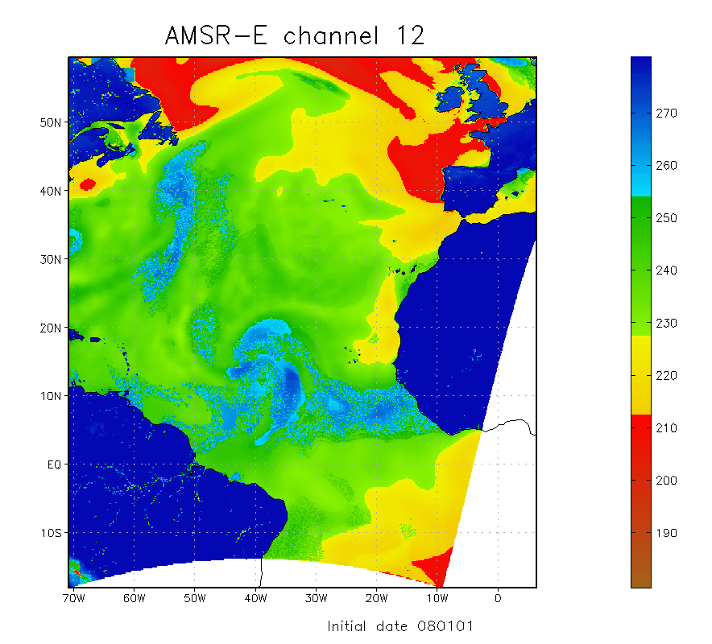
Example of assimilation results using GSI
Image AMSRE 8 Ghz
ASSIMILATED “geo-AIRS” clear only
Image AMSRE 89Ghz
NO ASSIMILATION

Slide 10
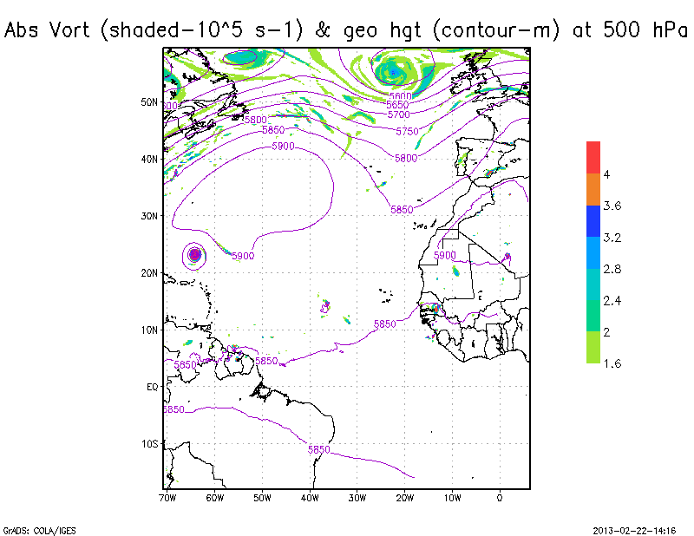
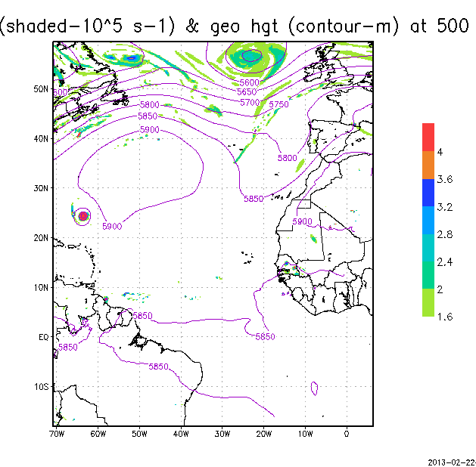
Impact in forecast
MSLP forecast
NO ASSIMILATION
MSLP forecast
WITH ASSIMILATION

