Slide 1
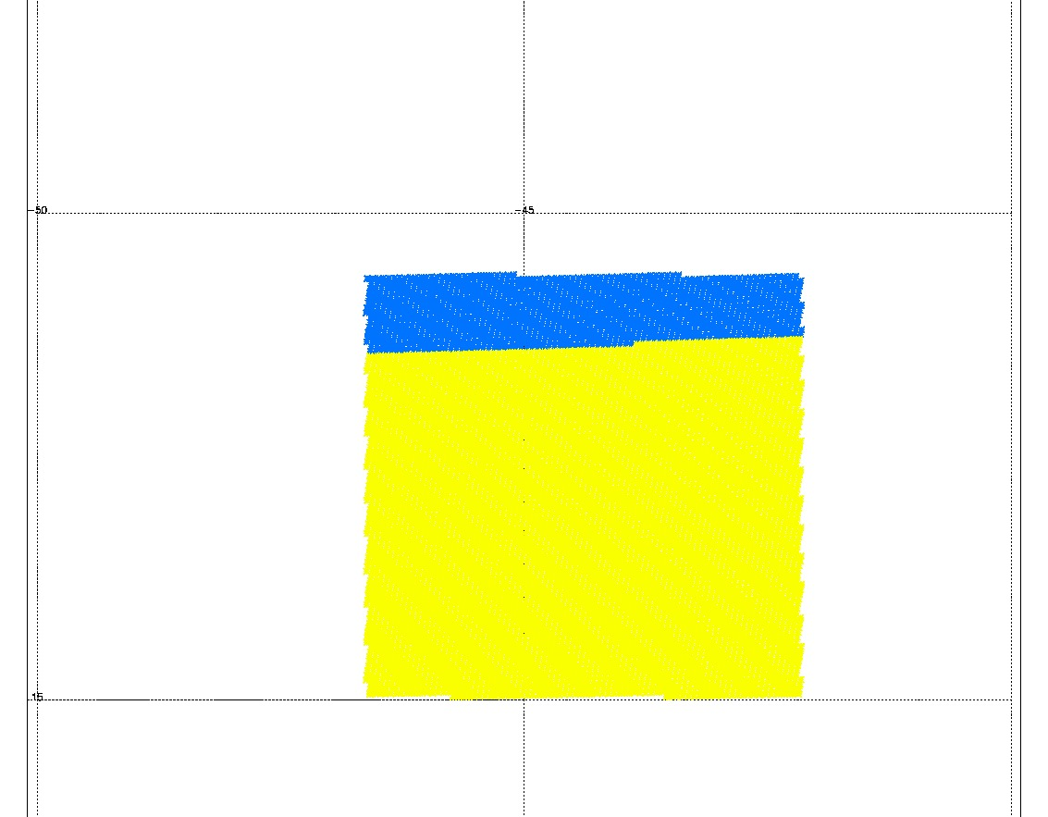
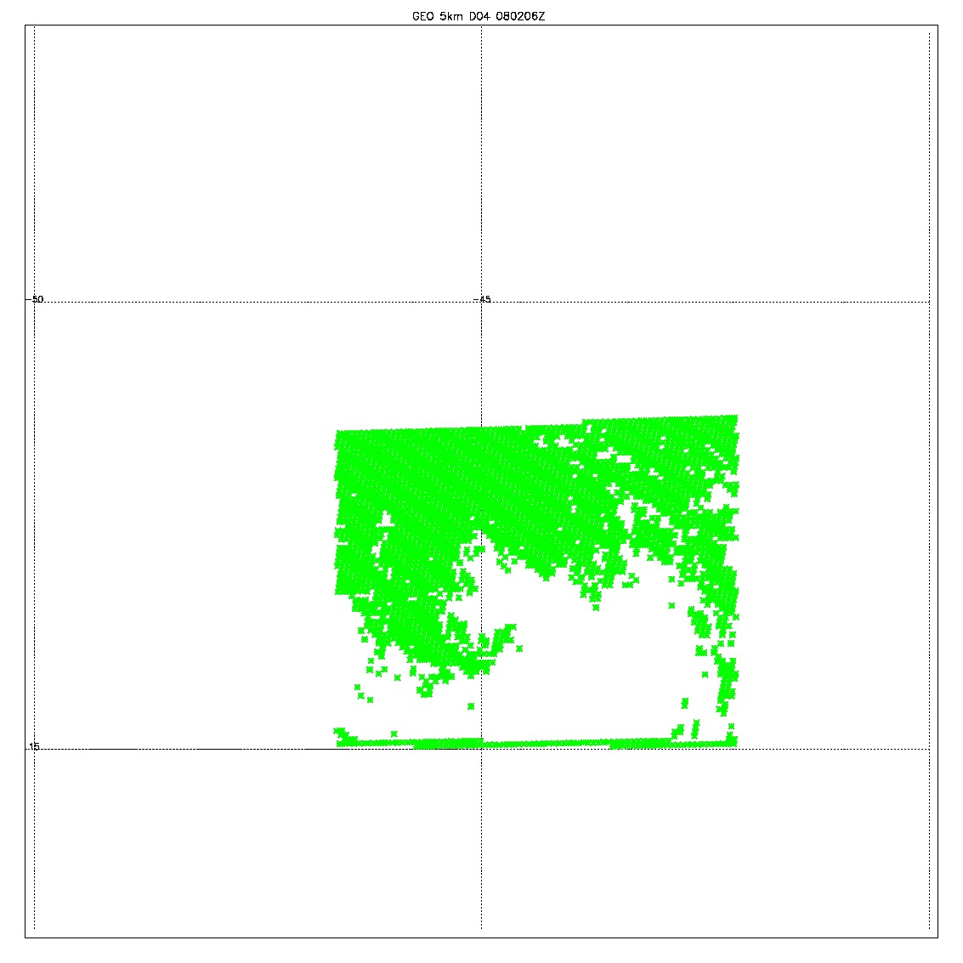
GEO
0802 6Z
Original data from JCSDA; 98588
Filtered data (yellow); 82334
  Removed 9 levels
  Removed the null data points
All zero data (blue); 16254
QCD data (green): 41889

