Slide 1
Problem with Data
Nine extra levels not in the nature run;
46.9, 30.3, 19.6, 11.5, 5.7, 3.3, 1.8, 0.96, 0.10

Slide 2
validfp
the number of footprints containing valid data
For 08/03 6z, corresponds to time index of 106 the validfp is 7309
Several thousands are all set to zero within validfp

Slide 3
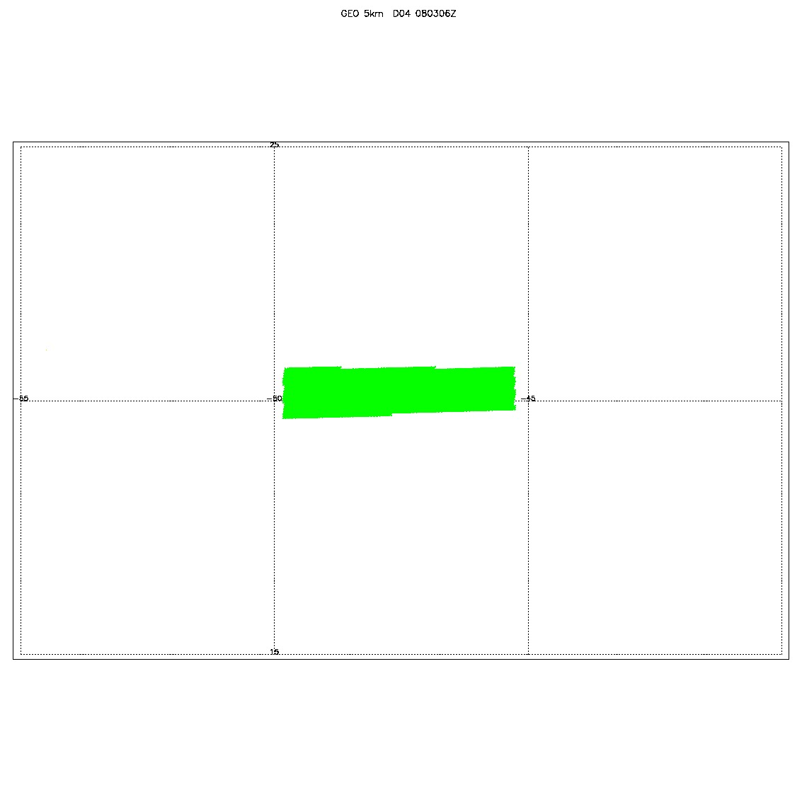
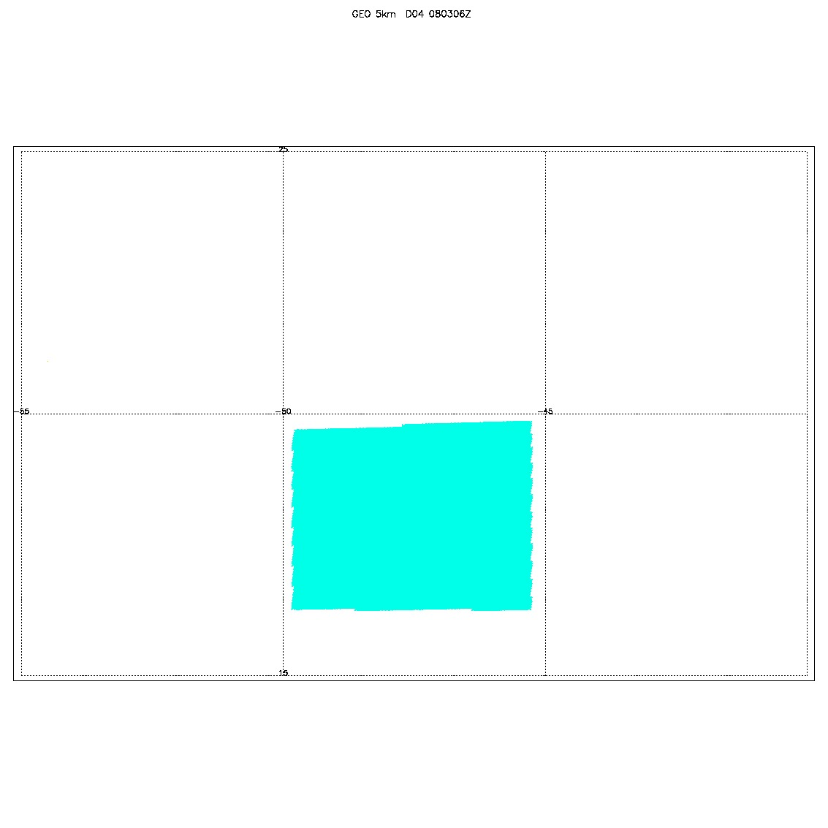
0803 at 6Z validfp is 7309
No Data filtered
Data value is Zero
Data is ok

