Slide 1
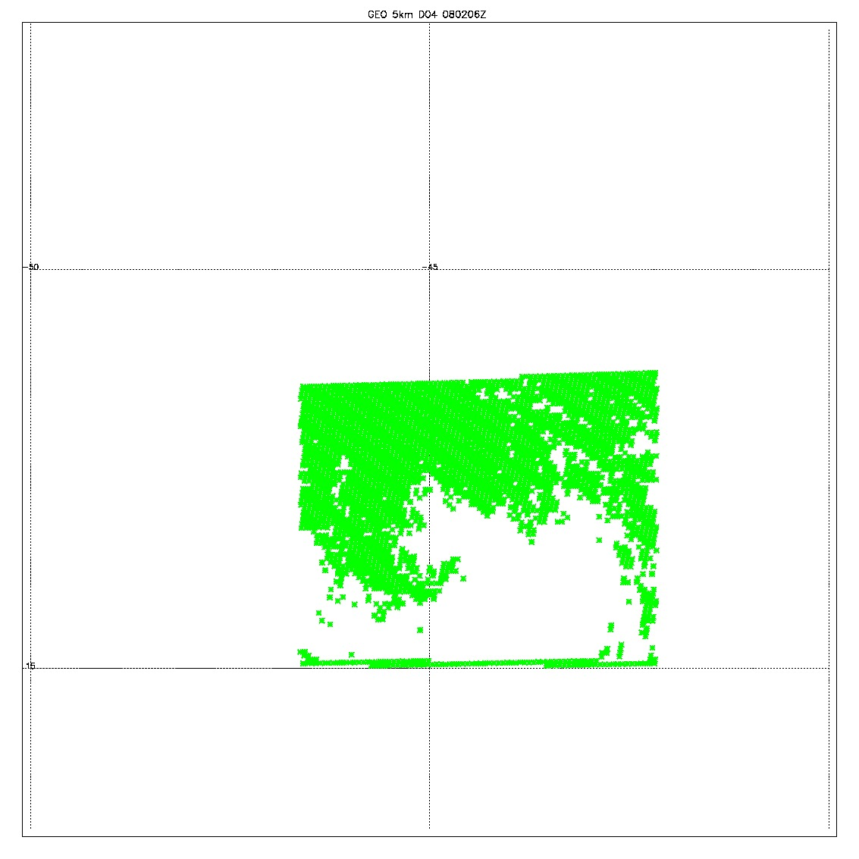
GEO 0802 6Z
Valid data from JCSDA; 98588
Filtered data (yellow); 82334
Removed 9 levels
Removed the null data points
All zero data (blue); 16254
QCD (qc_t >0.1) data (green): 41889

Slide 2
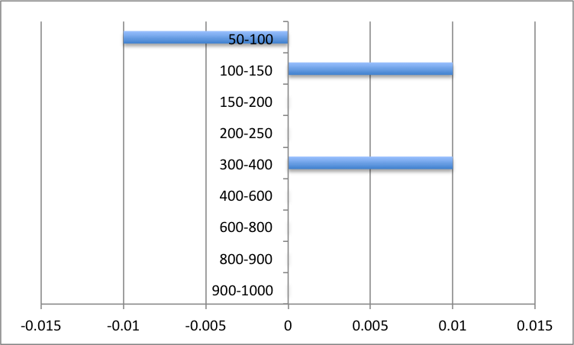
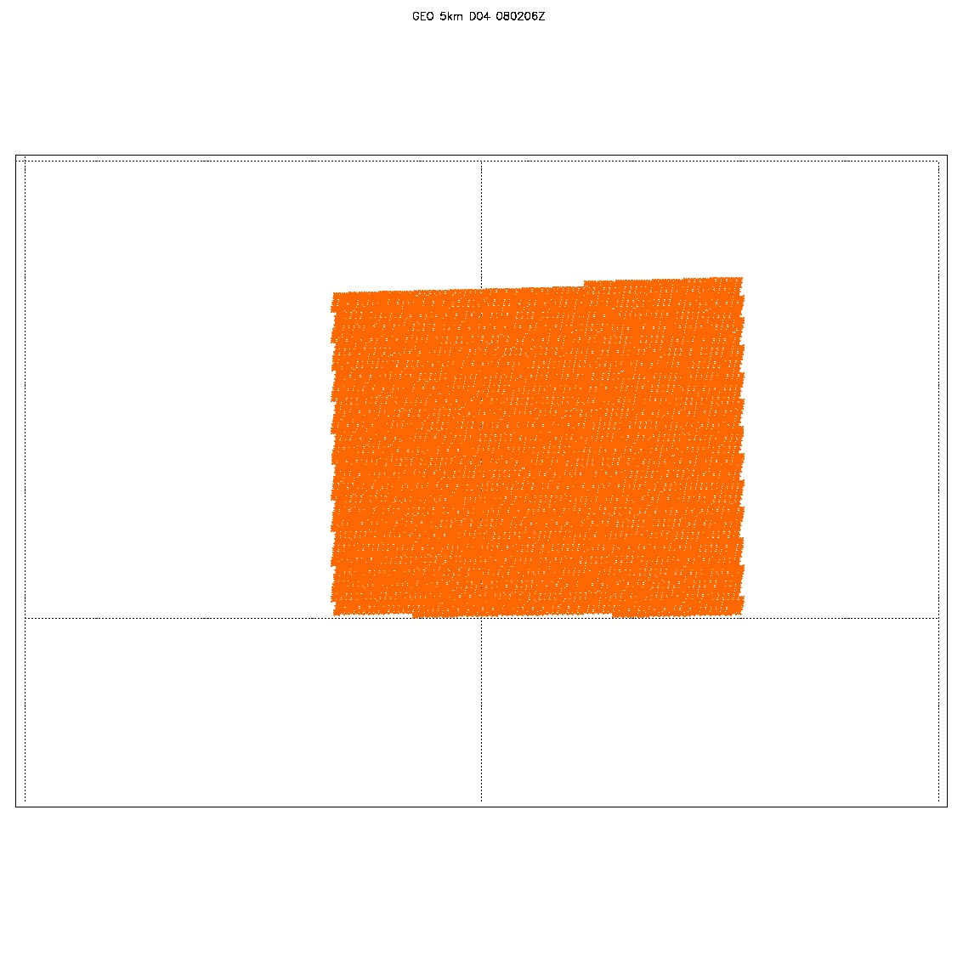
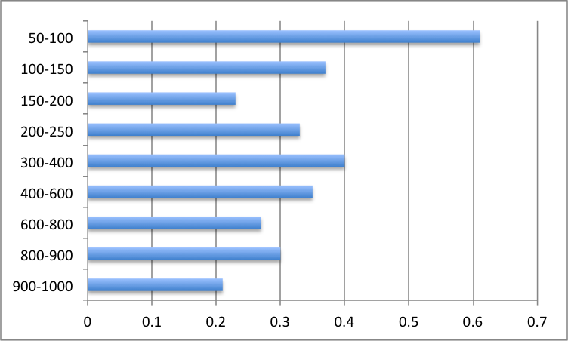
0802 6Z
All 82334 data point were assimilated
14 Levels; 943.8, 813.7, 705.8, 627.9, 544.1, 459.1, 381.9, 306.2, 240.5, 184.4, 142, 109.8, 82.9, 63.3
9 levels removed: 46.9, 30.3, 19.6, 11.5, 5.7, 3.3, 1.8, 0.96, 0.1

Slide 3
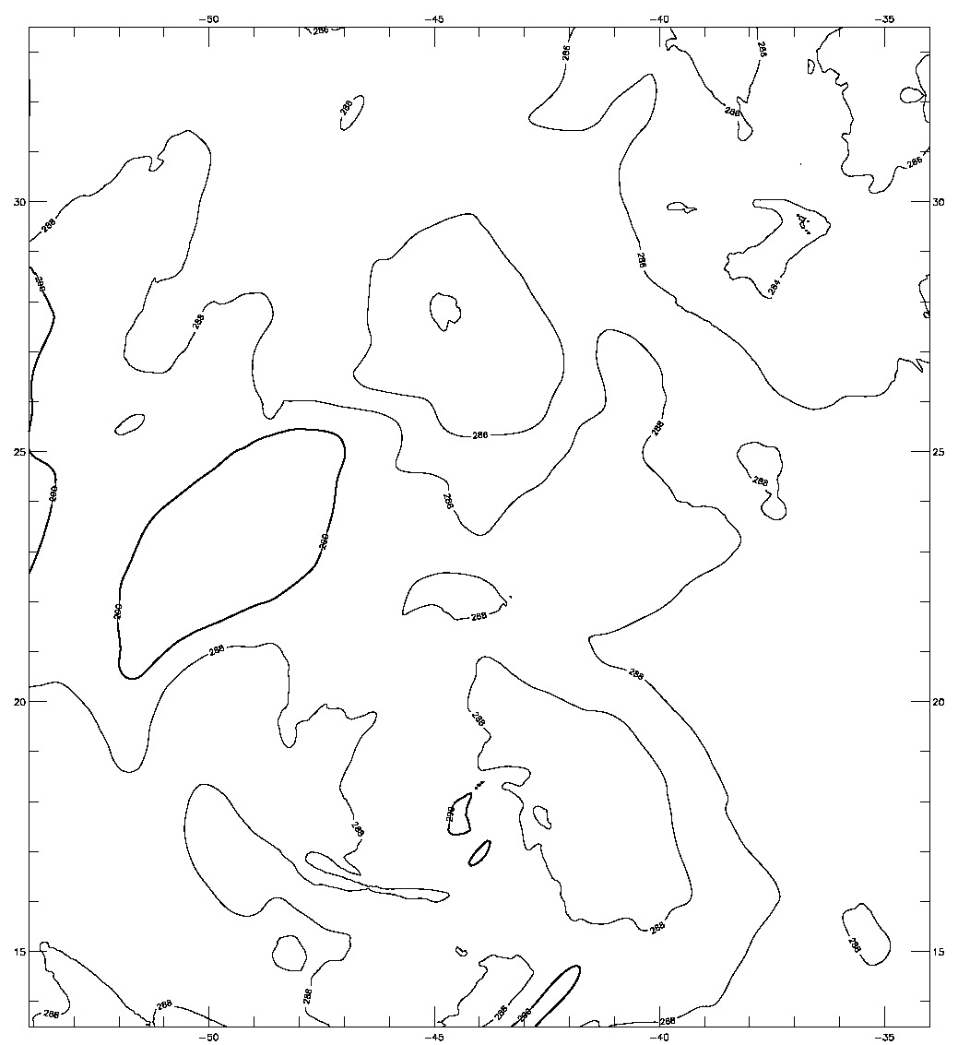
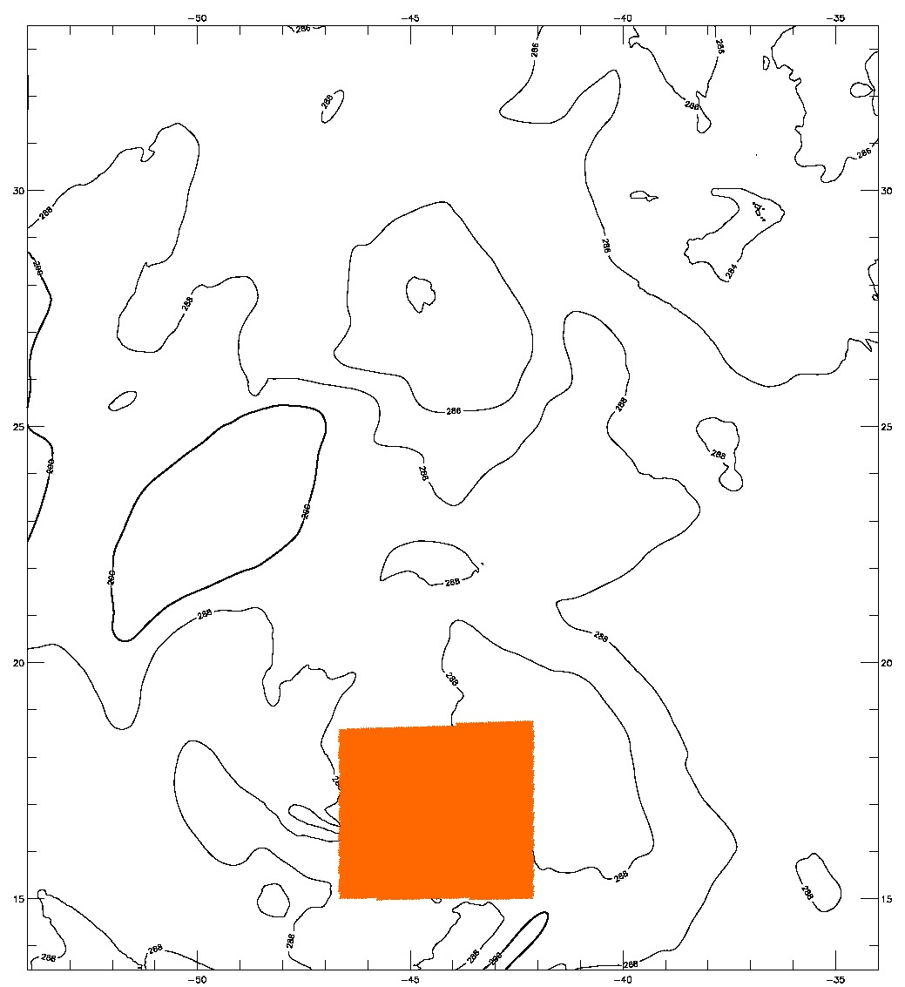
0802 6Z
Analysis at 800mb lvl
Obs at 813mb lvl
287.65<obs<290.850

Slide 4
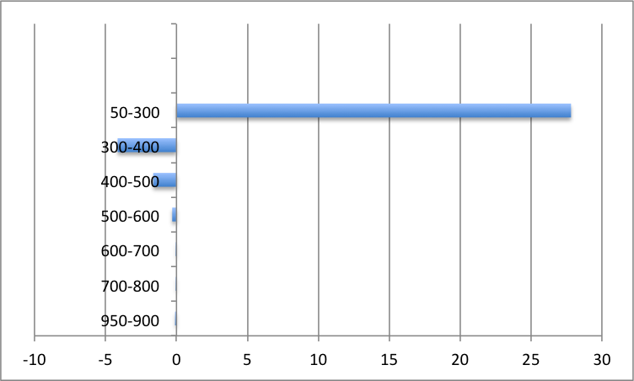
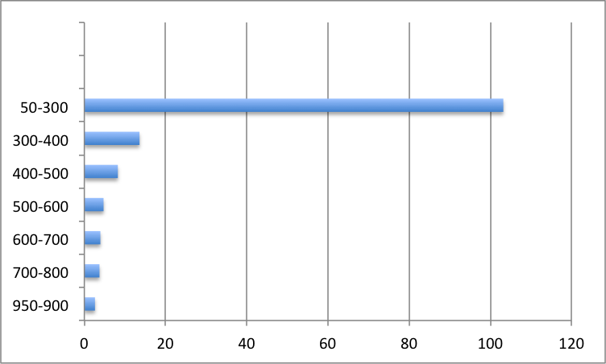
0802 6Z
56895 assimilated
10 pressure levels; 929.8, 776.2,660.5,554.5,458.4,374.1,328.5,292.8,215.4,110.3

