Slide 1
06/30 Update
Hourly cycling
a) 20 bufr files per day
b) obs bufr file missing for the cycles; 3Z,9Z,15Z and 21Z
c) 96 cycles for each experiment
control
control +temperature
control + q
control + t and q
d) 5 day forecast at 0Z, 6Z, 12Z, 18Z
e) forecast for 08/02 6Z failed

Slide 2
Storm Statistics Max Wind

Slide 3
Storm Statistics Pressure

Slide 4
Storm Statistics Track

Slide 5
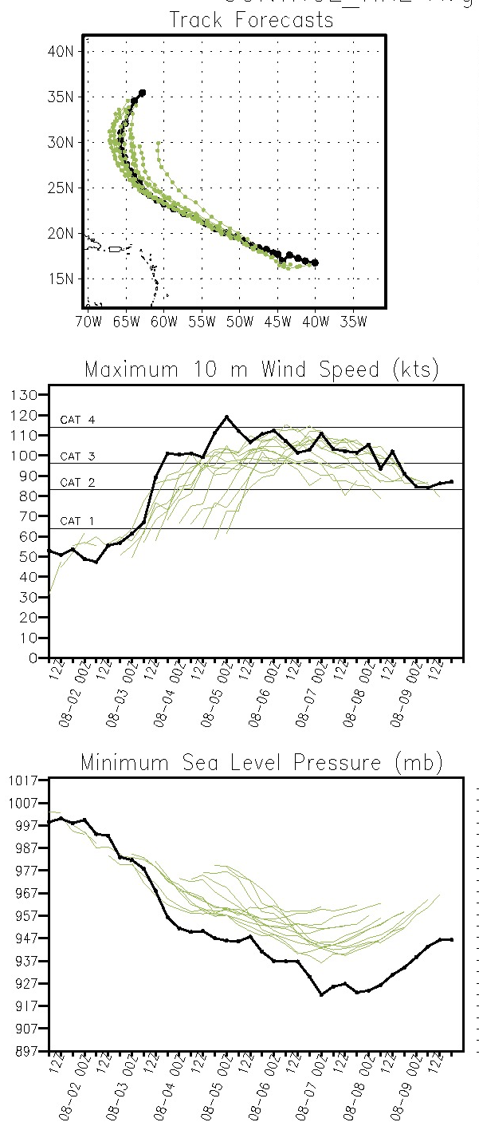
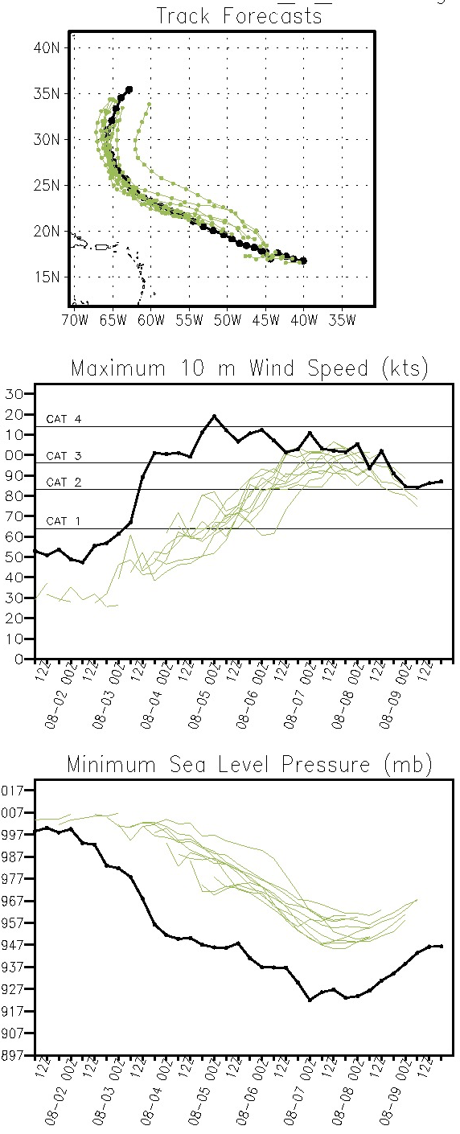
Control
Control + Q

Slide 6
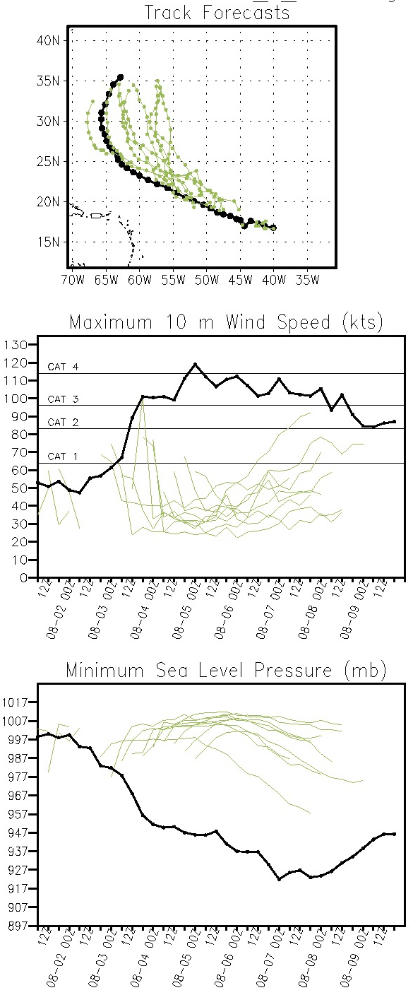
Control
Control + T

Slide 7
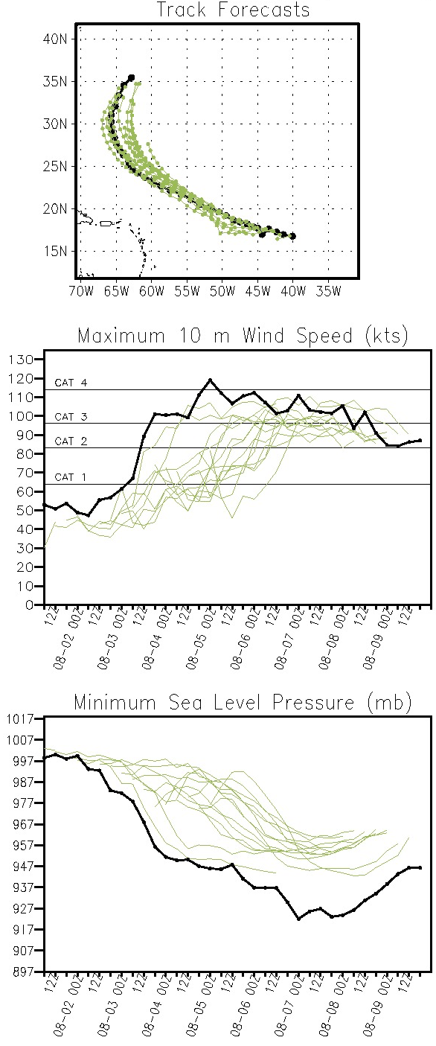
Control
Control + TQ

Slide 8
The data included in the control
Radiosondes, ships, buoys, surface stations
AMVs from GOES-Imager, SEVERI
T,q soundings from GOES-Sounder, HIRS, AIRS, MHS,GPS
T soundings from from AMSU-A, q soundings from AMSU-B

