Slide 1
Update
Hourly cycling
a) 20 bufr files per day,
b) 96 cycles, missing a bufr file for the cycles; 3Z,9Z,15Z and 21Z
90mns cycling
a) 20 bufr files per day,
b) 64 cycles, missing a bufr file for the 0Z cycle
Status:
1- Created bufr files for t, q
2- control: 92 cycles finished
3- hourly cycling: 70 cycles finised

Slide 2
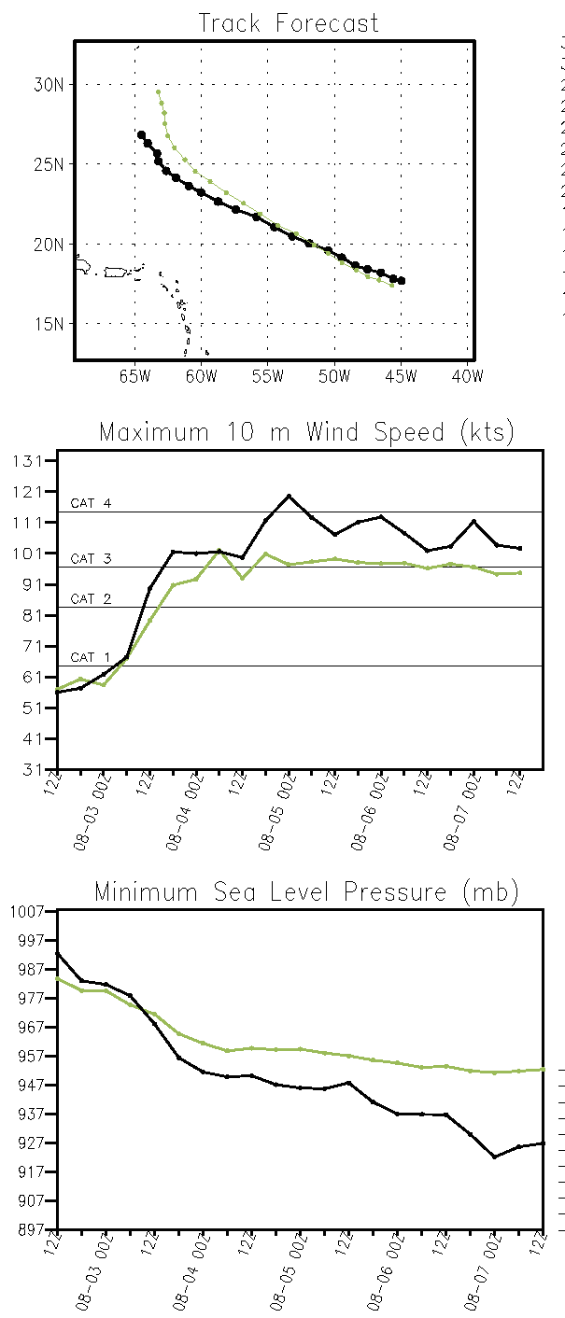
Control (syn) 08/02 12z
Control (hrl) 08/02 12z

Slide 3
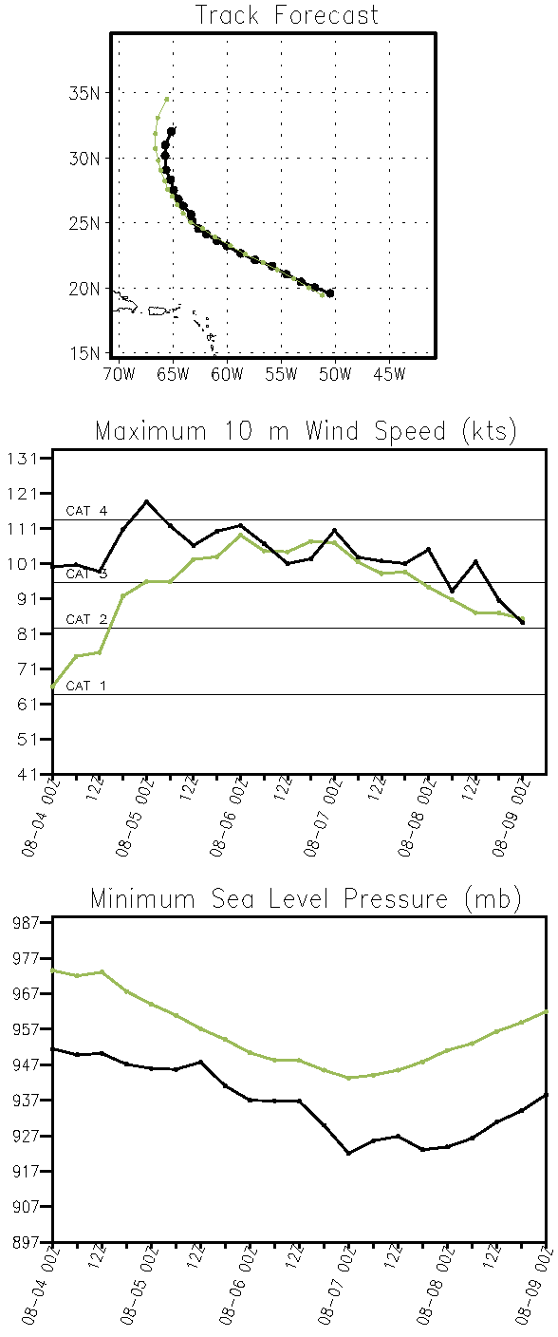
Control (syn) 08/04 00z
Control (hrl) 08/04 00z

Slide 4
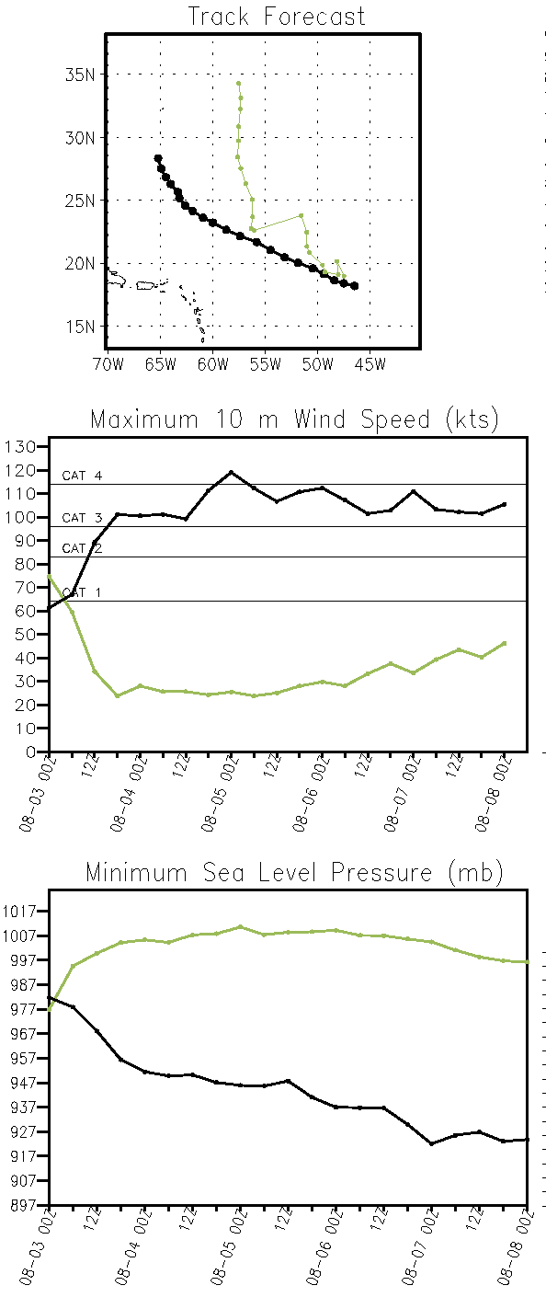
control+temp (syn) 08/03 00z
control+temp (hrl) 08/03 00z

