Slide 1
Motivation 0802 at 6Z Max Sfc Wind

Slide 2
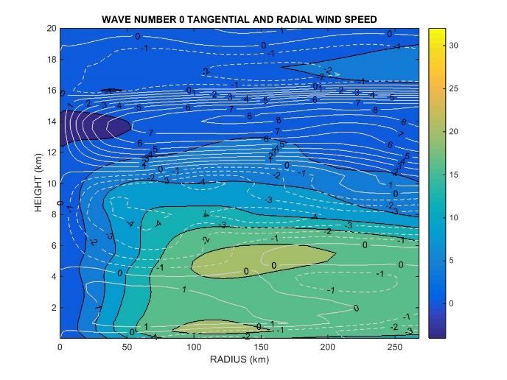
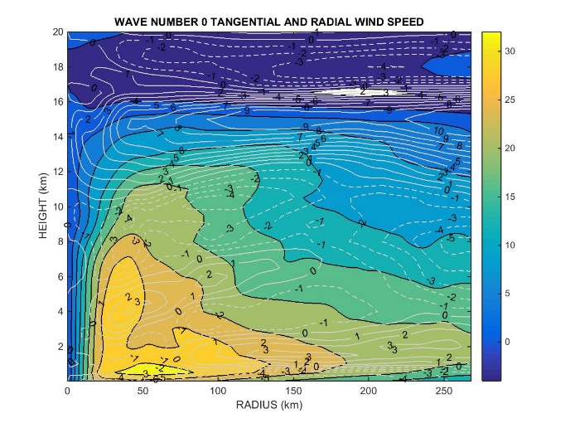
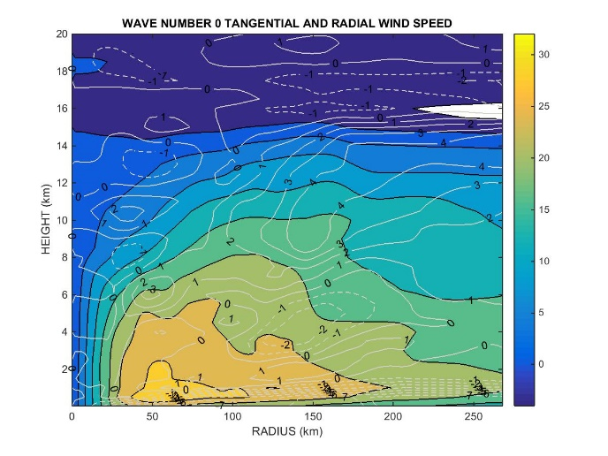
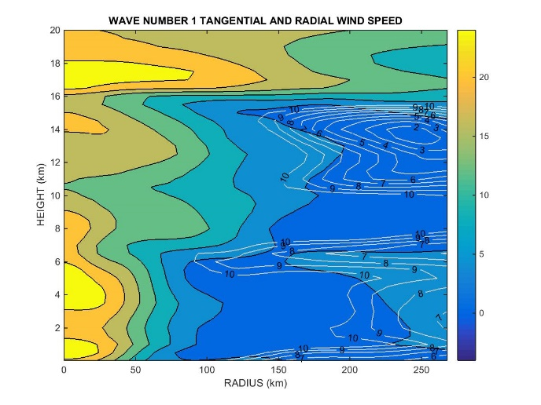
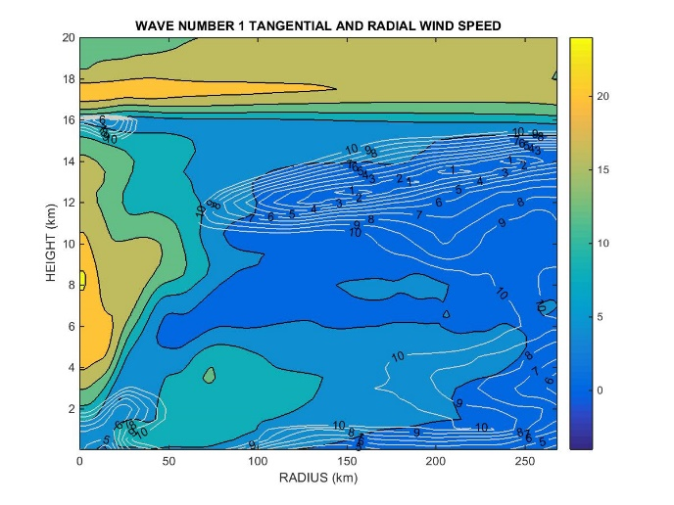
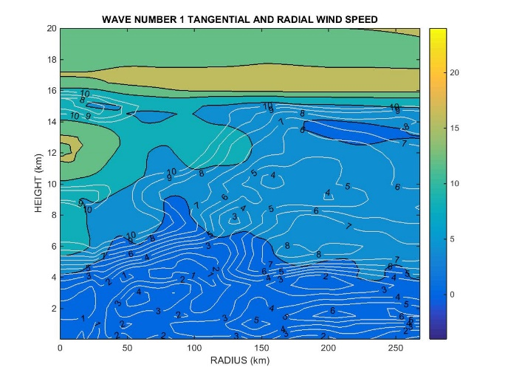
Azimuthal Mean Tangential Wind (shaded) and Radial Wind (contours)
0hr Analysis 6hr forecast 12hr forecast
Wave #0
Wave #1

Slide 3
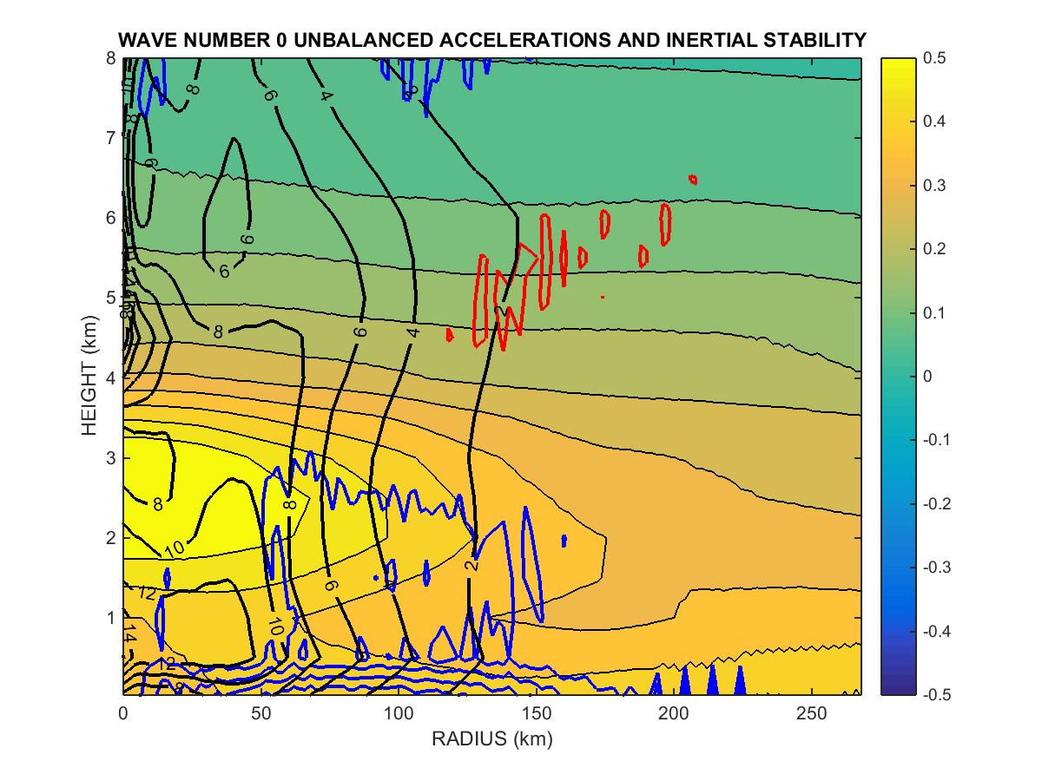
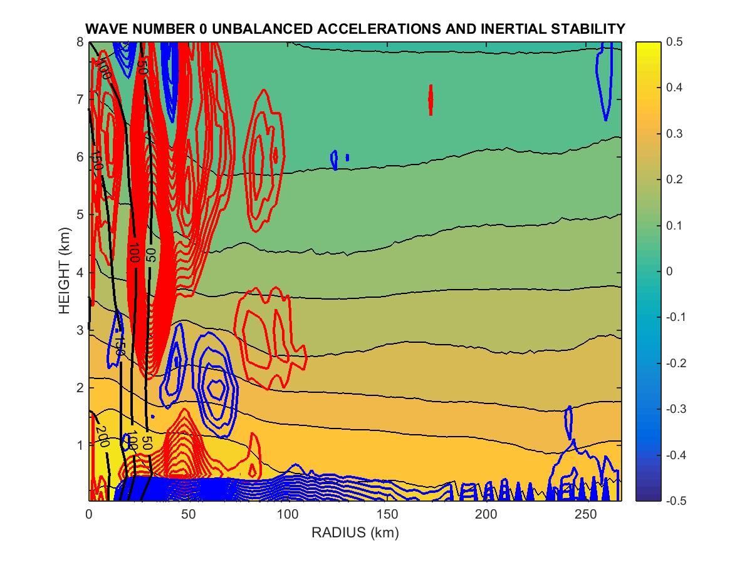
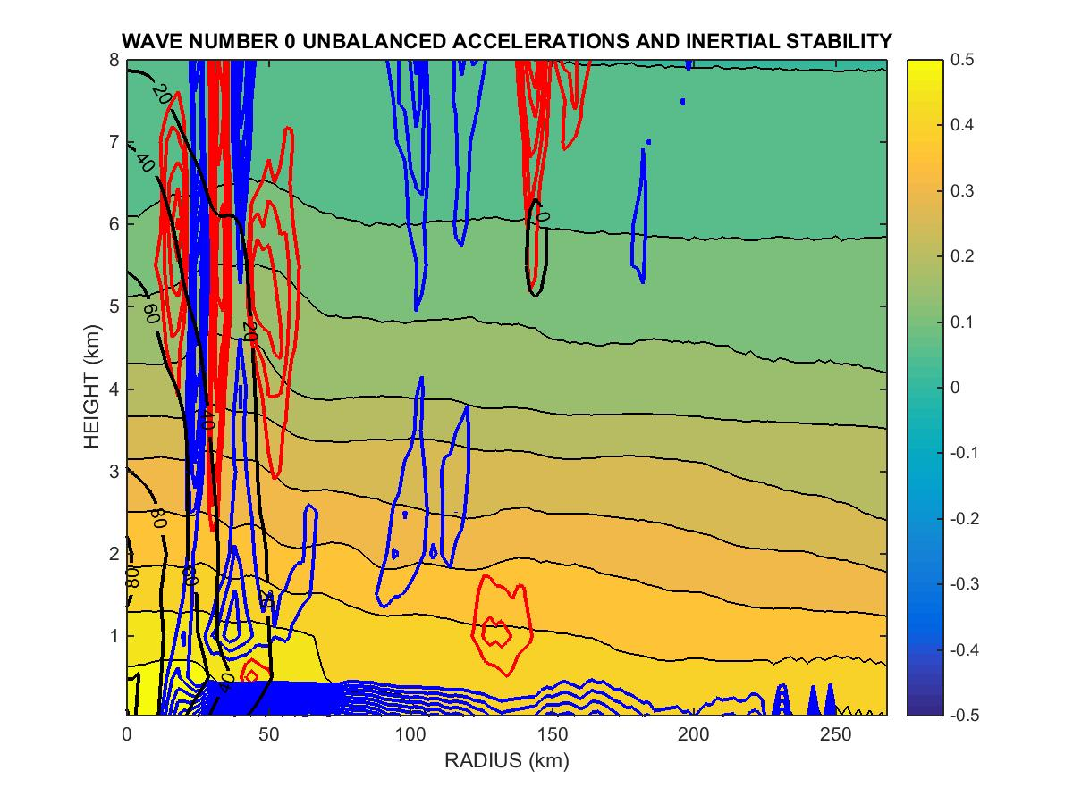
Balance and Stability Analysis: Shaded Contours = Non-Hydrostatic acceleration – (1/ρ*dP/dz + g)
Blue and Red Contours = A-gradient forcing V²/r – 1/ρ*dP/dr + fV
blue = inward red = outward Units = m/s
Black Contours = Inertial stability normalized by Vt_{max} * f² Units = s⁻²

Slide 4
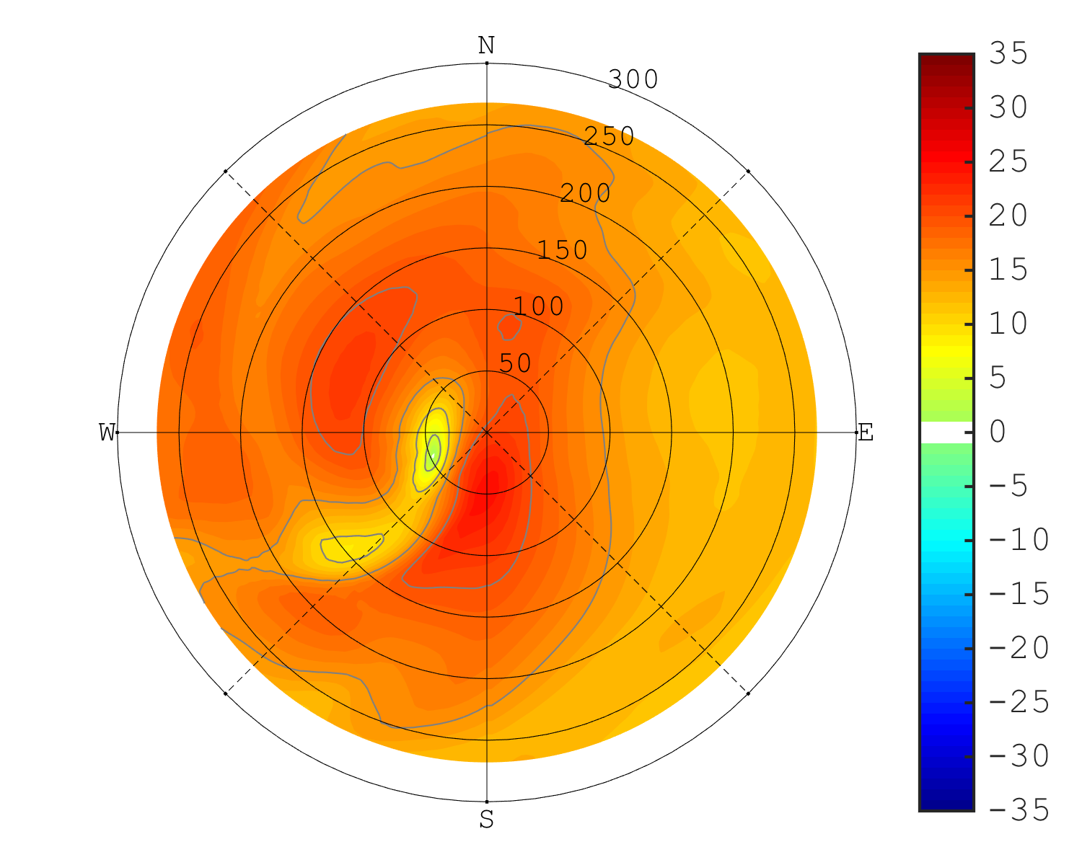
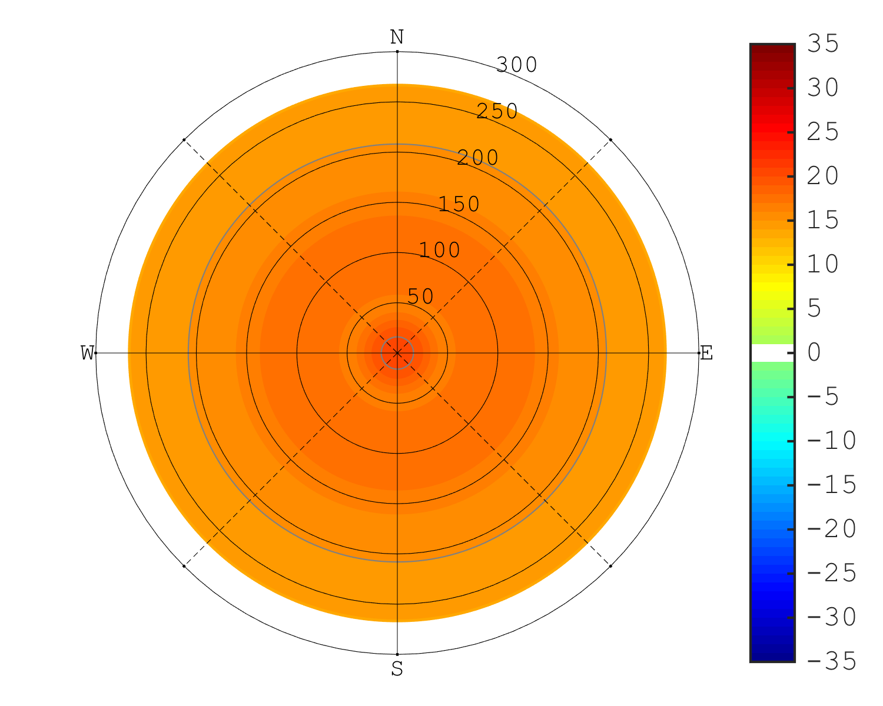
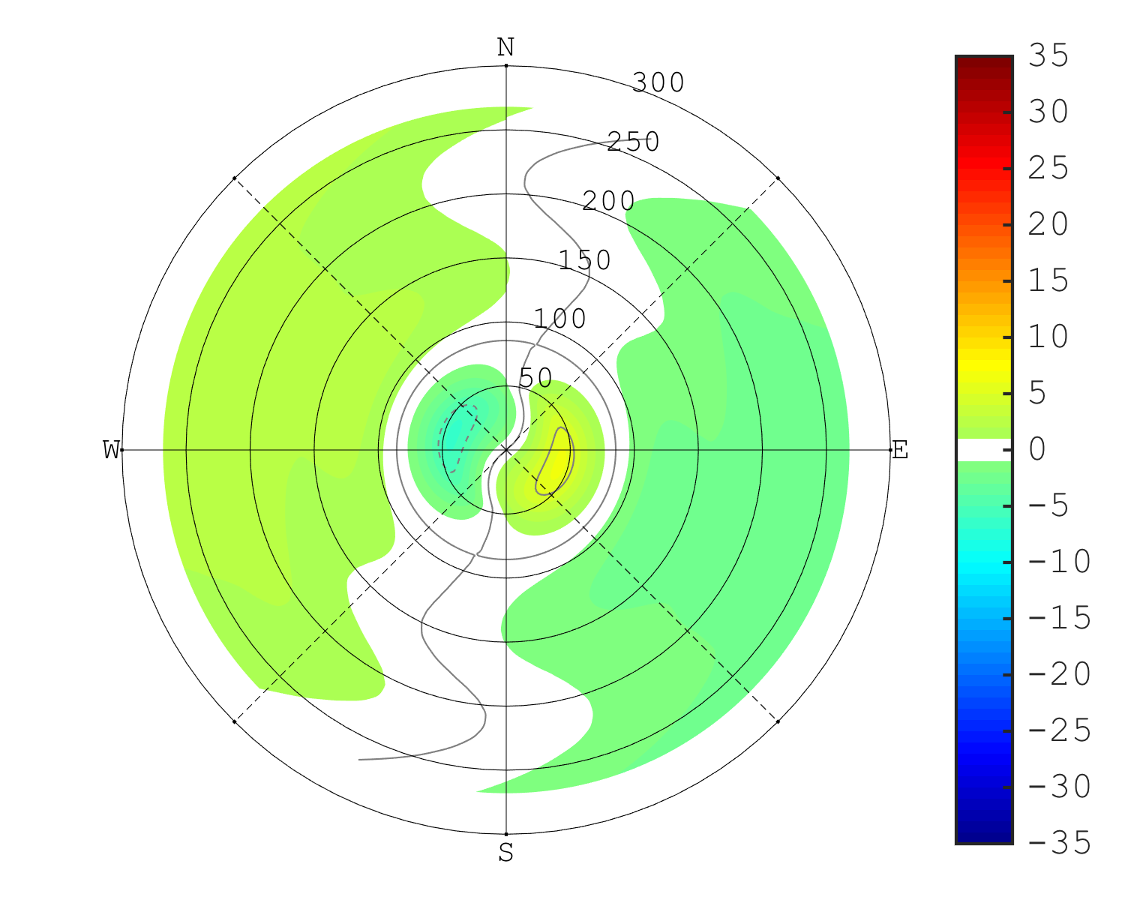
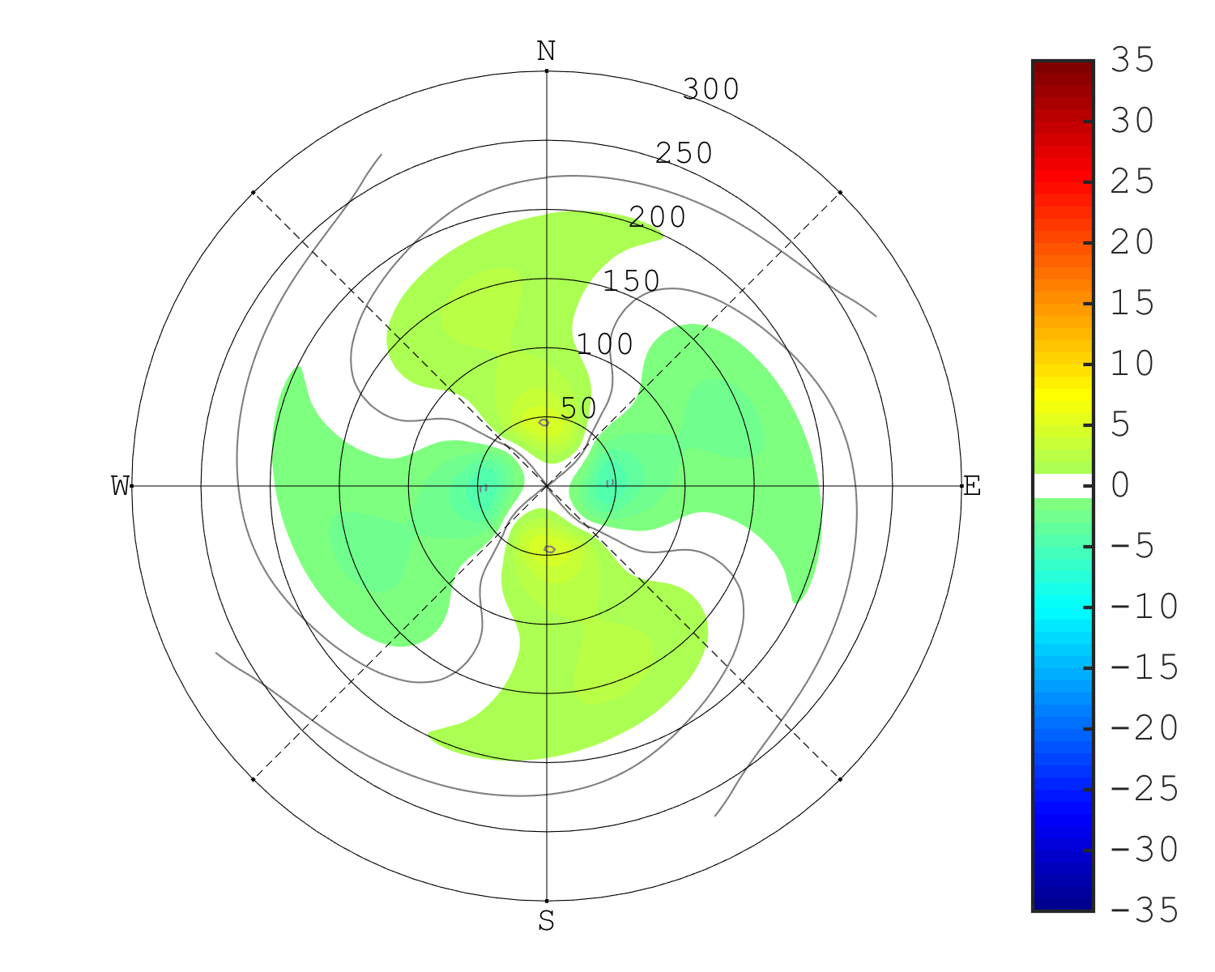
10-m Wind Speed
Time = 0 hr
Total Field
Wavenumber 0
Max = 24.7 m/s
Wavenumber 1
Wavenumber 2

Slide 5
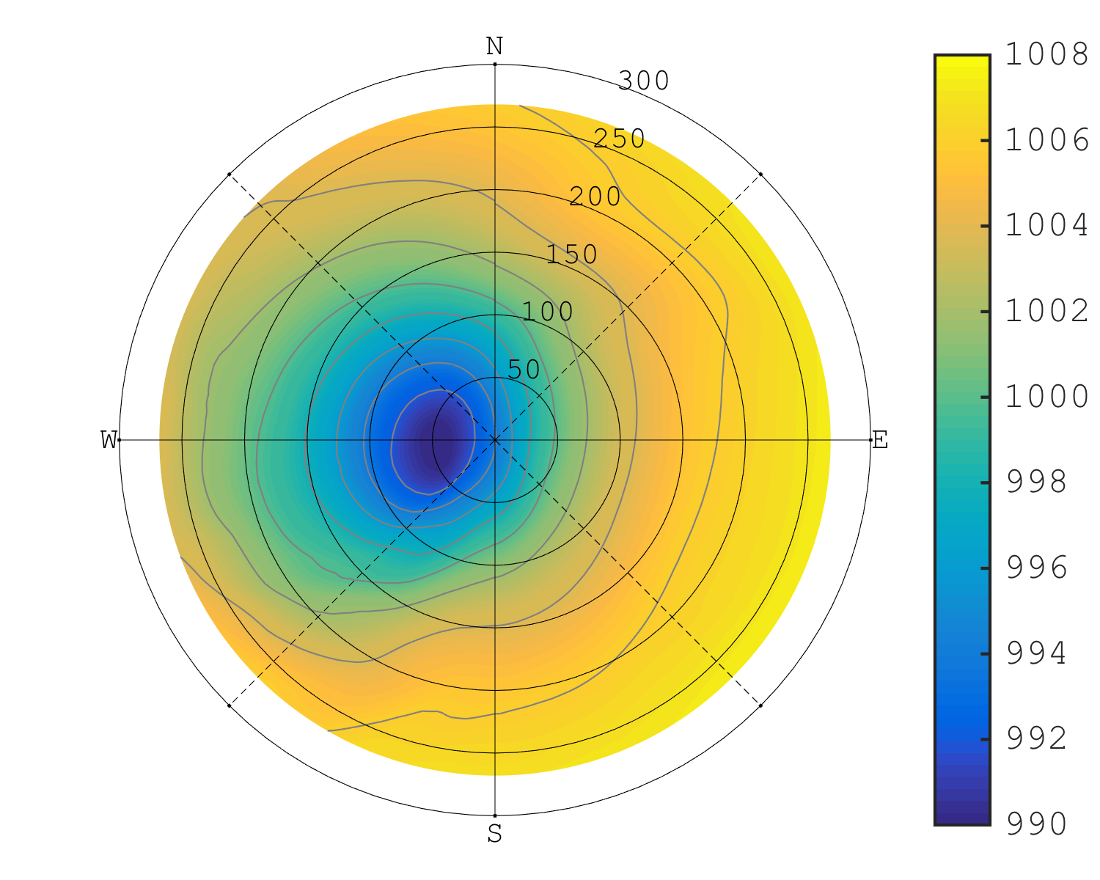
10-m Wind Speed vs MSLP
Time = 0 hr
Wind Speed
MSLP

Slide 6
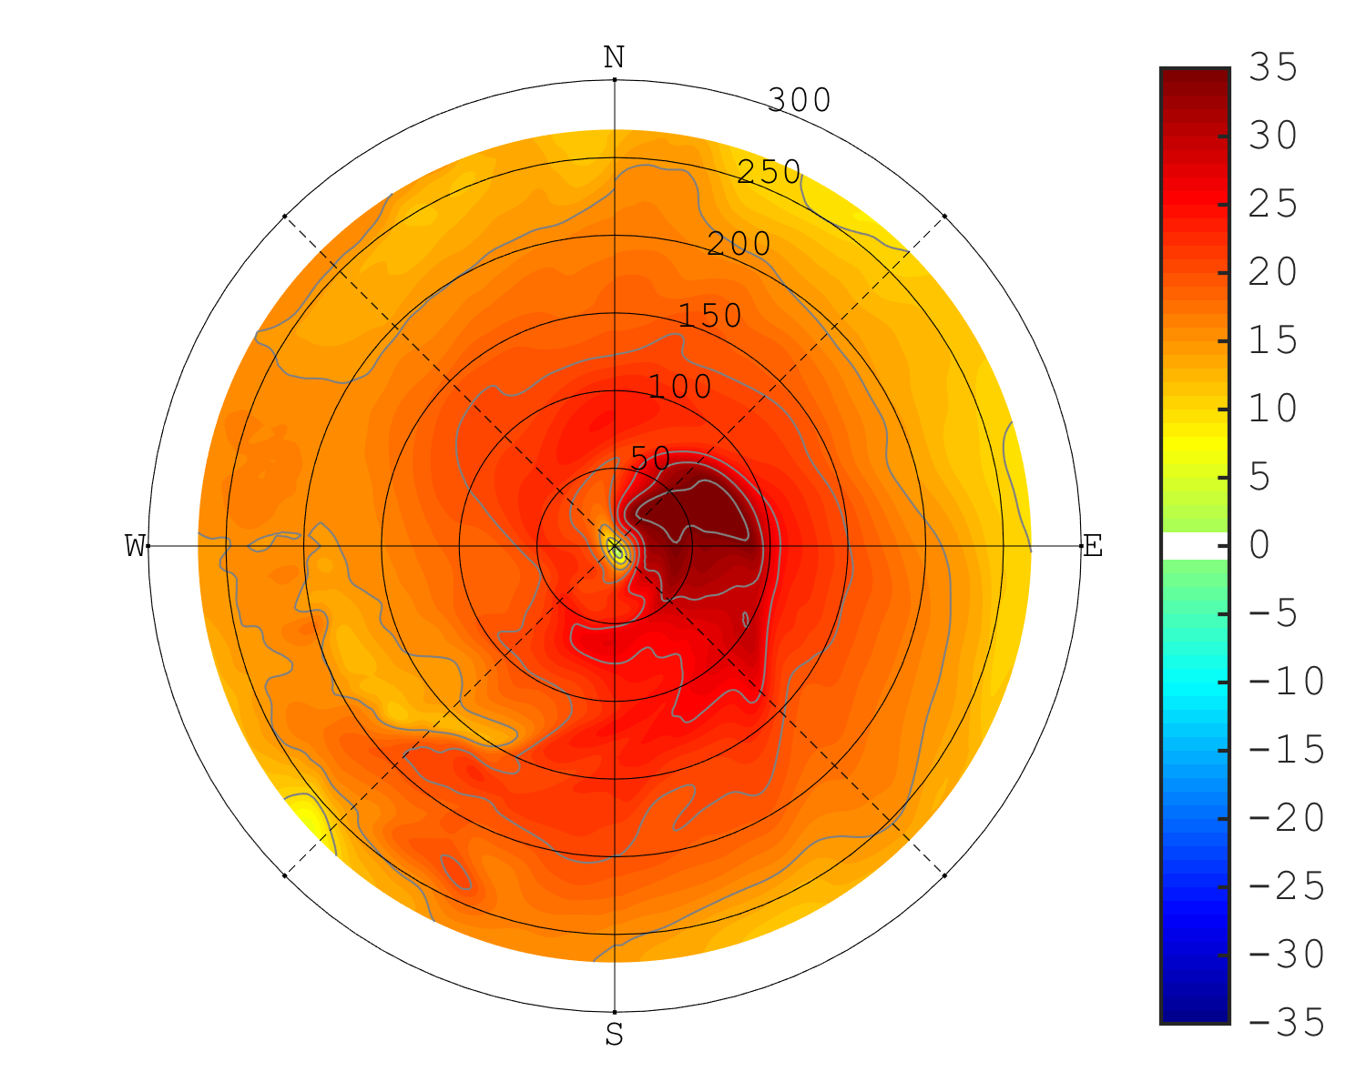
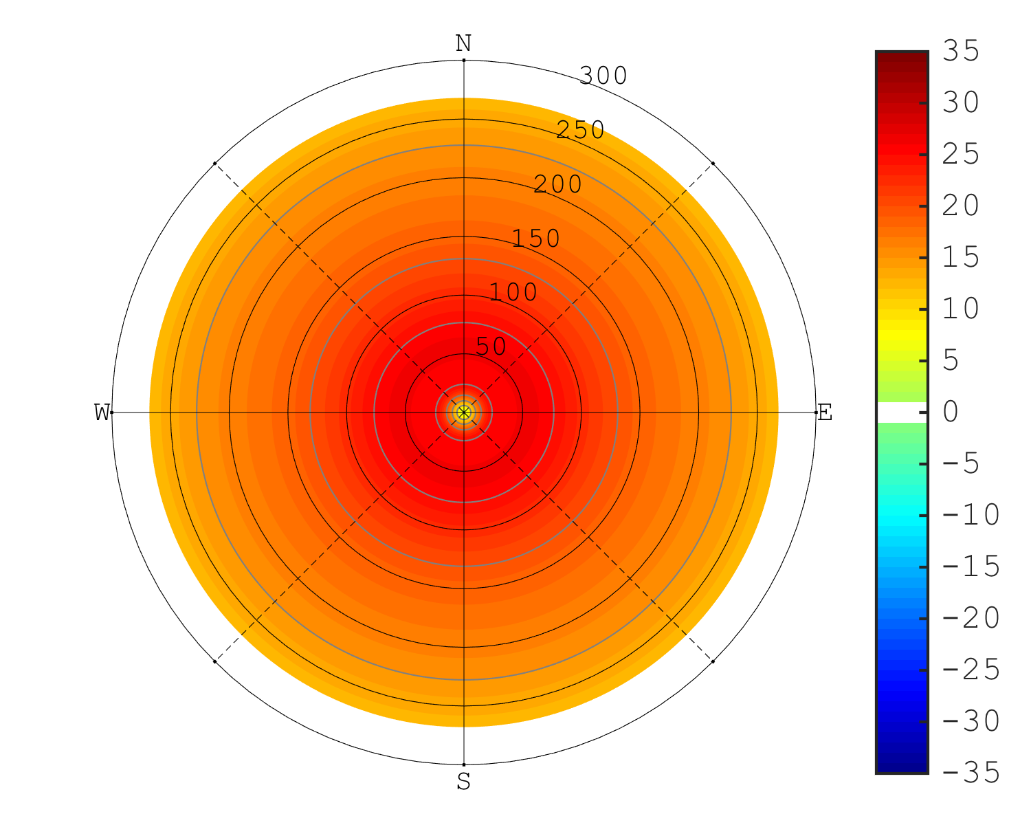
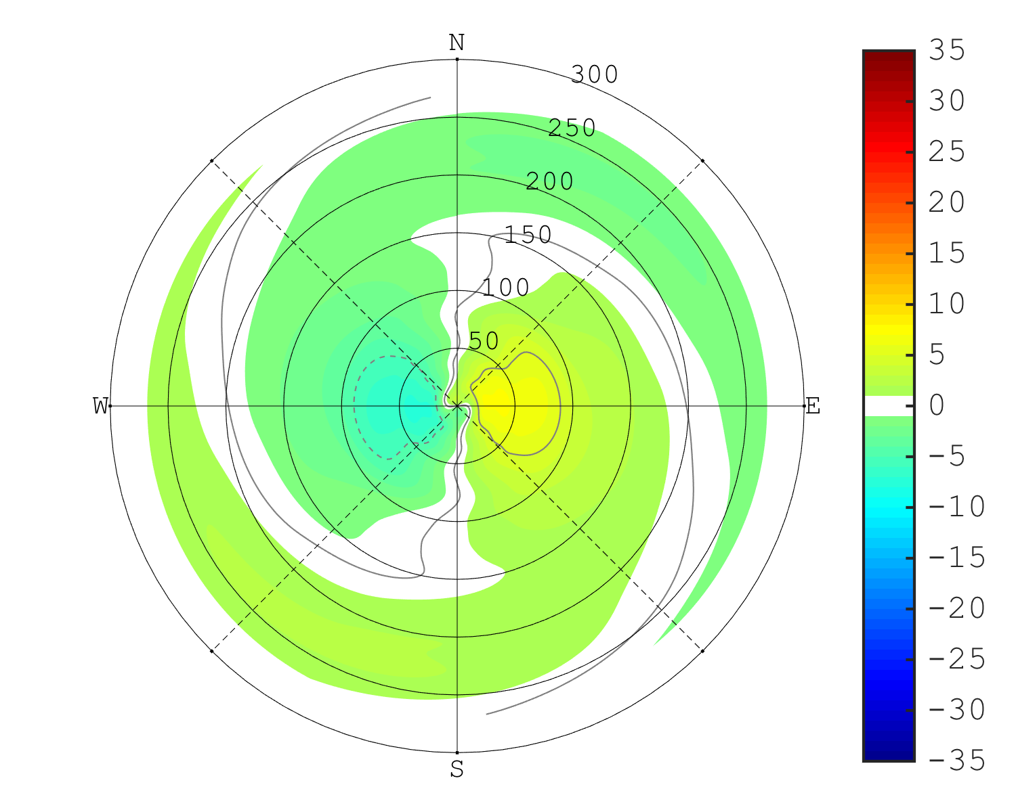
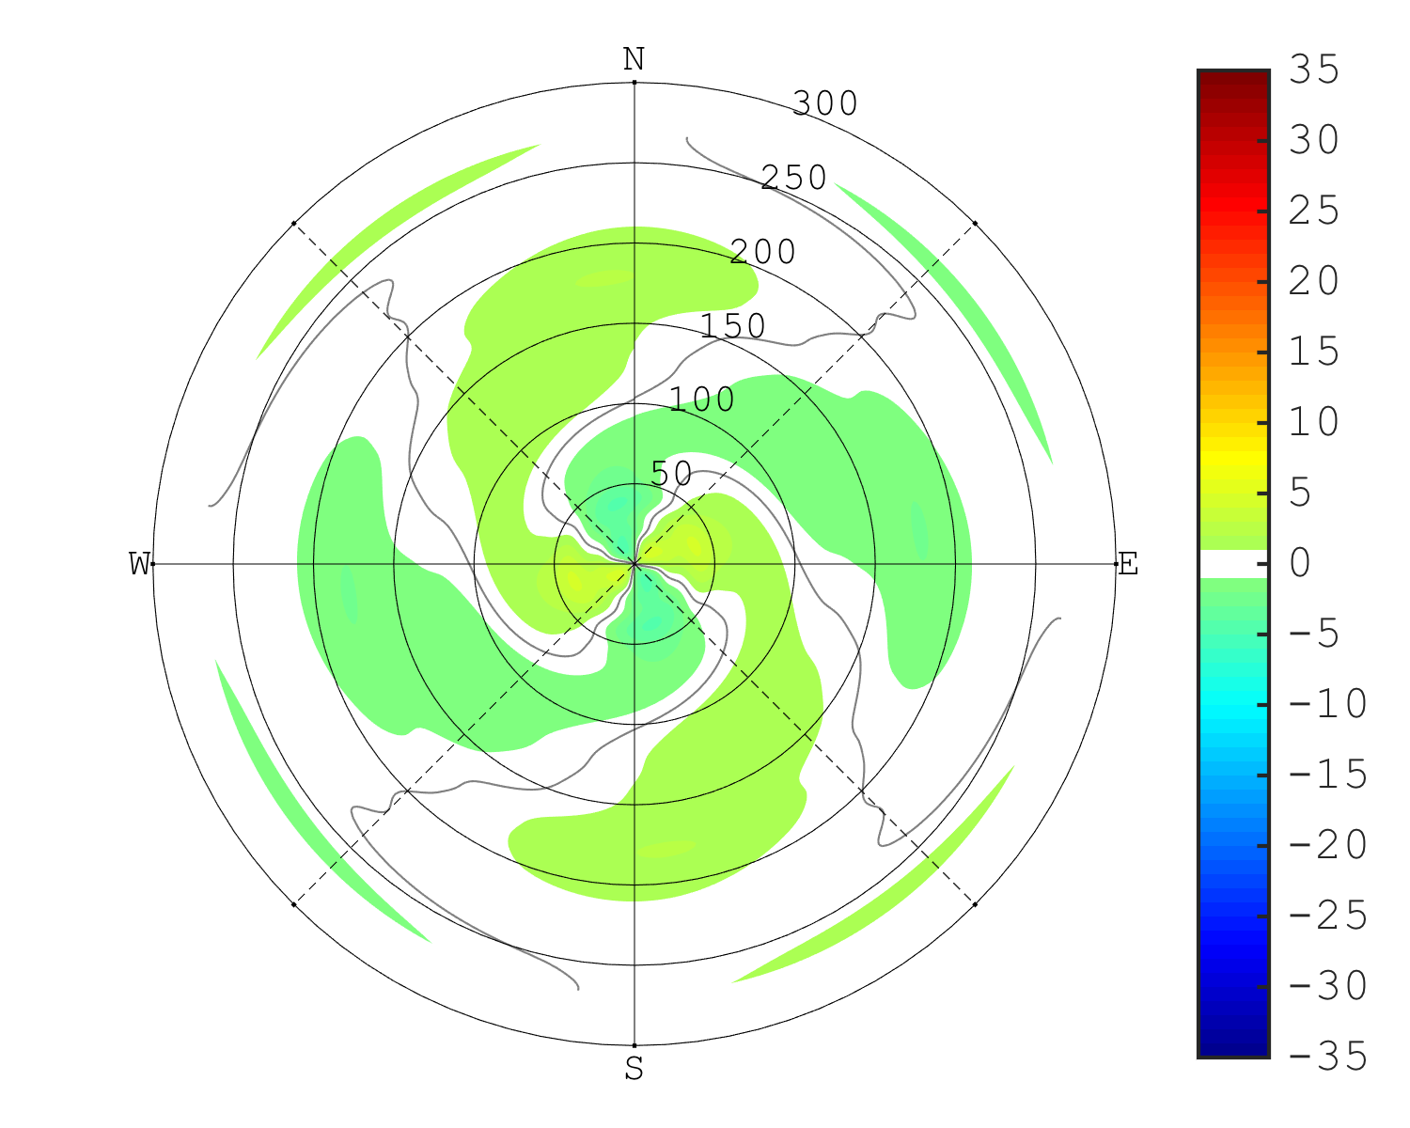
10-m Wind Speed
Time = 6 hr
Total Field
Wavenumber 0
Max = 39.4 m/s
Max = 26.2 m/s
Wavenumber 1
Wavenumber 2
Max = 7.3 m/s
Max = 4.6 m/s

Slide 7
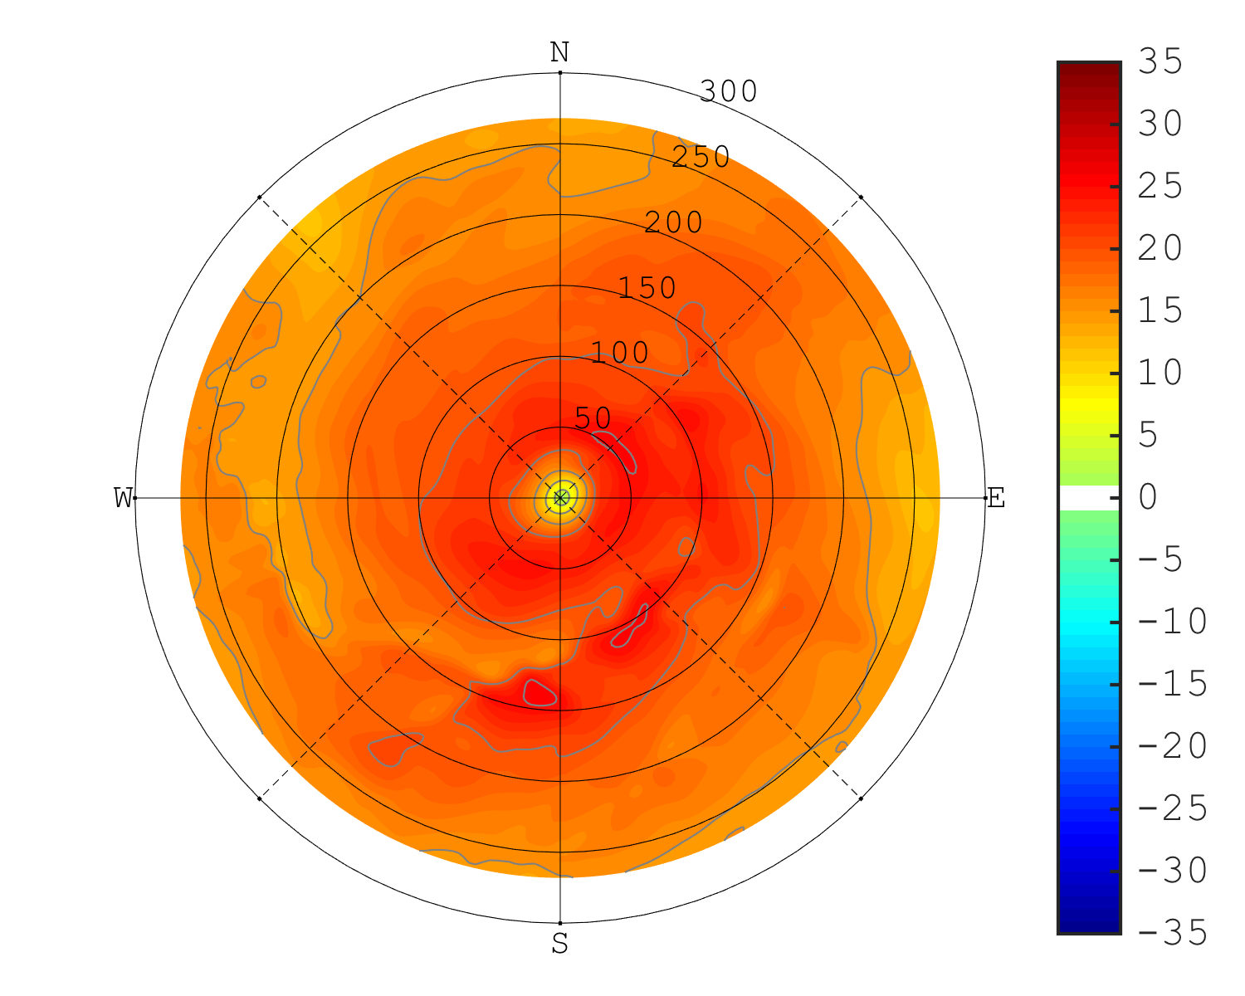
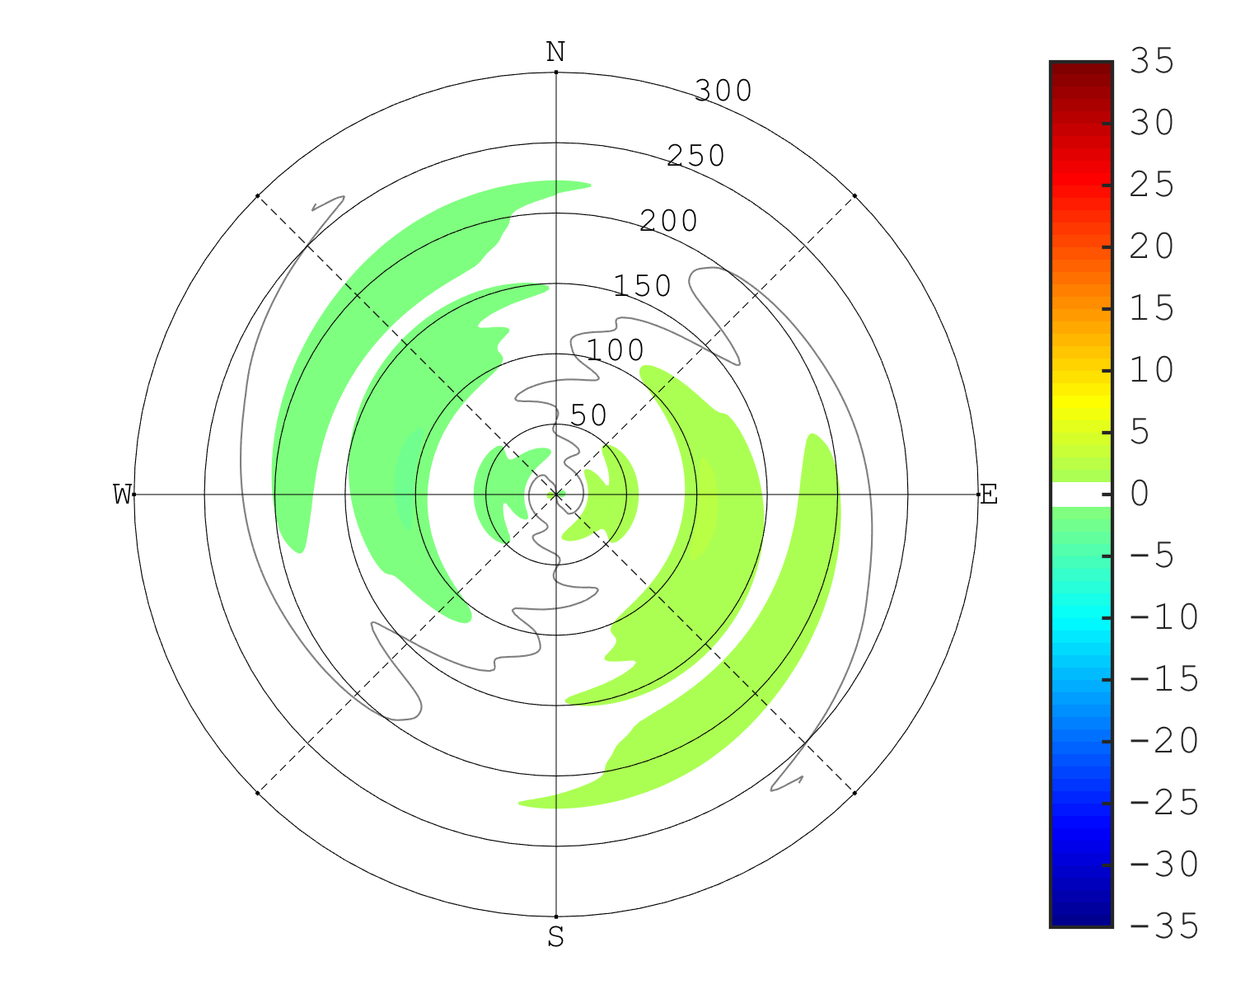
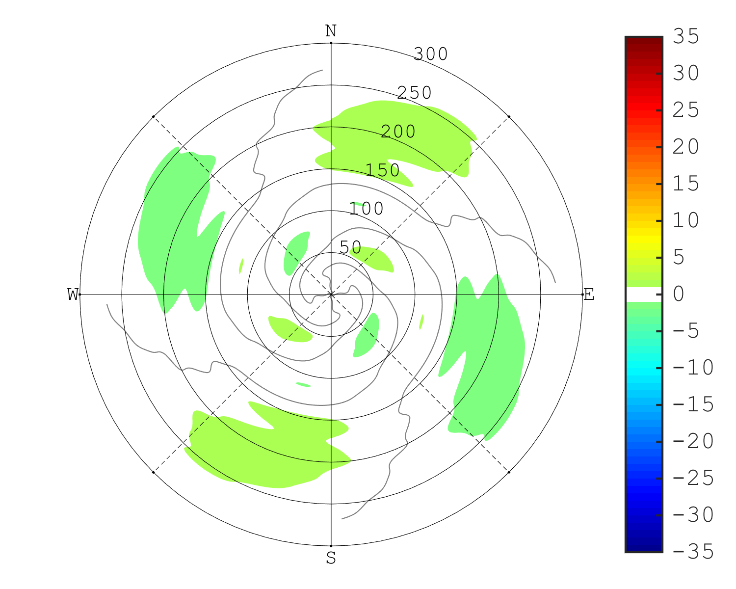
10-m Wind Speed
Time = 12 hr
Total Field
Wavenumber 0
Max = 25.8 m/s
Max = 23.4 m/s
Wavenumber 1
Wavenumber 2
Max = 2.1 m/s
Max = 1.5 m/s

Slide 8
Additional Slides

