Slide 1
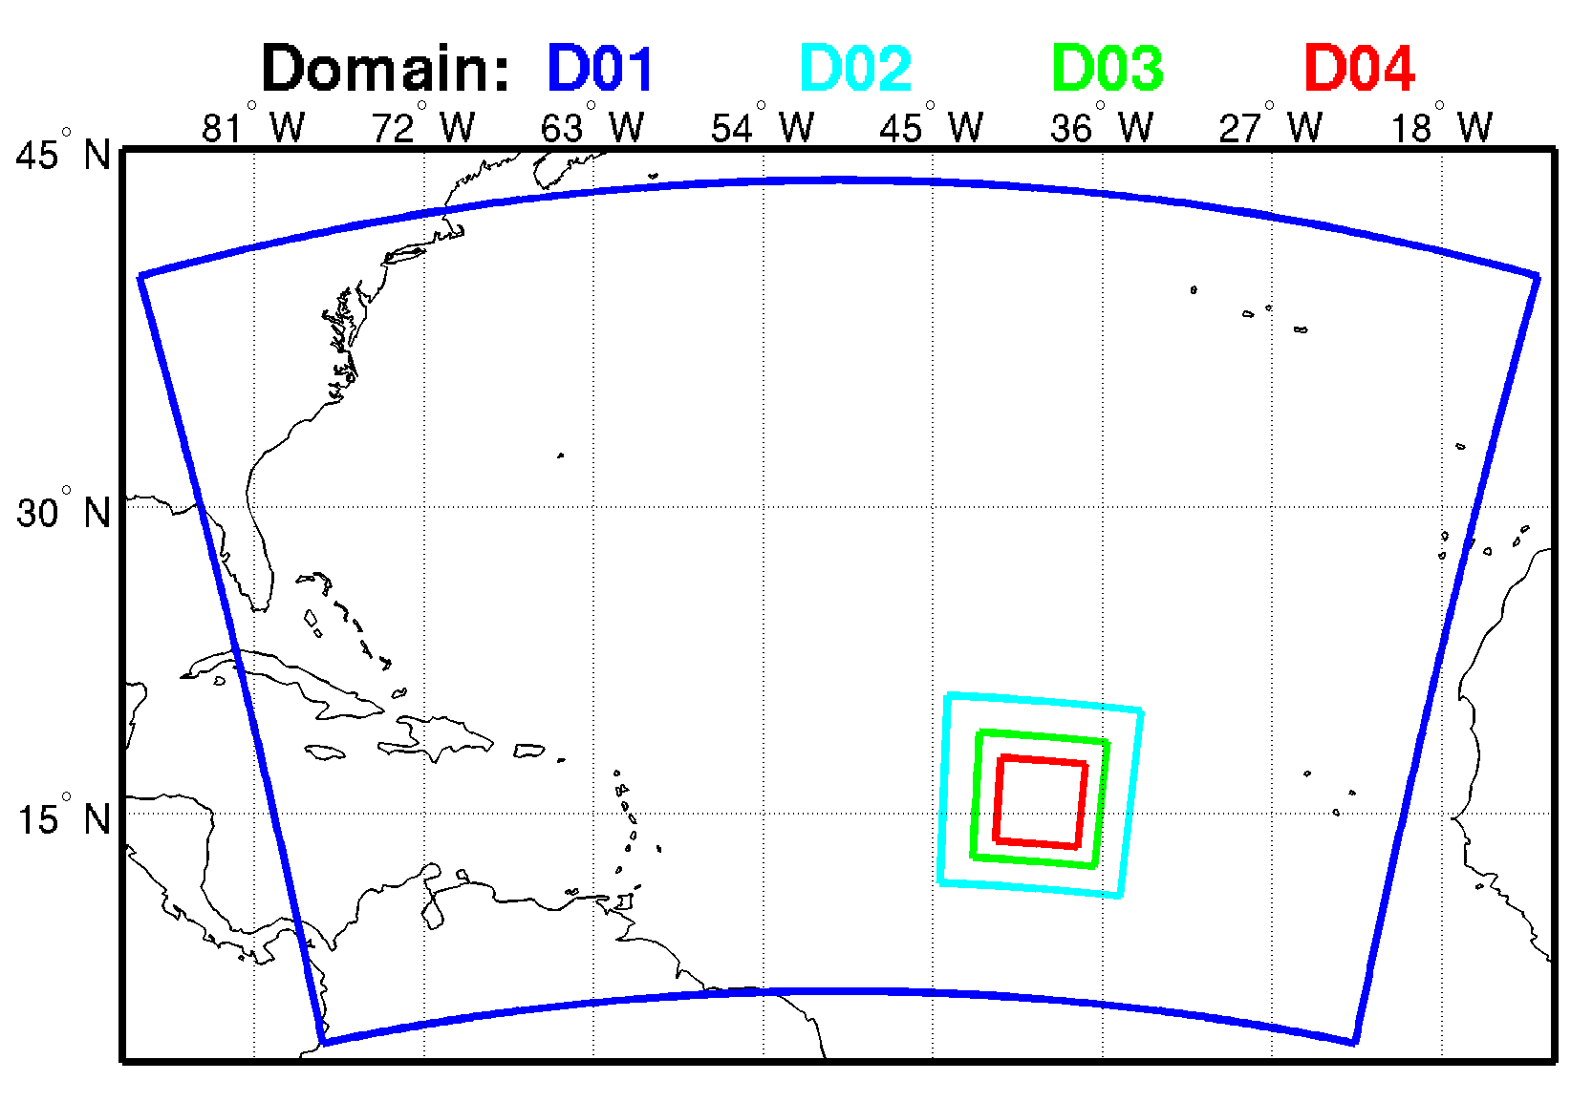
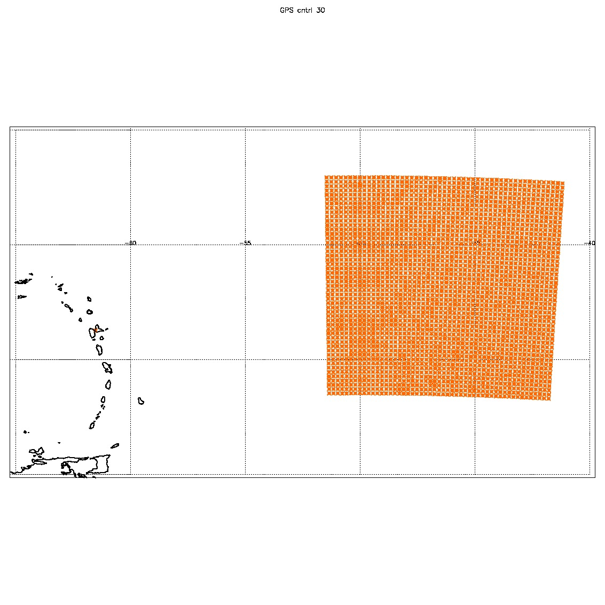
D01: 27 km(240x160), 30 min
D02: 9 km (120x120), 30 min
D03: 3 km (240x240), 30 min
D04: 1 km (480x480), 6 min
TROPICS data location
(res: 21 km) 0803 00z storm center at 18.2N 46.5W
TROPICS data location
(res: 21 km) 0802 00z storm center at 17.5N 43.4W
Data in D04/D03/D02 are merged , blurred/resampled to a uniform (or nearly uniform) 21 km grid

Slide 2
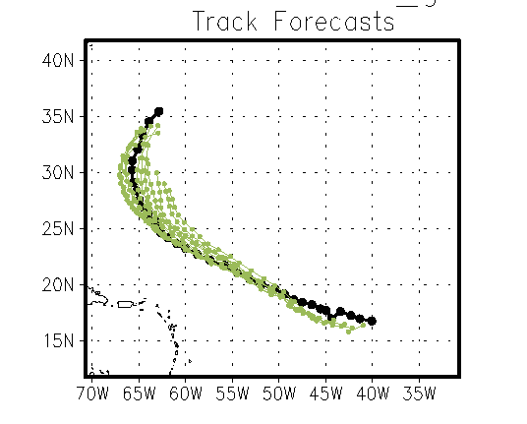
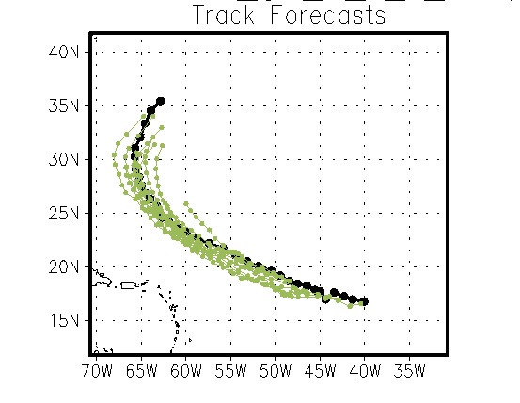
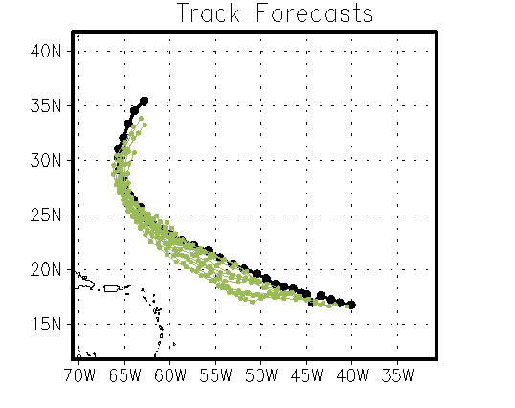
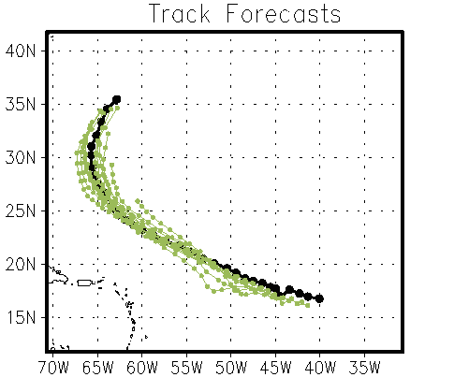
Control
Control, T
Control, T,Q
Control,Q

Slide 3
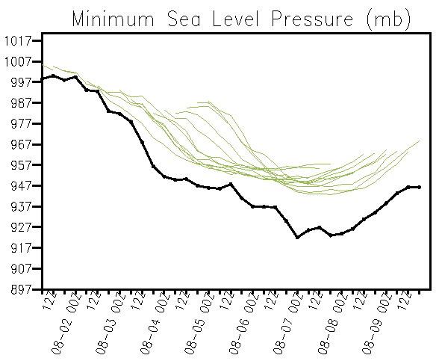
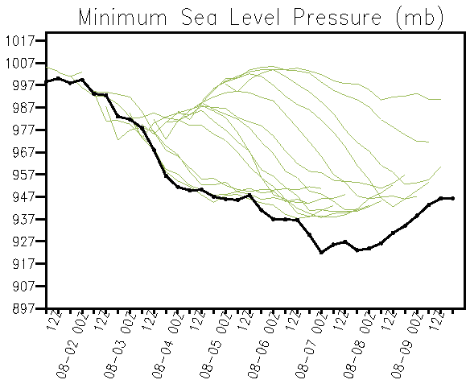
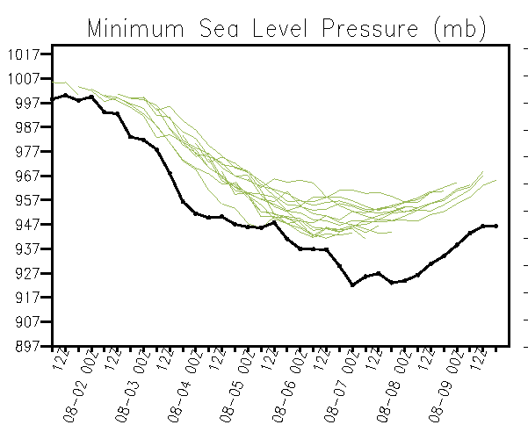
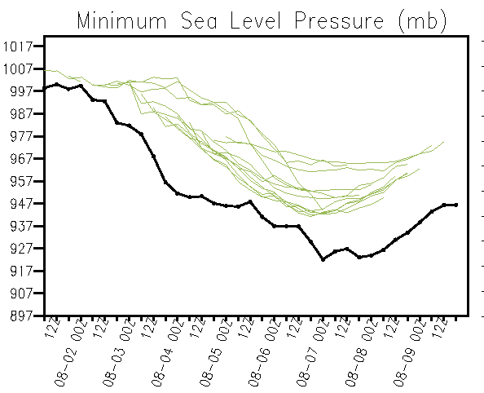
Control
Control, T
Control, T,Q
Control, Q

Slide 4
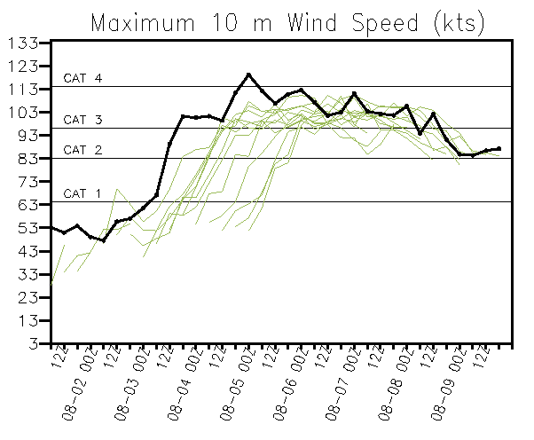
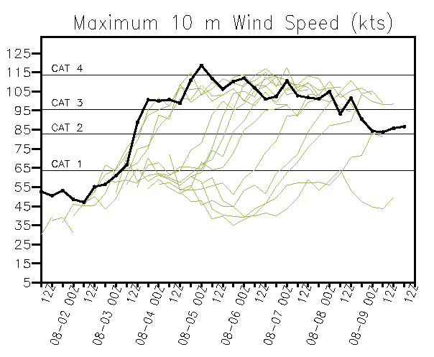
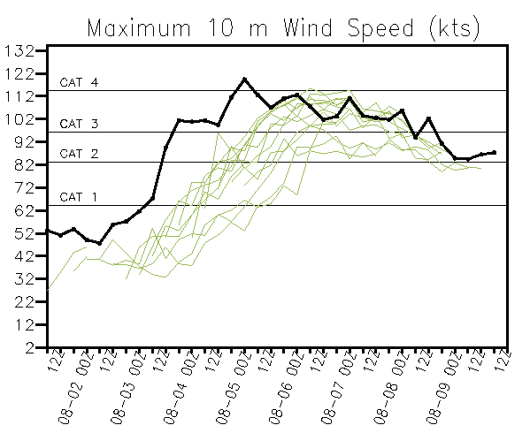
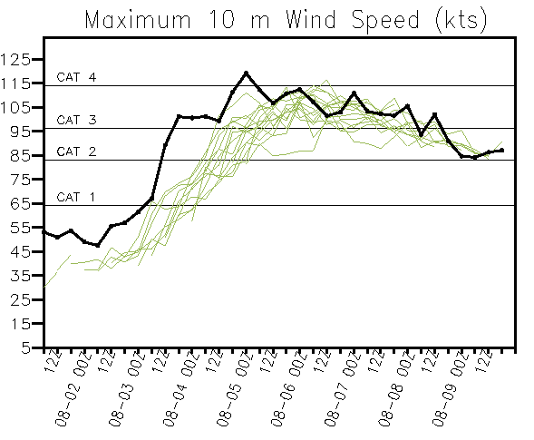
Control
Control, T
Control, T,Q
Control,Q

Slide 5
TC Stats

Slide 6
TC Stats

Slide 7
TC Stats

Slide 8
T(D4)-T(LG) at 855mb 0804 00Z

