Slide 1
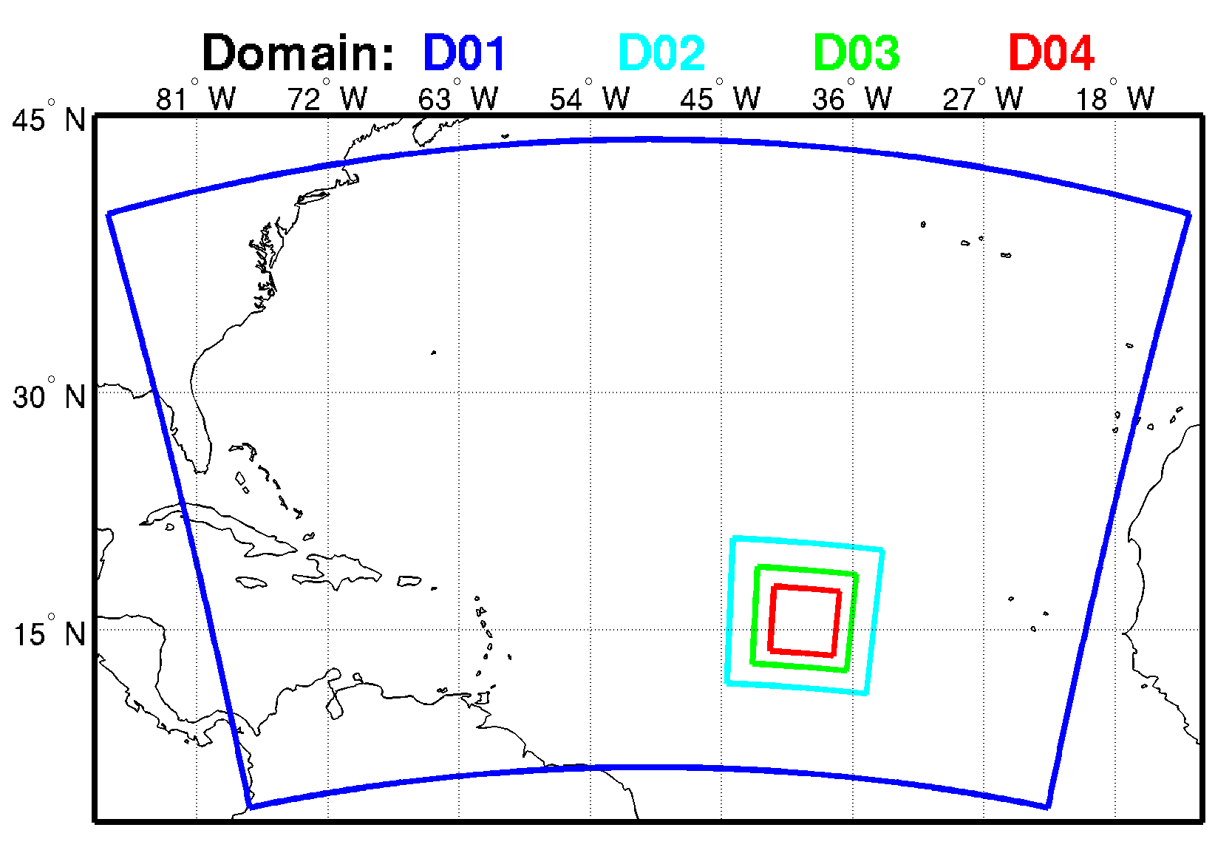
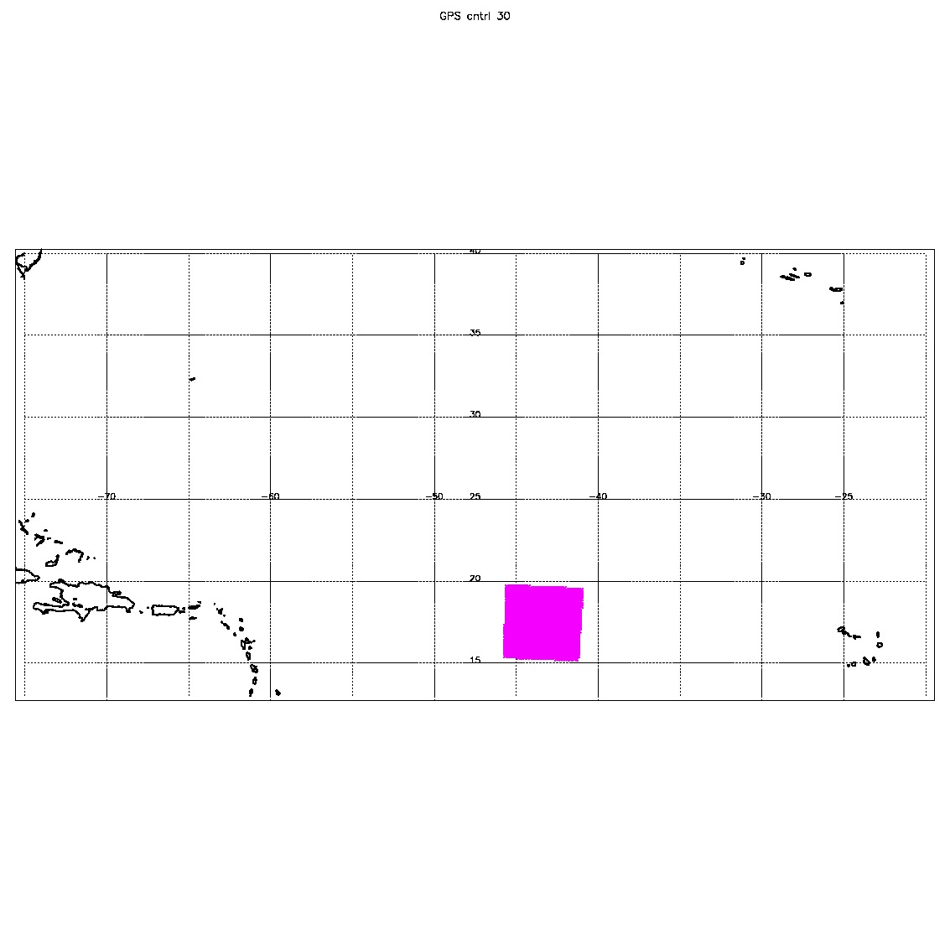
Four domains with different spatial and temporal resolutions
D01: 27 km(240x160), 30 min
D02: 9 km (120x120), 30 min
D03: 3 km (240x240), 30 min
D04: 1 km (480x480), 6 min
TROPICS data location
(res: 21 km) 0802 00z storm center at 17.5N 43.4W

Slide 2
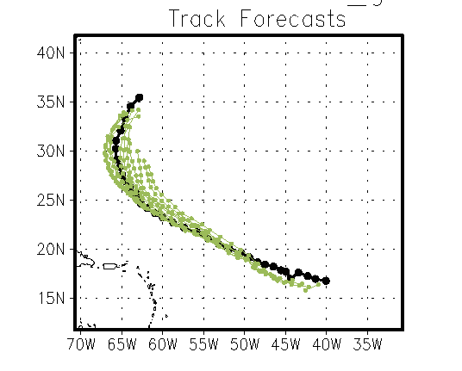
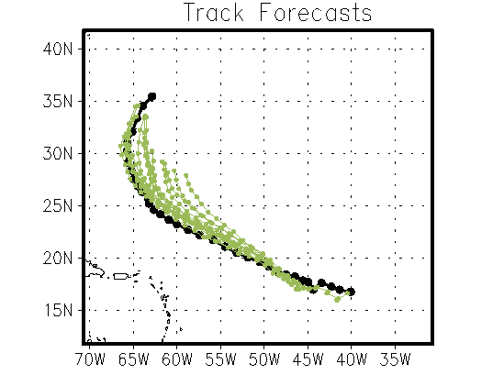
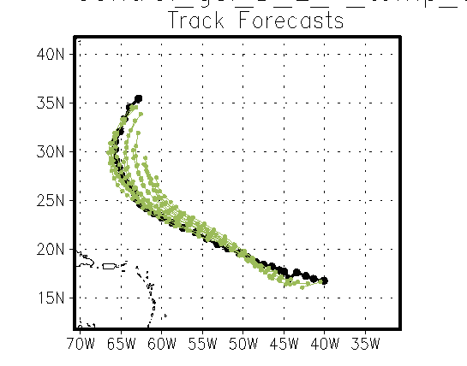
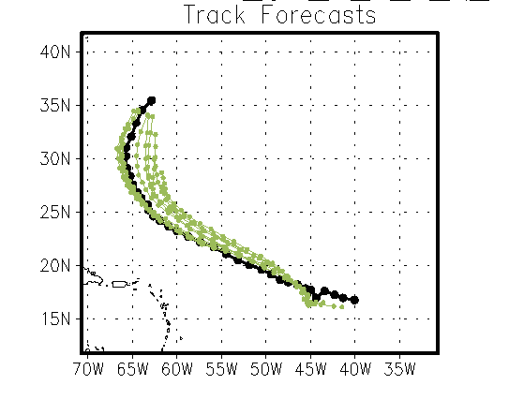
Control
Control, T
Control, T,Q
Control,Q

Slide 3
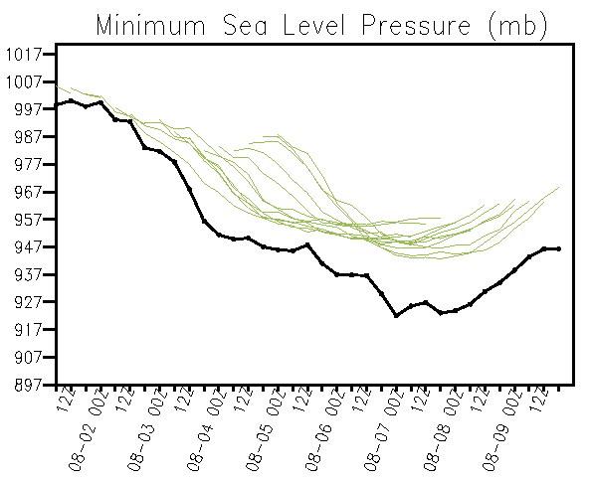
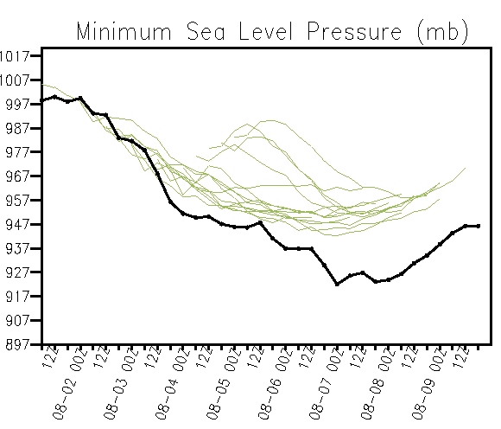
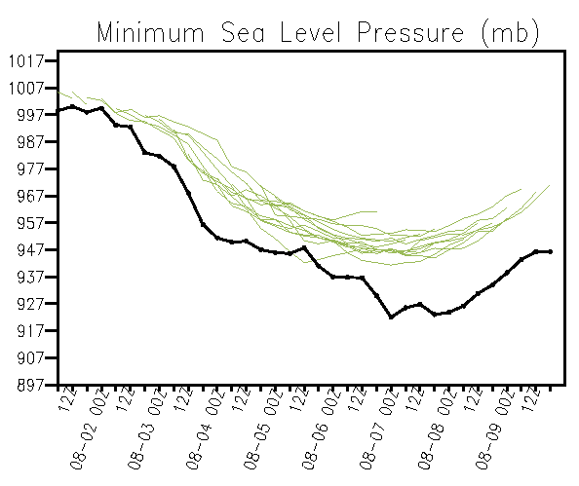
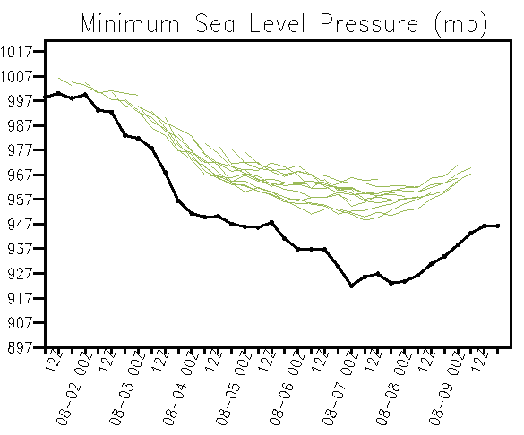
Control
Control, T
Control, T,Q
Control, Q

Slide 4
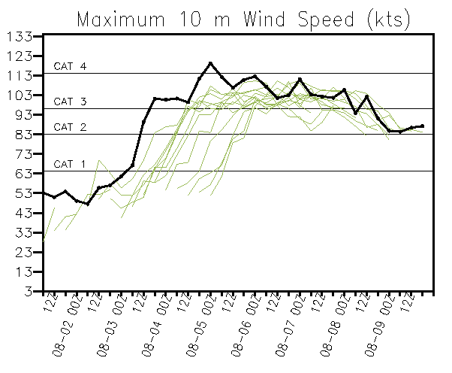
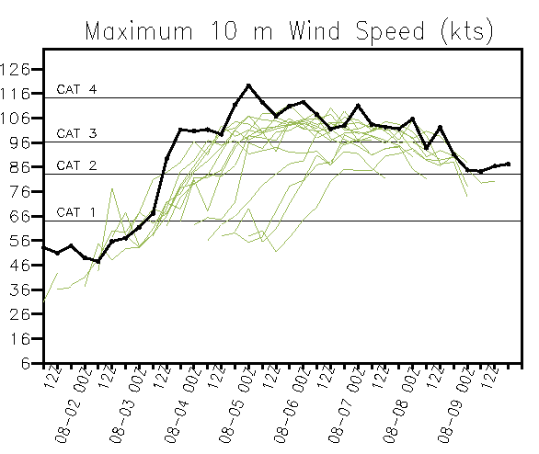
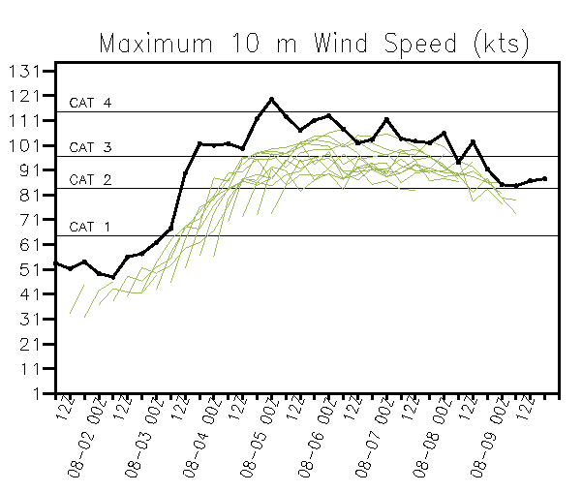
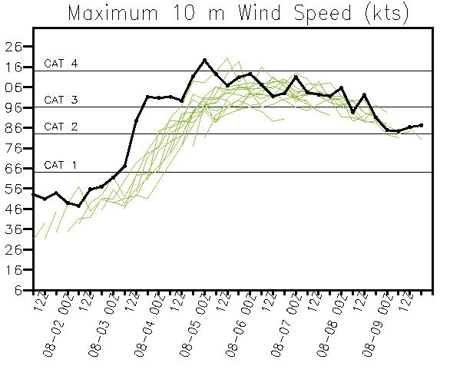
Control
Control, T
Control, T,Q
Control,Q

Slide 5
TC Stats

Slide 6
TC Stats

Slide 7
TC Stats

Slide 11
What is next?
TROPICS data location
(res: 21 km) 0803 00z storm center at 18.2N 46.5W
Assimilate Tb
Assimilate Data from D02 (~10x10)

