Slide 1
New Data at 21km resolution
'freq_avg' (Instrument channel frequencies)
'Tb' (Instrument brightness temperature, without noise)
'Tb_noisy' (Instrument brightness temperature, with noise)
'pressure_mbar' (Pressure profiles)
'surface_pressure_mbar’, u10, v10
'temperature_K' (Truth temperature profiles)
'temperature_K_est' (Retrieved temperature profiles)

Slide 2
'qvapor_g_m3' (Water vapor profiles, truth)
'qvapor_g_m3_est' (Water vapor profiles, retrieval)
'rain_surface_mm' (Surface rain rate, truth: Units are mm/5s
'rain_surface_mm_est' (Surface rain rate, retrieval: Units are mm/5s

Slide 3
New Data at 21km
- All files are now on what was previously called the "21 km" grid. The intent before was to capture the idea that the temperature channels have different resolution than the water vapor channels. That is still reflected here in the sense of the blurring of those channels with a larger kernel than the others, but that is applied before the sampling. All channels are now sampled with the same grid spacing. This should be more straightforward and more accurately reflects our intent.
- To answer a question that came up: This "grid" is meant to be a proxy for a set of virtual beams that would be sampling this region from the proposed instrument. Nadir-looking geometry and square-shaped beams sampling the original domain via block averaging are meant to simplify this simulation but provide a reasonable representation of what the instrument would be capable of.

Slide 4
Nature run for DOME Earth Venture TC Stats track

Slide 5
Nature run for DOME Earth Venture TC Stats Wind

Slide 6
Nature run for DOME Earth Venture TC Stats Pressure

Slide 7
Nature run for DOME Earth Venture Temperatures D02 avg at 850mb

Slide 8
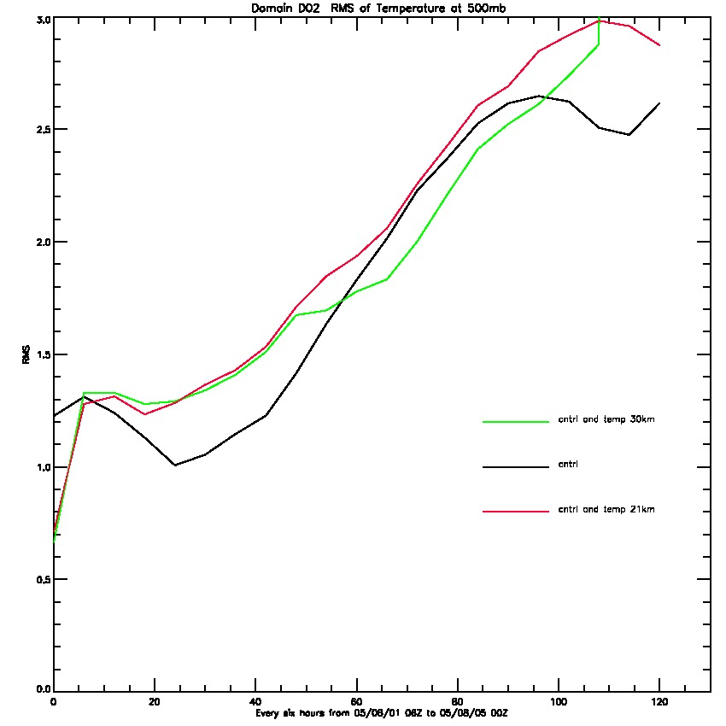
Temperatures D02 avg at 500mb

Slide 9
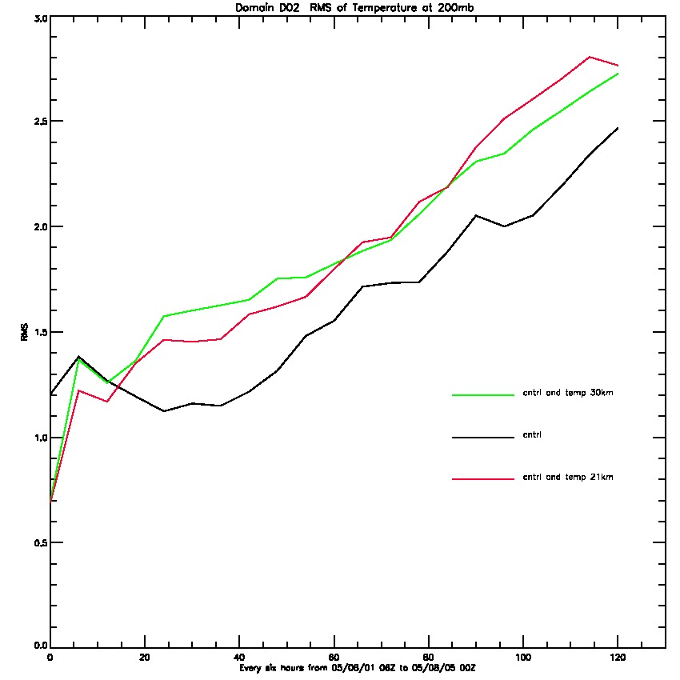
Temperatures D02 avg at 200mb

Slide 10
Data Location (21 km) 0802 00z storm center at 17.5N 43.4W

Slide 11
Data Location (21km) 0802 00z storm center at 17.5N 43.4W

Slide 12
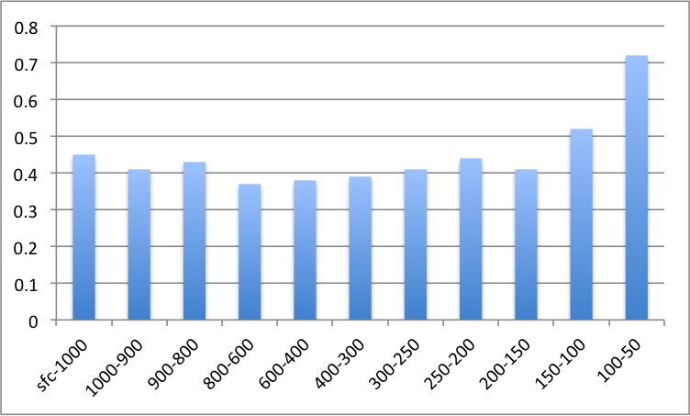
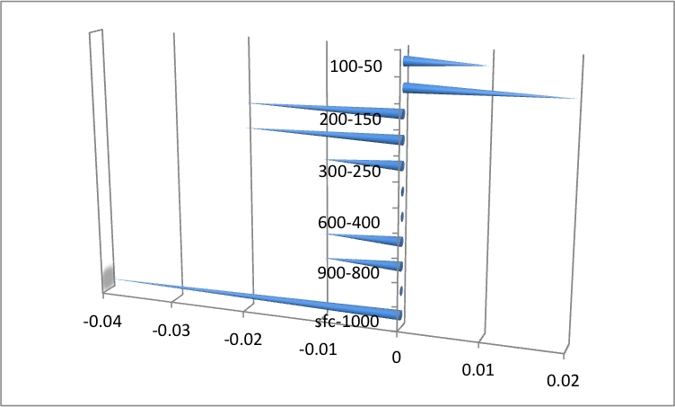
Statistics on 08/02 00z
RMS per layer
Number of points assimilated per layer
.No Data was rejected, all points 23x23x60 (31740) were assimilated
.A total of 31882 points assimilated
BIAS per layer

