Slide 1
Nature run for DOME Earth Venture variables
'freq_avg' (Instrument channel frequencies)
'Tb' (Instrument brightness temperature, without noise)
'Tb_noisy' (Instrument brightness temperature, with noise)
'pressure_mbar' (Pressure profiles)
'surface_pressure_mbar’
'temperature_K' (Truth temperature profiles)
'temperature_K_est' (Retrieved temperature profiles)

Slide 2
'qvapor_g_m3' (Water vapor profiles, truth)
'qvapor_g_m3_est' (Water vapor profiles, retrieval)
'rain_surface_mm' (Surface rain rate, truth: Units are mm/5s
'rain_surface_mm_est' (Surface rain rate, retrieval: Units are mm/5s

Slide 3
Avgdr= 6.022045e23; % molecules/mole
Lschmdt= 2.686754e19; % molecules/cm^3
Mair= 28.964; % grams/mole
To=273.15; % standard temp. kelvin
Po=1013.25; % standard pressure mb
for i=1:length(qvp_kgkg),
qvp_g_m3(i)=qvp_kgkg(i)*((Mair*Lschmdt*To)/(Avgdr*Po))*(pressure(i)/temp(i)*10^6)
end

Slide 4
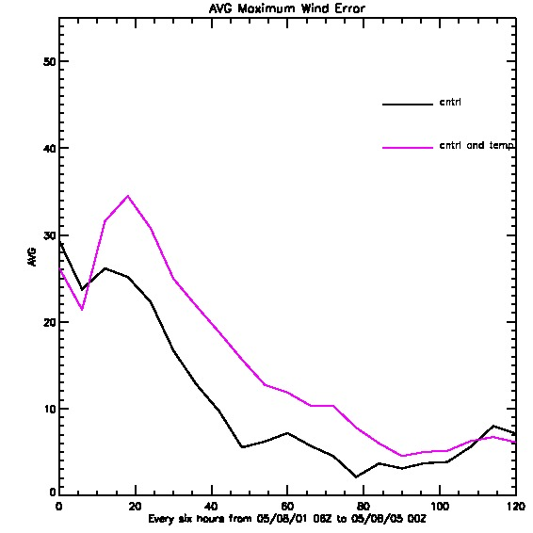
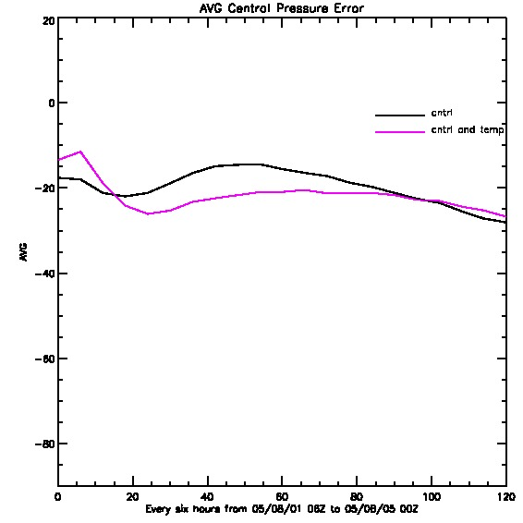
Nature run for DOME Earth Venture TC Stats

Slide 5
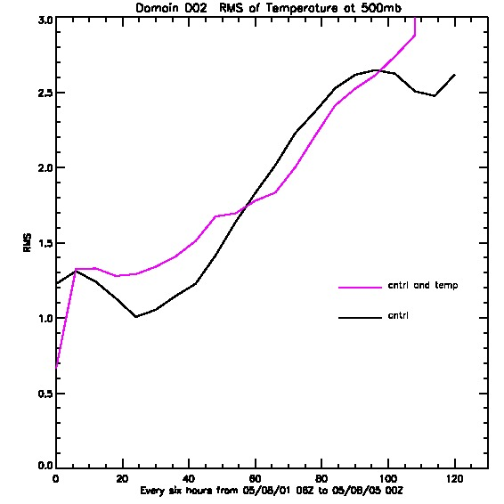
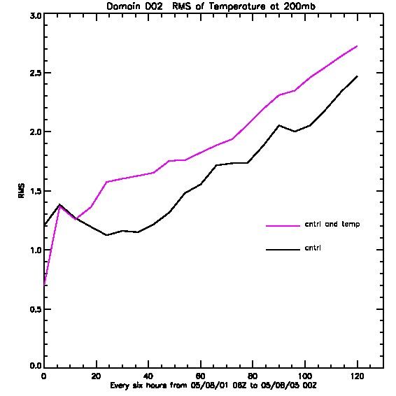
Nature run for DOME Earth Venture Temperatures avg at 850mb, 500mb, 200mb

Slide 6
Tracks and Average track error

Slide 7
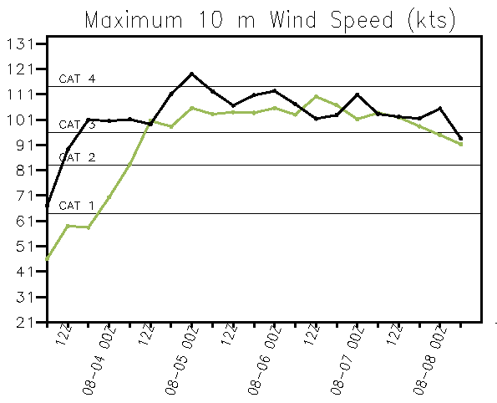
Example 0803 06z

Slide 8
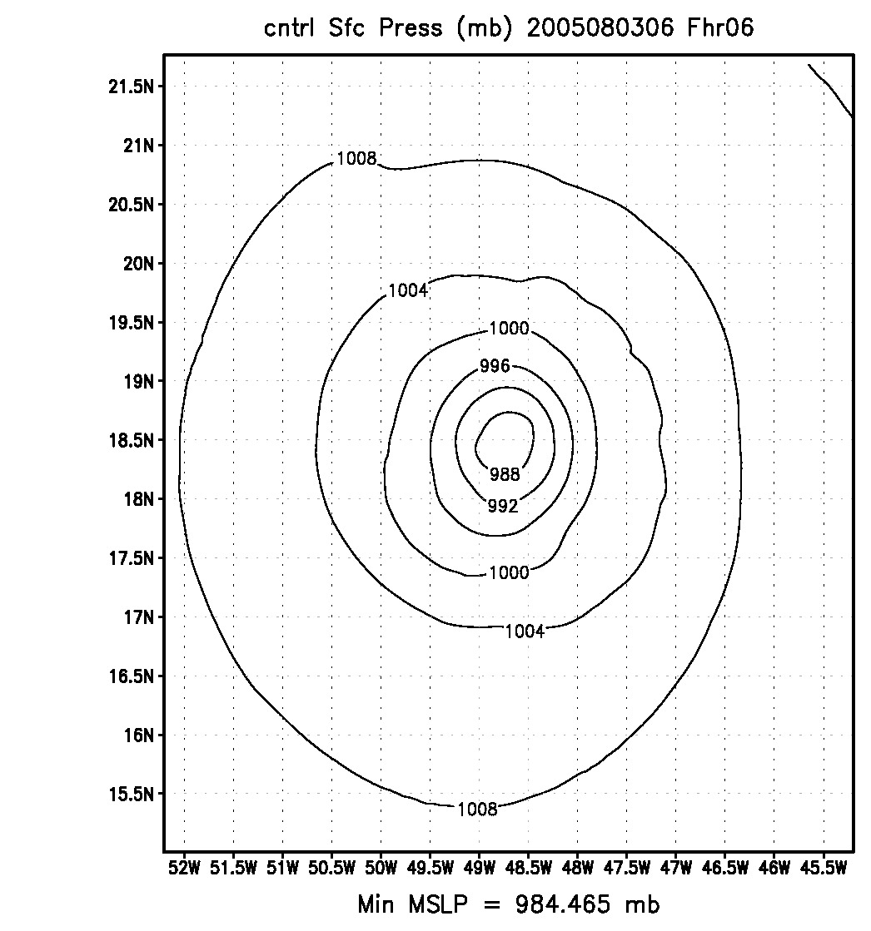
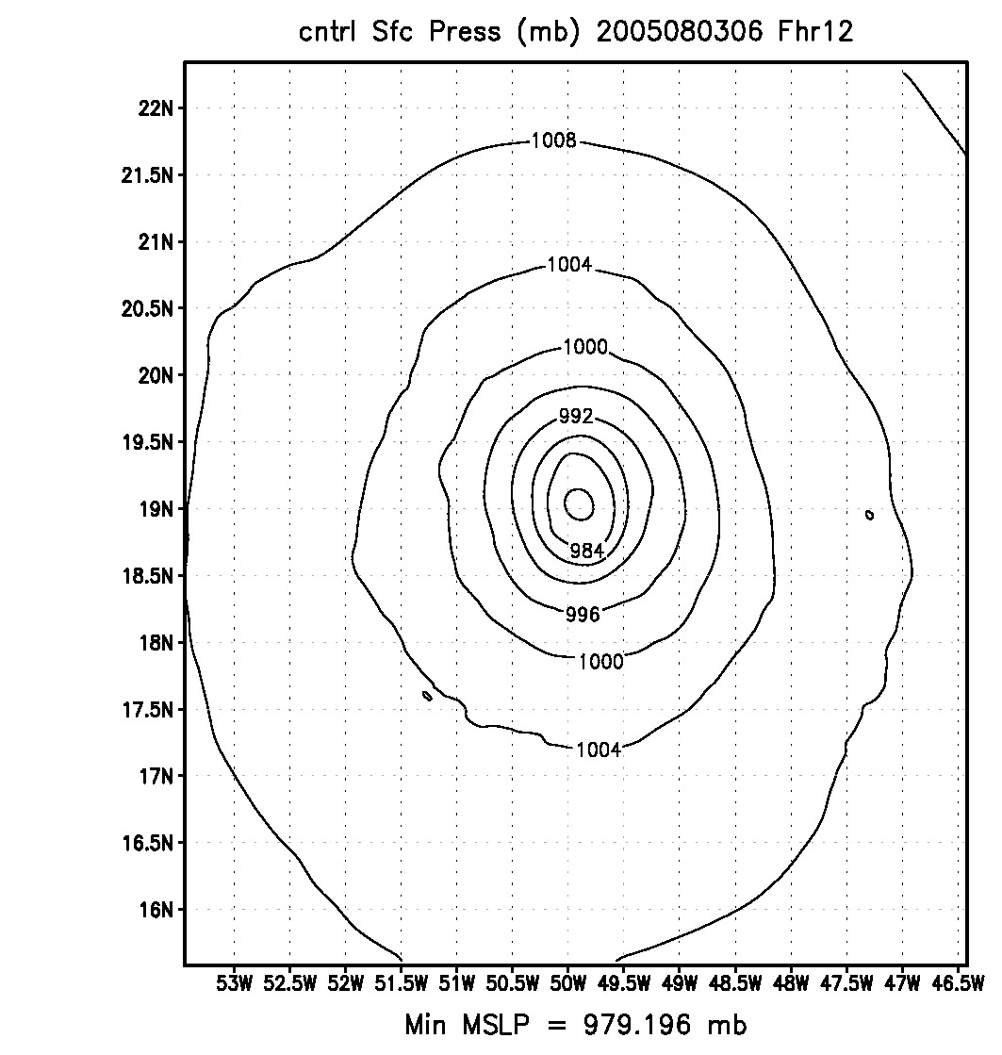
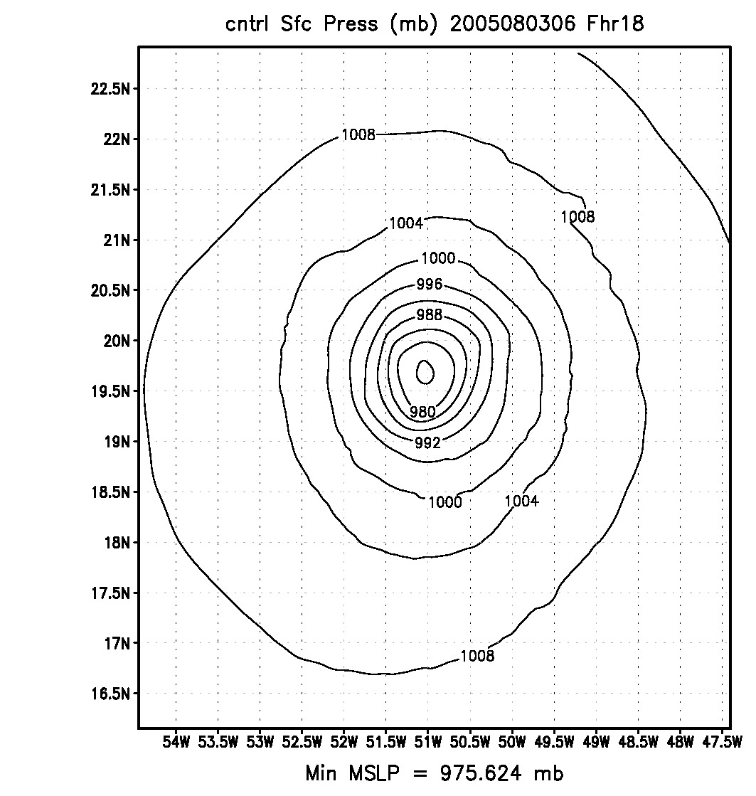
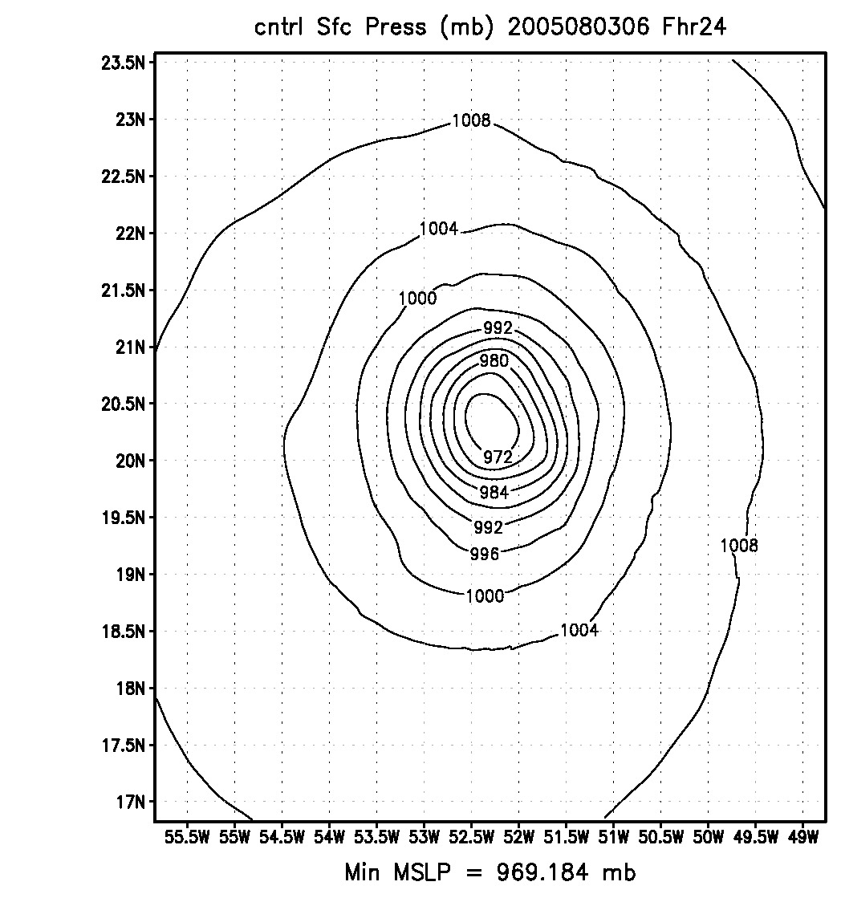

Slide 9
Zhaoxia Pu track errors

Slide 10
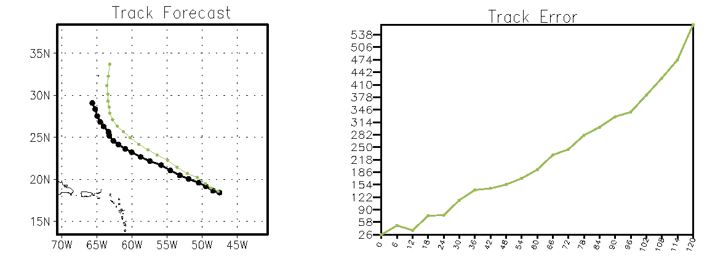
Comparaison on 0803 at 06z

