Slide 1
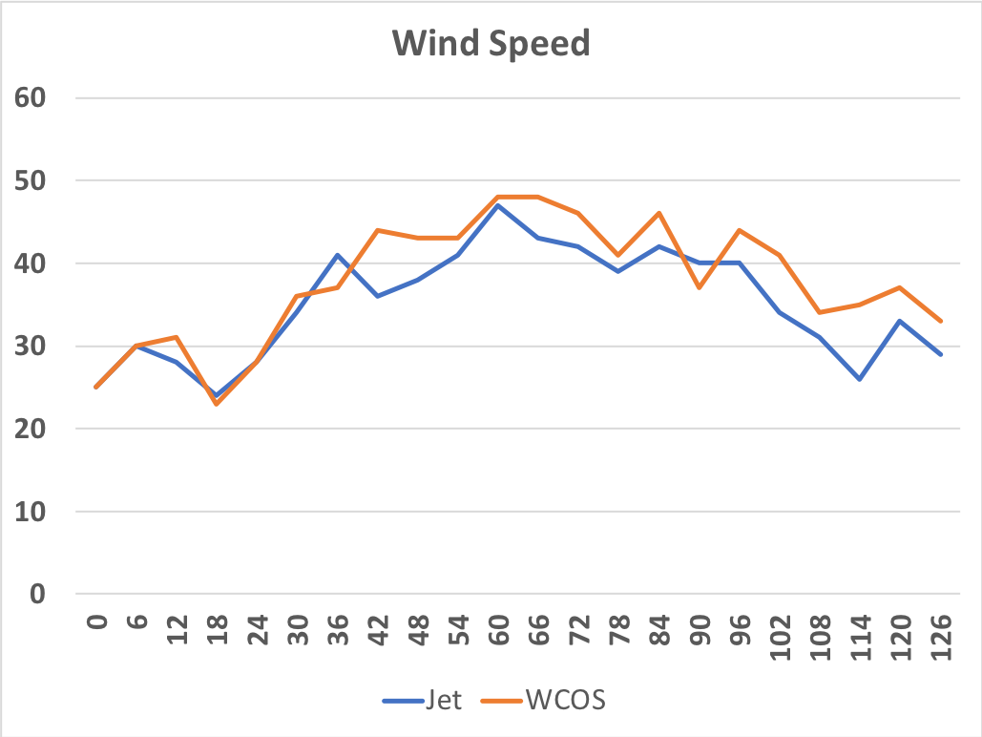
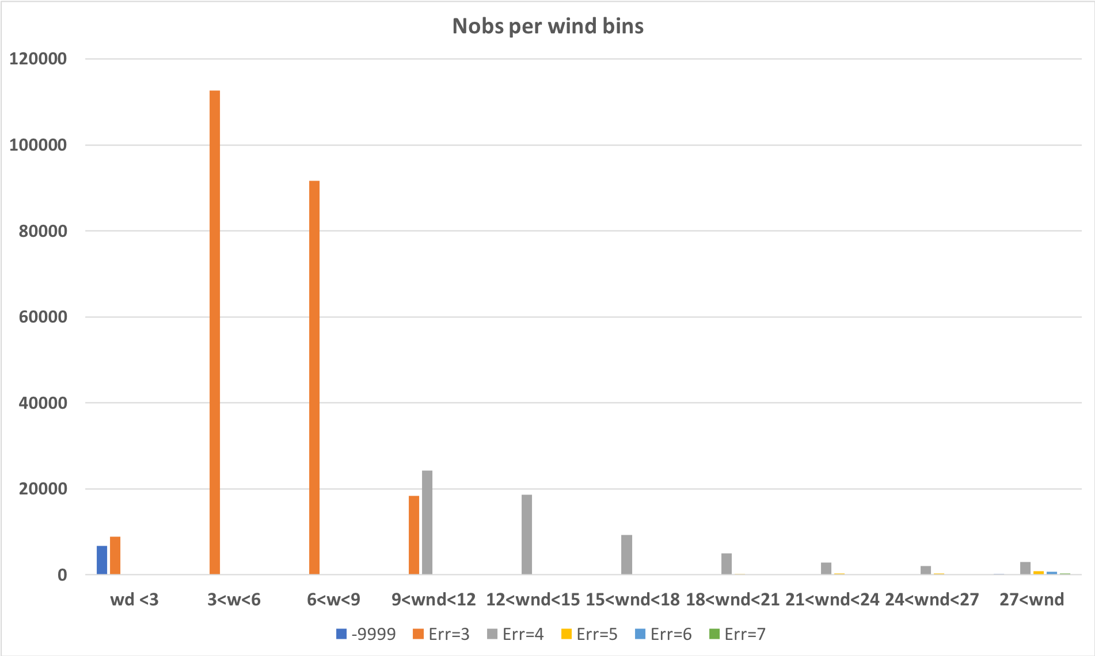
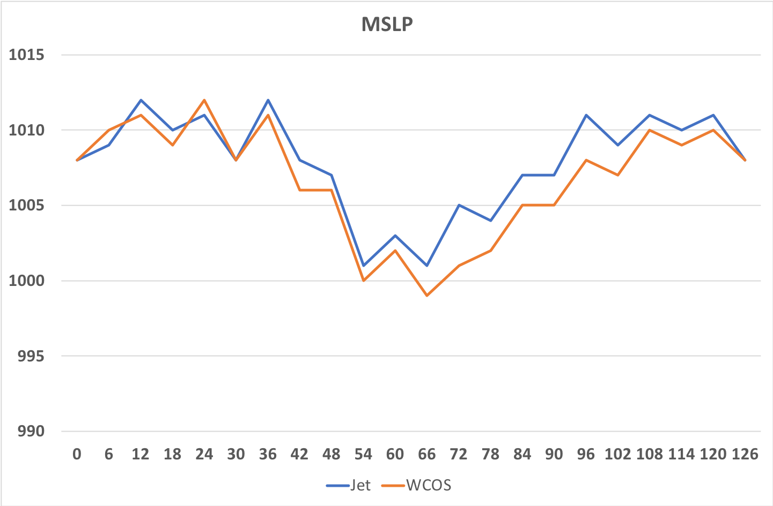
CYGNSS OSE update
Control for 93L, 95L, 96L, 09L and Cindy
We see differences between Jet and wcos runs (e.g 93L 082900)
Testing prepbufr file (Cindy 0619 18Z) using YSLF winds with error=3 m/s
Writing a prepbufr code that include the science team recommendations.

