Slide 1
CYGNSS update
Experiment | Hourly | 3 hourly | 6 hourly | Comment
CNTRL+ CYG | done | done | done
CNTRL+ CYG VECT | done | done | done
CNTRL+ VAM VECT | done | done | done

Slide 2
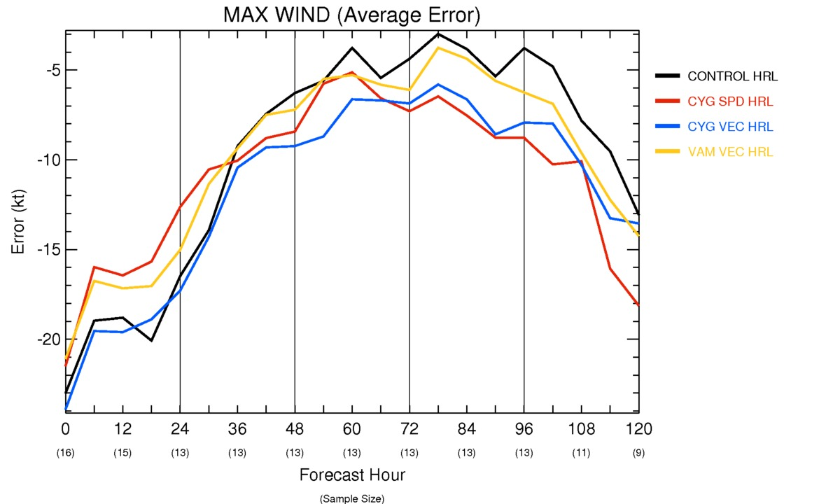
HRL results

Slide 3
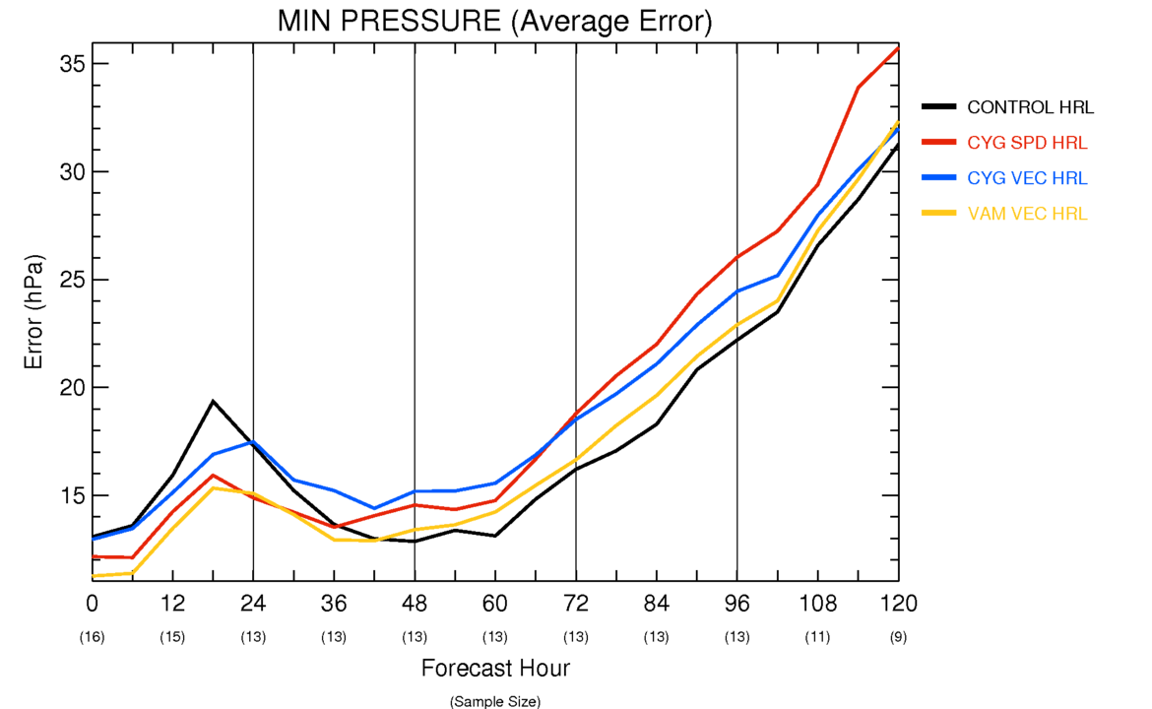
HRL results

Slide 4
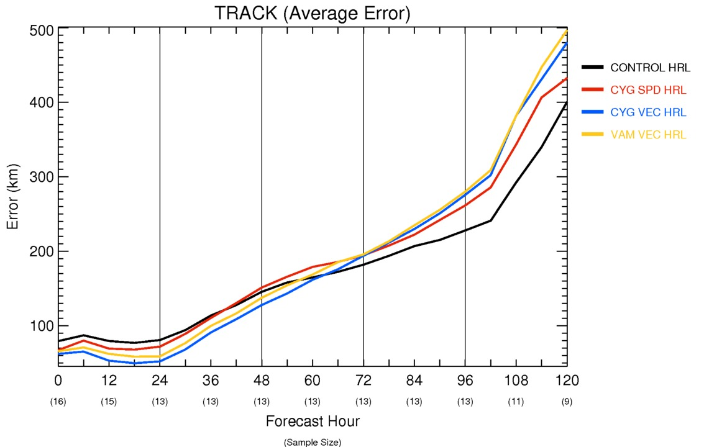
HRL results

Slide 5
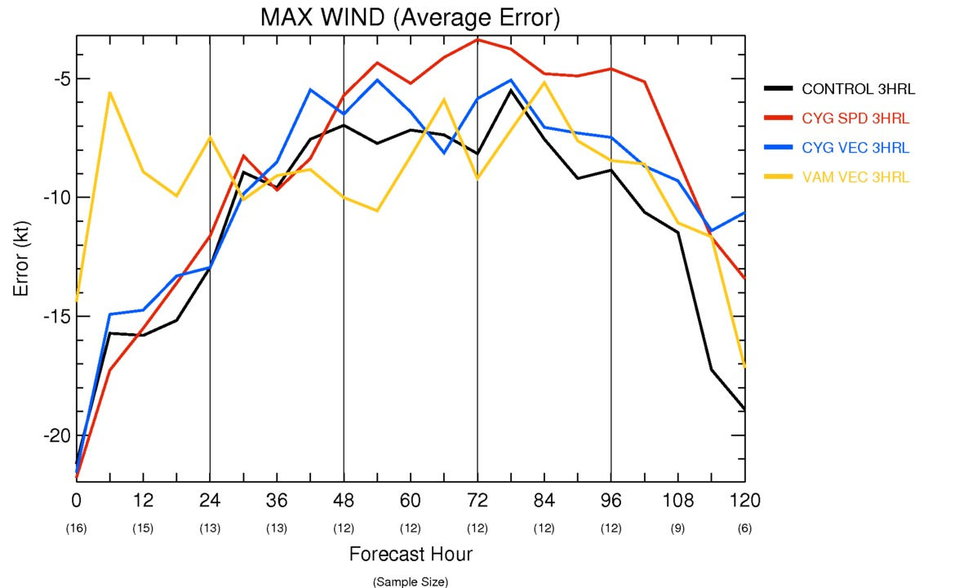
3 HRL results

Slide 6
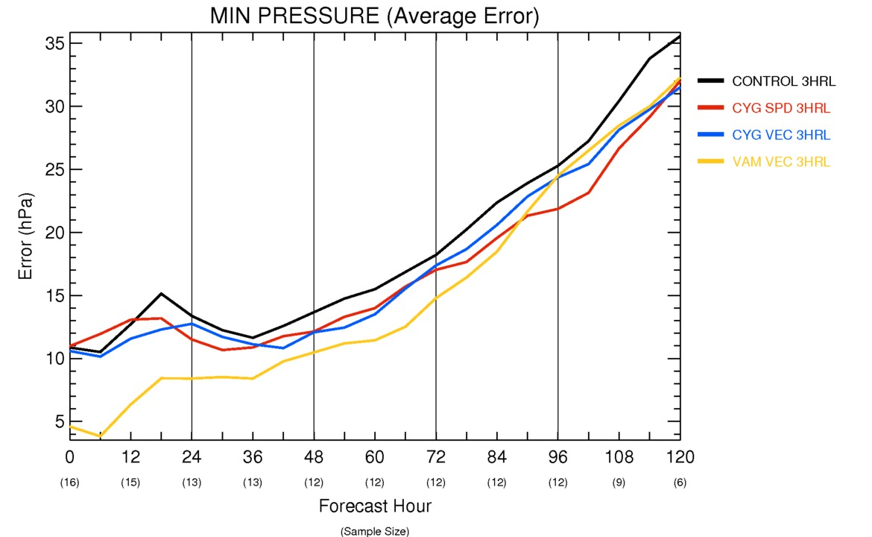
3 HRL results

Slide 7
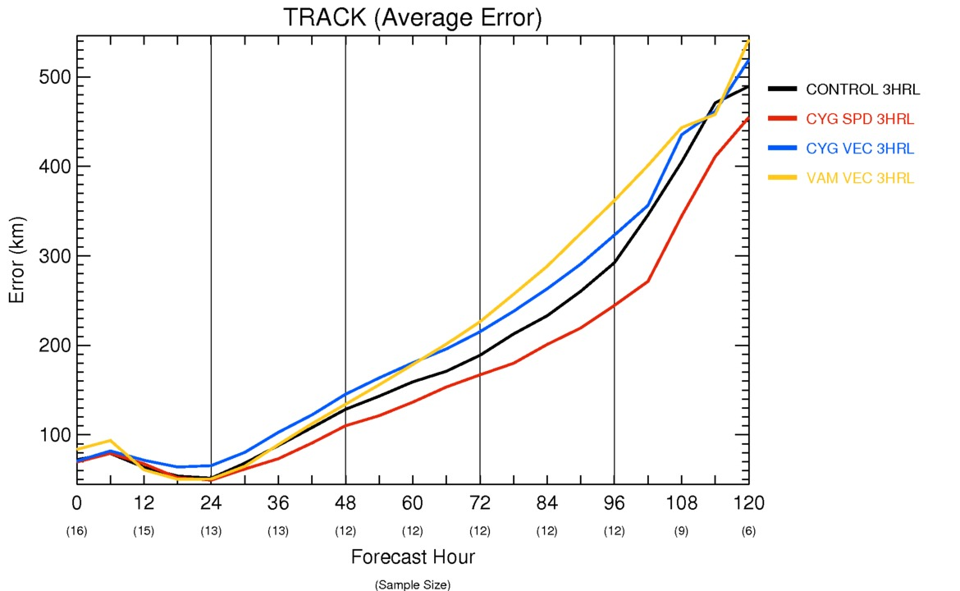
3 HRL results

Slide 8
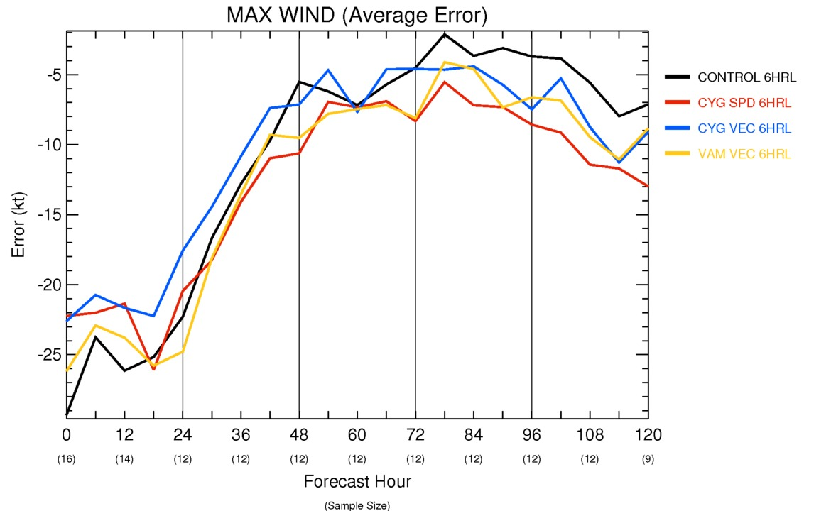
6 HRL

Slide 9
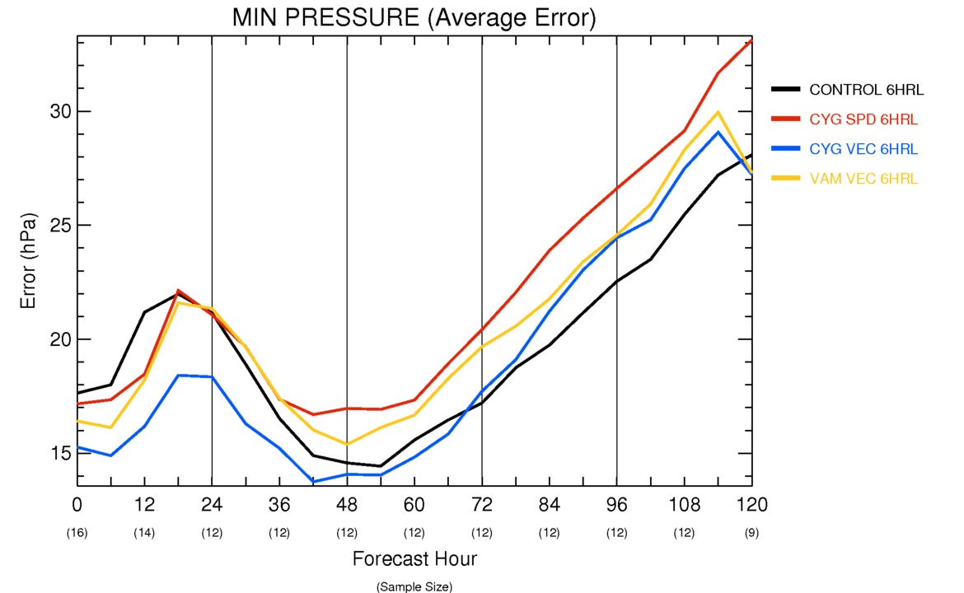
6 HRL

Slide 10
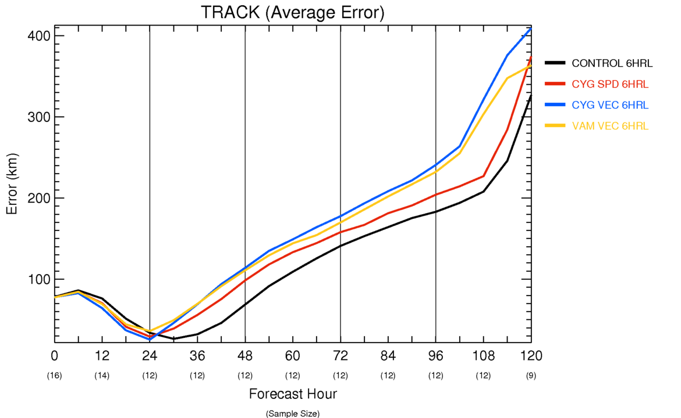
6 HRL

