Slide 1
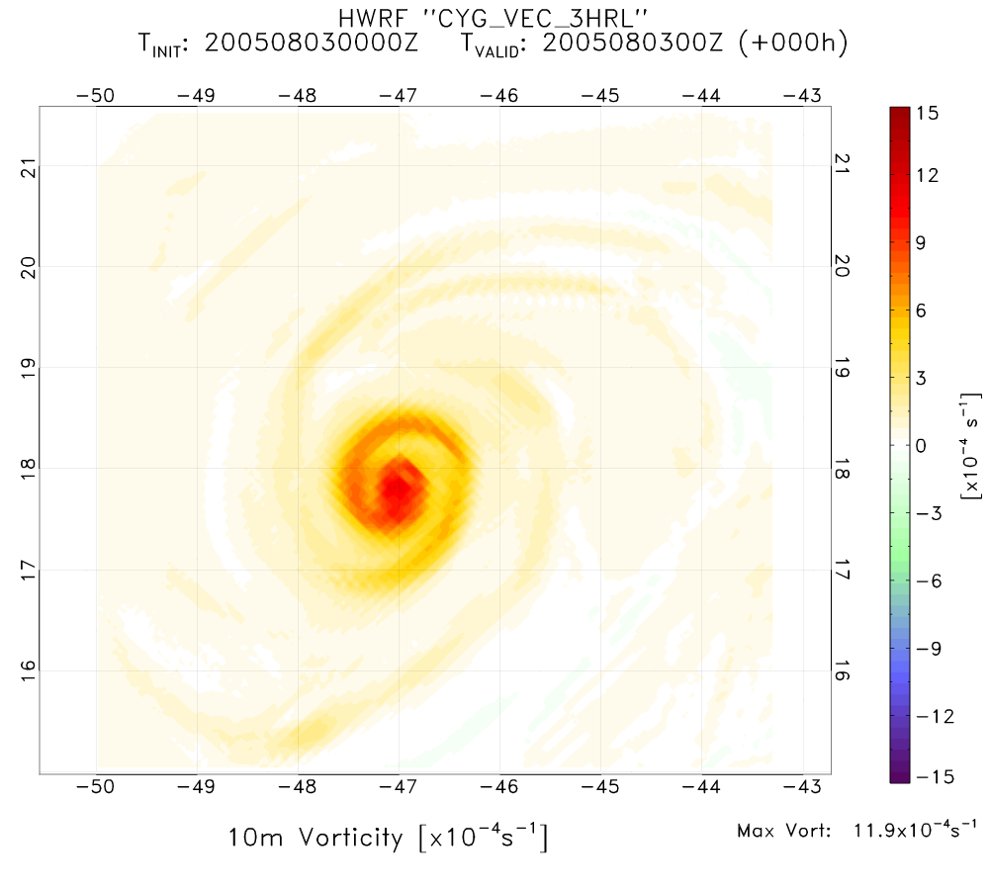
Vorticity comparison VAM VEC vs CYG VEC (0803)
VAM VEC vorticity field is a little smoother than CYG VEC.

Slide 2
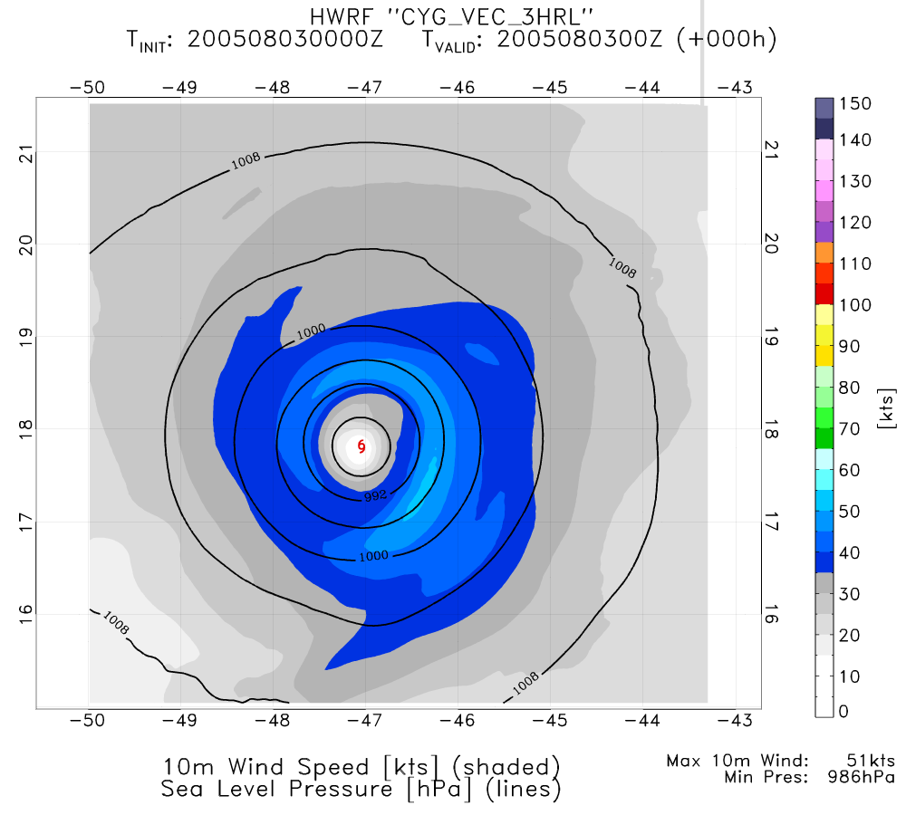
VAM VEC structure about the same as CYG VEC.

Slide 3
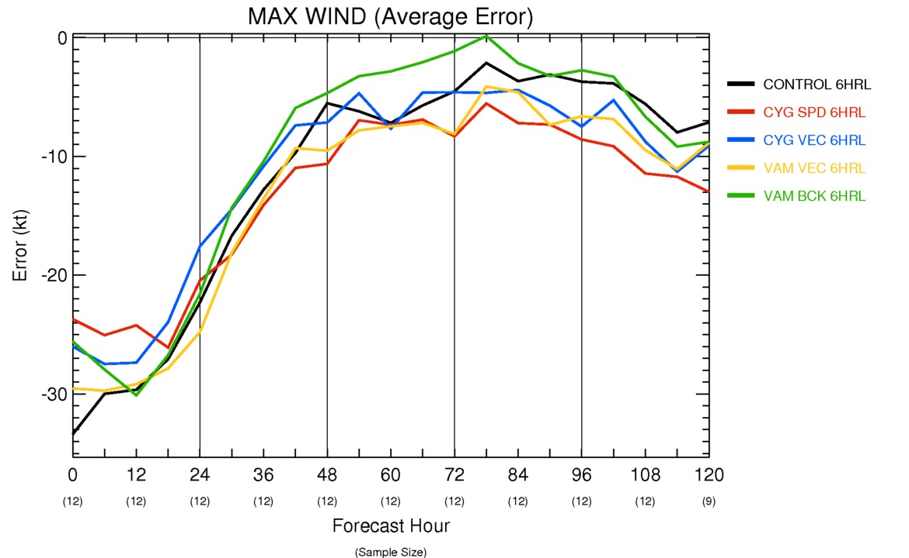
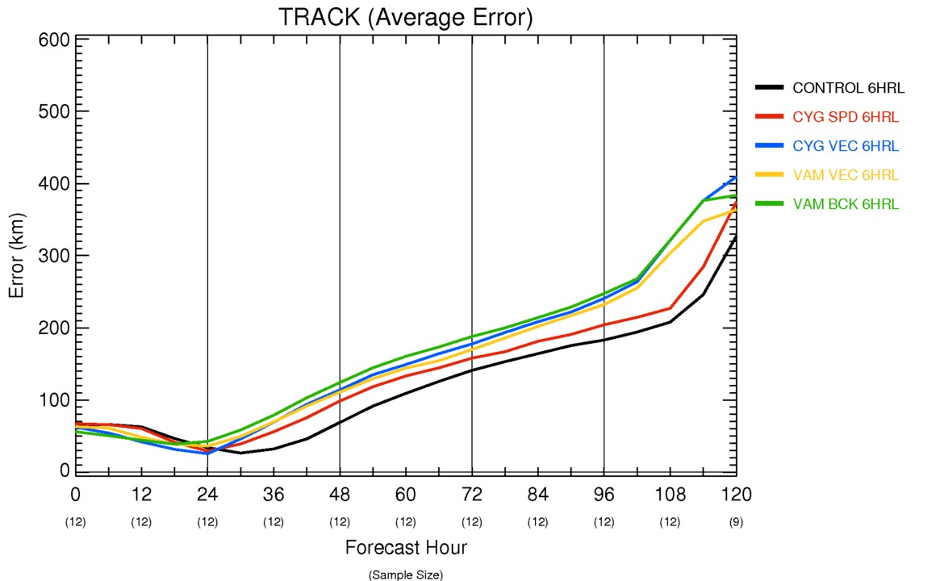
6 HRL storm statistics

Slide 4
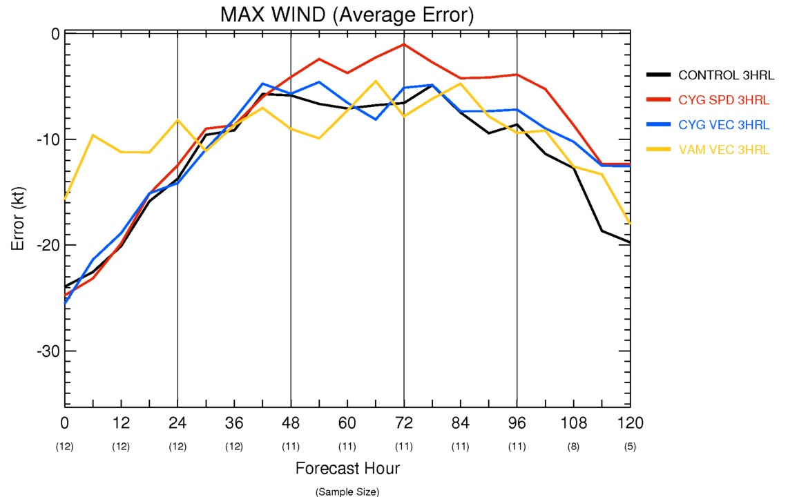
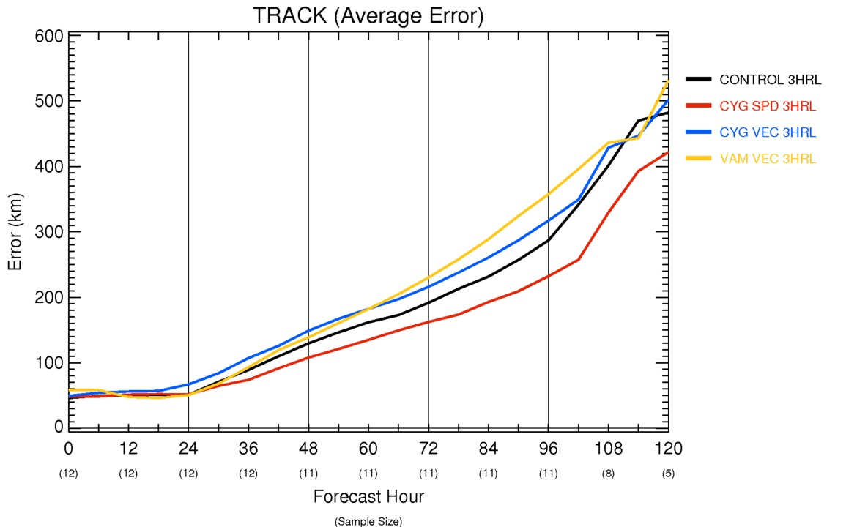
3 HRL storm statistics

Slide 5
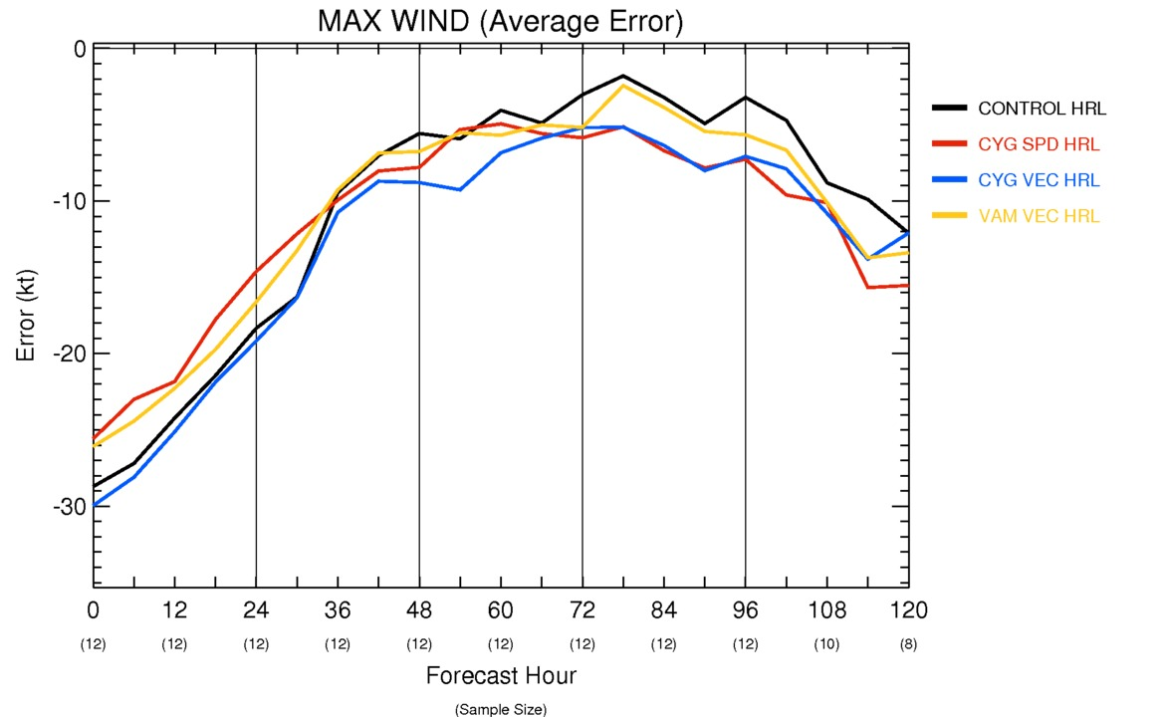
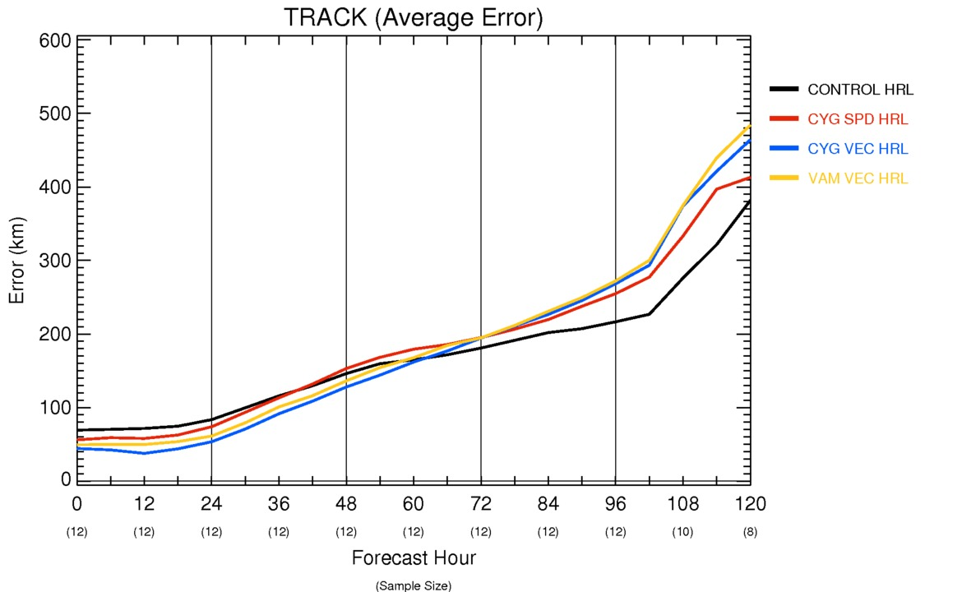
HRL storm statistics

Slide 6
Summary of VAM configurations
The 3-hourly VAM VEC is best for intensity in short term.
The hourly CYG VEC is worst for intensity in short term.
All CYG and VAM configurations improve track at 0-1 day.

Slide 7
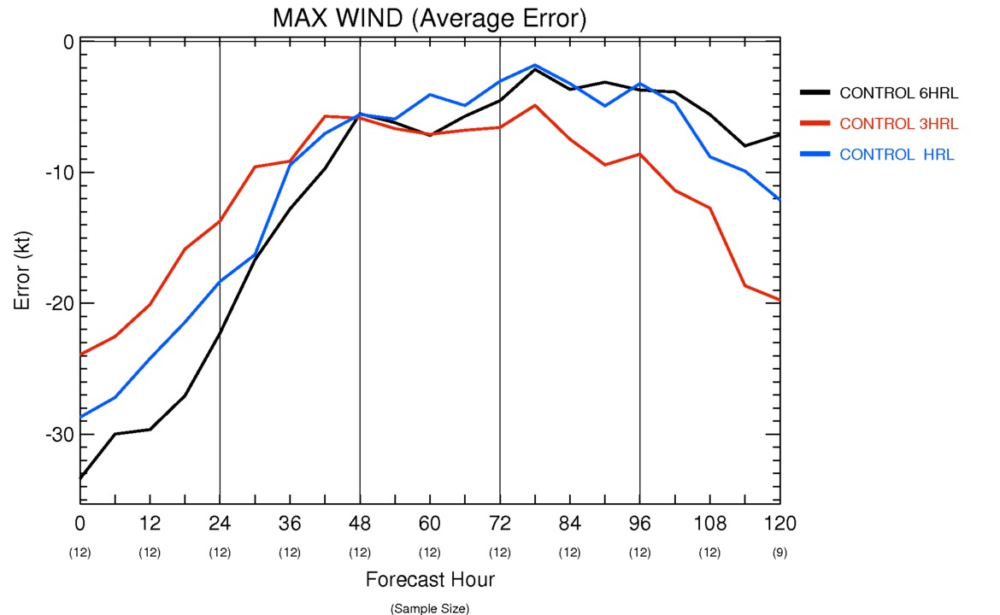
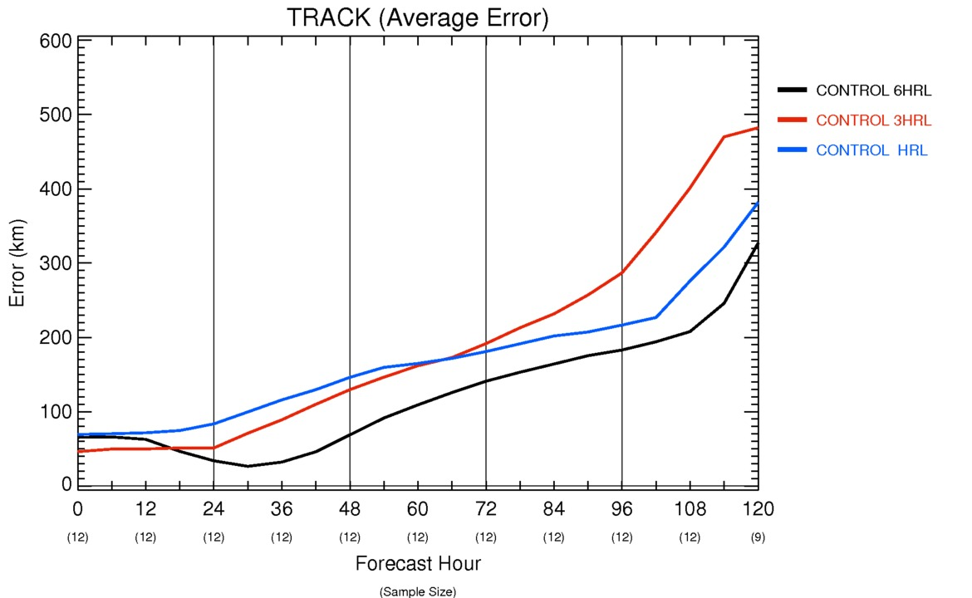
Cycling frequency statistics (control)

Slide 8
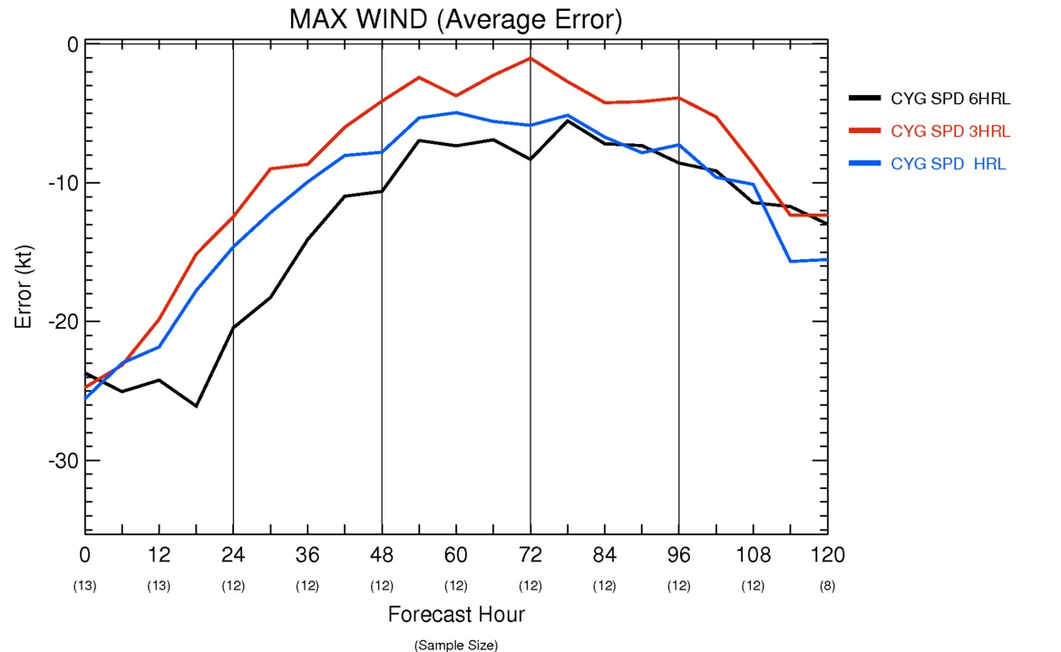
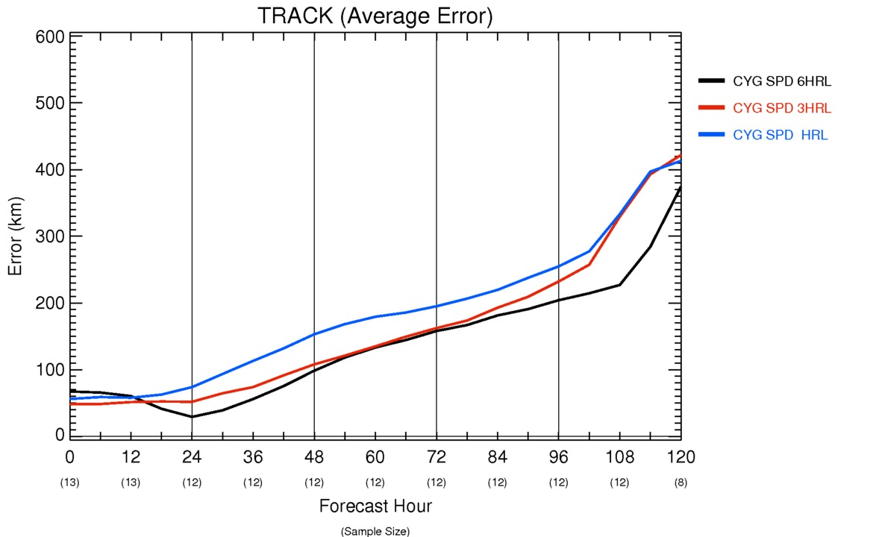
Cycling frequency statistics (CYG SPD)

Slide 9
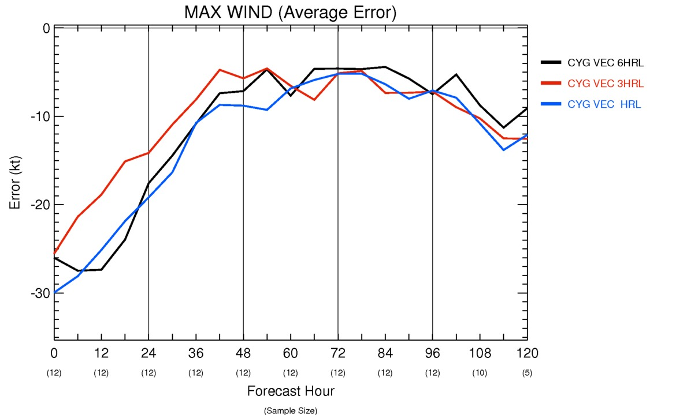
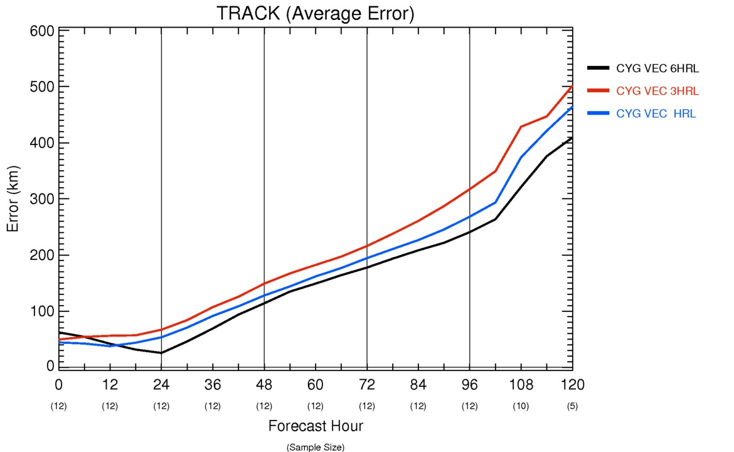
Cycling frequency statistics (CYG VEC)

Slide 10
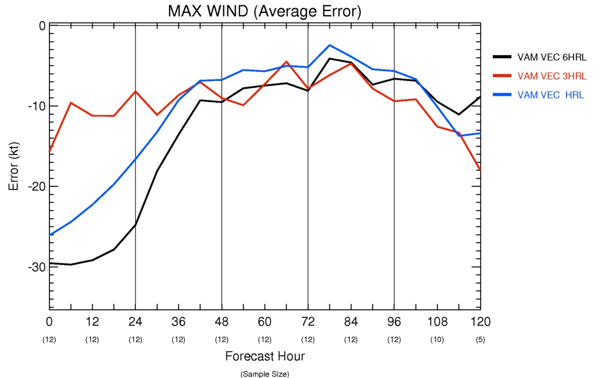
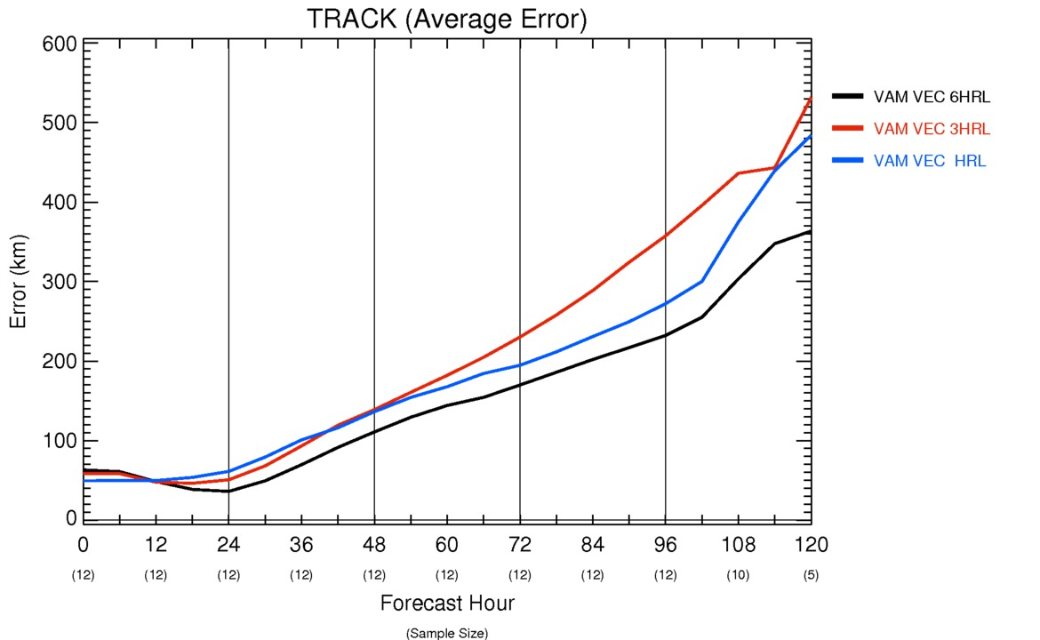
Cycling frequency statistics (VAM VEC)

Slide 11
Summary of Cycling Frequency
The analysis is better in all experiments with 3 hourly cycling.
On average the 3hrl cycling maintains better performance for about two days.
In the analysis the 6 hourly is always the worst performing.
Beyond the first day the 6 hourly is the worst for pressure, wind and the best for track.

