Slide 1
Impact of CYGNSS Data on Hurricane Analyses and Forecasts in a Regional OSSE Framework

Slide 2
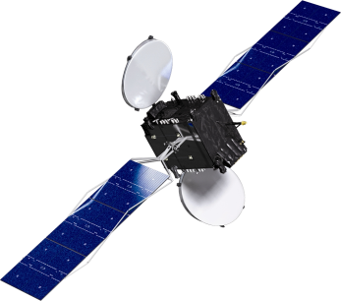
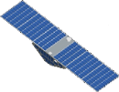
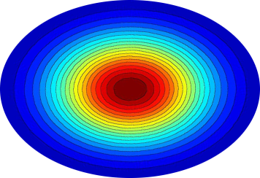
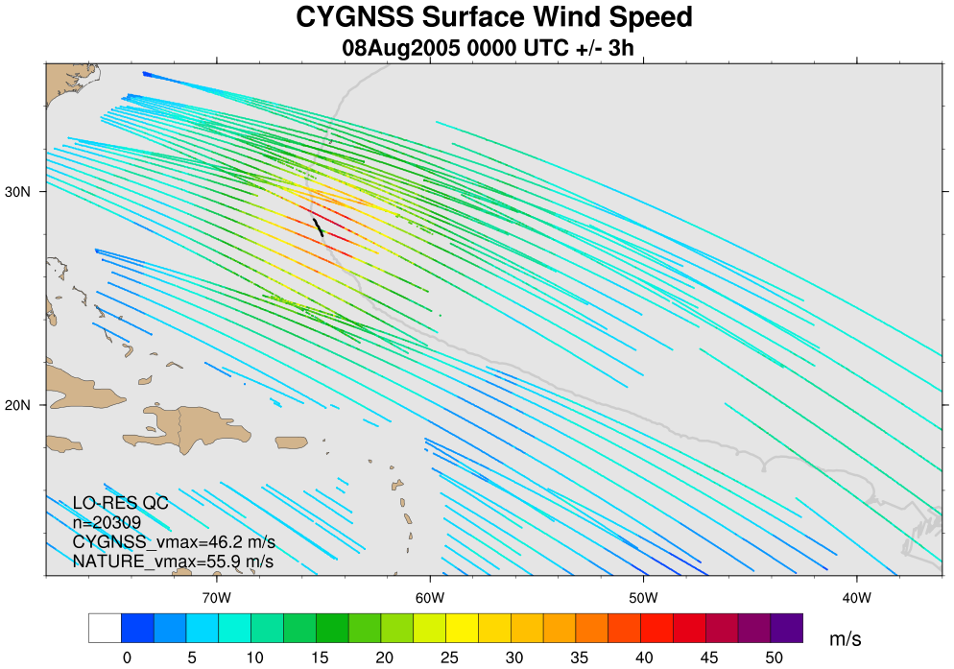
Observational Data: CYGNSS
GPS
· The Cyclone Global Navigation Satellite System (CYGNSS) is a NASA mission planned for launch in 2016 that consists of a constellation of 8 micro-satellites.
· These swan-sized satellites will receive signals reflected off the ocean by existing GPS satellites.
direct signal
CYGNSS
scattered signal
specular point
Fig 1. Geometry of GPS-based quasi-specular surface scattering. The GPS direct signal provides location, timing, and frequency references, while the forward scattered signal contains ocean surface information.
· Scattered signal contains information on ocean surface roughness, from which a wind speed can be derived under precipitating conditions and with sensitivity beyond 50 m/s.
· Spatial and temporal coverage pro-vided by the 8-satellite constellation will be superior to ASCAT and OSCAT combined.
Fig 2. Example of synthetic CYGNSS data coverage over a 6-hour window. Colors correspond to retrieved wind speed.

Slide 3
OSSE Framework
The regional OSSE (Observing System Simulation Experiment) framework described here was developed at NOAA/AOML and UM/RSMAS and features a high-resolution regional nature run embedded within a lower-resolution global nature run. Simulated observations are generated and provided to a data assimilation scheme which provides analyses for a high-resolution regional forecast model.
· Nature Runs
- ECMWF: low-resolution T511 (~40km) “Joint OSSE Nature Run”
- WRF-ARW: high-resolution 27km regional domain with 9/3/1 km storm-following nests (v3.2.1)
· Data Assimilation Scheme
- GSI: Gridpoint Statistical Interpolation. a standard 3D variational assimilation scheme (v3.3). Analyses performed at 9km resolution.
· Forecast Model
- HWRF: the 2014 operational Hurricane-WRF model (v3.5). Parent domain has ~9km resolution, single storm-following nest has ~3km resolution.
DA and model cycling performed every 6 hours, each run producing a 5-day forecast, for total of 16 cycles.
background
ECMWF NATURE RUN
observation
simulator
SYNTHETIC DATA
GSI
ANALYSIS
HWRF
WRF NATURE RUN
FORECASTS
verification

Slide 4
Experiments and Results
· Two synthetic CYGNSS datasets generated to span the WRF nature run.
- “low resolution”: ~25km effective footprint… nominal product
- “high resolution”: ~12km effective footprint… experimental product (much greater noise in the retrieval results in many dropped data points after quality control is applied)
· All experiments listed use identical configurations of GSI for data assimilation and HWRF for forecasts.
1) CONTROL: conventional data minus scatterometers
2) PERFECT_UV: CONTROL plus all available high-resolution CYGNSS data points; wind speed and direction are interpolated from WRF nature run and assumed to have zero error
3) PERFECT_SPD: CONTROL plus all available high-resolution CYGNSS data points; only wind speed is interpolated from WRF nature run and assumed to have zero error
4) REAL_SPD: CONTROL plus quality-controlled low-resolution CYGNSS data points; synthetic realistic wind speeds and errors are used
5) REAL_SPD_HI: CONTROL plus quality-controlled high-resolution CYGNSS data points; synthetic realistic wind speeds and errors are used

Slide 5
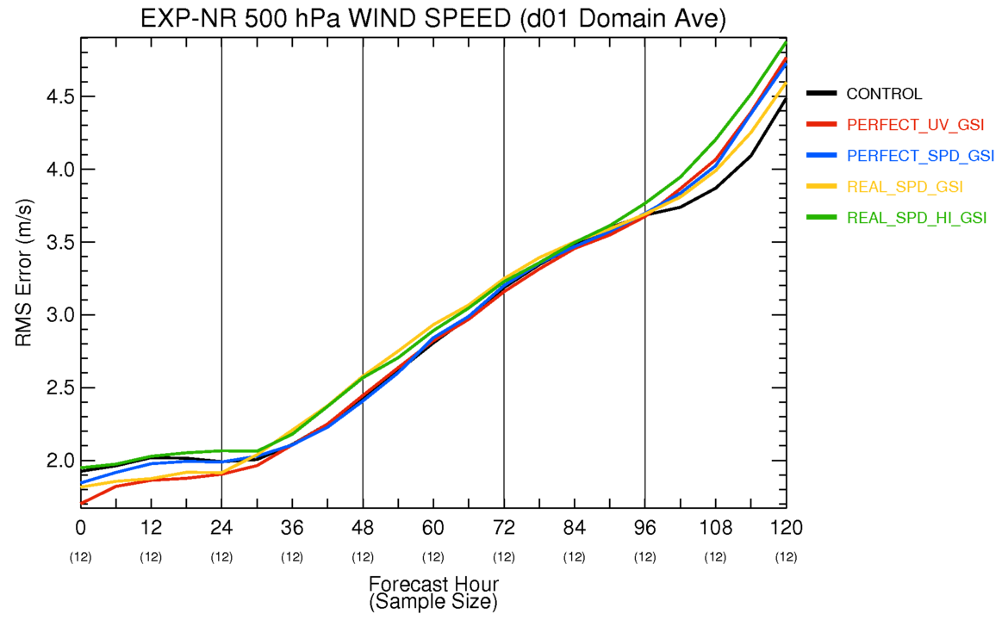
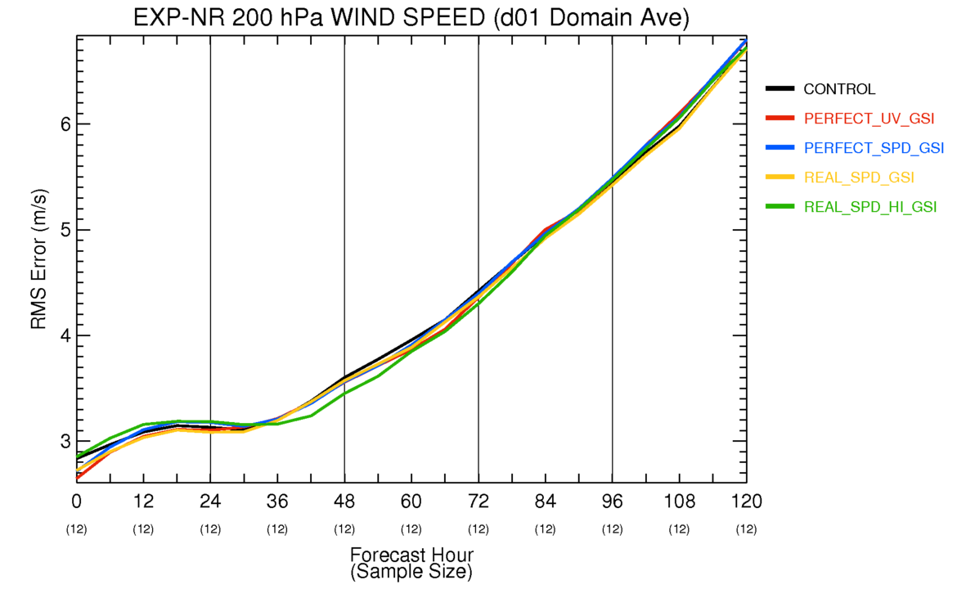
Large-scale ‘domain-averaged’ Errors
- Most improvement is seen in the first 24h, and especially in analyses.
- Improvements extend far beyond surface wind speed (not all fields are shown here, but include height, pressure, and temperature)

Slide 6
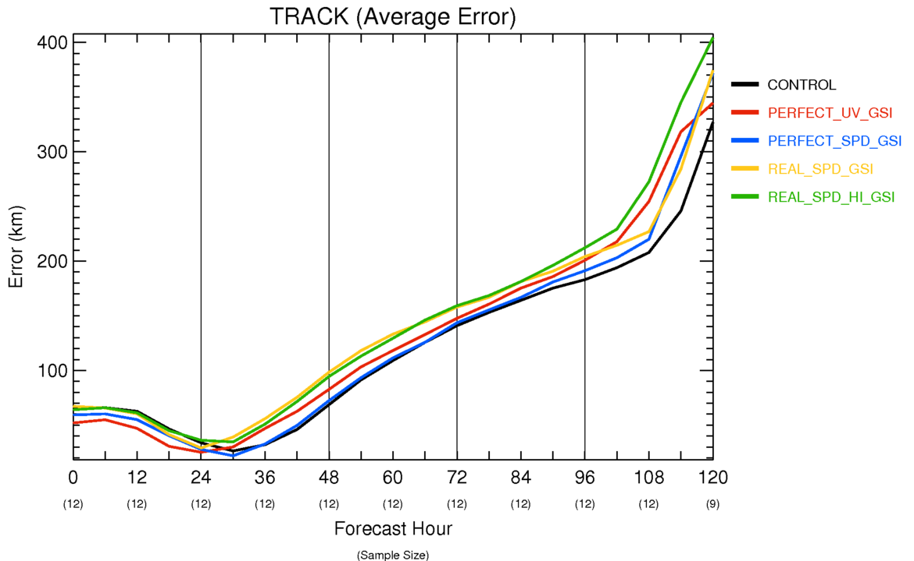
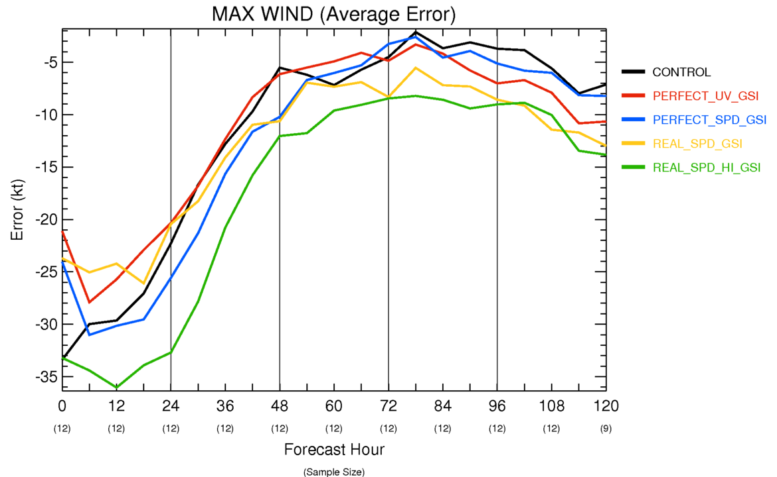
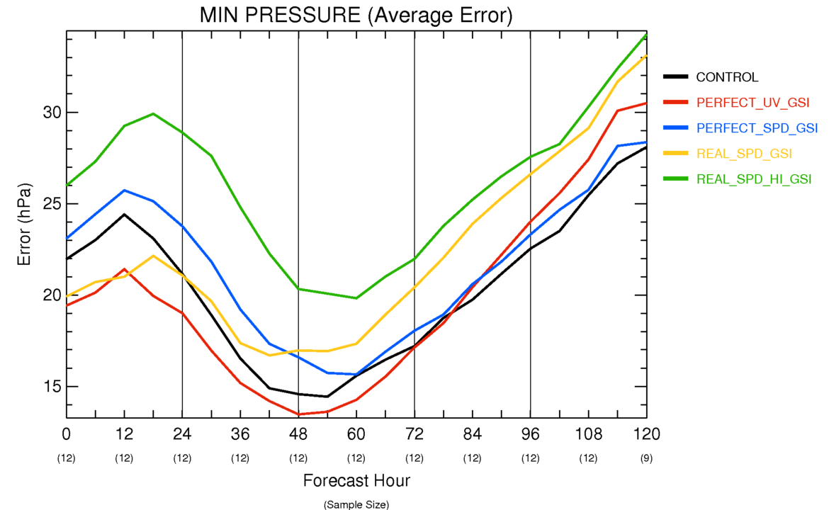
Average ERROR Storm Statistics
Average errors (experiment – nature run) over each forecast lead time are shown for track, maximum 10m wind speed, and minimum sea level pressure
Statistics cover 12 cycles: every six hours from 2Aug 06Z through 5Aug 00Z

Slide 7
Summary
· Assimilation of CYGNSS data with GSI almost always improves hurricane intensity and track analyses
· Assimilation of CYGNSS data with GSI always improves large-scale analyses of wind, pressure, temperature, height, etc. from the surface through upper troposphere
· Assimilation of CYGNSS data can improve hurricane and synoptic field forecasts with HWRF in short lead times
· Higher-resolution but noisier data degrade analyses when compared to lower-resolution higher-quality data
· Adding directional information to the CYGNSS wind speeds improves hurricane analyses in GSI
· GSI analyses are very sensitive to the exact location of the observational data… symmetry and coverage affect the result
· The stronger a storm is in an analysis, the more severely the short-range forecast suffers from vortex spin-down and adjustment
· We have very few samples from one storm, so error statistics are not robust, but provide some guidance

Slide 8
Additional Slides

Slide 9
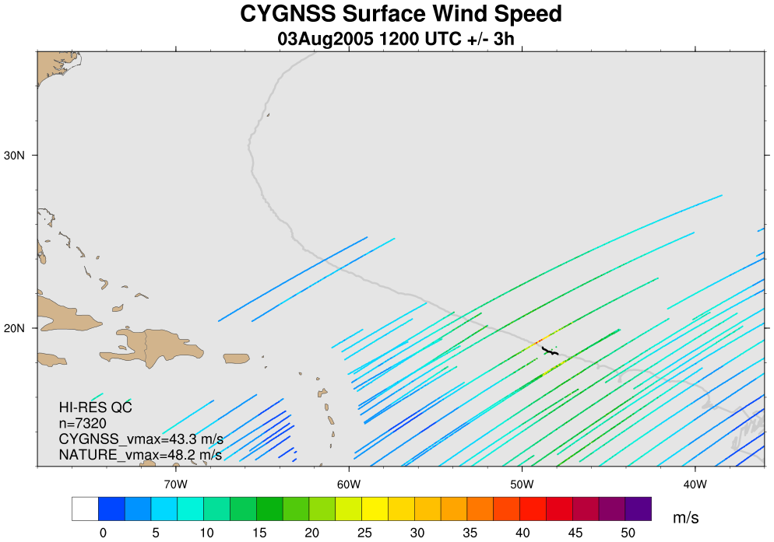
“REAL” HI-RES QC CYGNSS Coverage: 3Aug 12Z (+/-3h)

Slide 10
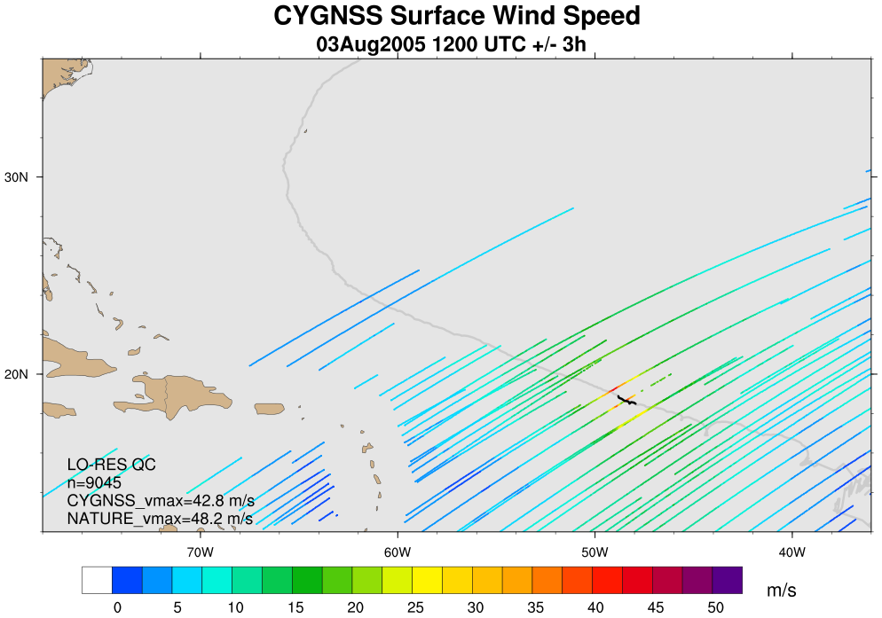
“REAL” LO-RES QC CYGNSS Coverage: 3Aug 12Z (+/-3h)

Slide 11
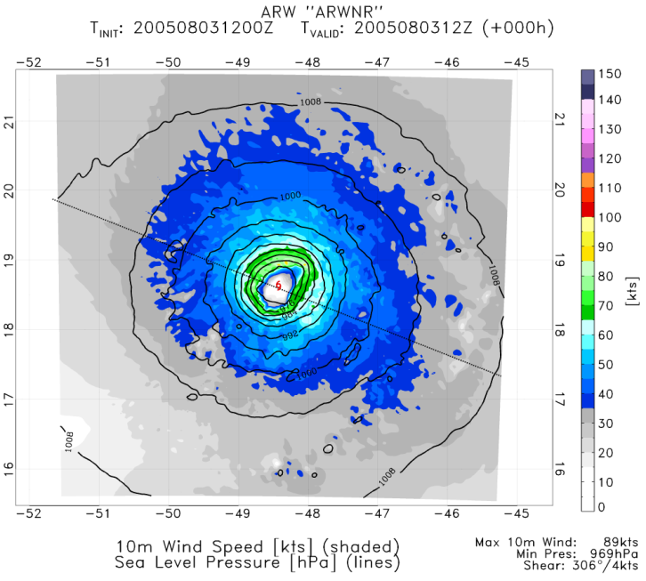
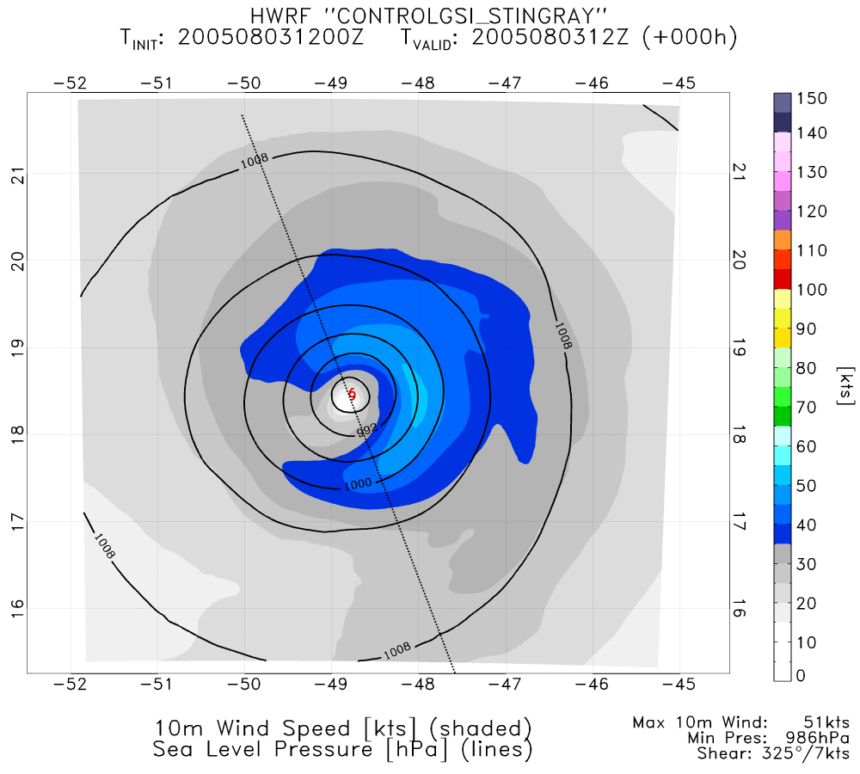
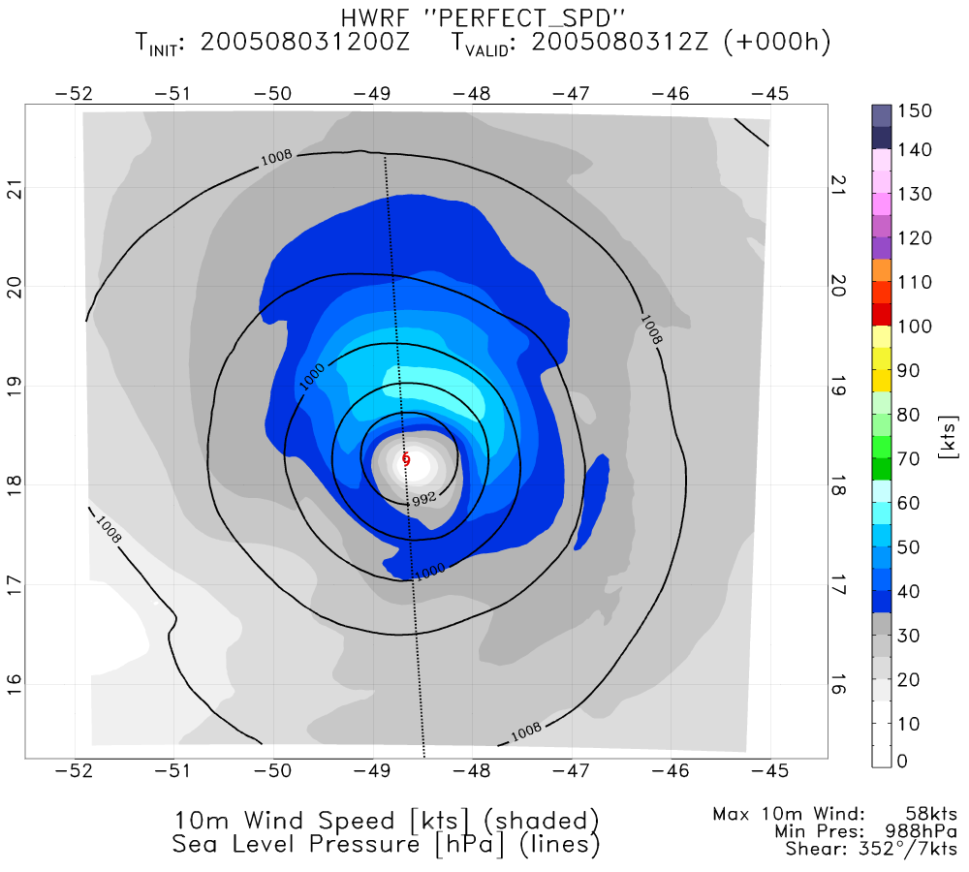
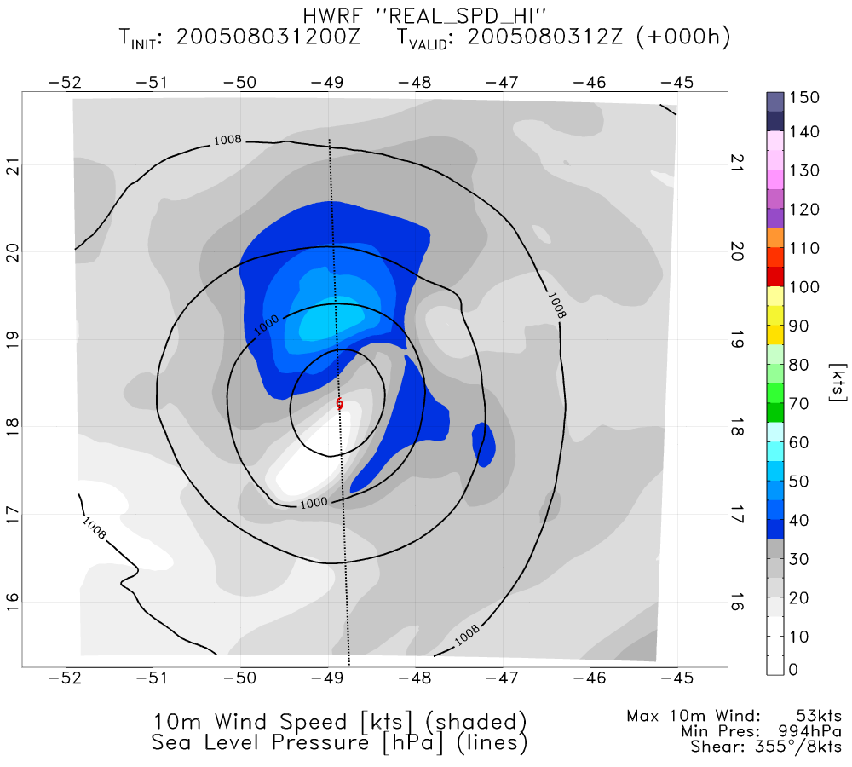
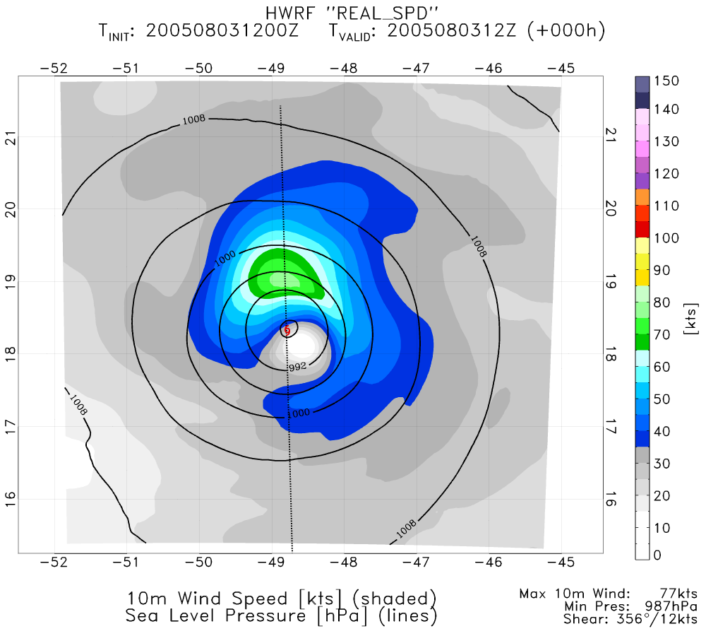
NATURE
CONTROL
PERFECT SPD (GSI)
REAL SPD HI (GSI)
REAL SPD (GSI)

