Slide 1
Community Global OSSE Package Framework
Ruifang Li Bachir Annane
2/21/2017

Slide 2
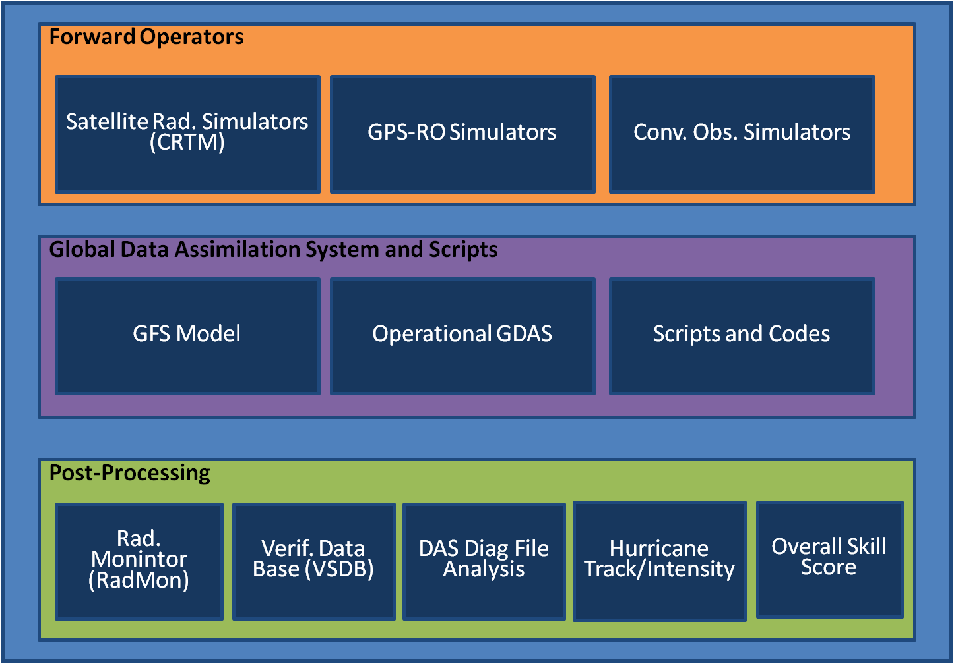
Forward Operators
Forward Operators
Forward Operators
Satellite Rad. Simulators (CRTM)
GPS-RO Simulators
Conv. Obs. Simulators
Forward Operators
Satellite Rad. Simulators (CRTM)
GPS-RO Simulators
Conv. Obs. Simulators
Forward Operators
Forward Operators
Satellite Rad. Simulators (CRTM)
GPS-RO Simulators
Conv. Obs. Simulators
Forward Operators
Satellite Rad. Simulators (CRTM)
GPS-RO Simulators
Conv. Obs. Simulators
Satellite Rad. Simulators (CRTM)
GPS-RO Simulators
Conv. Obs. Simulators
Satellite Rad. Simulators (CRTM)
GPS-RO Simulators
Conv. Obs. Simulators
Satellite Rad. Simulators (CRTM)
GPS-RO Simulators
Conv. Obs. Simulators
Global Data Assimilation System and Scripts
Global Data Assimilation System and Scripts
GFS Model
Operational GDAS
Scripts and Codes
Global Data Assimilation System and Scripts
GFS Model
Operational GDAS
Scripts and Codes
Global Data Assimilation System and Scripts
Global Data Assimilation System and Scripts
GFS Model
Operational GDAS
Scripts and Codes
Global Data Assimilation System and Scripts
GFS Model
Operational GDAS
Scripts and Codes
Global Data Assimilation System and Scripts
GFS Model
Operational GDAS
Scripts and Codes
GFS Model
Operational GDAS
Scripts and Codes
GFS Model
Operational GDAS
Scripts and Codes
Post-Processing
Post-Processing
Rad. Monintor (RadMon)
Verif. Data Base (VSDB)
DAS Diag File Analysis
Hurricane Track/Intensity
Overall Skill Score
Post-Processing
Rad. Monintor (RadMon)
Verif. Data Base (VSDB)
DAS Diag File Analysis
Hurricane Track/Intensity
Overall Skill Score
Post-Processing
Post-Processing
Rad. Monintor (RadMon)
Verif. Data Base (VSDB)
DAS Diag File Analysis
Hurricane Track/Intensity
Overall Skill Score
Post-Processing
Rad. Monintor (RadMon)
Verif. Data Base (VSDB)
DAS Diag File Analysis
Hurricane Track/Intensity
Overall Skill Score
Post-Processing
Rad. Monintor (RadMon)
Verif. Data Base (VSDB)
DAS Diag File Analysis
Hurricane Track/Intensity
Overall Skill Score
Rad. Monintor (RadMon)
Verif. Data Base (VSDB)
DAS Diag File Analysis
Hurricane Track/Intensity
Overall Skill Score
Rad. Monintor (RadMon)
Verif. Data Base (VSDB)
DAS Diag File Analysis
Hurricane Track/Intensity
Overall Skill Score

Slide 3
OSSE CGOP Framework
Community Global OSSE Package(CGOP):
(Boukabara et. al, 2016)
NASA 7km GEOS-5 as the nature run
(Gelaro et al, 2015)
CRTM/GPSRO model to simulate satellite radiance and GPSRO observations
(Han et. Al 2006, Cucurull,2013)
NCEP GDAS/GFS as the data assimilation system and forecast model
Location
Interpolation
Nature Run
CRTM
GPSRO Model
Simulated Radiances
Conventional
Data
GPSRO profiles
Calibration
Simulated Observations
First Guess
GDAS/GFS
Forecast
Analysis
Assessment

Slide 4
Creating simulated observations - Radiances
Run_osse_sat
Inputs:
  CRTM coefficients for each instrument
  Diag files for each instrument (containing the location of the real observations) or BUFR files from real observations
  Nature run files
Interpolates NR to the location of the observations
Simulate with CRTM
Write out in a BUFR file for each instrument
List of data; F16,F17,F18 (SSMI/S), N15(AMSU),N18/19(AMSU/MHS), SNPP(ATMS,CriS), Metop- A(AMSU,MHS,IASI,HIRS), Metop-B(AMSU,MHS,IASI), AQUA(AIRS,AMSUA),GOES 15(SNDRS),M10(SEVIRI)
Location
Interpolation
Nature Run
CRTM
Simulated Observations

Slide 5
Creating simulated observations - Conventional data
Run_osse_gpsconv (conv=yes)
Inputs:
  Prepqc BUFR from real observations
  Nature run files
Interpolates NR to the location of the observations
Write out in a new prepqc BUFR file
Location
Interpolation
Nature Run
Conventional Data
Simulated Observations

Slide 6
Creating simulated observations - GPSRO profiles
Run_osse_gpsconv (gpsro=yes)
Inputs:
  BUFR file from real GPSRO observations
  Nature run files
Interpolates G5NR to the location of observations
Use GSI bending angle forward operator to simulate the observation
Write out in a new RO BUFR file
Location
Interpolation
Nature Run
GPSRO profile
Simulated Observations

