Slide 1
ARIES 2km d04
10 files
0801 6Z and 18Z
0802 6Z
0803 6Z and 18Z
0804 6Z and 18Z
0805 6Z and 18Z

Slide 2
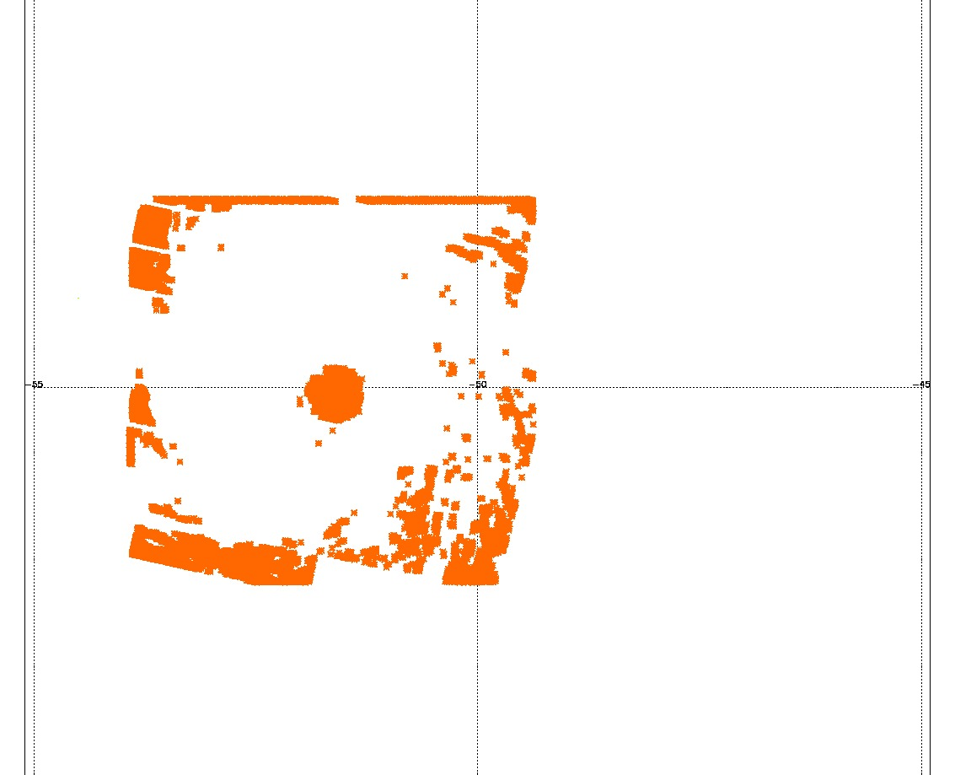
D04 080418Z
1- nature run center on 0804 18Z is 21.0N 54.5W
2-The data from aries2km_d04_05.nc has the center displaced to the east by over 1deg

Slide 3
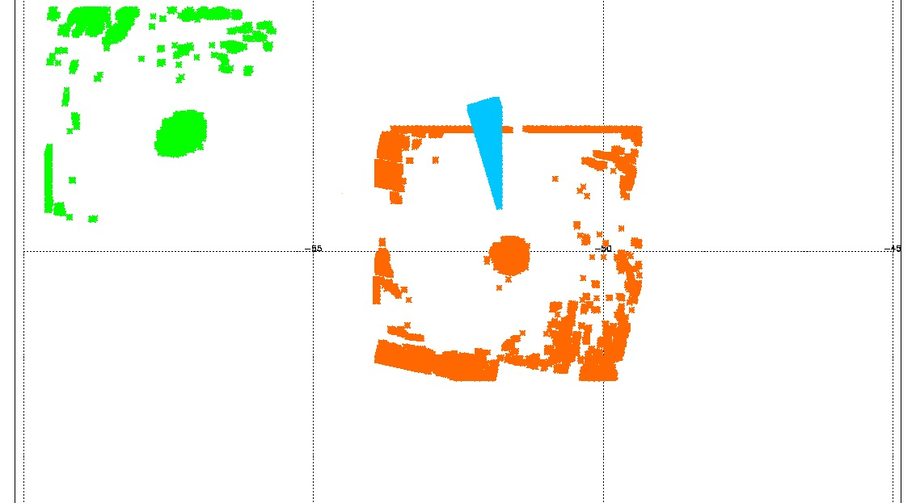
0804 18Z
0805 6Z -0805 18Z
On 5 at 18Z CENTER 23.1N 59.9W

Slide 4
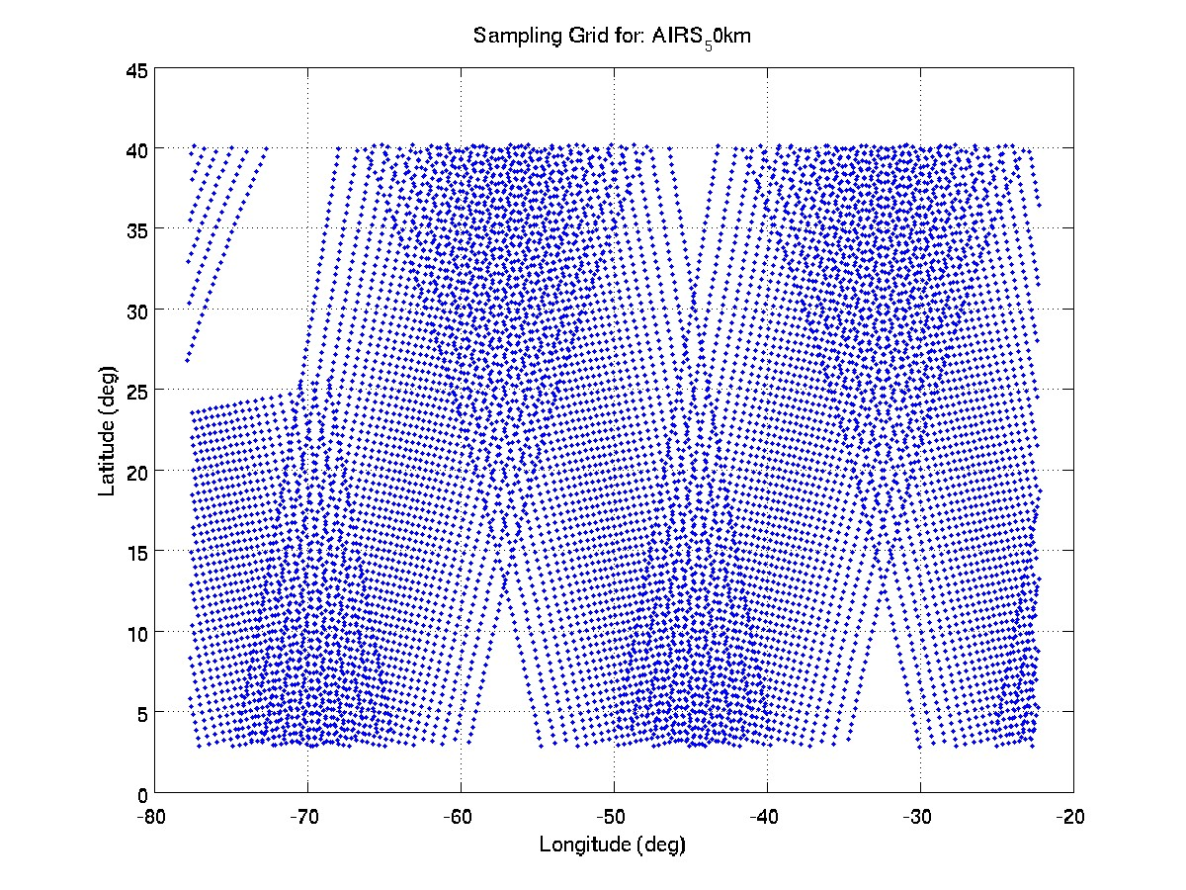
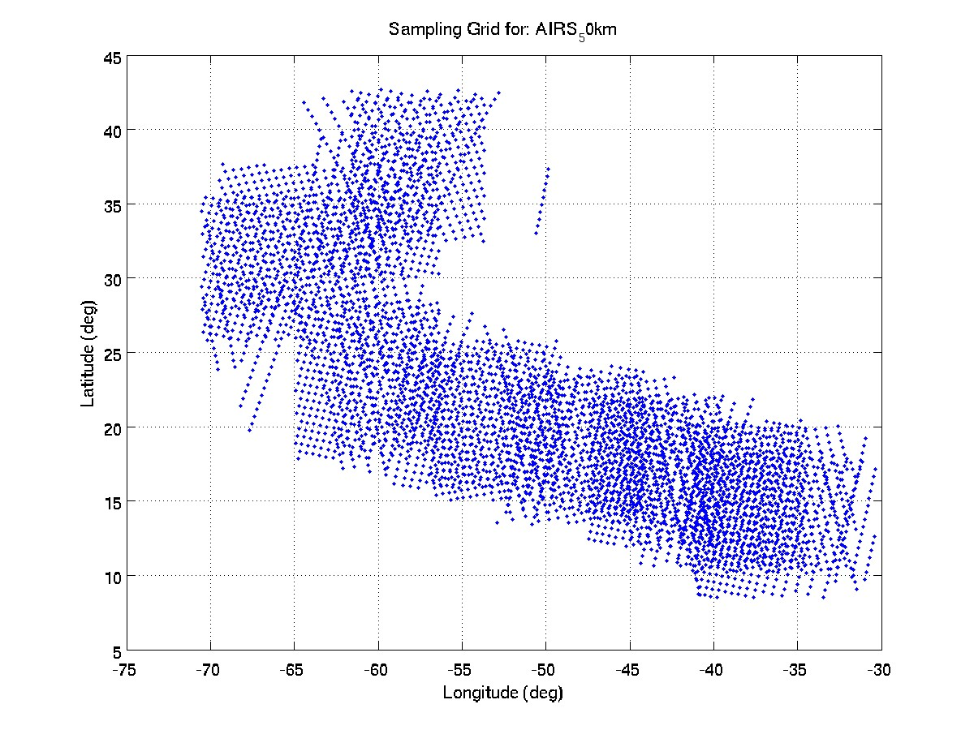
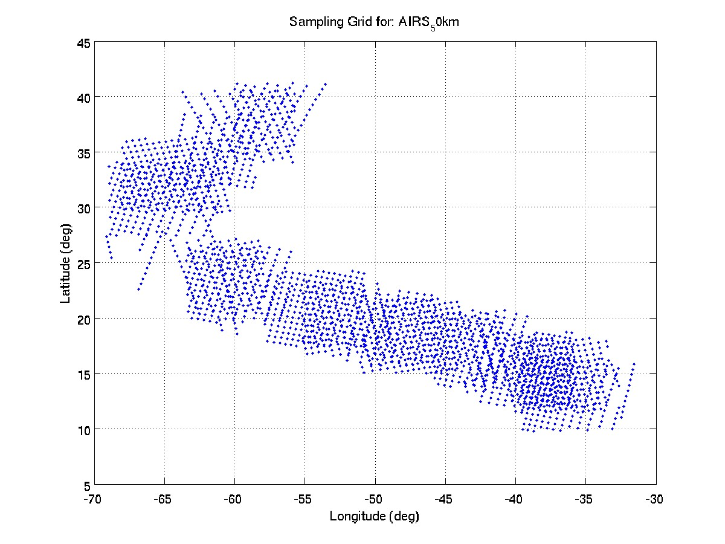
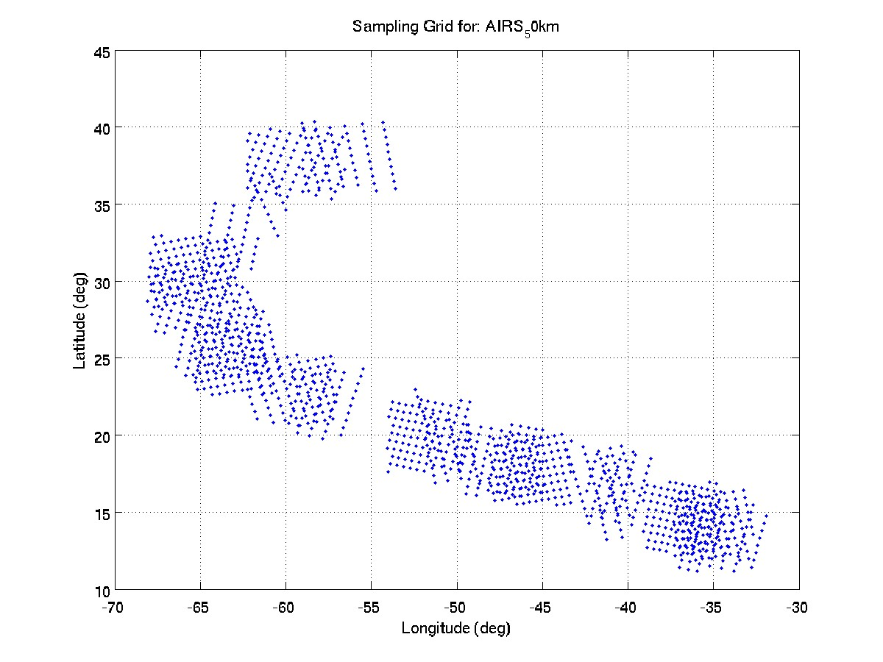
AIRS scans Nature Run providing thousands of soundings over 13 Days (at 4 scales)
d01
d02
d03
d04

Slide 5
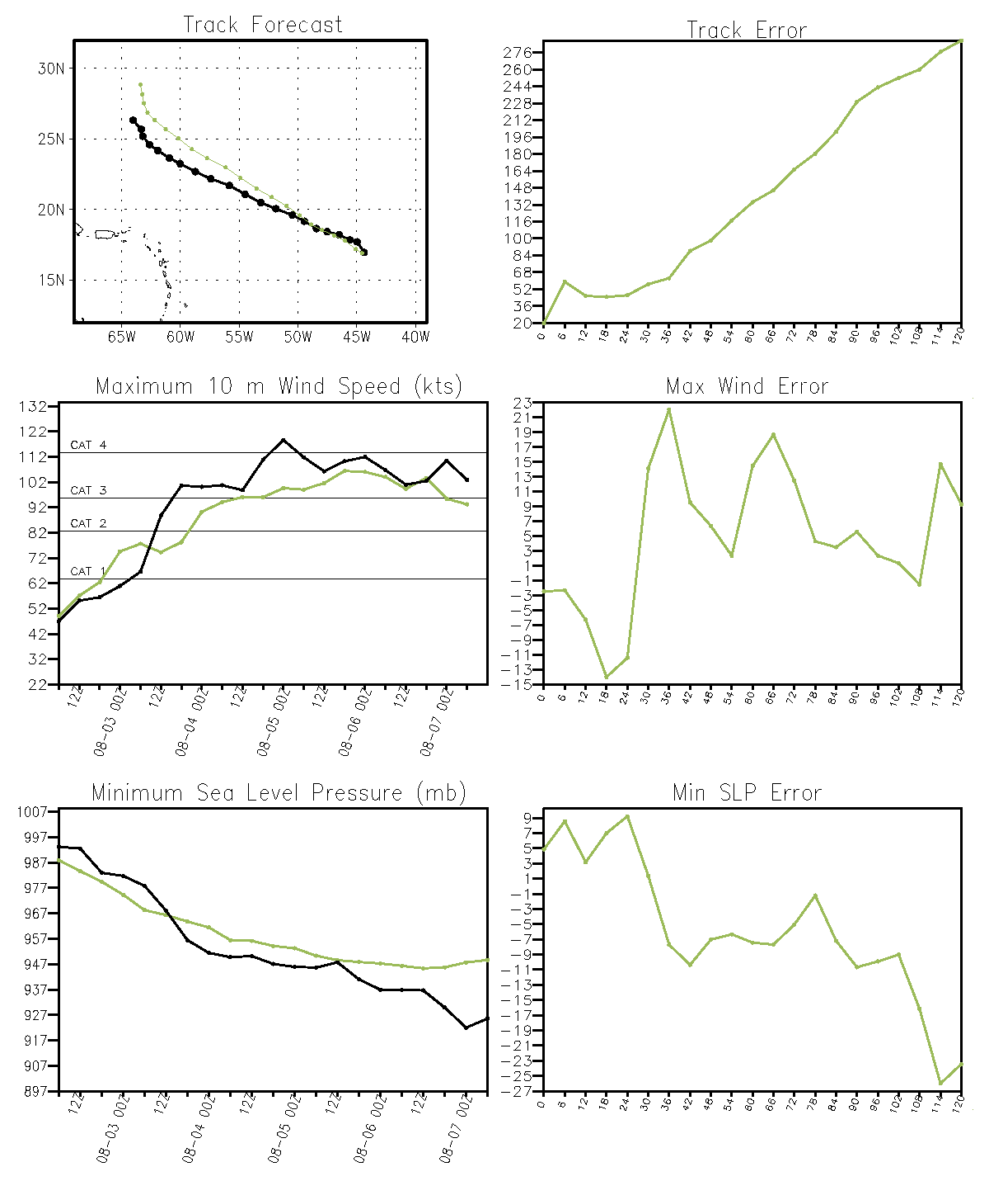
D01 0802 at 6Z

Slide 6
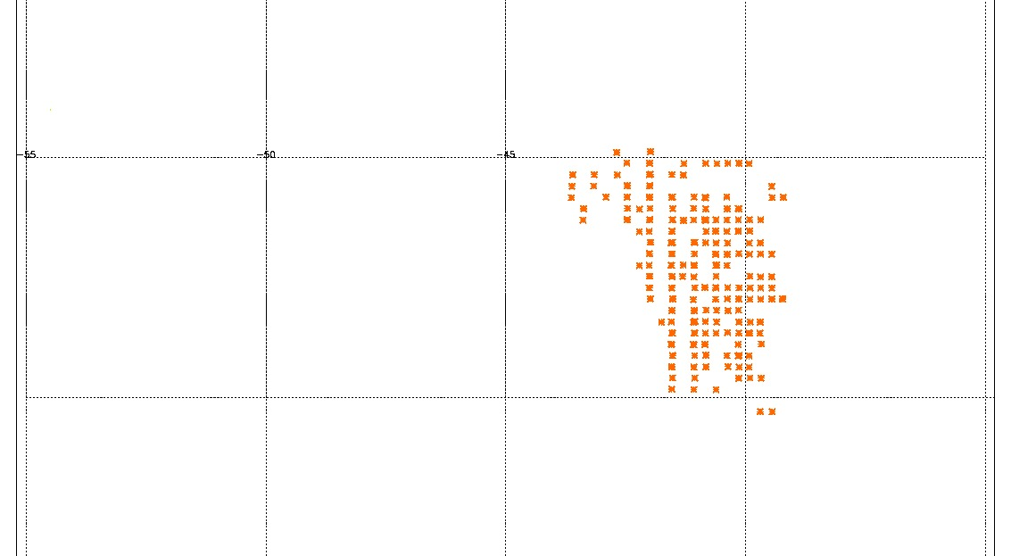
D01 0802 6Z
Center is at 16.7N 44.5W

