Slide 1
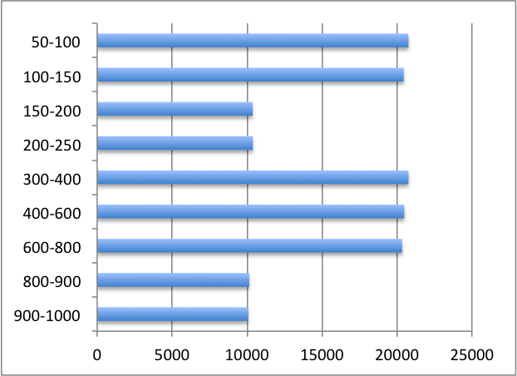
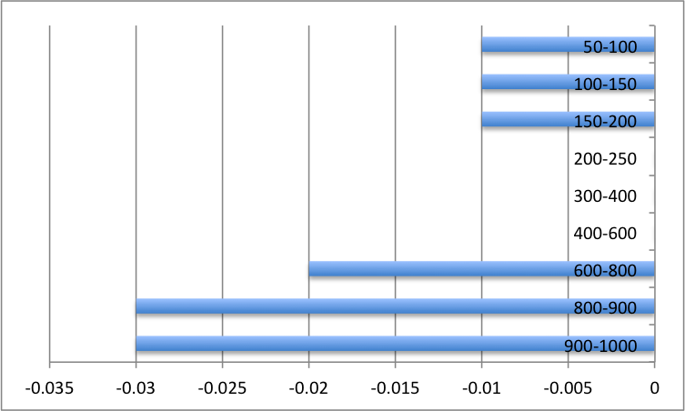
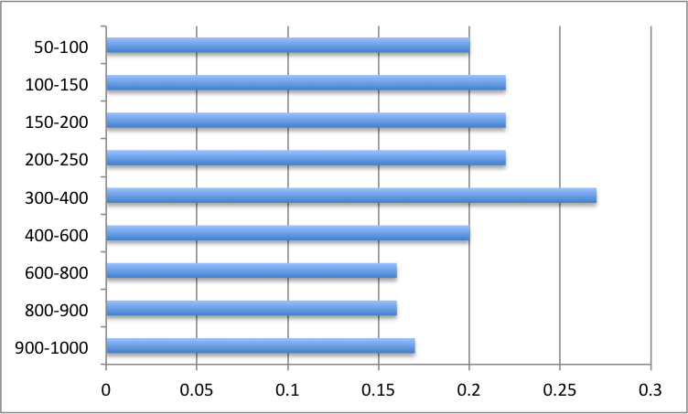
08/01 at 18Z
204757 data assimilated
32362 rejected with a mean 25.19 and rms 26.40

Slide 2
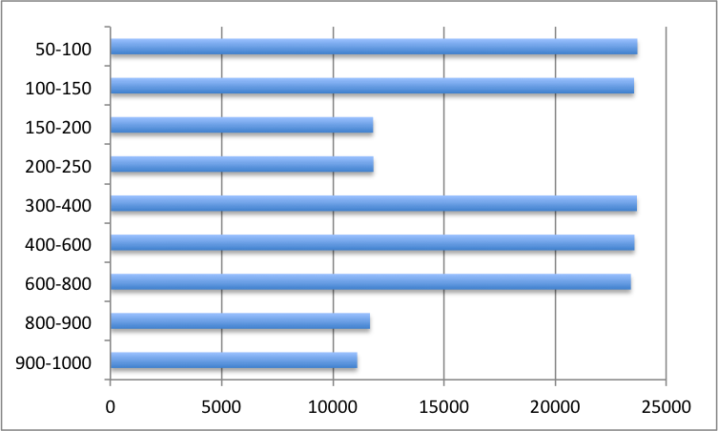
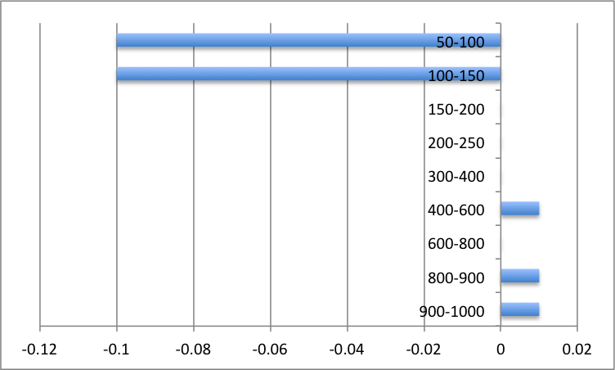
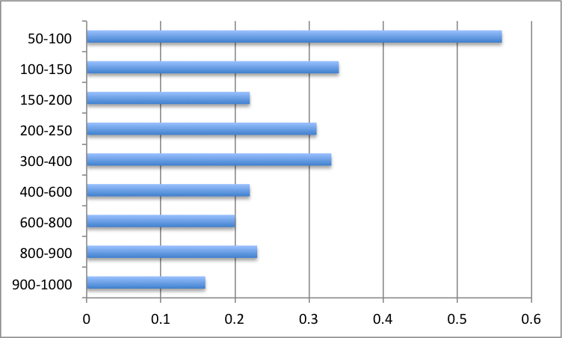
08/03 at 6Z
226982 data assimilated
43879 data rejected, with mean 21.14 and rms 29.06

Slide 3
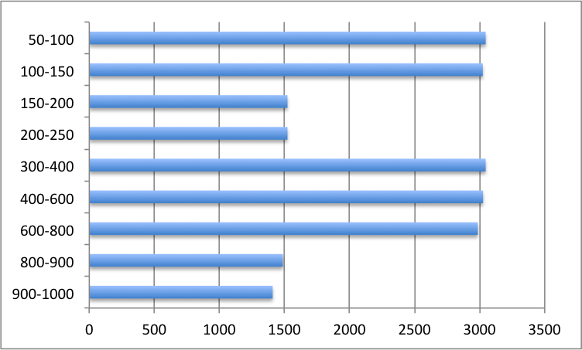
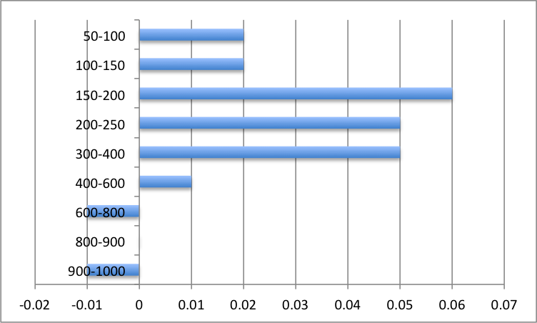
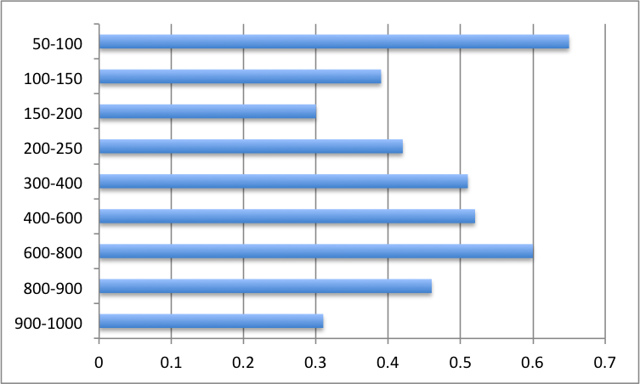
08/05 at 6Z
29970 data points assimilated
6808 data rejected with a mean 38.82 and rms 49.98

Slide 4
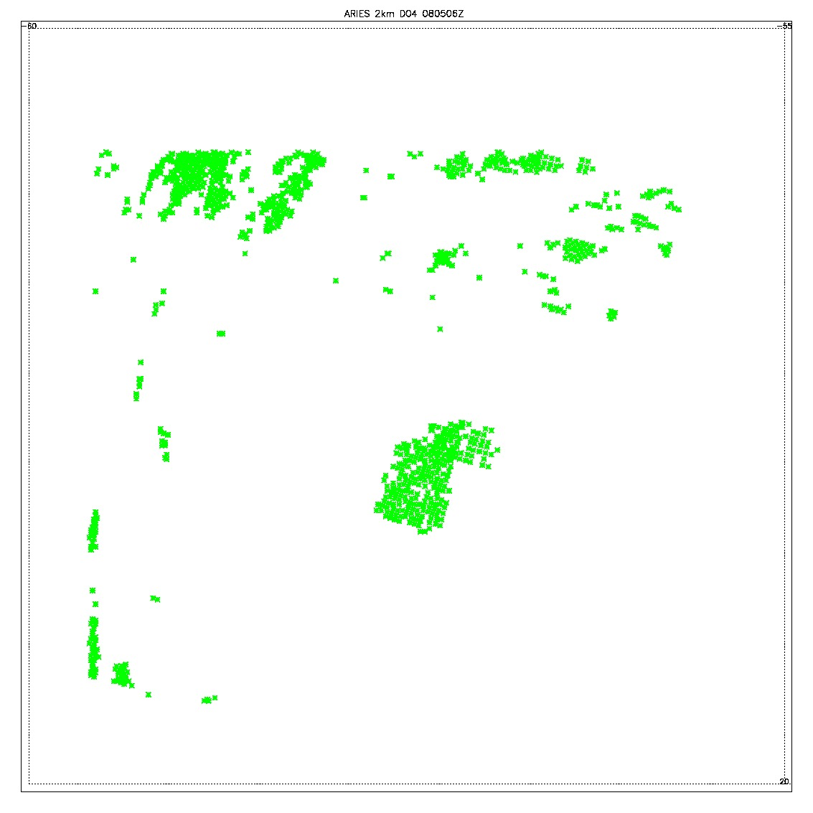
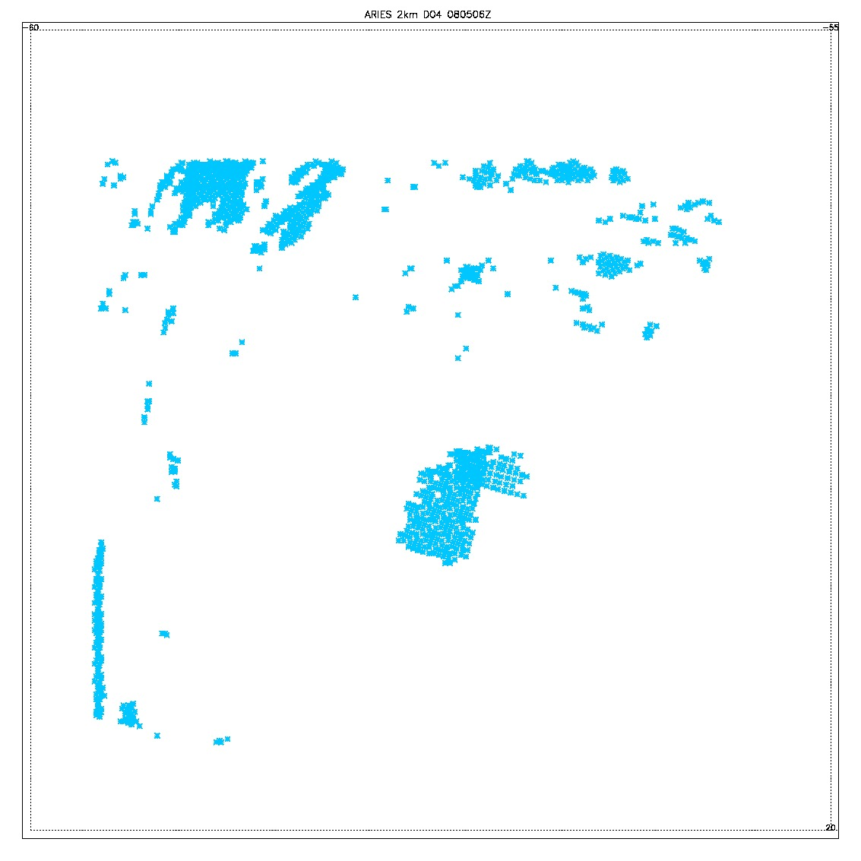
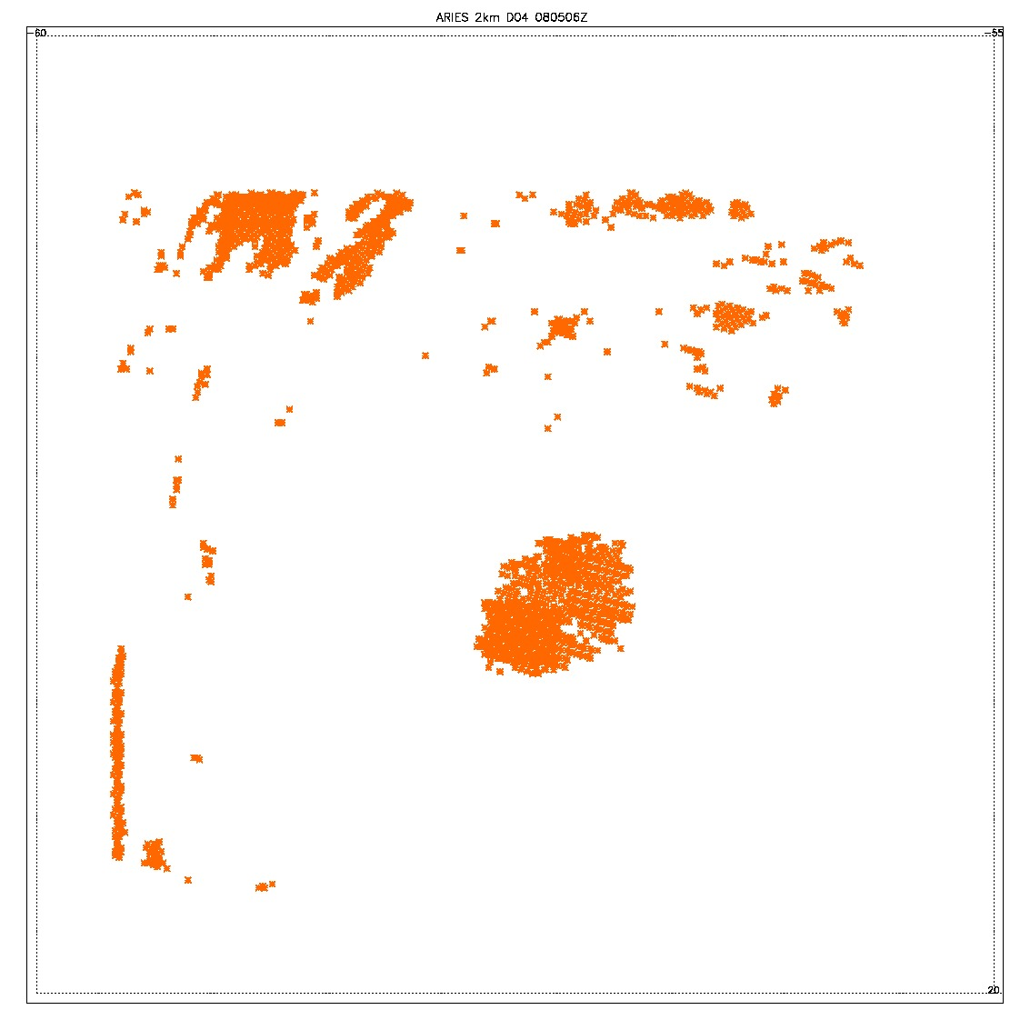
08/05 at 6Z
All assimilated data
Rejected data prs < 15mb
Rejected data prs > 15mb

