Slide 1





Optimizing the Utilization
of CYGNSS Wind Observations for
Numerical Prediction of Tropical Cyclones
Robert Atlas⁵, Lidia Cucurull³, Sharanya Majumdar² – Principal Investigators
Bachir Annane¹, Mark Leidner⁴, Brian McNoldy², and Ross Hoffman⁴
¹ Univ. of Miami/CIMAS and NOAA/AOML/HRD, Miami, FL
² Univ. of Miami/RSMAS, Miami, FL
³ NOAA/AOML, Miami, FL
⁴ Atmospheric and Environmental Research, Lexington, MA
⁵ NOAA/AOML, Retired
19-20 February 2020 • TROPICS Applications Workshop • Miami, Florida

Slide 2
Overview
Components of an OSE
Case Study
Experiments
Summary

Slide 3
CYGNSS Science Objectives
The CYGNSS science goals are enabled by meeting the following mission objectives:
Measure ocean surface wind speed in most naturally occurring precipitating conditions, including those experienced in the TC eyewall.
Measure ocean surface wind speed in the TC inner core with sufficient frequency to resolve genesis and rapid intensification.

Slide 4
CYGNSS Science Objectives
The CYGNSS science goals are enabled by meeting the following mission objectives:
Measure ocean surface wind speed in most naturally occurring precipitating conditions, including those experienced in the TC eyewall.
Measure ocean surface wind speed in the TC inner core with sufficient frequency to resolve genesis and rapid intensification.

Slide 5
Components of an OSE
. Observing System Experiment (OSE) using 2019 HWRF (“H219”)
NOAA/NCEP FV3 GFS; 6-hourly Hybrid 3d-Var/EnKF
HWRF Model and DA nested grids: 14.5 km / 4.5 / 1.5 km
Observations
All operational observations including radiances
  CYGNSS Version 2.1
  Fully Developed Seas (FDS) and Young Seas Limited Fetch (YSLF)
  Data thinning vs no thinning with inflated error values
  CYGNSS data with retrieval errors 3 m/s or less are included
  Wind directional information from VAM

Slide 6
Case Selection
There are two criteria that are used to pick case studies.
1. Based on the OSSE results, we are looking at cases where the operational HWRF had significant errors in the intensity forecast. We want to see if CYGNSS data can improve these forecasts.
2. Only lower-wind-speed retrievals are reliable. So, we are looking for tropical cyclones in their early stages (tropical depression and tropical storm), that are poorly observed. This is where CYGNSS can contribute information to the structure of the nascent system
Investigate early in the lifecycles of tropical storms;
  Dorian (2019)
  Erick (2019)
  Kiko (2019)
  Lekima (2019)
  Michael’s life cycle (Tropical Storm): Oct 7th 2018

Slide 7
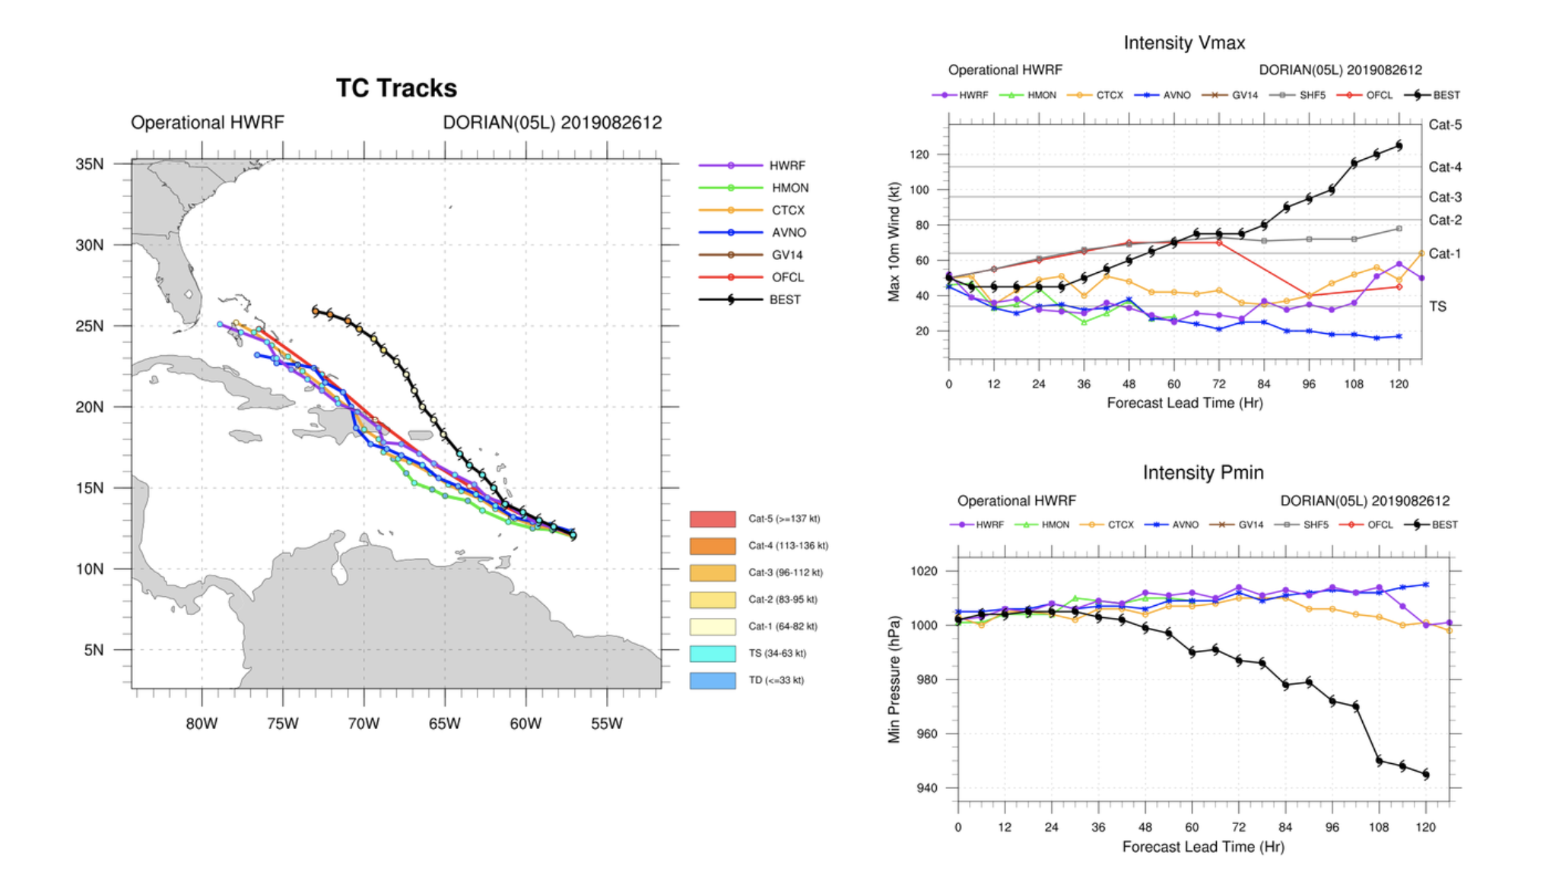

Slide 8
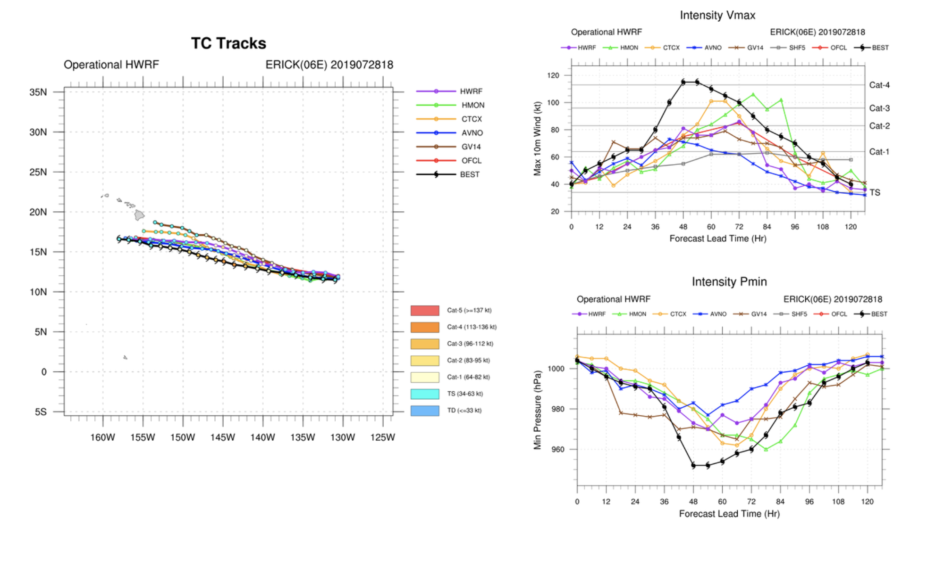

Slide 9
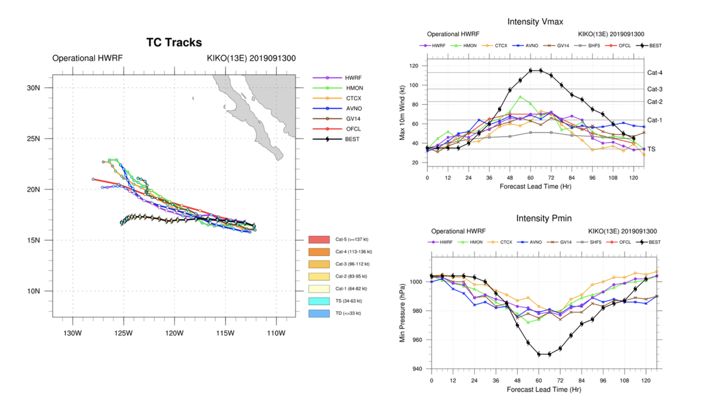

Slide 10
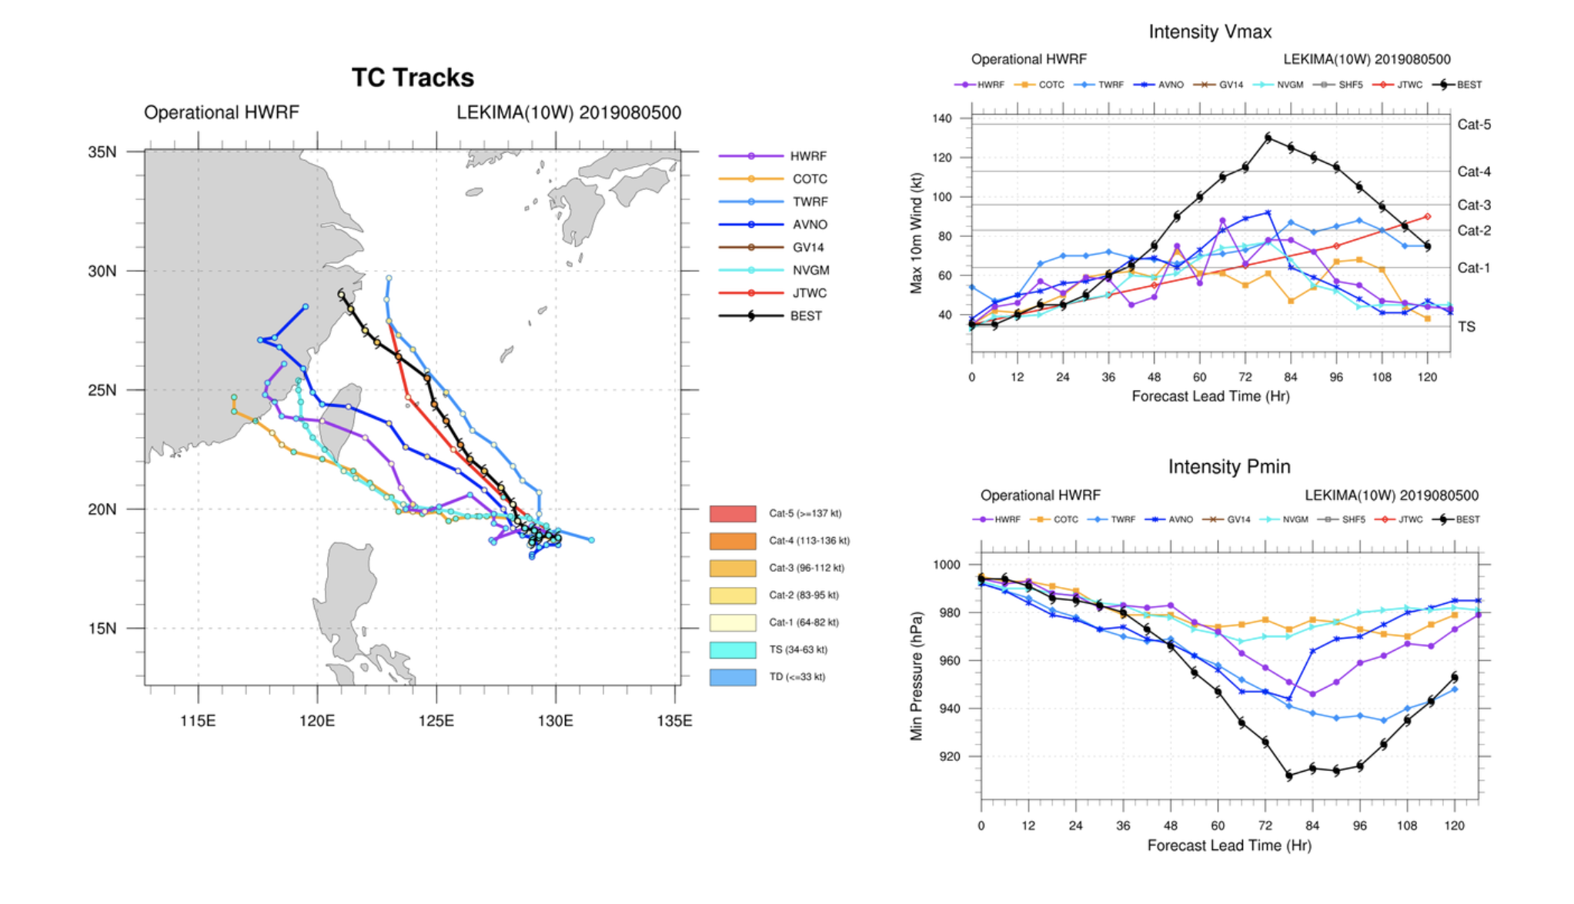

Slide 11
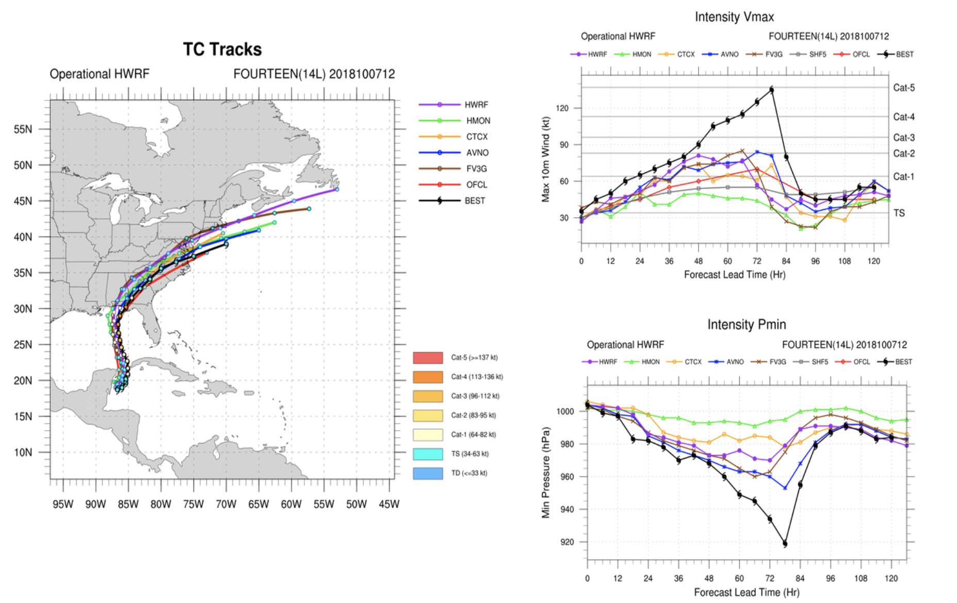
Case Study: Tropical Cyclone Michael
10/07/2018 00Z to 10/08/2018 06Z
11

Slide 12
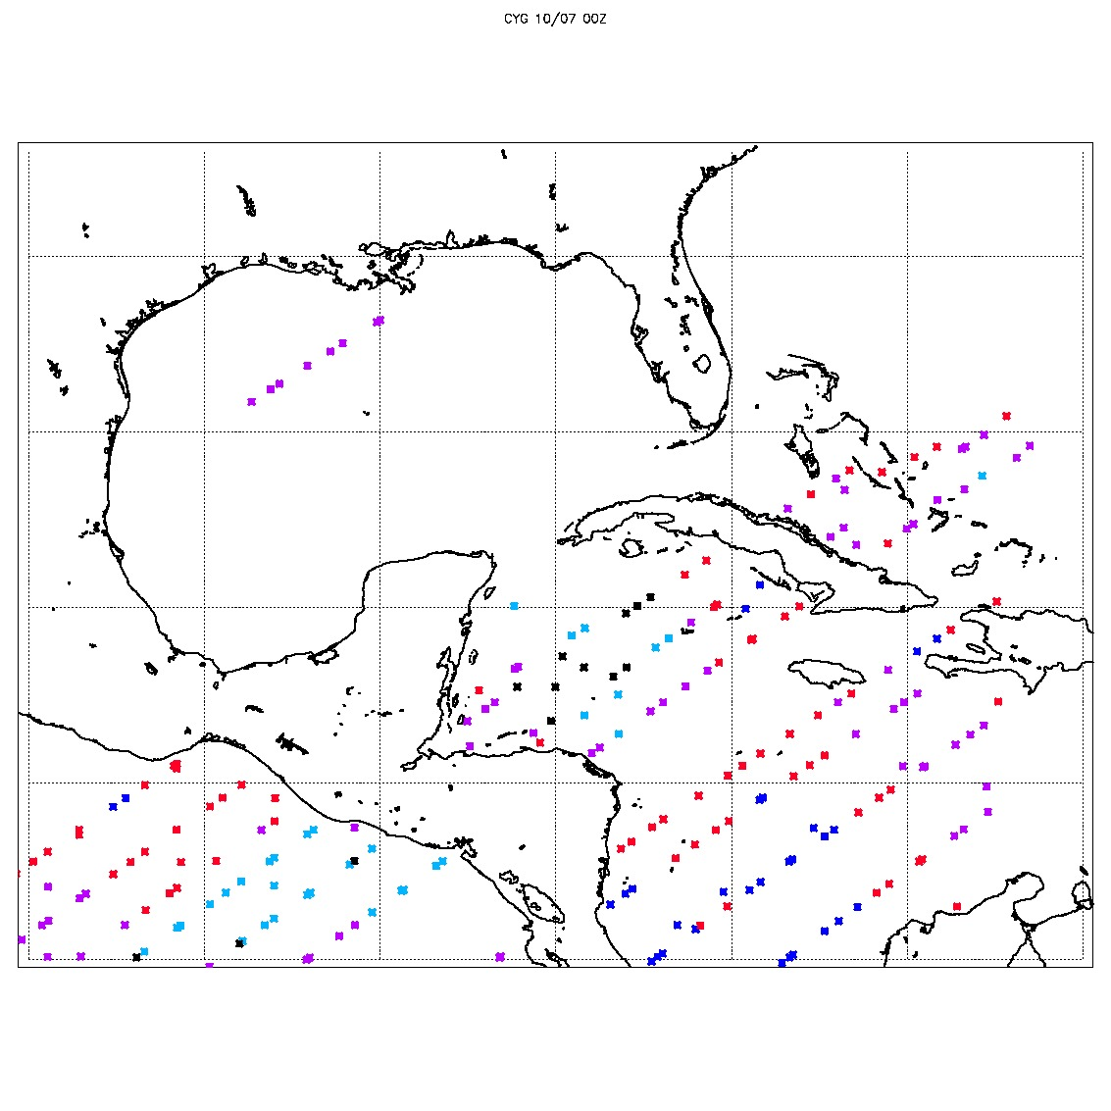
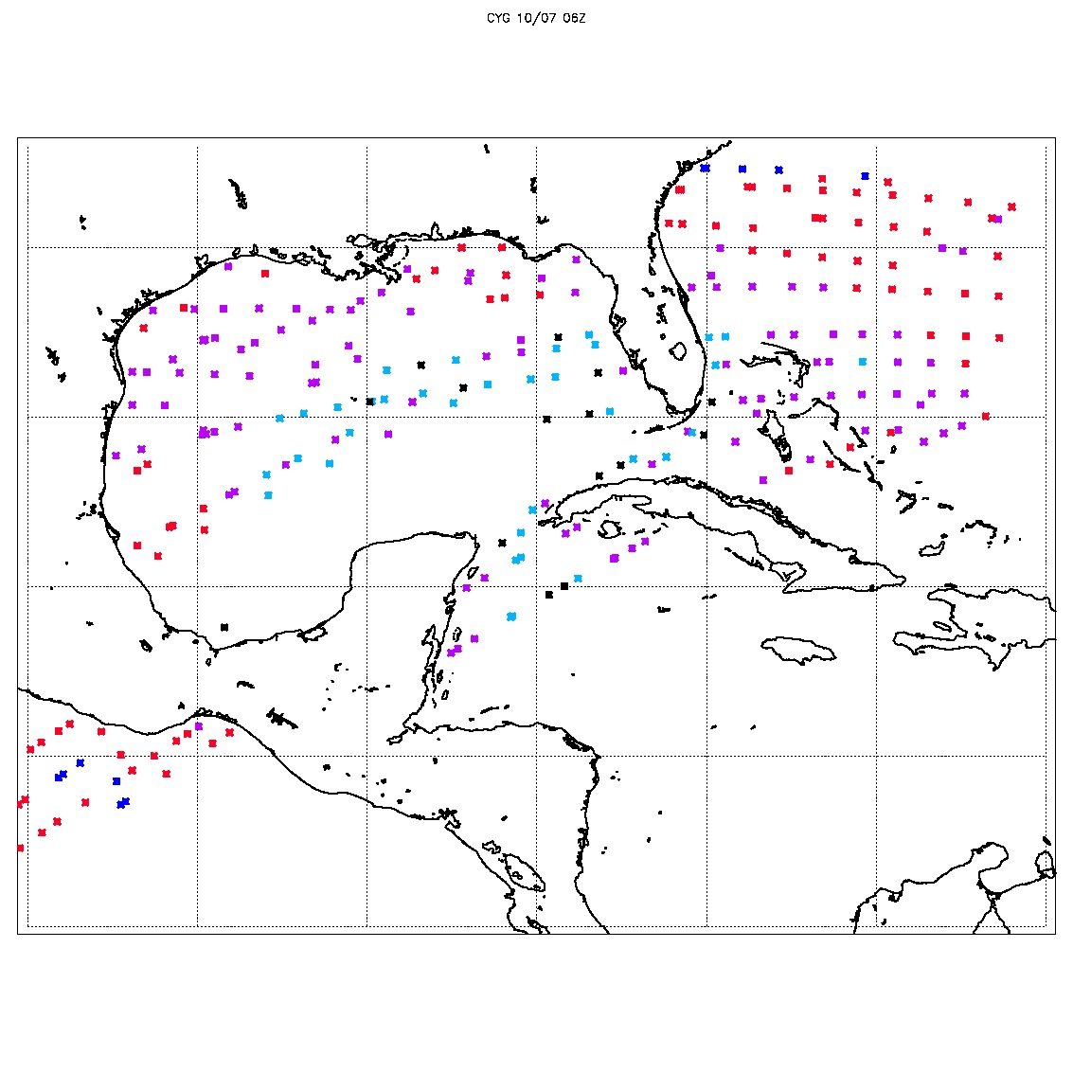
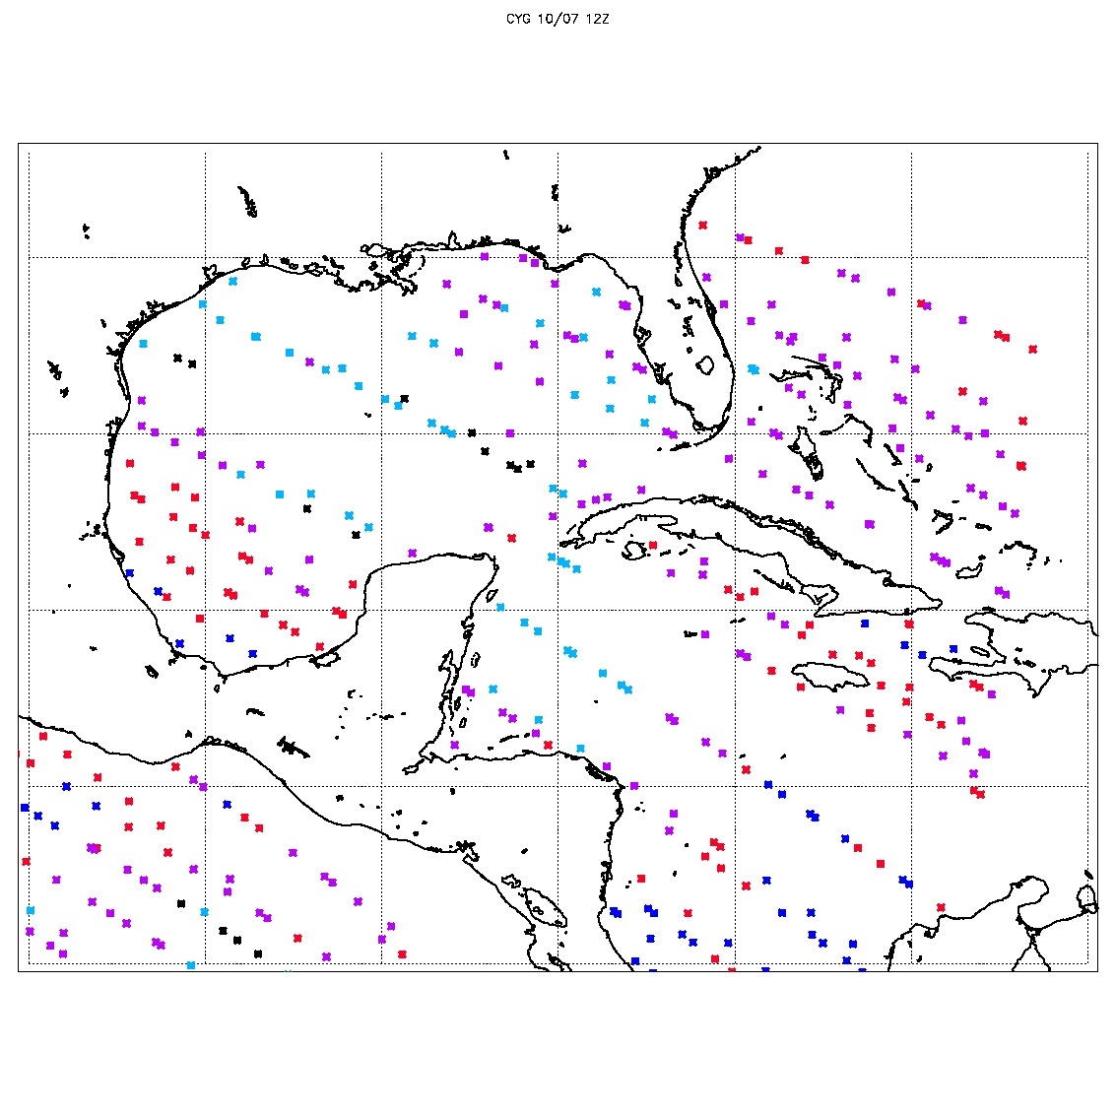
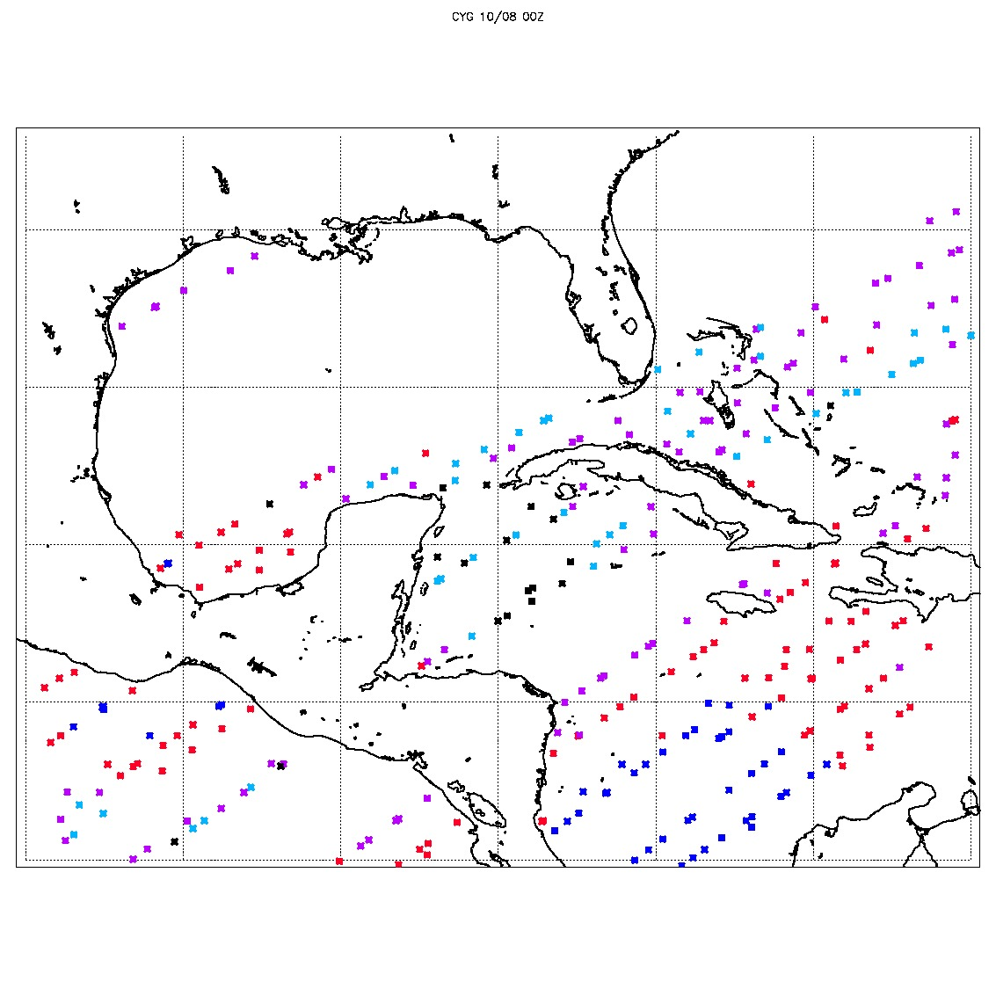
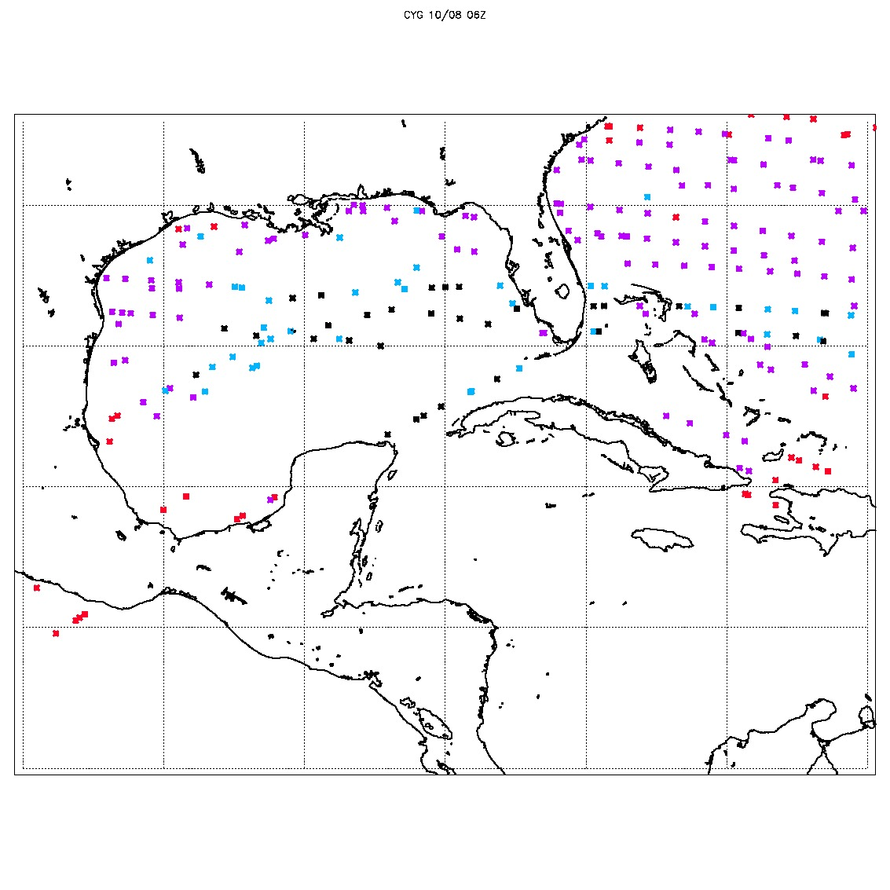
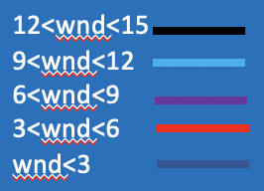
10/07 00Z
10/07 06Z
10/07 12Z
10/08 00Z
10/08 06Z
12

Slide 13
Vector wind analysis method
2-D Variational Wind Analysis
An optimal fit to CYGNSS observations is constrained by:
J_{b}: analysis should be “close” to the a priori, or “Background”, wind field
J_{o}: ensure the analysis is close to CYGNSS wind speeds
J_{c}: impose fluid dynamical constraints on the solution (vorticity, divergence)
MIN(J = J_{b} + J_{o} + J_{c})
Background winds are GFS operational analyses (0.25 x 0.25 degree).
Relative weights in minimization are consistent with CCMP analyses.
Hoffman, R. N., S. M. Leidner, J. M. Henderson, R. Atlas, J. V. Ardizzone, and S. C. Bloom, 2003: A two-dimensional variational analysis method for NSCAT ambiguity removal: Methodology, sensitivity, and tuning. J. Atmos. Oceanic Technol., 20 (5), 585–605.

Slide 14
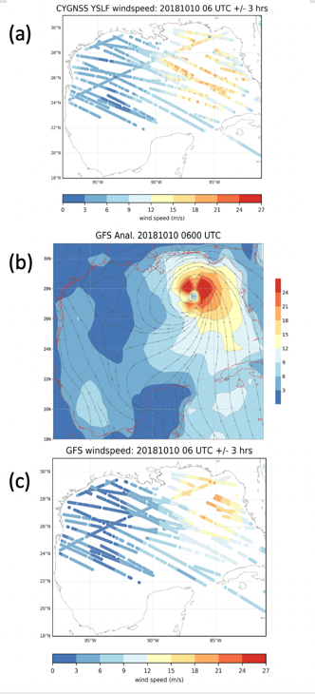
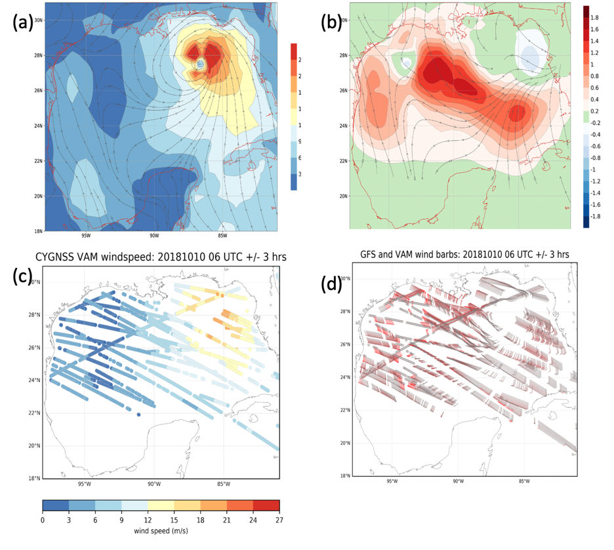
6 hours of CYGNSS data: quality controlled/thinned
+/- 3 hours around 0600 UTC Oct 10, 2018
VAM analysis, (b) increment (analysis-background), (c) interpolated VAM analysis at the CYGNSS location, and (d) VAM vectors at the CYGNSS location.
(a) Actual CYGNSS winds, (b) GFS analysis, (c) GFS windspeed interpolated at CYGNSS location.

Slide 15
Experiment Design
Experiment Name | Assimilated Data set Cycles (10/07 00Z- 10/08 06Z)
 | Conventional | Radiances | CYGNSS | CYGNSS-VAM
CTRL | Yes | Yes | No | No
CYG50 | Yes | Yes | Yes | No
VAM50 | Yes | Yes | No | Yes
CYG_NOTN | Yes | Yes | Yes | No
VAM_NOTN | Yes | Yes | No | Yes
15

Slide 16
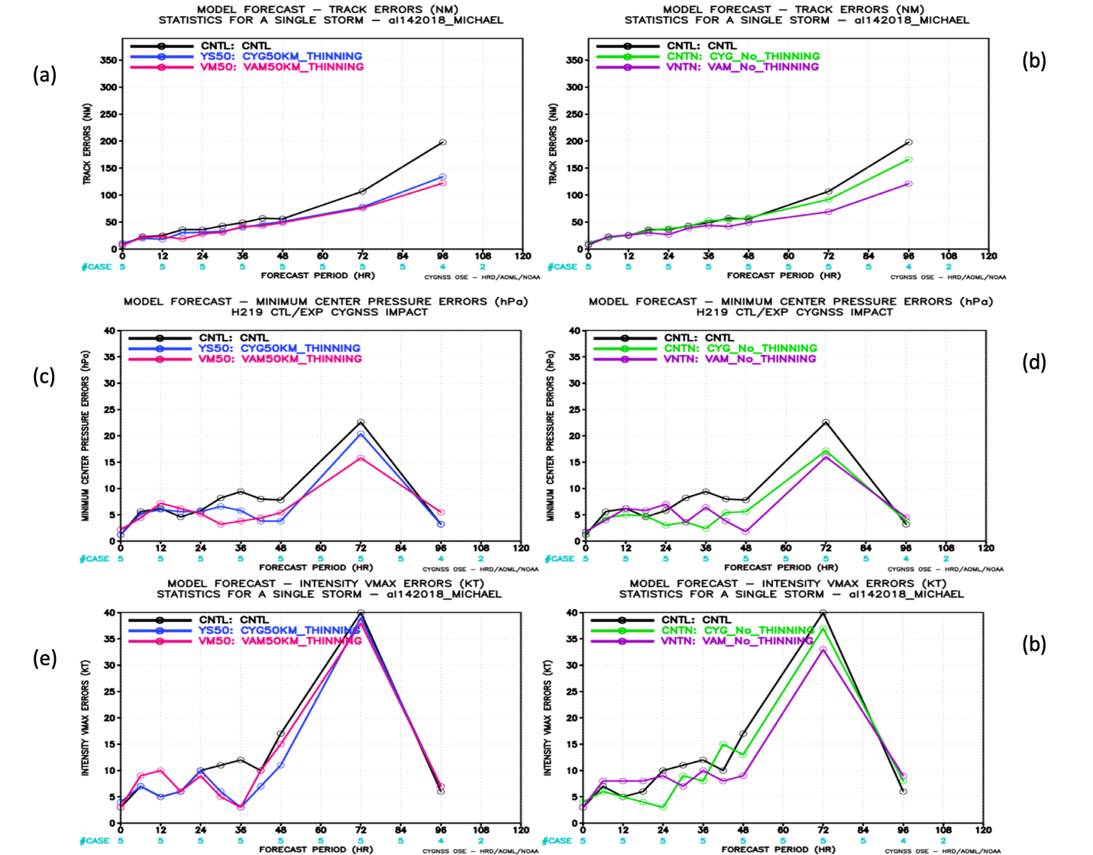
HWRF track and intensity forecast errors

Slide 17
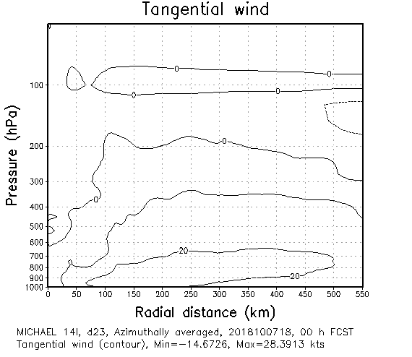
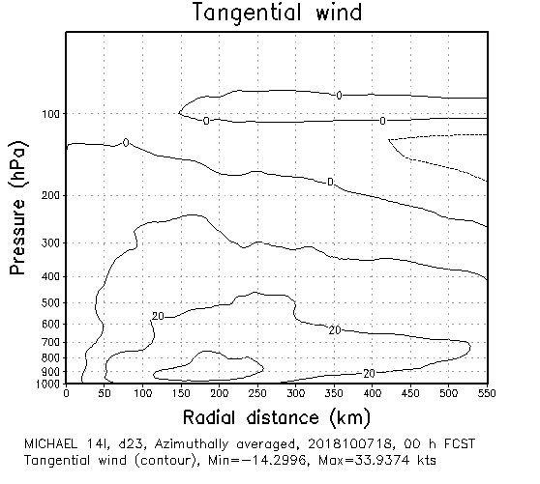
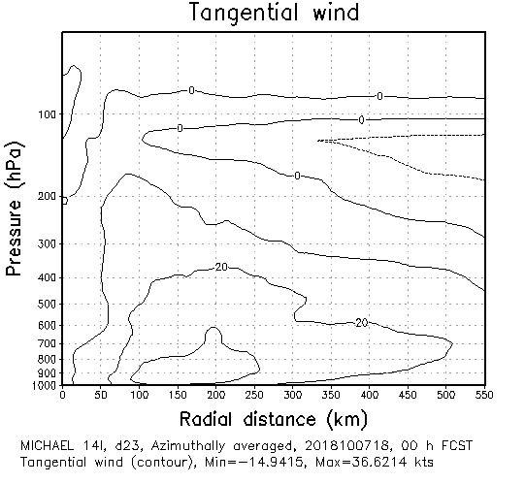
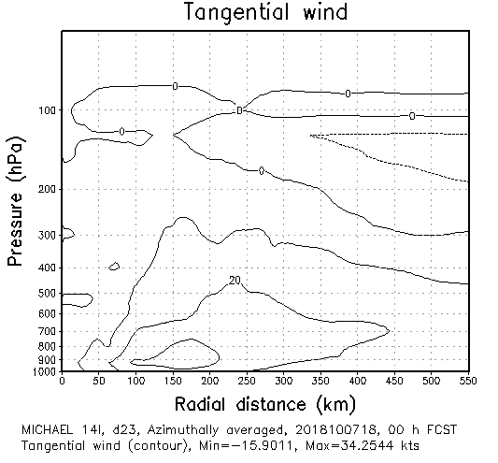
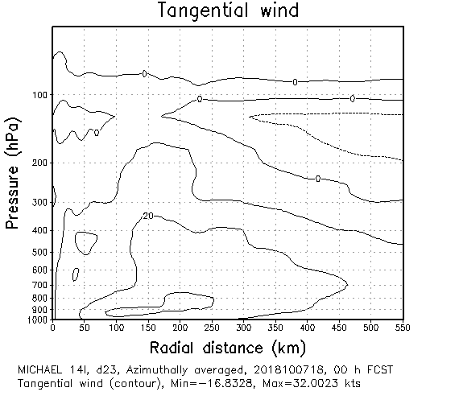
Analyses
CNTRL
CYG-NOTHN
VAM-NOTHN
10/07 18UTC
CNTRL
CYG50
VAM50

Slide 18
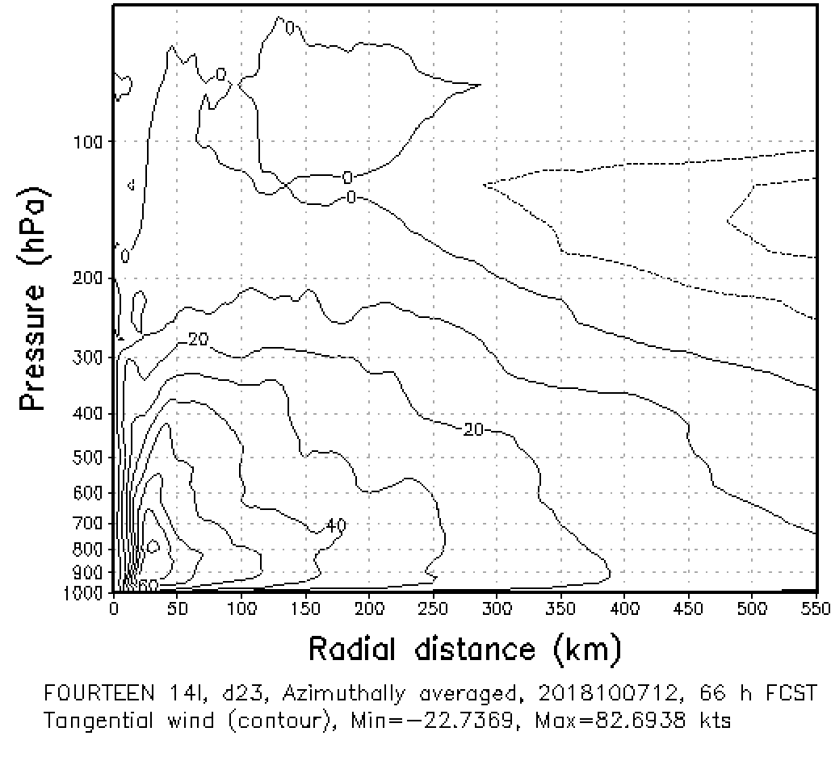
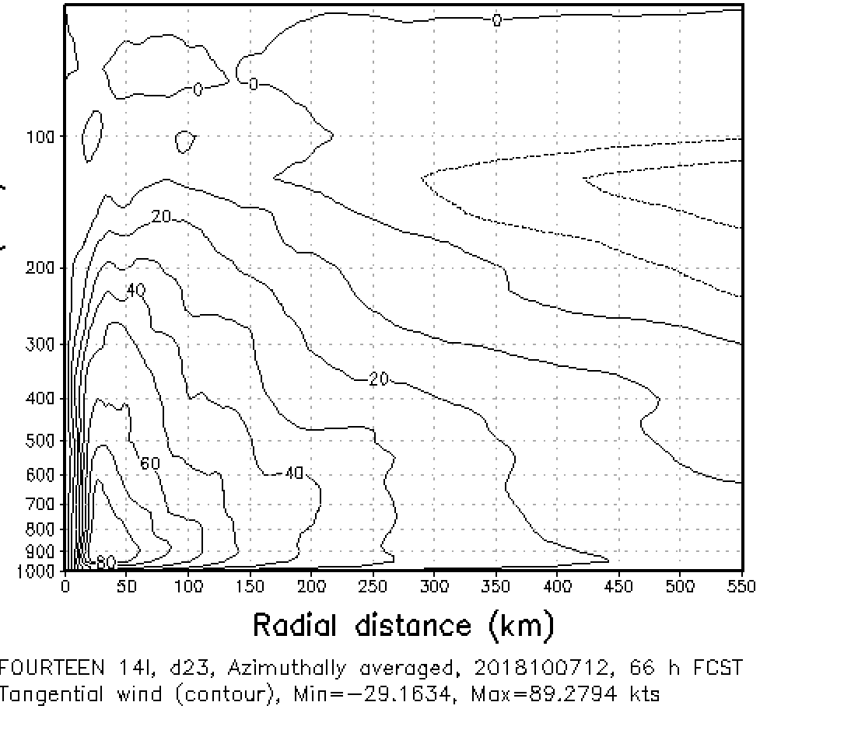
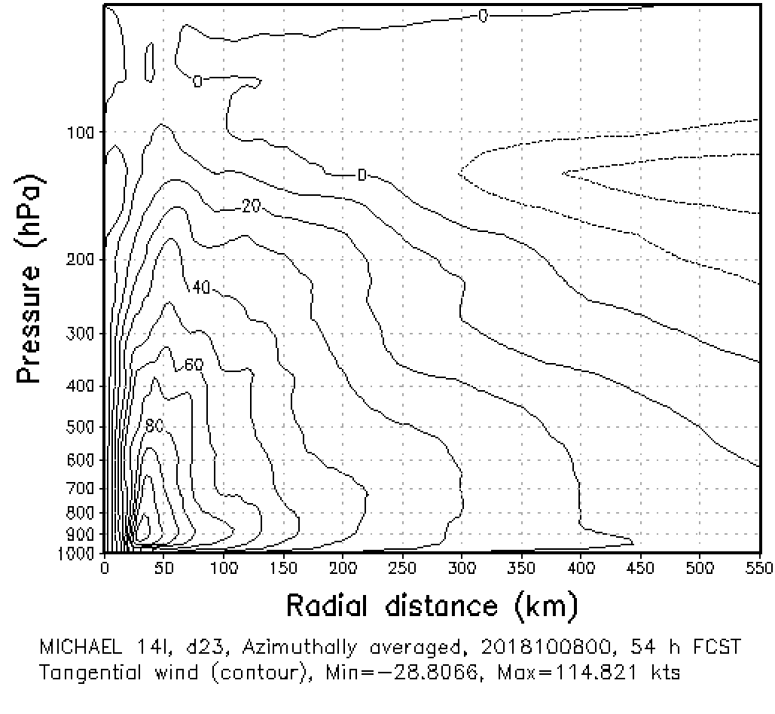
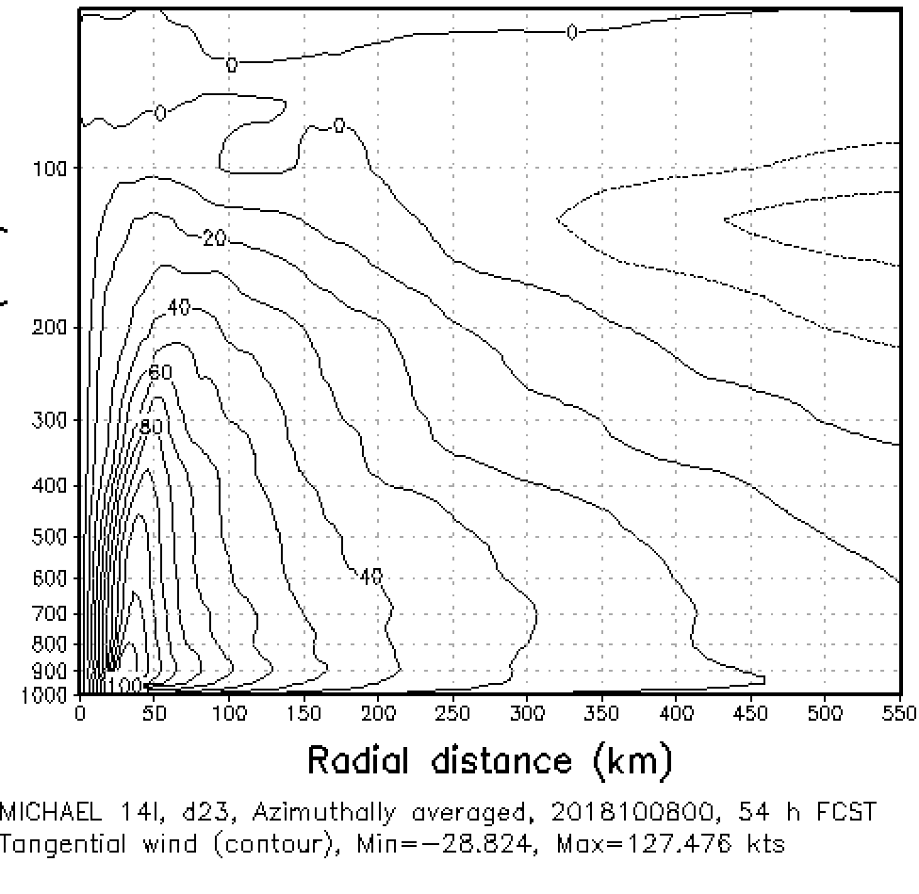
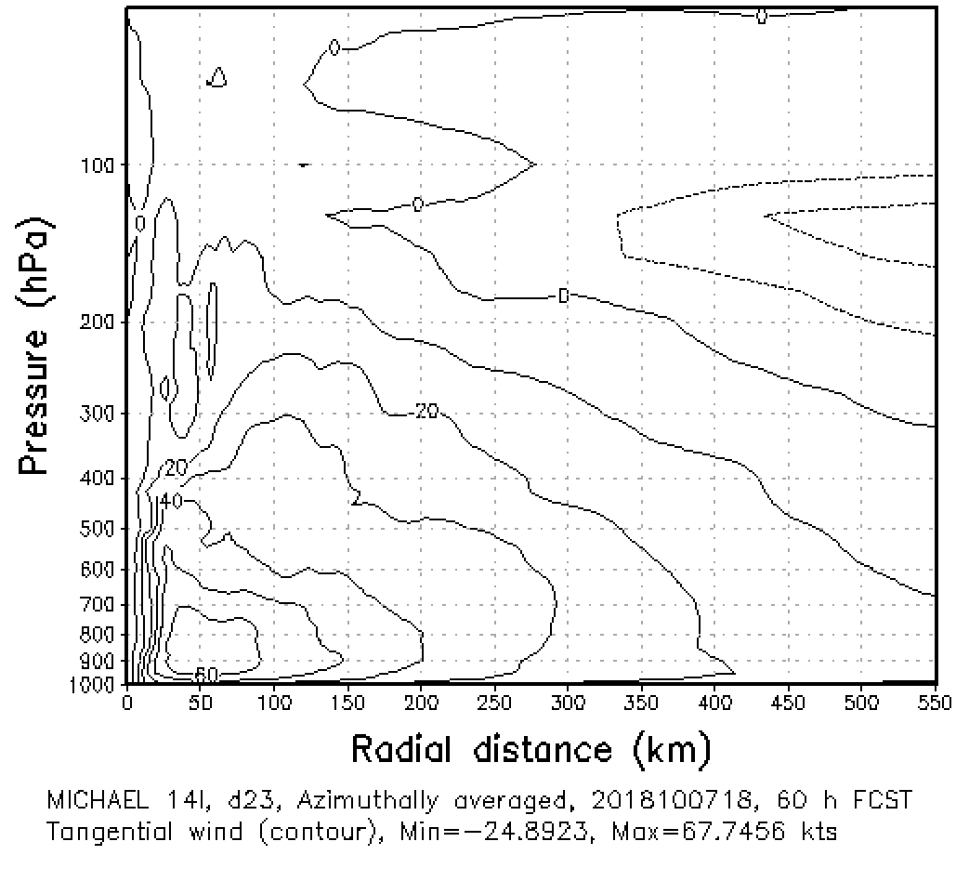
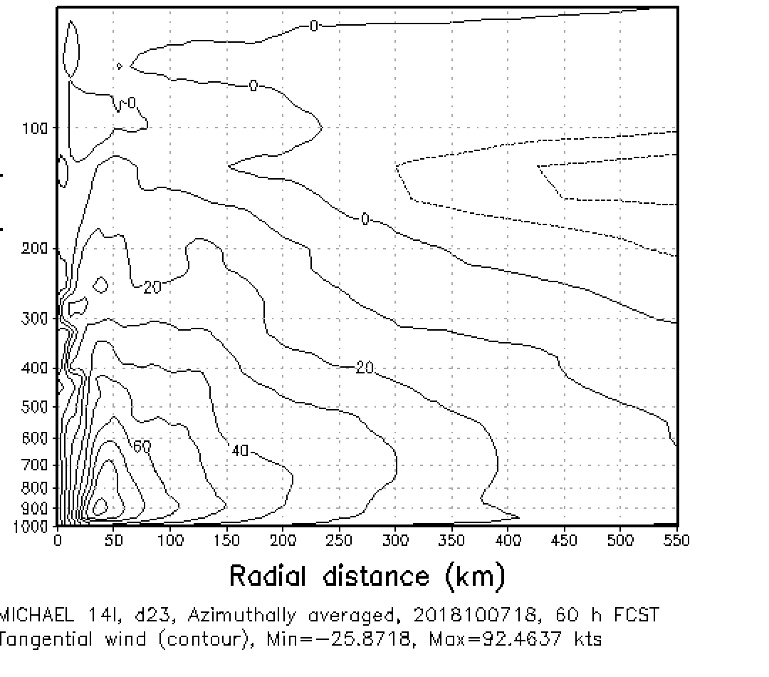
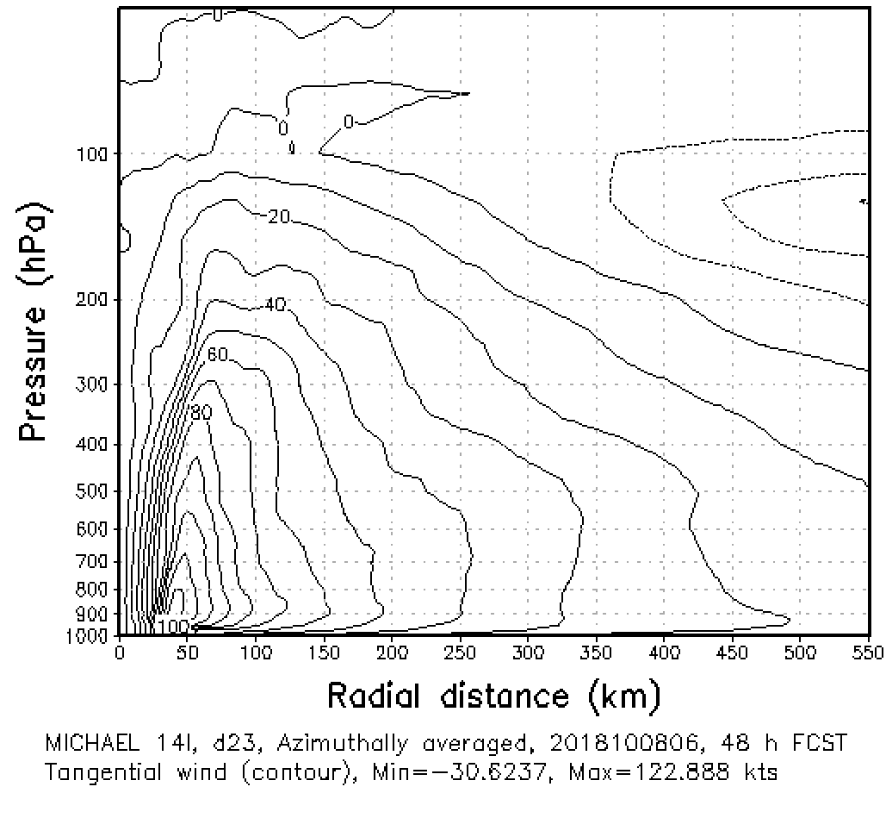
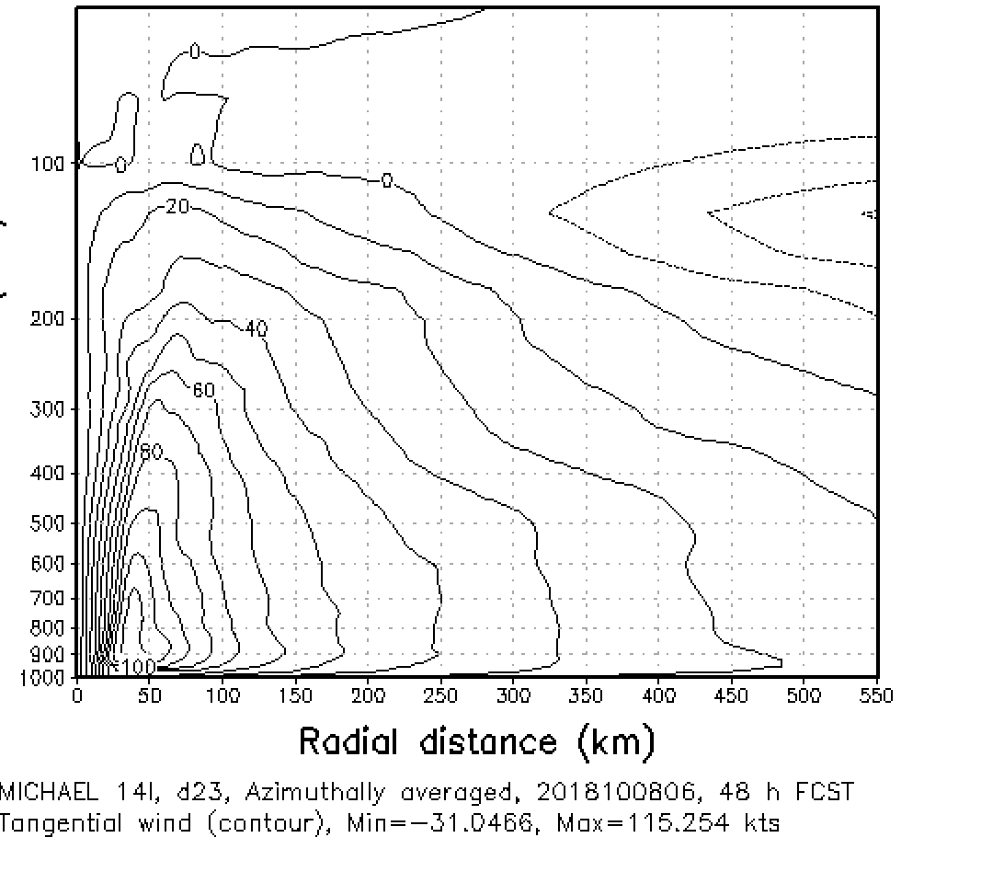
Forecasts
No CYGNSS
CYG_50
No CYGNSS
CYG_50
Forecasts
starting
Forecasts
starting
0712
0800
0718
0806
Azimuthally averaged tangential wind cross sections of forecasts started at 6 hour intervals, all valid at the same time, 0600 UTC 10 August 2018, about 12 hours before hurricane Michael made landfall.

Slide 19
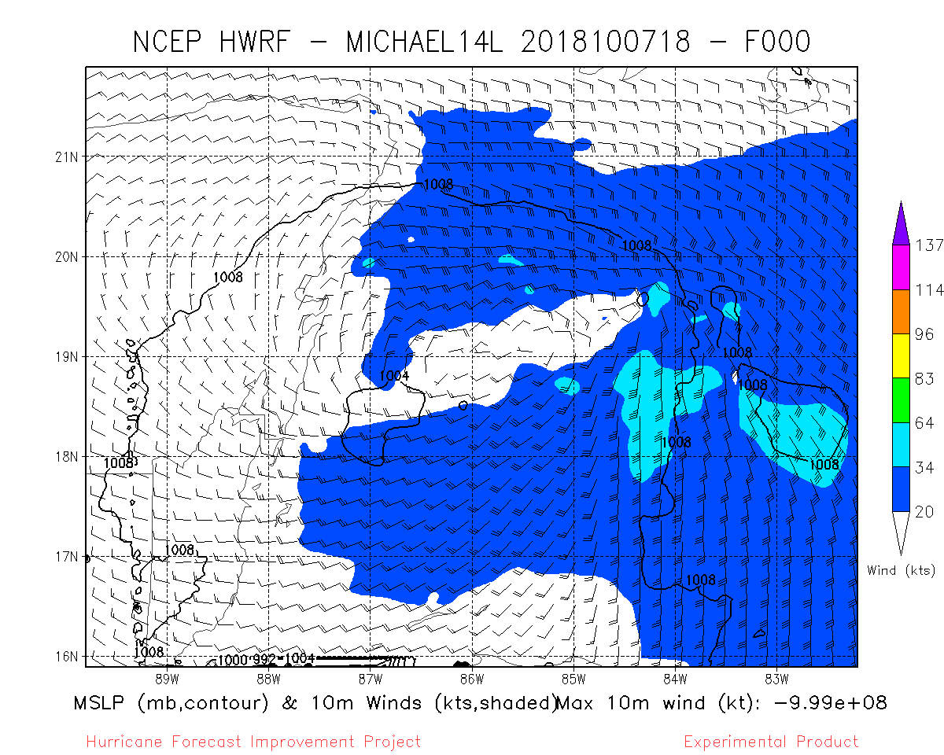
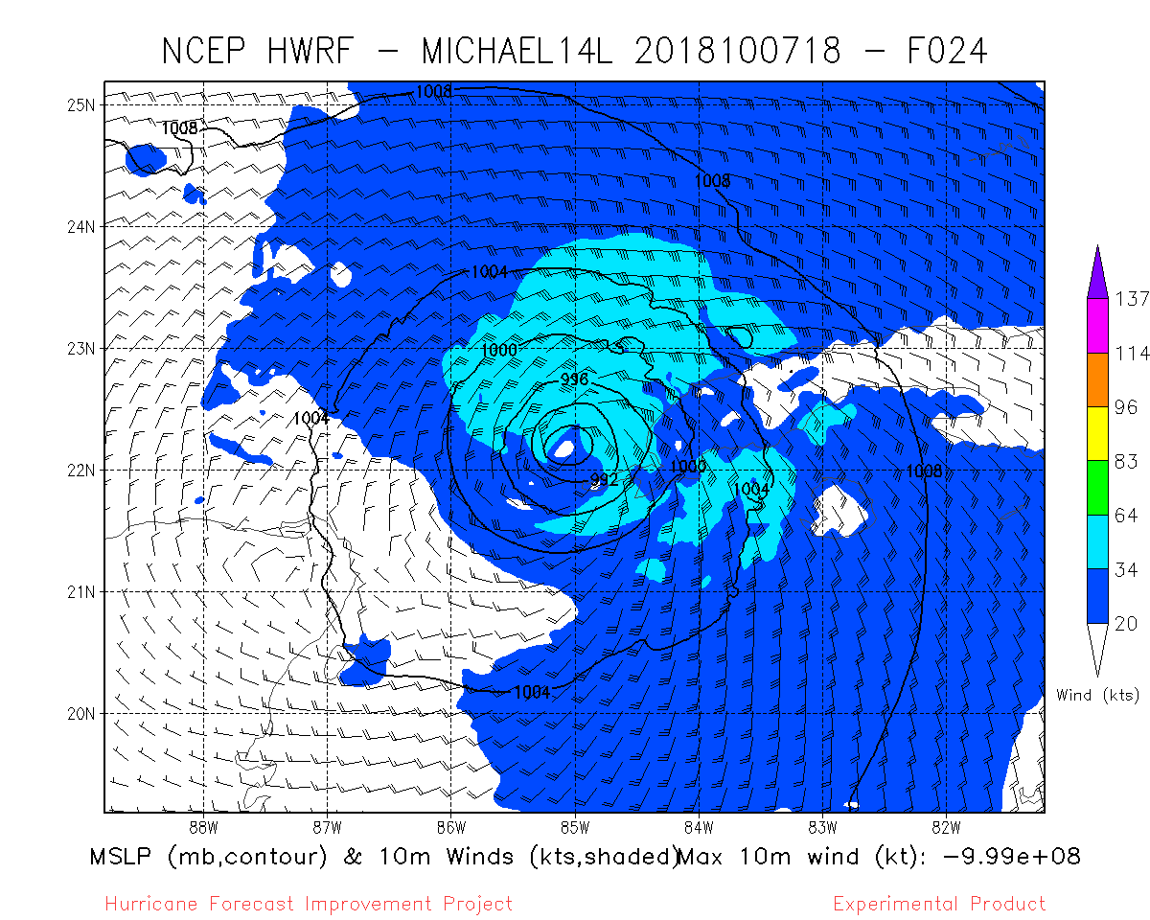
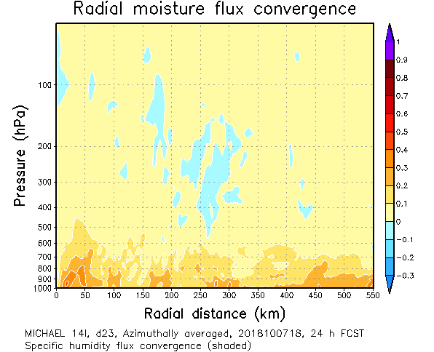
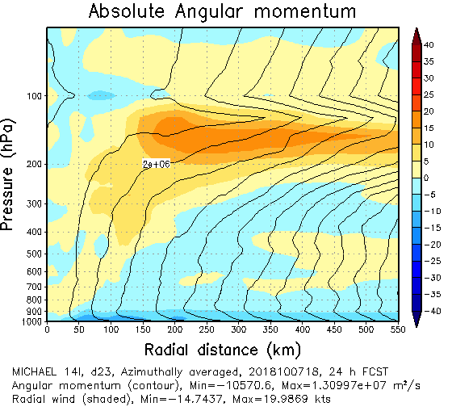
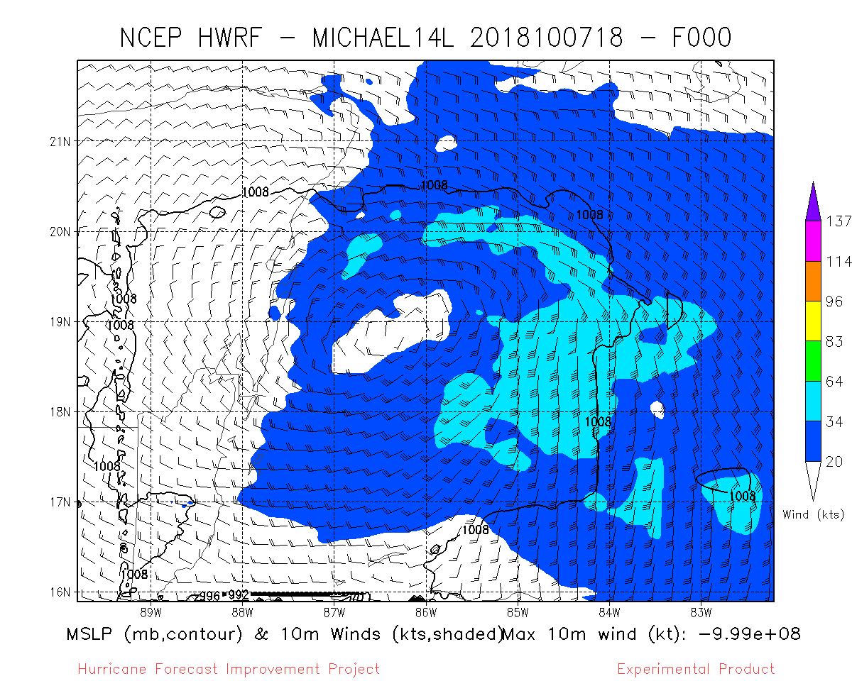
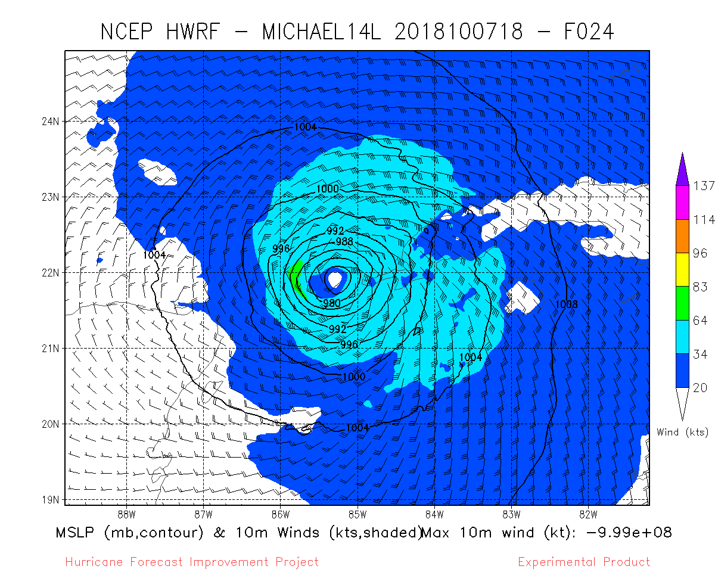
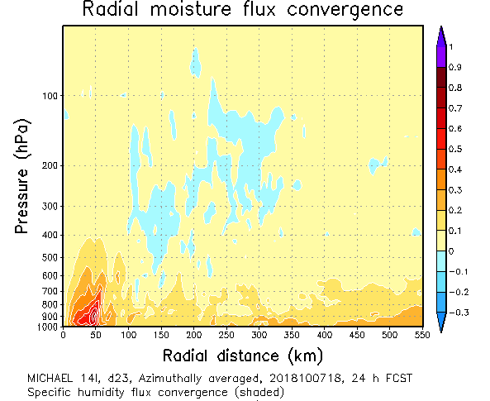
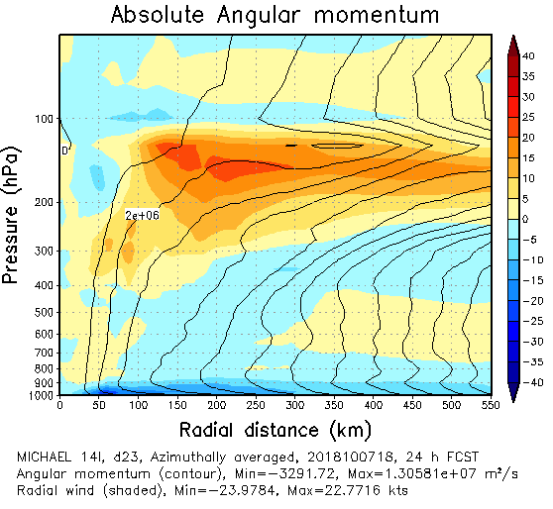
CYGNSS impact on analyses and forecasts
Analysis
24 hour forecast
24 hour forecast
24 hour forecast
CNTROL NO CYCGNSS
CYCGNSS NO THINNING, VAM
Moisture convergence, latent heating, secondary circulation enhanced by CYGNSS data.

Slide 20
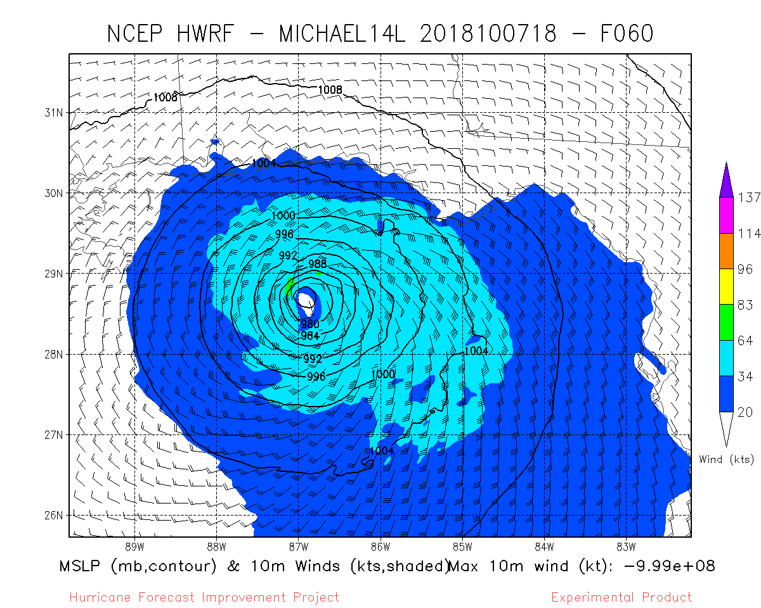
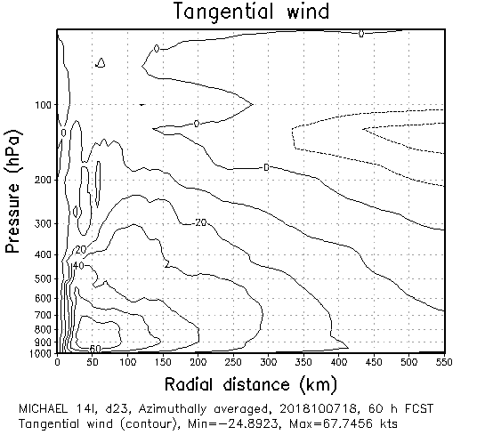
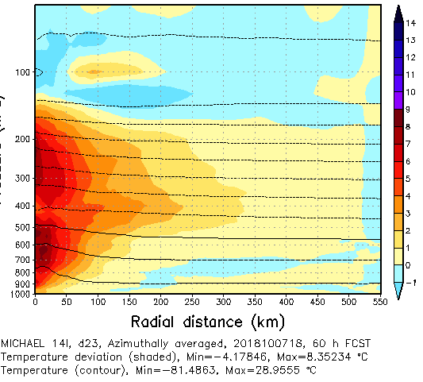
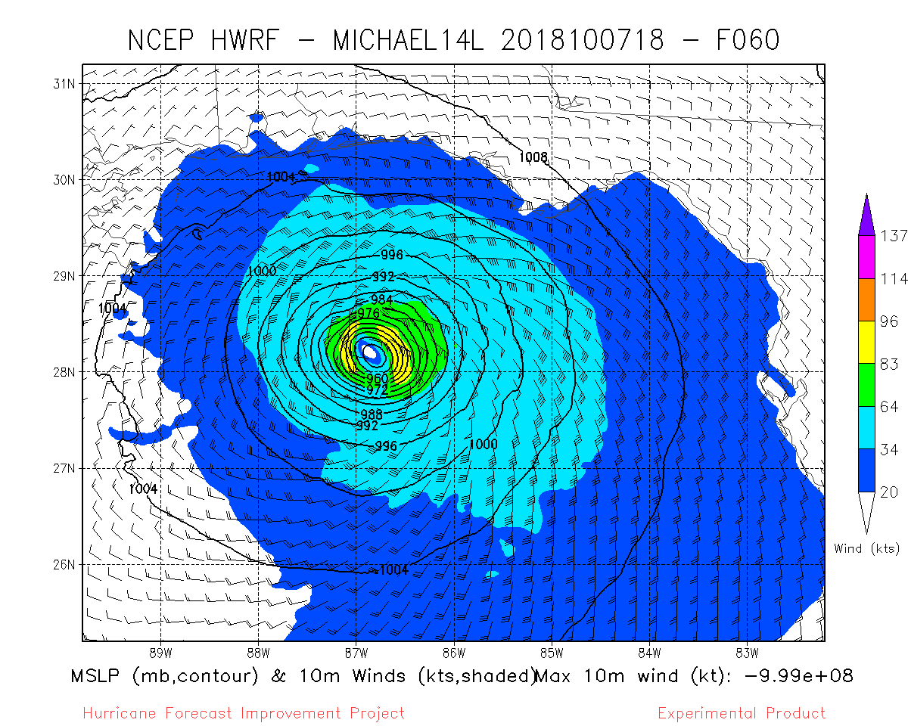
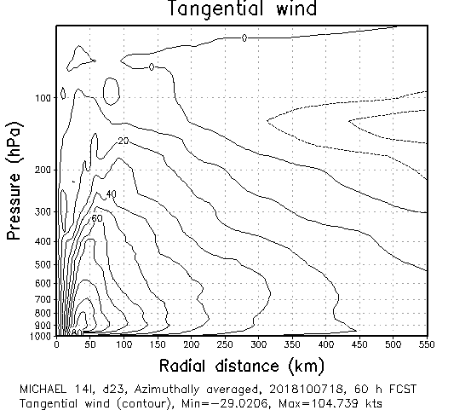
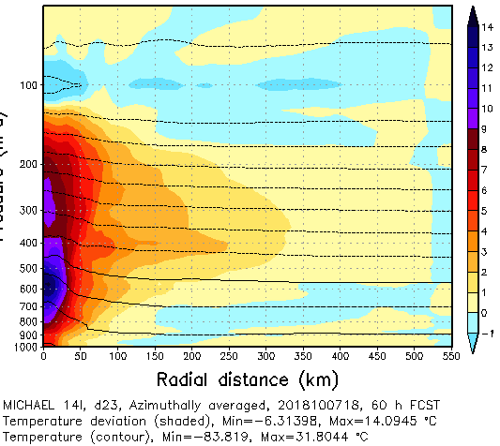
60-h Forecast
from
20181007
1800 UTC
10-m winds
Azimuthally-averaged
Tangential Wind
Azimuthally-averaged
Temperature Departure
Control
(no CYGNSS)
VAM-CYGNSS
20

Slide 21
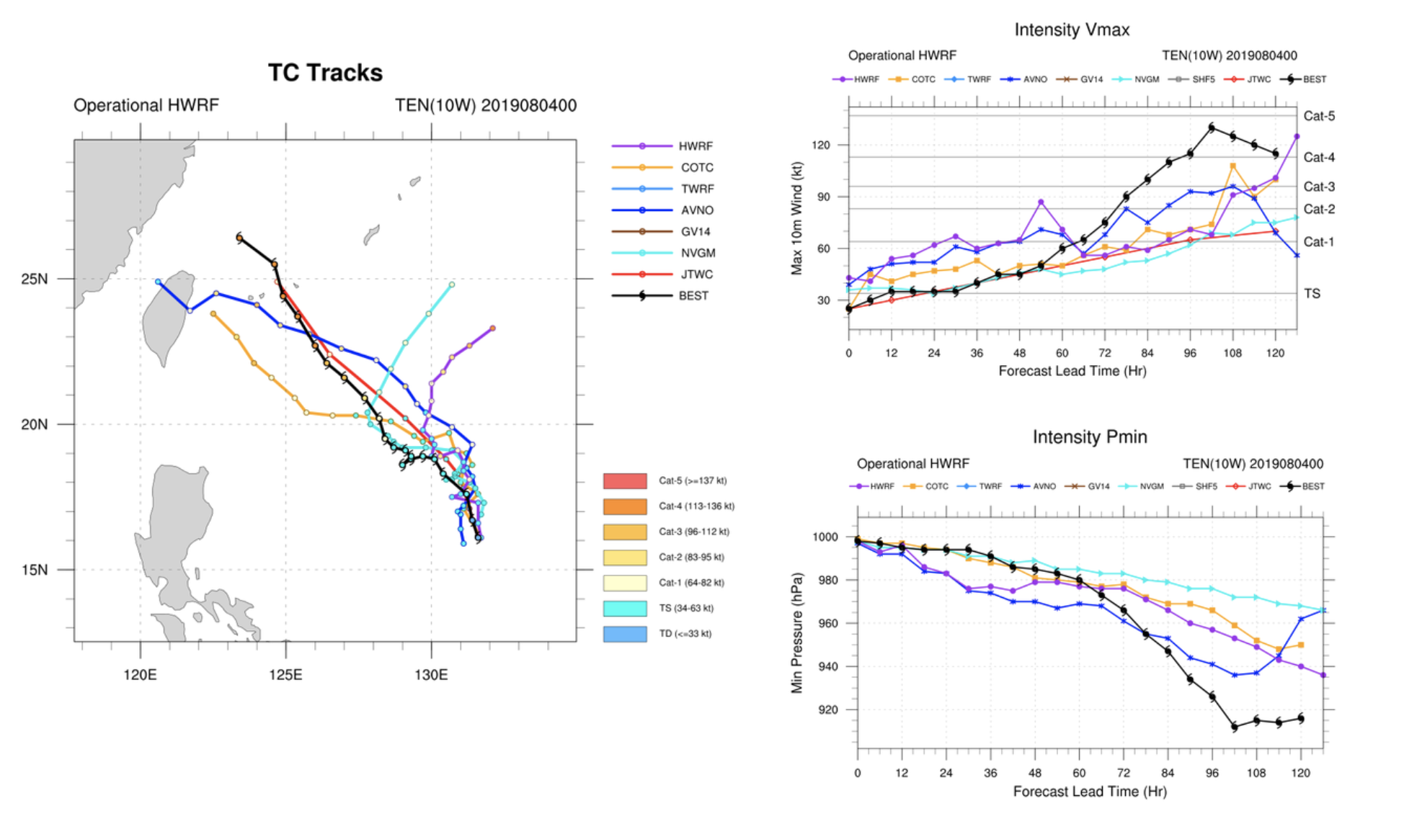

Slide 22
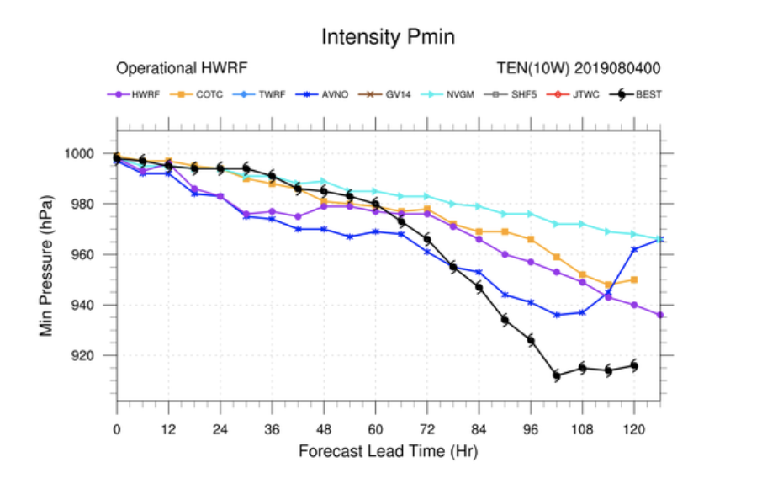
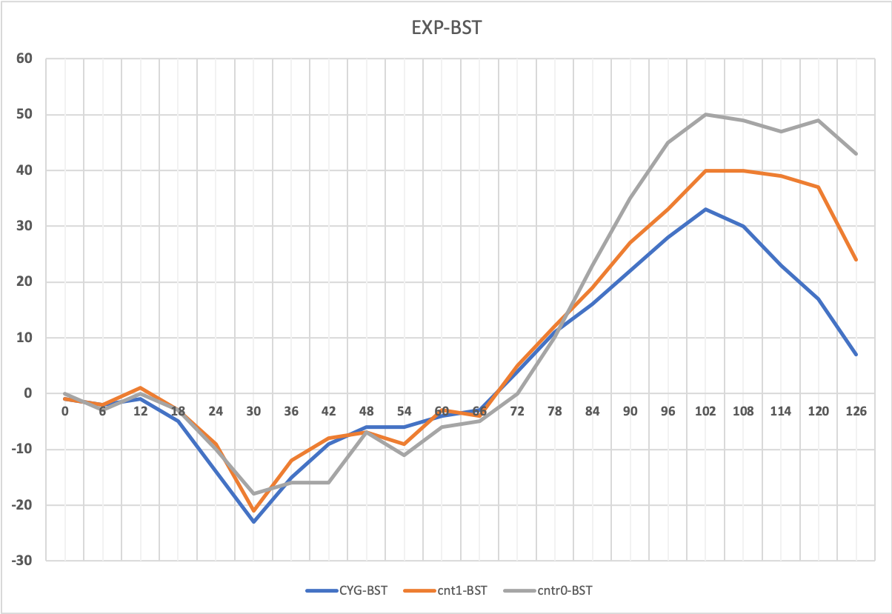
Tropical depression 10W
080400
Experiment-Best Track
Min Pressure Error (mb)
Forecast hour
CNTRL NO DA
CNTRL WITH DA
CYGNSS NO-THINNING

Slide 23
Conclusions & Next Steps
CYGNSS supplies critical observations early in Tropical Cyclone lifecycle
  Other observing systems are often absent when tropical storms are weak
Improved early analyses lead to the improvement in intensity forecasts
  Small changes to ocean/atmosphere fluxes can trigger a different evolution
  Improved surface fluxes modify the distribution of latent and sensible heat
Continue tuning of vector CYGNSS winds in regional DA (HWRF)
  Additional cases (2019): Dorian, Erick, Kiko, Lekima
  Preparing for use of vector CYGNSS winds in global DA (FV3-GFS)

Slide 24
Additional Slides

Slide 25
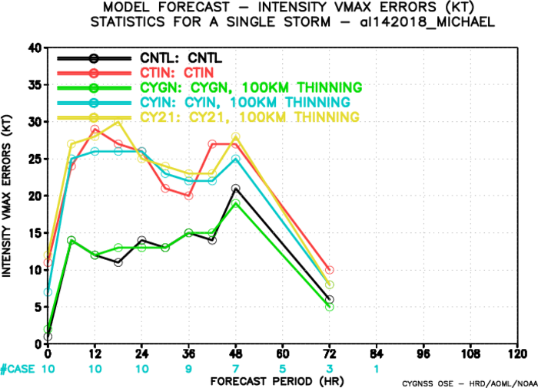

Slide 26
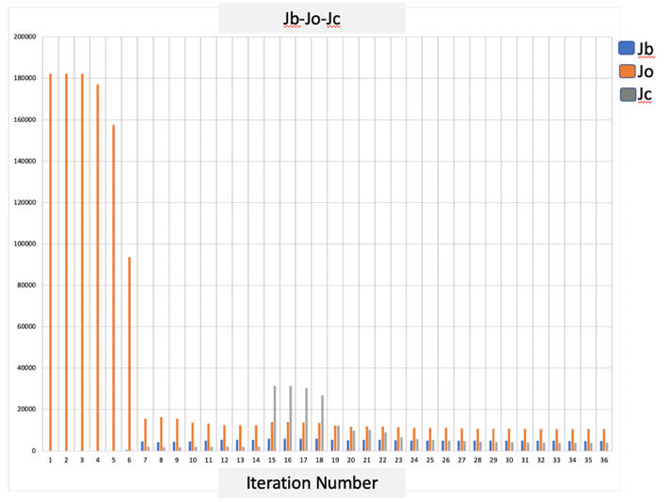

Slide 27

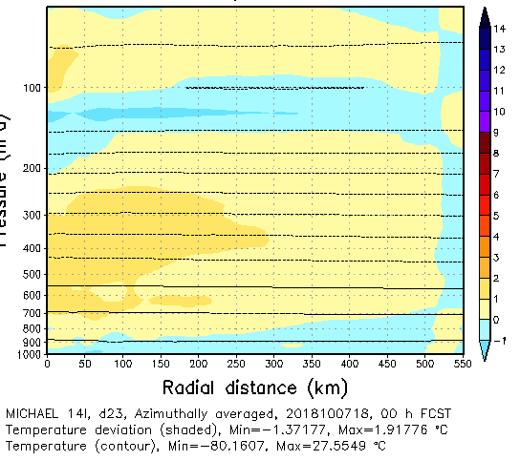
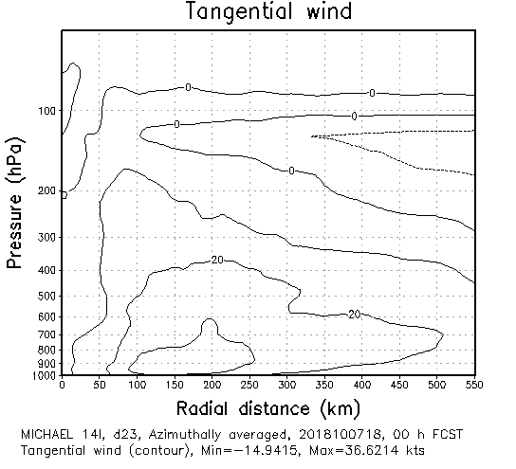
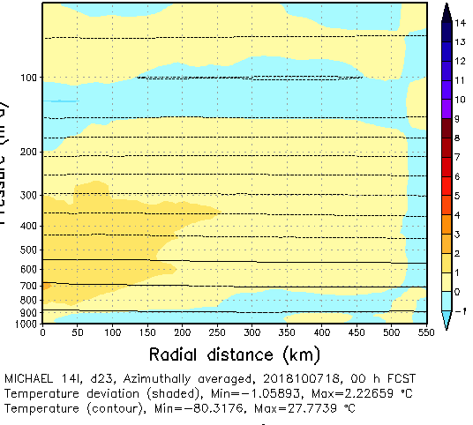
Analysis
valid
20181007
1800 UTC
10-m winds
Azimuthally-averaged
Tangential Wind
Azimuthally-averaged
Temperature Departure
Control
(no CYGNSS)
VAM-CYGNSS

Slide 28
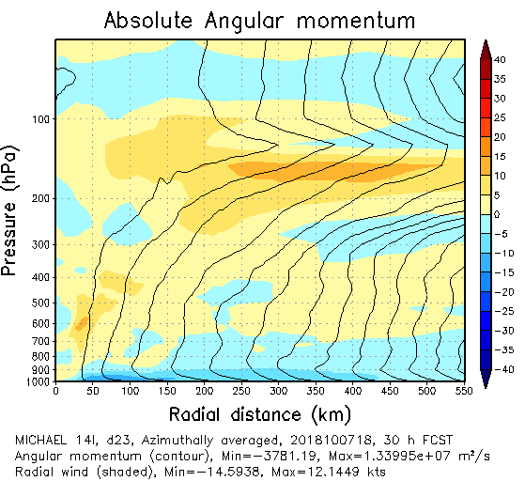



30-h Forecast
from
20181007
1800 UTC
Azimuthally-averaged Radial Inflow
Azimuthally-averaged Radial Moisture Flux Convergence
Control
(no CYGNSS)
VAM-CYGNSS

Slide 29
60-h Forecast
from
20181007
1800 UTC
10-m winds
Azimuthally-averaged
Tangential Wind
Azimuthally-averaged
Temperature Departure
Control
(no CYGNSS)
VAM-CYGNSS

Slide 30






10/07 18UTC
cntrl
cygntn
vamntn

Slide 31




10/07 18UTC
cntrl
cyg50
vam50

Slide 32









10/07 18UTC
cntrl
cyg50
vam50

Slide 33






10/07 18UTC
cntrl
cygntn
vamntn

Slide 34
Global Experiments

Slide 35
CYGNSS Impact Experiment
Month-long global experiment 15 September – 15 October 2018
  15-30 September spin-up; 1-15 October for impact study
  week-long forecast at 00Z each day during impact study
  Analysis cycling 4x per day
GDAS/GFS experimental system
  Global Data Assimilation System (C192; ~50km)
  Hybrid 4DEnVar Gridpoint Statistical Interpolation (GSI) – 6 hr assimilation windows
  Global Forecast System (C384; ~27km)
  Finite-Volume Cubed Sphere core (FV3)
Three tests: CYGCTL (conventional and radiances), CYGSPD (conventional, radiances, and CYGNSS-derived scalar winds), CYGDIR (conventional, radiances, and CYGNSS-derived vector winds (used VAM with GSM-GFS background)
Best track databases: HURDAT-2 (Atl/E. Pac.) and JTWC (W. Pac.)
7 tropical cyclones (Leslie, Michael, Nadine, Rosa, Sergio, Tara, Kong-rey)

Slide 36
Preparing CYGNSS data for assimilation
CYGNSS Dataset Used
Surface scalar winds derived from backscatter assuming “fully developed seas”
  Occurs when wind not strong or rapidly changing (majority of ocean surface)
Did not use wind over 15 ms⁻¹
  Stronger relationship between backscatter and surface wind at lower wind speeds
  More difficult to distinguish between 25 ms⁻¹ and 30 ms⁻¹ than between 5 ms⁻¹ and 10 ms⁻¹
CYGNSS yields lots of data
Avoid thinning data, but don’t want to overfit: Assigned inflated observation errors to weight individual observations less

Slide 37




Global Impacts on Tropical Cyclones (1-15 October 2018)
Track Errors
Maximum Wind Speed Errors
1000
CYGCTL
CYGSPD
CYGCTL
CYGSPD
30
800
Significant improvement (~50km) at 36 – 60 hr
Neutral otherwise
Small average impacts at all lead times (+/- 2 kt)
Significant degradation at 6 hr
Neutral otherwise
Track Error (km)
Wind Error (kt)
600
20
400
10
200
200
SPD - CTL
6
SPD - CTL
100
3
Wind Error Diff (kt)
Track Error Diff (km)
Bars: 95% confidence intervals w.r.t. CTL
0
Bars: 95% confidence intervals w.r.t. CTL
0
-3
-100
Bars: 95% confidence intervals w.r.t. CTL
-6

Slide 38




Global Impacts on Tropical Cyclones (1-15 October 2018)
Track Errors
Maximum Wind Speed Errors
1000
CYGCTL
CYGDIR
CYGCTL
CYGDIR
30
800
Significant improvement (~50km) at 36, 42, and 90 hr
Neutral otherwise
Small average impacts at all lead times (+/- 2 kt)
Significant degradation at 0 and 72 hr
Neutral otherwise
Track Error (km)
Wind Error (kt)
600
20
400
10
200
100
DIR - CTL
DIR - CTL
4
0
2
Track Error Diff (km)
Bars: 95% confidence intervals w.r.t. CTL
Wind Error Diff (kt)
Bars: 95% confidence intervals w.r.t. CTL
0
-100
-2
Bars: 95% confidence intervals w.r.t. CTL
-4

