Slide 1




A Thermodynamic Pathway Leading to Rapid Intensification of Tropical Cyclones in Shear
Xiaomin Chen^{1,2}
NOAA/AOML/Hurricane Research Division; 2. National Research Council
Jun A. Zhang^{1, 3} and Frank D. Marks¹
3. University of Miami, CIMAS
HRD Science Meeting
October 8, 2019
Chen X., J. Zhang, and F. Marks, 2019: A thermodynamic pathway leading to rapid intensification of tropical cyclones in shear. Geophys. Res. Lett..

Slide 2
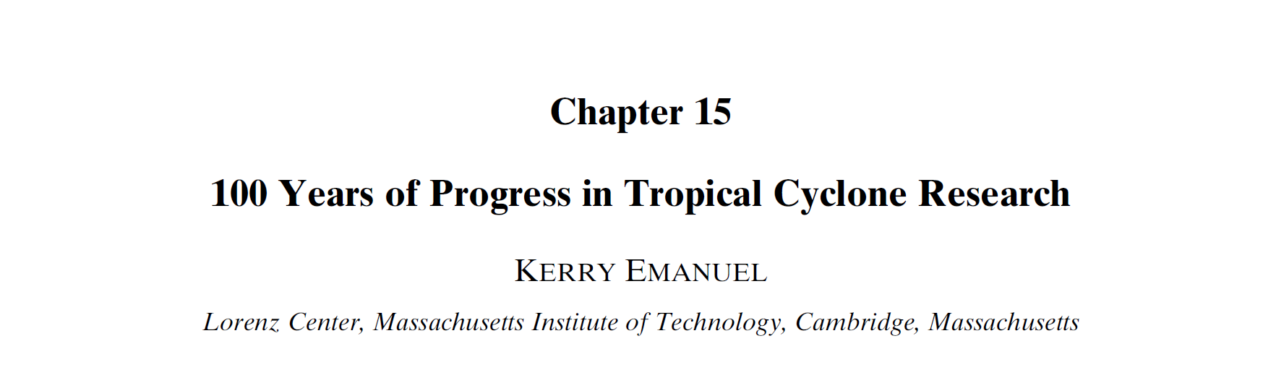
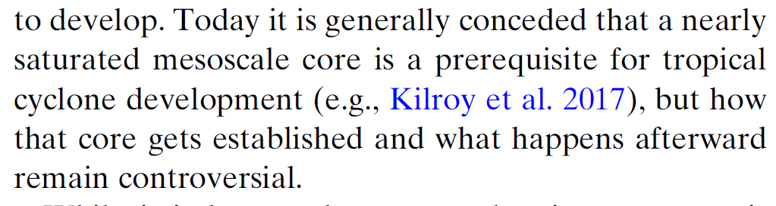
Emanuel (2018)

Slide 3
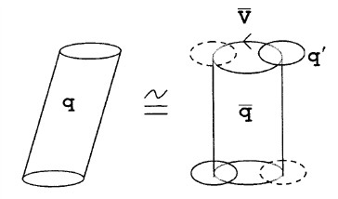
Early-stage tropical cyclones in shear
Westerly VWS
What drives the moistening in the core region?
“Ventilation”
Tang and Emanuel (2010)
Riemer et al. (2010, 2012)

Slide 4
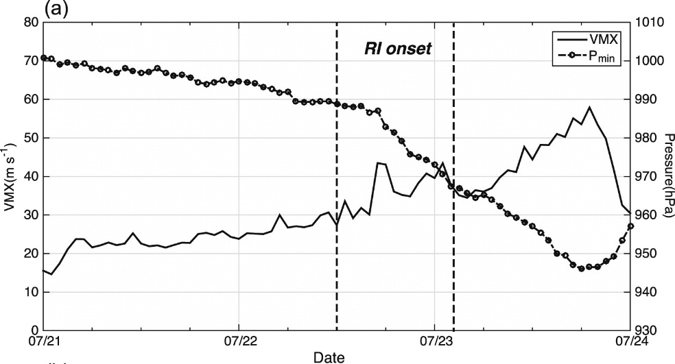
A review of Typhoon Vicente’s (2012) RI
RI onset
Chen et al. (2017, 2018)
Moderate VWS
(5-7 m/s)
Downshear reformation:
Transition from a broad, tilt parent vortex to
a compact and nearly-aligned new core

Slide 5
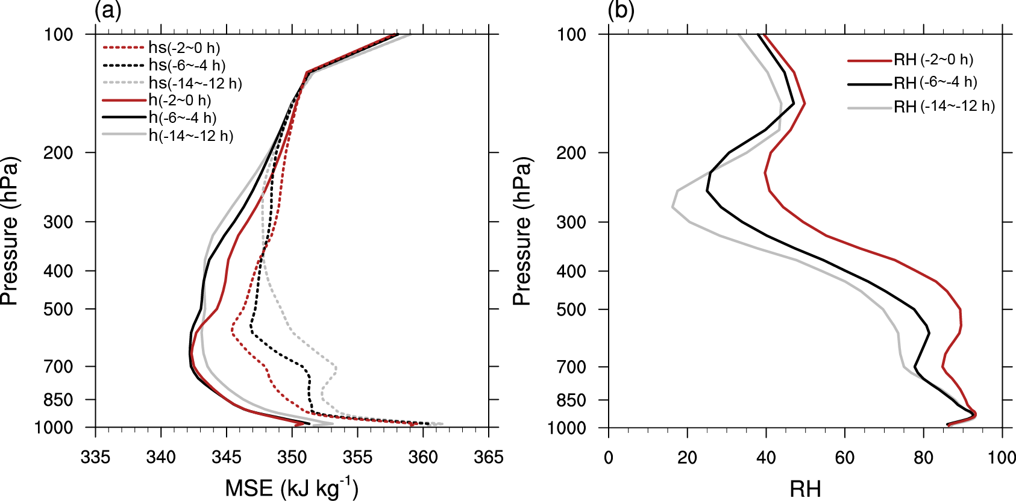
Moistening before RI onset
300*300 km
The lower-mid troposphere becomes nearly-saturated at RI onset.

Slide 6

Analysis framework
Moist static energy (MSE)：
T：temperature
q：specific humidity
MSE is a useful thermodynamic variable for studying convective process due to its approximate conservation under adiabatic motions
Column-integrated MSE budget equation (Sobel et al. 2014):
Horizontal
advection
Vertical
advection
Surface
Heat flux
Radiation
<>: Surface to 100 hPa

Slide 7
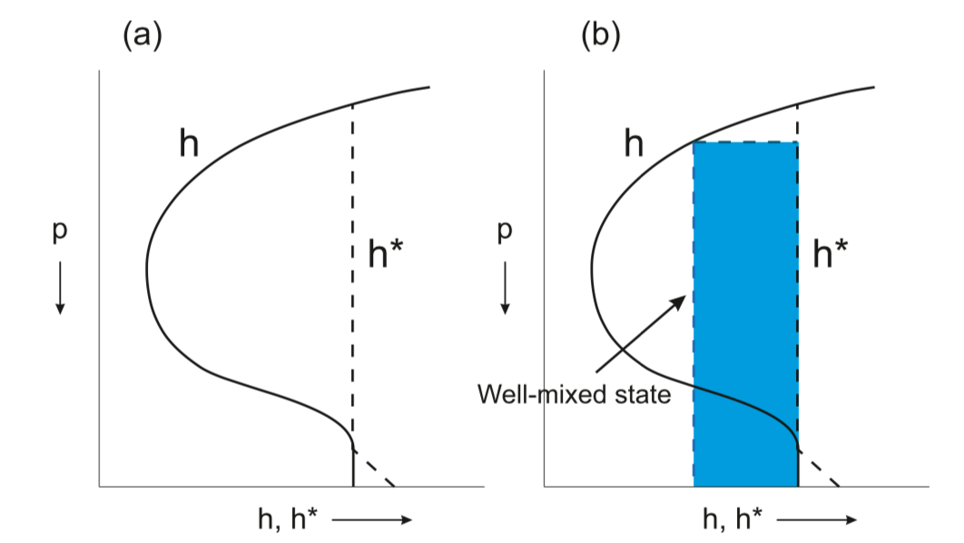
Routes to moistening a column
Column-integrated MSE
Emanuel (2018)
Route 2: Addition of energy into the column
Route 3: Decrease of MSE is possible without WTG limit (column cools)
Route 1: convective mixing → column cooling
WTG assumption
Notes:
. The core assumption behind this route is the WTG assumption, as adding any form of energy into the column, rising motion help saturate the parcels.

Slide 8
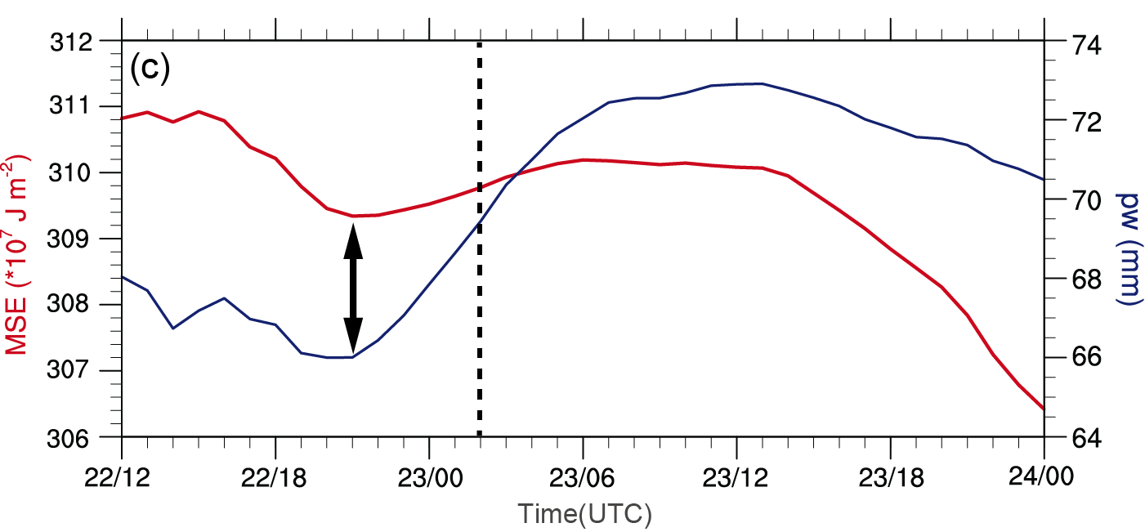
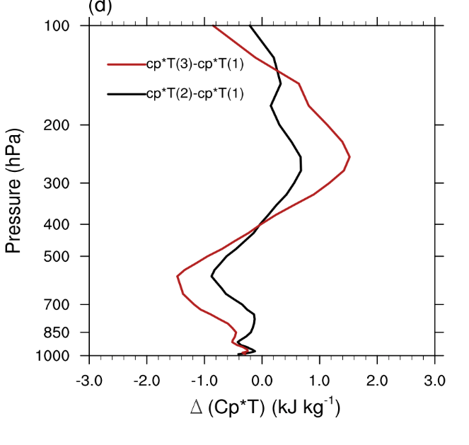
Thermodynamic state evolution of Vicente
Stage 1: column-integrated MSE decreases, less efficient moistening above 700 hPa.
Stage 2: column-integrated MSE increases, more efficient moistening above 900 hPa.
Cooling
more qv and cooling
Stage 1
Stage 2
RI onset
1
2
3
3
2
1
Net cooling
Cool down

Slide 9
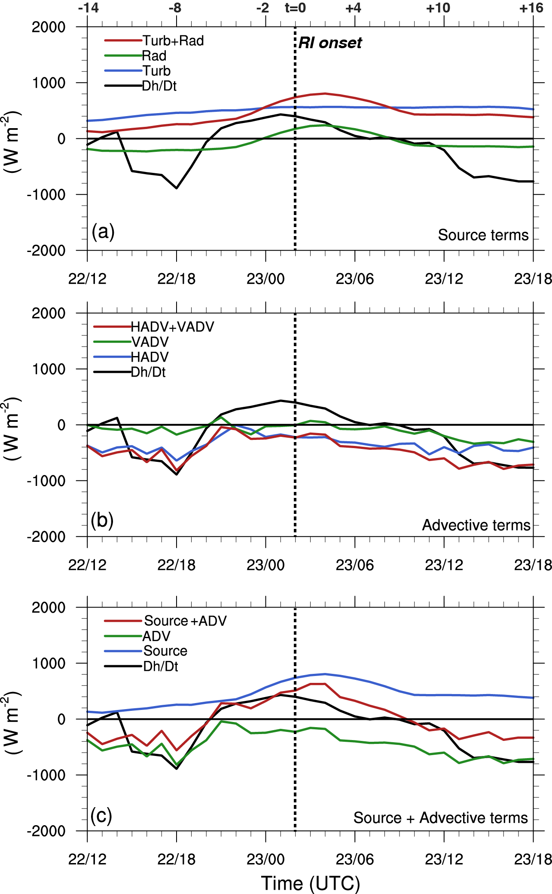
Column-integrated MSE budget
Column-integrated MSE
Surface heat flux
sunrise
Longwave cooling
Solar shortwave heating
HADV (ventilation)
The column cannot accumulate energy until the ventilation weakens.

Slide 10
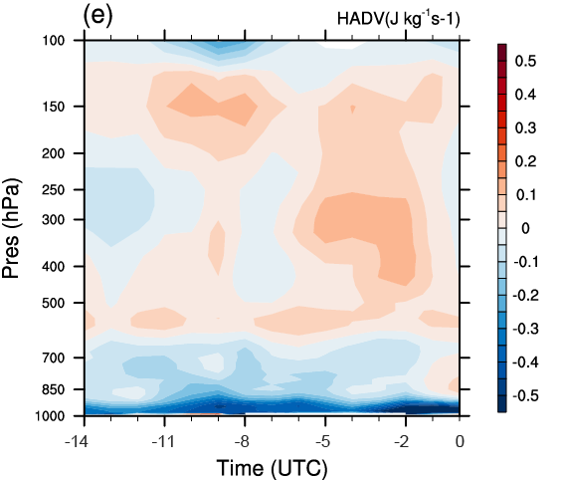
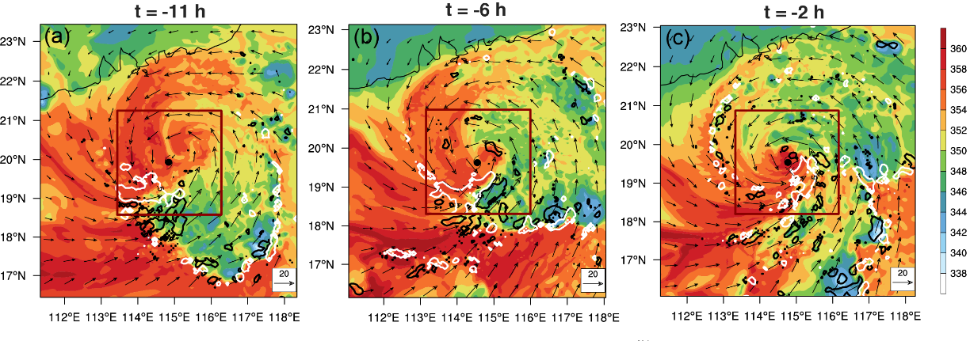
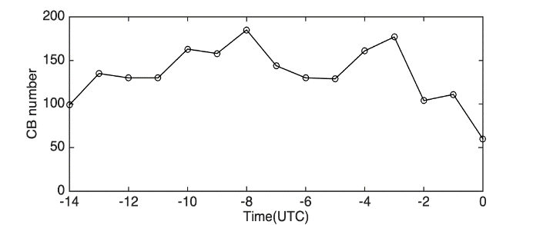
HADV term
Stage 1
MSE -
Stage 2
MSE +
Lowest level MSE
Shading: MSE (kJ kg^{–1} )
White contour: 0.5 m s⁻¹ at 2-km height (convective rainband)
Black contour: –0.2 m s^{–1} at 1-km height (downdraft at the top of PBL)
RI
Low-level ventilation (Riemer et al. 2010) correlates to the convective activity.
CB number
RH within 700-900 hPa increases only in stage 2, as ventilation in this layer weakens.

Slide 11
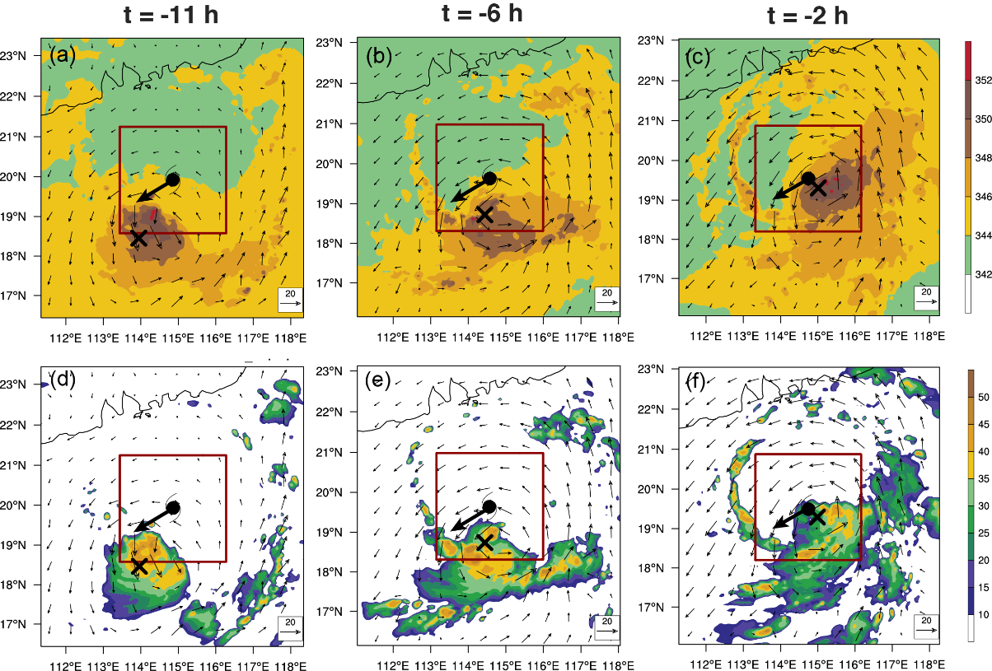
HADV term
Stage 1
MSE -
Stage 2
MSE +
300-hPa MSE
300-hPa Ref
RI
Upper-level ventilation weakens as vortex aligns
RH above 700 hPa increases more notably in stage 2 than in stage 1.

Slide 12
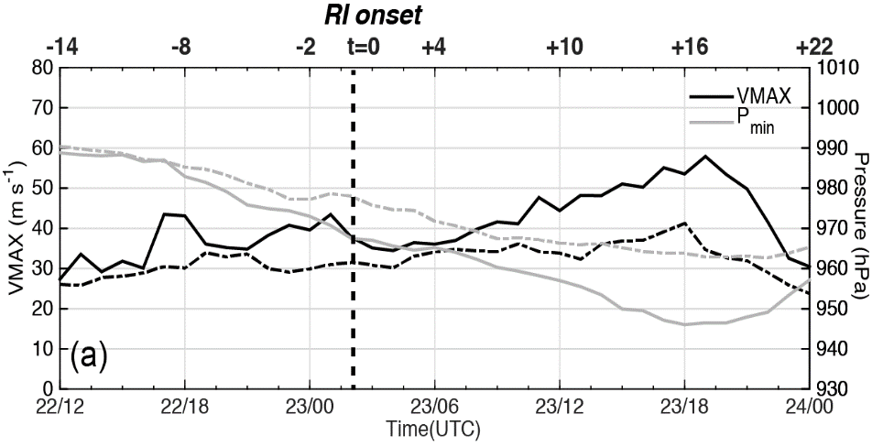
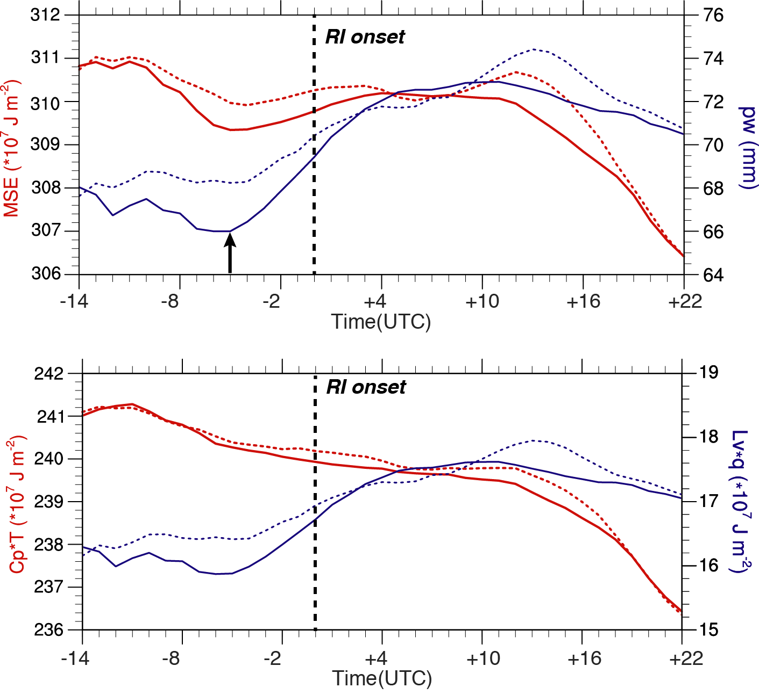
RI & null (SI) experiments
Solid: RI
Dashed: null
Increase in the column-integrated MSE in a necessary, but not sufficient, condition for the RI occurrence (Juracic and Raymond 2016)
The mean column T is cooler for the RI case

Slide 13
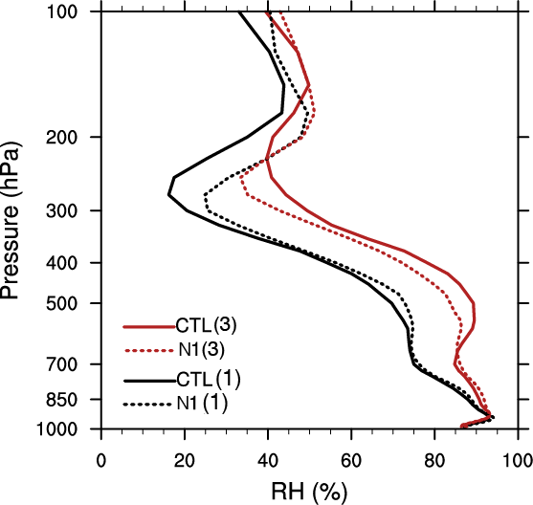
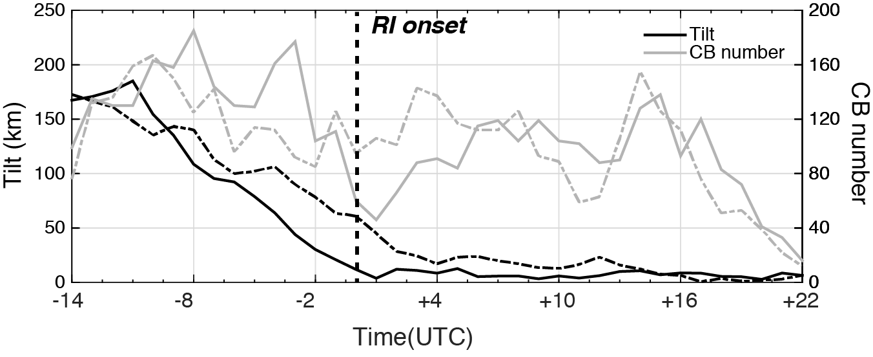
RI & null (SI) experiments
RI TC
Smaller vortex tilt (weaker subsidence warming)
More CBs (convective mixing cooling)
Cooler T, larger RH
The differences in the vortex structure/alignment can help differentiate the RI and slow intensification (SI) cases.

Slide 14
Summary
The nearly saturated lower-middle troposphere in the inner core region precedes the tropical cyclone (TC) rapid intensification in shear.
The moistening of the inner-core region is governed by a competition between surface heat fluxes, radiation, and ventilation effects.
The sign of the column-integrated MSE tendency is largely determined by the ventilation effect.
Vortex structure/alignment impacts the adjustment of thermodynamic state under vertical wind shear.
  It benefits the moistening of the TC inner core by reducing ventilation effects.
  It help differentiate the RI and SI cases: RI TC is characterized by cooler column T and higher RH in the inner-core region.

