Slide 1
A Characterization of Turbulent Kinetic Energy and its Generation in Idealized Tropical Cyclone Simulations
Joshua Wadler
Co-authors: Jun Zhang, Nick Shay, and Dave Nolan
HRD Science Meeting: August 9, 2018

Slide 2
Motivation
Our measurements of turbulent kinetic energy (TKE) in tropical cyclones are limited, with no direct measurements of TKE in the inner-core or precipitating regions of TCs

Slide 3
Motivation
Our measurements of turbulent kinetic energy (TKE) in tropical cyclones are limited, with no direct measurements of TKE in the inner-core or precipitating regions of TCs
The CBLAST experiment was the last major research initiative to obtain turbulence measurements, in which we were able to get the first direct measurements of boundary layer turbulence (Black et al. 2007; French et al. 2007; Drennan et al. 2007; Zhang et al. 2008, 2009)

Slide 4
Motivation
Our measurements of turbulent kinetic energy (TKE) in tropical cyclones are limited, with no direct measurements of TKE in the inner-core or precipitating regions of TCs
The CBLAST experiment was the last major research initiative to obtain turbulence measurements, in which we were able to get the first direct measurements of boundary layer turbulence (Black et al. 2007; French et al. 2007; Drennan et al. 2007; Zhang et al. 2008, 2009)
To supplement the direct methods, the TKE has also been estimated indirectly.
Using flight level data in Hurricanes Allen (1980) and Hugo (1989), Zhang et al. (2011) estimated the TKE and momentum flux
Using Doppler radar analyses, Lorsolo et al. (2010) estimated the TKE in several hurricanes.
Zhu (2008), using a large eddy simulation of Hurricane Ivan, showed that these indirect methods may underestimate boundary layer TKE. However, the large eddy simulation from Zhu (2008) was over land

Slide 5
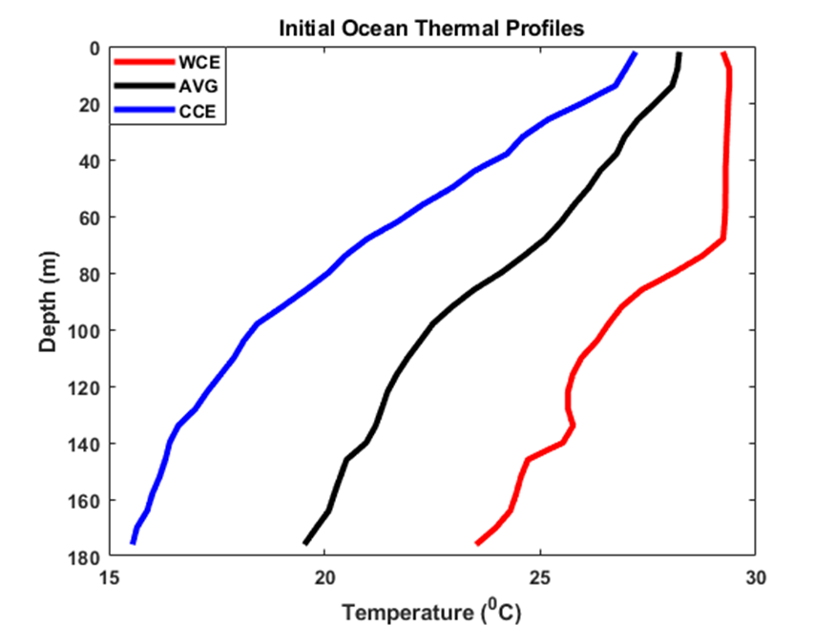
Model Setup
Idealized simulations using the method of point-downscaling (Nolan et al. 2011) in WRF v3.9.1.1
40 vertical eta levels on 4 domains (27 km, 9 km, 3 km, 1 km) with time steps (60 sec, 20 sec, 6.67 sec, 3.33 sec) run for 6 days
Uniform atmospheric sounding – Jordan (1958), on an f-plane (20 N) with constant 5 m/s shear
No longwave or shortwave radiation
Cumulus parameterization (27 km domain only) is Kain–Fritsch Scheme (Kain 2004)
Microphysics scheme is WRF single moment class 5 scheme (Hong et al.2004)
Surface layer parameterization is based off of MM5 Monin-Obukhov similarity scheme (Paulson 1970; Dyer and Hicks 1970; Beljaars 1994) with a drag coefficient that levels off at higher wind speeds (e.g. Powell et al. 2003; Donelan et al. 2004)
Ocean model is the 3-D Price-Weller Pinkel (Price 1981; Price et al. 1994) ocean mixed layer model that is initialized with a horizontally uniform profile
3 oceans (warm-core eddy (WCE), cold-core eddy (CCE), average between them (AVG)

Slide 6
Model Setup
Boundary layer scheme is Mellor-Yamada-Nakanishi-Niino (MYNN) level 2.5 TKE scheme which explicitly solves the 1-D TKE equation
Less common boundary layer scheme than MYJ, YSU
Compared to MYJ, the coefficients in the MYNN scheme are tuned to output from LES, which allows it to perform better over a wide range of stability regimes (Nakanishi and Niino 2009).
Allow for an output of TKE, and all of the budget terms in the 1-D TKE Equation
Allows for TKE advection to be turned on (-WA) or turned off (-NA) – rare in WRF boundary layer schemes
Has been shown to produce reasonable boundary layer structure (Green and Zhang 2014)
Struggles to produce eyewall mesovorticies (Zhu et al. 2008), similar to the MYJ scheme (Nolan et al. 2009a,b)
Change in TKE
Vertical turbulent transport
Shear generation
Buoyancy
Dissipation
Red = warm ocean
Blue = cold ocean
Validation of model output of TKE at the hourly RMW, against the flight level estimates obtained in Zhang et al. (2011)

Slide 7
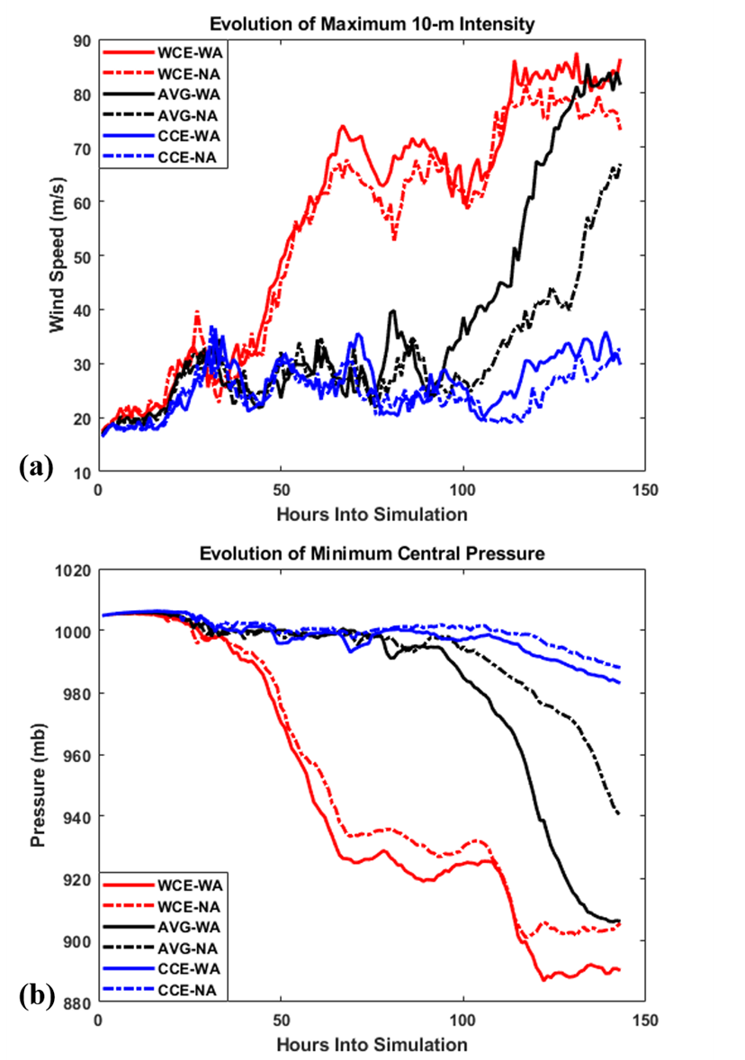
Axisymmetric Results
Solid lines are simulations that INCLUDE TKE advection
Dashed lines are simulations that DO NOT INCLUDE TKE advection
Red = warm ocean
Blue = cold ocean
Black = average ocean

Slide 8
Axisymmetric Results
Unsurprisingly, warmer oceans lead to greater intensities
Solid lines are simulations that INCLUDE TKE advection
Dashed lines are simulations that DO NOT INCLUDE TKE advection
Red = warm ocean
Blue = cold ocean
Black = average ocean

Slide 9
Axisymmetric Results
Unsurprisingly, warmer oceans lead to greater intensities
The steady-state intensities are greater in the simulations that include TKE advection. They also have lower central pressures
Solid lines are simulations that INCLUDE TKE advection
Dashed lines are simulations that DO NOT INCLUDE TKE advection
Red = warm ocean
Blue = cold ocean
Black = average ocean

Slide 10
Axisymmetric Results
Unsurprisingly, warmer oceans lead to greater intensities
The steady-state intensities are greater in the simulations that include TKE advection. They also have lower central pressures
The warm and cold oceans reach steady state intensities by the end of the simulations – they are the focus of the rest of the analysis.
Solid lines are simulations that INCLUDE TKE advection
Dashed lines are simulations that DO NOT INCLUDE TKE advection
Red = warm ocean
Blue = cold ocean
Black = average ocean

Slide 11
Mean Vortex Structure – Averaged Over Last 24 hours
With TKE advection
No TKE advection
Shading is TKE
Black lines are tangential wind
Gray lines are vertical velocity (solid = positive; dashed = negative)
White lines are radial wind (dashed= inflow, solid =outflow)
Notes:
In (a) and (b) the contour interval is 10 m2 s-2 for TKE, 10 m s-1 for tangential wind, 5 m s-1 for radial wind and 2 m s-1 for vertical velocity. In (c) and (d) the contour interval is 1 m2 s-2 for TKE, 5 m s-1 for tangential wind, 2 m s-1 for radial wind, and 0.1 m s-1 for vertical velocity.

Slide 12
Mean Vortex Structure – Averaged Over Last 24 hours
With TKE advection
No TKE advection
Maximum TKE is slightly larger when TKE advection is included
Shading is TKE
Black lines are tangential wind
Gray lines are vertical velocity (solid = positive; dashed = negative)
White lines are radial wind (dashed= inflow, solid =outflow)
Notes:
In (a) and (b) the contour interval is 10 m2 s-2 for TKE, 10 m s-1 for tangential wind, 5 m s-1 for radial wind and 2 m s-1 for vertical velocity. In (c) and (d) the contour interval is 1 m2 s-2 for TKE, 5 m s-1 for tangential wind, 2 m s-1 for radial wind, and 0.1 m s-1 for vertical velocity.

Slide 13
Mean Vortex Structure – Averaged Over Last 24 hours
With TKE advection
No TKE advection
Maximum TKE is slightly larger when TKE advection is included
Largest difference in the TKE is in the eyewall (above 3 km) – much larger vertical extent when TKE is included.
Shading is TKE
Black lines are tangential wind
Gray lines are vertical velocity (solid = positive; dashed = negative)
White lines are radial wind (dashed= inflow, solid =outflow)
Notes:
In (a) and (b) the contour interval is 10 m2 s-2 for TKE, 10 m s-1 for tangential wind, 5 m s-1 for radial wind and 2 m s-1 for vertical velocity. In (c) and (d) the contour interval is 1 m2 s-2 for TKE, 5 m s-1 for tangential wind, 2 m s-1 for radial wind, and 0.1 m s-1 for vertical velocity.

Slide 14
Mean Vortex Structure – Averaged Over Last 24 hours
With TKE advection
No TKE advection
Maximum TKE is slightly larger when TKE advection is included
Largest difference in the TKE is in the eyewall (above 3 km) – much larger vertical extent when TKE is included.
No difference in TKE in the inflow layer
Shading is TKE
Black lines are tangential wind
Gray lines are vertical velocity (solid = positive; dashed = negative)
White lines are radial wind (dashed= inflow, solid =outflow)
Notes:
In (a) and (b) the contour interval is 10 m2 s-2 for TKE, 10 m s-1 for tangential wind, 5 m s-1 for radial wind and 2 m s-1 for vertical velocity. In (c) and (d) the contour interval is 1 m2 s-2 for TKE, 5 m s-1 for tangential wind, 2 m s-1 for radial wind, and 0.1 m s-1 for vertical velocity.

Slide 15
Mean Vortex Structure – Averaged Over Last 24 hours
With TKE advection
No TKE advection
Maximum TKE is slightly larger when TKE advection is included
Largest difference in the TKE is in the eyewall (above 3 km) – much larger vertical extent when TKE is included.
No difference in TKE in the inflow layer
Similar wind field distribution
Shading is TKE
Black lines are tangential wind
Gray lines are vertical velocity (solid = positive; dashed = negative)
White lines are radial wind (dashed= inflow, solid =outflow)
Notes:
In (a) and (b) the contour interval is 10 m2 s-2 for TKE, 10 m s-1 for tangential wind, 5 m s-1 for radial wind and 2 m s-1 for vertical velocity. In (c) and (d) the contour interval is 1 m2 s-2 for TKE, 5 m s-1 for tangential wind, 2 m s-1 for radial wind, and 0.1 m s-1 for vertical velocity.

Slide 16
Mean Vortex Structure – Averaged Over Last 24 hours
With TKE advection
No TKE advection
Maximum TKE is slightly larger when TKE advection is included
Largest difference in the TKE is in the eyewall – much larger vertical extent when TKE is included.
No difference in TKE in the inflow layer
Similar wind field distribution
Shading is TKE
Black lines are tangential wind
Gray lines are vertical velocity (solid = positive; dashed = negative)
White lines are radial wind (dashed= inflow, solid =outflow)
Notes:
In (a) and (b) the contour interval is 10 m2 s-2 for TKE, 10 m s-1 for tangential wind, 5 m s-1 for radial wind and 2 m s-1 for vertical velocity. In (c) and (d) the contour interval is 1 m2 s-2 for TKE, 5 m s-1 for tangential wind, 2 m s-1 for radial wind, and 0.1 m s-1 for vertical velocity.

Slide 17
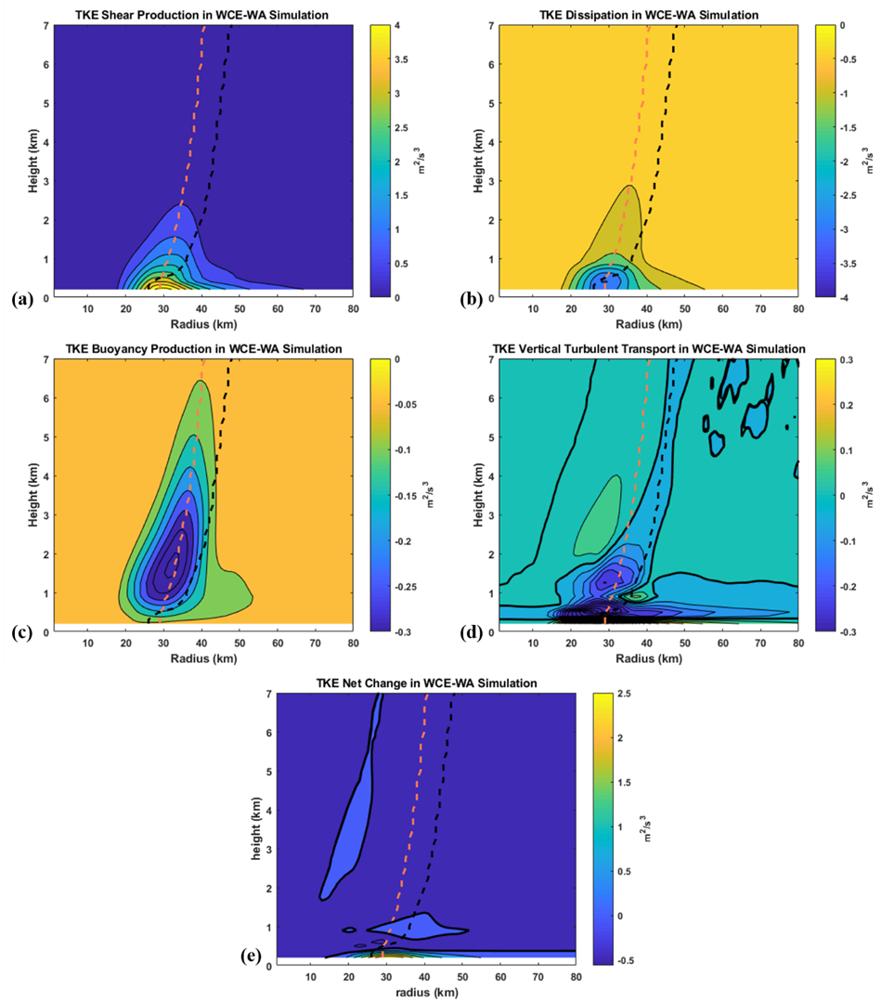
TKE Budget – Averaged Over Last 24 hours
shear
dissipation
Warm ocean – with TKE advection
Black dashed line –RMW
Orange dashed line- maximum TKE axis
Note the colorbars are an order of magnitude different between the top and bottom plots
buoyancy
Vertical transport

Slide 18
TKE Budget – Averaged Over Last 24 hours
Shear generation and dissipation are an order of magnitude larger than the other terms
shear
dissipation
Warm ocean – with TKE advection
Black dashed line –RMW
Orange dashed line- maximum TKE axis
Note the colorbars are an order of magnitude different between the top and bottom plots
buoyancy
Vertical transport
Notes:
In (a) and (b) the contour interval is 10 m2 s-2 for TKE, 10 m s-1 for tangential wind, 5 m s-1 for radial wind and 2 m s-1 for vertical velocity. In (c) and (d) the contour interval is 1 m2 s-2 for TKE, 5 m s-1 for tangential wind, 2 m s-1 for radial wind, and 0.1 m s-1 for vertical velocity.

Slide 19
TKE Budget – Averaged Over Last 24 hours
Shear generation and dissipation are an order of magnitude larger than the other terms
Buoyancy always destructs TKE advection
shear
dissipation
Warm ocean – with TKE advection
Black dashed line –RMW
Orange dashed line- maximum TKE axis
Note the colorbars are an order of magnitude different between the top and bottom plots
buoyancy
Vertical transport
Notes:
In (a) and (b) the contour interval is 10 m2 s-2 for TKE, 10 m s-1 for tangential wind, 5 m s-1 for radial wind and 2 m s-1 for vertical velocity. In (c) and (d) the contour interval is 1 m2 s-2 for TKE, 5 m s-1 for tangential wind, 2 m s-1 for radial wind, and 0.1 m s-1 for vertical velocity.

Slide 20
TKE Budget– Averaged Over Last 24 hours
Shear generation and dissipation are an order of magnitude larger than the other terms
Buoyancy always destructs TKE advection
Vertical transport is positive below 500 m and negative below
shear
dissipation
Warm ocean – with TKE advection
Black dashed line –RMW
Orange dashed line- maximum TKE axis
Note the colorbars are an order of magnitude different between the top and bottom plots
buoyancy
Vertical transport

Slide 21
TKE Budget – Averaged Over Last 24 hours
Shear generation and dissipation are an order of magnitude larger than the other terms
Buoyancy always destructs TKE advection
Vertical transport is positive below 500 m and negative below
Almost all terms are maximized along TKE axis
shear
dissipation
Warm ocean – with TKE advection
Black dashed line –RMW
Orange dashed line- maximum TKE axis
Note the colorbars are an order of magnitude different between the top and bottom plots
buoyancy
Vertical transport

Slide 22
TKE Budget – Averaged Over Last 24 hours
Warm ocean – with TKE advection
Black dashed line –RMW
Orange dashed line- maximum TKE axis
This is not the change in TKE from the model output, since that was not necessarily the sum of all the other terms (Joseph Olsen, personal communication)

Slide 23
TKE Budget – Averaged Over Last 24 hours
Warm ocean – with TKE advection
Black dashed line –RMW
Orange dashed line- maximum TKE axis
This is not the change in TKE from the model output, since that was not necessarily the sum of all the other terms (Joseph Olsen, personal communication)
Positive TKE production below 700 m at all radii
Negative TKE production ~ 1 –km n the eyewall, and near negligible elsewhere

Slide 24
Eyewall TKE Budget
Mean + 2 standard errors (shaded) of each of the budget terms, centered on the 500 m RMW and averaged 5 km radially inward and outward

Slide 25
Eyewall TKE Budget
Mean + 2 standard errors (shaded) of each of the budget terms, centered on the 500 m RMW and averaged 5 km radially inward and outward
Positive TKE production below 500 m, and at ~ 1 km altitude.

Slide 26
Eyewall TKE Budget
Mean + 2 standard errors (shaded) of each of the budget terms, centered on the 500 m RMW and averaged 5 km radially inward and outward
Positive TKE production below 500 m, and at ~ 1 km altitude.
Variations in net TKE generation are mainly driven by (shear-dissipation) and vertical turbulent transport

Slide 27
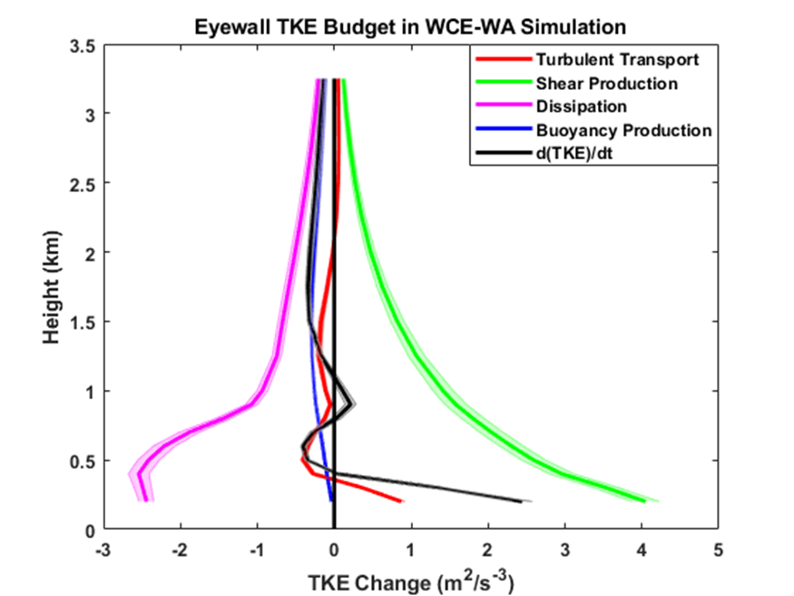
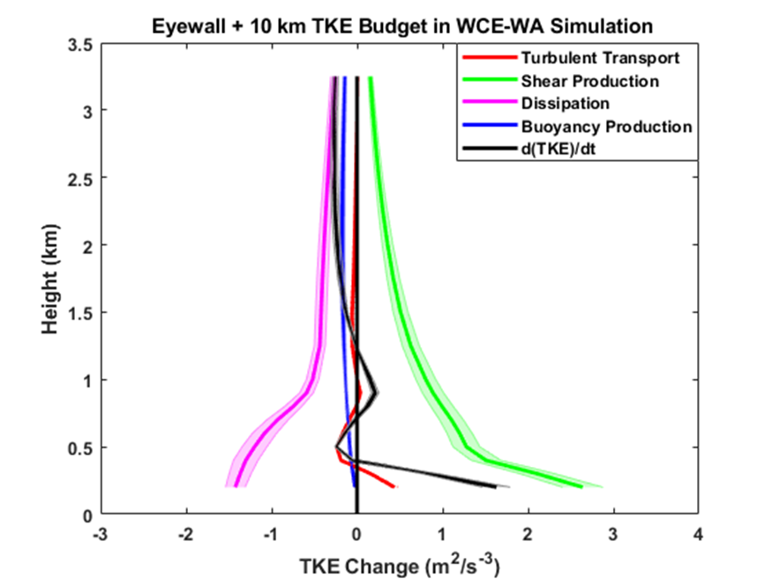
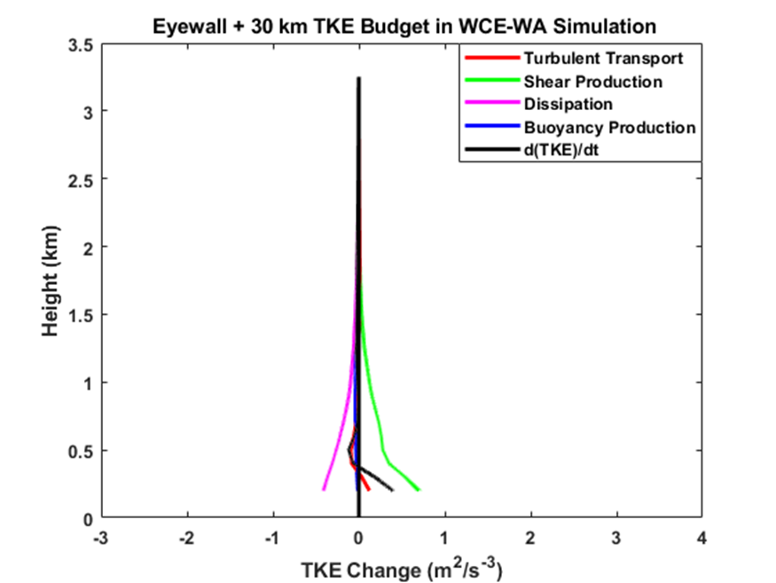
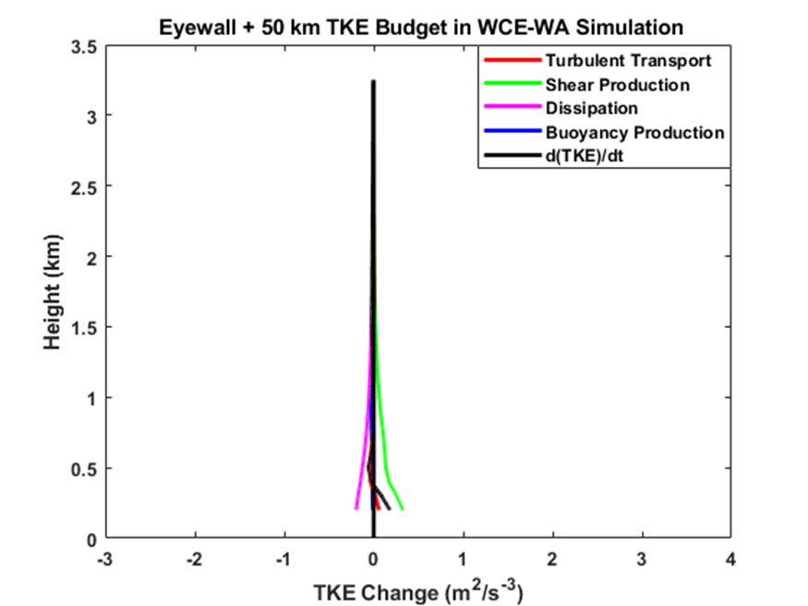
TKE Budget with Radius
At 10-km away from the RMW, the net TKE generation decreased by ~ 25 percent
eyewall
eyewall+10 km
eyewall+30 km
eyewall+50 km

Slide 28
TKE Budget with Radius
At 10-km away from the RMW, the net TKE generation decreased by ~ 25 percent
At 30 and 50-km away from RMW, the terms continually decrease by ~ 50 %
eyewall
eyewall+10 km
eyewall+30 km
eyewall+50 km

Slide 29
TKE Budget with Radius
At 10-km away from the RMW, the net TKE generation decreased by ~ 25 percent
At 30 and 50-km away from RMW, the terms continually decrease by ~ 50 %
Even so, the general relationships between the variables remain constant. – this was consistent in all the simulations
eyewall
eyewall+10 km
eyewall+30 km
eyewall+50 km

Slide 30
Summary
In the MYNN boundary layer parameterization
TKE advection affects the vertical distribution of TKE in the eyewall and the strength of the TC
No relationship to the wind field
Maximum TKE was ~ 700 m altitude in Category 5 simulations and ~ 400 m in Tropical Strom Simulations
TKE Budget
The shear and dissipation terms are an order of magnitude larger than the vertical turbulent transport and buoyancy term.
Variations in net TKE production with height are related to vertical turbulent transport
The relative roles of the TKE budget terms are near-constant with radius.
Implications/Future Work
Targeted turbulence observations using unmanned aircraft
The turbulence asymmetries are related to SST cooling/ affects height of maximum TKE
Other boundary layer schemes? TKE evolution of a specific phenomena (e.g. convection)?

Slide 31
Extra Slides

Slide 32
Composite TKE from Doppler radar in Lorsolo et al. (2010)

Slide 33
TKE Budget Using CBLAST data in Zhang et al. (2009)

Slide 34
TKE Budget in Zhu (2008) LES of Hurricane Ivan

Slide 35
Eyewall TKE Budget in all Simulations

Slide 36
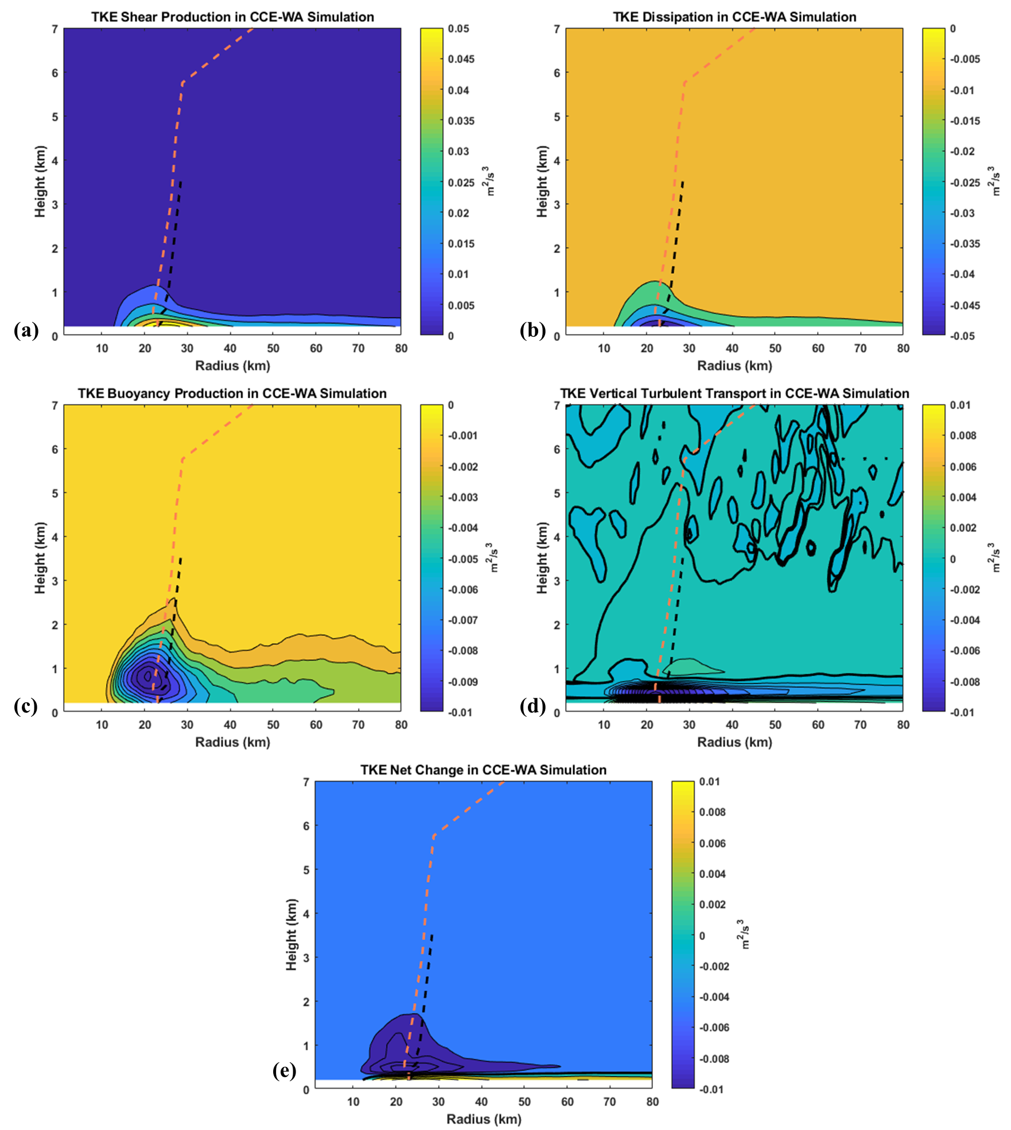
TKE Budget for CCE-WA simulation

Slide 37
Thermal Differences Between Simulations

Slide 38
TKE By Quadrant

