Slide 1




The Basin-Scale HWRF:
2018 HFIP Real-Time Demos
Ghassan J. Alaka^{1,2}
Jonathan Poterjoy^{2,3}, Xuejin Zhang^{1,2}, Gopal², Frank Marks², Mu-Chieh Ko^{1,2}, Russell St. Fleur^{1,2}
Collaborators: NOAA/EMC, DTC
¹Cooperative Institute for Marine and Atmospheric Studies, University of Miami ²NOAA/AOML/Hurricane Research Division
³University of Maryland
08 August 2018 HFIP Bi-Weekly Telecon 1

Slide 2
What is Basin-Scale HWRF (HWRF-B)?
An experimental version of the community HWRF developed at NOAA/AOML/HRD in collaboration with NOAA/NWS/EMC and DTC, uniquely configured to serve as a testbed for the improvement of HWRF forecasts.
Primary Objectives:
To improve TC guidance available for NOAA/NWS/NHC
To establish a framework for TC forecasts in FV3
To study TC-TC, TC-land, and TC-environment interactions
To explore new data assimilation & ensemble capacities
To extend TC forecasts to 7 days
To improve TC genesis guidance
08 August 2018 HFIP Bi-Weekly Telecon 2

Slide 3

Motivation: R2O for HWRF
AOML/HRD has transitioned the following research-to-operations projects for HWRF:
Addition of 3rd high-resolution moving nest
Updated vertical eddy diffusivity based on observations
More frequent physics calls during model integration
Basin-Scale HWRF now in community HWRF trunk (DTC)
HWRF forecast improvements can be linked to these R2O efforts
Schematic showing movement of HWRF nests
08 August 2018 HFIP Bi-Weekly Telecon 3

Slide 4
Project 1
“Traditional” Basin-Scale HWRF
(HWRF-B)
08 August 2018 HFIP Bi-Weekly Telecon 4

Slide 5
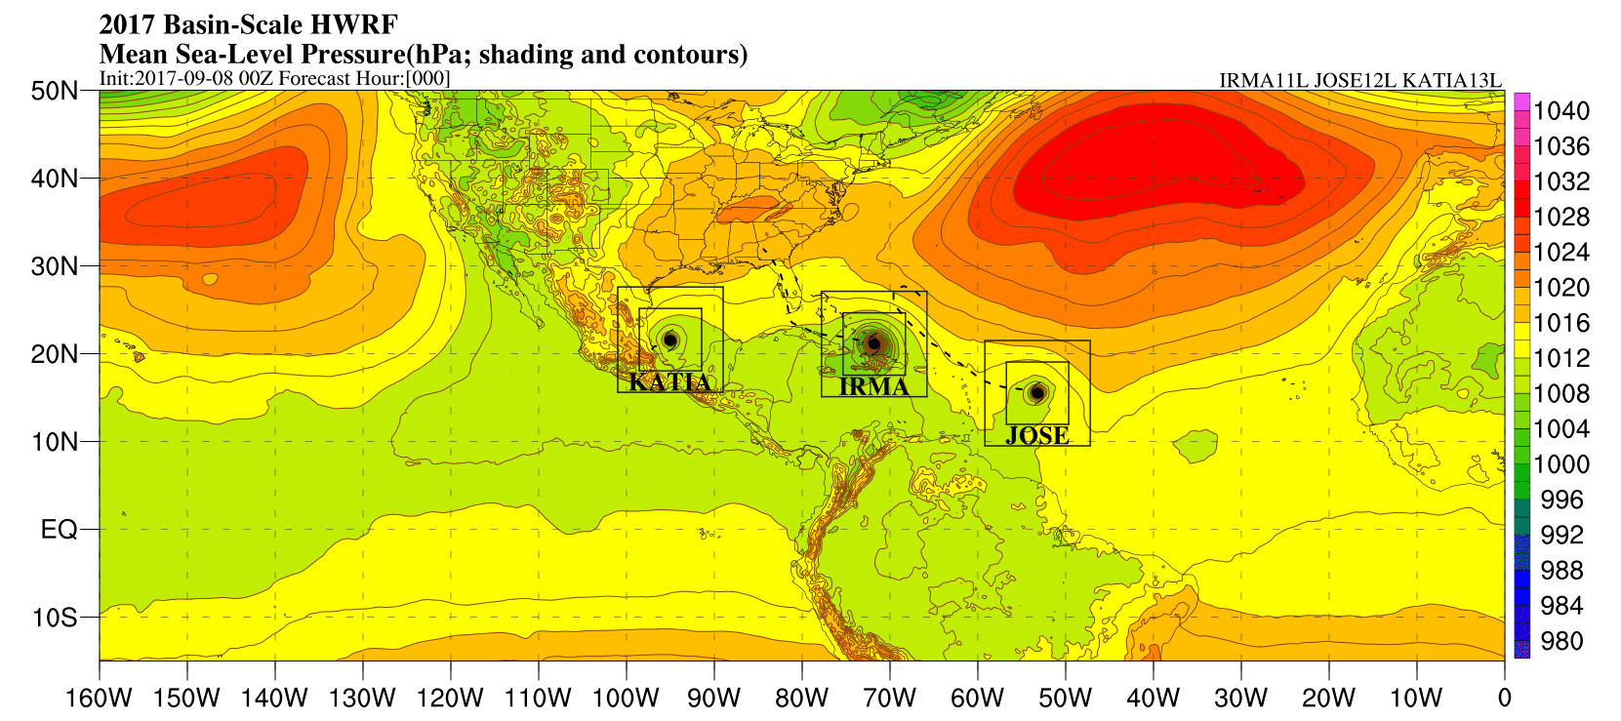
A busy day in the tropics…
08 August 2018 HFIP Bi-Weekly Telecon 5

Slide 6
HWRF-B Configuration Options
HB18 = 2018 Basin-Scale HWRF
H218 = 2018 Operational HWRF
Most configuration options are identical
  Dynamical core
  All physics
  vertical resolution (75 levels)
  13.5/4.5/1.5 km horizontal resolution (new in 2018)
Key configuration differences for HB18:
  Outermost domain size
    Spans Atlantic & E. Pacific basins
  Multi-storm
    Up to 3 this year (resource dependent)
  Data assimilation
    No TDR ensemble
  Ocean coupling
    Coupled for D01 only (new in 2018)
Configuration Options | HB18 | H218
Domain | 13.5 km: 194.0° x 84.2° 4.5 km: 17.8° x 17.8° 1.5 km: 5.9° x 5.9° | 13.5 km: 77.2° x 77.2° 4.5 km: 17.8° x 17.8° 1.5 km: 5.9° x 5.9°
Model Top | 10 hPa | 10 hPa
Vertical Levels | 75 | 75
Vortex Init. | at 1.5 km | At 1.5 km
Data Assimilation | Hybrid DA | Hybrid DA & TDR Ensemble
Ocean Coupling | 13.5 km: YES (POM) 4.5 km: Downscaled 1.5 km: Downscaled | 13.5 km: YES (POM) 4.5 km: YES (POM) 1.5 km: Downscaled
Multi-Storm | YES (up to 3) | NO
PHYSICS SCHEMES
Microphysics | Ferrier-Aligo | Ferrier-Aligo
Radiation (LW,SW) | RRTMG | RRTMG
Surface Layer | GFDL | GFDL
PBL | GFS Hybrid-EDMF | GFS Hybrid-EDMF
Convection | Scale-Aware SAS | Scale-Aware SAS
Land Surface | Noah LSM | Noah LSM
08 August 2018 HFIP Bi-Weekly Telecon 6

Slide 7
HWRF-B Configuration Options
HB18 = 2018 Basin-Scale HWRF
H218 = 2018 Operational HWRF
Most configuration options are identical
  Dynamical core
  All physics
  vertical resolution (75 levels)
  13.5/4.5/1.5 km horizontal resolution (new in 2018)
Key configuration differences for HB18:
  Outermost domain size
    Spans Atlantic & E. Pacific basins
  Multi-storm
    Up to 3 this year (resource dependent)
  Data assimilation
    No TDR ensemble
  Ocean coupling
    Coupled for D01 only (new in 2018)
Alaka et al. 2017
08 August 2018 HFIP Bi-Weekly Telecon 7

Slide 8
Parallel Moving Nests in HWRF-B
D01
How do multiple TCs interact in HWRF-B?
Parallel TC 1
Parallel TC 2
D02
D04
D03
D05
2-storm schematic
Multiple TCs will interact with one another via the parent domain (D01)
Two-way interaction
TC1 ←→ D01 ←→ TC2
08 August 2018 HFIP Bi-Weekly Telecon 8

Slide 9
Parallel Moving Nests in HWRF-B
D01
How do multiple TCs interact in HWRF-B?
Same holds true even if nests overlap!
Parallel TC 1
D02
D03
TC1 ←→ D01 ←→ TC2
2-storm schematic
Parallel TC 2
D04
D05
Two-way interaction
08 August 2018 HFIP Bi-Weekly Telecon 9

Slide 10
Project 2
HWRF Cycled Data Assimilation & Ensemble Prediction System
(HWRF-C)
08 August 2018 HFIP Bi-Weekly Telecon 10

Slide 11
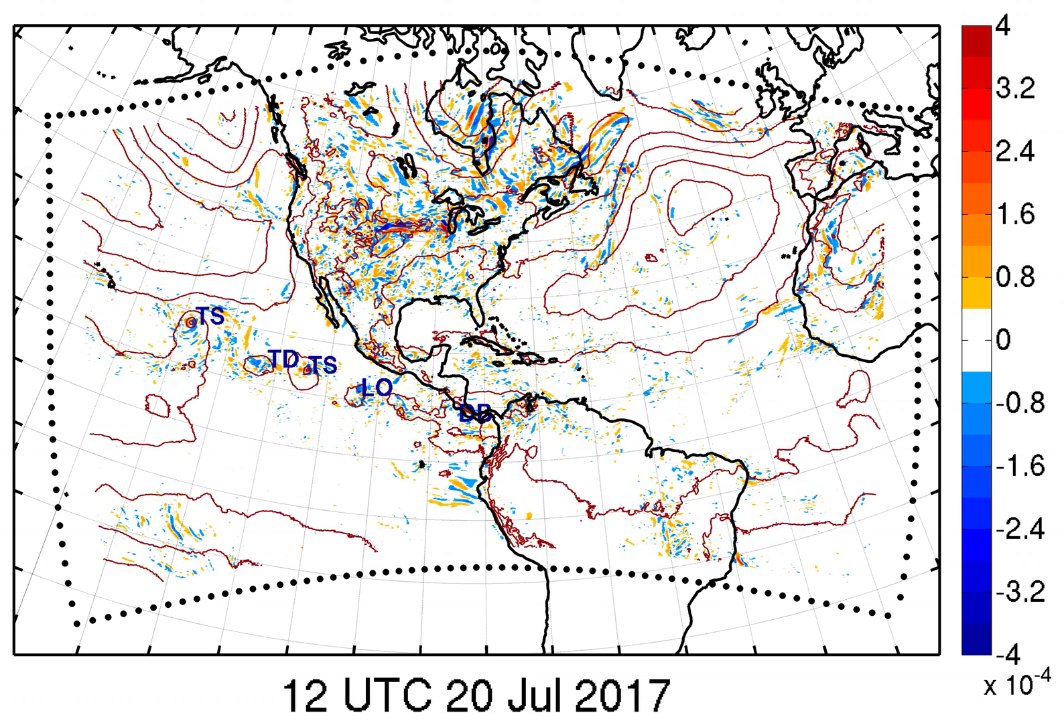
The Basics of Cycling HWRF
Objective:
Provide probabilistic predictions for tropical cyclone activity over the Atlantic and Pacific basins
Configuration:
D01 from HWRF-B at 13.5 km
EnKF data assimilation
  60-member ensemble
Conventional and radiance obs assimilated every 6 h
Ensemble forecasts:
  10-members, 4x daily
  180-h integration
Cycled DA for HWRF was run as an HFIP demo in 2017:
Single EnKF Member
MSLP (red lines), 850-mb vorticity increments
08 August 2018 HFIP Bi-Weekly Telecon 11

Slide 12
HWRF-C Workflow
Data Assimilation Step:
EnKF updates HWRF ensemble members and radiance bias correction coefficients for next cycle.
Ensemble Forecast Step:
A 6-h HWRF forecast runs from each EnKF member using GFS surface and lateral boundary conditions.
Prior member 1
Observations
HWRF
Post member 1
Prior member 1
Prior member 2
Post member 2
HWRF
Prior member 2
…
…
…
…
…
…
EnKF
Prior member 60
Post member 60
HWRF
Prior member 60
Radiance bias correction coefficients
Radiance bias correction coefficients
Radiance bias correction coefficients
08 August 2018 HFIP Bi-Weekly Telecon 12

Slide 13
The Basics of Cycling HWRF
Benefits:
Built into the operational HWRF framework.
No dependence on GFS for initial conditions and radiance bias correction, thus allowing for a more vigorous verification of the HWRF model and potential physics upgrades.
Introduces a platform for satellite DA research that transitions seamlessly into community packages used by operational models.
Provides continuous guidance for genesis forecasting.
Emphasizes probabilistic multi-scale DA and forecasting – similar to future global NWP systems like FV3.
08 August 2018 HFIP Bi-Weekly Telecon 13

Slide 14
Applications
Post-processing & Web Site
08 August 2018 HFIP Bi-Weekly Telecon 14

Slide 15
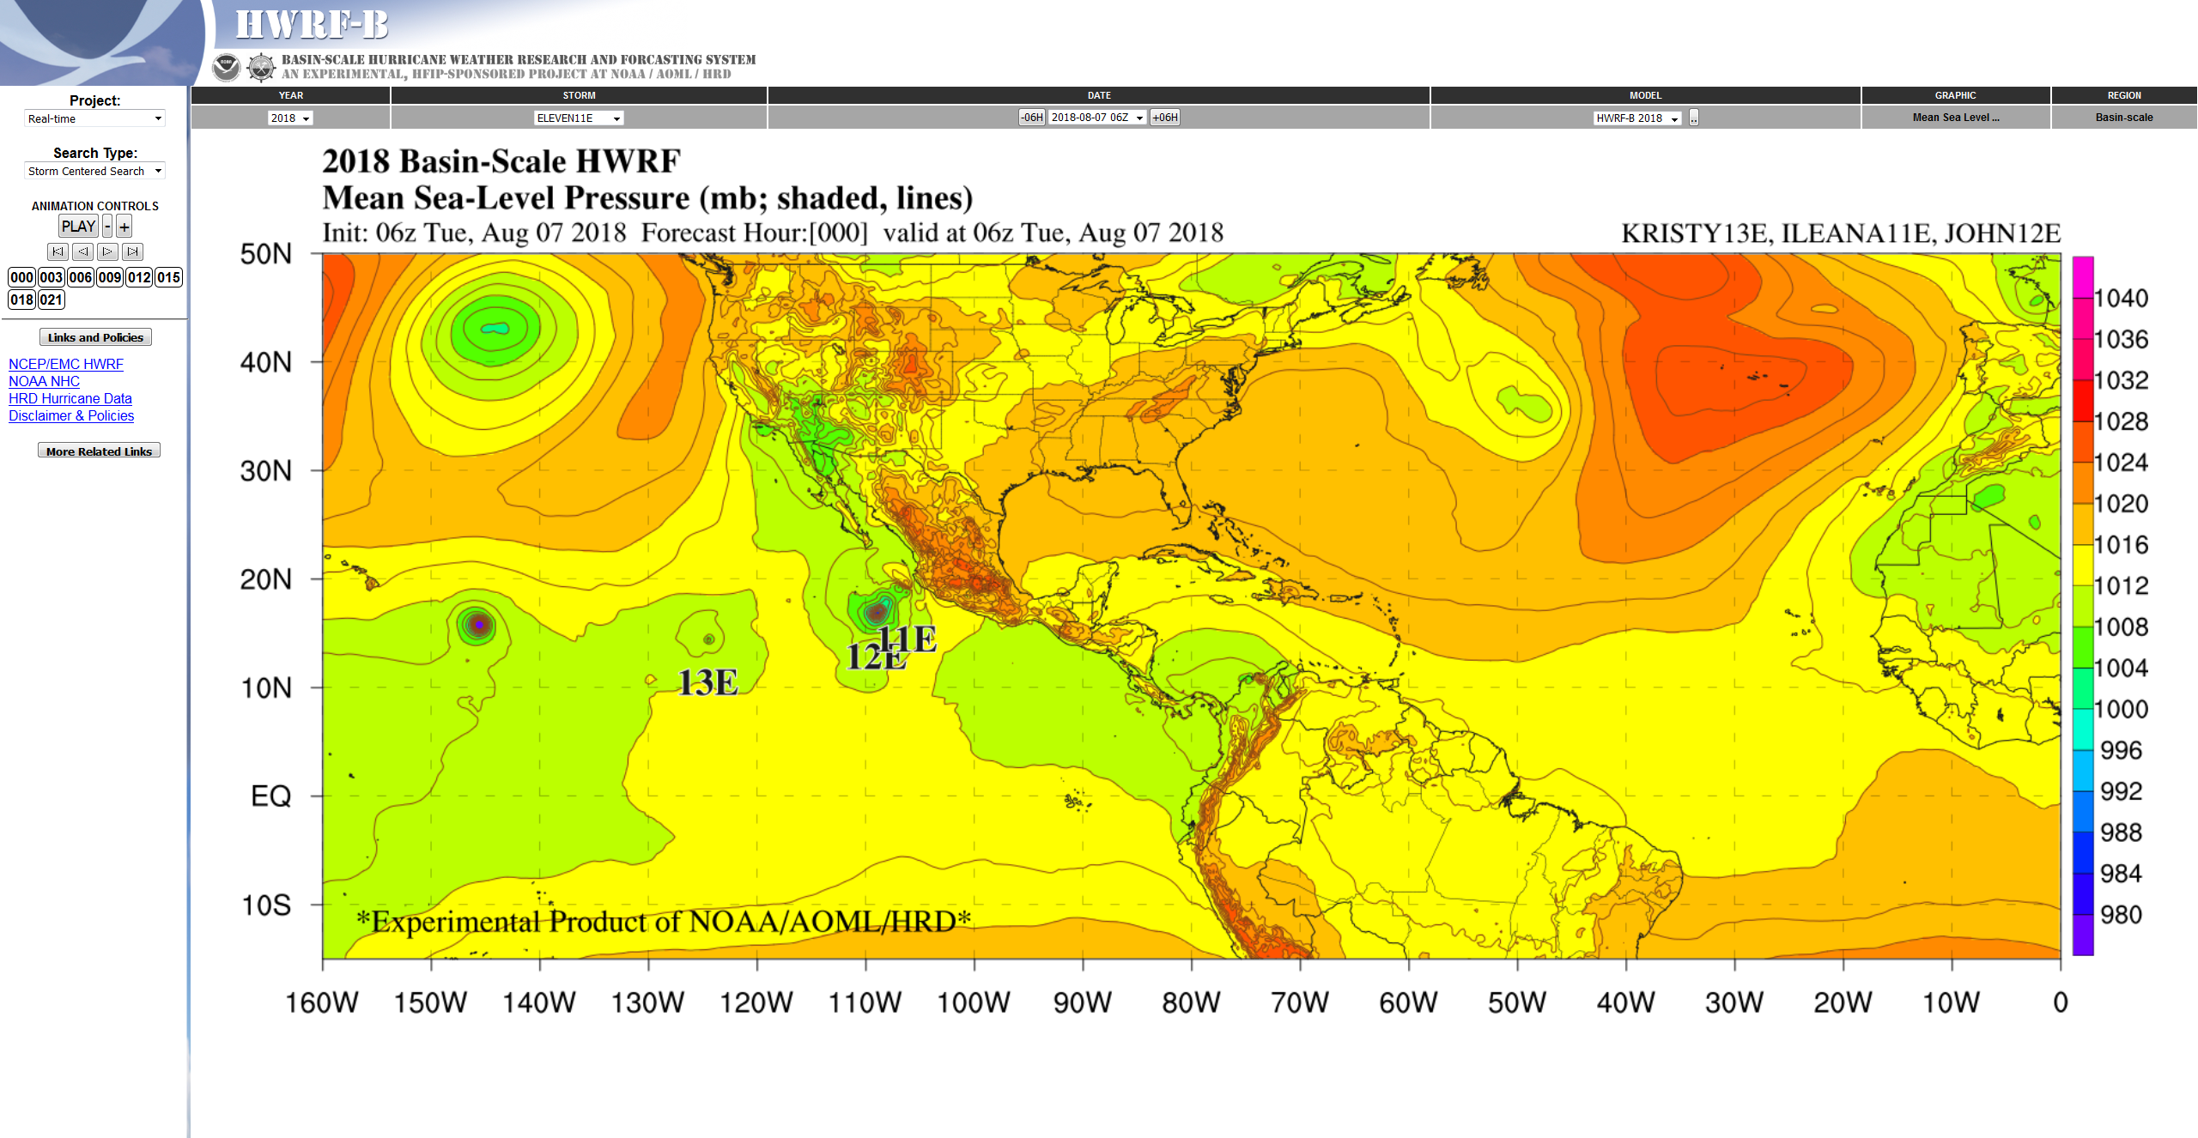
GPLOT: Graphical Post-processed Locus of
Output for Tropical cyclones
Real-Time Graphical Post-Processing
HRD HWRF-B Website
Model GRIB Outputs
20+ fields of interests maps
MAPS
View: Basin Scale, Atlantic, Eastern US, East Pac, Vortex
Model ATCF Files
SHIPS Parameters & Graphics
GPLOT
SHIPS
Multi-model Performance Comparison
NHC
A and B DECK
STATS
08 August 2018 HFIP Bi-Weekly Telecon 15
Developed by G. Alaka. Currently Maintained by M. Ko

Slide 16
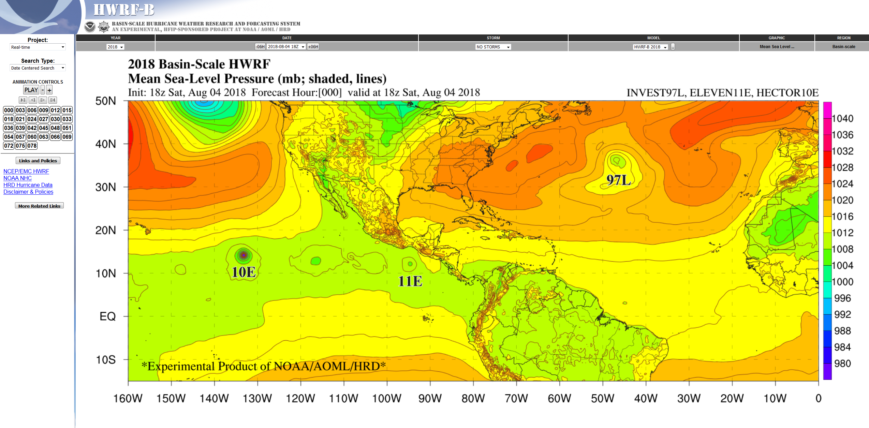
Real-Time Web Site: storm.aoml.noaa.gov
08 August 2018 HFIP Bi-Weekly Telecon 16

Slide 17
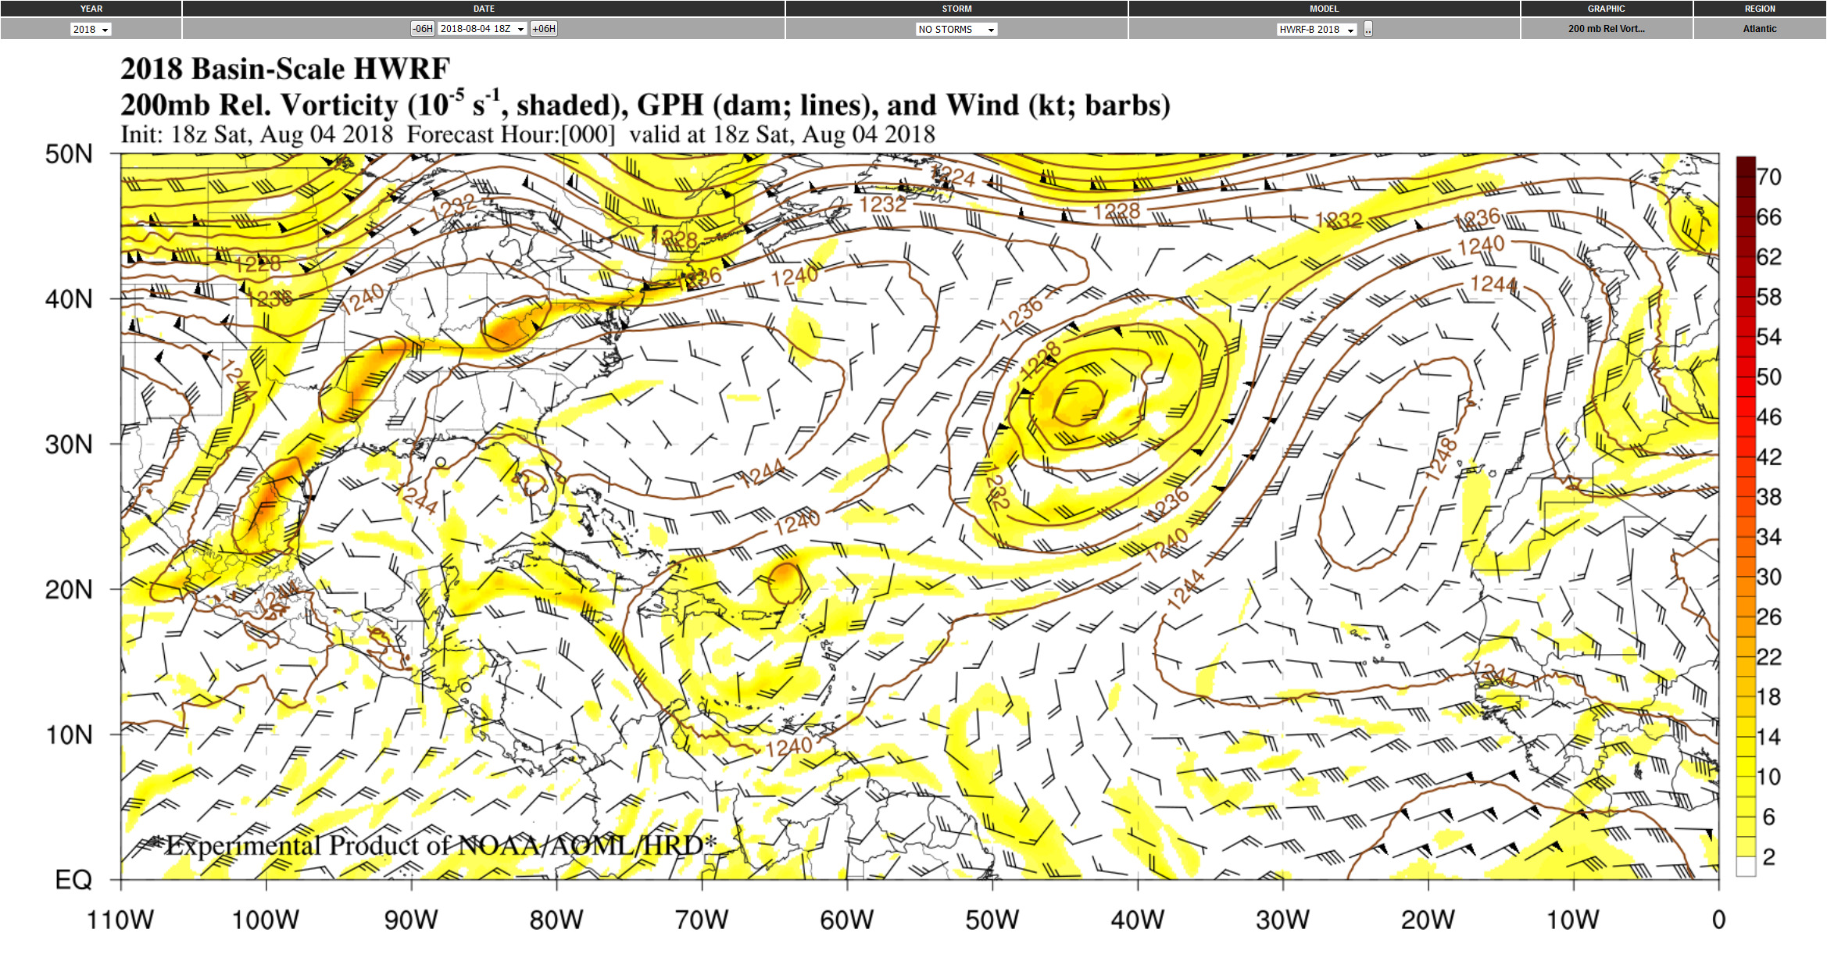
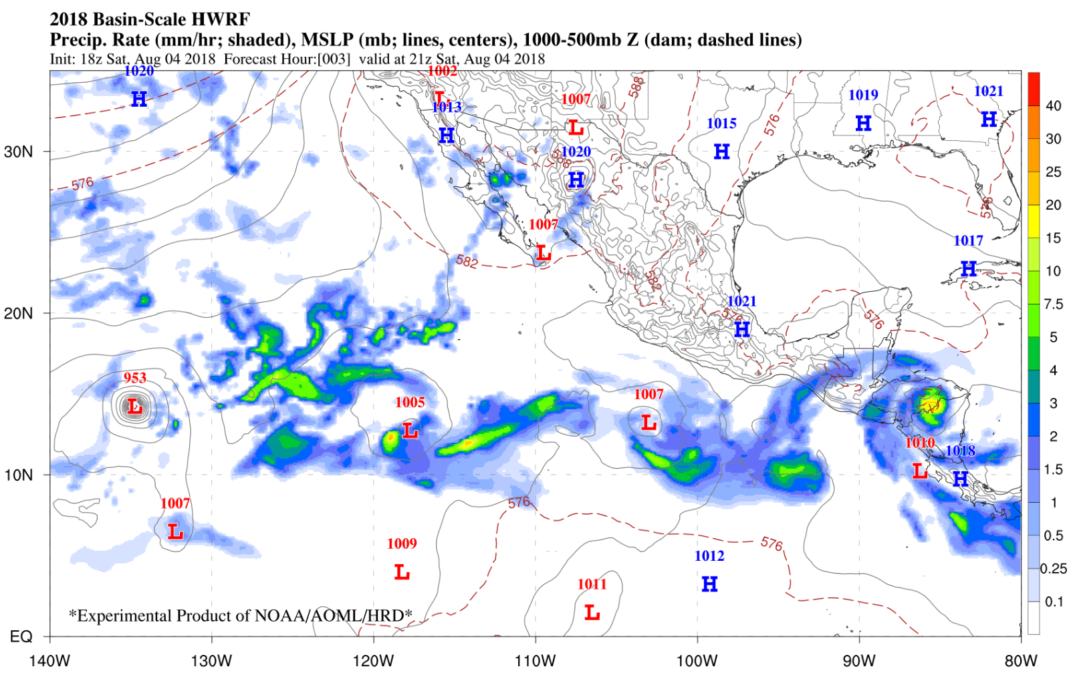
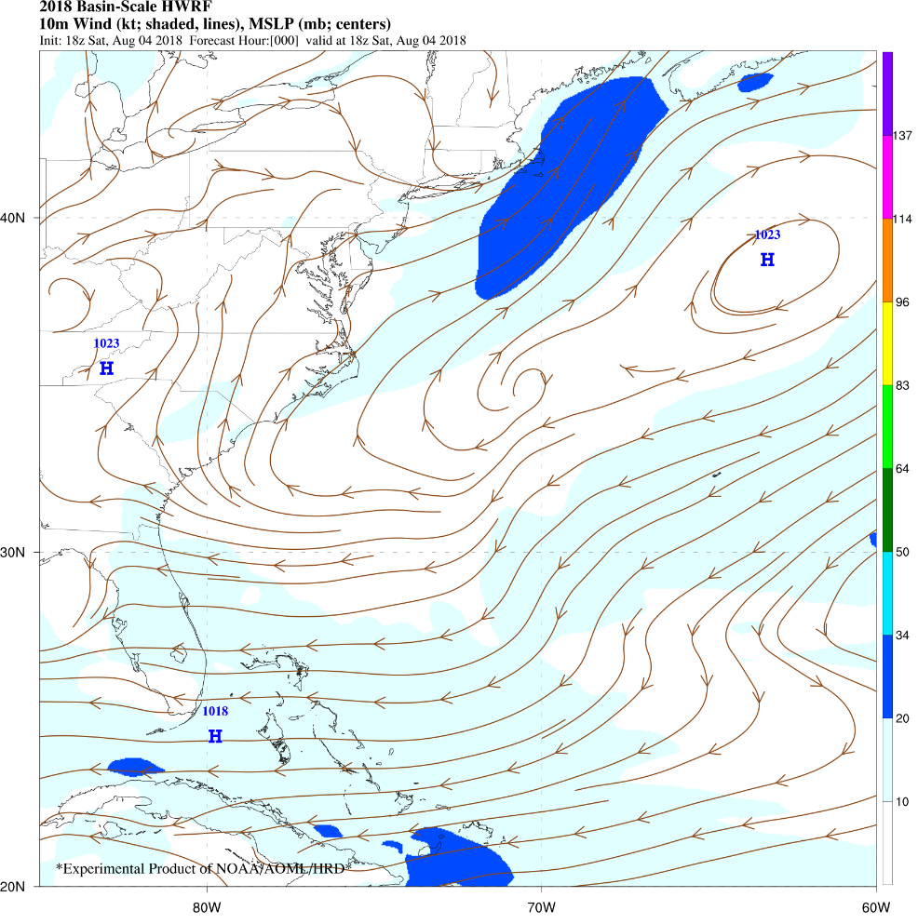
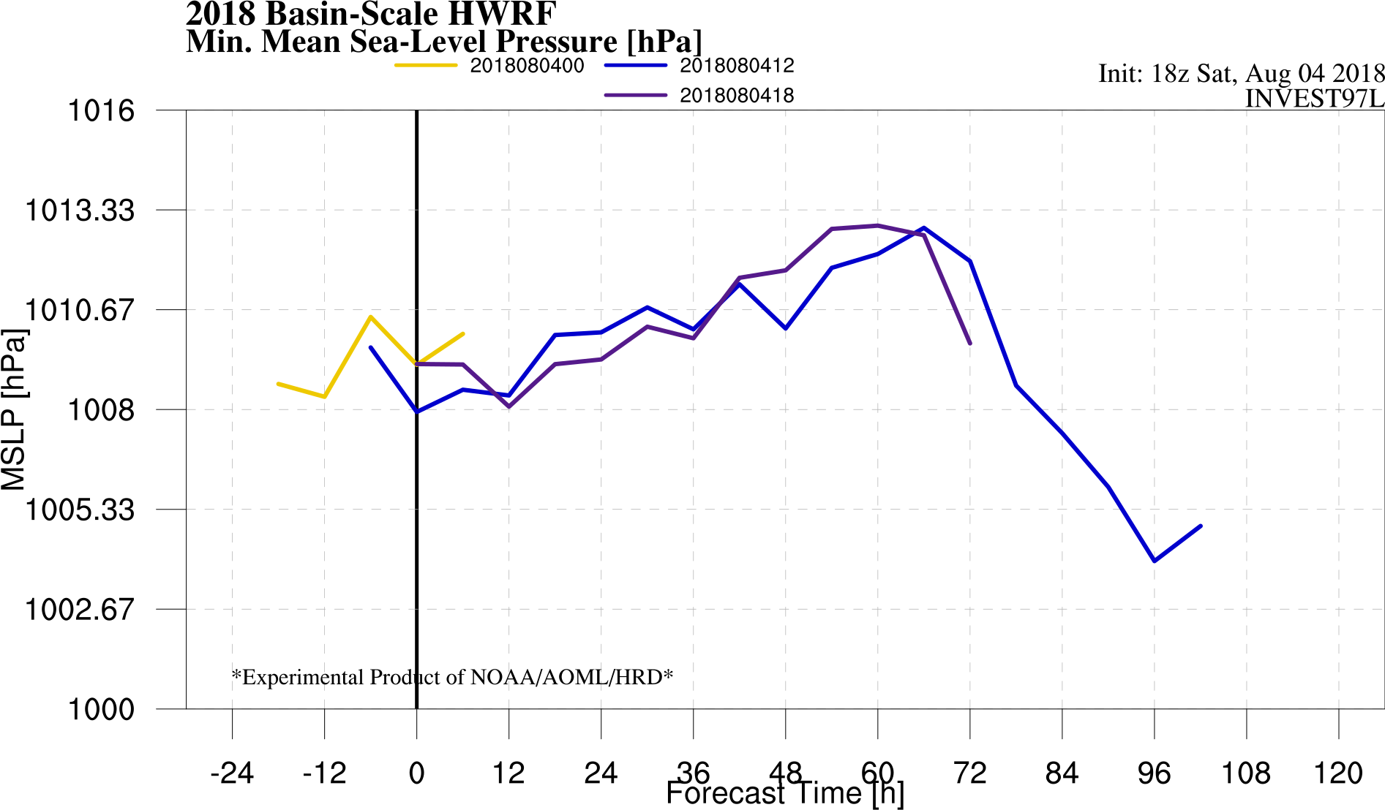
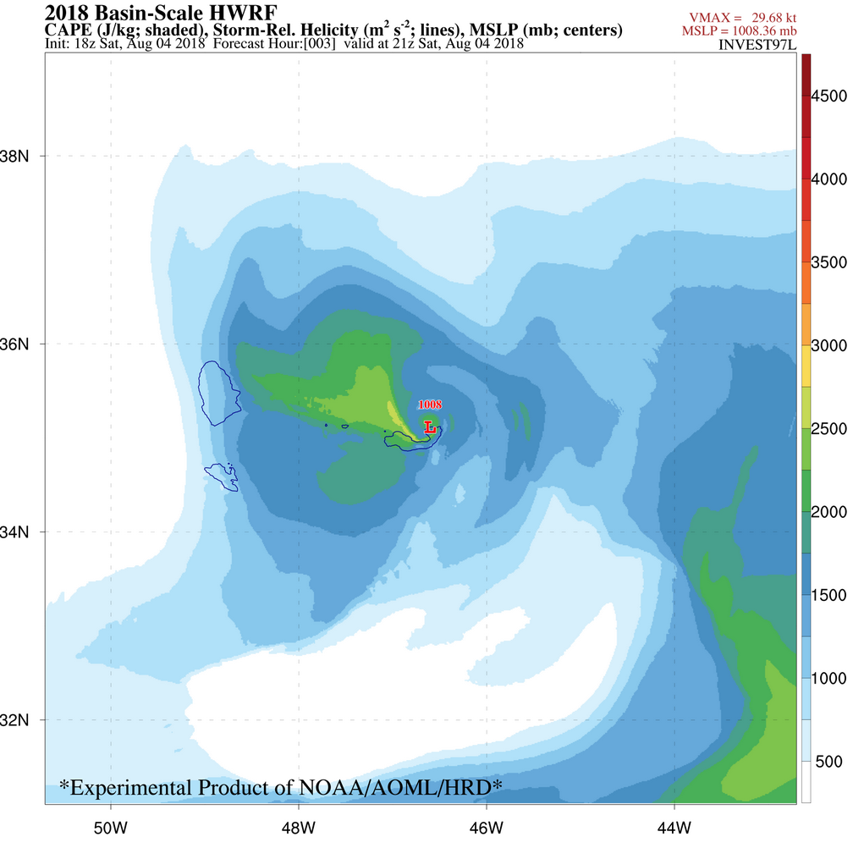
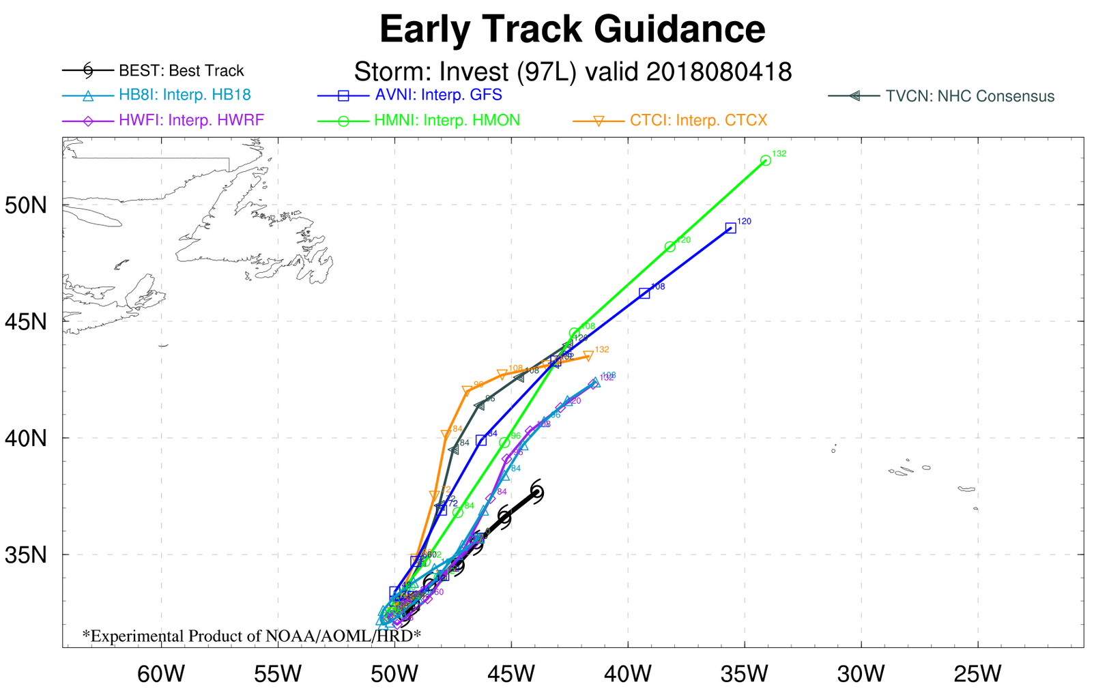
East Pacific
Rain Rate
Atlantic
Relative Vorticity
Eastern U.S.
10m Wind
SHIPS Parameter
MSLP
Basin Scale
MSLP
Vortex
(Storm Centered)
CAPE and Helicity
Statistics
Track Guidance
Developed by G. Alaka. Currently Maintained by M. Ko

Slide 18
The Future for HWRF-B
Cycled Outer Domain Satellite DA
Ensemble & Probabilistic Prediction System
Works
This needs work!
Works
Vortex TDR DA
Hi-Resolution Deterministic Forecast System
Works
08 August 2018 HFIP Bi-Weekly Telecon 18

