Slide 1




Impact of Simulated CYGNSS Ocean Surface Winds on Tropical Cyclone Analyses and Forecasts in a Regional OSSE Framework
Bachir Annane¹, Brian McNoldy², Mark Leidner^{4,}
Robert Atlas³ , Ross Hoffman¹,Sharanya Majumdar²
¹ Univ. of Miami/CIMAS and NOAA/AOML/HRD, Miami, FL
² Univ. of Miami/RSMAS, Miami, FL
³ NOAA/AOML, Miami, FL
⁴ AER, Lexington, MA

Slide 2

What is CYGNSS?
The Cyclone Global Navigation Satellite System (CYGNSS) is a NASA mission that consists of a constellation of 8 micro-satellites.
The body of each satellite measures roughly 51x64x28 centimeters, slightly larger than a standard carry-on suitcase.
When fully assembled, the satellites will each weigh about 29 kilograms.
With its solar panels deployed, each microsatellite has a wingspan of 1.67 meters.
Rendition of a single CYGNSS observatory
in orbit over a hurricane. (NASA)
Mission Updates:
· CYGNSS successfully launched on December 15, 2016 and the eight observatories are all on orbit
· Successfully measured out first ocean DDMs on January 4, 2017, just east of Brazil.

Slide 3
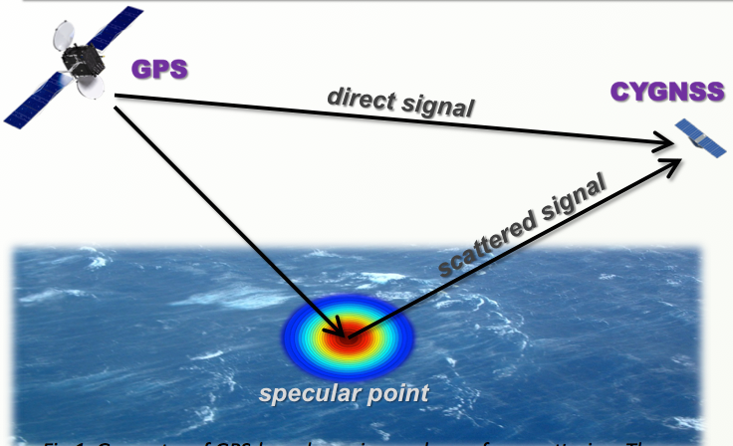
What is CYGNSS?
Utilize signals from existing GPS satellites to measure surface wind speeds (surface roughness affects forward-scattered signal) along the satellite ground tracks.
Capable of retrieving usable data over a large range of wind speeds (0-70 m/s) in all precipitating conditions throughout the tropics and subtropics with a frequent revisit times.
Basic geometry of bi-static quasi-specular
scatterometry

Slide 4
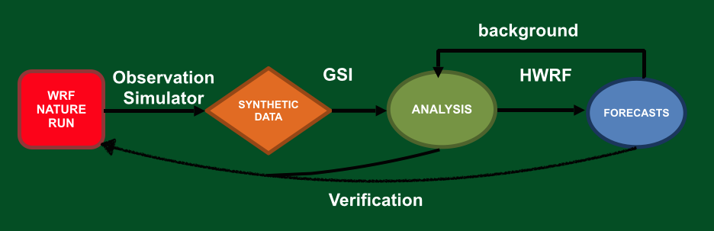
OSSE Framework
The regional OSSE (Observing System Simulation Experiment) framework was developed at NOAA/AOML and UM/RSMAS and features a high-resolution regional nature run embedded within a lower-resolution global nature run.
Simulated observations are generated and provided to a data assimilation scheme which provides analyses for a high-resolution regional forecast model.

Slide 5
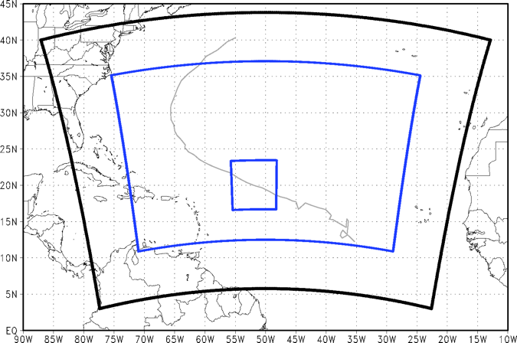
OSSE Framework Details
Nature Runs
- ECMWF: low-resolution T511 (~40km) “Joint OSSE Nature Run”
- WRF-ARW: high-resolution 27km regional domain with 9/3/1 km storm-following nests (v3.2.1)
Data Assimilation Scheme
- GSI: Gridpoint Statistical Interpolation. a standard 3D variational assimilation scheme (v3.3).
Analyses performed at 9km resolution.
Forecast Model
- HWRF: the 2014 operational
Hurricane-WRF model (v3.5).
Parent domain has ~9km resolution,
single storm-following nest has ~3km
resolution.
DA and model cycling performed every 6, 3, 1 hours, each run producing a 5-day forecasts every 6 hours.

Slide 6
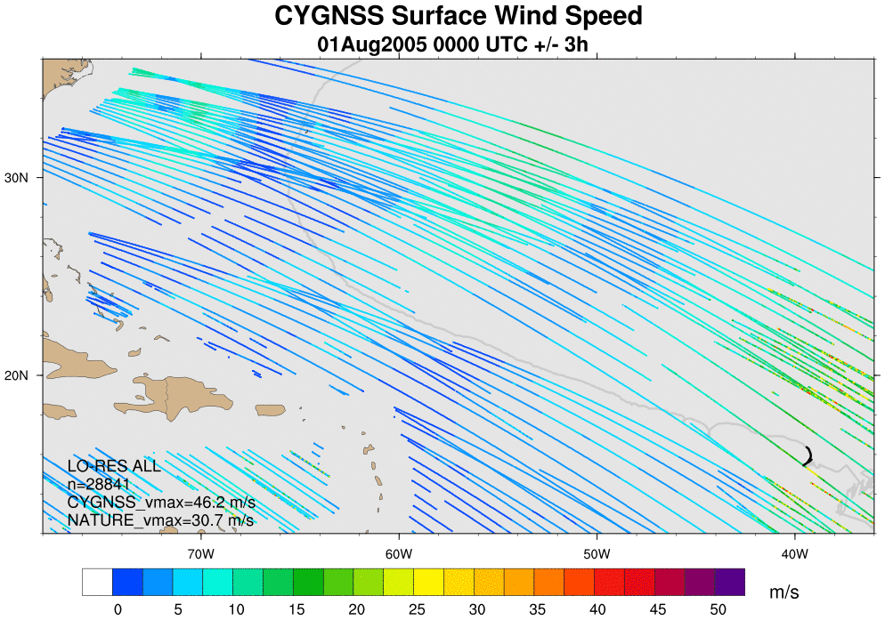
CYGNSS data
One synthetic CYGNSS datasets generated to span the WRF nature run.
0801 00z - 0805 00z

Slide 7
Synthetic data generated
Direction information added to CYGNSS wind speeds using 2D Variational Analysis Method (VAM)
CONTROL :
Conventional Satellite/ Surface /sounding data, no CYGNSS
Taken from T511 “Joint OSSE Nature Run”
CYGNSS
End-to-End
Simulator
WRF
Hurricane
Nature Run
CYGNSS scalar winds
2D
variational analysis
method
(VAM)
VAM-CYGNSS vector winds
2D vector wind background
Observation
Simulator
ECMWF
T511 global JONR
Simulated
Conventional and Satellite Obs

Slide 8
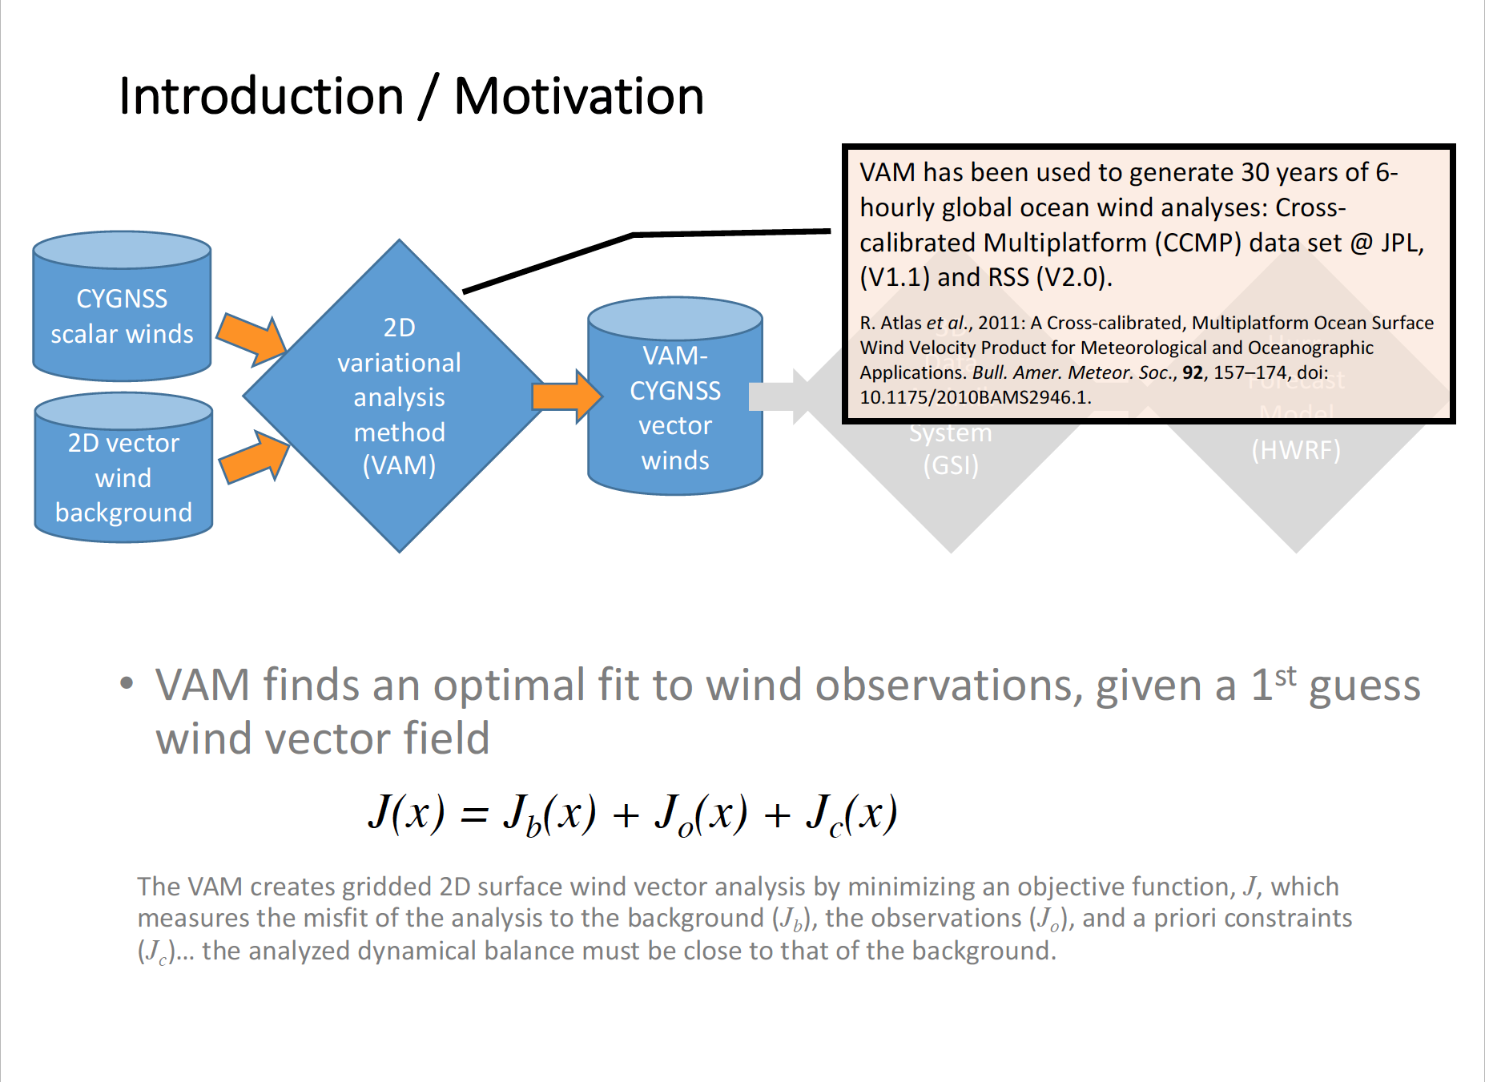
Experiments

Slide 9
Experiments
All experiments listed use identical configurations of GSI for data assimilation and HWRF for forecasts.
1) CONTROL: Conventional Satellite/ Surface /sounding data, no CYGNSS
2) CONTROL+CYG: CONTROL plus all available CYGNSS wind speed
3) CONTROL+VAM: CONTROL plus VAM wind vectors at CYGNSS retrieval coordinates. (VAM analyses use 9-km HWRF background; 6-hr forecasts)
There are a total of 16, 5-day forecasts, but first 4 forecasts runs omitted from verification to allow for model spin-up (12 cases)
Vary data assimilation cycling frequency
6 hourly cycling: 16
3 hourly cycling: 32
1 hourly cycling: 96

Slide 10
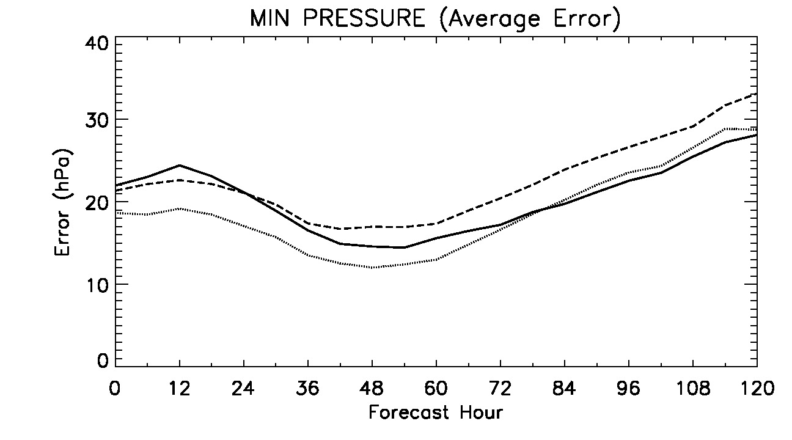
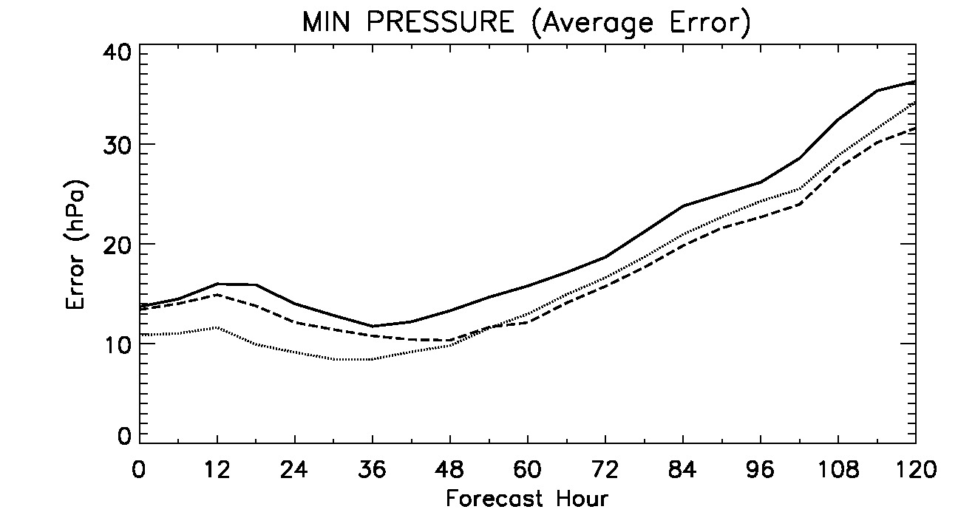
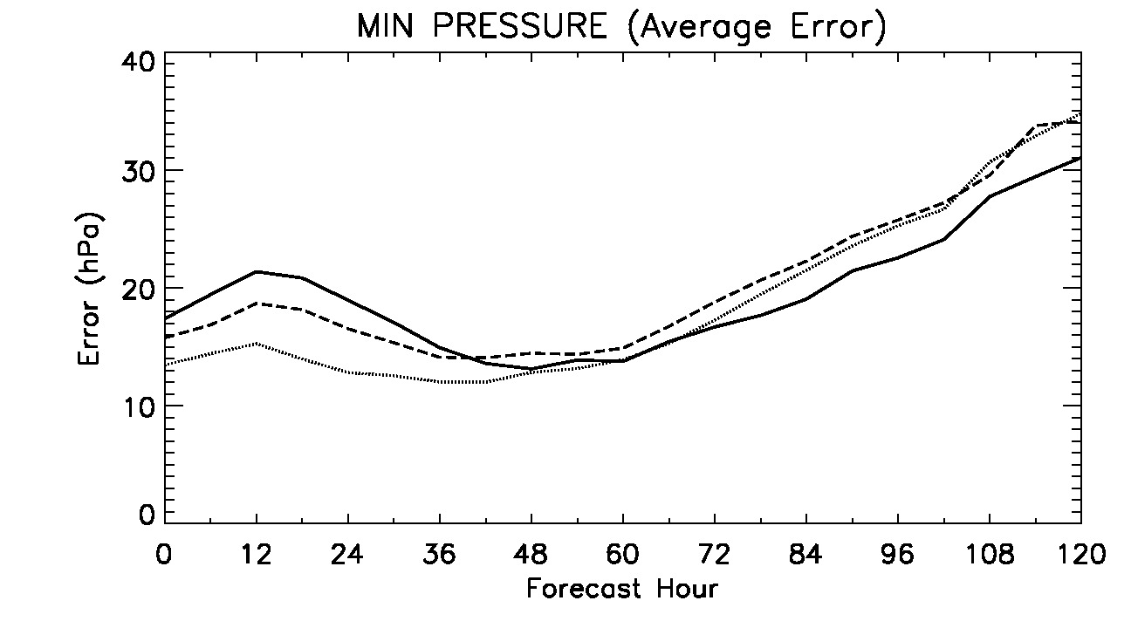

Average Forecast Errors N = 12 five-day forecasts
6-hourly DA cycling
3-hourly DA cycling
Hourly DA cycling
10

Slide 11
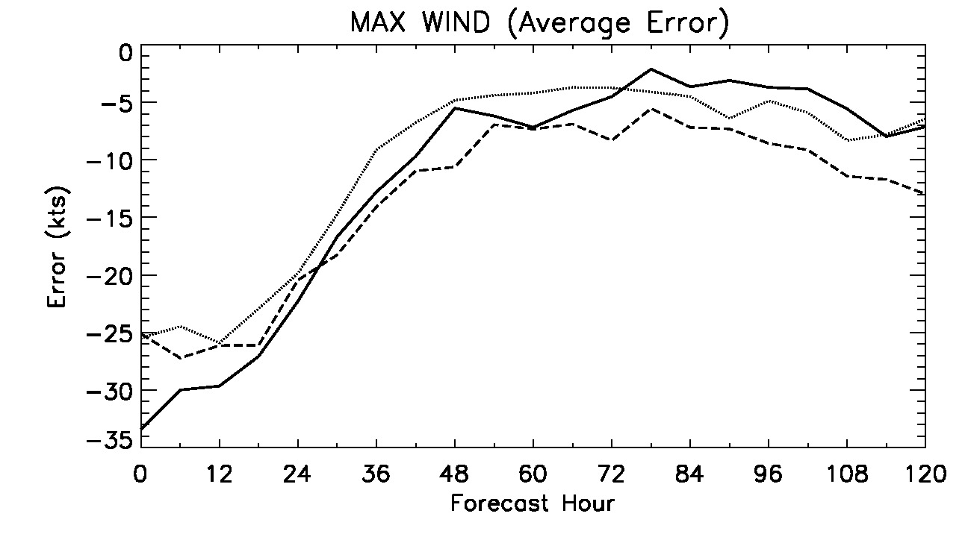
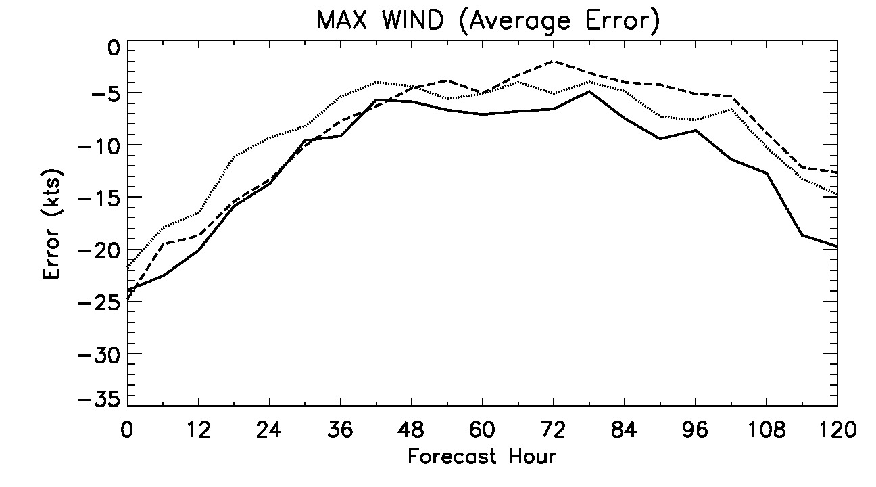
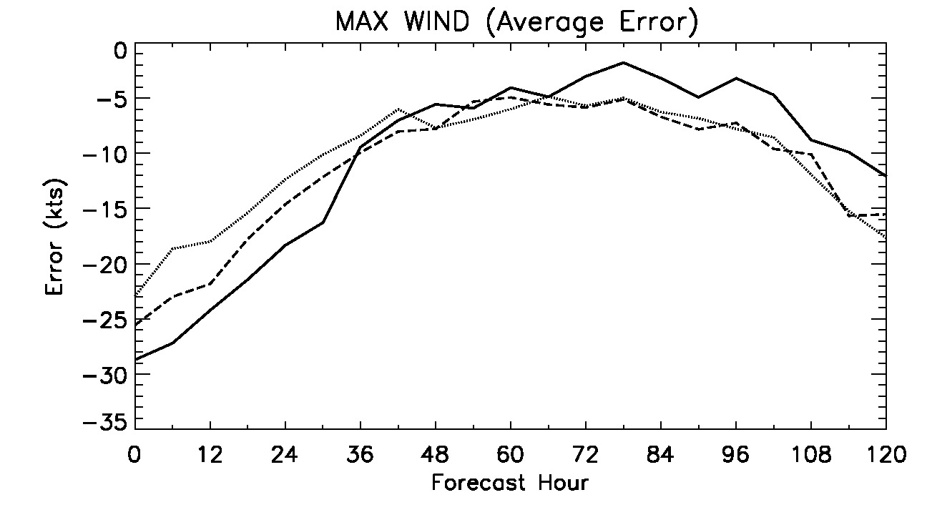
Average Forecast Errors N = 12 five-day forecasts
6-hourly DA cycling
3-hourly DA cycling
Hourly DA cycling
11

Slide 12
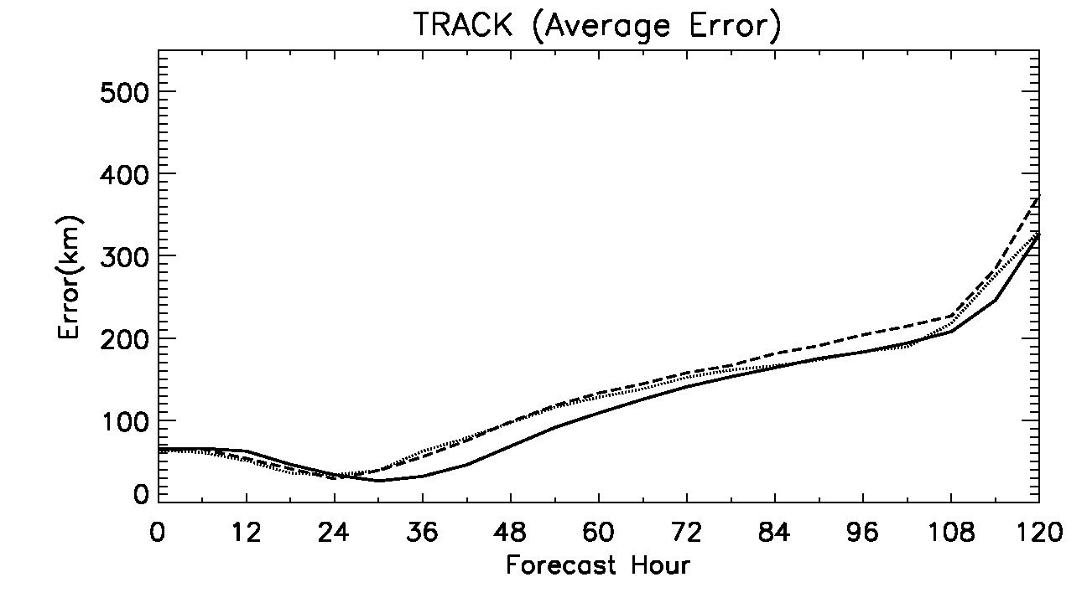
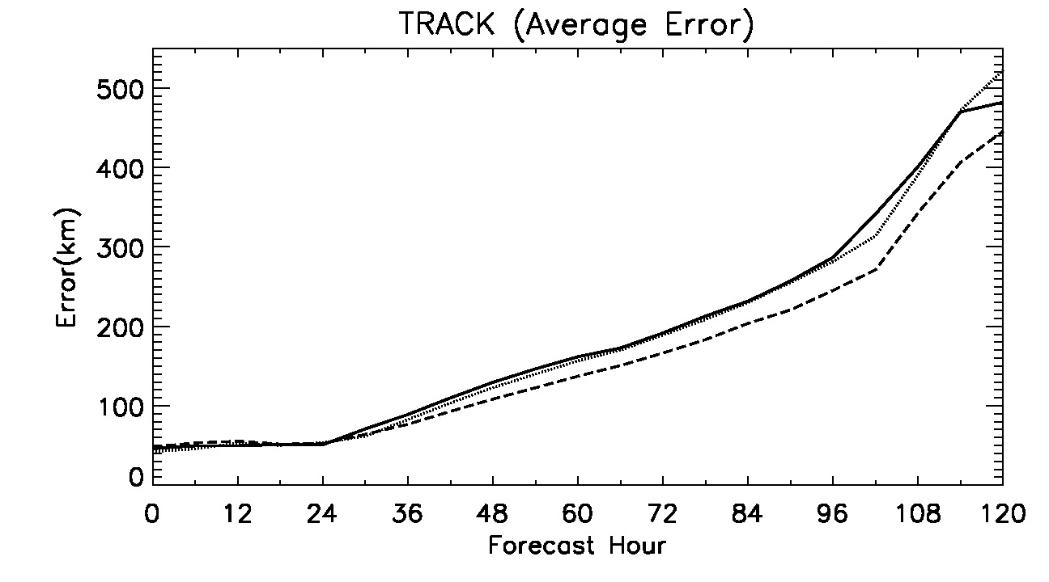
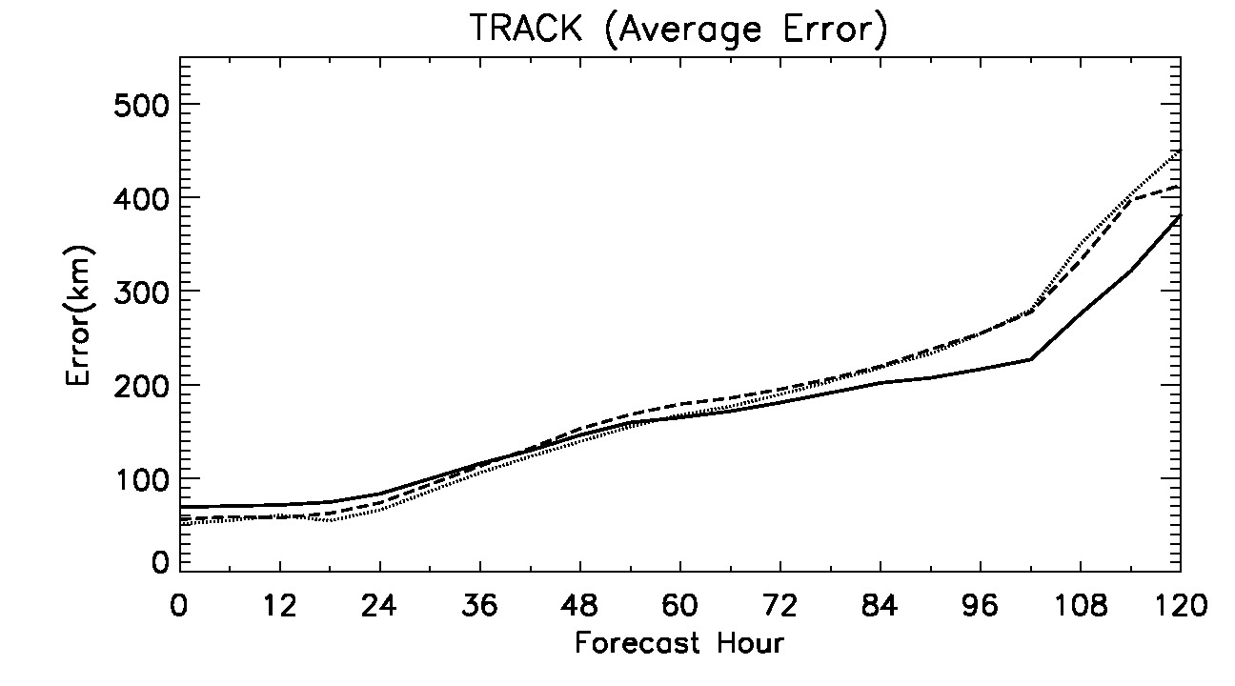
Average Forecast Errors N = 12 five-day forecasts
6-hourly DA cycling
3-hourly DA cycling
Hourly DA cycling
12

Slide 13
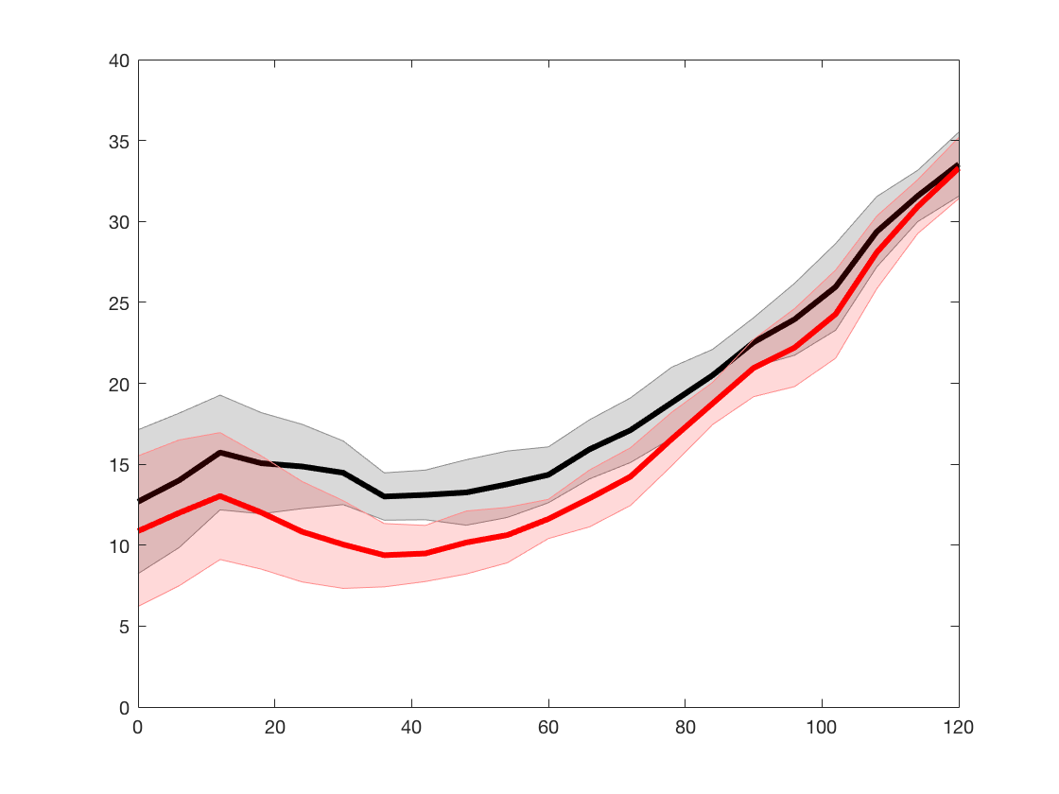
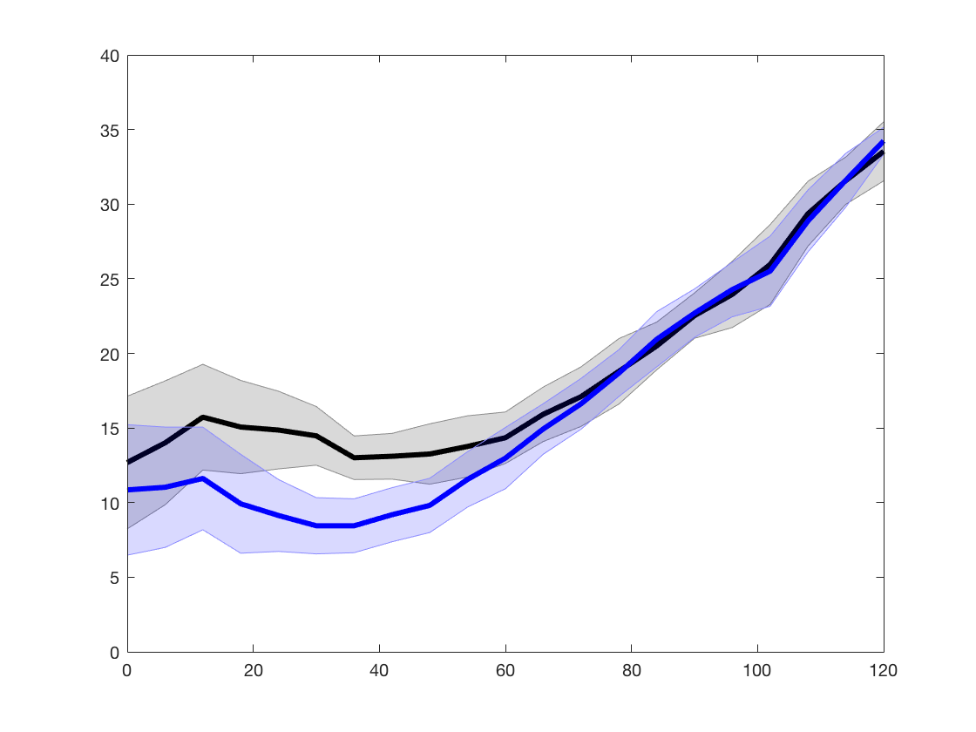

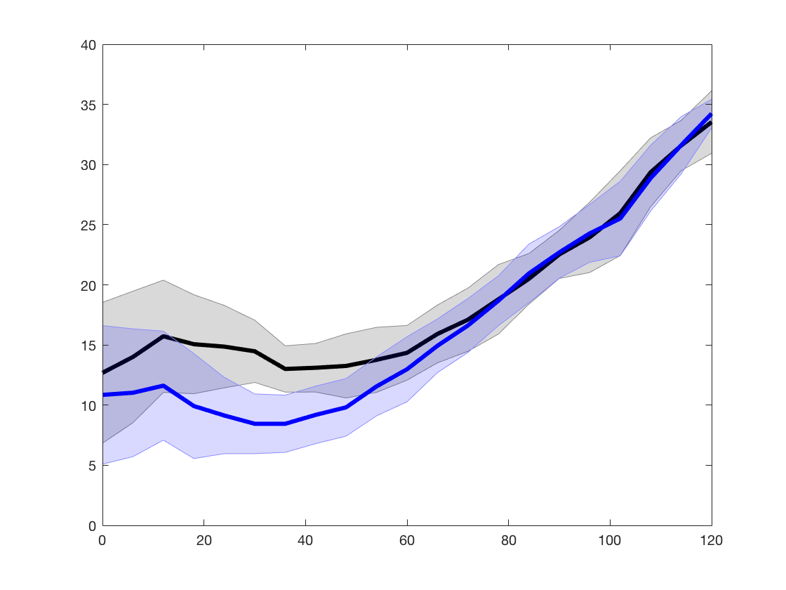
Statistical Significance
N = 12 five-day forecasts 3-hourly DA cycling
Min. central pressure error [hPa]
Control+CYG
Control+VAM
80%
Confidence
Interval
90%
Confidence
Interval
13

Slide 14
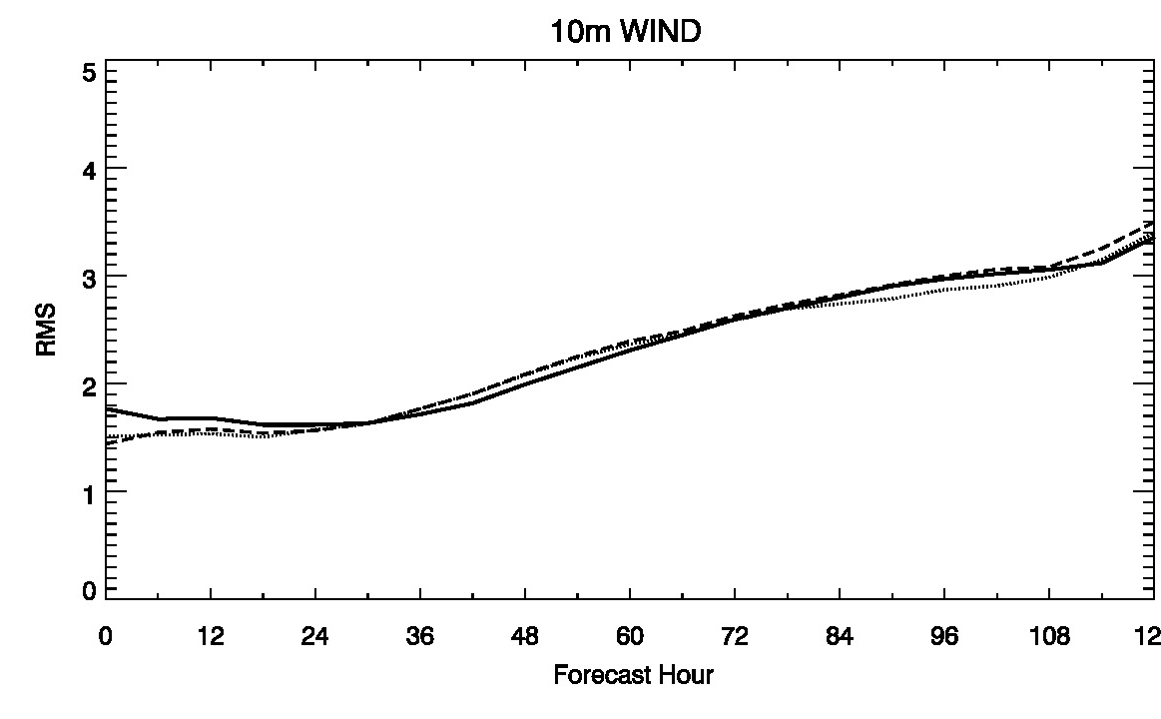
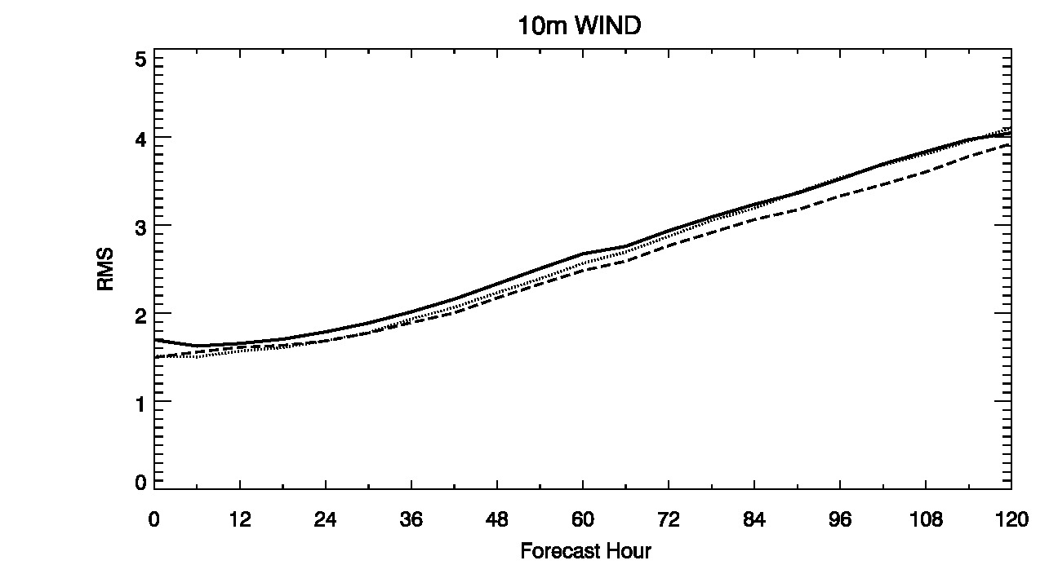
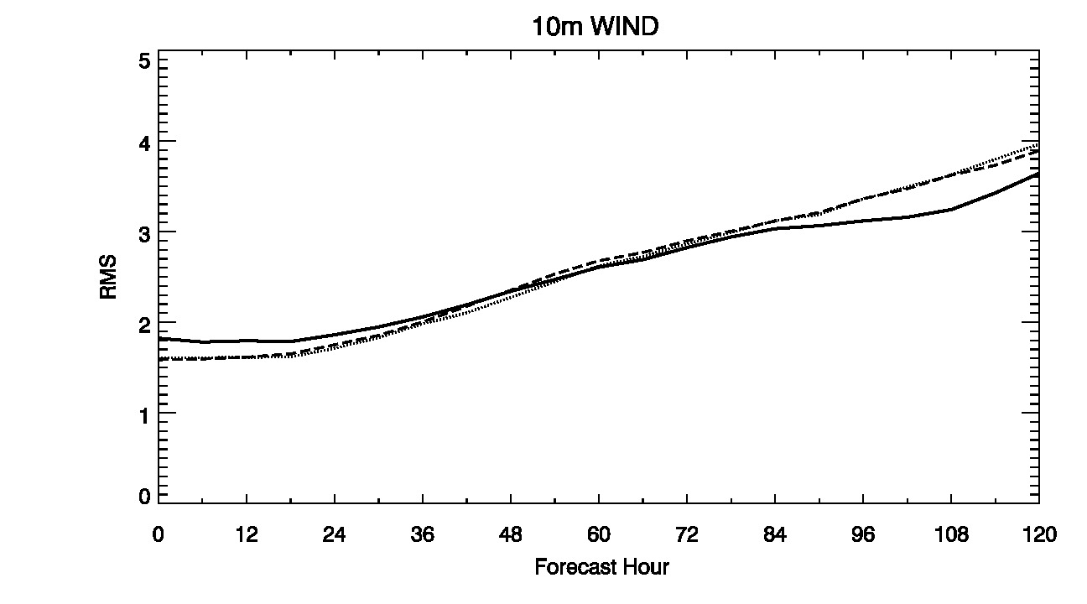
Domain Average statistics
6-hourly DA cycling
3-hourly DA cycling
Hourly DA cycling

Slide 15
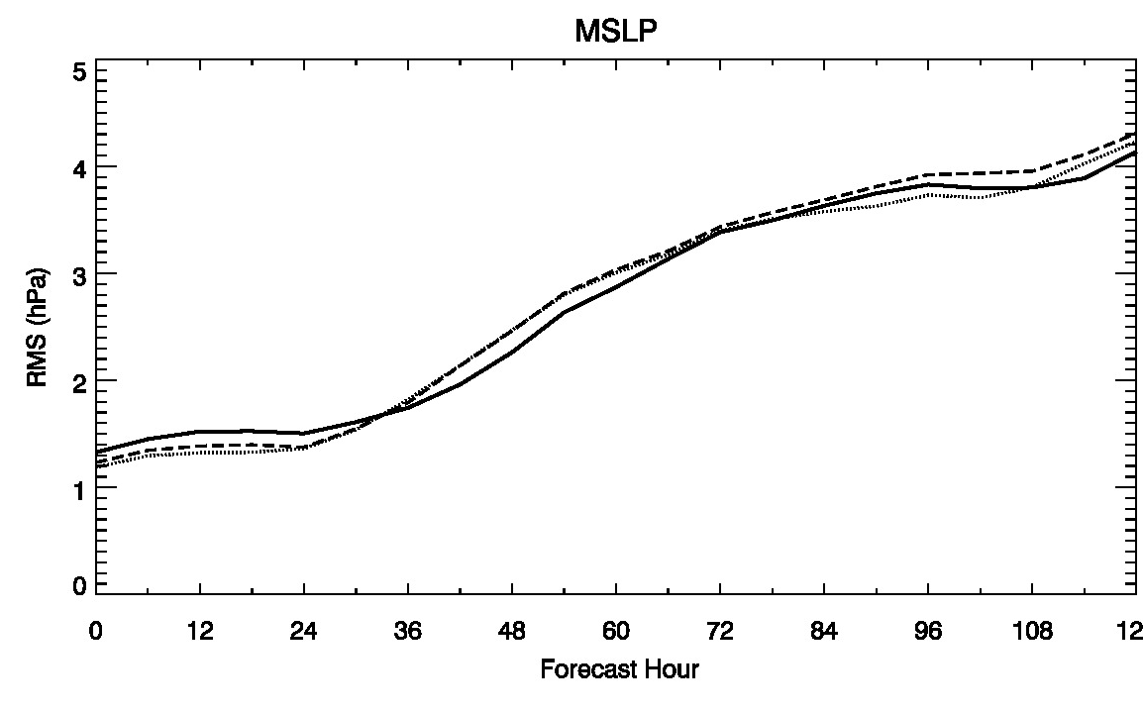
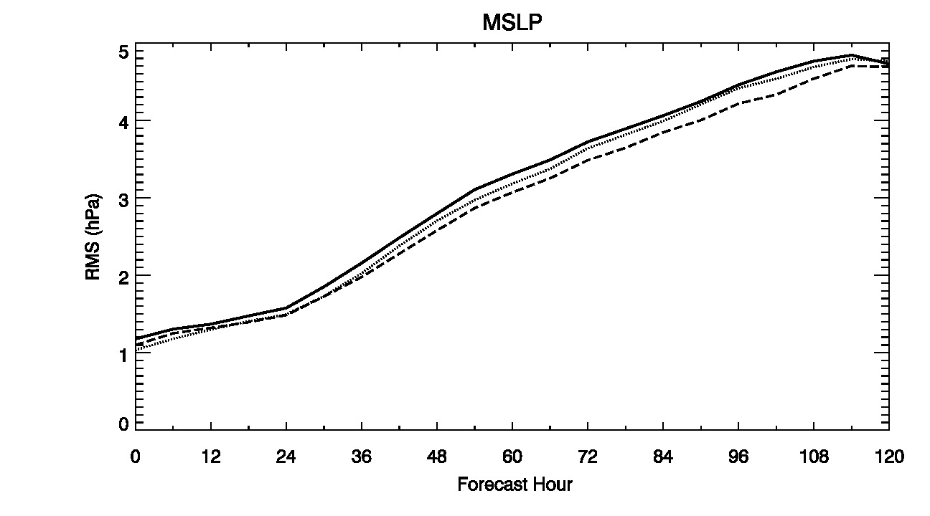
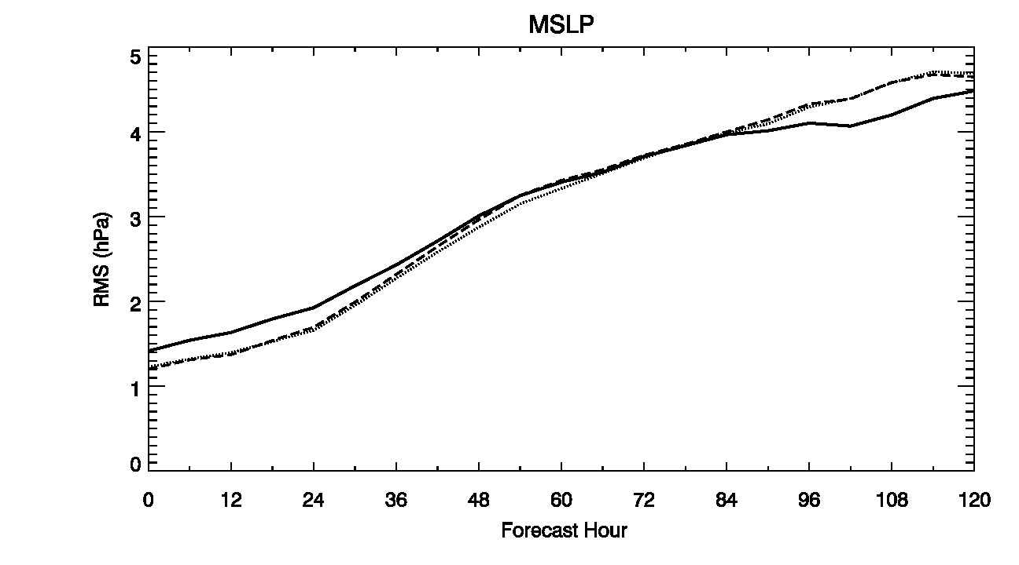
Domain Average statistics
6-hourly DA cycling
3-hourly DA cycling
Hourly DA cycling

Slide 16
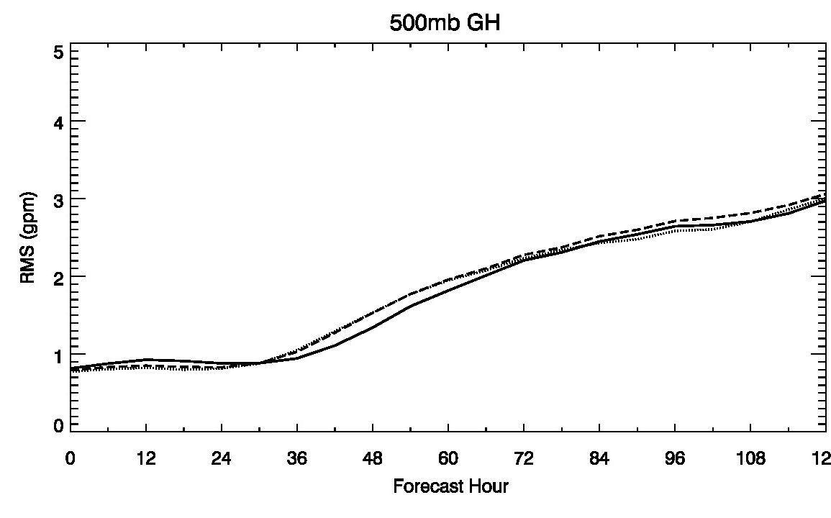
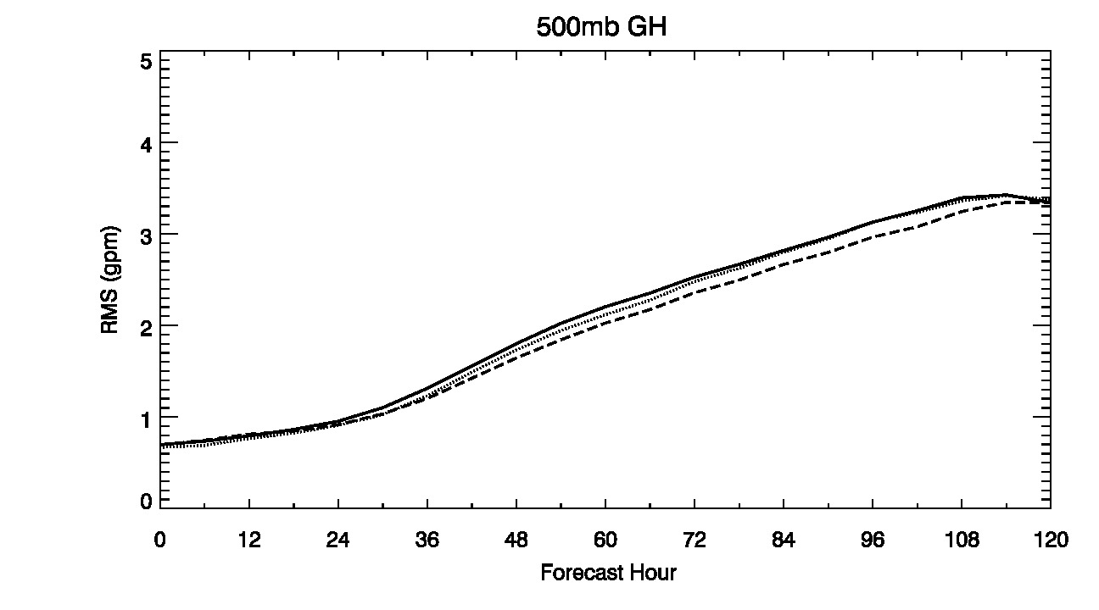
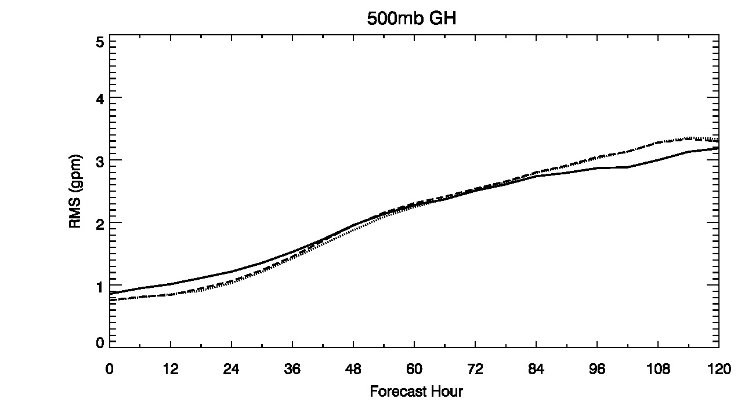
Domain Average statistics
6-hourly DA cycling
3-hourly DA cycling
Hourly DA cycling

Slide 17
SUMMARY
1- Analysis of TC intensity (pressure, wind) improved with addition of CYGNSS data at all DA cycling frequencies
2- DA cycling frequencies affects analyses and forecasts
3- 3-hourly cycling produces the smallest errors for this sample
4- RMS track error at 0-24 hr very slightly improved with addition of CYGNSS data
5- CYGNSS data improves the representation of the surface wind speed structure (intensity and asymmetry)
6- We have relatively a few samples from one storm, so error statistics are not robust but provide guidance.

Slide 18
Future work
Preparations are underway for impact assessment of CYGNSS during the 2017 hurricane season
Assessment with a near-operational assimilation and forecast framework (HWRF)
Variations of assimilation strategies: nests, scalar/vector
Comparison with NCEP HWRF operational forecasts
For more, see poster 1001 tomorrow, Observation Symposium, 2:30 pm:
“Assimilation of CYGNSS Ocean Surface Winds in HWRF”

Slide 19
QUESTIONS?

Slide 20
Backup Slides

Slide 21
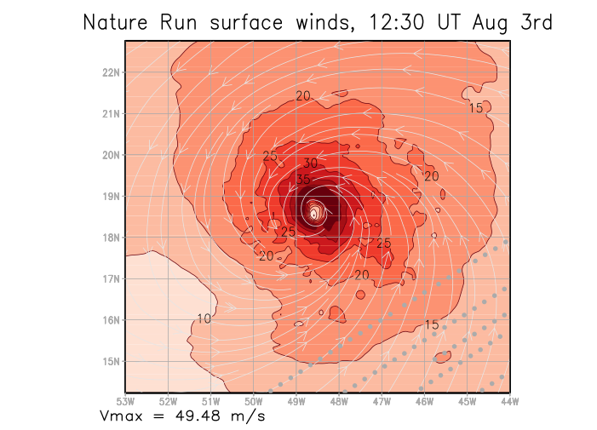
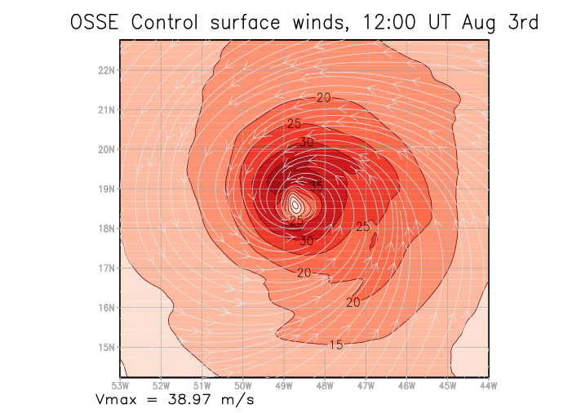
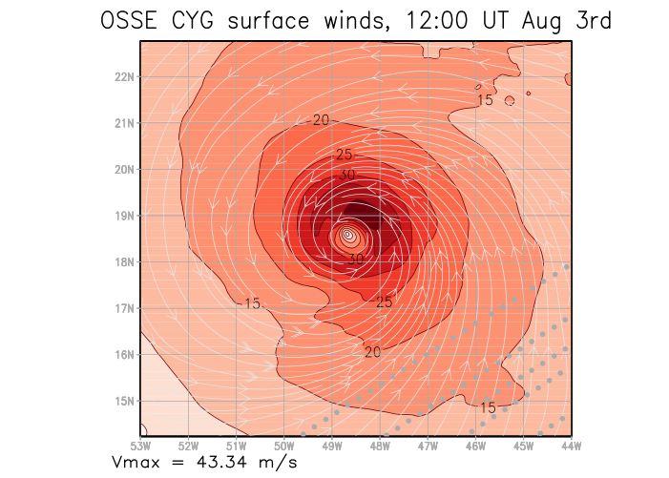
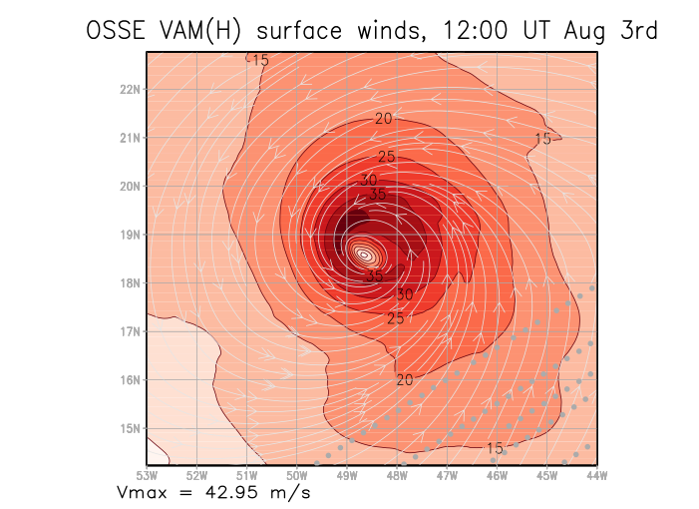
Surface Layer Wind analysis 1200 UTC August 3, 2005
After 10 DA cycles (6 hourly); lowest 30 hPa
Nature
49.5 m/s
Control
39.0 m/s
Control+CYG
43.3 m/s
Control+VAM
43.0 m/s

Slide 22
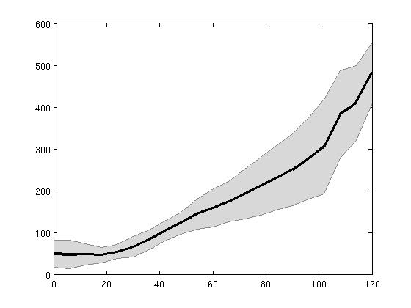
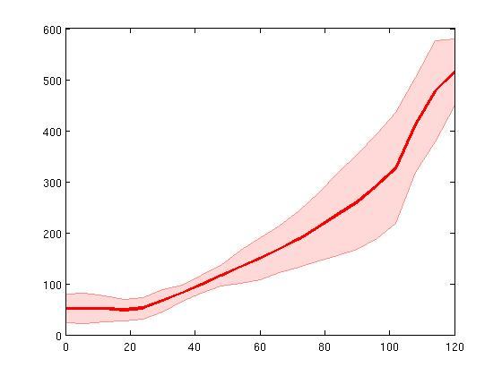
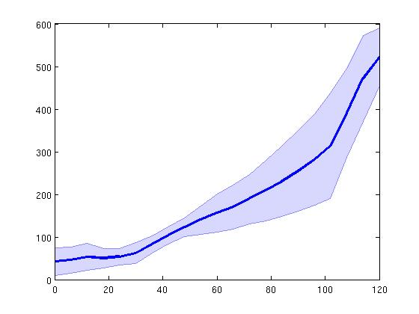
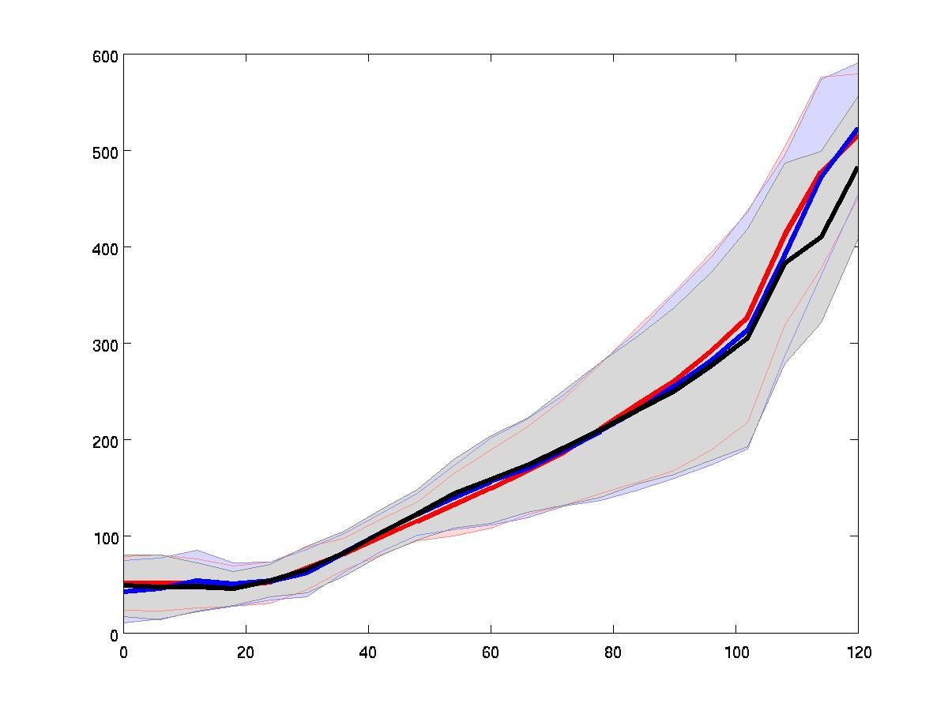
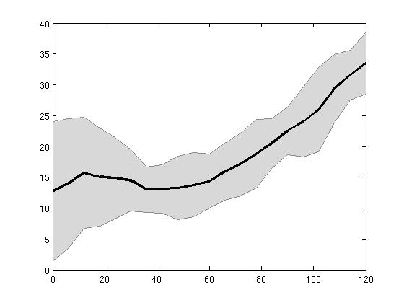
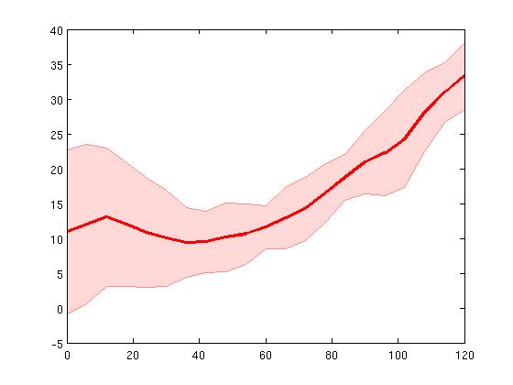
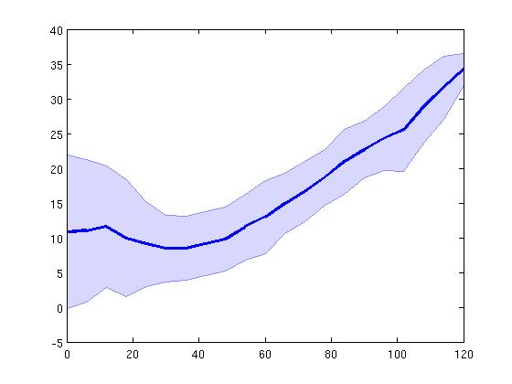
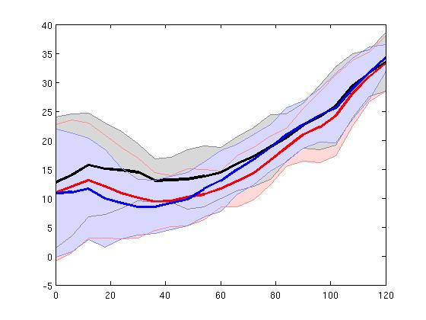
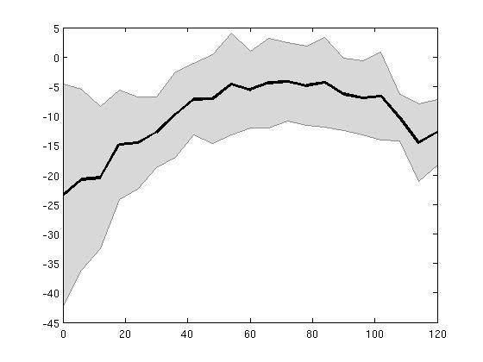
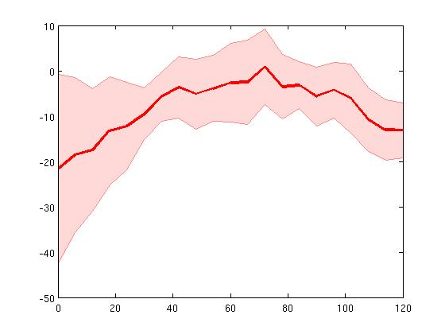
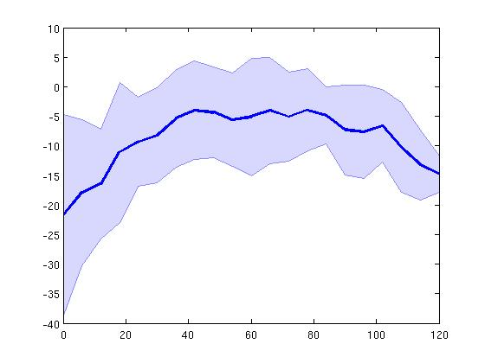
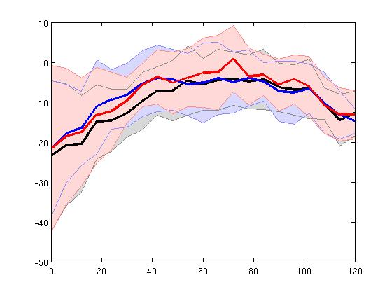
Hurricane Error Std. Deviation
3-hourly DA cycling N = 12 five-day forecasts
Control
Control+CYG
Control+VAM
ALL
Track
error
[km]
Min.
Press.
error
[hPa]
Max.
Wspd
error
[kts]

