Slide 1


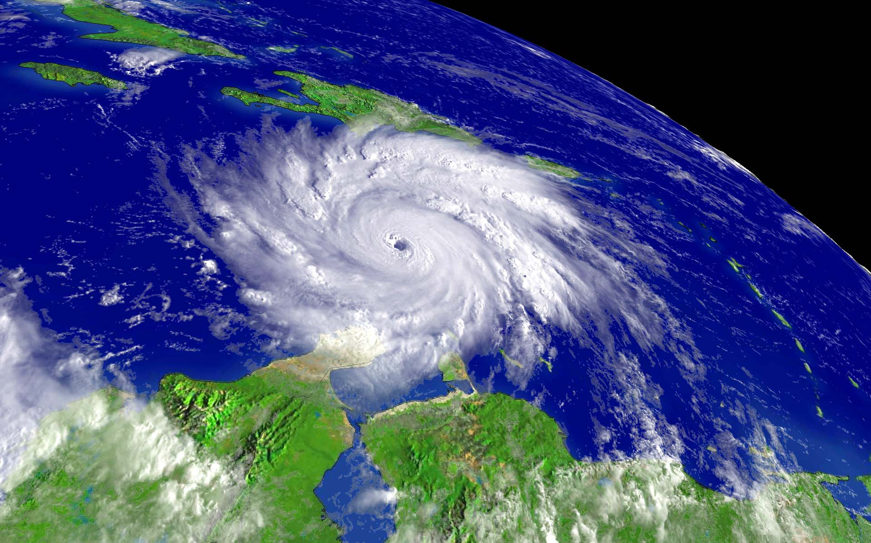
HURRICANES 101
Sim Aberson
NOAA/Atlantic Oceanographic and Meteorological Laboratory/Hurricane Research Division
sim.aberson@noaa.gov

Slide 2

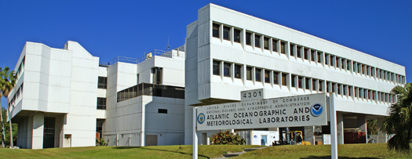
Who am I?
Dr. Sim Aberson
My office windows
I’m a research meteorologist who studies
hurricanes at the National Oceanic and
Atmospheric Administration in Miami.

Slide 3
What is a hurricane ?
Notes:
The subtropical ridge is a quasi-permanent high pressure cell also known as the Bermuda High or the Azores High.

Slide 4
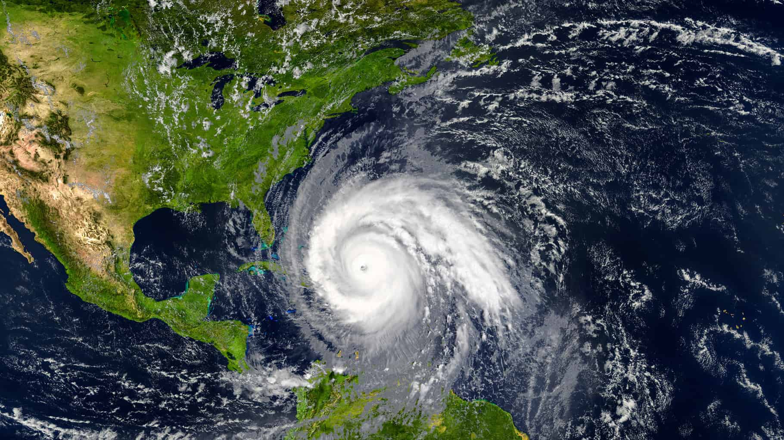
What is a hurricane ?
A large storm that forms over warm ocean made up of thunderstorms, with winds of at least 74 miles per hour. In addition to the wind, hurricanes have heavy rainfall, flooding, and storm surges.
Notes:
The subtropical ridge is a quasi-permanent high pressure cell also known as the Bermuda High or the Azores High.

Slide 5
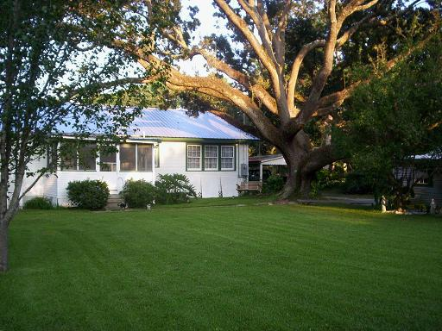
Before Katrina…
David & Kimberly King Waveland, MS
Notes:
Sometimes they don’t even have convection associated with them. They may just be a wave in the pressure and wind fields.

Slide 6
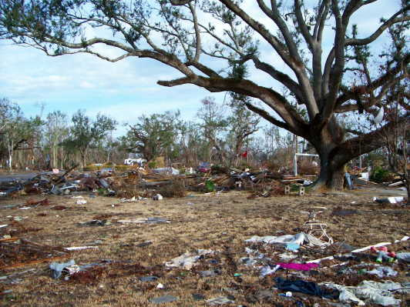
…After Katrina
David & Kimberly King Waveland, MS
Notes:
Some of these rainbands may begin to form the eyewall in more developed storms.

Slide 7
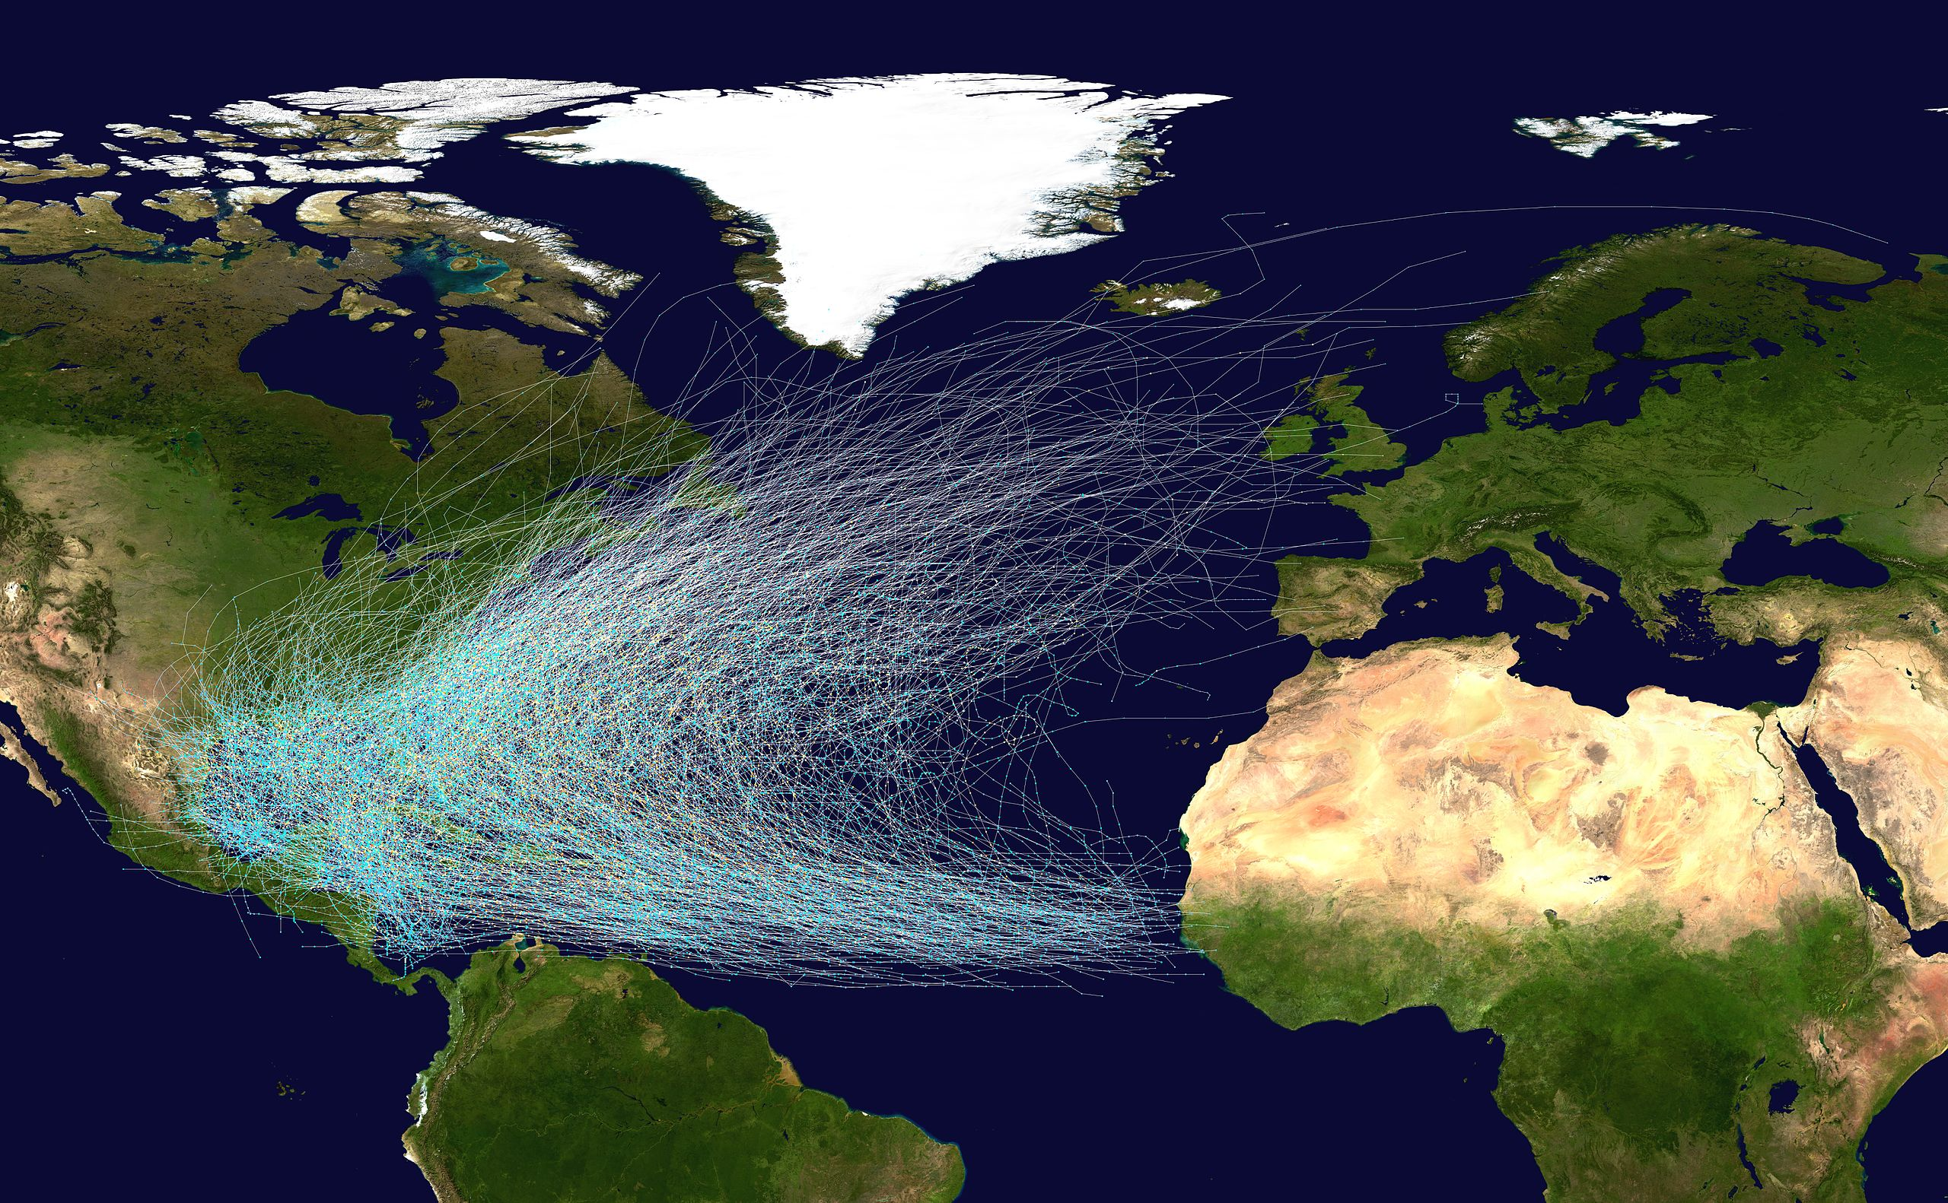

Where do they happen?
Notes:
These waves originate over the African continent and are formed by instability between the hot, dry air of the Sahara and the hot, moist air of the Congo basin.

Slide 8
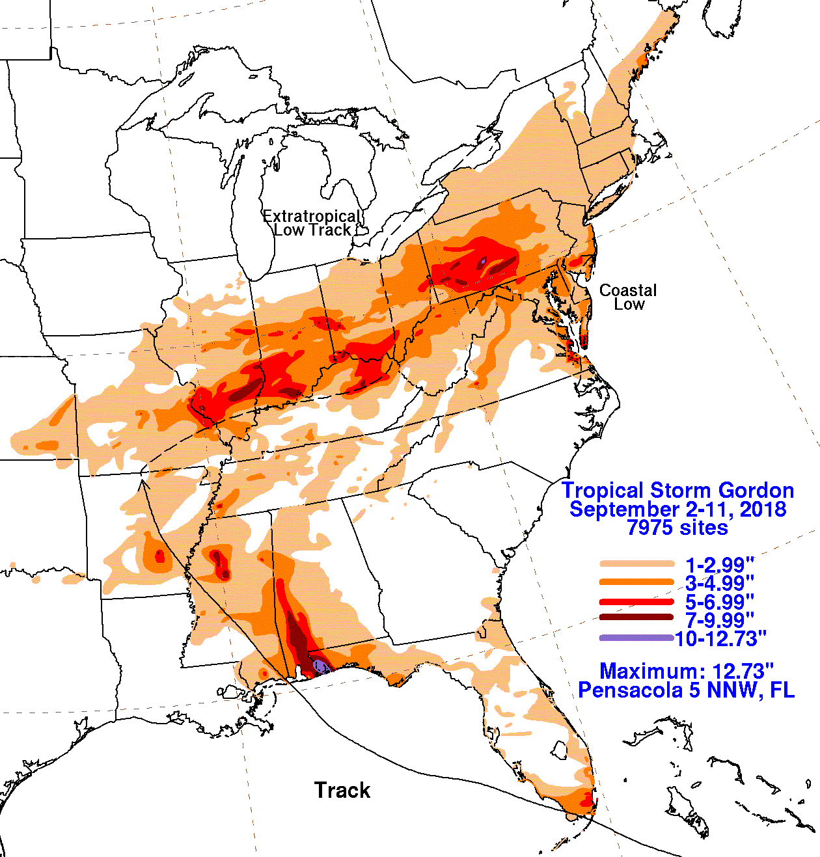
David & Kimberly King Waveland, MS
Notes:
Some of these rainbands may begin to form the eyewall in more developed storms.

Slide 9
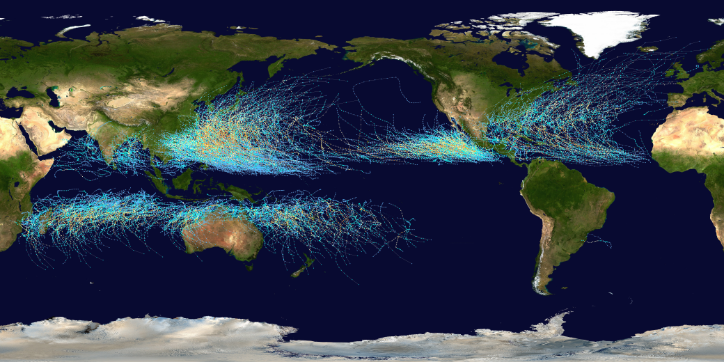
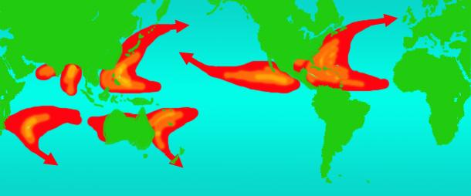
Where do they happen?
Typhoons
Hurricanes
Cyclones
Notes:
These waves originate over the African continent and are formed by instability between the hot, dry air of the Sahara and the hot, moist air of the Congo basin.

Slide 10
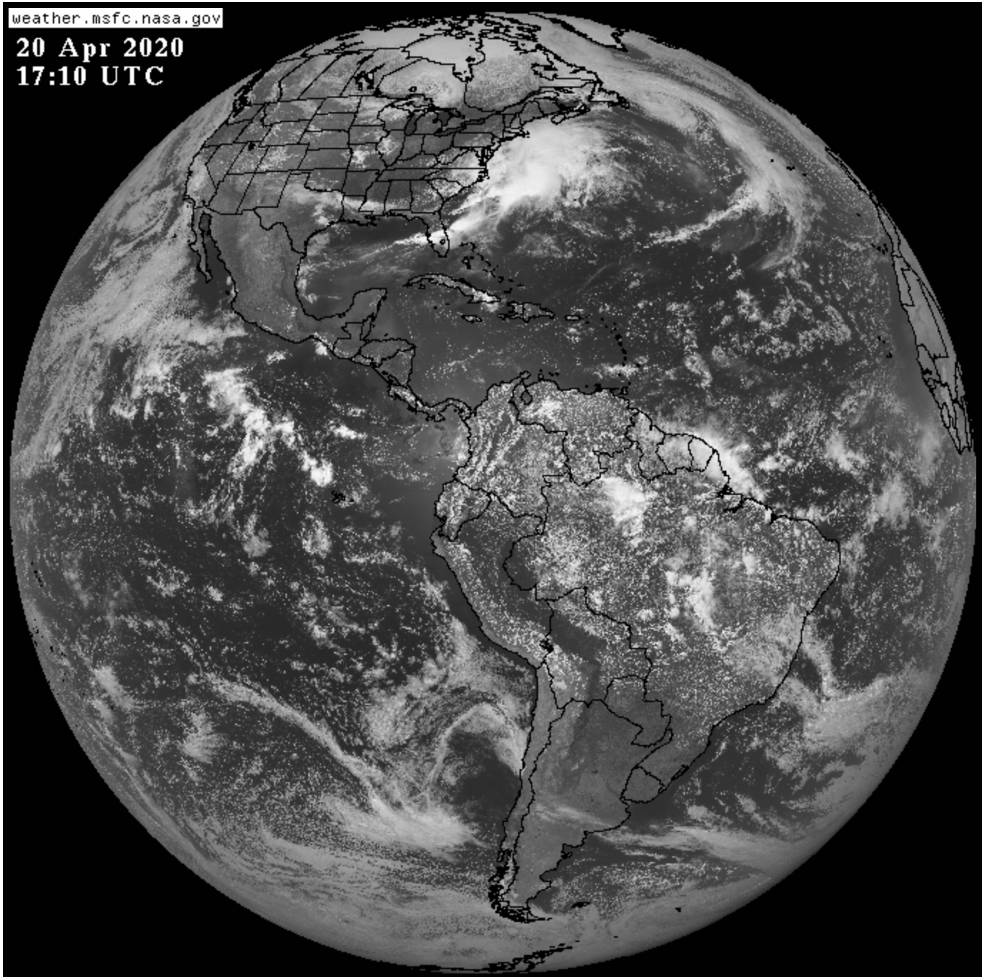
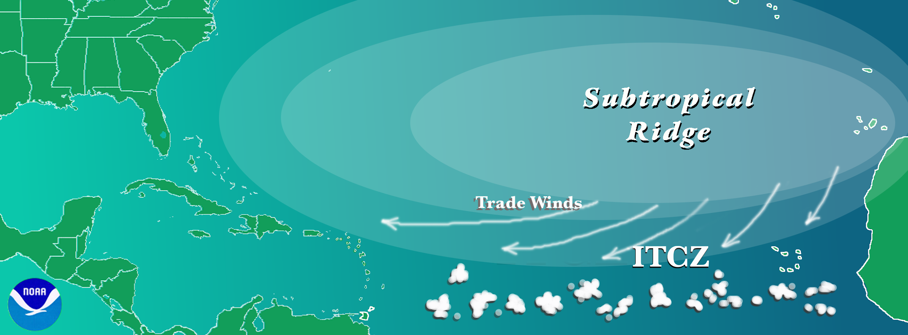
The Atlantic Basin
The Atlantic Basin is usually dominated by a big area of high pressure and good weather. An area of storms, the Inter-Tropical Convergence Zone is to the south.

Slide 11
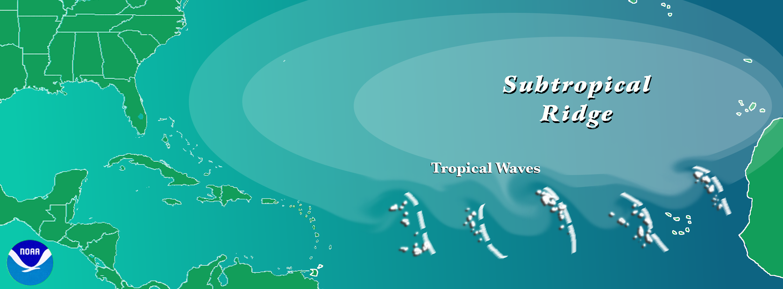
The Atlantic Basin
Disturbed areas of weather form over Africa and are pushed out into the Atlantic. These are known as African Easterly Waves.
Notes:
The formation of a closed circulation is one of the most important steps in the progression from wave to more organized systems.

Slide 12
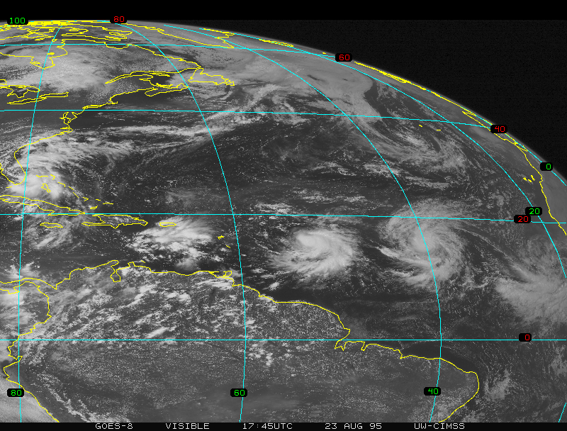
The Atlantic Basin
These Waves will sometimes intensify into Tropical Depressions, Tropical Storms, and even Hurricanes.
Notes:
Here we see the total activity in the database by time of year, with number of tropical storms, hurricanes, and major hurricanes depicted versus time of year.

Slide 13
What is necessary for a hurricane to form ?
Warm ocean water at least 80°F [26.5°C] at least 100 feet [40 m] deep.
An atmosphere where thunderstorms can form, what we call unstable.
A lot of humidity from the ocean surface to about 3 miles (5 km) up.
A weather disturbance, like a tropical wave.
Wind blowing in the same direction near the bottom and the top of the atmosphere (low wind shear).
Notes:
NOAA has fewer aircraft, but they are more highly equipped with scientific instruments. The Air Force planes carry out the bulk of reconnaissance requirements, but the NOAA planes do most research flights.

Slide 14
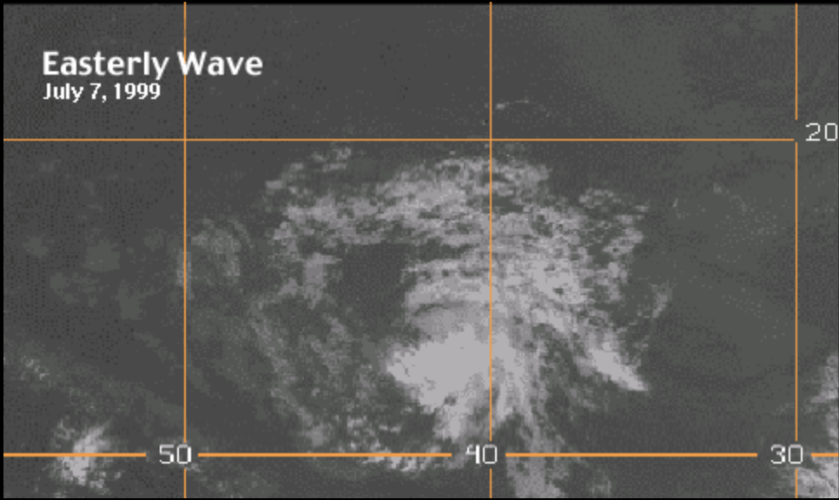
Tropical Waves
Tropical Waves have thunderstorms around a weak area of low pressure
Notes:
Both radio back weather information to the launch site, providing an atmospheric profile where they were released.

Slide 15
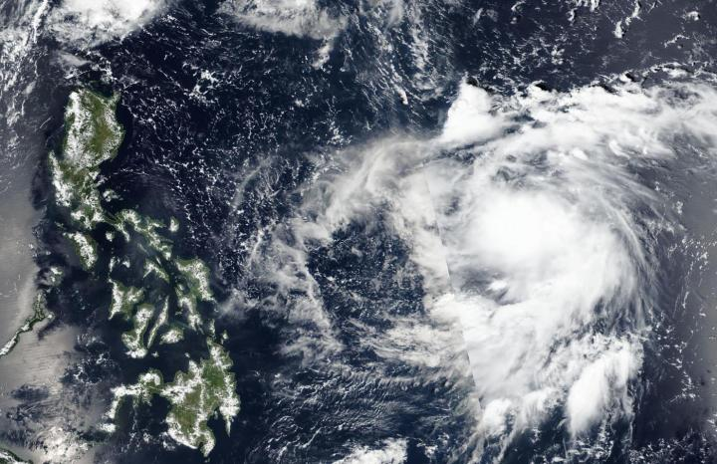
Tropical Depressions
Tropical Depressions have storms clustered around a stronger area of low pressure at the surface.
Notes:
NOAA operates a fleet of research ships, as do academic and oceanographic research institutions. NOAA also has a cooperative agreement with many commercial ships to radio in weather observations and even water temperature profiles.

Slide 16
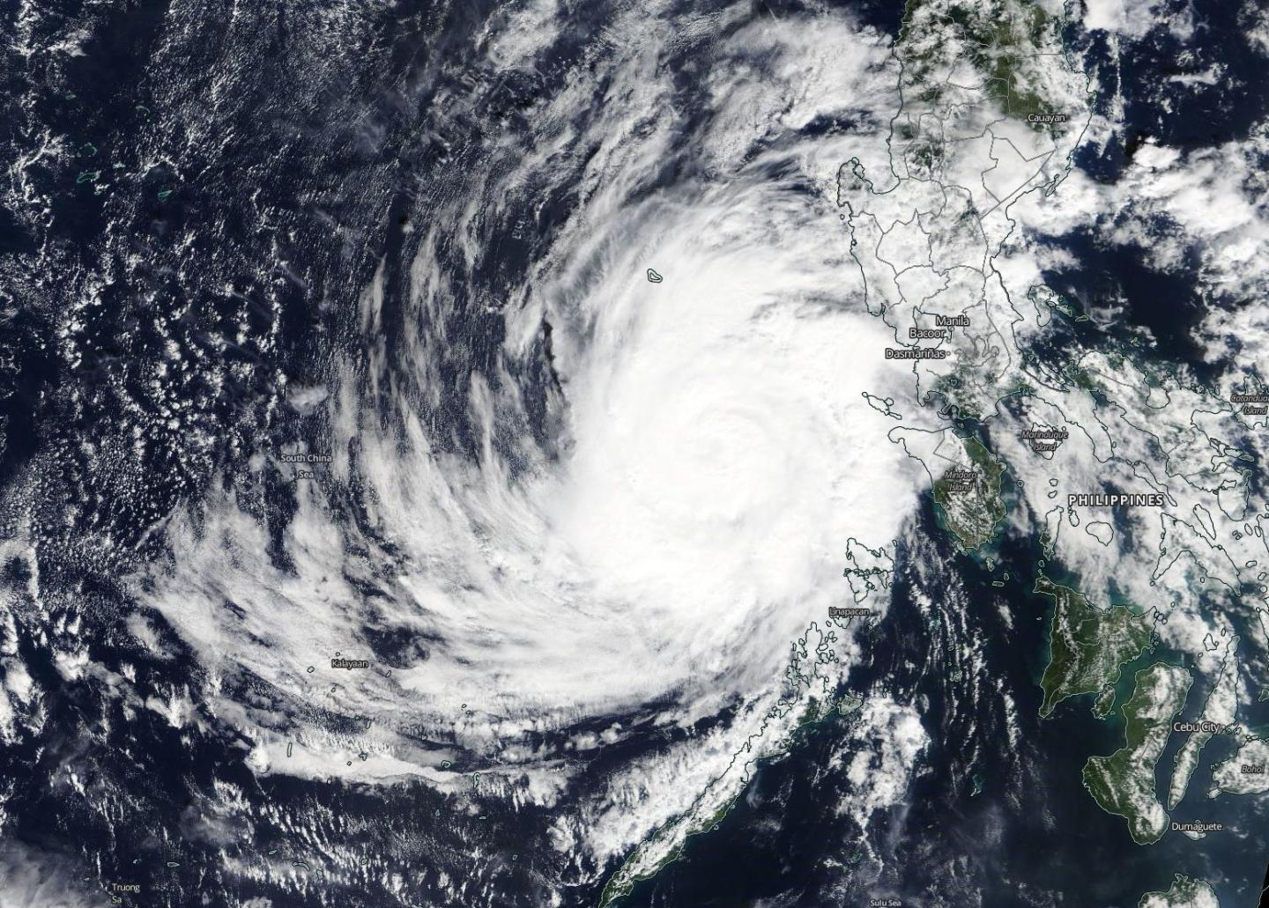
Tropical Storms
Tropical Storms are more organized with the thunderstorms spiraling inward toward the center in distinct rainbands.
Notes:
Radars keep constant watch over a given area, but are limited by the horizon how far they can see approaching storms.

Slide 17
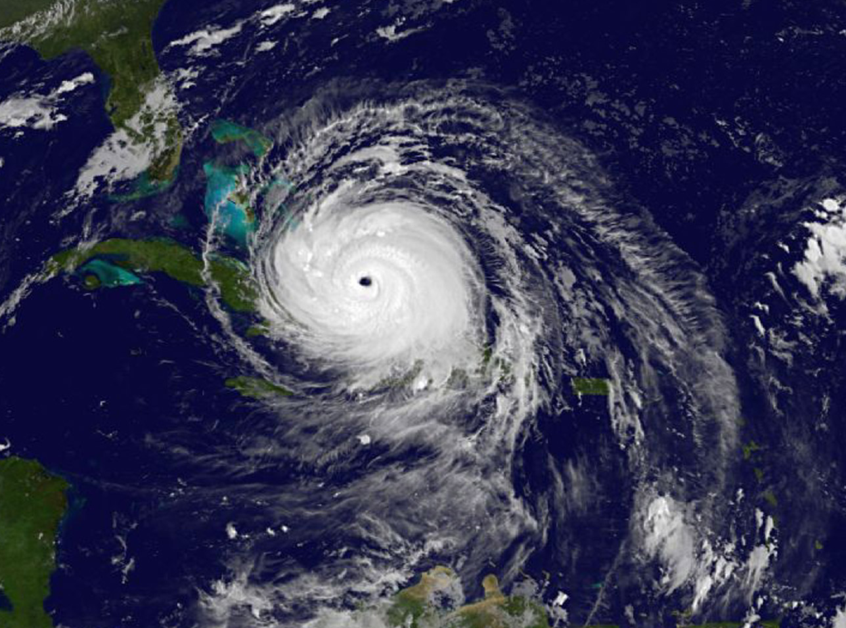
Hurricanes
Hurricanes have thunderstorms organized into a ring around a clear, calm eye known as the eyewall.
Notes:
Note that the pressure values are only approximate, since there is a great deal of scatter in the pressure-wind relationship.

Slide 18
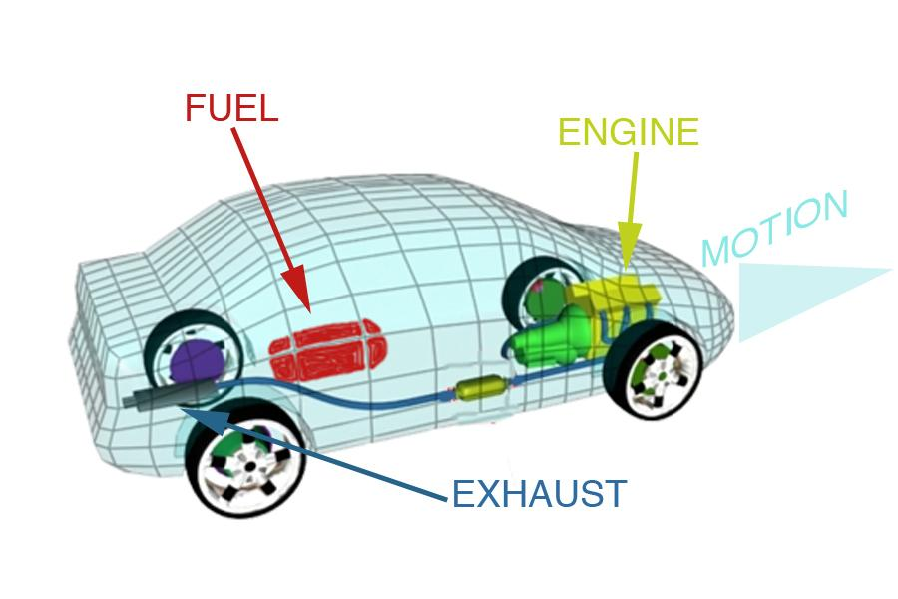
Hurricane Heat Engine
An engine is something which converts one form of energy into another. An old-fashioned gasoline engine converts the chemical energy of gasoline into the mechanical energy of motion.
Notes:
Ocean heat content is more important than sea surface temperature in estimating the energy available to a hurricane passing over a given spot in the ocean.

Slide 19
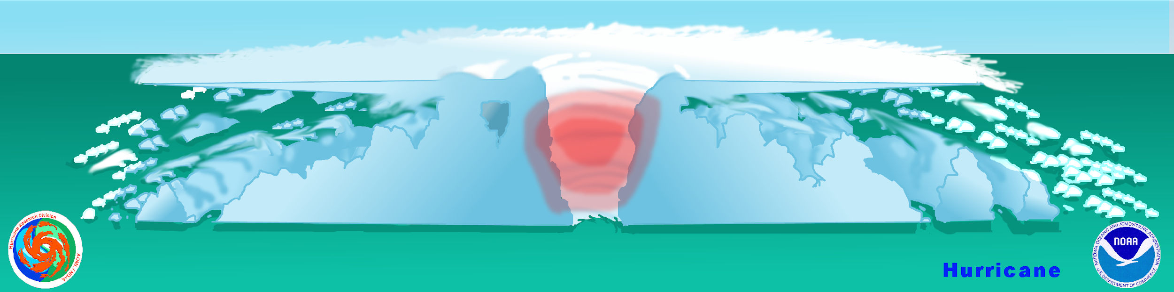
Hurricane Heat Engine
Hurricanes are heat engines which convert…

Slide 20
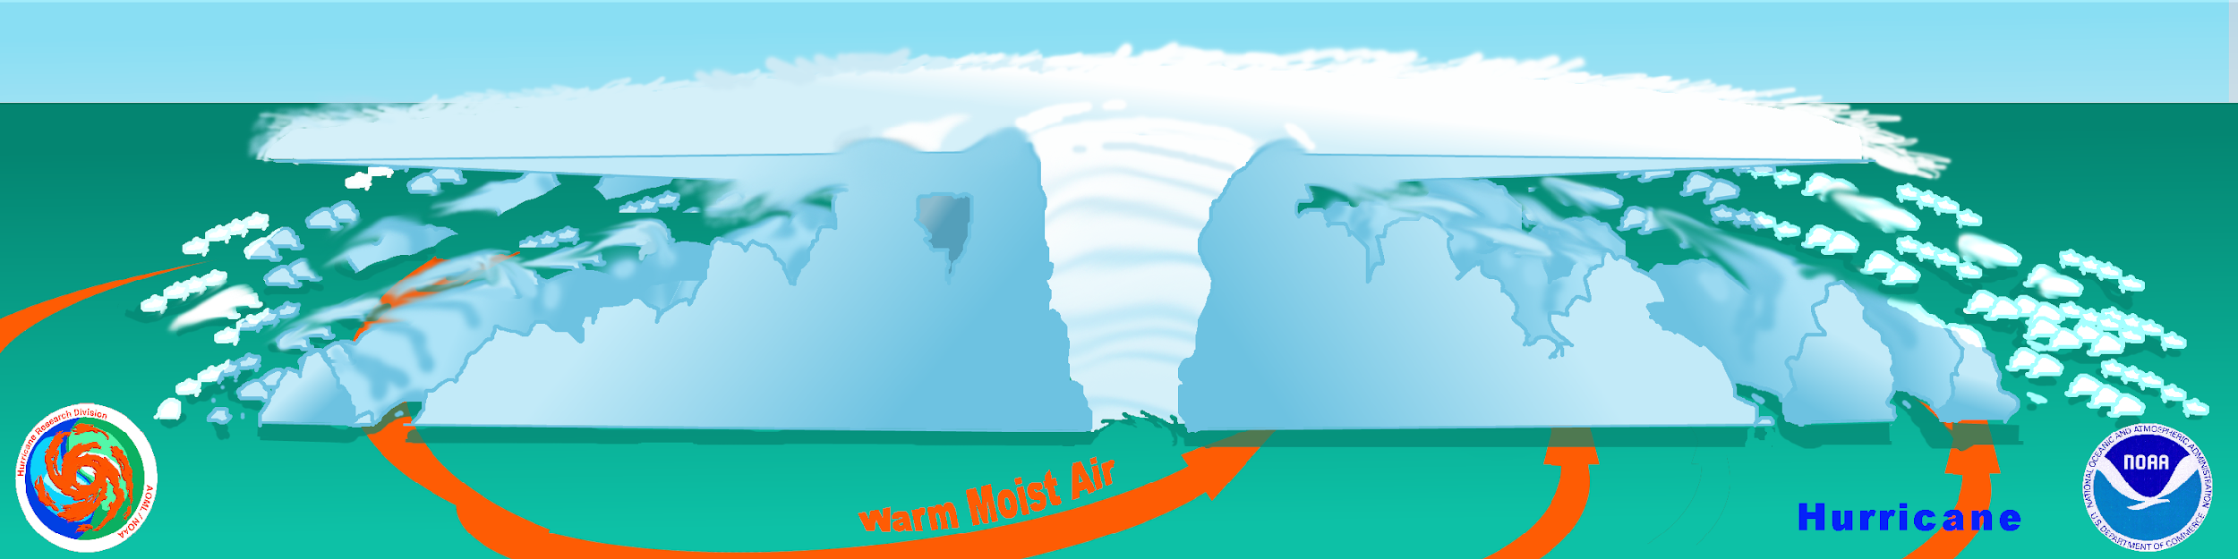
Hurricane Heat Engine
…heat, in the form of warm, moist air
and convert it into….
Notes:
These data can be entered into computer weather models to improve the quality of the forecast.

Slide 21
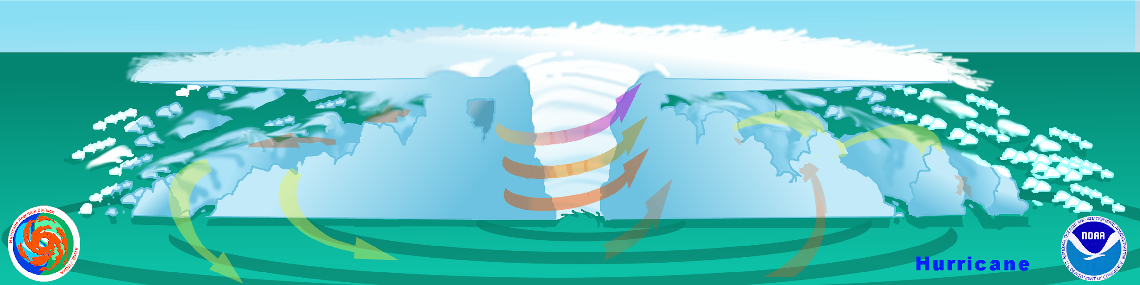
Hurricane Heat Engine
…wind (mechanical energy).
Notes:
In other parts of the world, hurricanes are called typhoons or tropical cyclones. The general term is tropical cyclone.

Slide 22
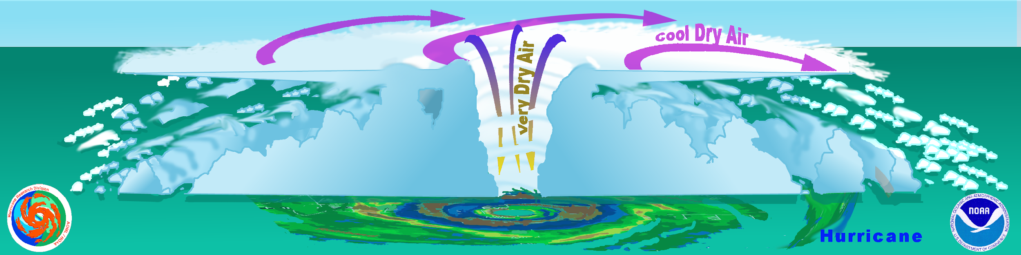
Hurricane Heat Engine
The exhaust products of the engine are the cool, drier air that produces cirrus clouds at the top, and the torrential rains that remove the water from the air.
Notes:
Not all ships report radar or weather conditions, and the quality of ships reports can vary widely depending on the training of the crew.

Slide 23

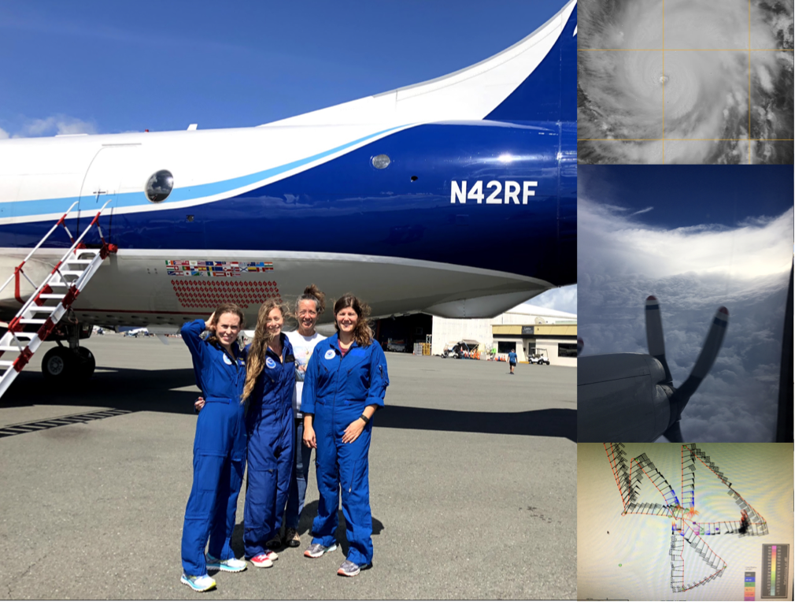


Flying into hurricanes

Slide 24
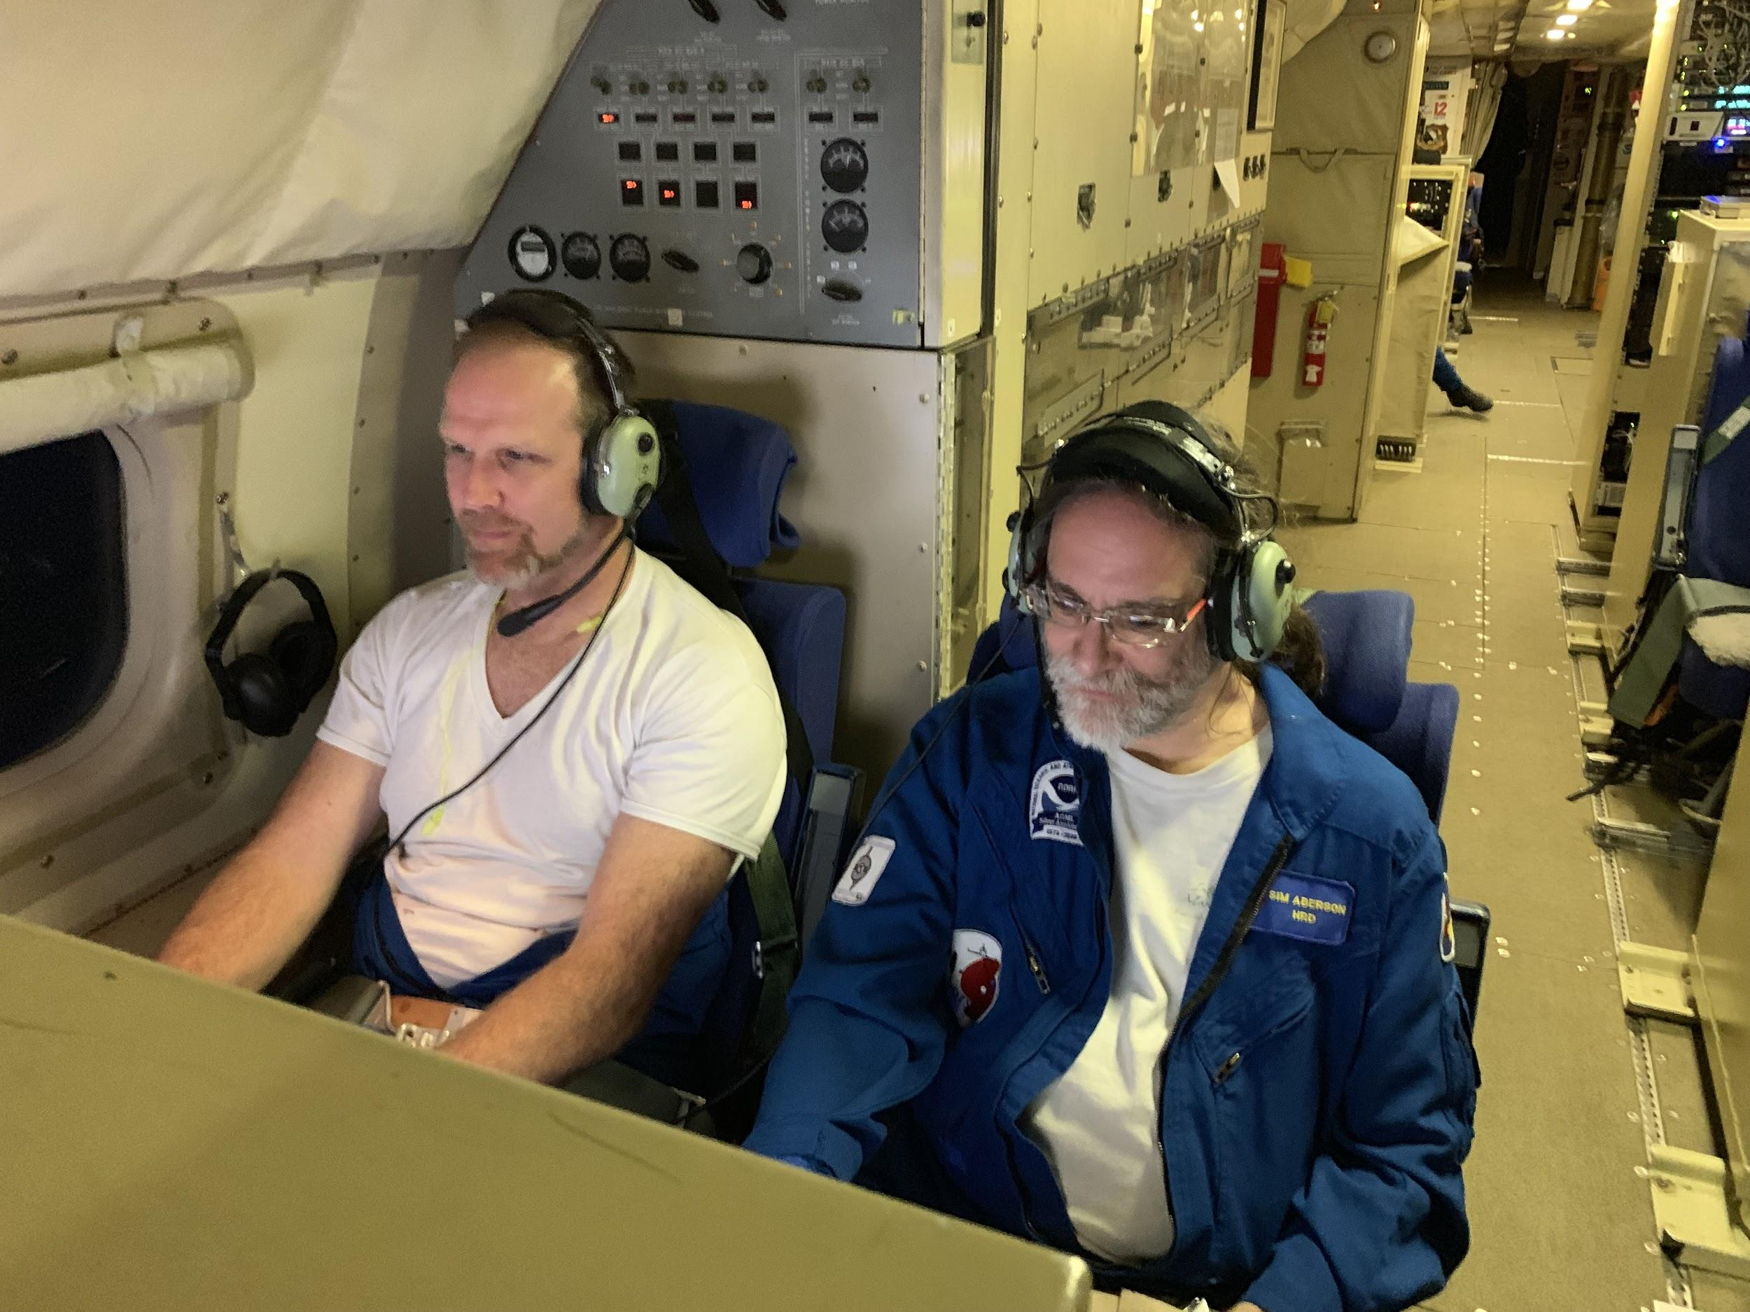
Flying into hurricanes
These missions can be fun and exciting…

Slide 25
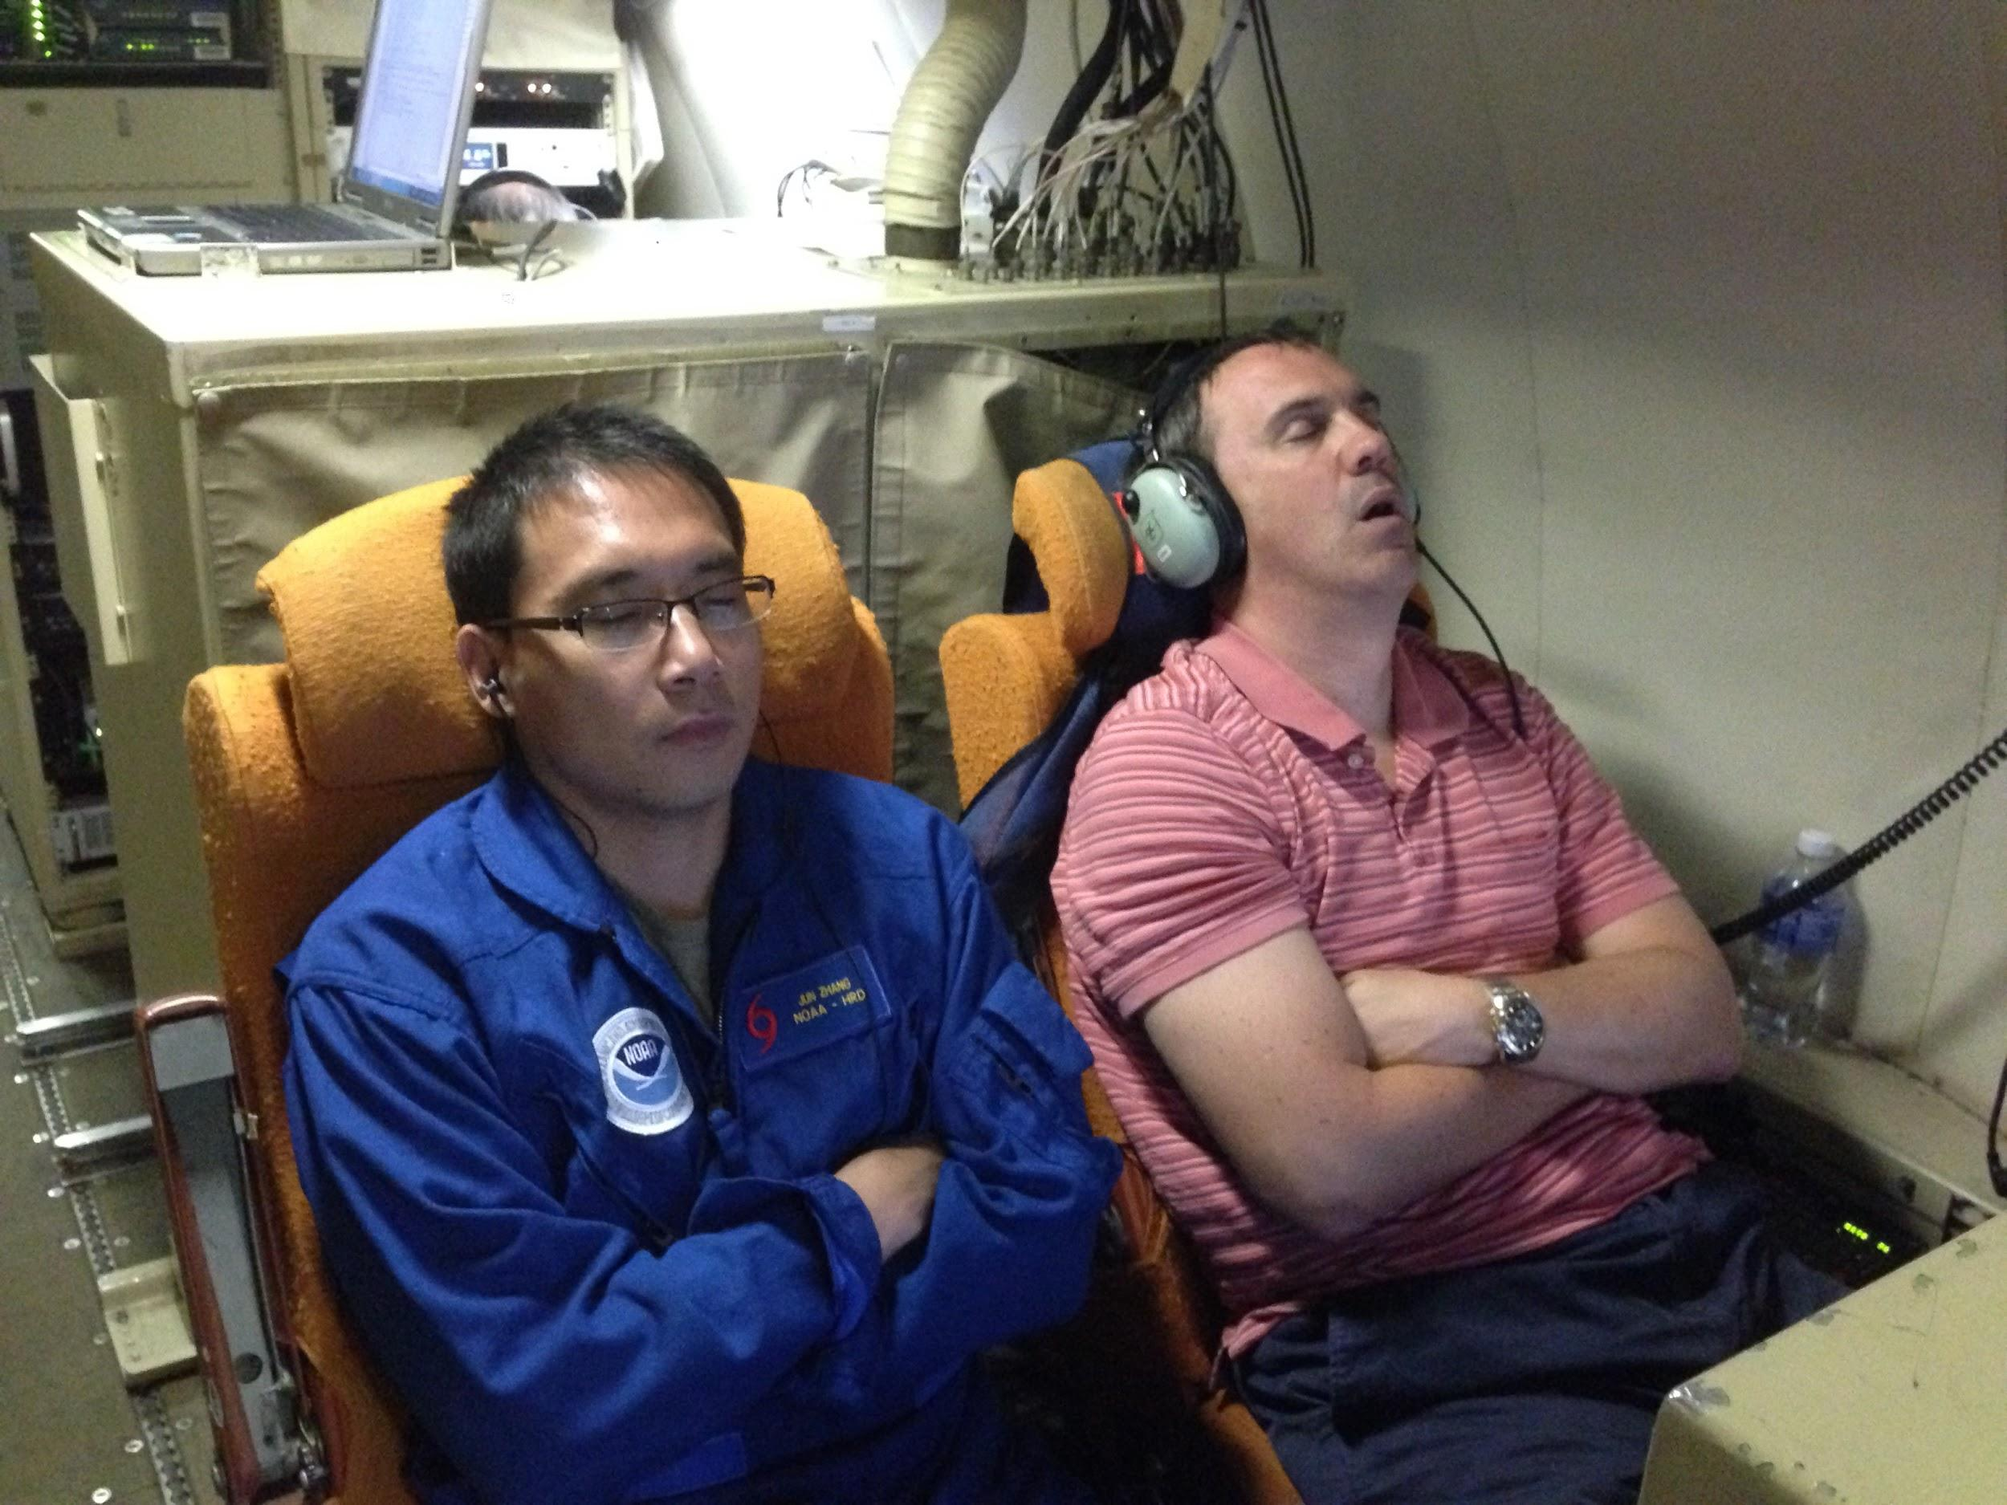
Flying into hurricanes
… and sometimes not.

Slide 26
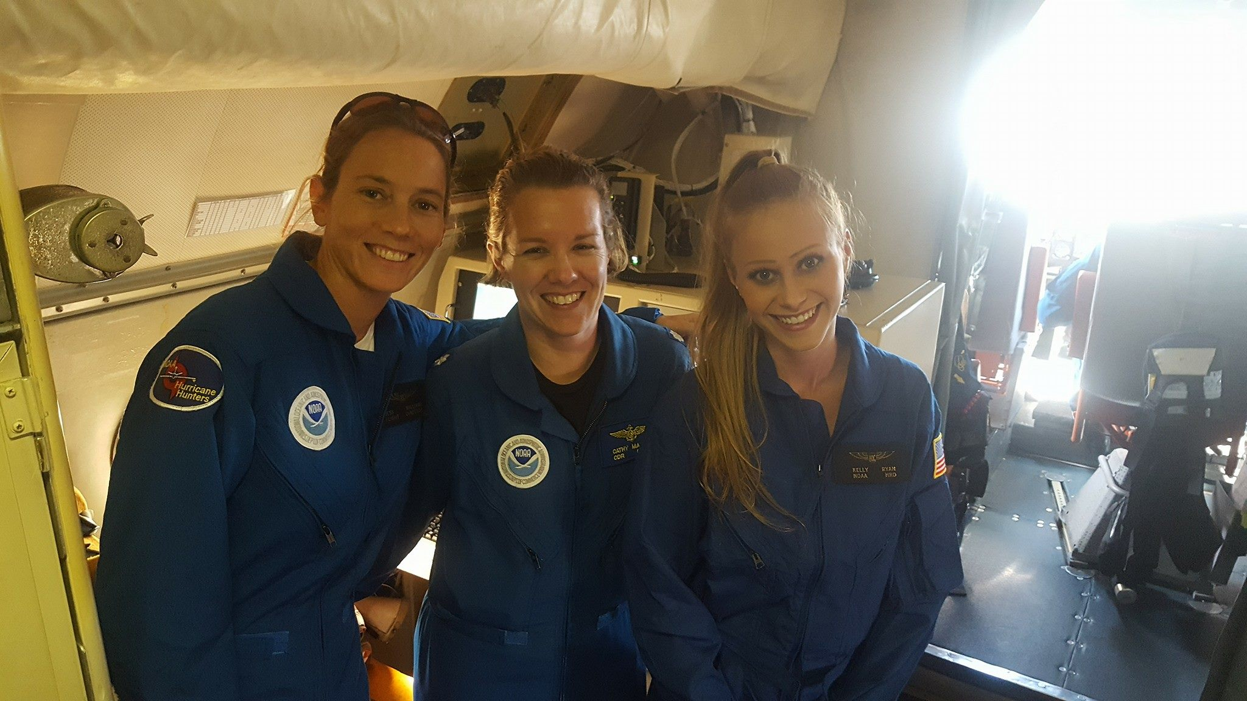
Flying into hurricanes
But we’re very happy that we get to do this!

Slide 27
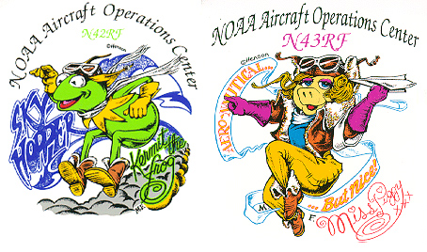
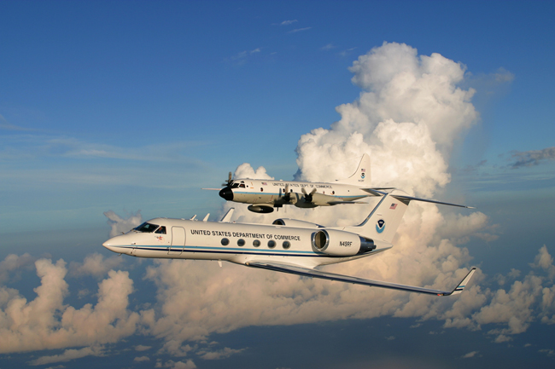

Aircraft
NOAA (2) Orion P-3 “Kermit”& “Miss Piggy” and one Gulfstream-IV jet “Gonzo”
USAF Reserves 53rd WRS (10) C-130J
The crews are made up of pilots, navigators, scientists, and engineers
Other countries also fly into hurricanes
Notes:
Make that 51 people.

Slide 28
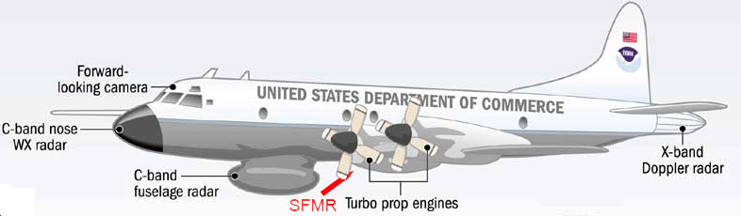
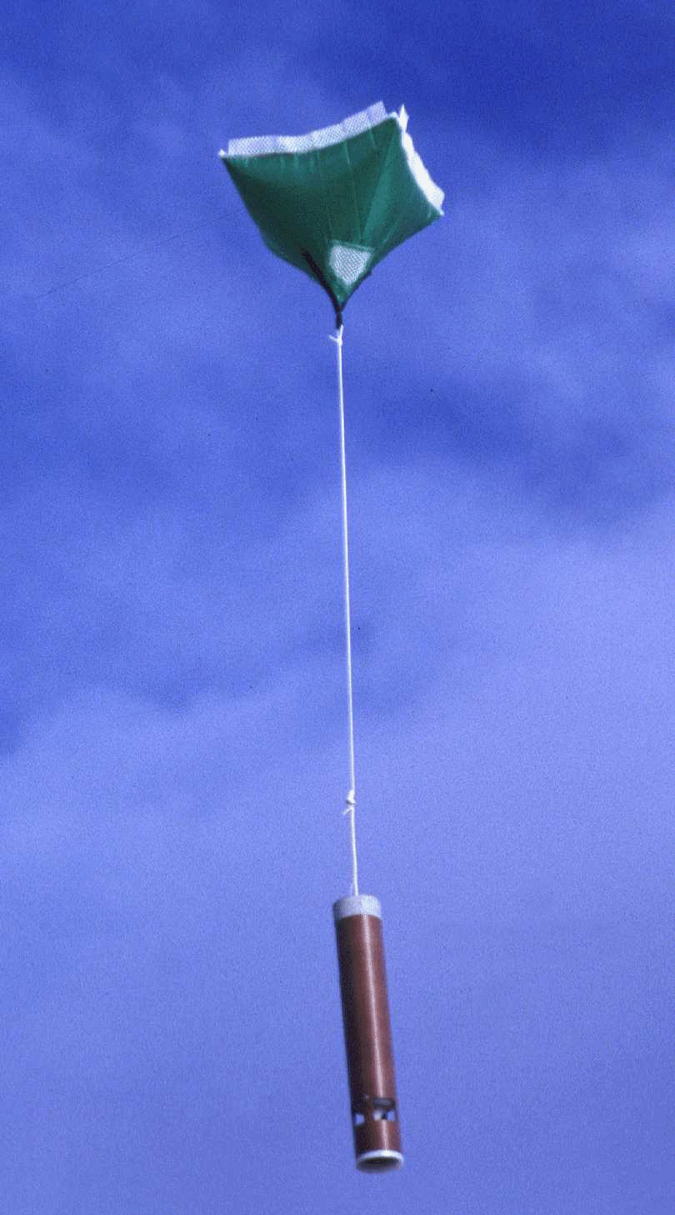
Aircraft
Dropwindsondes measure wind, temperature, humidity,
and pressure as they fall to the surface.
Radars tell us where rain is happening and how strong the wind is.
The Stepped Frequency Microwave Radiometer (SFMR) measures wind speed at the ocean surface.
Instruments on the plane measure wind, temperature, humidity, and
pressure where the plane is.

Slide 29
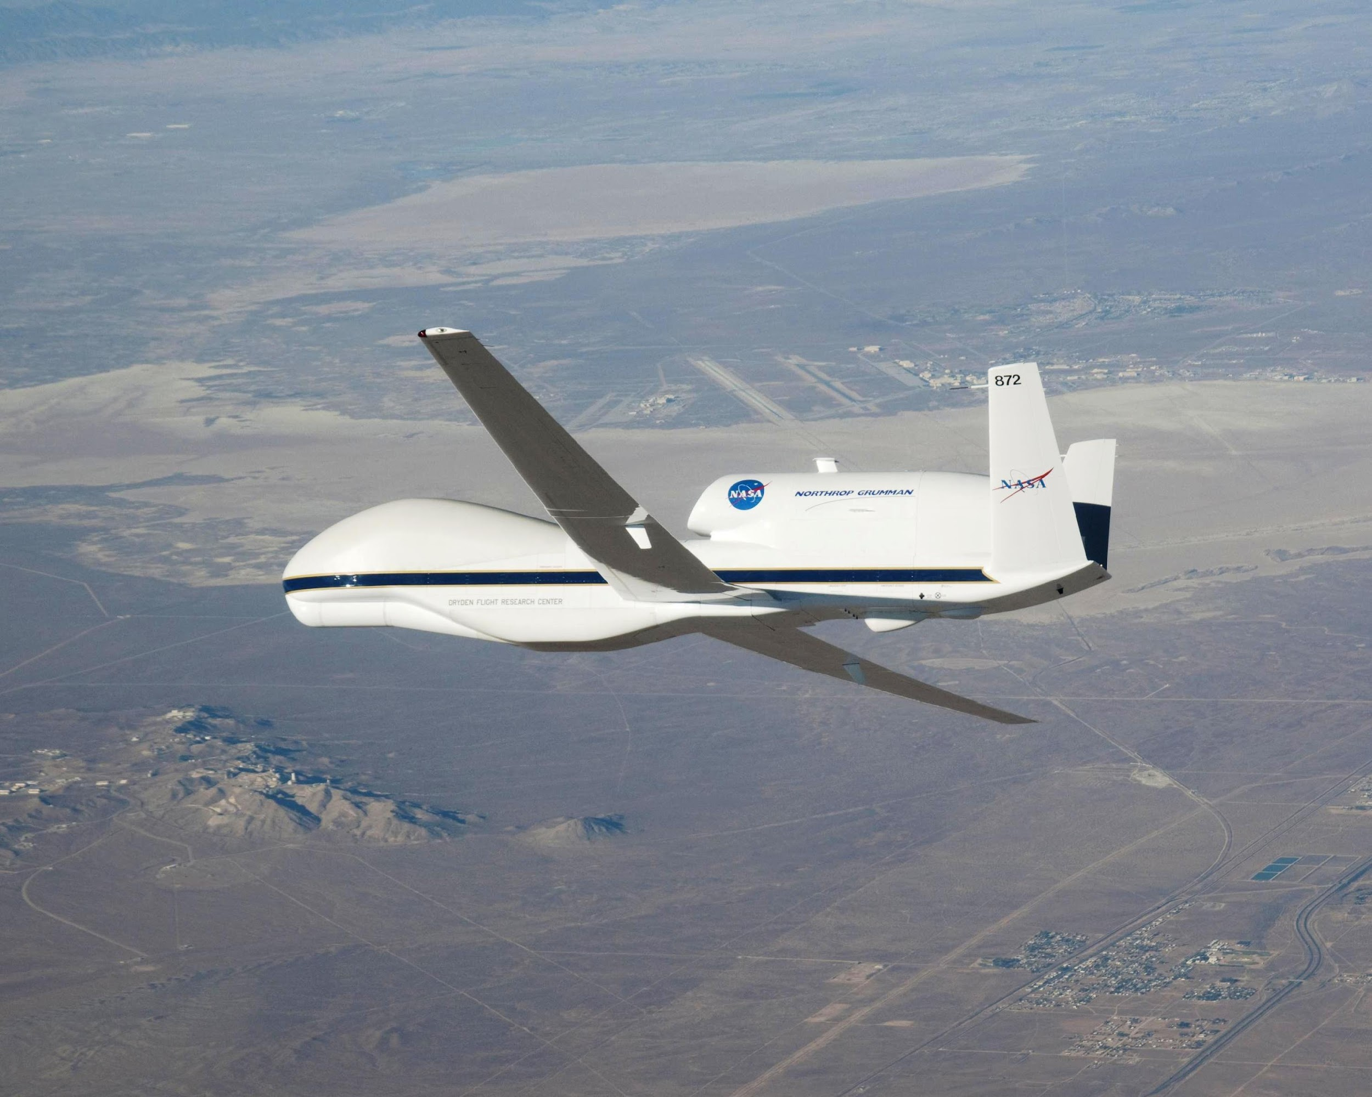
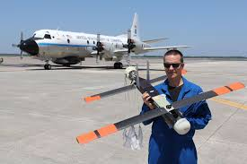
Tools of the Future
Drones
  Global Hawk
  Coyote

