Slide 1
ASPEN Update
NCAR |
EOL
Isabel Suhr (NCAR/EOL)
AVAPS User Group Meeting
April 24, 2018
Notes:
Welcome address

Slide 2
Overview
Data Q/C
User interface
BUFR
TEMP
Dry bias
This year:
Code commits | 206
Aspen releases | 4

Slide 3
Data Q/C
Changed lower threshold for RH from 0.2% to 0.1%
Set RH values > 100% to 100% instead of removing them
Add equilibration time constants specific to RSS421 sensor
Added max winds and tropopause levels to sounding database and synoptic map
Cleaned up netcdf output

Slide 4
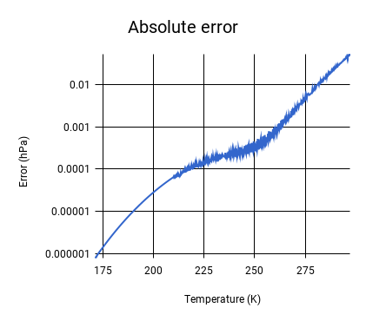
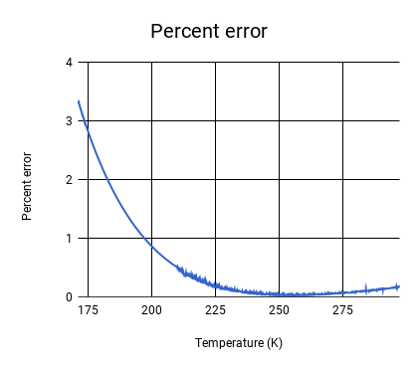
Data Q/C - Saturation vapor pressure
Herzegh (PAM II Parameters, 1988) -> Hardy (Thermo Scientific, 1998)
Netcdf and skew-T output

Slide 5
User interface
Fixed crash when displaying sats-dz XY plot
Fixed crash in switching tabs after modifying levels
Fixed error in setting TEMP header in BatchAspen
Fixed library paths and option parsing for commandline Aspen on OS X
Added TEMP example files

Slide 6
BUFR
Reduce data by averaging together all values per second
Merge levels data with QC data and set appropriate flags
‘Local usage’ flag set for aircraft observations
Remove entries for times with no data
Added OB number to BUFR output

Slide 7
TEMP
Only update 61616, 62626, abbreviated header if sounding is descending
Add input masks to WMO abbreviated header configuration
Fixed bug of REL level appearing without SPG level
Levels use observed lat/lon when ReportObservedPos set
Corrections to decoding 62626 groups and LAST REPORT
Correct adding levels from decoded TEMP to synoptic map

Slide 8
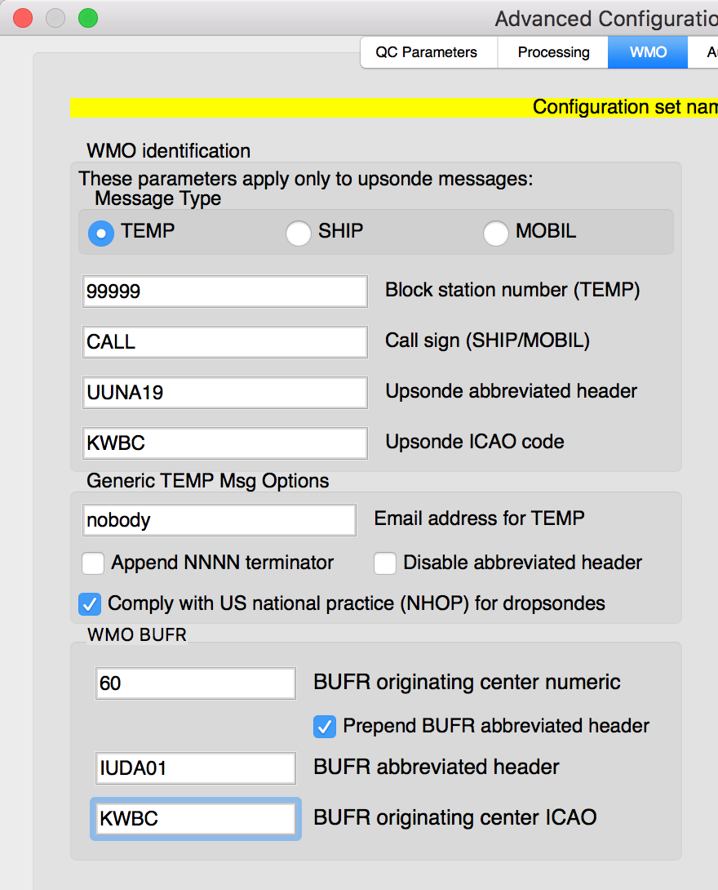
TEMP - NHOP standard
Added a config parameter to select NHOP-compatible WMO
set dew point for RH < 20% to 80
set dew point for temp < -40ºC to //

Slide 9
Dry bias
Set (post-correction) RH values < 1% to 0.1% rather than discard
Don’t display dew point temp for values with RH of 0.1% on skew-Ts

Slide 10
Upcoming
Short term
Resolve dry bias 0.1%RH
BUFR support
Long term
Qt5 upgrade
Standalone synoptic map
Improved Aspen documentation

Slide 11
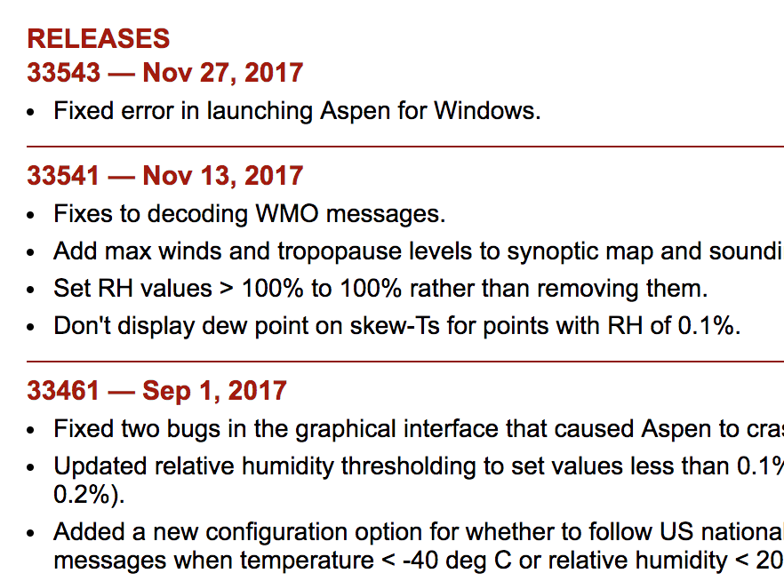
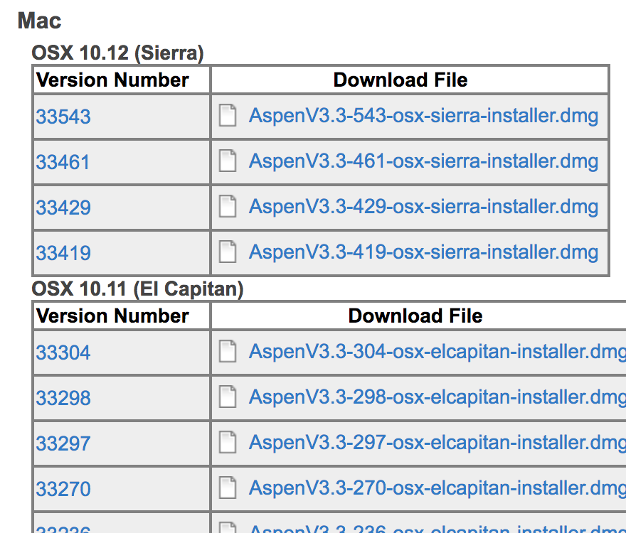
Hurricane season release: May 18 2018
www.eol.ucar.edu/software/aspen

Slide 12
Communication
eol-aspen@ucar.edu

